Slide 1
CONSUMER HEALTH INFORMATICS
Color index:
Important
Golden notes
Doctors notes
Editing File

Slide 2
What is Consumer health informatics
It is a branch of Health informatics that:
Analyzes information needs of consumers. Look into the methods to implement these needs and make information and services available
Studies and implements methods of making health information and services accessible to consumers.
Integrates consumer preferences into health care information systems. The most important thing is to satisfy your clients (patient, consumer and public)
CHI does a lot of things but these THREE are the main focus. All these things aim to enable your consumer to take the right decisions by informing and educating them.
In this view, informatics analyzes consumers' needs for information; studies and implements methods for making information and services accessible to consumers; and models and integrates consumers' preferences into health information systems.
Consumer informatics stands at the crossroads of other disciplines, such as nursing informatics, public health, health promotion, health education, library science how to make information best available for the public, and communication science.
Consumer Health Informatics: focuses on and addresses:
consumer or patient views.
patient-focused informatics,
health literacy
consumer education.
health information literacy,
consumer-friendly language,
personal health records, and Internet-based strategies and resources.
Consumer empowerment
Selfcare & self action
Consumer Health informatics
Integration of consumer health information and information technology in an environment of shared healthcare decision-making that supports effective self-health action
Who are Consumer?
More broader than patient it may include the well and caregivers. Because consumers have more needs while patients they only need medical care. Also, consumers could be your future ‘patients’
It is a very diverse group.

Slide 3
What is Consumer health informatics
Information age health care
Industrial age medicine
Cybermedicine
Telemedicine
Ambulatory medicine
Hospital medicine
Prevention and self help
Safe care
Assisted care
Disease management
Public health
Clinical medicine
Consumer health informatics . Provider printed medical informatics
Focus of new medical informatics
Focus of traditional medical informatics
The focus of healthcare consumer health informatics is shifting from health professionals to be consumers centered
Empowered consumers
Granting of power to a dependent group or enhancing an individual's ability for self determination. It is a holistic approach
“a social process of recognizing, promoting and enhancing people’ abilities to meet their own needs, to solve their own problems, and mobilize the necessary resources in order to feel in control of their lives”. (Gibson , 1991)
Consumers Health Informatics applications support the empowered consumers concept (a power balance in the patient-health professional relationship) by e.g:
Providing Informing about health concerns.
Assisting in finding others with similar concerns.
Assisting in navigating the healthcare system and services, and access clinical records, and personal care management tools. Through patient portals.
Access to clinical records and personal care management tools.
History of Consumer health informatics (CHI)
Consumer movement of 1970s.
Increased demand for information. consumers , public, and healthcare professionals
Greater participation in “medical” decision making.
Prominence of “self-help” phenomenon of 1980s. Because hospitalization is not the answer
Huge increase in health information for lay audience.
Widespread use of the Internet.
Increased dramatically throughout 1990s.

Slide 4
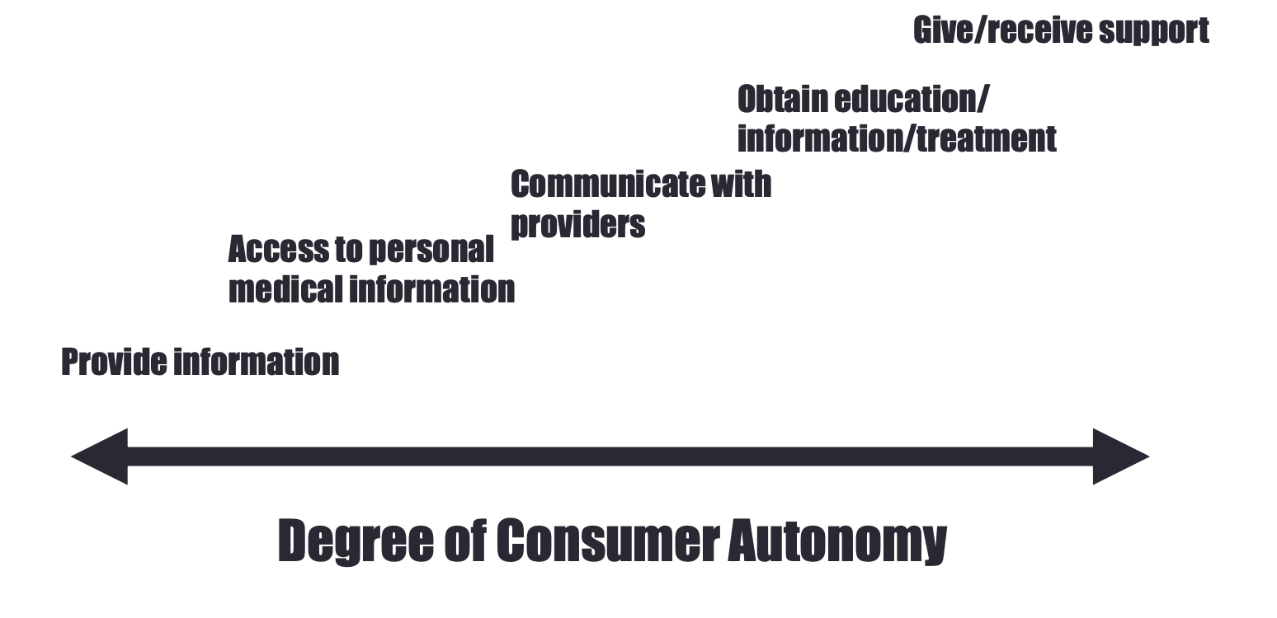
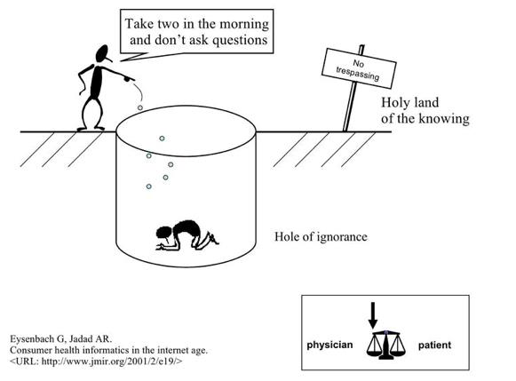
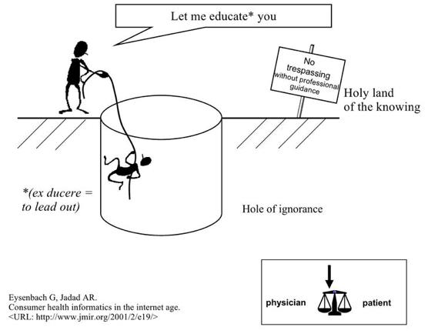
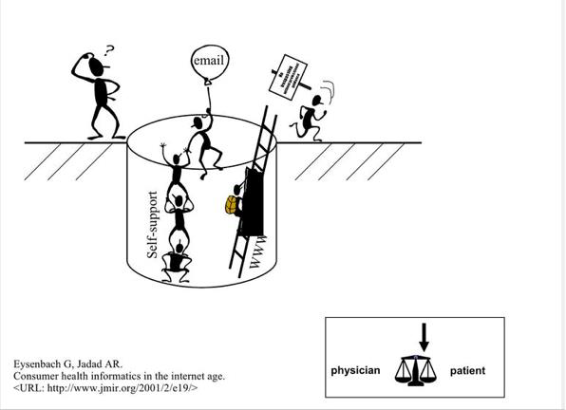
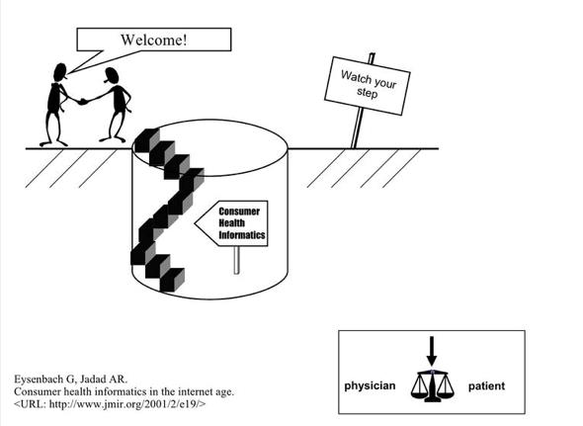
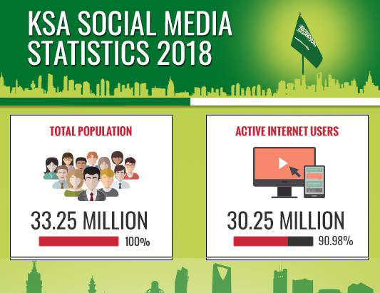
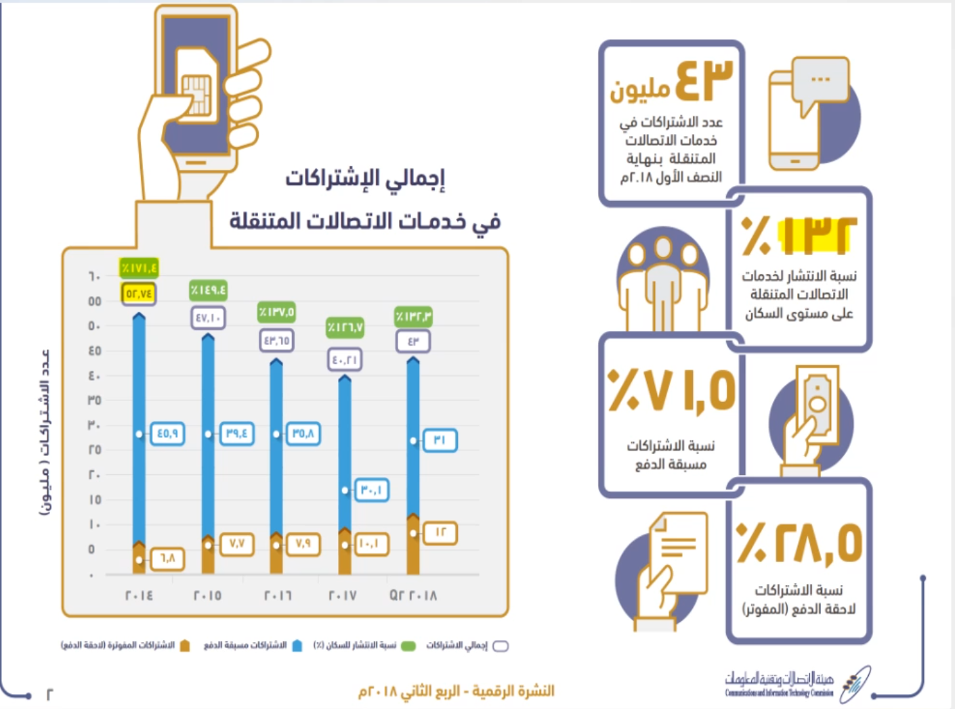
History of Consumer health informatics (CHI)
CHI continuum
Degree of consumer autonomy:
in 1960s and and below, the relationship was bad that there was not any balance. No education for the consumer.
There is basic education; not well established. 1980
- recognize need for educating
1990; explosion of access methods to knowledge; people have knowledge but not able to understand and put it into context.
CHI development to bridge the gap between clinician and patients.
Consumer health informatics
Diverse and crossroads or several specialities; including:
Mobile health (mHealth)
Telehealth monitoring patient at home
Patient education
Patient health record
patient portal
Health literacy, health promotions and games for health
Internet-based strategies and resources
Saudi Arabia: internet growth
More people use that internet that's why we should utilize it
2011= 12.5 million
2014= 16.5 million
2015= 21.5 million
Saudi Arabia: internet growth
More people use that internet that's why we should utilize it
2011= 12.5 million
2014= 16.5 million
2015= 21.5 million

Slide 5
Mobile health
M-health or Mobile health is a term used for the practice of medicine and public health, supported by mobile devices. The term is mainly used in reference to using mobile communication devices, such as mobile phones, tablets and PDAs,
for health services and information.
The mobile Health is a sub-segment of eHealth,
The mHealth market earned revenues of $230 million in 2010 and is
estimated to reach $392 million in 2015 in USA, according to a new report from research firm Frost & Sullivan.
Mobile is the most Pervasive technology ever invented
Consumer Health Informatics
Consumer health informatics can be organized into three general systems that:
provide health information to the user (one-way communication)
(CD-ROC, online health articles)
Tailor specific information to the user’s unique situation (customized communication)
automated systems that obtain information from the consumer about his or her general health or other health-related factors (such as family disease histories and smoking habits) and, on the basis of this information, suggest a need for preventive health procedures (such as mammograms), or identify actions to curb high-risk behaviors.
allow the user to communicate and interact with healthcare providers or other users (two-way communication)
electronic mail, electronic bulletin boards, online discussion groups
Roles of Health Professionals in CHI
Professionals serve as sources of content
Professionals provide important guidance in moderating public electronic discussion groups and responding to patients’ electronic messages
Clinicians become information brokers and interpreters for patients.

Slide 6
Consumer Health Informatics
The quality of health information on the internet rests on four pillars:
Educating the consumer
Encouraging the self regulation of providers of health information
Having third parties evaluate the information
Enforcing consents in cases of dissemination of fraudulent or harmful information.
Challenges & Barriers: it is very challenging i don't know why they do it
Privacy; Security concerns especially where patient upload data to PHR and access information. There data and information are vulnerable to cyber risks and hacking
User-friendly
Access to computer and internet: not all have acees, and not all have same quality of access. Having access is an assumption but not a fact
Physical disability; elderly may have trouble to access PHR, internet and mobile apps without assistance. Making it simple and support disability
Access to PHR systems;
Cognitive disabilities
Low health literacy consumers; they might not understand the readings and the interpretations
Terminology; “medical jargons” could be too complex and confuse patients
Familiarity; consumers are more likely to use applications that look familiar to other systems they use .
Ensure data accuracy ; consumers are naturally concerned with accuracy, meaning both complete and without error
Legal Barrier; prevent doctors from practicing telehealth, because of the issue of liability. The two main reported barriers are: Legislative: to remove trade barriers & Technical; to ensure security
Speed and connectivity; the system will run on different levels of connectivity; especially for video conference used for diagnosis.
Cost; costs of implementation and running and maintaining the system. It is important to provide solution tailored to budget, and work with low speed internet.
Resistant to change: Patient acceptance of mobile and telehealth is also a challange
Lack of physician support
Lack of exciting technology; example is primary care centers biggest barrier
Lack of support; for training and maintenance
Reliability; you will quickly lose trust
Low availability; may not be available in the specific criteria
Lack of search precision; patient might take wrong advice
language : not everyone speaks english
Lack of patient motivation;
Fast developing field, new systems
Where clinical IS and Consumer health informatics meet?
Patient Portals: Patient interface to clinical information systems. Portal is a set of different applications.
Personal Health Record: Internet based- set of tools that allows people to access and coordinate their life-long health information and make appropriate parts of it available to those who need it.

Slide 7
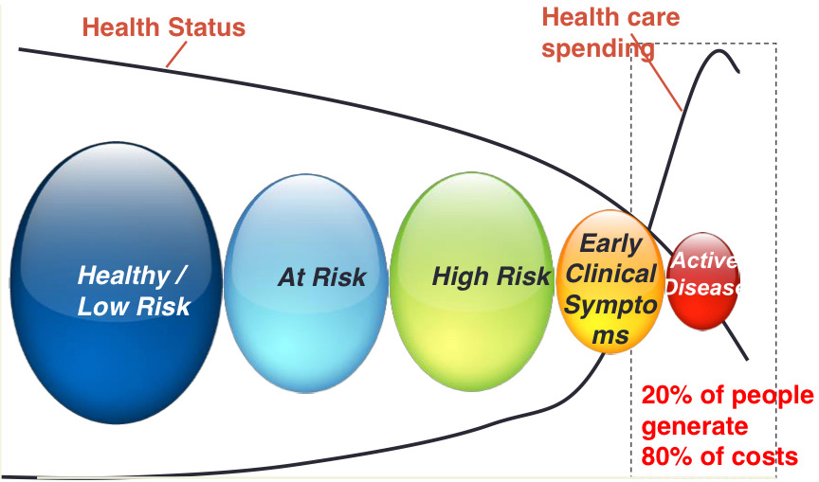
CHI
Credibility Criteria:
The FA4CT Algorithm: A New Model and Tool for Consumers to Assess and Filter Health Information on the Internet
CREDIBLE Criterion
Current and frequently updated
Reference cited
Explicit purpose
Disclosure of sponsors
Interest disclosed and no conflicts found (e.g financial)
Balanced
Level of Evidence
Patient Centric Healthcare
“care that is respectful of, and responsive to, individual patient preferences, needs, and values ́ and that ensures that patient values guide all clinical decisions.”́
This definition highlights the importance of clinicians and patients working together to produce the best outcomes possible.
Crossing the Quality Chasm, IOM
Patient/People Engagement
WHO defines People Centered Care as: “Care that is focused & organized around the health needs & expectations of people & communities rather than on disease”
Characteristics of Patient Centered Care
Respect for patients values, preferences & needs
Coordinated and integrated care
Information, Communication & Education
Physical Comfort
Emotional Support
Involvement of family & friends social support
Continuity of care
Access to care
Is 3At the Point of Care ́ Too Late?
- Early detection of at-risk patients. Chances of being treated is less in the early clinical symptoms phase
- Provide personalized evidence to enable pro-active decision
It’s a Different Ball game
In an eHealth environment, Information Moves rather than the Physician or the Patient
eHealth ePhysician - eConsumer
Actions
Technology victories and chronic disease, e-Health takes a prominent role in the management of healthcare
To aggregate rather than segregate healthcare system
Consumer health education and empowerment
Preventive medicine takes precedence over treating the sick
Focus on vulnerable members of society

Slide 8
Questions
1. Insures that the patient has access to information resources necessary to participate fully in the health care
process:
A. Telemedicine
B. health informatics
C. consumer health informatics
D. bioinformatics
2. What is the main reason influencing physician to use smart phones rather than feature phones:
A. Available application
B. Battery life
C. Internet and email access
D. Multimedia capability
3. electronic records that are owned, maintained and updated by an individual is known as which of the
following:
A. Patient Health Education Record B. Personal Health Record
C. Electronic health record
D. Electronic Medical Record
4. Consumer health informatics is as Integration of:
A. Human Resources and information technology
B. Human Resources and health information
C. Consumer health information and information technology
D. Consumer health information and financial services
5. The mobile Health is a sub-segment of:
A. telemedicine
B. eHealth
C.telehealth
D.EHR
6. Informing the patient that smoking can increase the risk of CVD is:
A.one-way communication
B. customized communication
C. two-way communication
3- three-way communication
1.C 2.A
3.B
4.C
5.B
6. A

Slide 9
Good Luck!
DONE BY OUR AMAZING MEMBER:
Khalid Alkhani
NOTE TAKER BY OUR SHARP MEMBER:
TEAM LEADER
JUDE ALOTAIBI
TEAM LEADER
KHALID ALKHANI

