Slide 1
HEALTH INFORMATION PRIVACY AND SECURITY
Color index:
Important
Golden notes
Doctors notes
Editing File

Slide 2
Three Pillars of Data Security
Information Rich Environment
A lot of resources
Pillar 1: confidentiality
Pillar 2: availability
Pillar 3: integrity
prevention of data loss
category most easily identified with HIPAA privacy and security within healthcare environments
usernames, passwords, and encryption are common measures implemented to ensure confidentiality
system and network accessibility
focuses on power loss or network connectivity outages
Loss of availability may be attributed to natural or accidental disasters , but also refer to man-made scenarios
backup generators, continuity of operations planning and peripheral network security equipment are used to maintain availability
describes trustworthiness and permanence of data, an assurance that the lab results or personal medical history of a patient is not modifiable by unauthorized entities or corrupted by a poorly designed process
Database best practices, data loss solutions, and data backup and archival tools are implemented to prevent data manipulation, corruption, or loss
Healthcare Education (in KSU)
Types | Examples
1. Problem-based learning Case-based learning | —
2. Content In 1st and 2nd year during medical school we learn the physiological processes while during 3rd year up to 5th year, we learn procedures, effects of interventions. Throughout the five years of medical school we learn the soft skills. | Components of the content: Physiological processes. Procedures, Effects of Intervention. Soft skills (interpersonal skills (interviewing patients), leadership, ethics). Information & Communication Technology (ICT) skills (basic Office, library database, smartphone Apps).
3. Teaching Strategies | One-way lecture based. Passive learning Two-way interactive (Computer-based, e-learning). Online.
4. Assessment Methods | Multiple choice Questions (Midterm, Final). Short answers. Assignment. Project. Presentation.
Defense in Depth for Healthcare
Data must be classified to determine its risk.
Healthcare organizations must develop a set of controls to protect. confidentiality, integrity and availability of data.
One layer of defense is not likely to be adequate.
Healthcare organizations will need technical, administrative and physical safeguards.
Types of Safeguards
1- Administrative Safeguard:
Security management processes to reduce risks and vulnerabilities.
Security personnel responsible for developing and implementing security policies.
Information access management-minimum access to perform duties.
Workforce training and management.
Background checks, drug screens, etc. for new employees.
Evaluation of security policies and procedures.
1- Why we need computer in healthcare
2- Multidisciplinary team means we have different professionals who all need to share their information! This creates an information rich environment that needs proper interaction to share all these information. Here the role of computer comes -we can use EHR- to help us share the information and deliver the quality of care we are aiming to.

Slide 3
Types of Safeguards
Theories of learning
2- Physical Safeguard:
Limit physical access to facilities.
Workstation and device security policies and procedures covering transfer, removal, disposal, and re-use of electronic media.
Badge with photo.
3- Technical Safeguard:
Access control that restricts access to authorized personnel.
Audit controls for hardware, software, and transactions.
Integrity controls to ensure data is not altered or destroyed.
Transmission security to protect against unauthorized access to data transmitted on networks and via email.
Unique usernames and passwords, encrypted software, anti-virus software, secure email, firewalls, etc.
Behaviorism¹
How one learn by looking at the observable behaviour.
Based on stimuli and responses.
Not all process of learning can be measured (such as understanding, reasoning).
Cognitive Science
The process of learning is based on thinking.
Mind is information processing system.
Learning is permanent change in cognition.
Brain is no longer black box, it is a dynamic system.
Constructivism (used in KSU)
Learning process through interaction.
Problem-based learning (PBL).
Arriving to solution given the knowledge available.
Healthcare Regulatory Environment
Health Insurance Portability & Accountability Act (HIPAA - 1996).
Laid groundwork for privacy and security measures in healthcare . Initial intent was to cover patients who switched physicians or insurers (portability).
Next important Act was the American Recovery and Reinvestment Act (ARRA - 2209) & HITECH Act that imposed new requirements for breach notification and stiffer penalties.
Mode of Computer-based learning
Student needs references to facts.
Must know how to apply to form.
Computer is used for a wide range students to allowing student to and knowledge diagnostic hypothesis & plan therapies of learning methods from drilling explore a body of material.
Examples:
Drill and Practice.
Digital Lecture.
Exploration.
Problem- based learning
Simulation
Covered Entities or Those Who Must
Follow HIPAA Privacy Rule
Health Plans
Health Care Providers
Health insurers.
HMOs.
Company health plans
Government programs: such as Medicare and Medicaid.
who conduct business electronically:
Most doctors.
Clinics.
Hospitals.
Psychologists.
Chiropractors.
Nursing homes.
Pharmacies.
Dentists.
1- Behaviorism: Like rewarding a child when does a good thing so this becomes a stimulus for their behavior. Also, when the lecturer gives a picture to answer a question so they stimulate us to answer. We need to understand these theories in order to understand how to use the computer to support these theories
2- It allows for updated practice (using up-to-date resources)

Slide 4
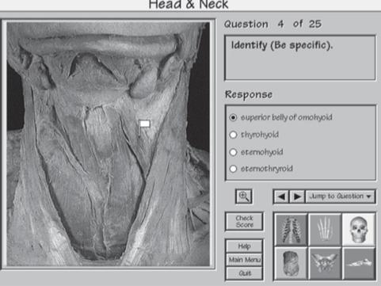
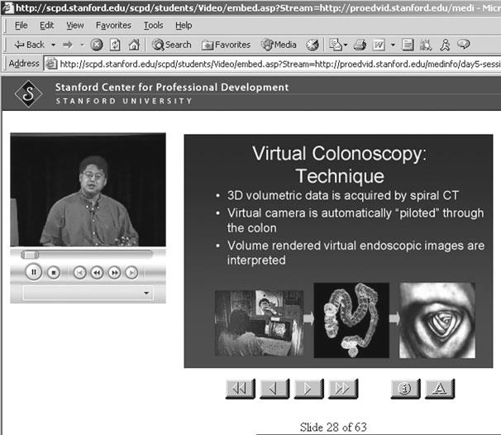
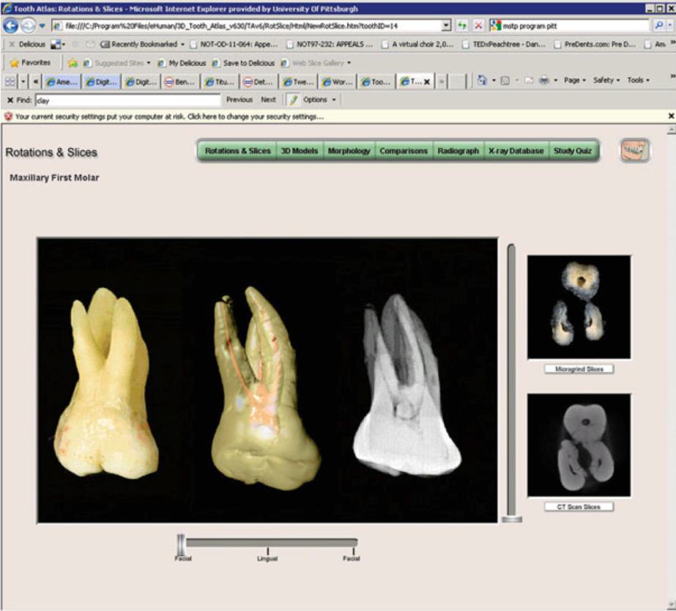
Modes of computer based learning
Saudi Legislation
The Saudi Health Information Exchange Policies (the SHIE Policies), published by the Ministry of Health.
In line with Vision 2030, the MoH published a suite of policies relating to the Saudi Health Information Exchange (SHIE) initiative (also referred to as the Saudi eHealth Exchange SeHE).
Broadly aimed at the use of health information, including patient data, in the context of the increased adoption of technology and digitalization in the health system.
The policies provide a clearer understanding of what the MoH expects in terms of the use of data in a healthcare context.
Mode | Definition | Advantages & Disadvantages
Drill and Practice | Present material to students Answer MCQ Repeat till mastery Move to the next material The student will answer the MCQ and during that he/she will be assessed and would not be able to proceed to next question until they got the right answer. | Advantages: Student can learn factual material. Allow everyone to learn on their own pace without needing one to one guidance. Anytime, anywhere!
Digital Lecture | Recorded and broadcast to students. Podcast, Webinars. Other media: Youtube, Slideshare. Open Courseware by MIT (2001) can be shared across partner universities. | Advantages: You can go back to the lecture at any time and listen to it repeatedly. Disadvantages: The lecturer won’t be available when needed
Exploration | Students have the freedom to explore without guidance and interruptions. Totally the opposite of drill and practice E.g Brain structure- explore the images, observing the location, size of structure change. Examples: Tooth Atlas Exploring dental anatomy 3D model and radiographs It has an MCQ that assess the knowledge | Advantages: Encouraged self discovery and experimentation. Disadvantage: Without guidance, students may be lost (do not meet learning objectives) and wasting time exploring different aspects without the guidance leading to insufficient learning
Saudi Guidelines
The Patient's Bill of Rights and Responsibilities (the Patient's Bill) (MOH bill), as an example.
The Patient's Bill sets out patients' main rights and duties whenever receiving health. services from the relevant health facilities (a health facility is defined by the Patient's Bill as the agency affiliated to the MoH or operating under its supervision and providing health services to patients; whether a clinic, health center, infirmary, hospital, or laboratory).
One of these essential rights is the patient's right to confidentiality and security.
Covered Entities: Patient Rights
Request and receive a copy of their health records
Request an amendment to their health record
Receive a notice that discusses how health information may be used and shared, the Notice of Privacy Practices
Request a restriction on the use and disclosure of their health information
Receive a copy of their “accounting of disclosures”
Restrict disclosure of the health information to an insurer if the encounter is paid for out of pocket
File a complaint with a provider, health insurer, and/or organization if patient rights are being denied or health information is not being protected.
Protected Health Information (PHI)
Individually identifiable health information:
Information created by a covered entity
And “relates to the past, present, or future physical or mental health or condition of an individual”
Or identifies the individual or there is a reasonable basis to believe that the individual can be identified from the information.
Drill & practice
Digital lecture
Exploration

Slide 5
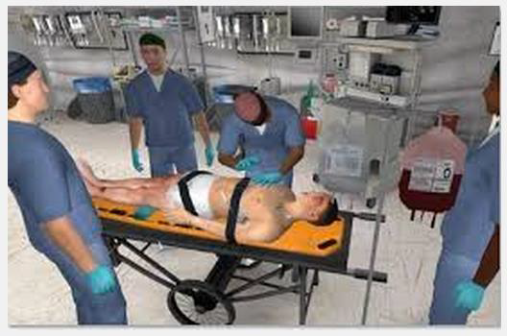
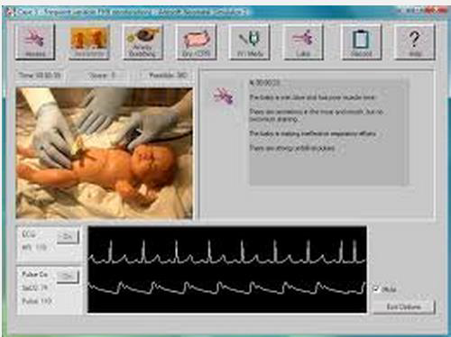
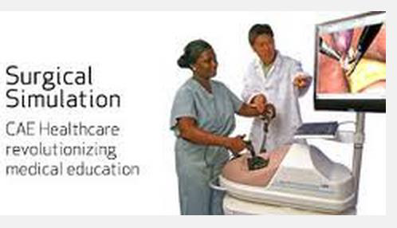
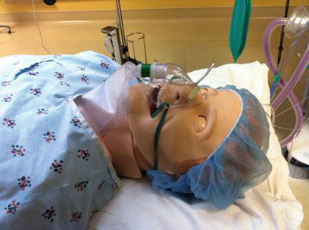
Modes of computer based learning
HIPAA
Protections apply to all personal health information (PHI), whether in hard copy records, electronic personal health information (ePHI) stored on computing systems, or even verbal discussions between medical professionals
Covered entities must put safeguards in place to ensure data is not compromised, and that it is only used for the intended purpose
The HIPAA rules are not designed to and should not impede the treatment of patients
Mode | Definition
Problem- based learning | It is under the constructivism theory Process of arriving at a solution through accessing and using a body of knowledge. The computer presents the learner with a story that includes a problem that could be a text or any other form of data. The learner may be required to investigate the situation. By examination, finding the problem and looking at lab and test results to find the solutions by which the computer will the an action
Simulation | A lot of skills can be learned in such environment Engage and actively involved in decision making Interaction between a student and a simulated patient Approximate the real-world experience of patient care Put attention to subject being presented Simulation can be static vs dynamic Static: predefined problems and clinical outcomes. Nothing can be changed; students action doesn’t influence the pathway Dynamic: simulate changes as students are interacting; make students understand their actions and clinical outcomes. Effective learning using constructive approach to learning E.g. Immersive simulated environments
Privacy Rule Mandates Removal of 18
Identifiers
Names
All geographic subdivisions smaller than a state
All elements of dates (except year)
Telephone numbers
Facsimile numbers
Electronic mail addresses
Social security numbers
Medical record numbers
Health plan beneficiary numbers
Account numbers
Certificate/license numbers
Vehicle identifiers and serial numbers, including license plate numbers
Device identifiers and serial numbers
Web universal resource locators (URLs)
Internet protocol (IP) address numbers
Biometric identifiers, including fingerprints and voiceprints
Full-face photographic images and any comparable images
Any other unique identifying number, characteristic, or code
Permitted Uses and Disclosures of Patient
Data
To the individual
For treatment, payment or health care operations
Uses and disclosures with opportunity to agree or object
Facility directories
For notification and other purposes
Incidental use and disclosure
Public interest and benefit activities
Required by law
Public health activities
Victims of abuse, neglect or domestic violence
Health oversight activities
Judicial and administrative proceedings
Law enforcement purposes
Decedents
Cadaveric organ, eye, or tissue donation
Research
Serious threat to health or safety
Essential government functions
Workers’ compensation
Simulation
The immersive environment of stimulation learning will be in real life settings; OR, trauma centers, ICU and the physician office. The patient will be an artificial mannequin that has the same dynamic of real patient; vital signs ..etc.
The learners can play any role; the nurse, the surgeon … etc
We need this type of learning for:
1-regular training
2-cognitive training (??)

Slide 6
Modes of computer based learning
Administrative Requirements for the Privacy Rule
Develop and implement written
privacy policies and procedures
Designate a privacy official
Workforce training and management
Mitigation strategy for privacy
breaches
Data safeguards - administrative,
technical, and physical
Designate a complaint official and procedure to file complaints
Establish retaliation and waiver policies and restrictions
Documentation and record retention - six years
Fully-insured group health plan exception
Mode | Definition
Problem- based learning | It is under the constructivism theory Process of arriving at a solution through accessing and using a body of knowledge. The computer presents the learner with a story that includes a problem that could be a text or any other form of data. The learner may be required to investigate the situation. By examination, finding the problem and looking at lab and test results to find the solutions by which the computer will the an action
Simulation | A lot of skills can be learned in such environment Engage and actively involved in decision making Interaction between a student and a simulated patient Approximate the real-world experience of patient care Put attention to subject being presented Simulation can be static vs dynamic Static: predefined problems and clinical outcomes. Nothing can be changed; students action doesn’t influence the pathway Dynamic: simulate changes as students are interacting; make students understand their actions and clinical outcomes. Effective learning using constructive approach to learning E.g. Immersive simulated environments
Organizational role
Policy regarding information security practices is often set by chief information officers (CIOs), chief technology officers (CTOs), information technology (IT) directors or similar; often with input from chief medical informatics officers (CMIOs), HIPAA compliance officers, or the like
Depending on resources, the information technology teams may consist of network, system administration, security and data personnel, or could be the very same technical staff relied upon for all office or clinic IT needs.
Threat Actors
Insiders
Hacktivists
Organized crime
Types of Attacks
Social Engineering: most common
Phishing: via email or text messaging
Shoulder surfing: attacker looks over the shoulder
Tailgating: attacker uses someone else's ID
Free software: USB drive is found and plugged into a computer, introducing a virus
Denial of Service (DOS): website is flooded with traffic, shutting it down
Brute Force: random credential are rapidly thrown at website hoping to gain access
Doxing: gathers info about a victim and publishes that to harass or embarrass the individual.
Simulation
Security Breaches and Attacks
Identity theft on the rise
Physical Theft
Stolen laptops, computers, storage devices and servers
The HHS website lists all of the reported data breaches affecting over 500 users. The site lists the covered entity, the number of breach victims, the type of breach and the location of data (laptop, server, paper, etc.)
Breaches: https://ocrportal.hhs.gov/ocr/breach/breach_report.jsf
The immersive environment of stimulation learning will be in real life settings; OR, trauma centers, ICU and the physician office. The patient will be an artificial mannequin that has the same dynamic of real patient; vital signs ..etc.
The learners can play any role; the nurse, the surgeon … etc
We need this type of learning for:
1-regular training
2-cognitive training (??)

Slide 7
Modes of computer based learning
Threat Countermeasures
Authentication & Identity Management
Accomplished with photo identification, biometrics, smart card technologies, tokens, and the old standard; username and password
Basic Authentication may vary depending on:
sensitivity of data
the capabilities of the systems
resource constraints - both technical and monetary
the frequency of access
Methods rely on what is known as two or multi-factor authentication:
something one knows, something one has, or something that one is
Mode | Definition
Problem- based learning | It is under the constructivism theory Process of arriving at a solution through accessing and using a body of knowledge. The computer presents the learner with a story that includes a problem that could be a text or any other form of data. The learner may be required to investigate the situation. By examination, finding the problem and looking at lab and test results to find the solutions by which the computer will the an action
Simulation | A lot of skills can be learned in such environment Engage and actively involved in decision making Interaction between a student and a simulated patient Approximate the real-world experience of patient care Put attention to subject being presented Simulation can be static vs dynamic Static: predefined problems and clinical outcomes. Nothing can be changed; students action doesn’t influence the pathway Dynamic: simulate changes as students are interacting; make students understand their actions and clinical outcomes. Effective learning using constructive approach to learning E.g. Immersive simulated environments
Basic authentication
Username and password combination still employed by a majority of users today, combining two things that a user knows
Another option is utilizing a grid card, smart card, USB token, one time password (OTP) token, or OTP service in combination with something a user knows, such as a passphrase or PIN
Single Sign On (SSO)
One set of credentials to easily access many of the resources one uses every day securely; example is Google
Smart Cards
Used in Healthcare in many countrie
Vital information with a self-contained processor and memory
Low cost, ease of use, portability and durability, and ability to support multiple applications
Capable of encrypted patient information, biometric signatures and personal identification (PIN)
Drawbacks: lack of standardization and positive identification
Simulation
Biometric Authentication
When combined with passphrases or the tokens, cards, and OTP solutions discussed previously, a two or multi-factor authentication solution can be employed
Physical user identifiers: fingerprint, retinal scan, voice imprint
Theft Countermeasures
The immersive environment of stimulation learning will be in real life settings; OR, trauma centers, ICU and the physician office. The patient will be an artificial mannequin that has the same dynamic of real patient; vital signs ..etc.
The learners can play any role; the nurse, the surgeon … etc
We need this type of learning for:
1-regular training
2-cognitive training (??)
Render data unusable to thieves
Encryption standards such as FIPS 140-2
Hardware and software encryption techniques
See encrypted USB device to the right

Slide 8
Book summary

Slide 9
Modes of computer based learning
Conclusions
Mode | Definition
Security of healthcare data is critical for future success of HIT
Saudi laws and guidelines supplement the administrative, physical and technical safeguards implemented by HIPAA
Security measures will continue to improve but so will the efforts of hackers and criminals who seek access to healthcare record data and identity theft
Problem- based learning | It is under the constructivism theory Process of arriving at a solution through accessing and using a body of knowledge. The computer presents the learner with a story that includes a problem that could be a text or any other form of data. The learner may be required to investigate the situation. By examination, finding the problem and looking at lab and test results to find the solutions by which the computer will the an action
Simulation | A lot of skills can be learned in such environment Engage and actively involved in decision making Interaction between a student and a simulated patient Approximate the real-world experience of patient care Put attention to subject being presented Simulation can be static vs dynamic Static: predefined problems and clinical outcomes. Nothing can be changed; students action doesn’t influence the pathway Dynamic: simulate changes as students are interacting; make students understand their actions and clinical outcomes. Effective learning using constructive approach to learning E.g. Immersive simulated environments
As we conclude Feel free to use this space to express
your love for medical informatics❤️
Simulation
The immersive environment of stimulation learning will be in real life settings; OR, trauma centers, ICU and the physician office. The patient will be an artificial mannequin that has the same dynamic of real patient; vital signs ..etc.
The learners can play any role; the nurse, the surgeon … etc
We need this type of learning for:
1-regular training
2-cognitive training (??)

Slide 10
Questions
1-Security personnel responsible for developing and implementing security policies is an example of which of the following?
A- Physical Safeguard
B- Administrative Safeguard
C- Technical Safeguard
D- Constitutional safeguard
2- One set of credentials to easily access many of the resources one uses every day securely is an example of which threat countermeasure:
A- Smart card
B- Biometric authentication
C- FIPS 140-2
D- Single Sign on (SSO)
3-Attacker uses someone elses ID is:
A- Tailgating
B- Phishing
C- Shoulder surfing
D- Doxing
4- Doxing is...
A- attacker looks over the shoulder
B- USB drive is found and plugged into a computer, introducing a virus
C- gathers info about a victim and publishes that to harass or embarrass the individual
D- gathers info about a victim and publishes that to harass or embarrass the individual.
5- Which of the following best describes Integrity?:
A- Laid groundwork for privacy and security measures in healthcare . Initial intent was to cover patients who switched physicians or insurers
B- focuses on power loss or network connectivity outages
C- trustworthiness and permanence of data, an assurance that the lab results or personal medical history of a patient is not modifiable by unauthorized entities or corrupted by a poorly designed process
D- usernames, passwords, and encryption are common measures implemented to ensure confidentiality
6- Which ONE of the following is not considered as an identifier:
A- BMI numbers
B- Facsimile numbers
C- Electronic mail addresses
D- Social security numbers
B
D
A
C
C
A

Slide 11
Good Luck!
DONE BY OUR AMAZING MEMBER:
NOTE TAKER BY OUR SHARP MEMBER:
TEAM LEADER
JUDE ALOTAIBI
TEAM LEADER
KHALID ALKHANI

