Slide 1
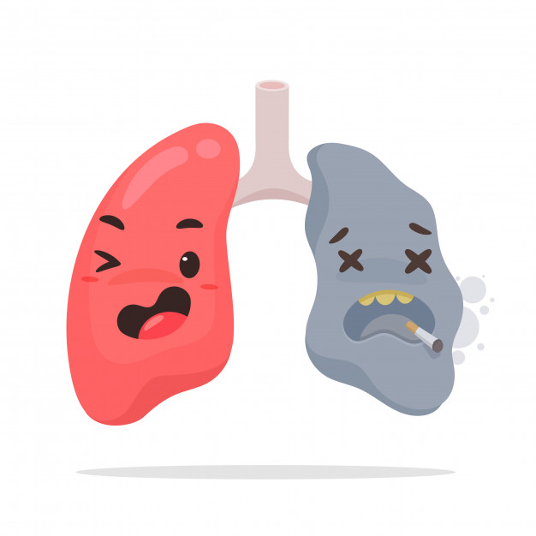
Lecture 11
Editing file
Pulmonary embolism
Objectives:
Prevalence of PE
Risk factors
Clinical features
Pathophysiology
Massive PE
Diagnostic workup
Treatment
Color index:
Color index:
Original text Females slides Males slides
Doctor’s notes Textbook Important Golden notes Extra

Slide 2
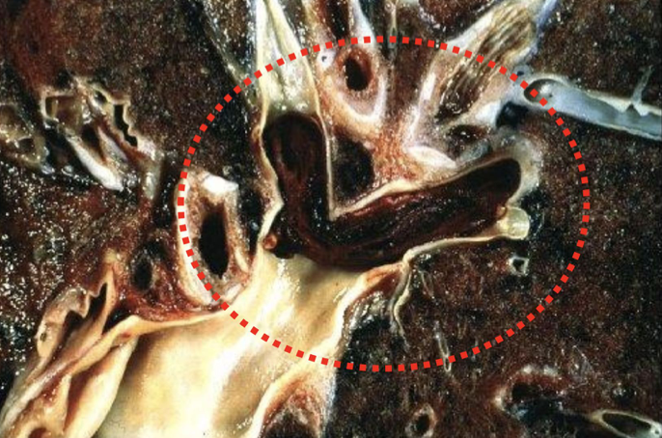
Pulmonary Embolism
Definition
The majority of pulmonary emboli arise from the propagation of lower limb deep vein thrombosis.
Rare causes include:
Septic emboli (from endocarditis affecting the tricuspid or pulmonary valves)
Tumour (especially choriocarcinoma)
Fat following fracture of long bones such as the femur
Air and amniotic fluid, which may enter the mother’s circulation following delivery
Saddle shaped thrombi U shaped
Epidemiology
50,000 individuals die from PE each year in USA
The incidence of PE in USA is 500,000 per year
The annual incidence of pulmonary embolism in the population is 1 per 1000 people, but this increases sharply with age. 1.4 per 1000 people aged 40-49
11.3 per 1000 aged 80 years or over
89%
Survival >1hr
563,000
Total Incidence
630,000
11%
Death within 1 hr
67,000 ¹
71%
Dx not made
400,000
29%
Dx made, therapy instituted 163,000
70 %
Survival 280,000
30% ²
Death 120,000
92%
Survival 150,000
8%
Death 120,000
Massive pulmonary embolism ³
It is a catastrophic entity which often results in acute right ventricular failure and death
Frequently undiscovered until autopsy.
Fatal PE typically leads to death within one to two hours of the event.
1-Death within 1h is caused by Massive PE
2- if you send them home without treatment there’s a high risk they will get another fatal PE
3-Massive means major hemodynamic effect (shock & hypotension), not reserved to the size

Slide 3
Risk Factors
Risk factors for venous thrombosis (Virchow Triad)
Stasis
(eg.HF or any obstruction such as tumors.
Injury to venous intima
eg. Autoimmune diseases causing Vasculitis
Alterations in the coagulation-fibrinolytic system (increase the chances of clot formation)
eg. Deficiency in protein S or C or the presence of factor leiden 5 (mutated form of Factor 5)
50% of venous thromboembolism events are associated with a transient risk factor, 20% are associated with cancer
The remainder are associated with minor or no risk factors and are thus classified as unprovoked
Source of emboli
1
2
Deep venous thrombosis (>95%) ¹
Other veins: Renal, Uterine, Right cardiac chambers
Risk factors of DVT :
General anesthesia
Lower limb or pelvic injury or surgery²
Congestive heart failure
Prolonged immobility ³
Pregnancy
Oral contraceptives pills
Malignancy
Obesity
Advanced age
Coagulation problems
Postpartum
Strong risk factor (odds ratio > 10)
Hip or leg fracture
Hip or leg joint replacement
Major general surgery
Major trauma
Spinal cord injury ⁴
Moderate risk factor (odds ratio 2-9)
Arthroscopic knee surgery
Central venous lines (femoral central lines)
Congestive heart or respiratory failure⁵
Hormone replacement therapy
Oral contraceptive therapy
Malignancy
Paralytic stroke
Postpartum
Previous DVT
Thrombophilia (high platelet count)
weak risk factor (odds ratio <2)
Bed rest >3 days
Immobility due to sitting
Increasing age
Laparoscopic surgery
Obesity
Pregnancy
Varicose veins
1- when you get a pt with PE it’s better to look for signs of DVT
2-thrombi of lower legs usually don't detach and travel to the rest of the body, mostly hips and pelvic thrombi are the ones that do that
3- as in stroke patient or long distance travel especially for elderly
4- Muscles become flaccid with weak contractions → unable to pump up blood
5- Respiratory failure due to polycythemia (develop due to hypoxia)

Slide 4
Pathophysiology
Pulmonary Embolism Death Spiral:
Pulmonary Embolism
Increased pulmonary vascular resistance
RV dilation
Increased RV wall stress, ineffective contraction
Septum bows into LV, decreased LV filling
RV hypoperfusion
& ischemia
Physician gives more fluid
Hypotension
Pathophysiology :
This is important to understand; Pulmonary vessels have a very low resistance. For that, we call the RV “the volume chamber” cause it pumps the same amount of blood as the LV but with a very much lower resistance
When PE occurs, the Pulmonary Arterial Pressure [PAP] (resistance) increases dramatically and acutely, as a result: RV becomes dilated
Massive PE causes an increase in Pulmonary Vascular Resistance [PVR], PAP, and right ventricular pressure → right ventricular outflow obstruction → decrease left ventricular preload → Decrease CO.
If it is severe (large blockage), acute cor pulmonale may result
Acute cor pulmonale: This sudden right heart failure may be caused by a saddle embolus obstructing the pulmonary artery or sudden overload of a chronic cor pulmonale by pneumonia.
Chronic cor pulmonale: This form of chronic right heart failure is a consequence of chronic pulmonary hypertension.
In patients without cardiopulmonary disease, occlusion of 25-30 % of the vascular bed → increase in PAP
Hypoxemia ensues → stimulating vasoconstriction → increase in PAP.
More than 50% of the vascular bed has to be occluded before PAP becomes substantially elevated.
When obstruction approaches 75%, the RV must generate systolic pressure in excess of 50 mmHg to preserve pulmonary circulation.
The normal RV is unable to accomplish this acutely and eventually fails.
Blood flow decreases in some areas of the lung. Dead space is created in areas of the lung in which there is ventilation but no perfusion. The resulting hypoxemia and hypercarbia drive respiratory effort, which leads to tachypnea.
If the size of the dead space is large (large PE), clinical signs are more overt (SOB, tachypnea).

Slide 5
Sign & Symptoms
Sudden onset dyspnea
Pleuritic chest pain¹
Haemoptysis²
Clinical clues cannot make the diagnosis of PE their main value lies in suggesting the diagnosis
Note that only one-third of patients with PE will have signs and symptoms of a DVT.
Syncope seen in large PE.
Signs or symptoms observed in patients with thromboembolism ( a study )
Disease | Sign & Symptoms | Stein et al., % (n=117) | Anderson et al., % (n=131)
Deep vein thrombosis | Swelling Pain Tenderness Warmth Redness Homan’s sign Palpable cord | 28 26 - - - 4 - | 88 56 55 42 34 13 6
PE | Dyspnea Tachypnea Chest pain Cough Tachycardia Cyanosis Hemoptysis Wheezing Hypotension Syncope ↑Jugular venous pulse Temp > 38.5℃ S3 gallop Pleural friction rub | 73 70 66 37 30 1 13 9 - - - 7 3 3 | 77 70 55 - 43 18 13 - 10 10 8 - 5 2
1- Pleuritic chest pain is characterized by being: localized (the patient locate the pain with his finger), stabbing pain , occur during inspiration
2- not common nor specific

Slide 6
PE Probability Scores¹
1
Modified and simplified Geneva rules
Modified Geneva Rule | Points
Age ≥ 65 years Previous DVT or PE Surgery or fracture within 1 month Active cancer Unilateral lower limb pain Pain on deep palpation of lower limb and unilateral edema Hemoptysis HR 75-94 beats\min HR ≥ 95 beats\min | 1 3 2 2 3 4 2 3 5
Simplified Geneva Rule | Points
Age > 65 years Surgery or fracture within 1 month Active cancer Unilateral lower limb pain Hemoptysis Pain on deep palpation of lower limb and unilateral edema HR 75-94 beats\min HR > 94 beats\min | 1 1 1 1 1 1 1 2
Using modified score:
<3 points indicates low probability
4-10 points indicates intermediate probability
>10 points indicates high probability.
Using simplified score, ≤2 points indicates that PE is unlikely.
2
Wells rule
Wells Rule | Points
Sign or symptom of DVT Alternative diagnosis is less likely than PE HR > 100 beats\min Immobilization\surgery in previous 4 weeks History of DVT or PE Hemoptysis Active cancer | 3 3 1.5 1.5 1.5 1 1
Using traditional score:
<2.0 points indicates low probability
2.0- 6.0 points indicates moderate probability
>6.0 points indicates high probability
Using simplified score
>4 points indicates that PE is likely
≤4 points indicates that PE is unlikely.
1- I don’t like to ask about these scores in the exam but they may ask you about them in OSCE

Slide 7
PE risk prediction scores
1
The Pulmonary Embolism Severity Index and
the Simplified versions
The Pulmonary Embolism Severity Index (PESI) is a risk stratification tool to determine the mortality of patients with newly diagnosed pulmonary embolism (PE). It supports physicians in identifying those patients who could potentially be treated as outpatient
The Simplified Pulmonary Embolism Severity Index (sPESI) was designed to remove some of the more complicated elements of the Pulmonary Embolism Severity Index (PESI) and aid in the risk stratification of patients with pulmonary embolism (PE).
Parameter | Original version | Simplified version
Age Male sex History of Cancer History of heart failure History of chronic lung disease Pulse rate ≥ 110 Systolic BP <100 mmHg RR > 30 breath\min Temperature <36 ℃ Altered mental status Arterial Hb saturation < 90% | Age in years + 10 points + 30 points + 10 points + 10 points + 20 points + 30 points + 20 points + 20 points + 60 points + 20 points | 1 point (if age >80) - 1 point - 1 point 1 point 1 point - - - 1 point
Original Ver:
Class 1: ≤65 points
very low mortality risk
Class2: 66-85 points
low mortality risk
Class3: 86-105 points
moderate mortality risk
Class4: 106-125 points
high mortality risk
Class5: >125 points
very high mortality risk
Class I and II defined as low risk.
Simplified Ver:
0 point= low risk
30 day mortality risk 1%
≥1 point = high risk
30 day mortality risk 10.9%
2
Hestia criteria (Yes\ No Questions)
If any of the following Qs answered with [Yes]; Patient need to be admitted
Is the patient hemodynamically unstable? Is the thrombolysis or embolectomy necessary? Active bleeding or high risk for bleeding? >24 h of O2 supply to maintain O2 saturation >90%? Is PE diagnosed during anticoagulant treatment? Severe pain needing I.V pain med for > 24h? | Medical or social reasons for treatment in hospital >24h (infection, malignancy, no support system? Does the patient have a creatinine clearance < 30mL\min? Does the patient have severe liver impairment ? Is the patient pregnant? Does the patient have a documented history of HIT?

Slide 8
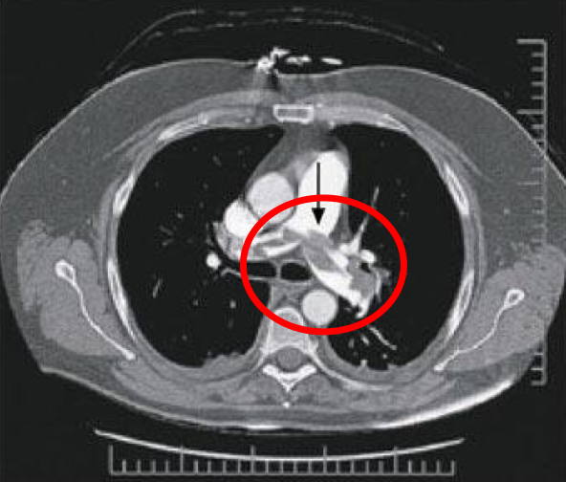
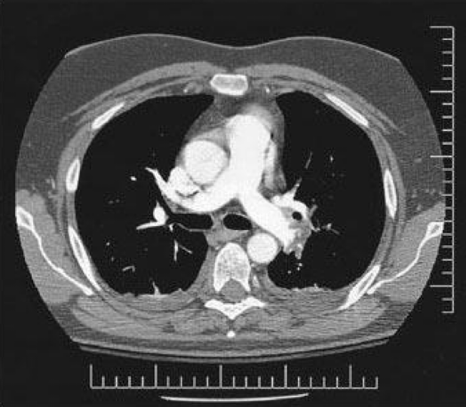
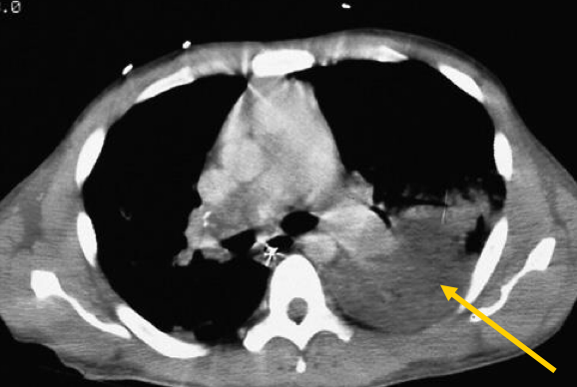
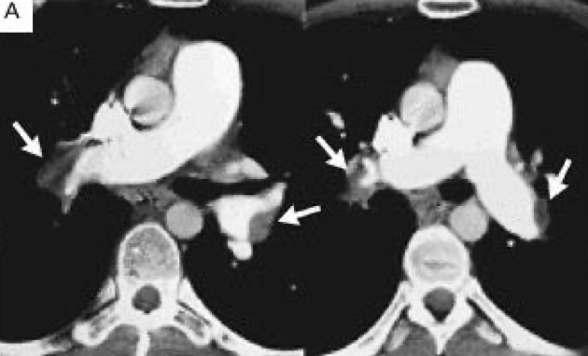
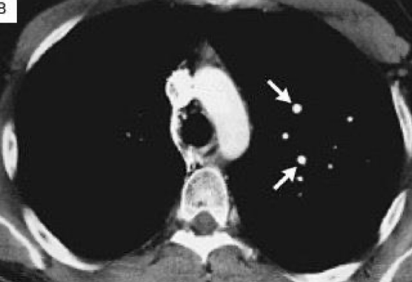
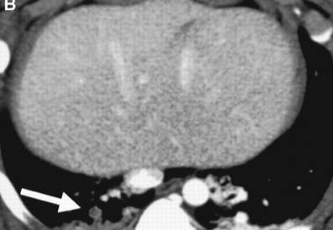
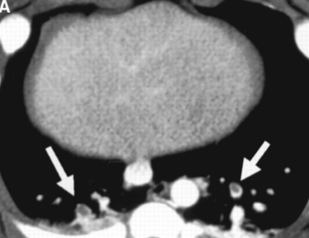
Diagnosis
The diagnosis of massive PE should be explored whenever oxygenation or hemodynamic parameters are severely compromised without explanation
The diagnosis of pulmonary embolism may be aided by asking three questions:
Is the clinical presentation consistent with PE?
Does the patient have risk factors for PE?
Are there any alternative diagnoses that can explain the patient’s presentation?
Diagnosis Methods
CXR
ABG
ECG
V\Q
Spiral CT
Echo
Angio
D-dimer
Spiral CT (first-line diagnostic test)
Computed tomographic pulmonary angiography (CTPA) (Spiral CT):
Data suggest that a negative Spiral CT is an adequate criterion for excluding PE in patients with a non-high clinical probability of PE
Has been found to have good sensitivity (>90%) and specificity
Can visualize very small clots (as small as 2 mm); may miss clots in small subsegmental vessels (far periphery).
The test of choice in most medical centers
In combination with clinical suspicion, guides treatment
CTA cannot be performed in patients with significant renal insufficiency because of the IV contrast that is required.
Before
After
Large clot in right main pulmonary artery (infarcted left lung)¹
Normally aorta is larger than pulmonary but here pulmonary is dilated due to the presence of a clot
signet ring sign
1-lung infarction is rarely seen

Slide 9
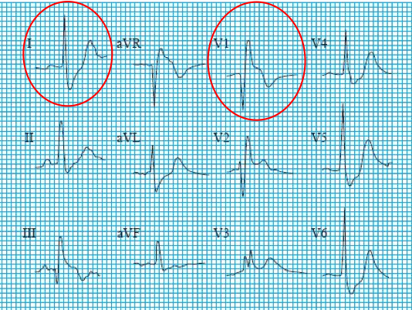
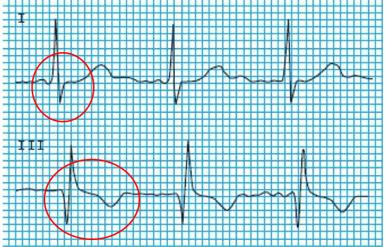
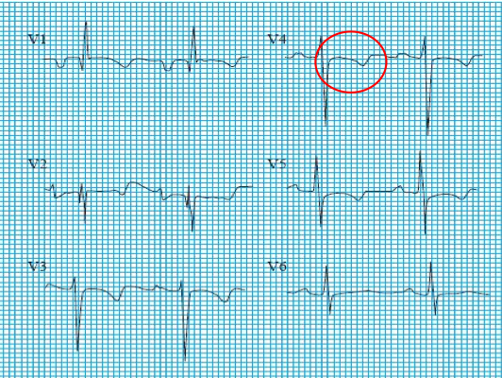
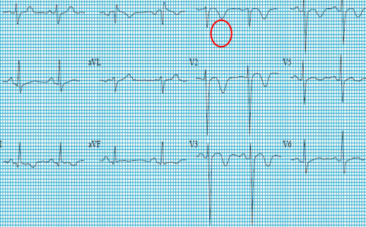
Diagnosis
ECG:
Rt. Bundle Branch Block
S1 Q3 T3 Pattern
Findings:
- Lead 1: S wave
- V1,2: Slurred R wave
- There are 2 types of RBBB:
1- Complete RBBB: QRS duration is prolonged
2- Incomplete RBBB: Normal QRS duration (<0.12s or 4 small squares)
Findings:
You see the S wave in lead 1 and the Q and T waves in lead 3
-This finding is helpful but not diagnostic for PE
Rt. Ventricular Strain
T-wave inversion
Findings:
- ST-segment depression
- T-wave inversion
Findings:
T-wave inversion in V1,V2,V3
V\Q (ventilation perfusion scan)¹
This test is performed in two stages:
perfusion phase: in which technetium-labelled albumin aggregates are injected intravenously and blood flow to the lungs is assessed
ventilation phase: in which patients inhale radiolabelled xenon or technetium to assess air delivery to the lungs
Traditionally, this was the most common test used when PE is suspected, but has been replaced by CT angiography (CTA) as the initial study of choice in many medical centers.
Plays an important role in diagnosis when there is a contraindication to CTA. (This technique has the advantage of a lower radiation dose and is preferred in those with renal impairment and allergies to intravenous contrast agents.)May be useful when the chest x-ray is clear and when there is no underlying cardiopulmonary disease.
1- not used for COPD patients, also it’s rarely used now (time consuming)

Slide 10
The use of ventilation perfusion scan in diagnosing pulmonary embolism
Interpretation of results, can be either
normal
low probability
intermediate probability
or high probability (treatment guidelines based on PIOPED study).
A high-probability V/Q scan has a very high sensitivity for PE; treat with heparin.
If there is low or intermediate probability, clinical suspicion determines the next step.If clinical suspicion is high, pulmonary angiography is indicated. Alternatively, perform a lower extremity duplex ultrasound to avoid pulmonary angiography. If the duplex is positive, treatment for DVT is the same as for PE. If the duplex is negative/uncertain, then pulmonary angiography is indicated to exclude PE.
A diagnosis of PE is made if there are mismatched defects in the perfusion scan, indicating impaired blood flow to the lungs, but normal ventilation because air entry to the lungs is normal.
Normal scan virtually rules out PE—no further testing is needed but a scan is almost never “normal” in anyone.
Prospective Investigation of Pulmonary Embolism Diagnosis (PIOPED) results:
Scan category | PE present | PE absent | PE uncertain | No angiogram | Total
High probability | 102 | 14 | 1 | 7 | 124
Intermediate probability | 105 | 217 | 9 | 33 | 364
Low probability | 39 | 199 | 12 | 62 | 312
Near normal or normal | 5 | 50 | 2 | 74 | 131
Total | 251 | 480 | 24 | 176 | 931

Slide 11
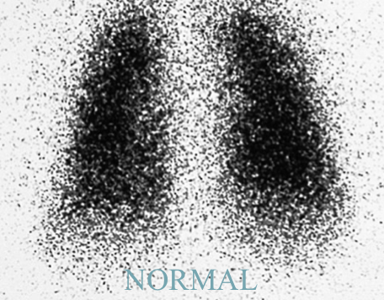
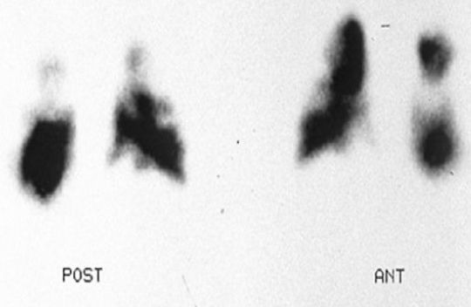
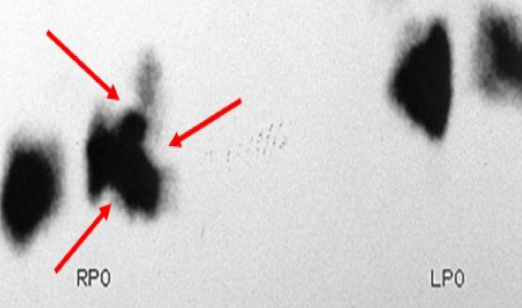
The use of ventilation perfusion scan in diagnosing pulmonary embolism
skipped by the dr
=2 large segmental (>75% of a segment) perfusion defects without corresponding ventilation or radiographic abnormalities or substantially larger than matching ventilation or radiologic abnormalities.
OR
=2 moderate segmental (>25% and <75% of a segment) perfusion defects without matching ventilation or chest radiographic abnormalities plus one large unmatched segmental defect.
OR
● =4 moderate segmental perfusion defects without matching ventilation or chest radiologic abnormalities.
High probability
Intermediate probability
Scans that do not fall into normal, very low, low, or high probability categories.
Non-Segmental perfusion defects.
OR
Single moderate mismatched segmental perfusion defect with normal chest radiograph.
OR
Any perfusion defect with a substantially larger abnormality on chest radiograph.
OR
Large or moderate segmental perfusion defects involving no more than four segments in one lung and no more than three segments in one lung region with matching or larger ventilation/radiographic abnormalities.
OR
More than three small segmental perfusion defects (<25% of a
segment) with a normal chest radiograph.
Low probability
Very Low probability
Three or fewer small segmental perfusion defects with a normal chest radiograph.
Normal
No perfusion defects present

Slide 12
Diagnosis
CXR:
Pulmonary infarct in right lower lobe
CXR usually normal.
Atelectasis or pleural effusion may be present.
The main usefulness is in excluding alternative diagnoses, e.g. pneumonia or pneumothorax
Classic radiographic signs, such as Hampton hump or Westermark sign, are rarely present.
infarction is not that common because the lung has dual supply (Supplied by pulmonary and aortic vessels)
Findings | COPD % (N=21) | No prior cardiopulmonary disease, %(N=117)
Atelectasis or pulmonary parenchymal abnormality | 76 | 68
Pleural effusion | 52 | 48
Pleural-based opacity | 33 | 35
Elevated diaphragm | 14 | 24
Decreased pulmonary vascularity | 38 | 21
Prominent central pulmonary artery | 29 | 15
Cardiomegaly | 19 | 12
Westermark’s sign | 5 | 7
Pulmonary edema | 14 | 4
D-Dimer¹
The D-dimer is a degradation product of fibrinolysis and is increased in patients with acute venous thromboembolism (PE and DVT) as well other non-thrombotic disorders
D-dimer is a sensitive (90% to 98%). If results are normal and clinical suspicion is low, PE is very unlikely, but not specific diagnostic test it may also be elevated in MI, CHF, pneumonia, and postoperative state (or in any state of acute inflammation). Any cause of clot or increased bleeding can elevate the D-dimer level
A low clinical probability score is useful for excluding of venous thromboembolism
If pretest probability of PE is low, D-dimer test is a good noninvasive test to rule out PE. So if D-dimer is negative, you can rule out a clot. But if it is positive, this does not help you.
1- measured by ELISA

Slide 13
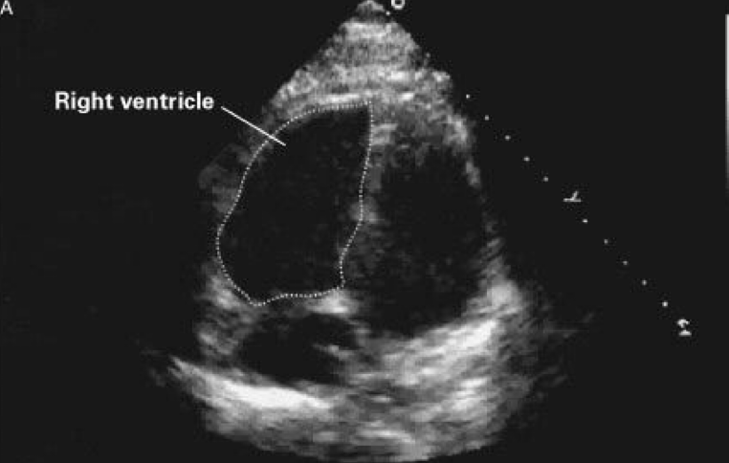
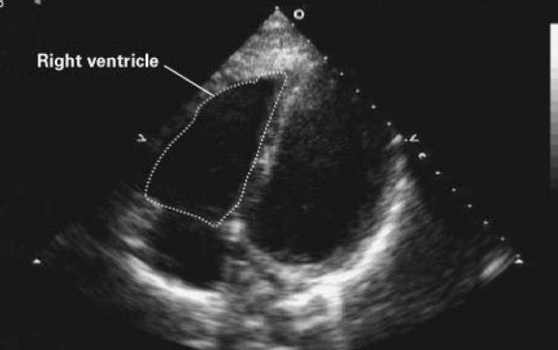
Diagnosis
ABG
Significant hypoxemia is almost uniformly present when there is a hemodynamically significant PE
ABG levels are not diagnostic for PE
PaO2 and PaCO2 are low (the latter due to hyperventilation) and pH is high; thus, there is typically a respiratory alkalosis.
A more accurate test is to measure alveolar arterial gradient [ A-a gradient ] (PAo2)-(Pao2).Normal gradient is between 5-10, A–a gradient is usually elevated 15 or above. A normal value makes PE less likely, but cannot be relied on to exclude the diagnosis. A–a gradient is usually elevated.
MRA real time
Comparison in the sensitivity of Spiral CT, MRA and RT- MRA
Reader | CT | MRA | RT-MRA
1 | 72.1 | 79.1 | 97.7
2 | 69.8 | 81.4 | 97.7
Mean | 71 | 80.3 | 97.7
K | 0.86 | 0.84 | 1
MRA with contrast¹
Echo :
-the RV is pushing the septum to the left
-returns to normal size after treatment
Before
After
1- MRA simply is MRI with angio

Slide 14
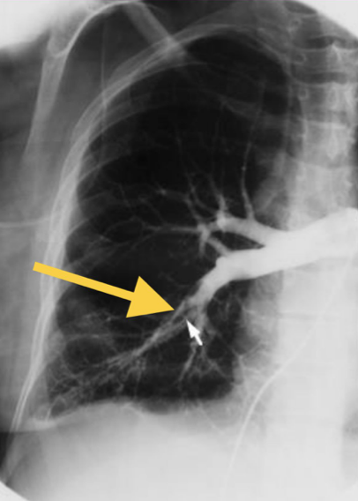
Diagnosis
Pulmonary angiogram:
Pulmonary angiography is the gold standard.
Definitively diagnoses or excludes PE, but is invasive. Contrast injected into the pulmonary artery branch after percutaneous catheterization of the femoral vein.
Consider when noninvasive testing is equivocal and risk of anticoagulation is high, or if the patient is hemodynamically unstable and embolectomy may be required. Angiography is rarely performed because it carries a 0.5% mortality.
Pulmonary angiogram is not used now cause it's time consuming , CT angiogram is much better
Suggested diagnostic strategy for venous thromboembolism¹:
All patient
V\Q high probability
V\Q intermediate or low probability
V\Q normal or near normal
Treatment for PE
Noninvasive leg imaging
No therapy
Thrombus present
No thrombus
Treatment for DVT
Adequate cardiac-respiratory reserve
Poor cardiac-respiratory reserve
Serial noninvasive leg imaging or pulmonary angiogram
Pulmonary angiogram
+ve
-ve
+ve
-ve
Treat
No treatment
Treat
No treatment
1- The boxes with green borders were covered in the dr slides with (SPIRAL CT SCAN OF THE CHEST).
* After you do Hx, ABG, ECG, D-dimer, CXR. Do CT angio
* If CT is +ve --> treat
* If -ve --> Do ultrasound for the leg
if thrombus present --> treat (follow the left side of the algorithm)
If no thrombus (follow the right side of the algorithm)

Slide 15
Treatment¹
The main principle of treatment for PE is anticoagulant.
Prompt initiation of anticoagulation while awaiting investigations is prudent because of the high risk of early mortality with untreated pulmonary embolism (if there’s no contraindications in the pt then start treatment immediately)
Anticoagulants
Direct Oral Anticoagulants [DOACs]² are given at fixed dose and do not necessitate routine laboratory monitoring.
Each DOAC has been deemed non-inferior to the Vitamin K Antagonist \ Low molecular weight Heparin [VKA/LMWH] combination for the prevention of symptomatic recurrent venous thromboembolism in patients with an acute venous thromboembolism.
DOACs have significantly fewer major bleeding events compared with VKAs
DOACs:
Drug | Target | Peak effect | Half life | Renal clearance | Protein binding
Dabigatran | Factor IIa (Thrombin) | 1.5 h | 14-17 h | > 80% ³ | 35%
Apixaban | Factor Xa | 3 h | 8-14 h | 25% | 85%
Edoxaban |  | 4 h | 8-11 h | 35% | 55%
Rivaroxaban |  | 2-3 h | 7-11 h | 33% | 90%
Rivaroxiban 15 mg and 20 mg tablets should be taken with food for maximum absorption and efficacy.
What agents reverse anticoagulation?
Andexanet alfa reverses rivaroxaban, apixaban, and edoxaban.
Idarucizumab reverses dabigatran.
Prothrombin complex concentrate (PCC) reverses warfarin
Dosage and monitoring of anticoagulant therapy:
1
Warfarin
2
Heparin ⁴
5 mg/d can be started on day 1 of therapy; there is no benefit from higher starting doses
Platelet count should be monitored at least every 3 d during initial heparin therapy
Therapeutic APTT should correspond to plasma heparin level of 0.2–0.4 IU/mL
is usually continued for 5–7 d
Can be stopped after 4–5 d of warfarin therapy when INR is in 2.0– 3.0 range
3
LMWH
1-When PE is diagnosed, mortality is 10% in the first 60 minutes. Of those who survive the initial event, approximately 30% of patients will die of a recurrent PE, if left untreated. Most deaths are due to recurrent PE within the first few hours of the initial PE. Treatment with anticoagulants decreases the mortality to 2% to 8%.
2-DOAC They are anticoagulant better than warfarin and heparin because it has less adverse effect.
3-avoid in renal failure
4-Start heparin first due to its fast action then warfarin + monitor INR carefully. if INR is stable, continue warfarin and stop heparin

Slide 16
Treatment
Important drug interactions with warfarin:¹
Drugs that decrease warfarin requirement
Drugs that increase warfarin requirement
Second- and third-generation cephalosporins
Barbiturates
Carbamazepine
Rifampin
Penicillin
Griseofulvin
Cholestyramine
Phenylbutazone
Metronidazole
Trimethoprim-sulfamethoxazole
Amiodarone
Clofibrate
Erythromycin
Anabolic steroids
Thyroxine
Complications:
Heparin
Complication | Management
Bleeding | Stop heparin infusion. For severe bleeding, the anticoagulant effect of heparin can be reversed with intravenous protamine sulfate 1 mg/100 units of heparin bolus or 0.5 mg for the number of units given by constant infusion over the past hour; provide supportive care including transfusion and clot evacuation from closed body cavities as needed.
Heparin-induced thrombocytopenia and thrombosis ² | Carefully monitor platelet count during therapy; Stop-heparin for platelet counts <75,000. Replace heparin with direct inhibitors of thrombin like desirudin if necessary. These agents do not cause heparin-induced thrombocytopenia. Avoid platelet transfusion because of the risk for thrombosis.
Heparin-induced osteoporosis (therapy >1mo) | LMWHs may have lower propensity to cause osteoporosis as compared with unfractionated heparin; consider LMWH if prolonged heparin therapy is necessary
1- you don’t need to know the names of the drugs just know that it has a lot of interactions. if the pt is using any of them ask to monitor INR after few days of initiation of treatment
2-AKA HIT syndrome or White-clot syndrome
Characterized by activation of fibrinogen which in turn will form A mesh that will trap platelets. Lab investigation will show very rapid fall in Platelets count, that’s why you have to test platelet count in the first week of administration

Slide 17
Treatment
Warfarin
Complication | Management
Bleeding | Stop therapy. Administer vitamin K and fresh frozen plasma for severe bleeding; provide supportive care including transfusion and clot evacuation from closed body cavities as needed
Skin necrosis (rare) | Supportive care
Teratogenicity | Do not use in pregnancy or in patients planning to become pregnant.
Thrombolytics
Approved thrombolytics for pulmonary embolism :
1
Recombinant
tissue-plasminogen activator¹
2
Streptokinase
3
Urokinase
100 mg as a continuous peripheral intravenous infusion administered over 2 h
250,000 IU as loading dose over 30 min, followed by 100,000 U/h for 24 h
4400 IU/kg as a loading dose over 10 min, followed by 4400 IU/kg/h for 12-24 h
Indications in PE:
Contraindications
Hemodynamic instability
Relative:
- Recent surgery within last 10 d
- Previous arterial punctures within 10 d
- Neurosurgery within 6 mo
- Bleeding disorder (thrombocytopenia, renal failure, liver failure)
- Ophthalmologic surgery within 6 wk
- Hypertension >200 mm Hg systolic or 110 mm Hg diastolic
- Placement of central venous catheter within 48 h
- Hypertensive retinopathy with hemorrhages or exudates
- Intracerebral aneurysm or malignancy
- Cardiopulmonary resuscitation within 2 wk
- Cerebrovascular disease
- Major internal bleeding within the last 6 mo
- Pregnancy and the 1st 10 d postpartum
- Infectious endocarditis
- Severe trauma within 2 mo
- Pericarditis
Hypoxia on 100% oxygen
Right ventricular dysfunction by echocardiography
For massive PE use thrombolytic + anticoagulant. Any other PE use anticoagulant only (Thrombolytic doesn't show any improvement in mortality in these cases)
Diuretics and vasodilators should also be avoided, as they will reduce cardiac output.
Absolute:
- Active internal bleeding
1-Recombinant tissue-plasminogen activator is the one we’re using currently

Slide 18
Treatment
Treatment phases :
Initial
(0-7 days)
Long term
(1 week - 3 months)
Extended (3 month - indefinitive)
- Apixaban 10mg BID for 7days
- Rivaroxaban 15mg BID for 21days
- LMWH\fondaparinux for minimum 5 days * and INR≥2 for 2 days
- Apixaban 5mg BID
- Dabigatran 150mg BID
- Edoxaban~ 60mg daily
- Rivaroxaban 20mg daily
- Warfarin for INR 2-3
- Apixaban 2.5- 5mg BID “
- ASA 81-100 daily, if anticoagulant not possible
- Dabigatran 150 mg BID
- Edoxaban~ 60mg daily
- Rivaroxaban 10-20mg daily “
- Warfarin for INR 2-3
BID: twice daily. INR: international normalized ratio> LMWH: low molecular wight heparin
*LMWH is needed for 5-10 days before starting dabigatran or edoxaban
~ 30 mg daily if creatinine clearance is 30-50 mL/min or weight < 60 kg
“ Dose reduction may be considered after 6 months of therapy
Identify category of Venous Thromboembolism [VTE] event
Provoked by transient risk factor
Unprovoked
Cancer association
- Women at high risk of recurrent VTE
- Men or women at low or moderate risk of bleeding
- Women at low risk of recurrent VTE.
- Men or women at high risk of bleeding
3 months anticoagulant
Indefinitive anticoagulant therapy
3-6 months anticoagulant therapy
6 months anticoagulants or as long as cancer is active
Outpatient vs inpatient therapy :
RCTs have compared outpatient versus inpatient management of pulmonary embolism and found no difference in outcomes in selected patients.
Conclusions:
PE is common and under-recognized serious medical problem
Early diagnosis and treatment is essential for good outcome
High index of suspicion is needed in high risk patients

Slide 19
Summary from Davidson’s
Features of Pulmonary thromboemboli:
 | Acute massive PE | Acute small/medium PE | Chronic PE
Patho- physiology | Major haemodynamic effects: ↓cardiac output acute right heart failure | Occlusion of segmental pulmonary artery → infarction ± effusion | Chronic occlusion of pulmonary microvasculature Right heart failure
Symptoms | Faintness or collapse Crushing central chest pain Apprehension Severe dyspnoea | Pleuritic chest pain Restricted breathing Haemoptysis | Exertional dyspnoea Late: Symptoms of pulmonary hypertension Right heart failure
Signs | Major circulatory collapse: Tachycardia Hypotension ↑JVP RV gallop rhythm Loud P2 Severe cyanosis ↓urinary output | Tachycardia Pleural rub Raised hemidiaphragm Crackles Effusion (often blood-stained) Low-grade fever | Early: may be minimal Later: RV heave, loud P2 Terminal: signs of right heart failure
Chest X-ray | Usually normal; may be subtle oligaemia | Pleuropulmonary opacities Pleural effusion Linear shadow Raised hemidiaphragm | Enlarged pulmonary artery trunk Enlarged heart Prominent right ventricle
ECG | S1Q3T3 anterior T-wave inversion RBBB | Sinus tachycardia | RV hypertrophy and strain
Arterial blood gas | Markedly abnormal with ↓PaO2 and ↓PaCO2 Metabolic acidosis | May be normal or ↓PaO2 or ↓PaCO2 | Exertional ↓PaO2 or desaturation on formal exercise testing
Alternative diagnosis | Myocardial infarction Pericardial tamponade Aortic dissection | Pneumonia Pneumothorax Musculoskeletal chest pain | Other causes of pulmonary hypertension

Slide 20
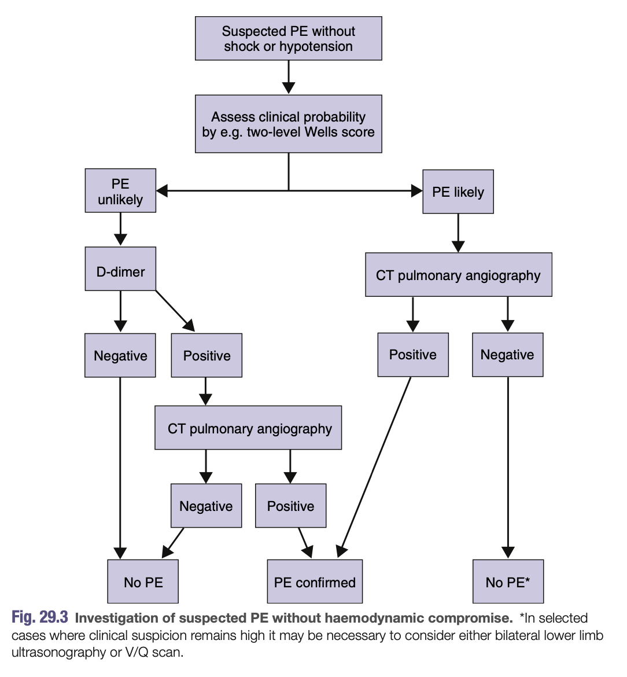
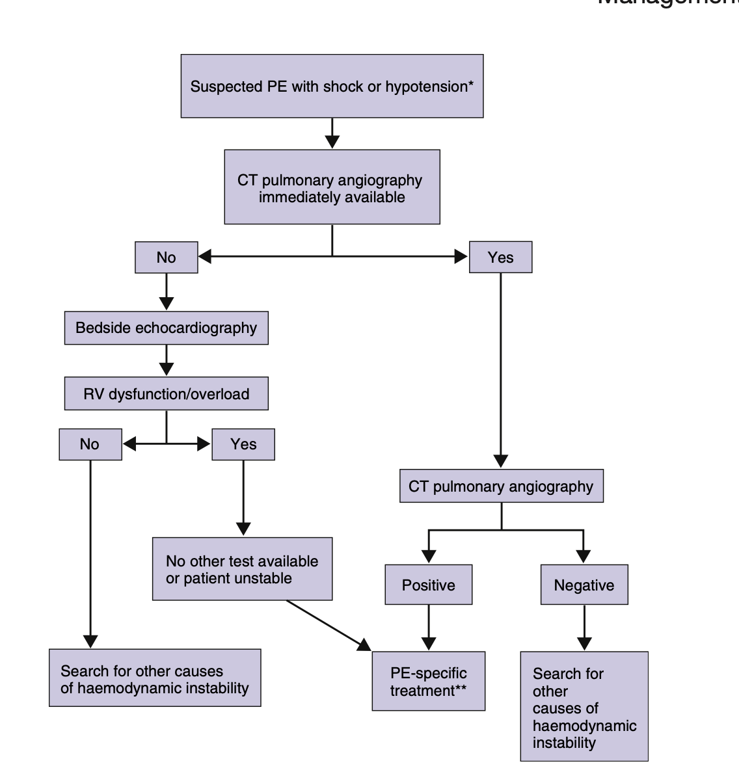
PE is a medical emergency! Early diagnosis and management is crucial for reducing mortality
Stasis
Risk factors for DVT and PE include :
Malignancy
General anesthesia
Coagulation problems
Prolonged immobility
Congestive Heart Failure
Advanced age
Oral contraceptive pill
Injury to venous intima
Obesity
Pregnancy/postpartum
Lower limb/pelvic injury or surgery
Clinical features :
Investigation :
Sudden onset dyspnea
First step is to determine whether the patient is stable or not .
The following investigative guidelines should be followed based on patient risk :
Pleuritic chest pain
Hemoptysis
Summary from Davidson’s
Pharmacological treatment :
Massive PE | Any other PE
thrombolytics+anticoagulant Recombinant tissue-plasminogen activator Streptokinase Urokinase | anticoagulants Heparin Warfarin NOACs ( eg. Dabigatran , Rivaroxaban )

Slide 21
Q1: A 41-year-old woman is referred for assessment after suffering a second pulmonary embolus within a year. She has not been travelling recently, has not had any surgery, does not smoke and does not take the oral contraceptive pill. She is not currently on any medication as the diagnosis is retrospective and she is now asymptomatic. What should be the next step in her management ?
A- Initiation of warfarin therapy
B- ECG
C- Thrombophilia screen
D- Insertion of inferior vena cava filter
E- Duplex scan of lower limb veins and pelvic utrasound
Q2: A 60-year-old woman is receiving chemotherapy for metastatic breast cancer. A staging computed tomographic scan reveals multiple pulmonary emboli in segmental arteries. She is asymptomatic. Which of the following
treatments is the best?
A- Give dalteparin and transition her to warfarin.
B- Give dalteparin and continue it at least as long as she is receiving
chemotherapy.
C- Give rivaroxaban.
D- Give warfarin.
E- No therapy.
Q3: A 47-year-old obese Asian man complains of a sharp pain on the left side of his chest with difficulty breathing. The pain started a few hours ago and does not radiate anywhere, the patient also reports feeling increasingly short of breath and became extremely anxious when he started coughing blood-stained sputum. He states he has been flying all week on business trips and is getting late for his next flight. The most likely diagnosis is ?
A- Myocardial infarction
B- Muscular injury
C- Pneumothorax
D- Pulmonary embolism
Q4:A 38-year-old previously healthy woman presents to the emergency
department with a 7-day history of low-grade fever, shortness of breath on exertion, and nonproductive cough. Her heart rate is 90 beats/min, her oxygen saturation on room air is 98%, and her chest radiograph is normal. Which of the following tests would help to exclude the diagnosis of pulmonary embolism?
A- Bilateral compression ultrasound examination of the lower extremities
B- D-dimer
C- Electrocardiogram
D- Computed tomographic pulmonary angiogram
E- Ventilation-perfusion lung scan
Q5: A 59-year-old obese woman underwent a coronary artery stent procedure. She is a well-controlled type 2 diabetic. The operation was successful. However, after 1week during recovery, the patient complained of severe chest pain and shortness of breath. Her heart rate was 115 bpm and blood pressure 107/89 mHg. Following resuscitation of the airway, breathing and circulation, an electrocardiogram (ECG) showed sinus tachycardia and right axis deviation. The most appropriate treatment is ?
A- Warfarin
B- Intravenous adrenaline
C- Alteplase
D- Salbutamol
E- Intravenous heparin
Answers: Q1:C | Q2:B | Q3:D | Q4:B | Q5:E
Answers Explanation File!

Slide 22
THANKS!!
This lecture was done by:
Ghalia Alnufaei
Razan Alrabah
May Babaeer
Quiz and summary maker:
Sarah Alarifi
Note taker:
Renad Almutawa
Khalid Alharbi
Females co-leaders:
Raghad AlKhashan
Amirah Aldakhilallah
Males co-leaders:
Mashal Abaalkhail
Ibrahim AlAsous
Send us your feedback:
We are all ears!

