Slide 1
Lecture 12
Editing file
Pleural effusion
Objectives:
Describe the pathophysiology of a pleural effusion.
Describe the main causes of a pleural effusion.
Differentiate among the manifestations of fluid collections.
Describe the signs and symptoms of a pleural effusion
Explain diagnostic methods.
Describe the various treatment options.
Color index:
Color index:
Original text Females slides Males slides
Doctor’s notes Textbook Important Golden notes Extra

Slide 2
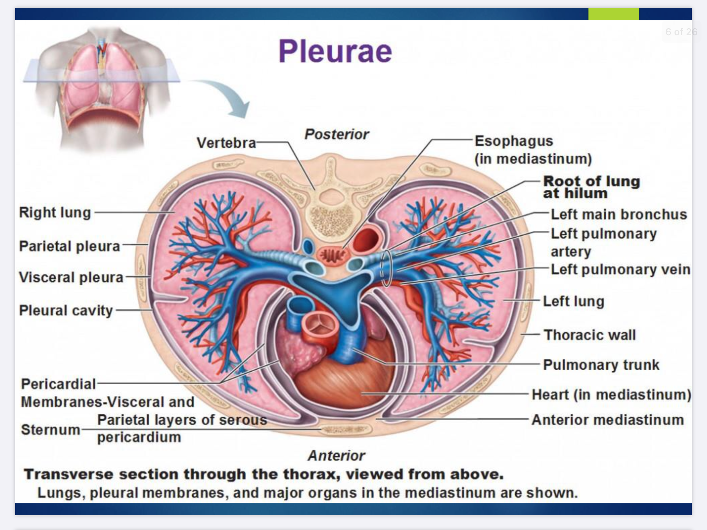
Pleural Effusion
Pleura ¹
Serous fluid (5-15ml) that allows for the parietal pleura (outer lining) and visceral pleura (inner lining) to glide over each other without separation
Pleural fluid is produced by the parietal pleura and absorbed by the visceral pleura as a continuous process.
The visceral pleura absorbs fluid, which then drains into the lymphatic system and returns to the blood
about 100-200 ml of fluid circulates through the pleural space within a 24-hour period.
Pleural effusion
Pleural effusion is an excessive accumulation of serous fluid within the pleural space.
Is there a normal effusion ? NO.. there is only normal pleural FLUID.
Development of Pleural effusion The doctor said it’s not imp
Pulmonary capillary pressure (CHF)
Pleural membrane permeability (Malignancy)
Capillary permeability (Pneumonia)
Lymphatic obstruction (Malignancy)
Intrapleural pressure (Atelectasis)
Diaphragmatic defect (Hepatic hydrothorax)
Thoracic duct rupture (Chylothorax²)
Plasma oncotic pressure (Hypoalbuminemia)
Diaphragmatic defect (hepatic hydrothorax)
The accumulation of:
The accumulation can be caused by one of the following mechanisms:
1
Frank pus is termed empyema
1
Increased production of fluid by cells in the pleural space.
2
blood is haemothorax
2
Increased drainage of fluid into pleural space.
3
chyle is a chylothorax following trauma or infiltration by carcinoma.
3
Decreased drainage fluid from the pleural space.
1- functions of pleural fluid : facilitate pleural movement and lubricate (to prevent atelectasis)
2-Caused by accumulation of lymph in the pleural space.

Slide 3
Causes and types of pleural effusion
 | CHF is the most common cause Pneumonia (bacterial) Malignancies: lung (36%) breast (25%), lymphoma (10%)
 | Transdative ¹ | Exudative¹
 | Due to elevated capillary hydrostatic pressure in visceral or parietal pleura (e.g., CHF) Due to decreased plasma oncotic pressure (e.g.,hypoalbuminemia) Due to decreased intrapleural pressure (eg. atelectasis) The protein content is less than 30 g/L, the LDH is less than 200 IU/L and the fluid to serum LDH ratio is below 0.6. | ↓ lymphatic flow from pleural surface due to damage to pleural membranes or vasculature. ↑ pleural membrane permeability (eg.malignancy) Thoracic Duct rupture (eg. Chylothorax)⁴ Lymphatic Obstruction (eg. malignancy)⁴ ↑ capillary permeability (eg. Pneumonia)⁴ The protein content is over 30 g/L and the LDH is more than 200 IU/L. If an exudative effusion is suspected, perform the following tests on the pleural fluid: differential cell count, total protein, LDH, glucose, pH, amylase, triglycerides, microbiology, and cytology.
 | the causes are always related to a big organ CHF Nephrotic syndrome Hypoalbuminemia Hepatic hydrothorax (Liver Cirrhosis) Atelectasis Hypothyroidism | Tuberculosis Pneumonia + empyema Malignancy ²⁻³ (rarely transudate) PE Inflammatory: pancreatitis, ARDS, uremic pleurisy, etc.. Connective tissue disease. autoimmune rheumatic diseases (SLE , rheumatoid arthritis and sjogren's syndrome) Viral/parasitic disease Esophageal rupture Post coronary bypass surgery Post myocardial syndrome Drug induced
4. Pulmonary embolism (PE)
5. Viral diseases
6. Cirrhosis with ascites
(also known as hepatic hydrothorax)
Causes
Pathophysiology
Main causes
1-according to the Dr the red ones are the main ones and it’s a common question in the exam.
2- In females, what’s the most common non-lung malignancy that will cause pleural effusion ? Breast cancer.
3- In males, what’s the most non-lung malignancy that will cause pleural effusion ? Adrenal cancer.
4- it was mentioned in the previous page not extra

Slide 4
Pleural fluid evaluation
5Cs:
Color:
Doctor’s notes:
Yellow: Any of the mentioned causes below can cause yellow it's the most common color (also called urine color)
Pus : empyema
White/Milky: Lymphatic obstruction
Red: bleeding (could be due to trauma or iatrogenic while performing thoracentesis), malignancy, TB, connective tissue disease.
If a countanour of bloody pleural effusion was brought to you and you were asked if it was caused by a blunt trauma or caused iatrogenically .. how would you know ? pleural fluid with hematocrit greater than 50% of the patient’s blood then it’s blunt trauma.
Black/Brown: fungal infection
Turbid (cloudy): Acute bacterial infection (Parapneumonic effusion)
Green: Fungal infection. Rarely seen.
Cytology:
To tell you if there’s malignancy or not e.g. cells of metastatic adenoma from the breast.
Culture:
for diagnosis of Parapneumonic effusion, Empyema, TB
Cell count:
It’s simply a CBC of that fluid.. Don’t know any specific details just look for the DDx depending on the predominant cells (>60%) not the total number of WBC
Lymphocytic(>50%) : Malignancy (30-35%) , TB (15-20%) , Sarcoidosis. Indicates usually chronic infection and accompanies red colored effusion
PMN: Empyema, Parapneumonic, Rheumatoid, Pulmonary infarction.
PMNs or Lymphocytic: PE, Conn tissue disease, Post-cardiac injury.
Eosinophilic (> 10%) :Trauma, pneumothorax, Malignancy, Asbestos, parasites, pneumonia.
RBC > 100,000/mm: Malignancy, Trauma, Pulmonary infarction.
Chemistry:
pH: decrease in acute infection, empyema
Glucose: decrease in malignancy ,acute infection (parapneumonic effusion) and connective tissue disease

Slide 5
Pleural fluid tests
pleural TB is diagnosed by pleural biopsy

Slide 6
Pleural Effusion
Pleural fluid pearls:
Elevated pleural fluid amylase
Milky, opalescent fluid
Frankly purulent fluid
Bloody Effusion
Exudative effusions that are primarily lymphocytic
pH < 7.2 (most important indication for inserting chest drain)
Esophageal rupture, pancreatitis, malignancy.
Chylothorax (lymph in the pleural space)
Empyema (pus in the pleural space)
Malignancy
TB
Parapneumonic effusion or empyema
Light’s criteria:
98% sensitive and 83% specific for exudative effusion using Light's criteria.
Pleural effusion is exudative if one or more of the following:
Ratio of pleural fluid protein level to serum protein level > 0.5
Ratio of pleural fluid LDH level to serum LDH level > 0.6
Pleural fluid LDH level > 2/3 the upper limit of normal for serum LDH level.
absence of all 3 criteria = Transudative
Diagnosis
1.history/ symptoms
2.Physical examination/signs
3.Chest x-ray
4.CT scan
5.Ultrasound
6.Thoracocentesis
Often asymptotic
Dyspnea on exertion (most common)
Pleuritic chest pain (always peripheral ,starts from the lower part and related to breathing)
Cough (not necessary <occurs when the underlying cause is causing cough)
Pain on inspiration
Peripheral edema
Orthopnea
Paroxysmal nocturnal dyspnea
Other symptoms related to underlying cause . most important clinical presentation of pleural effusion are the symptoms of other systems e.g. if the cause of pleural effusion is the heart then we will find cardiovascular symptoms.
Findings usually present for effusions > 300
Inspection :
Tachypnea
Palpation:
- Asymmetric chest expansion ( reduced in affected side)
-asymmetric expansion is more common but if the pt has renal or heart failure >bilateral effusion>symmetric expansion.
-Tracheal shift away from the affected side. ¹
Percussion:
dullness ( stony dullness )
Decreased tactile and vocal fremitus.² (imagine that the patient is talking under the water)
Auscultation:
Decreased breath sounds.
Absent breath sounds and vocal resonance
Bronchial breathing or crackles above effusion
1- trachea is normally central and slightly to the right, in case of pleural effusion or pneumothorax it will shift to the other side, in case of mass it will shift to the same side
2-increase in consolidation and mass

Slide 7
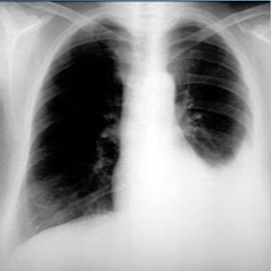
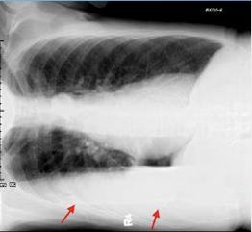
Diagnosis
Diagnosis
1.history/ symptoms
2.Physical examination/signs
3.Chest x-ray
4.CT scan
5.Ultrasound
6.Thoracocentesis
Initial diagnostic test for pleural effusion. (Very simple and non-invasive)
Postero-anterior: Around 250-500 mL of pleural fluid must accumulate before an effusion can be detected. Look for: blunting of costophrenic angle.
Lateral decubitus films¹ (patient lying on one side): very sensitive, can detect effusions as small as 50 mL.
Diagnosis
1.history/ symptoms
2.Physical examination/signs
3.Chest x-ray
4.CT scan
5.Ultrasound
6.Thoracocentesis
Better characterization of underlying lung parenchyma and certain processes that may be obscured on radiographs by large pleural effusions.
indicated to know the underlying cause especially in malignancy is suspected , not to diagnose pleural effusion.
2nd diagnostic test after CXR
Cheap and available at bedside
Can help identify free vs.loculated effusions,
one of the most important and diagnostic tests.
it is operator dependent (needs practice)
1-nowadays not clinically significant

Slide 8
Diagnosis
Diagnosis
1.history/ symptoms
2.Physical examination/signs
3.Chest x-ray
4.CT scan
5.Ultrasound
6.Thoracocentesis
Thoracentesis can facilitated by ultrasound guidance or blind
thoracocentesis is both diagnostic and therapeutic
Indications for thoracentesis:
Pleural effusion of unknown etiology, with >10mm depth on lateral decubitus CXR or Ultrasound.
Concern for empyema.
Air fluid level in pleural space.
Therapeutically for symptomatic relief (Mainly dyspnea)
Comparison from the Dr:
complicated and uncomplicated parapneumonic effusion> look at the chemistry
Empyema and complicated parapneumonic effusion > look at the color
Character | Type
 | Empyema | Complicated Parapneumonic effusion | Uncomplicated parapneumonic effusion
Color | Pus | Turbid
pH | < 7.2 |  | normal
Glucose | Very low (≤ 60 mg/dL) |  | Low
Treatment | Chest tube + Antibiotics |  | Antibiotics

Slide 9
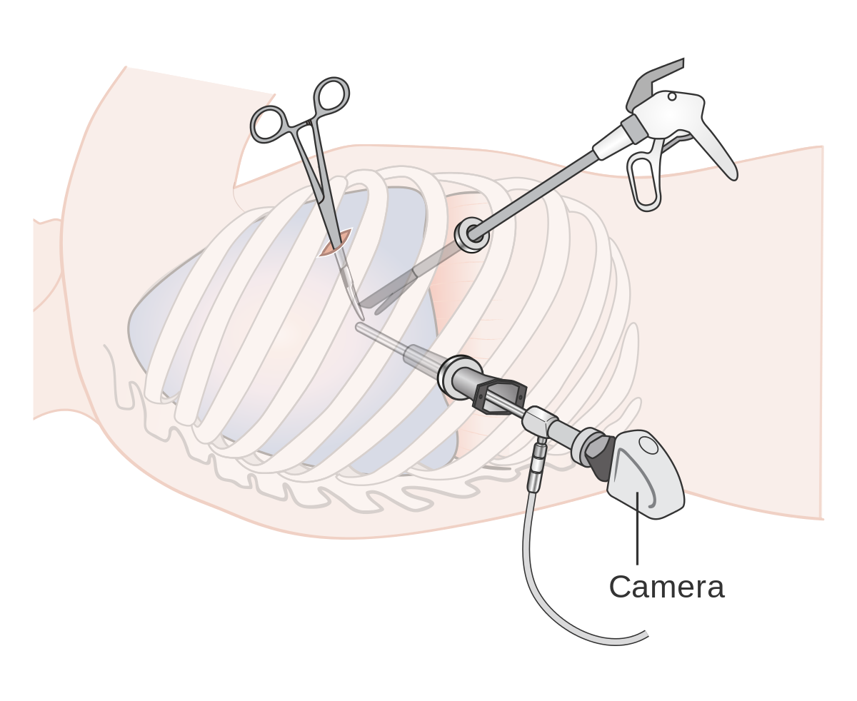
Treatment
Thoracentesis¹
Treat underlying disease
thoracentesis : is done for symptomatic relief or to take a sample from pleural fluid and removed immediately
chest tube: can remain connected to the pt up to 4 days
Parapneumonic effusions
Malignant effusion
Hemithorax involved/empyema
tube thoracostomy +/- VATS ( video assisted thoracoscopic surgery)
Uncomplicated: antibiotics alone.
Complicated or empyema:
Chest tube drainage and antibiotics.
Intrapleural injection of thrombolytic agents (streptokinase or urokinase); may accelerate the drainage.
Surgical lysis of adhesions may be required.
chest tube +/- pleurodesis (sclerosants) VATS
Malignant pleural effusions that reaccumulate and are symptomatic can be aspirated to dryness followed by the instillation of a sclerosing agent such as tetracycline or talc.
Transudative effusion
Exudative effusion
Diuretics and sodium restriction.
Therapeutic thoracentesis (only if massive effusion is causing dyspnea)
Treat underlying cause.
1-procedure in which a needle is inserted into the pleural space between the lungs and the chest wall. This procedure is done to remove excess fluid, known as a pleural effusion, from the pleural space to help you breathe easier.

Slide 10
Cases (Doctor’s slides)
Case study 1:
A 55-year-old man presents with progressive shortness of breath. Other than a history of heavy smoker, the patient has no significant past medical history. Breath sounds are absent two-thirds of the way up on the left side of the chest. Percussion of the left chest reveals stony dullness, the trachea appears to be deviated toward the right.
Which of the following diagnoses is most likely?
Bacterial pneumonia
Viral pneumonia
Bronchial obstruction
Pleural effusion
Pneumothorax
The correct answer is D
Case study 2:
A 59-year-old male presents with a community acquired pneumonia complicated by pleural effusion. A thoracentesis is performed, but the results are not currently available.
Which characteristic of the pleural fluid is most suggestive complicated parapneumonic pleural effusion?
Presence of more than 30% polymorphonucleocytes (PMNs)
Glucose less than 150 mg/dl
Presence of more than 100 white blood cells
pH less than 7.20
Lactate dehydrogenase (LDH) more than two-thirds of the normal upper limit for serum
The correct answer is D
Case study 3:
A 67-year-old man presents to the emergency department with a 5-day history of fever and cough that produces green sputum. He has a history of tobacco use and ischemic cardiomyopathy with a left ventricular ejection fraction of 25%. He was admitted with a presumptive diagnosis of pneumonia and is started on antibiotics. A chest radiograph is obtained and shows a left-sided consolidation and moderate-size effusion.
Which of the following studies can be used to determine if the patient effusion is due to his CHF ( a transudate) or is a parapneumonic effusion (an exudate)?
Pleural fluid pH
Pleural fluid glucose
Pleural fluid cell count
Lactate dehydrogenase (LDH)
The correct answer is D

Slide 11
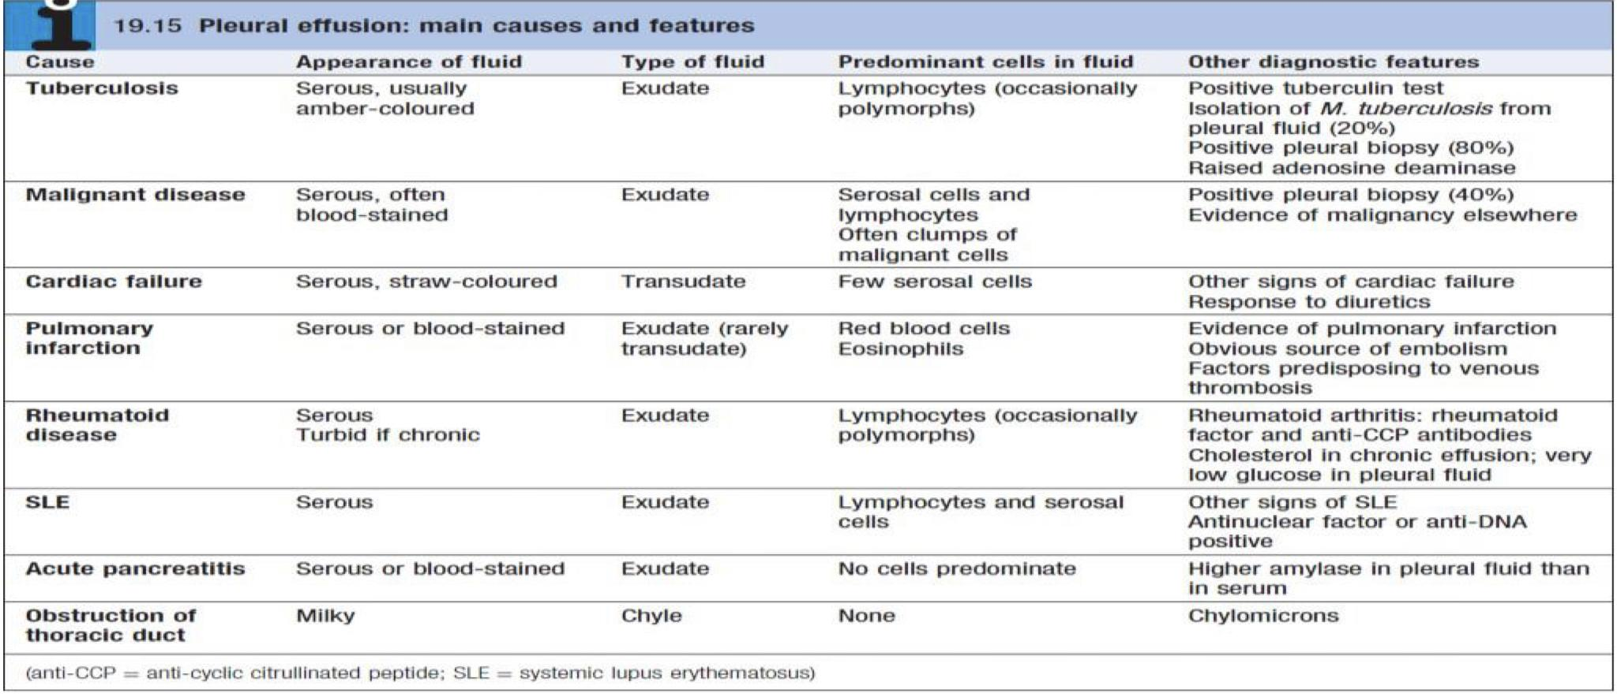
Pleural effusion
Is an excessive accumulation of serous fluid within the pleural space .
If it’s :
Types
Frank pus
Empyema
Blood
Haemothorax
Exudative
Transudative
Chyle
Chylothorax
Clinical Features
Light’s criteria: Exudative effusions have at least one of the following :
Chest pain
Decrease vesicular breath sounds
Cough
dullness
1- Protein (pleural)/protein (serum) >0.5
Dyspnea
Reduced tactile fremitus
2- LDH (pleural)/LDH (serum) >0.6
Trachea will shift away from the affected side
3- LDH >2\3 the upper limit of normal serum LDH
Diagnosis
Initial diagnostic test > Chest x-ray
Treatment
Thoracentesis – then treat underlying disease
Cytology
Lymphocytes : Malignancy, TB, Connective tissue disease
Neutrophils : Parapneumonic (Acute infection), Empyema
Culture
Eosinophils : Lymphatic obstruction,Fungal Infection, Allergy, Drugs
Manifestations of Fluid Collections THE 5 C’s:
Cell count
RBC > 100,000/mm : Malignancy, Trauma, Pulmonary infarction
Red : Blood (Hemorrhagic effusion), Green : Fungal infection
Malignancy, TB
Color / Character
White/Milky : Thoracic duct injury, Yellow : Any causes
Chylothorax
Chemistry
Turbid : (Parapneumonic effusion) Brown/Roasted : → Pus → Empyema.
PH (< 7.2), Glucose, Protein & LDH ( for Light’s criteria )

Slide 12
Q1: A 55-year-old man who has been smoking 20 cigarettes a day for the last 30 years has been diagnosed with a right-sided pleural effusion following admission with a week’s history of shortness of breath. From the list below, select the most likely findings that one would ascertain during examination of the chest wall ?
A- Decreased air entry coupled increased vocal fremitus and resonant percussion on the right side of the chest
B- Normal air entry coupled decreased vocal fremitus and resonant percussion on the right side of the chest
C- Normal air entry coupled increased vocal fremitus and dull percussion on the right side of the chest
D- Decreased air entry coupled decreased vocal fremitus and dull percussion on the side of the chest
Q2: A 54-year-old woman is seen in clinic with a history of weight loss, loss of appetite and shortness of breath. Her respiratory rate is 19 and oxygen saturations (on room air) range between 93 and 95 per cent. On examination, there is reduced air entry and dullness to percussion on the lower to mid zones of the right lung. There is also reduced chest expansion on the right. From the list below, select the most likely diagnosis ?
A- Right middle lobe pneumonia
B- Pulmonary embolism
C- Right-sided pleural effusion
D- Right-sided bronchial carcinoma
Q3: A 56-year-old woman who has recently been discharged from your ward, with oral antibiotics for right basal community-acquired pneumonia, is re-admitted with transient pyrexia and shortness of breath. She is found to have a right-sided pleural effusion which is drained and some pleural aspirate sent for analysis. The results reveal an empyema. Which of the following, from the pleural aspirate analysis, would typically be found in a patient with an empyema?
A- pH >7.2, ↑ LDH, ↑ glucose
B- pH <7.2, ↑ LDH, ↑ glucose
C- pH >7.2, ↓ LDH, ↓ glucose
D- pH <7.2, ↑ LDH, ↓ glucose
E- pH <7.2, ↔ LDH, ↔ glucose
Q4: Which one of the following is considered the most common cause of pleural effusion ?
A- Primary lung cancer
B- Congestive heart failure
C- Mesothelioma
D- Trauma.
Q5: A 45-year-old woman with unexpected weight loss, loss of appetite and shortness of breath presents to you in clinic. On examination, there is reduced air entry and dullness to percussion in the right lung. A pleural tap is performed and the aspirate samples sent for analysis. You are told that the results reveal a protein content of >30 g/L. From the list below, select the most likely diagnosis:
A- Bronchogenic carcinoma
B- Congestive cardiac failure
C- Liver cirrhosis
D- Nephrotic syndrome
E- Meig’s syndrome
Answers: Q1:D | Q2:C | Q3:D | Q4:B | Q5:A

Slide 13
THANKS!!
This lecture was done by:
Njoud Alali
Razan Alrabah
Lama Alasiri
Quiz and summary maker:
Sarah Alarifi
Note taker:
Joud Alkhalifah
Mohammed Alqahtani
Females co-leaders:
Raghad AlKhashan
Amirah Aldakhilallah
Males co-leaders:
Mashal Abaalkhail
Ibrahim AlAsous
Send us your feedback:
We are all ears!

