Slide 1
Lecture 13
Editing file
Hypertension
Objectives:
To be able to recognize the definition of hypertension.
To be able to identify the stages of hypertension ( ACC/AHA -European society of cardiology/European society of hypertension (ESC/ESH).
To find out the complication of hypertension.
To learn how to measure blood pressure.
To acquire knowledge on how to treat hypertension.
Color index:
Color index:
Original text Females slides Males slides
Doctor’s notes Text book Important Golden notes Extra

Slide 2
Introduction
Definition
Hypertension is a condition in which arterial BP is chronically elevated. BP occurs within a continuous range, so cutoff levels are defined according to their effect on patients’ risk.
Epidemiology of Hypertension:
The global prevalence of hypertension was estimated to be 1.13 billion in 2015 The 4th most common cause of death worldwide. 20% of deaths worldwide are related to hypertension. The overall prevalence of hypertension in adults is around 30 - 45% . The onset of primary hypertension ranges between 25 to 55 years, mainly in 40 to 50.¹. | The overall prevalence of hypertension in Saudi is 25.5-31.4%. More common with advancing age. Prevalence of >60% in people aged >60 years. Only 72% are aware of their disease². 55% of participants on medication for hypertension had their blood pressure uncontrolled³.
The global prevalence of hypertension was estimated to be 1.13 billion in 2015
The 4th most common cause of death worldwide.
20% of deaths worldwide are related to hypertension.
The overall prevalence of hypertension in adults is around 30 - 45% .
Onset ranges between 25 to 55 years, mainly in 40 to 50. The primary hypertension but secondary hypertension can occur at any age¹.
The overall prevalence of hypertension in Saudi is 25.5-31.4%.
More common with advancing age.
Prevalence of >60% in people aged >60 years.
Only 72% are aware of their disease².
55% of participants on medication for hypertension had their blood pressure uncontrolled³.
Risk of hypertension:
As populations age⁴
Sedentary lifestyles
Increase their body weight
Mechanism of Blood Pressure:
More common with advancing age.
Prevalence of >60% in people aged >60 years.
Only 72% are aware of their disease².
55% of participants on medication for hypertension had their blood pressure uncontrolled³.
Risk of hypertension:
As populations age⁴
Sedentary lifestyles
Increase their body weight
Stroke Volume
Salt and Water Retention
Cardiac Output
HR
Blood Pressure
Elasticity
Sympathetic
Cortisol
Aldosterone
Norepinephrine
Epinephrine
Angiotensin II (vasoconstrictor)
System Vascular Resistance
Parasympathetic
General Characteristics:
Hormonal
In most patients, hypertension results from unknown pathophysiologic etiology (essential or primary hypertension). This form of hypertension cannot be cured, but it can be controlled.
A small percentage of patients have a specific cause of their hypertension (secondary hypertension).
In order to establish the diagnosis of hypertension, blood pressure measurements must be repeated in a calm state over time.
A diabetic patient with blood pressure above 140/90 mm Hg is hypertensive.
The most common risk factor for the most common cause of death: myocardial infarction
Endothelin-1
Nitric Oxide
Endothelium
Recall from cardio physiology: BP= CO (SV x HR) x SVR. So increasing CO or SVR will increase BP.
What are the determinants of SVR?
Loss of Elasticity: Vessels in old ppl are stiff and rigid due to loss of elasticity so it doesn’t Vasodilate → ↑BP
Sympathetic activation: e.g. Anxiety and stress → ↑BP
Parasympathetic activation: When baroreceptors in carotid are stimulated → Activate Beta-receptors → vasodilation → ↓BP
Hormones: Think of adrenal gland hormone and angiotensin II. Angiotensin II is the most important hormone and has the strongest effect.
Endothelial factors: Release endothelin-1 (vasoconstrictor) in response to damage of blood vessels. It also releases NO (Vasodilator)
1: if patient is younger than 40 year old, HTN is usually secondary.
2: Because HTN is a silent killer, mostly asymptomatic
3: Either due to noncompliance because of the side effects of the drugs, or the fact that they need more than one drug to control it .

Slide 3
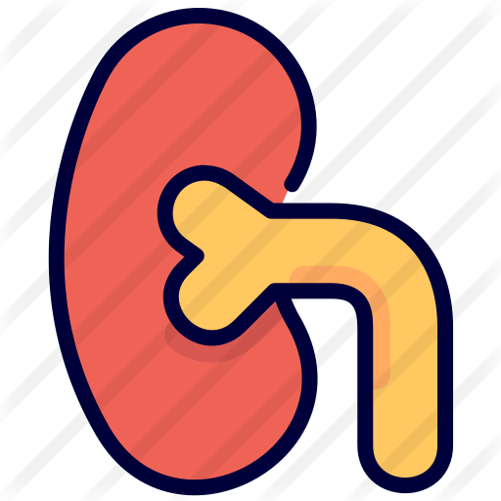
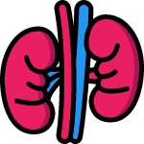
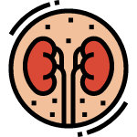
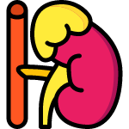
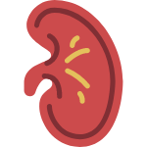
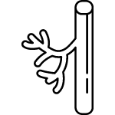
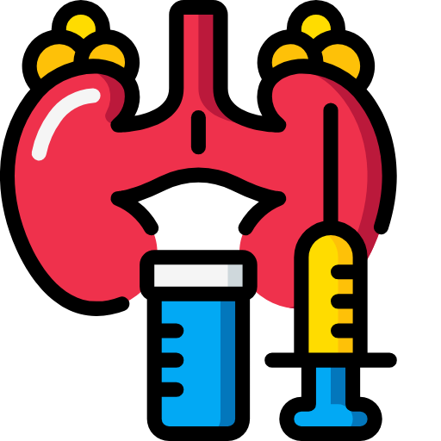
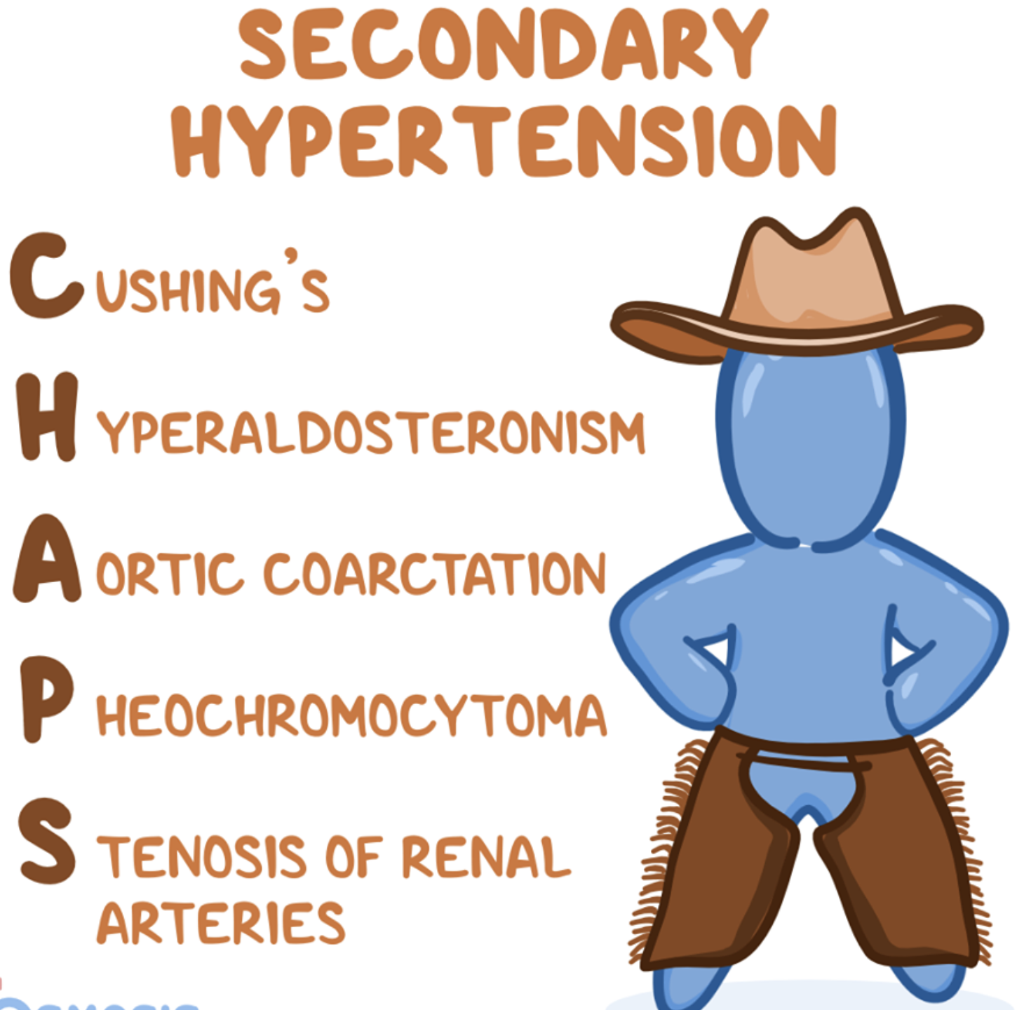
Types of Hypertension
Primary (Essential) Hypertension (90-95%):
No cause can be found.
Risk Factors
Modifiable | Non-Modifiable
Obesity-metabolic syndrome Unhealthy diet: Excessive salt intake¹ low potassium intake² Excessive alcohol intake Polycythemia → High blood volume (↑SV) Lack of exercise³ Non-steroid anti-inflammatory drugs⁴ | Family history of essential HTN Aging Race (African american) & genetic
Caffeine and smoking increase the BP acutely but are not risk factors for the development of chronic essential HTN. Hence why you shouldn’t drink coffee or smoke for at least half an hour before measuring BP (Bc it will temporarily raise BP)
Secondary Hypertension (5-10%):
C’s
Primary renal disease
Renovascular disease
Oral contraceptives
e.g. Chronic kidney disease (CKD), Polycystic kidney disease (PCKD), Glomerulonephritis
e.g. Renal artery stenosis (RAS). In RAS you will hear abdominal bruits on auscultation.
As they ↑salt and water retention, ↑weight and ↑production of angiotensinogen.
Other drugs: corticosteroids, sympathomimetic agents, NSAIDs and Carbenoxolone
Different HTN Concepts
1
Text
Hypertensive crisis is defined as high blood pressure in association with:
Confusion
Blurry vision
Dyspnea
Chest pain
Hypertensive crisis is not defined as a specific level of blood pressure. It is defined as hypertension associated with end-organ damage.
Sleep apnea syndrome
Primary hyperaldosteronism
Cushing’s syndrome
2
Text
Highly recommend you read about this topic!!
Click here
Breathing-related sleep disorder and is typically associated with obesity. Have an increased risk of hypertension, heart failure, myocardial infarction and stroke.
AKA Conn’s syndrome. Excess of aldosterone due to adrenal hyperplasia or adrenal adenoma. Aldosterone causes Na-water retention and hypokalemia. often asymptomatic and found to have hypertension at routine health checks.
Typical clinical features include central obesity, thin, easily bruisable skin, abdominal striae, secondary hypertension, hyperglycemia, and proximal muscle weakness.
3
Text
4
Text
Pheochromocytoma
Coarctation of the aorta
Other endocrine
Increase production of adrenaline from adrenal gland
Signs & Symptoms: Episodic Sudden attack, anxiety, tachycardia, headache, pale, sweating and hypertensive
Narrowing of aorta.
Signs and Symptoms: Difference in radio-radial artery, BP in leg will be lower than the arm (Normally leg has higher pressure), Radio-femoral delay, Usually young and present with claudication
e.g. Hyperparathyroidism, Thyrotoxicosis, Acromegaly, primary hypothyroidism, congenital adrenal hyperplasia (CAH) due to 11-B-hydroxylase or 17-a-hydroxylase deficiency
2) In renal artery stenosis > decreased perfusion > stimulation of the juxtaglomerular apparatus > increase renin release > increase BP
3) they will increase angiotensinogen production
4) the patient will present with sudden onset palpitations, Episodic hypertension and headache
5) such as hyperparathyroidism and thyrotoxicosis
6) narrowing of the aorta , usually in young pt
1: HTN pts are advised to decrease salt intake to 2.5-3.5g
2: Especially those who don’t eat fruits
3: Actually even those who don’t lose weight but exercise may have normal BP
4: causes salt and water retention

Slide 4
EXTRA
Secondary HTN: Clinical and diagnosis
Cause | Clinical history | Physical examination | Laboratory investigations | First-line test | Additional test
Common causes
Renal parenchymal disease | History of UTI or obstruction, hematuria, analgesic abuse, family history of polycystic kidney disease | Abdominal mass (polycystic kidney disease) | Protein, erythrocytes or leukocytes in urine, decreased GFR | Renal ultrasound | Detailed work-up for kidney disease
Renal artery stenosis | Fibromuscular dysplasia: Early-onset hypertension (especially in women). Atherosclerotic plaque: Abrupt-onset hypertension, worsening or difficult to treat; flash pulmonary edema | Abdominal bruit | Difference of >1.5cm in length between the two kidneys (Renal ultrasound), rapid deterioration in renal function (spontaneous or in response to RAA blockers) | Renal duplex doppler ultrasonography | Renal arteriogram: Catheter angiography (intra-arterial digital subtraction angiography) “GOLD STANDARD” MRI angiography, spiral CT,
Primary aldosteronism | Muscle weakness; family history of early-onset hypertension and cerebrovascular events age <40 years | Arrhythmias (if severe hypokalemia) | hypokalemia (spontaneous or diuretic induced); incidental discovery of adrenal masses | Aldosterone:renin ratio under standardized conditions (correction of hypokalemia and withdrawal of drugs affecting RAA system) | Confirmatory test (oral sodium loading, saline infusion, fludrocortisone suppression, or captopril test); adrenal CT scan; adrenal vein sampling
Uncommon causes
Pheochromocytoma | paroxysmal HTN; headache, swelling, sweating, palpitations, pallor; positive family history | Skin stigmata of neurofibromatosis (cafe au lait spots, neurofibromatosis) | Incidental discovery of adrenal masses (some cases are extra-adrenal) | Measurement of urinary fractionated metanephrines or plasma-free metanephrines | CT or MRI of abdomen and pelvis; ¹²³I-labelled meta-iodo benzyl-guidance scanning; genetic screening for pathogenic mutations
Cushing’s syndrome | weight gain, polyuria, polydipsia, psychological disturbances | Typical body habitus (Central obesity, moon face, buffalo hump, red stria, hirsutism) | Hyperglycemia | 24h urinary cortisol excretion | Dexamethasone suppression test

Slide 5
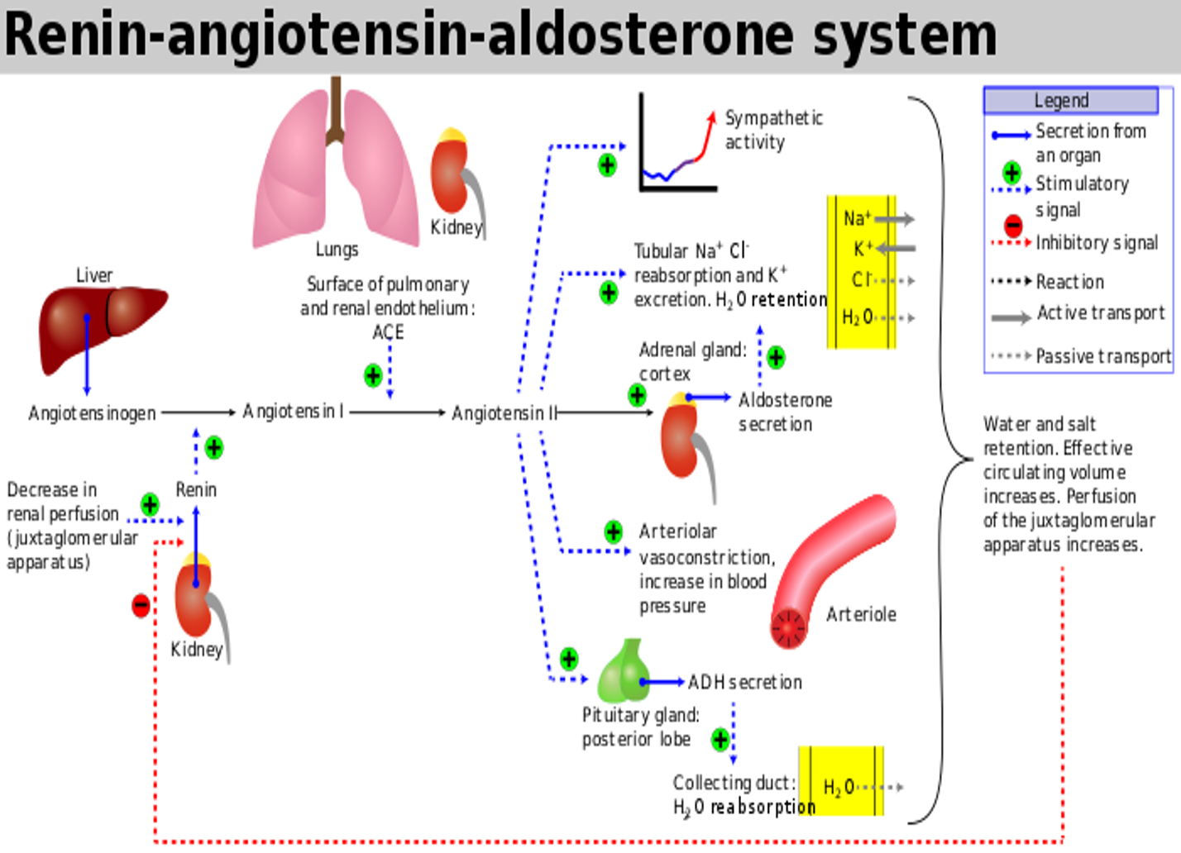
Pathophysiology of Hypertension
Renin-Angiotensin-Aldosterone system:
The RAAS is a hormone system that regulates BP and fluid balance, this system is controlled by the renal blood flow, when BP drops and/or plasma volume gets depleted the renal perfusion will decrease, this will stimulate the juxtaglomerular apparatus to release Renin into the circulation, Renin then cleaves Angiotensinogen -another protein from the liver- into Angiotensin I which will continue in the circulation to go to the Lungs and be converted to Angiotensin II by an enzyme called angiotensin converting enzyme (ACE),
Angiotensin II then will cause:
Sympathetic activation
Na-Cl and water retention
Arteriole vasoconstriction
ADH secretion which will cause water reabsorption
All these effects are to compensate the Low BP and Low blood volume
Classification of Blood Pressure Level
Definition of HTN:
European: ≥140/90 (old, not used)
AHA: ≥130/80
American heart association classification
BP category | Systolic BP | and/or | Diastolic BP
Normal | <120 mmHg | and | <80 mmHg
Elevated | 120-129 mmHg | and | <80 mmHg
Hypertension
Stage 1 | 130-139 mmHg | or | 80-89 mmHg
Stage 2 | ≥ 140 mmHg | or | ≥ 90 mmHg
Notes:
Individuals with SBP and DBP in 2 categories should be designated to the higher BP category.
Blood pressure should be based on an average of ≥ 2 careful readings obtained on ≥ 2 occasions.
European Society of Nephrology Classification of Blood Pressure Level (Not used anymore)
Category | Systolic BP (mmHg) | Diastolic BP (mmHg)
Optimal blood pressure | <120 | <80
Normal blood pressure | <130 | <85
High-normal blood pressure | 130-139 | 85-89
Grade 1 hypertension (mild) | 140-159 | 90-99
Grade 2 hypertension (moderate) | 160-179 | 100-109
Grade 3 hypertension (severe) | ≥ 180 | ≥ 110
Isolated systolic hypertension | >140 | <90

Slide 6
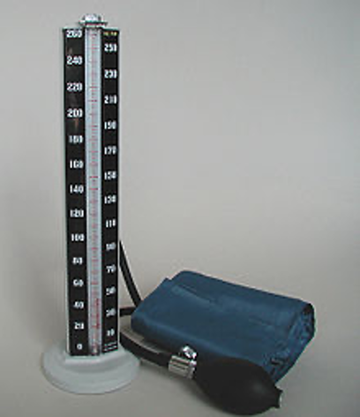
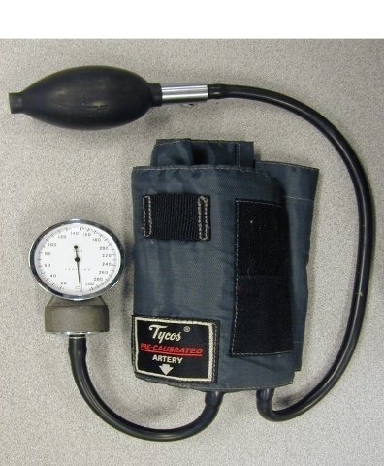
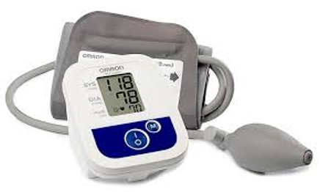
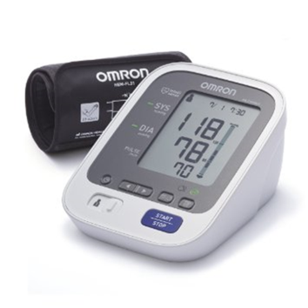
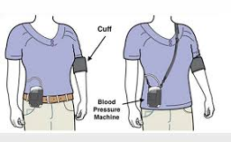
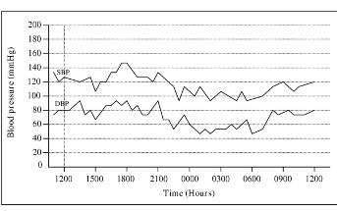
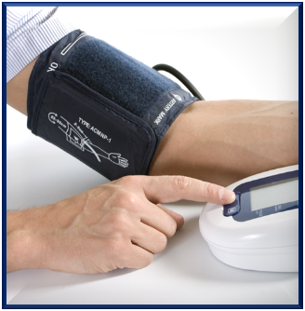
Blood Pressure Measurement
Types of Devices |  |  | Definition of HTN
 |  |  | SBP | DBP
Non-automated device [non-AOBP] |  | Mercury Type | ≥140 (≥130 ACC/AHA) | ≥90 (≥80 ACC/AHA)
 |  | Aneroid Type
Half automated device
Automated Device |  | Digital Type
Ambulatory BP¹ |  | Day-time (awake) | ≥135 | ≥85
 |  | Night-time (sleep) | ≥120 | ≥70
 |  | 24h | ≥ 130 | ≥80
Home BP Monitoring (HBPM) |  | Arm, Wrist, Finger (Finger and/or wrist BP measuring devices are not recommended) Not accurate, used in emergency only if others are not available | ≥135 | ≥85
AOBP (Automated office blood pressure) |  | Recommended method. (is the preferred method of performing in-office BP measurement) | ≥135 | >85
1: A series of automated ambulatory BP measurements obtained over 24 hours or longer provide a better profile than a limited number of clinic readings and correlate more closely with evidence of target organ damage than casual BP measurements. The average ambulatory daytime (not 24-hour or night-time) BP should be used to guide management decisions

Slide 7
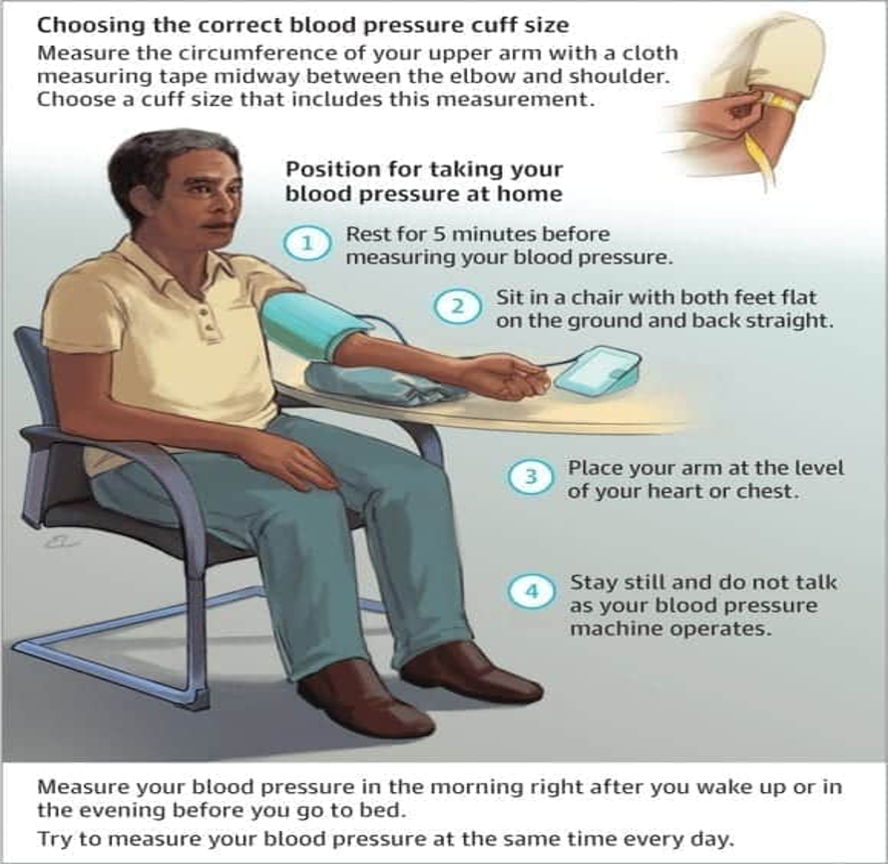
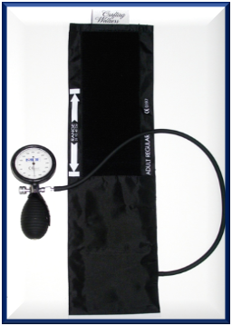
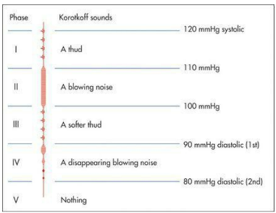
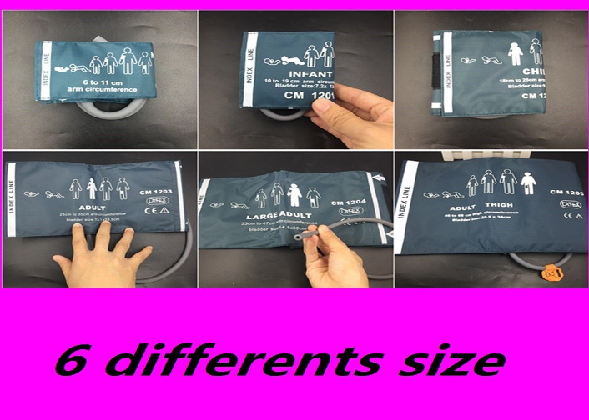
Blood Pressure Measurement
Observe the following to obtain an accurate BP reading:
Apply to adults on no antihypertensive medications and who are not acutely ill.
If there is a disparity in category between the systolic and diastolic pressures, the higher value determines the severity of the hypertension. ALWAYS one abnormal reading (either systolic or diastolic) is enough to say pt has HTN e.g. If systolic is 120 (Normal) and and diastolic is 90 (High), then the pt is said to have HTN because diastolic is high. Another example: if systolic is 150(High) and diastolic is 70(Normal) the pt is considered to have HTN
Measure blood pressure to arm the high reading. Same goes for arms e.g. if BP is normal in left arm but high in right, we go with the right arm reading.
Tips for Office blood pressure measurement:
Allow the patients to sit for 3–5 minutes before beginning BP measurements, Back straight and arm supported at heart level.
Take at least two BP measurements, spaced 1–2 min apart, and additional measurements if the first two are quite different. Consider the average BP if deemed appropriate.
use a standard bladder (12–13 cm wide and 35 cm long) A larger bladder for larger arm (circumference >32 cm).
The bladder of the pressure cuff should encircle at least 80% of the upper arm
Steps in measuring BP:
1
2
3
Place the cuff at the heart level, whatever the position of the patient.
Measure BP in both arms at first visit to detect possible differences. In this instance, take the arm with the higher value as the reference.
Measure BP in sitting and standing position in elderly subjects and diabetic patients¹
Use phase I and V (disappearance) Korotkoff sounds to identify systolic and diastolic BP, respectively.
The diagnosis of mild hypertension should not be made until the blood pressure has been measured on at least two times in three visits.
Average of 10 to 15 mmHg decrease between visits 1 and three.²
1: To detect orthostatic hypotension which could be a side effect from antihypertensive drugs. Orthostatic hypotension is defined as a decrease by 20 mmHg in systolic pressure or a decrease by 10 mmHg in diastolic pressure.
2: If you find high BP in distressed pts you can’t diagnose them with HTN. To diagnose HTN, you have to find high BP in a normal relaxed pt. And of course this is only true if there was a mild increase in BP, but if BP is like 180/90, then he definitely has HTN.

Slide 8
Different HTN Concepts
Hypertensive crisis | Hypertensive Emergency
 | Severe hypertension (SBP >180-220 mm Hg or DBP above 120 mmHg) WITH end organ damage (MI, STROKE, AKI, CHF) “troponin, creatinine increases” If the pt left untreated he may present with stroke, sudden MI, Arrhythmia, sudden death. Admit to ICU and treat with IV antihypertensive medication.
 | Malignant (Accelerated) Hypertension (New name)
 | Systolic BP >180-220 mm Hg or diastolic BP above 110-120 mmHg with encephalopathy, retinal hemorrhages, exudates, or papilledema.
Hypertensive Urgency | Severe hypertension ( systolic BP >180-220 mm Hg or diastolic blood pressure above 110- 120 mmHg) in asymptomatic patients with no evidence of target organ damage. There is no proven benefit from rapid reduction in BP in asymptomatic patients who have no evidence of acute end-organ and are little short-term risk. The goal of therapy is with these cases is to reduce BP within 24 hours. Could be because the patient skipped a dose or emotional factors (e.g. Stress) or certain food Treatment is oral antihypertensive. No admission needed
“White Coat” Hypertension (Pseudo-HTN) | A phenomenon in which patients exhibit a blood pressure level above the normal range, in a clinical setting, though they do not exhibit it in other settings Approximately 20 to 25% of patients with mild office hypertension More common in elderly. If clinic BP measurements show borderline levels of BP or if white coat hypertension is suspected, then ambulatory measurement or home-based measurements may be of value in confirming the diagnosis.
Hypertensive Cries necessitate immediate therapy to decrease BP within minutes to hours. usually admitted to an intensive care unit for continuous cardiac monitoring
The best initial therapy for hypertensive crisis is IV labetalol or nitroprusside or hydralazine. Because nitroprusside needs monitoring with an arterial line, this is not usually the first choice.
Equally acceptable forms of therapy for acute hypertensive crises are:
Enalapril
CCBs: diltiazem, verapamil
Esmolol
Hydralazine
Peripheral dopamine receptor antagonist: fenoldopam
In accelerated phase hypertension (Malignant HTN), lowering BP too quickly may compromise tissue perfusion due to altered autoregulation and can cause cerebral damage, including occipital blindness, and precipitate coronary or renal insufficiency. Even in the presence of cardiac failure or hypertensive encephalopathy, a controlled reduction to a level of about 150/90 mmHg over a period of 24–48 hours is ideal.

Slide 9
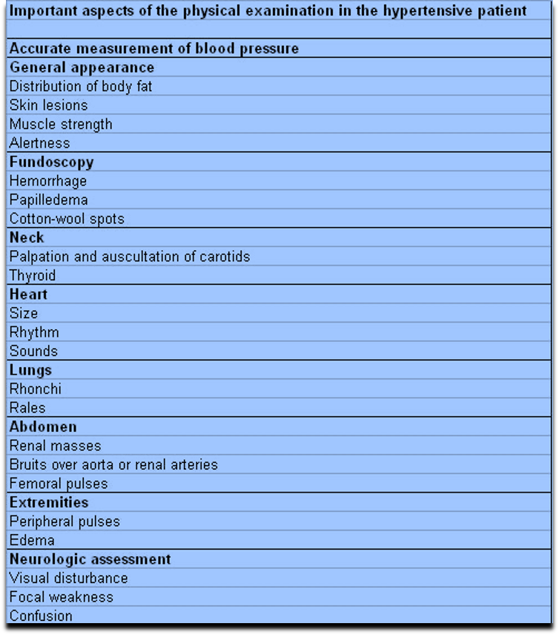
Diagnosis
1
2
3
4
Clinical presentation
Mostly asymptomatic but may also present with headache, epistaxis, chest discomfort¹, Symptoms of complication (e.g. Stroke AF).
We don’t diagnose HTN based on history or symptoms, the diagnosis is made at a routine physical examination or when a complication arises. Reflecting this fact, a BP check is advisable every 5 years in adults over 40 years of age to pick up occult hypertension.
1
2
3
4
Physical examination
Confirm the diagnosis of HTN, by obtaining accurate, representative BP measurements
Detect causes of secondary HTN.
Assess other risk factors and quantify cardiovascular risk.
Organ damage.
identify comorbidity that may influence the choice of antihypertensive therapy e.g. DM, Dyslipidemia.
Laboratory tests
1: ↑ BP → ↑ Afterload → ↑ Cardiac muscle size → ↑ Oxygen Demand → Angina.

Slide 10
Diagnosis
1
2
3
4
Screening
Every one year for persons with systolic and diastolic pressures below < 120 mmHg and 80 mmHg.
Every 3-6 months for persons with systolic and diastolic pressures higher >120 mmHg and 80 mmHg.
For patients above 40 years of age, If they present to the clinic with mild to moderate elevation of BP, we can not diagnose them with hypertension directly. Mild to moderate elevation needs at least 3 visits and each visit 2 readings of BP. While if the patient present with severe elevation of BP, mostly they’re hypertensive.
1
2
3
4
Laboratory tests
Routine Tests
Optional Tests
(e.g. If you suspect CKD or pt has chronic HTN)
Laboratory tests
ECG:
V1,2,3: Deep S wave
V4,5,6: Tall R wave
Lead I,II: LAD
Urinalysis: Proteinuria or hematuria. To check whether HTN causes renal dysfunction or not.
Electrolytes: Serum sodium, serum potassium, creatinine, or the corresponding estimated GFR, and calcium.
Blood glucose, and hematocrit (Polycythemia)
Lipid profile, after 9- to 12-hour fast, that includes high density and low-density lipoprotein cholesterol, and triglycerides.
Measurement of urinary albumin excretion or albumin/creatinine ratio.
Chest X-ray: to detect cardiomegaly, HF, coarctation of the aorta.
Ambulatory BP recording: To assess borderline or ‘White coat’ hypertension.
Echocardiogram: to detect or quantify LVH
Renal ultrasound: To detect possible renal disease.
Renal angiography: To detect or confirm presence of renal artery stenosis
Urinary catecholamines: To detect possible pheochromocytoma.
Urinary cortisol & dexamethasone suppression test: to detect possible cushing syndrome
Plasma renin activity and aldosterone: to detect possible primary aldosteronism
More extensive testing for identifiable causes is not generally indicated unless BP control is not achieved.
1: Hypokalemic alkalosis may indicate primary hyperaldosteronism but is usually due to diuretic therapy.

Slide 11
Management
When to treat? ★
BP (mmHg) | CVD risk¹ | Lifestyle modifications | Drug therapy | Reassess in
<120/80 | No | No | No | 12 months
120-129/<80 elevated BL pressure | No | Yes | No | 3 to 6 months
130-139/80-89 | <10% | Yes | No | 3 to 6 months
130-139/80-89 | ≥10% (means presence of comorbid conditions like DM) | Yes | Yes (one drug) | 1 month
≥140/90 | NO | Yes | Yes (two drugs) | 1 month
Antihypertensive drug treatment:
For essential HTN with no comorbidities
Initial choice of medication
Key notes:
A = ACE inhibitors.
B = angiotensin II receptor blocker (ARB).
C = Calcium channel blocker (CCB).
D = Thiazide-like diuretic.
An area for your notes
Aged under 55 years and caucasian
Aged over 55 years or black person of africa
If BP > 20/10 mmHg above goal (140/90), may start with 2 BP lowering medications
(A)- ACE Inhibitors
or
(B)- Angiotensin receptor blockers
(C)- Calcium Channel Blockers
or
(D)- Thiazide²
A(B)+C or A(B)+D
ONE PILL DUAL COMBINATION
If BP > 20/10 mmHg above goal (140/90), may start with 2 BP lowering medications → A(B)+C or A(B)+D (ONE PILL DUAL COMBINATION)
DO NOT start with B-Blockers (Used as last option) Unless indicated by co-morbid condition
DO NOT use ACEI and ARBs together
BP target of less than 130/80 mmHg is recommended “To reduce risks of complications”.
1: Calculated by a tool that estimates the 10-year risk for atherosclerosis cardiovascular disease (ASCVD) which is defined as coronary death or nonfatal myocardial infarction, or fatal or nonfatal stroke Most of the excess morbidity and mortality associated with hypertension are attributable to CAD and many treatment guidelines are therefore based on estimates of the 10-year CAD risk. Total cardiovascular risk can be estimated by multiplying CAD risk by 4/3 (i.e. if CAD risk is 30%, cardiovascular risk is 40%).

Slide 12
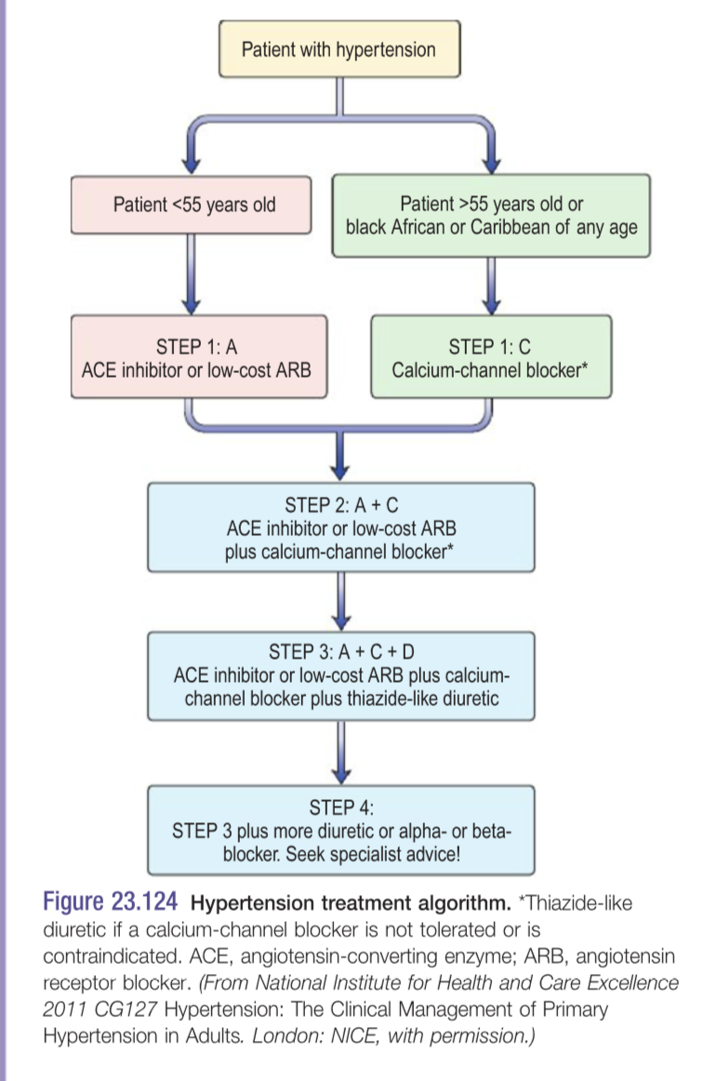
Management
Antihypertensive drug treatment:
For essential HTN with no comorbidities
Initial choice of medication
Key notes:
A = ACE inhibitors.
B = angiotensin II receptor blocker (ARB).
C = Calcium channel blocker (CCB).
D = Thiazide-like diuretic.
Aged under 55 years and caucasian
Aged over 55 years or black person of africa
(A)- ACE Inhibitors
or
(B)- Angiotensin receptor blockers
(C)- Calcium Channel Blockers
or
(D)- Thiazide
If BP > 20/10 mmHg above goal (140/90), may start with 2 BP lowering medications → A(B)+C or A(B)+D (ONE PILL DUAL COMBINATION)
DO NOT start with B-Blockers (Used as last option) Unless indicated by co-morbid condition
DO NOT use ACEI and ARBs together
BP target of less than 130/80 mmHg is recommended “To reduce risks of complications”.
BP target of less than 130/80 mmHg is recommended “To reduce risks of complications”.
STEP 1: A(or B) or C (or D)
First-line therapy for patients under 55 years is an ACE inhibitor, such as enalapril, or a low-cost ARB, such as candesartan if ACEI is not tolerated (e.g. pt develops cough). In angina or young women of childbearing potential, treatment with beta-blockers may be preferred.
First line therapy for patients aged 55 years and above, and black African or Caribbean patients, is a calcium-channel blocker, such as amlodipine (a thiazide-like diuretic should be used in patients with heart failure or those who develop troublesome ankle oedema). If diuretic treatment is to be initiated or changed, offer a thiazide-like diuretic, such as chlorthalidone (12.5–25.0 mg once daily) or indapamide (1.5 mg modified-release once daily or 2.5 mg once daily) in preference to a conventional thiazide diuretic such as bendroflumethiazide or hydrochlorothiazide. For people who are already having treatment with bendroflumethiazide or hydrochlorothiazide and whose blood pressure is stable and well controlled, continue treatment with the bendroflumethiazide or hydrochlorothiazide.
STEP 2: A(or B) + C (or D)
If BP control is inadequate, then the combination of an ACE-inhibitor or ARB with a calcium-channel blocker is recommended (or a thiazide-like diuretic as above).
For black people of African or Caribbean family origin, consider an ARB in preference to an ACE inhibitor, in combination with a CCB.
STEP 3: A(or B) + C + D
Before considering step 3 treatment, review medication to ensure step 2 treatment is at optimal or best tolerated doses.
At this point, Triple therapy of an ACE inhibitor or ARB with a calcium-channel blocker and a thiazide-like diuretic is recommended.
STEP 4: Same as step 3 + more diuretic or alpha- or beta-blocker.
If BP remains >140/90mmHg on three agents, then the patient should be referred for specialist advice. In those with preserved renal function and resistant hypertension, spironolactone 25mg daily can be added if the serum potassium is ~4.5 mmol/L. If the potassium is >4.5mmol/L, an increased dose of thiazide-like diuretic can be used with monitoring of electrolytes (sodium and potassium) within 1 month and repeat as required thereafter. Alpha- or beta- blockers can be used if these measures are not effective.
If BP > 20/10 mmHg above goal (140/90), may start with 2 BP lowering medications
A(B)+C or A(B)+D
ONE PILL DUAL COMBINATION

Slide 13
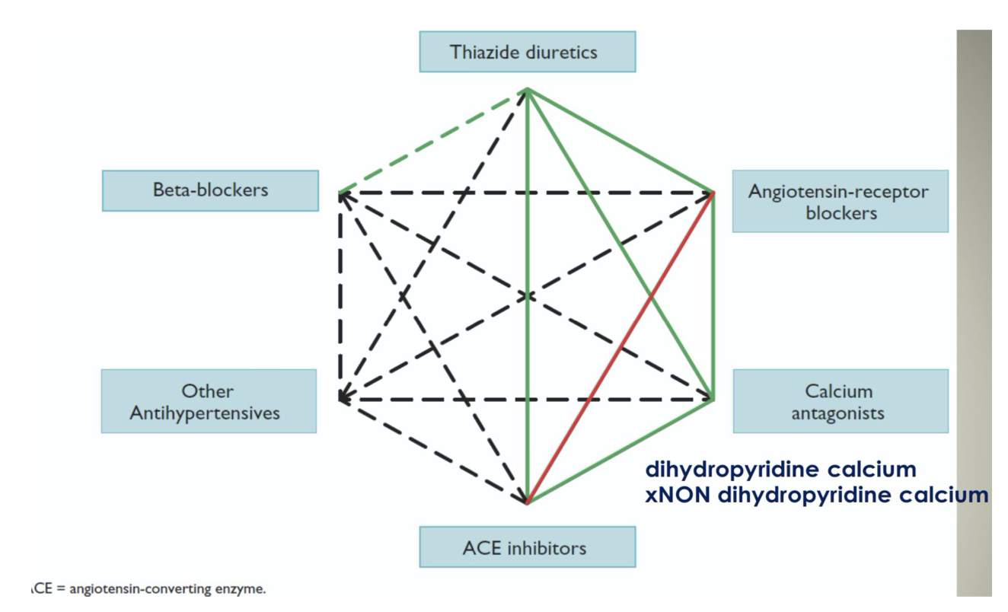
One pill triple combination
Management
High Risk Group Therapy (Special Cases):
Condition | Preferred therapy
Congestive heart failure | Thiazide, ACEI, Aldosterone antagonist, BB
Post Myocardial Infarction | BB, ACEi
Diabetes mellitus with proteinuria | ACEi, ARBs, NO
Diabetes mellitus without Proteinuria | Thiazide, CCB, ARBs, ACEi
Chronic kidney disease | ACEi, ARB, Thiazide
Stroke | CCB+ACEi
Benign prostatic hyperplasia | α antagonists e.g. prazosin, terazosin, doxazosin
Pregnancy | Hydralazine (vasodilator), nifedipine (CCB), Aldomet (methyldopa), labetalol Oral labetalol is first-line therapy during pregnancy. Second Line agents are methyldopa and nifedipine. In breastfeeding, ACE inhibitors, beta-blockers and nifedipine are safe. Methyldopa should be avoided because of the risk of depression.
Antihypertensive drug complications:
DRUG | Contraindication | ADR
Thiazide Diuretics | Gout | Hypokalemia
Beta-Adrenergic blockers | Asthma or COPD | Bradycardia
ACEI | Pregnancy, Renovascular disease | Hyperkalemia, Cough, Angioedema
Angiotensin II Receptor Blocker | Pregnancy | Hyperkalemia
Calcium Channel Blockers | AV-block, HF | Edema, Tachycardia, Bradycardia, Constipation, flushing, palpitations and fluid retention
Alpha-Adrenoceptor Antagonist | Urinary incontinence | 1st dose postural hypotension,
Drugs with Central Sympatholytic Action | - | Drowsiness
Arteriolar Dilators | - | Tachycardia, Edema
Possible combinations of classes of antihypertensive drugs.
Green continuous lines: preferred combinations.
green dashed line: useful combination (with some limitations).
black dashed lines: possible but less well-tested combinations.
red continuous line: not recommended combination.
Although verapamil and diltiazem are sometimes used with a beta-blocker to improve ventricular rate control in permanent atrial fibrillation, only dihydropyridine calcium antagonists should normally be combined with beta-blockers.

Slide 14
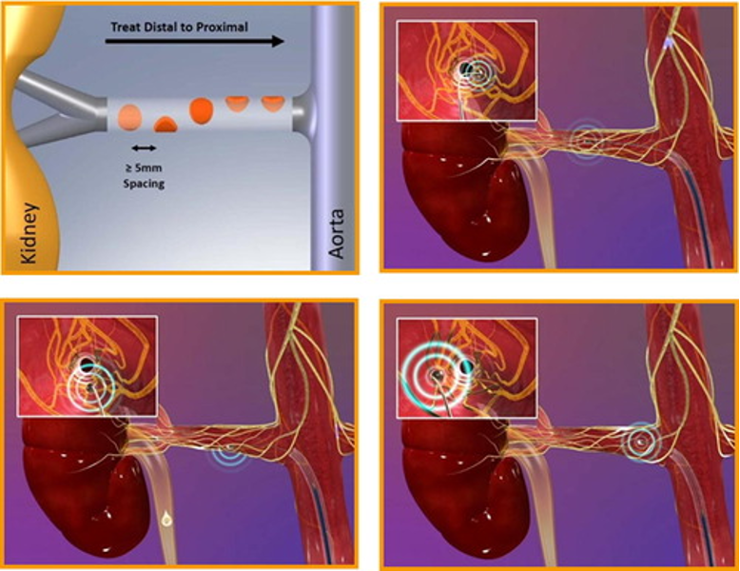
Management
What is lifestyle modification?
lifestyle modification intervention | reduction in BP (mmHg)
Weight loss | 1 mmHg/ 1kg loss
Dash-type diet | 11 mmHg
Reduce dietary sodium (1500 mg) | 5-6 mmHg
Increase dietary potassium (3500 mg) | 4-5 mmHg
Aerobic exercise 90 – 150 min/week | 5-8 mmHg
Reduce/ stop alcohol intake | 4 mmHg
Weight loss: BMI 25 kg/m.
DASS Diet: high consumption of vegetables and fruits, low-fat dairy.
Limit alcohol intake
Vit D replacement
Regular physical exercise: 30 min of moderate-intensity aerobic exercise 5-7 days/week.
Smoking cessation.
Super important:
NaCl (Salt restriction): 3000 mg/day
Na (Sodium restriction): 1500 mg/day
READ THE QUESTION CAREFULLY WHETHER IT IS “SALT” OR “SODIUM” RESTRICTION.
Other treatment options:
Hypertension renal denervation:
A controlled trial of renal denervation for resistant hypertension. this blinded trial did not show a significant reduction of systolic blood pressure in patients with resistant hypertension 6 months after renal-artery denervation as compared with a sham control.
RDN had significantly greater BP reductions vs sham control in both 24-hour systolic ABPM (4.0 mmHg, p<0.001), and office systolic BP (6.6 mmHg, p<0.001).
Barostim
An implanted device designed to activate baroreceptors to reduce blood pressure does not appear to reduce blood pressure.
Benefits of Lowering BP:
Disease | Incidence reduction
Stroke | 35-40%
Myocardial infarction | 20-25%
Heart failure | 50%
Renal failure | 35-50%
2 mmHg decrease in mean systolic BP will lead to:
7% reduction in risk of ischemic heart disease mortality
10% reduction in risk of stroke mortality.
Reduce the risk of cardiovascular events up to 10%
Follow up and monitoring
Patients should return for follow-up after 2-4 weeks and adjustment of medications monthly until the BP goal is reached
More frequent visits for stage 2 HTN or with complication comorbid conditions
Serum potassium and Cr monitored 1-2 times per year

Slide 15
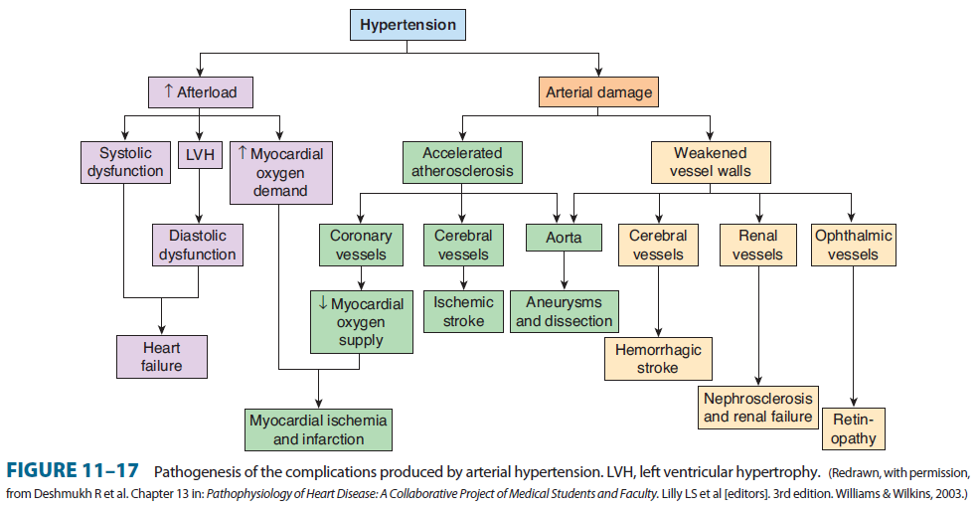
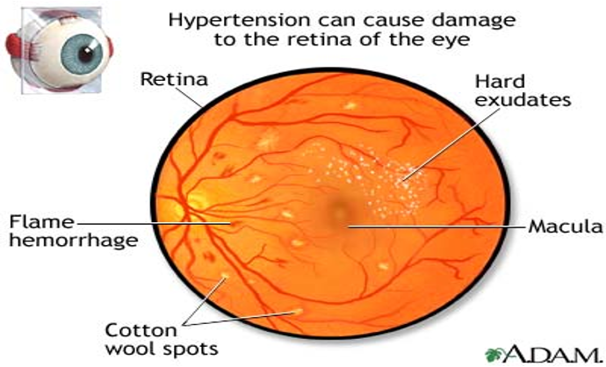
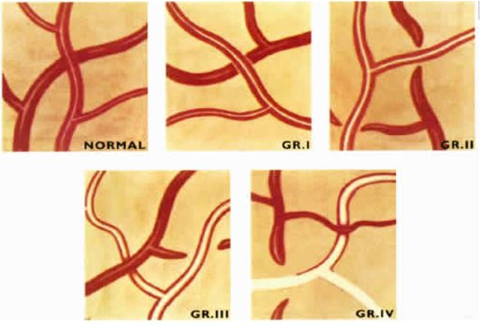
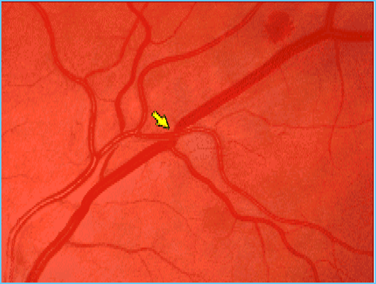
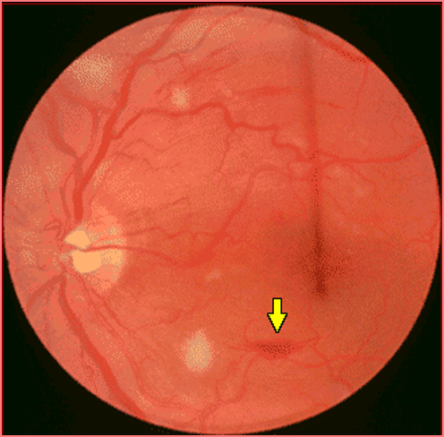
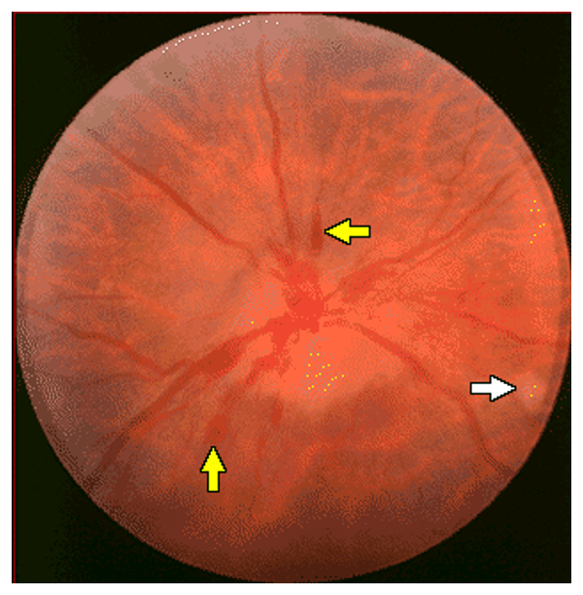
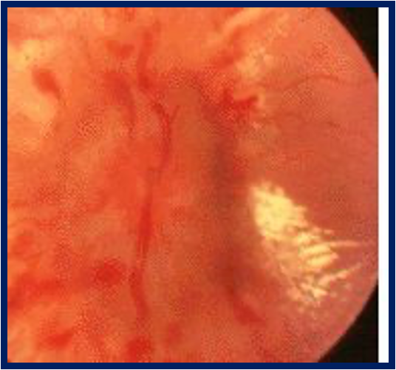
Complications of Hypertension
Complications
1
Cardiac¹
CAD, Arrhythmia (Atrial fibrillation), CHF, LVH, Sudden death
2
Cerebral
Ischemic/ Hemorrhagic Stroke
Alzheimer’s disease
Cognitive imbalance
3
Vascular¹
Aortic Dissection, Peripheral vascular disease, Hypertensive crisis urgency/ emergency
4
Renal disease
5
Eye
Retinal hemorrhage
Hypertensive retinopathy
Hypertensive retinopathy:²
Grade | Description
I | Minimal narrowing and thickening of retinal arteries and increased reflectiveness (“Silver Wiring”)
II | Arteriovenous nipping (yellow arrow): Narrowing of retinal arteries in conjunction with regions of focal narrowing. Produced when thickened retinal arteries pass over the retinal veins
III | Abnormalities seen in Grade I II, plus flame-shaped retinal hemorrhages, hard exudates and cotton wool spots, as well as copper wiring of blood vessels.
IV | Abnormalities encountered in Grade I through III, as well as swelling of the optic nerve head and macular star. There is blurring of the borders of the optic disk with hemorrhages (yellow arrows) and exudates. papilledema from malignant hypertension The lipid-rich component of the exudate is able to penetrate into the outer plexiform layer, creating what is clinically seen as a macular star pattern.
1: Hypertension has a number of adverse effects on the cardiovascular system. In larger arteries (>1 mm in diameter), the internal elastic lamina is thickened, smooth muscle is hypertrophied and fibrous tissue is deposited. The vessels dilate and become tortuous, and their walls become less compliant. In smaller arteries (<1 mm), hyaline arteriosclerosis occurs in the wall, the lumen narrows and aneurysms may develop. Widespread atheroma develops and may lead to coronary and cerebrovascular disease, particularly if other risk factors are present.
2: Examination of the optic fundi reveals a gradation of changes linked to the severity of hypertension; fundoscopy can, therefore, provide an indication of the arteriolar damage occurring elsewhere

Slide 16
Case summary
Case 1 (From Dr slides):
Case: A 47 years old man came to the clinic with headache for 3 weeks. The nurse measure his blood pressure and was found to be 150/ 95 mmHg .
Does he have hypertension?.
What is the stage of hypertension?
What investigation should you perform?
What could be your management in his case?
Is there any possible prevention to his disease and its complication?
Does he have hypertension? We can’t tell by one measurements because according to AHA, HTN is defined as a systolic blood pressure ≥ 130 mm Hg or a diastolic blood pressure ≥ 80 mm Hg on at least two measurements in three visits.
What is the stage of hypertension? We can’t tell
What investigation should you perform? ECG, Urinalysis, Electrolytes, lipid profile, blood glucose
What could be your management in his case? Mainly Lifestyle modification If inadequate start with ACEI
Is there any possible prevention to his disease and its complication? Lifestyle modification and reassess multiple times
Case 2 (EXTRA):
Case: A 35-year-old black man with no significant past medical history presents to the outpatient clinic for a follow-up examination 4 weeks after he was noted to have a blood pressure of 150/80 mm Hg on a routine health maintenance examination. He has no complaints, takes no medications, and does not smoke or use alcohol or other drugs. His family history is significant for a father with high blood pressure and a maternal grandmother who died of breast cancer. His blood pressure on this visit is 150/90 mm Hg.
What’s the most likely diagnosis?
Primary (essential) hypertension. Hypertension is defined as a systolic blood pressure ≥ 130 mm Hg or a diastolic blood pressure ≥ 80 mm Hg on three separate measurements at least 2 weeks apart. Although this patient has only had two measurements, it is likely that he will have a third that satisfies the criteria for diagnosing hypertension. Although primary hypertension is technically idiopathic, and therefore a diagnosis of exclusion, it represents 95% of all cases of hypertension. Thus, it is reasonable for physicians to begin therapy for primary hypertension without undertaking a full workup for causes of secondary hypertension, especially if there is a family history of hypertension.
What are the risk factors for this condition?
Family history of hypertension or heart disease, High-sodium diet, Obesity, Older age, Race (blacks > whites), Smoking
What are the common complications associated with this condition?
Because hypertension is asymptomatic until complications develop, patients who do not receive regular medical care may develop the sequelae of untreated hypertension. Specifically, untreated hypertension leads to end-organ damage: Heart (hypertrophy, myocardial infarction, CHF), Brain (stroke, TIA), Kidney (chronic kidney disease, renal failure), Vasculature (peripheral vascular disease) and Eye (retinopathy)

Slide 17
HYPERTENSION
Definition |  | Systolic pressure ≥130 mm Hg Diastolic pressure ≥80 mm Hg
Etiology |  | 95 percent of hypertension has no clear etiology and can be called “essential hypertension” Secondary hypertension causes: Renal artery stenosis Glomerulonephritis Coarctation of the aorta Obstructive sleep apnea Pheochromocytoma Hyperaldosteronism Cushing syndrome
presentation |  | The vast majority of cases are found on routine screening of asymptomatic patients. Complications: Coronary artery disease Cerebrovascular disease CHF Visual disturbance Renal insufficiency Peripheral artery disease
Diagnostic Tests |  | The diagnosis of hypertension should not be made until the blood pressure has been measured on at least two times in three visits. Those with hypertension are also tested with: EKG Urinalysis Glucose measurements to exclude concomitant diabetes Electrolytes Lipid profile
Management | General information | Threshold of treatment start 130/80 mm Hg if there is CVS risk. If not, it is just lifestyle modification & reassess in 3-6 months Blood pressure goal is < 130/80 mm Hg
 | initial therapy | Age < 55 → ACE or ARB Age >55 or Black → CCB or thiazide diuretics If blood pressure is very high on presentation (>140/90 mm Hg), 2 medications should be used at the outset.
 | Pregnancy | Oral labetalol is first-line therapy during pregnancy. Second Line agents are methyldopa and nifedipine. In breastfeeding, ACE inhibitors, beta-blockers and nifedipine are safe. Methyldopa should be avoided because of the risk of depression.

Slide 18
Q1: A 48-year-old woman has been diagnosed with essential hypertension and was commenced on treatment three months ago. She presents to you with a dry cough which has not been getting better despite taking cough linctus and antibiotics. You assess the patient’s medication history. Which of the following antihypertensive medications is responsible for the patient’s symptoms?
A- Amlodipine
B- Lisinopril
C- Bendroflumethiazide
D- Furosemide
E- Atenolol
Q2: A 57-year-old male is admitted complaining of headaches and blurring of vision. His blood pressure is found to be 240/150 mmHg and he has bilateral papilloedema, but is fully orientated and coherent. He had been known to be hypertensive for about five years and his blood pressure control had been good on three drugs. However, he had decided to stop all medication two months before this event. Which of the following would be your preferred parenteral medication at this point?
A- Glyceryl Trinitrate
B- Hydralazine
C- Labetalol
D- Sodium nitroprusside
Q3:A 44-year-old woman presents with episodes of headaches, associated with anxiety, sweating and a slow pulse rate. At the time of her initial consultation, her blood pressure was 150/95 mmHg seated, but 24 hour ambulatory monitoring shows a peak of 215/130 mmHg, associated with the symptoms described above. Which of the following would be your initial diagnostic procedure??
A- Magnetic resonance imaging (MRI) scans of the abdomen and pelvis
B- Measurement of random plasma catecholamines
C- Measurement of urinary metanephrines over several 24 hour periods
D- Glucose tolerance test
Q4: A 57-year-old man is reviewed in a hypertension clinic, where it is found that his blood pressure is 165/105 mmHg despite standard doses of amlodipine, perindopril, doxazosin and bendroflumethiazide. Electrolytes and physical examination have been, and remain, normal. Which of the following would be your next stage in his management?
A- Arrange for his medication to be given under direct observation
B- Add spironolactone to his medication
C- Arrange urinary catecholamine assays
D- Request an adrenal CT scan
Q5: A 41-year-old woman with type 2 diabetes attends a hypertension clinic. She has been doing well on metformin and has maintained good glycaemic control alongside dietary changes and regular physical exercise. She has been meeting her HbA1c targets consistently. However, her blood pressure has been poorly controlled despite lifestyle changes and is currently 157/97 mmHg. The most appropriate first- line therapy is?
A- Diuretics
B- Angiotensin II receptor blocker
C- Calcium channel blocker
D- β-blocker
E- Angiotensin-converting enzyme (ACE) inhibitor
Answers: Q1:B | Q2:D | Q3:C | Q4:A | Q5:E
Answers Explanation File!

Slide 19
THANKS!!
This lecture was done by:
Aued Alanazi
Jehad AlOrainy
Mashal AbaAlkhail
Females co-leaders:
Raghad AlKhashan
Amirah Aldakhilallah
Males co-leaders:
Mashal AbaAlkhail
Ibrahim AlAsous
Send us your feedback:
We are all ears!

