Slide 1
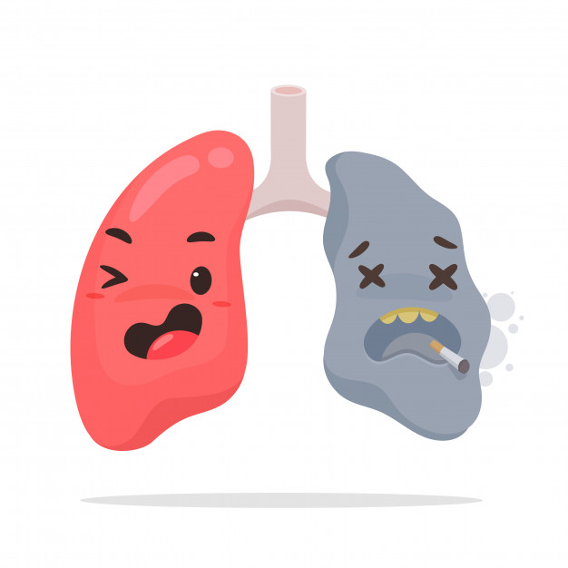
Lecture 15
Editing file
Investigation of lung diseases
Objectives:
Type of pulmonary diagnostic procedures
Role of various specialized pulmonary procedures in diagnosing lung diseases
When to apply specific tests
Color index:
Color index:
Original text Females slides Males slides
Doctor’s notes Textbook Important Golden notes Extra

Slide 2
Pulmonary diagnostic procedures
Diagnostic Methods
Imaging
Thoracentesis
Pleural biopsy
Pulmonary function test
Bronchoscopy
Scintigraphic imaging
Imaging
Chest X-ray
Chest X-ray: performed on the majority of patients suspected of having chest disease.
Common Chest X-ray abnormalities
Abnormality | Causes
Pulmonary & pleural shadowing | Consolidation: infection, infarction, inflammation and, bronchoalveolar cell carcinoma (rare) Lobar collapse: mucus plugging, tumour, compression by lymph nodes Solitary nodule Multiple nodules: miliary tuberculosis (TB), dust inhalation, metastatic malignancy, healed varicella pneumonia, rheumatoid disease Ring shadows, tramlines and tubular shadows: bronchiectasis Cavitating lesions: tumour, abscess, infarct, pneumonia (Staphylococcus/Klebsiella), granulomatosis with polyangiitis (formerly known as Wegener’s granulomatosis) Reticular, nodular and reticulonodular shadows: diffuse parenchymal lung disease, infection Pleural abnormalities: fluid, plaques, tumour
Increased translucency | Bullae Pneumothorax Oligaemia
Hilar abnormalities | Unilateral hilar enlargement: TB, lung cancer, lymphoma Bilateral hilar enlargement: sarcoid, lymphoma, TB, silicosis
Other abnormalities | Hiatus hernia Surgical emphysema

Slide 3
CT scan
Computed tomography
Provides detailed images of the pulmonary parenchyma, mediastinum, pleura and bony structures.
3 modalities of CT scan:
HRCT (Doesn’t require contrast) : Used if you are interested in lung parenchyma or interstitium e.g. Bronchiectasis, pulmonary fibrosis, emphysema
CT with contrast: Used if you are interested in the mediastinal lymph nodes, pleura
CT Angio: pulmonary vasculature e.g. PE
HRCT (high resolution CT scan)
Designed for detailed evaluation of interstitial structures of the lung .
Assessment of diffuse inflammatory and infective parenchymal processes.
Uses narrow slice thickness (1-2 mm) compared with 5-10 mm for routine scan
Principal indications
Suspected interstitial lung disease
Characterization of interstitial lung disease e.g. sarcoidosis¹, hypersensitivity pneumonitis², occupational lung disease and any other form of interstitial pulmonary fibrosis³
Diagnosis of lymphangitis carcinomatosa.
Suspected opportunistic lung infection in immunocompromised patients
Characterization of solitary pulmonary nodules
Diagnosis of bronchiectasis; it has a sensitivity and specificity of greater than 90%.
Distinction of emphysema from diffuse parenchymal lung disease or pulmonary vascular disease as a cause of a low gas transfer factor with otherwise normal lung function
1- Characterized by immune-mediated, widespread noncaseating granulomas, elevated serum ACE levels, and elevated CD4/CD8 ratio in bronchoalveolar lavage fluid. It’s more common in African-American females. Often asymptomatic except for enlarged lymph nodes. CXR shows bilateral adenopathy and coarse reticular opacities ; CT of the chest better demonstrates the extensive hilar and mediastinal adenopathy. Associated with Bell palsy, Uveitis, Granulomas (noncaseating epithelioid, containing microscopic Schaumann and asteroid bodies), Lupus pernio (skin lesions on face resembling lupus), Interstitial fibrosis (restrictive lung disease), Erythema nodosum, Rheumatoid arthritis-like arthropathy, hypercalcemia (due to increased 1-alpha -hydroxylase –mediated vitamin D activation in macrophages). Biopsy is the gold standard for diagnosis.
2- Mixed type III/IV hypersensitivity reaction to environmental antigen. Causes dyspnea, cough, chest tightness, fever, headache. Often seen in farmers and those exposed to birds. Reversible in early stages if stimulus is avoided.
3- Repeated cycles of lung injury and wound healing with increased collagen deposition, “honeycomb” lung appearance, traction bronchiectasis and digital clubbing. The conditions takes an insidious course that initially presents with exertional dyspnea that progresses to dyspnea at rest, persistent nonproductive cough, and fatigue. Progression to respiratory failure usually occurs within 3–7 years.

Slide 4
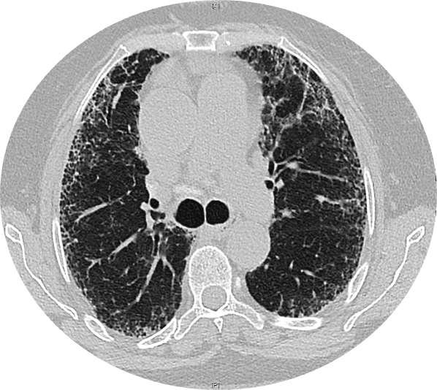
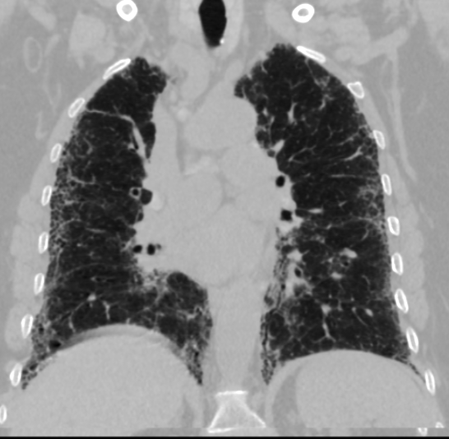
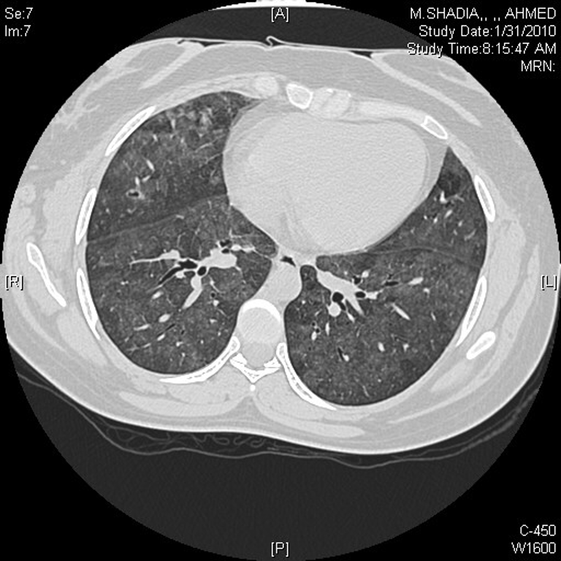
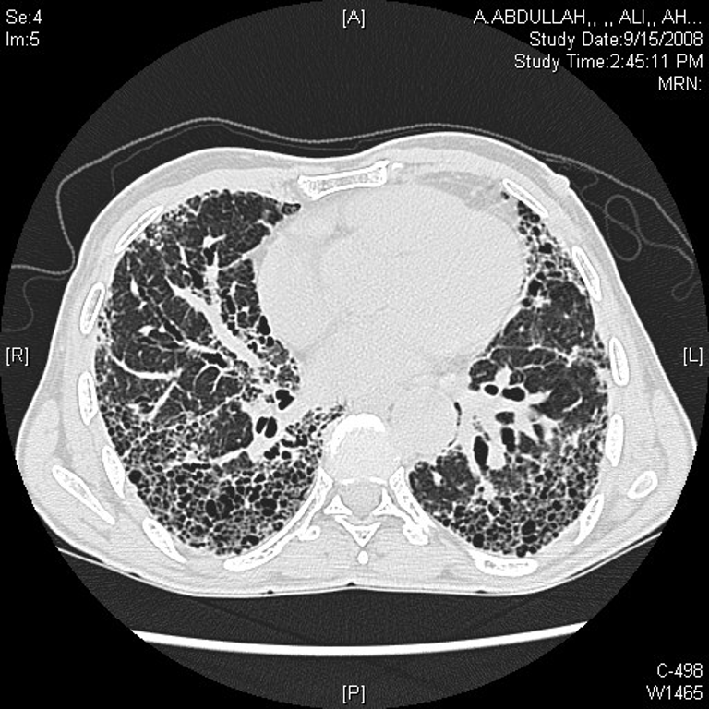
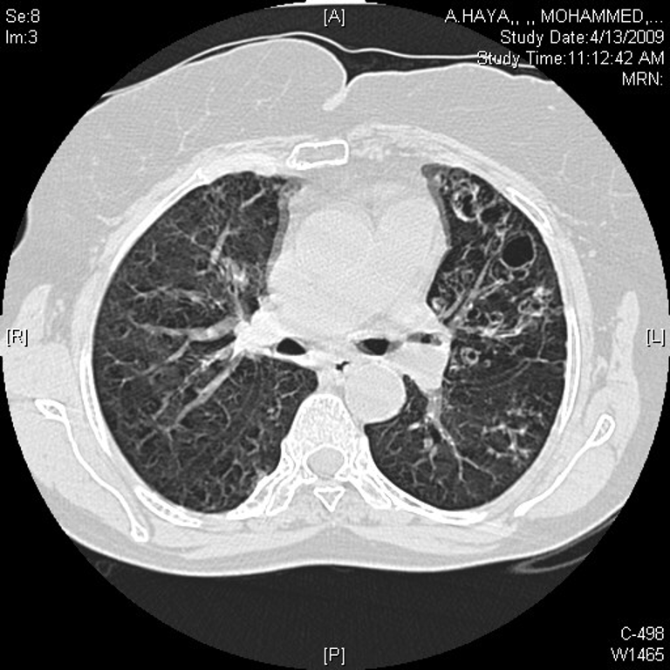
HRCT
Reticulation bilaterally with small cystic structure (Honeycombing or fibrotic strands)
With these finding we can diagnose this patient with pulmonary fibrosis (But you can’t say that the patient has idiopathic pulmonary fibrosis (IPF), you have to exclude other causes of pulmonary fibrosis first e.g. Connective tissue disorders, drug-induced, environmental factor, familial, congenital)
Hypersensitivity Pneumonitis : mosaic pattern (=air trapping), ground-glass opacity, (normal & abnormal areas)
an example is a patient working in a farm and exposed to pigeon
Sarcoidosis: it has similar picture to pulmonary fibrosis but it has predilection toward the bronchioles and you can see the fibrotic strands are going central.
severe pulmonary fibrosis
Here it shows cystic type (Grape-like) bronchiectasis
An area for your notes

Slide 5
CT Imaging
CT angiography
Image data are acquired continuously as the tube and detector rotate within the gantry and the patient moves continuously through the gantry.
If the filling defect is present we diagnose the patient with Pulmonary Embolism. The patient undergoes CT angiography with contrast which is white in images. We detect filling defects when there is stoppage of contrast movement, which appears as black colored spaces in images.
Grey opaque opacity sitting on the bifurcation of the pulmonary artery (Saddle PE)
Contraindications
Advantages
Renal failure
Allergy to contrast¹
Pregnancy¹
It’s quick so it can be done in critically ill patients and children.
Less volume of intravenous contrast.
Permits greater processing of the raw data.²
MRI
MRI has been used in staging lung cancer and assessing tumour invasion in the mediastinum and chest wall and at the lung apex
Vascular structures can be clearly differentiated as flowing blood produces a signal void on MRI.
Transthoracic Ultrasound
Used for:
01
Confirming & assessing a pleural effusion (provides details about the nature of the effusion, such as whether it is a simple pleural effusion (single collection heavily loculated with adhesions or organized (more gelatinous).
02
Assists in determining the best site for pleural aspiration and intercostal chest drain placement
03
Ultrasound guided biopsy is used for lung masses that abut the pleura or pleural masses, if appropriate.
04
It is also used in bronchoscopy (endobronchial ultrasound, EBUS) to stage and sample mediastinal lymph nodes.
1-CT angiography is not done when the pt is allergic to contrast or is contraindicated to it (pregnancy). Instead we do V/Q scan to those patients.
2- You can visualize the pulmonary vasculature, lung parenchyma and other mediastinal structures

Slide 6
Thoracentesis
2. Thoracentesis
Fluid is drained from the pleural cavity with a needle (aspiration).
Before performing the procedure check the patient’s CBC and coagulation profile, to exclude any bleeding problem (for e.g. thrombocytopenia) and confirm pleural effusion by ultrasound (or decubitus film if US isn’t available).²
What to look for ?
Appearance
Gram stain and cultures
(Can be done within 3min in ER)
pH
Chemistry
(glucose,LDH amylase, protein)
Cytology
If any of the following features¹ are present, what’s the best next step? Do CHEST TUBE (large bore)
Gross appearance of pus (Indicating empyema)
Gram stain positive
pH below 7.20 (Indicating complicated parapneumonic effusion or empyema)
Light’s criteria:
98% sensitive and 83% specific for exudative effusion using Light's criteria.
Pleural effusion is exudative if one or more of the following:
Ratio of pleural fluid protein level to serum protein level > 0.5
Ratio of pleural fluid LDH level to serum LDH level > 0.6
Pleural fluid LDH level > 2/3 the upper limit of normal for serum LDH level.
absence of all 3 criteria = Transudative
Indications for thoracentesis:
Recall from pleural effusion lecture
Pleural effusion of unknown etiology, with >10mm depth on lateral decubitus CXR or Ultrasound.
Therapeutically for symptomatic relief (Mainly dyspnea)
Concern for empyema.
Air fluid level in pleural space.
Complications of thoracentesis³:
Pneumothorax
Bleeding
Infection
Hypotension
Hypoxemia
Air embolism
Splenic laceration
1- Why are these features so important? Because if we don’t drain IMMEDIATELY in these cases patients will develop fibrosis (If neglected the patient will suffer from a life-time fibrothorax, the patient will be restricted and he might require oxygen for the rest of his life)
2- So the proper order should be: CXR → Check CBC, coagulation profile, LFT, RFT → US (or decubitus film) → thoracocentesis
3-NEVER do thoracentesis for a patient with collapsed lungs → you will cause pneumothorax on top of collapse. Instead, do bronchoscopy.

Slide 7
Pulmonary diagnostic procedures
Chest tube:
Indications for chest tube insertion :
01
02
03
04
05
Empyema
Complicated parapneumonic effusion
Symptomatic pleural effusion
Hemothorax
Pneumothorax
3. Pleural biopsy
A procedure in which a sample of the pleura (parietal) is removed with a special biopsy needle or during surgery to determine if Granulomatous disease, malignancy or another condition is present.
When is pleural biopsy indicated?
01
Granulomatous disease e.g. TB
02
Malignancy
4. Pulmonary function test
Spirometry
Lung volumes
PEFR
Diffusion capacity
Respiratory muscle strength
Used to aid diagnosis, quantify functional impairment, and monitor treatment or progression of disease.
Categorization of different types of lung diseases: knowing whether it’s restrictive or obstructive.

Slide 8
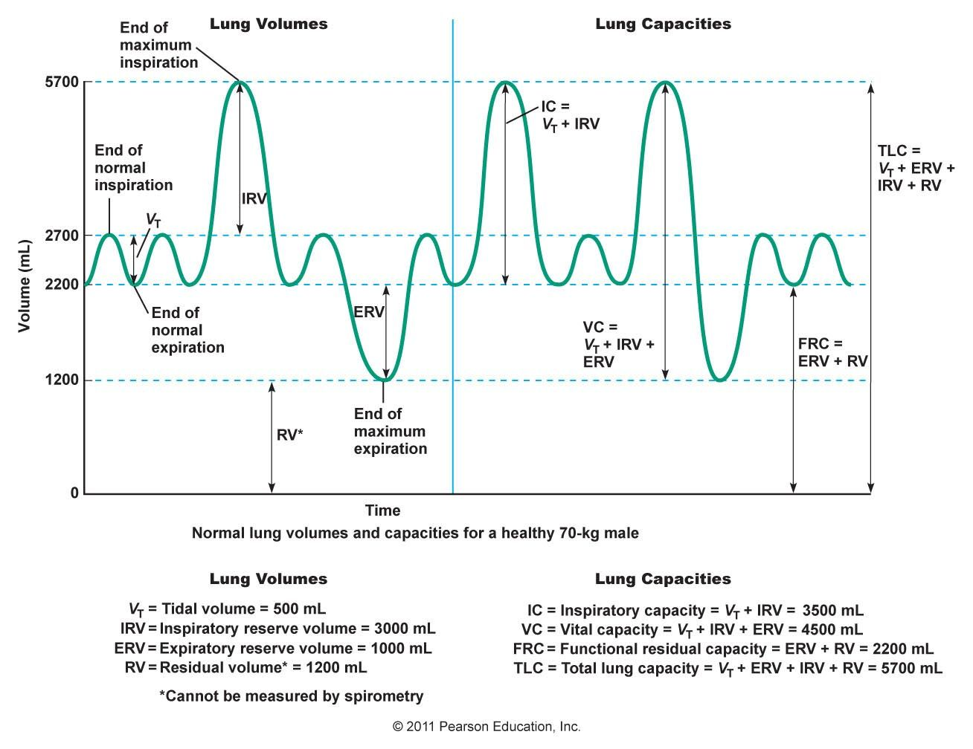
EXTRA
Special thanks to physiology 438 team
Spirometry
What is Spirometry?
It’s a pulmonary function test that measures lung volumes and capacities , 4 volumes and 4 capacities.
TV
IRV
ERV
Tidal Volume:
Volume of air inspired or expired during normal (quiet) breathing
Inspiratory Reserve Volume:
The extra volume of air that can be inspired by a maximal inspiratory effort after normal inspiration
Expiratory Reserve Volume:
The extra volume of air that can be expired by forceful expiration after the end of a normal tidal expiration
500ml or 0.5L (M + F)
300ml or 3L
(3.3L M ,1.9L F)
1100ml or 1.1L
(1000ml M ,700ml F)
RV
IC
Residual Volume:
Volume of air remaining in the lungs after the most forceful expiration.
Inspiratory Capacity:
Volume of air inspired by a maximal inspiratory effort after normal expiration
1200ml or 1.2L
3500ml or 3.5L
TV+IRV
VC
TLC
FRC
Vital Capacity:
The volume of air that can be maximally expired after maximum inspiration.
Total Lung Capacity:
Is the maximum volume to which the lungs can be expanded with the greatest possible effort
Functional Residual Capacity:
The amount of air that remains in the lungs at the end of normal expiration
4600ml or 4.6L
TV+IRV+ERV
5800ml or 5.8L
VC+RV
2300ml or 2.3L
EVR+RV

Slide 9
Pulmonary function tests
1
Spirometry
What it used for: | Measuring what?
Diagnose obstructive lung disease suggest restrictive lung disease but can’t diagnose. It’s used when you suspect problem in the airways e.g. COPD and asthma | FVC (L) (forced vital capacity): predicted¹ > 90% FEV1 (L) (forced expiratory volume in 1st second): predicted¹ > 90% FEV1/FVC (ratio:) >70
Obstructive:
Decreased both FVC and FEV1, but FEV1 is decreased more than FVC → The FEV1/FVC (ratio) less than 70 → decreased
Increased resistance to expiratory airflow.
Restrictive:
Decreased both FVC and FEV1, but FEV1 is decreased less than FVC → The FEV1/FVC (ratio) normal or increased.
What is the meaning of:
2
Lung volume
What it used for:² | Measuring what?
Diagnose restrictive lung disease. Can diagnose air trapping. Can suggest obstructive lung disease. | Total lung capacity (TLC): >90% predicted. Residual Volume (RV): > 90% predicted.
3
Peak expiratory flow rate (PEFR)
Used to: | Diagnose asthma, and to monitor exacerbations of asthma and response to treatment.
1-based on the age, gender, height for each individual we have a predicted number for each individual
2- If there’s a problem with the lung parenchyma (Interstitium), then you measure lung volumes by the body plethysmograph.

Slide 10
Pulmonary function tests
4
Diffusion capacity (DC)
What it used for: | Measuring what?
Measures the ability of gases to diffuse from the alveoli into the pulmonary capillary blood. Patients inhale a test mixture of 0.3% carbon monoxide(CO), which is taken up avidly by haemoglobin in pulmonary capillaries. Carbon monoxide is not normally present in the lungs or blood but it’s more soluble in blood than lung tissue TLco or DLco also depends on the V/Q relationship as well as on the area and thickness of the alveolar membrane | Transfer factor (TLco): Decreased DLco: Reflects loss or damage to the gas exchanging surface of the lung, Normal: >80% the defect is either in the alveoli , capillary membrane or both of them. Conditions with low DLco: Emphysema: this distinguishes emphysema from chronic bronchitis or chronic asthma in which DLco is normal or increased Interstitial lung diseases Pulmonary vascular disease. Increased TLCO in: alveolar hemorrhage that is caused by (wegener disease, goodpasture syndrome and SLE).
5
Respiratory muscle strength
What it used for: | Measuring what?
Measured by pressure transducer at the mouth when subject make a maximal inspiratory effort from full expiration or maximal expiration effort from full inspiration. PImax: Maximal inspiratory pressure PEmax: Maximal expiratory pressure Causes of respiratory muscle weakness: Motor neuron disease, Guillain-Barré Syndrome. ¹ | PImax, PEmax: PI→ reflect inspiratory muscles as diaphragm. PE → expiratory muscles as abdominal muscles
1-Metabolic disease , C.T disease (myositis), Drugs (steroids for long period of time), can also be caused by autoimmune disorders (SLE)

Slide 11
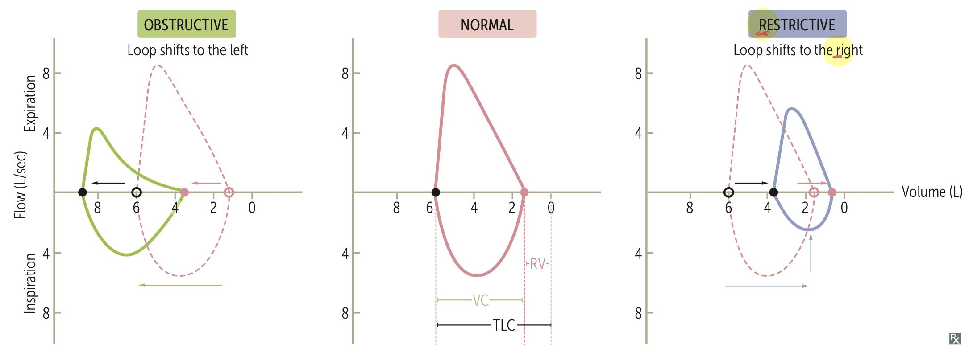
EXTRA
Pulmonary function tests
Obstructive Vs Restrictive lung diseases
Parameter | Obstructive lung disease | Restrictive lung disease
RV | ↑ | ↓
FRC | ↑ | ↓
TLC | ↑ | ↓
FEV1 | ↓↓ | ↓
FVC | ↓ | ↓
FEV1/FVC | ↓ (FEV1 decreased more than FVC) | Normal or ↑ (FEV1 decreased proportionately to FVC)
DLco
DLco | Restrictive | Obstructive | Normal FEV1/FVC
↓ DLco | Late interstitial lung disease e.g. Sarcoidosis Post-pneumonectomy Pulmonary edema (e.g., as a result of severe congestive heart failure) | Emphysema | Pulmonary vascular diseases (pulmonary hypertension, pulmonary embolism, hepatopulmonary syndrome) Early interstitial lung disease Pre-existing carboxyhemoglobinemia (e.g., due to smoking) Anemia
Normal DLco | Respiratory muscle weakness Pleural disorders Thoracic cage deformities Obesity | Alpha-1-antitrypsin deficiency Bronchiectasis Cystic fibrosis Chronic bronchitis Bronchial asthma | Healthy findings
↑ DLco | Obesity | Bronchial asthma | Polycythemia Mild heart failure and left-to-right cardiac shunts

Slide 12
Pulmonary function tests
How do we approach pulmonary function test?
First, we differentiate whether it is obstructive or restrictive → by spirometry.
Second, we give bronchodilator ; to know if it's reversible or irreversible (COPD).
Lastly →DLCO to know what type of COPD is it (emphysema → decreased, bronchitis → normal).
Measure the inspiratory ”diaphragm”/expiratory muscles, if all the tests are normal and SOB is present. Example, connective tissue dis/autoimmune dis ( SLE, scleroderma, dermatomyositis, polymyositis) affecting muscles.
If the patient is known to have connective tissue disease + progressive SOB→ MIP and MEP will show very low muscles strength, particularly EP “expiratory”.
The patient is stable, so steroids intake is usually the cause of his myopathy! “Which is the reason behind his dyspnea”
So we always have to think about drugs since they reduce muscle force.
Dr’s explanation:
↓FVC + ↓FEV1 :
Suggestive of obstructive
↑ FEV1/FVC:
Suggestive of restrictive
How to confirm restrictive?
By lung volume
↓ TLC :
Diagnosis with restrictive lung disease confirmed
↓PI + ↓PE :
Abnormality in the diaphragm and abdominal muscles
↓ TLCO:
Decreased perfusion capacity
What is the diagnosis?
the patient has obstructive and restrictive lung disease with respiratory muscle weakness and decreased DLco
Which diseases can give such as these findings?
Sarcoidosis
SLE
Scleroderma
Due to corticosteroid therapy on top of lung disease (causing muscle weakness)

Slide 13
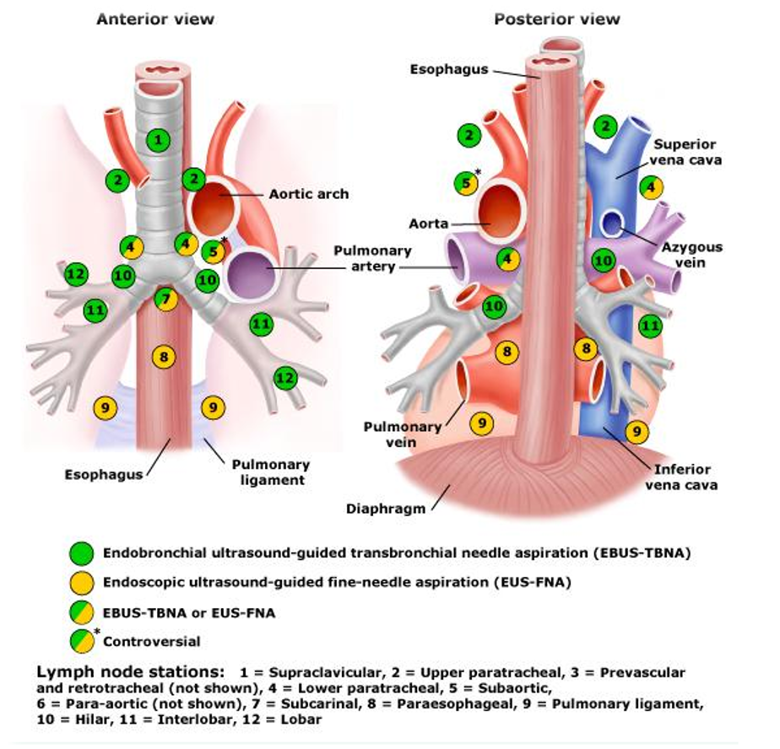
Bronchoscopy
5. Bronchoscopy
Is an endoscopic procedure allows direct visualization of the endo-bronchial tree down to the subsegmental level which is used for diagnostic and therapeutic purposes. ¹
Diagnostic indications
Suspected lung cancer
Staging of lung cancer.
Abnormal CXR. (collapsed lobes or segments)
Hemoptysis.
Localized wheeze or Stridor.
Positive sputum cytology.
Unexplained pleural effusion.
Lung abscess.
Obtain culture material.
Airway trauma.
Tracheoesophageal fistula.
Diffuse lung disease
Refractory cough
Unexplained cough.
Mediastinal lymph nodes.
Therapeutic indication
Remove foreign bodies.
in an elderly patient, look for broken dentures
In children, think of toys.
In the mid range around 25-30, think of a slow growing tumor.
Remove abnormal endobronchial tissue.
Difficult endotracheal tube intubation.
Endobronchial stent placement if there’s tracheal stenosis.
Collapse
implying obstruction of the lobar bronchus) is accompanied by loss of volume and displacement of the mediastinum towards the affected side.
What is the source of collapse?
Something in the airway (inside the lumen)
Something in the wall of the airway
Something in the outer wall of the airway
foreign body
inflammation
Mass: causing a significant loss of volume or compression by enlarged lymph nodes
mucus plugging
granuloma
Malignancy
tumor
1-If you want to see outside the luminal cavity (e.g. lymph nodes), you can use endobronchial ultrasound. If the patient is a smoker and the X-Ray or CT shows a mass then you always have to think of malignancy first. Do a bronchoscopy and biopsy to confirm suspicion.

Slide 14
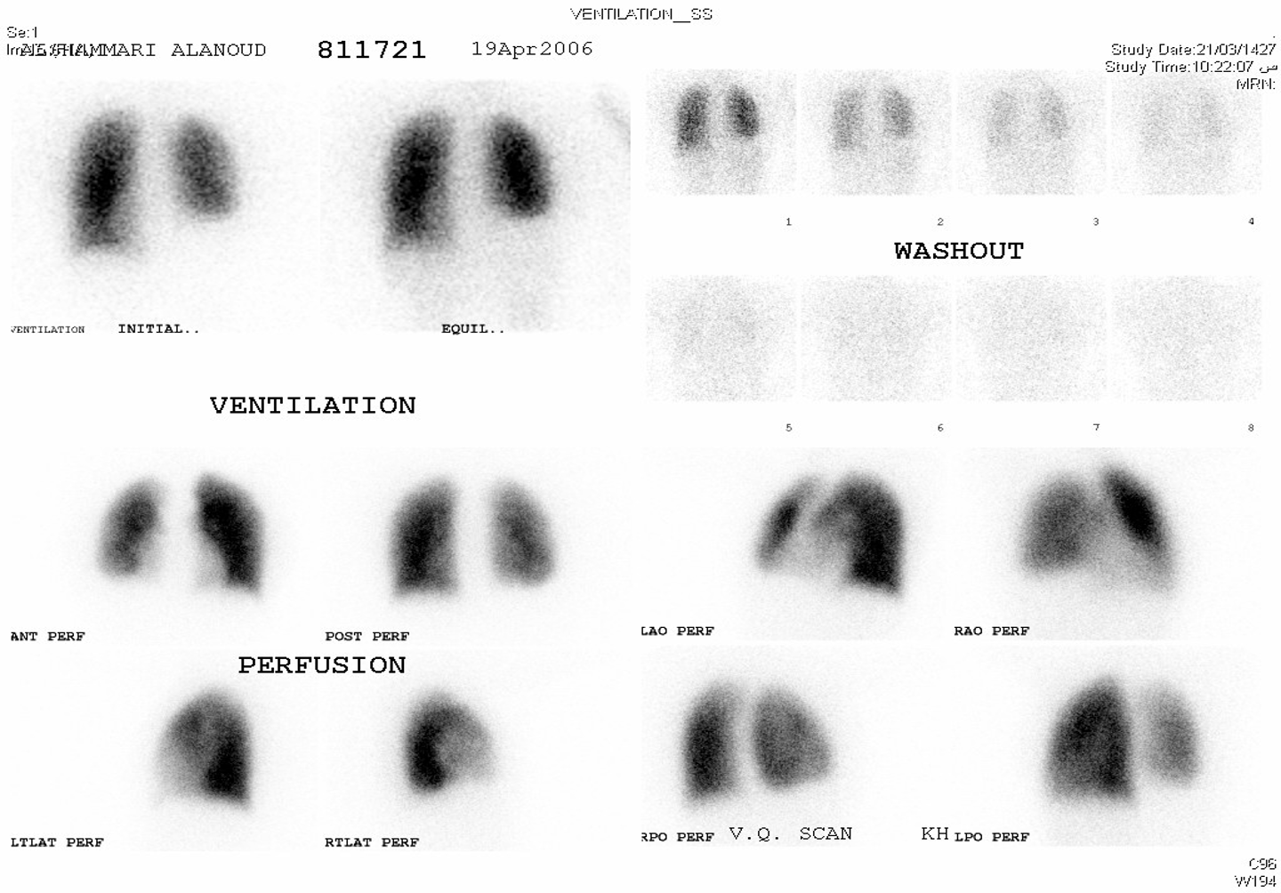
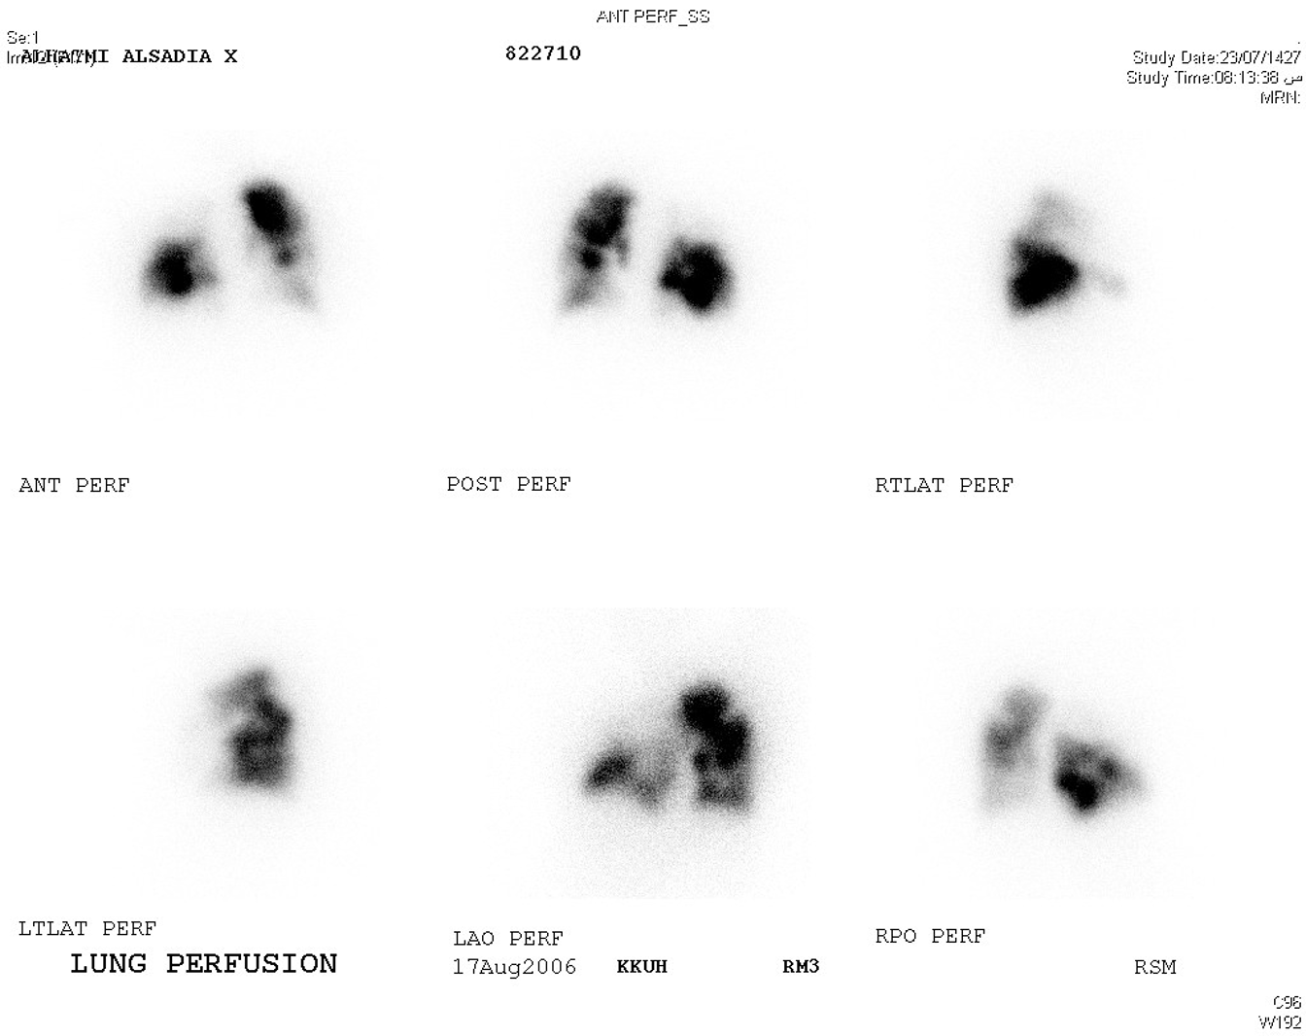
Scintigraphic imaging
6. Scintigraphic imaging
Widely used for detecting pulmonary emboli although it is now performed less often owing to widespread use of D-dimer measurements and CT pulmonary angiography
Lung Scans V/Q (Ventilation/Perfusion)¹:
Ventilation | Perfusion
Radioactive tracer gas inhaled to lungs → picture here shows areas of lung that are not receiving enough air or retain too much air. | Radioactive substance injected into the vein→ to lungs → shows areas in lung which are not receiving enough blood.
Normal perfusion:
When injected via peripheral venous site, the first capillaries encountered are the pulmonary capillaries. if perfusion is present at the capillary level of the lungs, nuclear medicine perfusion image would demonstrates “activity in the periphery of the lungs”
perfusion defect:
If there is an obstructing vascular lesion in the pulmonary arterial circulation → blocked perfusion to the distal capillary level → nuclear medicine perfusion image would demonstrate “no activity in the periphery of the lungs” (will appear as gray areas)
To assess perfusion:
Technetium (Tc) 99m radionuclide is tagged to macroaggregated albumin to make small radioactive particles.
is injected intravenously → they impact in pulmonary capillaries, where they remain for a few hours. → When Tc decays→ it emits a gamma ray detected by the nuclear medicine gamma camera → a nuclear medicine image is formed by detection of many gamma rays.
The resultant pattern indicates the distribution of pulmonary blood flow; cold areas occur where there is defective blood flow (e.g. in pulmonary emboli).
There’s multiple segmental perfusion defects, highly suggestive of PE
Normal
1-It is used when patient is allergic to contrast although it only gives a probability.
2-V/Q scan isn’t used to diagnose pulmonary embolism (it supports the diagnosis). The modality of choice to diagnose pulmonary embolism is CT angiography.

Slide 15
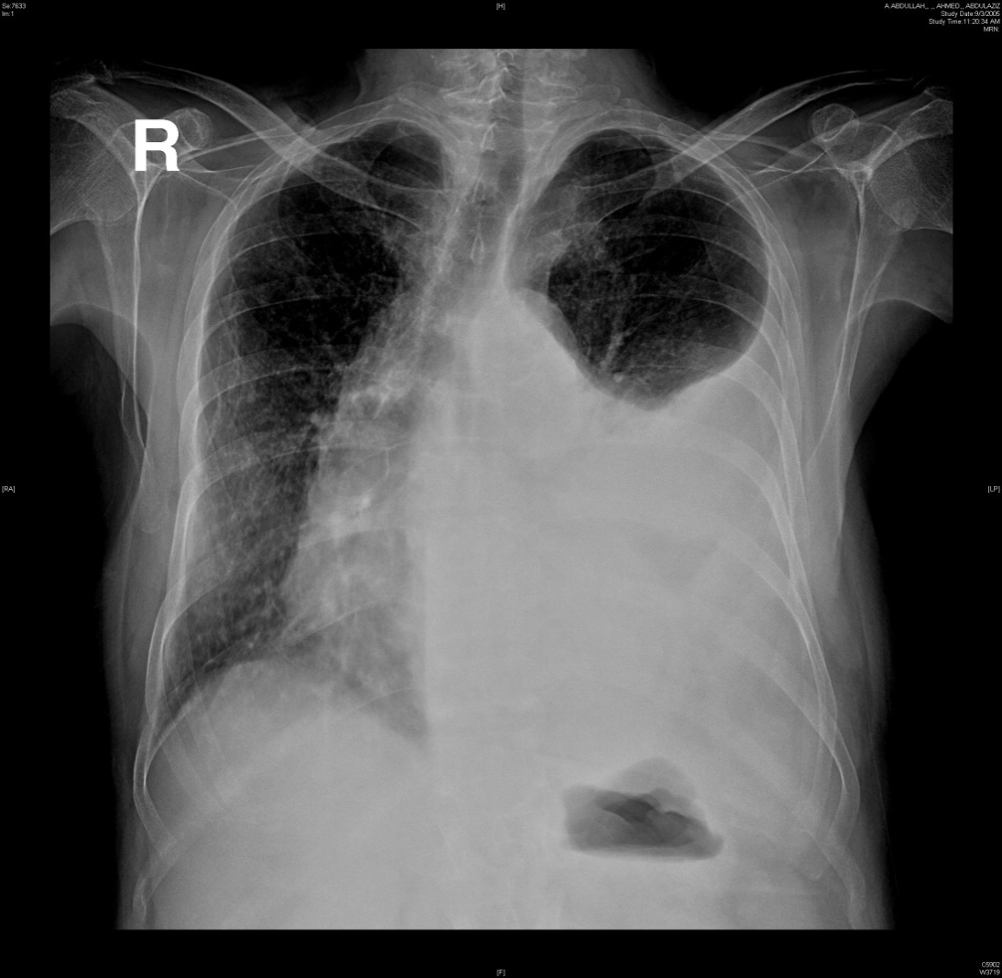
Dr. notes
Clinical cases (From Doctor)
Case study 1:
A 30 y/o gentleman presented to the ER complaining of SOB and fever for 1 week . No previous medical history of similar illness. On clinical examination the patient is diaphoretic, RR=28, T=38.9, BP= 90/60, O2=84%, on percussion there’s stony dullness, absent breath sound and bronchial breath sounds are heard on the affected side. On the front examination, the trachea is shifted to the opposite side.
X-Ray:
Right Lung: Normal
Left lung: White opacity and black like ball in the upper zone (representing the remnant of normal lung)
Q1: What’s the most likely diagnosis?
Diaphoretic + Fever + Consolidation of left middle and lower lung lobes → Pneumonia
Stony dullness + absent breath sounds + Trachea is pushed to the opposite side → Pleural effusion
So, the patient has Parapneumonic effusion
Q2: How would you manage such patient?
1st: ABC (to stabilize the patient because he’s is unstable (low O2 and BP))
2nd (For the O2): 10 liter face-masked Oxygen; it’s ok to give him 100% O2 because he’s young and healthy (If old or has COPD you might kill him)
3rd (For the hypotension): Establish IV access and give normal saline as a bolus
After that the patient became stable. What should you next?
1st: Do CBC (Why? To check platelet count. If platelet count was 10000 (Low), will you do thoracentesis? NO, it will cause bleeding and make things worse)
2nd: LFT, RFT and Coagulation studies
3rd: Do Ultrasound (Confirmatory test and modality of choice, to MAKE SURE THAT THE PATIENT HAS PLEURAL EFFUSION BEFORE GOING FOR THORACENTESIS)
What if you don’t have an ultrasound? Do decubitus film (If the patient has a pleural effusion in the right side then ask for a right decubitus film, to see the fluid layering: if it’s more than 1cm depth from the outside layer then you can go for thoracentesis but If there were no layering it means that the fluid has been there for a long time and it loculated (formed fibrinous strands) and in this case it’s really dangerous to do thoracentesis (this may cause pneumothorax).
Ok, so let’s say that patient is suitable for thoracentesis:
Once you insert the needle, the first thing you see is the appearance (based on the appearance you intervene immediately, don’t wait for culture and other stuff e.g. if the you see pus (this indicates empyema), now this is not just the simple parapneumonic effusion it’s complicated and you need to intervene immediately with a LARGE BORE CHEST TUBE. If the you don’t see pus then do gram stain (you can do it within 3min in the emergency department) if gram stain is positive this also indicates a complicated parapneumonic effusion and requires immediate CHEST TUBE. (After all this you can send the sample for culture, pH, chemistry (Glucose, amylase, LDH, protein and check if it’s transudate or exudate) and cytology.

Slide 16
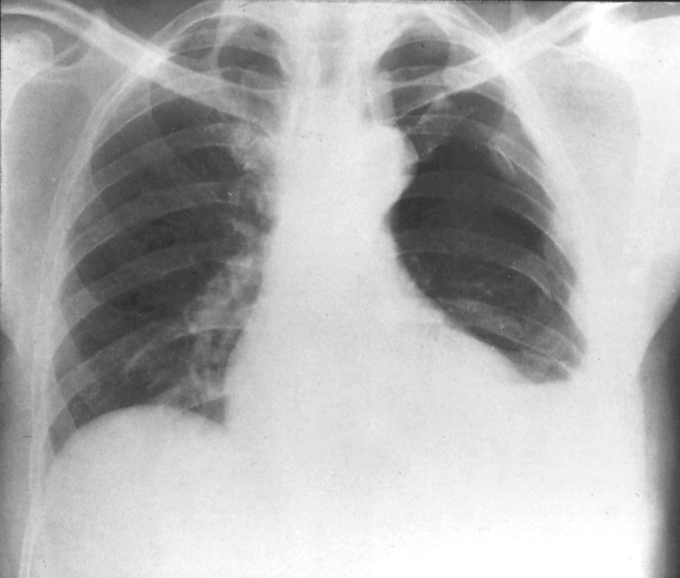
Dr. notes
Clinical cases (From Doctor)
Case study 2:
45y/o gentleman presented to the ER with a main complaint of SOB over the past 6 months, fever and weight loss (~10kg) over the past 3 months, patient reported that he was in prison 9 months ago (before his illness). On clinical examination his vital signs were stable, Trachea is central. Lung examination reveals stony dullness and absent breath sounds in the affected side.
Q1: Is this presentation acute or chronic?
Chronic (while in previous case it’s acute)
Q2: What’s the most likely diagnosis?
Could be TB (since he was in prison) or malignancy.
He has stony dullness which indicated pleural effusion (but less severe than the previous case)
Q3: How is this case different from the previous case?
The difference here is that you suspect TB and malignancy. So, thoracentesis by itself isn’t enough!! You HAVE to do pleural biopsy (the main diagnostic test in this case)
Q4: How would you manage such patient?
1st: ABC always begin with it (even though he’s stable)
2nd: Establish IV access
3rd: CBC , RFT, LFT, Coagulation studies, blood culture
4th: Confirm pleural effusion by ultrasound or decubitus film
5th: Go for thoracentesis and pleural biopsy
Case study 3:
A 30 y/o gentleman with no prior history of medical illness, presented with sudden onset of SOB and minimal cough.he reported that he was playing with metal in his mouth before starting to have SOB and he denied any history of fever. On clinical examination, RR=24, O2=84%, BP=95/40, T=37. Lung examination reveals tracheal shift to the affected side, dullness to percussion with absent breath sounds.
Q1: What’s the most likely diagnosis?
Obstruction with lung collapse.
Q2: Can we do thoracocentesis in this case?
NO, the patient will develop pneumothorax bc the blockage in INSIDE the lumen of the left main stem bronchus.
Q3: How would you manage such patient?
1st: ABC
2nd: Establish IV access and give oxygen
3rd: CBC , RFT, LFT, Coagulation studies
4th: Bronchoscopy (No need for confirmation to do bronchoscopy, it’s a waste of time)

Slide 17
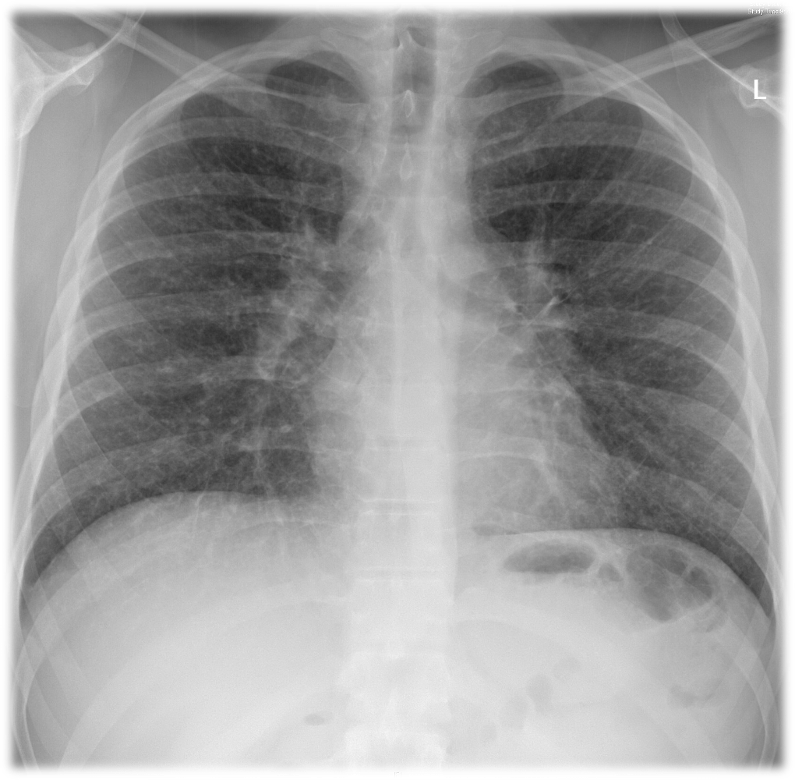
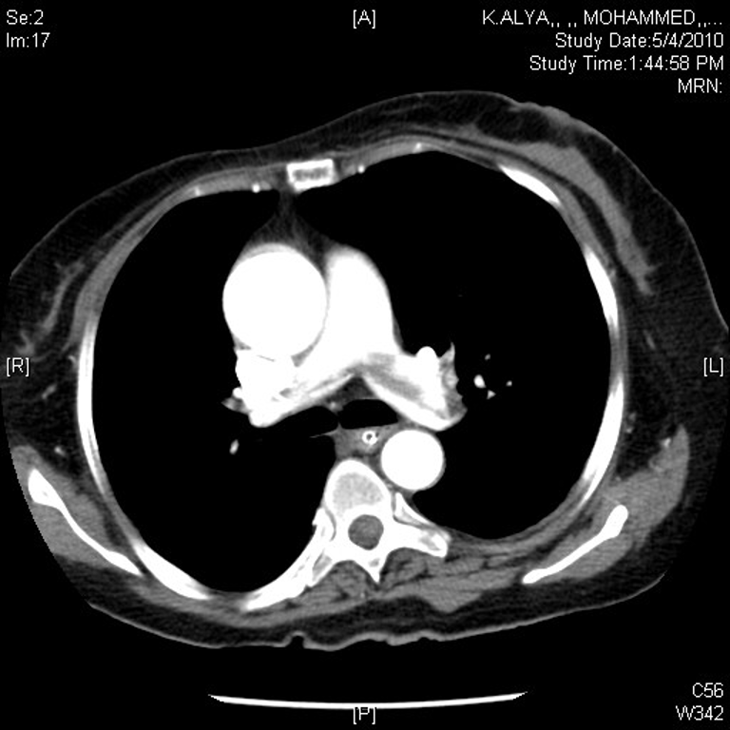
Clinical cases (From Doctor)
Case study 4:
50 yr old male with SOB and cough >3yrs.
Exam: clubbing and bilateral inspiratory crackles
CXR: reticulation bilateral
ABG: hypoxic respiratory failure
PFT: restrictive defect with significant impairment in DLco.
Q1: Is this acute or chronic? Chronic
Q2: What diseases give you crackles? Abnormality in the bronchiole (e.g. Bronchiectasis) or abnormality in the interstitium (e.g. Pulmonary fibrosis)
Q3: What diseases cause reticulation bilaterally? interstitial lung disease (e.g. Pulmonary fibrosis)
Q4: What diseases cause hypoxic respiratory failure? Any chronic lung disease
Q5: What does the PFT here indicate? pulmonary fibrosis
Q6: How to confirm Pulmonary fibrosis? High resolution CT-scan (HRCT)
Case study 5:
A 45 years old female with Right sided chest pain for 1 day (acute).
on Investigation:
ABG : pH 7.32, PaCO2 28¹, PaO2 50¹, O2sat 88%¹
ECG : sinus tachycardia.
CXR : normal
Spiral CT
V/Q Scan
Q1: What’s your interpretation of the ABG?
She’s hypocapnic and has hypoxic respiratory failure
Q2: What’s the most likely diagnosis?
Pulmonary embolism (PE)
Q3: What’s the best diagnostic method for PE?
CT-angiography: red arrows are pointing at multiple filling defects both at the bifurcation of pulmonary trunk “hypodense” ("saddle" pulmonary embolism).
Q4: If the patient was allergic to contrast or Pregnant; what’s the modality of choice?
V/Q scan

Slide 18
Thoracentesis (removing fluid from the space between pleura and the wall of the chest.) | Bronchoscopy (Visualization of the central airways down to subsegmental level)
What to look for in thoracentesis ? - Appearance (color) - Gram stain, and cultures: - pH - Chemistry: (glucose, amylase, LDH5 , protein) - Cytology light’s criteria: - pleural protein/serum protein ratio (Transudate is <0.5), (Exudates is >0.5) - Effusion LDH/serum LDH ratio (Transudate is <0.6), (Exudate is >0.6) - Effusion LDH level greater than two-thirds the upper limit of the laboratory's reference range of serum LDH Note: - NEVER do thoracentesis for a patient with collapsed lungs → you will cause pneumothorax on top of collapse. Instead, do bronchoscopy. - If the fluid’s appearance is Pus OR Gram stain is positive OR pH is below 7.2 → Chest tube immediately | Diagnostic indications: - Suspected lung cancer + Staging of lung cancer. - Abnormal CXR. (collapsed lobes or segments) - Hemoptysis. - Refractory or Unexplained cough. - Localized wheeze or Stridor. - Positive sputum cytology. - Mediastinal lymph nodes. - Unexplained pleural effusion. - Lung abscess. - Obtain culture material - Airway trauma. - Tracheoesophageal fistula - Diffuse lung disease Therapeutic indications: - Remove foreign bodies. - Remove abnormal endobronchial tissue. - Difficult endotracheal tube intubation. - Endobronchial stent placement
Pleural Biopsy
When is a pleural biopsy indicated? - Granulomatous disease. Ex(TB) - Malignancy Note: if dealing with TB or Malignancy order Thoracentesis + Pleural biopsy

Slide 19
 | Pulmonary Function Test (PFT)
 | What it used for | Measuring What?
Spirometry | - Can diagnose obstructive lung disease - Can suggest restrictive lung disease but can’t diagnose. | - FEV1 (L) - FVC (L)
Lung Volume | - Can diagnose restrictive lung disease. - Can diagnose air trapping. - suggest obstructive | - Total lung capacity (TLC) - Residual Volume (RV): - Vital capacity (VC) - If TLC, VC, RV < 90% → restrictive.
Diffusion Capacity (DLCO) | - Measures the ability of gases to diffuse from the alveoli into the pulmonary capillary blood. | Transfer factor (DLco): - Decreased DLco reflects loss or damage to the gas exchanging surface of the lung. - Emphysema - Interstitial lung diseases - Pulmonary vascular disease.
Respiratory muscle strength | - Diagnosing diseases that affect the muscle in the respiratory system; - Motor neuron disease, Guillain-Barré Syndrome. | PImax, PEmax: - PI→ reflect inspiratory muscles as the diaphragm. - PE → expiratory muscles as abdominal muscles.
CT Imaging (HRCT, CT with contrast, CT Angiography), for PTs suspected to have interstitial disease
HRCT (high resolution CT scan): | CT Angiography
- Designed for detailed evaluation of interstitial structures of the lung -Principal indications: ● Suspected interstitial lung disease ● Characterization of interstitial lung disease ● Characterization of solitary pulmonary nodules ● Diagnosis of bronchiectasis | Advantages: - Critically ill patients - Children - Less volume of intravenous contrast - Permits greater processing of the raw data Contraindications: - Renal failure - Allergy to contrast - Pregnancy If the filling defect is present we diagnose the patient with Pulmonary Embolism.

Slide 20
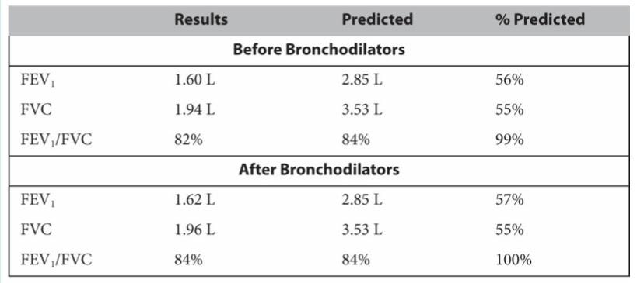
Q1: In which of the following patients CT Angiography must be avoided?
A. a critically ill patient
B. a pediatric patient
C. a renal failure patient
D. a patient of suspected pulmonary embolism
Q2: A 61-year-old male former smoker (40 pack-years) complains of dyspnea and cough. Pulmonary function testing shows normal spirometry and lung
volumes; there is an isolated reduction in diffusing capacity (Dlco). The most useful next test is
A. Echocardiography
B. Right-sided heart catheterization
C. High-resolution computed tomography of the chest
D. Maximal respiratory pressures
E. Bronchoalveolar lavage for hemosiderin-laden macrophages
Q3: Which of the following procedures can be used to remove foreign bodies?
A. HRCT
B. Bronchoscopy
C. Thoracentesis
D. Chest tube
Q4: You are discussing a patient with your registrar who has become acutely short of breath on the ward. After performing an arterial blood gas, you have high clinical suspicion that the patient has a pulmonary embolism. Which of the following is the investigation of choice for detecting pulmonary embolism?
A. High-resolution CT chest (HRCT)
B. Chest x-ray
C. Ventilation/perfusion scan (V/Q scan)
D. CT pulmonary angiogram (CT-Pa)
Q5: You are asked to request imaging for a patient with a suspected pneumothorax who you have just examined in accident and emergency. Which of the following would be the most appropriate first step imaging modality?
A. CT-chest
B. Ultrasound chest
C. Chest x-ray
D. V/Q scan
E. CT - Pa
Q6: A 45-year-old woman with rheumatoid arthritis is seen for dyspnea on exertion that has occurred over the past 3 to 4 months. She has not noticed cough or fever and has had no associated orthopnea, paroxysmal dyspnea, edema, or chest pain. She has hypertension. Regular medications include lisinopril and methotrexate. She has smoked a package of cigarettes daily since age 20. Results of pulmonary function tests (PFTs) are shown in the table.
What is the correct interpretation of her PFTs?
A. Obstructive lung disease, not responsive to bronchodilators
B. Obstructive lung disease, responsive to bronchodilators
C. Restrictive lung disease
D. Mixed obstructive and restrictive lung disease
E. Small airways disease
Answers: Q1:C | Q2:C | Q3:B | Q4:D | Q5:C | Q6:C
Answers Explanation File!

Slide 21
THANKS!!
This lecture was done by:
Renad Alkanaan
Amirah Alzahrani
Quiz and summary maker:
Wejdan Alshamri
Note taker:
Leen AlMazroa
Abdulaziz AlGhamdi
Special Thanks to our amazing academic leader
Noura Alturki and may babaeer !
Females co-leaders:
Raghad AlKhashan
Amirah Aldakhilallah
Males co-leaders:
Mashal AbaAlkhail
Ibrahim AlAsous
Send us your feedback:
We are all ears!

