Slide 1
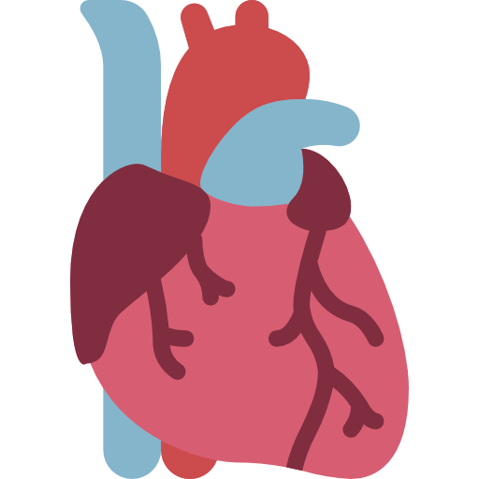
Lecture 2
Editing file
Arrhythmias
Objectives:
Epidemiology and Mechanisms of AF
Evaluation of AF patients
Classification of AF
Treatment and Risk stratification of AF
Identify other forms of Arrhythmia
Color index:
Color index:
Original text Females slides Males slides
Doctor’s notes Text book Important Golden notes Extra

Slide 2
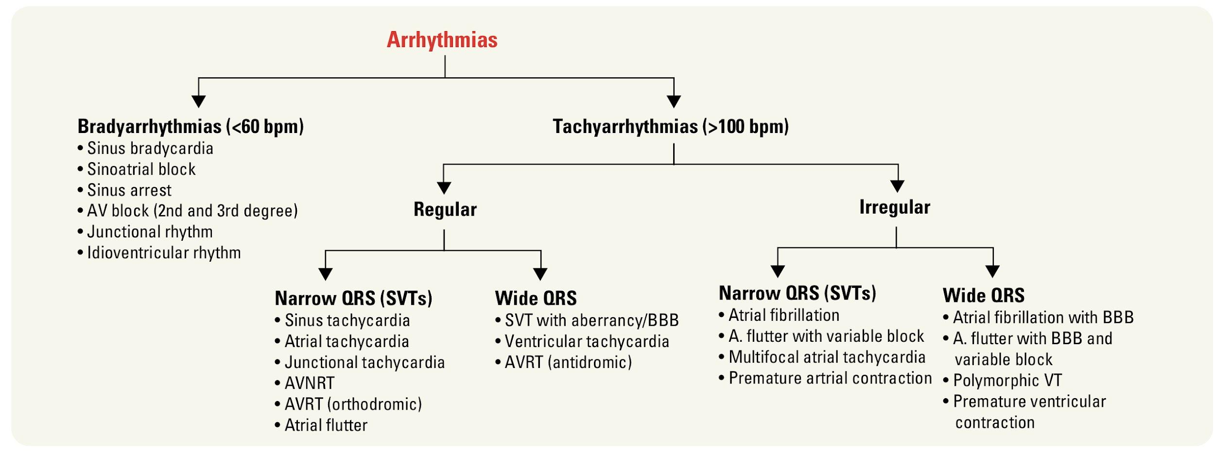
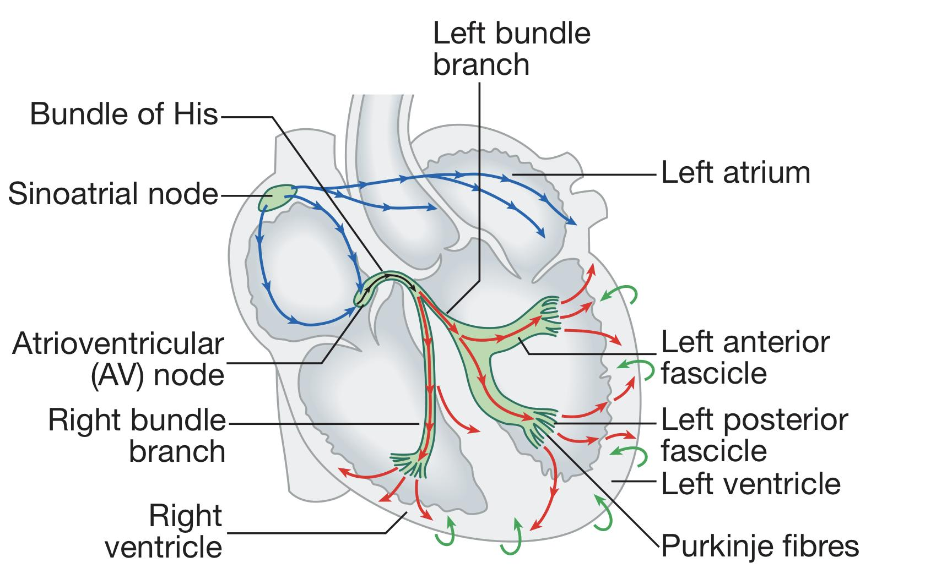
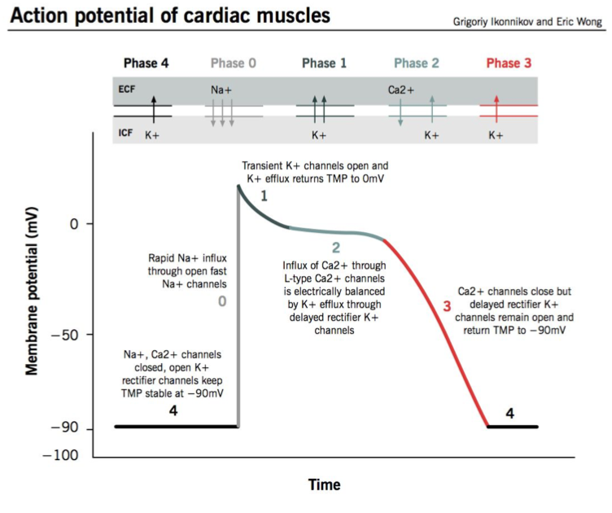
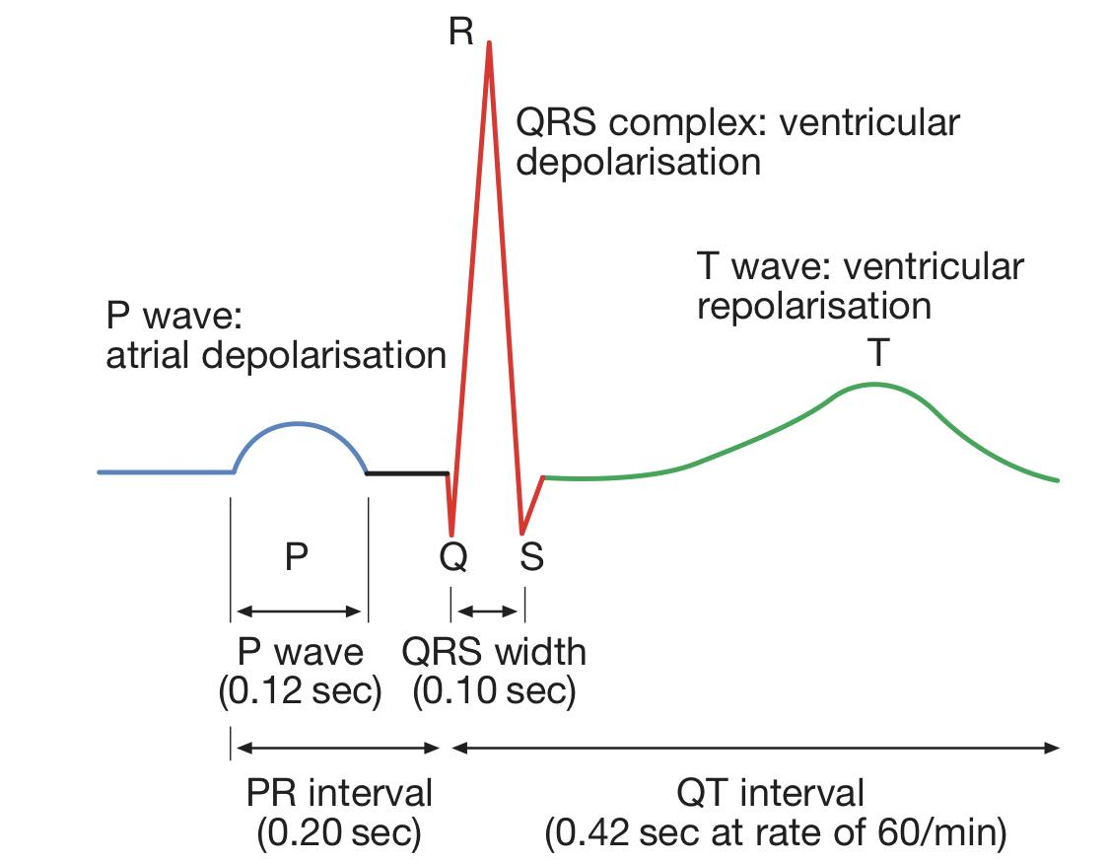
EXTRA
Review of basics
Normal cardiac rhythm (Sinus rhythm)
Characteristics of normal cardiac rhythm:
Heart rate (60-100 bpm)
Abnormal: Check table
Origin of impulses should be from S.A node (sinus node)
Abnormal: Any place other than sinus node e.g.
Supraventricular arrhythmias:¹ AV node (Nodal/junctional arrhythmias), Atrium it self (Atrial arrhythmias)
Ventricular arrhythmias
Cardiac impulse should propagate through normal conduction pathway*
Normal velocity
> 350 bpm | Fibrillation
250-350 bpm | Flutter
150-250 bpm | Paroxysmal tachycardia
100-150 bpm | Simple Tachycardia
60-100 bpm | Sinus rhythm
< 60 bpm | Bradycardia
* What’s the normal conduction pathway?
Depolarisation starts in the sinoatrial node and spreads through the atria (blue arrows), and then through the atrioventricular node (black arrows). Depolarisation then spreads through the bundle of His and the bundle branches and purkinje fibres to reach the ventricular muscle (red arrows). Repolarisation spreads from epicardium to endocardium (green arrows).
Action potential of cardiac muscles
Phase 0: Depolarization occurs through fast Na+ channels.
Phase 1: Na+ channels close and K+ starts leaving the cell, causing slight repolarization.
Phase 2: or better known as the “plateau phase”, Ca+2 gets in the cell and K+ leaves the cell
Phase 3: K+ leaves the cell → restores resting membrane potential RMP
Phase 4: maintained by Na+/K+ ATPase channel
ECG basics
P wave: Atrial depolarisation
QRS complex: ventricular myocardial depolarisation.
T wave: For ventricular repolarization, while Atrial repolarization does not cause a detectable signal
PR interval: it largely reflects the duration of AV nodal conduction.
QT interval: represents the total duration of ventricular depolarisation and repolarisation.
RR interval: Time between beats - is used to calculate heart rate
1- Sinus arrhythmias are also considered supraventricular arrhythmias, but it differs from the other two in that it’s origin is from S.A node.

Slide 3
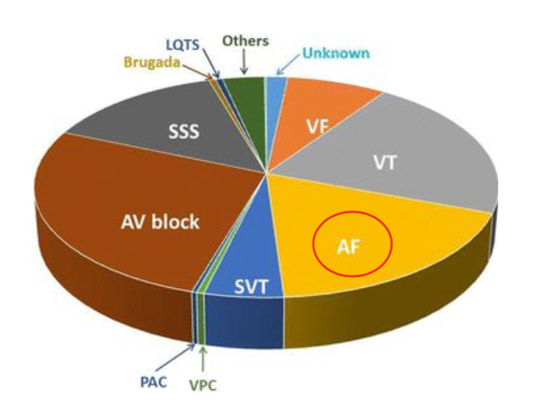
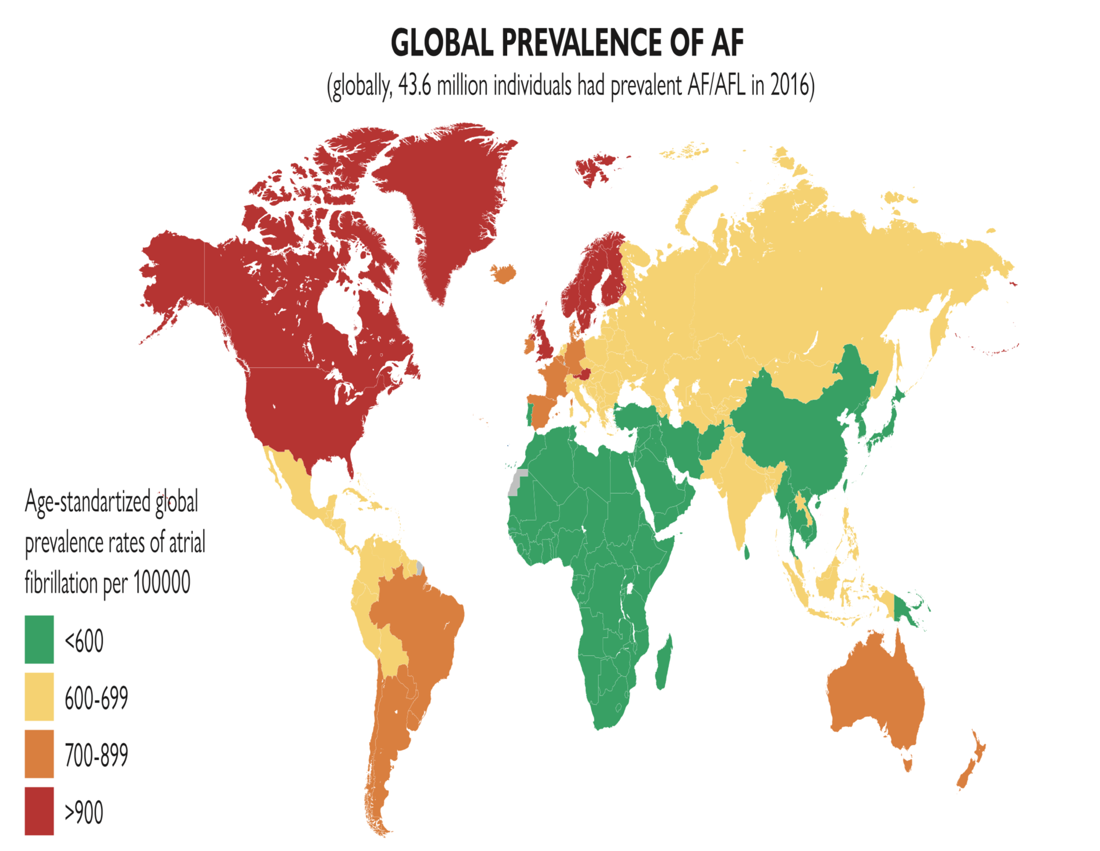
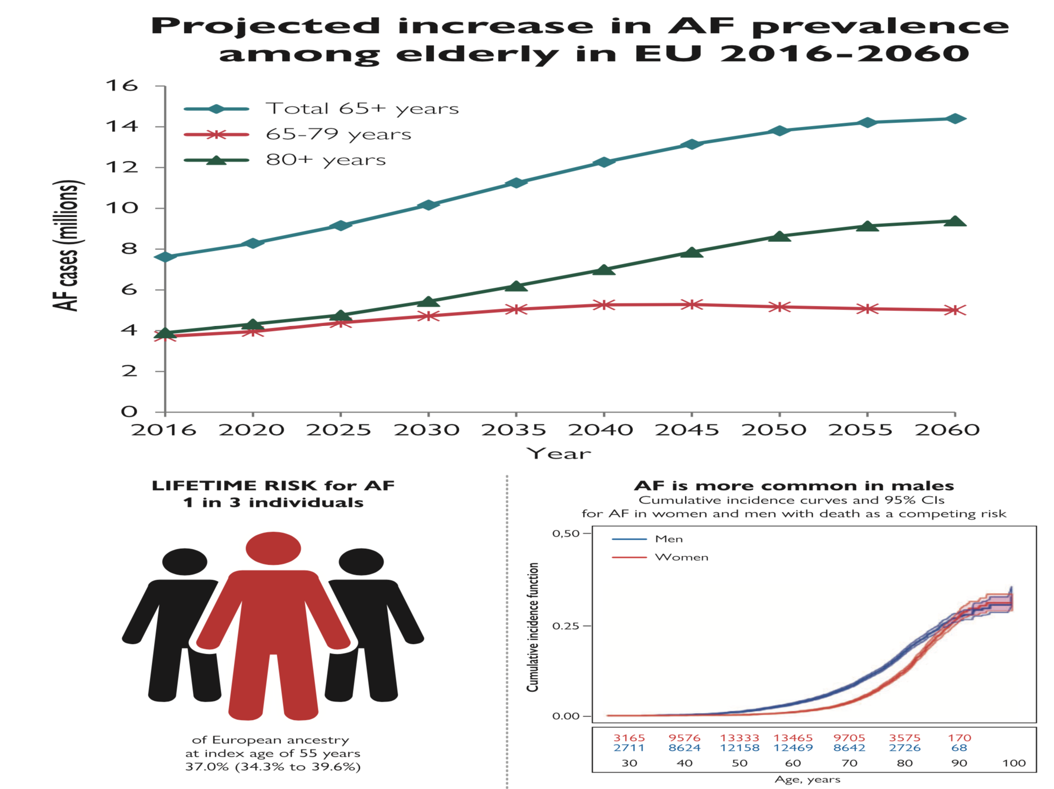
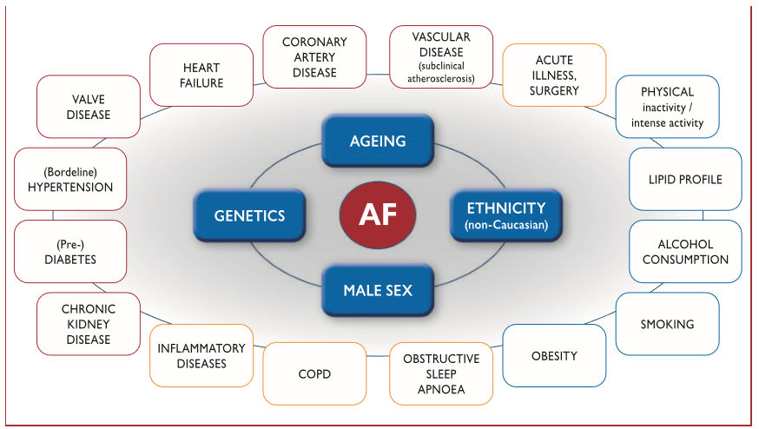
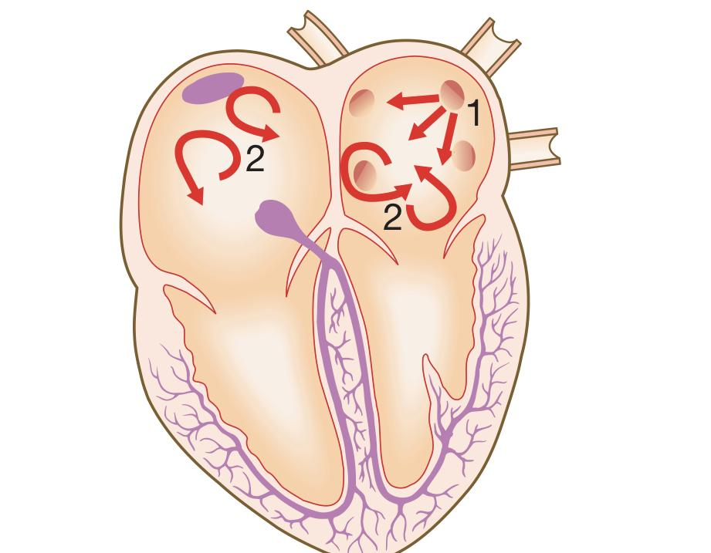
Introduction to AF
General info
AF is the most common overall (30-40%) followed by Ventricular tachycardia (VT) then AV block then Ventricular fibrillation (VF) then Sick sinus syndrome (SSS) then Supraventricular tachycardia (SVT)
Other less common arrhythmias: ventricular premature contraction (VPC), Premature atrial contraction (PAC), Long QTs syndrome (LQTS)¹ and Brugada syndrome²
Atrial fibrillation (AF) is the most common sustained cardiac arrhythmia, with prevalence rising with age (>55y/o). It’s also more common in males.
It is associated with significant morbidity and a two-fold increase in mortality.
AF is associated with a five-fold increased risk of stroke, primarily as a result of embolism of a thrombus that has formed in the atrium
Men have higher incidence in all age strata
Saudi Arabia is in the green zone due to the young population
Pathogenesis
AF is a complex arrhythmia characterised by both abnormal automatic firing and the presence of multiple interacting re-entry microcircuits looping around the atria, most often located within pulmonary veins.
During episodes of AF, the atria beat rapidly but in an uncoordinated, chaotic and ineffective manner → ↓ Cardiac Output
The AV node conducts a proportion of the atrial impulses to produce an irregular ventricular response, giving rise to an irregularly irregular pulse.
Loss of atrial contraction and left atrial dilatation cause stasis of blood in the LA and may lead to thrombus formation in the left atrial appendage. This predisposes patients to stroke and other forms of systemic embolism.
Causes of AF
3 PARTIES
Cardiac causes | Non-cardiac causes
Most common causes: Hypertensive heart disease & Heart failure Ischemic heart disease Valvular heart disease: Rheumatic (major cause in KSA): mitral stenosis Non-rheumatic: aortic stenosis, mitral regurgitation Pericarditis Cardiac tumors: Atrial myxoma Sick sinus syndrome³ (Tachy-Brady syndrome) Cardiomyopathy: Hypertrophic Idiopathic dilated (? cause vs. effect) Post-coronary bypass surgery: 50% post cardiac patients develop AF | Pulmonary: COPD Pneumonia Pulmonary embolism Metabolic: Thyroid disease: hyperthyroidism Electrolyte disorder Toxic: Alcohol “Ethanol” (‘holiday heart’ syndrome)
1- A congenital disorder characterized by a prolongation of the QT interval on ECG and a propensity to ventricular tachyarrhythmias, which may lead to syncope, cardiac arrest or sudden death.
2- A genetically inherited disorder that causes a repolarization abnormality in cardiac myocytes that can lead to sudden cardiac death, especially in athletes and young people. It is characterized by ECG findings including the presence of a "pseudo-right bundle branch block" and persisting ST elevations in V1–V2.
3- Due to wear and tear process in SA node. Sick sinus syndrome (SSS) refers to the dysfunction of the sinoatrial node and is responsible for several types of arrhythmia. It comprises bradyarrhythmias (e.g., sinus bradycardia, sinoatrial pauses, blocks, and arrest), and may alternate with supraventricular tachyarrhythmias, in which case it is referred to as tachycardia-bradycardia syndrome.

Slide 4
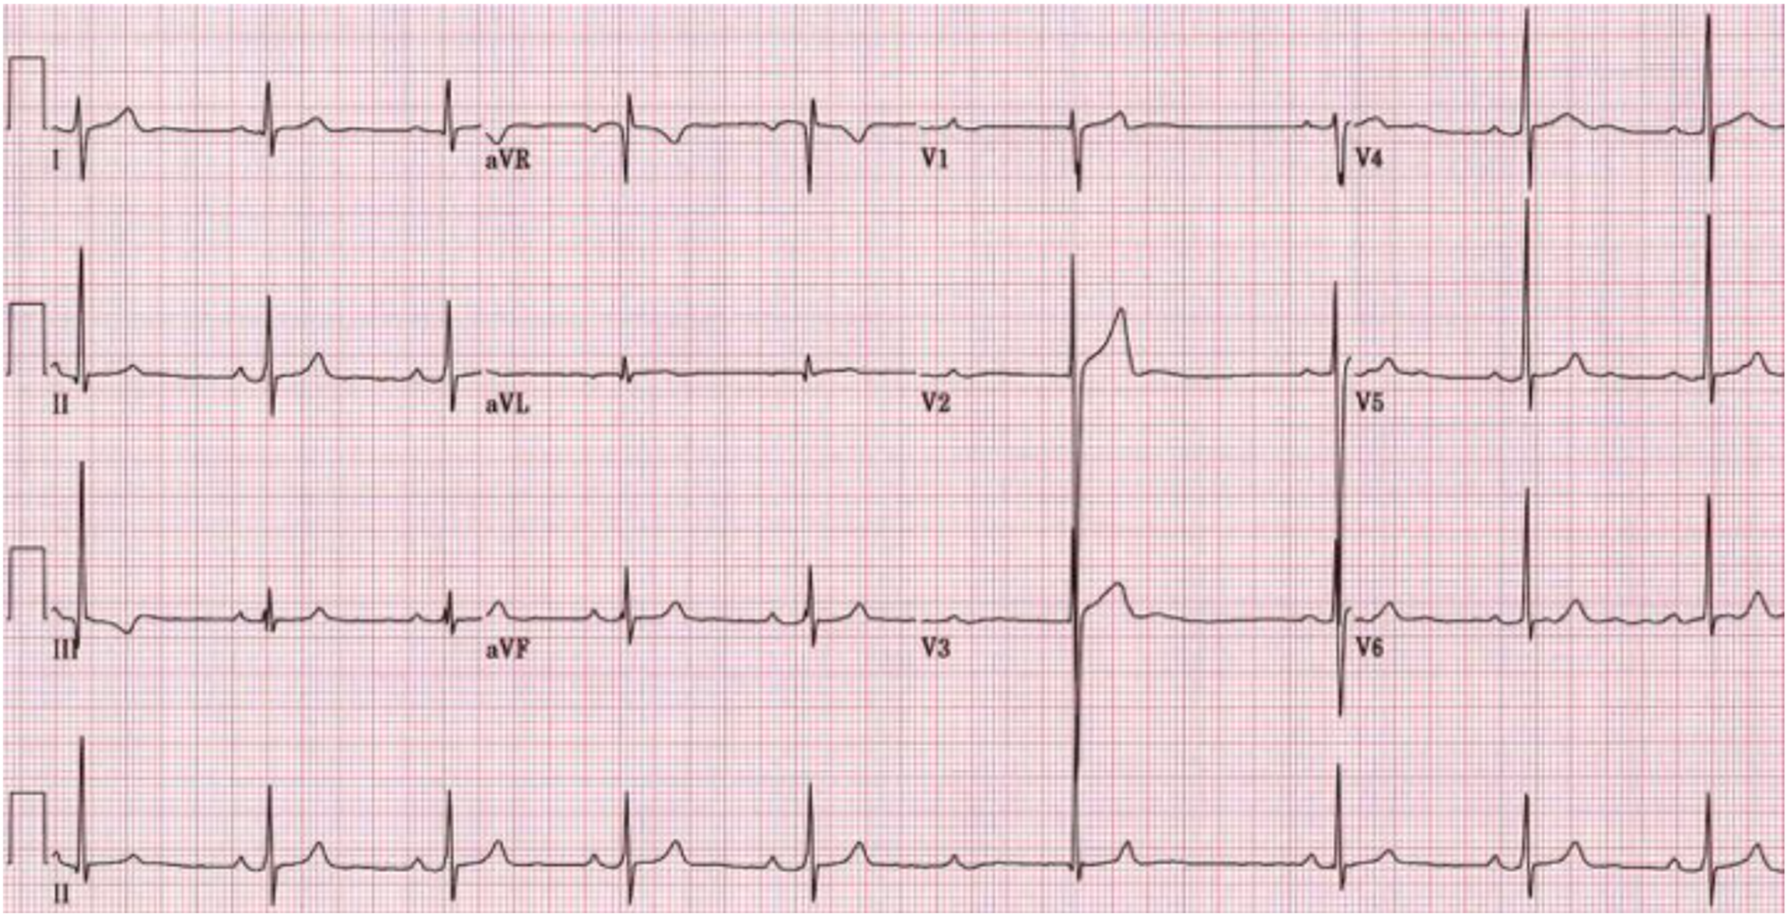
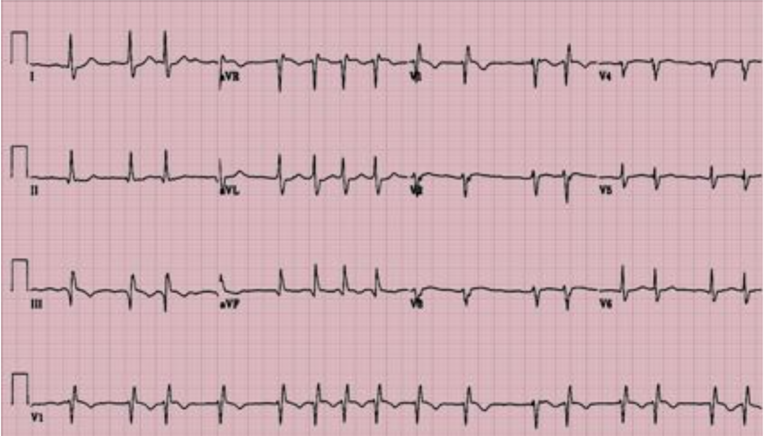
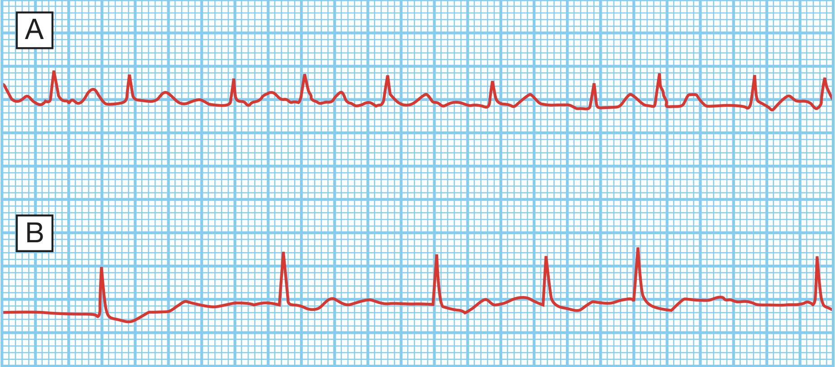
Atrial fibrillation (AF) ECG
Heart rhythm in AF
Normal heart rhythm is disrupted in AF
Rapid (350–600 beats/min)¹ and irregular atrial rhythm.
Reduced filling of the left and right ventricles.
Conduction of most impulses from the atria to ventricles is blocked at the AV node
Contraction of the ventricles can be:
Fast AF: Irregular and rapid (110–180 beats/min; tachycardia), Doesn’t exceed 180bpm because of AV node delay.
Slow AF: Irregular and slow (<50 beats/min; bradycardia) seen in elderly (>70y/o)²
Controlled AF: Normal
Cardiac output can be reduced
(If AV node fails to block the impulses from atria)
ECG changes in AF
Normal ECG | AF ECG
Normal heart rate (60-100 bpm) Regular rhythm Normal P Waves and QRS complexes Steady baseline | Absent P waves (Because atria doesn’t contract) , only a fine oscillation of the baseline (so-called fibrillation or f waves) Fast and irregular ventricular response (QRS complex) → irregular RR intervals (irregularly irregular rhythm)³ Increased heart rate (Tachyarrhythmias) Irregular baseline
There is usually a fast ventricular rate, between 120 and 160/min, at the onset of atrial fibrillation.
In chronic atrial fibrillation, the ventricular rate may be much slower, due to the effects of medications and AV nodal fatigue
1- Will the AV node deliver all these beats? No, there’s AV node delay. It has a feature called decremental conduction, which will automatically block its conduction once it senses it is over conducting to give the ventricles time to fill. Recall CO= SV x HR, If HR is very high the ventricles will not have time to fill → Decrease in preload → Decrease SV → Decreased CO.
2- Because of AV node degeneration (wear and tear), the AV node ما فيها حيل to conduct
3- There are 2 types of irregularity:
Regularly irregular: Cyclic irregularity which means it’s predictable and has a pattern → Atrial flutter
Irregularly irregular: Not predictable and has no pattern → Atrial fibrillation

Slide 5
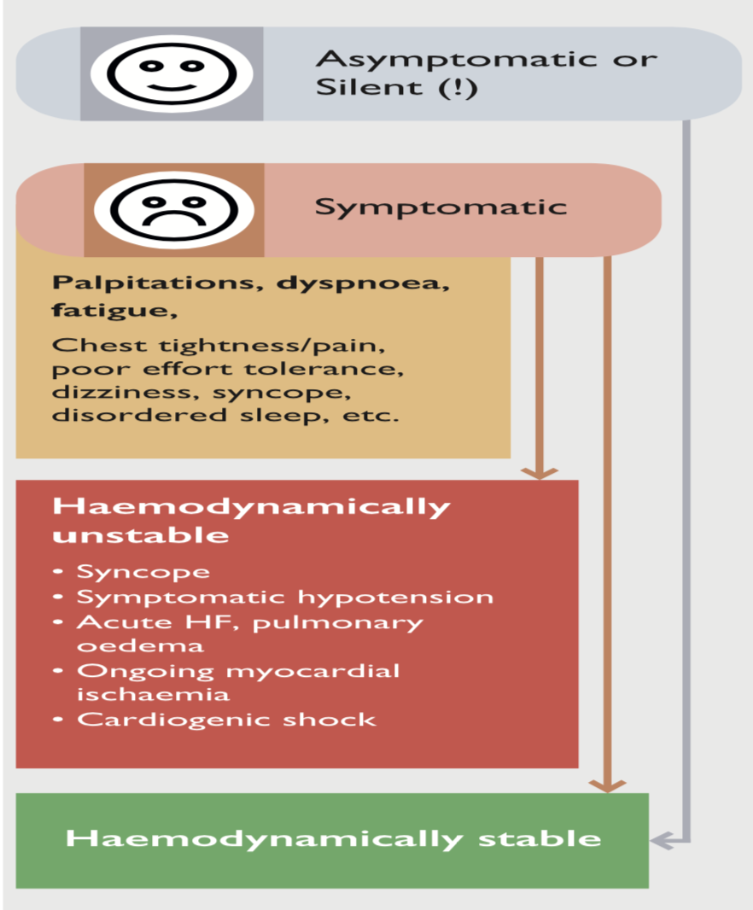
AF Clinical presentation
AF Begets (Generates) AF:
AF gives rise to AF, how?.
By causing remodeling
Electrophysiological changes occur in the atria within a few hours of the onset of AF, that tend to maintain fibrillation.
When AF persists for a period of months, structural remodeling occurs with atrial fibrosis and dilation that further predispose to AF
Electrical remodeling
Structural remodeling
Over time AF tends to become persistent or permanent. However, Many episodes of AF resolve spontaneously.
Signs & Symptoms
The typical presentation is with palpitation, breathlessness and fatigue.
It’s usually episodic with symptoms being absent or intermittent
Up to 90% of episodes may not cause symptoms
Symptoms vary according to: Irregularity and rate of ventricular response, Functional status, AF duration, Patient factors, Comorbidities.
Patient may present with or without detectable heart diseases.
Cause | Sign / Symptom
Irregular heart beat | Irregularly irregular pulse Palpitations
Cardiac ischemia | Chest pain (Angina)
Hypotension | Dizziness and fainting (syncope)
Increased risk of clot formation | Thromboembolic TIA → Stroke Could be the first presentation!
Decreased Cardiac output | Fatigue Diminished exercise capacity Breathlessness (dyspnoea) Weakness (asthenia)

Slide 6
AF Classification
Signs & Symptoms cont’
European Heart Rhythm Association (EHRA) Score:
Score | Symptoms | Description
1 | None | AF does not cause an symptoms
2a | mild | Normal daily activity not affected by symptoms related to AF
2b | Moderate | Normal daily activity not affected by symptoms related to AF, but patient troubled by symptoms
3 | Severe | Normal daily activity affected by symptoms related to AF
4 | Disabling | Normal daily activity discontinued
Classification of AF
Class | Definition
Paroxysmal AF | AF that terminates spontaneously or with intervention within 7 d of onset. Episodes may recur with variable frequency.
Persistent AF | Continuous AF that is sustained > 7 d but less than 12 months.
Long-standing persistent AF | Continuous AF >12 months in duration.
Permanent AF | The term “permanent AF” is used when the patient and clinician make a joint decision to stop further attempts to restore and/or maintain sinus rhythm. Acceptance of AF represents a therapeutic attitude on the part of the patient and clinician rather than an inherent pathophysiological attribute of AF. Acceptance of AF may change as symptoms, efficacy of therapeutic interventions, and patient and clinician preferences evolve
Lone or primary | Presence of paroxysmal, persistent or permanent atrial fibrillation with no evidence of cardiopulmonary or structural heart disease. Patients with lone AF are usually <60 and have less risk for thromboembolism.
Non Valvular AF | AF in the absence of rheumatic mitral stenosis, a mechanical or bioprosthetic heart valve, or mitral valve repair. No longer used

Slide 7
AF diagnosis
History and physical examination
01
Clinical conditions associated with AF
Underlying heart conditions (e.g. valvular heart disease, heart failure, coronary artery disease, hypertension)
Other reversible conditions
Ask about possible causes (Discussed earlier)
02
Family history
Familial AF (lone AF in a family)
AF secondary to other genetic conditions (familial cardiomyopathies)
Type of AF
First episode, paroxysmal, persistent, permanent
Triggers – e.g. emotional stress, alcohol, physical exercise, gastroesophageal disease
Specific symptoms
Response to any treatments administered
03
ECG
Essential for ALL patients with AF to identify:
1
Abnormal heart rhythm¹ (verify AF)
2
Pre- excitation
3
Prior MI
4
Left ventricular hypertrophy
5
Bundle branch block
6
Differential diagnosis of other atrial arrhythmias
Laboratory tests
Routine blood tests should be carried out at least once in patients with AF
Important parameters to assess include:
Thyroid function (TSH)
Renal function
Hepatic function
Serum electrolytes & Complete blood count
1- Changes were discussed earlier (Absent P-waves & Irregularly irregular rhythm)

Slide 8
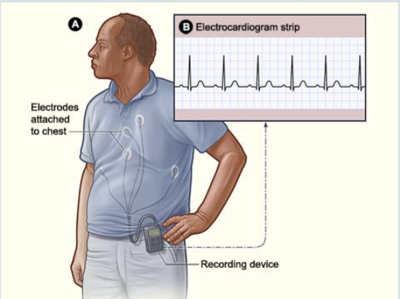
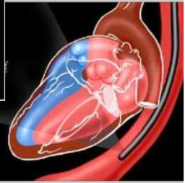
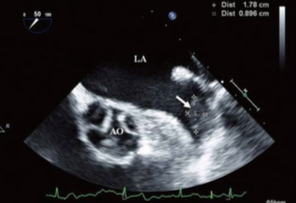
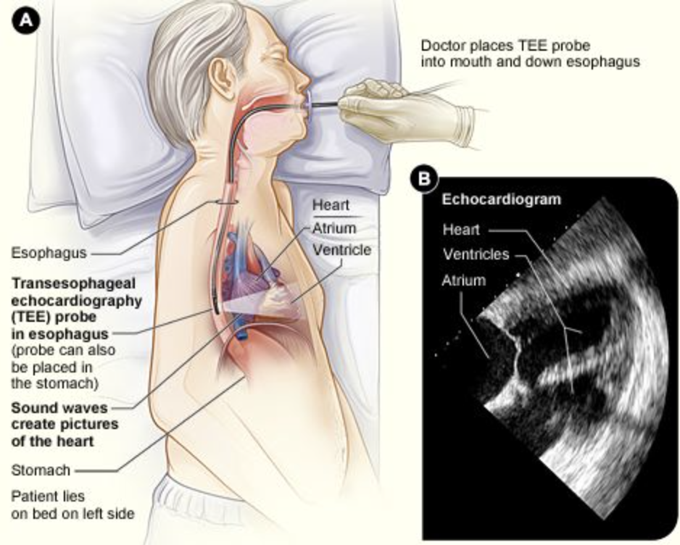
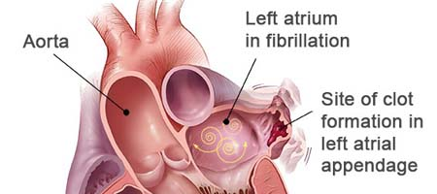
AF diagnosis cont’
4- Transthoracic echocardiography (TTE) | 5- Chest radiography
Non-invasive, Used to identify: Size and functioning of atria and ventricles Ventricle hypertrophy Pericardial disease Valvular heart disease | When clinical findings suggest an abnormality chest radiography may be used to: Evaluate pulmonary pathology and vasculature Detect congestive heart failure Assess enlargement of the cardiac chambers
6- Holter monitor
Portable ECG device (Now it can be done by modern wearable devices e.g. Smart watches) Useful for diagnosis¹ and follow up to see if the treatment is effective.² Continuous monitoring for a short period of time (typically 24-48 h) Useful for Detecting: asymptomatic AF Evaluating patients with paroxysmal AF Associating symptoms with heart rhythm disturbance Assessing response to treatment
7- Transesophageal echocardiography (TEE)
Ultrasound transducer positioned close to the heart using an endoscope-like device High quality images of cardiac structure and function: Particularly the left atrial appendage, the most common site of thrombi in patients with AF (This is the only reliable method to rule out left atrial appendage thrombus) Not routinely used but useful for: Accurate assessment of risk of stroke Detection of low flow velocity (‘smoke’ effect) Sensitive detection of atrial thrombi
1-e.g. If a patient presents to you saying that he has palpitations, but at the time of presentation he was in sinus rhythm, palpitations could be caused by anything so you give him this device and ask him to come back after 24hrs (sometimes 48 or 72hrs, depends on the episode) this device will monitor the ECG of the patient will help you determine whether the patient has AF or not.
2- e.g. You diagnosed a patient with AF and started treatment to control his symptoms, yet when he goes to the community he still complains of palpitations, so you give this device to monitor him and check if the AF is controlled or not and whether the patient requires a higher dose of treatment or not.

Slide 9
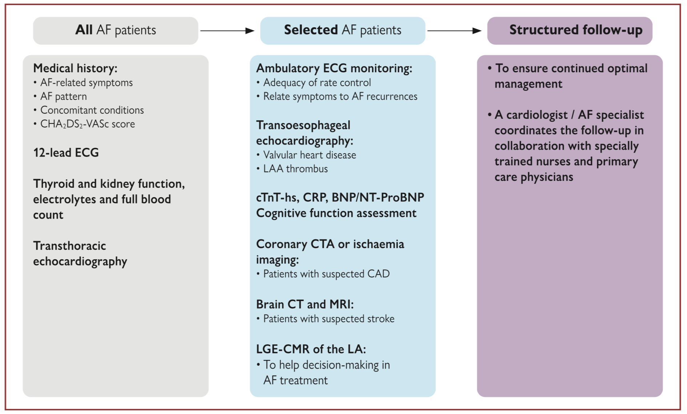
AF complications
AF evaluation summary (From Dr slides)
Click here for a very nice summary
AF complications
Complication | General Info
Death | AF Increases mortality 1.5 - 3.5 folds, due to sudden death, HF, comorbidities or stroke.
Stroke | 20-30% of all ischemic strokes (preventable) and 10% of cryptogenic strokes are due to AF. Mainly due to cardioembolic or related to comorbid vascular atheroma.
Hospitalizations | 10-40% of AF are hospitalized every year. For AF management, related to HF or MI or AF related symptoms also for treatment of associated complications.
Quality of life | More than 60% of patients. It’s related to AF burden, comorbidities, psychological functioning and medication, distressed personality type.
Left ventricular dysfunction (LVD) & HF¹ | LVD is found in 20-30% of all AF patients. Due to excessive ventricular rate, irregular ventricular contractions, a primary underlying cause of AF.
Cognitive decline and vascular dementia | HR 1.4/1.6 (irrespective of stroke history). Due to Brain matter lesions, inflammation or hypoperfusion and micro-embolism.
Depression | In 16-20% of patients (even suicidal ideation). Due to severe symptoms, decreased QoL and drug side effects.
1- How does AF cause HF? By decreasing ventricular filling, pulmonary congestion and dilation of ventricles.

Slide 10
AF Management
Treatment of AF
First treat the underlying cause then to initiate treatment for the arrhythmia you have to determine if the patient is hemodynamically stable or not.
How? If there’s chest pain, shortness of breath, altered mental status (confusion), or a systolic BP < 90, then the patient is considered unstable. If they’re unstable use electricity. If instead the patient has symptoms, but not any one of those listed above, the patient is stable. A patient who is stable has time to fix the rhythm. They’re not going to die at this moment; pharmacotherapy can be used.
Hemodynamic stability
ABCD
Stable patients
Rate control (BB or Ca++ blockers or Digoxin)
Rhythm control (Cardioversion)
Anticoagulation
Unstable patients
Do synchronized electrical Cardioversion (Shock) immediately.
1) Rate control
Target heart rate for AF patients is < 110 bpm during activity and 60-80 bpm during rest.
Drugs: (BB and CCB have equal efficacy, choice depends on the pt situation, digoxin has lowest efficacy)
Beta-blockers: Atenolol, Metoprolol (Used in cases of Graves disease, CHF, IHD, HTN)
Ca2+ - channel blockers: Verapamil , diltiazem (Used if patient is Asthmatic)
Digoxin: (Used if patient is hypotensive or suffering from LV systolic dysfunction)
Pace and ablate strategy¹
2) Rhythm control
Electrical Direct current (DC) cardioversion (More effective) or pharmacological cardioversion may be used.
Likelihood of successful cardioversion decreases with the duration of AF:
Pharmacological cardioversion is most effective when initiated within 7 days of AF onset.
It’s advocated for younger, symptomatic and physically active patients.
Pharmacologic cardioversion use depends on the presence or absence of of underlying heart disease: (It’s mainly used if electrical cardioversion fails or not feasible)
Absent: Class IC antiarrhythmics e.g. IV Flecainide, Propafenone Or Class IA e.g. Procainamide
Present: Class III antiarrhythmics e.g. IV Amiodarone² Or Dronedarone (alternative)
Others: Ablation³, Surgery (MAZE)
AF for <48hr → Cardiovert immediately either pharmacologically or electrically (or both) then anticoagulate for 4 wks
AF for ≥48hr (or unknown) → Either do TEE to check atrial thrombus then cardiovert (If no thrombus) Or Give Anticoagulants for ≥3wks → Cardiovert → Give Anticoagulants again for at least 4wks.
Why do we give anticoagulants before cardioversion? Because LAA thrombus can dislodge and cause stroke
Why do we give anticoagulants after cardioversion? Because cardioversion may lead to atrial stunning → Blood stasis → Thrombus formation.
Click here for a summary of all antiarrhythmics (EXTRA!!)
3) Stroke prevention
Patient with AF related Moderate or severe mitral stenosis or the presence of a mechanical heart valve should always be anticoagulated (With Warfarin) because the risk is so high. In other patients, CHA₂DS₂-VASc score is used to assess the risk of stroke.
New Oral AntiCoagulants (NOAC) “First line treatment”:⁴
Dabigatran, Apixaban, Rivaroxaban, Edoxaban
Warfarin⁵ (Coumadin®) “used in cases of Mitral stenosis or if pt has metal valve”
WATCHMAN® device or surgery: For removal/isolation of left atrial appendage.
1- In exceptional cases, poorly controlled and symptomatic AF can be treated by implanting a permanent pacemaker and then deliberately inducing complete AV nodal block with catheter ablation. This is known as the ‘pace and ablate’ strategy.
2- The most effective antiarrhythmic drug for AF is amiodarone followed by flecainide and propafenone. The problem with amiodarone is it’s sides effects (e.g. Photosensitivity skin discoloration, corneal deposits, thyroid dysfunction, alveolitis, nausea and vomiting, hepatotoxicity, peripheral neuropathy, torsade de pointes; potentiates digoxin and warfarin) so it’s usually reserved for old people (>70), but for young people flecainide and propafenone are better.
3- Catheter ablation is sometimes used to restore and maintain sinus rhythm in resistant cases
4- The anticoagulants used for AF decrease the risk of stroke by almost 70% (except aspirin by 20%). In general the NOACs are better than warfarin why? Because of no need of monitoring (in warfarin you have to keep the INR between 1-3), No Drug food interaction (in warfarin, the patient can’t eat Vit K containing food), Minimum Drug-Drug interaction. BUT REMEMBER YOU SHOULDN’T GIVE THESE DRUGS TO PATIENTS WITH MITRAL STENOSIS OR MECHANICAL VALVE!! (The first line for them is VKA “warfarin”)
5- Most patients should be anticoagulated (INR 2.0-3.0) long term: the exception being young patients (<65 years) with lone AF. This latter group is treated with aspirin alone.

Slide 11
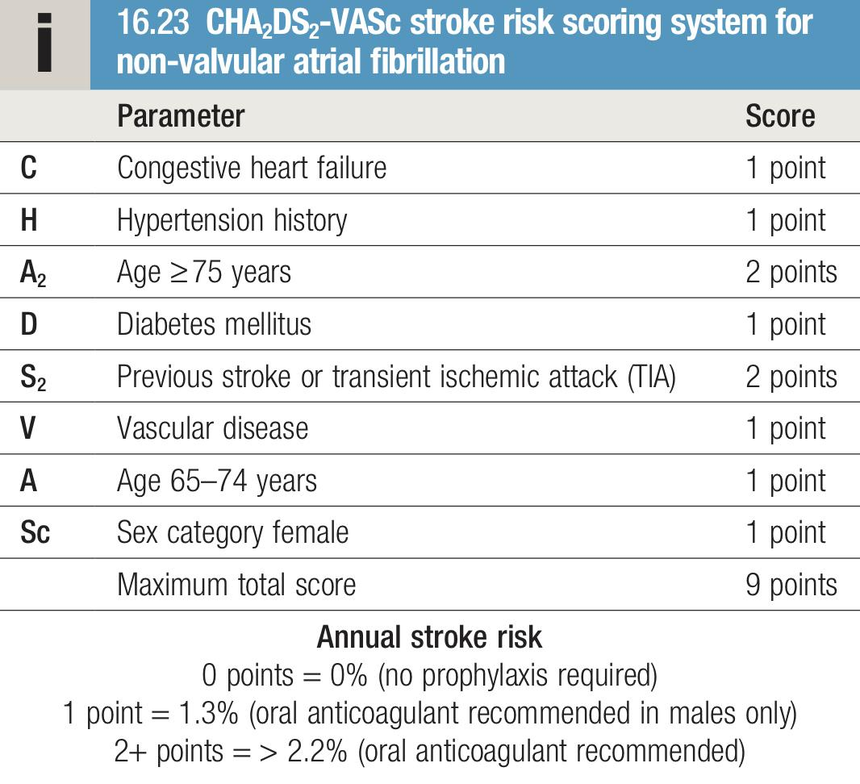
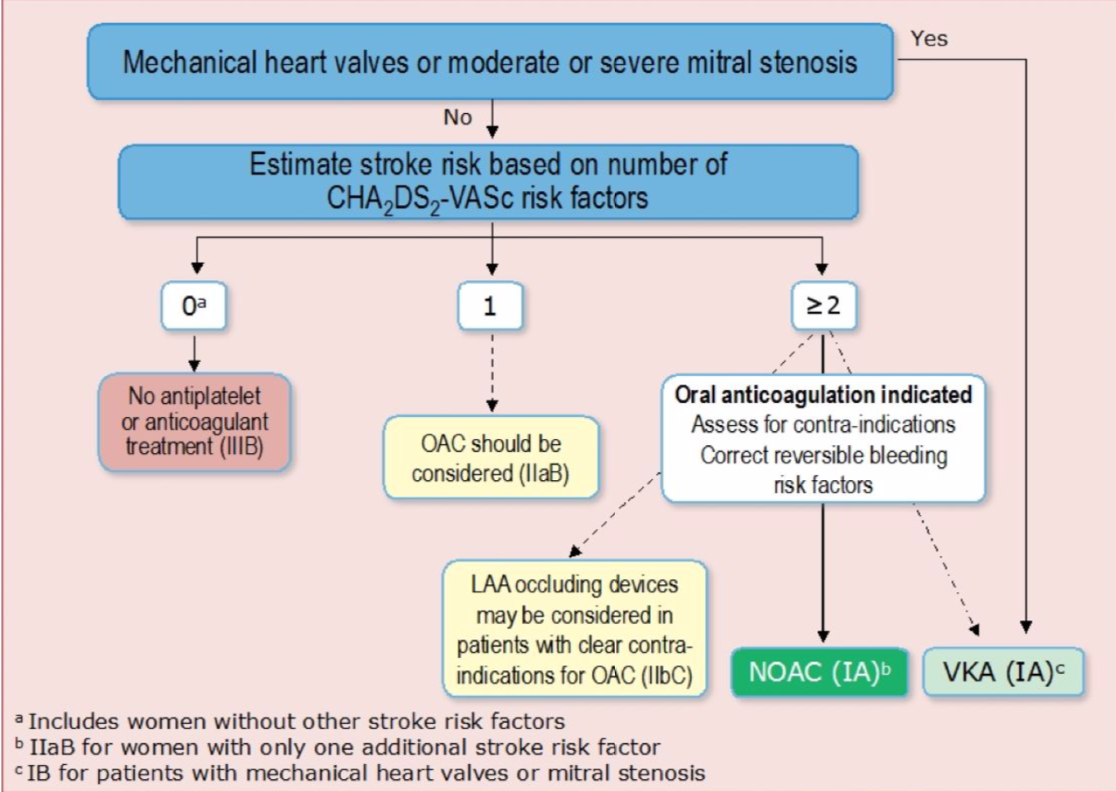
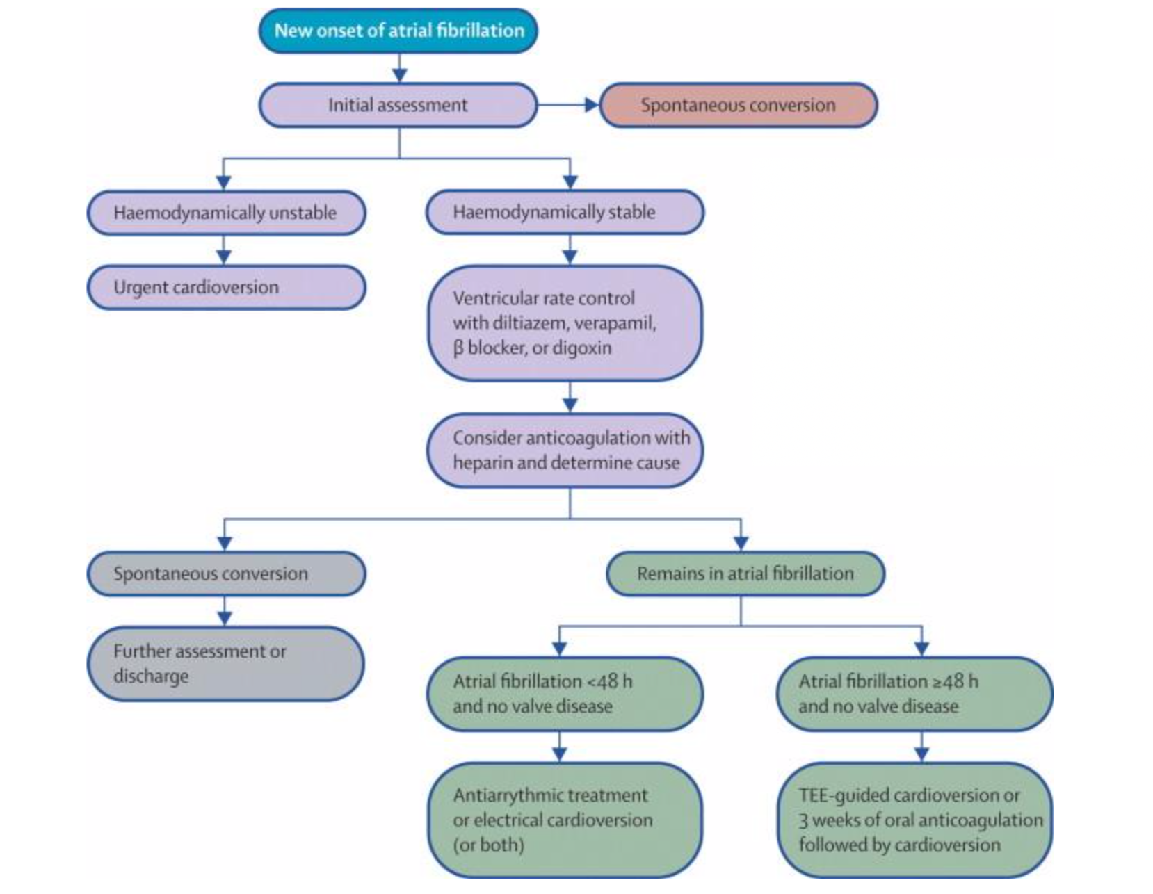
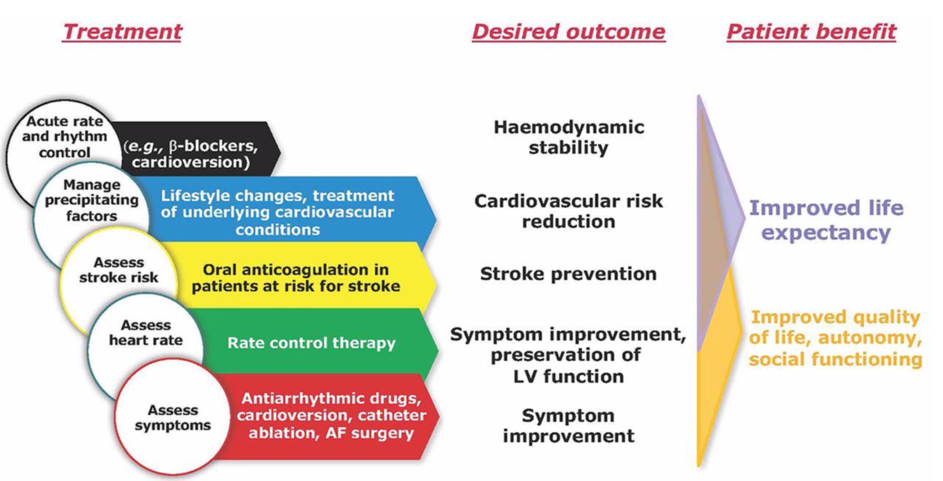
AF Management cont’
CHA₂DS₂-VASc scoring system
A scoring system used to identify which patient is at high risk of thromboembolic complications and will benefit from anticoagulation therapy.
0 → Low risk (No need for anticoagulants)
1→ Moderate risk (the need of anticoagulants is controversial)
2 or more → High risk (Requires anticoagulation)
NOAC= new oral anticoagulants
VKA = vitamin K antagonists
AF Management Summary

Slide 12
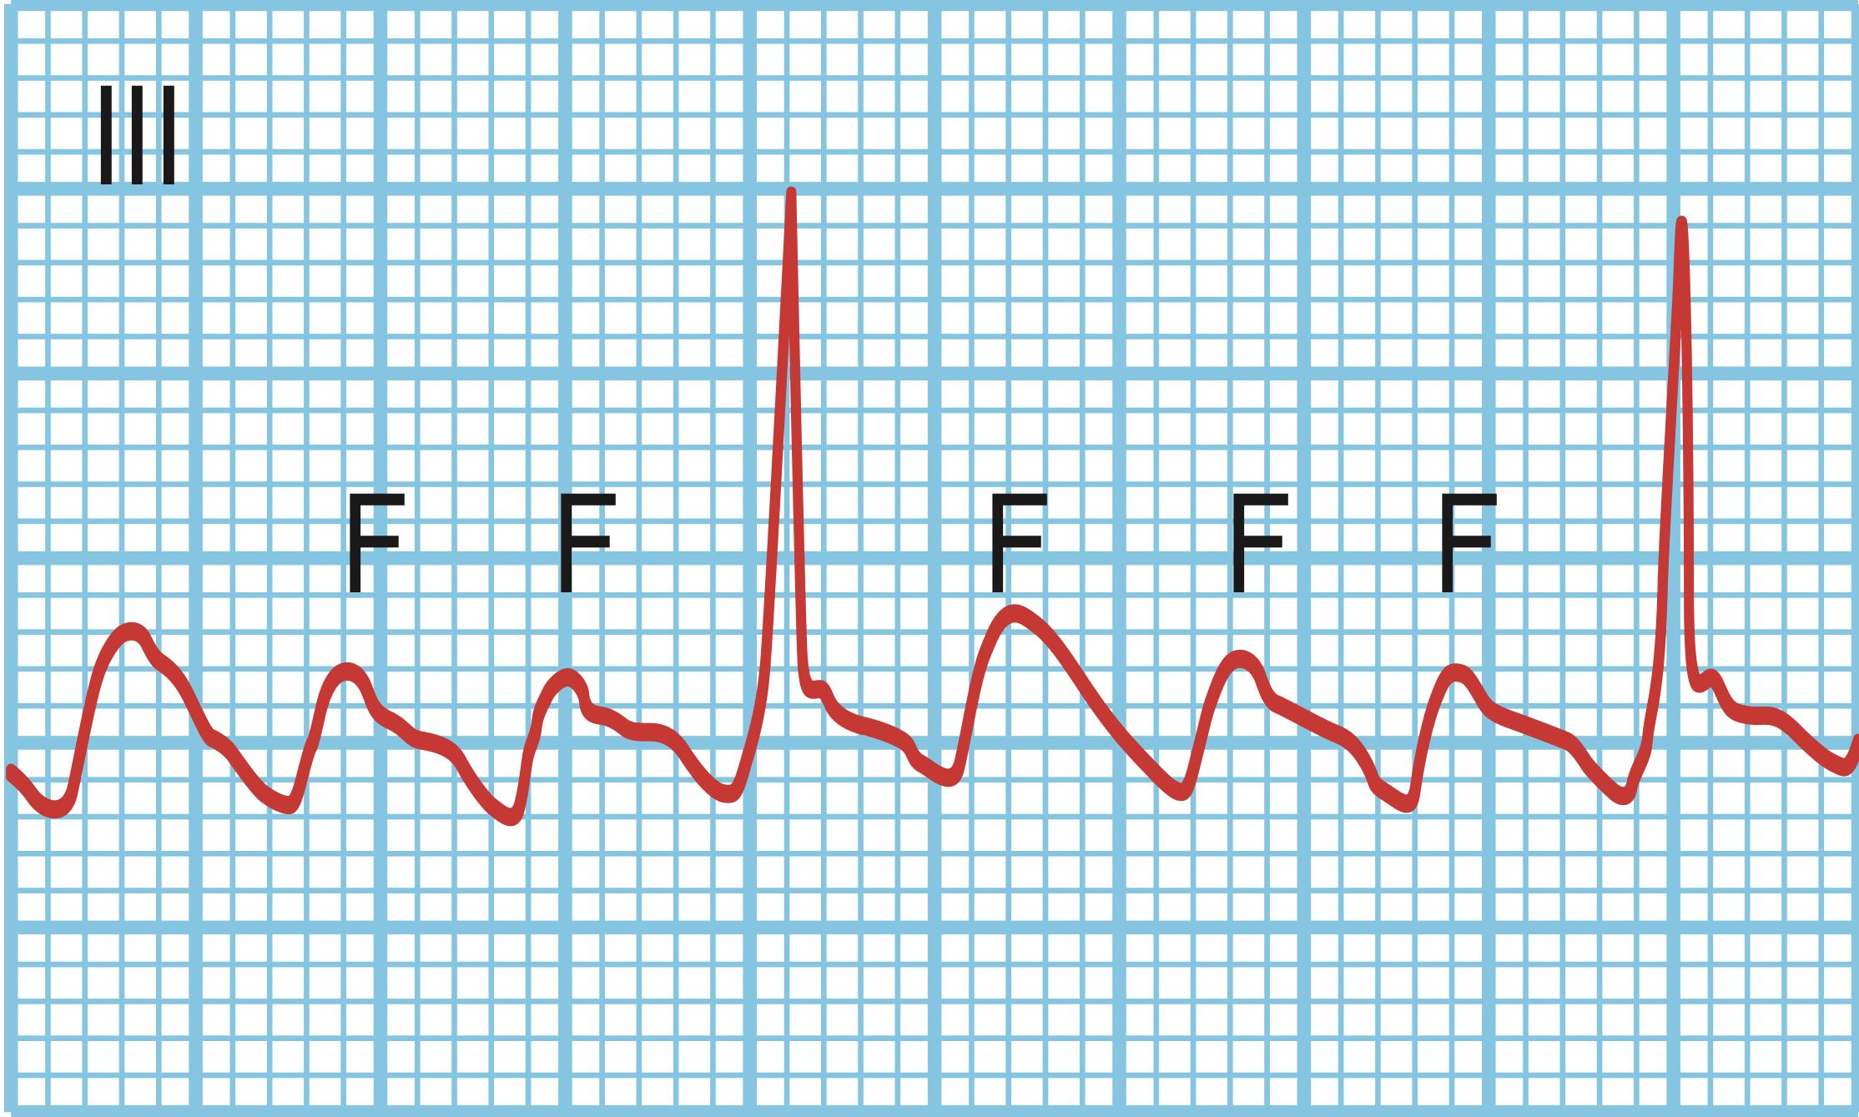
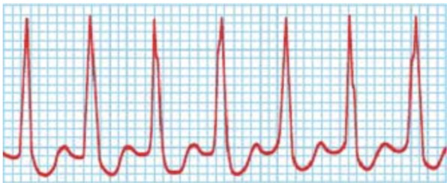
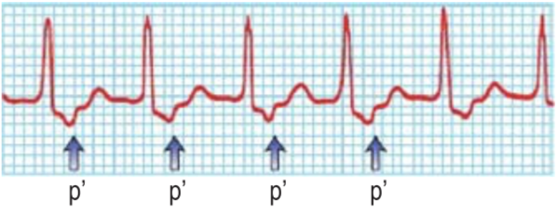
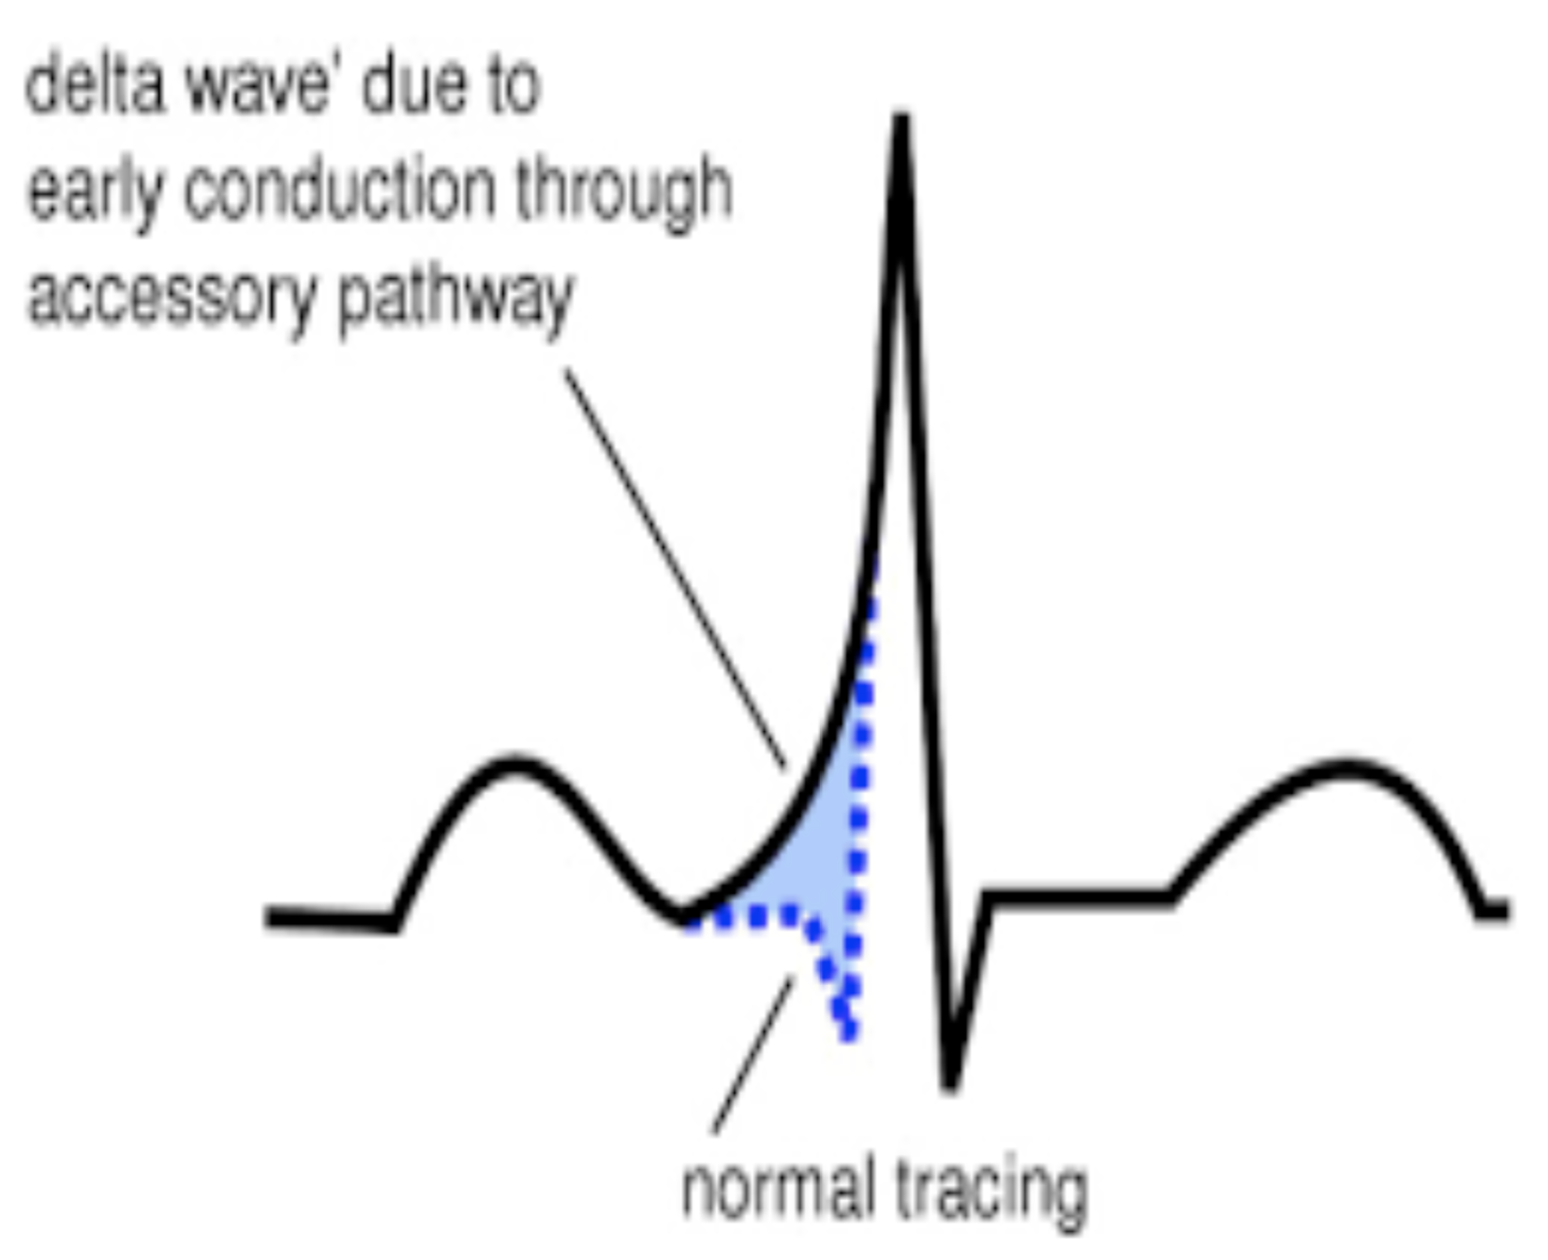
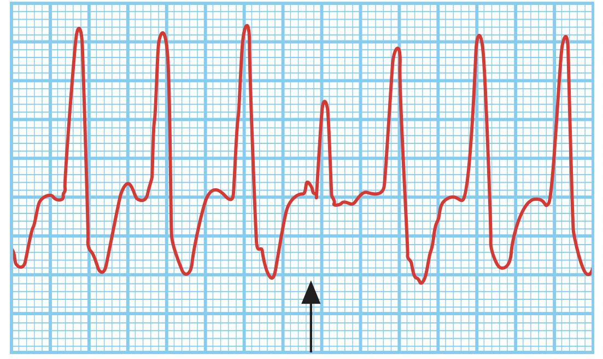
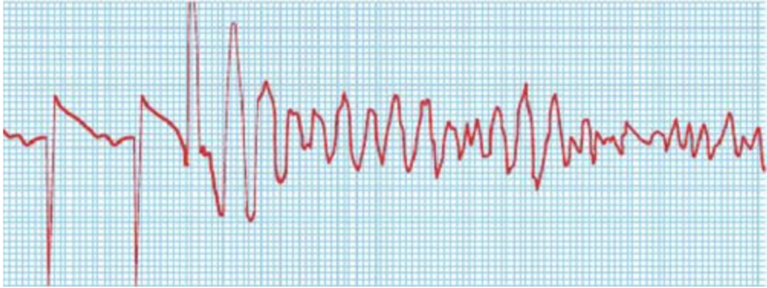
Other Arrhythmias
Type of arrhythmia | General info | ECG | Management
Atrial flutter | One irritable automaticity focus (macrocircuit) in the atria fires at about 250 to 350 bpm (typically very close to 300 bpm), giving rise to regular atrial contractions. Causes: Heart disease: Heart failure (most common association), rheumatic heart disease, CAD, COPD, Atrial septal defect (ASD) | ECG provides a saw-tooth baseline, with a QRS complex appearing after every second or third “tooth” (F wave). | Similar to Atrial fibrillation treatment except that most cases of flutter can be cured with radiofrequency catheter ablation of the re-entry circuit.
Supraventricular tachycardia (Benign) | These are usually regular narrow-complex tachycardias and are characterised by a re-entry circuit or automatic focus involving the atria. The three types are: Atrioventricular nodal re-entrant tachycardia (AVNRT) (60%) Atrioventricular re-entrant tachycardia (AVRT) (30%) e.g. WPW Atrial tachycardia (10%) | 1) AVNRT: QRS complexes are narrow and the P waves cannot be seen. 2) AVRT : The tachycardia P waves (arrowed) are clearly seen after narrow QRS complexes (Wolf-Parkinoson-White syndrome, WPW) ECG: Characteristic delta wave | Medical therapy¹ Radiofrequency ablation
Ventricular tachycardia | Defined as rapid and repetitive firing of three or more PVCs in a row, at a rate of between 100 and 250 bpm CAD with prior MI is the most common cause | Wide and bizarre QRS complexes | Treat the underlying cause. Automatic implantable defibrillators Note: Vfib is a medical emergency! Immediate defibrillation and CPR are indicated, Fatal if untreated.
Ventricular fibrillation | Multiple foci in the ventricles fire rapidly, leading to a chaotic quivering of the ventricles and no cardiac output. Most episodes of VFib begin with VT (except in the setting of acute ischemia/ infarction). | No atrial P waves can be identified. No QRS complexes can be identified. In sum, no waves can be identified; there is a very irregular rhythm.
Click here for more info
1- Wolfe-Parkinson-White (WPW) syndrome patients who present in AF with rapid ventricular response: If baseline ECG shows a delta wave or if the current ECG shows wide, bizarre QRS complexes during AF, avoid AV nodal blocking agents (β-blockers, CCBs, adenosine, digoxin). The treatment of choice is IV procainamide or ibutilide, which slows conduction in the entire atrium. If AV nodal blocking agents are given in this situation, the atrial impulses in rapid AF can proceed down the accessory pathway and cause VF and death.

Slide 13
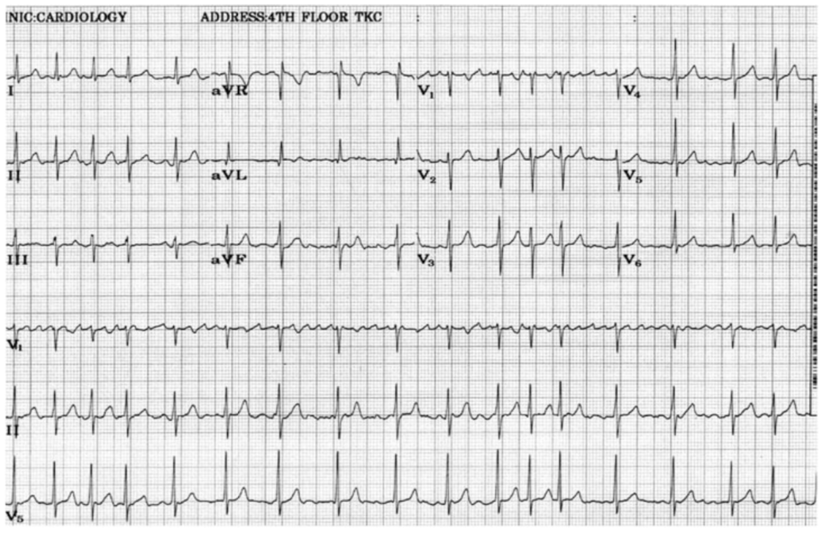
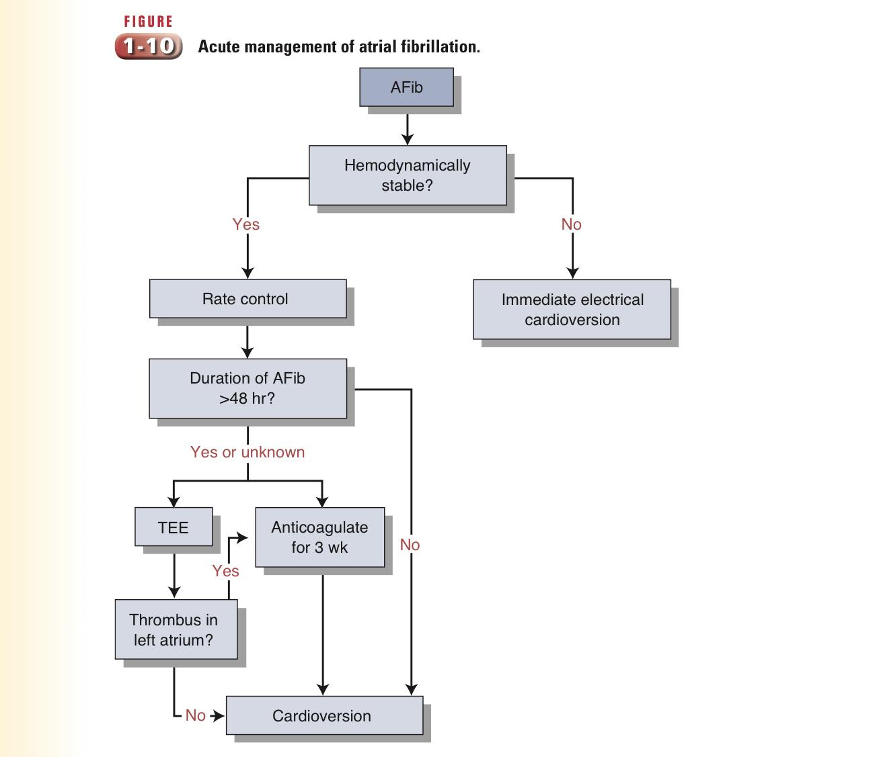
EXTRA
Case 1
A 75-year-old man with a past medical history of diabetes mellitus and hypertension presents to the emergency department complaining of the sudden onset of shortness of breath accompanied by palpitations beginning 6 hours ago. The palpitations last for approximately 10 minutes at a time and recur at least once an hour. He admits to a 5-year history of intermittent similar symptoms. He denies chest pain, cough, or light- headedness. He takes no medications and does not smoke cigarettes, but admits to drinking six to eight beers per day over the past 3 days. Vital signs include a temperature of 37.2°C (98.9°F), blood pressure of 135/90 mm Hg, pulse rate of 130/min, and respiratory rate of 22/min. The patient is speaking in full sentences, has a midline trachea, and has no inspiratory rales, dullness to percussion, or increased tactile fremitus over the lung fields. His heart examination is notable for an irregularly irregular rhythm without murmurs; there is no chest wall tenderness. An ECG is shown in Figure
Q1: What’s the most likely diagnosis?
Atrial fibrillation (AF). This is the only common arrhythmia in which the ventricular rate can be rapid and irregular. Atrial flutter is often confused with AF; however, atrial flutter has a rapid regular ventricular response with a rate about 150 beats per minute and the characteristic ECG finding of flutter waves.
Q2: How is this condition classified?
Paroxysmal
Persistent
Long- standing Persistent
Permanent
Lone
Non-vavlular
Q3: What are the possible causes?
Hypertensive heart disease, HF and 3 PIRATES
Q4: Describe his ECG.
Absent P waves, only a fine oscillation of the baseline (so-called fibrillation or f waves)
Fast and irregular ventricular response (QRS complex) → irregular RR intervals (irregularly irregular rhythm)
Increased heart rate (Tachyarrhythmias)
Q5: What’s the appropriate treatment for this condition in general?
ABCD
Unstable: In patients with acute-onset AF and hemodynamic
instability, electrical cardioversion is indicated.
Stable: If the duration of the AF is unknown or > 48 hours, or the patient
is at high risk of embolization, transesophageal echocardiography (TEE)
is performed to locate atrial clots prior to cardioversion. Alternatively,
cardioversion may be delayed for 3 weeks for anticoagulation to minimize
the risk of embolization in a stable patient then followed by another 4 weeks of anticoagulation.

Slide 14
EXTRA
Case 2
Setting: ED
CC: “I feel a fluttering in my chest”
VS: RR: 32 breaths/minute: BP: 118/88 mmHg: P: 128bpm, irregularly irregular; T: 98.1ºF
HPI: A 42-year-old gastroenterologist comes to the office with 1 single day of palpitations and fluttering in his chest. He has never had this before. He denies chest pain, lightheadedness, or shortness of breath. He is very anxious. He drinks a large amount of vodka at night four to five times a week and frequently travels to present papers at international meetings.
PMHx: None
Medications: None
PE:
Neuro: Normal
Cardio: No murmurs, rubs or gallops
Abdomen: normal
Extremities: no edema
Initial orders:
ECG
CHEM-7
CXR
Oximeter
CBC
As you move the clock forward 10-20 min, all the laboratory results come back as normal except for the ECG, which shows AF at a rate of 125 to 130 bpm.
Q1: When is immediate electrical cardioversion for AF correct?
Electrical cardioversion is indicated for tachyarrhythmias when there is life-threatening hemodynamic instability, such as chest pain, shortness of breath, decreased systolic BP or hemodynamically related altered mental status (confusion). Although uncomfortable, none of other symptoms described in the case here are severe enough to put the patient through the risk and discomfort of electrical cardioversion. Pallor, anxiety, sweating and palpitations are all subjective, hard to measure and not life-threatening.
Q2: What’s the first line treatment for this case?
Rate control with either a beta-blocker, CCB or digoxin is the first step in managing rapid AF. Rate control is more important than trying medications such as antiarrhythmics to chemically convert AF into normal sinus rhythm. Anticoagulation is not needed for AF present for <48hrs. The echocardiogram results may help tell who needs anticoagulation, but controlling the rapid ventricular response is not dependent on echocardiogram findings.
After metoprolol or diltiazem, the patient’s HR reduces to 80bpm. All symptoms resolve. admittance to the ICU is not necessary and the patient is placed on a regular hospital ward. Heparin is not necessary. The echocardiogram shows a normal heart size and shape with no significant valvular disease and no thrombi. The AF does not stop, but the rate remains controlled and there are no symptoms.
Q3: What’s the best therapy?
A- Warfarin
B- Dabigatran
C- Aspirin
D- Rivaroxaban
A: C. This patient has a CHADS score of 0 so aspirin alone is sufficient. If CHADS score is 0 or 1, Aspirin alone is enough, if >2 give NOAC or Warfarin.

Slide 15
Summary
Atrial fibrillation
General info | Prevalence rise with age. It’s also more common in males.
Pathogenesis | Multiple interacting re-entry microcircuits looping around the atria, most often located within pulmonary veins
Causes | Hypertensive heart disease, HF and 3 PIRATES
AF rhythm & ECG changes | Absent P waves, only a fine oscillation of the baseline (so-called fibrillation or f waves) Fast and irregularly irregular ventricular response → irregular RR intervals Increased heart rate (Tachyarrhythmias) irregularly irregular rhythm.
AF begets AF | Electrical remodeling | Structural remodeling
 | Electrophysiological changes occur in the atria within a few hours of the onset of AF, that tend to maintain fibrillation | When AF persists for a period of months, structural remodeling occurs with atrial fibrosis and dilation that further predispose to AF
S & S | Irregularly irregular pulse palpitation, breathlessness and fatigue Thromboembolic TIA → Stroke
Classification | Paroxysmal AF → AF <7d Persistent AF → >AF >7d Long-standing persistent AF → >AF 12 mo Permanent AF → Joint decision between pt and clinician not to pursue rhythm control Lone AF → AF without clinical/ECG evidence of cardiopulmonary disease Non valvular AF
Diagnosis | History & Physical examination: Clinical type of AF, presence of underlying heart diseases, Response to any treatments administered, Triggers, family history. ECG: Abnormal Rhythm (verify AF), LVH, pre-excitation, Prior MI, Bundle branch block Transthoracic echocardiogram (TTE): Size and functioning of atria and ventricles, LV hypertrophy, VHD Blood tests to check the thyroid, renal and hepatic Holter monitor: If diagnosis of type of arrhythmia is in question. Chest X-ray Transesophageal echocardiogram (TEE): To identify LA thrombus in LAA, to guide cardioversion
Complications | Stroke, Death, Hospitalizations Impaired quality of life, Left ventricular dysfunction (LVD), Cognitive decline and vascular dementia
Management | Stable |  | Unstable
 | Rate control: BB or Ca++ blockers or Digoxin Rhythm control: AF for <48hr → Cardiovert immediately either pharmacologically or electrically (or both) AF for >48hr → Either do TEE to locate atrial thrombus then cardiovert Or Give Anticoagulants for 3wks → Cardiovert → Give Anticoagulants again for 4wks. Anticoagulation: NOAC or Warfarin |  | Synchronized electrical Cardioversion (Shock) immediately
ABCD

Slide 16
Q1: A third-year medical student has been reading about the dangers of excessive anticoagulation and bleeding potential. He reviews the charts of several patients with atrial fibrillation currently taking Coumadin. Which of the following patients is best suited to have anticoagulation discontinued?
A- A 45-year-old man who has normal echocardiographic findings and no his- tory of heart disease or hypertension, but a family history of hyperlipidemia
B- A 62-year-old man with mild chronic hypertension and dilated left atrium, but normal ejection fraction
C- A 75-year-old woman who is in good health except for a prior stroke, from which she has recovered nearly all function
D- A 52-year-old man with orthopnea and paroxysmal nocturnal dyspnea
Q2: A 48-year-old woman is noted to have atrial fibrillation with a ventricular heart rate of 140 bpm. She is feeling dizzy and dyspneic with a systolic blood pressure of 75/48 mm Hg. Which of the following is the most appropriate next step?
A- Intravenous digoxin
B- DC cardioversion
C- Vagal maneuvers
D- Intravenous diltiazem (Cardizem)
Q3: : A 45-year-old woman is noted to have dizziness, pounding of the chest, and fatigue of 3 hours’ duration. On examination, she is noted to have a blood pressure (BP) of 110/70 mm Hg and heart rate of 180 bpm. She is noted on ECG to have atrial fibrillation, and a prior baseline ECG showed delta waves. The ER physician counsels the patient regarding cardioversion, but the patient declines. Which of the following is the best therapy for her condition?
A- Digoxin
B- Angiotensin-converting enzyme (ACE) inhibitor
C- Calcium channel blocker
D- Procainamide
Q4: A 68-year-old man presents with a 2-week history of increasing dyspnea and is found to be in atrial fibrillation with a ventricular rate of 120 beats per minute. The most appropriate test to evaluate for left atrial thrombus before cardioversion is
A- ECG
B- Transthoracic echocardiography
C- No testing is needed
D- Transesophageal echocardiography
Q5: A 79-year-old woman is admitted to the coronary care unit (CCU) with unstable angina. She is started on appropriate medication to reduce her cardiac risk. She is hypertensive, fasting glucose is normal and cholesterol is 5.2. She is found to be in atrial fibrillation. What is the most appropriate treatment?
A- Aspirin and clopidogrel
B- Digoxin
C- Warfarin
D- Cardioversion
Q6: A 62-year-old male presents with palpitations, which are shown on ECG to be atrial fibrillation with a ventricular rate of approximately 130/minute. He has mild central chest discomfort but is not acutely distressed. He first noticed these about 3 hours before coming to hospital. As far as is known this is his first episode of this kind. Which of the following would you prefer as first-line therapy?
A- Anticoagulate with heparin and start digoxin at standard daily dose
B- Attempt DC cardioversion
C- Administer bisoprolol and verapamil, and give warfarin
D- Attempt cardioversion with IV flecainide
Answers: Q1:A | Q2:B | Q3:D | Q4:D | Q5:C | Q6:B
Answers Explanation File!
Answers Explanation File!

Slide 17
THANKS!!
This lecture was done by:
Mashal AbaAlkhail
Note taker:
Raghad AlKhashan
Females co-leaders:
Raghad AlKhashan
Amirah Aldakhilallah
Males co-leaders:
Mashal AbaAlkhail
Ibrahim AlAsous
Send us your feedback:
We are all ears!

