Slide 1
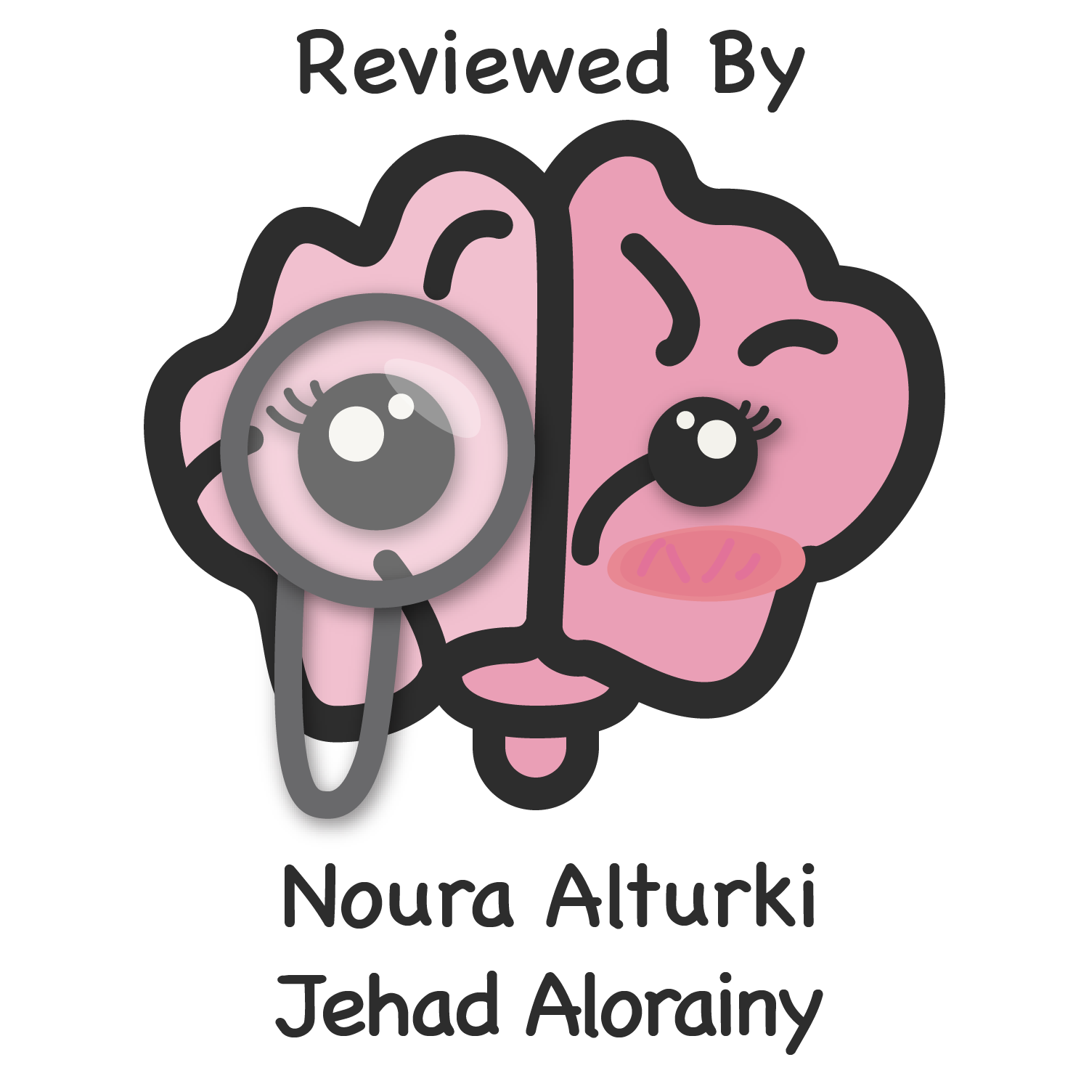
Lecture 20
Editing file
Glomerular diseases
Objectives:
Understand the physiology / pathophysiology of Glomerular structure.
Recognize Normal & abnormal urine analysis in making diagnosis of Glomerular Disease vs Non-Glomerular disease
Recognize the differences between Nephritic & Nephrotic Glomerular diseases.
To recognize the early features of Glomerular diseases before it is too late! Early Dx & Rx makes a huge difference
To learn the common causes of Nephrotic & Nephritic renal diseases.
Color index:
Color index:
Original text Females slides Males slides
Doctor’s notes Text book Important Golden notes Extra

Slide 2
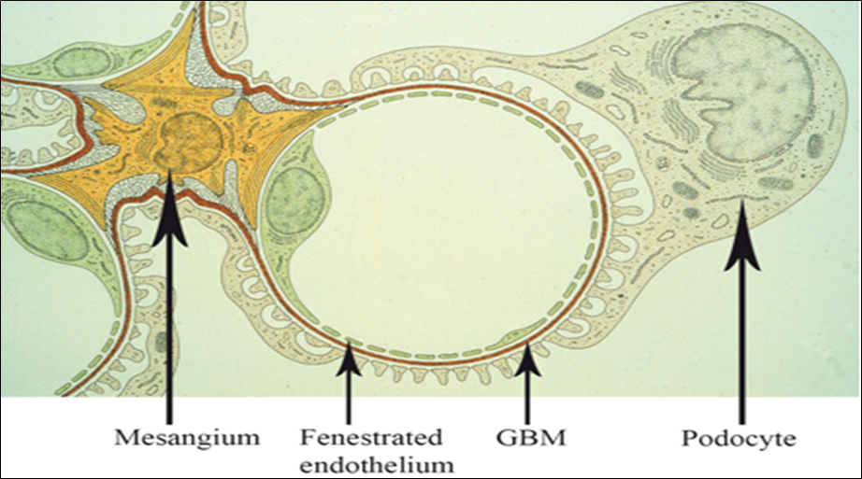
Glomerular Diseases¹
Normal structure is needed to:
Keeps the glomerular filtration normal, thus maintains normal kidney function.
Maintain urine volume and hence, preventing fluid retention in the body which causes edema and high blood pressure.
Prevents the blood components (cells, proteins) from leaving the bloodstream and appearing in the urine.
01
02
03
renal cortex is the most important functional part of the kidney because it has the glomeruli
if the Glomerular structure is intact the urine will show:
No protein
No RBCs
(Accept: <2 RBCs/high power field)
No heme
No cellular casts
Devoid of fats
How glomerular diseases start?
The insult to the glomeruli is either an autoimmune attack or is the result of deposition of antibody-antigen complex in the kidney which will attack the glomeruli which will lead to a local inflammation there. The pathology depends on the component of the glomeruli that is affected (basement membrane, mesangium…)
Here we are talking about primary glomerular diseases that are mostly caused by immune system dysfunction.
Auto-antibodies targeting glomerular structure or immune- complexes (antigen-antibody) depositing and traumatizing the glomerular components.
Glomerular diseases are named based on their histopathological characteristics seen under the microscope. So, almost always a kidney biopsy is needed to diagnose any suspected primary glomerular disease. Urinalysis & blood tests are also used.
The manifestations of a glomerular disease are usually indicative of which components of glomerulus structure was affected mainly by the disease process:
If Podocytes were the main target of the disease process this leads mainly to proteinuria ( at large amount) due to foot process effacement ; thus Nephrotic Syndrome will be the main finding.
If endothelial cells OR Mesangial cells OR GBM OR all of them together were targeted; then Glom Capillary wall will be damaged by inflammation so blood components will leak to the urine space causing: hematuria, proteinuria and abnormal renal function; thus Nephritic pattern of renal disease will be present
( Clinically called: Glomerulonephritis or GN )
Glomerular disorders are characterized by impairment in selective filtration of blood, resulting in excretion of larger substances such as plasma proteins and blood cells. As disease advances, GFR decreases proportionally, leading to renal failure and the possible need for dialysis and/or transplantation. The classic features are proteinuria, hematuria, or both.
Glomerular diseases are generally chronic and all of them can cause nephrotic syndrome.
Biopsy is the most accurate test to establish a diagnosis (though not always needed)
Often treated with steroids (several resolve spontaneously)
Additional immunosuppressive medications (cyclophosphamide, mycophenolate) are frequently used.

Slide 3
Glomerular Diseases
Disease of The Kidney
Tubular
Vascular
Glomerular¹
Obstructive
Cysts and tumors
But to make things easier, we can put Glomerular diseases in two main clinical categories
Nephrotic syndrome
Nephritic syndrome
Primary causes
IgA nephropathy
Minimal change disease
Poststreptococcal glomerulonephritis (PSGN)
Membranous nephropathy
Lupus nephritis
Focal segmental glomerulosclerosis
Rapidly progressive glomerulonephritis
secondary causes
Anti-GBM (Goodpasture's disease)
IgA nephropathy
ANCA vasculitis ( e.g. Wegner’s Granulomatosis)
membranoproliferative glomerulonephritis (MPGN)
Membranoproliferative GN (MPGN)
Diabetic nephropathy
Alport’s syndrome²
Amyloidosis
The degree or amount of proteinuria is the main difference between glomerulonephritis and nephrotic syndrome.
Alport’s syndrome (hereditary nephritis): X-linked or autosomal dominant inheritance with variable penetrance. It is a congenital defect of collagen. Features include hematuria, pyuria, proteinuria, high-frequency hearing loss without deafness, visual disturbance, progressive renal failure. No effective treatment.

Slide 4
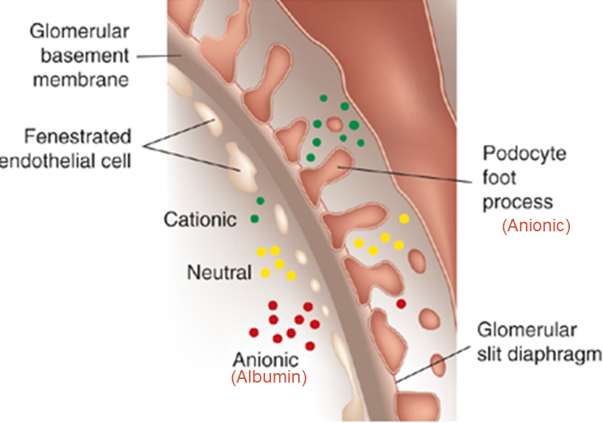
Nephrotic syndrome
Pathological findings:
Podocytes abnormality is the primary finding
Podocytes will sustain a structural dysfunction; making them lose their Foot-processes (called : foot process effacement), while their cells bodies remains intact. This pathology makes Glom capillary wall becomes permeable to Albumin.
This will lead to significant amount of protein appearing in the urine (Proteinuria).
Normal foot processes
Diffuse Foot Processes Effacement
Pathophysiology:
Podocytes are negatively charged so they will repel the negatively charged albumin from appearing in the urine ,if they are effaced then albumin will find its way to appear in urine
Important definitions about Proteinuria:
How many milligrams of proteins are normally secreted in the urine per-day?
< 150 mg/day of all kinds of proteins. (albumin & non-albumin proteins), on average; 4-7 mg/day^{1,2} out the 150mg/Day is Albumin, the remaining is Non Albumin proteins.
Proteinuria > 150 mg/day is a pathological indicator and is usually made of Albumin in Glomerular diseases
If Albumin urinary secretion : 30-300 mg/day is called Microalbuminuria (indicates early renal disease)
> 300 to < 3500 mg/ Day : overt proteinuria
> 3500 mg/ Day : Nephrotic range Proteinuria Or Heavy Proteinuria
In a healthy adult, how many grams of albumin does the liver make everyday? 10 g
Loss of urinary protein (largely albumin) of the order of 3.5 g or more daily in an adult may lead to hypoalbuminemia. Normal dietary protein intake in the UK is around 70 g daily and the normal liver can synthesize albumin at a rate of 10–12 g daily. How then does a daily urinary protein loss of 3.5 g result in hypoalbuminemia? This can be partly explained by increased catabolism of reabsorbed protein, largely albumin, in the proximal tubules, even though the rate of albumin synthesis is increased.
1- We can only detect it when it reaches 30 mg/day
2- Some people extend the range to 15 mg

Slide 5
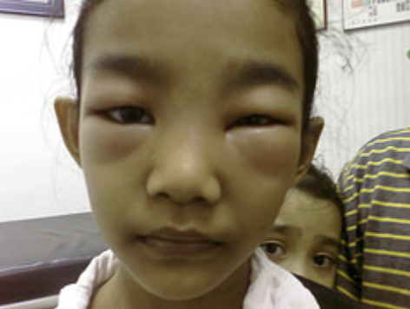
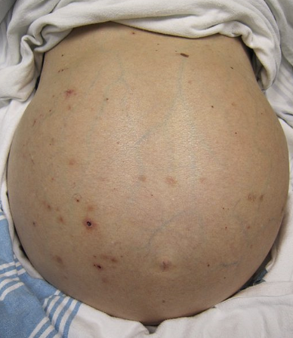
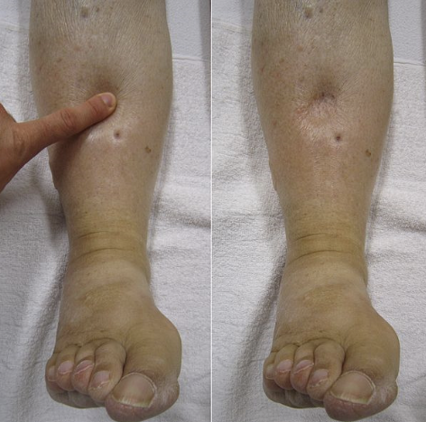
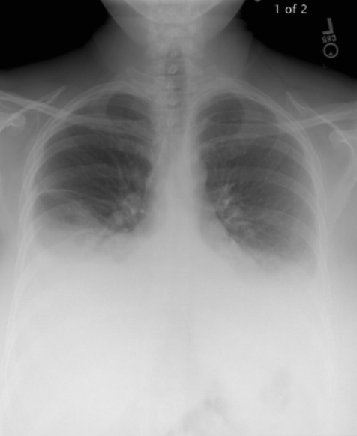
Nephrotic syndrome
Urine Analysis: the best initial test.
Heavy proteinuria (>3.5g = > 3500 mg “nephrotic range” per 24 hrs. of urine collection)
No RBCs (some times few RBCs are occasionally seen)
No RBCs casts
Fat (Lipiduria): Fatty casts, oval fat bodies & fat droplets.
No WBCs (few may be seen)
Blood Analysis:
Hypoalbuminemia (<30 g/L) the Normal serum Albumin level : 35-55g/L
Hyperlipidemia Why? The liver is overworking and producing proteins to compensate for albumin loss. One of the proteins that will be manufactured by the liver is lipoprotein which is cholesterol carrier → increased lipoprotein → more cholesterol carried in the blood → hyperlipidemia.
Clinical presentation:
Periorbital edema¹
Ascites
Pitting edema
Pleural effusion²
(Bilateral)
Edema Caused by:
1
Low serum albumin (↓oncotic pressure)
2
Increased renal sodium retention. Because of uncontrolled activation of the epithelial sodium channels (ENaC channels in the renal tubules)
Patient may present with:
Fatigue & Anorexia³ | Frothy (foamy) urine (froth persists for long time after voiding) | Weight gain due to fluid retention | Shortness of breath If having pleural effusion
Nausea & vomiting⁴ | Abdominal pain due to bowel edema | Signs & symptoms of DVT, PE as complications | Peripheral or generalized edema
1-- Especially in children after waking up. But after walking and playing during the day → gravity will pull the fluid down → it will disappear.
2- Why do patients with nephrotic syndrome get pleural effusion and not pulmonary edema? The cause is that pulmonary cardiac circulation doesn’t depend on oncotic pressure (it is hydrostatic dependent ).
3 The stomach and bowel is edematous → no feeling of hunger.
4- Peristalsis is impaired due to edema.

Slide 6
Management of nephrotic syndrome
General measures:
Initial management should be with dietary sodium restriction and a loop diuretic
Initial management should be with dietary sodium restriction and a loop diuretic (e.g. furosemide or bumetanide). Unresponsive patients require furosemide 40–120 mg daily (or more) with the addition of amiloride (5 mg daily; monitor serum potassium concentration regularly).
Nephrotic patients may malabsorp diuretics (as well as other drugs) owing to gut mucosal oedema, and intravenous administration may be needed initially. Patients are sometimes hypovolaemic, and moderate oedema may have to be accepted in order to avoid postural hypotension.
Normal protein intake is advisable. A high- protein diet (80–90 g protein daily) increases proteinuria and can be harmful in the long term.
prophylactic anticoagulation
Hypercoagulable states predispose to venous thrombosis. The hypercoagulable state is due to loss of clotting factors (e.g. antithrombin) in the urine and an increase in hepatic production of fibrinogen. Prolonged bed rest should be avoided, as thromboembolism is very common (particularly in membranous nephropathy). Long- term prophylactic anticoagulation may be indicated, and if renal vein thrombosis occurs, permanent anticoagulation is required.
pneumococcal vaccine
Sepsis is a major cause of death in nephrotic patients. The increased susceptibility to infection is partly due to loss of immunoglobulin in the urine. Pneumococcal infections are particularly common and pneumococcal vaccine should be given. Early detection and aggressive treatment of infections, rather than long- term antibiotic prophylaxis, constitute the best approach.
HMG- CoA reductase inhibitor
Lipid abnormalities are responsible for an increase in the risk of cardiovascular disease in patients with proteinuria. Treatment of hypercholesterolaemia starts with an HMG-CoA reductase inhibitor (a statin).
ACEI and/or ARB
Lastly, ACE inhibitors and/or angiotensin II receptor antagonists (AII- RAs) are indicated for their antiproteinuric properties in all types of glomerulonephropathy, but most especially the nephrotic syndrome. These drugs reduce proteinuria.
specific measures:
treat the underlying cause of any protein leak

Slide 7
Nephrotic syndrome
Complications:
1
3
Infection and sepsis¹
Acute kidney injury
2
4
End stage renal disease³ (ESRD) if proteinuria does not resolve
Thrombosis²
Glomerular Diseases that may present as Nephrotic Syndrome:
There are different causes but those are what we see quite often in SA:
Focal Segmental Glomerulosclerosis (FSGS)
Minimal Change Disease
Membranous Nephropathy
01
02
03
An area for your notes
1- Due to Loss of immunoglobulins
2- Loss of antithrombotic proteins
3- After long period of exposure of the renal tubules to proteins they will become atrophied and fibrosed

Slide 8
Focal Segmental Glomerulosclerosis (FSGS) ¹
A common cause of Nephrotic syndrome in adults.
If a child presented to you with FSGS it will be usually secondary to other causes.
Causes 12 – 35 % of the cases in adults.
Could be Primary Or Secondary Or Genetic
Focal: some glomeruli are affected by sclerosis (the rest of them look normal)
Segmental means: sclerosis only involves a segment of each glomerulus that is affected by the disease. .
 | Primary FSGS | Secondary FSGS²
Clinical features | Has sudden onset of heavy proteinuria and other manifestation of nephrotic syndrome | - Proteinuria is less heavy than other causes of nephrotic syndrome,even less < 3.5 gm/Day - Serum Albumin is not very low like the primary type. - Renal impairment is commonly seen with the secondary FSGS and this is not a good prognostic sign
Diagnosis | But most importantly, all glomeruli (the ones affected be sclerosis and the ones that are not affected) will have a diffuse foot processes effacement (thus nephrotic syndrome appears) | Possible causes³
 |  | A number of conditions which include: 1. Diabetes mellitus. 2. Obesity. ⁴ 3. Nephron loss (>75% of renal mass e.g renal agenesis). 4. Reflux nephropathy. 5. Healing of prior GN (e.g IgA). 6. Severe preeclampsia. 7. Drugs : Interferon, Bisphosphonates (Pamidronate), Heroin. 8. Anabolic steroid abuse. 9. Infections : HIV 10. Sickle cell anemia
Possible causes | The exact mechanism is unknown Circulating Factor (like autoantibodies) targets podocytes and causes effacement We don’t test for it because it’s difficult to find.
Treatment | Immunosuppressive therapy is indicated in most patients with primary FSGS First line: corticosteroids Second line: cyclosporine or tacrolimus (CNIs) | Not typically treated with Immunosuppression. treat the primary cause and add supportive measures to protect the kidneys, e.g. keeping blood pressure well controlled with ACE inhibitors.
Microscopic findings
FSGS, like minimal change disease, diffuse foot process effacement with segmental sclerosis
1- It has a fair to poor prognosis. It is generally resistant to steroid therapy—patients develop renal insufficiency within 5-10 years of diagnosis. The course is progressive to ESRD.
2- secondary FSGF is more common in Saudi Arabia than primary FSGS while in MCD primary causes are common
3- Secondary FSGS with similar glomerular changes is seen as a secondary phenomenon when the number of functioning nephrons is reduced for any reason.
4-We have a fixed number of glomeruli since birth , when the person is obese the glomeruli will compensate by hypertrophy and will heal by fibrosis leading to sclerosis and ending in renal failure.

Slide 9
Membranous nephropathy
Most common cause of Primary nephrotic syndrome in adults (15% and 33%)
Mostly secondary in children (hepatitis B antigenemia)
Presentation: slowly developing nephrotic syndrome (few weeks)
Microscopic findings:
1
Notice the Diffuse thickening of the glomerular capillary throughout all glomeruli (IgG and C3 deposition)
Types:
 | Primary | Secondary
Clinical features | Accounts for 75% of cases in adults. | ——
Possible causes | idiopathic | A few conditions: Systemic lupus erythematosus (SLE)²: Class V Lupus Nephritis (10-20%) other autoimmune disease (e.g.thyroiditis) Drugs: penicillamine, IV gold salts, high dose Captopril, and NSAIDs, Anti-TNF. Infections: Hepatitis B, Hepatitis C, syphilis, schistosomiasis,Plasmodium malariae) Malignancies ^{1,3} : solid tumors like prostate, carcinoma of the lung, or GI tract,colon, stomach, breast and lymphoma
Treatment | -Corticosteroids plus Cyclophosphamide or cyclosporine -May be Rituximab | Mainly target the primary disease that caused membranous nephropathy and treat the Nephrotic syndrome manifestations
1- It might be idiopathic but it is sometimes caused by cancer e.g. If someone is old or in his 50s and has risk factors for cancer and he presented with membranous nephropathy we will screen them for cancer (CXR, abdominal CT and colonoscopy is important) cuz it may be their only manifestation.
2- the most imp cause of 2ndary MN
3- the 2nd most imp cause of 2ndary MN

Slide 10
Minimal Change Disease (MCD)
The most important difference between MCD and the FSGS is the presence of glomerular sclerosis in FSGS (there’s no sclerosis in MCD¹)
MCD is the main cause of Nephrotic syndrome in children :
The cause in 90 % of cases in children < 10 years old.
> 50% of cases in older children
It causes 10-25 % of Nephrotic syndrome cases in adults
Current evidence points to systemic T-cell dysfunction as the most likely root cause of MCD.
Types:
Primary | Secondary
Idiopathic | Drugs (NSAIDs, lithium, sulphasalazine, pamidronate, D-Penicillamine, some antibiotics) Neoplasm (Hodgkin lymphoma, non-hodgkin lymphoma and leukemia) Infections (TB and syphilis) Allergies
Microscopic findings:
EM: shows the diffuse foot process effacement
basically no abnormality is seen in light microscopy called (nil disease) nil =nothing
Clinical features:
Typically has a sudden onset Edema (few days)
BP may be normal or slightly elevated
Heavy proteinuria (Nephrotic range)
Lipiduria
Hypoalbuminemia (usually very low serum Albumin)
Hyperlipidemia
Creatinine is always within the normal range or slightly elevated and normalizes with remission
1- If there is sclerosis even in one glomeruli it will be a different disease. This is important because MCD responds very well to steroids, GS is a different disease.

Slide 11
Minimal Change Disease (MCD)
Diagnosis
Treatment:
Adults: Must do kidney biopsy in adult patients with this presentation, It shows diffuse effacement of foot process ONLY.
Children: In children; typically is corticosteroid responsive in > 90%, thus kidney biopsy is commonly not done and treatment is given empirically for such cases. So, usually nephrotic syndrome in a child < 10 years old is MCD until proven otherwise.
- First line:
Corticosteroids, given x 3-4 months then taper over 6 months
- Second line:
oral Cyclophosphamide, Cyclosporine
Other important 2ndry causes of nephrotic syndrome in adults
Diabetes mellitus
MPGN
Amyloidosis
IgA nephropathy
Amyloidosis is a systemic disorder of protein folding, in which normally soluble proteins or fragments are deposited extracellularly as abnormal insoluble fibrils (usually β- pleated sheets that are resistant to proteolysis), causing progressive organ dysfunction and death. The disease may be acquired or inherited. Classification is based on the nature of the precursor plasma proteins (at least 20) that form the fibrillar deposits. The most common forms are AL amyloidosis (where abnormal protein may be derived from light chains or immunoglobulin) and AA amyloidosis (where deposits form from serum amyloid A protein). The renal consequences are similar, even if systemic features differ.
An area for your notes

Slide 12
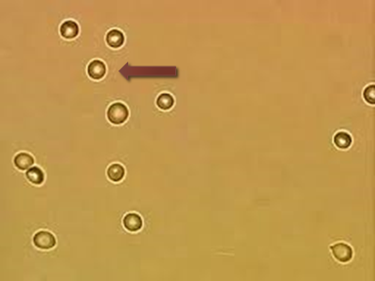
Nephritic syndrome
introduction:
When we say Nephritic, it means a clinical pattern of presentation for a group of glomerulonephritis, and not a syndrome like what we saw in Nephrotic causes.
The Nephritic pattern is always indicative of underlying inflammatory process in the glomeruli; causing inflammatory modulators attraction, cellular proliferation and eventually glomerular permanent dysfunction if left untreated.
The Glomerular mesangium, endothelium and Glomerular basement Membrane components of the Glomerulus are likely going to be targeted because of their proximity to blood circulation
Urine Analysis:
RBCs In renal cell carcinoma, stone in the renal pelvis, the bladder or prostate → when they bleed there will be no change in the shape of RBCs.
Dysmorphic RBCs (RBCs lose their smooth surface passing through the cracks in inflamed glomerular capillary wall) considered a red flag for glomerular inflammation that has not manifested yet (critical).
RBC casts or cellular casts formed by naturally occurring Tamm-Horsfall mucoprotein in the distal tubules & collecting ducts when they become loaded with RBCs coming from the inflamed Glomerulus (due to GN) Dysmorphic RBCs & RBC casts are called Active Urinary Sediments when seen under microscope in urine sample (Active = indicative of underlying glomerular inflammatory process; requiring urgent medical attention)
Proteinuria (at variable amounts from subnephrotic to nephrotic range) ○Those are called Active Urinary Sediments (Active = is indicative of underlying glomerular inflammatory process; requiring urgent medical attention)
Normal looking RBCs in microscopy
RBCs casts
Dysmorphic RBCs
Nephritic clinical manifestations:
1
AKI
Decreased Urine output
Edema ¹
(Acute Kidney Injury) =Acute Renal impairment or Failure= elevated Creatinine) & electrolytes imbalance.
2
3
4
5
Systemic vasculitis
Positive immune markers
High Blood Pressure
May have other manifestations of systemic vasculitis since some glomerulonephritis types are actually vasculitis (e.g. skin rash, pulmonary hemorrhage , etc)
6
ANA, Anti-DNA, low complements, +ve ANCA (depends on the cause)
1- Filtration barrier disrupted → decrease in GFR → RAAS activation → Fluid retention.

Slide 13
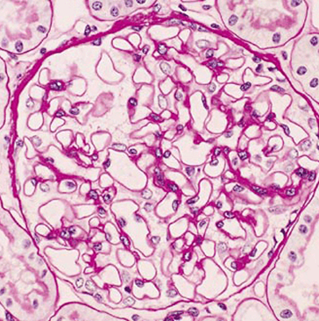
Nephritic syndrome
Microscopic findings:
LM:
Glomeruli with proliferation (inflammatory) GN
Normal glomerulus
LM: Glomeruli with crescent¹ (very bad!):
- indicates severe inflammation & worse outcome if not treated in a short time from presentation
Renal diseases that can present with nephritic picture:
IgA Nephropathy / HSP (Henoch-Schönlein purpura)
Post streptococcal glomerulonephritis (PSGN)
Lupus Nephritis
Anti-GBM (Goodpasture's disease)
ANCA vasculitis ( e.g. Wegener's Granulomatosis)
Membranoproliferative GN (MPGN)
1- Proliferation of parietal cells of bowman’s capsule is a MEDICAL EMERGENCY IN NEPHROLOGY. we have to treat the patient in the same night with immunosuppression, if you don't treat him, patient will develop ESKD within days or weeks.

Slide 14
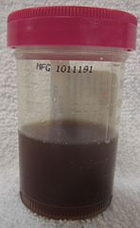
IgA Nephropathy (Berger’s disease)/ HSP (Henoch-Schönlein purpura) ⁴
General characteristics:
Most common type of Primary GN in developed countries
IgA nephropathy tends to occur in children and young males
Can present actively and can be silent.asymptomatic microscopic haematuria or recurrent macroscopic haematuria following an upper respiratory or gastrointestinal viral infection.
Surprisingly, recurrent macroscopic haematuria is a good prognostic sign, although this may be due to ‘lead- time bias’ , as patients with overt haematuria come to medical attention at an earlier stage of their illness.
It has a chronic course that may or may not worsen.
HSP (Henoch-Schönlein purpura) is a systemic vasculitis caused by immune deposition of IgA in different organs; typically skin, bowel and kidneys.
Microscopic findings:
LM:
IF:
Pathophysiology
It is thought to be secondary to altered mucosal immunity that leads to excessive IgA synthesis¹ followed by deposition in the glomeruli.
Can present as dark urine² (hematuria) 1-3 days³ after upper respiratory tract infection. (< one week of Clinical URT infection)
01
Clinical features
Commonly picked up incidentally by finding abnormal urine analysis (Hematuria +/- Proteinuria) done for other reasons with no symptoms; e.g. pre-employment investigations.
02
1- We have IgA mainly in the upper respiratory mucosa. If there is an abnormality in IgA synthesis and inflammation occur. abnormal IgA secretion will increase → filtered by the kidney → trapped in the glomerulus → inflammation.
2- Some pt might mention when they have URTI their urine becomes darker or cola like color.
3- Synpharyngitic haematuria: intercurrently with an episode of pharyngitis.
4-when IgA affect the kidney only this is called IgA nephropathy, while HSP is systemic IgA disorder, in which the skin, kidney and other organs will be affected

Slide 15
IgA Nephropathy (Berger’s disease)/ HSP (Henoch-Schönlein purpura)
Diagnosis
There is really no effective immunosuppressive therapy except in severe cases where it can be tried.
Most important treatment is to control the blood pressure which also decreases the proteinuria. Severe proteinuria is treated with ACEi or ARB.
All patients, with or without hypertension and proteinuria, should receive an ACE inhibitor or an AII- RA, to reduce proteinuria and preserve renal function.
The diagnosis is made by finding abnormal deposition of IgA immunoglobulin in the Glomeruli, it elicits a local inflammatory response in the glomerular mesangium (mesangial expansion)
Needs kidney biopsy to reach the diagnosis
treatment
Post streptococcal glomerulonephritis (PSGN)
Possible causes:
Typically caused by throat infection with Gram positive
cocci (Group A beta-hemolytic Streptococcus (GAS).
1
But also can be caused by Staphylococcus soft tissue or bone infection in adults.
2
Bacterial Antigen cross react with glomerular antigens, or may be an immune complex (Antigen-antibody) response that is responsible.
3

Slide 16
Post streptococcal glomerulonephritis (PSGN)
Clinical features:
Patients present with frank hematuria usually after one week and up to 3 weeks¹ from the start of infection. Patients present with dark (cola-colored) urine, edema that is often periorbital, hypertension, and oliguria.
Diagnosis
Treatment is usually supportive = wait and see.
Children have better and faster recovery than adults.
Serum will show positive Antistreptolysin (ASO) titer.
Low C3, Normal or slightly low C4 in the serum.
May have positive throat culture.
treatment
Lupus Nephritis
Lupus (SLE): The Disease with a Thousand Faces. It can cause membranous nephropathy and lupus nephritis (Nephrotic and nephritis)
Kidneys can be affected by SLE like other organs.³
The degree of involvement can be from mild (or even not visible to the physician) to a very severe one causing ESRD in few months or few weeks.
Most important in dealing with these cases is having high suspicion of its presence and to start immediate workup & referral for diagnosis and treatment
Diagnosis
Lupus Nephritis treatment² depends on the findings in renal biopsy
It usually involves high degree of immunosuppressive medications.
Kidney biopsy is mandatory to make the diagnosis
Low complements ⁴ (C3, C4) level along with the positive Lupus markers (ANA, Anti DNA), abnormal urine analysis & abnormal renal function should make you think of its presence.
Treatment
1- More severe and acute than IgA and can cause renal shutdown. Non synpharyngitic (develops after a few weeks), while in IgA it may happen within 3 days.
2-Treated aggressively cuz it can lead to loss of kidney function and renal failure in weeks if not treated.
3- Long-standing SLE may simply “scar” the kidneys and biopsy will show glomerulosclerosis, which has no active inflammatory component but may lead to such damage as to require dialysis.
4- low complement in blood is due to deposition in the kidney

Slide 17
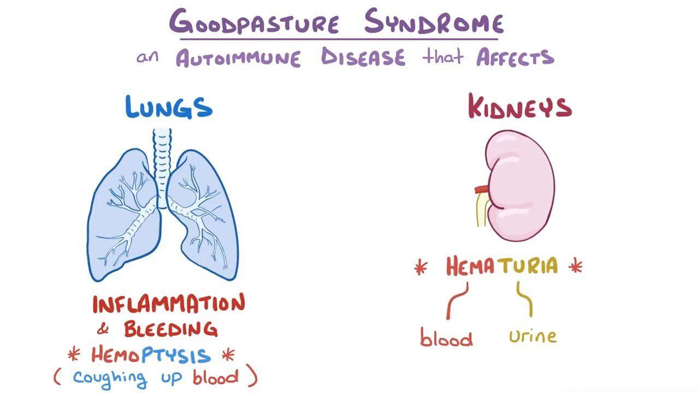
Anti-GBM glomerulonephritis
Microscopic findings:
1
Linear Anti-GBM staining in the Glomerulus by Immunofluorescence is a Diagnostic test In ANCA , IF will be negative or little
Possible causes
Due to autoantibody against (alpha-3 chain) of type IV Collagen that is found in Glomerular
and alveolar (lungs) basement membrane. ¹
Clinical features:
01
GN (can be the only presenting finding)
02
Pulmonary hemorrhage (disease is called Goodpasture’s disease if Lung vasculitis + GN)
Diagnosis
Positive test for Anti-GBM antibodies in the serum
Kidney biopsy shows the diagnostic Immunofluorescence pattern:
Linear stain of IgG and C3.
Treatment is always started immediately to remove the antibodies by Plasmapheresis and preventing further antibodies production by giving heavy immunosuppression that includes corticosteroids and cyclophosphamide
treatment
1-Specifically targets middle aged smoker women (smoking exposes their lungs collagen as an antigen, so antibodies will be released against it) this collagen is similar to the kidney basement membrane)

Slide 18
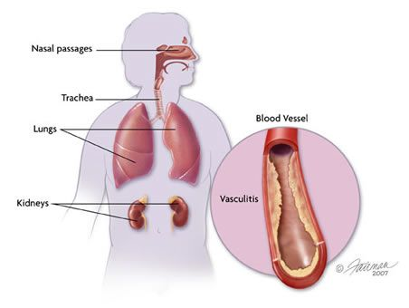
ANCA vasculitis
( e.g. Wegener's Granulomatosis)
Autoimmune disease that involves the presence of Neutrophils adhesion enhancing molecule called ANCA= anti-neutrophil cytoplasmic antibody¹, This molecule establishes vascuilitis cascade
Types ² :
C-ANCA | P-ANCA
Cytoplasmic type, more commonly causing Granulomatous Polyangiitis = old name Wegener's Granulomatosis (so a granuloma forming disease) Angiitis: means small vessels vasculitis | Perinuclear type, more commonly associated with Microscopic Polyangiitis & Churg- Strauss syndrome
Clinical features:
Upper airways and lung involvement is common and patients can present with renal and pulmonary manifestations (GN + Pulmonary hemorrhage: hemoptysis).
Diagnosis
Diagnosis is made by kidney biopsy and positive ANCA titer in the serum.
Kidney pathology will show sever Glomerulonephritis; maybe RPGN; but all staining with immunofluorescence for immunoglobulins is NEGATIVE; hence the name Pauci-Immune vasculitis or GN ( Pauci = little or non )
The best indicators of adverse prognosis are pulmonary haemorrhage and severity of renal failure at presentation.
Treatment
The sooner treatment is instituted, the greater chance there is of recovery of renal function.
It is usually an aggressive disease that should be treated with potent immunosuppressive medications (high dose corticosteroids & cyclophosphamide).
Rituximab is equally effective in inducing remission in ANCA- associated vasculitides in the short term (6–12 months), with similar adverse event rates. Rituximab may be a therapeutic option in patients who cannot tolerate cyclophosphamide, and in those whose disease is poorly controlled and who relapse while on cyclophosphamide.
1-ANCA is a neutrophil stimulating molecule that causes neutrophils to adhere to blood vessels causing vasculitis
2-P-ANCA and C-ANCA are descriptions of the staining characteristic, so if the stain for ANCA is positive in the cytoplasm it’s called C-ANCA, and if the stain is visible around the nucleus it’s called P-ANCA

Slide 19
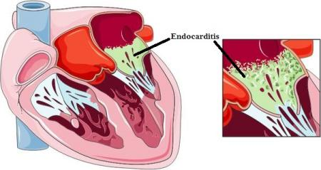
Membranoproliferative GN (MPGN)
Very complicated topic I don’t advise you to go through it’s details
It is a pathological description & has multiple causes.
It may present with Nephritic picture or Nephrotic syndrome
Types:
The primary (idiopathic) MPGN is mainly seen in children.
The secondary type is seen in adults due to:
Possible causes
Hepatitis B and C
Endocarditis
Lupus and Sjogren’s syndrome
Cancer
Complement deficiency
Syndrome | Nephrotic(NS) | Nephritic (GN)
Pathology | - Mainly a Podocytes disease present with Pathology foot process effacement +++ - Usually No Glomerular inflammation | Is an inflammatory disease involves any or all of Glomerular elements: Base Membrane, Endothelium or mesangium. Foot Processes Effacement ++
Proteinuria | > 3.5 g/Day | Variable amount from few 100s mg to grams / day
Urine microscopy | - No hematuria - + Lipids (Lipiduria) | + RBCs, + dysmorphic RBCs, + RBC casts (active sediments)
Labs | - Low serum Alb < 30 gm/L - High Cholesterol | - Low GFR ( Renal impair) - Electrolytes imbalance
Clinical | - Edema ++++ - BP maybe high | - Edema ++ depends High BP ++ - Symptoms & signs of renal impairment or vasculitis
Complications (Acute) | - Thrombosis - Infection, AKI | - RPGN ( crescentic disease) - AKI
Complication¹ (Chronic) | - Vascular Atherosclerosis -renal Tubular atrophy & Fibrosis then CKD then ESRD | Glomerular sclerosis then CKD (chronic Kidney disease) to ESRD
1- They both have the same outcome but the progression to ESKD is faster in nephritic than nephrotic syndrome

Slide 20
How to approach a patient with glomerulonephritis?

Slide 21
Nephrotic Syndrome
FSGS | Primary (autoimmune): sudden onset of heavy proteinuria & other manifestations of nephrotic syndrome. Treatment: corticosteroids Secondary: proteinuria is less heavy than other causes of nephrotic syndrome. Associated with sickle cell anemia, steroids & obesity. Treatment: treating the underlying cause. Diagnosis: Focal: some glomeruli are affected by sclerosis (the rest look normal) Segmental: sclerosis only involves a segment of each affected glomerulus but most importantly all glomeruli will have diffuse foot processes effacement (Nephrotic Syndrome)
Minimal Change | Main cause of Nephrotic Syndrome in children. Primary: Idiopathic. Secondary: Drugs (NSAIDs) Light microscopy: normal glomeruli Electron microscopy: diffuse effacement of the epithelial cells’ foot processes only The most important difference between Minimal Change Disease and FSGS is the presence of glomerular sclerosis in FSGS. Nephrotic syndrome in a child < 10 years old is MCD until proven otherwise. Clinical features: Heavy proteinuria (nephrotic range), Lipiduria, Hypoalbuminemia, Hyperlipidemia. Treatment: corticosteroids
Membranous | Most common cause of primary nephrotic syndrome in adults. Primary: Idiopathic Treatment: corticosteroids Secondary: SLE, Solid tumors Treatment: treating the underlying cause Diagnosis: Diffuse thickening of the glomerular capillary throughout all glomeruli (IgG and C3 deposition)
Secondary causes of Nephrotic Syndrome: Diabetes Mellitus

Slide 22
Nephritic Syndrome VERY BAD CRESCENTIC GLOMERULI
IgA/Henoch-Schönlein | Most common type of primary glomerulonephritis in developed countries. Can present actively and can be silent. Diagnosis: abnormal deposition of IgA in the glomeruli. Can present as dark urine (hematuria) 1-3 days after upper respiratory tract infection. Henoch-Schönlein Purpura: systemic vasculitis caused by immune deposition of IgA in different organs; typically skin, bowel and kidneys. There’s no effective immunosuppressive therapy.
Poststreptococcal | Typically caused by a throat infection with gram positive cocci (Group A Beta-Hemolytic Streptococci) Patients present with frank hematuria usually after one week and up to 3 weeks from the start of the infection. Serum will show positive ASO titer.
Anti-GBM (Goodpasture) | Due to autoantibodies against alpha-3 chain of type IV collagen that is found in glomerular and alveolar basement membrane. Clinical features: glomerulonephritis & pulmonary hemorrhage (collectively known as goodpasture's disease) Diagnosis: Linear stain of IgG and C3 under IF.
ANCA Vasculitis (Wegener’s) | Autoimmune disease that involves the presence of neutrophil adhesions enhancing molecule called ANCA (anti-neutrophil cytoplasmic antibodies) C-ANCA: Cytoplasmic type, more commonly causes Granulomatous Polyangiitis AKA Wegener's Granulomatosis. P-ANCA: Perinuclear type, more commonly associated with Microscopic Polyangiitis & ChurgStrauss Syndrome. Upper airway and lung involvement is common and patients can present with renal and pulmonary manifestations (Glomerulosclerosis & Pulmonary Hemorrhage: hemoptysis). Kidney pathology shows severe glomerulonephritis; maybe RPGN; but all staining with IF for immunoglobulins is NEGATIVE; hence the name Pauci-Immune Vasculitis or Glomerulosclerosis (Pauci = little or none)

Slide 23
Q1: A 21-year-old man presents with painless haematuria which he has noticed in the last 3 days. He suffers from type 1 diabetes which is well controlled, but is otherwise fit and healthy. The patient has recently recovered from a mild throat infection. Urine dipstick analysis reveals blood and protein in the urine. The most likely diagnosis is:
A- Henoch–Schonlein Purpura
B- Benign Prostatic Hypertrophy
C- IgA Nephropathy
D- Diabetic Nephropathy
Q2: A 64-year-old woman with type 1 diabetes presents to clinic with several months of sinus problem and a 4-day history of oliguria. Her blood pressure is 137/80, serum results show mildly elevated urea and creatinine, absence of anti-GBM antibodies, while a C-ANCA assay is positive. Red blood cell (RBC) casts are present in the urine and her renal biopsy reveals glomerular crescents. The most likely diagnosis is:
A- Post-streptococcal Glomerulonephritis
B- Goodpasture’s Syndrome
C- Minimal Change Glomerulonephritis
D- Wegener's Granulomatosis
Q3: A 38-year-old woman presents with newly diagnosed Hodgkin lymphoma associated with bilateral lower extremity edema. Lab workup reveals 10g of proteinuria on a 24-hour urine collection. Which of the following pathological entities most likely explains the presence of proteinuria in this patient?
A- Membranous Nephropathy
B- Minimal Change Disease
C- Focal Segmental Glomerulosclerosis
D- IgA Nephropathy
Q4: A 50-year-old white man presents with mild hypertension, nephrotic syndrome, microscopic hematuria, and venous thromboses (including renal vein thrombosis). Renal biopsy reveals a thickened glomerular basement membrane with subepithelial immunoglobulin deposition. The most likely diagnosis is:
A- IgA Nephropathy
B- Anti-glomerular Basement Membrane Disease
C- Focal Segmental Glomerulosclerosis
D- Membranous Nephropathy
Q5: Patient presents to the clinic complaining of blood in the urine. Patient says I had a sore throat 2 weeks ago after that I felt pain in my joints then this morning I saw blood in my urine. What is the most likely diagnosis?
A- Post-streptococcal Glomerulonephritis
B- Membranous Nephropathy
C- ANCA Vasculitis
D- IgA Nephropathy
Answers: Q1:C | Q2:D | Q3:B | Q4:D | Q5:A |

Slide 24
THANKS!!
This lecture was done by:
Rema Almutawa
Maha Alnahdi
Nawaf Albhijan
Quiz and summary maker:
Ghaida AlBraithen
Note taker:
Lama Alzamil
Mohammad Alqahtani
Females co-leaders:
Raghad AlKhashan
Amirah Aldakhilallah
Males co-leaders:
Mashal Abaalkhail
Ibrahim AlAsous
Send us your feedback:
We are all ears!

