Slide 1
Filled by the lecture leader
Lecture 23
Editing file
Chronic Diarrhea
Objectives:
To have an overview regarding chronic diarrhea:
Definition.
Pathophysiology.
Classification.
Approach.
To discuss common causes of chronic diarrhea:
Celiac Disease.
Whipple Disease.
Tropical Sprue.
Small Bowel Bacterial Overgrowth.
Exocrine Pancreatic Insufficiency.
Bile Salt-Induced Diarrhea.
Color index:
Color index:
Original text Females slides Males slides
Doctor’s notes Text book Important Golden notes Extra

Slide 2
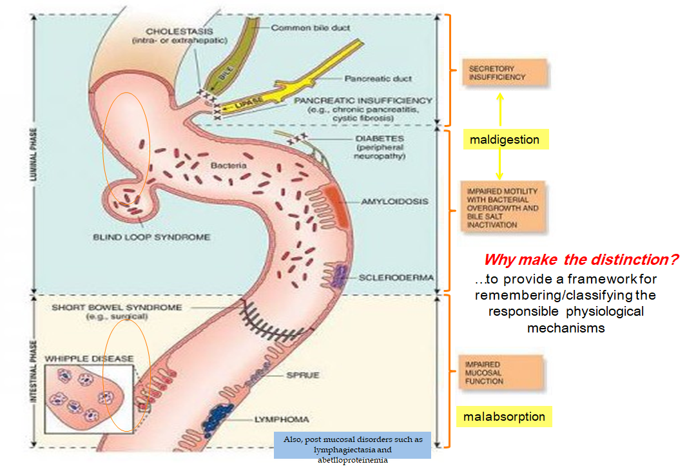
Diarrhea
Definitions
Diarrhea: A change in consistency (subjectively become loose) or volume of liquid in the stool or increased frequency
Acute Diarrhea: <2 wks (Usually due to infectious causes)
Subacute Diarrhea: 2-4wks
Chronic Diarrhea: >4-6 wks
Maldigestion: Inadequate breakdown of large molecules.
Malabsorption: Inadequate mucosal transport of digested products to the blood stream
Pathophysiology
Each day, 9–10L of fluid enter the jejunum. Small intestine absorbs 90% of this fluid load.
The colon absorbs 90% of the remaining load (about 900 ml/24 hours); leaving approximately 80–100 ml excreted each day in feces. (normal)
A normal colon can compensate (if there is diarrhea) by absorbing up to 3000–4000 ml/24 hours. the colon can’t adapt for more than 4L
So, Which one will cause LARGE VOLUME diarrhea; Small or large bowel disease?
Small bowel, because normally it absorb most of the fluid (9L)
Classification of Diarrhea
Fatty
Non-inflammatory
Secretory
Diarrhea
Watery
Osmotic
Inflammatory
OVERVIEW:
- Sudden onset of bowel frequency associated with crampy abdominal pains, and a fever, will point to an infective cause
- bowel frequency with loose, blood-stained stools to an inflammatory basis
- The passage of pale, offensive stools that float, often accompanied by loss of appetite and weight loss, to steatorrhoea.

Slide 3
Common medications and toxins associated with diarrhea
Fecal Osmotic Gap (FOG)
Acid-reducing agents (H2 blockers, PPIs).
Magnesium-containing antacids.
Antiarrhythmics (eg, digitalis, quinidine).
Antibiotics.
Antineoplastic agents.
Antiretrovirals.
Beta blockers.
Colchicine.
Levothyroxine.
SSRIs.
Furosemide.
Metformin.
NSAIDs, ASA.
Prostaglandin analogs (ie, misoprostil).
Theophylline.
Amphetamines.
Caffeine.
Alcohol.
Narcotic/opioid withdrawal.
Narcotic it self can cause constipation, after withdrawal Diarrhea ensue
Watery Diarrhea
Osmotic Diarrhea
Poorly absorbed substances that remain in the lumen of the intestine and obligate retention of water within the lumen by virtue of their osmotic effects
Osmotic diarrhea is RELIEVED by fasting
Fecal osmotic Gap = 290 - 2( stool Na + stool k )
>50 mOsm/Kg is Suggestive of an osmotic diarrhea
>100 mOsm/Kg is more specific (Definitive!)
Ingestion of poorly absorbed agent
Loss of nutrient transporter
Carbohydrate malabsorption: diet high in Fructose or sugar alcohols
Diuretics: Mannitol
Osmotic laxatives: Magnesium, phosphate, sulfate, sorbitol, lactulose
Lactose intolerance (due to lactase deficiency)
Disaccharidase deficiency
Glucose-galactose malabsorption

Slide 4
Watery Diarrhea
1. Watery | Osmotic | B. Secretory
Overview | Poorly absorbed substances that is osmotically active remain in the intestine and exert osmotic effect > obligate retention of water within the lumen by virtue of their osmotic effects. There is actively osmotic agent (lactose) within lumen preventing water from being absorbed this agent will bind to water and increase water content in the stool → diarrhea. | Malabsorption or secretion of electrolytes and water.
Effect of Fasting | Fasting improve the condition | Lack of response to fasting
Secretory Diarrhea
There is both active intestinal secretion of fluid and electrolytes, and decreased absorption.
How to differentiate between Osmotic and Secretory ?
Diagnostic fast test: Osmotic diarrhea is RELIEVED by fasting, while secretory diarrhea does NOT respond to fasting !
Fecal osmotic gap:
>100 mOsm/kg → Osmotic diarrhea
<50 mOsm/kg → Secretory diarrhea
Causes include:
1
2
3
Infections: The most common cause is a bacterial toxin.
Pancreatic insufficiency
Inflammation & Dysregulation: Diverticulitis, Vasculitis, microscopic colitis, Gastroenteritis
4
5
6
1. Watery | Osmotic | B. Secretory
FOG | Fecal osmotic gap (FOG) of > 50 mosm/kg is suggestive of an osmotic diarrhea and a gap of >100 mosm/kg is more specific. | Low fecal osmotic gap.
Causes | Loss of nutrient transporter (causes Malabsorption) e.g. lactase deficiency, lactose intolerance, celiac disease. Ingestion of poorly absorbed agents (called Osmotic laxatives) eg. Fructose, Mannitol, Sorbitol, Lactulose, Magnesium, Phosphate, Sulfate (all cause osmotic diarrhea). | Circulating secretagogues (endocrinopathies), as in Addison's disease, Hyperthyroidism, Carcinoid syndrome, Pheochromocytoma, Gastrinoma, VIPoma, Somatostatinoma. Pancreatic Insufficiency. Bile Acid-Induced Diarrhea: Ileal bile acid, malabsorption. Abnormal motility: DM-related dysfunction, IBS, Post-vagotomy diarrhea. Malignancy: Colon CA, Lymphoma, Rectal villous adenoma. Vasculitis. Congenital chloridorrhea. Idiopathic: Epidemic (Brainerd), Sporadic. Medications, stimulant laxative abuse, toxins.
Absence of an ion-transport mechanism.
Reduction of mucosal surface area by surgery or disease.
Congenital chloridorrhea
7
8
9
Bile Acid induced diarrhea: Ileal bile acid malabsorption.
Idiopathic: Epidemic (Brainerd), Sporadic.
Medications (NSAIDs, Colchicine), stimulant laxative abuse, toxins.
10
11
12
Malignancy: Colon CA, lymphoma, rectal villous adenoma
Abnormal motility: DM-related dysfunction, IBS, Post-vagotomy diarrhea.
Circulting secretagogues (endocrinopathies): as in Addison's disease, Hyperthyroidism, Carcinoid syndrome, Pheochromocytoma, Gastrinoma (a.k.a ZE syndrome) VIPoma, Somatostatinoma.
An area for your notes

Slide 5
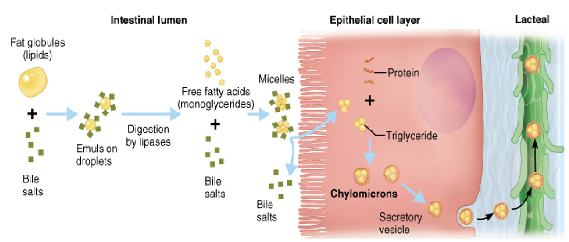
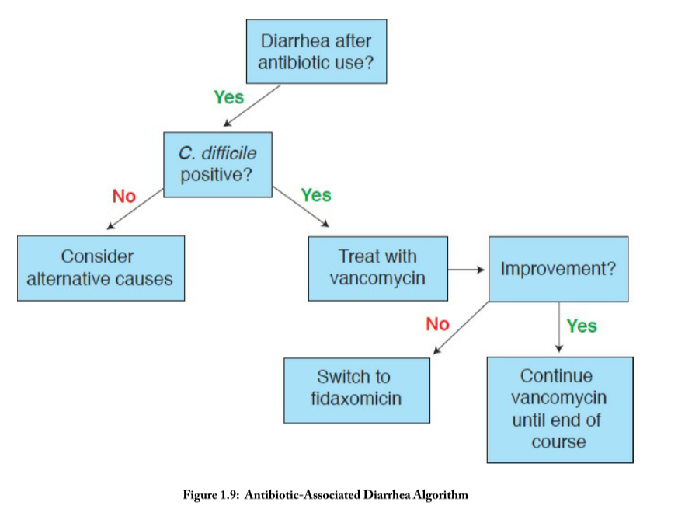
2) Fatty Diarrhea (Steatorrhea)
Present with Bloating, flatulence, greasy malodorous stools that is foul smelling and difficult to flush
Weight loss, s/s of vitamin deficiencies¹ (peripheral neuropathy, easy bruising)
Iron deficiency anemia, coagulopathy, hypoalbuminemia, osteopenia.
Malabsorption
inadequate mucosal transport of digestion products
Maldigestion
inadequate breakdown of triglycerides
Mucosal diseases (eg, Celiac sprue, Whipple’s disease).
Mesenteric ischemia.
Structural disease: Short bowel syndrome, Post-resection diarrhea.
Small bowel bacterial overgrowth (bile salt deconjugation).
Lymphatic obstruction (Due to radiation, infection, Lymphoma)
Pancreatic exocrine insufficiency (eg, chronic pancreatitis, CF).
Inadequate luminal bile acid concentration (eg, advanced primary biliary cirrhosis).
3) Inflammatory Diarrhea
Presents as small volume diarrhea with Blood, mucus, and pus, with abdominal pain and fever.
Positive fecal leukocytes, gross or occult blood, ESR/CRP, leukocytosis , Persists on fasting.
Causes/DDx
Inflammatory bowel disease: |  |  | Ischemic colitis. Radiation colitis. Neoplasia: Colon cancer Lymphoma
Ulcerative colitis, Crohn's disease, Diverticulitis, Ulcerative jejunoileitis.
Infectious diseases:³
Pseudomembranous colitis (Clostridium difficile infection)² Invasive bacterial infections (e.g., some types of E. Coli, Shigella, TB, MAC, yersiniosis) Ulcerating viral infections (e.g., cytomegalovirus, Herpes simplex) Invasive parasitic infections (e.g., amebiasis, strongyloides).
1. Fat soluble vitamins (AKED)
2. Diarrhoea occurs in the first few days after taking the antibiotic or even up to 6 weeks after stopping the drug. The causative agent is C. difficile. First-line antimicrobial therapy involves metronidazole (500 mg orally 3 times daily for 10 days) or vancomycin (125 mg orally 4 times daily for 7–10 days). Although vancomycin is more effective than metronidazole against hypervirulent C. difficile strains (e.g. ribotype 027), it is more expensive and may drive the emergence of vancomycin resistance in other organisms (e.g. enterococci, Staph. aureus). For these reasons, some authorities reserve its use for relapse (15–30% of patients), failure of initial response or severe infection.
3. SEECSY: Salmonella, E.coli, Entamoeba, Campylobacter, Shigella, Yersinia enterocolitica

Slide 6
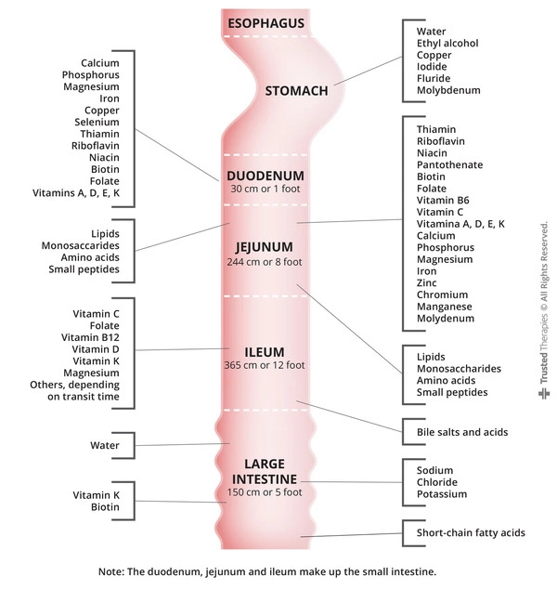
Malabsorption
Why this is important?
You expect abnormalities when resecting a certain part of the GI.
Disease of terminal ileum → Vit. B12 deficiency
Disease of the colon → Vit. K deficiency
(coagulopathy and megaloblastic anemia).
Nutrient / vitamin absorption¹
Duodenum/Jejunum | Ileum
Carbohydrates / simple sugars. Fats. Amino Acids. Iron. Fat Soluble Vitamins (A, D, E, K). Calcium. Magnesium. Minerals. | Vitamin B12. Bile salts. Magnesium.
 | Colon
 | Short-chain fatty acids. Vitamin K * Vitamin B7 (Biotin) * * Produced by bacterial gut flora.
Signs / Symptoms of Malabsorption
Malabsorption of | Clinical features | Lab findings
Calories | Weight loss w/ normal appetite | -
Fat | Pale voluminous stool, steatorrhea | Stool fat >6 g daily
Protein | Edema, muscle atrophy, amenorrhea | Low albumin, low protein
Carbohydrates | Watery diarrhea, flatulence, milk intolerance | Stool pH < 6²; stool osmotic gap >100; increased breath hydrogen
Vitamin B12 | Anemia, subacute combined degeneration of spinal cord (paresthesias, ataxia, loss of position/ vibratory sense), hypersegmented neutrophils, neuropathy | Macrocytic anemia; low B12 level; increased MMA and homocysteine levels; abnormal Schilling test
Folic acid | Anemia | Macrocytic anemia; decreased serum/RBC folate; increased homocysteine level
Iron | Anemia, glossitis, pagophagia | Microcytic anemia; decreased serum iron and ferritin levels; increased TIBC
Calcium and Vitamin D | Paresthesia, tetany, pathologic fractures, positive Chvostek and Trusseau signs, osteoporosis | Low serum calcium; abnormal DEXA; elevated Alk Phos
Vitamin A | Follicular hyperkeratosis, night blindness | Decreased serum carotene
Vitamin K | Easy bruising, bleeding disorders | Elevated INR; decreased Vitamin K-dependent coagulation factors (2, 7, 9, 10)
Vitamin B (general) | Cheilosis, painless glossitis, angular stmatitis, acrodermatitis | -
Common Medications and Toxins Associated with Diarrhea
Acid-reducing agents (H2 blockers, PPIs).
Magnesium-containing antacids.
Anti-arrhythmics (eg, digitalis, quinidine).
Antibiotics.
Anti-neoplastic agents.
Antiretrovirals.
Beta blockers.
Colchicine.
Levothyroxine.
SSRIs.
Furosemide.
Metformin.
NSAIDs, ASA.
Prostaglandin analogs (ie, misoprostil).
Theophylline.
Amphetamines.
Caffeine.
Alcohol.
Narcotic/opioid withdrawal.
Why this is important? You expect abnormalities when resecting a certain part of the GI. For eg, disease of the terminal ileum → Vit. B12 deficiency. Disease of the colon → Vit. K deficiency (coagulopathy and megaloblastic anemia).
due to colonic bacterial fermentation to CO2, H2, and short chain FA

Slide 7
How to approach a patient with diarrhea?
History
Physical examination
General (Fluid balance, nutrition)
Skin (Flushing, rashers, dermatographism)
Thyroid (Masses)
Chest (Wheezing)
heart (murmur)
Abdomen (Hepatomegaly, mass, ascites, tenderness)
Onset
Congenital, abrupt or gradual
Pattern
Continuous, intermittent
Duration
Acute, Subacute, Chronic
Epidemiology
Travel, Food, water
Stool characteristics
Watery, bloody, fatty
Fecal incontinence
Abdominal pain
IBD, IBS or ischemia
Weight loss
Malabsorption,Neoplasm
Aggravating factors
Diet, stress
Mitigating factors
Diet, OTC or Rx drugs
Previous evaluation
Iatrogenic diarrhea
Drugs, radiation, surgery
Factitious diarrhea
Laxatives
Systemic diseases
Hyperthyroidism, DM, Collagen vascular disease, tumor syndromes, AIDS, Ig deficiencies
Physical examination
General
Fluid balance, nutrition
Chest
Wheezing
Skin
Flushing, rashers, dermatographism
Thyroid
Masses
Heart
Murmur
Abdomen
Hepatomegaly, mass, ascites, tenderness
Anorectal
Sphincter competence, Fecal occult, blood test
Extremities
Edema
Routine laboratory tests
CBC
Anemia*, leukoctosis** *As a consequence of nutrients deficiency or GI bleeding **Seen in inflammatory etiologies
Chemistry screen
Fluid electrolyte, nutritional status and serum protein/ globulin
Stool analysis
Weight
Electrolytes
Osmotic gap
pH¹
carbohydrates malabsorption
Fecal occult blood testing
Bleeding
Stool WBCs
inflammation
Fat output
Sudan stain Quantitative
Laxative screen
Because if the CHO didn't get absorbed, the normal flora will fermit them generating acidic radicals

Slide 8
How to approach a patient with diarrhea?
Special laboratory tests
Physical examination
General (Fluid balance, nutrition)
Skin (Flushing, rashers, dermatographism)
Thyroid (Masses)
Chest (Wheezing)
heart (murmur)
Abdomen (Hepatomegaly, mass, ascites, tenderness)
Stool culture (more useful only for acute), An ova and parasite (O&P) exam, Giardia Ag, C diff, Coccidia, Microsporidia, Cryptosporidiosis.
Fecal leukocytes (or marker for neutrophils: lactoferrin or calprotectin).
Fecal occult blood.
Stool electrolytes for osmolar gap = 290 – 2[Na + K].
Fat content (48h or 72h quantitative or Sudan stain).
Laxative screen (if positive, repeat before approaching pt).
Imaging:
Small bowel series.
CT/MRI or CT/MR enterography.
Endoscopy with small bowel biopsy and aspirate for quantitative culture. (Esp. for celiac disease)
Colonoscopy, including random biopsies. (Esp. for IBD)
An area for your notes

Slide 9
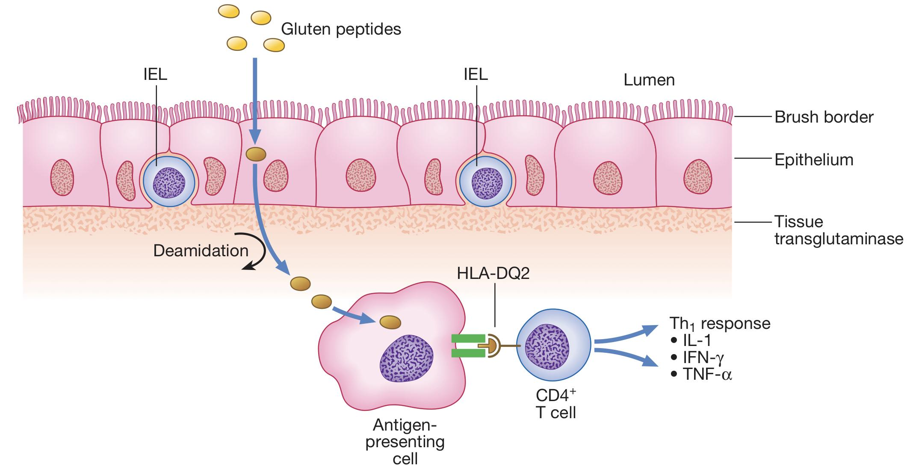
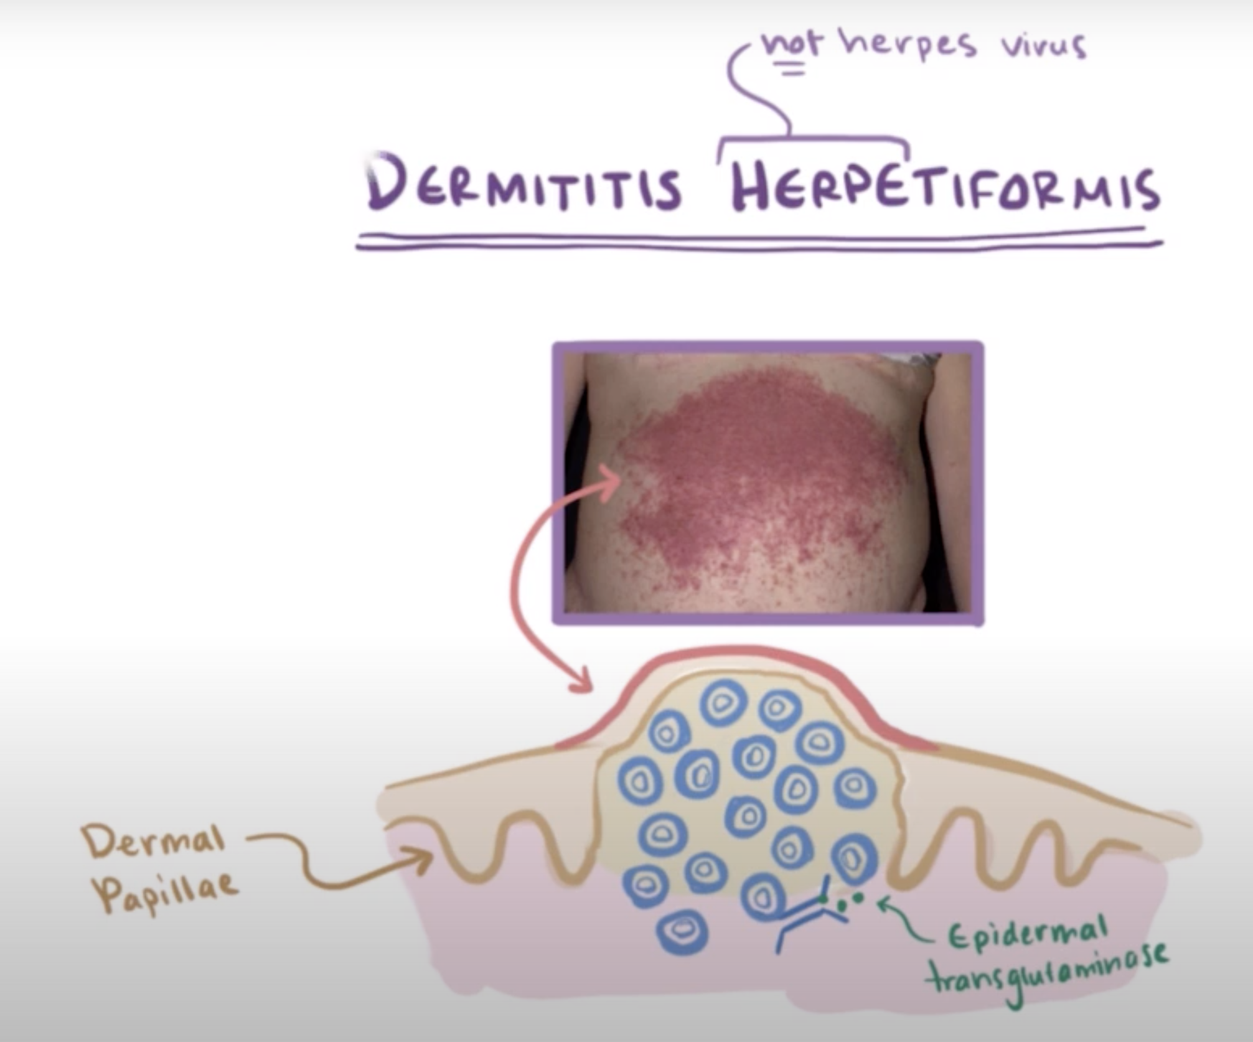
Celiac Disease¹
Introduction
Introduction
Small intestinal² malabsorption of nutrients following the ingestion of wheat gluten or related proteins from rye, barley and oats.
A characteristic, though not specific, villous atrophy of the small intestinal mucosa.
Prompt clinical and histologic improvement following strict adherence to a gluten free diet.
Clinical and histologic relapse when gluten is reintroduced.
The disease affect the mucosa with marked variation.
Loss of normal villous structure (flattening)
Intestinal crypts are elongated and open onto a flat absorptive surface.
Leaky mucosa with increased permeability due to structural changes of the tight junctions between damaged absorptive cells.
Marked increase in cellularity of the lamina propria – plasma cells and lymphocytes.
Pathophysiology
1
The disease affect the mucosa with marked variation ⟹Loss of normal villous structure (flattening) ⟹ Intestinal crypts are elongated and open onto a flat absorptive surface.
2
Leaky mucosa with increased permeability due to structural changes of the tight junctions between damaged absorptive cells.
3
Marked increase in cellularity of the lamina propria – plasma cells and lymphocytes.
Asymptomatic.
Non-specific GI symptoms:
Diarrhea.
Bloating.
Dyspepsia.
Nutritional deficiency:
Anemia (Iron & folate).
Osteoporosis.
Fat soluble vitamin deficiencies:
Vit A: poor night vision, follicular hyperkeratosis.
Vit D: hypocalcemia, osteoporosis.
Vit K: easy bruising & bleeding, elevated INR.
Dermatitis herpetiformis.
Elevated ALT & AST.
Malignancy.
T-cell lymphoma.
Small bowel adenoCa.
Presentations
Non-specific GI symptoms
Nutritional deficiency
Fat soluble vit. deficiencies
Malignancy
Other
Most common:
Diarrhea.
Bloating.
Dyspepsia.
Vit A: poor night vision, follicular hyperkeratosis.
Vit D: hypocalcemia, osteoporosis.
Vit K: easy bruising & bleeding, elevated INR.
T-cell lymphoma.
Small bowel adenoCa.
Dermatitis herpetiformis.⁵
Elevated ALT & AST.
Asymptomatic⁴
Anemia⁶
(Iron & folate).
Osteoporosis.
At Risk³
IgA deficiency (2-3%).
Type 1 DM (3-6%).
Autoimmune thyroid disease (6-8%).
Connective tissue disease.
Down’s syndrome.
Autoimmune disease that is positive in serology, complicated when uncontrolled, differ from gluten intolerance that has no microscopic abnormalities or antibodies.
Endoscopic biopsy (GOLD standard) taken from the duodenum because it is the first contact with gluten,
If these patients present with non-specific GI symptoms, you should think of celiac
If you diagnosed someone with CD, you have to screen 1st degree relatives. You may find structural abnormalities with no symptoms. There is a strong genetic component, with around 10% of first-degree relatives of an index case affected, and there is strong (approximately 75%) concordance in monozygotic twins.
If they start gluten-free strict diet, it will disappear but some patients require additional treatment with dapsone
CBC may show microcytic or macrocytic anaemia from iron or folate deficiency and features of hyposplenism (target cells, spherocytes and Howell–Jolly bodies).

Slide 10
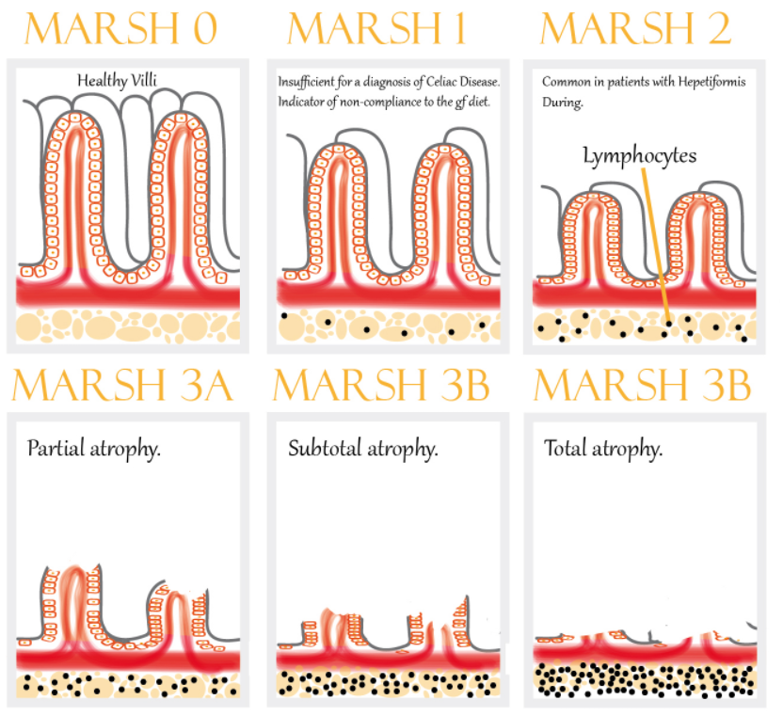
Celiac Disease Cont’
Serology
Anti-tissue transglutaminase antibody (IgA):¹
Endomysial antibody (IgA):
Sensitivity 95%; specificity 97.5%.
BEST INITIAL
Sensitivity 85-98% (~93)
Specificity 97-100% (~99).
IgA anti-gliadin antibodies:
IgG anti-gliadin antibodies:
Sensitivity 75-90% (~80)
Specificity 82-95% (~85).
Sensitivity 69-85% (~75) Spec 73-90% (~80).
Can be used in IgA deficient patients.
Diagnosis
Endoscopy: might be Normal.²
Loss of mucosal folds, Crypt hyperplasia
Flattening of mucosa. (Villous atrophy)
Scalloping of mucosa. Ulcerations.
HLA- DQ2 is present in 90–95% of coeliac disease patients and HLA- DQ8 in about 8%
Biopsy histology: MARSH classification
Management
Education: most common reason for failure to improve with dietary treatment is accidental or unrecognised gluten ingestion
Gluten-free diet: avoid wheat, barley, rye & oat.
Correct nutritional deficiencies (Iron, Ca, Vit D, folate).
Anticipate complications.
As the disease progress, there is more villous atrophy and leukocytosis
Whipple Disease
Chronic systemic infection by Tropheryma whipplei. (an intracellular gram-positive bacteria)
Has GI, CNS, CVS, MSK & skin manifestations.
Pathophysiology
Malabsorption – weight loss, diarrhea (watery or fatty³) and abdominal pain:
Caused by bacterial and macrophage-predominant inflammatory cell infiltration of the small intestinal mucosa and obstruction of mesenteric lymph nodes.
1) If the antibody screen is positive, adult patients should remain on a gluten-containing diet until duodenal biopsies are taken. High-titre serology in children can be diagnostic without the need for endoscopy and biopsy. Antibody titres usually become negative with successful treatment.
2) Endoscopic appearances should not preclude biopsy, as the mucosa usually looks normal. As the histological changes can be patchy, an adequate number of biopsies – currently, more than four biopsies from the second part of the duodenum plus one from the duodenal bulb – should be retrieved.
3) Fatty diarrhea because of lymphatic obstruction

Slide 11
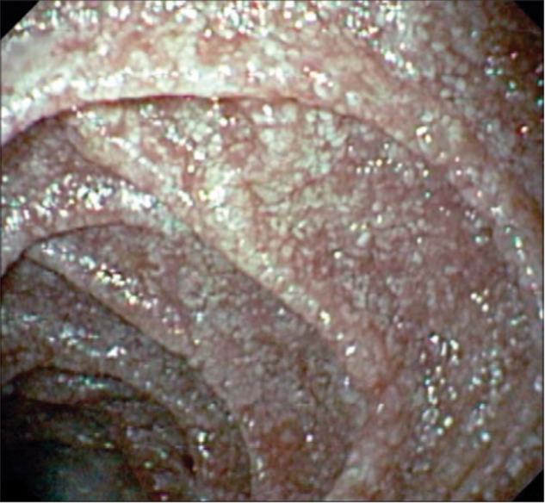
Whipple Disease Cont’
PAS the foamy Whipped cream in a CAN
Effect of The Disease on Other Organs or Systems¹
Neurologic:
CVS:
Progressive dementia.
Supranuclear ophthalmoplegia.
Altered LOC.
Oculo-masticatory & oculo-facial skeletal dysfunction.
Endocarditis – MV most common.
Myocarditis.
Pericarditis.
MSK:
Skin (common):
Seronegative oligo or polyArthralgias.
Hyperpigmentation.
Histopathology
Foamy macrophages on routine H&E.
Numerous PAS-positive granular particles² (pink/purple appearing):
Lysosomes filled with T. whipplei.
Diagnosis
Diagnosis is made by the characteristic features on small bowel biopsy, with characterisation of the bacillus by polymerase chain reaction (PCR).
Whitish to yellow plaque-like patches in 75% of patients (representing lipid droplets and/or lymphangiectasia).
Management
2 weeks with Abx to cross BBB:
Ceftriaxone 2g IV daily monotherapy THEN Septra (TMP/SMX) DS tab BID x 1 year.³
OR Penicillin G (2 MU IV q4h) PLUS streptomycin THEN Septra (TMP/SMX) DS tab BID x 1 year
Low-grade fever is common and most patients have joint symptoms to some degree, often as the first manifestation. Occasionally, neurological manifestations may predominate and CNS involvement is the most serious consequence.
periodic acid–Schiff (PAS) very specific for whipple disease
Long-term follow-up is essential, as clinical relapse occurs in up to one-third of patients, often within the CNS; in this case, the same therapy is repeated or else treatment with doxycycline and hydroxychloroquine is necessary.
Central Nervous System:
Progressive dementia.
Supranuclear ophthalmoplegia.
Altered LOC.
Oculo-masticatory & oculo-facial skeletal dysfunction.
Cardiovascular System:
Endocarditis – MV most common.
Myocarditis.
Pericarditis.
Musculoskeletal:
Oligo or polyarthralgias.
Skin (common):
Hyperpigmentation.

Slide 12
Small Bowel Bacterial Overgrowth (SBBO)
Normal Microbiome
Normal Microbiome | Jejunum 0-10⁴: Gram +ve aerobes (oral streptococci, lactobacillus); no gram –ve aerobes. Ileum 10⁵-10⁹. Colon 10¹⁰-10¹²: Anaerobes: bacteroides, peptostreptococcus, lactobacillus, bifidobacterium, clostridium. Facultative aerobes: e. coli, enterococcus, staphylococcus.
1
Stomach 0-10³ CFU/ml.
2
Jejunum 0-10⁴:
Gram +ve aerobes (oral streptococci, lactobacillus); no gram –ve aerobes.
3
ileum 10⁵-10⁹.
4
Colon 10¹⁰-10¹²:
Anaerobes: bacteroides, peptostreptococcus, lactobacillus, bifidobacterium, clostridium.
Facultative aerobes: e. coli, enterococcus, staphylococcus.
Notice the increasing concentration throughout the tract
Normal barriers that prevent SBBO (a.k.a blind loop syndrome)
Gastric acid & pancreatic enzymes
What disrupts this barrier? chronic pancreatitis, low HCl from surgery, pernicious anemia, partial gastrectomy or Long Term PPI.
Intact bowel structure
What disrupts this barrier? Surgery, diverticulum. because of bowel stasis
Cleansing effect of bowel motility – interdigestive migrating motor complex
What disrupts this barrier? dysmotility (Systemic sclerosis, Diabetic autonomic neuropathy, Chronic intestinal pseudo-obstruction)
Gut immunity – intraluminal secretory IgA
What disrupts this barrier? immunodeficiency (Eg, hypogammaglobulinemia)
Competent ileocecal valve
What disrupts this barrier? scarring from inflammation, surgery
Competition by other bacteria
What disrupts this barrier? antibiotics.

Slide 13
Small Bowel Bacterial Overgrowth (SBBO)
Effect of SBBO
1
Bile acids metabolism → deconjugated bile acids. (Bile is important for fat absorption)
3
CHO metabolism → C02, H2, D-lactic acid, organic acids (short chain fatty acids).
2
Bilirubin metabolism → Deconjugated bilirubin.
4
Lipid metabolism → short chain fatty acids.
Protein metabolism → amines, ammonia
Investigations¹
Jejunal culture – Gold standard. (If >10⁴ it’s abnormal)
Schilling’s test: determine whether you're absorbing vitamin B-12 properly
(Explained Next slide)
C14-labeled bile acid breath test.
C14-xylose breath test.
H breath test.
Presentation
Bloating, watery diarrhea, abdominal pain, weight loss, neuropathy.
Iron deficiency.
Hypoproteinemia, hypoalbuminemia.
Fat and CHO malabsorption.
B12 deficiency¹ – utilized by the bacteria for nutrition.
Elevated folate² level - produced by bacteria.
Vitamin A,D,E,K deficiency: therefore bruising, night blindness, bone diseases.
Management
Treat underlying cause: Most important thing.
e.g. discontinue acid suppressive meds, treat inflammatory Crohn’s disease, remove strictures, etc.
Nutrition – replace fat soluble vitamins, B12:
Low CHO diet to limit bacteria substrate.
1
2
7 – 10 days of antibiotics:
Metronidazole, Amox/Clav, Tetracycline, Doxycycline, Amoxicillin.
May need to cycle Abx to avoid resistance.
If breath testing reveals high methane production, addition of neomycin may be beneficial.
3
Bowel cleanse with PEG, Prokinetic.
Octreotide – at low dose, has a promotility effect: Causes hypomotility at higher doses.
Probiotics – minimal evidence.
4
leading to anemia
There is NORMAL to ELEVATED folate; in contrast to extensive celiac disease or bowel resection

Slide 14
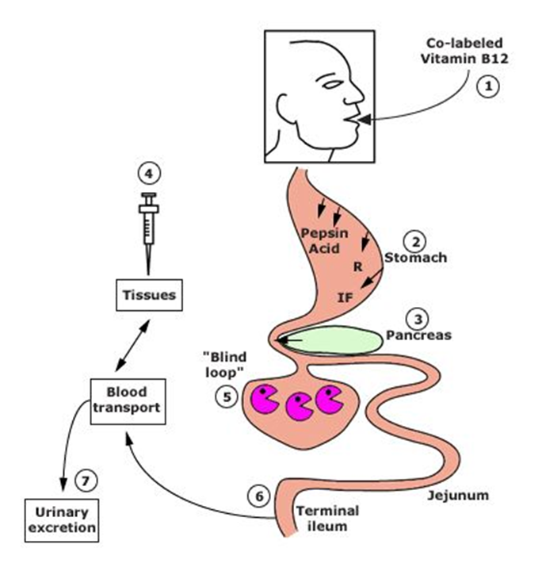
Small Bowel Bacterial Overgrowth (SBBO) Con.
Schilling’s Test
Differential Results of The Schilling Tests in Several Diseases Associated With Cobalamin Malabsorption
Cause of Fat Malabsorption | ⁵⁸Co-Labeld Cobalamin | With Intrinsic Factor | With Pancreatic Enzymes | After 5 Days of Antibiotics
Pernicious Anemia | Reduced | Normal | Reduced | Reduced
Chronic Pancreatitis | Reduced | Reduced | Normal | Reduced
Bacterial Overgrowth | Reduced | Reduced | Reduced | Normal
Ileal Disease | Reduced | Reduced | Reduced | Reduced
Malabsorption of vitamin B12 may occur as a consequence of:
Deficiency of intrinsic factor (eg, pernicious anemia (improved with intrinsic factor ), gastric resection).
Pancreatic insufficiency (improved with pancreatic enzyme).
Bacterial overgrowth (improved with antibiotic).
Ileal resection or disease.
To distinguish between these causes of fat malabsorption, the Schilling test is performed on 4 stages. Radiolabeled B₁₂ is given orally (given in every stage), in each stage you’ll add one of the following and then measure B₁₂ from urine sample:
Stage I: + IM unlabeled vitamin B₁₂. if B₁₂ levels are normal then the cause of its deficiency was decreased intake. If not do Stage II
Stage II: + intrinsic factor (IF) if B₁₂ is normal after supplement of IF then the cause was lack of intrinsic factor (Eg, pernicious anemia). If not do Stage III
Stage III: + oral antibiotics. if B₁₂ is normal after antibiotics then the cause was bacterial overgrowth. If not do Stage IV
Stage IV: + supplement of pancreatic enzymes. if B₁₂ is normal after supplement of pancreatic enzyme (trypsin) then the cause was pancreatic insufficiency.
If B₁₂ is not normal after all of these stages the cause of deficiency might be ileal disease.

Slide 15
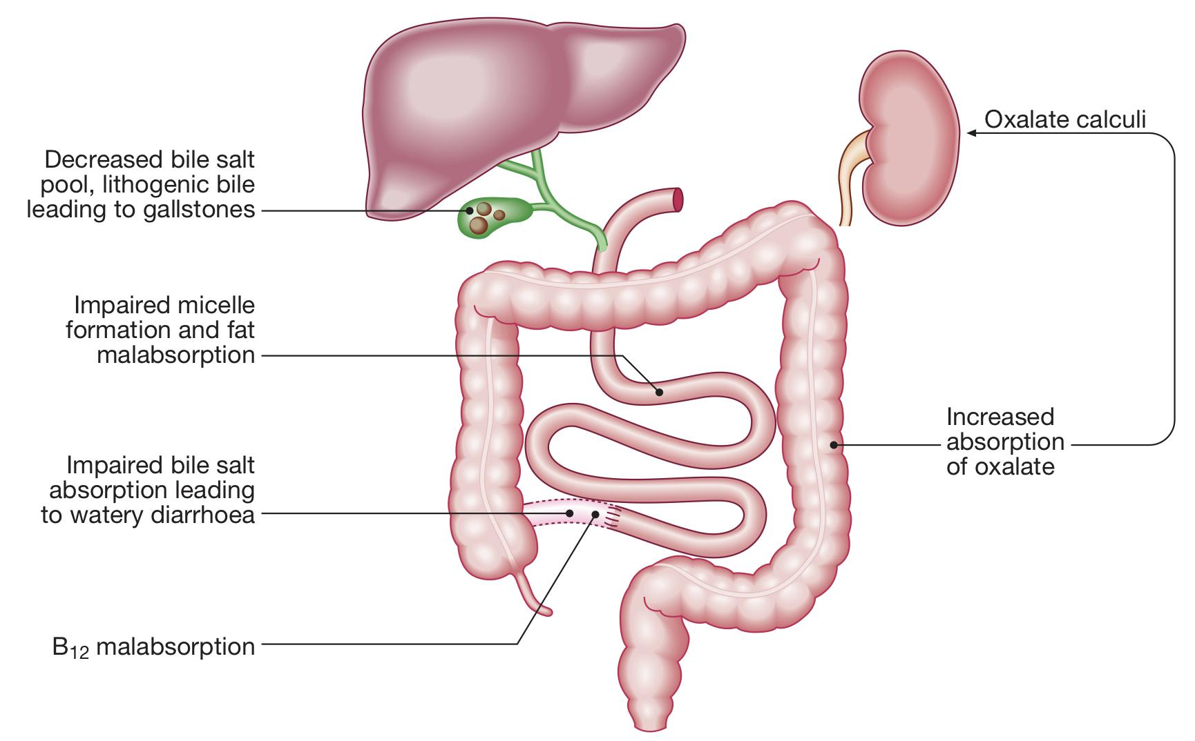
Tropical Sprue
Tropical Sprue
Introduction
Introduction | Is characterized by villous atrophy and crypt hyperplasia. Most tropical regions of Asia, Africa, the Middle East, the Caribbean and Central and South America: It is an acquired defect – not present in newborns. Travelers from the industrialized world may develop it.
Cause | Not known, but seems to be due to continuous bacterial contamination of the upper small bowel and nutritional deficiency.
Presentations | Chronic diarrhea often with steatorrhea, anorexia, abdominal cramps, bloating B12 and folate deficiency.
Investigations | If suspicion is high – jejunal aspirate and biopsy.
Management | Folate & B12 Supplement . tetracycline for 3-6 months. Severely ill patients require resuscitation with fluids and electrolytes for dehydration, and nutritional deficiencies should be corrected. Vitamin B12 (1000 μg) is also given to all acute cases.
Is characterized by villous atrophy and crypt hyperplasia.
Most tropical regions of Asia, Africa, the Middle East, the Caribbean and Central and South America:
It is an acquired defect – not present in newborns. Travelers from the industrialized world may develop it.
The cause is unknown, but seems to be due to continuous bacterial contamination of the upper small bowel and nutritional deficiency.
Present with:
Chronic diarrhea often with steatorrhea, anorexia, abdominal cramps, bloating
B12 and folate deficiency. (Unlike SBBO)
features of megaloblastic anaemia
Investigation:
If suspicion is high ⟹ jejunal aspirate and biopsy. GOLD STANDARD
Management:
Tetracycline for 3-6 months is the treatment of choice
Folate & B12 Supplement .
Severely ill patients require resuscitation with fluids and electrolytes for dehydration, and nutritional deficiencies should be corrected. Vitamin B12 (1000 μg) is also given to all acute cases.
Bile Acid-Induced Diarrhea
Obj.
SeHCAT test, in which a radiolabelled bile acid analogue is administered and percentage retention at 7 days calculated (<19% retention abnormal).
An elevated serum 7α-hydroxycholestenone is a useful non-invasive marker of bile acid diarrhoea
Definition:
Bile acids get synthesized in the liver and secreted into the bowel (95% get absorbed in the terminal ileum and only 5% go to the colon). If the small intestine is resected and bile is not absorbed, free bile acid is very irritant to the colon. Bile salts which overflow into the colon causes secretion of water and electrolytes → Diarrhea
increased oxalate absorption → renal oxalate stones.
Etiology:
Bile acid diarrhoea can occur idiopathically (type 1) or as a complication of small bowel resection, post cholecystectomy (type 2)
SxS:
Urgent watery diarrhea or mild steatorrhea
Diagnosis:
Contrast studies and tests of B12 and bile acid absorption, such as the 75Se-homocholic acid taurine (SeHCAT) test
An elevated serum 7α-hydroxycholestenone is a useful non-invasive marker of bile acid diarrhoea.
Treatment:
Bile acid sequestrants e.g. cholestyramine (it binds to bile acids thus reducing its irritant effects).
1. Diagnosis is made using the SeHCAT test, in which a radiolabelled bile acid analogue is administered and percentage retention at 7 days calculated (<19% retention abnormal).
Treatment is with bile salt sequestrants such as colestyramine, a resin that binds and inactivates the action of bile acids in the colon. The best treatment results are obtained in patients with a SeHCAT retention of <5%.
Most common scenario
is in patients with Crohn’s disease who have undergone ileal resection.

Slide 16
Exocrine Pancreatic Insufficiency
Introduction
Mainly in patients with chronic pancreatitis (most common cause is alcohol), Steatorrhea
Improves with pancreatic enzymes replacement therapy (Protease and lipase supplements)
Hx of abdominal pain, high alcohol intake for long time, diarrhea = pancreatic insufficiency.
Enzyme Secretion of Pancreas and Role in Digestion
Secretion | Site of Action | Active Enzyme | Substrate and Products
Pancreatic Juice | Duodenum | Pancreatic Amylase | Starch → Maltose
 |  | Trypsin | Protein → Peptide
 |  | Chymotrypsin | Protein → Peptide
 |  | Pancreatic Lipase | Fats → Fatty Acids + Glycerol
Diseases & Mechanisms Associated With Exocrine Pancreatic Insufficiency
Disease or Condition | Pathological Mechanism
Chronic Pancreatitis, CF, Diabetes, Sequelae of Acute Necrotizing Pancreatitis, Hereditary Pancreatitis. | Loss of Pancreatic Parenchyma (Responsible for Most Cases of EPI).
Periampullary Tumors, IPMN, Pancreatic Head Carcinoma, Benign Pancreatic Tumors. | Obstruction of Main Pancreatic Duct.
Celiac Disease, Crohn’s Disease, Schwachman-Diamond Syndrome. | Decreased Pancreatic Stimulation.
Zollinger-Ellison Syndrome. | Acid-mediated Inactivation of Pancreatic Enzymes.
Gastrectomy, Gastric Bypass, Extensive Small Bowel Surgery. | Gastrointestinal/Pancreatic Surgery.

Slide 17
Summary
Chronic diarrhea (>4 weeks) can be osmotic, secretory, inflammatory or fatty diarrhea. Fecal osmotic gap is helpful to point toward osmotic diarrhea Iron, Ca & folate are absorbed in proximal bowel; while B12 is absorbed in ileum.
Celiac disease | Should always be suspected in patients with iron-def anemia, diarrhea or dyspepsia. Anti-TTG is most helpful. Biopsy shows villus atrophy. Gluten-free diet. Watch for complications: nutritional & malignancy
Whipple Disease | Chronic systemic infection by Tropheryma whipplei. Has GI, CNS, CVS, MSK & skin manifestations Biopsy: Foamy macrophages & PAS-positive granular particles Tx Ceftriaxone 2g IV daily monotherapy THEN Septra (TMP/SMX) DS tab BID x 1 year. OR Pen G (2 MU IV q4h) PLUS streptomycin THEN Septra (TMP/SMX) DS tab BID x 1 year
SBBO | Look for & treat underlying causes B12 def Schilling’s test
Tropical Sprue | Hx of travel to tropical area for long period
Bile acid-induced diarrhea | Watery diarrhea Improves with cholestyramine
Exocrine pancreatic insufficiency | Mainly in patients with chronic pancreatitis Steatorrhea Improves with pancreatic enzymes replacement therapy

Slide 18
Lecture Quiz
Q1: You see a 25-year-old woman who presents with a 24-hour history of watery diarrhoea. She states that she has opened her bowels 11 times since her onset of symptoms. Associated symptoms include nausea and vomiting with abdominal cramps and pain which started in the evening following a barbeque meal in the afternoon that day. The patient is alert and orientated and her observations include a pulse rate of 69, blood pressure of 124/75 and temperature of 37.1°C. On examination, her abdomen is soft, there is marked tenderness in the epigastric region and bowel sounds are hyperactive. The patient is normally fit and well with no past medical history. The most likely diagnosis is
A. Irritable bowel syndrome
B. Gastroenteritis
C. Ulcerative colitis
D. Laxative abuse
Q2: A 35-year-old woman presents with a 24-hour history of watery diarrhoea. She has opened her bowels nine times since the onset of her symptoms. You diagnose gastroenteritis after learning that the patient and her family all ate at a new restaurant and the rest of her family have had similar problems. The most appropriate management is:
A. Oral rehydration advice, anti-emetics and discharge home
B. Oral antibiotic therapy and discharge home
C. Admission for intravenous fluid rehydration
D. Admission for intravenous antibiotic therapy
E. No treatment required
Q3: A 56-year-old man presents with a 2-week history of diarrhoea which has not settled following an episode of ‘food poisoning’. Which of the following would be the most appropriate investigation?
A. Full blood count
B. Urea and electrolytes
C. Stool sample for microscopy, culture and sensitivities
D. Abdominal x-ray
E. Liver function tests
Q4: A 2-year-old boy presents with a history of smelly, bulky diarrhea and poor weight gain. A small bowel biopsy shows villous atrophy. What is the most likely etiology?
A. Bacillus cereus
B. Campylobacter jejuni
C. Carcinoid
D. Celiac disease
E. Clostridium difficile
F. Crohn’s disease
Q5: A 62-year-old farmer presents for a second opinion after unrevealing extensive workup of migrating joint pain for the past 2 years and chronic diarrhea, postprandial abdominal cramping, and weight loss for the past 6 months. Your suspicion for Whipple disease is high. Which of the following statements regarding this disease is true?
A. Chronic diarrhea is common, but extraintestinal symptoms are rare.
B. Prolonged antibiotic treatment is required to eradicate the causative organism.
C. The causative organism, Tropheryma whipplei, is easily cultured.
D. The disease is more common in women than in men.
E. Colonoscopy with biopsy is the diagnostic test of choice.
Answers: Q1:B | Q2:A | Q3:C | Q4:D | Q5:B
Answers Explanation File!

Slide 19
THANKS!!
This lecture was done by:
Jehad Alorainy
Noura Alturki
Abdulrahman Bedaiwi
Females co-leaders:
Raghad AlKhashan
Amirah Aldakhilallah
Males co-leaders:
Mashal AbaAlkhail
Nawaf Albhijan
Send us your feedback:
We are all ears!

