Slide 1
Filled by the lecture leader
Lecture 25
Editing file
Abdominal pain And IBS
Objectives:
Abdominal pain includes:
PUD
Acute pancreatitis
Celiac disease (covered in diarrhea lecture)
Causes of Abdominal pain
Functional dyspepsia
Approach to management of dyspepsia
Management of H pylori
Irritable bowel syndrome
Color index:
Color index:
Original text Females slides Males slides
Doctor’s notes Text book Important Golden notes Extra

Slide 2
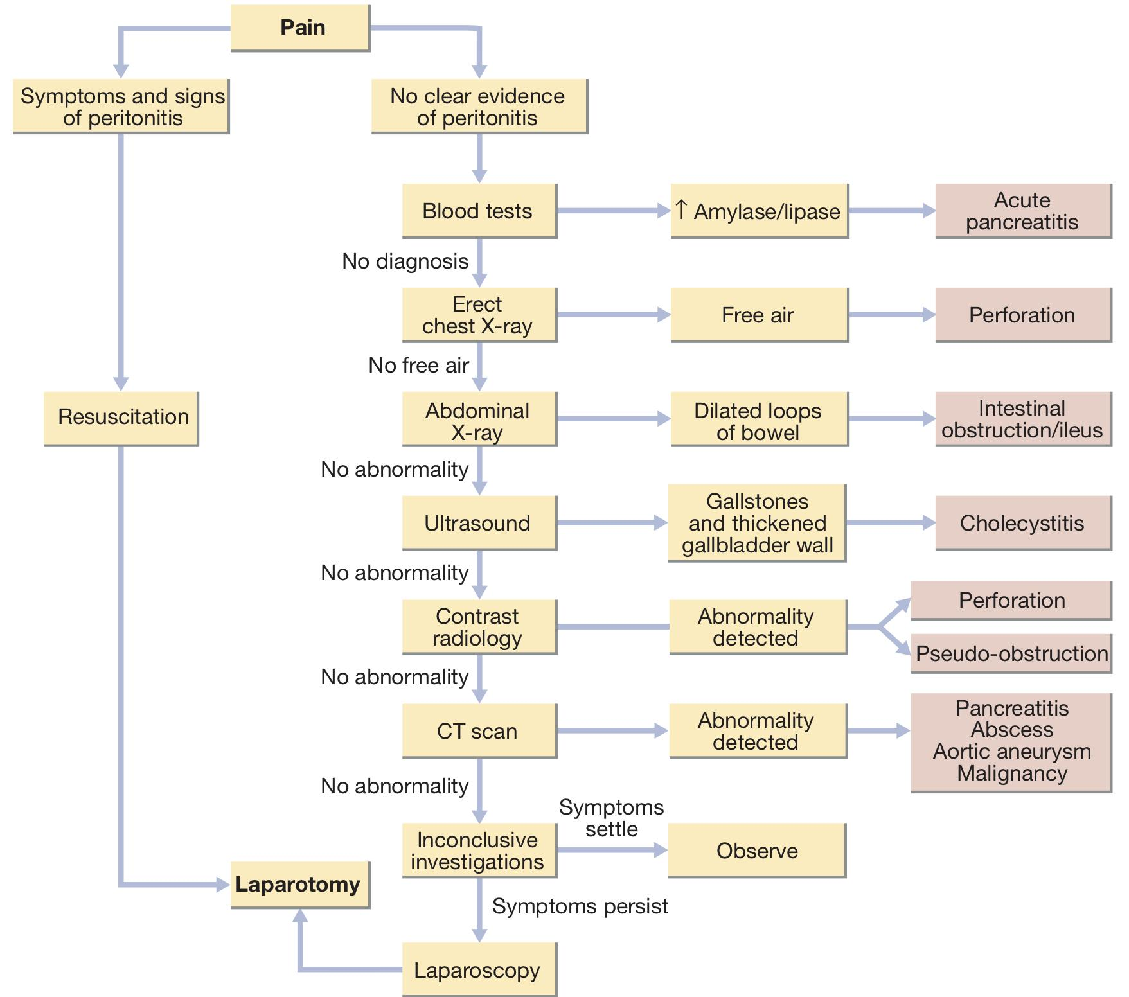
Introduction to Acute abdominal pain
Introduction
Abdominal pain accounts for approximately 50% of all urgent admissions to general surgical units. The acute abdomen is a consequence of one or more pathological processes:
Inflammation
Pain develops gradually, usually over several hours.
Perforation
Pain starts abruptly; it is severe and leads to generalised peritonitis.
Obstruction
Pain is colicky, with spasms that cause the patient to writhe around and double up.
Causes of acute abdominal pain
Surgical | Medical
Appendicitis Cholecystitis Bowel obstruction Acute mesenteric ischemia Perforation Trauma Peritonitis | Cholangitis (inflammation of bile duct) Pancreatitis Choledocholithiasis (stone in the bile duct) Diverticulitis PUD Peptic Ulcer Disease Gastroenteritis Non-abdominal causes that can cause abdominal pain as MI in diabetic and HTN patients FUNCTIONAL causes (More of chronic)¹
Approach to Acute abdominal pain
1- Our talk is going to be about functional causes which are chronic pain. Acute pain is more serious than chronic pain. why? Because chronic pain is less likely to be an inflammation or cancer. Most abdominal pain that requires surgery is acute, less likely chronic abdominal pain needs surgery e.g. bowel ischemia “bowel angina”

Slide 3
Introduction to Dyspepsia
Definition
Dyspepsia: is a collection of symptoms including nausea bloating and epigastric pain
Functional Dyspepsia: This is defined as chronic dyspepsia in the absence of organic disease.
Definition: (Rome III committee):
There is a new classification including two distinct diagnostic categories “for dyspepsia”:
Postprandial distress syndrome (PDS) (feeling nausea, bloating or early satiety, there is more of discomfort rather than a pain. usually after a meal)
Epigastric pain syndrome (EPS) which indicate meal-related and unrelated symptoms (Meal-related epigastric pain)
Etiology
Dyspepsia caused by structural or biochemical causes
Peptic ulcer, GERD, Biliary pain, Chronic abdominal pain, Gastric/esophageal cancer. Gastroparesis, pancreatitis, Carbohydrate malabsorption Medications (Including K+ supplements, digitalis, iron, theophylline, oral antibiotics (especially ampicillin and erythromycin), NSAIDs, corticosteroids, niacin, gemfibrozil, narcotics, colchicine quinidine, estrogens, levodopa) Infiltrative disease of the stomach (e.g. Crohn’s disease sarcoidosis) Metabolic disturbances (hypercalcemia, hyperkalemia) Hepatoma, Ischemic bowel disease Systemic disorders (DM, Thyroid and parathyroid disorders, connective tissue disease) Intestinal parasites (Giardia, strongyloides) Abdominal cancer, especially pancreatic cancer
Most common cause of epigastric pain is functional dyspepsia (60%).
Abdominal wall pain is worsened by movement and may cause guarding
Clinical approach
History:
Physical examination
First step is to rule out organic causes of dyspepsia and that's done by history.
Ulcer-like or acid dyspepsia (eg, burning, epigastric hunger pain with food, antacid, and antisecretory agent relief).
Dysmotility-like dyspepsia (with predominant nausea, bloating, and anorexia).
Unspecified dyspepsia.
Usually normal
Presence of palpable mass needs further action

Slide 4
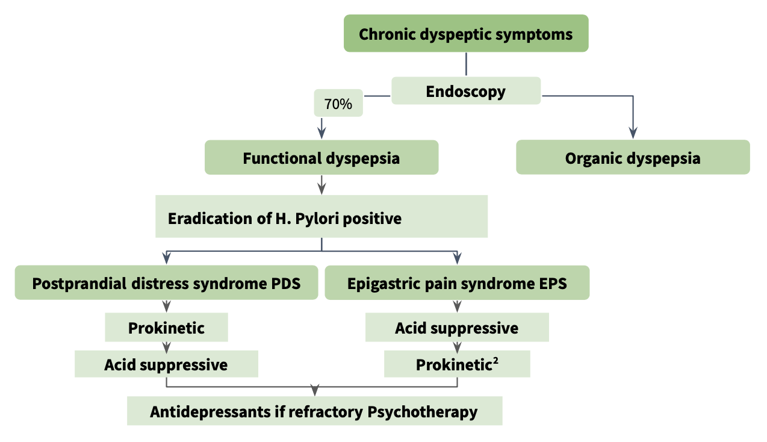
Functional dyspepsia
Alarm symptoms :
VAW got a PhD
Unintended Weight loss
Persistent Vomiting
Progressive Dysphagia
Odynophagia
unexplained Anemia or iron deficiency
Hematemesis Or nocturnal pain and bleeding
Palpable abdominal mass or lymphadenopathy
Family history of upper gastrointestinal cancer
Previous gastric surgery
Jaundice / Lymphadenopathy / mass / Ascites
NPV=99%:
Negative Predictive Value of 99% means if all of the above is negative, then the chance that this patient has “functional dyspepsia” is 99%
Investigations:
Routine laboratory tests
Endoscopy (GOLD standard)
We usually start with basic workup like Routine blood counts and blood chemistry: To rule out any extra-intestinal cause of abdominal pain; diabetes and hyperthyroidism .. etc"
Gold standard test to exclude gastroduodenal ulcers, reflux esophagitis, and upper gastrointestinal cancers.
Beneficial because up to 40% of patients have an organic cause of dyspepsia.
It also provides reassurance to patients.
Disadvantages:
Expensive, Invasive
Not cost-effective in young patients without alarm symptoms as up to 50% are normal.
Functional dyspepsia management algorithm:
Prokinetic: such as metoclopramide (10 mg 3 times daily) or domperidone (10–20 mg 3 times daily)
Antacids: such as hydrotalcite
Antidepressants: such as Amitriptyline

Slide 5
Functional dyspepsia
Management of dyspepsia based on age and alarm features:
Dyspepsia without GERD or NSAIDS
Age > 55¹ or alarm symptomes present
Age ≤ 55
no alarm symptomes
EGD
(Esophagogastroduodenoscopy)
Test for H. Pylori
Negative
Positive
Reassurance reassess diagnosis
PPI trial 4-6 weeks
Treat for H. pylory
Fails
Consider EGD
Fails
PPI trial 4 weeks
Management of non responding functional dyspepsia
H. pylori negative functional dyspepsia (normal endoscopy) and failed and adequate trial of PPI
1- Re-evaluate the symptoms and diagnosis
2- Consider other sources of abdominal pain: pancreas, colon, biliary tract
3- Does the patient have symptoms or delayed gastric emptying? (Like gastroparesis in diabetics)
4- Does the patient have IBS?
5- Does the patient have panic disorder or other psychological issued?
Persistent symptomes
no other cause established
Consider: Antidepressants, hypnotherapy,
behavior therapy, prokinetic agents
Click here for a nice algorithm
So if a 60 yo presented with symptoms of functional dyspepsia, go with ENDOSCOPY

Slide 6
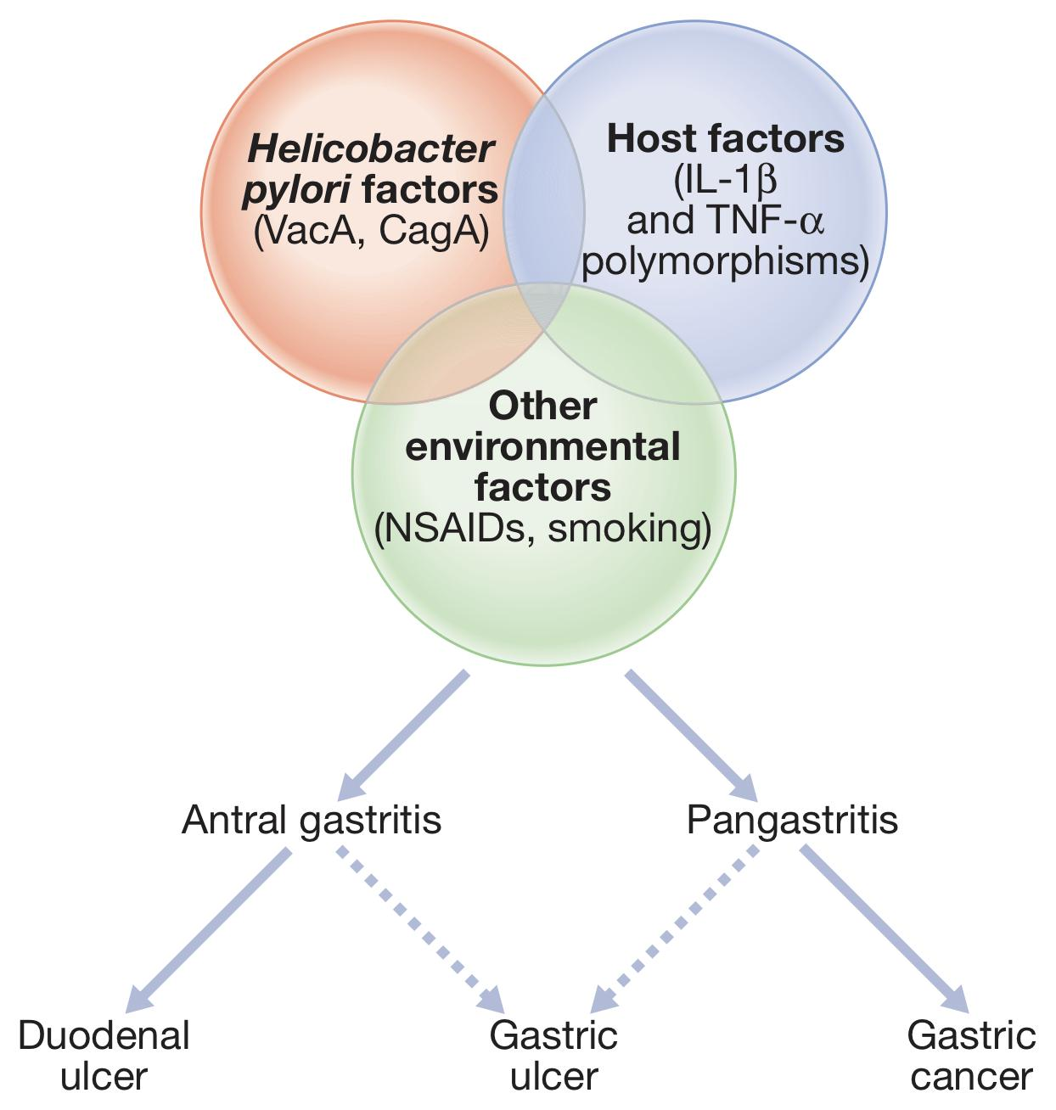
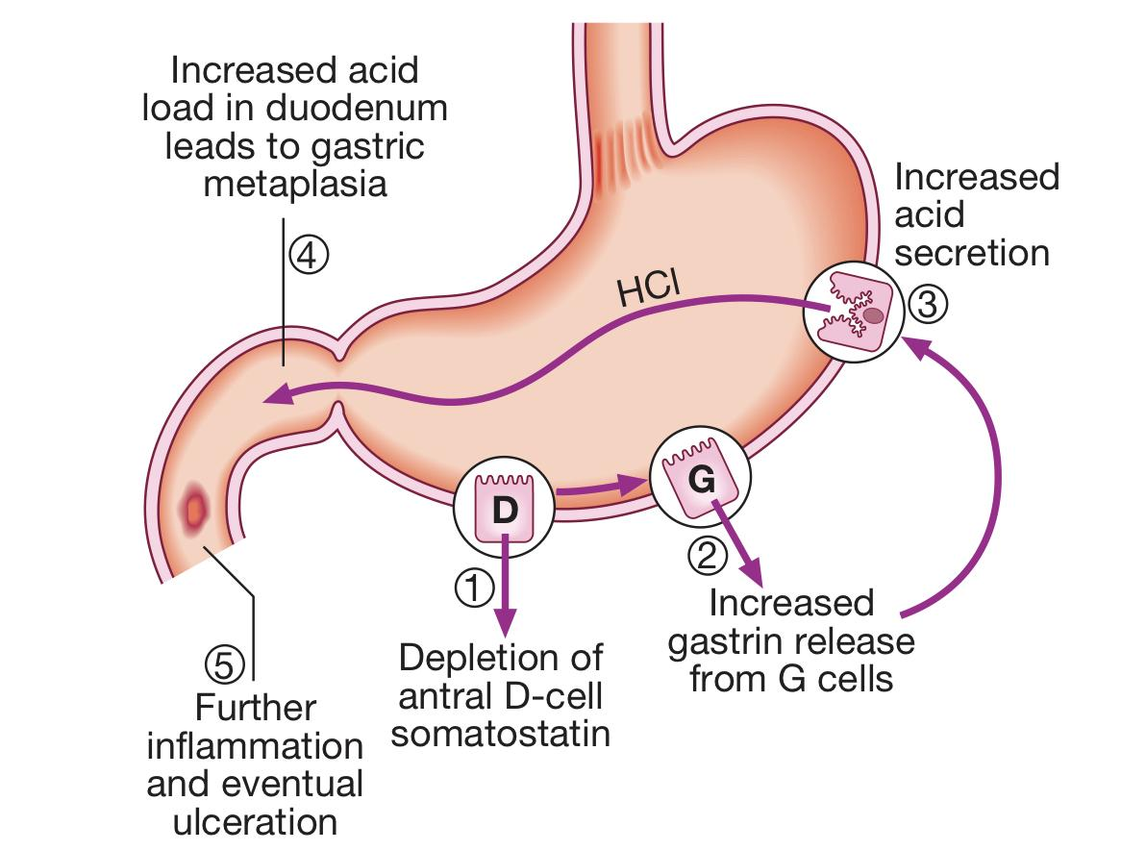
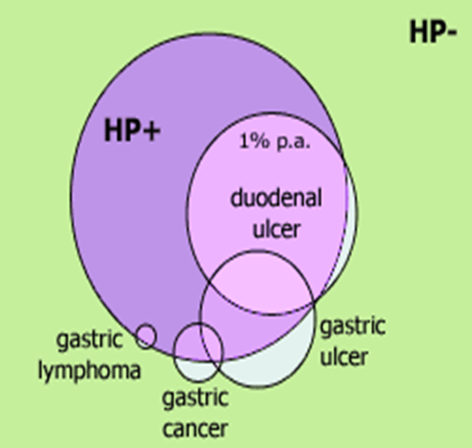
Peptic Ulcer Disease (PUD)
Definition
The term ‘peptic ulcer’ refers to an ulcer in the lower oesophagus, stomach or duodenum, in the jejunum after surgical anastomosis to the stomach or, rarely, in the ileum adjacent to a Meckel’s diverticulum.
What’s the difference between an ulcer and erosion?
Ulcers: Penetrate muscularis mucosae
Erosions: Don not penetrate muscularis mucosae
Note: Gastric and duodenal ulcers coexist in 10% of patients and more than one peptic ulcer is found in 10–15% of patients.
Etiology:
Helicobacter pylori infection 80% (most common)*
NSAIDs (e.g. Aspirin): inhibit prostaglandin production which is the major stimulant for mucus production that form the protective barrier, leads to impaired mucosal defenses.
Zollinger–Ellison syndrome
Smoking (Gastric more than duodenal)
*The strongest evidence for the pathogenic role of H. pylori in peptic ulcer disease is the marked decrease in the recurrence rate of ulcers following the eradication of infection.
Epidemiology of H. pylori infection:
Socioeconomic status of the family is the main risk factor as reflected by the level of sanitation and household hygiene. These infections are probably acquired in childhood by person-to-person contact (Fecal-oral route, Gastro-oral route or Oral-oral route)
The vast majority of colonised people remain healthy and asymptomatic, and only a minority develop clinical disease.
95% of duodenal ulcer patients and 85% of gastric ulcer patients are infected with H. pylori. The remaining 15% of gastric ulcers are caused by NSAIDs.
Microbiology of H. pylori:
Gram negative spiral organism with following characteristics:
Slow growing, microaerophilic
Has multiple flagella at one end, which make it highly motile, allowing it to burrow and live beneath the mucus layer adherent to the epithelial surface.
Urease producing

Slide 7
Peptic Ulcer Disease (PUD) cont’
Clinical presentation:
Recurrent episodes of epigastric pain that is described as dull, sore, and gnawing. Although the most common cause of upper GI bleeding is PUD, the majority of those with ulcers do not bleed.
How to differentiate between gastric and duodenal ulcer?
Gastric ulcer: pain is Greater after a meal, hence the weight loss.
Duodenal ulcer: pain Decreases after a meal
EXTRA | Duodenal ulcer | Gastric ulcer
Pathogenesis | Caused by an increase in offensive factors (higher rates of basal and stimulated gastric acid secretion) | Caused by a decrease in defensive factors (gastric acid level is normal/low unless ulcer is pyloric or prepyloric)
H.pylori infection | 90% | 85%
Malignant potential | Low (malignancy is very rare) | High (5%-10% are malignant); therefore must always be biopsied and followed up to ensure healing.
Locations | Majority are 1-2 cm distal to pylorus (usually on posterior wall) | Type I (Most common): on lesser curvature Type II: Gastric and duodenal ulcer (Two) Type III: Prepyloric (within 2cm of pylorus) Type IV: Near esophagogastric junction (Door)
Age distribution | Occurs in younger patients (<40 y/o) | Occurs in older patients (>40 y/o)
Associated blood type | Type O | Type A
Risk factors | NSAIDs | Smoking
Other | Eating usually relieves pain Nocturnal pain is more common than in gastric | Eating worsens pain Complication rates are higher than those of duodenal ulcers. There is a higher recurrence rate with medical therapy alone
Investigations:
One is Less, Two has Two, Three is pre, Four is by the door
Endoscopic biopsy is the gold standard
If perforation is suspected, perform upright CXR to evaluate air under the diaphragm or CT scan of the abdomen.
In recurrent or refractory cases, check serum gastrin levels to screen for Zollinger-Ellison syndrome.
Patients should be tested for H. pylori infection (discussed in next page)

Slide 8
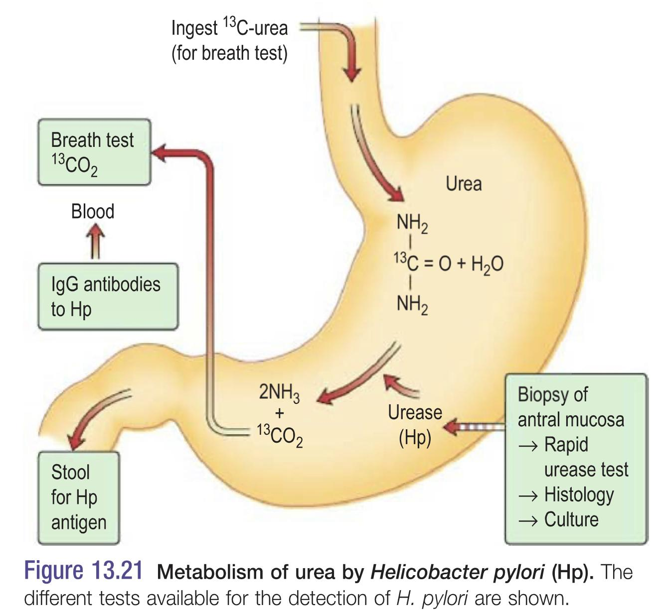
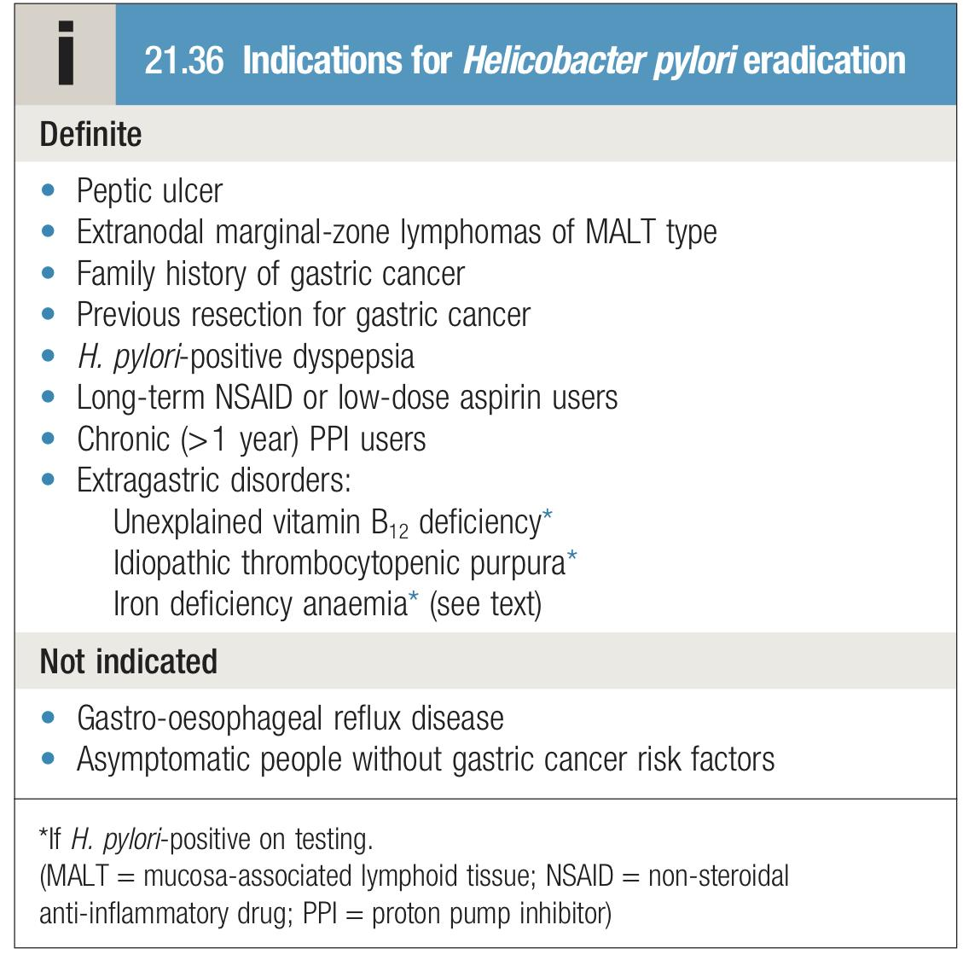
Peptic Ulcer Disease (PUD) cont’
Tests for H.pylori:
Non-invasive
Serum antigen: Detects IgG antibodies to H.pylori. Lacks specificity as it can’t differentiate between active and treated disease. (Low diagnostic yield)
Urea Breath Test (UBT): H. pylori urease converts radiolabeled urea (C14 or C13) to CO2 and ammonia; this test detects CO2 formed from urea metabolism. Has high sensitivity and specificity. PPIs may cause false results.
Stool antigen: Detects H. pylori antigens in stool. Cost-effective initial test for H.pylori. Patients should be off PPls for 2 weeks.
Both of UBT and stool antigen methods are good to measure the effect of treatment
Invasive (Endoscopic)
Histology: Specific but has a lot of false negatives (usually due to PPIs). H. pylori can be detected histologically on routine (Giemsa) stained sections of gastric mucosa obtained at endoscopy.
Rapid urease test: Cheap, quick, specific (>95%) with sensitivity of 85%. Can produce false negative if pt is on PPI. Gastric biopsies, usually antral unless additional material is needed to exclude proximal migration, are added to a substrate containing urea and phenol red . If H. pylori is present, the urease enzyme that the bacteria produce splits the urea to release ammonia, which raises the pH of the solution and causes a rapid colour change (yellow to red).
Microbiological culture: GOLD standard, This technique is typically used for patients with refractory H. pylori infection to identify the appropriate antibiotic regimen; routine culture is rare.
PCR
Indications for H. Pylori eradication:
All patients with proven ulcers who are H. pylori-positive should be offered eradication as primary therapy.
When is surgery indicated in PUD?
In cases of emergency (Perforation or Hemorrhage)
Or elective (Gastric flow obstruction, Persistent ulceration despite adequate medical therapy or Recurrent ulcer following gastric surgery)

Slide 9
Management of PUD
European Helicobacter Pylori study group guidelines
Triple therapy with omeprazole (20 mg twice daily), amoxicillin (1 g twice daily), and clarithromycin (500 mg twice daily) for 7 to 14 days.
A longer duration of treatment (14 versus 7 days) may be more effective in curing infection but this remains controversial. more than 14 days is not recommended
Treatment regimens
Regimen¹ | comment
(Triple therapy) PPI, amoxicillin 1 gm, clarithromycin 500 mg all twice daily for 7-14 days. | 1st line treatment² regimen of choice (can substitute metronidazole 500 mg twice daily for amoxicillin but only in penicillin allergic patients) metronidazole has bad taste.
(Quadruple therapy) Bismuth 525 mg, metronidazole 500 mg, tetracycline 500 mg all four times daily with PPI twice daily for 7-14 days. | Can be used as 1st line treatment (7-14 days) but generally reserved for retreatment (14 days) Quadruple therapy can be used when there is resistance to clarithromycin
PPI, amoxicillin 1 gm, metronidazole 500 mg all twice daily for 14 days | 1st line treatment in macrolide allergic patients and retreatment if failed 1st line treatment of choice
Please Make Tummy Better
Treatment Regimen | Duration ( days ) | Eradication Rate (%)
Omeprazole 20 mg BID + Amoxicillin 1 g BID + Clarithromycin 500 mg BID | 14 | 80 - 86
Lansoprazole 30 mg BID + Amoxicillin 1 g BID + Clarithromycin 500 mg BID | 10 - 14 | 86
Bismuth subsalicylate 525 mg QID + Metronidazole 250 mg QID + Tetracycline 500 mg + PPI | PPI for another 14 taken OD or BID) | 80
OD = Once a day. | BID = twice a day. | QID = 4 times a day.
1- all of them are 1st line therapy. But it depends on the region.
2- According to Dr this is NOT the first line therapy in saudis because of high rates (>20%) of clarithromycin resistance!
It is the first line of treatment if there is no clarithromycin resistance.
SO Bottom line, what is the first line in our region? (Quadruple therapy) Bismuth, metronidazole, tetracycline, PPI for 14 days

Slide 10
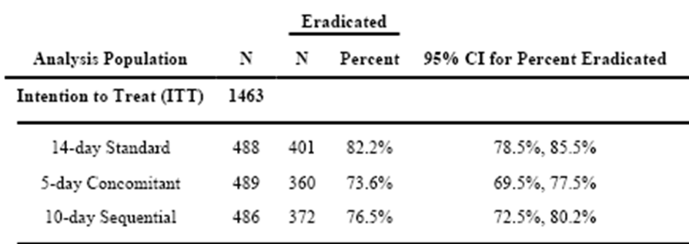
Management PUD cont’
Clarithromycin-resistant bacteria
Pooled data from 20 studies involving 1975 patients treated with standard triple therapy showed an eradication rate of 88% in clarithromycin-sensitive strains vs 18% in clarithromycin-resistant strains.
A 10-day sequential regimen
First 5 days: PPI and amoxicillin 1 g, each given twice daily.
second 5 days: PPI, clarithromycin 500 mg, and tinidazole 500 mg, each given twice daily.
Improved overall eradication rates compared with standard PPI triple therapy (89% vs. 77 %), but was particularly better for clarithromycin-resistant bacteria (89% vs. 29%).
Concomitant therapy¹
Novel regimen which was proved successful in the presence of clarithromycin resistance. This is a 4-drug regimen containing a PPI ,clarithromycin (500 mg, b.i.d.), amoxicillin (1 g, b.i.d.) and metronidazole (500 mg, b.i.d.) which are all given for the entire duration of therapy.
Rescue therapy²:
Regimen | comment
PPI, levofloxacin 250 to 500 mg, amoxicillin 1 gm all twice daily for 14 days | "Rescue" therapy for those failing two course of above treatments
PPI, rifabutin 150 mg, amoxicillin 1 gm all twice daily for 14 days | Alternative "rescue" therapy
Based on culture | If all medications listed above didn’t work then we do culture. Why usually we don’t do culture? because it takes time, we usually do UBT, endoscopy and routine histopathology
Poor compliance with medication, and patient demographics such as younger age, smoking, prior antibiotic use, and underlying condition (functional dyspepsia vs. peptic ulcer).
Some patients don’t continue their therapy course, why?
They think they are already cured (but actually it was PPI relief)
They want to stop because of therapy’s side effects
1- first line along with quadruple therapy in Saudi Arabia (if both are choices in the exam, choose quadruple)
2- When some patients had resistance for sequential therapy, they came up with rescue therapy.

Slide 11
Peptic Ulcer Disease (PUD) cont’
Complications of PUD:
 | Clinical findings | Diagnostic studies | Management | Other
Perforation | Acute, severe abdominal pain, signs of peritonitis, hemodynamic instability | Upright CXR (free air under diaphragm), CT scan is the most sensitive for perforation (detects free abdominal air) | Emergency surgery to close perforation and perform definitive ulcer operation (such as highly selective vagotomy or truncal vagotomy/pyloroplasty) | Can progress to sepsis and death if untreated
Gastric outlet obstruction | Nausea/vomiting (poorly digested food), epigastric fullness/early satiety. weight loss | Barium swallow and upper endoscopy; saline load test (empty stomach with as nasogastric tube, add 750mL saline, aspirate after 30min - test is positive if aspirate >400mL | Initially, nasogastric suction; replace electrolyte/ volume deficits; supplement nutrition if obstruction is long standing. Surgery is eventually necessary in 75% of patients | Most common with duodenal ulcers and type III gastric ulcers
GI bleeding | Bleeding may be slow (leading to anemic symptoms) or can be rapid and severe (leading to shock) | Stool guaiac, upper GI endoscopy (diagnostic and therapeutic) | Resuscitation; diagnose site of bleed via endoscopy and treat; perform surgery for acute bleeds that require transfusion of 6U or more of blood | PUD is the most common cause of upper GI bleeding

Slide 12
EXTRA
(but part of OBJ)
Acute pancreatitis
Introduction
There is inflammation of the pancreas resulting from prematurely activated pancreatic digestive enzymes that invoke pancreatic tissue autodigestion.
Most patients with acute pancreatitis have mild to moderate disease but up to 25% have severe disease.
There are two forms of acute pancreatitis, mild and severe:
Mild acute pancreatitis is most common and responds well to supportive treatment.
Severe acute pancreatitis (necrotizing pancreatitis) has significant morbidity and mortality.
Causes
Gallstones (40%)—The gallstone passes into the bile duct and blocks the ampulla of Vater. “ALWAYS consider gallstone pancreatitis and rule it out even in pt with hx of alcohol use”
Alcohol abuse (40%)
Post-ERCP¹ —Pancreatitis occurs in up to 10% of patients undergoing ERCP² .
Viral infections (e.g., mumps, Coxsackievirus B)
Drugs: Sulfonamides, thiazide diuretics,NSAIDS, furosemide,
estrogens, HIV medications.
Postoperative complications. (high mortality rate)
Scorpion bites.
Pancreas divisum³.
Pancreatic cancer.
Hypertriglyceridemia, hypercalcemia.
Uremia.
Blunt abdominal trauma (most common cause of pancreatitis in children)
Clinical Features
Symptoms: 1. Abrupt onset of severe abdominal pain, usually in the epigastric region. May radiate to back (50% of patients). Often steady, dull, tenderness and severe; worse when supine and after meals 2. Nausea and vomiting, anorexia Signs: 1. Low-grade fever, tachycardia, hypotension, leukocytosis. 2. Epigastric tenderness, abdominal distention. 3. Decreased or absent bowel sounds indicate partial ileus. 4. The following signs are seen with hemorrhagic- pancreatitis as blood tracks along fascial planes: ➢ Grey Turner’s sign (flank ecchymoses) ➢ Cullen’s sign (periumbilical ecchymoses) ➢ Fox’s sign (ecchymosis of inguinal ligament) Signs of severe Necrotizing Pancreatitis: Cullen sign: Blue discoloration around the umbilicus -> due to hemoperitoneum. Turner’s sign: Bluish purple discoloration of flanks -> tissue catabolism of Hb
1- “Endoscopic retrograde cholangiopancreatography”
2- Presumably because of back pressure from injection of contrast material into the ductal system. Most people have asymptomatic increase in amylase, only 2-8% of pt will actually develop symptomatic pancreatitis.
3- Is a congenital anomaly in the anatomy of the ducts of the pancreas in which a single pancreatic duct is not formed, but rather remains as two distinct dorsal and ventral ducts.

Slide 13
EXTRA
(but part of OBJ)
Acute pancreatitis
Diagnosis
Serum amylase is the most common test (Best initial test), but many conditions cause hyperamylasemia (nonspecific) and its absence does not rule out acute pancreatitis (nonsensitive). However, if levels are more than five times the upper limit of normal, there is a high specificity for acute pancreatitis.
Serum lipase—(more specific for pancreatitis than amylase).
LFTs. “To identify cause (gallstone pancreatitis).”
Hyperglycemia, hypoxemia, and leukocytosis may also be present.
Order the following for assessment of prognosis (Ranson’s criteria):
glucose, calcium, hematocrit, BUN, arterial blood gas (PaO2, base deficit), LDH, AST, WBC count
1
Laboratory studies:
2
Radiological studies:
1. Abdominal radiograph:
Has a limited role in the diagnosis of acute pancreatitis.
More helpful in ruling out other diagnoses,
such as intestinal perforation (free air).
The presence of calcifications can suggest chronic pancreatitis.
if severe; “sentinel loop” or “colon cutoff sign” may be seen.
2. Abdominal ultrasound:
Can help in identifying cause of pancreatitis (e.g., gallstones).
Useful for following up pseudocysts or abscesses.
3. CT scan of the abdomen:
Most accurate test for diagnosis of acute pancreatitis and for identifying complications of the disease.”
Indicated in patients with severe acute pancreatitis.
4. ERCP (indications):
Severe gallstone pancreatitis with biliary obstruction.
To identify uncommon causes of acute pancreatitis if disease is recurrent.

Slide 14
EXTRA
(but part of OBJ)
Acute pancreatitis
1. Pancreatic necrosis (may be sterile or infected): Sterile pancreatic necrosis—Half of all cases resolve spontaneously. Should be monitored closely in an ICU. Infected pancreatic necrosis—has high mortality rate (results inmultiple organ failure in 50% of cases); surgical débridement and antibiotics indicated. The only way to distinguish sterile from infected necrosis is via CT-guided percutaneous aspiration with Gram stain/culture of the aspirate.
2. Pancreatic pseudocyst: Encapsulated fluid collection that appears 2 to 3 weeks after an acute attack— unlike a true cyst, it lacks an epithelial lining. Complications of untreated pseudocysts include rupture, infection, gastric outlet obstruction, fistula, hemorrhage into cyst, and pancreatic ascites. Diagnosis: CT scan is the study of choice. Treatment: ➢ Cysts <5 cm: observation. ➢ Cysts >5 cm: drain either percutaneously or surgically.
3. Hemorrhagic pancreatitis: Characterized by Cullen’s sign, Grey Turner’s sign, and Fox’s sign. CT scan with IV contrast is the study of choice.
4. Adult respiratory distress syndrome —a life-threatening complication with high mortality rate.
5. Pancreatic ascites/pleural effusion. “The most common cause is inflammation of peritoneal surfaces.”
6. Ascending cholangitis. “Due to gallstone in ampulla of Vater, leading to infection of biliary tract”
7. Pancreatic abscess (rare). “Develops over 4 to 6 weeks and is less life threatening than infected pancreatic necrosis.”
Complications
Treatment
1. Patients with mild acute pancreatitis:
Bowel rest (NPO).
IV fluids. “Correct electrolyte abnormalities.”
Pain control.
Nasogastric tube. “If severe nausea/vomiting or ileus present.”
2. Patients with severe pancreatitis:
Should be admitted to the ICU.
Early enteral nutrition in the first 72 hours is recommended through a nasojejunal tube.
If the severe acute pancreatitis has not resolved in a few days, supplemental parenteral nutrition should be started.
If more than 30% of the pancreas is necrosed, prophylactic antibiotics (imipenem) should be considered to prevent infection. “Which has high morbidity and mortality”

Slide 15
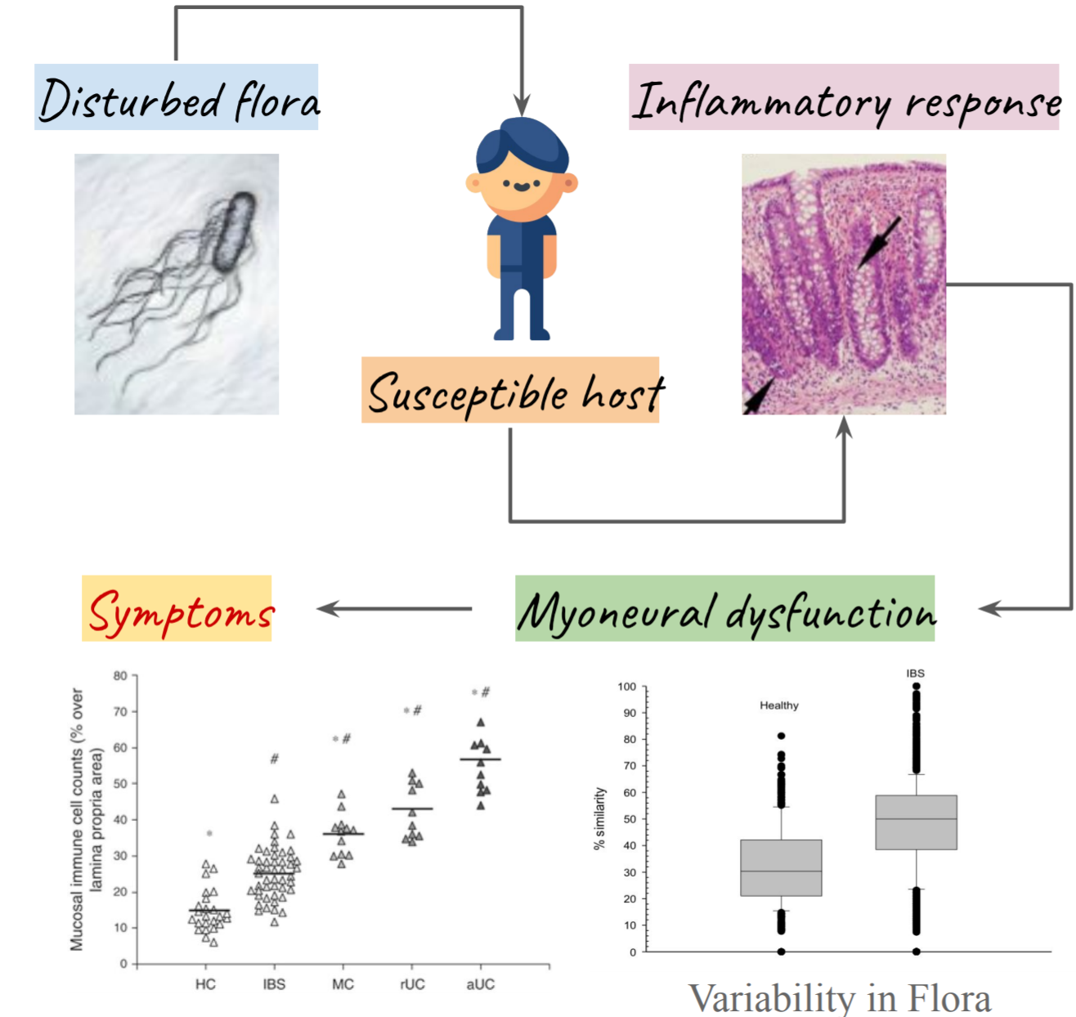
Irritable bowel syndrome (IBS)
What is IBS?
Definition
Irritable bowel syndrome (IBS) is an intestinal disorder that causes abdominal pain or discomfort, cramping or bloating, and diarrhea or constipation. Irritable bowel syndrome is a long-term but manageable condition.
It is predominantly a pain syndrome of unknown etiology that is often relieved by bowel movement.
Educate patient that this is a chronic disease that stays for life.
Who gets IBS?
It is estimated that between 10% and 15% of the population of North America, or approximately 45 million people, have irritable bowel syndrome.
Only about 30% of them will consult a doctor about their symptoms.
IBS tends to be more common in In women, IBS is 2 to 3 times more common than in men.
Young female women, Type A personality
IBS is sometimes associated with a history of physical or sexual abuse and this is an important aspect of the history as these patients benefit from psychologically based therapy.
IBS pathophysiology
There is no clear pathophysiology but these are hypotheses:
Heredity; nature vs nurture
Dysmotility, “spasm”
Visceral Hypersensitivity (they feel every bowel movement)
Altered CNS perception of visceral events
Psychopathology
Infection/Inflammation
Altered Gut Flora
Mucosal Compartment
Frank inflammation
Immune Activation
↑ IEL’s
↑ CD3+, CD25+
Decreased IgA + B Cells
Altered expression of genes involved in mucosal immunity
IBS Subtypes
Diarrhoea predominant.
Constipation predominant.
Pain predominant.
Most patients alternate between episodes of diarrhoea, constipation and pain. but it is useful to classify them as having predominantly constipation or predominantly diarrhoea.
Those with constipation tend to pass infrequent (less than 3) pellety stools, usually in association with abdominal pain or proctalgia. Those with diarrhoea have frequent defecation (more than 3) but produce low-volume stools and rarely have nocturnal symptoms.

Slide 16
Irritable bowel syndrome (IBS) cont’
Clinical features
The most common presentation is that of recurrent abdominal discomfort. This is usually colicky or cramping in nature, felt in the lower abdomen and relieved by defecation.
Patients do not lose weight and are constitutionally well.
Physical examination is generally unremarkable, with the exception of variable tenderness to palpation.
Associated symptoms:
In people with IBS in hospital OPD.
25% have depression, 25% have anxiety.
In one study 30% of women IBS sufferers have fibromyalgia
Rome III diagnostic criteria:
At least 12 weeks history, which needs not be consecutive in the last 12 months of abdominal discomfort or pain that has 2 or more of the following:
Relieved by defecation.
Onset associated with change in stool frequency.
Onset associated with change in form (appearance) of stool.
General:
Feeling of incomplete evacuation.
Abdominal fullness , bloating or swelling¹
Passage of mucus per rectum. but rectal bleeding does not occur
Alarm features in IBS
1
2
3
Age >50 years; male gender
Weight loss
Nocturnal symptoms
4
5
6
Family history of colon cancer
Anemia
Rectal bleeding
1- Abdominal bloating worsens throughout the day; the cause is unknown but it is not due to excessive intestinal gas.

Slide 17
Irritable bowel syndrome (IBS)
Differential diagnosis:
IBD
Cancer
Diverticulosis
Endometriosis
Celiac disease
Assessment:
History: type of pain, location, associated symptoms, constitutional symptoms
Results should be normal or non-specific.
Abdomen and rectal examination.
Diagnostic testing in IBS
1- CBC, LFT
2- Stool analysis
3- Thyroid function test¹
4- Celiac Ab
Note: Current best evidence does not support the routine use of blood tests to exclude organic gastrointestinal disease in patients who present with typical IBS symptoms without alarm features.
Hydrogen Breath Testing:
Lactose malabsorption (typically diagnosed via abnormal hydrogen breath testing) is estimated to be approximately 25% in western countries and perhaps as high as 75% worldwide. it is underdiagnosed condition, make sure you ask about it in your history. If you suspect it do not forget to request hydrogen breath test
Abdominal Imaging:
Abdominal Imaging
Barium enema
US
Colonoscopy
Prevalence of colorectal cancer in these studies was low, ranging from 0 to 0.51%.
Abdominal imaging is usually not used in IBS patients, If you take good history, good physical, basic workup and all of them are normal in a susceptible pt, no need to do these expensive procedures
Should be tested in most of GI symptoms

Slide 18
Referral & Management of IBS
Reasons to Refer
Reasons to Refer | Urgent Referral
Age > 45 years at onset. Family history of bowel cancer. Failure of primary care management. Uncertainty of diagnosis. Abnormality on examination or investigation | Constant abdominal pain Constant diarrhea Constant distension Rectal bleeding Weight loss or malaise.
Management of IBS:
Patients’ concerns (The most important thing is patient - doctor relationship) ~50% of the treatment
Explanation
Treatment approaches
Placebo effect of up to 70% in all IBS treatments.
Treatment should depend on symptom sub-type.
Antidepressants:
Poor evidence for efficacy.
Better evidence for tricyclics. (if it is pain predominant you might give little TCA)
Very little evidence for SSRIs
SSRIs
Six studies have been conducted to date, two each involving fluoxetine, paroxetine and citalopram.
Most patients noted an improvement in overall wellbeing, although none of the studies showed any benefit with regards to bowel habits, and abdominal pain was generally not improved.
If IBS is Pain Predominant:
Antispasmodics will help 66%.
Mebeverine is probably first choice.
Hyoscine 10mg qid can be added.
A recent meta-analysis of 22 studies involving 1778 patients and 12 different antispasmodic agents demonstrated modest improvements in global IBS symptoms and abdominal pain
However, up to 68% of patients suffered side effects when given the high dose required to improve abdominal pain

Slide 19
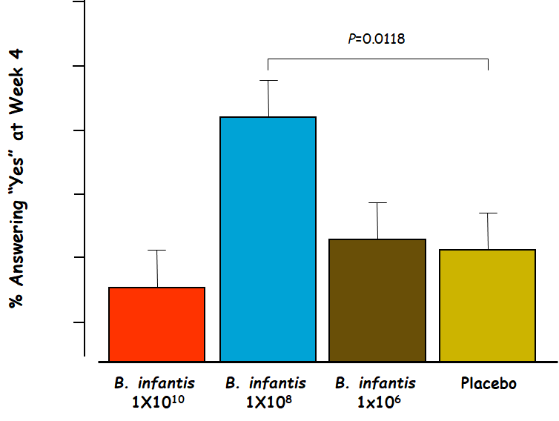
Management of IBS
Constipation and Diarrhea Predominant IBS
Constipation Predominant IBS: | Diarrhea Predominant IBS:
Lifestyle Modifications (exercise and diet) A lot of water Bowel Training and Education Fibre¹ Twelve randomized controlled trials have been performed to date evaluating the efficacy of fiber in the treatment of IBS. Four of these studies noted an improvement in stool frequency (polycarbophil and ispaghula husk), while one noted an improvement in stool evacuation No improvement in abdominal pain 30-50% of patients treated with a fiber product will have a significant increase in gas Lubiprostone stimulates type 2 chloride channels in epithelial cells of the gastrointestinal tract thereby causing an efflux of chloride into the intestinal lumen Why chloride channels? when chloride is not absorbed thus sodium also is not absorbed, when sodium is not absorbed water is not absorbed thus this may relief constipation It was approved by the FDA for the treatment of adult men and women with chronic constipation in January 2006 Nausea and diarrhea 6-8% | Increasing dietary fibre is sensible advice. Fibre varies, 55% of patients will get worse with bran. Loperamide inhibiting intestinal secretion and peristalsis, loperamide slows intestinal transit and allows for increased fluid reabsorption, thus improving symptoms of diarrhea Alosetron is 5-HT3 receptor antagonist that slows colonic transit Meta-analysis of eight randomized controlled trials involving 4842 patients determined that alosetron provided a significant reduction in the global symptoms of diarrhea, abdominal pain, and bloating in patients with IBS and diarrhea Four-fold increased risk of ischemic colitis compared
Probiotics
Mode of Action of Probiotics?
Competition with, and exclusion, of pathogens
Anti-bacterial:
Produce bacteriocins
Destroy toxins
Enhance barrier function, motility
Enhance host immunity by :
Immune modulation
Cytokine modulation
IgA production
Metabolic functions
Global assessment of symptom relief:
1- Actually fibers are used in both diarrhea and constipation… what is the difference? It depends on the amount of water you take with the fiber. If you take too much water with fiber then it works as a lubricant and improves bowel movement. While if you take fibers with minimal amount of water (as adding fibers to yoghurt then fibers work as a sponge and make stool bulky

Slide 20
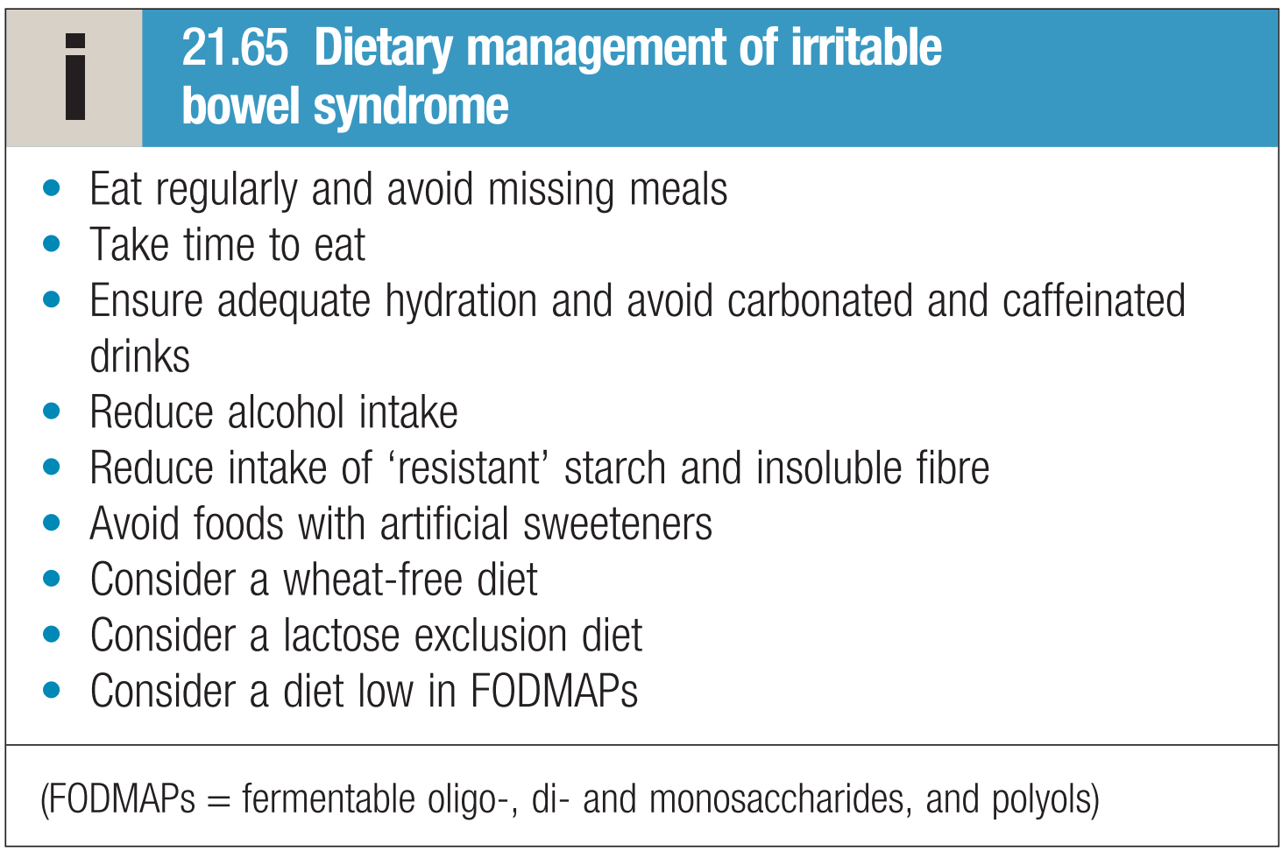
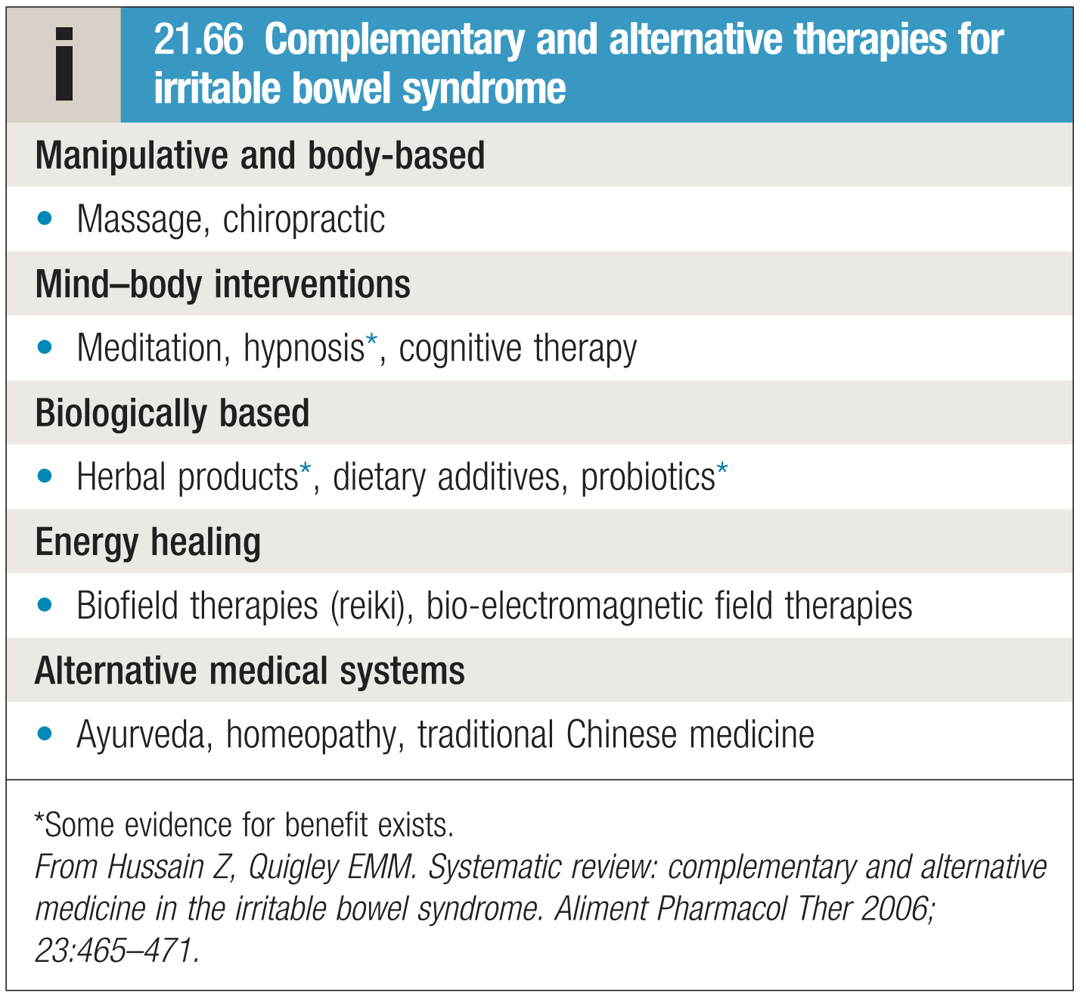
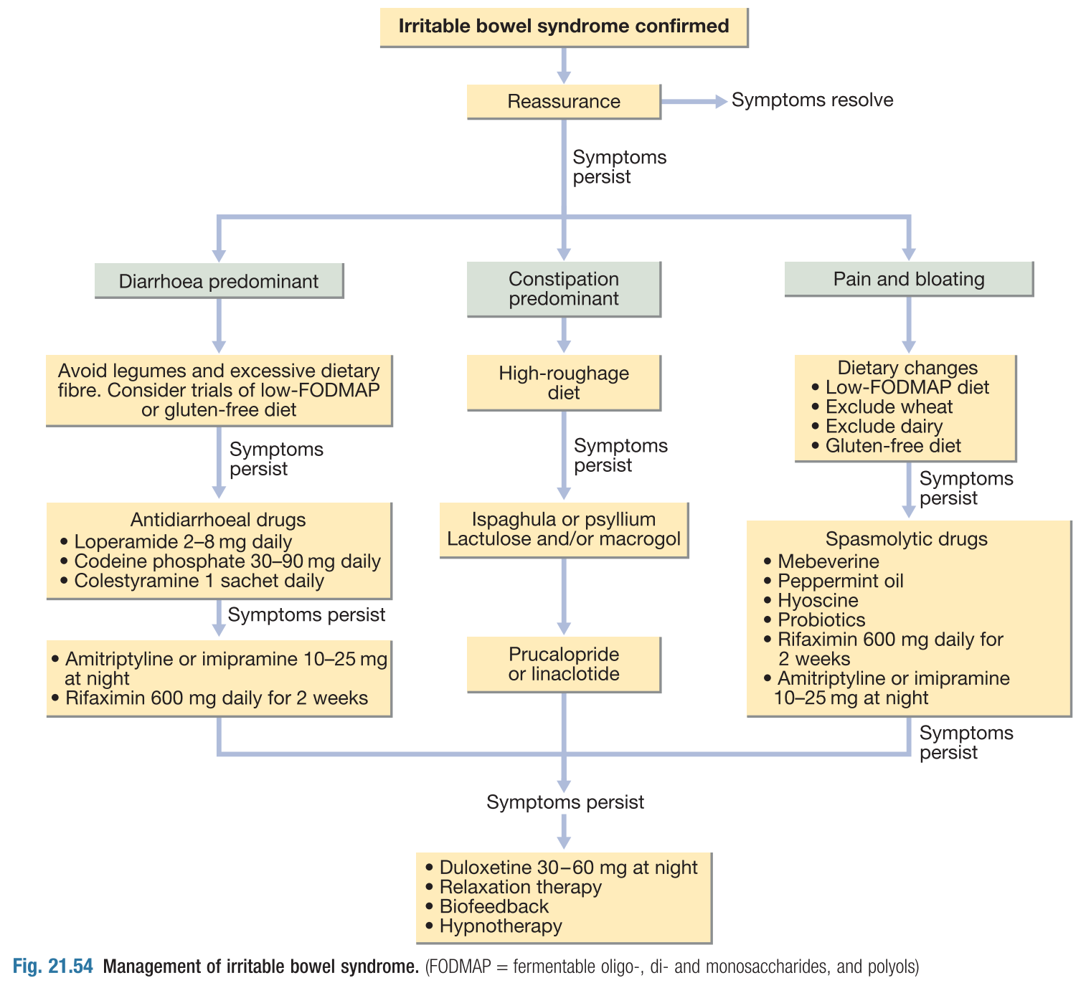
Management of IBS
What about diet?
Avoid caffeine.
Limit your intake of fatty foods.
If diarrhea is your main symptom, limit dairy products, fruit, or the artificial sweetener sorbitol.
Increasing fiber in your diet may help relieve constipation.
Avoiding foods such as beans, cabbage, or uncooked cauliflower or broccoli can help relieve bloating or gas.
Alternative and complementary medicine:
Peppermint, germanium, lavender oils
RCT of 57 IBS patients randomized to receive either peppermint capsules or placebo demonstrated a significant benefit for the peppermint-treated group after 4 weeks.
Seventy-five percent of the study group versus 38% of the placebo group reported a greater than 50% reduction in total IBS symptoms
Alternative Medicine:
Hypnosis: Hypnosis can help some people relax, which may relieve abdominal pain.
Relaxation or meditation: Relaxation training and meditation may be helpful in reducing generalized muscle tension and abdominal pain.
Biofeedback: Biofeedback training may help relieve pain from intestinal spasms. It also may help improve bowel movement control in people who have severe diarrhea.
Self-help: IBS network - IBS support group - Awareness
Algorithm for Management of IBS:

Slide 21
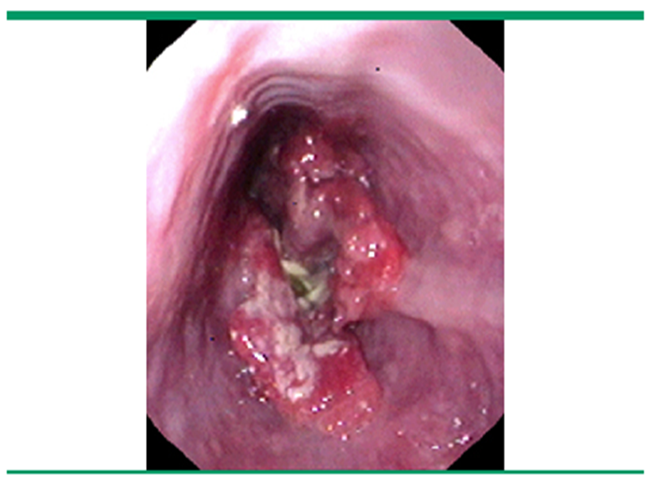
Dr slides
Cases
Case study 1
Q1: A 34 y/o lady who comes to your clinic because of epigastric pain since 5 months ago. She complains of bloating and early satiety too. There is no alarm symptom in her history. She use no medications. Her physical examination is normal.
- What is the most important information from this scenario?
- What is the most likely diagnosis?
A- Dyspepsia
B- Peptic ulcer disease
C- Pancreatitis
D- Gastric cancer
- What is the best next step?
A- Endoscopy
B- High dose PPI
C- H pylori testing
D- Ultrasound abdomen
What is the most important information from this scenario?
1- Age
2- Duration, it’s chronic pain
3- No alarming symptoms
What is the most likely diagnosis? Answer: A
What is the best next step?
Answer: C
A- Endoscopy (no alarming symptoms in this case so not the best answer)
B- High dose PPI (If we are in an area with low prevalence of H pylori, we ho with PPI)
C- H pylori testing (the best answer according to this case, and in our culture H.pylori is prevalent so it is better to do it first)
D- Ultrasound abdomen (not the first line of investigation)
So, we start with H pylori testing, if the test is -ve we give high dose PPI. if it didn’t work we go for endoscopy
Case study 2
A patient was a 60 y/o lady who was referred to me because of constant epigastric pain. She mentioned 6 kg wt loss since 3m ago. She was anemic with ferritin =5. What is the best diagnostic test?
A- Endoscopy
B- High dose PPI
C- H pylori testing
D- Ultrasound abdomen
Answer: A, because of the presence of alarming symptoms in this case as weight
loss and anemia. When do we do endoscopy? In presence of alarming symptoms
or when not responding to treatment or age >55.

Slide 22
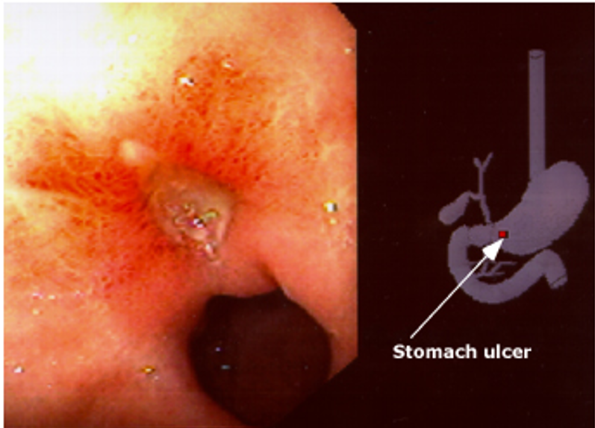
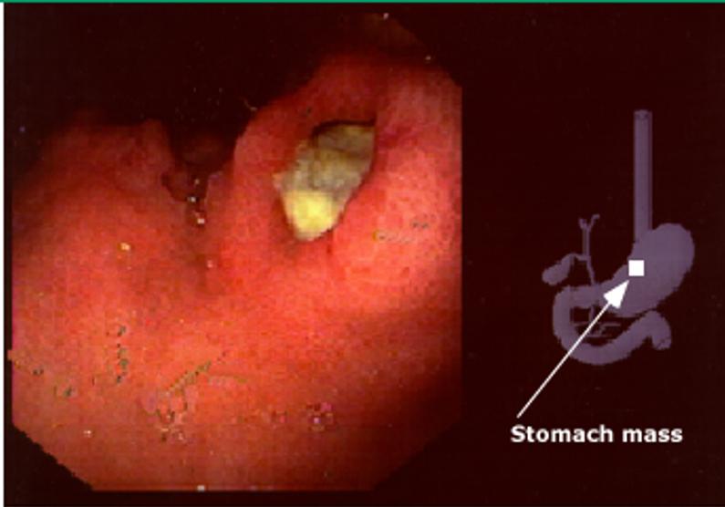
Dr slides
Cases
Case study 3
A 44 y/o lady who was referred to me because of chronic epigastric pain mainly at night and vomiting. She gave a history of one day history of melena but no other alarm symptoms. What is the next step?
A- Endoscopy
B- High dose PPI
C- H pylori testing
D- Ultrasound abdomen
Answer: A,
A 44 y/o (middle age) lady who was referred to me because of chronic epigastric pain mainly at night (you need to think about structural or organic disease rather than functional) and vomiting. She gave a history of one day history of melena (indicate upper GI bleeding) but no other alarm symptoms. What is the next step?
A- Endoscopy
B- High dose PPI
C- H pylori testing
D- Ultrasound abdomen
Case study 4
A 30 years old lady with chronic abdominal pain mainly central associated with bloating . Alternating bowel habit and history of passing mucus with loose motions no Wt loss no blood/rectum. What is the likely diagnosis?
A- Pancreatitis
B- PUD
C- IBS
D- Gastric cancer
Answer: C,
We get from the history : Age (not old), chronicity, central with Alternating bowel habit and no alarming symptoms.
You did it <3

Slide 23
Dyspepsia
Clinical Approach:
History | Ulcer-like or acid dyspepsia Dysmotility-like dyspepsia Unspecified dyspepsia
Physical examination | usually normal
Routine laboratory tests:
Routine blood count
Blood chemistry
Indications for endoscopy
Age >55
Presence of alarming symptoms | Unintended weight loss Persistent vomiting Progressive dysphagia Odynophagia Hematemesis Unexplained anemia or iron deficiency Palpable abdominal mass or lymphadenopathy Family history of upper gastrointestinal cancer Previous gastric surgery Jaundice
Irritable bowel syndrome
Clinical Feature | Recurrent Cramping abdominal pain characterized by “Relieved by defecation and Less at night” Change frequency and consistency of stool Abnormal stool passage Bloating
Diagnosis “clinical diagnosis of exclusion” | Rome III criteria Manning’s Criteria. Rome II Diagnostic Criteria Ask about Alarm symptoms that suggest other serious diseases to exclude them
Reasons to Refer | Age > 45 years at onset. Family history of bowel cancer. Failure of primary care management. Uncertainty of diagnosis. Abnormality on examination or investigation.
Urgent Referral | Constant abdominal pain. Constant diarrhoea. Constant distension. Rectal bleeding. Weight loss or malaise.

Slide 24
Summary
Management of H.pylori
Clarithromycin-resistant
10-day sequential regimen | “PPI+amoxicillin” 2/day for the first 5 days, followed by “PPI+ clarithromycin+ tinidazole” each given 2/day for the remaining 5 days
Clarithromycin-sensitive
1st line treatment regimen of choice | “PPI, amoxicillin, clarithromycin” twice daily for 7-14 days
Penicillin allergy | “PPI, metronidazole, clarithromycin” twice daily for 7-14 days
Macrolide allergy | “PPI, amoxicillin, metronidazole” twice daily for 14 days
generally reserved for retreatment | “Bismuth, metronidazole, tetracycline” 4 times daily + PPI twice daily for 7-14 days
H.pylori as a cause of PUD
Diagnosis
Non endoscopic methods | Serum antigen Urea breath test Stool antigen
Endoscopic methods | Histology Rapid urease test Culture PCR

Slide 25
1. You see a 47-year-old man in clinic with a three-month history of epigastric dull abdominal pain. He states that the pain is worse in the mornings and is relieved after meals. On direct questioning, there is no history of weight loss and the patient’s bowel habits are normal. On examination, his abdomen is soft and experiences moderate discomfort on palpation of the epigastric region. The most likely diagnosis is:
A. Gastric ulcer
B. Gastro-oesophageal reflux disease (GORD)
C. Duodenal ulcer
D. Gastric carcinoma
E. Gastritis
2. You see an 80-year-old man who presents to accident and emergency with epigastric pain. The pain started 3 days ago and today he noticed that the colour of his stools has changed to a ‘tarry-black’ colour. Associated symptoms include nausea and lethargy. The patient is a smoker of 20 cigarettes a day and has recently finished eradication treatment for a duodenal ulcer. The patient is alert and orientated with a pulse rate of 99 and blood pressure of 98/69, respiratory rate of 18, oxygen saturations of 98% on room air and temperature of 37.2°C. On examination, the abdomen is soft with marked tenderness in the epigastric region and bowel sounds are present. The rectum is empty, on PR examination, with some traces of malaena. The patient has been started on high flow oxygen and has been given some oral analgesia. The most appropriate next step in managing this patient is:
A. Keep nil by mouth and arrange endoscopy
B. Request an erect chest x-ray
C. Intravenous pantoprazole
D. ECG
E. Intravenous cannulation and fluids
3. A 32-year-old white woman complains of abdominal pain off and on since the age of 17. She notices abdominal bloating relieved by defecation as well as alternating diarrhea and constipation. She has no weight loss, GI bleeding, or nocturnal diarrhea. On examination, she has slight LLQ tenderness and gaseous abdominal distension. Laboratory studies, including CBC, are normal. Which of the following is the most appropriate initial approach?
A. Recommend increased dietary fiber, antispasmodics as needed, and follow-up examination in 2 months.
B. Refer to gastroenterologist for colonoscopy.
C. Obtain anti-endomysial antibodies.
D. Order UGI series with small bowel follow-through.
E. Order small bowel biopsy.
Q4: A 35-year-old woman has chronic crampy abdominal pain and intermittent constipation and diarrhea, but no weight loss or gastrointestinal bleeding. Her abdominal pain is usually relieved with defecation. Colonoscopy and upper endoscopy with biopsies are normal, and stool cultures are negative. Which of the following is the most likely diagnosis?
A- Infectious colitis
B- Irritable bowel syndrome
C- Crohn disease
D- Ulcerative colitis
Q5: A 42-year-old overweight but otherwise healthy woman presents with sudden
onset of right-upper abdominal colicky pain 45 minutes after a meal of fried
chicken. The pain is associated with nausea and vomiting, and any attempt to eat
since has caused increased pain. Which of the following is the most likely cause?
A. Gastric ulcer
B. Cholelithiasis
C. Duodenal ulcer
D. Acute hepatitis
Q6: Which of the following is the most accurate statement regarding H pylori infection?
A. It is more common in developed than underdeveloped countries.
B. It is associated with the development of colon cancer.
C. It is believed to be the cause of nonulcer dyspepsia.
D. The route of transmission is believed to be sexually transmitted.
E. It is believed to be a common cause of both duodenal and gastric ulcers.
Q7: A 45-year-old man was brought to the ER after vomiting bright red blood. He
has a blood pressure of 88/46 mm Hg and heart rate of 120 bpm. Which of the
following is the best next step?
A. Intravenous fluid resuscitation and preparation for a transfusion
B. Administration of a proton-pump inhibitor
C. Guaiac test of the stool
D. Treatment for H pylori
Q8: Which one of the following patients should be promptly referred for endoscopy?
A. A 65-year-old man with new onset of epigastric pain and weight loss
B. A 32-year-old patient whose symptoms are not relieved with ranitidine
C. A 29-year-old H pylori-positive patient with dyspeptic symptoms
D. A 49-year-old woman with intermittent right-upper quadrant pain following meals
Answers: Q5:D | Q6:C | Q7:B | Q8:D
Answers: Q1:C | Q2:E | Q3:A | Q4:B | Q5:B | Q6:E | Q7:A | Q8:A
Answers Explanation File!

Slide 26
THANKS!!
This lecture was done by:
Mohammad Ajarem
Quiz and summary maker:
Mohammad Ajarem
Note taker:
Jehad AlOrainy
Special Thanks to Mohammed Alhumud & Abdulaziz Alshoumar for their huge efforts!
Females co-leaders:
Raghad AlKhashan
Amirah Aldakhilallah
Males co-leaders:
Mashal AbaAlkhail
Nawaf Albhijan
Send us your feedback:
We are all ears!

