Slide 1
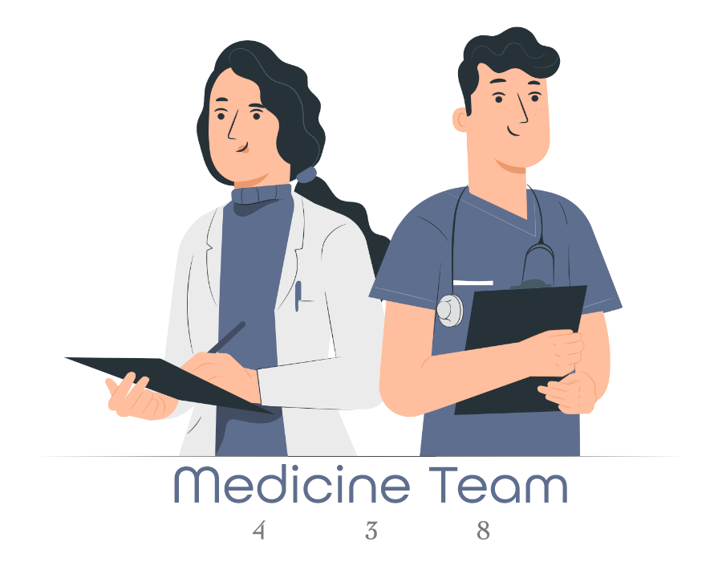
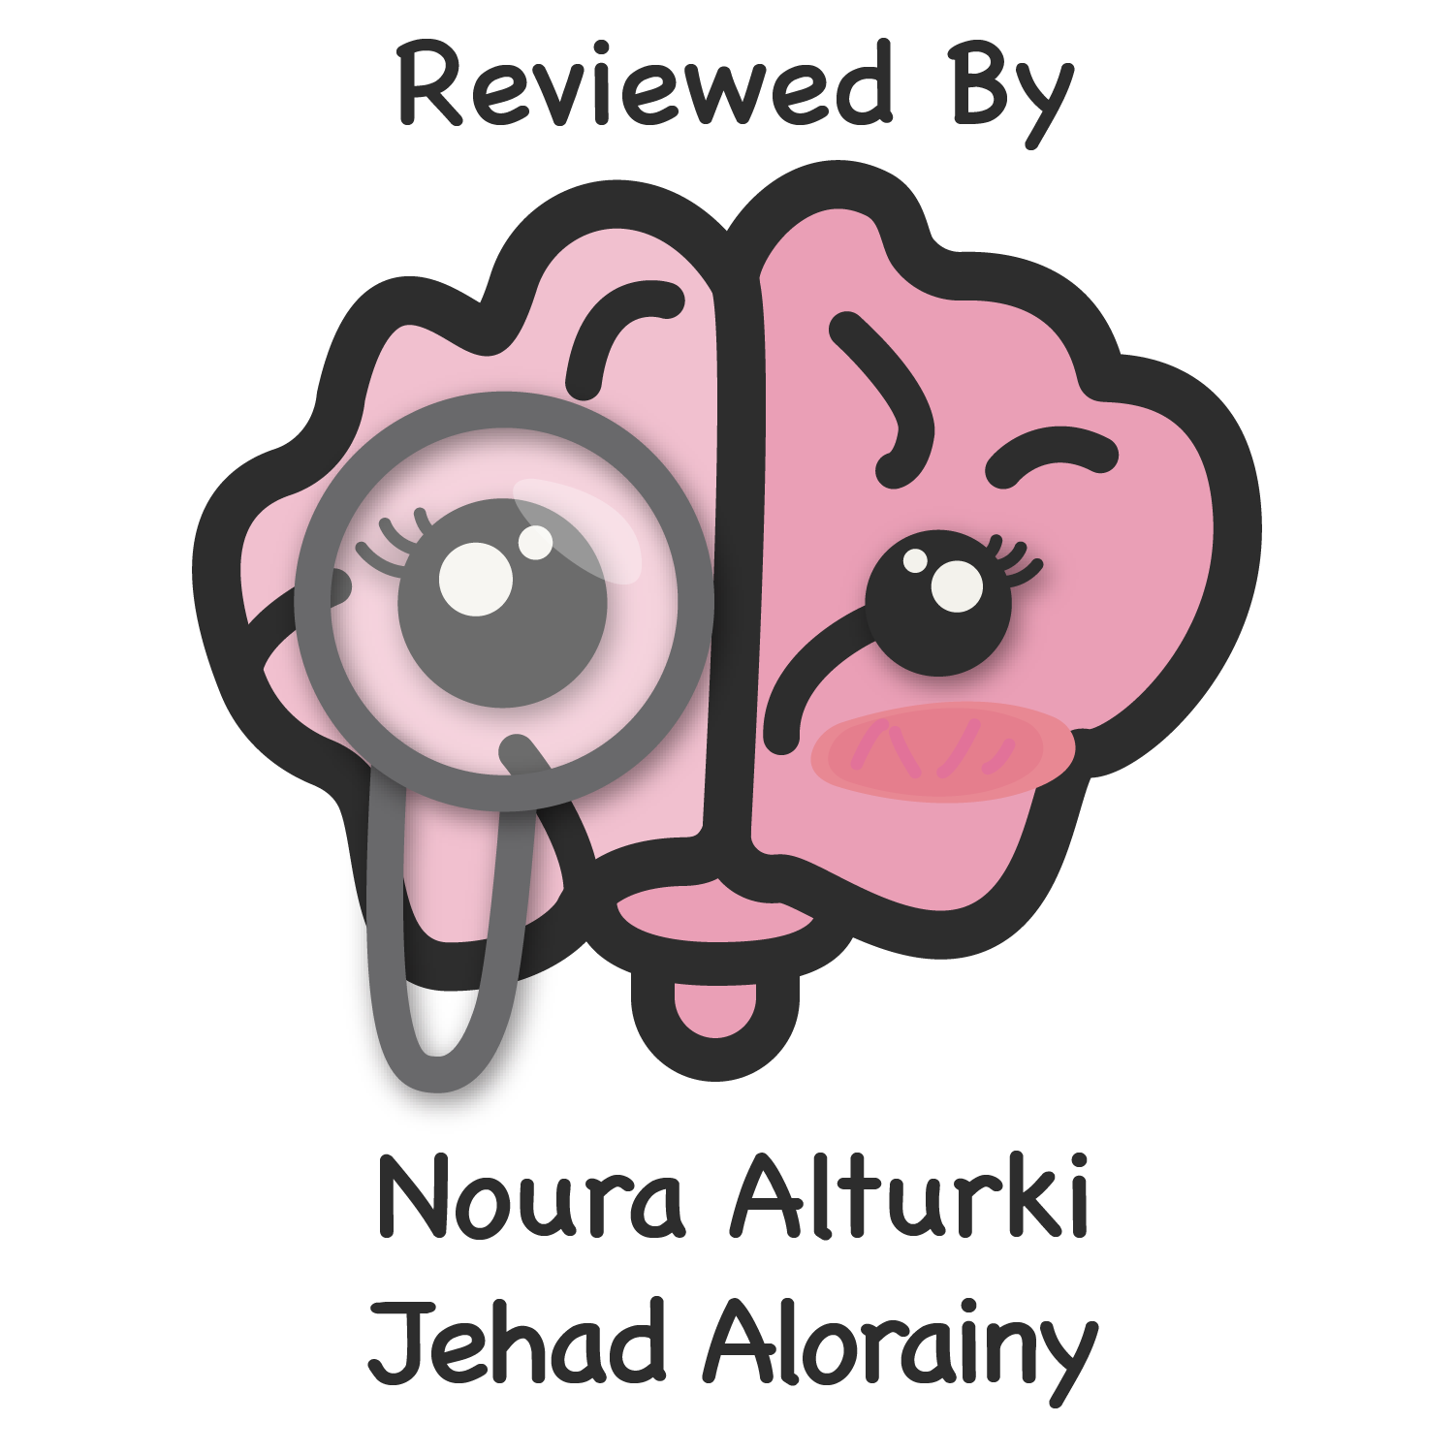
Lecture 26
Editing file
Gastrointestinal Bleeding
Objectives:
List the causes of Upper GI bleeding (UGIB).
Explain the pathophysiology of shock from upper gastrointestinal bleeding.
Identify the symptoms for patients presenting with GI bleeding.
Discuss the risk stratification and initial assessment for patient with UGIB.
Illustrate important physical signs in patients presenting with UBIG
Outline the investigations required.
Plan the management of patients with UGIB
Recognize the clinical manifestations of upper gastrointestinal bleeding.
Understand the principles of managing patients with upper gastrointestinal bleeding.
Understand the principles of pharmacological therapy of patients with upper gastrointestinal bleeding.
Recognize the differences between variceal and non-variceal hemorrhage.
Color index:
Color index:
Original text Females slides Males slides
Doctor’s notes Text book Important Golden notes Extra

Slide 2
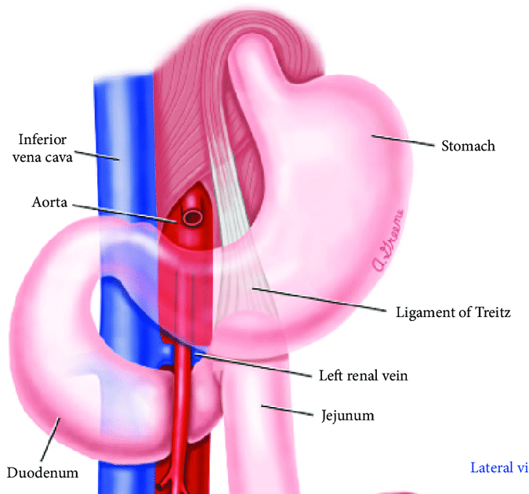
Introduction
Anatomical landmarks and location of gastrointestinal bleeding:
Upper GI Bleeding
Lower GI Bleeding
From 437 medicine team
A source of bleeding above the ligament of Treitz (suspensory muscle of duodenum).
Including: Esophagus, stomach and duodenum
A source of bleeding Bleeding below the ligament of Treitz.
Including: Small & large bowel and the rectum
Acute upper gastrointestinal bleeding:
This is the most common gastrointestinal emergency, with approximately 10% mortality rate
The cardinal features are¹:
Haematemesis
Melaena
Could present with unaltered blood can appear per rectum (hematochezia) , but the bleeding must be massive and is almost always accompanied by shock.
lower gastrointestinal bleeding:
EXTRA
Acute: Massive bleeding from the lower gastrointestinal tract is rare and presents with profuse red or maroon diarrhoea and with shock. usually from
diverticular disease
ischaemic colitis.
subacute or chronic: small bleeds. commonly caused by:
Haemorrhoids. ²
Anal fissures.³
Chronic gastrointestinal bleeding:⁴
Patients usually present with iron-deficiency anaemia
can occur with any lesion of the GI tract that produces acute bleeding
The primary concern is to exclude cancer. particularly of the stomach or right colon and coeliac disease
1- symptoms are explained in details in coming slides.
2- Haemorrhoidal bleeding is bright red occur during or after defecation. (On toilet paper)
3-present with fresh rectal bleeding and anal pain occur during defecation.
4-hookworm is the most common worldwide cause of chronic GI blood loss.

Slide 3
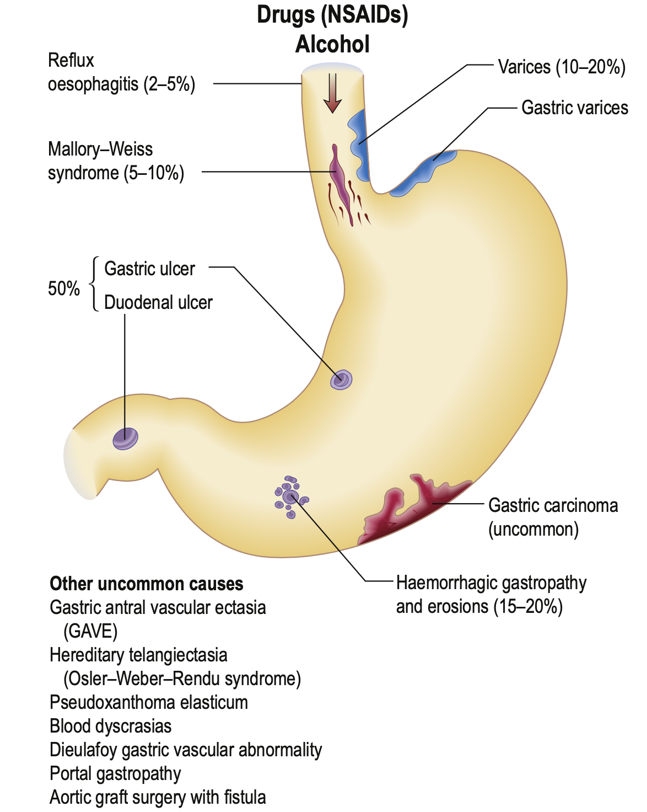
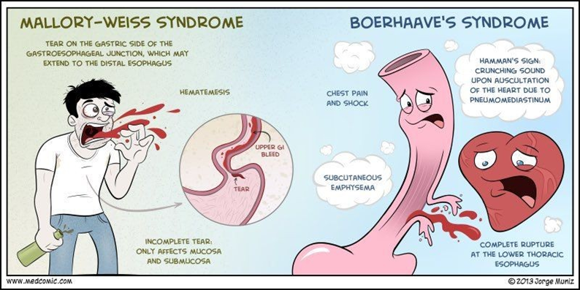
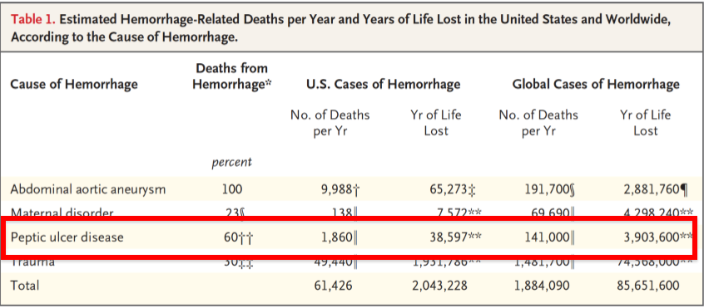
Upper GI Bleeding
UGIB Incidence; 57-78 cases per 100,000 population
Etiology:
01
Peptic ulcer disease (duodenal and gastric ulcers) The most common cause of upper GI bleeding (36-50%)
02
Variceal bleeding ¹ 2nd most common cause
Mucosal Erosive disease (Esophagitis, Gastritis, Duodenitis)
04
Mallory weiss tear ²
03
05
Malignancy
Arteriovenous malformation
07
Gastric antral vascular ectasia (GAVE)
08
Dieulafoy's lesion ³
06
1
2
1- common in egyptians due to high prevalence of hepatitis C and Schistosomiasis
2- a linear mucosal tear occurs at the oesophagogastric junction and produced by a sudden increase in intra-abdominal pressure. It often occurs after a bout of coughing or retching and is classically seen after alcoholic ‘dry heaves’. : recurrent vomiting which can be due to medications especially chemotherapy, pregnancy and classically after alcohol intake. They can have hematemesis or coffee ground emesis .
Figure 1 explanation: When the tear goes to the full thickness causing muscle tear and not limited only to the surface then it is called boerhaave's syndrome and people die from it . pt will have bleeding to the mediastinum and mediastinitis which have a high fatality rate
3- rare, the vessel below the surface of the mucosa opens up and bleeds then disappears ( no abnormality found in endoscopy) can be picked up when the pt is actively bleeding
Figure 2 explanation : it shows the risk of PUD, 4 millions years were lost due to PUD only

Slide 4
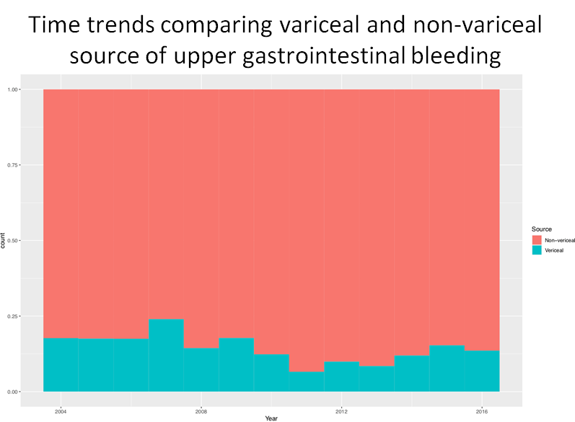
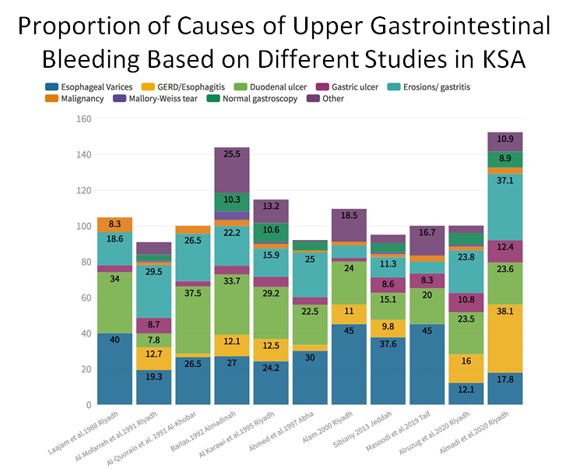
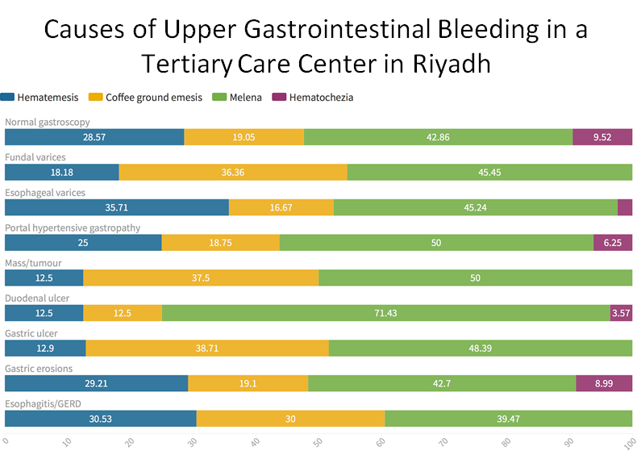
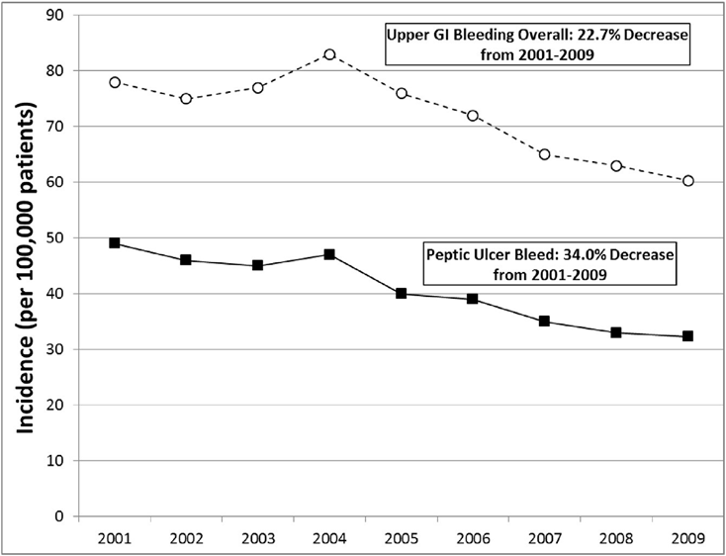
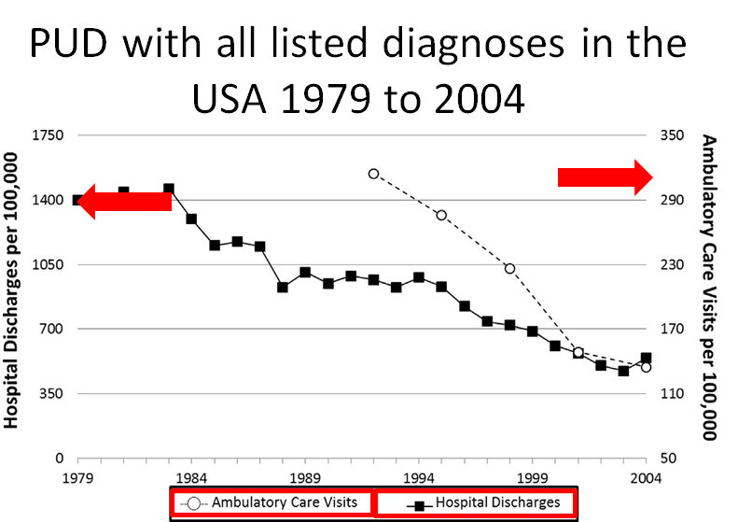
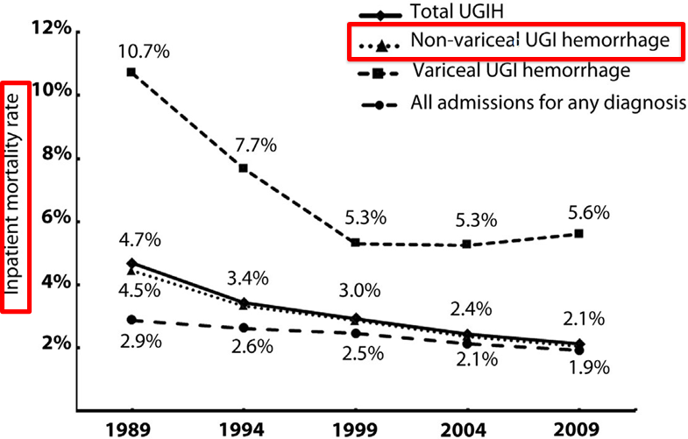
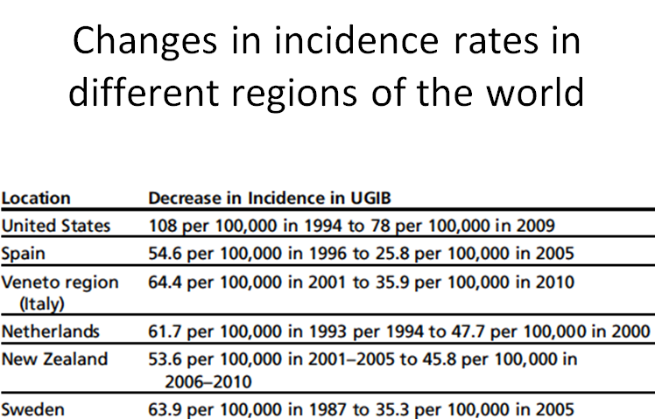
Males slides
GI Bleeding
study conducted at alshumaisi hospital, during 13 years , the vast majority of GI bleeding were due to non variceal causes
this study shows the different presentations of pt presenting with the same disease. Having hematochezia is not always due to lower GI bleed , symptoms can vary.
PUD is decreasing globally , could be due to better treatment of heartburn and PUD with PPI and h.pylori eradication also, the use of NSAIDs is not encouraged and usually given with a medications to prevent PUD
Risk Factors
- Age > 65 | - Concomitant use of: NSAID & low dose aspirin can produce ulcers and erosions Oral bisphosphonates (eg. Alendronate) Corticosteroids in the usual therapeutic doses have no influence on gastrointestinal haemorrhage. However, the combination of glucocorticoids and NSAIDs results in a synergistic increase in the incidence of gastrointestinal haemorrhage. Anticoagulant or coagulopathy Antiplatelets (eg. Clopidogrel) Anticoagulants and antiplatelet agents do not cause acute gastrointestinal haemorrhage per se, but bleeding from any cause is greater if the patient is anticoagulated. SSRI
- Previous peptic ulcer or ulcer-related upper GI complication
- Multiple or High-dose NSAIDs
- Selection of NSAID (eg. COX1 vs COX2 inhibitors)
- NSAID related dyspepsia
- Aspirin (including cardioprotective dosage)
- H.pylori infection
- Cigarette smoking and Alcohol consumption
- Chronic debilitating disorders (eg. Cardiovascular disease, rheumatoid arthritis), liver cirrhosis and renal disease
Females slides

Slide 5
Clinical Features
Types of bleeding:
1
Hematemesis:
Vomiting fresh, red blood. suggests upper GI bleeding. occur when bleeding is rapid and profuse ( moderate to sever)
2
“Coffee grounds” emesis :
Suggests upper GI bleeding. occur when bleeding is less severe and at lower rate.vomitus has enough time to be oxidised and transformed into coffee grounds
3
Melena: ¹
black, tarry, foul-smelling stool containing altered blood
The characteristic colour and smell result by the action of digestive enzymes and bacteria on haemoglobin
indicates that blood has remained in GI tract for several hours.
Melena suggests upper GI bleeding 90% of the time. But it can occur with bleeding from any lesion proximal to the right colon.
Note that dark stools can also result from bismuth², iron³, spinach, charcoal, and licorice.
4
Hematochezia:
bright red blood per rectum
usually represents a lower GI source (typically left colon or rectum).
Consider diverticulosis, arteriovenous malformations, hemorrhoids, and colon cancers.
It may result from massive upper GI bleeding (5-10% of hematochezia) that is very heavy and quick (so that blood does not remain in colon to turn into melena).
patient often has some degree of hemodynamic instability.
5
Occult blood in stool: Guaiac +ve stool
Invisible blood or its breakdown products in stool.
presents with iron deficiency anaemia.
Source of bleeding may be anywhere along GI tract.
the most important cause is colorectal cancer.
1- soft stool not hard
2- used to treat heartburn but we don't use it here. causes black discoloration of the stool
3- how to know if it is melena or due to iron supplements ? if the patient is taking iron the stool won't be loose and it will not have foul smell

Slide 6
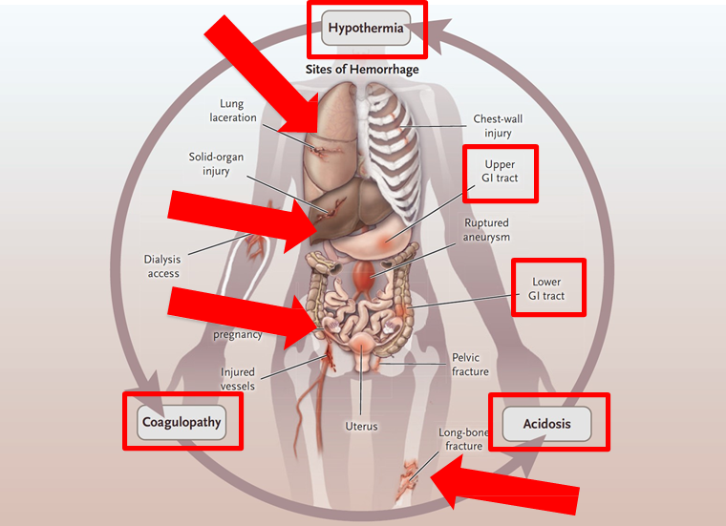
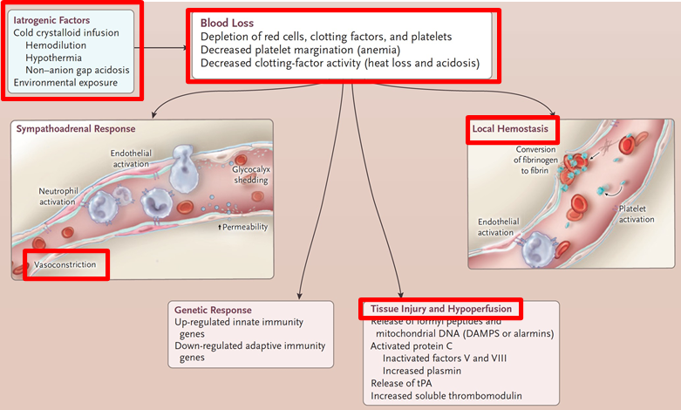
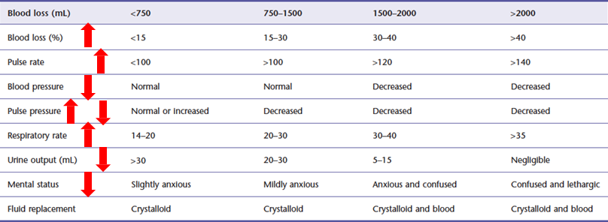
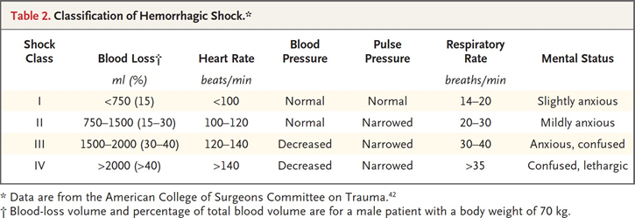
Males slides
Clinical Features cont’
Signs of volume depletion
Pathophysiology of shock :
all the causes in red can manifest as shock which can cause acidosis , hypothermia , and coagulopathy. It is a vicious cycle
Managing GI bleeding with IV fluids can make it physiologically worse.
In this figure, we can see that the blood is diluted due to the loss of it’s components that accompanies bleeding.
when the pt is bleeding and you give them IV fluids you will dilute the blood products even more.
The fluids can be cold which can decrease body temperature. Sometimes we warm up the fluids before introducing them to the pt.
clinical features based on the amount of blood loss:

Slide 7
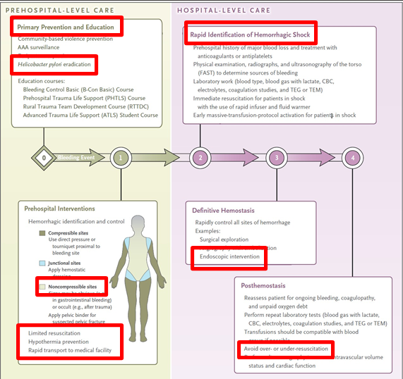
Clinical Features cont’
Signs and Symptoms of anemia
(e.g., fatigue, pallor, exertional dyspnea)
Essentials of diagnosis
Symptoms | Coffee ground vomiting, hematemesis, melena, hematochezia, anemic symptoms
PMH | Liver cirrhosis, use of NSAIDs
Signs | Hypotension, tachycardia, pallor, altered mental status, melena or blood per rectum, decreased urine output
Bloods | Anemia, raised urea, high urea or creatinine ratio
Endoscopy | Ulcers, varices, Mallory-Weiss tera, erosive disease, neoplasms, vascular ectasia, and vascular malformations
Females slides
Management
Pre hospital care : mainly primary prevention. the red box on the left lower corner is what you want to achieve before reaching the hospital
Hospital level : Avoid over or under resuscitation (Nobody knows what is the cutoff of each), this is important to avoid permissive hypotension, it means that our aim is not to return the pt to 100% normal, we try to achieve 70-80% because we don't want to give too much fluids causing the disruption we have discussed before .

Slide 8
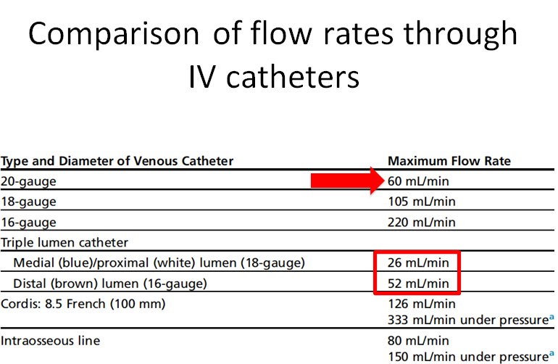
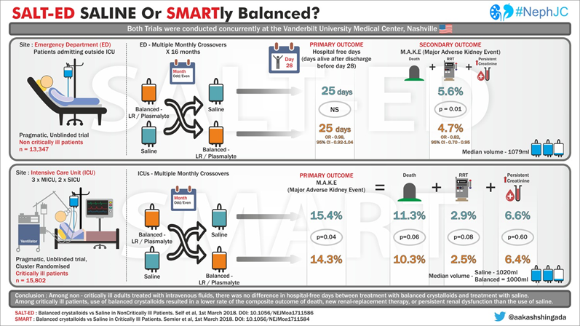
Males slides
Management
1
Pre endoscopic management
Initial Resuscitation:
Maintain airway, breathing and circulation
Ensure large-bore I.V access and consider monitored setting
Resuscitate initially with crystalloid solutions ¹
Send blood work including CBC, coagulation studies and type and cross- matching
Full blood count. Chronic or subacute bleeding leads to anaemia. Thrombocytopenia may be a clue to the presence of hypersplenism in chronic liver disease.
Hemoglobin/hematocrit level (may not be decreased in acute bleeds): A hemoglobin level >7 to 8 g/dL is generally acceptable in young, healthy patients without active bleeding. However, most elderly patients (especially those with cardiac disease) should have a hemoglobin level >10 g/dL.
A low MCV is suggestive of iron deficiency anemia (chronic blood loss). Patients with acute bleeding have normocytic red blood cells.
Urea and electrolytes. may show evidence of renal failure. The blood urea rises in upper GI bleeding because the blood will be digested to protein then absorbed from the small intestine and converted to urea in the liver ; an elevated blood urea with normal creatinine concentration implies severe bleeding.
Liver function tests. may show evidence of chronic liver disease.
Coagulation profile (platelet count, PT: Check with clinical suggestion of liver disease or in anticoagulated patients, PTT, INR).
Cross-matching. At least 2 (Davidson’s) units of blood should be cross-matched if a significant bleed is suspected. cross-match at least 4 (Kumar) units of blood if there is evidence of a large bleed (BP <100 mmHg, pulse >100 beats/min, cool or cold extremities with slow capillary refill, Hb <100 g/L).
Comparison of flow rates through IV catheters
the larger the number the smaller the catheter. 16 gauge is the largest , you can give 1L in 5 minutes . triple lumen is very small, it is a long catheter with 3 openings.
intraosseous line : used usually in children and can be used in trauma.
you can use either crystalloids or normal saline . the outcomes with crystalloids are better . two studies were done, smart trial for critical and severe cases which revealed better outcomes with crytalloids, salted trial in less severe cases showed no difference between the two interventions.
1-resuscitate the pt by IV fluids, IV fluids, IV fluids, IV fluids, IV fluids, IV fluids→ then blood. (SUPER IMPORTANT!)
It takes time to wait for blood bank so u save the pt with iv fluids . If u don't have time and you need to give the pt blood so you can use unmatched blood "O-" , if you have time you match them.

Slide 9
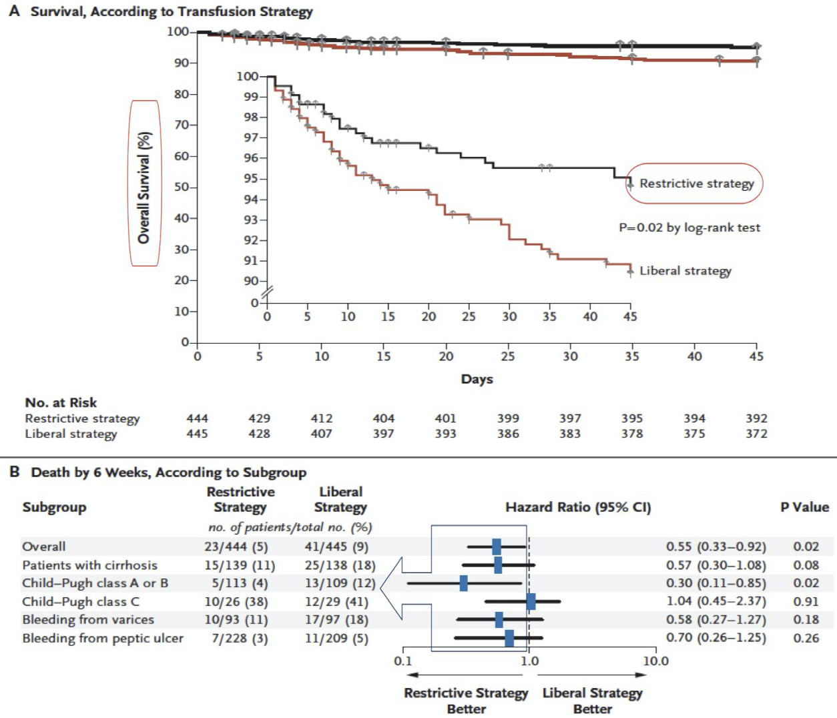
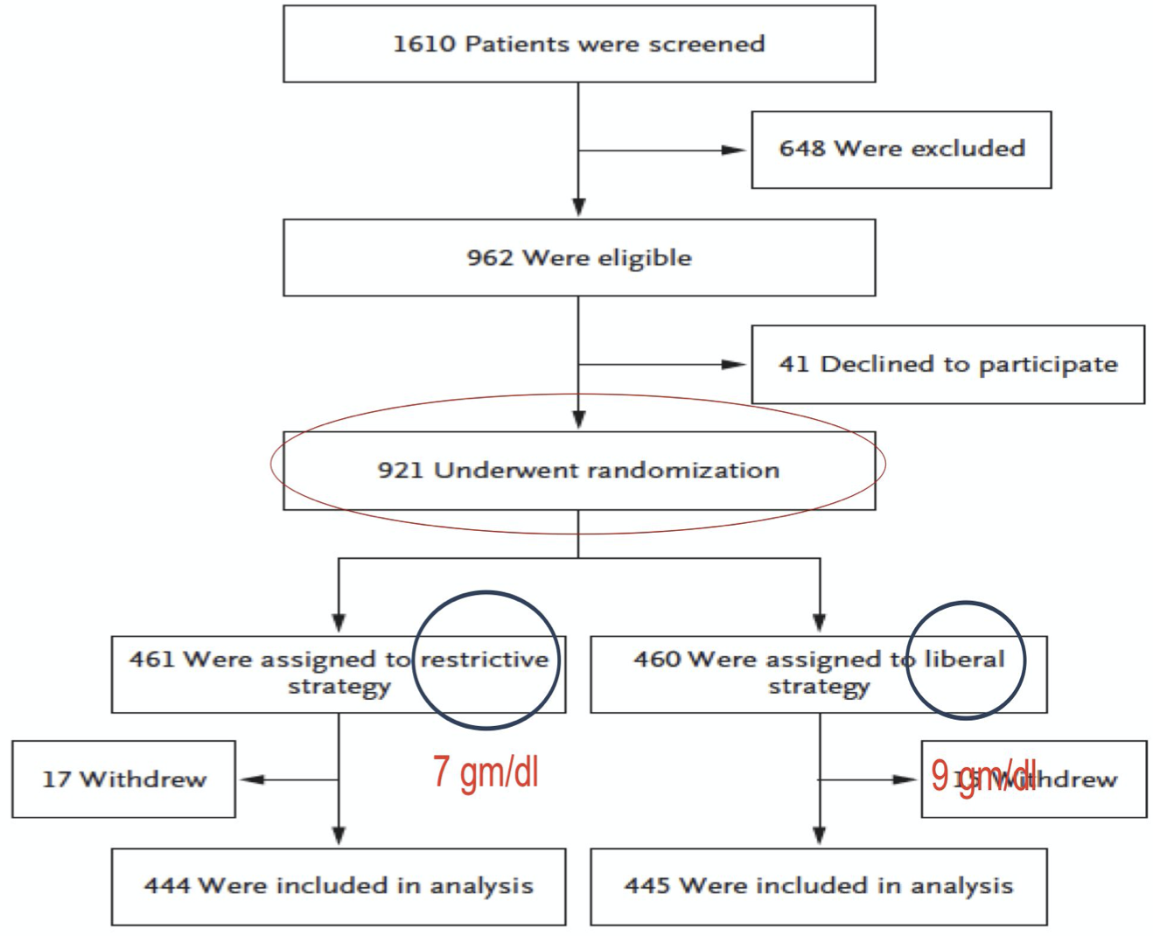
Management
1
pre endoscopic management cont’
Transfusion Requirements:
The role of transfusion in clinically stable patients with mild GI bleeding remains controversial, with uncertainty at which hemoglobin level transfusion should be initiated. Literature suggesting poor outcomes in patients managed with a liberal transfusion.
The restrictive RBC transfusion had significantly improved survival and reduced rebleeding.
Packed red blood cells: If the hemoglobin level < 7 g/dL or If hemoglobin < 10 g/dL in patients with preexisting cardiovascular disease or patients with symptoms.
Transfuse platelets only if platelet count < 50x109/L or <100x109/L with suspected platelet dysfunction
Fresh frozen plasma: if INR is elevated.
Risk stratification:
Early identification
Appropriate intervention
Minimizes morbidity and mortality ²
Low vs. high¹ risk
Glasgow - blatchford score ³
Rockall score ³
AIMS65 score ³
[ AIM565 score ]
Males slides
The following factors affect the risk of rebleeding and death:
Risk Factor | Score
Albumin < 3 g\dL | 1
INR > 1.5 | 1
Altered mental status | 1
SBP≤ 90 mmHg | 1
Age > 65 | 1
Age.
Evidence of comorbidity, e.g. cardiac failure, ischaemic heart disease, chronic kidney disease and malignant disease.
Presence of the classical clinical features of shock (pallor, cold peripheries, tachycardia and low blood pressure).
Endoscopic diagnosis, e.g. Mallory–Weiss tear, peptic ulceration.
Endoscopic stigmata of recent bleeding, e.g. adherent blood clot, spurting vessel.
Clinical signs of chronic liver disease.
1-inform the surgeon that this pt has a high risk and s/he might need to be taken to the OR.
2-avoid surgery due to high morbidity and mortality. consult interventional radiology, gastroenterology and admit to ICU to avoid surgery.
3- there’s no need to memorize them

Slide 10
Management
1
pre endoscopic management cont’
[ Glasgow - blatchford score¹]
 | Risk factor at presentation | Threshold | Score
Urea | Blood Urea Nitrogen (mmol\L) | 6.5 - 7.9 8 - 9.9 10 - 24.9 ≥ 25 | 2 3 4 6
CBC | Hb for men (g\L) | 120 - 130 100 - 119 < 100 | 1 3 6
 | Hb for women (g\L) | 100 - 120 < 100 | 1 6
Physical examination | Systolic BP (mmHg) | 100 - 109 90 - 99 < 90 | 1 2 3
 | HR (bpm) | >100 | 1
History | Melena | Present | 1
 | Syncope | Present | 2
 | Hepatic disease | Present | 2
 | Cardiac failure | Present | 2
Total score (0-23). Patient with score >0 are considered to be at high risk and requires admission
1-the best score so far. Scoring systems have been developed to assess the risk of rebleeding or death. The Blatchford score uses the level of plasma urea, haemoglobin and clinical markers but not endoscopic findings to determine the need for intervention such as blood transfusion or endoscopy in GI bleeding.

Slide 11
Management
1
pre endoscopic management cont’
[ Rockall score¹ ]
 |  | Variable |  | Score
 |  | Age (History) | < 60 60 - 79 ≥80 | 0 1 2
 |  | Shock (Physical exm) | HR >100 Systolic BP < 100 | 1 2
 |  | Coexisting illness (History) | Ischemic heart disease, congestive HF, other major illness Renal or hepatic failure, metastatic cancer | 2 3
 | - | Endoscopic diagnosis | No lesion observed, Mallory weiss tear Peptic ulcer, erosive disease, esophagitis Cancer of upper GI | 0 1 2
 |  | Endoscopic stigmata of recent hemorrhage | Clean base ulcer, flat pigmented spot Blood in upper GI, active bleeding, visible vessel, clot | 0 2
Clinical Rockall score
Complete Rockall Score
Pre-endoscopic therapy:
Provide erythromycin I.V 30 minutes prior to endoscopy
High-dose I.V PPI should initiated¹
The routine use of nasogastric lavage and/or tranexamix acid is not recommended
Patients receiving anticoagulants:
correction of coagulopathy is recommended
Endoscopy should not be delayed for a high INR unless the INR is supratherapeutic ²
Aspirin, NSAIDs and warfarin are stopped and the INR reversed if necessary.
2
Endoscopic management
Definition of early endoscopy:
Ranges from 2 to 24 hours AFTER INITIAL PRESENTATION ³
May need to be delayed or deferred:
Active acute coronary syndromes
Suspected perforation ⁴
1- not used anymore, Rockall score is based on clinical and endoscopic findings.
2- anything less than 2-2.5 you can do your intervention.Supratherapeutic: 6-9 . you need to reduce INR with either vit K in pt taking warfarin, the antidote for heparin or fresh frozen plasma AKA cryoprecipitate
3-non variceal within 24h, Variceal within 12 hours
4- surgery is a better choice

Slide 12
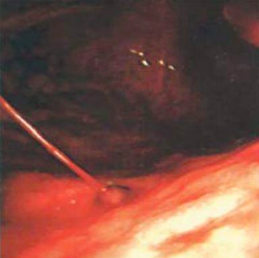
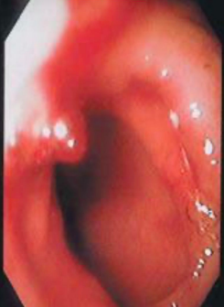
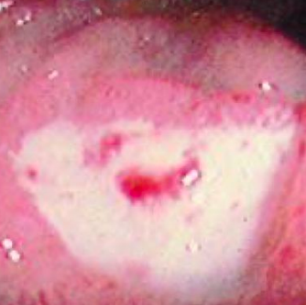
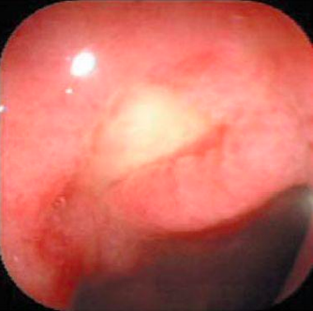
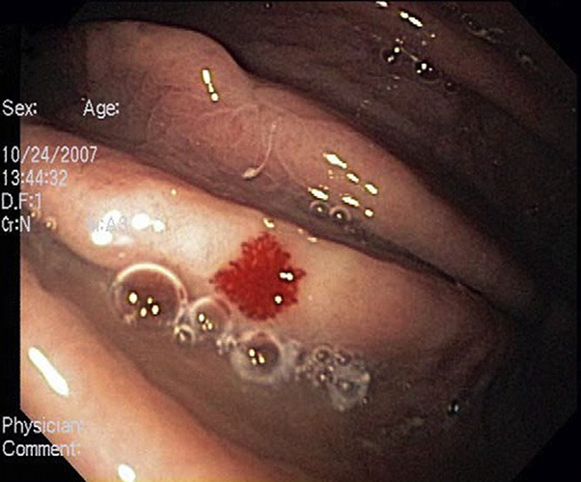
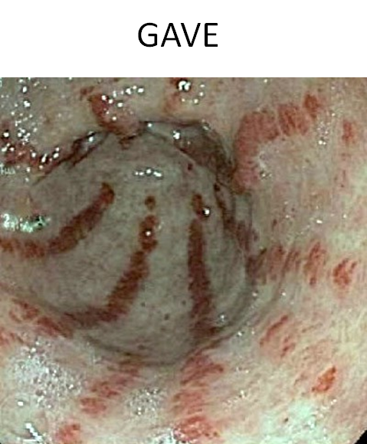
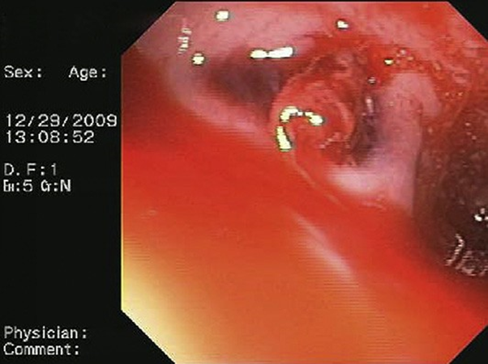
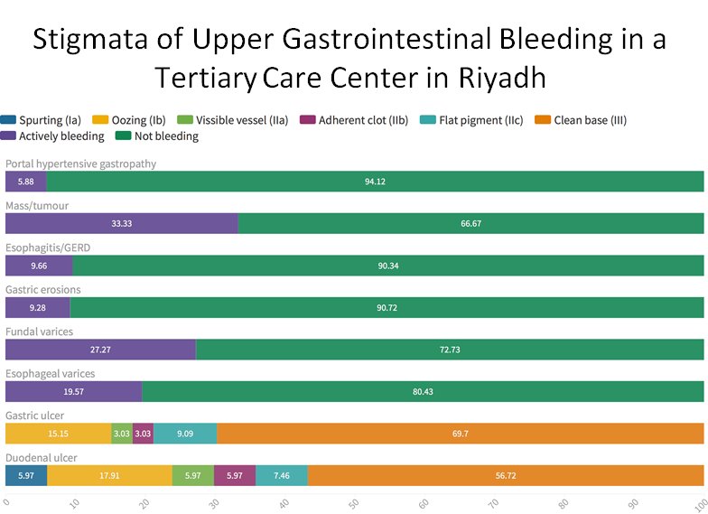
Management
2
Endoscopic management
Endoscopic findings:
Spurting Blood
Non-bleeding Visible Vessel
Flat, Pigmented Spot
Clean Base³
High-risks lesions are those that spurt blood, ooze blood , contain a non bleeding visible vessel , or have an adherent clot .
Low-risk lesions are those that have a flat, pigmented spot or a clean base .
AV malformation ¹
GAVE ²
Visible vessel
1- looks like a tree, can be seen in liver cirrhosis, pregnancy (high estrogen state) and hereditary telangiectasia
2- Gastric antral vascular ectasia AKA watermelon stomach , the red lines are vascular malformations . Happens usually in elderly who do renal dialysis and sometimes without known reason
3- Give only PPI. It is one of the indications to look for h.pylori and treat it

Slide 13
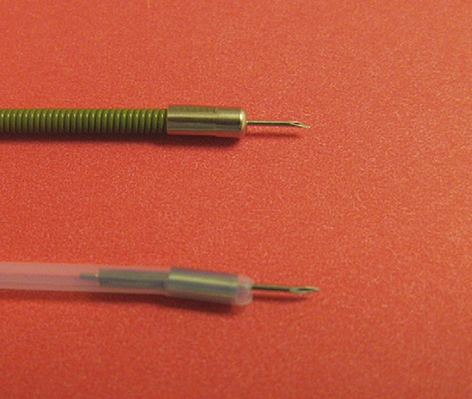
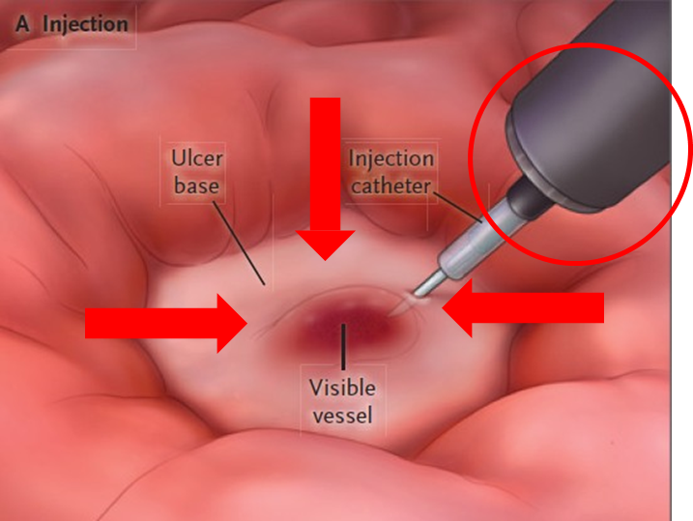
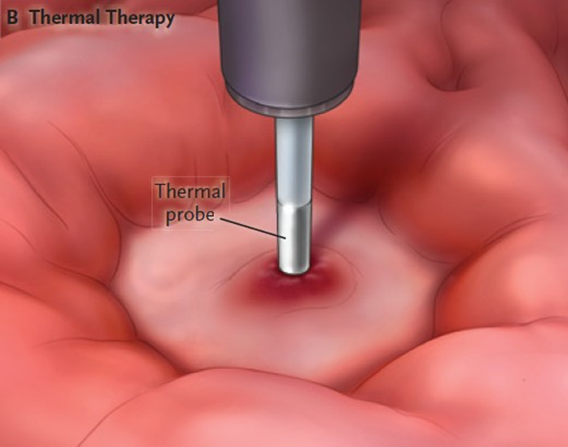
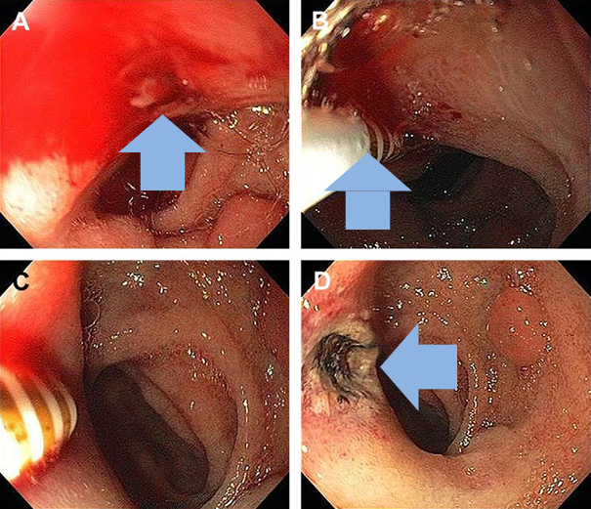
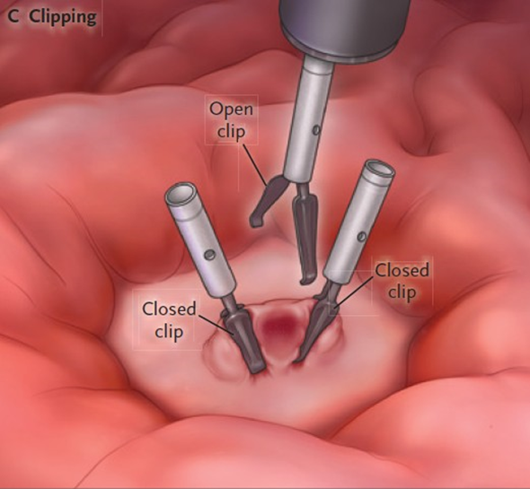
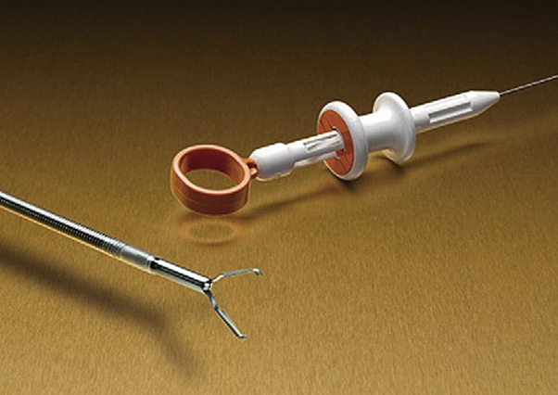
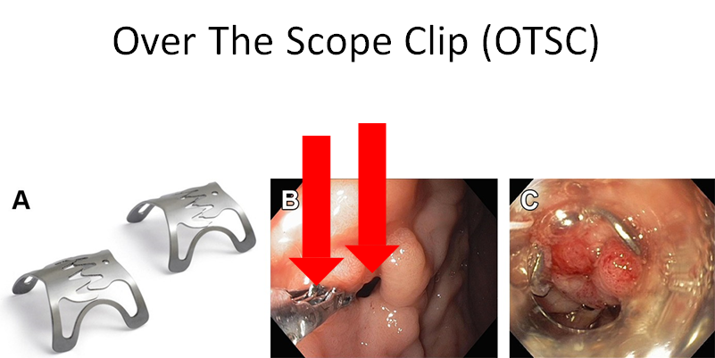
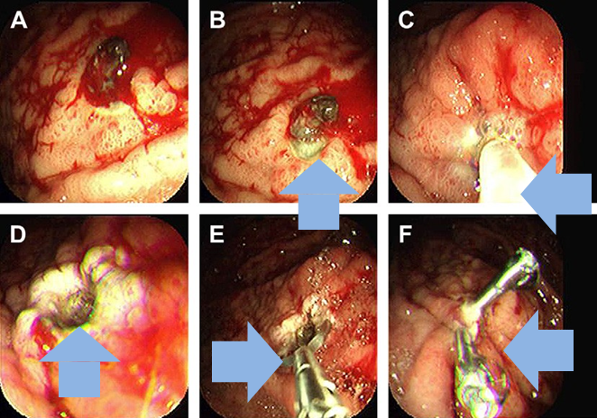
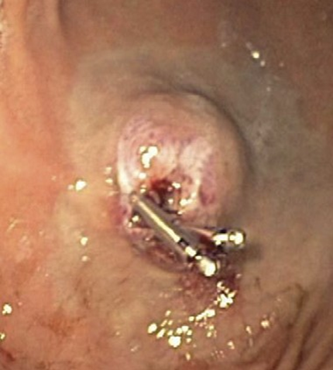
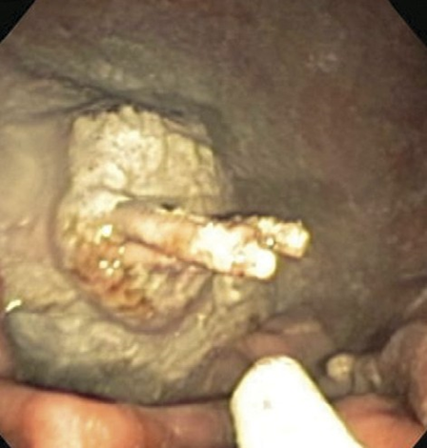
Males slides
Management
2
Endoscopic management
Endoscopic hemostasis
Mechanical clips
Over the scope clip (OTSC)
Hemostatic powder spray ⁴
combination of 2 techniques : ³
epinephrine injection ¹
Thermal therapy ²
thermal therapy and clips
clips and powder spray
1-what do we do when we find a visible vessel ? inject a fluid composed of epinephrine diluted by normal saline to cause vasoconstriction around the vessel using a needle .The whole idea is to create pressure to stop bleeding .
2- we burn to stop the bleeding
3-in real life we usually use more than one modality.
4- يستعمل بالجيش لانه سريع, اذا بخيته يسوي زي العجين

Slide 14
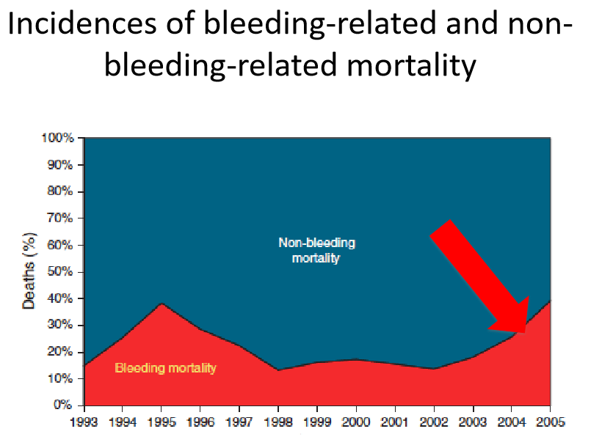
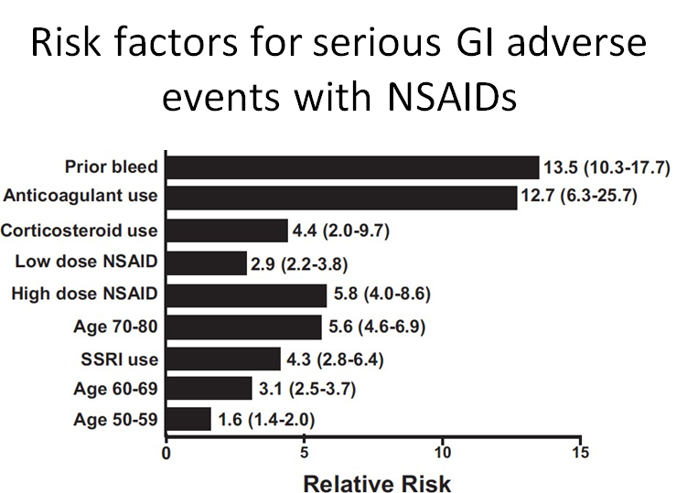
Males slides
Management
3
pharmacological therapy
Hospitalization :
It takes 72 hours for most high-risk lesions to become low-risk lesions AFTER endoscopic therapy.
60% -76% of patients who had rebleeding within 30 days AFTER endoscopic hemostasis PLUS high-dose PPI therapy did so within the first 72 hours.
In-hospital mortality 1.7−3.7%
30-day mortality 6−11% , When you discharge the patient that doesn't mean there is no risk anymore, there is still a high risk of mortality
Incidences of bleeding related and non-bleeding related mortality
High portion of mortality is not due to bleeding it self. is is caused by non-bleeding like pneumonia, UTI, CVA, etc
Admission to a monitored setting:
For at least the first 24 hours on the basis of risk or clinical condition
Hemodynamic instability
Severe comorbidity
Large ulcer size (>2 cm)
will be discussed in the next slide
Increasing age
Active bleeding at endoscopy
Estimated risk for post endoscopic bleeding risk
Periprocedual management of NOACs

Slide 15
Males slides
Management
3
pharmacological therapy
[Initial treatment of ulcer bleeding, according to the endoscopic feature of the ulcer]
Endoscopic Feature | Active bleeding or visible vessels | Adherent clot | Flat pigment spot | Clean base
Endoscopic Therapy | Endoscopic therapy | May consider endoscopic therapy | No endoscopic therapy | No endoscopic therapy
Medical Therapy | Intensive PPI therapy | Intensive PPI therapy | Once daily PPI therapy | Once daily PPI therapy
Diet | Clear liquids for ~2 days | Clear liquids for~2 days | Clear liquids for ~1 day | Regular diet
Hospital Stay | 3 days | 3 days | 1-2 days | Discharge after endoscopy
Intensive proton-pump inhibitor (PPI) therapy is an intravenous bolus (80 mg) followed by an infusion (8 mg per hour) for 72 hours or an oral or intravenous bolus (e.g, 80 mg) followed by intermittent high-dose PPI therapy (e.g. 40 to 80 mg twice daily) for 3 days."
The diets shown are diets after endoscopy in patients who do not have nausea or vomiting.
The duration of hospital stay after endoscopy is shown in patients who are in stable condition and do not have further bleeding or concurrent medical conditions requiring hospitalization.
H.pylori ulcer
Patients with bleeding peptic ulcers should be tested for H. pylori
Receive eradication therapy if present
Confirmation of eradication urea breath test or faecal antigen testing.
Negative H. pylori diagnostic tests obtained in the acute setting should be repeated.
No need for continuing PPI therapy after eradication of the H.pylori
NSAID- induced ulcer
Idiopathic ulcers
No need for continuing PPI therapy after discontinuation of NSAID.
If NSAID required, consider COX-2 inhibitor with PPI therapy.
Use PPI with low dose Aspirin if needed for secondary prevention ¹
PPI therapy should be prescribed indefinitely
1-usually we will tell them to stop for less than 3 days, return it ASAP. you might stop nsaids and they will die from MI. stop NSAIDs and anticoagulants if they are not highly indicated . if you can't then continue with PPI

Slide 16
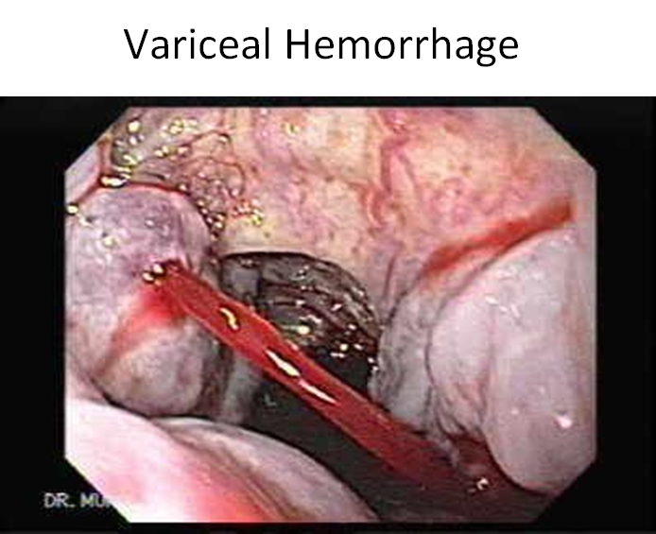
Males slides
Management of variceal hemorrhage
venous bleeding with a high flow rate
primary : before bleeding
secondary: bleeding occurred
Patients with Moderate / Large Varices that have NOT Bled:
Dose
Therapy goal
Follow-up
- 20 mg orally twice a days. Adjust every 2-3 days until the goal is achieved.
- Maximum daily dose is 320mg
Aiming for resting HR of 50-55 beats\minutes
- Every outpatient visit make sure patient on therapy.
- Continue indefinitely
- No need for follow-up EGD
Propranolol ¹
- 40 mg orally once a days. Adjust every 2-3 days until the goal is achieved.
- Maximum daily dose is 160 mg
Nadolol
- Start with 6.25mg once a day. After 3 days increase to 12.5 mg.
- maximum dose is 12.5 mg\day (except arterial hypertension patients)
Systolic BP shouldn’t be< 90 mmHG
Carvedilol
EVL
Every 1-4 weeks until the obliteration of varices.
-Obliterate varices
- Eradicate new varices after initial obliteration
- First EGD performed 1-3 months after obliteration and every 6-12 months thereafter
1- As a primary or secondary prevention. Patients who recently diagnosed with cirrhosis should start primary prevention by giving them propranolol to decrease portal pressure, thus, decreasing the risk of varices progression and bleeding.

Slide 17
Males slides
Management of variceal hemorrhage
Most Commonly Used Vasoactive Agents in the Management of Acute Hemorrhage: ¹
Drug | Somatostatin | Octreotide (Somatostatin analogue) | Terlipressin (Vasopressin analogue)
Dose | - Initial IV bolus 250mcg (can be repeated in the first hour if ongoing bleeding) - Continuous IV infusion of 250-500 mcg\h | - Initial IV bolus 50mcg (can be repeated in the first hour if ongoing bleeding) - Continuous IV infusion of 50 mcg\h | - Initial 48 hrs: 2mg IV every 4 hrs until control bleeding - Maintenance: 1mg IV every 4hrs to prevent re-bleeing
Duration | Up to 5 days
MOA | - Inhibits vasodilator hormone similar to glucagon, causing splanchnic vasoconstriction and reduces portal blood flow - Facilitates adrenergic vasoconstriction |  | - Splanchnic vasoconstriction. The active metabolite “lysin-vasopressin” is released gradually over several hrs in tissue, thus decreasing typical systemic vasopressin side effect
Pharmacological therapy in the management of acute esophageal variceal hemorrhage : ^{2,3}
1- pt should be admitted for 5 days and remains on IV infusion with vasoactive agent after performing endoscopy , DON'T DISCHARGE.
2- we don't use norfloxacin in KSA , we use ciprofloxacin instead
3- Antibiotics are given as prophylaxis to prevent SBP with ascites “spontaneous bacterial peritonitis”

Slide 18
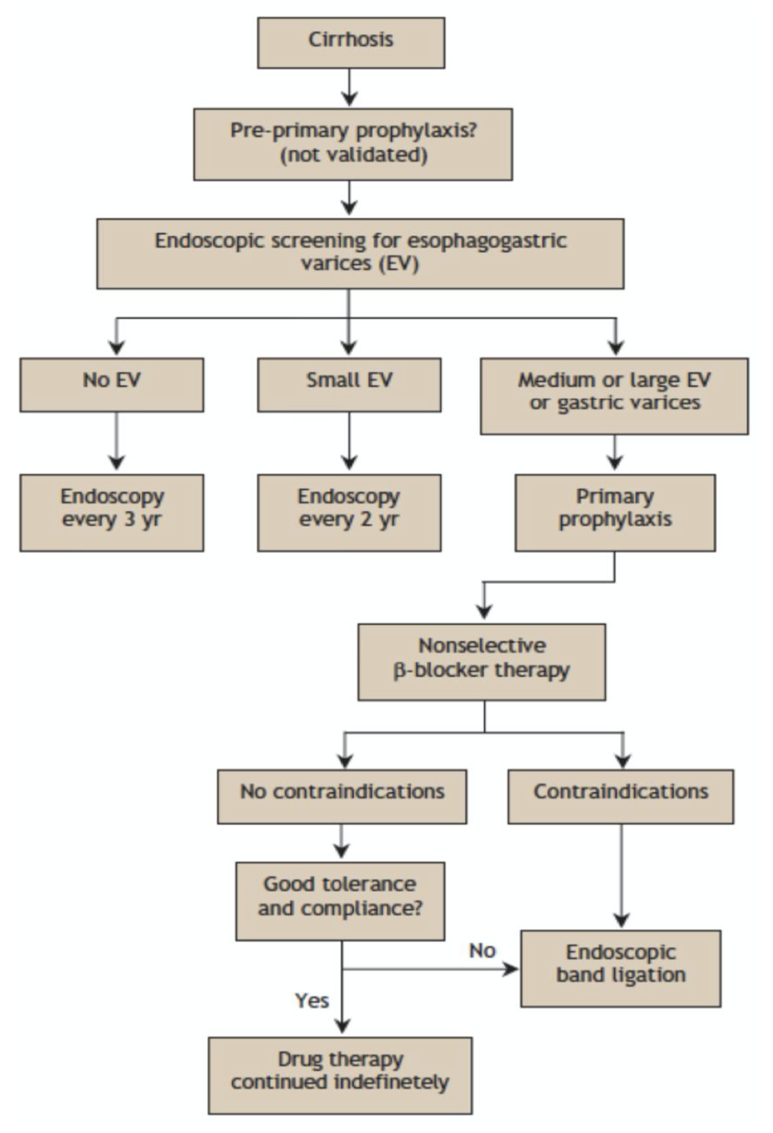
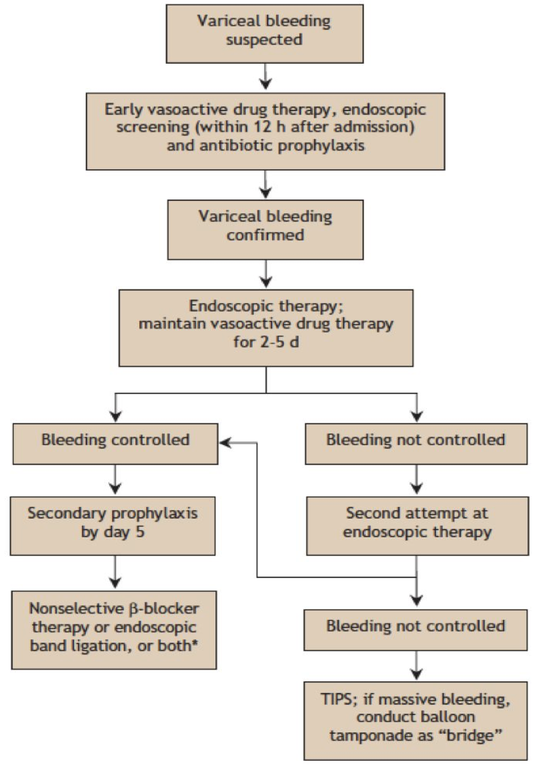
Males slides
Management of variceal hemorrhage
management of patients who have bled from varices and in whom the goal is to prevent recurrence of hemorrhage :

Slide 19
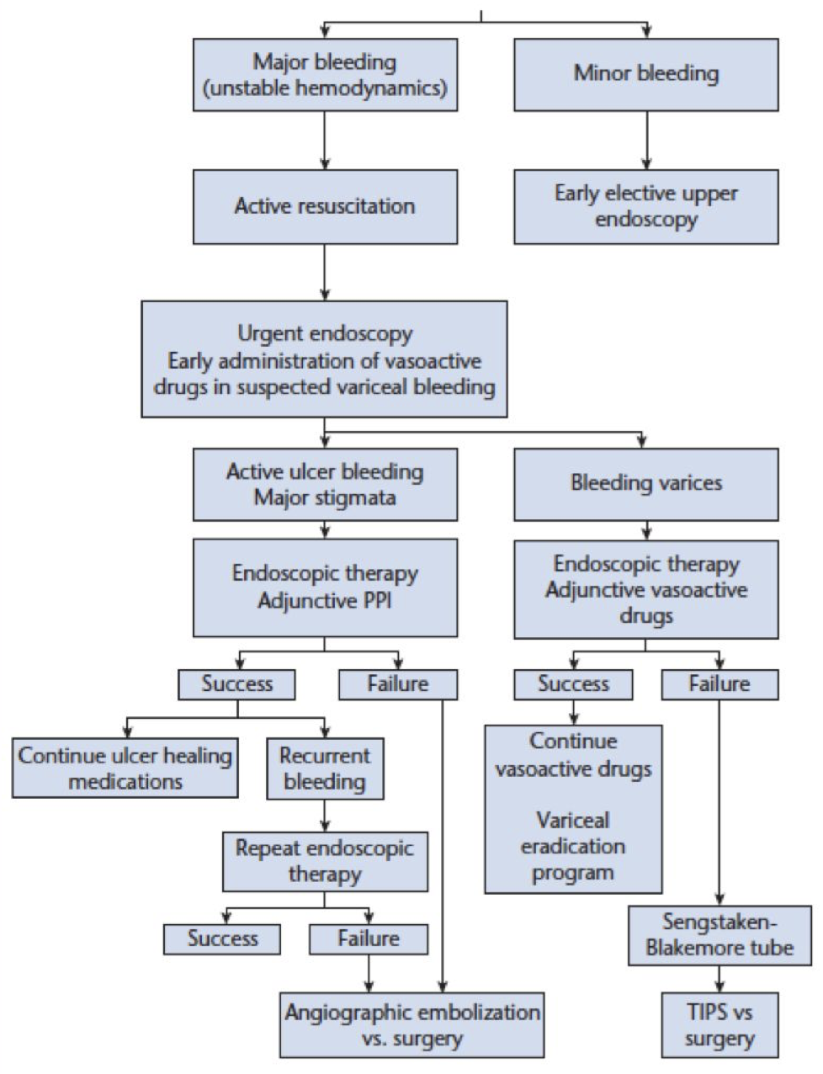
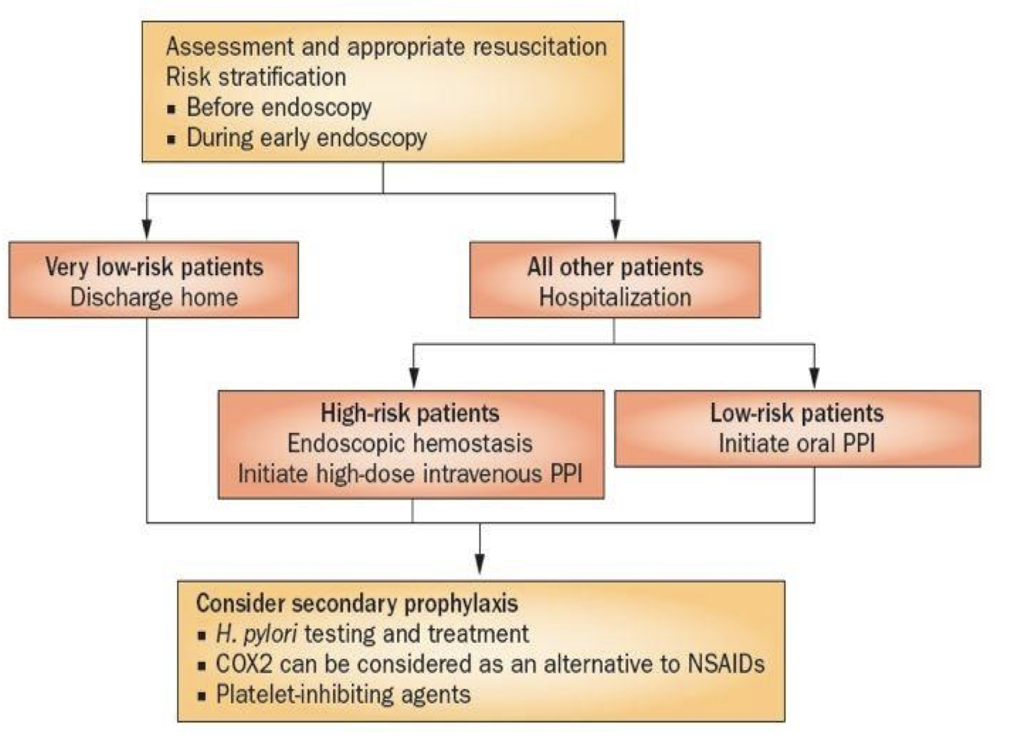
Females slides
GI bleeding
Summary of GI bleeding approach:
1
Initial assessment detailed history.
2
Hemodynamic status and resuscitation physical examination
1-Tachycardic 2- Hypotensive.
3
Blood transfusion
4
Risk assessment and stratification Anemia Hb<7 transfer blood + Uremia.
5
Pre-endoscopic medical therapy PPI (will stop the bleeding ulcer) + Octreotide (vasoconstriction the bleeding vessels) (both IV), so we can see clearly while scoping.
6
6
Timing of endoscopy
7
Endoscopic therapy clipping, banding, cauterizing.
8
Post-endoscopy
Algorithm for the management of acute GI bleeding:

Slide 20
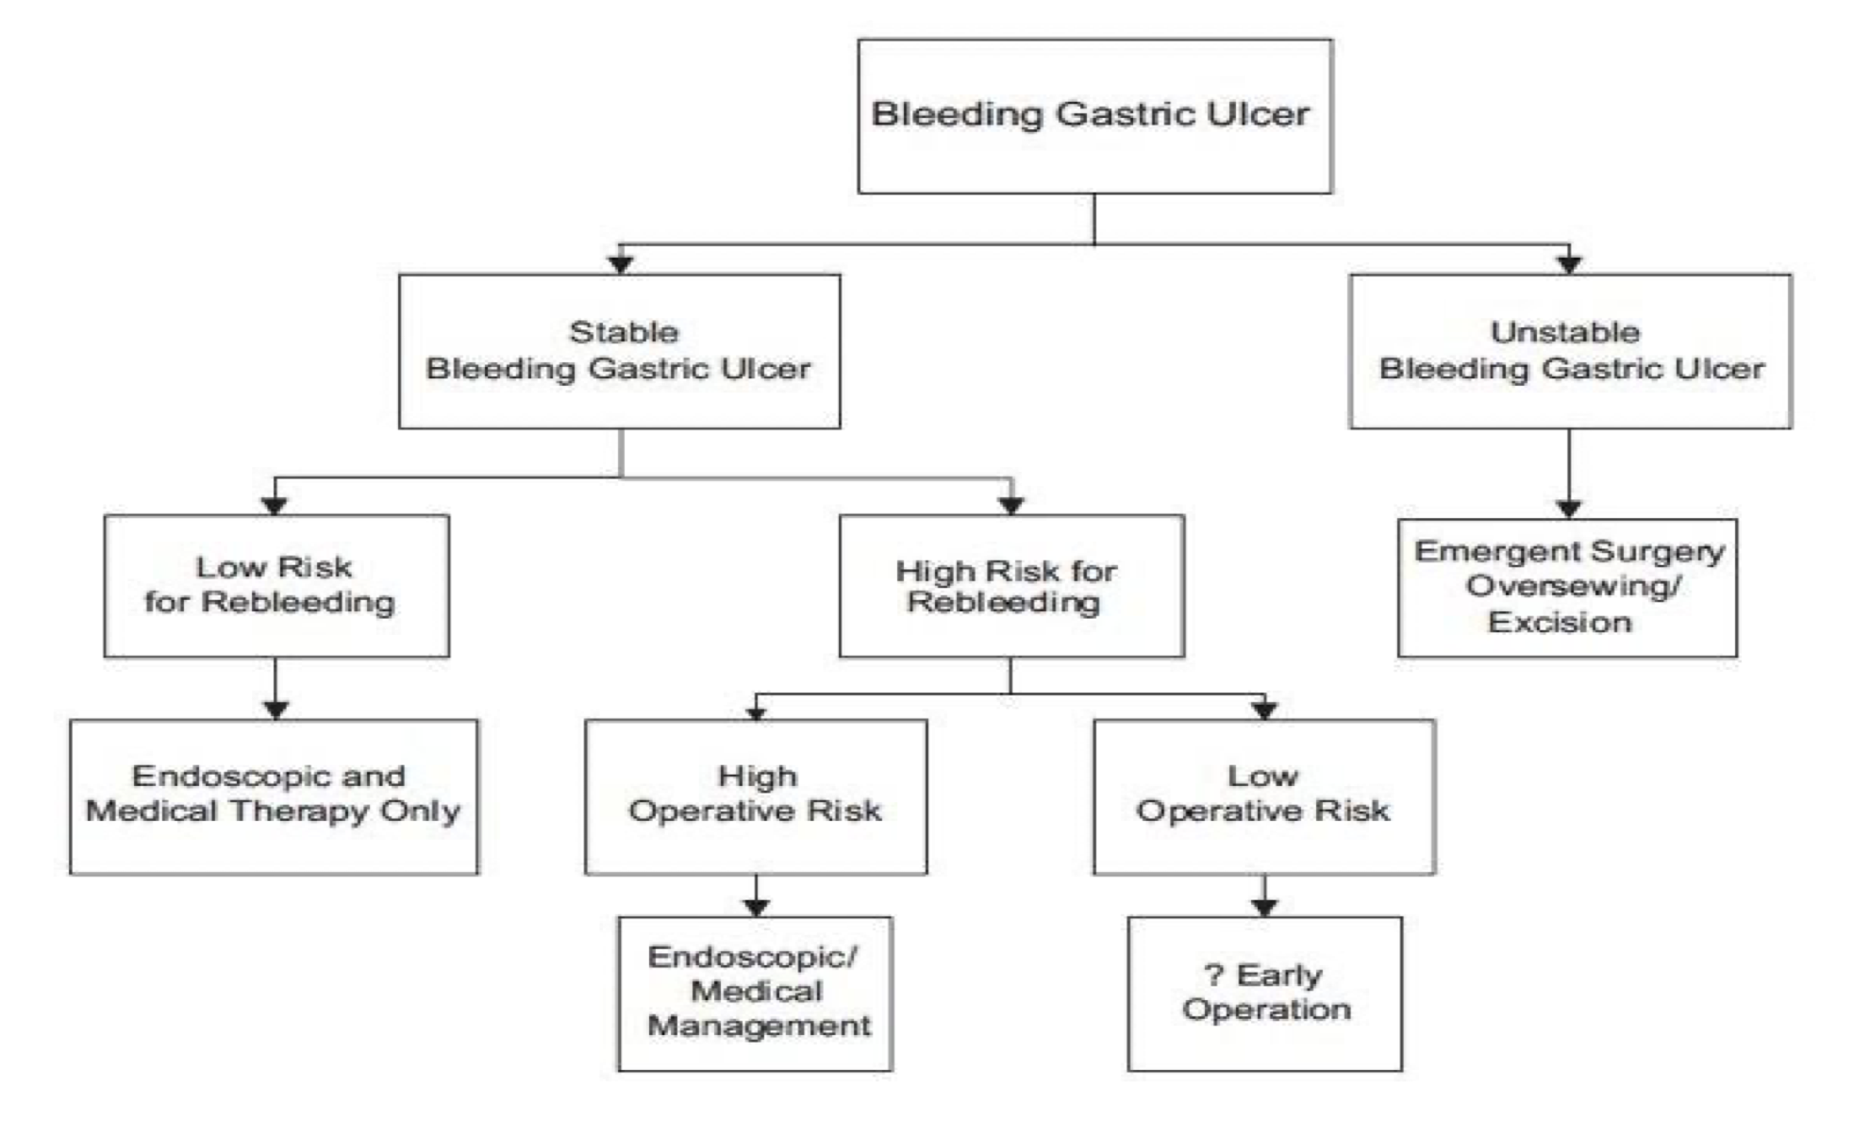
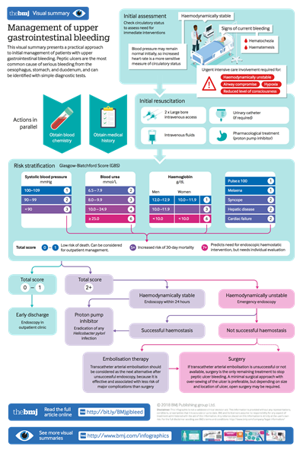
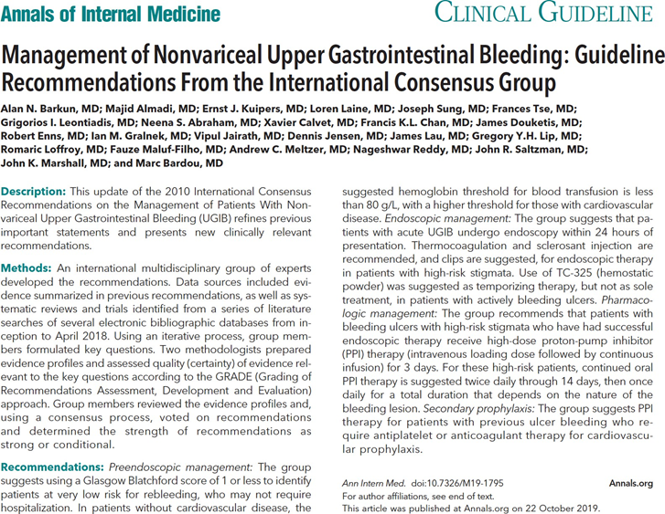
GI bleeding
When to go to surgery?
Conclusion
Resuscitation should be initiated prior to any diagnostic procedure.
Gastrointestinal endoscopy allows visualization of the stigmata, accurate assessment of the level of risk and treatment of the underlying lesion.
Intravenous PPI therapy after endoscopy is crucial to decrease the risk of cardiovascular complications and to prevent recurrence of bleeding.
Helicobacter pylori testing should be performed in the acute setting.

Slide 21
Females slides
Cases
‹#›
Case study 1:
A 65 y/o male referred for evaluation of 4 months HX of weight loss, fatigue and weakness. He also gave history of passing dark stool intermittently for the last 3 months. He is known DM on insulin, hyperlipidemia on statin and occasionally aspirin.
What other information you would like to ask?
start by detailed abdominal history
abdominal pain
Hematemesis
vomiting
Hematochezia
heartburn
dysphagia
Other symptoms like odynophagia or dysphagia (with solids or fluids) for esophageal pathology Anemic symptoms: fatigue, SOB, dizziness, palpitation.
Hypotension: in severe presentation not like this case (3 months).
Trauma (abdominal aortic aneurysm) but not suitable with Hx of 3 months.
P.M/ cirrhosis , jaundice , any liver disease , NSAIDS , reflux
What is the likely diagnosis? Gastric cancer
What will be the next step? endoscopy
Case study 2:
A 42 years old male complaining of chronic recurrent epigastric pain which worsen recently especially when he is fasting²
For the last 2 days he started to have frequent vomiting associated with blood.
He is not known to have any chronic medical problems and not on any medications.
What is the best next step in the approach of such patient?
Detailed HX, Full Physical examination: Vital signs, look for clubbing, spider nevi, fluid thrill, splenomegaly, lymph nodes, etc..
How would you assess the bleeding severity?
By Risk Stratification¹ :
Glasgow- Blatchford Score (GBS)
Rockall Score
Modified-GBS
AIMS65
What is the diagnosis and its associated risk factors?
Duodenal ulcer.
1- Direct you toward admission:
send home and perform endoscopy the next day?
admit?
admit to ICU?
2-May indicate duodenal ulcer (as it’s worsened with fasting).

Slide 22
Females slides
Cases
Case study 3:
A 52 years old lady presented to ER with one day history of vomiting of fresh blood. She also notices passing black tarry stool. She is feeling dizzy and unwell .
Past HX of jaundice no other medical problems and not on any medications.
Clinically jaundiced and pale.
Vital signs BP 100/70 pulse 110/min
Abdomen examination showed liver span of 7 cm and spleen felt 3 fingers below costal margin¹ with few spider nevi seen over chest.
What is the likely diagnosis of this case and list 4 common aetiology ?
Diagnosis → Liver Cirrhosis with portal hypertension.
Aetiology → Drug induced hepatitis (alcohol, acetaminophen), Viral hepatitis B, C, Autoimmune hepatitis, NASH, hemolysis disease (Sickle cell..).
What is the priority in the management of this patient?
stabilize the pt
IV Fluid Resuscitation. 2 large bore cannula
endoscopy can be done after 6 hours after stabilizing the patient
What is the target Hb and INR prior to the endoscopy for this case?
Target Hb is 7 g/dL and above.
Case study 4:
A 47 years old male known to have alcoholic liver disease presented with hematemesis of large amount and dizziness
after resuscitation an upper GI endoscopy done which showed multiple large esophageal varix which was banded, however 12 hrs post endoscopy he continued to have melena with drop of Hb and hypotension.
What is the next step in the patient management?
consult gastroenterology, interventional radilogy, surgery and admit to ICU.
since it’s persistent we can perform a surgery.

Slide 23
Gastrointestinal Bleeding
Upper Vs. Lower GI Bleeding | Upper GI Bleeding: Peptic ulcer disease (most common cause) Variceal bleeding (2nd most common cause)
Clinical Features | Type of bleeding: Hematemesis “Coffee grounds” emesis Melena Hematochezia Occult blood in stool Sign of volume depletion Sign and symptoms of anemia
Diagnosis & Management | Intravenous access At least one large-bore cannula. Initial clinical assessment Define circulatory status Seek evidence of liver disease. Identify comorbidity Basic investigations Full blood count Urea and electrolytes (elevated blood urea with normal creatinine concentration implies severe bleeding) Liver function tests Prothrombin time Cross-matching Resuscitation Intravenous crystalloid fluids: should be given to raise the blood pressure Packed red blood cells: If the hemoglobin level < 7 g/dL or If hemoglobin < 10 g/dL in patients with preexisting cardiovascular disease or patients with symptoms. Fresh frozen plasma: if PT or INR is elevated. Oxygen Endoscopy Diagnostic and potentially therapeutic. This should be carried out after adequate resuscitation, ideally within 24 hours. Treating endoscopically using a thermal or mechanical modality combined with intravenous proton pump inhibitor (PPI) therapy, prevent rebleeding, thus avoiding the need for surgery. Monitoring Surgery Eradication All patients should avoid NSAIDs and those who test positive for H. pylori infection should receive eradication therapy.
Lower GI Bleeding:
Diverticular disease (most common cause)

Slide 24
Q1: Which of the following presentations suggests variceal hemorrhage?
A- Unexplained iron deficiency anemia
B- Dysphagia
C- Abdominal bloating
D- Abdominal pain
E- Hematemesis
Q2: The effect of H. pylori eradication therapy always needs to be assessed in patients with which of the following?
A- A bleeding peptic ulcer
B- Reflux esophagitis
C- Non Ulcer dyspepsia
D- Uncomplicated peptic ulcer
E- Chronic active gastritis
Q3: A 80-year-old woman presents with melena, hematemesis, and syncope. Examination reveals hypotension and tachycardia. What is the first step in management?
A- Emergent endoscopy
B- Nasogastric lavage
C- Intravenous proton pump inhibitor
D- Tagged red blood cell scan
E- Intravenous access and intravascular volume repletion
Q4: A 50-year-old man without any prior medical problems began taking ibuprofen 800 mg three times daily for lower back pain after a work-related injury. He subsequently developed nausea followed by hematemesis and melena. He now presents to the emergency department for further evaluation. On the basis of this presentation and epidemiologic studies, what is the most likely cause of the suspected upper gastrointestinal (GI) hemorrhage?
A- Peptic ulcer
B- Mallory-Weiss tear
C- Esophagitis
D- Esophageal varices
E- Dieulafoy lesion
Q5: A 70-year-old woman presents to the emergency department with dizziness and five episodes of bright red blood per rectum in the last 24 hours. Nasogastric tube lavage yields bilious fluid without blood. What is the most common cause of severe hematochezia?
A- Diverticulosis
B- Colonic angiodysplasia
C- Internal hemorrhoids
D- Ulcerative colitis
E- Ischemic colitis
Q6: A 45-year-old man is brought to the emergency department after an episode of hematemesis. The patient had spent the night at a bar drinking with his colleagues. After leaving the bar, he vomited multiple times and noticed bright-red blood mixed with the vomitus, and he called an ambulance. Past medical history is notable for hypertension, for which he is taking lisinopril. Vital signs are within normal limits. Physical examination shows a patient in no acute distress. Cardiac, pulmonary, and abdominal exams are non-contributory. Which of the following additional findings will most likely develop in this patient?
A- Abdominal pain exacerbated with eating
B- Black tarry stools
C- Sloughed mucosa mixed with stool
D- Passage of bright red blood from the anus
E- Foul smelling oily stool
Answers: Q1:E | Q2:A | Q3:E | Q4:A | Q5:A | Q6:B
Answers Explanation File!

Slide 25
THANKS!!
This lecture was done by:
Danah Alhalees
Razan Alzohaifi
Quiz and summary maker:
Razan AlRabah
Note taker:
Leen Almazroa
Amirah Aldakhilallah
Females co-leaders:
Raghad AlKhashan
Amirah Aldakhilallah
Males co-leaders:
Mashal AbaAlkhail
Nawaf Albhijan
Send us your feedback:
We are all ears!

Slide 26
This lecture was done also by:
May babaeer
اللهمّ إنّا نسألك لفقيدتنا الغالية أن تصب على قبرها الضياء والنور والفسحة والسرور
اللهم ارضَ عنها وجازها بالحسنات إحسانا، وبالسيئات عفوًا
وغفرانًا
اللهم اجعل قبرها روضة من رياض الجنة
اللهم إنها في ضيافتك فأكرمها يا أكرم الأكرمين، واجمعنا بها في الفردوس الأعلى يا أرحم الراحمين
ربي أسألك أن تظلها تحت ظلك، وأسألك أن تطيب ثراها وأن تكرم منزلتها ومثواها، وأن تسكنها الجنة وتجعلها سكنًا لها ومأواها
اللهم كما طيبت ذكرها في أرضك بين خلقك ،طيب ذكرها في سمائك بين ملائكتك، وارحمها واغفر لها وانظر إليها بعين لطفك وكرمك يا أرحم الراحمين

