Slide 1
Lecture 27
Editing file
Non-Alcoholic Fatty Liver Disease (NAFLD)
Objectives:
Definition, criteria for NAFLD, and disease spectrum.
Epidemiology and risk factors
Pathophysiology of NAFLD, and natural history
Diagnosis and management approach
Clinical approach to NAFLD patients
Color index:
Color index:
Original text Females slides Males slides
Doctor’s notes Text book Important Golden notes Extra

Slide 2
Introduction to NAFLD
Introduction
Non-alcoholic fatty liver disease (NAFLD) is common medical condition globally and increasing in incidence with the epidemic of obesity and, metabolic syndrome¹.
The leading cause of liver cirrhosis and liver transplantation in many countries.
Definition: Liver disease, where there is accumulation of excess fat in the liver cells, in people who drink little or no alcohol.
Criteria
Liver fat > 5%: Estimated by
Cross-section on histology
Non-invasively by MRI.
1
Lack of secondary causes of hepatic fat accumulation, such as:
Significant alcohol consumption (daily alcohol consumption >30g for men and >20 g for women).
Long-term use of a steatogenic medications.
Monogenic hereditary disorders.
2
Classification of NAFLD
NAFL
Non-Alcoholic Fatty Liver
NASH
Non-Alcoholic Steatohepatitis
Steatosis (no inflammation) other terms: simple steatosis, benign steatosis
Non-progressive
Steatosis with inflammation², hepatocyte injury with or without fibrosis
Progressive: Cirrhosis, HCC
Disease spectrum
NAFL
(Steatosis)
NASH
NASH with fibrosis
NASH cirrhosis (liver decomposition +- /cancer)
1- NAFLD is also associated with polycystic ovary syndrome, obstructive sleep apnoea and small-bowel bacterial overgrowth.
2- Characterized by necroinflammation (Hepatocyte ballooning, Mallory-Denk bodies, megamitochondria). Cellular damage triggers cell death and inflammation, which leads to stellate cell activation and development of hepatic fibrosis that culminates in cirrhosis.
Perisinusoidal fibrosis is a characteristic feature of NASH. Several genetic modifiers of disease severity have been identified, with PNPLA3 and its product, adiponutrin, being the best validated.

Slide 3
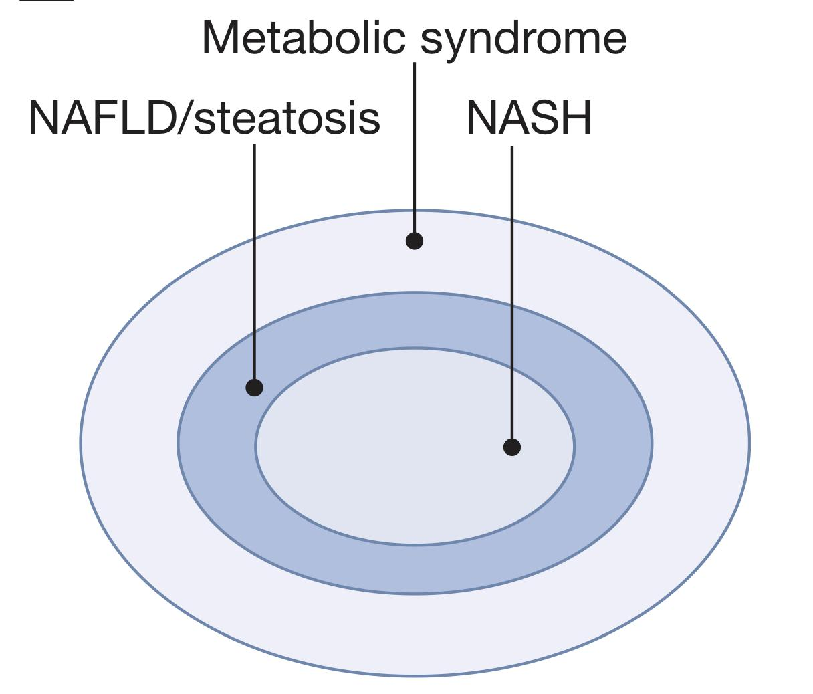
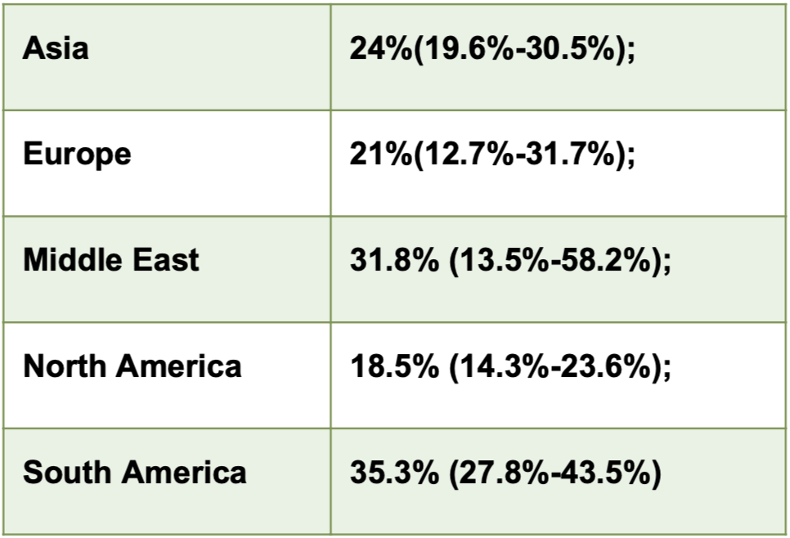
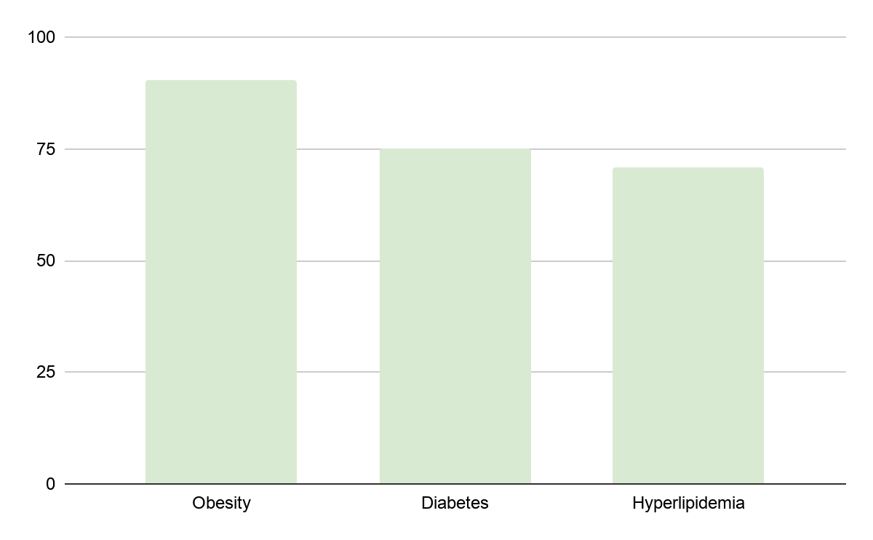
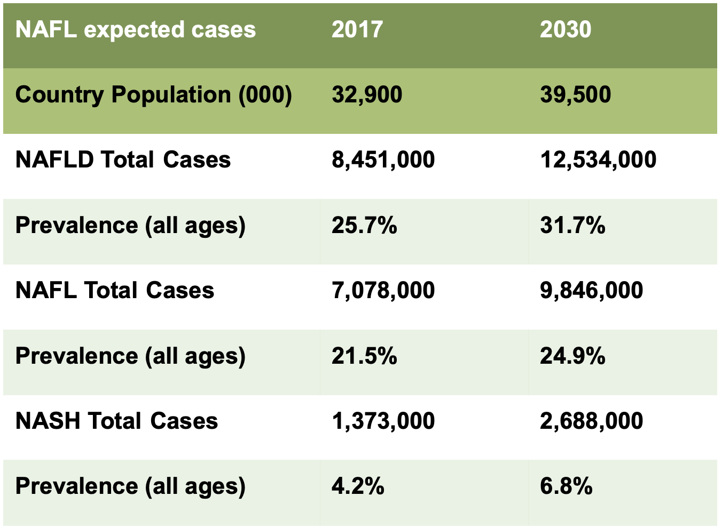
Risk factors & Global burden of NAFLD
Risk Factors
NAFLD is considered by many to be the hepatic manifestation of the ‘metabolic syndrome’, as it is strongly associated with:
1
Insulin resistance
4
Hyperlipidaemia
7
Lifestyle
(sedentary lifestyle)
2
Obesity (central)
5
Male
8
Western diet
3
Type 2 Diabetes mellitus
6
Medications
(e.g Tamoxifen)
9
Hypertension
Global burden
Prevalence is Higher in Risk Groups:
One billion individuals worldwide have NAFLD.
Most common cause of abnormal liver tests
Most common cause of chronic liver disease.
The second leading etiology of liver disease among adults awaiting liver transplantation in many countries (expected to be number one).
Patients with NAFLD have increased overall mortality compared to matched control populations without NAFLD.¹
The frequency of steatosis varies with ethnicity (45% in Hispanics, 33% in whites and 24% in blacks) and gender (42% white males versus 24% white females) but only a minority of patients will progress to cirrhosis and end-stage liver disease.
Global prevalence of NAFLD prevalence was 21.3% (17.9%- 30.5%); =20%
NASH was prevalent in 26.2% of NAFLD patients
Global epidemiology of NAFLD:
NOT IMP
NASH
Cirrhosis (5%)
NASH or Type 3,4 NAFL (25%)
Types 1,2 (NAFL 60%)
simple steatosis
Histology?
Histology?
1- Overall 33.2% risk of death or liver transplantation was observed, with liver-related mortality being the third most common cause of death after cardiovascular disease and extrahepatic malignancy.

Slide 4
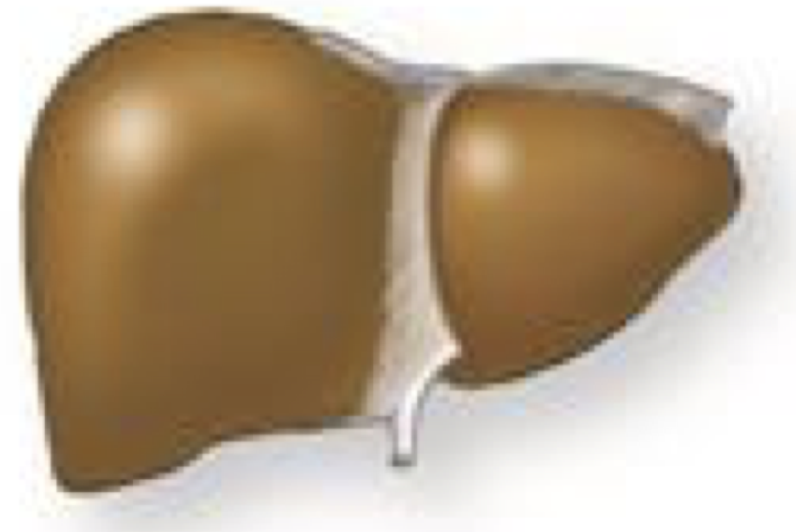
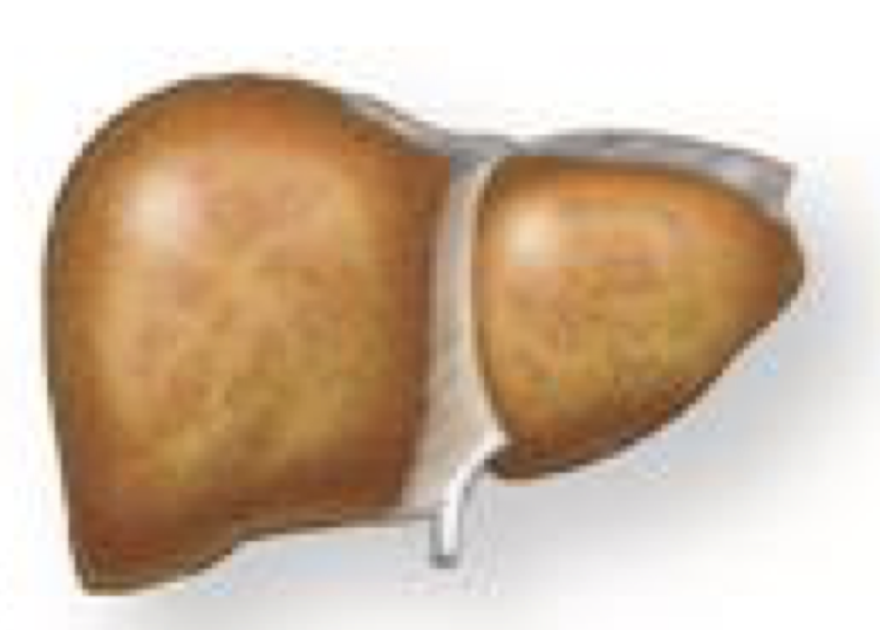
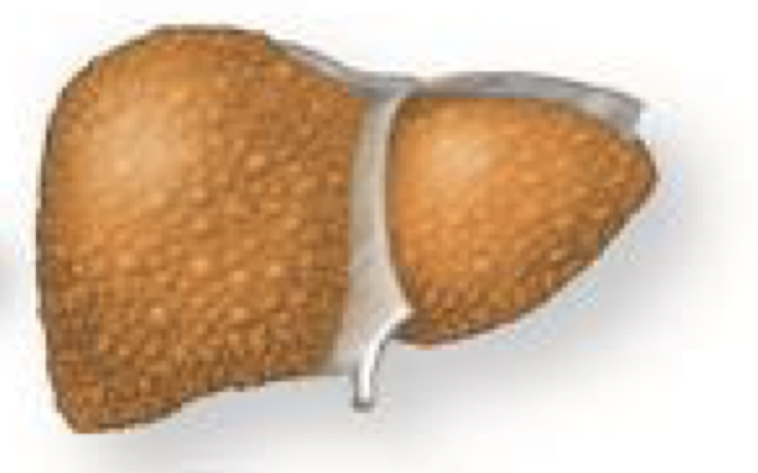
Pathogenesis and Natural History of NAFLD
Pathogenesis of NAFLD
The initiating events in NAFLD are based on the development of obesity and insulin resistance, leading to increased hepatic free fatty acid flux. This imbalance between the rate of import/synthesis and the rate of export/catabolism of fatty acids in the liver leads to the development of steatosis.¹
This may be an adaptive response through which hepatocytes store potentially toxic lipids as relatively inert triglyceride.
Overview: The phases of fat accumulation and inflammation are overlapping. There is fat accumulation due to high fructose intake (de novo lipogenesis) + insulin resistance + other factors (eg, mitochondrial dysfunction, etc ) → Hepatic Triglyceride accumulation → Lipotoxic effect with the release of many cytokines & inflammatory markers. This is also driven by many factors (eg, Gut microbiota).
Insulin resistance is the first step in most.
Insulin resistance leads to:
↑ lipolysis → FFA
↑ hepatic uptake of free fatty acids (FFA) and accumulation of hepatic triglyceride.
De novo lipogenesis (eg, excess fructose³)
→ Accumulation of hepatic triglycerides
Gut microbiota
Adipose tissue inflammation
Simple steatosis
NASH
Fibrosis
Cirrhosis
Oxidative stress
Hepatocyte apoptosis
Hepatic inflammation
Natural History of NAFLD
Isolated fatty liver
1. None to very minimal progression to fibrosis
2. No ↑ risk of death compared with general population
.
75%
Fatty liver with minimal inflammation
NAFLD
25%
Possible sampling variability with some risk of progression
~7.2% over 6.5 years
NASH
HCC
~11% over 15 years, but Significant variability
1. ↑Risk of death compared with general population; causes of death:
1. Cardiovascular⁴. (Most common)
2. Malignancy.
3. Liver-related.
2. NASH with fibrosis portends worse prognosis
1. Fibrosis progression a/w DM, severe IR, weight gain > 5kg, rising ALT, AST.
NASH Cirrhosis²
19-45% over 7-10 years
Decompensation
1- This should not be confused with acute fatty liver, which can occur in hepatic mitochondrial cytopathies, e.g. acute fatty liver of pregnancy, or in other situations, e.g. Reye’s syndrome or drug toxicity (sodium valproate, tetracyclines), or with bacterial toxins (e.g. Bacillus cereus). In these, defective mitochondrial beta-oxidation of lipids leads to fat droplet accumulation in hepatocytes and microvesicular steatosis
2- It is important to note that hepatic fat content tends to diminish as cirrhosis develops and so NASH is likely to be under-diagnosed in the setting of advanced liver disease, where it is thought to be the underlying cause of 30–75% of cases in which no specific aetiology is readily identified (so-called ‘cryptogenic cirrhosis’).
3- The only place to deal with fructose is the liver.
4- It is mainly due to the accompanying comorbidities, not the liver it self.

Slide 5
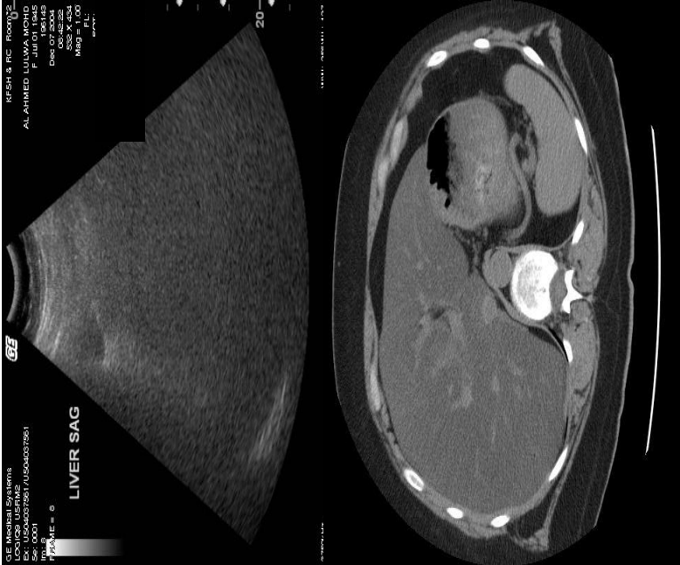
Evaluation of patient with NAFLD
1
2
3
History & Symptoms
Most are asymptomatic² (even with advanced disease)
Non-specific symptoms
Sometimes symptoms related to associated conditions (DM, Obesity etc..)
Sometimes symptoms of liver decompensation are the first presentation
Exclude other causes of fatty liver
Alcohol, medications
HCV, HBV, HIV, autoimmune, Wilson
Stigmata of liver disease
Identify at risk population
Obesity, diabetes, dyslipidemia
Metabolic syndrome (MS)
Hypertension
Ethnicity (Asians, hispanics)
1
2
3
Physical examination & Imaging
Physical examination
As any other liver disease
Abdominal obesity
Enlarged liver
Signs of cirrhosis/
decompensation
Imaging³
Ultrasound^{1,5} of abdomen:
Enlarged liver
Increase echogenicity (bright)
CT (hypodense), MRI, MR spectroscopy,
Elastrography
1
2
3
Laboratories
Consistent with metabolic syndrome
LFT¹:
Normal⁴ (in most of the cases)
OR Elevated bilirubin, AST, ALT⁶, AP, GGT
Click here to check NFS and FIB-4 scores (EXTRA!!)
Hepatic panel, Albumin, INR, platelets
Emerging noninvasive panels (NAFLD fibrosis score, ELF score, APRI, BARD, FIB-4)
1- BEST INITIAL: Liver function test (LFT) & Ultrasound and GOLD standard is Liver biopsy
2- It is commonly identified as an incidental biochemical abnormality during routine blood tests or as a fatty liver during an ultrasound or CT scan of the abdomen. Alternatively, patients with progressive NASH may present late in the natural history of the disease with complications of cirrhosis and portal hypertension, such as variceal haemorrhage, or with hepatocellular carcinoma.
3- No routine imaging modality can distinguish simple steatosis from steatohepatitis or accurately quantify hepatic fibrosis short of cirrhosis.
4- Raising Liver enzymes indicates NASH, But keep in mind there might be changes at the histological level without raising in the enzymes!
5- The sensitivity of Ultrasound is very low incase the liver fat is <20%
6- ALT levels fall as hepatic fibrosis increases and the characteristic AST : ALT ratio of < 1 seen in NASH reverses (AST : ALT > 1) as disease progresses towards cirrhosis, meaning that steatohepatitis with advanced disease may be present even in those with normal-range ALT levels.

Slide 6
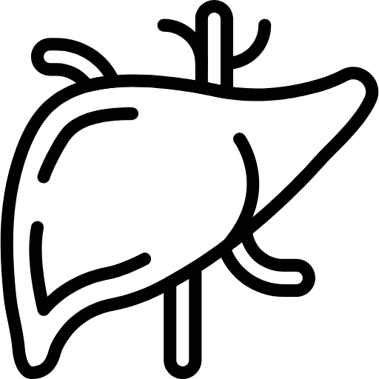
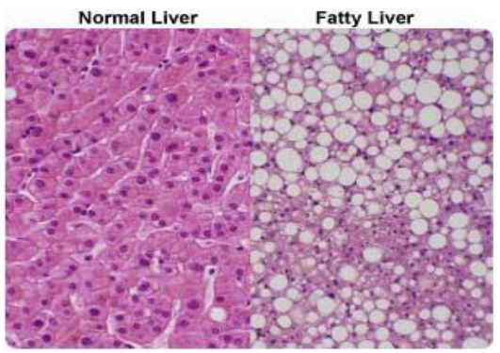
Evaluation of patient with NAFLD
Fibrosis assessment
Degree of fibrosis is the most important factor in prognosis
Non-invasive methods
Liver elasticity ( e.g fibroscan)
Non-invasive serum markers scores
Liver biopsy (Gold standard for DIAGNOSIS OF NASH)¹
Confirm diagnosis and fibrosis stage
Determine disease activity Fibrosis: stage
Exclude other diagnosis ( when there is possibility of
existence of other liver disease)
Not needed routinely
NAFLD Management
Targets
Liver disease
Reduce fibrosis, inflammation ( NASH), and steatosis
2) Mange other Associated metabolic disorders
Obesity, insulin resistance, DM & hyperlipidemia.
Pharmacologic Therapy
NO FDA approved drug for NASH, Why? because they do not affect the fibrosis. “remember fibrosis is the most important prognostic factor”
Treatment directed at coexisting metabolic disorders:
To improve insulin sensitivity (with Glitazones), treat dyslipidemia (with Statins) and HTN
Reduce oxidative stress effect
Stop/slow necro-inflammation/fibrosis
Improve underlying metabolic syndrome
Timing of Drug Action
Medications either in phase 3 clinical trials, OTC, or not FDA approved for NASH indication
NOT IMP
Normal Liver
Steatosis
Inflammation/Apoptosis
Fibrosis
1- The histological definition of NASH is based on a combination of three lesions (steatosis, hepatocellular injury and inflammation) with a mainly centrilobular, acinar zone 3 distribution.

Slide 7
NAFLD Management (cont.)
Lifestyle modifications (Most important)
Cornerstone Management.
The only intervention with established evidence suggesting it is benefit and safety with a clear dose-response association regardless the type of exercise.
Should be recommended as the primary intervention for NAFLD; includes:
Weight loss, Exercise & Dietary modification.
These three interventions are more important than any medication. Weight loss is the most important one.
Other measures: Stop alcohol (for those who drink)
and Treat other conditions (DM, Hyperlipidemia, etc..)
1
2
Weight Loss
3
Dietary Composition
Physical Activity
Strength of evidence
1) Weight Loss:
Weight loss¹ reduces associated risk factors, Consistently beneficial if sustained².
≥ 5% weight loss improves Steatosis.
≥ 7% weight loss improves NASH.
≥ 10% weight loss regress Fibrosis.
2) Dietary Composition
Beneficial without weight loss.
Low glycemic food.
Increased mono & polyunsaturated.
Avoid of high fructose containing food.
Reduce liver fat.
NASH and fibrosis (some evidence).
Reduce risk for HCC.
3) Physical Activity
Aerobic & Resistance activity independently:
Reduce liver fat.
NASH and fibrosis (little evidence).
1. Orlistat, an enteric lipase inhibitor causing malabsorption of dietary fat, is used with a low-fat diet as an adjunct in subjects with a body mass index (BMI) of more than 30kg/m². Only those achieving a loss of body weight of more than 5% in 3 months should continue orlistat, and then for only 1 year, as fat-soluble vitamin deficiency may occur.
2. Sustained weight reduction of 7–10% is associated with significant improvement in histological and biochemical NASH severity.

Slide 8
NAFLD Management (cont.)
Other interventions
Intervention | Indication |  | Concerns
Bariatric surgery¹ | Obese individuals with NAFLD or NASH. Considered as another way of weight reduction, Benefits: Resolution of steatosis. Resolution of NASH. Resolution of fibrosis (in some) Improve other comorbidities, e.g DM
Vit E | Biopsy-proven NASH, Non-diabetic (Discuss benefits and risks) |  | - Mortality². - Hemorrhage. - Prostate cancer.
Pioglitazone | Biopsy-proven NASH with Diabetics Non Diabetics (Discuss benefits and risks) |  | - Weight gain. - Osteoporosis. - Bladder cancer.
Obeticholic acid | Still further data needed. |  | - Increase cholesterol. - Rebound weight gain.
Liraglutide | For DM patients No enough data to recommend.
Metformin/ Ursodeoxycholic acid / Omega FA | Not recommended.
The best thing is to reduce the body weight, first by lifestyle modification then through the other methods (either pharmacological or Bariatric surgery)
Diabetics: Pioglitazone or Liraglutide
Non-diabetics: Vit E
Dr notes
Take home messages
The disease spectrum ranges from simple steatosis to nonalcoholic steatohepatitis (NASH), with or without fibrosis and can progress to cirrhosis.
The presentation is variable from asymptomatic patient to liver cirrhosis with decompensation.
Diagnosis based on radiology and non-invasive tests and sometimes liver biopsy is needed
Treatment based mainly of life style modification (weight reduction with diet and exercise)
No approved drugs for treatment of NASH
1. should be avoided in those with advanced cirrhosis and portal hypertension, but gastric bypass and sleeve gastrectomy have been shown to achieve weight loss and improve obesity-related co-morbidities in Child-Pugh A cirrhotic patients.
2. a meta-analysis showed an increase in all-cause mortality at doses over 400 IU/day, and an increased risk of haemorrhagic stroke and prostate cancer has also been reported.

Slide 9
Definition/ Classification | Liver disease, where there is accumulation of excess fat in the liver cells (steatosis), in people who drink little or no alcohol. NAFL: Steatosis without inflammation. NASH: Steatosis with Inflammation.
Criteria | Liver fat > 5%: Histology or MRI. Lack of secondary causes (NASH is a diagnosis of exclusion).
Epidemiology | - One billion people have it worldwide. - Most common cause of abnormal liver tests and chronic liver disease.
Risk Factors | Metabolic syndrome, Insulin resistance (& T2DM), Central obesity, Hyperlipidemia, Male & Sedentary lifestyle.
Pathophysiology | Insulin resistance > ↑ Peripheral lipolysis, ↑ Triglyceride synthesis & ↑ Hepatic uptake of fatty acids.
Natural History | NAFLD →^{25%} NASH →^{11%} NASH Cirrhosis →^{7.2%} HCC / →^{19-45%} Decompensation.
Therapeutic modalities
1) Pharmacologic Therapy | NO FDA approved drug | Stop/slow necro-inflammation/fibrosis Improve underling metabolic syndrome | To improve insulin sensitivity Reduce oxidative stress effect
2) Lifestyle modifications Cornerstone Management | Should be recommended as the primary intervention for NAFLD: includes weight loss, exercise & dietary modification. Other measures: - Stop alcohol (for who drink) - Treat other conditions (DM, Hyperlipidemia, etc..)
 | Weight Loss: (reduce associated risk factors) Consistently beneficial if sustained. ≥ 5% weight loss Steatosis. ≥ 7% weight loss NASH. ≥ 10% weight loss Fibrosis. The only intervention with established evidence suggesting it is benefit and safety with a clear dose-response association regardless the type of exercise. | Dietary Composition: - low glycemic food. - increased mono & polyunsaturated. - Avoid of high fructose containing food). Beneficial without weight loss. - Reduce liver fat. - NASH and fibrosis (some evidence). - Reduce risk for HCC. | Physical Activity: Aerobic & Resistance activity independently: - Reduce liver fat. - NASH and fibrosis (little evidence).
Intervention | Indication |  | Concerns
Bariatric surgery | Obese individuals with NAFLD or NASH. Considered another way of weight reduction, Benefits: - Resolution of steatosis. - Resolution of NASH. - Resolution of fibrosis (in some) - Improve other comorbidities, e.g DM
Vit E | Biopsy-proven NASH, Non-diabetic (Discuss benefits and risks) |  | - Mortality. - Hemorrhage. - Prostate cancer.
Pioglitazone | Biopsy-proven NASH with or without DM (Discuss benefits and risks) |  | - Weight gain. - Osteoporosis. - Bladder cancer.
OCA | Still further data needed. |  | - Increase cholesterol. - Rebound weight gain.
Liraglutide | No enough data to recommend.
Metformin/ UDCA/ Omega FA | Not recommended.

Slide 10
Q1: A 45-year-old man comes to the physician for a routine health maintenance examination. He feels well. He has type 2 diabetes mellitus. There is no family history of serious illness. He works as an engineer at a local company. He does not smoke. He drinks one glass of red wine every other day. He does not use illicit drugs. His only medication is metformin. He is 180 cm (5 ft 11 in) tall and weighs 100 kg (220 lb); BMI is 31 kg/m2. His vital signs are within normal limits. Examination shows a soft, nontender abdomen. The liver is palpated 2 to 3 cm below the right costal margin. Laboratory studies show an aspartate aminotransferase concentration of 100 U/L and an alanine aminotransferase concentration of 130 U/L. Liver biopsy shows hepatocyte ballooning degeneration, as well as inflammatory infiltrates with scattered lymphocytes, neutrophils, and Kupffer cells. Which of the following is the most likely diagnosis?
A- Primary biliary cirrhosis
B- Alcoholic fatty liver disease
C- Viral hepatitis
D- Nonalcoholic steatohepatitis
Q2: In most patients with NAFLD, the first step in the pathogenesis is:
A- Increase LDL
B- Increases TGs
C- Insulin resistance
D- Increased hepatic uptake of FFAs
Q3: What is the gold standard in the diagnosis of NASH?
A- Liver Elasticity (fibroscan)
B- Biopsy
C- Serum Markers
D- Liver MRI
Q4: Which of the following interventions has established evidence for the treatment of NAFLD?
A- Weight Loss
B- Orlistat
C- Metformin
D- Liraglutide
Q5: Which one of the following statements regarding non alcoholic fatty liver disease (NAFLD) is false?
A- Weight loss improves liver biochemistry
B- Liver biopsy should be considered in patients with diabetes or age >45yrs
C- Insulin resistance is almost universal
D- Cirrhosis develops in almost 40% of patients of NASH
E- Prevalence of NAFLD is up to 30% whereas prevalence of NASH is only up to 6%
Q6: Bariatric surgery can improve NASH, but rarely results in total resolution.
A- True
B- False
Q7: 14 year old African-American young woman is referred for evaluation of asymptomatic elevation of serum transaminases. She has not received blood transfusions. She is not taking medications. Examination shows that her body mass index is 34. She is anicteric and has no signs of portal hypertension but has prominent acanthosis nigricans in her neck folds and axilla.
Laboratory evaluation: AST 100 IU/l
Hepatitis B surface Antigen Negative ALT 120 IU/
Hepatitis B surface antibody Positive Total serum bilirubin level 0.4 mg/dl
Hepatitis C antibody Negative Serum immunoglobulin level Normal
If a liver biopsy were performed, the most probable histologic findings would be:
A- Mixed portal infiltration with necrotic hepatocytes at the limiting plate
B- Macrovesicular hepatic steatosis with mild portal inflammation
C- Microvesicular hepatic steatosis
D- Cirrhosis with portal inflammation and Mallory bodies
E- Normal histology
Answers: Q1:D | Q2:C | Q3:B | Q4:A | Q5:D | Q6:B | Q7:B
Answers Explanation File!

Slide 11
THANKS!!
This lecture was done by:
Jehad Alorainy
Mohammed Alhumud
Note taker:
Jehad Alorainy
Females co-leaders:
Raghad AlKhashan
Amirah Aldakhilallah
Males co-leaders:
Mashal Abaalkhail
Nawaf Albhijan
Send us your feedback:
We are all ears!

