Slide 1
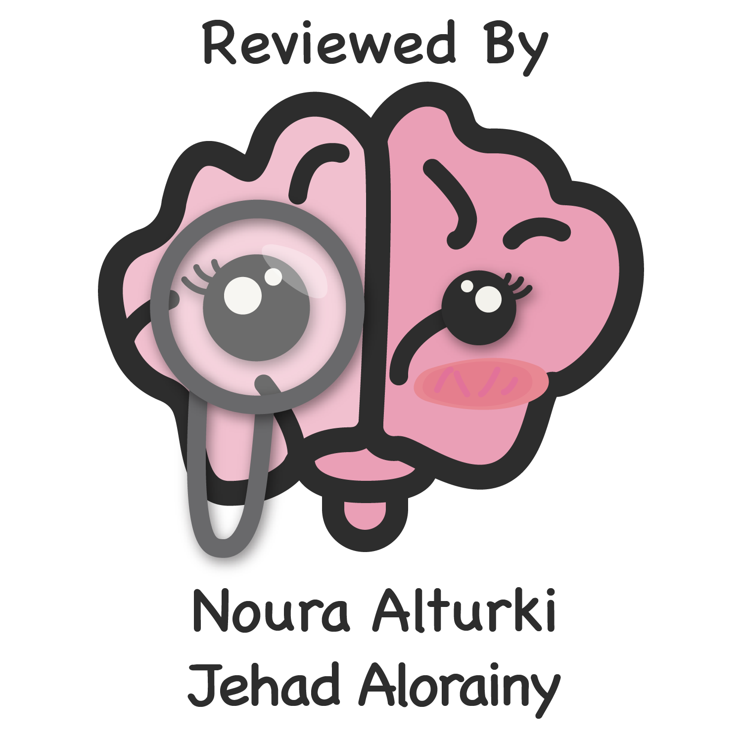
Lecture 28
Editing file
Esophageal Diseases
Objectives:
Describe the major components in the anatomy of the esophagus and physiology of swallowing.
Explain the pathophysiology and etiology of common esophageal disorders.
Name the common presenting symptoms and complications of reflux disease (GERD).
List the main points in the management of GERD.
Differentiate between oropharyngeal and esophageal dysphagia.
Explain the differences between anatomical and functional esophageal disorders.
Explain the pathophysiology of common causes of dysphagia.
List the common presenting symptoms, appropriate investigations and treatment options in different causes of dysphagia.
Color index:
Color index:
Original text Females slides Males slides
Doctor’s notes Text book Important Golden notes Extra

Slide 2
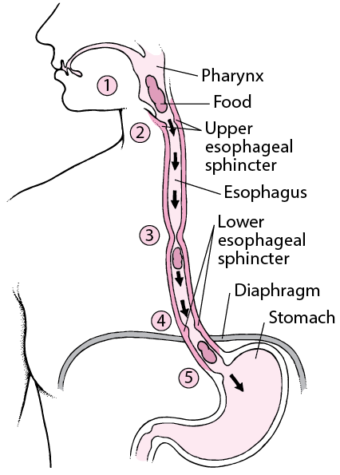
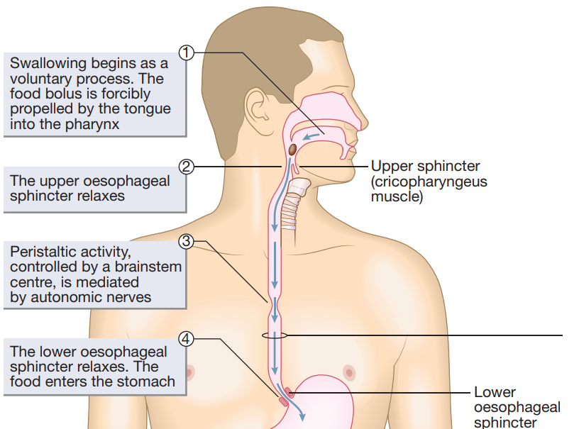
Introduction
Anatomy of the esophagus
Muscular tube 20-25 cm long, located between the pharynx and the stomach.
it has an UES & LES that help empty food between swallows while preventing regurgitation of stomach contents
The oesophagus is lined by stratified squamous epithelium, which extends distally to the squamocolumnar junction where the oesophagus joins the stomach.
striated muscles make up the proximal ⅓.
smooth muscles make up the distal ⅔.
how long does it take a bolus to pass the entire esophagus?
about 7-10 seconds.
Esophageal sphincters
Upper esophageal sphincter
VS
Lower esophageal sphincter
Functions to prevent regurgitation into oral cavity and larynx
Restricts airflow into the esophagus during inspiration.
Composed of striated muscles and are under conscious control, used when breathing, eating, belching, and vomiting.
A physiological sphincter comprised of smooth muscles.
Normally located within the diaphragmatic hiatus with ⅔ in the abdominal cavity and ⅓ in the thoracic cavity. Can be displaced proximally by hiatus hernia (discussed later)
It maintains a high pressure zone between stomach and esophagus (barrier to reflux)
Physiology of swallowing
UES opens and bolus is introduced into the esophagus. esophagus distends causing a contraction proximal to distal. propagating sequence.
Primary peristalsis: initiated in the pharynx by a swallow. the waves are slow moving and sweep the entire length of the esophagus.
Secondary peristalsis: initiated by esophageal distention by food. these waves are important to remove all the food from the esophagus if it has not been totally cleared by primary peristalsis
LES open at the end of swallowing to allow the food to pass to the stomach

Slide 3
GASTROESOPHAGEAL REFLUX DISEASE (GERD)
Introduction
Symptoms or complications resulting from the reflux of gastric contents into esophagus or beyond, into the oral cavity (including larynx) or lung
Transient lower esophageal sphincter relaxations (TLESRs¹) are part of normal physiology, but occur more frequently in patients with GERD, allowing gastric acid to flow back into the oesophagus.
Prevalence in Saudi Arabia is 30%-40%.
What causes GERD?
Hiatal hernia
Hypotensive LES
Increase Intra-abdominal pressure (eg: Pregnancy, obesity)
Factors associated with GERD
1
Pregnancy or obesity
2
Fat, chocolate, coffee or alcohol ingestion, Large meals
3
Cigarette smoking
4
Drugs – antimuscarinic, calcium-channel blockers, nitrates
5
Hiatus hernia, Systemic sclerosis
6
Treatment for achalasia
SYMPTOMS OF GERD
Typical | Heartburn is the major feature. This is a burning chest pain that is aggravated by bending, stooping and lying down, all of which promote acid exposure. Regurgitation of food and acid into the mouth occurs, particularly on bending or lying flat. This can lead to excess salivation in the mouth, commonly known as water-brash.
Atypical | Chest pain, Early satiety, Nausea, Bloating, belching and Globus sensation³
Extra Esophageal | Cough, Asthma, Laryngitis, Sinusitis/recurrent otitis media, Dental erosions
Classic features of GERD and cardiac ischaemic pain
A cardiac cause should be excluded in patients with chest pain before starting GI evaluation².
Reflux Pain | Cardiac Ischaemia Pain
Rarely radiates to the arms | Gripping or crushing, Radiates to neck or left arm
Worse with spicy food, hot drinks or alcohol | Worse with exercise
Relieved by antacids | Accompanied by dyspnoea
1- In TLESR the LES sphincter relax 3-6 time every hour for 3-10 sec to allow gases to go out of the stomach, otherwise bloating will occur (Considered as a protective mechanism)
2- All patient with chest pain must undergo cardiac evaluation first (ECG) before doing any GI evaluation. Even if they present with very suggestive signs and symptoms of GERD
3- Very common, pt words “I feel something is stuck in my throat, and isn’t relieved by eating or drinking” . It’s a sensation caused by the irritation of the esophagus.

Slide 4
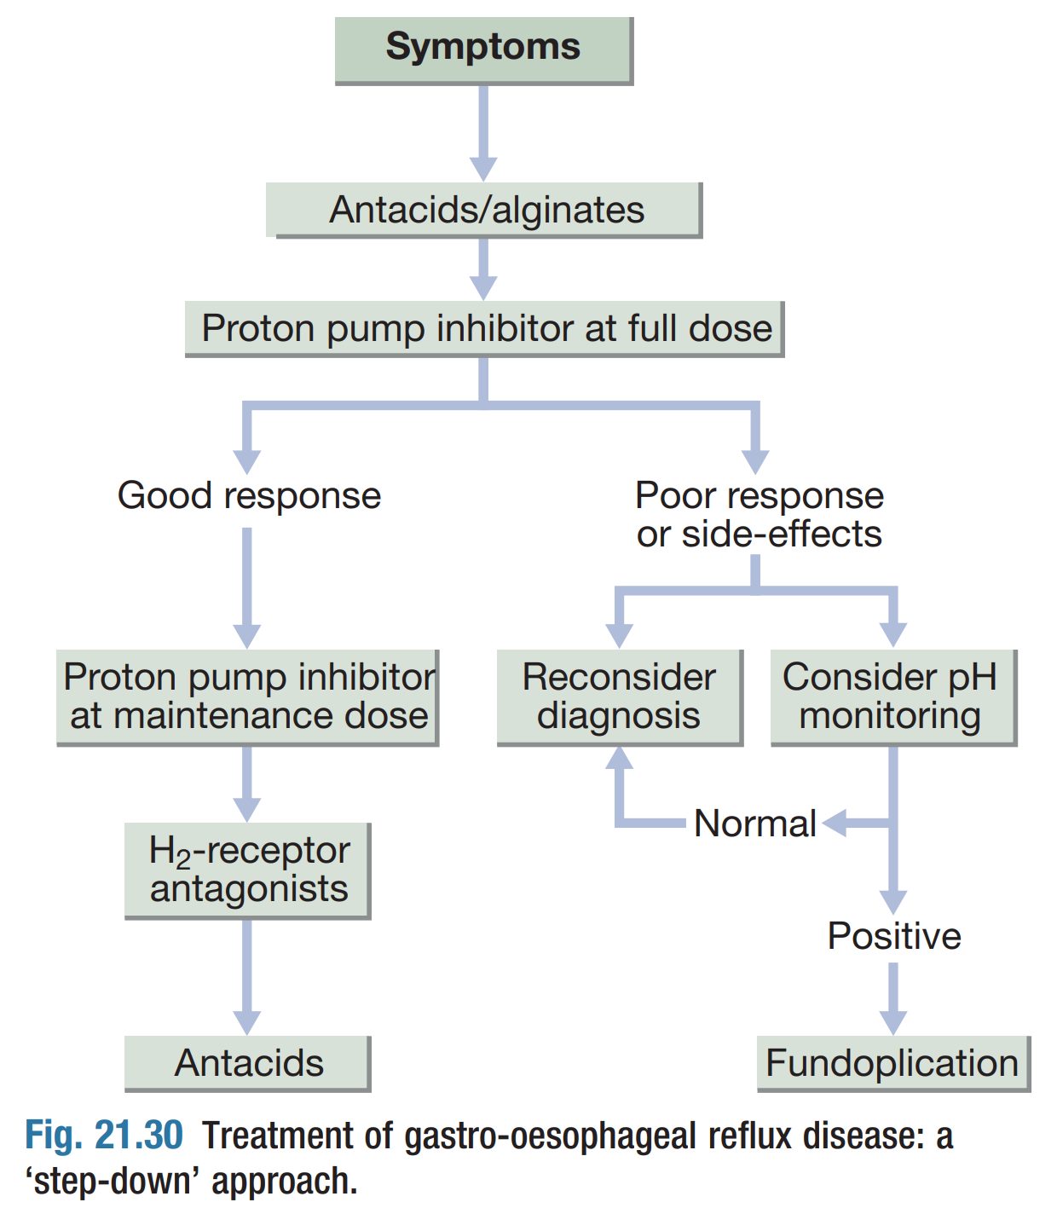
GASTROESOPHAGEAL REFLUX DISEASE (GERD)
HOW TO DIAGNOSE GERD?
The clinical diagnosis can usually be made without investigation and is often made using mainly:
Typical symptom presentation.
Antisecretory responsiveness. (PPI responsive)
In some cases you will need to go further with:
Endoscopy
Ambulatory reflux monitoring (PH study)
indications for endoscopy in suspected GERD:
Alarm symptoms, like?
Dysphagia, Weight loss, Positive family or personal history of esophageal malignancy
Hematemesis, Melena, Anemia.
Non-Cardiac chest pain
Screening high risk patients for Barrett’s: overweight, white males, older than 50, chronic GERD, smokers, Family history
Patients that are unresponsive to PPI
Indications for ambulatory PH monitoring:
Suspected GERD with normal Endoscopy (to confirm GERD)
Persistent symptoms even with PPI¹ (To R/o other causes)
MANAGEMENT OF GERD
Lifestyle changes | Weight loss, Head of bed elevation at night, Smoking Cessation Avoidance of meals 2-3 hours before bedtime for patients with nocturnal GERD. Culprits: fatty foods, caffeine, chocolate, ETOH, spicy foods, carbonated beverages, peppermints
Medical | Proton pump inhibitors (PPIs) are the most commonly used medications, usually effective in resolving symptoms and healing esophagitis. domperidone, when dysmotility features are prominent, can be helpful. antacids and alginates can also provide symptomatic benefit. H2-receptor antagonist drugs, helpful in resolving symptoms without healing esophagitis.
Surgical | Fundoplication², which can treat both hiatal hernia and GERD, the Indications for Fundoplication are: Persistence reflex even with PPI’s Barrett’s esophagus
1- Patients with functional esophagitis: the esophagus is hypersensitive and gets irritated from anything, not necessarily acid. We monitor the pH to know the nature of the reflux causing the irritation
2-Patients undergoing Fundoplication must be evaluated first by endoscopy to make sure they have a reflux. If normal, do PH monitoring.

Slide 5
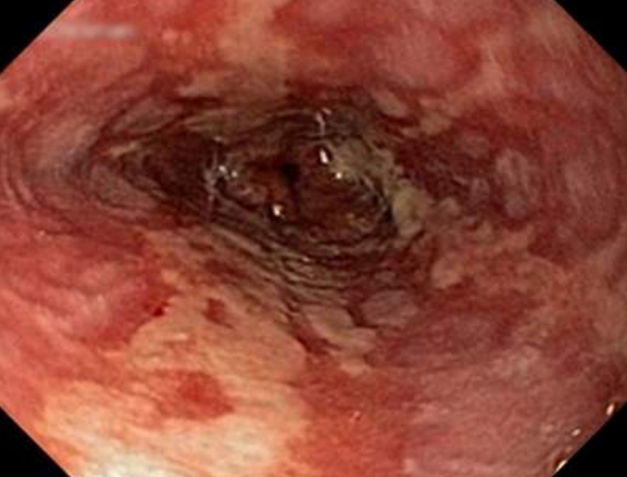
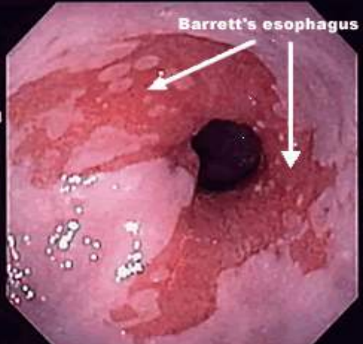
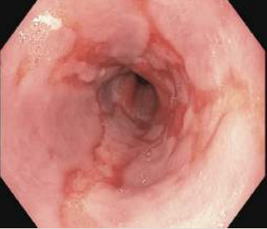
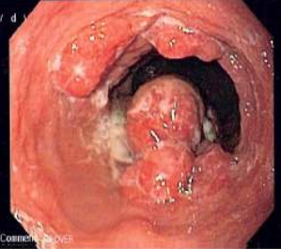
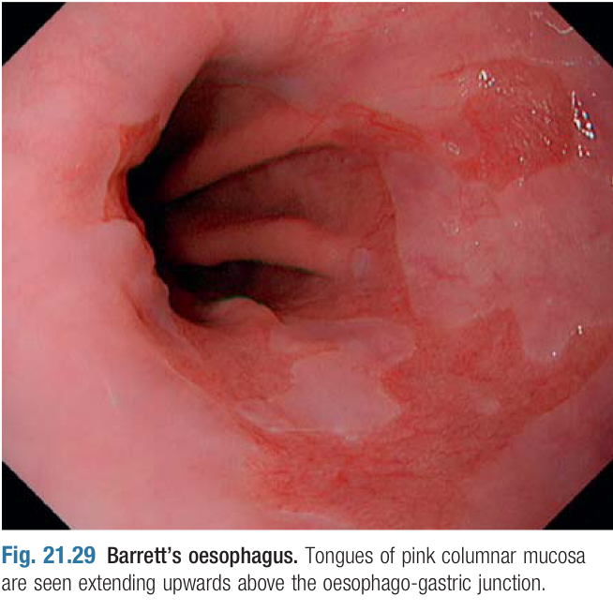
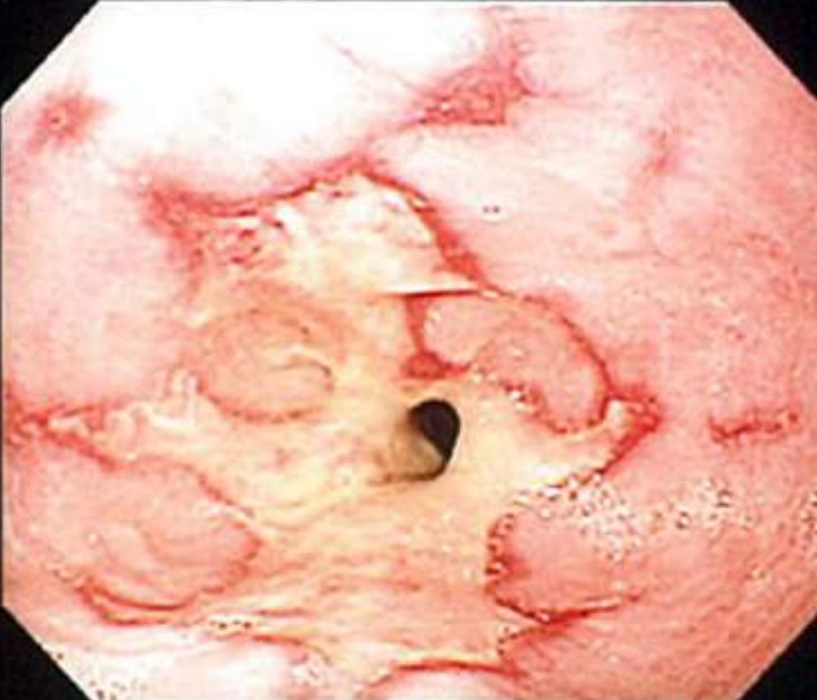
GASTROESOPHAGEAL REFLUX DISEASE (GERD)
Complications
01
Erosive Esophagitis:
AKA Ulcerative esophagitis, if left untreated it will lead to Barrett’s Esophagus.
Treatment : proton pump inhibitors (PPIs)
02
Barrett’s Esophagus:
Metaplastic columnar epithelium (gastric and intestinal) replaces the stratified squamous epithelium in the distal esophagus, it’s More common in Men.
Risk Factors for Barrett’s :
Chronic (>5 years) GERD symptoms, Advancing age (>50 years).
Male gender, Caucasian race, Family history
Tobacco usage, Central obesity.
Alcohol doesn’t increase risk of Barrett’s
The risk of cancer seems to relate to the severity and duration of reflux rather than the presence of Barrett’s oesophagus per se.
Metaplasia¹ (Barrett’s)
High Grade dysplasia
(HGD)
01
02
03
04
05
GERD
Low Grade dysplasia (LGD)
Adenocarcinoma ²
03
Peptic Stricture:
They usually occur in patients over the age of 60 and present with intermittent dysphagia for solids, which worsens gradually over a long period.
Mild cases may respond to PPIs alone.
More severe cases need endoscopic dilation and long-term PPI therapy.
Surgery is required if medical treatment fails.
1- PPi’s have the capability to stop the progression of Barretts’s metaplasia to dysplasia, But has no benefit once patients develop dysplasia (even low grade).
2- A patient has cancer in the lower esophagus, what is the most likely type ? Adenocarcinoma
What is the most likely risk factor ? Barrett’s esophagus secondary to GERD

Slide 6
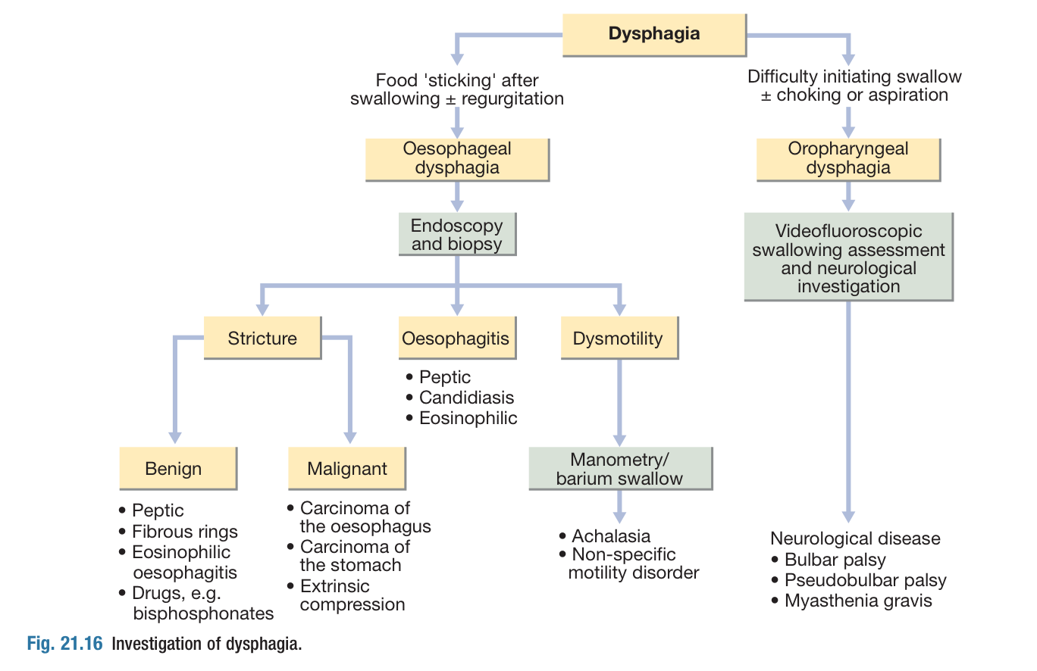
DYSPHAGIA
Introduction
Subjective sensation of difficulty or abnormality of swallowing.
Oropharyngeal vs Esophageal dysphagia¹.
Oropharyngeal Dysphagia | Esophageal Dysphagia ²
Recurrent Pneumonia (Aspiration)
Weight loss
Coughing or choking with swallowing. | Usually no problem with initiation of swallowing.
Difficulty initiating swallowing. | Sensation of food getting Stuck in the chest.
Change in Voice or Speech | Can have Pain in the chest from food bolus.
Nasal regurgitation. | Oral or Pharyngeal regurgitation.
Systemic Neurologic (Such as Stroke) or Myopathic (Such as dermatomyositis) Syndromes. | Functional or Anatomical abnormalities in the esophagus
Intrinsic Functional or Anatomical abnormalities in the esophagus
Functional causes: Achalasia. Secondary dysphagia. Esophageal spasm. Eosinophilic esophagitis. | Anatomical causes: Esophageal strictures Esophageal ring. Esophageal web. Malignancy.
Functional causes:
Achalasia.
Secondary dysphagia.
Esophageal spasm.
Eosinophilic esophagitis.
Anatomical causes:
Esophageal strictures
Esophageal ring.
Esophageal web.
Malignancy.
HISTORY TAKING IN DYSPHAGIA
01
03
05
07
Onset
02
Duration (weeks/months vs years)
04
Stable vs progressive
06
Associated symptoms (weight loss, anemia/blood in stool …)
Intermittent vs persistent
Solids vs Solids + liquids
Regurgitation
Oropharyngeal or esophageal
Solid vs both solid and liquid
CARDINAL SIGNS FOR DYSPHAGIA
Persistent vs intermittent
Important associated symptoms
1- it’s very imp to differentiate between them.
2-In esophageal dysphagia, function refers to the “movement” While anatomy refers to obstruction caused by cancer/strictures

Slide 7
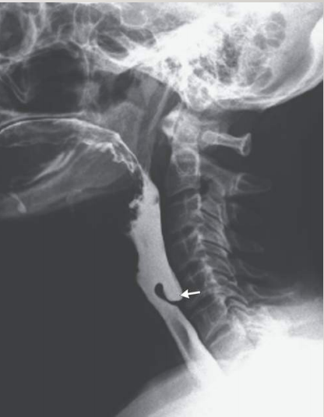
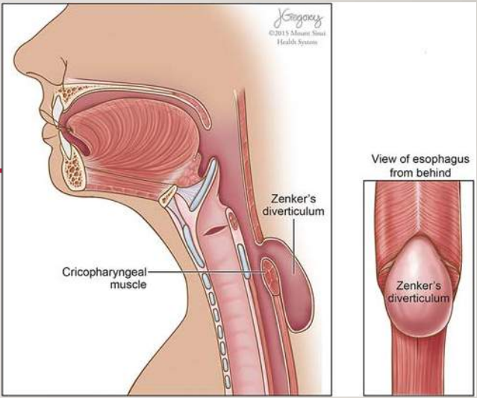
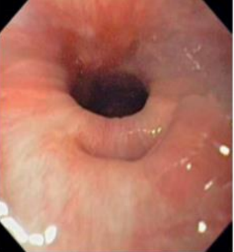
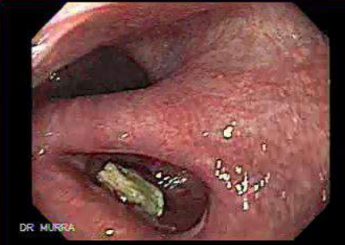
Oropharyngeal Dysphagia
Zenker’s diverticulum
Introduction | AKA cricopharyngeal diverticulum, Sac like, outpouching of the mucosa and submucosa in the area of muscular weakness in the hypopharynx between the inferior constrictor and cricopharyngeus muscle above the UES. An area of weakness known as Killian’s dehiscence allows a pulsion diverticulum to form.
Cause | Hypertensive / noncompliance of the Upper esophageal sphincter
Symptoms² | Oropharyngeal dysphagia symptoms. Food undigested on the pillow at night or after meals. Halitosis¹. Weight Loss happens in late stages (the diverticulum becomes big & obstructs the esophagus) Occasionally, patients present with recurrent pneumonia following aspiration of food into the trachea. They may also complain that a gurgling sound is heard in the neck following a swallow as liquid and food collect in the pouch.
Treatment:
Surgical, either via an external approach through the neck where the pouch is excised or, more commonly, via endoscopy with stapling of the party wall
Diagnosis:
Video swallow testing
Modified barium swallow.
Endoscopy may be hazardous, since the instrument may enter and perforate the pouch.
1-Halitosis is considered as a “characteristic feature” of Zenker’s diverticulum that every physician must keep an eye on secondary to retention of undigested food.
2- In late stages of zenker's diverticulum, Patients may present with symptoms of both oropharyngeal and esophageal dysphagia as it begins to obstructs the esophagus.

Slide 8
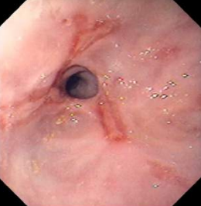
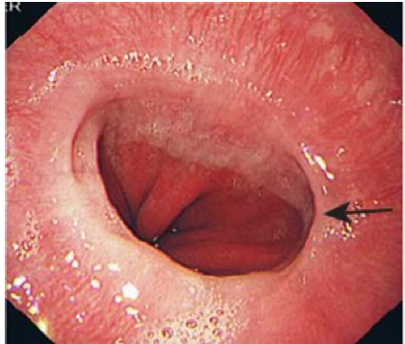
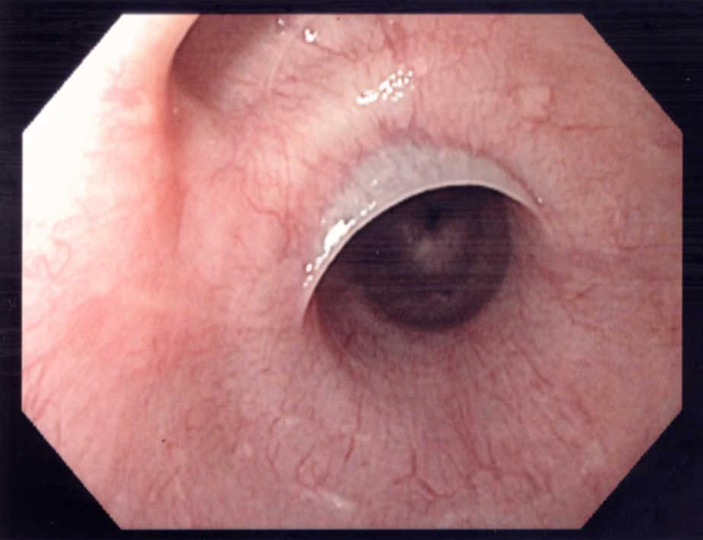
Esophageal Dysphagia
1- ESOPHAGEAL STRICTURE
Causes:
Benign peptic stricture caused by GERD
Malignant stricture
Iatrogenic? eg: Suicidal ingestion of acids
Diagnosis:
Done by endoscopy
Treatment:
Depends on the cause: 3 months history of dysphagia? most likely secondary to GERD treat it with PPI’s. Didn't work? then its either secondary to fibrosis > Dilation, or cancer > resection
2- ESOPHAGEAL RINGS AND WEBS
Esophageal ring | Esophageal web
Common in the lower esophagus (above LES) | Usually in upper esophagus (cervical)
Connective tissue + muscularis mucosa | Thin membrane
Caused by ? GERD | Unknown cause? Genetic
Schatzki’s ring | Plummer vinson syndrome¹ (triad²)
No cancer risk | PVS has increased risk for squamous cell cancer in the esophagus, hypopharynx and oral mucosa.
Diagnosis: barium, endoscopy
Treatment: endoscopic dilation if needed (persistent symptoms)
PPI daily for GERD | Iron replacement therapy if PVS
1-Supplementing PVS patients with iron will make esophageal web disappear,however they need continuous surveillance as they have an increased risk of esophageal squamous cell carcinoma
2- the triad of Plummer vinson syndrome are: Dysphagia, Iron deficiency anemia, and esophageal web. Very common in young females

Slide 9
ESOPHAGEAL DYSPHAGIA
ESOPHAGEAL MOTILITY DISORDERS CAUSING DYSPHAGIA
Esophageal spasms
Aperistalsis in esophagus (connective tissue disease) (Scleroderma)
Achalasia
3-Achalasia
Achalasia
Primary Achalasia¹ | Pathophysiology: Failure of lower esophageal sphincter to relax (lacking ganglion cells in the myenteric plexus in the distal esophagus). Males = Females Characterised by: A hypertonic lower esophageal sphincter, which fails to relax in response to swallowing waves. Failure of propagated esophageal contraction, leading to progressive dilatation of the gullet. Etiology: Immune mediated. Genetic predisposition.
Secondary Achalasia² | Chagas disease, Parasitic Infection by Trypanosoma cruzi (common in latin America), Result in achalasia with features of diffuse enteric myenteric destruction, including megacolon, heart disease (cardiomyopathy), and neurologic disorders. Diagnosis: serology testing. Treatment: Anti trypanosoma like Benznidazole (GI symptoms managed symptomatically³)
Pseudoachalasia⁵ | Achalasia symptoms and similar diagnostic findings. Due to Malignancy (tumors in the gastric cardia or those infiltrating the myenteric plexus like adenocarcinoma of gastroesophageal junction, pancreatic, breast, lung, or hepatocellular cancers) When to suspect (rapid onset over weeks-months⁴, elderly and risk factors for cancer) Need to get CT scan or endoscopic US for further workup.
1-Primary achalasia is the comments, Patients present with history of esophageal dysphagia that persist for years ( 2-3 years history)
2- The main feature of secondary achalasia is that it is multi-system (unlike primary) and not restricted to the esophagus only. It is Important to look for and ask about travel history in secondary achalasia
3- Symptoms are reversible following anti trypanosoma treatments except for the esophagus(irreversible damage), thats why its managed symptomatically
4- Keep in mind that even 8 Months in Pseudo-achalasia is considered as rapid onset in comparison to primary achalasia (which usually takes 2-3 years)
5- in pseudo achalasia, CT scan or endoscopic US is a MUST to roll-out carcinoma specially in high risk group (but it has to be done after the usually workup approach: (barium, endoscopy, and manometry to diagnose and confirm achalasia first)

Slide 10
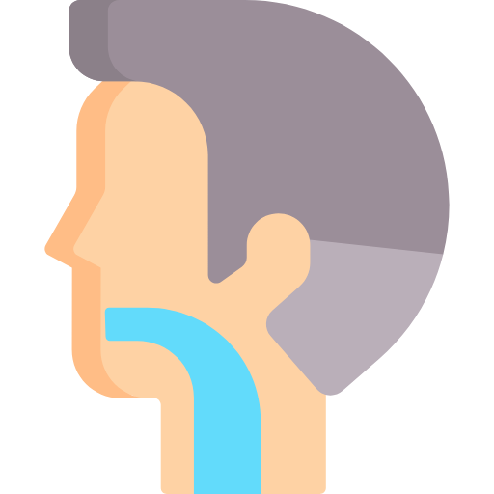
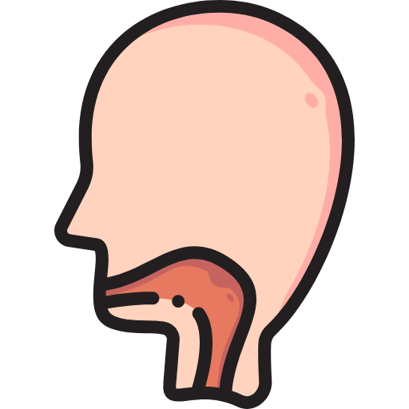
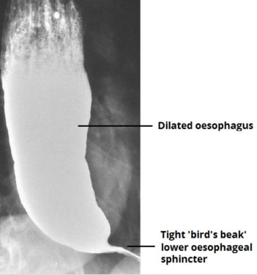
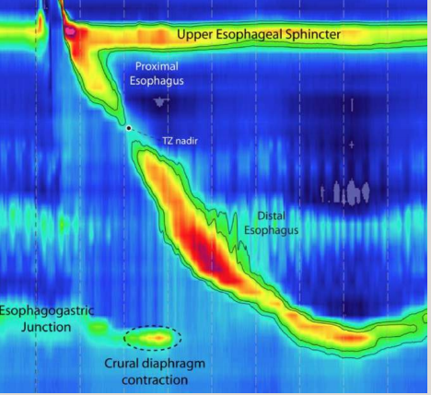
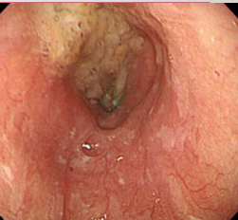
ESOPHAGEAL DYSPHAGIA
3-Achalasia (Cont.)
Symptoms of Achalasia:
Dysphagia to solids and liquids
Regurgitation of undigested food
Dysphagia to solids and liquids
Regurgitation of undigested food
Heartburn¹
Chest pain⁶
Weight loss
Heartburn¹
Chest pain⁶
Weight loss
Diagnosis of Achalasia:
Barium swallow (First Step):
Dilated esophagus
Tight LES
BIRD BEAK APPEARANCE
Esophageal Manometry:
Shows aperistalsis of the esophagus and failure of relaxation of the LOS.
Confirmatory test
01
03
Endoscopy
Normal with some resistance at the LES
Dilated esophagus.
Retained saliva, liquid, and food in the esophagus without mechanical obstruction from stricture or mass
02
Management of achalasia:
Medical therapy³:
Calcium channel blocker
Nitrate
Antimuscarinic agents.
Endoscopic therapy:
Pneumatic dilatation⁴ (effective/ longer term/ more complications)
Botox injection at LES. (effective/ short term 3-6 months)
Peroral endoscopic myotomy (POEM)
Surgical (Heller’s myotomy):
performed laparoscopically or as opened surgery, accompanied by a partial fundoplication anti-reflux surgery.
Higher risk for Esophageal squamous cell cancer.
1- Heartburn in achalasia is due to acids in foods which accumulate in the esophagus
3- Medical therapy for achalasia almost never work, however we can describe it for elderly patients with comorbidities that prevent them from doing any endoscopic or surgical procedure
4- pneumatic dilation is associated with risk of perforation
6- some patients experience severe chest pain due to esophageal spasm; it might be misdiagnosed as cardiac pain.

Slide 11
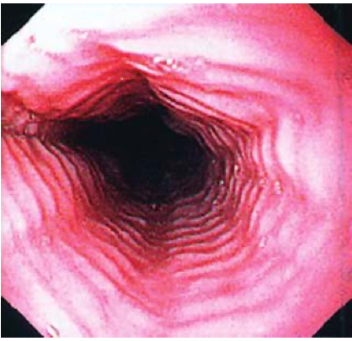
ESOPHAGEAL DYSPHAGIA
4- Diffuse esophageal spasm (DES)
Diffuse esophageal spasm (DES) (corkscrew esophagus)
A severe form of esophageal dysmotility that presents in late middle age with episodic retrosternal chest pain (that can mimic angina) and transient dysphagia. Could occur as a response to gastroesophageal reflux. Can be precipitated by drinking cold liquids. On barium swallow, the appearance may be that of a corkscrew esophagus. Nutcracker, a variant of diffuse esophageal spasm, is characterized by very high-amplitude peristalsis within the esophagus. Treatment is based on PPI when gastroesophageal reflux is present, antispasmodics, nitrates, calcium channel blocker (nifedipine) and GABA agonists (baclofen) are also used. Occasionally, balloon dilatation or longitudinal esophageal myotomy is necessary. DES and nutcracker can be distinguished only by manometry.
5- Eosinophilic Esophagitis
Eosinophilic Esophagitis¹
Overview | Chronic inflammation due to immune-mediated disease resulting in eosinophilic infiltration of esophagus No malignancy Potential. Commonly present with food impaction. Main symptom is dysphagia. History of allergies is seen in >50% of these patients.
Diagnosis | Endoscopy: Can be normal. Strictures. linear furrows. Trachealization of the esophagus. BIOPSY shows 15 or more eosinophils/hpf on microscopy (from proximal and distal esophagus²)
Treatment | PPI first for 8 weeks then repeat Endoscopy if Eosinophils is still 15 or more: Corticosteroids³ (swallowed fluticasone/ budesonide/betamethasone)for 8-12 weeks. If symptoms persists repeat endoscopy if there’s a ring try dilation. Leukotriene inhibitor (montelukast) for refractory symptoms. Elimination diets for children.
An area for your notes
1- Patients with Eosinophilic esophagitis may present with history of allergies eg: Asthma, allergic rhinitis, food allergies
2- Biopsy MUST be taken from both ends of the esophagus as refluxes may also cause eosinophilia
3- Corticosteroids are initiated if PPI didn’t work, it has to be swallowed (the patient has to use corticosteroid inhaler(not tablets!) but instead of inhaling the substances he swallows them)

Slide 12
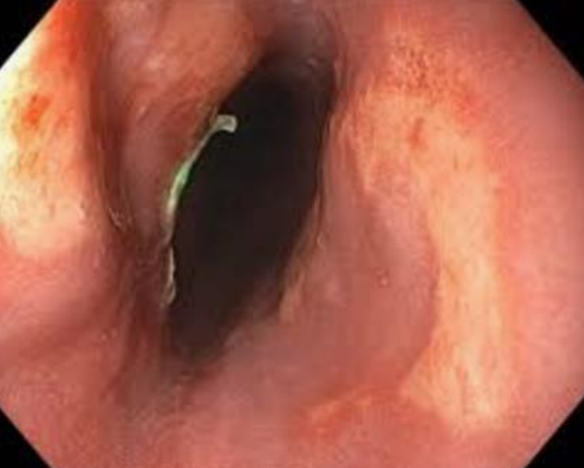
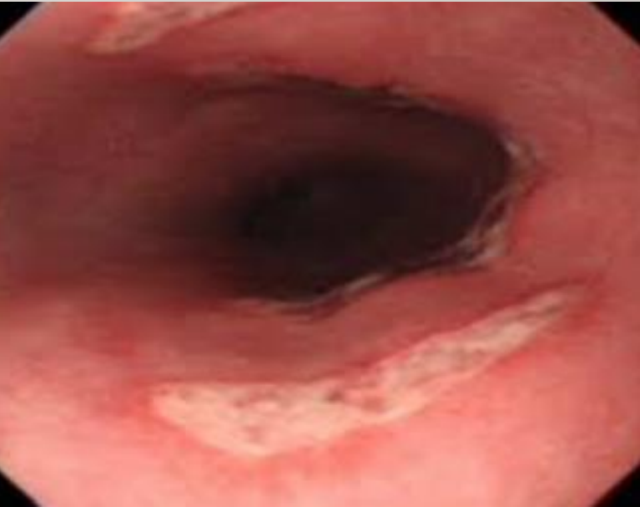
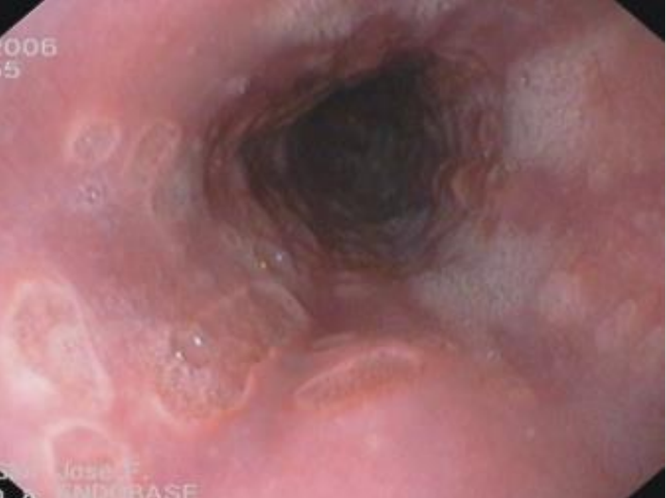
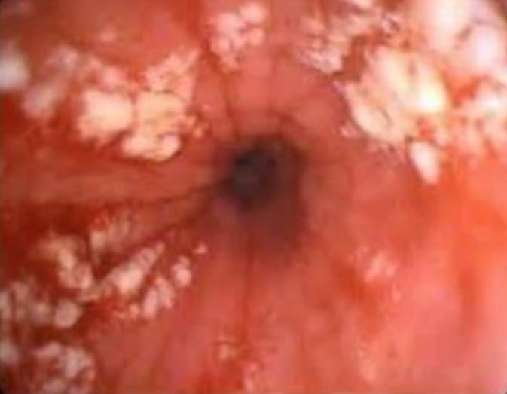
ODYNOPHAGIA+/- DYSPHAGIA
Acute Esophagitis
1
2
Pill-induced¹
Antibiotics: (Tetracycline/Doxycycline)
A patient taking tetracycline for his acne present complaining of acute odynophagia for one week, what is the most likely the diagnosis and the cause?
Bisphosphonate (alendronate)
A 50 years old post menopausal woman present with odynophagia following bisphosphonate therapy for her osteoporosis, what is mostly likely the diagnosis and the cause ?
Potassium
A HF patient on lasix and diuretics with hypokalemia using potassium supplements
Treatment :
Stop the medication and give them PPI
1
2
Infections
Immunocompromised patients
Patients on corticosteroid therapy are at risk of “Infection induced” acute esophagitis
Viral (CMV, HSV)
Treatment: antiviral
Candida
Treatment: anti fungal
1- The comments site for pill induced acute esophagitis is at the aortic constriction of the esophagus as it is considered as the tightest area of the esophagus where pills can get stuck (produce kissing ulcer appearance), for that when you prescribe these medications, advise the pt to drink a lot of water and stay in upright position at least for 30 min after taking the pill.

Slide 13
GERD
Sx | Typical: heartburn (the major feature), regurgitation Atypical: nausea, chest pain, bloating and belching, globus sensation, early satiety. extra-esophageal: sinusitis / recurrent otitis media, cough, asthma, dental erosions, laryngitis.
Dx | clinical: typical symptom presentation, antisecretory responsiveness. endoscopy: in case of alarm symptoms, non cardiac chest pain, screening high risk patients for Barrett’s, Pts unresponsive to PPI. 24h pH monitoring and motility: suspected GERD with normal endoscopy, Persistent symptoms even with PPI.
MGT | PPI, antacids and alginates, domperidone, H2 receptor antagonist.
Cx | peptic strictures: >60, intermittent dysphagia for solids which worsens gradually. erosive esophagitis. Barrett’s esophagus: white men >50, chronic GERD symptoms, Fx history, tobacco, central obesity, Risk for adenocarcinoma.
Zenker’s diverticulum
Sx | oropharyngeal dysphagia symptoms, undigested food on the pillow at night or after meals, Halitosis, Weight loss in late stage
Dx | modified barium swallow, video swallowing testing
Tx | surgical Either via external approach (through the neck) or endoscopy (more commonly) with stapling of the party wall.
eosinophilic esophagitis
Sx | dysphagia or food bolus obstruction chest pain and heartburn caused by the eosinophil induced esophageal inflammation History of allergy seen in >50% of patients.
Dx | endoscopy: can be normal / strictures / linear furrows / trachealization of the esophagus
Tx | PPI: used first for 8 weeks then repeat endoscopy. corticosteroids: swallowed fluticasone / budesonide / betamethasone montelukast: for refractory symptoms
Esophageal webs and rings
Esophageal ring | Esophageal web
Common in the lower esophagus (above LES) | Usually in upper esophagus (cervical)
Connective tissue + muscularis mucosa | Thin membrane
Caused by ? GERD | Unknown cause ?genetic
Schatzki’s ring | Plummer vinson syndrome (triad)
No cancer risk | PVS has increased risk for squamous cell cancer in the esophagus, hypopharynx and oral mucosa.
Diagnosis: barium, endoscopy
Treatment: endoscopic dilation if needed (persistent symptoms)
PPI daily for GERD | Iron replacement therapy if PVS

Slide 14
Esophageal strictures
causes | Benign peptic strictures, malignant strictures, iatrogenic.
Dx | Endoscopy.
Tx | Depends on the cause: 3 months history of dysphagia? most likely secondary to GERD treat it with PPI’s. Didn't work? then its either secondary to fibrosis > Dilation, or cancer > resection
Achalasia
Primary achalasia: Hypertonic LES which fails to relax in response to swallowing waves, and failure of propagated esophageal contraction leading to progressive dilation of the gullet. Immune mediated and genetic predisposition.
Sx | dysphagia (develops slowly,initially intermittent, solids and liquids), chest pain( due to esophageal spasm), regurgitation and pulmonary aspiration, heartburn and weight loss.
Dx | barium esophagography shows dilatation of the esophagus narrowing into a “beak-like” pattern at the lower end. esophageal manometry shows increased LES resting pressure + no/partial relaxation, low amplitude contraction, no propagation. endoscopy normal with some resistance at the LES, dilates esophagus and retained saliva, liquid and food in the esophagus.
MGT | drugs: nitroglycerin / calcium channel blocker / antimuscarinic agents. endoscopic: forceful pneumatic dilatation / botulinum toxin injection / peroral endoscopic myotomy. surgical myotomy (Heller’s operation).
Diffuse esophageal spasm (corkscrew esophagus)
Sx | Episodic retrosternal chest pain and (can mimic angina), dysphagia, precipitated by drinking cold liquids.
Dx | Barium swallow: appearance maybe that of a corkscrew esophagus.
Tx | PPI when GER is present.
 | Antispasmodics, Nifedipine (CCB) and nitrates.
functional
-achalasia
-secondary dysphagia
-esophageal spasm
-eosinophilic esophagitis
esophageal
anatomical
dysphagia
-esophageal stricture
-esophageal ring
-esophageal web
-malignancy
Zenker’s diverticulum
oropharyngeal
neurologic
myopathic

Slide 15
(Dr’s slides)
Q1: A 42 y/o male presents for evaluation of heartburn. He denies any dysphagia or weight loss. He has no other medical conditions and is currently not taking any medications. You suspect that he may have GERD. Which of the following describes the role of upper endoscopy in the evaluation of this patient?
A- He should undergo an Esophagogastroduodenoscopy with biopsy to ensure a more serious condition is not missed
B- He should undergo an Esophagogastroduodenoscopy only if he has no improvement in his symptoms after an empiric trial of twice daily PPI therapy.
C- He should undergo ambulatory PH monitoring while on PPI therapy to ensure the medication is working
D- He should undergo both an Esophagogastroduodenoscopy and ambulatory PH monitoring prior to the initiation of any therapy.
Q2: A 45-year-old man is evaluated for a 2-month history of a burning sensation starting in his stomach and radiating into his chest, usually occurring 4 to 5 times weekly. He says that he usually eats dinner late and then goes to sleep. He often wakes up with a sour taste in his mouth. He reports no dysphagia or unintentional weight loss. He takes no medication. On physical examination, vital signs are normal; BMI is 34. The remainder of the examination, including abdominal examination, is unremarkable. What would be the next step in his management?
A- PH testing
B- Barium esophagography
C- Empiric trial of proton pump inhibitor
D- Esophagogastroduodenoscopy
Q3: - A 56-year-old woman is evaluated for chest discomfort after meals occurring intermittently over the preceding month. She describes a sensation of heaviness on her chest, and says that she also notices this pain sometimes while walking up stairs. She reports no nausea, dysphagia, or reflux. She has been taking ranitidine with minimal relief of symptoms. She also takes atorvastatin for hyperlipidemia. She smokes half a pack of cigarettes daily. On physical examination, her blood pressure is 140/90 mm Hg and other vital signs are normal; BMI is 34. The remainder of the examination, including abdominal examination, is unremarkable. What is your next step?
A- Barium esophagography
B- Electrocardiography
C- Empiric trial of a proton pump inhibitor
D- Esophagogastroduodenoscopy
Q4: - A 75-year-old man is evaluated for progressive dysphagia of 8 months' duration for both solids and liquids and the necessity to induce vomiting several times each month to relieve his symptoms. He also has experienced chest pain and heartburn symptoms. He has lost approximately 6 kg (13 lb) of weight over the preceding 3 months and a total of 9 kg (20 lb) since his symptoms began. He has a long history of cigarette and alcohol use. His medical history and review of systems is otherwise negative. He has no travel history outside the northeastern United States. He takes no medication. On physical examination, vital signs are normal; BMI is 23. He appears thin and tired. The remainder of the physical examination is unremarkable. Esophagogastroduodenoscopy findings reveal retained saliva, liquid, and food in the esophagus without mechanical obstruction. Manometry demonstrates incomplete lower esophageal relaxation and aperistalsis. What is the most likely diagnosis?
A- Achalasia
B- Pseudoachalasia
C- EOE
D- Chagas disease
Q5: A 52-year-old man is evaluated for dysphagia of 3 months' duration. He reports regurgitating undigested food soon after eating solid food, occasional coughing and choking after swallowing, and chronic halitosis. He reports no weight loss or chest pain. He drinks two beers weekly and does not smoke. On physical examination, vital signs are normal; BMI is 25. The remainder of the examination, including abdominal examination, is unremarkable. What is your next step?
A- Barium esophagram
B- Esophagogastroduodenoscopy
C- Manometry
D- PH study
Q6: A 25 year old man is evaluated for a sensation of solid food "sticking" several times per week. He reports that he sometimes forces himself to vomit when he feels food "stuck" in the esophagus, but he has never gone to the emergency department. He takes a multivitamin and is generally healthy.On physical examination, vital signs and other findings, including those of an abdominal examination, are unremarkable. Esophagogastroduodenoscopy findings are shown. Biopsies of the esophagus show more than 18 eosinophils/hpf. Which of the following is the most likely diagnosis?
A- Achalasia
B-Eosinophilic esophagitis
C- Gastroesophageal disease
D- Pill induced esophagitis
Answers: Q1:B | Q2:C | Q3:B | Q4:B | Q5:A | Q6:B

Slide 16
THANKS!!
This lecture was done by:
Faisal G Al-Zahrani
Nawaf Albhijan
Quiz and summary maker:
Faisal G Al-Zahrani
Note taker:
Khaled Al-harbi
Females co-leaders:
Raghad AlKhashan
Amirah Aldakhilallah
Males co-leaders:
Mashal AbaAlkhail
Nawaf Albhijan
Send us your feedback:
We are all ears!

