Slide 1
Lecture 29
Editing file
Inflammatory bowel disease
Objectives:
Describe & Distinguish the Inflammatory bowel disease (IBD) is comprised of two major disorders: Ulcerative colitis (UC), Crohn's disease (CD).
Know the disorders have both distinct and overlapping pathologic and clinical characteristics.
know the Genetic factors: NOD2/CARD15
Know the ENVIRONMENTAL FACTORS: Smoking, Appendectomy: protect UC, Diet
Color index:
Color index:
Original text Females slides Males slides
Doctor’s notes Text book Important Golden notes Extra

Slide 2
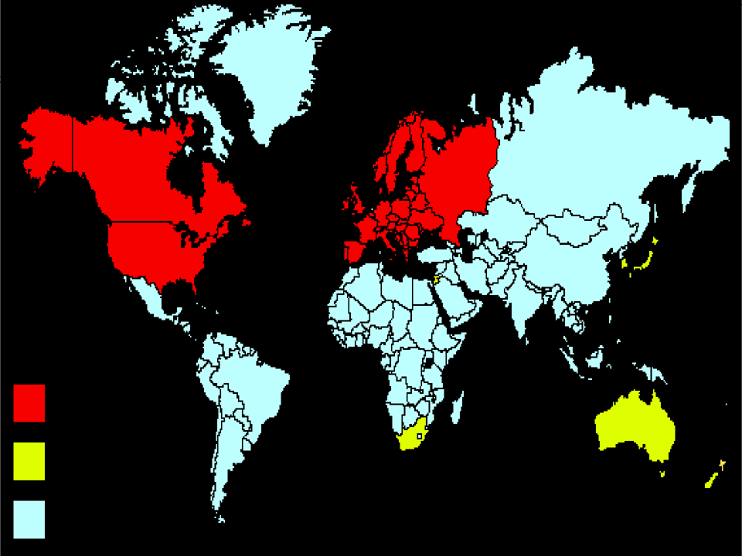
Introduction
Definition
IBD is comprised of two major disorders: Ulcerative colitis (UC) and Crohn’s disease(CD) also include Microscopic Colitis & Indeterminate (Undetermined) Colitis When it’s difficult to distinguish between Crohn’s Disease & Ulcerative Colitis.
These disorders have both distinct and overlapping pathologic and clinical characteristics.
Epidemiology
More common in the west, but the incidence is increasing in the developing countries including saudi arabia.
IBD can present at any age:
The peak: 15-30 years
A second peak is 50 years old
Etiology
1
2
3
Defective Mucosal integrity
Diet
Persistent infection
Altered mucus
Increased permeability
Cellular starvation
Impaired restitution
Western diet and Frozen food increase the chance of developing IBD, especially in children less 10 years-old
Mycobacteria
Helicobacter sp
Measles,Mumps
Listeria
Toxiginic E.coli
4
5
6
Dysbiosis
Dysregulated
immune response
Host factors
Change in microbiota of the gut:
↓protective bacteria
↑aggressive commensals
Loss of tolerance
Aggressive cellular activation
Defective apoptosis
Major genetic factors¹ for CD: There are more than 300 genes.
Nucleotide Oligomerization Domain 2 (NOD2/CARD15)*
1- The NOD2 protein on chromosome 16 is an intracellular sensor of bacterial peptidoglycan, present in bacterial cell walls. NOD2 is expressed in epithelial cells, macrophages and endothelial cells. Individuals who are homozygote or compound heterozygote for one of several mutations in the NOD2 gene have a significantly increased risk of developing ileal CD. Likewise, mutations in the autophagy genes ATG16L1 and IRGM (immunity-related GTPase M- protein) and IL- 23 receptor gene increase CD risk, and mutations in genes associated with the mucosal barrier increase UC risk. Specific genetic defects in the IL- 10 receptor pathway are associated with a severe form of extremely early- onset colitis and perianal disease in children.
6
*Genetics of IBD:
The NOD2 protein on chromosome 16 is an intracellular sensor of bacterial peptidoglycan, present in bacterial cell walls.
UC and CD are both associated with genetic variants at HLA locus, and with multiple genes involved with immune signalling (especially IL-23 and IL-10 pathways)
CD is associated with genetic defects in innate immunity and autophagy (NOD2, ATG16L1 and IRGM genes)
UC is associated with genetic defects in barrier function
NOD2 is associated with ileal and stricturing disease, and hence a need for resectional surgery
HLA-DR*103 is associated with severe UC
10% have first-degree relative/1 or more close relative with IBD
High concordance in identical twins (40–50% CD; 20–25% UC)
Environmental factors
Smoking:
Increases the chance for crohn’s disease.
It has a protective role in Ulcerative colitis.
Appendectomy:
Have a protective role in Ulcerative colitis.
1- Genetic Factors are not enough so there must be a combination with environmental factors

Slide 3
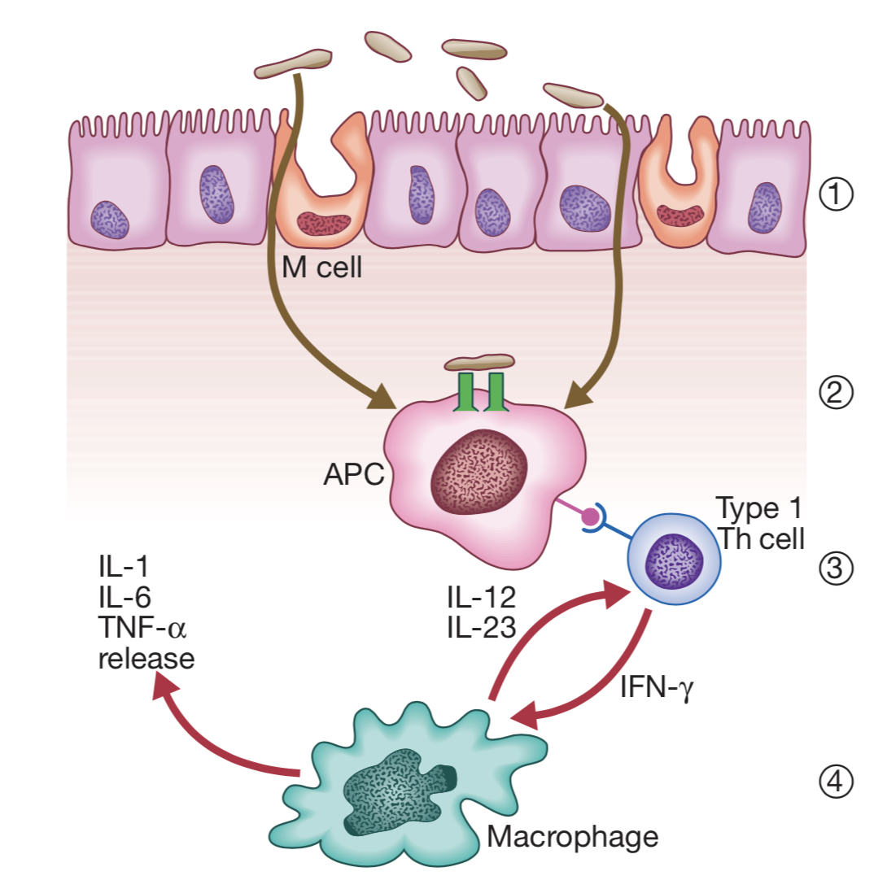
Introduction cont’
Pathophysiology (Hypothesis) of IBD
Bacterial antigens are taken up by specialised M cells, pass between leaky epithelial cells or enter the lamina propria through ulcerated mucosa.
After processing, they are presented to type 1 T-helper cells by antigen- presenting cells (APCs) in the lamina propria.
T-cell activation and differentiation results in a Th1 T cell-mediated cytokine response
with secretion of cytokines, including interferon gamma (IFN-γ). Further amplification of T cells perpetuates the inflammatory process with activation of non-immune cells and release of other important cytokines, including interleukin 12 (IL-12), IL-23, IL-1, IL-6 and tumour necrosis factor alpha (TNF-α). These pathways occur in all normal individuals exposed to an inflammatory insult and this is self-limiting in healthy subjects. In genetically predisposed persons, dysregulation of innate immunity may trigger inflammatory bowel disease.
Overview on UC and CD
 | Ulcerative Colitis | Crohn's disease
Wall involvement | Mucosal, submucosal ulcers | Full-thickness inflammation with knife-like fissures
Location | Begins in rectum and can extend proximally up to cecum | Anywhere from mouth to anus with skip lesions Terminal ileum is the most common site
Symptoms | Left lower quadrant pain (rectum) with bloody diarrhea | Right lower quadrant pain (ileum) with non-bloody diarrhea
Inflammation | Crypt abscess with neutrophils | Lymphoid aggregates with Granulomas
Gross appearance | Pseudopolyps | Cobblestone mucosa, creeping fat and strictures
Complications | Toxic megacolon, Carcinoma | Malabsorption with nutritional deficiency, Calcium oxalate nephrolithiasis, fistula formation and Carcinoma
Smoking | Protects against UC | Increases risk

Slide 4
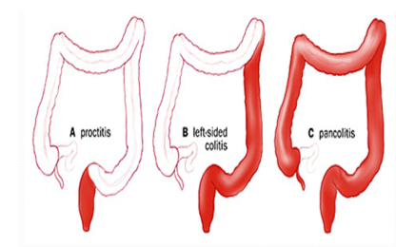
Ulcerative Colitis
Definition
UC is a chronic inflammatory disease characterized by recurrent episodes of inflammation limited to the mucosal layer of the rectum and colon. Starts at the rectum then extends proximally
Types / Locations¹
Ulcerative proctitis
Ulcerative proctosigmoiditis
Left-sided colitis
Extensive colitis
Pancolitis
Rectum alone
Rectum and sigmoid colon
Disease that extends beyond the rectum and as far proximally as the splenic flexure.
Beyond the splenic flexure
Clinically it’s similar to Pancolitis in the way of treatment.
Whole colon
40-50% of patients have disease limited to the rectum
and rectosigmoid
1
Patients with proctitis usually pass fresh blood or bloodstained mucus either mixed with stool or streaked onto the surface of normal or hard stool
2
When the disease extends beyond the rectum, blood is usually mixed with stool or grossly bloody diarrhea may be noted
30-40% of patients have disease extending beyond the sigmoid
3
When the disease is severe, patients pass a liquid stool containing blood, pus, fecal matter
20% of patients have pancolitis
4
Other symptoms in moderate to severe disease include: anorexia, nausea, vomiting, fever, weight loss
Signs & Symptoms^{2,3}
How to differentiate between mild and severe UC? Click here (EXTRA!!!!)
Bloody diarrhea
Crampy abdominal pain
Iron deficiency anemia
Rectal bleeding
Tenesmus
“Pain during defecation “
Passage of mucus
1- Inflammation invariably involves the rectum (proctitis) and spreads proximally in a continuous manner to involve the entire colon in some cases (pancolitis). In long-standing pancolitis, the bowel can become shortened and post-inflammatory ‘pseudopolyps’ develop; these are normal or hypertrophied residual mucosa within areas of atrophy. The inflammatory process is limited to the mucosa and spares the deeper layers of the bowel wall.
2- The first attack is usually the most severe and is followed by relapses and remissions. Emotional stress, intercurrent infection, gastroenteritis, antibiotics or NSAID therapy may all provoke a relapse.
3-Ulcerative colitis patients present earlier than Crohn’s Disease.

Slide 5
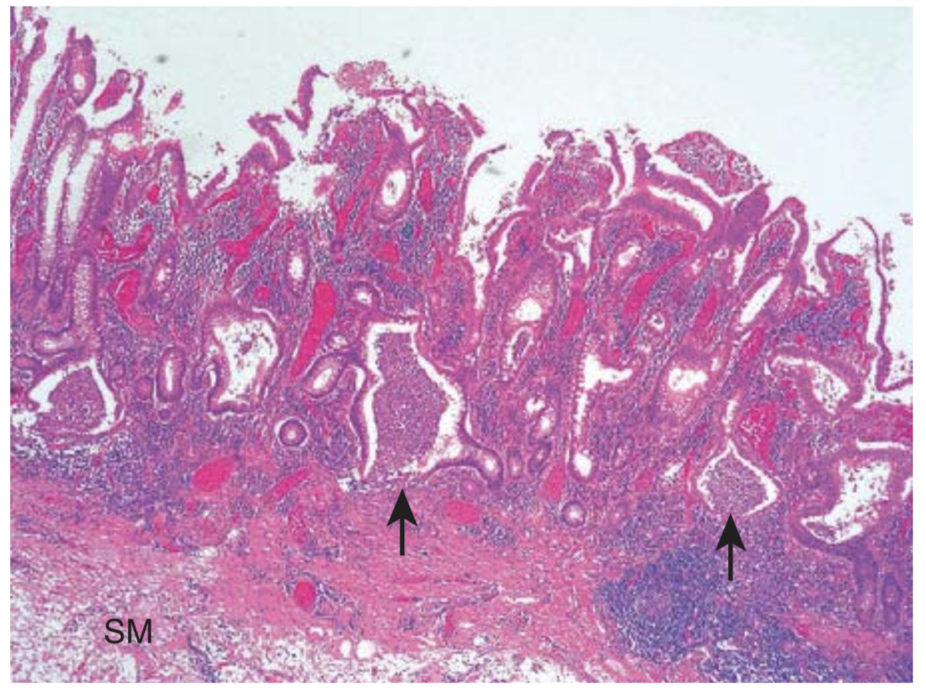
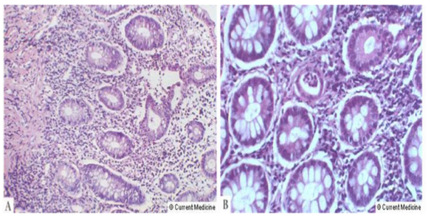
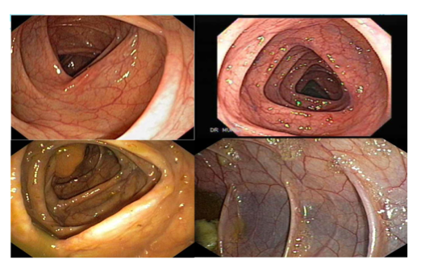
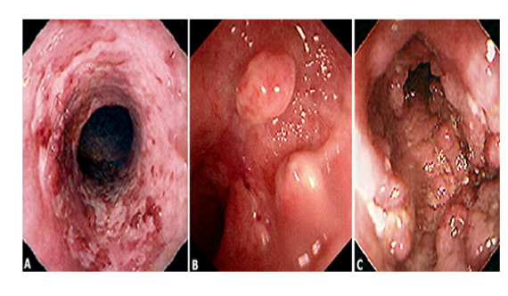
Ulcerative Colitis cont’
1
2
Diagnosis
No single modalities is enough for diagnosis
Combination of clinical picture, laboratory, endoscopy, pathology are required for the diagnosis of UC
No single modalities is enough for Diagnosis. Combination of Clinical picture, laboratory, Endoscopy, pathology.
The most important issue is to distinguish the first attack of acute colitis from infection. In general, diarrhoea lasting longer than 10 days in Western countries is unlikely to be the result of infection.
Faecal calprotectin has a high sensitivity for detecting gastrointestinal inflammation and may be elevated, even when the CRP is normal. It is particularly useful for distinguishing inflammatory bowel disease from irritable bowel syndrome at diagnosis, and for subsequent monitoring of disease activity.
At initial presentation, stool microscopy, culture and examination for Clostridium difficile toxin or for ova and cysts, blood cultures and serological tests should be performed.
ESR and CRP are often raised; liver biochemistry may be abnormal, with hypoalbuminaemia occurring in severe disease. pANCA may be positive. This is contrary to CD, where pANCA is usually negative
Colonoscopy:
● Vascular markings are lost. colon mucosa will disappear
● Petechiae, exudates, touch friability and frank hemorrhage “ rectal bleeding” may be present.
● Colonic involvement is continuous in ulcerative colitis, in contrast to the patchy nature of Crohn's disease.
● Endoscopy with mucosal biopsy is the gold standard investigation for diagnosis of UC
● Sigmoidoscopy is usually abnormal, showing an inflamed, bleeding and friable mucosa.
3
Colonoscopy¹
The vascular markings are lost, petechiae, exudates, touch friability, and frank hemorrhage may be present.
Colonic involvement is continuous in ulcerative colitis, in contrast to the patchy nature of Crohn's disease.
Endoscopy with mucosal biopsy is the GOLD standard
Pathology
Pathology
Chronic changes including branching of crypts, atrophy of glands, and loss of mucin in goblet cells.
PMNs accumulate in the crypts of the colon (crypt abscesses).
Crypt abscesses²
Chronic changes including branching of crypts, atrophy of glands, and loss of mucin in goblet cells³
UC has 3 main features:
1- Confined to the mucosa with excess inflammatory cells in the lamina propria
2- Loss of goblet cells
3- Crypt abscesses (arrows)
Rule out infection
Anti TNF therapy
5 ASA therapy
- Oral
- Recal
Corticosteroids
Systemic:
Prednisolone
Local acting:
Enema.
Management⁴
Click here for more details about the meds (EXTRA!!!!!!)
Medical
Surgery
Rule out infection
Anti TNF therapy (Induction & maintenance)
5 ASA therapy: The 1st line therapy. Used for induction & maintenance of remission. (Oral/Rectal:Suppository for Disease up to 10 cm while Enema for disease involving 10-20 cm if more than 20 cm then we combine oral with rectal)
Corticosteroids: Used for induction ONLY NEVER used for Maintenance of remission.
Systemic: Prednisolone
Local acting: enema. Such as Budesonide MMX that acts locally in the colon.
Immunomodulators: (Just for maintenance)
Azithyoprine
Methotrexate
Severe attacks that fail to respond to medical therapy.
Complications of a severe attack (e.g., perforation, acute dilatation (Toxic megacolon)
Chronic continuous disease with an impaired quality of life.
Dysplasia or carcinoma.
5 ASA therapy
- Oral
- Recal
Corticosteroids
Systemic:
Prednisolone
Local acting:
Enema.
Ulcerative Colitis
Normal
Ulcerative Colitis
Goals of therapy
Induce and maintain remission | Ameliorate symptoms
Improve pts quality of life | Adequate nutrition
Prevent complication of both the disease and medications
Complications
Hemorrhage.
Perforation.
Colon cancer
Toxic megacolon: is the leading cause of death in UC and affects <5% of patients. It is associated with a risk of colonic perforation . (It is a transverse colon with a diameter of more than 5-6 cm with loss of haustration)
1- Investigations: blood tests ( raised in white cells, platelet count, ESR and CRP, iron deficiency anemia is present and hypoalbuminemia) , faecal calprotectin/lactoferrin will be elevated , pANCA may be positive , Imaging plain abdominal x-ray is essential to exclude colonic dilation which is detected by ultrasound , liver biochemistry may be abnormal
1- Patients who present with diarrhoea plus raised inflammatory markers or alarm features, such as weight loss, rectal bleeding and anaemia, should undergo ileocolonoscopy. Flexible sigmoidoscopy is occasionally performed to make a diagnosis, especially during acute severe presentations when ileocolonoscopy may confer an unacceptable risk; ileocolonoscopy should still be performed at a later date, however, in order to evaluate disease extent. Barium enema is a less sensitive investigation than colonoscopy in patients with colitis and, where colonoscopy is incomplete, a CT colonogram is preferred.
2- Both acute and chronic inflammatory cells infiltrate the lamina propria and the crypts (‘cryptitis’). Crypt abscesses are typical.
3- Goblet cells lose their mucus and, in long-standing cases, glands become distorted. Dysplasia, characterised by heaping of cells within crypts, nuclear atypia and increased mitotic rate, may herald the development of colon cancer. When should screening occur? After 8 to 10 years of colonic involvement, with colonoscopy every 1 to 2 years
4-For mild use 5-ASA agents (eg, sulfasalazine “not used anymore due to its side effects”, mesalamine such as Pentasa & Asacol), topical or oral; corticosteroids for flare-ups and immunomodulators (eg, azathioprine) or biologics (eg, infliximab) for refractory or moderate to severe disease. Want more details? click here

Slide 6
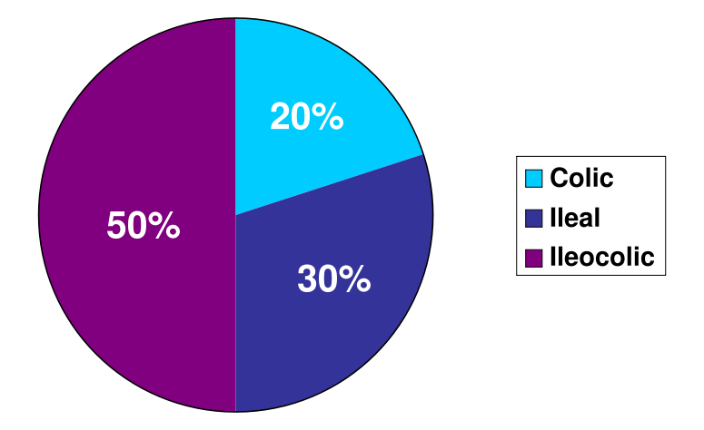
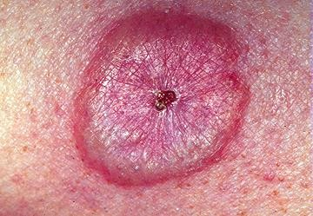
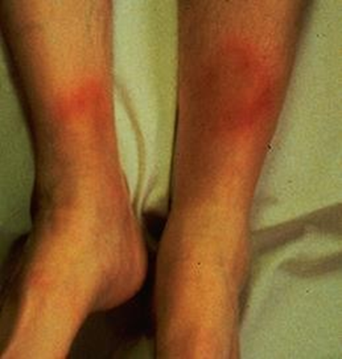
Crohn’s disease (CD)
Introduction
Introduction
Is a disorder of uncertain that is characterized by chronic transmural inflammation of the gastrointestinal tract.
Location:
CD may involve the entire gastrointestinal tract from mouth to the perianal area
80% small bowel , 50% ileocolitis, 30% perianal disease , 20% colon, UGI < 5%
Characterized by transmural inflammation of the gastrointestinal tract.
Involve the entire gastrointestinal tract from mouth to the perianal area
80% small bowel , 50% ileocolitis, 30% perianal disease , 20% colon, UGI < 5%
Perianal Diseases rarely comes alone & usually combined with other sites such as colon or ileocecal.
Clinical manifestation
General: Fatigue, Diarrhea, Abdominal pain, Weight loss, Fever.
Intestinal manifestations
ExtraIntestinal manifestations
Intestinal | Extraintestinal CD & UC share a number of Extraintestinal manifestations
Phlegmon/abscess: walled off inflammatory mass without bacterial infection | Arthritis Bone loss and Osteoporosis
Perianal disease, Gallstones | Skin disorders
Severe oral involvement: aphthous ulcers. | Primary sclerosing cholangitis
Esophageal involvement: odynophagia and dysphagia. | Venous and arterial thromboembolism Renal stones
Gastroduodenal CD: upper abdominal pain and symptoms of gastric outlet obstruction. | Vitamin B12 deficiency
Fistulas: Tracts or communications that connect two epithelial-lined organs. Enterovesical Enterocutaneous Enteroenteric Enterovaginal | Eye involvement Uveitis Iritis Episcleriti
Fever, fatigue
Abdominal pain
Weight loss
diarrhea
Extraintestinal manifestation:
CD and ulcerative colitis share a number of extraintestinal manifestation
Arthritis
Eye involvement
Skin
primary sclerosing cholangitis
Venous and arterial thromboembolism
Renal stones
bone loss and osteoporosis
Vitamin B12 deficiency
CD and ulcerative colitis share a number of extraintestinal manifestations
Phlegmon/abscess: Phlegmon is walled off inflammatory mass without bacterial infection if there’s is a bacterial infection it’s called abscess.
Perianal disease can present with fistula/abscess. Gallstones: develop because Crohn’s Disease can affect terminal ileum and interferes with bile salt absorption
Severe oral involvement: aphthous ulcers.
Esophageal involvement: odynophagia and dysphagia.
Gastroduodenal CD: upper abdominal pain and symptoms of gastric outlet obstruction.
Fistulas: Tracts or communications that connect two epithelial-lined organs. Enterovesical Enterocutaneous Enteroenteric Enterovaginal
Arthritis: Type 1 (Pauci/oligoarticular arthritis): swelling and pain of 5 or fewer joints, tends to be acute and self-limiting. It particularly affects the large joints in the lower extremities. Type 1 correlates with IBD activity. Type 2 (Peripheral arthritis): Has a more polyarticular distribution (>5 joints). Lasts longer (Months to years) and it is usually associated with uveitis. Type 2 is INDEPENDENT of IBD activity.
Skin disorders e.g. Erythema nodosum & Pyoderma gangrenosum Primary sclerosing cholangitis: Common with Ulcerative colitis & with increased risk of malignancy “Cholangiocarcinoma”.
Bone loss and Osteoporosis & Osteopenia. Venous and arterial thromboembolism Renal stones Vitamin B12 deficiency¹
Eye involvement Uveitis, Iritis, Episcleriti
Key points in CD
-Phlegmon/abscess: walled off inflammatory mass without bacterial infection.
-Fistula: are tracts or communications that connect two epithelial-lined organs
Perianal disease.
With other loop of the intestines (enteroenteric).
With bladder (enterovesical)
Vagina (enterovaginal)
With skin(enterocutaneous)
Severe oral involvement aphthous ulcers. Rarely
Esophageal involvement odynophagia and dysphagia.
Gastroduodenal CD upper abdominal pain and symptoms of gastric outlet obstruction.
Gallstones
CD main features
Submucosal or transmural inflammation
Deep fissuring ulcers
Fistulae
Patchy changes
Non-caseating granulomas
• Usually watery and does not contain blood or mucus
• Reduced growth velocity and delayed puberty may be the main presenting features in children
• CD is complicated by anal and perianal disease
• Examination: The anus should always be examined to look for oedematous anal tags, fissures or perianal abscesses.
1- Anaemia is common and may be the normocytic, normochromic anaemia of chronic disease. However, deficiency of iron and/or folate also occurs. Despite terminal ileal involvement in CD, megaloblastic anaemia due to vitamin B12 deficiency is unusual, although serum B12 levels can be below the normal range.

Slide 7
Crohn’s disease (CD) cont’
Diagnosis
Colonoscopy
Colonoscopy is performed if colonic involvement is suspected, except in patients presenting with severe disease (in whom a limited unprepared sigmoidoscopy should be carried out).
Endoscopic features include:
Focal ulcerations adjacent to areas of normal appearing mucosa along with polypoid mucosal changes that give a cobblestone
Wireless capsule endoscopy: Before doing this step, make sure that the pt doesn’t have strictures. To avoid retention of the capsule used in capsule endoscopy (CE), the patency capsule (PC), a self-disintegrating sham capsule, is administered prior to CE in patients suspected of small intestinal strictures. If the PC is excreted intact within 30 hours of ingestion, the patient can undergo CE without retention. However, if the PC is not excreted within 30 hours, its location must be confirmed as in either the small intestine or the colon The patient swallows it & it takes a picture/second for 8 hours.
2
3
Pancreatic insufficiency
Inflammation & Dysregulation: Diverticulitis, Vasculitis, microscopic colitis, Gastroenteritis
Wireless capsule endoscopy
Stool tests
Imaging studies¹
Stool cultures, including C. difficile toxin assay, should always be performed if diarrhoea is present.
Faecal calprotectin and lactoferrin are raised in active intestinal disease
Small bowel follow through (SBFT)
Computed tomography: CTS or CT enterography
Magnetic resonance imaging (MRI) or MR enterography it’s used more than SBFT &. CT.
Markers
Antibody tests
Inflamatory marker: ERS, CRP
Serology may reveal:
Negative Antineutrophil cytoplasmic antibodies (pANCA) more common in ulcerative colitis if Positive.
Positive Anti-Saccharomyces cerevisiae antibodies (ASCA) more common with Crohn’s Disease
Management
Goals of therapy:
Induce and maintain remission.
Ameliorate symptoms.
Prevent complication of both the disease and medications
Improve pts quality of life
Adequate nutrition
Rule out infection
Anti TNF therapy as well as anti integrins or anti IL-12 & anti IL-23.
Corticosteroids: only for induction of remission.
Systemic: Prednisolone
Local acting: Budesonide.
Immunomodulators: used for maintenance of remission.
Azithyoprine
Methotrexate
Surgery indicated in:
Obstruction or stenosis.
Difficult fistulas or abscess.
Major bleeding
Severe perianal disease unresponsive to medical therapy
Severe disability
For more details Click here (EXTRA)
1- Small bowel imaging is mandatory in patients with suspected CD. An asymmetrical alteration in the mucosal pattern with deep ulceration, and areas of narrowing or structuring may be found. Although disease is commonly confined to the terminal ileum, other areas of the small bowel can be involved, and skip lesions with normal bowel are seen between affected sites. Axial imaging allows the diagnosis of extraintestinal sepsis in patients presenting acutely and is therefore preferred in this situation.

Slide 8
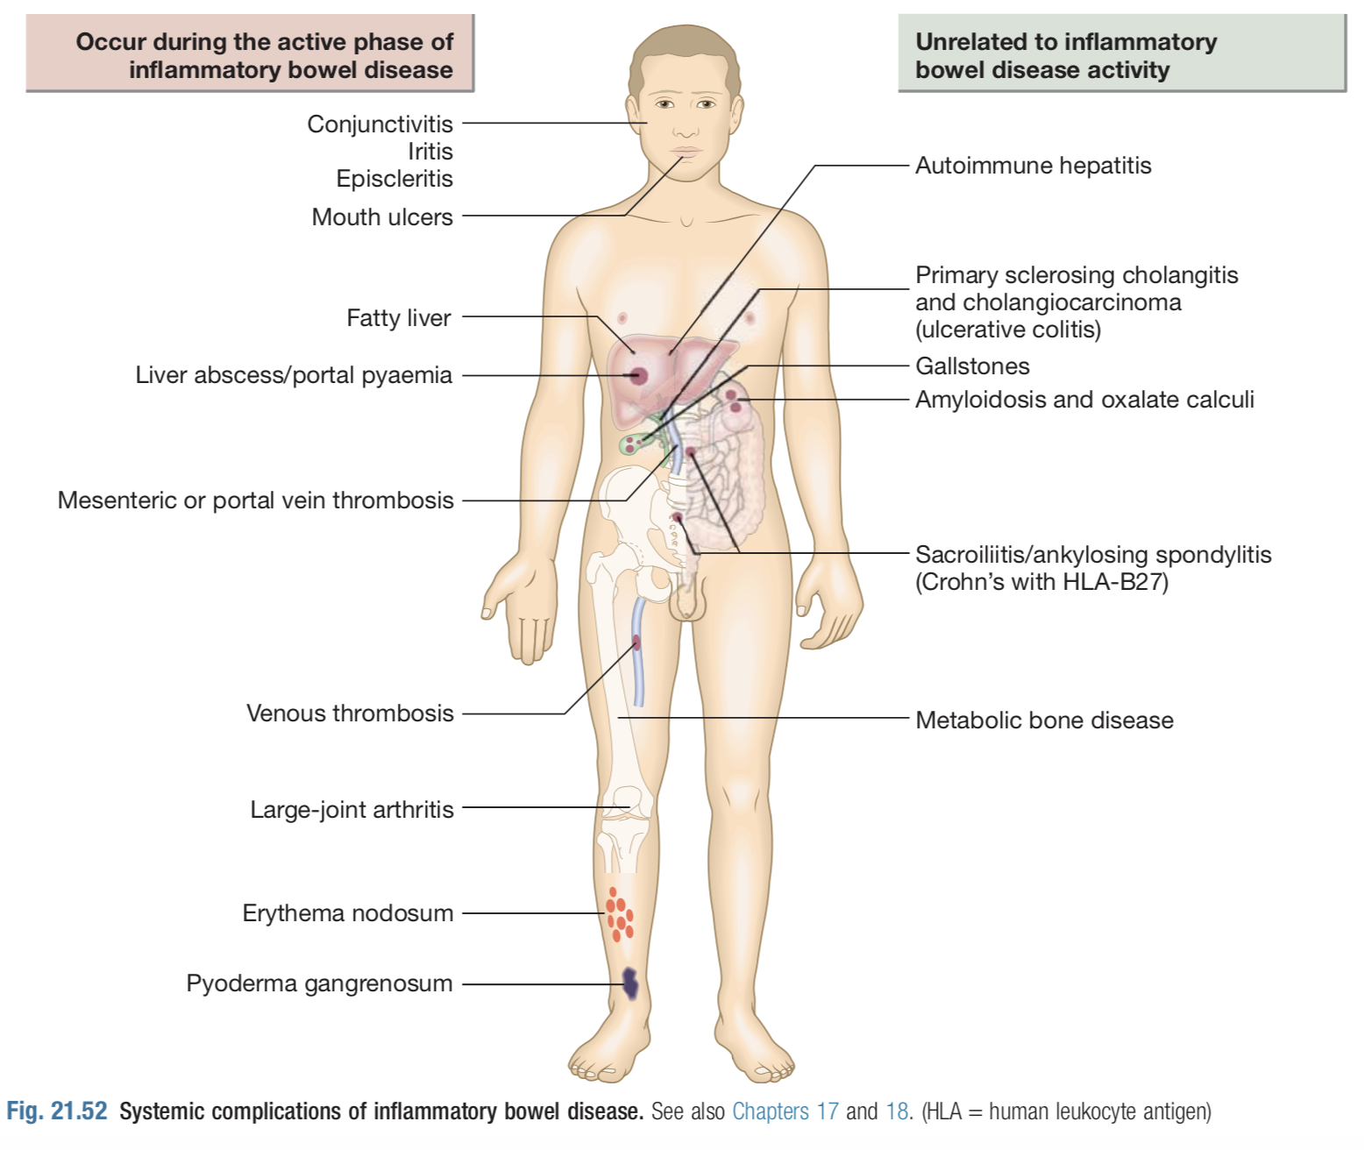
Complications of IBD
Complications
1- Hemorrhage
Haemorrhage due to erosion of a major artery is rare but can occur in both UC and CD.
2- Perforation
3- Fistulae
These are specific to Crohn’s disease.
Enteroenteric fistulae can cause diarrhoea and malabsorption due to blind loop syndrome.
Enterovesical fistulation causes recurrent urinary infections and pneumaturia.
An enterovaginal fistula causes a faeculent vaginal discharge.
Fistulation from the bowel may also cause perianal or ischiorectal abscesses, fissures and fistulae
4- Toxic megacolon
Transverse colon with a diameter of more than 5,0 cm to 6,0 cm with loss of haustration. This can occur in both ulcerative colitis and Crohn’s colitis.
Toxic megacolon (Dilated colon) is a serious complication associated with acute severe colitis. The plain abdominal X-ray shows a dilated, thin-walled colon with a diameter of >6 cm; it is gas-filled and contains mucosal islands . It is a particularly dangerous stage of advanced disease, with impending perforation and a high mortality (15-25%). Urgent surgery is required in all patients in whom toxic dilatation has not resolved within 48 hours. The differential diagnosis includes an infectious colitis, e.g. with C. difficile and cytomegalovirus.
5- Colon cancer
The risk of dysplasia and cancer increases with the duration and extent of uncontrolled colonic inflammation. Thus patients who have long-standing, extensive colitis are at highest risk
Oral mesalazine therapy reduces the risk of dysplasia and neoplasia in ulcerative colitis. Azathioprine also seems to reduce the risk of colorectal cancer in ulcerative colitis and Crohn’s colitis.
Cumulative risk for dysplasia in ulcerative colitis may be as high as 20% after 30 years but is probably lower for Crohn’s colitis
The risk is particularly high in patients who have concomitant primary sclerosing cholangitis for unknown reasons
Patients with long-standing colitis are therefore entered into surveillance programmes beginning 10 years after diagnosis
If high-grade dysplasia is found, panproctocolectomy is usually recommended because of the high risk of colon cancer.

Slide 9
Summary from Dr slides
Distinguishing characteristics of CD and UC
 | Crohn's disease | Ulcerative Colitis
Location | SB or colon | Colon
Anatomic distribution | Skip lesions | Continuous
Rectal involvement | Rectal spare | Involved in 90%
Gross bleeding | Only 25 % | Universal
Perianal disease | 1/3 | Rare
Fistuilization | Yes | No
Granulomas | 30% | No
Endoscopic features of CD and UC
 | Crohn's disease | Ulcerative Colitis
Mucosal involvement | Discontinuous | Continuous
Aphthous ulcers | Common | Rare
Surrounding mucosa | Relatively normal | Abnormal
Longitudinal cancer | Common | Rare
Cobblestoning | In severe cases | No
Mucosal fariability | Uncommon | Common
Vascular pattern | Normal | Distorted
Pathologic features of CD and UC
 | Crohn's disease | Ulcerative Colitis
Transmural inflammation | Yes | Uncommon
Fissures | Common | Rare
Fibrosis | Common | No
Submucosal inflammation | Common | Uncommon

Slide 10
Lecture Quiz
Q1: A 35-year-old white man presents with diarrhea, weight loss, and right lower quadrant (RLQ) pain. On examination, a tender mass is noted in the RLQ; the fecal occult blood test is positive. Colonoscopy shows segmental areas of inflammation. Barium small bowel series shows nodular thickening of the terminal ileum?
A- Ulcerative colitis
B- Crohn disease
C- Ischemic colitis
D- Diverticulosis
Q2: A 75-year-old African-American woman, previously healthy, presents with low-grade fever, diarrhea, and rectal bleeding. Colonoscopy shows continuous erythema from rectum to mid- transverse colon. The cecum is normal.?
A- Ulcerative colitis
B- Crohn disease
C- Ischemic colitis
D- Diverticulosis
Q3: You are asked to see a 29-year-old woman diagnosed with ulcerative colitis 18 months ago. Over the last 4 days she has been experiencing slight abdominal cramps, opening her bowels approximately 4–5 times a day and has been passing small amounts of blood per rectum. The patient is alert and orientated and on examination her pulse is 67, blood pressure 127/70, temperature 37.3°C and her abdomen is soft with mild central tenderness. PR examination is nil of note. Blood tests reveal haemoglobin of 13.5 g/dL and a CRP of 9 mg/L. The most appropriate management plan for this patient is?
A- Admission to hospital for intravenous fluid therapy and steroids
B- Oral steroid therapy + oral 5-ASA + steroid enemas + discharge
C- Admission and refer to surgeons for further assessment
D- Oral steroid therapy and discharge home
Q4: A 29-year-old anxious man is diagnosed with mild Crohn’s disease. Due to time constraints, the patient was asked to come back for a follow-up appointment to discuss Crohn’s disease in more detail. The patient returns with a list of complications he researched on the internet. Which of the following are not associated with Crohn’s disease?
A- Cigarette smoking reduces incidence
B- Fistula formation
C- Abscess formation
D- Non-caseating granuloma formation
Q5: You read a report which was handwritten in a patient’s medical notes who you suspect has inflammatory bowel disease. The report reads, ‘… there is cobblestoning of the terminal ileum with the appearance of rose thorn ulcers. These findings are suggestive of Crohn’s disease’. Select the most likely investigation that this report was derived from?
A- Colonoscopy
B- Sigmoidoscopy
C- Barium follow through
D- Abdominal CT
Answers: Q1:B | Q2:A | Q3:B | Q4:A | Q5:C
Answers Explanation File!

Slide 11
THANKS!!
This lecture was done by:
Fahad Alsultan
Mashal AbaAlkhail
Jehad Al Orainy
Quiz and summary maker:
Fahad Alsultan
Note taker:
Abdulaziz Alghamdi
Females co-leaders:
Raghad AlKhashan
Amirah Aldakhilallah
Males co-leaders:
Mashal AbaAlkhail
Nawaf Albhijan
Send us your feedback:
We are all ears!

