Slide 1
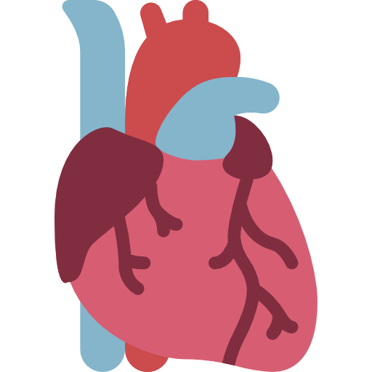
Lecture 5,6
Editing file
Heart Failure I & II
Objectives:
Know different classifications of heart failure.
Know the causes and precipitation factors for heart failure decompensation.
Describe the Pathophysiology, therapies that improve survival, and prognosis.
Color index:
Color index:
Original text Females slides Males slides
Doctor’s notes Text book Important Golden notes Extra

Slide 2
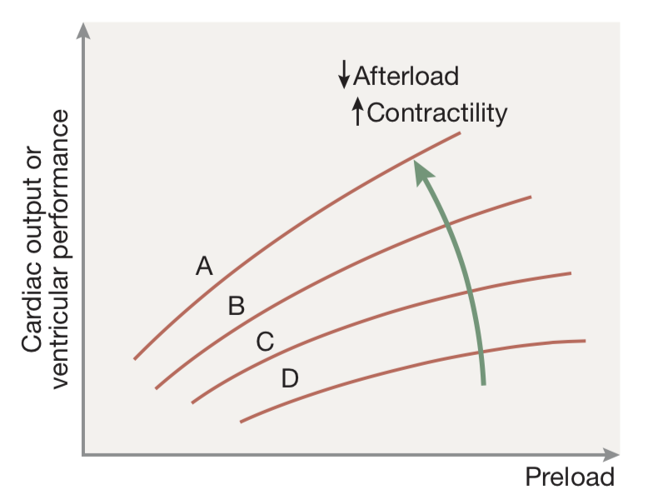
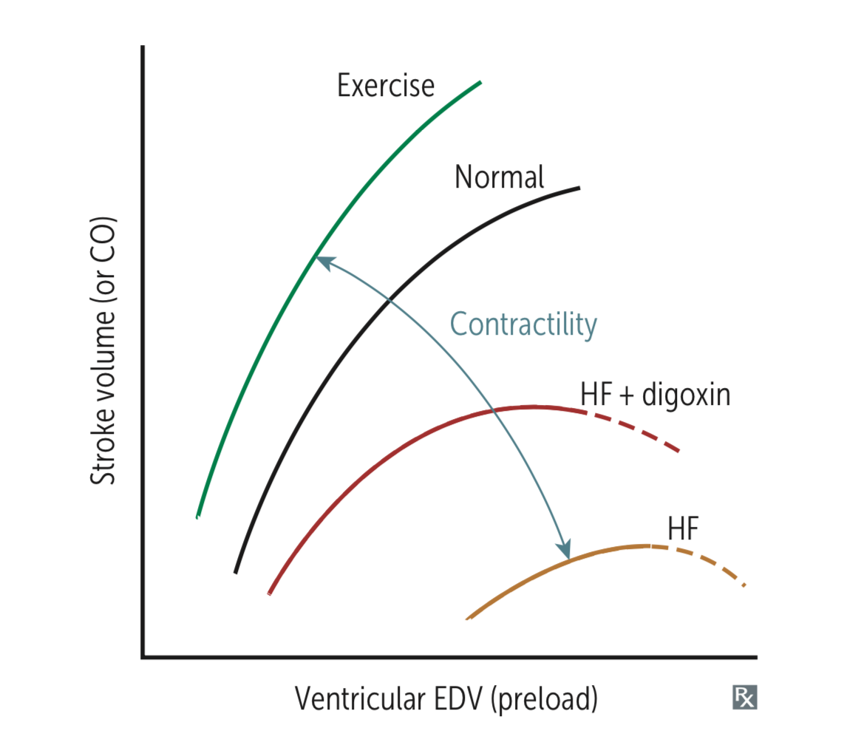
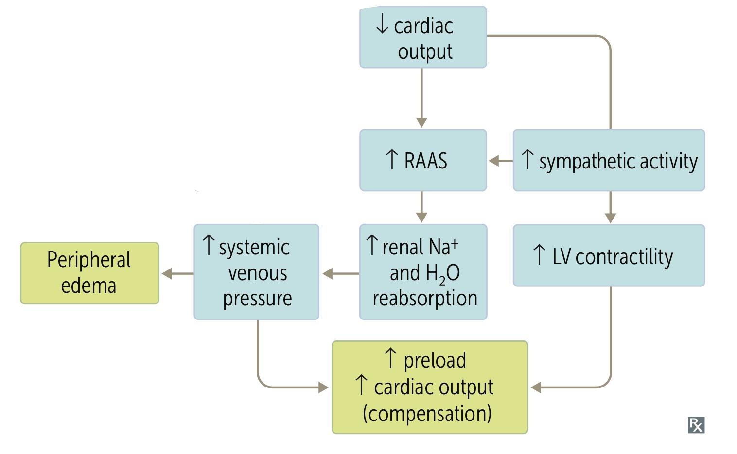
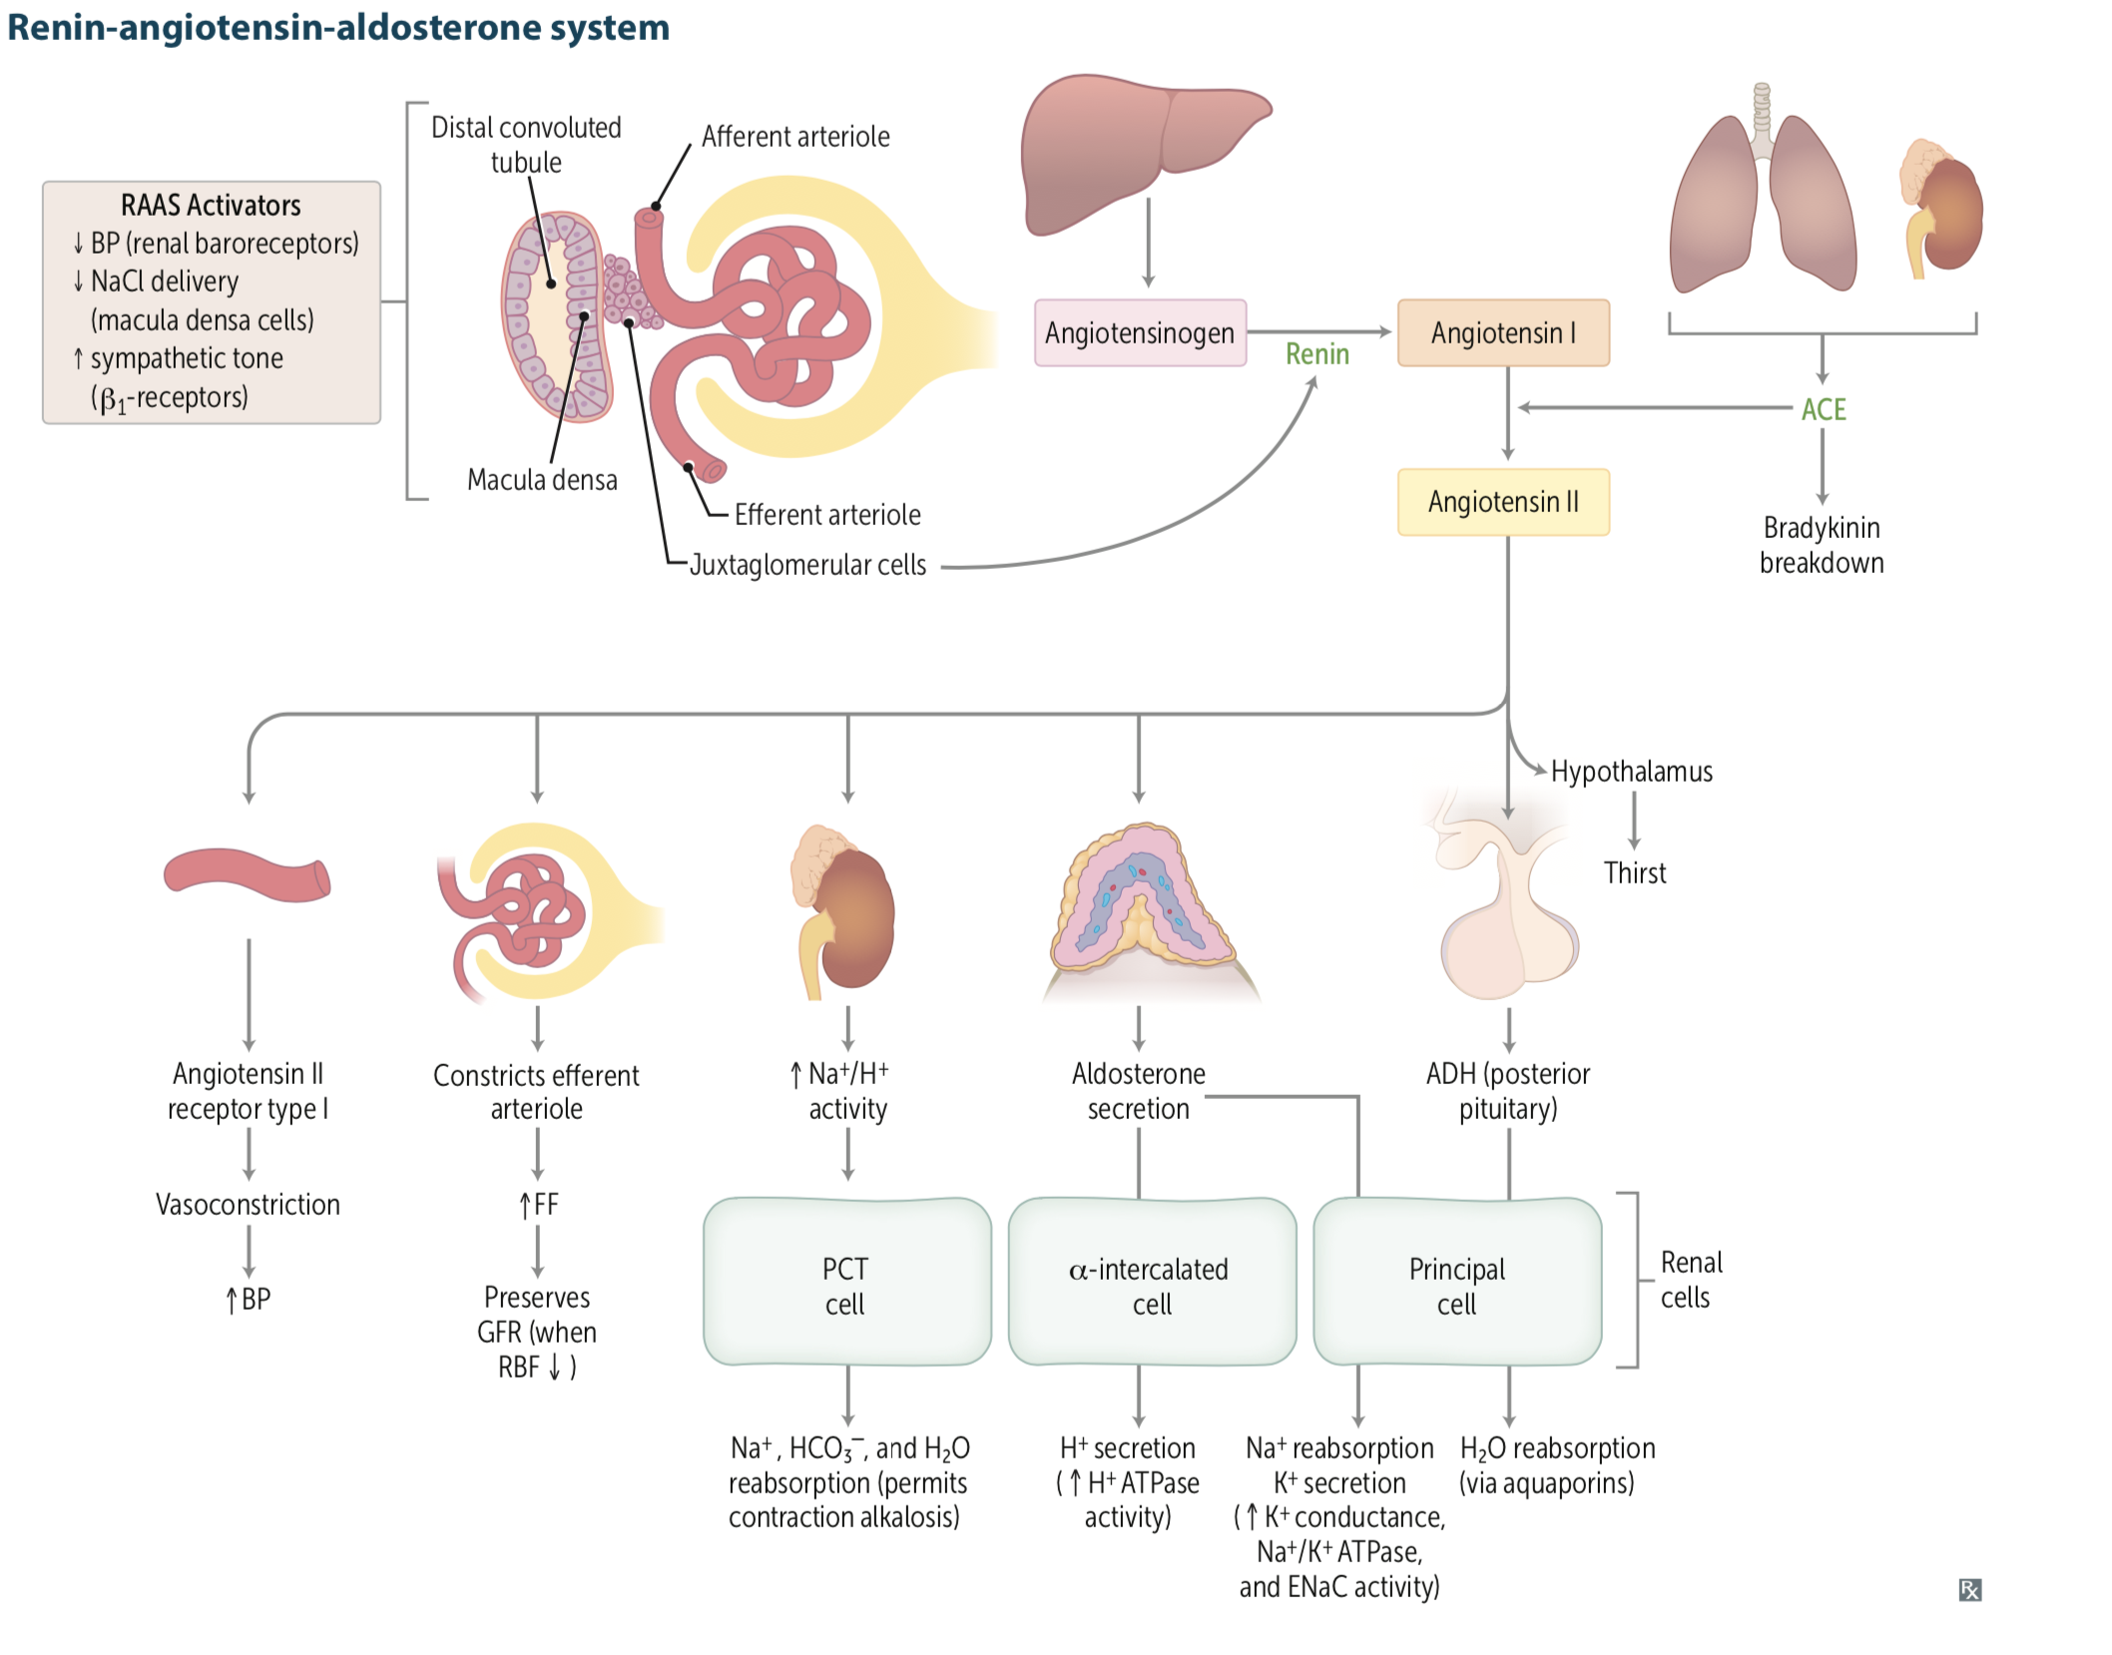
EXTRA
Review of basics
CO variables and Starling curve
Cardiac output is determined by SV and HR; SV is determined by the following:
Preload (the volume and pressure of blood in the ventricles at the end of diastole)
Afterload (The pressure that the heart must overcome to eject blood)
Myocardial contractility
SV increases with ↑Contractility, ↑preload and ↓afterload
What is Starling curve?
Starling’s law states that the stroke volume is directly proportional to the diastolic filling (i.e. the preload or ventricular end-diastolic pressure). As the preload is increased, the stroke volume rises (normal). Increasing contractility (e.g. increased with sympathetic stimulation) shifts the curve upwards and to the left . If the ventricle is overstretched the stroke volume will fall . In heart failure the ventricular function curve is relatively flat (Shift to the right) so that increasing the preload has only a small effect on cardiac output.
What happens when CO is decreased?
Activation of the SNS Improves ventricular function by increasing heart rate and myocardial contractility. Constriction of venous capacitance vessels redistributes flow centrally, and the increased venous return to the heart (preload) further augments ventricular function via the Starling mechanism . Sympathetic stimulation, however, also leads to arteriolar constriction, this increasing the afterload which would eventually reduce cardiac output.
Activation of RAAS The fall in cardiac output and increased sympathetic tone lead to diminished renal perfusion, activation of the renin–angiotensin system, and hence increased fluid retention. Salt and water retention further increases venous Cardiovascular disease pressure and maintains stroke volume by the Starling mechanism . As salt and water retention increases, however, peripheral and pulmonary congestion causes oedema and contributes to dyspnoea. Angiotensin II also causes arteriolar constriction, thus increasing the afterload and the work of the heart.
Natriuretic peptides These are released from the atria (atrial natriuretic peptide, ANP), ventricles (brain natriuretic peptide, BNP – so called because it was first discovered in the brain) and vascular endothelium (C-type peptide). They have diuretic, natriuretic and hypotensive properties. The effect of their action may represent a beneficial, albeit inadequate, compensatory response leading to reduced cardiac load (preload and afterload).

Slide 3
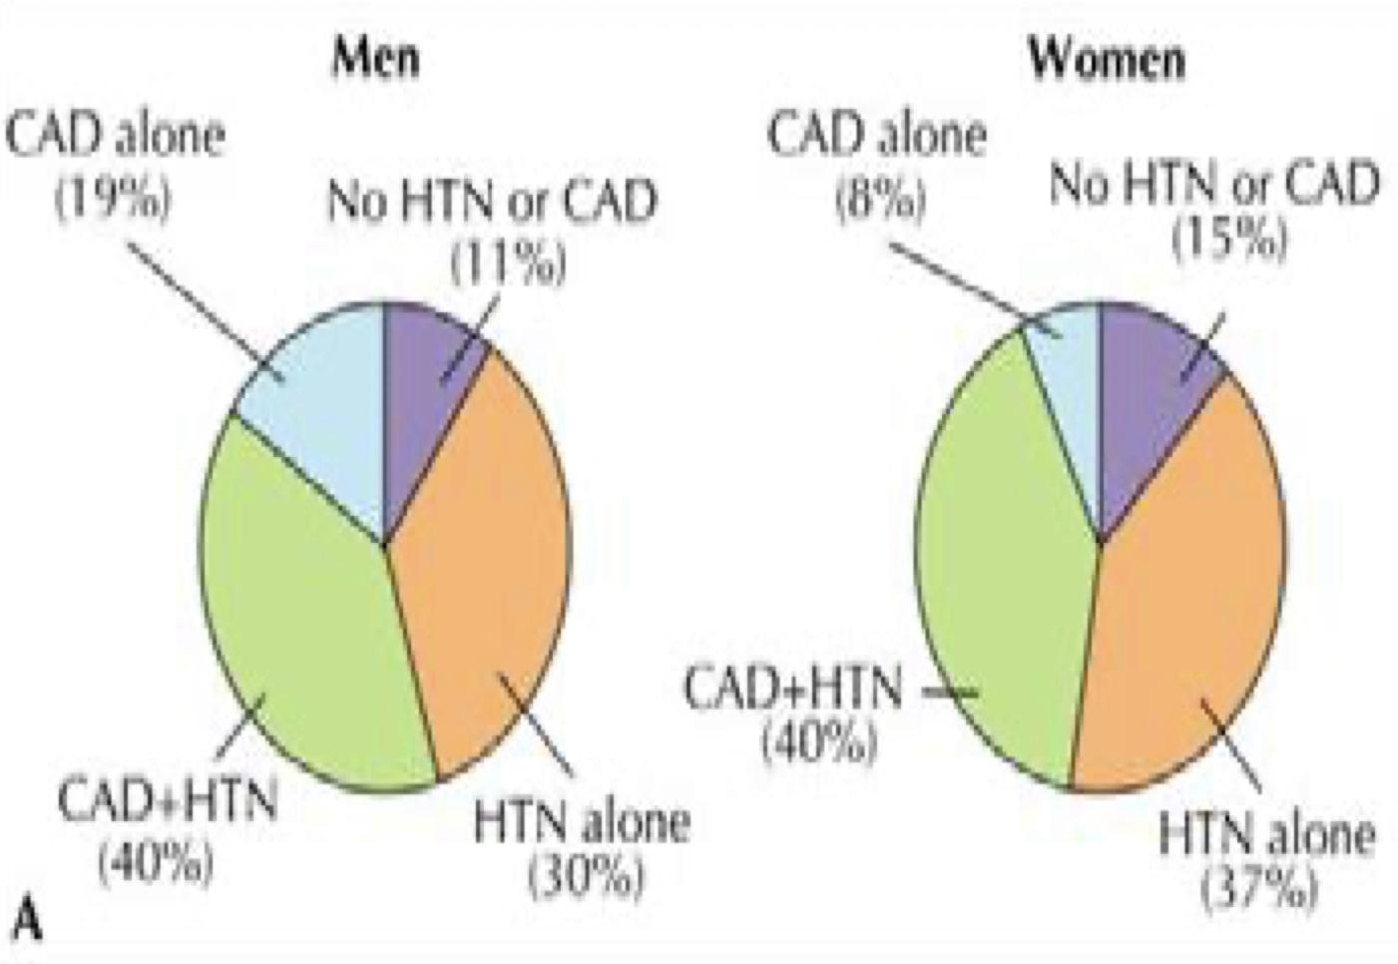
Introduction to HF
What’s heart failure?
Heart failure is a complex (clinical) syndrome that can result from any structural or functional cardiac disorder that impairs the ability of the ventricle to fill (e.g. LVH) and/or eject blood to meet the body demand.
HF is characterized by signs and symptoms of intravascular and interstitial volume overload and/or manifestations of inadequate tissue perfusion.
Typical presentation of HF:
Syndrome of decreased exercise tolerance
Syndrome of fluid retention
No symptoms but incidental discovery of LV dysfunction
Prevalence 0.4-2% overall, 3-5 % in over 65s, 10% of over 80s and > 10% also have AF
Commonest medical reason for admission with an annual mortality of 60% over 80s
Progressive condition - median survival 5 years after diagnosis
Family history is usually positive for patients with HF
REMEMBER: Left ventricular failure is a true life threatening emergency
Aggravating factors of HF:
Atrial fibrillation
Anemia
Comorbidities/differential diagnoses:
COPD
Obesity
Chronic venous insufficiency
Prevalence of heart failure
Etiology
It is a common endpoint for many diseases of cardiovascular system.
It can be caused by Inappropriate workload (volume or pressure overload) or Restricted filling or Myocyte loss
Heart failure is usually as a result from a chronic process but it may also result from an acute insult to cardiac function, such as a large myocardial infarction, valvular disease, myocarditis, and cardiogenic shock.
What are the most common causes of left HF?¹
Most common: Coronary artery disease (IHD)
2nd: Hypertension
3rd: VHD (e.g. AS)
4th: Dilated cardiomyopathy
Main causes | Most common: Ischemic heart disease (35–40%) Second: Cardiomyopathy (dilated) (30–34%) “Such as in Peripartum Cardiomyopathy “ Third: Hypertension (15–20%) Valvular heart disease (mitral, aortic, tricuspid)
Other causes | Cardiomyopathies (other than dilated): hypertrophic, restrictive (amyloidosis, sarcoidosis) Congenital heart disease (Atrial septal defect, ventricular septal defect). Drugs (chemotherapy – trastuzumab, imatinib, Doxorubicin). Hyperdynamic circulation (anaemia, sepsis, thyrotoxicosis, pregnancy and Paget‘s disease, AV fistula, Beriberi (alcohol abuse causes it)) Hypervolemic state (Renal failure; Iatrogenic) Haemochromatosis, radiation. Right heart failure (Cor pulmonale, right ventricular infarct, pulmonary hypertension, pulmonary embolism, COPD, Pneumonia, Interstitial lung disease). Tricuspid incompetence. Obesity Arrhythmias (atrial fibrillation, AV block, bradycardia (complete heart block, sick sinus syndrome)) Pericardial disease (constrictive pericarditis, pericardial effusion) Infections (e.g. myocarditis due to Chagas‘ disease), (Coxsackieviruses).
Causes of left ventricular failure
Volume overload
Pressure overload
Loss of muscles
Restricted filling
Regurgitate valve
High output status
Systemic hypertension
Outflow obstruction
Post MI
Chronic ischemia
Connective tissue diseases
Poisons (alcohol, cobalt, Doxorubicin)
Pericardial disease
Restrictive cardiomyopathy
Tachyarrhythmia
1- can be dependant on the region. In south america, chagas disease is one of the most common causes. And alcohol or toxic cardiomyopathy is common in western regions and hypertension is the most common cause in Africa.

Slide 4
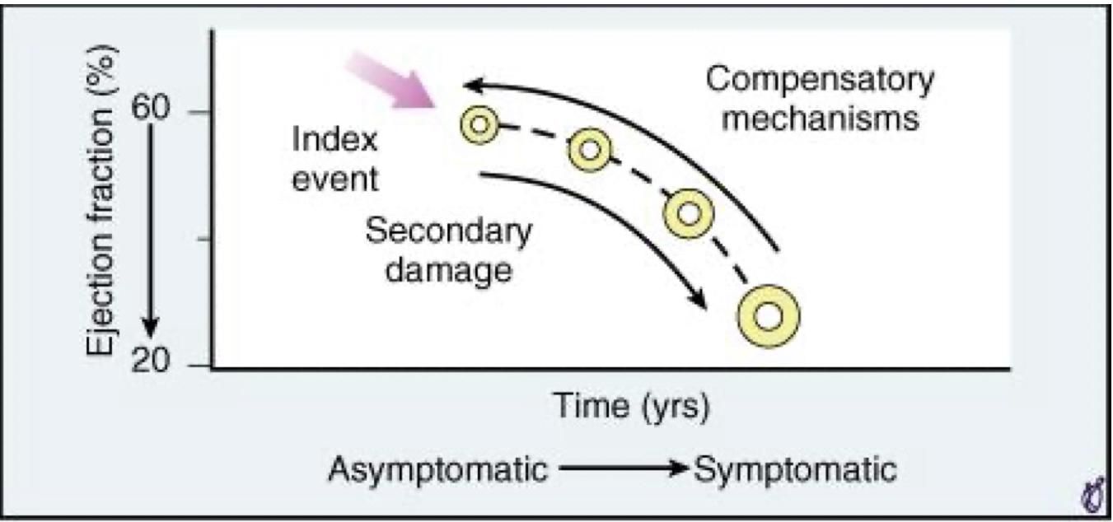
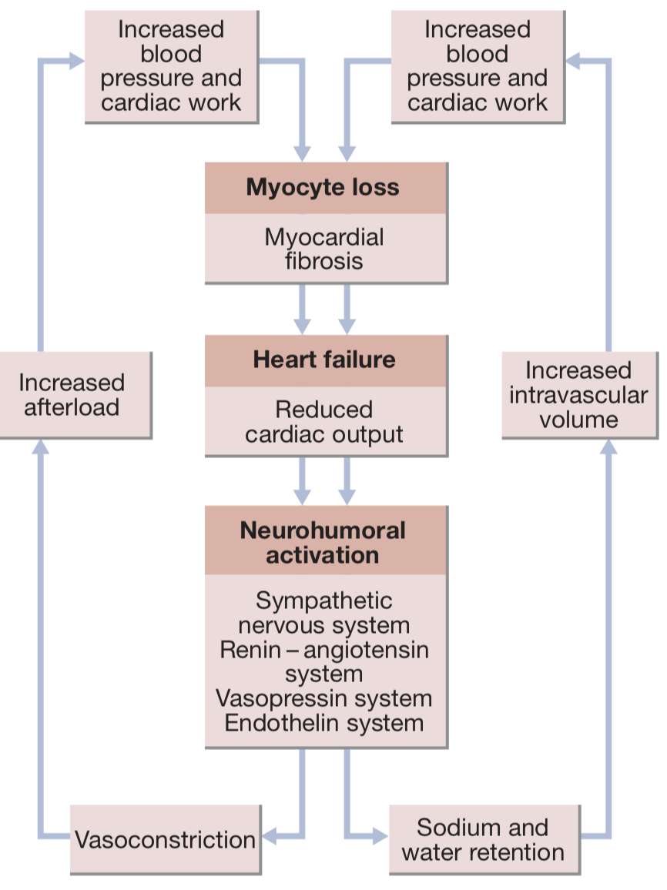
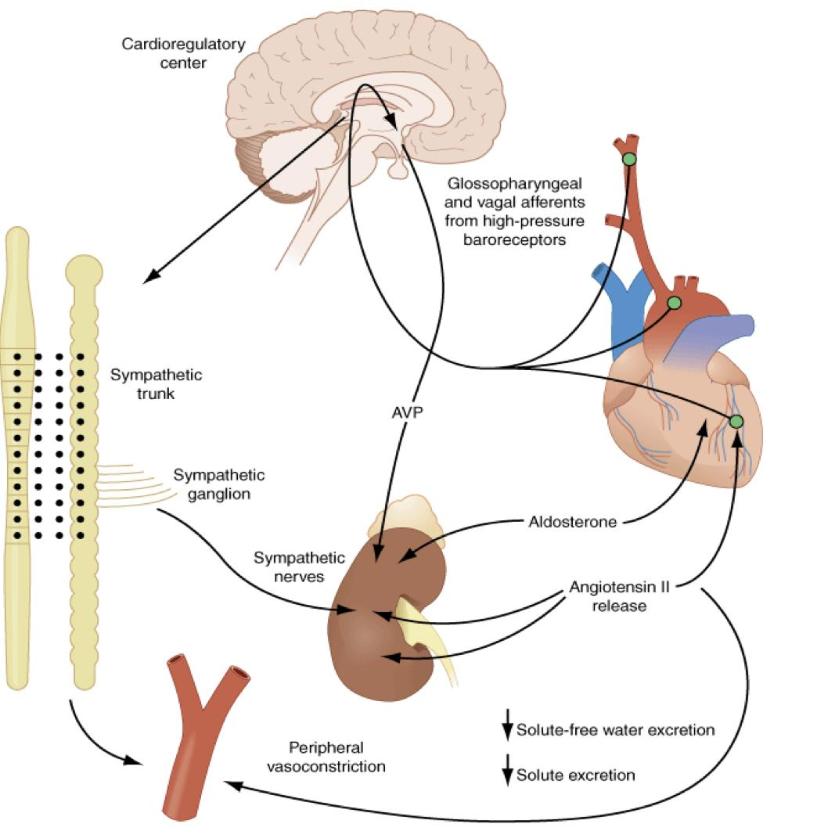
Introduction cont.
Background of HF pathophysiology
Heart failure pathophysiology:
Index event
Compensatory mechanisms
Maladaptive mechanisms
Changes in HF
Hemodynamic changes:
Ventricular dysfunction: (Heart failure syndrome)
The most common cause of heart failure. This can occur because of impaired systolic contraction, or diastolic dysfunction or both. The initial manifestations of hemodynamic dysfunction are a reduction in stroke volume and a rise in ventricular filling pressures under conditions of increased systemic demand for blood flow. This stimulates a variety of interdependent compensatory responses involving the cardiovascular system, neurohormonal systems, and alterations in renal physiology.
Neurohormonal changes:
1
2
N/H changes | Favorable effect | Unfavorable effect
↑ Increased sympathetic activity | ↑ HR and contractility Vasoconstriction→ ↑ Venous return, ↑ filling | ↑ Arteriolar constriction → ↑Afterload → ↑ workload → ↑ O2 consumption
↑ Renin-Angiotensin- Aldosterone | Salt & water retention¹ → ↑ Venous return | Angiotensin-II will lead to ↑ Arteriolar constriction → ↑ Afterload. Increased salt & water retention → peripheral and pulmonary edema.
↑ Vasopressin | Same effect | Same effect
↑ Interleukins & TNFα | May have a role in myocyte hypertrophy | Apoptosis
↑ Endothelin | Vasoconstriction → ↑ Venous return | ↑ Afterload
3
Cellular changes:
Hypertrophy, loss of myocytes and increased interstitial ﬁbrosis.
1- total body sodium will increase but we will also retain water which will dilute the sodium (the concentration won’t change). So if we see low sodium concentration it will be a bad sign.

Slide 5
Systolic and Diastolic HF
Systolic VS Diastolic Dysfunction
HFpEF: HF with preserved ejection fraction
HFrEF: HF with reduced ejection fraction
Systolic dysfunction (HFrEF)¹ | Diastolic dysfunction (HFpEF)¹
Owing to impaired contractility EF is reduced (<45%) Causes include: Ischemic heart disease or after a recent MI—infarcted cardiac muscle does not pump blood. HTN resulting in cardiomyopathy Valvular heart disease Myocarditis (postviral) Less common causes: Alcohol abuse, radiation, hemochromatosis, thyroid disease | Owing to impaired ventricular filling during diastole (hence decreased cardiac output), because of either: Impaired relaxation or Increased stiffness of ventricle or both. EF is preserved (>45-50%) Diastolic dysfunction is less common than systolic dysfunction. HTN leading to myocardial hypertrophy is the most common cause of diastolic dysfunction. Risk factors: Age, female, HTN, LVH, ischemia, DM, Obesity, RCM and HCM. Factors associated with decompensation: uncontrolled / labile HTN, AF, ischemia, volume overload and extracardiac cause.
Note: Usually both systolic and diastolic dysfunctions present simultaneously
High VS Low output HF
High Output HF | Low Output HF
Certain medical conditions increase demands on cardiac output, causing a clinical picture of heart failure due to an excessively high cardiac output. (e.g. severe anemia, thyrotoxicosis or pregnancy, A/V fistula, Beriberi and Paget's disease) | Cardiac output is inadequate to perfuse the body (i.e ejection fraction <40%), or can only be adequate with high filling pressures.
What is decapitated blood pressure?
Once HF is established and, especially, in patients with advanced HF, SBP is usually low (but high diastolic blood pressure), even in those who presented initially with HTN. This phenomenon has been called ‘decapitated hypertension’, that is, patients who have had HTN at the outset, progressively develop normal and even low BP as HF worsens and becomes more severe.
1- Scenario from doctor:
HFPEF: old 70 year old lady with high BP (190/80) presents with symptoms and signs of heart failure. Echo shows normal EF. we measure the septum and it’s 12-13 mm and LV hypertrophy with impaired relaxation. ecg and enzymes will be normal and relatives say she always had this high BP
HFREF: 60 years old, chest pain, shortness of breath physical examination will show edema, crackles and raised JVP, ECG will show STEMI. Patient will be cold bc of vasoconstriction. Echo will show reduced EF Diagnosis will be acute HFREF.

Slide 6
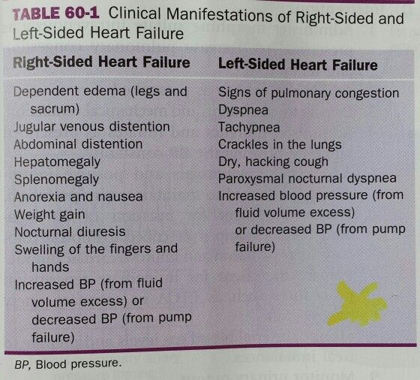
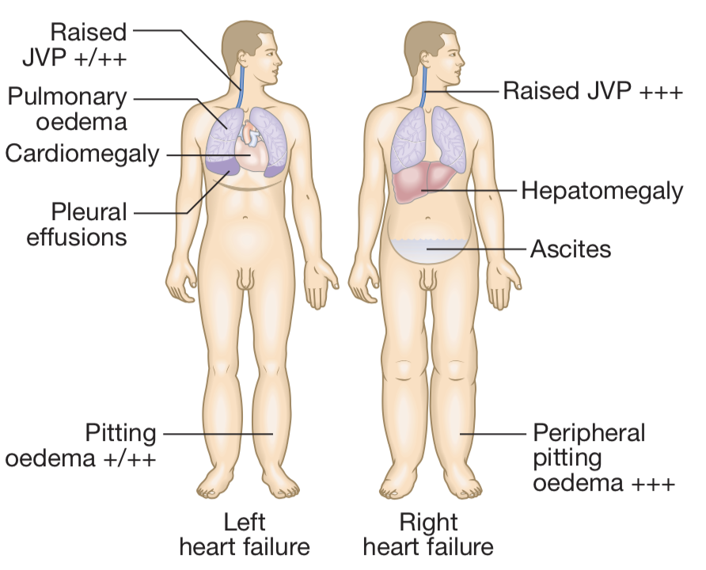
Right and Left HF
Left VS Right sided HF
 | Left heart failure | Right heart failure
Patho | There is a reduction in left ventricular output and an increase in left atrial and pulmonary venous pressure. An acute increase in left atrial pressure causes pulmonary congestion or pulmonary oedema; a more gradual increase in left atrial pressure, as occurs with mitral stenosis, leads to reflex pulmonary vasoconstriction, which protects the patient from pulmonary oedema. This increases pulmonary vascular resistance and causes pulmonary hypertension, which in turn impairs right ventricular function. (Causes were discussed earlier) Hallmark: Increased LVEDP | There is a reduction in right ventricular output and an increase in right atrial and systemic venous pressure. The most common cause of right Hf is left HF (present as congestive HF), other causes include: Pulmonary HTN and chronic lung disease (cor pulmonale) Pulmonary embolism and RV infarction Mitral stenosis and Pulmonic valve stenosis Hallmark: increased RVEDP and RA
Symptoms¹ | Dyspnea: Difficulty breathing secondary to pulmonary congestion/edema Orthopnea: Difficulty breathing in the recumbent position; relieved by elevation of the head with pillows” the severity can be determined by number of the pillows” Paroxysmal nocturnal dyspnea (PND): awakening after 1 to 2 hours of sleep due to acute shortness of breath (SOB), usually caused by pulmonary edema. Nocturnal cough (nonproductive): worse in recumbent position (same pathophysiology as orthopnea) Confusion and memory impairment: occur in advanced CHF as a result of inadequate brain perfusion Diaphoresis and cool extremities at rest: Occur in desperately ill patients (NYHA class IV) | Peripheral pitting edema (legs\ankle edema + sacral edema in bed bound patients): Pedal edema lacks specificity as an isolated finding. In the elderly, it is more likely to be secondary to venous insufficiency Nocturia: Due to increased venous return with elevation of legs Abdominal symptoms: anorexia, Nausea, abdominal fullness, right hypochondrial pain.
Signs¹ | Displaced and sustained PMI (usually to the left) due to cardiomegaly Pathologic S3 (ventricular gallop): low pitched sound that is heard during rapid filling of ventricle, usually due to sudden deceleration of blood as elastic limits of the ventricles are reached leading to vibration of the ventricular wall by blood filling, it’s common in children. S4 gallop (at the end of diastole) Crackles/rales (inspiratory) at lung bases (Bibasal crepitations) | Jugular venous distention (JVD) Painful Hepatomegaly/hepatojugular reflux Ascites Cardiac cirrhosis (on the long run) Right ventricular heave
Biventricular Heart failure
In biventricular failure, both sides of the heart are affected. This may occur because the disease process, such as dilated cardiomyopathy or ischaemic heart disease, affects both ventricles: ↑LVEDP → ↑LA pressure → ↑pulmonary capillary pressure → ↑PA pressure → ↑RV pressure → ↑RA pressure → CHF
Left heart failure |  | Right heart failure
There is a reduction in left ventricular output and an increase in left atrial and pulmonary venous pressure. An acute increase in left atrial pressure causes pulmonary congestion or pulmonary oedema; a more gradual increase in left atrial pressure, as occurs with mitral stenosis, leads to reflex pulmonary vasoconstriction, which protects the patient from pulmonary oedema. This increases pulmonary vascular resistance and causes pulmonary hypertension, which in turn impairs right ventricular function. |  | There is a reduction in right ventricular output and an increase in right atrial and systemic venous pressure. The most common causes include : Chronic lung disease (cor pulmonale) Pulmonary embolism Pulmonary valvular stenosis
Symptoms | Dyspnea: Difficulty breathing secondary to pulmonary congestion/edema Orthopnea: Difficulty breathing in the recumbent position; relieved by elevation of the head with pillows” the severity can be determined by number of the pillows” Paroxysmal nocturnal dyspnea (PND): awakening after 1 to 2 hours of sleep due to acute shortness of breath (SOB), usually caused by pulmonary edema. Nocturnal cough (nonproductive): worse in recumbent position (same pathophysiology as orthopnea) Confusion and memory impairment: occur in advanced CHF as a result of inadequate brain perfusion Diaphoresis and cool extremities at rest: Occur in desperately ill patients (NYHA class IV) Abdominal symptoms: anaroxia, Nausea, abdominal fullness, right hypochondrial pain. | Peripheral pitting edema: Pedal edema lacks specificity as an isolated finding. In the elderly, it is more likely to be secondary to venous insufficiency Nocturia: Due to increased venous return with elevation of legs
Signs | Displaced PMI (usually to the left) due to cardiomegaly Pathologic S3 (ventricular gallop) “low pitched sound that is heard during rapid filling of ventricle” S4 gallop Crackles/rales at lung bases | Jugular venous distention (JVD) Painful Hepatomegaly/hepatojugular reflux Ascites Right ventricular heave
Biventricular Heart failure
In biventricular failure, both sides of the heart are affected. This may occur because the disease process, such as dilated cardiomyopathy or ischaemic heart disease, affects both ventricles or because disease of the left heart leads to chronic elevation of the left atrial pressure → pulmonary hypertension → right heart failure.
1- you cannot differentiate between different heart failure classifications using signs and symptoms alone, you need investigations to confirm which type it is

Slide 7
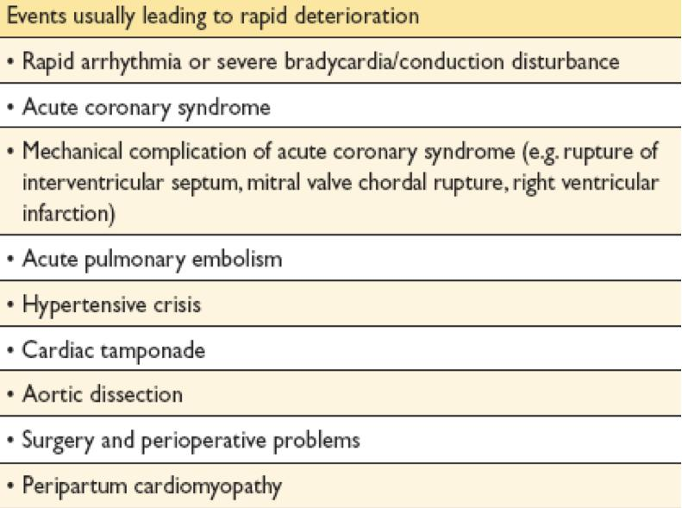
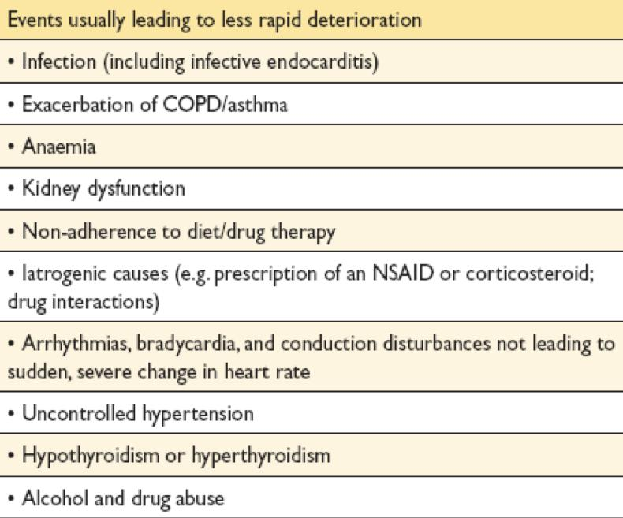
Acute and Chronic HF
Modified Framingham criteria
Click here for Boston criteria (Present in females slides only)
Major | Minor
PND Orthopnea Elevated JVP Pulmonary rales S3 Cardiomegaly on CXR Weight loss ≥4.5kg in 5 days in response to treatment of presumed heart failure. | Bilateral leg edema Nocturnal cough Dyspnea on ordinary exertion Hepatomegaly Pleural effusion Tachycardia (heart rate ≥120bpm) Weight loss ≥4.5kg in 5 days
Diagnosis
The diagnosis of HF requires that 2 major OR 1 major and 2 minor criteria cannot be attributed to another disease.
Acute VS Chronic HF
Acute heart failure | Chronic heart failure
Acute left heart failure presents with a sudden onset of dyspnoea at rest that rapidly progresses to acute respiratory distress, orthopnoea and prostration. Often there is a clear precipitating factor (e.g. large MI, aortic valve dysfunction, myocarditis, and cardiogenic shock ) which may be apparent from the history. SIgns & Symptoms: Rales JVD S3 gallop (Most specific) Edema Orthopnea | Patients with chronic heart failure commonly follow a relapsing and remitting course, with periods of stability and episodes of decompensation*, leading to worsening symptoms that may necessitate hospitalisation The clinical picture depends on: The nature of the underlying heart disease The type of heart failure that it has evoked (e.g. Left/Right HF) The changes in the SNS and RAAS that have developed Low cardiac output causes fatigue, listlessness and a poor effort tolerance; the peripheries are cold and the BP is low. To maintain perfusion of vital organs, blood flow is diverted away from skeletal muscle and this may contribute to fatigue and weakness. Poor renal perfusion leads to oliguria and uraemia.
*What are the factors that may precipitate acute decompensation of chronic heart failure?
Other factors:
Dietary indiscretion (eating salty food)
Iatrogenic volume overload (transfusion, fluid administration)
Pregnancy
Exposure to high altitude
Worsening mitral or tricuspid regurgitation
COVID-19
Events usually leading to rapid deterioration |  | Events usually leading to less rapid deterioration
Rapid arrhythmia or severe bradyca
CCB, BB and antiarrhythmics

Slide 8
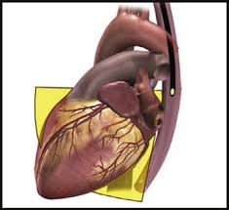
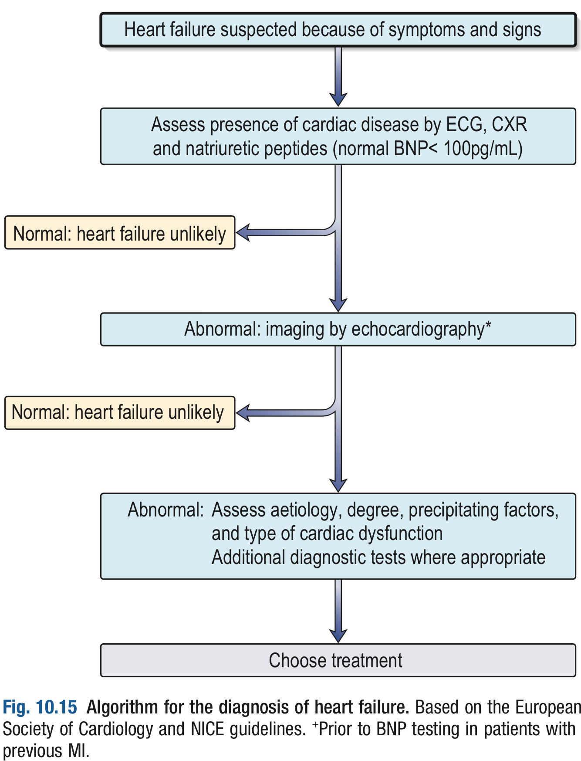
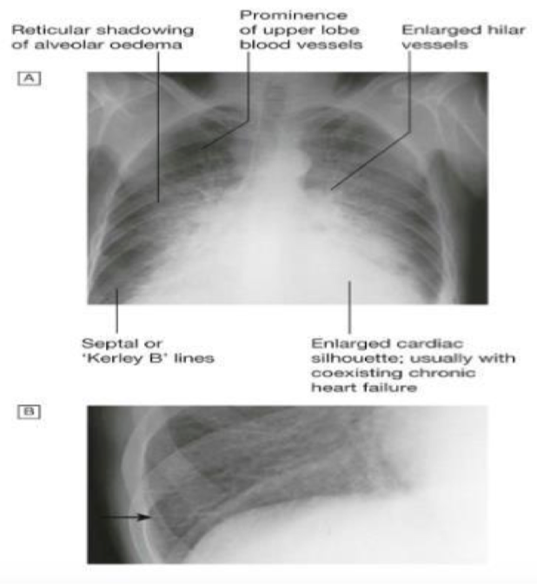
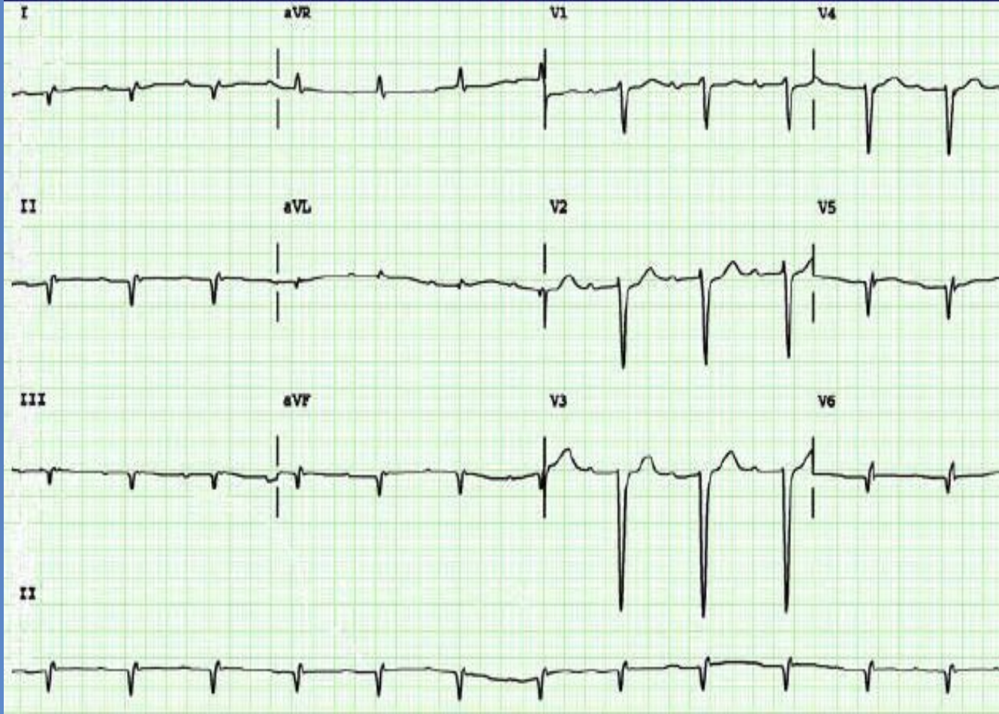
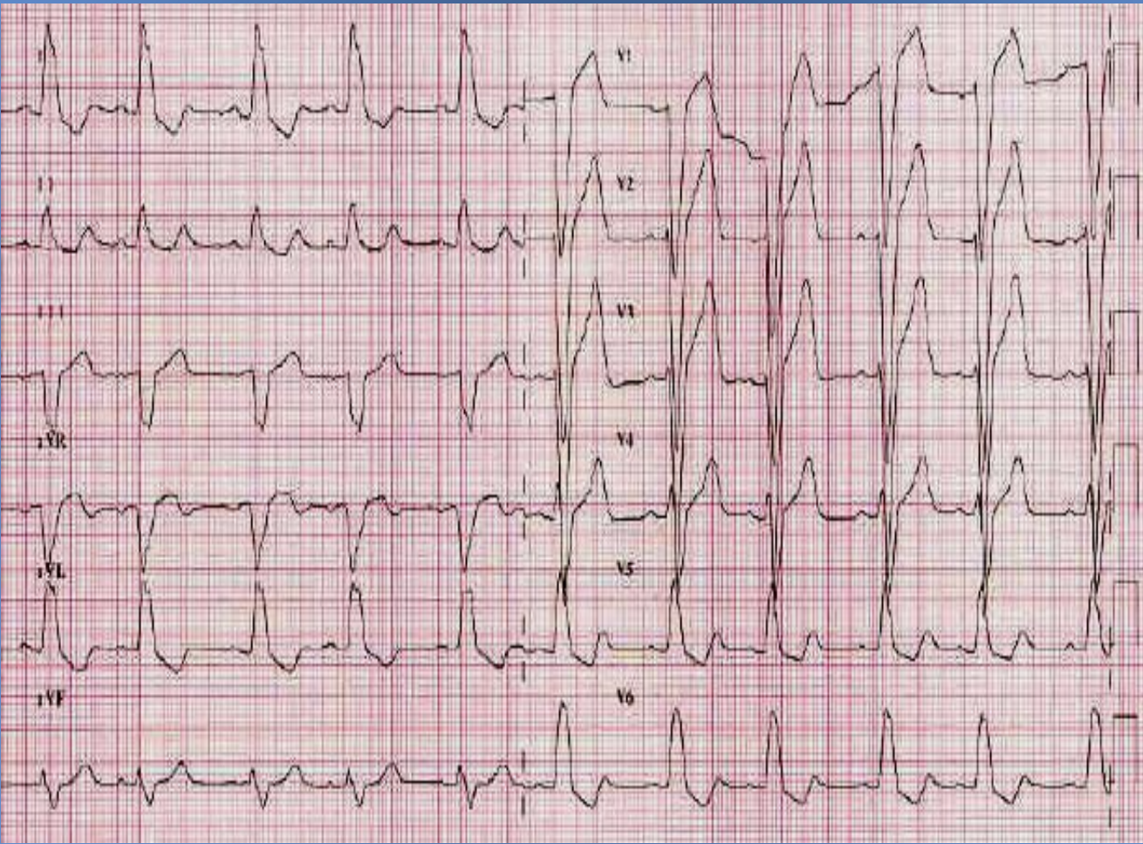
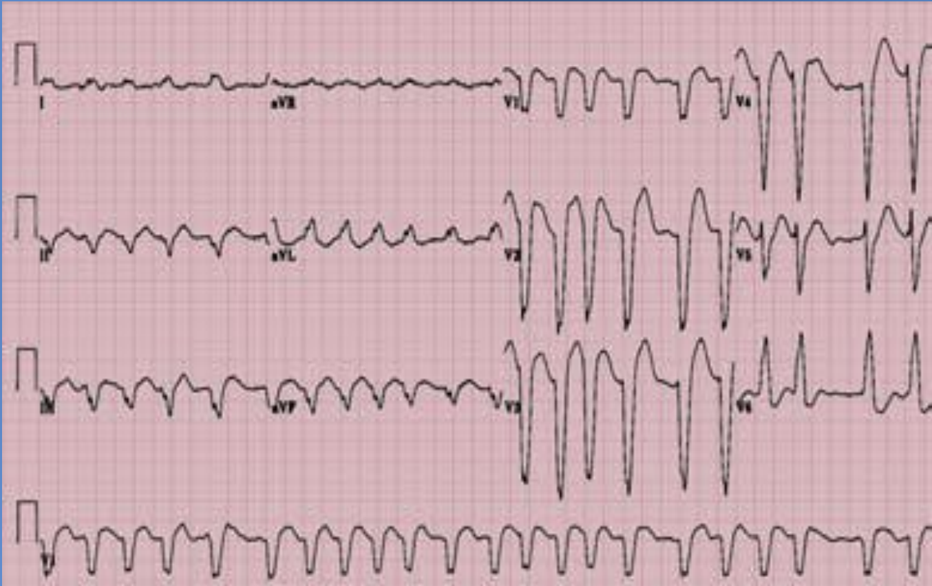
Diagnosis
Transthoracic echocardiogram:
Initial test of choice: should be performed whenever CHF is suspected based on history, examination, or CXR.
Useful in determining whether systolic or diastolic dysfunction predominates, and determines whether the cause of CHF is due to a pericardial, myocardial, or valvular process.
Estimates EF (very important): Patients with systolic dysfunction (EF <40%) should be distinguished from patients with preserved left ventricular function (EF >40%).
Shows chamber dilation and/or hypertrophy.
Identify patients who will benefit from long-term drug therapy, e.g. ACE inhibitors.
Chest X-ray (CXR):
A CXR should be performed in all cases.
Cardiomegaly
Kerley B lines are short horizontal lines near periphery of the lung near the costophrenic angles, and indicate pulmonary congestion secondary to dilation of pulmonary lymphatic vessel.
Prominent interstitial markings
Pleural effusion
ECG:
Nonspecific, but can be useful for detecting chamber enlargement and presence of ischemic heart disease or prior MI.
Recommended to determine rhythm, heart rate, QRS and to detect relevant abnormalities.
A completely normal ECG makes systolic HF unlikely.
Catheter:
Can clarify the cause of CHF if noninvasive test results are equivocal.
Precise valve diameter, septal defects (when CAD or valvular suspected or if heart transplant is indicated).
Blood tests:
Investigations for ALL patients
Transthoracic echocardiography
Echo is unquestionably the most important of all tests and should be performed whenever CHF is suspected based on history, examination, or CXR.
Asses function of both ventricles and motion abnormality that may signify CAD
Useful in determining whether systolic or diastolic dysfunction predominates, and determines the cause of CHF e.g. pericardial, myocardial, valvular process or Intracardiac shunts.
Estimates EF: Patients with systolic dysfunction (EF <45%) should be distinguished from patients with preserved left ventricular function (EF >45-50%). (Those patients in the grey zone with an LVEF of 40–50% have recently been classified as having heart failure with mid- range ejection fraction (HFmrEF).)
Assist in planning and monitoring of treatment and to obtain prognostic information.
Identify patients who will benefit from long-term drug therapy, e.g. ACE inhibitors.
Chest X-ray (CXR)
Has low sensitivity and specificity.
A CXR should be performed in all cases. It’s used to detect/exclude certain types of lung disease e.g. cancer (does not exclude asthma/COPD). It’s more useful in patient with suspected HF in acute setting
To check the size and shape of heart (cardiomegaly in Left HF)
Kerley B lines are short horizontal lines near periphery of the lung near the costophrenic angles, and indicate pulmonary congestion secondary to dilation of pulmonary lymphatic vessel.
Pleural effusion
Upper lobe diversion: indicative of HF
Brain natriuretic peptide (BNP) or (Pro BNP), if normal(<100pg/mL) exclude heart failure.
Liver biochemistry (may be altered do to hepatic congestion).
Electrolytes imbalance(including Ca / Mg)→ Chronic renal insufficiency
CBC to look for anemia which may exacerbate HF.
Electrocardiogram (ECG)
Has low sensitivity and specificity , but can be useful for detecting chamber enlargement and presence of ischemic heart disease, prior MI, arrhythmia, LBBB (may help in management) and some forms of cardiomyopathy are tachycardia related.
Recommended to determine rhythm, heart rate, QRS morphology, and QRS duration, and to detect other relevant abnormalities. The information also assist in planning of treatment and is of prognostic importance.
A completely normal ECG makes systolic HF unlikely.
Blood glucose, HbA1C. (For diabetes)
Lipids, Creatinine
Urea and electrolytes (as a baseline before starting diuretics and ACE inhibitors)
Thyroid function tests (in the elderly and those with atrial fibrillation).
1- When to answer Echo/BNP/CXR? Depends on the setting and presentation … complete later
Regular = not AF
Prominent Q wave= old MI
Abnormal ECG showing:
Wide QRS= bundle branch block
Peaked T wave = ischemia or electrolyte imbalance
(the combination of abnormal T wave and wide QRS favors ischemia)
Abnormal ECG showing:
Tachycardia and Irregularity= AF
Wide QRS= left bundle branch block

Slide 9
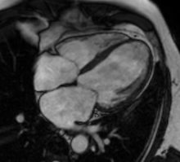
Diagnosis cont’
Transthoracic echocardiogram:
Initial test of choice: should be performed whenever CHF is suspected based on history, examination, or CXR.
Useful in determining whether systolic or diastolic dysfunction predominates, and determines whether the cause of CHF is due to a pericardial, myocardial, or valvular process.
Estimates EF (very important): Patients with systolic dysfunction (EF <40%) should be distinguished from patients with preserved left ventricular function (EF >40%).
Shows chamber dilation and/or hypertrophy.
Identify patients who will benefit from long-term drug therapy, e.g. ACE inhibitors.
Chest X-ray (CXR):
A CXR should be performed in all cases.
Cardiomegaly
Kerley B lines are short horizontal lines near periphery of the lung near the costophrenic angles, and indicate pulmonary congestion secondary to dilation of pulmonary lymphatic vessel.
Prominent interstitial markings
Pleural effusion
ECG:
Nonspecific, but can be useful for detecting chamber enlargement and presence of ischemic heart disease or prior MI.
Recommended to determine rhythm, heart rate, QRS and to detect relevant abnormalities.
A completely normal ECG makes systolic HF unlikely.
Catheter:
Can clarify the cause of CHF if noninvasive test results are equivocal.
Precise valve diameter, septal defects (when CAD or valvular suspected or if heart transplant is indicated).
Blood tests:
Investigations for ALL patients cont’
Blood tests
Measurement of Natriuretic peptide¹ (BNP, NT-proBNP or MR-proANP):
BNP >100pg/ml or NT-proBNP >300pg/ml is suggestive of heart failure. (Normal is <100pg/mL)
Normal BNP level will make HF less likely
Liver biochemistry (may be altered do to hepatic congestion).
Electrolytes imbalance (including Na, K+, Ca and Mg)→ to detect chronic renal insufficiency or hypocalcemia
CBC to look for anemia which may exacerbate HF or be an alternative cause of the patient S&S.
Blood glucose, HbA1C. (For diabetes)
Lipids, Creatinine and check serum ferritin/TIBC level (to detect hemochromatosis or iron deficiency)
Urea and electrolytes (as a baseline before starting diuretics and ACE inhibitors)
Thyroid function tests to detect hyperthyroidism (in the elderly and those with atrial fibrillation).
Investigations for SELECTED patients
Cardiovascular magnetic resonance (CMR) imaging (AKA cardiac MRI)
CMR imaging is recommended to evaluate cardiac structure and function, to measure LVEF, and to characterize cardiac tissue, especially in subjects with inadequate echocardiographic images or where the echocardiographic findings are inconclusive or incomplete (but taking account of cautions/contraindications to CMR)
Brain natriuretic peptide (BNP) or (Pro BNP), if normal(<100pg/mL) exclude heart failure.
Liver biochemistry (may be altered do to hepatic congestion).
Electrolytes imbalance(including Ca / Mg)→ Chronic renal insufficiency
CBC to look for anemia which may exacerbate HF.
Myocardial perfusion/ischemia imaging
Myocardial perfusion/ischemia imaging (echocardiography, CMR, SPECT or PET) should be considered in patients though to have CAD, and who are considered suitable for coronary revascularization, to determine whether there is reversible myocardial ischemia and viable myocardium
1- When to answer Echo/BNP/CXR? Depends on the setting and presentation … complete later
1- Natriuretic peptides can be used both as diagnostic and prognostic factors in HF, but they are not specific for HF as they can be increased in any condition where atrial pressure is elevated.

Slide 10
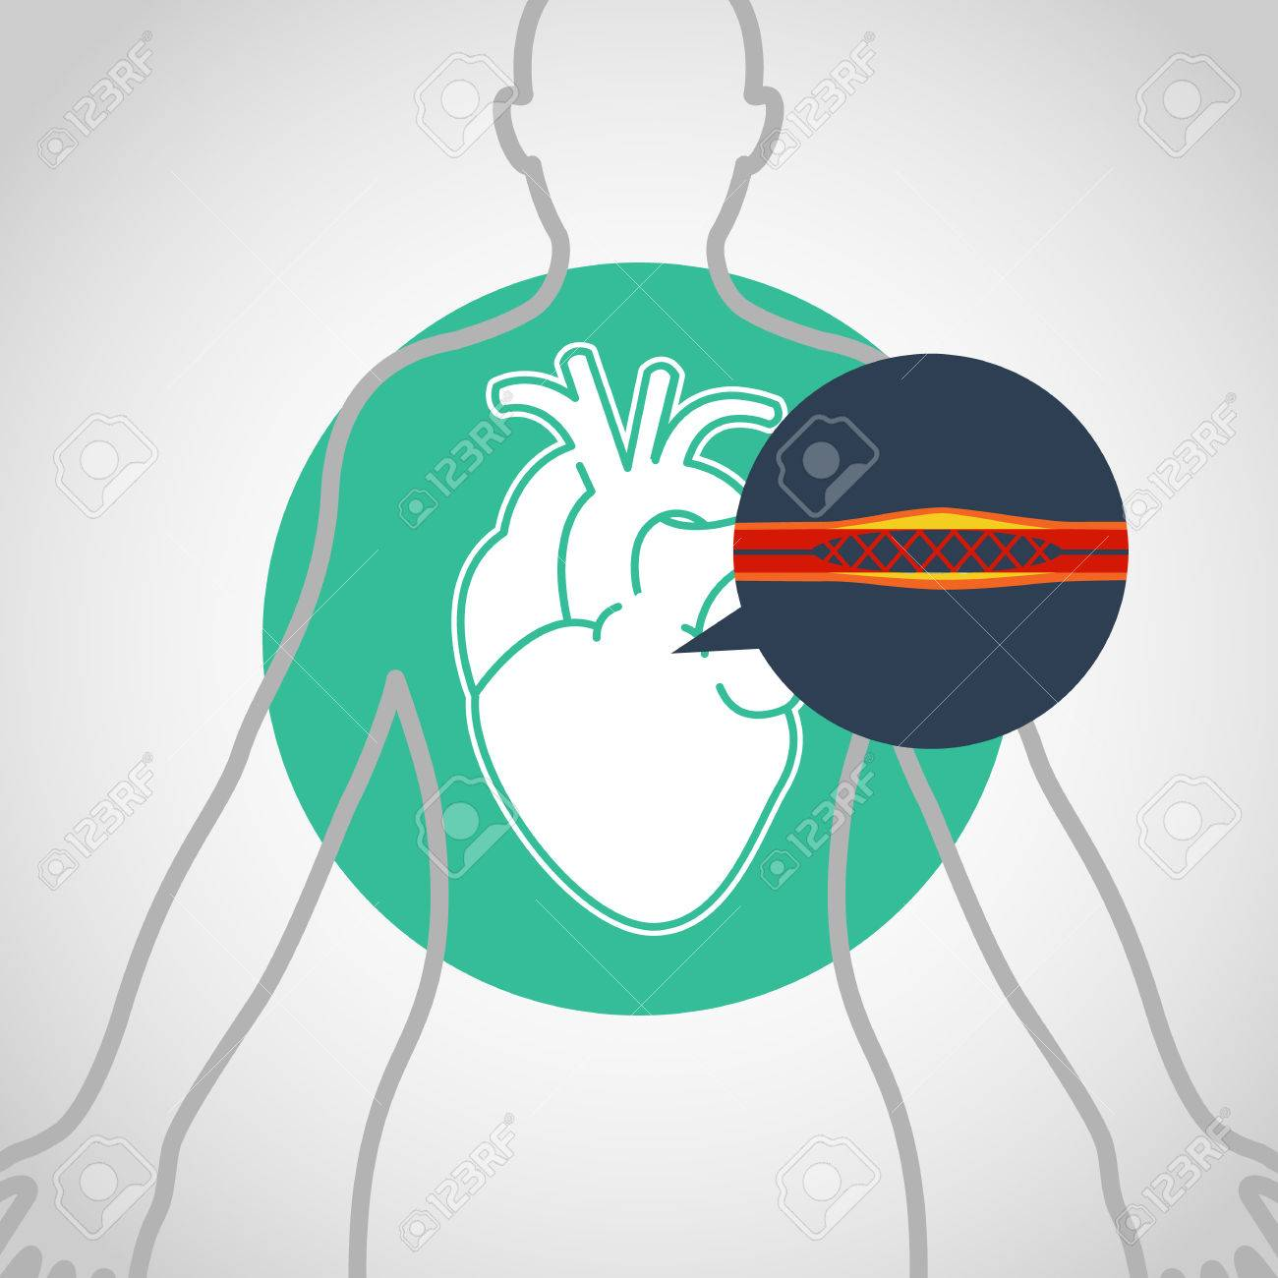
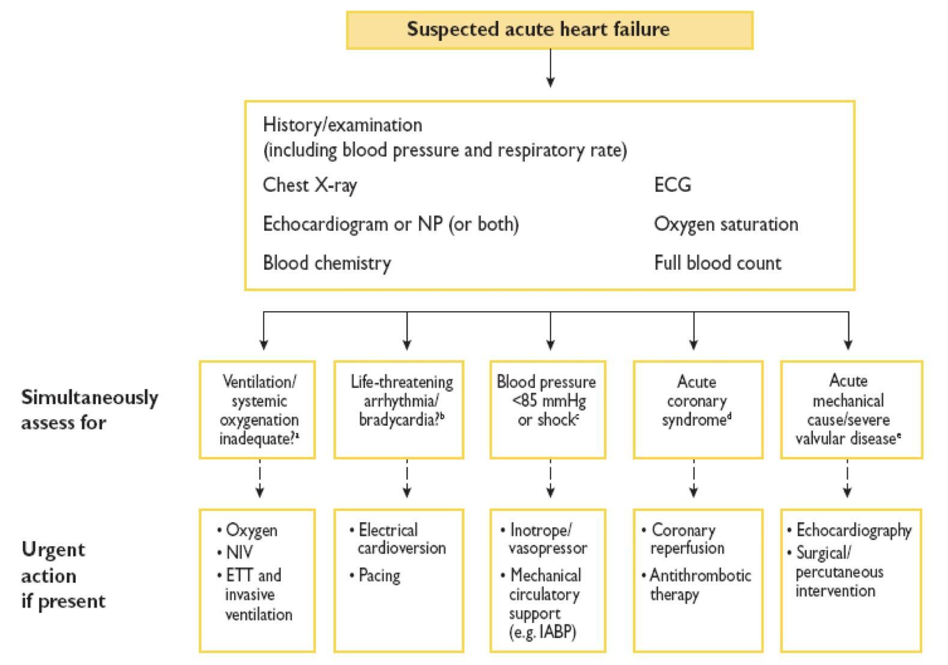
Diagnosis cont’
Transthoracic echocardiogram:
Initial test of choice: should be performed whenever CHF is suspected based on history, examination, or CXR.
Useful in determining whether systolic or diastolic dysfunction predominates, and determines whether the cause of CHF is due to a pericardial, myocardial, or valvular process.
Estimates EF (very important): Patients with systolic dysfunction (EF <40%) should be distinguished from patients with preserved left ventricular function (EF >40%).
Shows chamber dilation and/or hypertrophy.
Identify patients who will benefit from long-term drug therapy, e.g. ACE inhibitors.
Chest X-ray (CXR):
A CXR should be performed in all cases.
Cardiomegaly
Kerley B lines are short horizontal lines near periphery of the lung near the costophrenic angles, and indicate pulmonary congestion secondary to dilation of pulmonary lymphatic vessel.
Prominent interstitial markings
Pleural effusion
ECG:
Nonspecific, but can be useful for detecting chamber enlargement and presence of ischemic heart disease or prior MI.
Recommended to determine rhythm, heart rate, QRS and to detect relevant abnormalities.
A completely normal ECG makes systolic HF unlikely.
Catheter:
Can clarify the cause of CHF if noninvasive test results are equivocal.
Precise valve diameter, septal defects (when CAD or valvular suspected or if heart transplant is indicated).
Blood tests:
Investigations for SELECTED patients
Cardiac Catheterization
To evaluate right and left heart function and pulmonary arterial resistance
Can clarify the cause of CHF if noninvasive test results are equivocal.
Used when CAD or VHD are suspected
Recommended in patients being evaluated for heart transplant or mechanical circulatory support.
Gives precise valve diameter, and detects any septal defects
Exercise testing
Exercise testing should be considered:
To detect reversible myocardial ischemia
As part of the evaluation of patients for heart transplantation and mechanical circulatory support
To aid in the prescription of exercise training
To obtain prognostic information.
Other tests: Metanephrines, endomyocardial biopsy (if infiltrative disease (e.g. sarcoid, amyloid) is considered)
Summary of diagnosis (From Dr slides)
Brain natriuretic peptide (BNP) or (Pro BNP), if normal(<100pg/mL) exclude heart failure.
Liver biochemistry (may be altered do to hepatic congestion).
Electrolytes imbalance(including Ca / Mg)→ Chronic renal insufficiency
CBC to look for anemia which may exacerbate HF.
Click here for an algorithm from Kumar
1- When to answer Echo/BNP/CXR? Depends on the setting and presentation … complete later

Slide 11
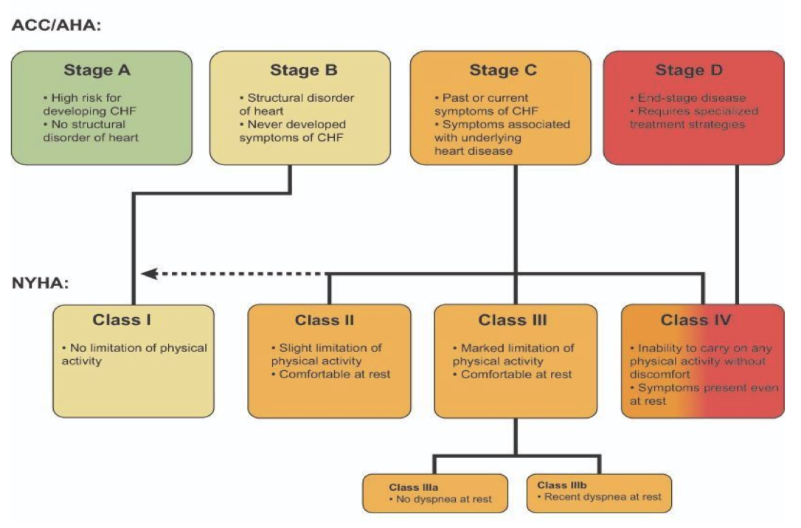
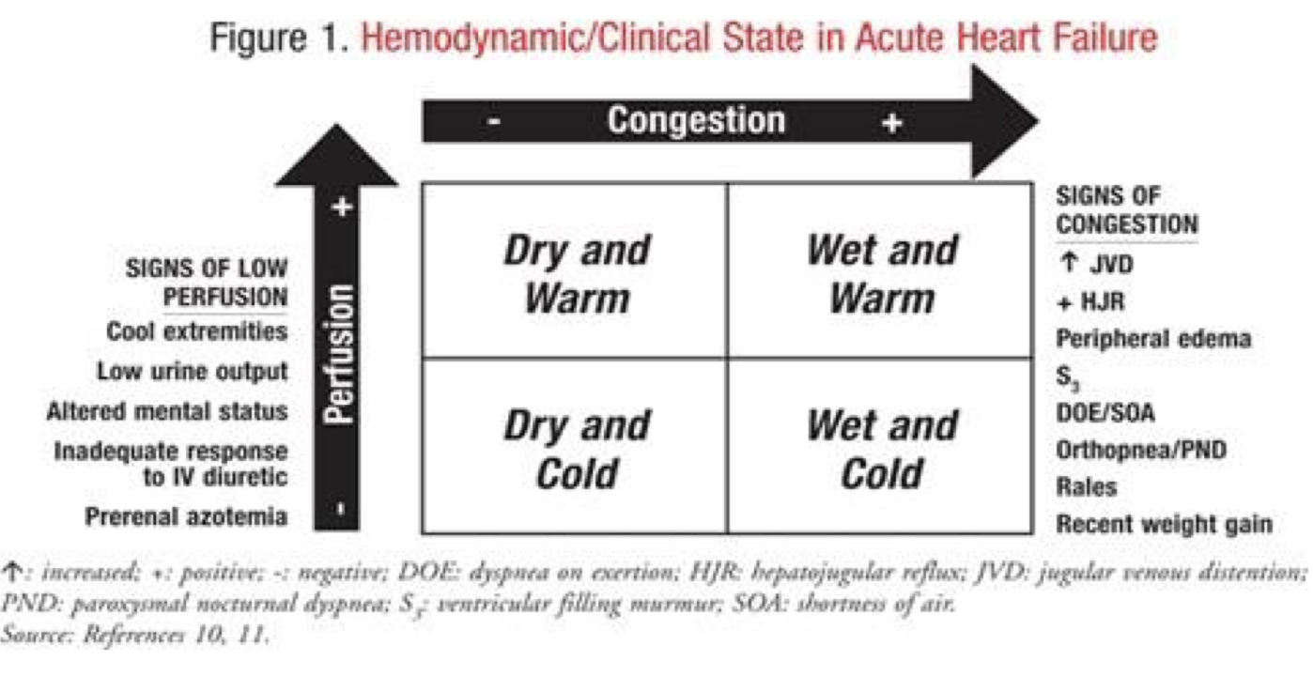
Classification
ACC: American College of Cardiology
AHA: American Heart Association
ACC/AHA Classification
 | At risk of HF |  | HF
Stage | Stage A | Stage B | Stage C | Stage D
Description | At high risk for HF but without structural heart disease or symptoms of HF | Structural heart disease but without signs or symptoms of HF | Structural heart disease with prior or current symptoms of HF | Refractory HF requiring specialized interventions
Who? | E.g. Patients with: Hypertension Atherosclerosis DM Obesity Metabolic syndrome Or patients Using cardiotoxins With family history of CM | E.g. Patients with: Previous MI LV remodeling including LVH and low EF Asymptomatic vascular disease | E.g. Patients with: Known structural heart disease and SOB, fatigue and reduced exercise tolerance | E.g. Patients who have marked symptoms at rest despite maximal medical therapy (e.g. those who are recurrently hospitalized or cannot be safely discharged from the hospital without specialized interventions)
Therapy | Goals: Treat hypertension Encourage smoking cessation Treat lipid disorders Encourage regular exercise Discourage alcohol intake, illicit drug use Control metabolic syndrome Drugs: ACEI or ARB | Goals: All measures under stage A Drugs: ACEI or ARB BB Devices in selected patients: Implantable defibrillators | Goals: All measures under stage A and B Dietary restriction Drugs for routine use: Diuretics ACEI BB Drugs in selected patients: Aldosterone antagonist ARBs Digitalis Hydralazine/nitrates Devices in selected patients: Biventricular pacing Implantable defibrillators | Goals: Appropriate measures under stages A, B, C Decisician re: appropriate level of care Options: Compassionate end-of-life care/hospice Extraordinary measures e.g. heart transplant, chronic inotropes, permanent mechanical support or experimental surgery or drugs
Dry: No congestion, Wet: Congestion, Warm: No decrease in perfusion, Cold: Decrease in perfusion

Slide 12
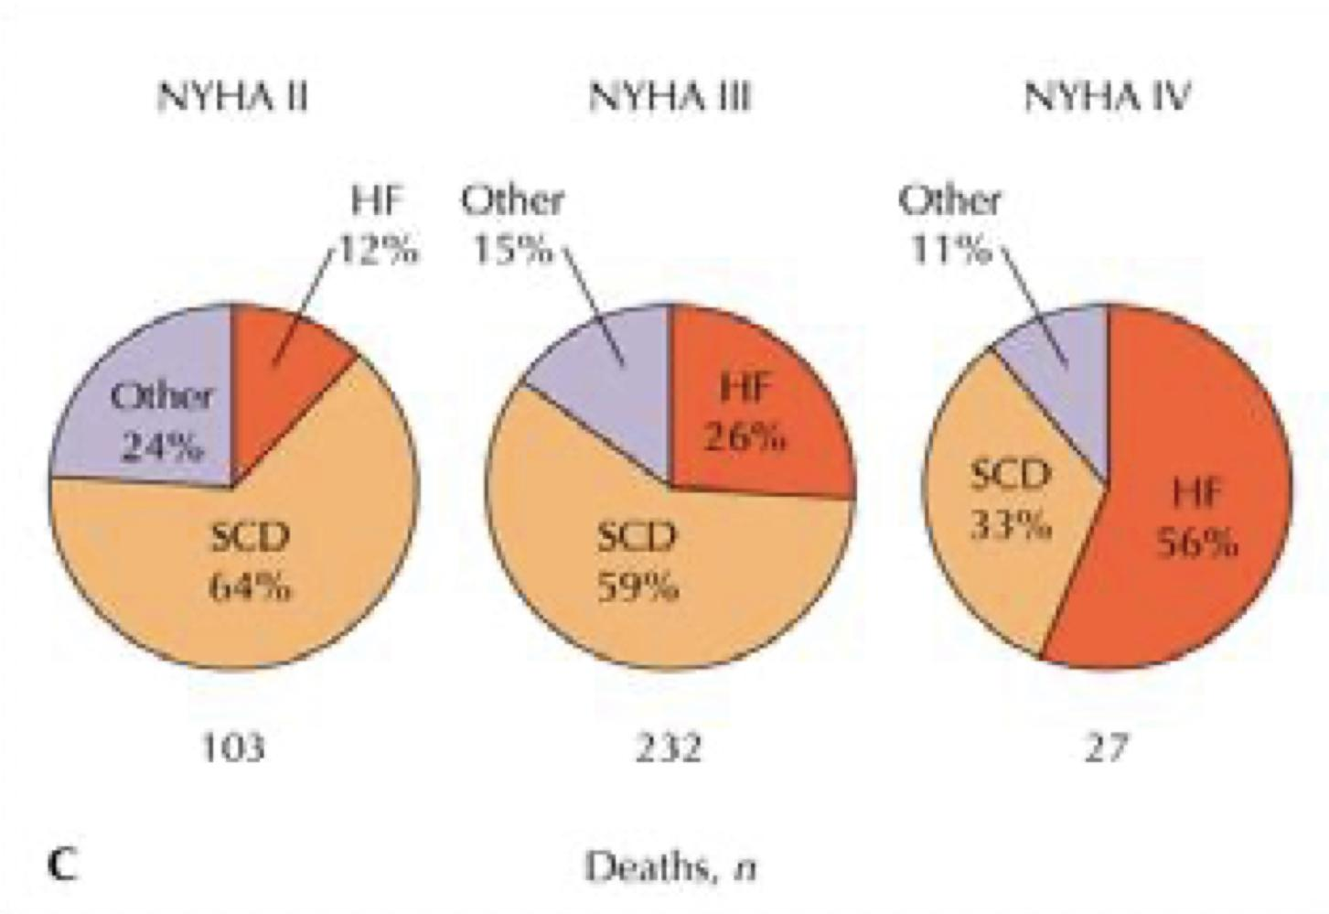
Classification cont’
New York Heart Association (NYHA) Classification
Used to assess severity
Class I | No limitations of activities. Symptoms only occur with vigorous activities, such as playing a sport. Patients are nearly asymptomatic.
Class II | Slight or mild limitation of activity. Symptoms occur with prolonged or moderate exertion, such as climbing a flight of stairs or carrying heavy packages. Slight limitation of activities.
Class III | Marker limitation if activity.Symptoms occur with usual activities of daily living, such as walking across the room or getting dressed. Comfortable at rest.
Class IV | Symptoms occur at rest. Incapacitating.
Forrester Classification¹
Other signs:
Narrow pulse pressure
Pulsus alterations
Declining serum Na level
ACEI-related symptomatic hypotension
Congestion at rest?
No Yes
A
B
Low perfusion at rest?
Yes No
And valsalva square wave
Class I
Class II
And ascites
L
C
And Loud P2
Dry: No congestion
Wet: Congestion
Warm: No decrease in perfusion
Cold: Decrease in perfusion
Class III
Class IV
Differential diagnosis of HF signs and symptoms
1
Pericardial diseases
2
Nephrotic syndrome
3
Liver diseases
4
Protein losing enteropathy
Dry: No congestion, Wet: Congestion, Warm: No decrease in perfusion, Cold: Decrease in perfusion
1- first, we look at the congestion state which is the fluid status (is he hypovolemic or overloaded?) and the BP (which is the perfusion status) if he’s not congested with normal BP we call him warm & dry, and if he’s the opposite then he’s Cold & wet (cardiogenic state) . when he’s warm & wet when he’s perfusing well he’s usually hypertensive. If they’re not having enough oral intake they’re Dry & cold

Slide 13
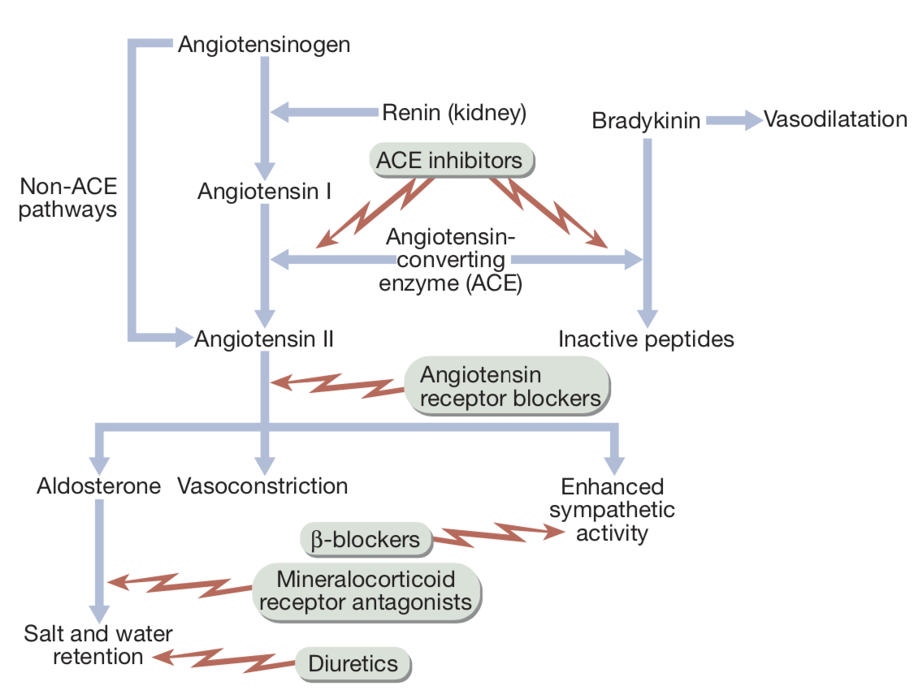
Management
Introduction to HF management
First correct the reversible causes e.g. Ischemia, VHD, thyrotoxicosis, anemia and other high output status, shunts, Arrhythmias (e.g. Afib, atrial flutter, CHB), medications (e.g. CCB, antiarrhythmics, NSAIDS)
Management tools
Lifestyle modification
Pharmacological
Surgical
Diet¹
Fluid intake
Exercise shows mortality benefit
Smoke cessation
Weight reduction
Oral medication
Immunization (flu, pneumococcal and covid-19 (hopefully)
Device therapy
Assisting devices
Transplant
Management of Chronic HF
General measures
Education of patients and families.
Physical activity: reduce during exacerbations to reduce work of the heart. Encourage low-level (e.g. 20- to 30-min walks 3–5 times weekly) with compensated heart failure
Diet and social: weight reduction if necessary (Daily weight “Tailor therapy”), no added salt diet (2g of Na=5g of NaCl), avoid alcohol (negative inotropic effects), stop smoking and fluid restriction (1.5-2L/day, about 8 cups)
Vaccine against pneumococcal disease influenza.
Correct aggravating factors, e.g. arrhythmias, anaemia, hypertension and pulmonary infections
Driving: unrestricted, except symptomatic heart failure disqualifies driving large lorries and buses
Sexual activity: tell patients on nitrates not to take phosphodiesterase type 5 inhibitors.
Pharmacological treatment
1
2
3
ACEI/ARB
𝛃-Blockers
Diuretic
4
4
5
Digoxin
Vasodilators
SGLT-2 inhibitors
Inotropic agents (I.V.)
1- total salt intake should be 2 grams per day. We don't restrict the patient completely from salt. To describe ot to the patient, tell him “don’t add any EXTRA salt, don’t eat canned food and try to avoid cheese (any kind). And to stay away from restaurant. For fluid they should.t exceed fluids above 1.5 liters

Slide 14
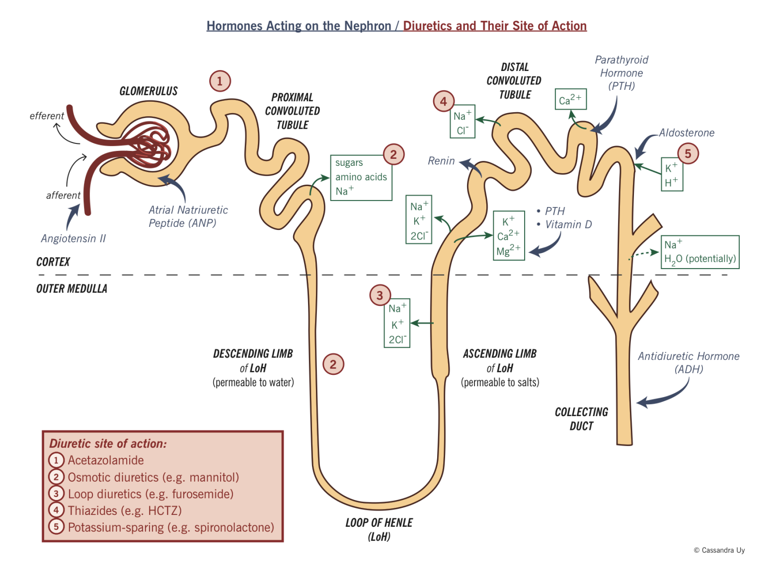
Management cont’
Management of Chronic HF cont.
Diuretics
Group | Loop diuretics Furosemide “Lasix” (20-320 mg QD) Bumetanide “Bumex” (1-8mg) Torsemide (20-200mg) | Thiazide diuretic (Hydrochlorothiazides, Chlorthalidone, Metolazone)
General | Most effective in controlling symptoms (Dyspnea & Peripheral edema), but have not been shown to reduce mortality or improve prognosis.
M.O.A | Inhibit chloride reabsorption in ascending limb of loop of Henle results in natriuresis, kaliuresis and metabolic alkalosis | Block Na reabsorption in loop of henle and distal convoluted tubules
Uses | Most potent diuretics used in moderate/severe HF. | Used for mild HF Ineffective with GFR < 30 --/min.
ADR | Pre-renal azotemia¹ Hypokalemia² Skin rash Ototoxicity | Pre-renal azotemia¹ Skin rashes Neutropenia Thrombocytopenia Hyperglycemia ↑ Uric Acid Hepatic dysfunction
Diuretics benefits:
Improves symptoms of congestion
Can improve cardiac output
Improved neurohormonal milieu
No inherit nephrotoxicity
Diuretics limitations:
Oral absorption unpredictable
Excessive volume Depletion
Electrolyte disturbance
1- in case of Chronic kidney disease they’re ineffective
2- Monitor renal function and check for hypokalaemia and hypomagnesaemia

Slide 15
Management cont’
Management of Chronic HF cont.
K+ sparing agents
Group | Spironolactone ^{(Aldosterone inhibitor)} | Eplerenone |  | Triamterene, amiloride
General | Relatively weak diuretics with a potassium-sparing action
M.O.A | Acts at the collecting duct by competitive inhibition of cytoplasmic aldosterone receptors →↑ Excretion of Na+,Cl & ↓Excretion of K+,H+,NH4 | Binds to the mineralocorticoid receptor and blocks the binding of aldosterone |  | Acts on distal tubules to ↓ K secretion
Uses | Spironolactone (25 mg daily) in combination with conventional treatment improves survival in patients with moderate/severe heart failure (Class III & IV), due to its effect on RAAS with subsequent effect on myocardial remodeling and fibrosis. | Reduces mortality in patients with acute myocardial infarction and heart failure. |  | -
Adverse effects | Gynecomastia (If pt develop this, switch to eplerenone), Hyperkalemia and chest pain. (Monitor renal function) | Hyperkalemia |  | -
𝛃-Blockers
Drug name | Bisoprolol | Carvedilol | Metoprolol
Uses | Has been traditionally contraindicated in pts with CHF Now they are the main stay in treatment on CHF & may be the only medication that shows substantial improvement in LV function In addition to improved LV function multiple studies show improved survival¹ “Start low, go slow”: Bisoprolol 1.25mg od, Carvedilol 3.124mg od Not rescue therapy. Consider cardioselective agents in mild to moderate reversible airways disease. The benefit of beta blockers likely stems from: Anti-Ischemic effect , Decreasing HR (Decrease O2 consumption) Antiarrhythmic effect
Contraindications | Severe decompensated CHF (AHF, Pulmonary edema) Peripheral Vascular Disease (PVD)
BB trials:
US Carvedilol studies 1996
65% decrease mortality in carvedilol group
27% reduction in hospitalisations, reduction in progression of CCF
CIBIS-II – Bisoprolol vs. placebo
34% reduction mortality (42% reduction in sudden death and 32% hospitalisations)
MERIT-HF - metoprolol
COPERNICUS
NYHA class IV, EF < 25%
35% reduction in mortality with carvedilol
CAPRICORN - 23% reduction in mortality post MI
Angiotensin II type 1 receptor blockers (ARBs)
Drug name | losartan | ibersartan | valsartan
Uses | Second-line therapy in patients intolerant of ACEI; Unlike ACEI they do not affect bradykinin metabolism and do not produce a cough.
1- Beta-blockers are more effective at reducing mortality than ACE inhibitors, with a relative risk reduction of 33% versus 20%, respectively.

Slide 16
Management cont’
Management of Chronic HF cont.
Angiotensin-converting enzyme inhibitors (ACEI)
Drug name | Perindopril | Lisinopril | Quinapril
M.O.A | Block the R-A-A system by inhibiting the conversion of angiotensin I to angiotensin II → vasodilation and ↓ Na and water retention.(decrease Afterload and preload) ↓ Bradykinin degradation ↑ its level → ↑ PG secretion & nitric oxide → Vasodilation They also ultimately inhibit cardiac remodelling
Uses | They improve symptoms, limit the development of progressive heart failure and prolong survival, and should be given to all patients with heart failure. ACE Inhibitors were found to improve survival in CHF patients: Delay onset & progression of HF in pts with asymptomatic LV dysfunction ↓ cardiac remodeling
Side effects | Angioedema Renal insufficiency, Hepatic dysfunction Rash, Hyperkalemia¹ Cough (If patient develops cough switch to ARBs) The major side-effect is first-dose hypotension. ACEI treatment should be introduced gradually with a low initial dose and gradual titration every 2 days to full dose with regular blood pressure monitoring and a check on serum potassium and renal function 1-2 weeks after starting therapy; creatinine levels normally rise by about 10–15% during ACEI therapy. If patient developed hyperkalemia or renal impairment or is pregnant→ switch from ACEI to Hydralazine with isosorbide dinitrate.
Contraindications | Renal failure Bilateral renal artery stenosis (RAS) Aortic stenosis
Trials for ACEI:
CONSENSUS 1987 – enalapril vs. placebo – 31% reduction mortality in enalapril group. Confirmed by SOLVD, AIRE, SAVE, TRACE.
1995 meta-analysis showed 23% reduction total mortality, 35% in combined mortality/hosp admission
Angiotensin II type 1 receptor blockers (ARBs)
Drug name | losartan | irbesartan | valsartan
Uses | Second-line therapy in certain conditions when ACE I are contraindicated (angioneurotic edema, cough) Has comparable effect to ACEI. Has mortality benefit.
ADRs | Renal dysfunction, hyperkalemia
Angiotensin II type 1 receptor blockers (ARBs)
Drug name | losartan | ibersartan | valsartan
Uses | Second-line therapy in patients intolerant of ACEI; Unlike ACEI they do not affect bradykinin metabolism and do not produce a cough.
1- can be beneficial in offsetting the hypokalemia associated with loop diuretic therapy.

Slide 17
Management cont’
Management of Chronic HF cont.
Angiotensin Receptor - Neprilysin inhibitors (ARNi)
Drug name | Combination of Valsartan & Sacubitril
General info | Recent FDA approval (2015) The only product available (valsartan/sacubitril) Valsartan = ARB Sacubitril = prodrug for sacubitrilat Inhibit neprilysin which breakdown the vasoactive peptides.
M.O.A | Inhibits neprilysin which is responsible for the breakdown of the endogenous diuretics ANP and BNP.
Uses | Used if patient LVEF ≤ 35% and still symptomatic with ACE/ARB In this specific group of patients it improves M&M.
Positive Inotropes
Drug name | Digitalis Glycosides (Digitoxin, Digoxin)^{1,2}
M.O.A | +ve inotropic effect by ↑ intracellular Ca & enhancing actin-myosin cross-bridge formation (binds to the Na-K ATPase → inhibits Na pump → ↑ intracellular Na → ↑ Na-Ca exchange Has Vagotonic effect and Arrhythmogenic effect
Uses | Indicated in patients with heart failure and atrial fibrillation. In patients with severe heart failure (NYHA class III–IV), digoxin reduces the likelihood of hospitalisation for heart failure, it also reduces symptoms, but it has no effect on long-term survival. The role of digitalis has declined somewhat because of safety concern (Narrow therapeutic to toxic ratio)
Digoxin toxicity | Cardiac manifestations |  |  | Non cardiac manifestations
 | Sinus bradycardia and arrest A/V block (usually 2nd degree) Atrial tachycardia with A/V Block Development of junctional rhythm in patients with AF PVC’s, VT/ V fib (bi-directional VT) |  |  | Anorexia Nausea, vomiting Headache Xanthopsia sotoma (yellow vision) Disorientation
Digoxin toxicity treatment | Hold the medications Observation. In case of A/V block or severe bradycardia → atropine followed by temporary PM if needed. In life threatening arrhythmia → digoxin-specific fab antibodies. Lidocaine and phenytoin could be used – try to avoid D/C cardioversion in non life threatening arrhythmia.
Positive inotropes are drugs that improve myocardial contractility (β adrenergic agonists, dopaminergic agents, phosphodiesterase inhibitors) e.g. Dopamine, Dobutamine, Milrinone, Amrinone
Several studies showed ↑ mortality with oral inotropic agents
So the only use for them now is in acute settings as cardiogenic shock
Angiotensin II type 1 receptor blockers (ARBs)
Drug name | losartan | ibersartan | valsartan
Uses | Second-line therapy in patients intolerant of ACEI; Unlike ACEI they do not affect bradykinin metabolism and do not produce a cough.
1- It’s ONLY given I.V. NOT Orally it also has a very narrow therapeutic index and does not decrease mortality. Only improves morbidity
2- Use with caution in renal impairment or conduction disease, and with amiodarone

Slide 18
Management cont’
Management of Chronic HF cont.
Vasodilators
Drug name | Hydralazine |  |  | Nitrate
M.O.A | Reduction of afterload by arteriolar vasodilation → reduce LVEDP, O2 consumption,improve myocardial perfusion, stroke volume and COP |  |  | Reduction of preload By venous dilation → ↓ the venous return → ↓ the load on both ventricles.
Uses | Valuable in chronic heart failure, when ACE inhibitors or ARBs are contraindicated. Usually the maximum benefit is achieved by using agents with both action. Has mortality benefit. Their use is limited by pharmacological tolerance and hypotension.
Anticoagulants
Drug name | Warfarin/NOAC
Uses | Atrial fibrillation H/o embolic episodes Left ventricular apical thrombus
Antiarrhythmics
Uses | Patients with h/o sustained VT or SCD → ICD implant Patients with non-sustained ventricular tachycardia Correction of electrolytes and acid base imbalance. Most common cause of Sudden Cardiac Death (SCD) in HF patients is ventricular tachyarrhythmia.
hyperpolarization-activated cyclic nucleotide-gated (HCN) channel blockers
Drug name | Ivabradine
M.O.A | Acts on the I_{f} inward current in the SA node (phase 4), resulting in reduction of heart rate.
Uses | Only use it if HR is not controlled by BB and remains > 70 bpm and the patient has sinus rhythm. (It is ineffective in patients with atrial fibrillation.) In this group of patients it improve M&M.
Angiotensin II type 1 receptor blockers (ARBs)
Drug name | losartan | ibersartan | valsartan
Uses | Second-line therapy in patients intolerant of ACEI; Unlike ACEI they do not affect bradykinin metabolism and do not produce a cough.

Slide 19
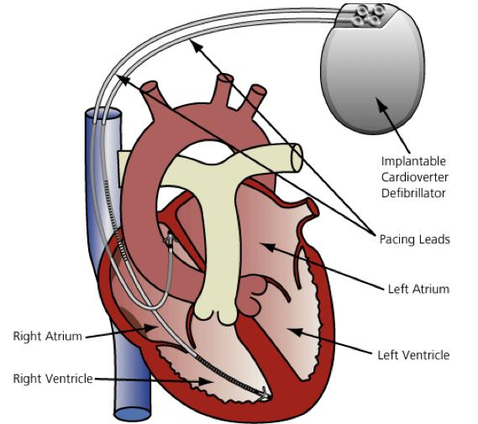
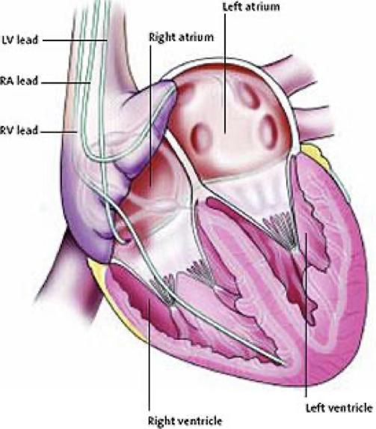
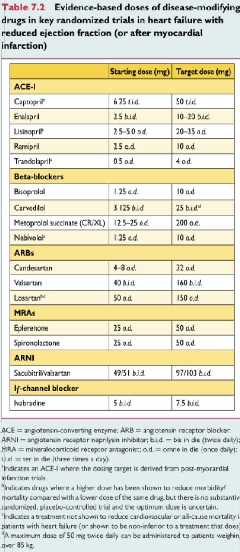
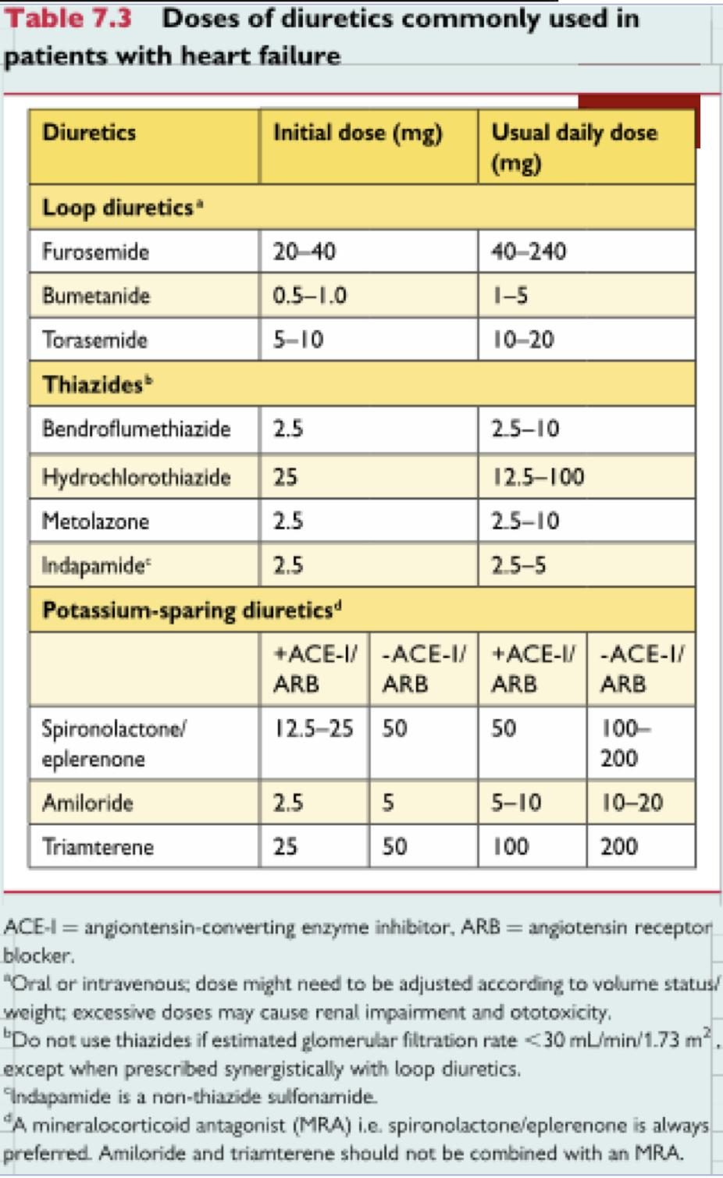
Management cont’
Management of Chronic HF cont.
SGLT-2 inhibitors
Drug name | Dabagliflozin, Empagliflozin
M.O.A | Work on the proximal convoluted tubule, by inhibiting reabsorption of the glucose. Reduce the blood glucose, systolic and diastolic blood pressure and work as diuretic.
Uses | Recent studies showed mortality benefit in patients with heart failure.
ADRs | UTIs, DKA and osteoporosis
Devices
Implantable Cardioverter Defibrillator (ICD)¹ | Biventricular pacemaker²
1-3 leads + pulse generator Sudden onset criteria Stability criteria Treatment zones Pacing Cardioversion Defibrillation Combined CRT-D available | Used only in patient with Wide QRS complexes & CHF Resynchronise ventricles by simultaneous pacing NICE guidance published 2007
Other assisting devices:
Temporary ventricular assist devices.
Implantable ventricular assist devices.
Cardiac Transplant:³
It has become more widely used since the advances in immunosuppressive treatment.
Survival rate:
1 year 80% - 90%
5 years 70%
Theses tables show that we should titre the dose of diuretics carefully (Give low dose initially) to avoid excessive volume depletion, which can cause a fall in cardiac output with hypotension (Cardiogenic shock), lethargy and renal failure.
1- Used for those with ischemic cardiomyopathy and EF below 30%. Has mortality benefit.
2- Indicated in those with dilated cardiomyopathy and an EF under 35% and a wide QRS >140ms who have persistent symptoms. Has mortality benefit.
3- When maximal therapy (ACEI, BB, spironolactone, diuretics, digoxin) and possibly the biventricular pacemaker fail to control symptoms of CHF, then the only alternative is to seek cardiac transplant.

Slide 20
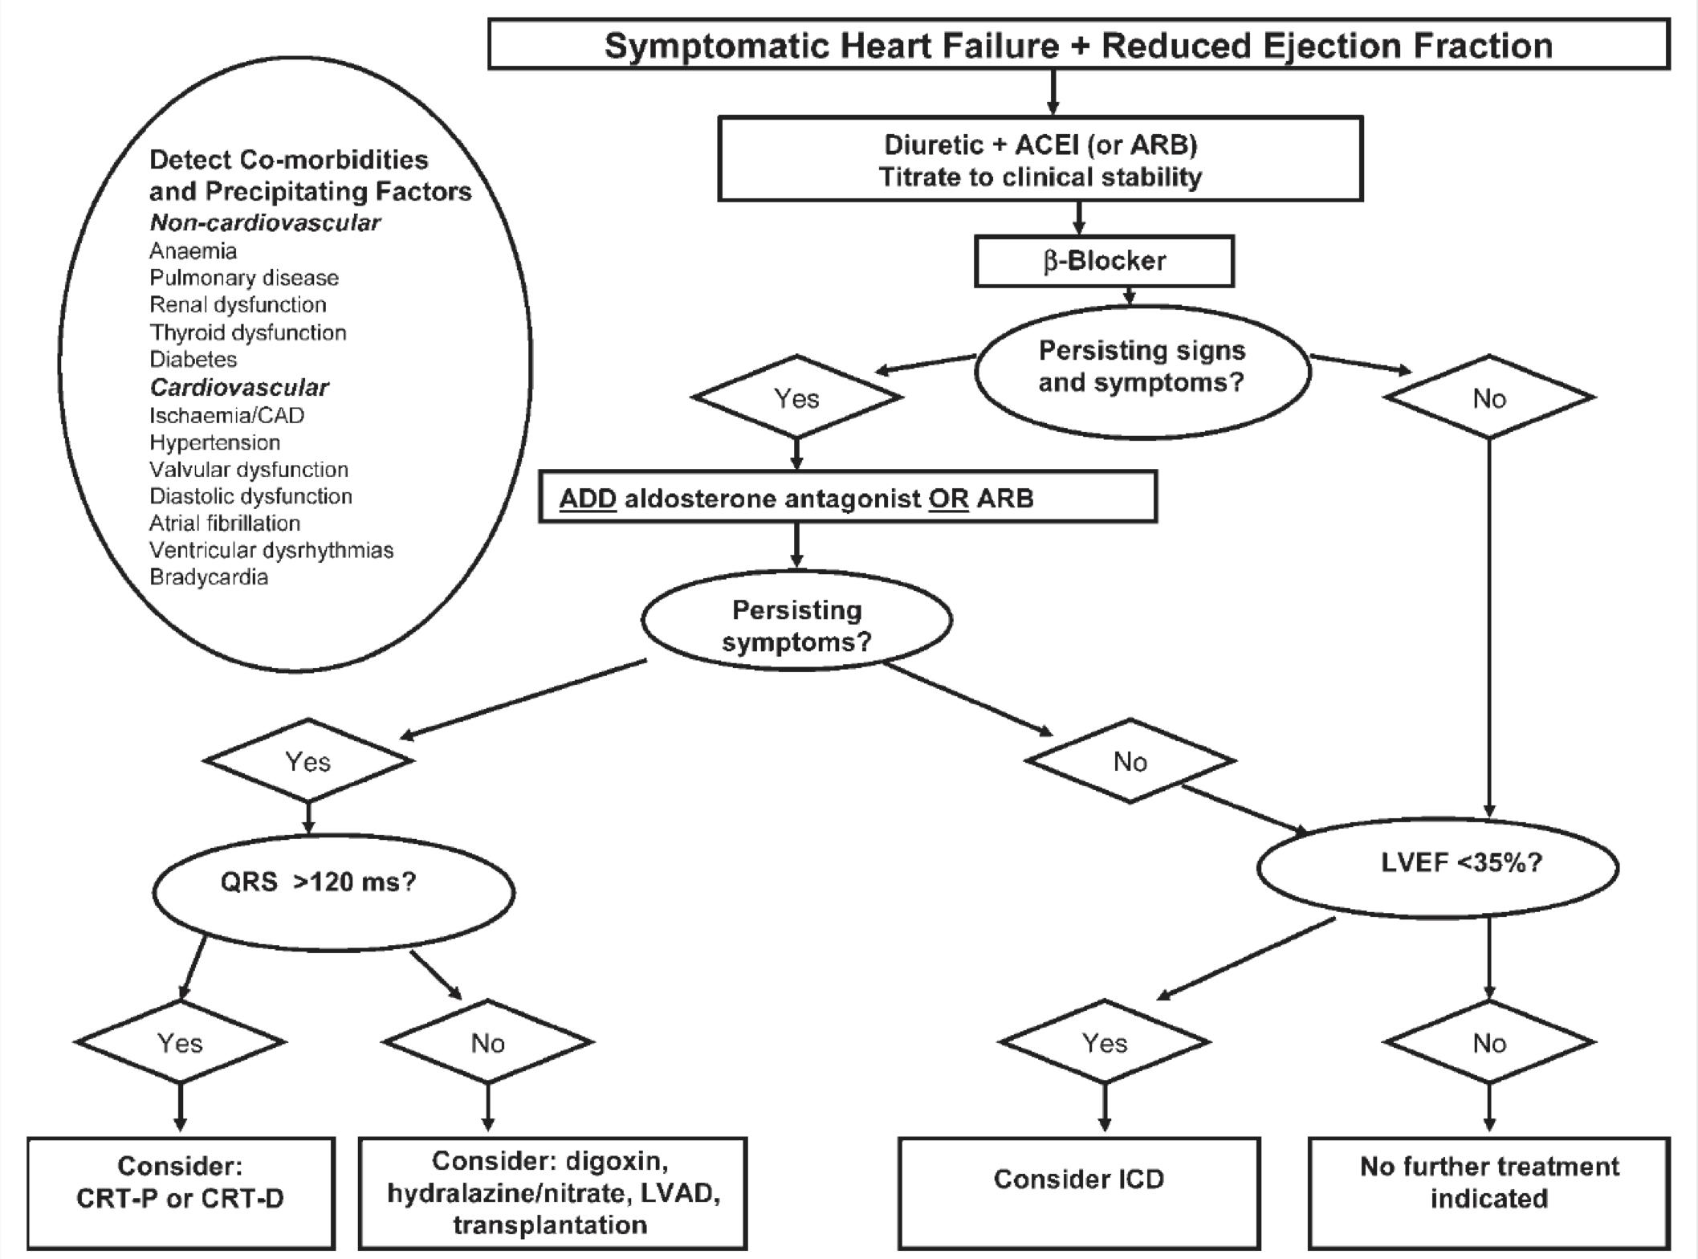
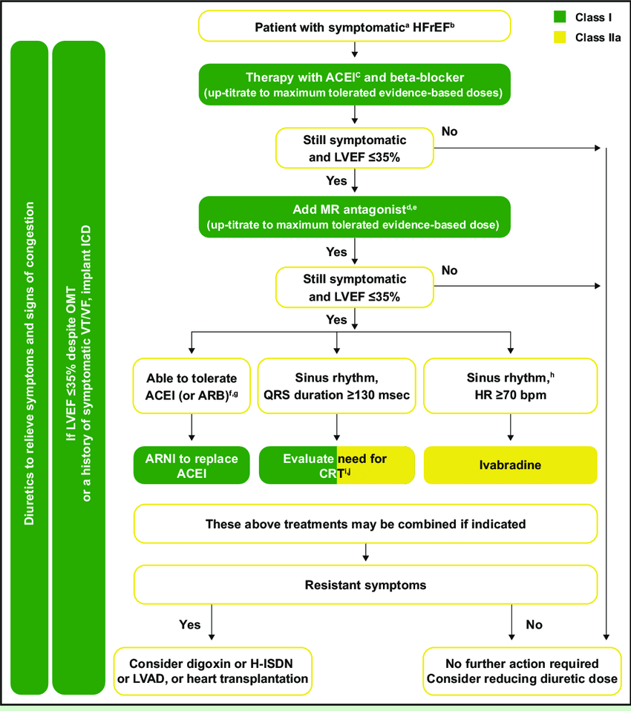
Management cont’
Management of Chronic HF cont.
Drugs used in (according to MTB)
Systolic dysfunction | Diastolic dysfunction
ACEI or ARB BB Spironolactone Diuretics Digoxin | Spironolactone Diuretics Uncertain: ACEI, ARBs NOT used: BB, Digoxin
General recommendations
An ACE inhibitor should be given to all patients with heart failure unless there are contraindications. In patients intolerant of ACE inhibitors, ARBs are an alternative (level of evidence, A).
In symptomatic patients with heart failure, beta-blockers are recommended to reduce mortality rates (level of evidence, A).
Aldosterone antagonists are recommended to reduce mortality rates in certain patients with heart failure. These include patients with current or recent history of dyspnea at rest, and patients with recent myocardial infarction who have systolic dysfunction with either clinically significant signs of heart failure or with concomitant diabetes mellitus (level of evidence, B).
For persistently symptomatic black patients with heart failure, direct-acting vasodilators reduce overall mortality rates when added to background therapy with ACE inhibitors, beta-blockers, and diuretics (if needed). Direct-acting vasodilators are also an alternative for patients with heart failure who are intolerant of ACE inhibitors (level of evidence, B).
For patients with heart failure and volume overload, diuretics are recommended (level of evidence, B).
Contraindicated drugs
Treatments (or combinations of treatments) that may cause harm in patients with symptomatic (NYHA class II-IV) systolic heart failure:
Thiazolidinediones (glitazones) should not be used as they cause worsening HF and increase the risk of HF hospitalization.
Most CCBs (with the exception of amlodipine and felodipine) should not be used as they have a negative inotropic effect and can cause worsening HF.
NSAIDs and COX-2 inhibitors should be avoided if possible as they may cause sodium and water retention, worsening renal function and worsening HF.
The addition of an ARB (or renin inhibitor) to the combination of an ACEI AND a mineralocorticoid antagonist is NOT recommended because of the risk of renal dysfunction and hyperkalemia

Slide 21
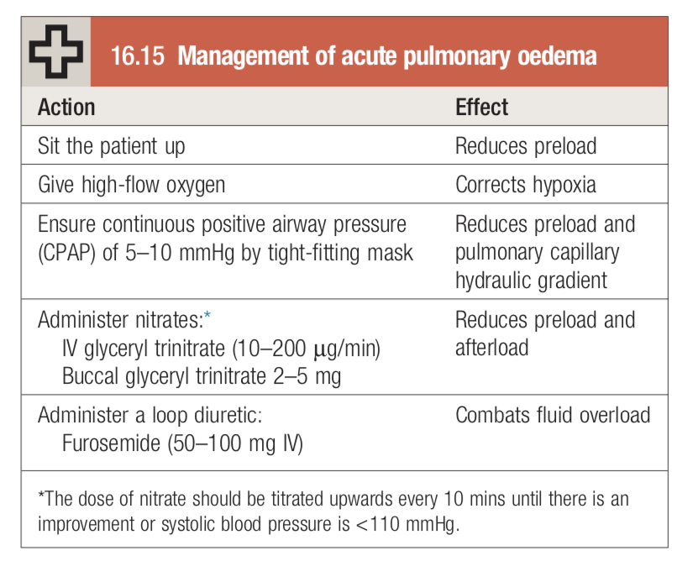
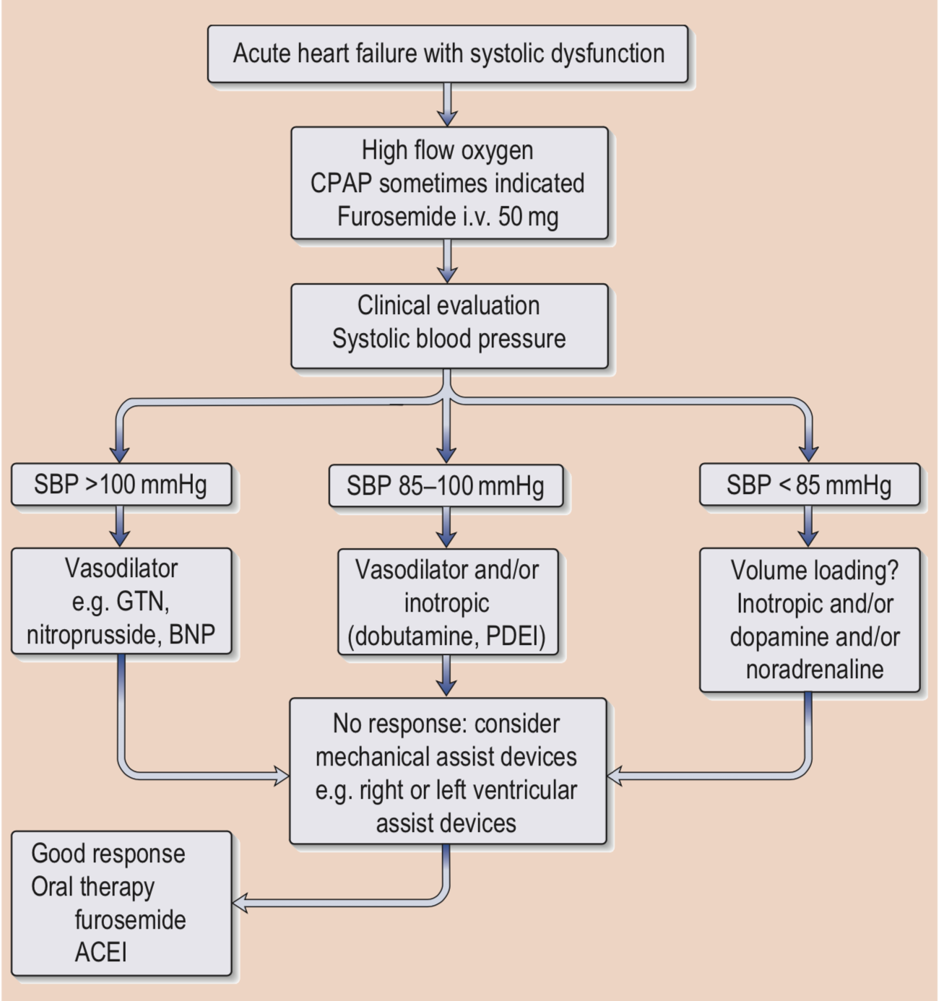
Management cont.
Management of Acute HF
Acute heart failure with pulmonary oedema is a medical emergency that should be treated urgently.
Note: If these measures prove ineffective use dobutamine.
Prognosis
Annual mortality rate depends on patients symptoms and LV function.
5% in patients with mild symptoms and mild ↓ in LV function.
30% to 50% in patient with advances LV dysfunction and severe symptoms.
40% – 50% of death is due to SCD.
What factors indicate poor prognosis in HF?
Clinical | High NYHA class, hypotension, tachycardia at rest, JVD, S3
Labs | Hyponatremia, elevated BNP, renal insufficiency
EKG | QRS >120, LBBB
Echo | Severe reduction in EF, pulmonary hypertension, diastolic dysfunction, RV function impairment
Associated conditions | Anemia, AF, DM

Slide 22
EXTRA
Case Summary
A 70-year-old man presents to the emergency department complaining of increased shortness of breath with minimal exercise, cough, and fatigue. These symptoms began 2 weeks ago and have progressed gradually. He reports he used to feel this way “all the time” years ago but that this has not happened much since he began using his inhalers and his “water pill.” He also has a history of chronic obstructive pulmonary disease (COPD), congestive heart failure (CHF), coronary artery disease (CAD), diabetes mellitus, hypertension, and 30-pack-year of smoking. He denies swelling of the extremities, fever or chills, productive cough, chest pain, or palpitations. He cannot remember the names of his medications but says he has not missed any doses. When asked about his diet, he says he has been eating more hot soup since the weather has gotten colder. His temperature is 37.5°C (99.5°F), blood pressure is 135/90 mm Hg, heart rate is 90/min, respiratory rate is 18/min, and oxygen saturation is 94% on room air. Examination of the neck reveals mild jugular venous distention. Examination of the lungs reveals loud crackles throughout the lung fields bilaterally. Examination of the heart reveals a laterally displaced point of maximum impulse with no murmurs, rubs, or gallops. There is mild clubbing of the extremities, as well as pitting edema of the lower extremities to the knee, bilaterally. His plasma brain natriuretic peptide level on rapid bedside assay is 500 pg/mL, and an x-ray of the chest reveals perivascular haziness, interstitial edema, and an enlarged cardiac silhouette.
Q1: What conditions should be included in the differential diagnosis?
CAD, COPD, and CHF each may present with dyspnea on exertion and fatigue. It is of primary importance to distinguish between them when evaluating the presenting symptoms. Etiologies of gradually worsening shortness of breath and fatigue can include both cardiac and pulmonary diseases, including the following: Anemia, Heart failure secondary to ischemia/infarction, dysrhythmia, valvular dysfunction, infection, or volume overload, Lung infections (pneumonia, bronchitis, bronchiectasis), Mechanical impairment of ventilation, Pulmonary edema, Pulmonary embolism, Sepsis.
Q2: What’s the most likely diagnosis?
CHF exacerbation leading to pulmonary edema. This patient’s dyspnea, jugular venous distension, and tachypnea in the presence of crackles, pulmonary edema, elevated brain natriuretic peptide (BNP) level, and cardiomegaly suggest an acute exacerbation of CHF. An exacerbation of COPD is unlikely given that this patient does not have fever, productive cough, or wheezing. Additionally, the patient reported increasing intake of soup, a particularly salty food, which can significantly increase water retention, thereby worsening CHF.
Q3: What are the typical laboratory and imaging findings in this condition?
In addition to an x-ray of the chest that may show pulmonary edema, patients with CHF exacerbations may have the following: Decreased hematocrit (anemia may exacerbate CHF), Increased potassium, creatinine, and blood urea nitrogen levels (renal failure may exacerbate CHF), Increased plasma BNP level, which is usually elevated in CHF exacerbations, A chest radiograph showing cardiomegaly, cephalization of pulmonary vessels, and/or pleural effusion, ECG changes showing left ventricular hypertrophy, arrhythmias, or ischemia or low-voltage or old infarcts (in fact, a normal ECG makes systolic dysfunction highly unlikely), ECG showing abnormal ventricular size (dilated, hypertrophic, or restrictive cardiomyopathy) or function (systolic or diastolic).
Q4: What’s the most appropriate treatment for this patient?
This patient appears to have stage C heart failure. His physical exam and x-ray of the chest show evidence of myocardial hypertrophy, and he is having recurrent symptoms. He should be admitted to the hospital for a trial of intravenous diuresis (which often succeeds when oral diuretics fail). An echocardiogram should be obtained to evaluate for left ventricular structural abnormalities as well as determine an ejection fraction. He should be prescribed an ACE inhibitor or an angiotensin receptor blocker (given his atherosclerosis, hypertension, and diabetes mellitus), a diuretic (given his evidence of fluid retention), and digitalis (if his ejection fraction is less than 25%, as this has been shown to reduce hospitalization). He should also receive frequent blood pressure and weight monitoring, exercise counseling, and possibly an aldosterone antagonist (depending on his ejection fraction). In addition, he should take aspirin and a statin for his CAD.

Slide 23
Heart failure
Classification | Systolic dysfunction (HFrEF) | Diastolic dysfunction (HFpEF)
 | Impaired contractility, EF is reduced. Causes: IHD, HTN, VHD etc | Impaired ventricular filling, EF is preserved. Causes: HTN leading to myocardial hypertrophy.
 | High Output HF | Low Output HF
 | Conditions that increase demand on CO, causing a clinical picture of heart failure due to an excessively high CO e.g. Severe anemia, thyrotoxicosis, pregnancy, A/V fistula, Beriberi and Paget’s disease | Cardiac output is inadequate to perfuse the body (i.e. EF <40%), or can only be adequate with high filling pressures.
 | Acute HF | Chronic HF
 | Acute left heart failure presents with a sudden onset of dyspnoea at rest that rapidly progresses to acute respiratory distress, orthopnoea and prostration. Often there is a clear precipitating factor (e.g. large MI, aortic valve dysfunction, myocarditis, and cardiogenic shock ) which may be apparent from the history. | Patients with chronic heart failure commonly follow a relapsing and remitting course, with periods of stability and episodes of decompensation*, leading to worsening symptoms that may necessitate hospitalisation
 | Left sided HF | Right sided HF
 | Reduction in left ventricular output and an increase in left atrial and pulmonary venous pressure. This increases pulmonary vascular resistance and causes pulmonary hypertension, which in turn impairs right ventricular function. Hallmark: Increased LVEDP Symptoms: Dyspnea, Orthopnea, PND Signs: Displaced PMI, Cardiomegaly, S3, S4 and crackles at lung bases. | Reduction in right ventricular output and an increase in right atrial and systemic venous pressure. The most common cause of right Hf is left HF other causes include: Pulmonary HTN and chronic lung disease (cor pulmonale) Symptoms: Peripheral edema, Nocturia, Abdominal symptoms Signs: JVD, Hepatomegaly and Ascites
Treatment | Acute HF
 | Oxygen Loop diuretics (Furosemide) Nitrate (IV and Buccal Glyceryl trinitrate) Morphine: Can be of value in distressed patients but must be used sparingly, as they may cause respiratory depression and exacerbation of hypoxaemia and hypercapnia. Note: If these measures prove ineffective use dobutamine.
 | Chronic HF
 | HFrEF | HFpEF
 | ACEI or ARB BB Spironolactone Diuretics Digoxin | Spironolactone Diuretics Uncertain: ACEI, ARBs NOT used: BB, Digoxin

Slide 24
Q1: A 78-year-old woman is admitted with heart failure. The underlying cause is determined to be aortic stenosis. Which sign is most likely to be present?
A- Pleural effusion on chest x-ray
B- Raised jugular venous pressure (JVP)
C- Bilateral pedal oedema
D- Bibasal crepitations
Q2: A 78-year-old woman is admitted to your ward following a 3-day history of shortness of breath and a productive cough of white frothy sputum. On auscultation of the lungs, you hear bilateral basal coarse inspiratory crackles. You suspect that the patient is in congestive cardiac failure. You request a chest x-ray. Which of the following signs is not typically seen on chest x-ray in patients with congestive cardiac failure?
A- Lower lobe diversion B- Cardiomegaly C- Pleural effusions D- Alveolar edema
Q3: A 71-year-old man is being treated for congestive heart failure with a combination of drugs. He complains of nausea and anorexia, and has been puzzled by observing yellow rings around lights. His pulse rate is 53/minute and irregular and blood pressure is 128/61mmHg. Which of the following medications is likely to be responsible for these symptoms?
A- Lisinopril
B- Spironolactone
C- Digoxin
D- Furosemide
Q4: A 71-year-old woman presents to ambulatory clinic with a chief complaint of dyspnea upon exertion. Over the past few weeks, she has had a chronic cough and shortness of breath when walking more than two city blocks. She has a long history of hypertension that has been poorly controlled in recent years. On physical examination, she has an elevated jugular venous pulse and rales are evident on lung examination. Cardiac enzymes are negative. Which modality is the most appropriate next step in distinguishing systolic from diastolic heart failure?
A- Cardiac catheterization
B- Clinical judgment based on physical examination
C- CT scan of the chest
D- Echocardiography
Q5: A 65-year-old woman with chronic systolic heart failure (left ventricular ejection fraction, 30%) comes for a routine clinic visit. She reports that she is dyspneic climbing one light of stairs and uses two pillows to sleep at night. She has intermittent lower extremity edema, especially after eating a salty meal. Her medications include lisinopril 20 mg daily, carvedilol 25 mg twice daily, spironolactone 25 mg daily, and torsemide 40 mg daily. On examination, she has a heart rate of 70 beats per minute, blood pressure of 110/70 mm Hg, no jugular venous dis- tention, normal heart sounds, a II/VI holosystolic murmur at the apex, and trace-1+ peripheral edema. Her laboratory values are notable for sodium 140 mEq/L, potassium 4.8 mEq/L, blood urea nitrogen 20 mg/dL, and creatinine 1.2 mg/dL. What is the next most appropriate step in her management?
A- Continue her current medications.
B- Increase lisinopril to 30 mg daily.
C- Stop lisinopril and start sacubitril/valsartan 49/51 mg twice daily after 36-hour washout.
D- Increase torsemide to 60 mg daily.
Q6: A 74-year-old man with hypertension, coronary artery disease, GERD, and osteoarthritis presents for follow-up. He had an ST segment myocardial infarction 2 years prior and underwent successful stenting of a complete LAD arterial occlusion. For the past 3 weeks, he has noted worsening dyspnea on light exertion coupled with lower extremity swelling. He has had no recurrent chest pain. His medications include metoprolol, nifedipine, aspirin, and rosuvastatin. On examination, his blood pressure is 126/80 mm Hg. His heart rate is 70 beats per minute. His jugular venous pressure is 14 cm H2O. The first and second heart sounds are normal, and a third heart sound is appreciated. here is lower extremity edema to the knee bilaterally. A stress echocardiogram reveals mild anterior wall hypokinesis at rest, and all walls augment appropriately with stress. he left ventricular ejection fraction at rest is estimated at 40%. In addition to diuresis and discontinuation of nifedipine, what is the most appropriate management?
A- Add hydralazine and isosorbide mononitrate.
B- Add clopidogrel.
C- Add lisinopril.
D- Add spironolactone..
Answers: Q1:D | Q2:A | Q3:C | Q4:D | Q5:C | Q6:C
Answers Explanation File!
Answers Explanation File!

Slide 25
THANKS!!
This lecture was done by:
Mashal AbaAlkhail
Raghad AlKhashan
Note taker:
Abdulaziz Alshomar
Females co-leaders:
Raghad AlKhashan
Amirah Aldakhilallah
Males co-leaders:
Mashal AbaAlkhail
Ibrahim AlAsous
Send us your feedback:
We are all ears!

