Slide 1
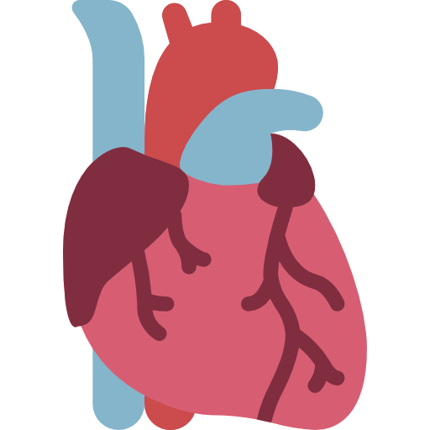
Lecture 7
Editing file
Infective Endocarditis
Objectives:
Understand Infective Endocarditis definition
Pathophysiology of endocarditis
Diagnostic criteria of infective endocarditis
Recognize the risk factors, signs, and symptoms of infectious endocarditis.
Anticipate possible complications of infective endocarditis
Treatment of endocarditis and appreciation of the necessity of rapid treatment.
Endocarditis prophylaxis
Color index:
Color index:
Original text Females slides Males slides
Doctor’s notes Text book Important Golden notes Extra

Slide 2
Introduction to IE
What’s Infective Endocarditis (IE)?
Infective Endocarditis is an infection of the endocardial surface of the heart, which may include; one or more heart valves (native or prosthetic), Chordae tendineae , a septal defect (e.g. ASD, VSD), AV shunt, Mural endocardium. (IE can extend to all layers of the heart)
IE develops most commonly on the mitral valve, followed by the aortic valve, combined mitral & aortic valve, tricuspid valve (especially In IVDU) & rarely, the pulmonic valve.
Epidemiology of IE
Developing countries (endemic RF), Subacute course, viridans group streptococci.
Developed countries, acute illness, Staphylococcus aureus, with numerous anatomic sites of metastatic foci of infection and worse outcomes.
Mechanical prosthetic & bioprosthetic valves exhibit equal rates of infection.
More common in males
It occurs in 5-7 per 100,000 person-years before 2000 and now 15 per 100,000 persons-years¹.
It remains a life threatening disease with significant mortality (About 20%) and morbidity.
Pathogenesis of IE
The IE is the net result of the complex interaction between the bloodstream pathogen with matrix molecules and platelets at sites of Endocardial cells damage.
Bacterial adherence
Endothelial damage
Invasion of the bloodstream (via mouth, skin or intravenous lines, or gastrointestinal tracts) by a microbial species that has the pathogenic potential to colonize this site (endocardium). This will result in the proliferation of bacteria within NBTE (leading to infiltration by neutrophils and macrophages) forming vegetations⁴ (hallmark of IE)
Caused by turbulent blood flow produced by either a congenital or acquired heart disease. This flow can be from a high to a low pressure chamber², High velocity jet or across a narrowed orifice (e.g. Aortic stenosis, Mitral stenosis) which traumatizes the endothelium.
01
02
03
Formation of NBTE
What’s the source of the bacteremia in IE?
Trauma to a mucosal surface heavily populated by endogenous microflora; Such as the gingiva around the teeth and oropharynx (Old: GI tract, urethra and vagina). This will releases many different microbial species transiently into the bloodstream which will leads to transient bacteremia caused by organisms e.g. Viridans group streptococci .
Endothelial damage creates a predisposition for deposition of platelets and fibrin on the surface of the endothelium, which results in Nonbacterial Thrombotic Endocarditis (NBTE)³.
1- Why is it increased nowadays? Because of the increase in IVDU.
2- Like in Ventricular septal defect; the left side of the heart has higher pressure than the right, so there will be turbulent blood flow from Lt to Rt traumatizing the endothelium.
3- AKA Marantic Endocarditis, it’s associated with metastatic cancer (Has poor prognosis), It becomes IE when bacterial colonization occurs. Another form of Nonbacterial endocarditis (NBE) is Libman - Sacks Endocarditis, which typically occurs in individuals with SLE. Other causes of NBE include: Cancer of lungs, ovaries.
4- (1) Local destruction: Vegetations may destroy the valve itself which may lead to regurgitation, HF etc, It also may form perivalvular abscess if it’s in aortic valve (Dangerous and Surgery is required in this case). (2) Septic embolization: Vegetations may detach → Septic embolization to any part of the body e.g. Peripherally, spleen, liver, lung, eyes , brain (mycotic aneurysm). Septic embolization may lead to stroke, abscess formation, Gangrene, Hematuria (→ Anemia) and elevated ESR, septic arthritis. Vegetations may also cause(3) immunological reaction → Glomerulonephritis, arthritis, Rheumatoid factor, Antinuclear antibody, CRP and ESR.

Slide 3
Risk factors for IE
Risk factors for IE
Patient factors | Comorbid conditions
Age: > 60 years Gender: Male IV drug abuser (IVDU) (Staph. aureus mainly) Poor dentition or dental procedure /infection (Strep. Viridans mainly) | Structural heart disease Valvular heart disease (VHD) Congenital heart disease Prosthetic heart valves / TAVR Previous endocarditis Intravascular device e.g. indwelling catheters Cardiac implantable electronic device Chronic hemodialysis HIV infection
Determining the risk of IE
Determining the risk depends on:
1- Presence or absence of cardiac condition. 2- The type of procedure to be done.
High risk (Need antibiotic prophylaxis)
Antibiotic prophylaxis is reasonable before dental procedures requiring manipulation of gingival or periapical region of teeth or perforation of oral mucosa in patients with the following: Prosthetic cardiac valves including transcatheter valve or prosthetic material used for cardiac valve repair (400x risk , Highest risk) History of previous endocarditis. Congenital heart defect(CHD) such as Ventricular septal defect (VSD), Patent Ductus Arteriosus (PDA) , Coarctation of aorta and Complex cyanotic disease (Tetralogy, Transposition, Single ventricle): Unrepaired cyanotic CHD, including palliative shunts/conduits Any type of CHD repaired with prosthetic material whether placed surgically or by catheter intervention during first 6 months after the procedure or lifelong if residual shunt or valve regurgitation remains Repaired CHD with residual defects at the site or adjacent to the site of a prosthetic patch/prosthetic device that inhibits endothelization Cardiac transplant with valve regurgitation due to a structurally abnormal valve (develop cardiac valvulopathy). Antibiotic prophylaxis is no longer recommended for any form of procedure or valvular or congenital heart disease, except for dental procedures that involve manipulation of gingival tissue, periapical region of teeth, Or perforation of oral mucosa and the conditions listed above.
Prophylaxis:
For dental procedure at risk​​ :​Amoxicillin or Ampicillin:
Adults: 2 g orally or IV, single dose 30-60min before the procedure​.
Children: 50mg/kg orally or IV, single dose 30-60min before the procedure​.
If Allergic to penicillin or ampicillin​: ​Clindamycin​ ​
Adults: 600 mg​ orally or IV, single dose 30-60min before the procedure​.
Children:20mg/kg orally or IV, single dose 30-60min before the procedure​.
Click here to check the table in females slides

Slide 4
Classification of IE
Classification of IE
Nature of the valve involved/ Type of lesion¹
Onset and progression
Acquisition of the infection
Native
Acute
(Symptoms up to 6wks)
Nosocomial
Congenital
Community
Prosthetic
Subacute
(Symptoms up to 6wks-3m)
Early
Late
Chronic
(Symptoms -3months)
IV drug abuse
Acute vs Subacute IE
 | Acute | Subacute
Causative organism | Staphylococcus aureus (High virulence organism) | Strept. viridans or bovis (Low virulence organisms)
Site | Normal heart valves (Most commonly Tricuspid) | Previously damaged heart valves
Prognosis | If untreated, fatal in less than 6 weeks | If untreated, takes much longer than 6 weeks to cause death
Overview on causative organisms
Staph aureus (Including MRSA) | Aggressive acute IE. Metastatic infection, valve destruction. Mortality 25-40% (left heart)
Coagulase negative Staph e.g. staph epidermidis | Foreign body infection/prosthesis Nosocomial infection
Strep. gallolyticus (previously known as Strep. bovis), | GI flora associated with polyps and colon cancer (do Colonoscopy) Subacute endocarditis, Highly sensitive to penicillin.
Beta-hemolytic strept group A-B-C-G | Frequent intracardiac & extracardiac complications, abscesses
Enterococci (faecalis, Faecium) | GI flora, associated with UTI/ nosocomial infection
What’s the most common overall causative agent? Streptococcus viridans
Patient with history of VHD (e.g. Chronic rheumatic heart disease and MVP) and dental procedure → Streptococcus viridans
IV drug user presented with endocarditis → Staphylococcus aureus
Patient who has done prosthetic valve surgery, presented with endocarditis later →
Staphylococcus epidermidis or aureus (If within 60d of surgery) or Streptococcus viridans (If after 60d of surgery)
Patient has colorectal cancer and presented with endocarditis → Streptococcus bovis
Patient presented with endocarditis but all blood cultures are negative → HACEK
1- What carries more risk of IE, native or prosthetic valve? Prosthetic bc it’s metal so has no blood supply → no abx can reach it

Slide 5
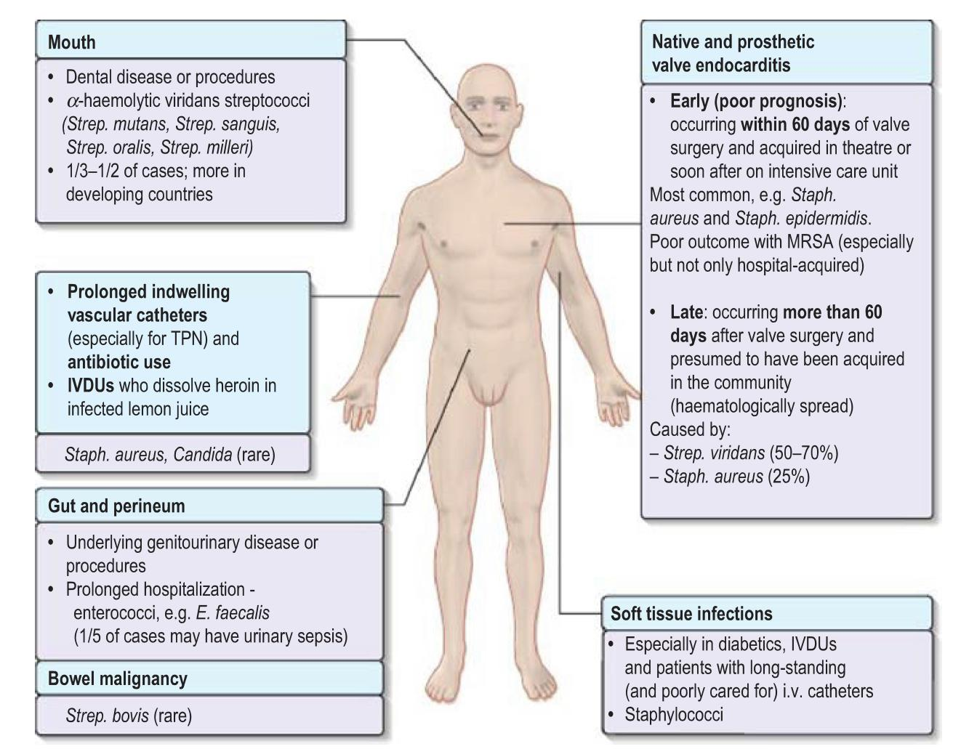
Microbiology of IE
How to determine the causative agent?
It vary depending on the population:
IV drug abusers
Patients with Prosthetic Heart Valve (PHV)
Hospital acquired vs Community acquired
What are the most common causative organisms of IE worldwide?
Streptococci:
Common cause of community acquired IE
Staphylococci:
Most common cause in the US & most developed countries.
Health care-associated IE
Enterococci
Click here for a few pics present in females slides only
Native valve IE | IV drug abusers IE | Prosthetic valve IE
Streptococci: (50-70%) Streptococcus viridans (50%) Staphylococci: (~25%) Mostly Coagulase +ve Staph aureus Or Staph. Epidermidis Enterococci¹ ( ~10%) HACEK: Haemophilus species, Actinobacillus, Actinomycetemcomitans, Cardiobacterium hominis, Eikenella, Kingella | Skin is the most predominant source of infection. 70 - 100% of Right sided IE results in pneumonia and septic emboli. It commonly affects tricuspid valve. | A) Early onset: (< 60d² after surgery)
 |  | It usually reflects perioperative contamination with Incidence around 1%. Staph. Epidermidis (30%) or Staph. Aureus (20%). Gram -ve aerobes (20%) Fungi (10%) Strep and Entero (5-10%)
 |  | B) Late onset: (>60d² after surgery)
 |  | Occurs after endothelialization with of Incidence 0.2 -0.5 %، due to transient bacteraemia from dental, GI or GU. Streptococcus viridans (resemble native valve IE)
Culture negative endocarditis³ (Female slides only)
HACEK: Fastidious gram-negative bacilli, Positive blood culture after 5 days of incubation & maybe longer, large vegetations. Coxiella burnetii (Q fever):⁴ Subacute endocarditis, elevated IgG Bartonella: Cat scratch disease Fungi (candida): risk factors are immunosuppression, prosthesis, central line, IVDU, invasive endocarditis Others: Brucella (history of contact with goats or cattle), tropheryma whipplei, Mycoplasma, legionella
Staphylococcus aureus 60%
Streptococci and Enterococci (20%)
Gram -ve bacilli (10%)
Fungi (Candida and Aspergillus) (5%).
Description of the organisms: (EXTRA)
Streptococcus Viridans: Gram positive cocci, catalase negative, alpha hemolytic and optochin resistance.
Staphylococcus aureus: Gram positive cocci, Catalase positive, coagulase positive
Staphylococcus epidermidis: Gram positive cocci, Catalase positive, coagulase negative, novobiocin sensitive
Strep. bovis: Gram positive cocci, catalase negative, oxidase negative, gamma hemolytic.
1- e.g. Enterococcus faecalis, and Strep. gallolyticus (previously known as Strep. bovis), they enter blood through bowel and Urinary tract. Patients who are found to have endocarditis caused by Strep. gallolyticus should undergo colonoscopy, since this organism is associated with colon cancer.
2- In females slides it’s 12 months, according to the female Dr, 60 days is the old classification, the new one is 12 months. (In Males slides and Kumar it’s 60d)
3- Culture-negative endocarditis usually is caused by prior administration of antibiotics before obtaining blood cultures or by infection with fungi or fastidious organisms.
4- In Q fever endocarditis due to Coxiella burnetii, the patient often has a history of contact with farm animals. The aortic valve is usually affected and there may also be hepatitis, pneumonia and purpura.

Slide 6
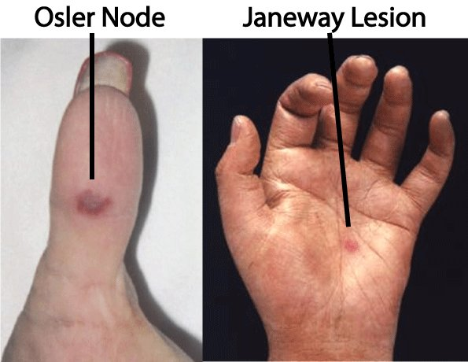
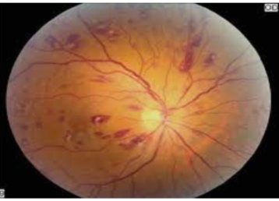
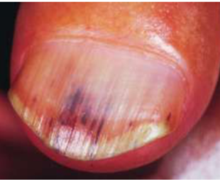
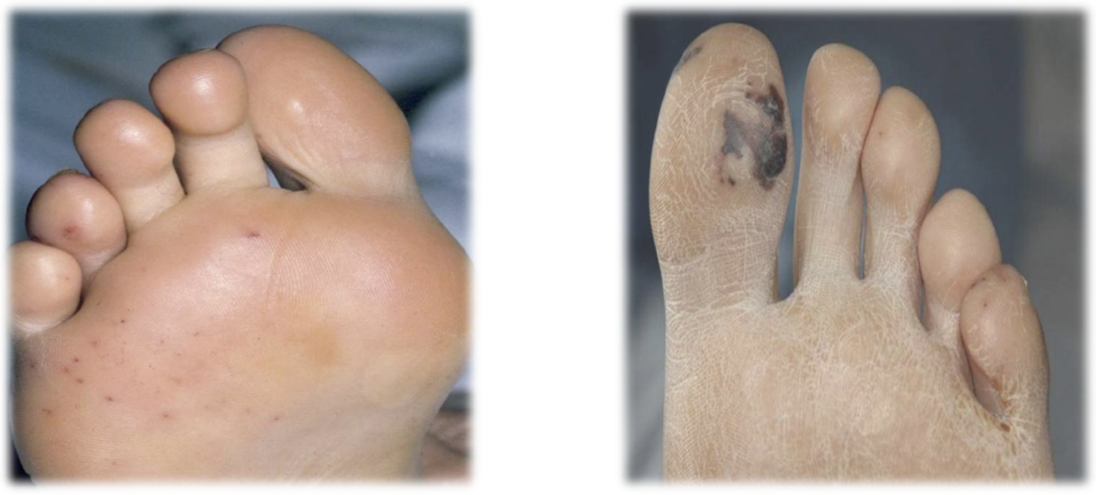
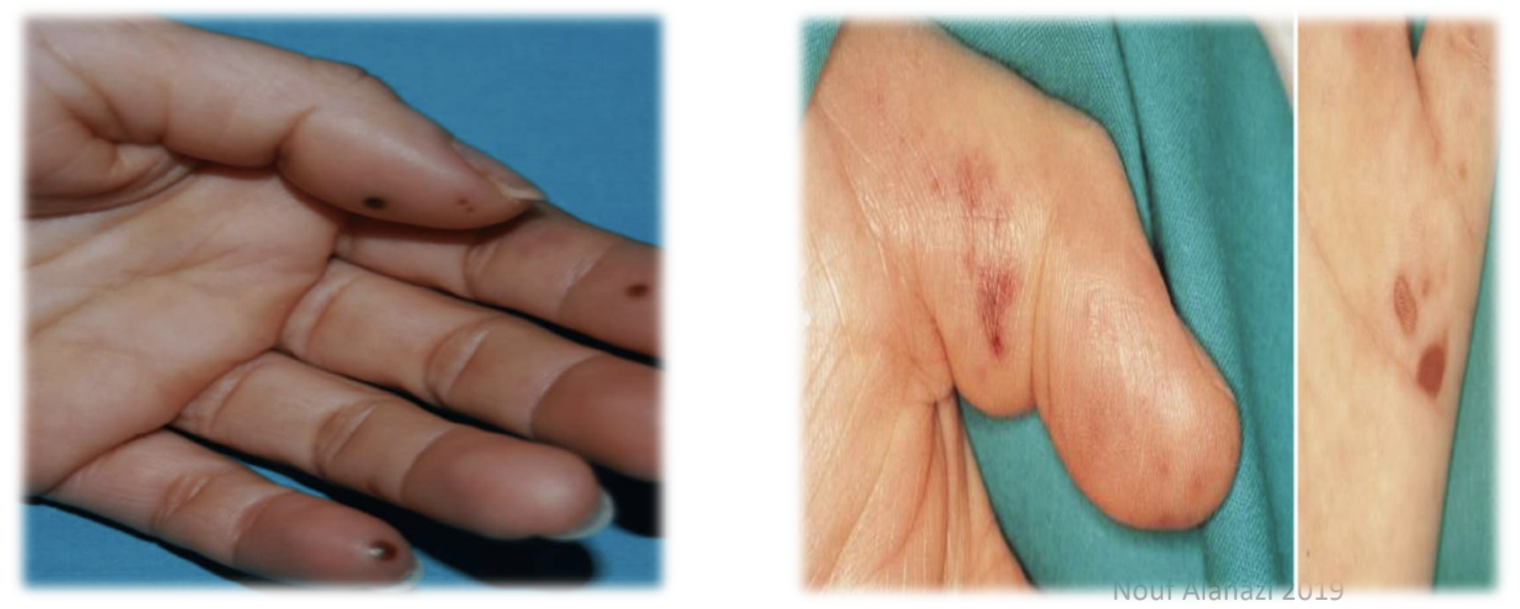
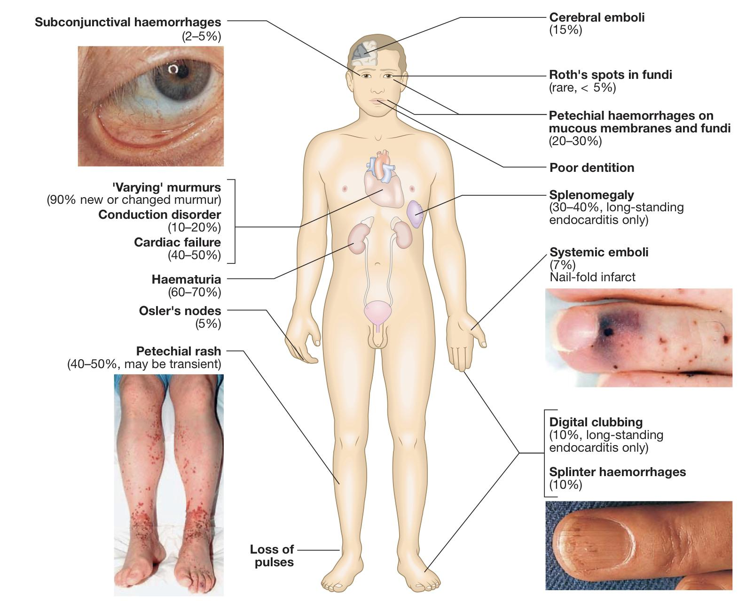
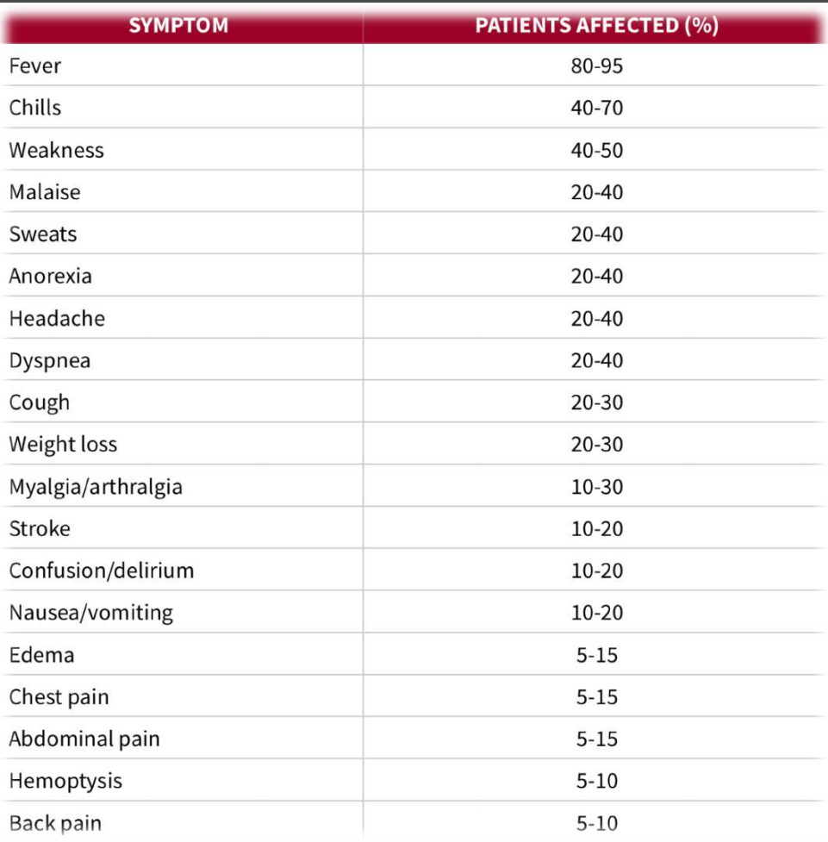
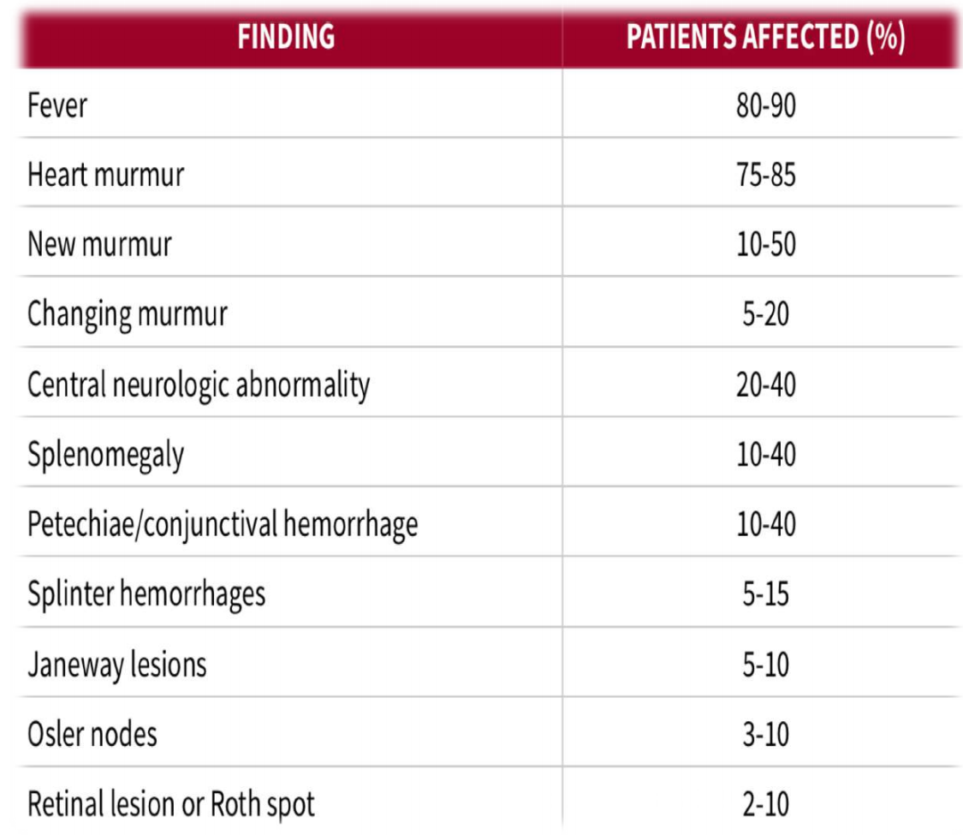
Clinical features of IE
Signs & Symptoms
FROM JANE
The onset of symptoms is usually within 2 weeks of infection.
Indolent course | Subacute endocarditis: Fever, malaise, fatigue, night sweats, anorexia and weight loss. (Constitutional Sx)
Explosive course | Acute endocarditis: Congestive cardiac failure (CCF), new/changing murmur with severe systemic sepsis.
Other Signs & Symptoms | Immunological features^{1,2} | Osler’s Nodes (10-25%): painful (tender), red, raised subcutaneous lesions found on the distal hands and feet. (OUCHler nodes to remember it’s painful) Roth Spots (5%): retinal hemorrhages with white or pale centers³. (seen best in slit lamp exam) Glomerulonephritis +ve Rheumatoid Factor
 | Vascular² and septic Emboli | Splinter/Nail bed (Or subungual) Haemorrhages: Dark-red, linear lesions in the nail beds, (5-10%). Septic arthritis. Janeway Lesion : painless (nontender) hemorrhagic skin lesion in the palm and sole Subconjunctival Hemorrhage Mycotic Aneurysm Hematuria → Anemia
 | Other | Splenomegaly (30%) Petechiae³ (20-40%): Nonblanching, pinpoint reddish brown macules in conjunctival, buccal mucosa, palate & skin in supraclavicular area. Delirium, Pallor, Cardiac arrhythmia, central neurologic abnormalities, Pericardial rub, and Pleural friction rub.
1- You must differentiate between Immunologic and Septic features.
2- splinter hemorrhage, Janeway lesions, Osler nodes and Roth spots are very specific regions (characteristic of IE) but are rarely seen nowadays due to earlier detection of IE. In clinical practice, one might not seen them unless treating a patient from a developing country where healthcare is insufficient.
3- reflects embolization with loss of blood supply surrounded by an area of hemorrhage.

Slide 7
Diagnostic criteria of IE
Duke criteria
BE FEVER I
Major criteria
Positive blood culture: Typical organism from two separate cultures e.g. Strep, Staph, HACEK Persistent positive blood cultures ≥ 2 positive blood cultures of blood samples drawn >12 hrs apart All of 3 or a majority of ≥ 4 separate cultures of blood (with 1st and last samples drawn ≥ 1h apart) Single positive culture for coxiella burnetii or phase I IgG antibody titre > 1:800 Endocardial involvement: (Check definitions next page) Positive echocardiographic findings of vegetations, Abscess , pseudoaneurysm ,intracardiac fistula , valvular perforation, aneurysm or New partial dehiscence of prosthetic valve Abnormal activity around the site of prosthetic valve implantation detected by F-FDG PET/CT (only if the prosthesis was implanted for >3 months) or radiolabeled leukocytes SPECT/CT. Definite paravalvular lesion by cardiac CT New valvular regurgitation
Minor criteria
Fever: > 38ºC Echo findings: Any finding not involved in the major criteria e.g. calcification Vascular phenomena (Including these detected only by imaging): Major arterial emboli , septic pulmonary infarcts , infectious (mycotic) aneurysm , intracranial hemorrhage , conjunctival hemorrhage and janeway’s lesions. Evidence from microbiology: Positive blood culture but does not meet a major criterion as noted above or serological evidence of active infection with organism consistent with IE. Risk factors and predisposition: Such as heart conditions (e.g. VHD, prosthetic valve, previous IE) or IV drug users Immunological phenomena: Glomerulonephritis , osler’s nodes , Roth’s spots and Rheumatoid factor

Slide 8
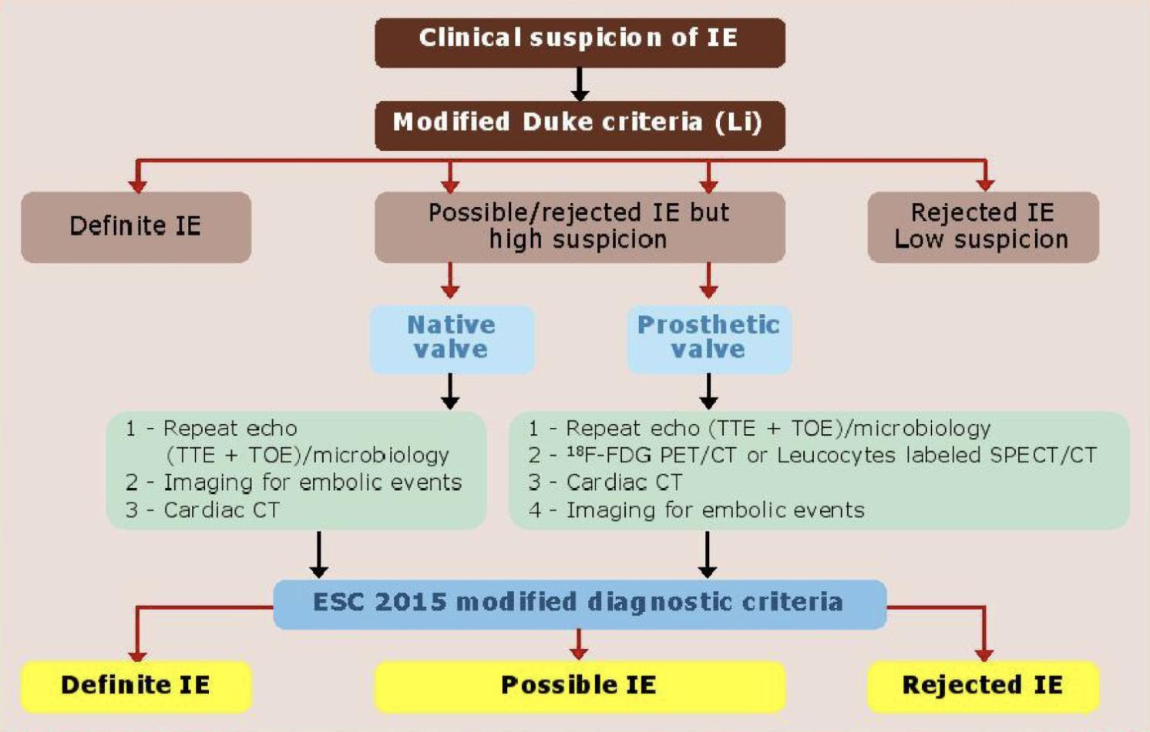
Diagnostic criteria of IE cont’
Duke criteria
Definitive IE: (Begin treatment right away)
Clinical criteria: Patients with 2 major, OR 1 major and 3 minor, OR 5 minor.
Pathologic criteria: Microorganisms or pathologic lesions: demonstrated by culture or histology in a vegetation, or in a vegetation that has embolized, or in an intracardiac abscess
Possible IE: (Requires further tests)
Clinical criteria: Patients with 1 major and 1 minor, OR 3 minor.
Rejected IE:
Firm alternate Diagnosis for manifestation of IE
Resolution of manifestations of IE, with antibiotic therapy for ≤ 4 days
No pathologic evidence of IE at surgery or autopsy, after antibiotic
therapy for ≤ 4 days)
Anatomic and echographic definitions
Pathology | Surgery/necropsy | Echocardiography
Vegetation | Infected mass attached to an endocardial structure or an implanted intracardiac material | Oscillating or non-oscillating intracardiac mass on valve or other endocardial structures, or on implanted intracardiac material
Abscess | Perivalvular cavity with necrosis and purulent material not communicating with the cardiovascular lumen | Thickened, non-homogeneous perivalvular area with echodense or echolucent appearance
Pseudoaneurysm | Perivalvular cavity communicating with the cardiovascular lumen | Pulsatile perivalvular echo-free space, with colour doppler flow detected
Perforation | Interruption of endocardial tissue continuity | Interruption of endocardial tissue continuity traversed by colour doppler flow
Fistula | Communication between 2 neighbouring cavities through a perforation | Colour-doppler communication between two neighbouring cavities through a perforation
Valve aneurysm | Saccular outpouching of valvular tissue | Saccular bilging of valvular tissue
Dehiscence of a prosthetic valve | Dehiscence of the prosthesis | Paravalvular regurgitation identified by TEE/TOE, with or without rocking motion of the prosthesis

Slide 9
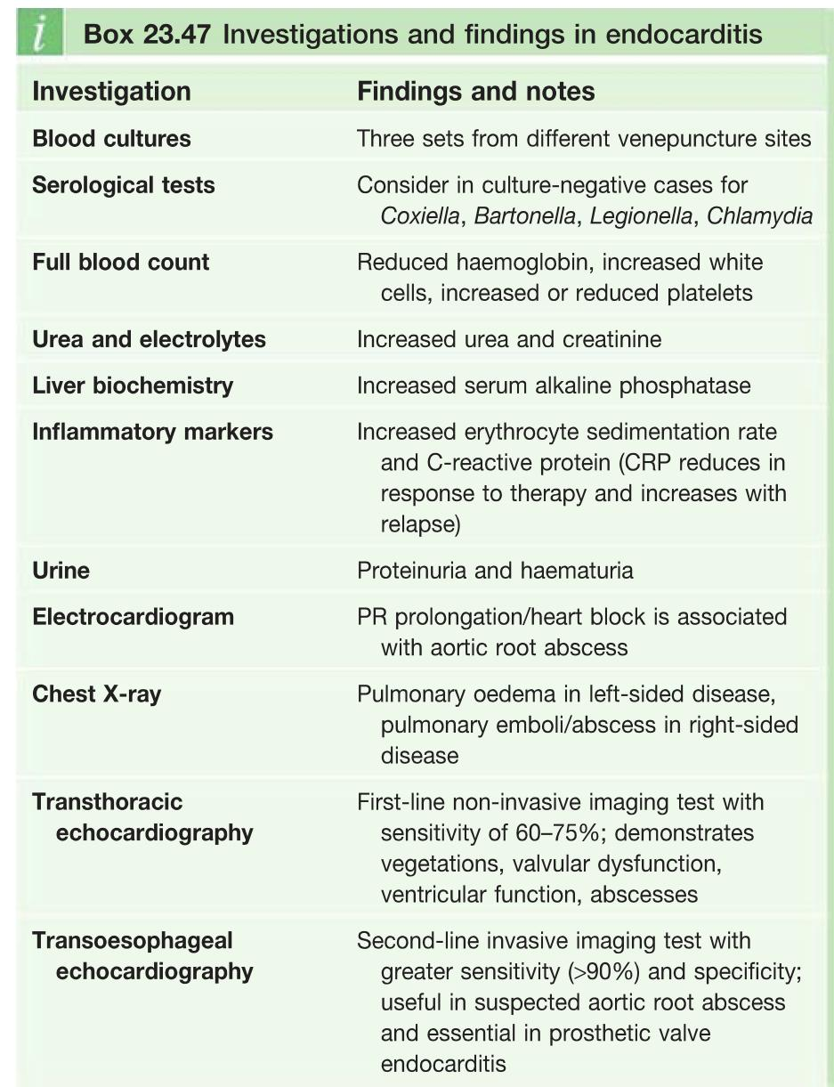
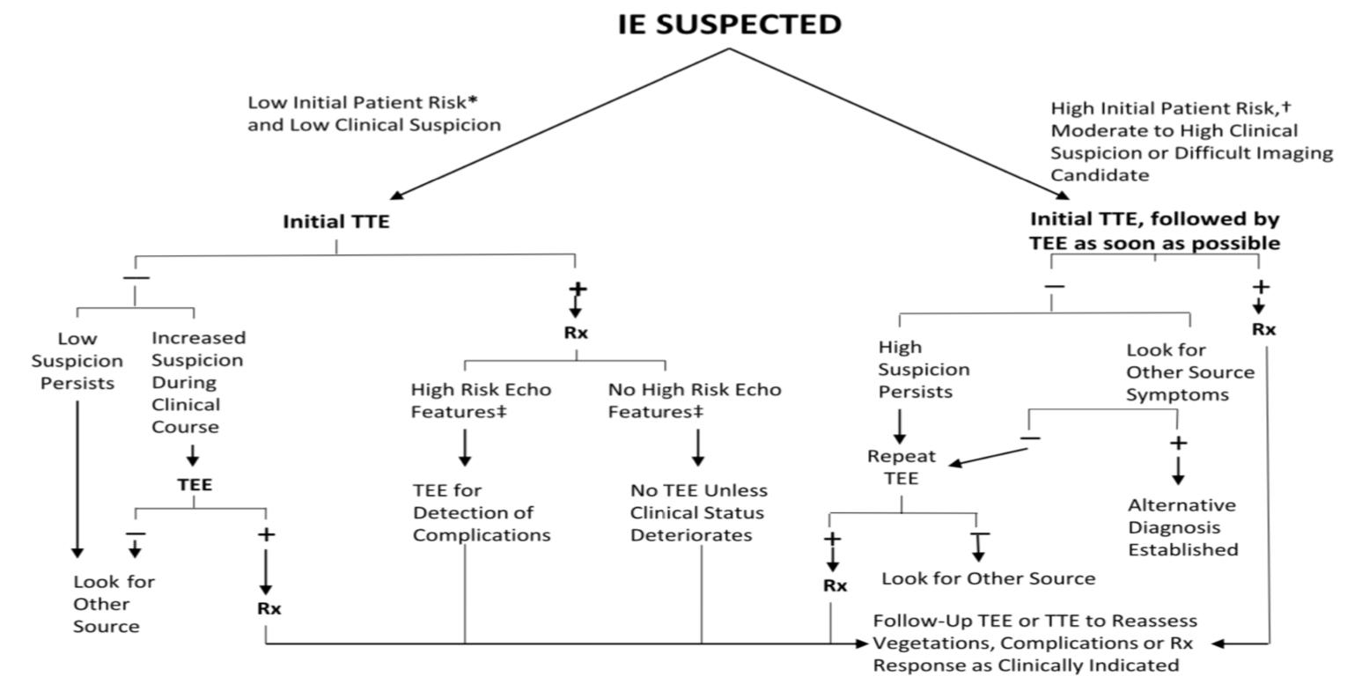
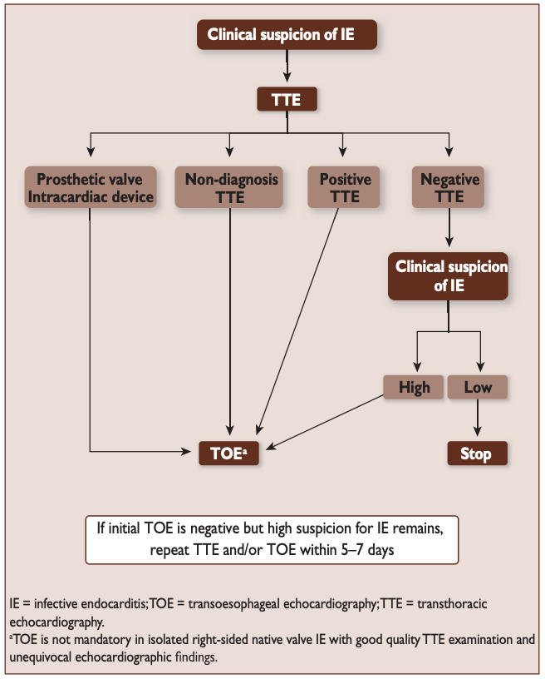
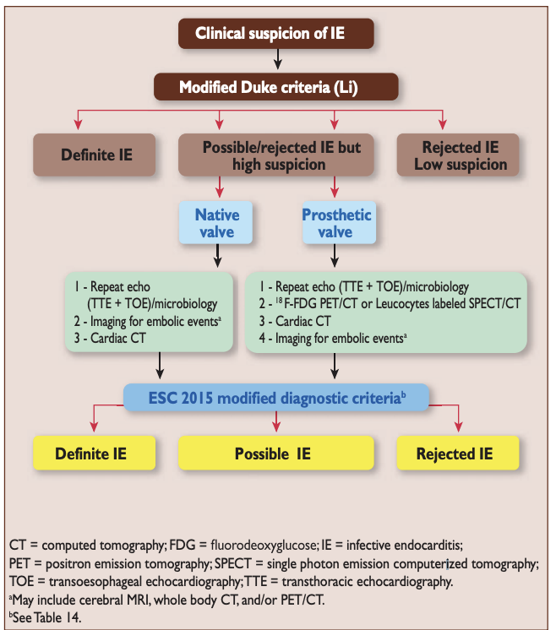
Pleural friction rub
Clinical suspicion & Investigations
Clinical suspicion
Investigations
The clinical presentation of infective endocarditis is dependent on the organism and the presence of predisposing cardiac conditions. Infective endocarditis may occur as an acute, fulminating infection but also as a chronic or subacute illness with low-grade fever and nonspecific symptoms.A high index of clinical suspicion is required to identify patients with infective endocarditis and certain criteria should alert the physician.
Investigation | Findings and notes
Blood cultures | It’s the key diagnostic investigation (Best initial) At least 3 sets of samples taken from different venipuncture sites¹ over 24h under a meticulous aseptic technique.
Serological tests | Consider in culture-negative cases for Coxiella, Bartonella, Legionella, Chlamydia
CBC | Reduced haemoglobin (anemia), increased white cells, increased or reduced platelets
Inflammatory markers | Increased erythrocyte sedimentation rate and C-reactive protein (CRP reduces in response to therapy and increases with relapse, making it helpful in monitoring therapy)
RFT | Increased urea and creatinine due to glomerulonephritis
Urine | Proteinuria and haematuria (Could be due to glomerulonephritis or sepsis)
ECG | PR prolongation/heart block is associated with aortic root abscess
CXR | Pulmonary oedema in left-sided disease, pulmonary emboli/abscess in right-sided disease
Echo (Cornerstone of diagnosis) | Transthoracic echocardiography² (TTE) | First-line non-invasive imaging test with sensitivity of 70%; demonstrates vegetations, valvular dysfunction, ventricular function, abscesses
 | Transesophageal echocardiography³ (TEE/TOE) | Second-line invasive imaging test with greater sensitivity (96%) and specificity; useful in suspected aortic root abscess and essential in prosthetic valve endocarditis, intracardiac devices or complications
High clinical suspicion if pt has: | Low clinical suspicion
New valve lesion/(regurgitant) murmur, Sepsis of unknown origin, Embolic event(s) of unknown origin, Haematuria, glomerulonephritis and suspected renal infarction Fever plus: Prosthetic material inside the heart First manifestation of congestive cardiac failure Positive blood cultures (with typical organism) Cutaneous (Osler, Janeway) or ophthalmic (Roth) lesions Peripheral abscesses (renal, splenic, spine) of unknown origin Other high predisposition for infective endocarditis, e.g. IV drug use Newly developed ventricular arrhythmias or conduction disturbances Predisposition and recent diagnostic/therapeutic interventions known to result in significant bacteraemia | Fever plus none of the mentioned in high clinical suspicion,
CBC for leukocytosis or anemia (anemia because of hematuria and bleeding under the skin and eyes) -ESR High (sensitive), all IE patients will have high ESR -Blood cultures +ve for suspected organisms
Renal Function Because there could be glomerulonephritis and causes AKI (increase in creatinine) -Urinalysis for hematuria or bacteriuria
ECG for conduction defects (AV blocks due to paravalvular abscess compression) ➔ Chest X-ray for septic abscess in the lung secondary to embolization, Heart failure ★ Echocardiogram: GOLD STANDARD for vegetations. If TTE does not detect it, we can do TEE
Hematology | Nephrology | Cardiac
CBC for leukocytosis or anemia (anemia because of hematuria and bleeding under the skin and eyes) ESR High (sensitive), all IE patients will have high ESR Blood cultures +ve for suspected organisms | Renal Function Because there could be glomerulonephritis and causes AKI (increase in creatinine) Urinalysis for hematuria or bacteriuria | Echocardiogram: GOLD STANDARD for vegetations. If TTE (first line) does not detect it, we can do TEE (more sensitive)
Diagnosis of IE:
Diagnosis of IE depends on clinical suspicion⁴, blood culture, Echocardiography
When IE is suspected the best initial test is to obtain serial blood cultures.
Patients with suspected IE should have appropriate blood cultures drawn prior to cardiac imaging studies. (TTE should be attempted first in most cases. TEE should be used if TTE is nondiagnostic)
1- to ensure it is an infection and not just a contaminated sample.
2- normal echo(TTE) cannot rule the diagnosis out because the vegetation can migrate , so maybe the pt had vegetation but it migrated to the brain or the abdomen
3- Only negative findings on (TEE) can reliably rule out endocarditis, as (TTE) is not sensitive enough!
4- By checking the patient history e.g. if the patient underwent a dental procedure in the last 4wks or if the patient has any cardiac lesions (e.g. Prosthetic valve) then you must have high clinical suspicion of IE.

Slide 10
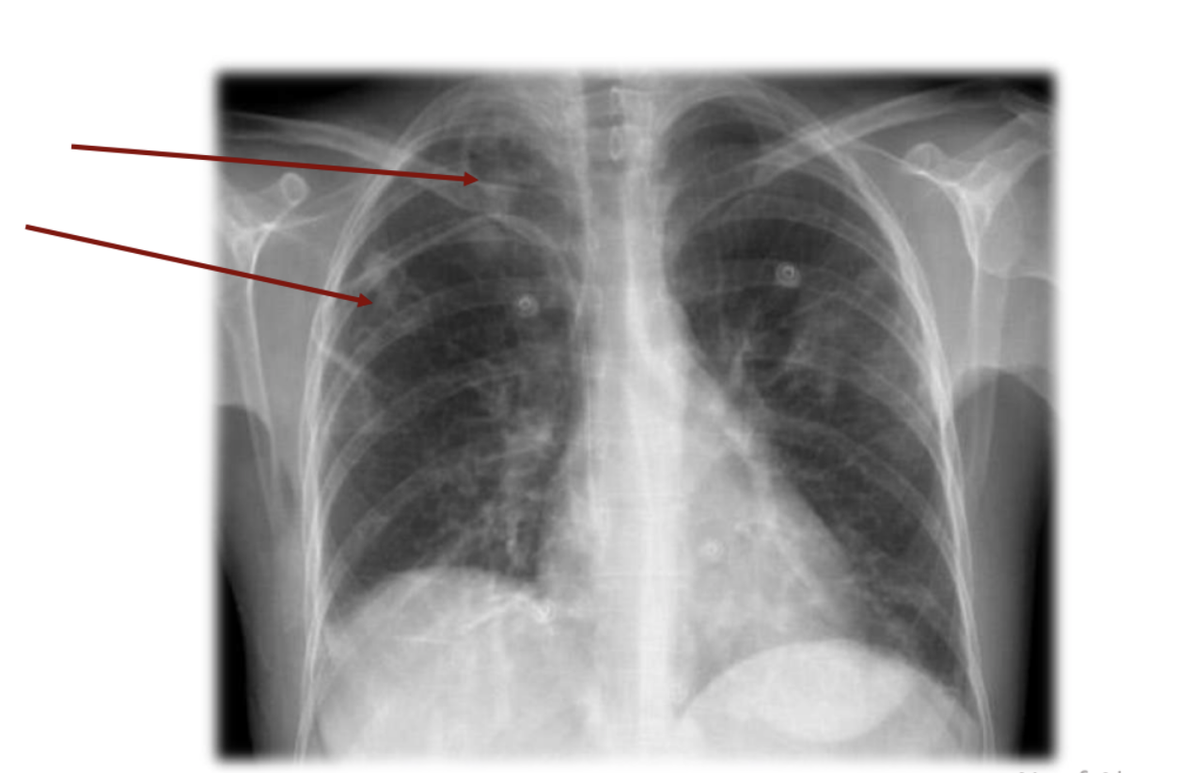
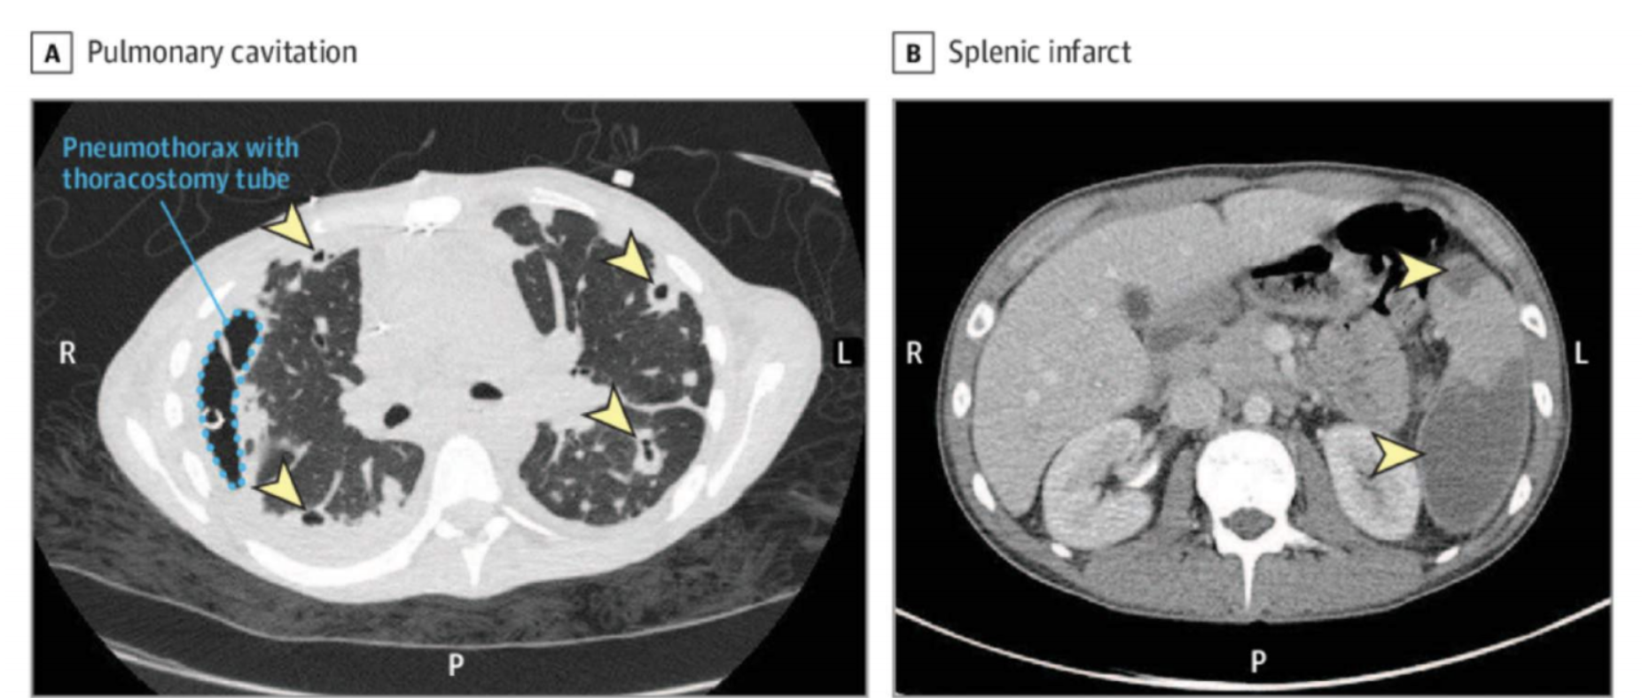
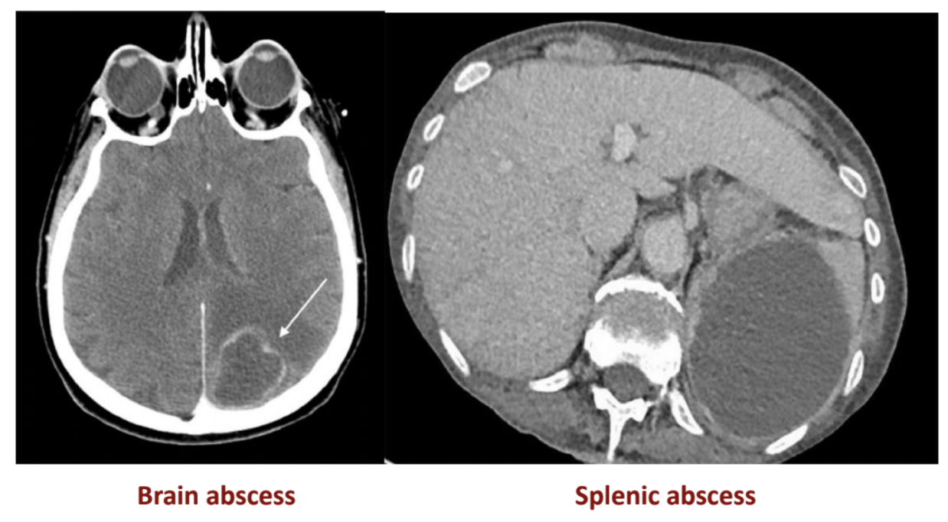
Complications of IE
Complications of IE
Embolic | Risk factors for embolic (Females slides only) | Size of vegetation (>10 mm) Left side vegetations Staph. Aureus Fungal pathogens Uncommon after 2 weeks of effective treatment
 | Complications | Neurological manifestations (1⁄3 of cases): caused by stroke either due to major embolism to MCA (25%) or ICH from a ruptured mycotic aneurysm (2-10%) or hemorrhagic transformation of stroke. MI, PE (Septic emboli “Pulmonary cavitation”) Ischemic limb, Mesenteric ischemia Splenic or renal infarction Digital infarcts
Local spread |  | Congestive Heart failure (The commonest complication): Caused by extensive valvular destruction, ruptured chordae tendineae, fistulas, valve obstruction, Myocarditis, Coronary artery embolism, MI and Myocardial Abscesses Paravalvular abscess: Most common in aortic valve, IVDA, staph, aureus AV block / conduction disorders: Myocardial abscesses Pericarditis
Metastatic spread |  | Rt. Sided vegetations: Lung abscesses, Pyothorax / Pyo-pneumothorax Lt. Sided vegetations: Pyogenic Meningitis, Splenic Abscesses, Pyelonephritis, Osteomyelitis Metastatic abscesses Septic arthritis
Formation of immune complexes |  | Immune complex glomerulonephritis leading to Acute renal failure Immunologic arthritis
Septic Emboli
Why would fever persist for a long time? (Females slides only)
Resolution of fever occurs in 5-7 days; persistence of fever indicates:
Abscess
Infected indwelling catheters or devices
Septic embolization
An extracardiac site of infection (native or prosthetic)
Inadequate antibiotic treatment of resistant organism
An adverse reaction to the antibiotic therapy itself

Slide 11
Management of IE
Medical therapy (Antibiotics)
Click here for a few treatment tables present in females slides only
Empirical therapy:
Empirical treatment depends on the mode of presentation, the suspected organism and the presence of a prosthetic valve or penicillin allergy.
After identification of the causal organism:
Principles of medical therapy: Treat vegetations with with high dose of IV bactericidal abx for prolonged duration (Generally native valve → 2-4wks and Prosthetic valve → 6-8wks.)
Acute onset | Subacute onset¹ | Prosthetic valve IE
Blood culture and start treatment within 3 hours. Abx: Vancomycin and Gentamicin | Blood culture then antibiotic can be started within 3d Abx: Amoxicillin with/without gentamicin | Abx: Vancomycin, gentamicin and rifampicin
Staphylococcus | Strep. viridans or bovis
Native valve MSSA: Flucloxacillin OR Naficillin OR Oxacillin for 4wks MRSA & Penicillin allergic Pts: Vancomycin for 4-6wks Prosthetic valve MSSA: Flucloxacillin with gentamicin and rifampicin MRSA & Penicillin allergic Pts: Vancomycin, with gentamicin and rifampicin | Penicillin susceptible: IV Ceftriaxone once daily for 4 weeks (cure rate >98%) OR Ceftriaxone 2g for 2 weeks followed by oral amoxicillin for 2 weeks OR IV penicillin G OR IV amoxicillin for 4 weeks In B-lactam allergic patients: Vancomycin. Penicillin resistant: Ceftriaxone with Gentamicin OR Penicillin G OR Amoxicillin. In B-lactam allergic patients: Vancomycin with Gentamicin
Enterococci: Ampicillin and gentamicin & for HACEK group use Ceftriaxone
Feel lost? click here
Surgical therapy
Indications for cardiac surgery in IE:
Heart failure due to valve damage e.g. Dehiscence, intracardiac fistula or prosthetic dysfunction
Failure of abx therapy: persistent infection (bacteremia or fever) lasting >5-7 days after starting abx
Large/persistent vegetations on left-sided heart valves with echo appearance suggesting high risk of recurrent emboli.
IE complicated by heart block, annular abscess, or destructive perforating lesions.
Patients with fungal endocarditis often require cardiac surgery.
Prosthetic valve IE caused by fungi or highly resistant organisms.
1- If the presentation is subacute, antibiotic treatment should ideally be withheld until the results of blood cultures are available. However, if empirical antibiotic treatment is considered necessary give the ones mentioned.

Slide 12
Prevention of IE
A 77-year-old man is brought to the emergency department by his daughter after he developed weakness in his right upper extremity. She says that he has been sick for the past two weeks with fever, chills, and night sweats and that he has lost nearly 4.5 kg (10 lb) during that time. He had attributed these symptoms to the flu, but he could not move his left arm when he woke this morning. He denies other symptoms. On further questioning, his general health is good except for poorly controlled hypertension, and he underwent an aortic valve replacement 2 months ago. Physical examination is remarkable for upper left hemiplegia, the click of his prosthetic valve, and the image below on fundoscopic exam. Vital signs include a temperature of 38.9°C (102.0 °F), blood pressure of 114/55 mm Hg, and pulse of 115/min.
Prevention
Main principles of prevention:
The principle of antibiotic prophylaxis when performing procedures at risk of IE in patients with predisposing cardiac conditions is maintained.
Antibiotic prophylaxis must be limited to patients with highest risk of IE undergoing the highest risk dental procedures.
Good oral hygiene and regular dental review are more important than antibiotic prophylaxis Aseptic measures are mandatory during venous catheter manipulation and during any invasive procedures in order to reduce the rate of healthcare-associated IE.
Whether the use of antibiotic prophylaxis is really associated with a change is the incidence of IE needs further investigations.
Q1: What’s the most likely diagnosis?
Given the patient’s history and physical findings, the most likely diagnosis is infective endocarditis (IE)
Q2: What tests and/or imaging tools could be used to confirm the diagnosis?
This diagnosis should be made by:
Three blood cultures separated by at least 1 hour from different venipuncture sites.
Echocardiography should be done in all patients with moderate suspicion of IE.
TTE should be attempted first in most cases. TEE should be used if TTE is nondiagnostic.
ECG baseline should be obtained.
Antibiotic treatment is organism specific and usually lasts 4–6 weeks for native valves and at least 6 weeks for prosthetic valves.
Q3: What are the Duke criteria?
BE FEVER I
Case: A 77-year-old man is brought to the emergency department by his daughter after he developed weakness in his right upper extremity. She says that he has been sick for the past two weeks with fever, chills, and night sweats and that he has lost nearly 4.5 kg (10 lb) during that time. He had attributed these symptoms to the flu, but he could not move his left arm when he woke this morning. He denies other symptoms. On further questioning, his general health is good except for poorly controlled hypertension, and he underwent an aortic valve replacement 2 months ago. Physical examination is remarkable for upper left hemiplegia, the click of his prosthetic valve, and the image below on funduscopic exam. Vital signs include a temperature of 38.9°C (102.0 °F), blood pressure of 114/55 mm Hg, and pulse of 115/min.
Q1: What’s the most likely diagnosis?
Given the patient’s history and physical findings, the most likely diagnosis is infective endocarditis (IE)
Q2: What tests and/or imaging tools could be used to confirm the diagnosis?
This diagnosis should be made by:
Three blood cultures separated by at least 1 hour from different venipuncture sites.
Echocardiography should be done in all patients with moderate suspicion of IE.
TTE should be attempted first in most cases. TEE should be used if TTE is nondiagnostic.
ECG baseline should be obtained.
Antibiotic treatment is organism specific and usually lasts 4–6 weeks for native valves and at least 6 weeks for prosthetic valves.
Q3: What are the Duke criteria?
BE FEVER I
Q4: What are the indications for prompt surgical intervention?
Heart failure due to valve damage
Failure of antibiotic therapy (persistent/uncontrolled infection)
Large vegetations on left-sided heart valves with echo appearance suggesting high risk of emboli
Previous evidence of systemic emboli or Abscess formation
Patients with prosthetic valve endocarditis or fungal endocarditis often require cardiac surgery.
Clinical case
Extra
A 77-year-old man is brought to the emergency department by his daughter after he developed weakness in his right upper extremity. She says that he has been sick for the past two weeks with fever, chills, and night sweats and that he has lost nearly 4.5 kg (10 lb) during that time. He had attributed these symptoms to the flu, but he could not move his left arm when he woke this morning. He denies other symptoms. On further questioning, his general health is good except for poorly controlled hypertension, and he underwent an aortic valve replacement 2 months ago. Physical examination is remarkable for upper left hemiplegia, the click of his prosthetic valve, and the image below on fundoscopic exam. Vital signs include a temperature of 38.9°C (102.0 °F), blood pressure of 114/55 mm Hg, and pulse of 115/min.
Q1: What’s the most likely diagnosis?
Given the patient’s history and physical findings, the most likely diagnosis is infective endocarditis (IE)
Q2: What tests and/or imaging tools could be used to confirm the diagnosis?
This diagnosis should be made by:
Three blood cultures separated by at least 1 hour from different venipuncture sites.
Echocardiography should be done in all patients with moderate suspicion of IE.
TTE should be attempted first in most cases. TEE should be used if TTE is nondiagnostic.
ECG baseline should be obtained.
Antibiotic treatment is organism specific and usually lasts 4–6 weeks for native valves and at least 6 weeks for prosthetic valves.
Q3: What are the Duke criteria?
BE FEVER I

Slide 13
Infective endocarditis
Definition | An infection of the endocardial surface of the heart, which may include; one or more heart valves (native or prosthetic), the mural endocardium
Pathophysiology | Endothelial damage → NBTE formation → Bacterial adherence → Formation of vegetations (Hallmark of IE)
Risk factors | Poor dentition, Cardiac issues (e.g. Congenital heart disease, VHD , prosthetic valve), IVDU.
Onset | Acute | Subacute
 | Causative organism: Staph. aureus Site: Normal valves Prognosis: If untreated, fatal in < 6 weeks | Causative organism: Strep. viridans Site: Previously damaged valves Prognosis: If untreated, takes > 6 weeks to cause death
Microbiology of IE | What’s the most common overall causative agent? Streptococcus viridans Patient with history of VHD (e.g. Chronic rheumatic heart disease and MVP) and dental procedure → Streptococcus viridans IV drug user presented with endocarditis → Staphylococcus aureus Patient who has done prosthetic valve surgery, presented with endocarditis later → Staphylococcus epidermidis or aureus (If within 60d of surgery) or Streptococcus viridans (If after 60d of surgery) Patient has colorectal cancer and presented with endocarditis → Streptococcus bovis Patient presented with endocarditis but all blood cultures are negative → HACEK (Haemophilus, Actinobacillus, Cardiobacterium, Eikenella, Kingella)
S & S | FROM JANE
Duke criteria | BE FEVER I Definitive IE: Clinical criteria: Patients with 2 major, or 1 major and 3 minor, or 5 minor Possible IE: Clinical criteria: Patients with 1 major and 1 minor, or 3 minor
Investigations | Blood cultures Echocardiography: TTE should be attempted first. TEE should be used if TTE is nondiagnostic Others: ECG, CBC, RFT, Inflammatory markers, CXR
Complications | Focal neurologic deficits from embolic strokes, splenic abscess, Congestive heart failure caused by valvular insufficiency, and glomerulonephritis.
Treatment
Staphylococcus | Strep. viridans or bovis
Native valve MSSA: Flucloxacillin MRSA & Penicillin allergic Pts: Vancomycin Prosthetic valve MSSA: Flucloxacillin with gentamicin and rifampicin MRSA & Penicillin allergic Pts: Vancomycin, with gentamicin and rifampicin | Penicillin susceptible: IV Ceftriaxone once daily (third generation cephalosporin) OR IV penicillin G OR IV amoxicillin for 4 weeks ; OR Ceftriaxone 2g for 2 weeks followed by oral amoxicillin for 2 weeks. In B-lactam allergic patients: Vancomycin. Penicillin resistant: Ceftriaxone with Gentamicin OR Penicillin G OR Amoxicillin. In B-lactam allergic patients: Vancomycin with Gentamicin

Slide 14
Q1: A 68-year-old man is hospitalized with Streptococcus bovis endocarditis of the mitral valve and recovers completely with appropriate therapy. Which of the following is the most important next step? A- Good dental hygiene and proper denture fitting to prevent reinfection of damaged heart valves from oral flora.
B- Repeat echocardiography in 6 weeks to ensure the vegetations have resolved.
C- Colonoscopy to look for mucosal lesions.
D- Mitral valve replacement to prevent systemic emboli such as cerebral infarction.
Q2: A 24-year-old intravenous drug user is admitted with 4 weeks of fever. He has three blood cultures positive with Candida spp and suddenly develops a cold blue toe. Which of the following is the appropriate next step?
A- Repeat echocardiography to see if the large aortic vegetation previously seen has now embolized.
B- Cardiovascular surgery consultation for aortic valve replacement. C- Aortic angiography to evaluate for a mycotic aneurysm, which may be embolizing. D- Switch from fluconazole to amphotericin B.
Q3: A 25-year-old woman presents to the emergency department with fever and back pain. he patient has been using intravenous heroin for the past few years; she had one prior episode of soft tissue abscess after injection but no other illnesses in the past. She now complains of 2 weeks of fevers, sweats, muscle aches, and some low back pain. On examination she is tachycardic, diaphoretic, febrile (102°F), and ill appearing. Cardiac examination reveals a new systolic murmur. Blood is drawn for basic laboratory findings and blood cultures (two sets). Given her ill appearance, the admitting physician decides to start empiric antibiotics for the most likely pathogens immediately. The best empiric antibiotic regimen for this patient is:
A- Vancomycin + Gentamicin
B- Vancomycin + gentamicin + rifampin C- Vancomycin + caspofungin
D- Ampicillin + gentamicin
Q4: A 32-year-old woman presents with fever. She has a salient medical history of intravenous drug abuse. On examination, her temperature is 102°F. She has a grade 2 of 6 diastolic blowing murmur at the base. here are splinter hemorrhages in the nails. Blood cultures grow methicillin-sensitive Staphylococcus aureus (MSSA). An electrocardiogram reveals normal sinus rhythm. A transthoracic echocardiogram reveals moderate aortic regurgitation and an 8-mm vegetation on the aortic valve. She is hospitalized for evaluation and treatment and is initiated on nafcillin. On hospital day 3, her fevers persist. An electrocardiogram demonstrates a prolonged PR interval with periods of Mobitz II AV block. What is the next step in diagnosis?
A- Electrophysiologic testing
B- Brain MRI
C- Transesophageal echocardiogram
D- Request blood cultures to be incubated for 14 days.
Q5: A 90-year-old man presents to accident and emergency with a 2-week history of fevers, lethargy and night sweats. He has recently had crowns fitted at the dentists. He has a past medical history of hypertension, gout and type 2 diabetes mellitus. On examination his temperature is 39°C, his pulse is 120bpm and splinter haemorrhages are seen in the nails. On auscultation of the heart a pansystolic murmur is audible. A diagnosis of endocarditis is suspected and blood cultures are taken. What organism is most likely to be grown?
A- Staphylococcus aureus B- Actinobacillus
C- Enterococcus faecalis
D- Streptococcus viridans
Answers: Q1:C | Q2:B | Q3:A | Q4:C | Q5:D
Answers Explanation File!
Answers Explanation File!

Slide 15
THANKS!!
This lecture was done by:
Mashal AbaAlkhail
Note taker:
Raghad AlKhashan
Mohaned Makkawi
Females co-leaders:
Raghad AlKhashan
Amirah Aldakhilallah
Males co-leaders:
Mashal AbaAlkhail
Ibrahim AlAsous
Send us your feedback:
We are all ears!

