Slide 1
Lecture 8
Editing file
Asthma
Objectives:
Definition
Epidemiology
Pathophysiology
Types
Diagnosis
Management
Color index:
Color index:
Original text Females slides Males slides
Doctor’s notes Textbook Important Golden notes Extra

Slide 2
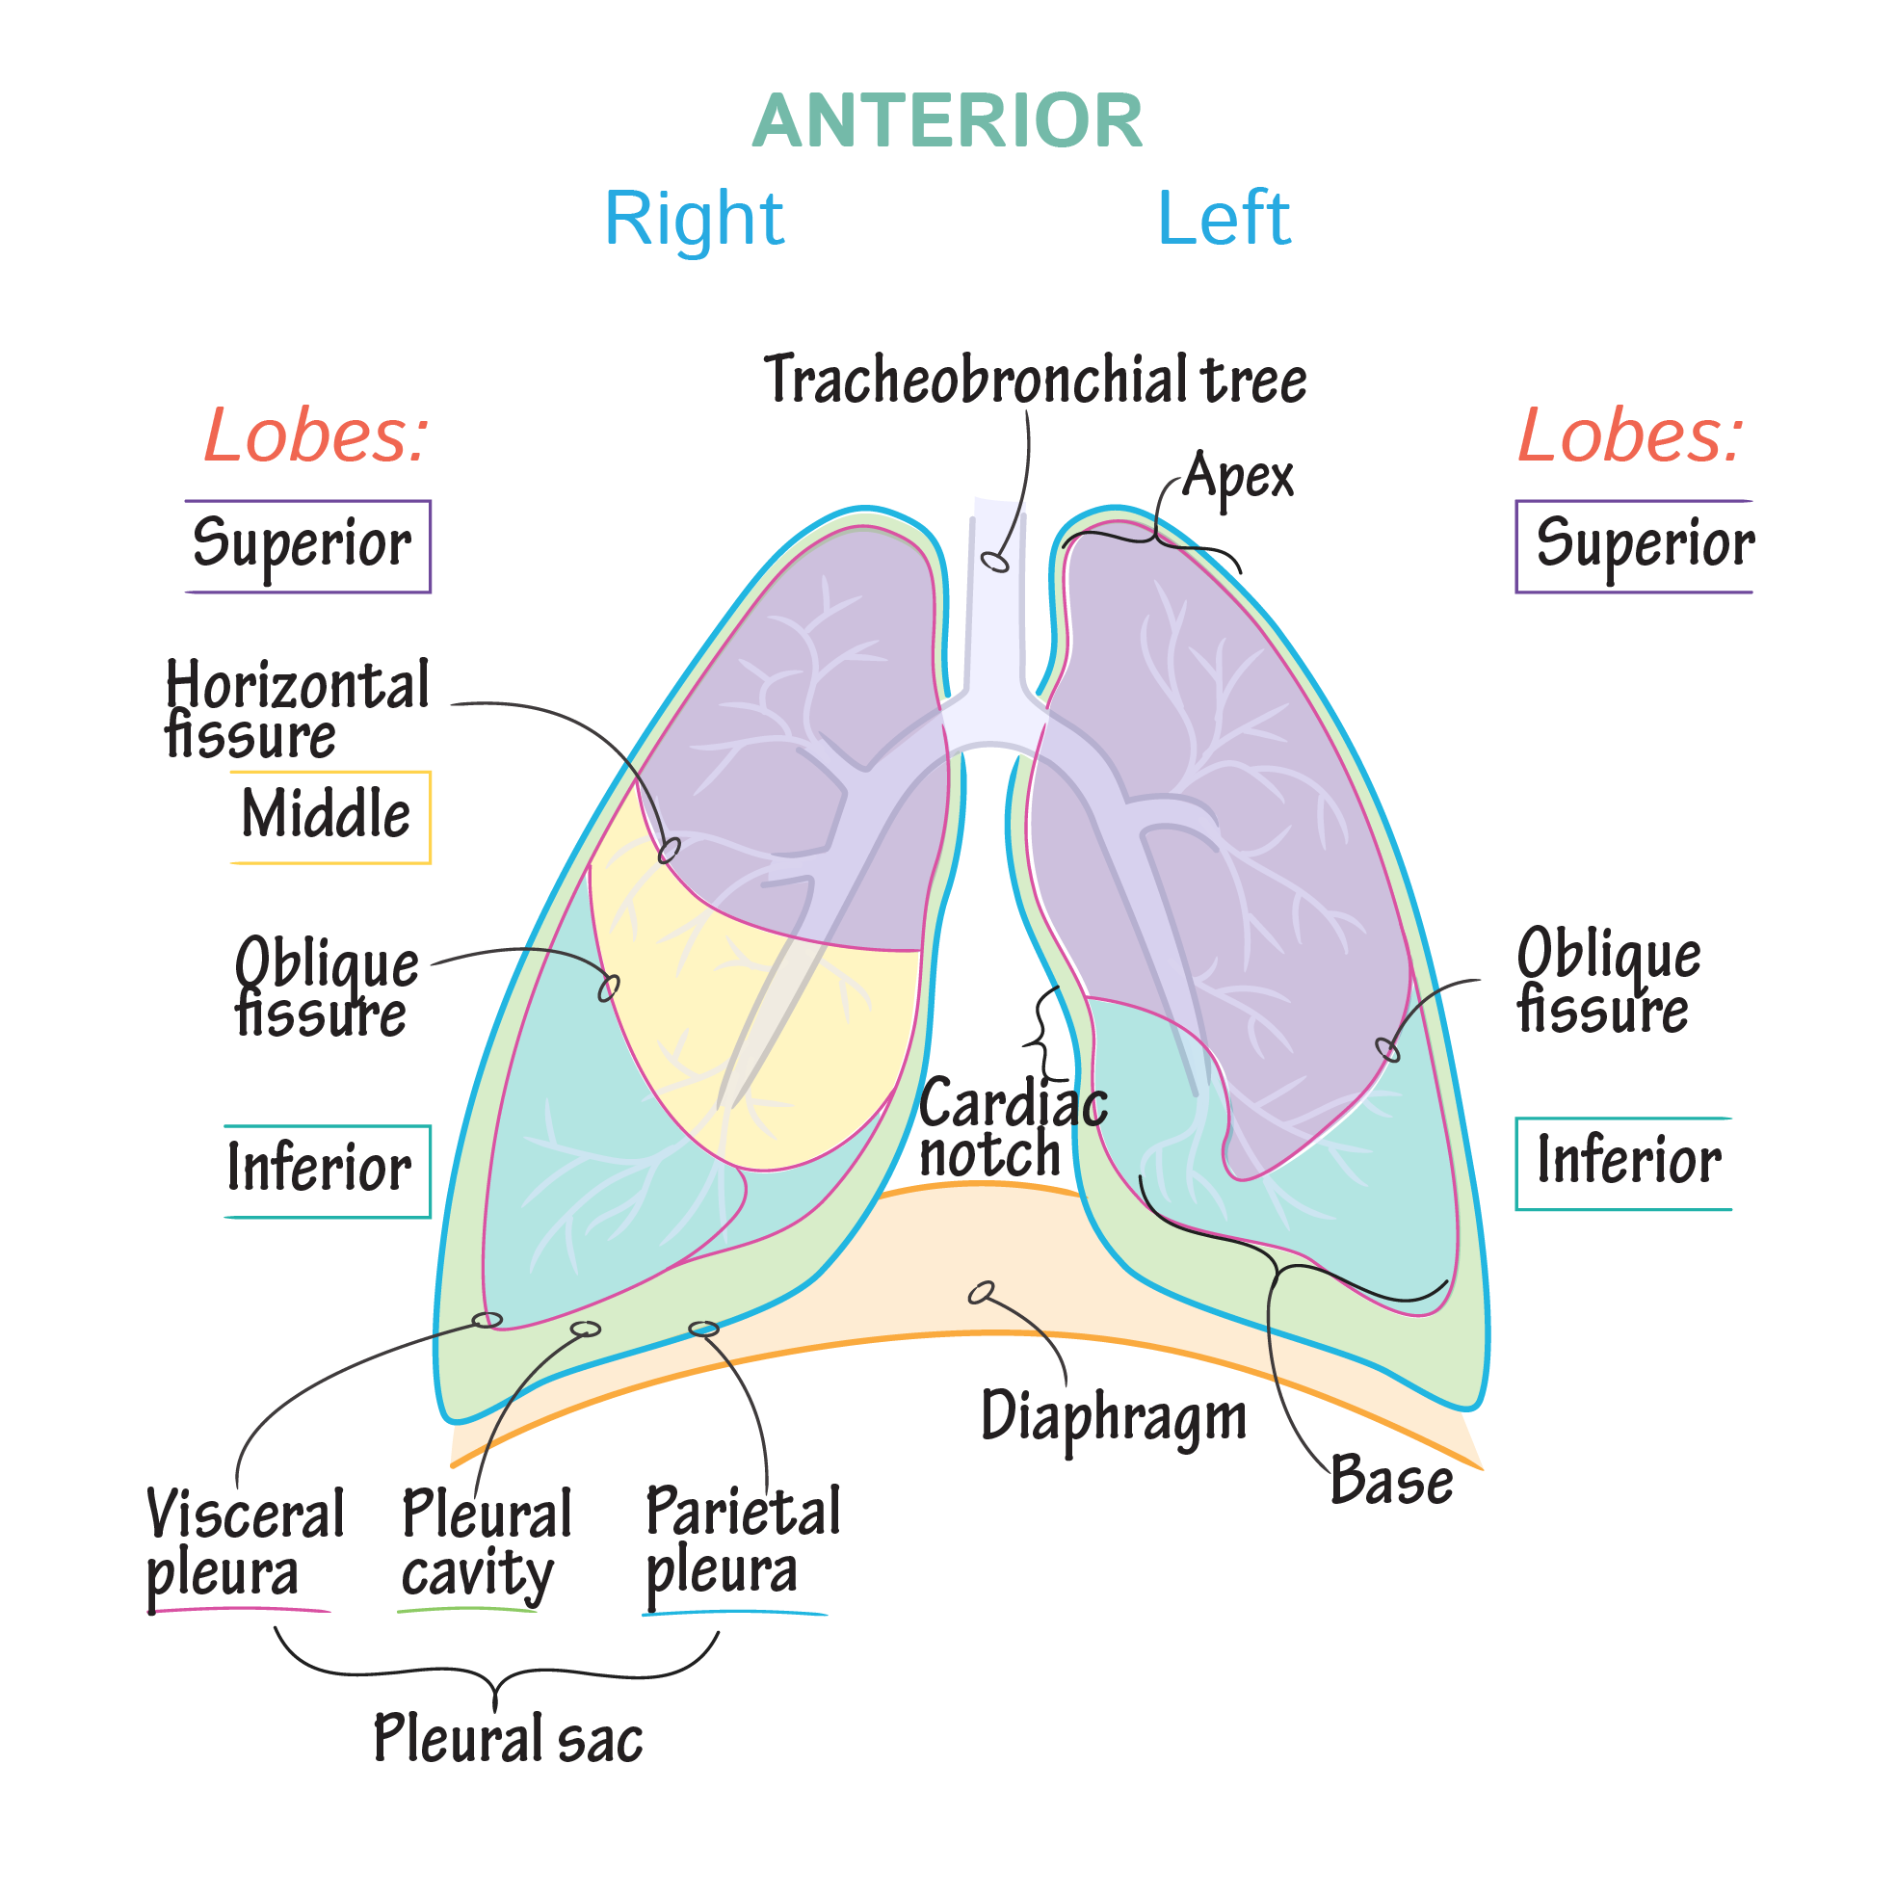
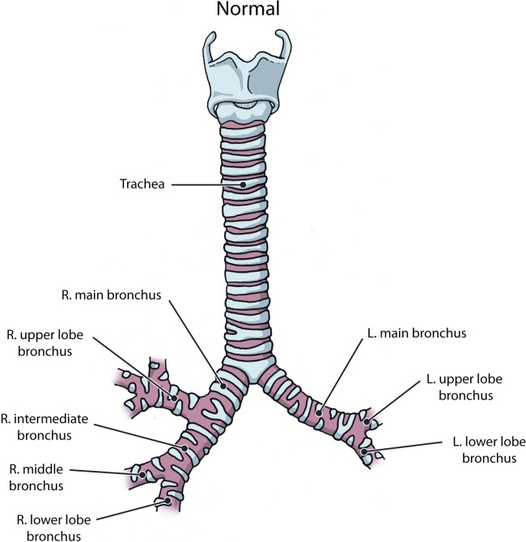
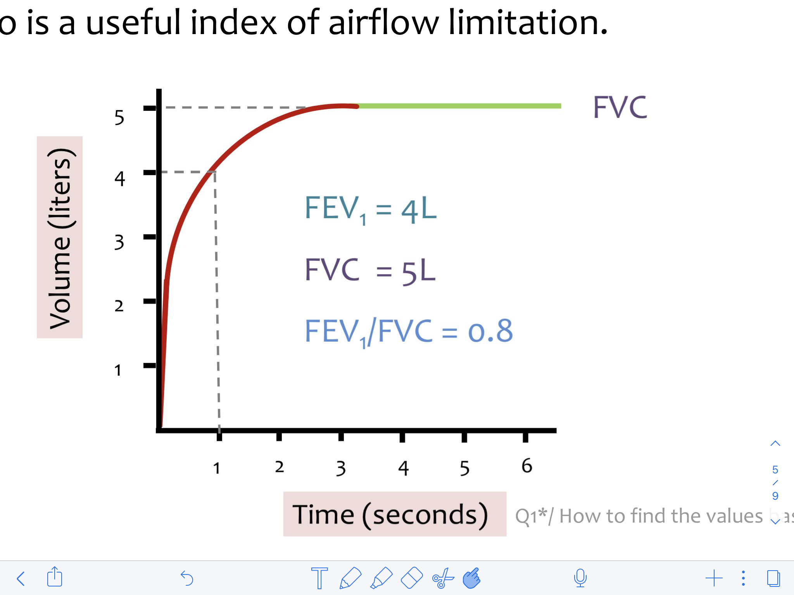
Review of the basics (extra)
Anatomy of the lungs
Special thanks to our amazing anatomy & physiology teamwork in respiratory block!!!
 | Right lung | Left lung
Fissures | 2 fissures ( horizontal and oblique ) | One fissure (oblique)
Lobes | 3 lobes ( Superior, middle, inferior ) | 2 lobes (Superior, inferior )
Secondary bronchi | 3 secondary bronchi ( R. Upper bronchus it branches before entering the hilum, R. Intermediate bronchus it enters to the hilum to give the two remaining bronchi , R. Middle bronchus, R. Lower bronchus) | 2 secondary bronchi ( L. Upper bronchi & L. Lower bronchi )
Comments | larger and shorter than the left lung | it has cardiac notch at lower part of its cardiac notch
Pulmonary function tests
Forced Expiratory Curve | Flow Volume Loop
The subject takes a maximal inspiration and then exhales as rapidly, as forcibly as maximally as possible in short time approximately 3-5 seconds. ● A plot of volume against time. FEV1 ( forced expiratory volume): Volume of air expelled in the 1st sec of forced expiration starting from full inspiration FVC (Forced Vital Capacity): The max volume of air that can be forcibly and rapidly exhaled following a max inspiration. ● FEV1 % or ratio (FEV1/FVC) * 100 Fraction of the VC expired during the 1st sec of a forced expiration (NL 70%-80%) - FEV1 is a useful measure of how quickly the lungs can be emptied. - ➔ The ratio is a useful index of airflow limitation. | This measures expiration & inspiration flow as a function of exhaled volume rather than against time. Measurements on flow V loop: ● PEFR (Peak Expiratory Flow Rate): Greatest flow achieved during forceful expiratory effort ➔ =6- 12 L/sec ● PIFR (Peak Inspiratory Flow Rate): max flow speed achieved during forceful inspiratory effort ➔ =6-12 L/sec ● MEF 50: max expiratory flow at 50% of FVC ● FVC = 4-6 L it can be measured over the X-axis (not like Forced Expiratory Curve)

Slide 3
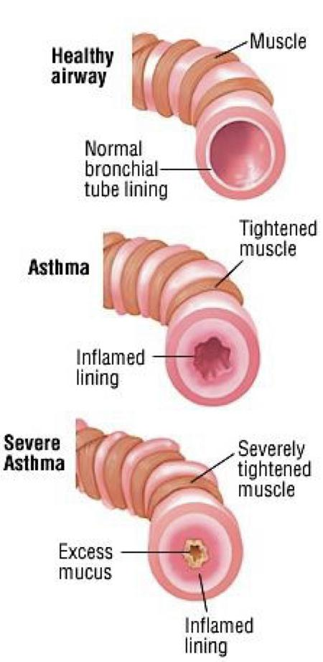
Introduction
Definition
Asthma is a chronic inflammatory disorder of the airways in which many cells play a role: in particular, mast cells, eosinophils, neutrophils, T-lymphocytes T lymphocyte will determine what type of inflammation you will have, macrophages and epithelial cells Treatment targets eosinophils and T lymphocytes
General characteristics
In susceptible individuals, this inflammation causes recurrent episodes¹ of coughing, wheezing, breathlessness, and chest tightness.
These episodes are usually associated with widespread but variable airflow obstruction (airway hyper-responsiveness) that is often reversible² either spontaneously or with treatment.
Classically, asthma has three characteristics:
airflow limitation, which is usually reversible spontaneously or with treatment
airway hyper-responsiveness to a wide range of stimuli (see later)
bronchial inflammation with T lymphocytes, mast cells, eosinophils with associated plasma exudation, oedema, smooth muscle hypertrophy, matrix deposition, mucus plugging and epithelial damage.
In chronic asthma, inflammation may be accompanied by irreversible airflow limitation as a result of airway wall remodelling, which may involve large and small airways and mucus impaction.
For years our concept of asthma was focused on relaxing bronchial smooth muscle (relieving airway obstruction) without dealing with the inflammation, this changed in the past few years.
-The outer diameter of the airways remain the same, it’s the diameter of the lumen inside that’s severely narrowed.
-Presence of secretions cause increase airway resistance.
Asthma triggers
Triggers include pollens, house dust, molds, cockroaches, cats, dogs, cold air,
viral infections, tobacco smoke, medications (β-blockers, aspirin) and exercise
Symptoms have variable severity and may not be present simultaneously.
Usually occur within 30 minutes of exposure to triggers.
Epidemiology
Saudi Arabia Figures
Etiology
Could occur at any age, but 75% are Dx at age <7
Remission around puberty
Prevalence on the rise. likely Multifactorial
Wide geographical variation (4-25%)
Females 40% higher prevalence
Severe asthma 10 % but morbidity / costs. Most of the money spent on asthma is spent on those with severe asthma
Asthma affects >2 million Saudis may be up to 6 million (20% of the population) are undiagnosed
Asthma control: 5% were controlled, 31% partially controlled, 64% uncontrolled.
Although asthma is multifactorial in origin, inflammation is believed to be the cornerstone of the disease and is thought to result from inappropriate immune responses to a variety of antigens in genetically susceptible individuals.
1- Symptoms tend to be intermittent, worse at night and in the early morning and provoked by triggers .
2- This is the main difference between asthma and COPD.

Slide 4
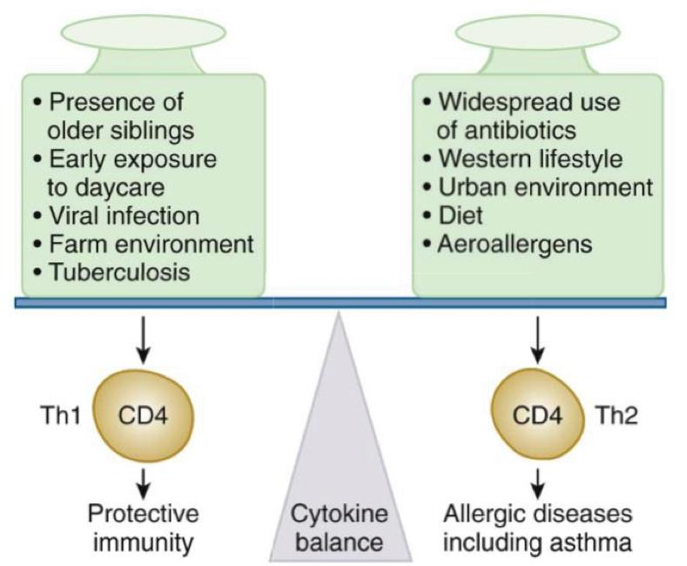
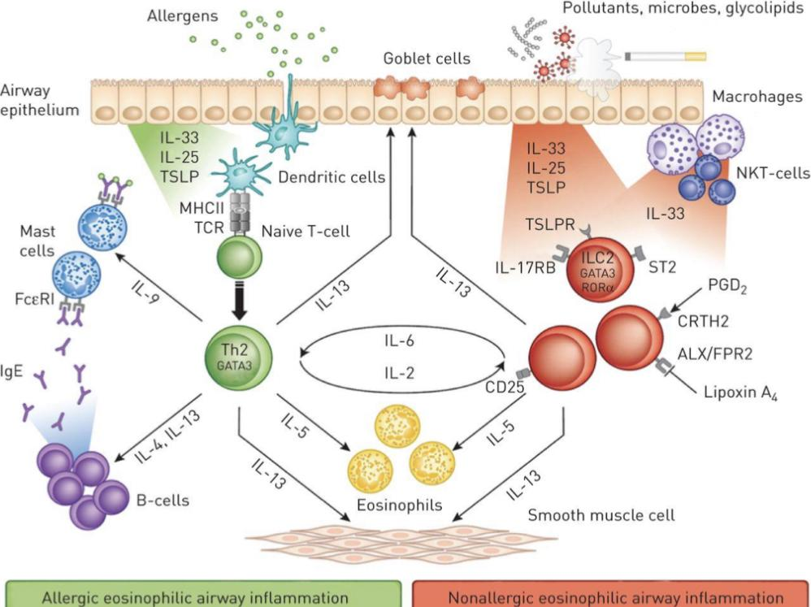
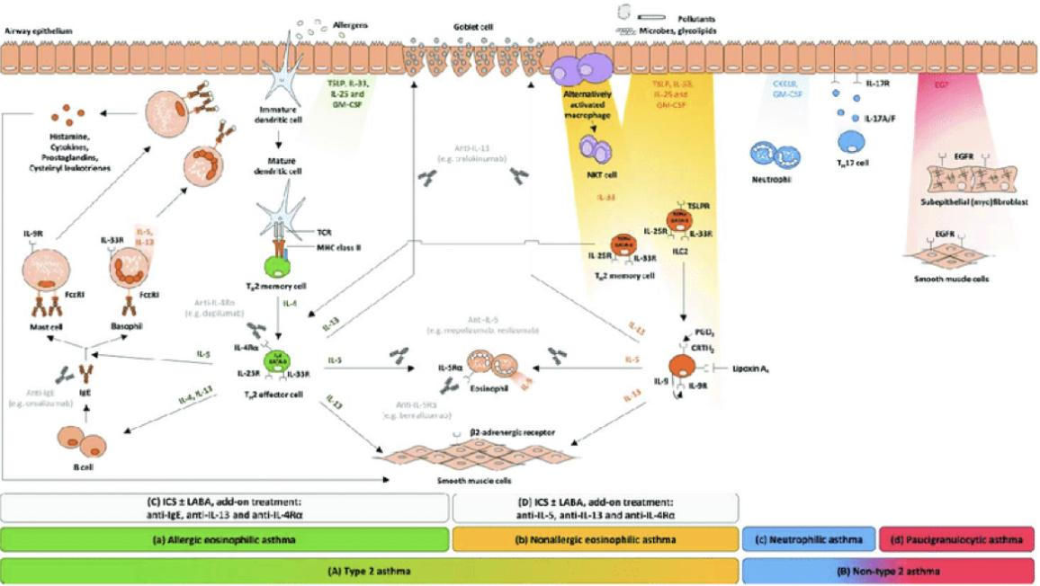
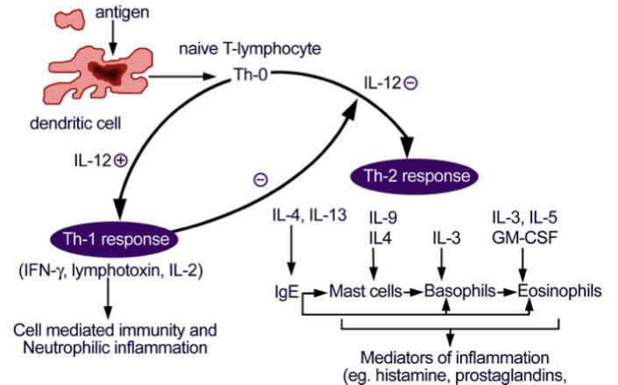
Pathogenesis
Pathogenesis of asthma
(It has acute and chronic phases)
Tightening of the airways
Airway remodeling
Thick mucus production
What causes asthma?
1
Hygiene hypothesis
2
Atopy ¹
3
Genetics
4
Smoking ² (controversial)
5
Obesity
(New under investigations)³
Hygiene hypothesis
Suggests that growing up in a relatively 'clean' environment may predispose towards an lgE response to allergens (Th-2). Conversely, growing up in a 'dirtier' environment may allow the immune system to avoid developing allergic responses (Th-1/ protective immunity).
The role of inflammatory cells in asthma
The antigen will be presented to the naïve T-lymphocyte by the dendritic cell
Then the response will be either Th1 or Th2 response
Th2 response: These lymphocytes, when stimulated by the appropriate antigen, release a restricted panel of cytokines (IL-4, IL-5, and IL-13) which play a part in the migration and activation of mast cells and eosinophils. In addition, production of IL-4 and IL-13 helps maintain the proallergic Th2 phenotype, favouring switching of antibody production by B lymphocytes to IgE. These IgE molecules attach to mast cells via high-affinity receptors which in turn release a number of powerful mediators acting on smooth muscle and small blood vessels, such as histamine and prostaglandins.
Th1 response: cell mediated immunity, neutrophilic inflammation
1-Atopic triad (Asthma, allergic rhinitis, atopic dermatitis "eczema")
2-It is Controversial, but we know that anybody with asthma and smokes their condition will worsen and end up with more inflammation
3-The relationship between obesity and asthma is not clear, although losing weight in obese asthmatics tends to improve their symptoms.

Slide 5
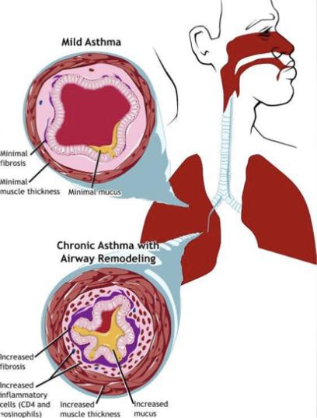
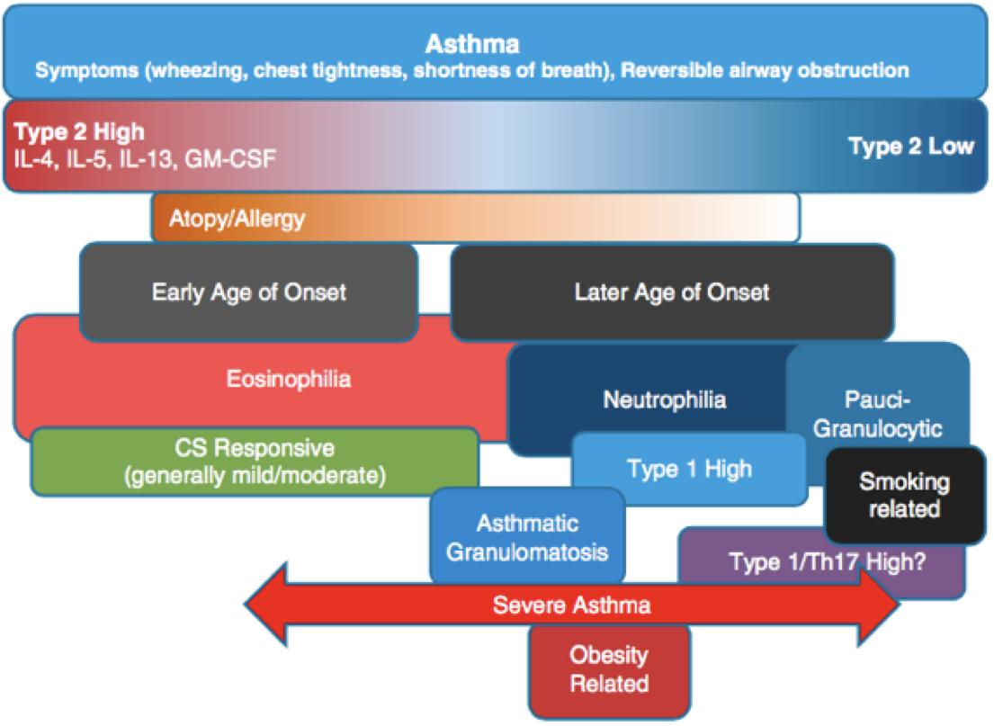
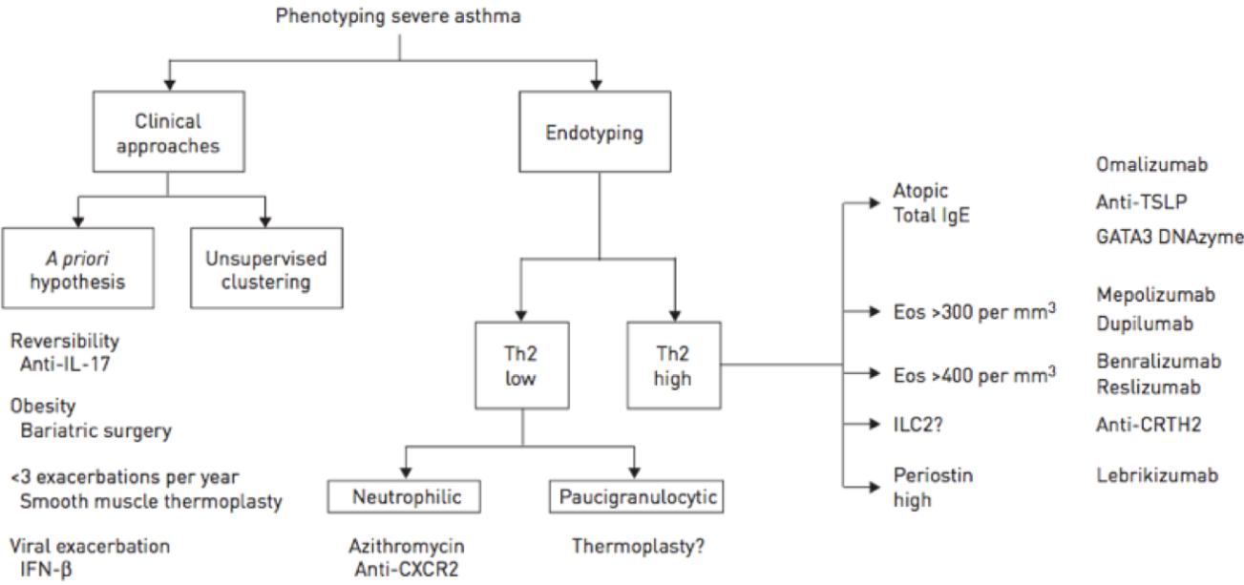
Pathogenesis cont’
Airway in asthmatic patients
Initially, there is minimal fibrosis and minimal secretions and no muscle hypertrophy, so no bronchoconstriction. But as the inflammation goes on and becomes a chronic process, this leads to to increased fibrosis, hyperplasia of mucous cells and smooth muscle cells, leading to hypersecretion and an increase in muscle thickness, which increases the obstruction of the airways.
Asthma types
 | Early onset (<12years) | Late onset (>12years)
Natural history | Childhood-onset asthma a relatively homogeneous group | Adult-onset asthmatics are a very mixed group (Heterogeneous) e.g, AERD( aspirin exacerbated respiratory disease) . It’s also related to smoking Late onset eosinophilic asthma
Atopy | Very high (Allergic asthma) | Atopic 34% (have less severe disease. Those with severe disease are less likely to be atopic) Non-atopic 52% (have mild-to-moderate persistent asthma)
Family history | High | Low
Eosinophilia | ✓ | -
Neutrophilia & paucigranulocytic cells | - | ✓
Check footnotes
What is Phenotyping? Phenotyping means classifying asthmatics based on the characteristics you can observe by looking and taking history:
young or old, history of allergies, smoker or not, obese or thin...
What is endotyping? endotyping means the things you can measure by doing tests, biochemicals, genetics, etc. In classifying asthma, we focus more on endotyping because this will allow us to use specific treatments. For example, Anti IgE: Omalizumab, is used for atopic asthma. And Anti IL-5: Mepolizumab, is used for eosinophilic asthma.
Remember that eosinophilic asthma (high eos) could be allergic “atopic”, which means having high IgE, and it also could be non-allergic.
Another thing we can measure in endotyping is exhaled nitric oxide from breath, which is a marker of eosinophilic inflammation, high levels of exhaled NO predicts an upcoming exacerbation even if symptoms are not present yet.

Slide 6
Diagnosis
History: Initial structured clinical assessment
The predictive value of individual symptoms or signs is poor, and a structured clinical assessment including all information available from the history, examination and historical records should be undertaken.
Factors to consider in an initial structured clinical assessment include:
Episodic symptoms
More than one of the symptoms of wheeze, breathlessness, chest tightness and cough occurring in episodes with periods of no (or minimal) symptoms between episodes. Note that this excludes cough as an isolated symptom in children.
For example:
• a documented history of acute attacks of wheeze, with symptomatic and objective improvement with treatment
• recurrent intermittent episodes of symptoms triggered by allergen exposure as well as viral infections and exacerbated by exercise and cold air, and emotion or laughter in children
• in adults, symptoms triggered by taking non-steroidal anti-inflammatory medication or beta blockers.
An historical record of significantly lower FEV, or PEF during symptomatic episodes compared to asymptomatic periods provides objective confirmation of obstructive nature of the episodic symptoms.
Wheeze confirmed by a healthcare professional on auscultation
• It is important to distinguish wheezing from other respiratory noises, such as stridor or rattly breathing.
• Repeatedly normal examination of chest when symptomatic reduces the probability of asthma.
Evidence of diurnal variability
Symptoms which are worse at night or in the early morning.
Atopic history
Personal history of an atopic disorder (ie, eczema or allergic rhinitis) or a family history of asthma and/ or atopic disorders, potentially corroborated by a previous record of raised allergen-specific IgE levels, positive skin-prick tests to aeroallergens or blood eosinophilia.
Absence of symptoms, signs or clinical history to suggest alternative diagnoses (including but not limited to COPD, dysfunctional breathing, obesity).2
If all 4 of these features (highlighted in table) are present, you are almost 100% sure of asthma diagnosis. As long as there is nothing in the history or clinical findings that would suggest an alternative diagnosis

Slide 7
Differential Diagnosis
Diagnosis
Clinical features that increase the probability of Asthma
More than one of the following symptoms: wheeze, breathlessness, chest tightness and cough, particularly if:
symptoms worse at night and in the early morning ¹
symptoms in response to exercise, allergen exposure and cold air ²
symptoms after taking aspirin or beta blockers (will be discussed later)
History of atopic disorder
Family history of asthma and/or atopic disorder
Widespread wheeze heard on auscultation of the chest
Otherwise unexplained low FEV, or PEF (historical or serial readings)
Otherwise unexplained peripheral blood eosinophilia
Clinical features that decreases the probability of Asthma
Prominent dizziness, light-headedness, peripheral tingling (These signs indicate hyperventilation)
Chronic productive cough in the absence of wheeze or breathlessness
Repeatedly normal physical examination of chest when symptomatic
Voice disturbance (most likely to be vocal cord dysfunction)
Symptoms with colds only
Significant smoking history (ie > 20 pack-years) (This more likely COPD)
Cardiac disease (Patients with HF may have a wheeze)
Normal PEF or spirometry when symptomatic*
Other Illness with wheezing / SOB
COPD (Smoker) - inflamed airways may be narrowed, or bronchospasm may be present
Heart failure - due to edema of airways and congestion of bronchial mucosa
Airway obstruction (Tumors, Foreign body) ³
Vocal cord dysfunction
May Coexist and complicate Dx of asthma
GERD gastric contests irritate the larynx which will cause coughing, and if it gets into the airways it will cause coughing, wheezing, SOB and makes the asthma worse.
OSA (Obstructive sleep apnea)
ABPA (Allergic bronchopulmonary aspergillosis)
1-Remember the circadian levels of cortisol? Cortisol is anti-inflammatory and its levels rise in the morning but become low at night and that’s why symptoms are worse at night.
2-Cold air triggers symptoms because it dries the airways and this induces bronchoconstriction.
3-In airway obstruction due to tumors or foreign bodies a monophonic wheeze is heard on auscultation as the is usually on obstruction of one airway. In asthma however, the wheeze is polyphonic as there are many small airways being obstructed.

Slide 8
Diagnosis
Examination
1
Upper respiratory tract (nasal secretion, mucosal swelling, nasal polyp)
2
Chest (Wheezing or prolonged phase of forced exhalation, Chest hyper-expansion, accessory muscles)
Wheezing— high-pitched whistling sounds when breathing out
-A lack of wheezing and a normal chest examination do not exclude asthma why? Because asthma is episodic, when they’re well you won’t hear wheezing.
4
Skin (atopic dermatitis, eczema)
(This indicates allergy)
3
Full Lung Functions
Spirometry – Routine (the initial diagnostic test)
FBC (full blood count) to check for eosinophilia
• ABGs -should be considered if the patient is in significant respiratory distress. ²
Tests
• Airway Hyper-responsiveness tests or Bronchoprovocation test. (If spiro normal) ¹
Usually if alternate Dx considered :
• CXR / CT Chest - Normal in mild to moderate cases; severe asthma reveals hyperinflation.
Only necessary in severe asthma to exclude other conditions (e.g, pneumonia, pneumothorax, pneumomediastinum ,foreignbody).
Asthma Dx - variable outflow limitation
• Confirm presence of airflow limitation
– Document that FEV1/FVC is reduced <0.75
(at least once)
• Confirm variation in lung function or Reversibility
– Excessive bronchodilator reversibility
(FEV1 >12% and >200mL) need both values to be significant
– Excessive diurnal variability twice-daily PEF monitoring
If this straight green line is concave, it indicates airway narrowing
The inspiratory loop in asthmatics isn’t affected much
1-It is where the patient is given a certain chemical to inhale (eg. histamine, methacholine) at different doses. If the patients airways go into constriction (bronchospasm) with low doses, this suggests asthma.
2- Hypocarbia is common. Hypoxemia may be present. Remember that patients with an asthma attack have an increased respiratory rate, which should cause the PaCO2 to decrease. Increased PaCO2 is a sign of respiratory muscle fatigue or severe airway obstruction, The patient should be hospitalized and mechanical ventilation considered. If the PaCO2 is normal or increased, respiratory failure may ensue.

Slide 9
Diagnostic Approach
Patient with respiratory symptoms
Are the symptoms typical of asthma?
Yes
No
Detailed history/examination for asthma
History/examination supports asthma diagnosis?
Clinical urgency, and other diagnoses unlikely
No
Further history and tests for alternative diagnoses
Alternative diagnosis confirmed?
Yes
Perform spirometry/PEF with reversibility test
Results support asthma diagnosis?
No
Repeat on another occasion or arrange other tests Confirms asthma diagnosis?
No
Empiric treatment with ICS and prn SABA
Review response
Diagnostic testing within 1-3 months
Yes
No
Yes
Consider trial of treatment for most likely diagnosis, or refer for further investigations
Yes
Treat for ASTHMA
Treat for alternative diagnosis

Slide 10
Management
Components of Asthma management ¹
01
Monitoring
04
Pharmacologic Management
• Symptoms
• Peak Flow (Home)
• Spirometry (Clinic)
• Novel FENO² and Sputum eosinophils
• Assess Severity and Control of asthma
Aims
The aim of asthma management is control of the disease. Complete control is defined as:
• no daytime symptoms
• no night time awakening due to asthma
• no need for rescue medication
• no asthma attacks
• no limitations on activity including exercise
• normal lung function (in practical terms FEV, and/or PEF >80% predicted or best)
• minimal side effects from medication⁴.
Approach
1. Start treatment at the level most appropriate to initial severity.
2. Achieve early control.
3. Maintain control by:
• increasing treatment as necessary
• decreasing treatment when control is good.
Before initiating a new drug therapy practitioners should check adherence with existing therapies, check inhaler technique and eliminate trigger factors.
02
Education ³
• Compliance
• Inhalers techniques
• Asthma Action plans
*Specific directions for daily management and for adjusting medications in response to increasing symptoms or decreasing PEFR
03
Environmental Factors
• Triggers (Aeroallergens, Irritants)
• Co-morbid conditions (Obesity, GERD, Rhinitis, ABPA,VCD, stress)
• Medications (Aspirin, Beta Blockers)
• Infections (Vaccinations)
1-Without knowing how to manage, educate and control the patient’s surroundings, the pharmacological treatment won’t be effective.
2-If Exhaled Nitric oxide (FENO) levels are high this indicates that there is a lot of inflammation going on in the lungs. A raised FENO in asymptomatic patients predicts that they will become symptomatic soon
3-You have to educate the patients on how to use the inhaler. You should also give them plans on what to do when their symptoms get worse.
4-For ex. giving ↑doses of steroids for a year will cause: weight gain, skin problems, HTN, water retention, osteoporosis, being prone to infections, etc..

Slide 11
Pharmacological treatment
Relievers
Preventer
Personalized Medicine
Short Acting Beta agonist
Steroids
Long acting Beta Agonist and LAMA (Long acting muscarinic antagonists) e.g. tiotropium
Leukotriene's receptors Antagonist
Theophylline
eg Anti IgE or Anti IL5
SABA: Short acting beta2 agonists / LABA: Long acting beta2 agonists (patients should not use LABA as monotherapy because it may be accompanied by an increased risk of life-threatening attacks or asthma death) / ICS: Inhaled corticosteroids / low dose ICS (budesonide) and formoterol, called (bud-form)
-Now we actually focus more on inflammation and that’s why we added an inhaled corticosteroid for step 1 too.
In all steps, a SABA can be used whenever needed as a reliever.
-Side effects of inhaled corticosteroids are due to oropharyngeal deposition and include sore throat, oral candidiasis (thrush),and hoarseness. Using a spacer with MDIs (metered dose inhaler) and rinsing the mouth after use help minimize these side effects.
● Step 1: someone who gets his symptoms twice or less a month.
Step |  | Step 1 | Step 2 | Step 3 | Step 4 | Step 5
Controller | Preferred | As-needed low dose ICS-Formoterol | Daily low dose ICS or as-needed low dose ICS-formoterol | Low dose ICS-LABA | Medium dose ICS-LABA | High dose ICS-LABA or refer for phenotypic assessment ± add on therapy*
 | Other | Low dose ICS taken whenever SABA is taken | Leukotriene receptor antagonist (LTRA), or low dose ICS taken whenever SABA taken | Medium dose ICS, or low dose ICS+LTRA | High dose ICS, add-on tiotropium, or add-on LTRA | Add low dose OCS, but consider side-effects
Reliever | Preferred | As-needed low dose ICS-Formoterol
 | Other | As needed SABA
*e.g. Tiotropium, anti-IgE (for purely allergic asthma), anti-IL5/5R (For eosinophilic asthma), anti-IL4R (For eosinophilic asthma)

Slide 12
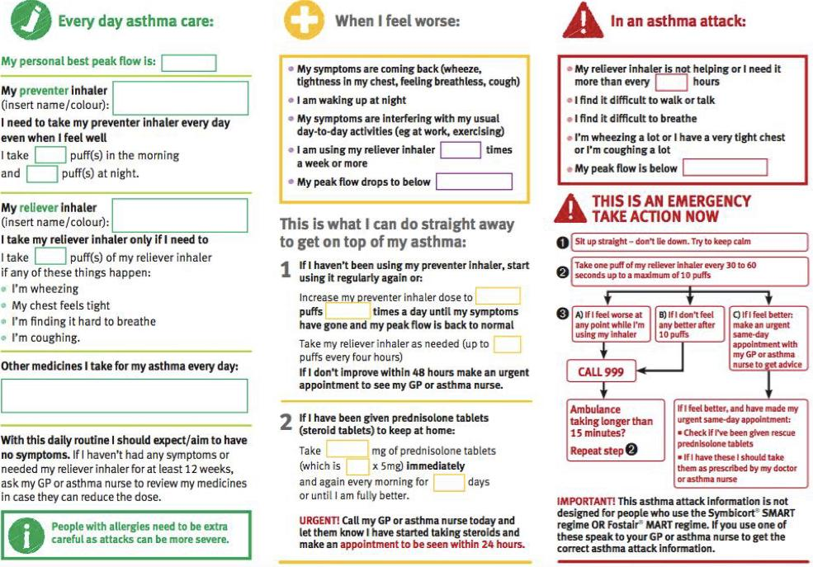
Management
Principles of asthma management
Provide guided self-management education (self-monitoring written action plan regular review)
Treat modifiable risk factors and comorbidities, eg. smoking, obesity, anxiety
Advise about non-pharmacological therapies and strategies, eg physical activity, weight loss, avoidance of sensitizer where appropriate
Consider stepping up uncontrolled symptoms, exacerbations or risks, but check diagnosis, inhaler technique and adherence first
Consider adding SLIT (sublingual immunotherapy) in adult HDM-sensitive patients (house dust mite) with allergic rhinitis who have exacerbations despite ICS treatment, provided FEV1 is >70% predicted
Consider stepping down if symptoms controlled for 3 months + low risk for exacerbations. Ceasing ICSs not advised.
Asthma self management
Communicate and educate patient
A written asthma action plan includes all the information you need to look after your asthma well, so you’ll have fewer symptoms and significantly cut your risk of an asthma attack.
Example of Asthma action plan:

Slide 13
Asthma
Avoid in asthmatics!!
 | Even selective beta blockers may induce symptoms because their selectivity is actually relative, also watch out for beta blockers that are used as eye drops for glaucoma, they may trigger the symptom too. Beta blockers inhibit cAMP which will increase muscle tone. |  | How aspirin/NSAIDS make asthma worse? By inhibiting COX-1 and diverting to lipoxygenase pathway. This leads to a decrease in PGs and an increase in leukotrienes. Aspirin Exacerbated Respiratory Disease (AERD) Definition: a chronic condition characterized by Samter's triad; exacerbated by a pseudoallergic sensitivity reaction to aspirin and other NSAIDS (NSAID intolerance) Clinical features: Samter's triad (asthma, chronic/recurrent rhinosinusitis, nasal polyps) Diagnosis: NSAID/aspirin challenge test Treatment: avoid NSAIDS; aspirin desensitization
Beta- blockers
Aspirin
Acute asthma attack - severity ¹
Level | Characteristics
Moderate asthma attacks | Increasing symptoms PEFR >50–75% best or predicted No features of acute severe asthma
Acute severe asthma | Any one of: PEF 30–50% best or predicted Respiratory rate ≥25/min o Heart rate 120/min Inability to complete sentences in one breath
Life-threatening asthma | Any one of the followings in a patient with severe asthma: SpO2<92% (PaO2<60 mmHg) on high-flow FIO2 PEF <30% best or predicted Bradycardia Dysrhythmia Cyanosis Hypotension Normal or high PaCO2 Exhaustion Confusion Silent chest (You hear nothing on auscultation) Coma Weak respiratory effort
Near-fatal asthma | Raised PaCO2 and/or requiring mechanical ventilation
Brittle asthma | Type 1: Wide PEF variability (>40% diurnal variation for >50% of the time over a period >3–6 months) despite intense therapy Type 2: Sudden severe attacks on a background of apparently well-controlled asthma
1-I want you to be able to say what features are you going to pick out in the patient to decide the level of severity

Slide 14
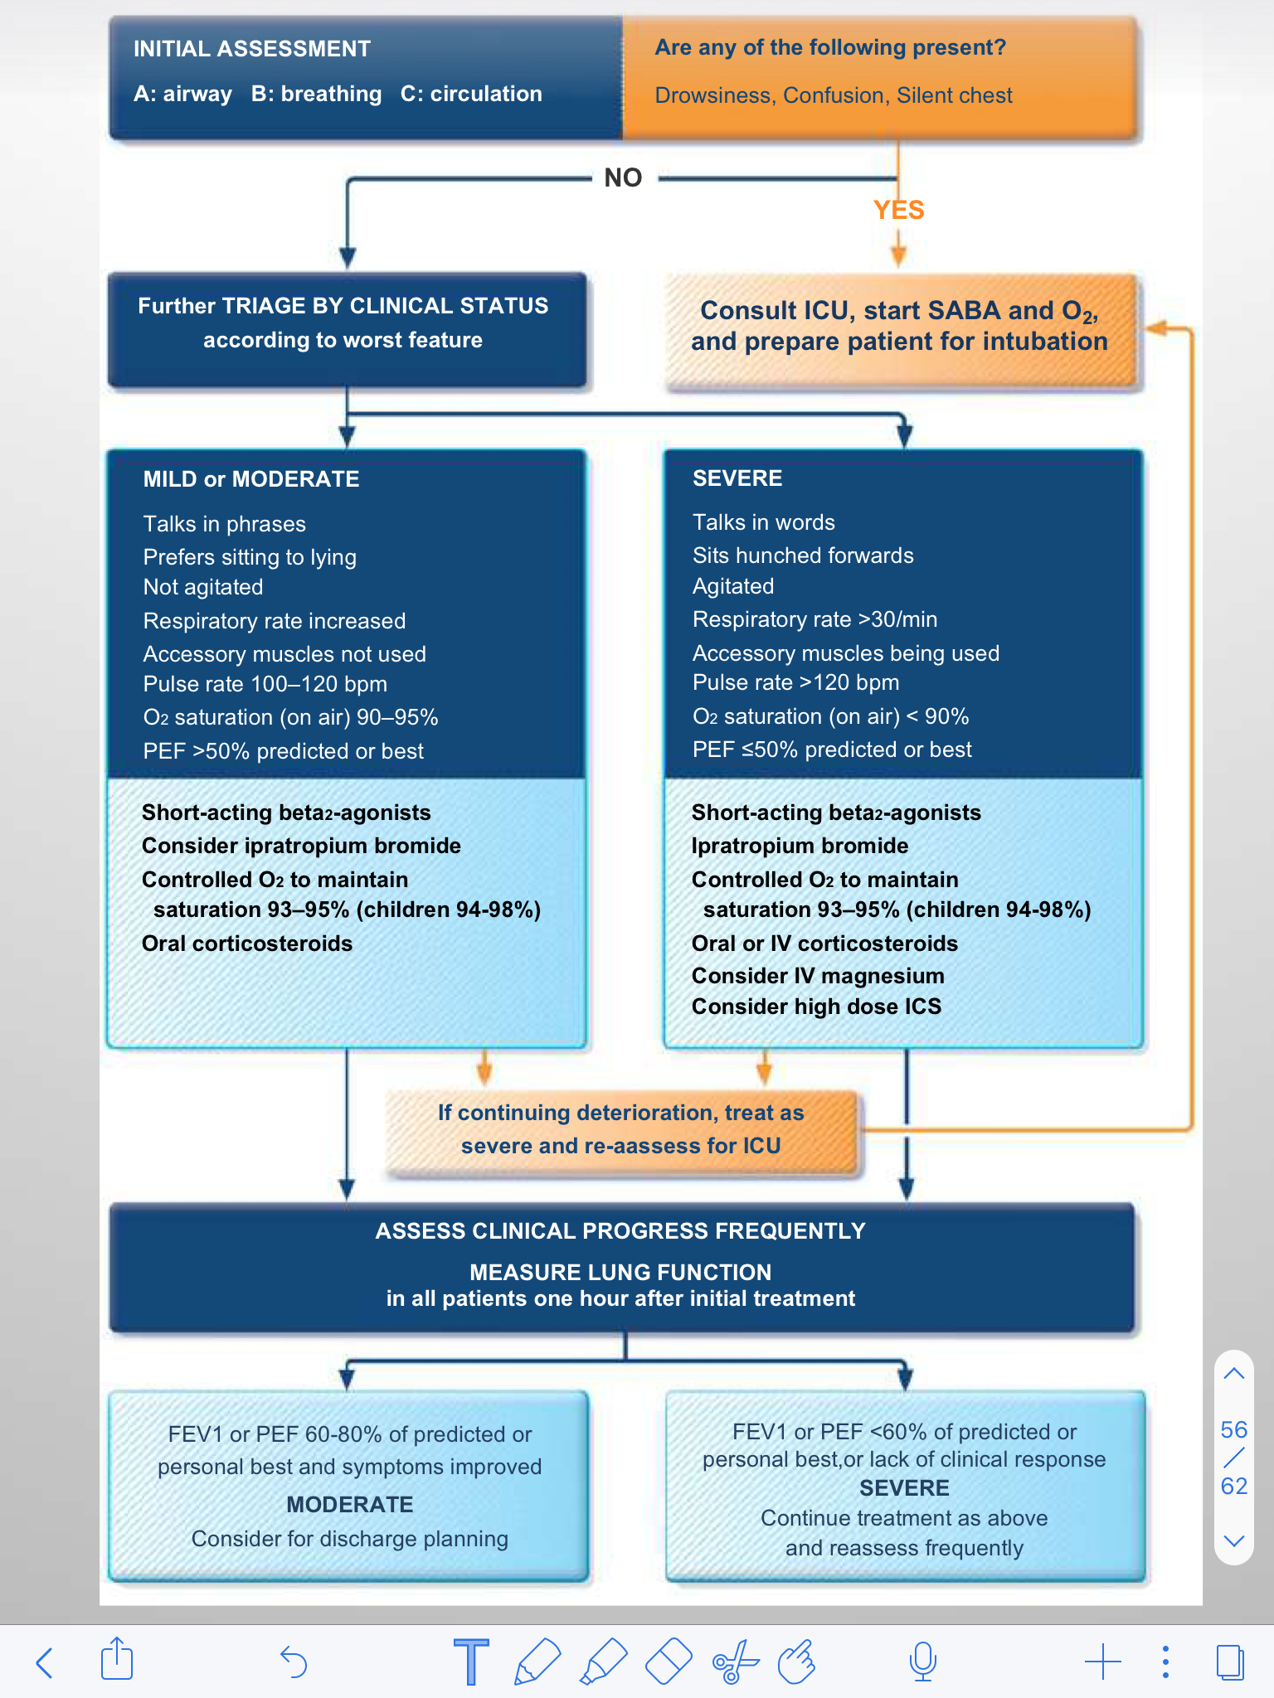
Managing exacerbations in acute care settings
Asthma is a chronic inflammatory condition associated with significant morbidity and mortality which is preventable and manageable with appropriate treatment and effective patient communication
Key message

Slide 15
Diagnosis
Management
Episodic Sx
Monitoring
Triggered
Education
Wheeze
Control of environmental factors
Atopic history
Pharmacologic
Prevention
Clinical features that increase asthma probability
Clinical features that decrease asthma probability
1
Sx worsen at night and in early morning
1
Prominent dizziness, light-headedness, peripheral tingling
2
Sx in response to exercise, allergen exposure and cold air
2
Chronic productive cough, cough in the absence of wheeze or breathlessness
3
Sx after taking aspirin or beta blockers
3
Voice disturbance
4
Family Hx of asthma/atopic disorder
4
Sx with colds only
5
Otherwise unexplained peripheral blood eosinophilia
5
Cardiac disease
6
Otherwise unexplained low FEV1 or PEF
6
Significant Hx of smoking > 20 pack-years
Treatment
Controller
Reliever
Controller
Reliever
Controller
Reliever
Low dose ICS - formoterol
other option
Low dose ICS taken whenever SABA is taken
As needed low dose ICS - formoterol
other option
As needed short acting B₂ agonist
Low dose ICS - LABA
other option
medium dose ICS or low dose ICS+LTRA
As needed low dose ICS - formoterol
other option
As needed short acting B₂ agonist
High dose ICS - LABA refer for phenotypic assessment + add on therapy
eg.Tiotropium AntiIGE Anti-IL5/5R Anti-IL4R
Other options
Add low dose OCS but consider side effects
As needed low dose ICS - formoterol
other option
As needed short acting B₂ agonist
Step 1
Step 2
Step3
Step 4
Step 5
Daily low dose inhaled corticosteroid or as needed low dose ICS - formoterol
other option
LTRA or low dose ICS taken whenever SABA is taken
As needed low dose ICS - formoterol
other option
As needed short acting B₂ agonist
Medium dose
ICS - LABA
other option
High dose ICS add tiotropium or LTRA
As needed low dose ICS - formoterol
other option
As needed short acting B₂ agonist
Controller
Reliever
Controller
Reliever

Slide 16
Q1: A 27-year-old woman with a history of persistent asthma presents to the Emergency Department with complaints of agitation, muscle tremors and a "racing heart". During her history, she mentions having recently increased the number of asthma medications being taken, as well as the frequency of use of her rescue inhaler. Which of the following is most likely responsible for her current symptoms?
A- Albuterol
B- ipratropium
C- Montelukast
D- Omalizumab
Q2: 25-year-old woman is admitted to accident and emergency with a severe exacerbation of asthma. On examination, her respiratory rate is 30, oxygen saturations are 95 per cent on 15 L O2 and temperature is 37.2°C. As you feel the peripheral pulse, the volume falls as the patient inspires. Which of the following explains this clinical sign ?
A- Increased left atrial filling pressures on inspiration
B- Decreased right ventricular filling pressures on inspiration
C- Peripheral vasodilation
D- Decreased left atrial filling pressures on inspiration
Q3: A 25-year-old woman who works in an office complains of shortness of breath during the recovery period from her usual aerobic exercise routine. She had a history of asthma as a child, but it went into remission when she was in junior high school. What single test would be the best to order to easily confirm that she is now having a return of her asthma?
A-Blood eosinophils
B- Measurement of forced vital capacity before and after bronchodilator
C-Measurement of the forced expiratory volume in the first second (FEV1) before and after bronchodilator
D-Testing for airway hyperresponsiveness with inhalation of cold air
E-Measurement of the diffusion capacity for carbon monoxide
Q4: A 25-year-old woman whose asthma is in good control comes to your office indicating that she and her husband are trying to have a child. Her only treatment has been inhaled albuterol on an as-needed basis, and she uses about four inhalers (each contains 200 pufs of medication) a year. What is the single statement most likely to be true about her asthma treatment?
A- There is no need to change her treatment while she is tryi ceive or becomes pregnant.
B- She should stop the albuterol inhaler and simply "suffer through" any asthma events.
C- She should continue the albuterol inhaler and start an inhaled corticosteroid.
D- She should consult an asthma specialist now before she attempts to become pregnant.
E- She should begin to use her albuterol inhaler on a regularly scheduled basis, two puffs four times a day. to con-
Q5: A 24-year-old G2P1 woman whom you observe for asthma comes in at 14 weeks' gestation. She has had increasing problems with her asthma, needing a rescue inhaler two or three times a day, and has had nocturnal awakening. She denies chest pain, recent upper respiratory infection, gastroesophageal reflux, or new exposures. What is the most likely cause of her asthma exacerbation?
A- The normal effects of pregnancy
B- The increased workload and oxygen consumption associated with pregnancy
C- She has discontinued her steroid inhaler and controller medication because of concern about the drug's effect on the fetus.
D- She has decreased her exercise.
E- The stress of work, pregnancy, and sleep deprivation
Answers: Q1:A | Q2:D | Q3:C | Q4:A | Q5:C
Answers Explanation File!

Slide 17
THANKS!!
This lecture was done by:
Rahaf Alshebri
Razan Alrabah
Quiz and summary maker:
Sarah Alarifi
Note taker:
Leen Almazroa
Mashal AbaAlkhail
Females co-leaders:
Raghad AlKhashan
Amirah Aldakhilallah
Males co-leaders:
Mashal AbaAlkhail
Ibrahim AlAsous
Send us your feedback:
We are all ears!

