Slide 1
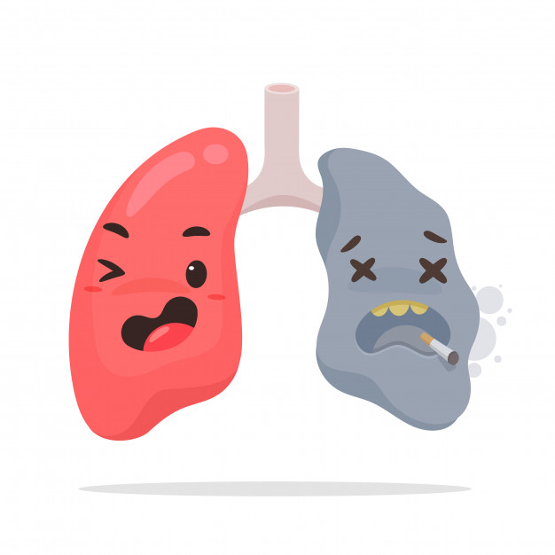
Lecture 9
Editing file
Community acquired pneumonia
Objectives:
List the 3 most common organisms of CAP
Be able to triage patients appropriately based on the pneumonia severity index (PSI)
Identify 3 criteria for clinical stability and discharge.
The risk factors and the most likely organisms associated with them are very important
Color index:
Color index:
Original text Females slides Males slides
Doctor’s notes Textbook Important Golden notes Extra

Slide 2
Community Acquired Pneumonia
Definition
Lower respiratory tract infection in a non-hospitalized person associated with symptoms of acute infection with or without new opacity on chest radiograph.
Acute infection of the pulmonary parenchyma acquired outside of a health care setting.
Classes of pneumonia
1
CAP (the most common)
2
Health care associated:
1.hospital acquired → role of 2 (2 days after admission or 2 days after discharge)
2.ventilator associated
3
Aspiration pneumonia
4
Pneumonia in immunocompromised.
Types & Microbiology of CAP
Streptococcus pneumonia (pneumococcus) and respiratory viruses are the most frequently detected pathogens in patients with CAP.
Typical CAP (60% - 70%) | Atypical CAP (30%- 40%)
Typical¹ bacteria: | Atypical² bacteria: | Respiratory viruses:
S.pneumoniae (most common bacterial cause) | Legionella spp ³ (contaminated water, air, ventilation systems) | Influenza A and B viruses
Haemophilus influenzae (the most common in smokers and COPD) | Mycoplasma pneumoniae (young, healthy people) | Rhinoviruses
Moraxella catarrhalis | Chlamydia pneumoniae (joints pain, headache, sinusitis) | Para influenza viruses
Staphylococcus aureus (recent viral infection ‘influenza’) | Chlamydia psittaci (birds) | Adenoviruses
Group A streptococci | Coxiella burnetii (farmers) | Respiratory syncytial virus
Aerobic gram-negative bacteria |  | Human metapneumovirus
Anaerobes (associated with aspiration) (Klebsiella pneumonia has a specific association with alcohol abuse) |  | Coronaviruses (e.g. Middle East respiratory syndrome coronavirus)
 |  | Human bocaviruses
1-Related to Streptococcus pneumoniae, classical symptoms (fever, cough, SOB, chest pain) as well as classical radiological findings (opacity on chest X Ray).
2-Presents with unclassical symptoms and chest x ray eg. Legionella (GI symptoms, headache and chest pain) causes Legionnaires
3-Most common cause of atypical pneumonia.

Slide 3
Risk factors
The risk of CAP rises with age.
The annual incidence of hospitalization for CAP among adults ≥65 years old
due to chronic diseases and comorbid conditions
They lose the elasticity of cilia in the airways → inability to clear the airways
Older age:
COPD, chronic lung disease (eg, bronchiectasis, asthma), chronic heart disease (particularly CHF), stroke, diabetes mellitus, malnutrition and immunocompromising conditions.
COPD and smoking are associated with H.influenza.
Bronchiectasis : most likely gram -ve bacteria such as pseudomonas.
Chronic comorbidities:¹
Viral respiratory tract infections can lead to primary viral pneumonias and also predispose to secondary bacterial pneumonia MERS AND COVID19 pneumonia + influenza A&B and H1N1 Bacterial infections in the upper respiratory tract are most likely to cause pneumonia the viral infections.
Viral respiratory tract infection: ²
Conditions that increase risk of macroaspiration of stomach contents and/or microaspiration of upper airway secretions predispose to CAP, such as alteration in consciousness (eg, due to stroke, seizure, anesthesia, drug (opioids) or alcohol use) or dysphagia due to esophageal lesions or dysmotility.Achalasia, Parkinson's, GERD, cerebral palsy, neuromuscular disorders, old age. Usually caused by anaerobes.
Impaired airway protection:
Aspiration³
Smoking, alcohol and opioid use are key modifiable behavioral risk factors for CAP .
Smoking and alcohol overuse:
Other factors that have been associated with an increased risk of CAP include crowded living conditions (eg, prisons, homeless shelters, Hajj)associated with staph aureus, residence in low-income settings, and exposure to environmental toxins (eg, solvents, paints, or gasoline)
Other lifestyle factors:
1-most importantly are patients with interstitial lung disease, those patient get streptococcal like others.
2-uncommon compared to bacterial pneumonia but if it happened it will be more severe.
3-young lady with classical symptoms of pneumonia but with uncontrolled seizure.

Slide 4
Signs, symptoms and diagnosis
the clinical presentation varies according to the immune state of the patient and the infecting agent. Features include:
Cough (productive or non-productive) sometimes with haemoptysis
Fever which, if swinging, may indicate empyema ,Chills /Rigors
Dyspnea¹
chest pain may be experienced, commonly pleuritic in nature and due to inflammation of the pleura; a pleural rub may be heard early on in the illness
Fatigue/Myalgia
extrapulmonary features
Gastrointestinal (Legionella)
In the elderly, CAP can present with confusion or non-specific symptoms such as recurrent falls. CAP should always be considered in the differential diagnosis of sick elderly patients, given their frequently atypical presentation.
Clinical symptoms
Dullness² to percussion of chest
Crackles³ on auscultation
Increase in vocal and tactile fremitus
Bronchial breath sounds⁴
Egophony (“E” to “A” changes)⁵
Physical exam
Diagnosis - labs
Intervention | Comments
CXR | All patients with suspected CAP should have chest radiograph PA and lateral CXR required to confirm the diagnosis. In classical pneumonia: clinical features and CXR are enough to diagnose.
Sputum Gram stain and antimicrobial sensitivity | (not sensitive, in 100 patient with CAP only <7% will have positive stain)
Blood cultures x 2 | marker of severity (negative unless the pt develop septicemia)
Serum/ urine antigen | (Legionella antigen) Urinary antigen assay for Legionella in selected patients .This test is very sensitive. The antigen persists in the urine for weeks (even after treatment has been started)
organ dysfunction | such as renal dysfunction, liver dysfunction, and/or thrombocytopenia . important especially for evaluating patient with known hepatic or renal disease
PCR | For influenza
Other tests: | Leukocyte count ,Inflammatory markers, (ESR), (CRP),procalcitonin ,CBC MERS-CoV, very important nowadays to do swab for COVID-19
1- common but if it’s progressing that is a bad sign. The patient may develop complications such as: pleural effusion, Acute respiratory distress syndrome (ARDS) or respiratory failure.
2- Dullness is caused by the consolidation (solid or pus) while in pleural effusion or fluid accumulation you will hear stony dullness.
3- Not very common.
4- Common in any consolidation.
5- common in the ER (you will not hear it usually in admitted patients after treatment with antibiotics)

Slide 5
Diagnosis
Radiologic evaluation¹
Classical finding in pneumonia
Opacity (semi rounded white area) cause by either:
A. Mass
B.Consolidation
usually caused by streptcoccus pneumoniae
Usually appears in atypical organisms
Consolidation
Cavity
Interstitial Infiltrates
air fluid level : it’s the line between the puss and normal lung tissue(air) in a cavity
When we see a cavity it’s either anaerobes or staph
In the upper zone: most likely staph
In the lower zone : anaerobes
Why ? Anything will enter to the lung will go most likely to the right because of the early bifurcation of the right bronchus and to the lower zone by gravity.
That’s why when we see a cavity in the right lower zone we will think about an organism associated with aspiration
Intensive care unit admission
Failure of antibiotic therapy (either outpatients or hospitalized patients)
Severe obstructive or structural lung disease
Immunocompromised host
Cavitary lesions
Active alcohol abuse
Pleural effusion
1-About the most likely organisms in relation to radiological findings : it’s just a clinical information not a rule!
Causes (of cavitary mnemonic CAVITY:
C: Cancer. finding)A: Autoimmune (Rheumatoid Arthritis, wegener's) V: Vascular (AV malformation)
I: Infection (Staph., TB) T: Trauma (Pneumatocele) Y: Young (Congenital infected cyst) ( from 437 team)

Slide 6
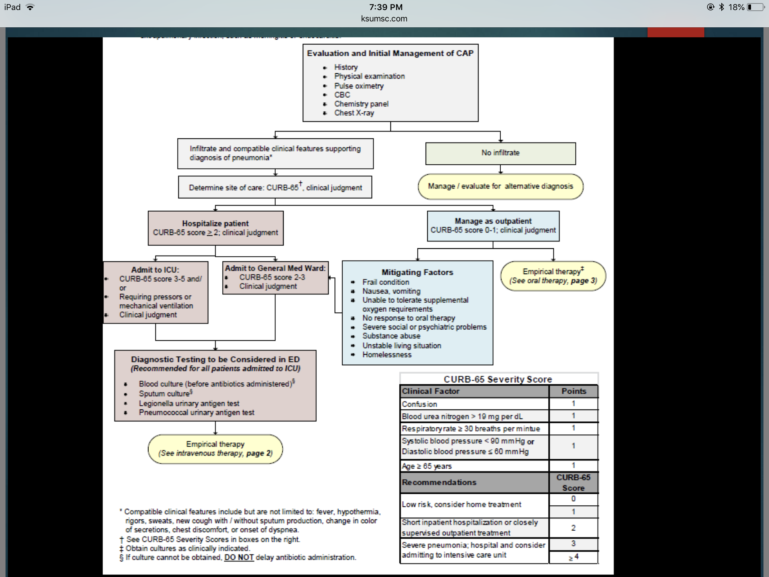
Evaluation and Initial Management of Community-Acquired Pneumonia (CAP)
After assessment of CAP (Clinical, PE, Radiological, Labs) what is the next best step in management?
- Allocate the pt based on the CURB-65 criteria
أهم من حياتك

Slide 7
Management
Doctor’s Notes
How to manage a patient with CAP?
First allocate the patient using CURB-65 score:
Score 0 or 1 = send home with azithromycin for 3-5 days
Score 2= admit to hospital and treat with ceftriaxone + azithromycin
Score 3 or more: ICU and treat with Tazocin (Piperacillin/tazobactam) also called piptaz.
Special conditions:
If the history is suggestive of aspiration pneumonia : clindamycin is the drug of choice
Risk of staph: vancomycin
bronchiectasis: gm -ve like pseudomonas, start them on levofloxacin or ciprofloxacin.

Slide 8
Extra
General management
Oxygen
-
-Supplemental oxygen should be administered to maintain saturations between 94% and 98%
Intravenous fluids
-
-These are required in hypotensive patients showing any evidence of volume depletion and hypotension.
Antibiotics
-The first dose of antibiotic should be administered within 1 hour of identifying any high-risk criteria and treatment should not be delayed while investigations are awaited.
-The antibiotic regimen should be adjusted specifically once culture and sensitivity results are available.
Analgesia
-
-Simple analgesia, such as paracetamol or an NSAID, helps treat pleuritic pain, thereby reducing the risk of further complications due to restricted breathing because of pain
Complications of pneumonia
Para-pneumonic effusion
Empyema
Retention of sputum causing lobar collapse
Deep vein thrombosis and pulmonary embolism
Pneumothorax, particularly with Staphylococcus aureus
Suppurative pneumonia/lung abscess
ARDS, renal failure, multi-organ failure
Ectopic abscess formation (Staph. aureus)
Hepatitis, pericarditis, myocarditis, meningoencephalitis
Arrhythmias (e.g. atrial fibrillation)
Pyrexia due to drug hypersensitivity

Slide 9
Cases
Case study 1:
A 68 y/ male presented to the ED with SOB and productive coughing for 2 days. Reports poor oral intake since onset due to nausea and intermittent vomiting. His wife had similar symptoms 1 week ago which improved with an unknown antibiotic. Patient is requesting to go home with antibiotic. He previously had tongue swelling and skin rash with use of augmentin. Reports good health otherwise. Denies chest pain, swelling of extremities, or diarrhea.
His vital signs are :
T 38.5 C, P 76, BP 128/82, spO2 94%, RR 16. Patient is alert and oriented. Crackles were heard
over left lower lung field. Labs showed WBC 14, BUN 20 mg/dL. Chest X-ray had a consolidation
in left lower lobe.
What is the best way to further manage this patient?
Send home with oral azithromycin
Send home with oral levofloxacin
Admit to medicine floor with iv levofloxacin
Admit to medicine floor with iv ceftriaxone and azithromycin
Admit to ICU with iv ceftriaxone and iv azithromycin
Answer: C
Doctor’s notes:
First Allocate the patient by CURB-65 Severity Score:
C: Confusion (Absent) = 0
U: BUN (20 mg/dl) = 1
R: RR (Does not meet criteria) = 0
B: BP (Does not meet criteria) = 0
65: Age (68 years old) = 1
Overall score= 2 (inpatient admission)
Based on the score we will exclude A,B and E
The patient has augmentin allergy so we will avoid ceftriaxone (due to cross reactivity).The answer is C, if the patient doesn't have augmentin allergy the answer is D.

Slide 10
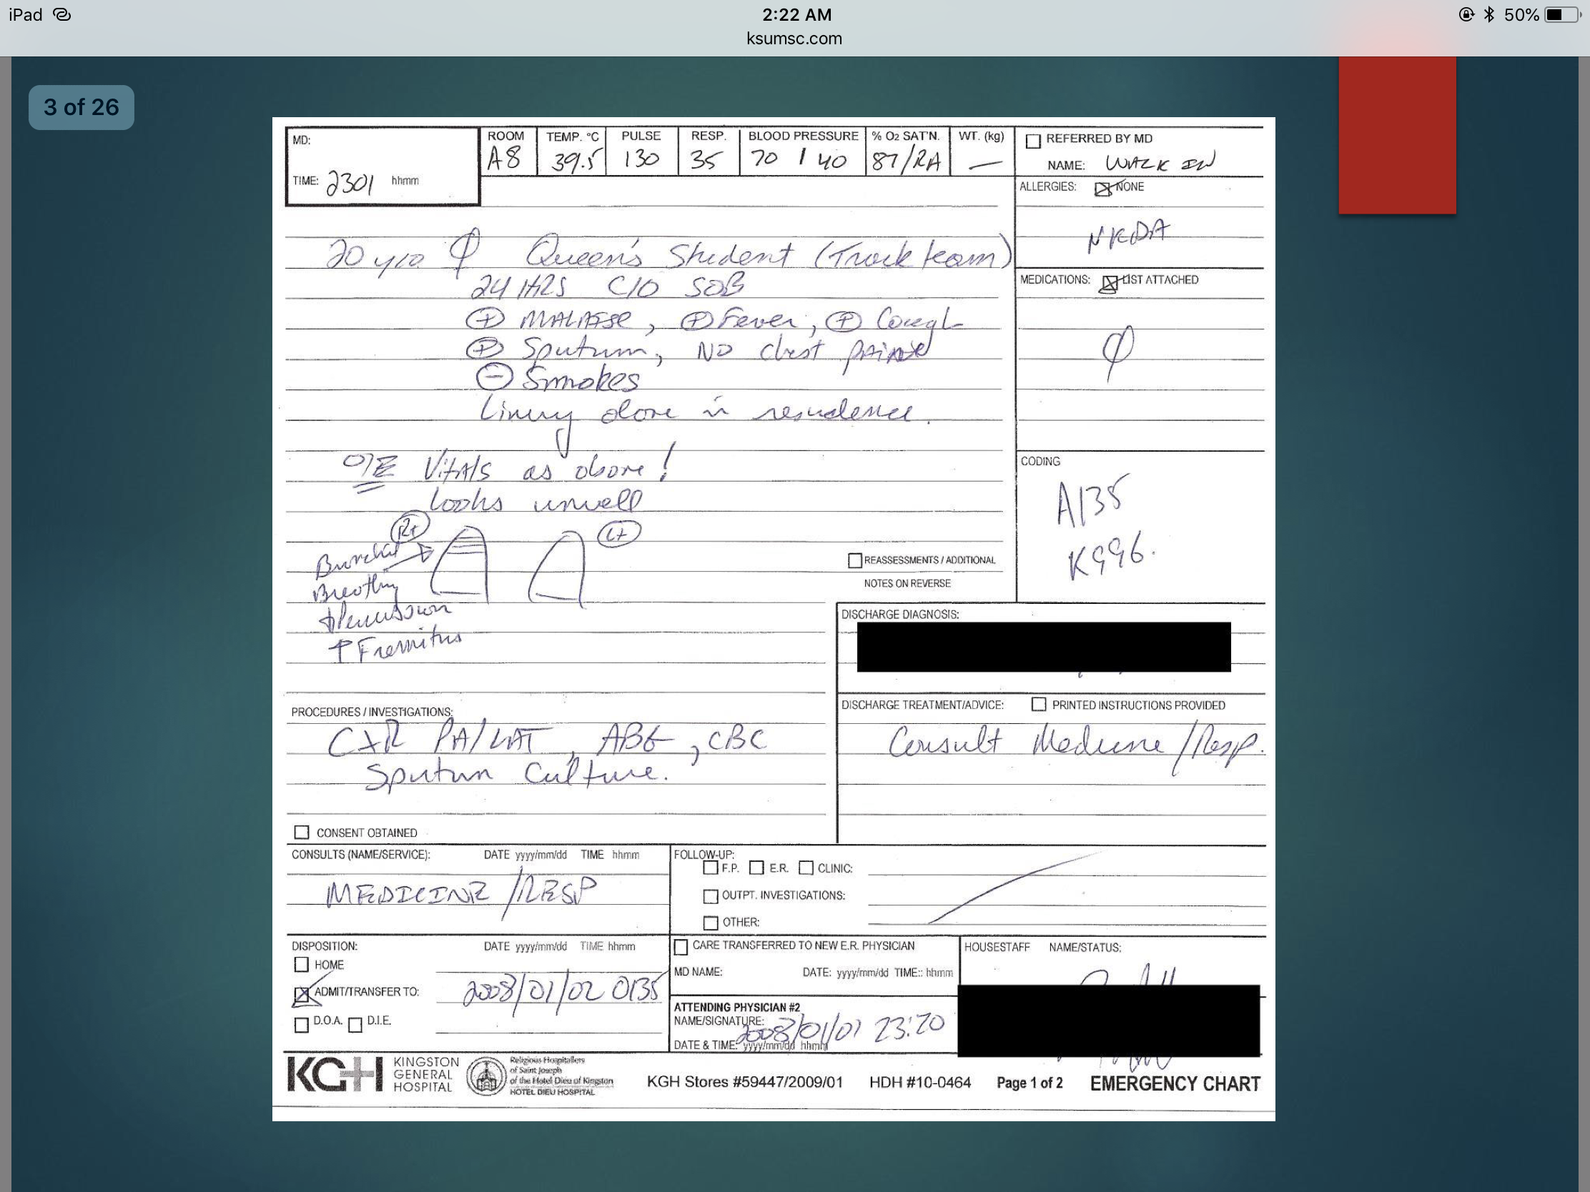
Cases
Case study 2:
20 years old female, Queen's student on the track team, came to the hospital complaining of 24 hours of SOB, has fever, malaise, cough and sputum, but no chest pain. She is a non-smoker. She lives alone in residence.
Her vitals signs are : Temperature 39.5ْ C, Pulse 130 bpm, RR: 35, BP: 70/40 ,% Oxygen Saturation: 87/RA (Room Air)
On examination: she Looks unwell, Bronchial breathing heard in Upper Rt, dullness on percussion, and Increased fremitus
Procedures and Investigations are: CXR (PA/LAT),ABG, CBC, and Sputum Culture]
What are the features of Jane’s history that suggest which organisms are most likely to be responsible for her presentation?
She has CAP, and the most common most likely organism is streptococcus pneumoniae, and she doesn't seem to have the risk factors related to the other organisms.
What additional information from her history would you like to know and why?
Look for any risk factors in the patient from what was mentioned before.
What are the features of Jane’s physical examination that indicate pneumonia?
Bronchial breathing (means consolidation), increased fremitus (tactile and vocal).
What are signs of pleural involvement? Does she have any?
Decreased tactile fremitus ,stony dullness, decreased or absent bronchial breathing.
No, she doesn't have any.
What are signs of serious sepsis? Does she have any?
Fever, hypotension, tachycardia, tachypnea, oxygen desaturation¹.
Yes she have.
Bonus: What are examples of extra-pulmonary infection that may complicate pneumonia?
Meningitis, pericarditis, reactive arthritis², and hepatits and AKI (acute kidney injury)
Most dangerous? Infective endocarditis (high mortality if present) esp staph aureus
Where should Jane be managed?
CURB-65 Severity Score: C: Confusion (Absent) = 0 , U: BUN (30 mg/dl) = 1 , R: 35 = 1 , B: BP 70/40 = 1 , 65: Age (20 years old) = 0
Overall score= 3
where to manage her?
In ICU, stabilize the patient (ABC..) and start broad spectrum antibiotics.
1- normal is >92%
2-reactive or septic arthritis and the favourite place is the knee (causing swelling in the knee)

Slide 11
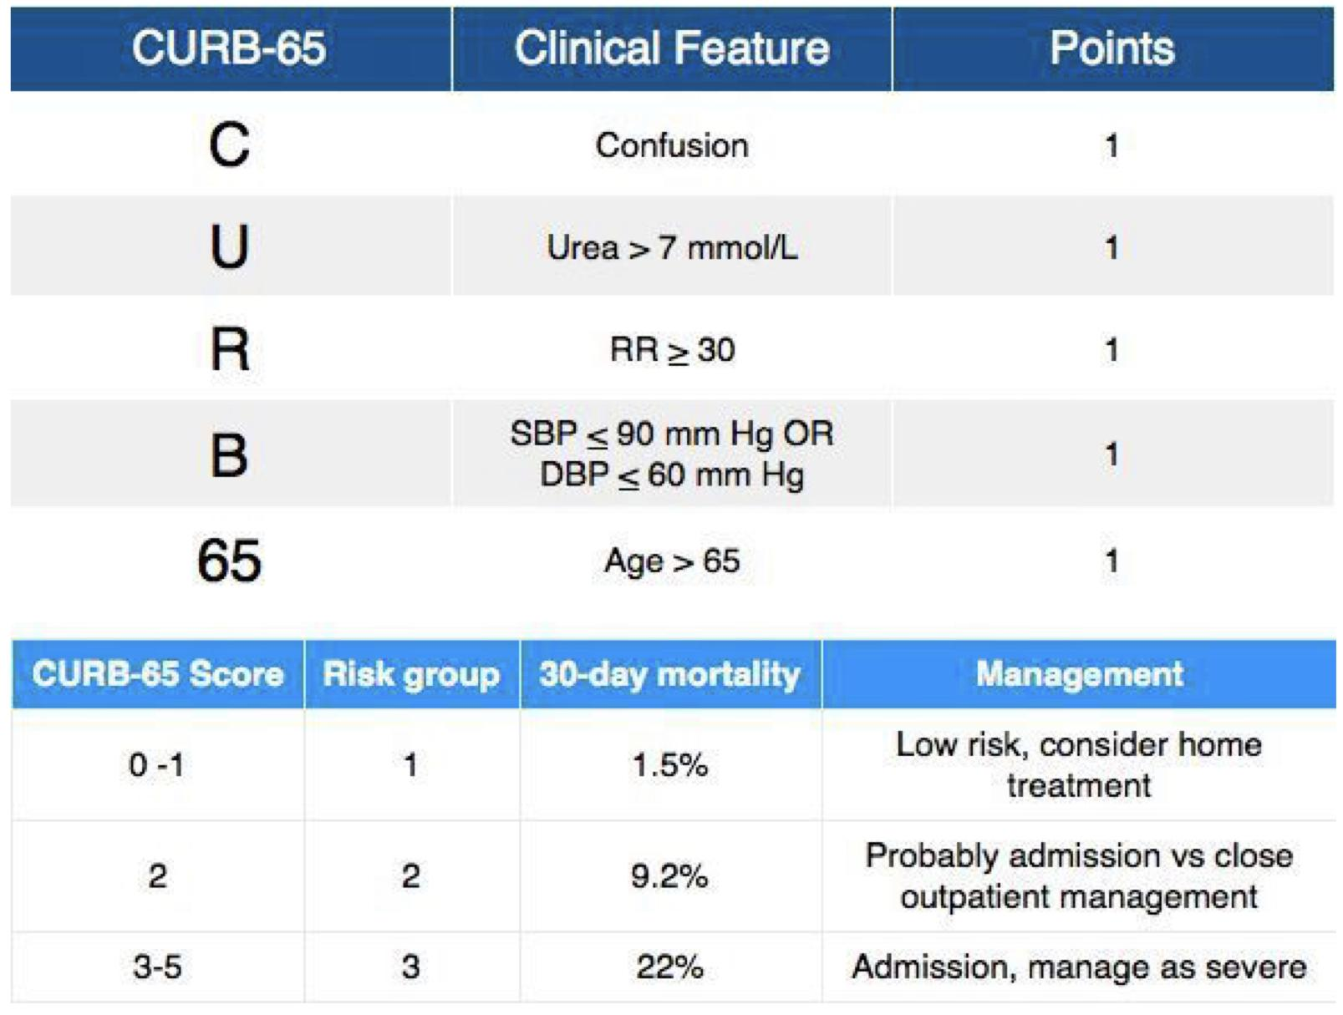
Types | ● Typical : S.pneumoniae (most common bacterial cause) ● Atypical : legionella spp contaminated water source , air conditioning.
Viruses | Very important causes especially in children. 1. Coronaviruses 2. Influenza A and B viruses
Clinical signs and symptoms | ● Cough (if productive rusty colored sputum) ● Fever, Chills ● Dyspnea ● Fatigue ● Gastrointestinal (Legionella) ● Dullness to percussion ● Crackles on auscultation ● Bronchial breath sounds ● Egophony (“E” to “A” changes) ● Increased vocal tactile fremitus
Risk factors | ● Older age ● Chronic comorbidities ● Viral respiratory tract infection ● Impaired airway protection Aspiration ● Smoking and alcohol overuse ● Other lifestyle factors
Diagnosis
All patients with suspected CAP should have chest radiograph
Urinary and serum antigens specific for legionella
Leukocyte count
Sputum Gram stain
Evaluation :
Management :
1- Healthy Individual with no risk factor (classified by the CURB-65 score as outpatient)
Azithromycin
2- Risk of aspiration (Anaerobes)
Clindamycin or Augmentin
3- Patient admitted but not ICU
Azithromycin + 3rd generation
Cephalosporin (Ceftriaxone)
4- ICU patients (Sepsis)
Empirical treatment
(Piptaz)

Slide 12
Q1: A 55-year-old man, who has never smoked and with no past medical history, has been diagnosed with right basal community-acquired pneumonia. There are minimal changes on his chest x-ray and bloods reveal a neutrophil count of 8.2 and a C-reactive protein (CRP) of 15. He has no drug allergies. Although he has a productive cough of green sputum, his respiratory rate is 16, oxygen saturations are 97 per cent on room air and his temperature is 37.4°C. You are asked to place him on treatment. Which of the following treatment options would be appropriate for this patient ?
A- Oral amoxicillin
B- Oral erythromycin
C- Intravenous ertapenem
D- Intravenous ertapenem with a macrolide (e.g. clarithromycin)
E- Intravenous tazocin
Q2: Which of the following organisms would typically be found in a patient with atypical community-acquired pneumonia ?
A- Staphylococcus aureus
B- Pseudomonas spp.
C- Streptococcus pneumonia
D- Legionella pneumophilia
Q3: 4. Which of the following conditions is not associated with an increased incidence or severity of pneumococcal pneumonia?
A- Poorly controlled hypertension
B- Diabetes mellitus
C- Renal insufficiency
D- Cirrhosis of the liver
E- Multiple myeloma
Q4: A 54-year-old investment banker presents to accident and emergency with a 5-day history of productive cough of green sputum, fevers and feeling generally unwell. On examination, there is bronchial breathing in the left lower zone. Chest x-ray demonstrates left lower zone consolidation. What is the most likely causative organism ?
A- Mycoplasma pneumoniae
B- Klebsiella pneumoniae
C- Staphylococcus aureus
D- Haemophilus influenzae
E- Streptococcus pneumoniae
Q5: Assessment of pneumonia A 67-year-old woman is admitted to accident and emergency with pyrexia (38.1°C) and a cough productive of green sputum. The observations show a pulse rate of 101, BP 80/60 and respiratory rate of 32. She is alert and orientated in space and time. Blood results reveal a WCC of 21, urea of 153mg/dL and chest x-ray shows a patch of consolidation in the lower zone of the right lung. She is treated for severe community-acquired pneumonia. Which of the following is the correct calculated CURB-65 score?
A- 6
B- 8
C- 4
D- 0
E- 1
Answers: Q1:A | Q2:D | Q3:A | Q4:E | Q5:C
Answers Explanation File!

Slide 13
THANKS!!
This lecture was done by:
Renad Alhaqbani
Razan Alrabah
Quiz and summary maker:
Sarah Alarifi
Note taker:
Lama Alzamil
Mohanad makkawi
Females co-leaders:
Raghad AlKhashan
Amirah Aldakhilallah
Males co-leaders:
Mashal Abaalkhail
Ibrahim AlAsous
Send us your feedback:
We are all ears!

