Slide 1
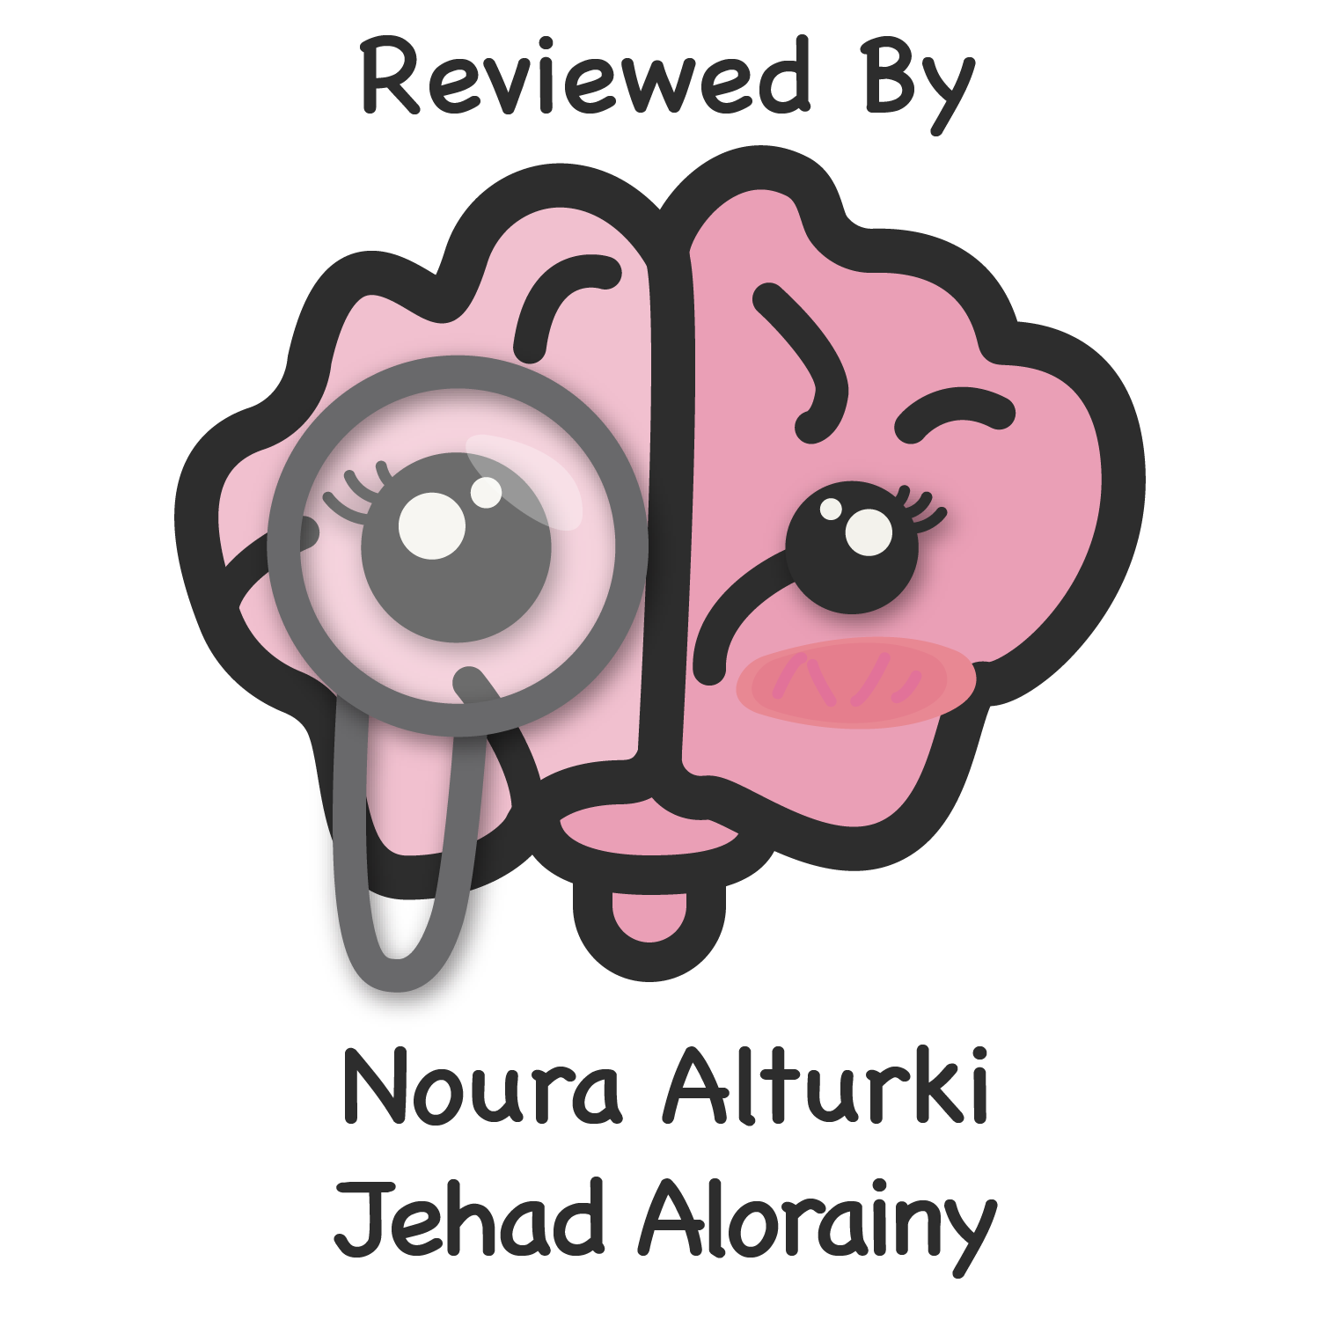
Lecture 55
Editing file
Peripheral Neuropathies
Understanding the cases at the end and the way they are
approached is the most important thing in this lecture.
Objectives:
Obtain informative history from a patient with peripheral neuropathy.
Use clinical information to recognize different patterns of peripheral neuropathy.
Provide differential diagnosis for each pattern.
Color index:
Color index:
Original text Females slides Males slides
Doctor’s notes Textbook Important Golden notes Extra

Slide 2
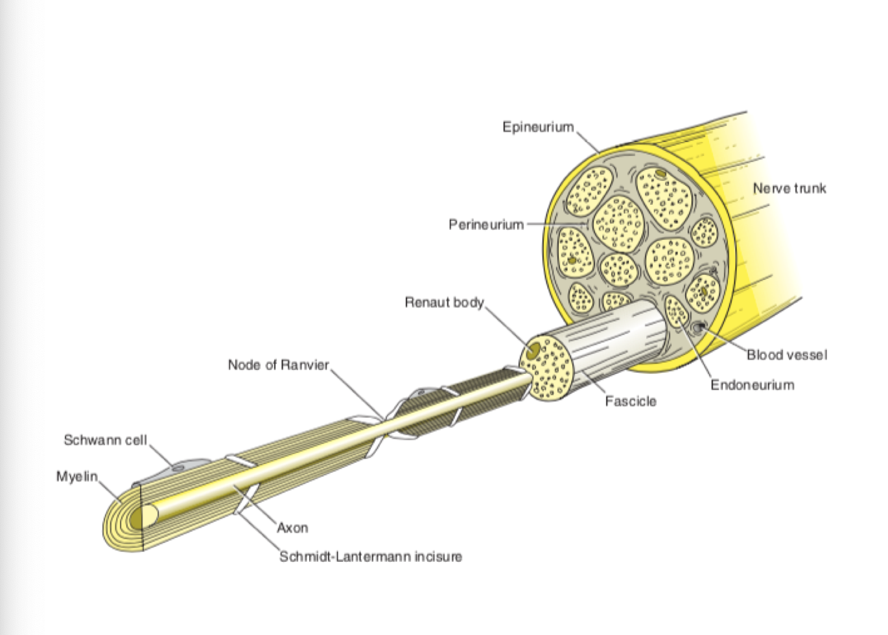
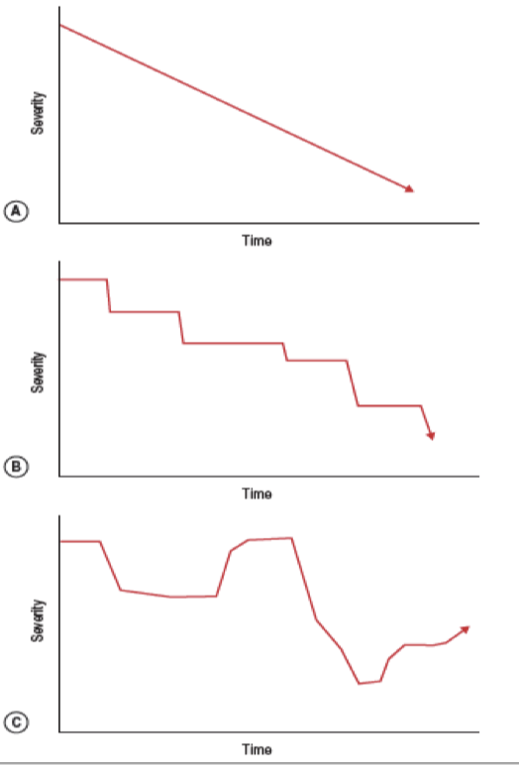
History
Overview of the basics
Dr notes:
The nerve is surrounded by the epineurium.
The nerves come out of the spinal cord and the epineurium is a continuation
of the dura mater.
Inside the nerves you have fascicle of axons and are surrounded by
perineurium.
Inside each fascicle you have many small nerves(fibers), and in between
these nerves there is endoneurium
The nerves are divided into small and large nerves the small nerves are unmyelinated or thinly myelinated and the large nerve fibers are myelinated.
Rods of ranvier separates the myelin sheath, they have condensed Na channels causing intense action potentials to reach the threshold and cause depolarization in the next part of the myelin sheath.
myelin helps with excitatory action potential as it improves the transmission of action potential
Symptoms
Abnormality | Description
Sensory | Tingling, burning, stabbing, throbbing, prickling, dead(numbness), icy, hot, clumsy, wooden, walking on sponges, cotton or something sharp, wearing stocking while they’re not.
Motor | Weakness , cramps, twitches (fasciculations)
Distal weakness | Turning keys, opening jars and doing up buttons Tripping, stepping over curbs, uneven ground pt. says he falls when he walks. my toes catch the floor and I trip and fall or having to raise the leg highly to walk up the stairs.
Proximal Weakness | Standing from sitting, walking up or down stairs, shaving, combing hair and brushing teeth pt. says the the he/she has difficulty washing hair .
Autonomic | Anhydrosis (don’t sweat), excessive sweating, orthostatic lightheadedness, impotence, dry mouth, early satiety “feeling full after small meals” blurred vision in bright light (pupil constriction and dilation problems)
Chronological pattern
Onset:
Timing: <4 weeks, 4-8 week , >8 weeks, chronic
Sudden, gradual, etc
Sometimes you ask the patient when did it start and he would say “I don’t know I’ve had it for a long time”. so you would ask: Were you a reasonable athlete as a child?, Did you finish last in foot races?, Were you able to skate or play soccer? to know if it started since childhood
Duration
Persistent
Intermittent
Progression
Chronic progression
Acute deterioration to nadir then stability or improvement
Fluctuating

Slide 3
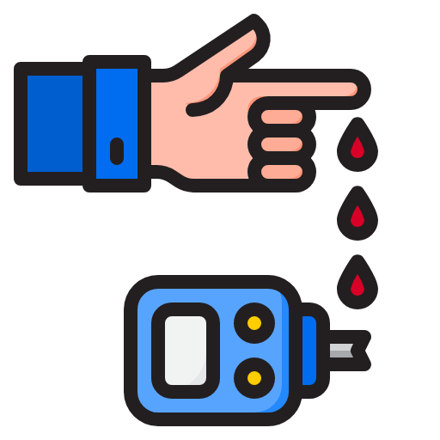
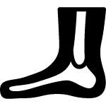
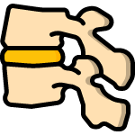
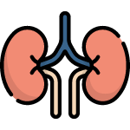
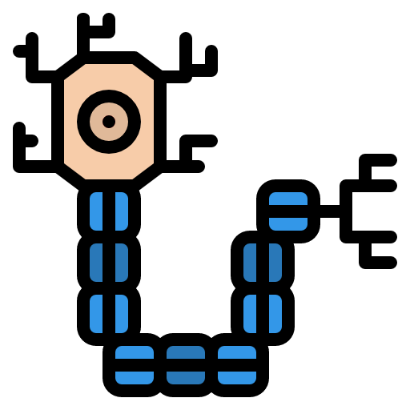
- some patients might say NO to family history.
so you have to ask if anyone in the family ever used a cane or a wheelchair early in life.
and if anyone in the family have foot deformity
- they might even tell you that his father for example has Rheumatoid Arthritis and he has weakness because of it when in fact he has it for the same reason (hereditary neuropathy)
History
Past history and comorbidities
some patients might say NO to family history, so you have to ask if anyone in the family ever used a cane or a wheelchair early in life, and if anyone in the family have foot deformity, they might even tell you that his father for example has Rheumatoid Arthritis and he has weakness because of it when in fact he has it for the same reason (hereditary neuropathy)
 | Diabetes (glucose intolerance) |  |  |  | Bariatric surgery¹ (B1 Deficiency)²
 | Orthopedic procedures on feet and ankles³ |  |  |  | Previous cervical or lumbar disc disease
 | Connective tissue disease: SLE Rheumatoid arthritis |  |  |  | Previous entrapment neuropathies: Multiple entrapments (consider HNPP, amyloidosis)
 | Thyroid disease |  | Renal failure |  | Malignancies |  | Hepatic failure
Diabetes (glucose intolerance)
Thyroid disease
Renal failure
Hepatic failure
Connective tissue disease:
SLE
Rheumatoid arthritis
Malignancies
Previous cervical or lumbar disc disease
Orthopedic procedures on feet and ankles
Bariatric surgery¹ (B1 Deficiency)²
Previous entrapment neuropathies:
Multiple entrapments (consider HNPP, amyloidosis)
the ex the doctor mentioned was: the person may mention to you that one of his family members has RA, you will find that they were misdiagnosed
Family history
Detailed family history
Walking difficulty, use of cane or wheelchair, Postural or foot deformities
Probe history of disabled or possibly affected individuals
Do not necessarily accept what diagnoses other individuals have
Some patients might say NO to family history, so you have to ask if anyone in the family have walking difficulty or used a cane or a wheelchair early in life, and if anyone in the family have foot deformity, they might even tell you that his father for example has Rheumatoid Arthritis and he has weakness because of it, then you will find that they were misdiagnosed and the deformity was due to the same reason (hereditary neuropathy)
Social History
Occupation | Cause of Neuropathy
Dentists | Nitrous Oxide
Painters, glue sniffers | Hexacarbons
Farmers | Organophophates
Welders | Lead
Jewelers | Arsenic
Plastic industry | Acrylamide
Not important for your exam but they love to ask it in the board exams
Exposure to Alcohol
Recreational Drugs
Tobacco
Vitamin and herb use
Occupation
Review of Systems
Joint pain, stiffness, swelling, fever, Skin rash and other systems
Undiagnosed connective tissue disease associated with neuropathy, cancer (polyneuropathy is seen as a paraneoplastic syndrome) or Brucella.
1- When people lose weight, they have malnutrition. like vitamin b1 (thiamin) and that can result in severe neuropathy if left untreated
2- Thiamine deficiency → impaired glucose breakdown → ATP depletion → tissue damage. This could lead to BeriBeri. Clinical features: Symmetrical peripheral neuropathy (sensory & motor) Progressive muscle wasting, Paralysis, Confusion. it resembles Guillain Barre syndrome. look for history to differentiate.
3- Peripheral neuropathy due to hereditary disease can be associated with deformity, they will undergo surgery and get referred to neuro.

Slide 4
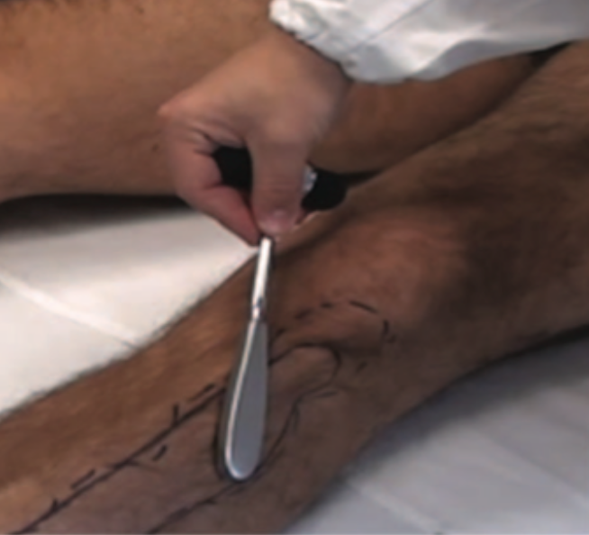
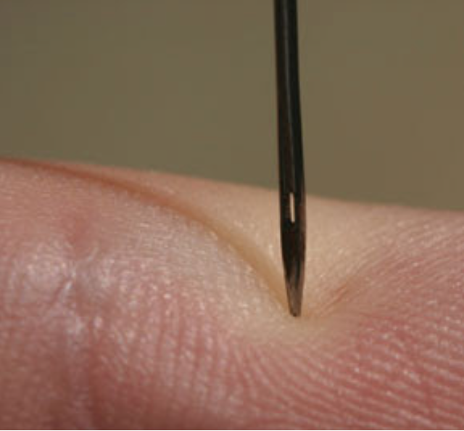
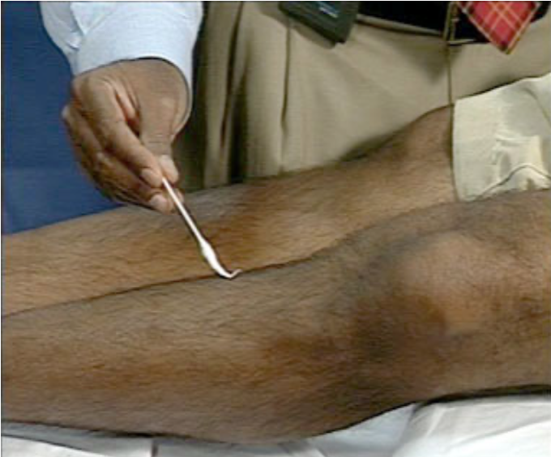
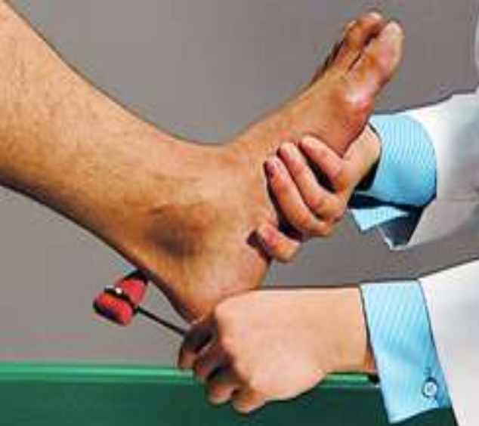
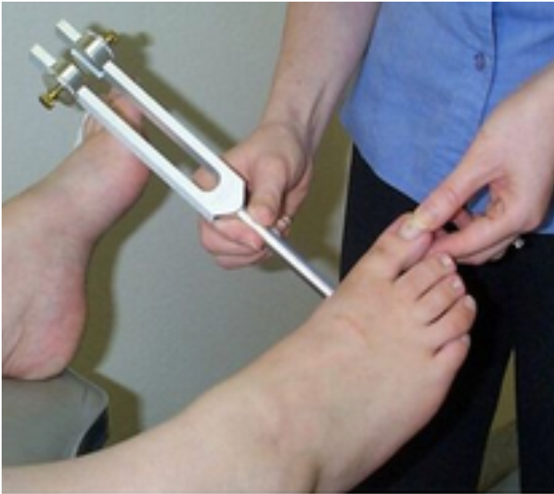
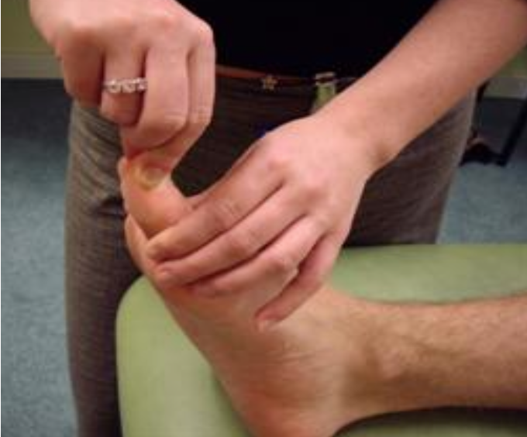
Neurological examination
Confirm localization
LMN vs UMN
myopathy vs neuropathy
Recognize pattern of neuropathy
Motor vs sensory vs sensory motor
Proximal vs distal
Symmetric vs asymmetric
Recognize features of hereditary neuropathy
Recognize features that narrows the differential diagnosis.
Purpura and levido reticularis
Autonomic features
BP & HR supine and standing
Pupillary reaction to light and accommodation
Other:
Skin: trophic changes (such as thin, shiny, and discolored skin)
ulcerations or amputations.
peripheral pulses.
Examination
Neurological examination
Confirm localization
Lower Motor Neuron (LMN) vs Upper Motor Neuron (UMN)
myopathy vs neuropathy
UMN vs LMN lesions¹ (possible theoretical OSCE question)
 | UMN | LMN
Definition | Lesion Typically above the anterior horn cell of the spinal cord or motor nuclei of the cranial nerves (e.g., motor cortex, brain stem) | Lesion anywhere along the nerve fibers between the anterior horn of the spinal cord and relevant muscle tissue
Muscles | Atrophy is absent. Fasciculations are absent. | Atrophy and fasciculations
Characteristics | ↑ Tone (clasp knife phenomenon), spasticity, clonus and hyperreflexia | ↓ Tone (no clasp knife phenomenon) and Hyporeflexia/areflexia
Bladder function | Detrusor hyperreflexia and detrusor/external urethral sphincter dyssynergia | Overflow incontinence
Babinski sign | Upgoing (positive) Except in children up to the age of 2 years | Downgoing (negative)
Pinprick + Cold = Small fibers C
Vibration & Reflexes are large fibers
light touch is both
Movement large??
Recognize pattern of neuropathy
Motor vs sensory vs sensory motor
Proximal vs distal
Symmetric vs asymmetric
Recognize features of hereditary neuropathy like pes cavus and hammer toe
Recognize features that narrows the differential diagnosis.
Purpura and levido reticularis
Autonomic features
BP & HR supine and standing
Pupillary reaction to light and accommodation
Other:
Skin: trophic changes (such as thin, shiny, and discolored skin)
rashes (vasculitis)
ulcerations or amputations.
peripheral pulses. especially for diabetic patients
Test for cold²
Pinprick²
light touch³
Reflexes⁴
Vibration⁴
Joint position⁴
1- In LOWer motor neuron lesions: muscle mass, tone, power, and reflexes are LOW.
In UPper motor neuron lesions: muscle tone, reflexes, and toes (Babinski sign) are UP.
2- Cold temperature and pinprick are classified as small fibers (pain and cold are transmitted through type C fibers “small fibers”)
3- light touch is both small and large fibers
4- Vibration, joint position and reflexes are transmitted through large fibers

Slide 5
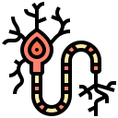
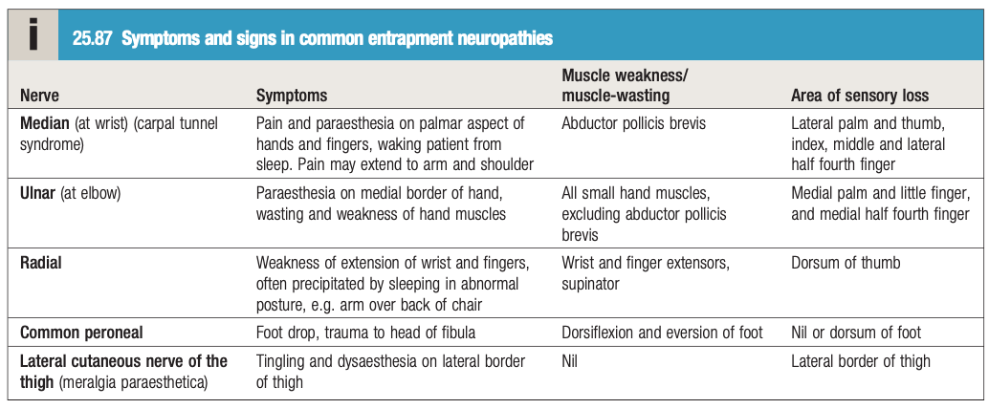
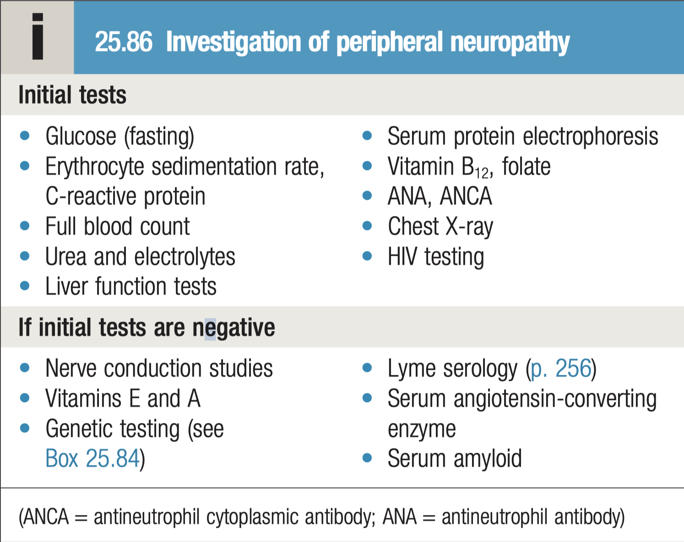
Overview of peripheral neuropathies
Nerve | Entrapment/compression site | Seen in
Median | Carpal tunnel (wrist) | typically not associated with any underlying disease. It is, however, seen in: • hypothyroidism • pregnancy (third trimester) • rheumatoid disease • acromegaly • amyloidosis, including in dialysis patients
Ulnar | Cubital tunnel (elbow) | This follows prolonged or recurrent pressure and elbow fracture ('tardy ulnar palsy', as onset is very delayed).
Radial | Spiral groove (of humerus) | The radial nerve is compressed acutely against the humerus: for example, when the arm is draped over a hard chair for several hours,
common peroneal | Neck of fibula | The common peroneal nerve is compressed against the head of the fibula following prolonged squatting, yoga, pressure from a cast, prolonged bed rest or coma, or sometimes, for no apparent reason.
Introduction
Disorders of the peripheral nervous system are common and may affect the motor, sensory or autonomic components, either in isolation or in combination.
The site of pathology may be nerve root (radiculopathy), nerve plexus (plexopathy) or nerve (neuropathy).
Neuropathies may present as mononeuropathy (single nerve affected), multiple mononeuropathies (‘mononeuritis multiplex’) or a symmetrical polyneuropathy
Pathophysiology
Damage may occur to the nerve cell body (axon) or the myelin sheath (Schwann cell), leading to axonal or demyelinating neuropathies.
The distinction is important, as only demyelinating neuropathies are usually susceptible to treatment.
Neuropathies can occur in association with many systemic diseases, toxins and drugs
Investigations:
The investigations required reﬂect the wide spectrum of causes.
Neurophysiological tests are key in discriminating between demyelinating and axonal neuropathies, and in identifying entrapment neuropathies.
Most neuropathies are of the chronic axonal type.
Extra from Davidson
Symptoms and signs in common entrapment neuropathies
Nerve | symptoms | Muscle weakness | Area of sensory loss
Median | Pain and paraesthesia on palmar aspect of hands and fingers, waking patient from sleep. Pain may extend to arm and shoulder | Abductor pollicis brevis | Lateral palm and thumb, index, middle and lateral half fourth ﬁnger
Ulnar | Paraesthesia on medial border of hand, wasting and weakness of hand muscles | All small hand muscles, excluding abductor pollicis brevis | Medial palm and little ﬁnger, and medial half fourth ﬁnger
Radial | Weakness of extension of wrist and ﬁngers, often precipitated by sleeping in abnormal posture, e.g. arm over back of chair | Wrist and ﬁnger extensors, supinator, | Dorsum of thumb
Common peroneal | Foot drop, trauma to head of ﬁbula | Dorsiﬂexion and eversion of foot | Nil or dorsum of foot

Slide 6
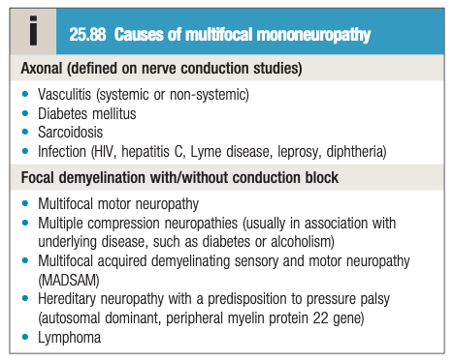
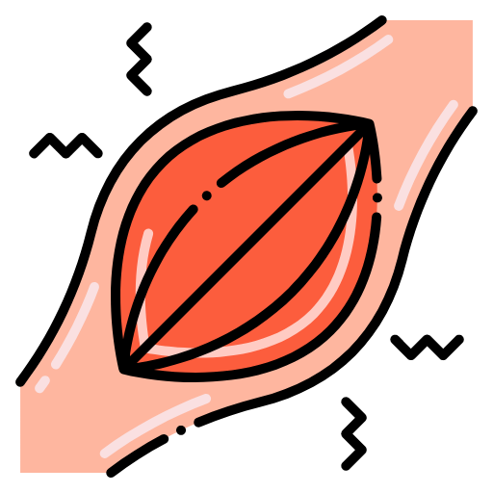
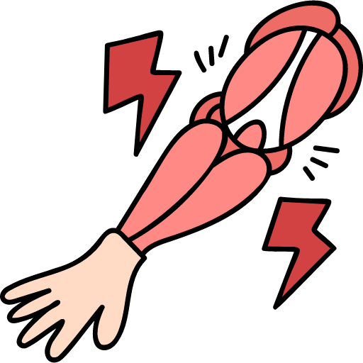
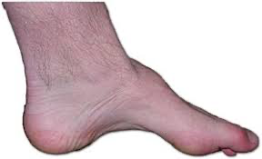
Overview of peripheral neuropathies
Mononeuritis multiplex
Several nerves, such as the ulnar, median, radial and lateral popliteal, become affected sequentially or simultaneously. When multifocal neuropathy is symmetrical, there is difficulty distinguishing it from polyneuropathy.
this can occurs in
diabetes mellitus
leprosy
vasculitis, including eosinophilic granulomatosis with polyangiitis
amyloidosis
malignancy
neurofibromatosis
HIV and hepatitis C infection
multifocal motor neuropathy with conduction block
Radiculopathy
Signs and symptoms reflect the nerve roots involved. clinical features include:
muscle weakness and wasting
Loss of reflexes
dermatomal sensory loss
Pain in the muscles of the affected roots
Hereditary neuropathy
Charcot–Marie–Tooth disease (CMT) is an umbrella term for the inherited neuropathies.
the disease typically progress slowly over many years
The members of this group of syndromes have different clinical and genetic features.
The most common CMT is the autosomal dominantly inherited CMT type 1
Common signs:
Distal wasting.
Pes cavus.
Variable loss of sensation and reflexes.
In advanced disease, severe foot drop results but patients usually remain ambulant.
Pes Cavus
Chronic inflammatory demyelinating polyneuropathy (CIDP)
CIDP typically presents with relapsing or progressive motor and sensory changes, evolving over more than 8 weeks (in distinction to the more acute GBS).
It is important to recognise, as it usually responds to glucocorticoids, plasma exchange or intravenous immunoglobulin.
There is no single diagnostic test but CSF protein is raised and patchy demyelination is usually seen on nerve conduction studies.

Slide 7
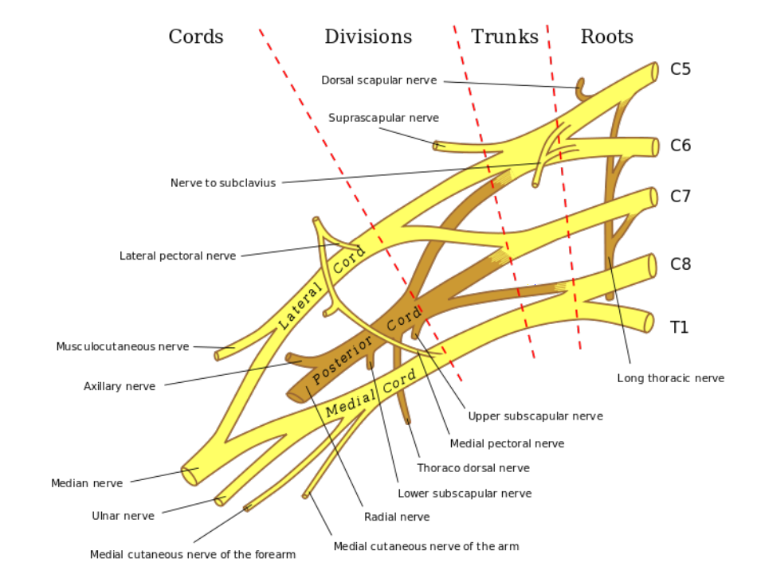
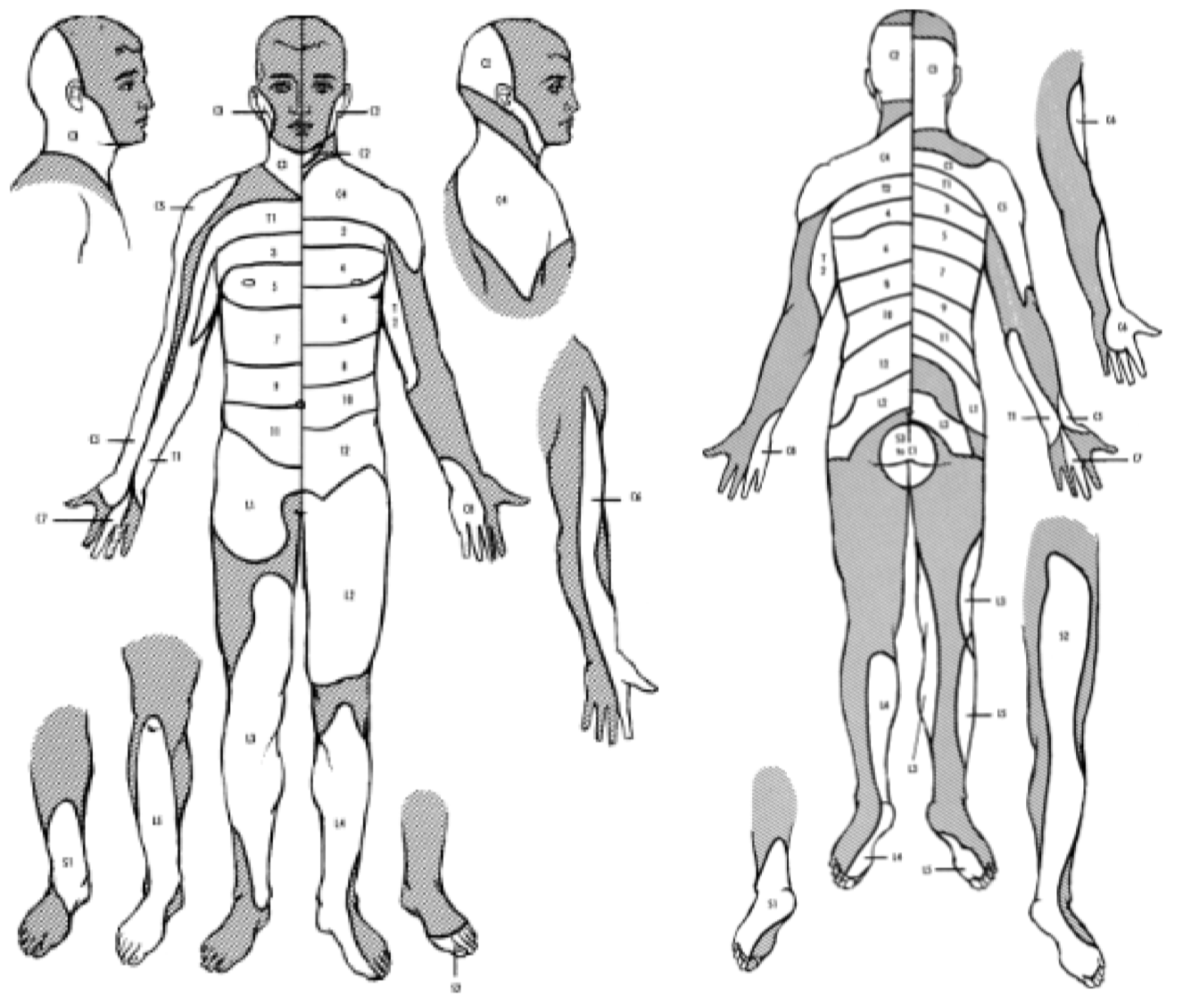
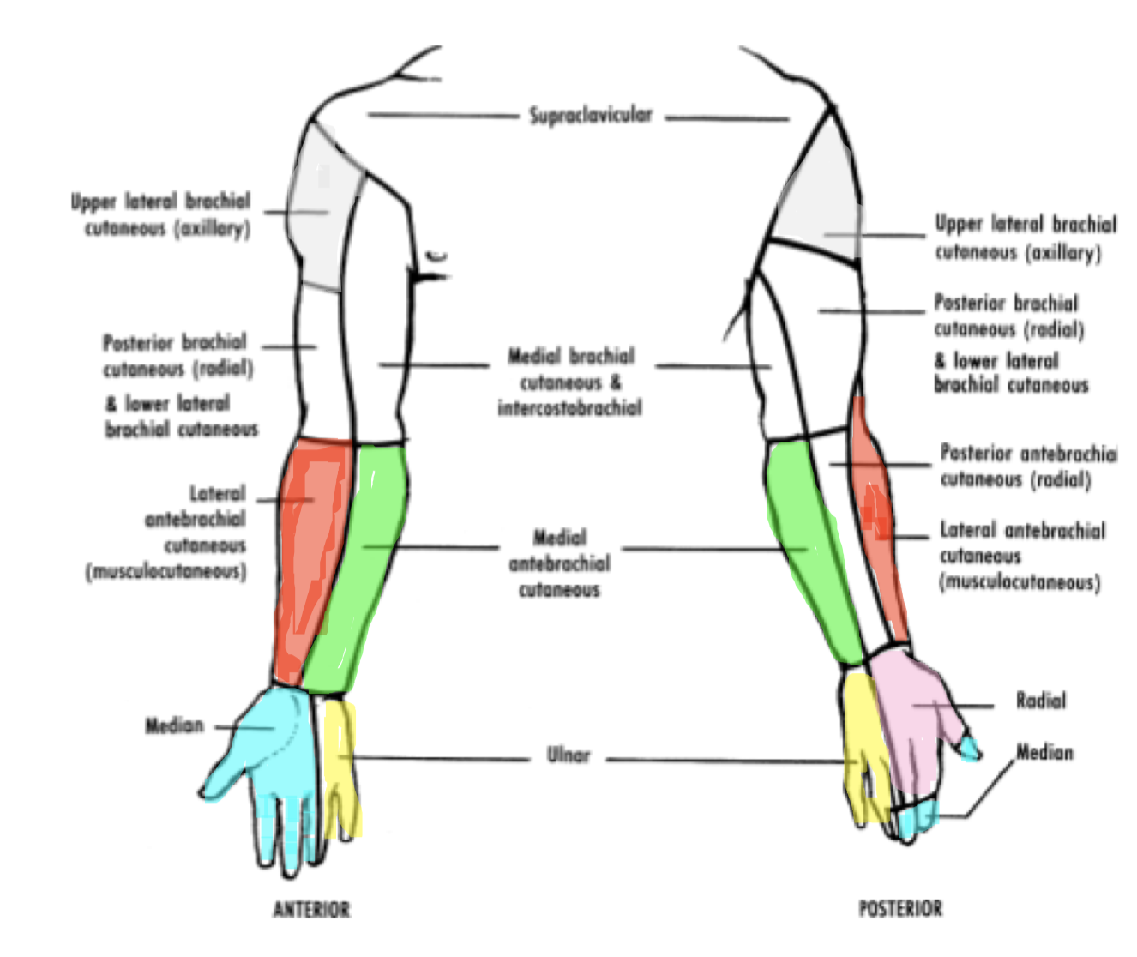
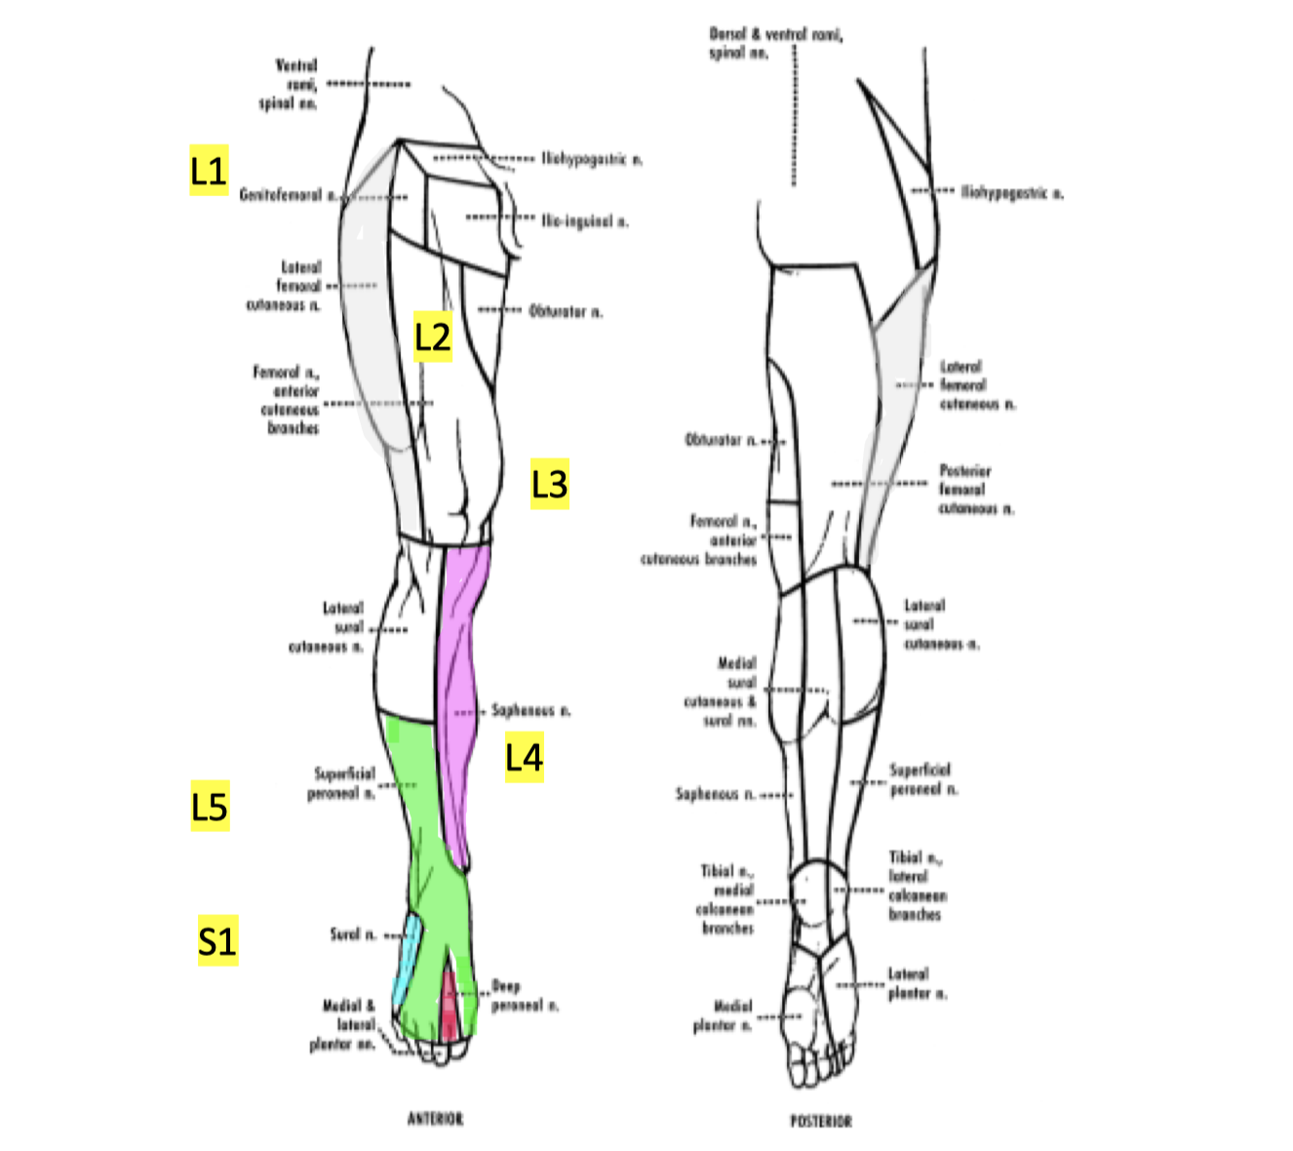
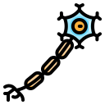
Overview of peripheral neuropathies
Dermatomal distribution
“Dr. notes”
Dermatomal & peripheral nerve distribution
upper limb Dermatomal distribution:
Lateral part of the shoulder → C5
Lateral part of the forearm to the thumb → C6
middle finger → C7
little finger → C8
medial part of the forearm → T1
Upper limb Dermatomal distribution:
1
Upper limb Dermatomal distribution:
Lateral part of the shoulder → C5
Lateral part of the forearm to the thumb → C6
middle finger → C7
little finger → C8
medial part of the forearm → T1
2
Peripheral nerves distribution
the peripheral nerves distribution is slightly different
- the lateral part of the arm is supplied by Axillary nerve (C5)
- the lateral part of the forearm is supplied by the lateral antebrachial (C6)
- the lateral 3 and a half fingers are supplied by the median nerve (C6 + C7)
- the medial 1 and a half finger is supplied by the ulnar nerve (C8)
- the medial part of the forearm is applied by medial antebrachial (T1)
The peripheral nerves distribution is slightly different:
The lateral part of the upper arm is supplied by Axillary nerve (C5)
The lateral part of the forearm and thumb is supplied by the lateral antebrachial (C6)
Thumb and lateral 3 and a half fingers are supplied by the median nerve (C6 + C7)
The medial 1 and a half finger is supplied by the ulnar nerve (C8)
The medial part of the forearm is applied by medial antebrachial (T1)
- The top of the foot is the superficial peroneal sensory nerve (L5)
- The area between the first and second Toes the deep peroneal sensory nerve (L5)
- The lateral part of the foot around the lateral malleolus is supplied by the sural nerve (S1)
- the sole of the foot is also (S1)
- The medial part of the leg from the knee to the medial malleolus is the saphenous nerve (L4)
- The medial part of the thigh and knee (L3)
- The Mid thigh is (L2)
- The inguinal ligament is (L1)
- The lateral part of the thigh is supplied by the lateral femoral cutaneous nerve of the thigh
3
Lower limb Distribution
The lateral aspect of the leg extending to the dorsum of the foot , superficial peroneal (L5)
The area between the first and second Toes the deep peroneal sensory nerve (L5)
The lateral part of the foot behind the lateral malleolus is supplied by the sural nerve (S1)
The sole of the foot is also (S1)
The medial part of the leg from the knee to the medial malleolus is the saphenous nerve (L4)
The medial part of the thigh and knee (L3)
The Mid thigh is (L2)
The inguinal ligament is (L1)
The lateral part of the thigh is supplied by the lateral femoral cutaneous nerve of the thigh
use this pic for lower limb distribution
(different sources differ)
use this pic for lower limb distribution
(different sources differ)
1- with root involvement (dermatome), the sensory loss is usually mild and not well demarcated as opposed to peripheral nerve where the sensory loss is more demarcated, why? because the dermatomes overlap and nerves don’t.
Introduction
Extra from Davidson
Disorders of the peripheral nervous system are common and may affect the motor, sensory or autonomic components, either in isolation or in combination.
The site of pathology may be nerve root (radiculopathy), nerve plexus (plexopathy) or nerve (neuropathy).
Neuropathies may present as mononeuropathy (single nerve affected), multiple mononeuropathies (‘mononeuritis multiplex’) or a symmetrical polyneuropathy
Pathophysiology
Damage may occur to the nerve cell body (axon) or the myelin sheath (Schwann cell), leading to axonal or demyelinating neuropathies.
The distinction is important, as only demyelinating neuropathies are usually susceptible to treatment.
Neuropathies can occur in association with many systemic diseases, toxins and drugs
Investigations:
The investigations required reﬂect the wide spectrum of causes.
Neurophysiological tests are key in discriminating between demyelinating and axonal neuropathies, and in identifying entrapment neuropathies. Most neuropathies are of the chronic axonal type.
Acute Neuropathy
Distribution
Modality
Focal or multi focal
Symmetric
Motor/sensory/Both
Autonomic
1. Vasculitis
1. GBS
2. ANAN
3. confluent multiple mononeuropathy
1. GBS
2. ANAN
3. Vasculitis
4. infections
5. Toxins
1. GBS
2. Toxins
3. Porphyria
4. Paraneoplastic
5. Idiopathic

Slide 8
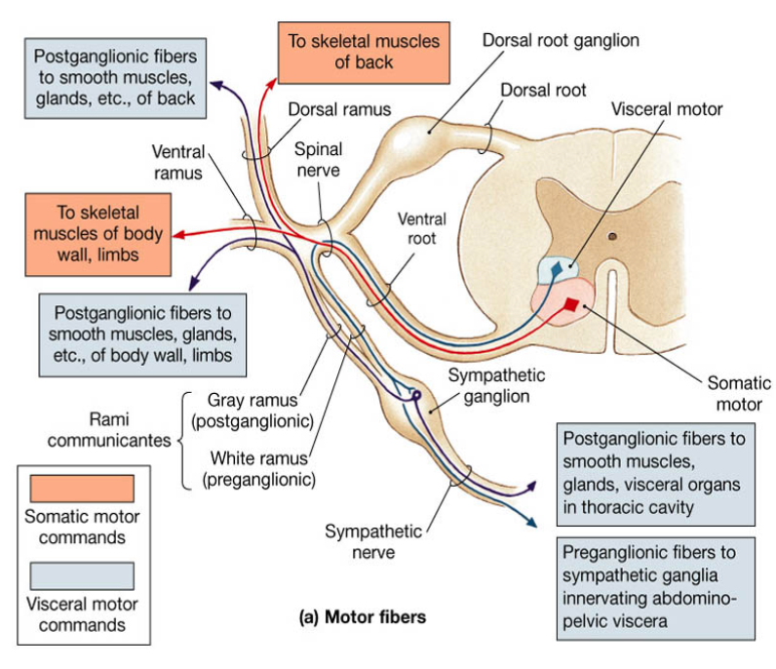
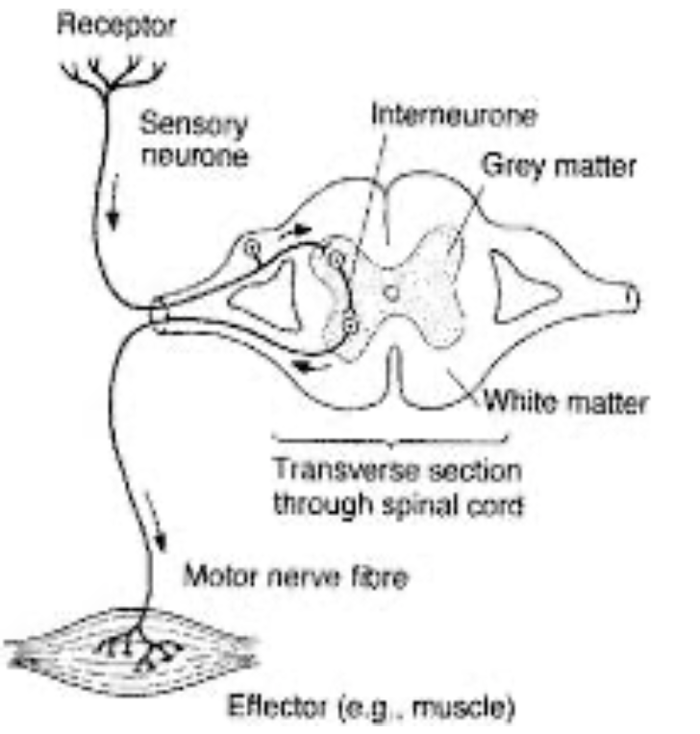
Approach
Introduction
Recognition of a clinical pattern.
There are 6 key questions the clinician should consider in arriving at the pattern that fits the patient best.
Most neuropathy and neuronopathy patients can be placed into one of 10 patterns
Approach - 6 Questions
6 Questions
What systems are involved?
What is the distribution of weakness?
What is the nature of the sensory involvement?
Is there evidence of UMN involvement?
What is the temporal evolution?
Is there evidence for a hereditary neuropathy?
Q1
Q2
Q3
Q4
Q5
Q6
Question 1- What systems are involved ?
Motor | localized to AHC (anterior horn cell), motor nerve roots, motor nerves,NMJ, muscle.
Sensory | peripheral nerve, plexus, DRG (dorsal root ganglion) , sensory nerve roots, small fibers, spinal cord, thalamus, sensory cortex.
Autonomic | peripheral nerve, autonomic nerves, lateral gray/white communicants (between nerve roots and sympathetic ganglia) If mild, we may not capture it by clinical assessment
Other | Most commonly combinations of any of the above
Dr notes “Localization of lesion”:
- AHC lesion: should present as a purely motor problem (no sensory involvement)
- Dorsal root lesion: could be motor and sensory problems
- DRG lesion: sensory problems, reflux loss and sensory ataxia (motor is not involved)
- plexus lesion: motor and sensory
- peripheral nerve lesion: motor and sensory
NMJ leison: motor only
muscle: motor only

Slide 9
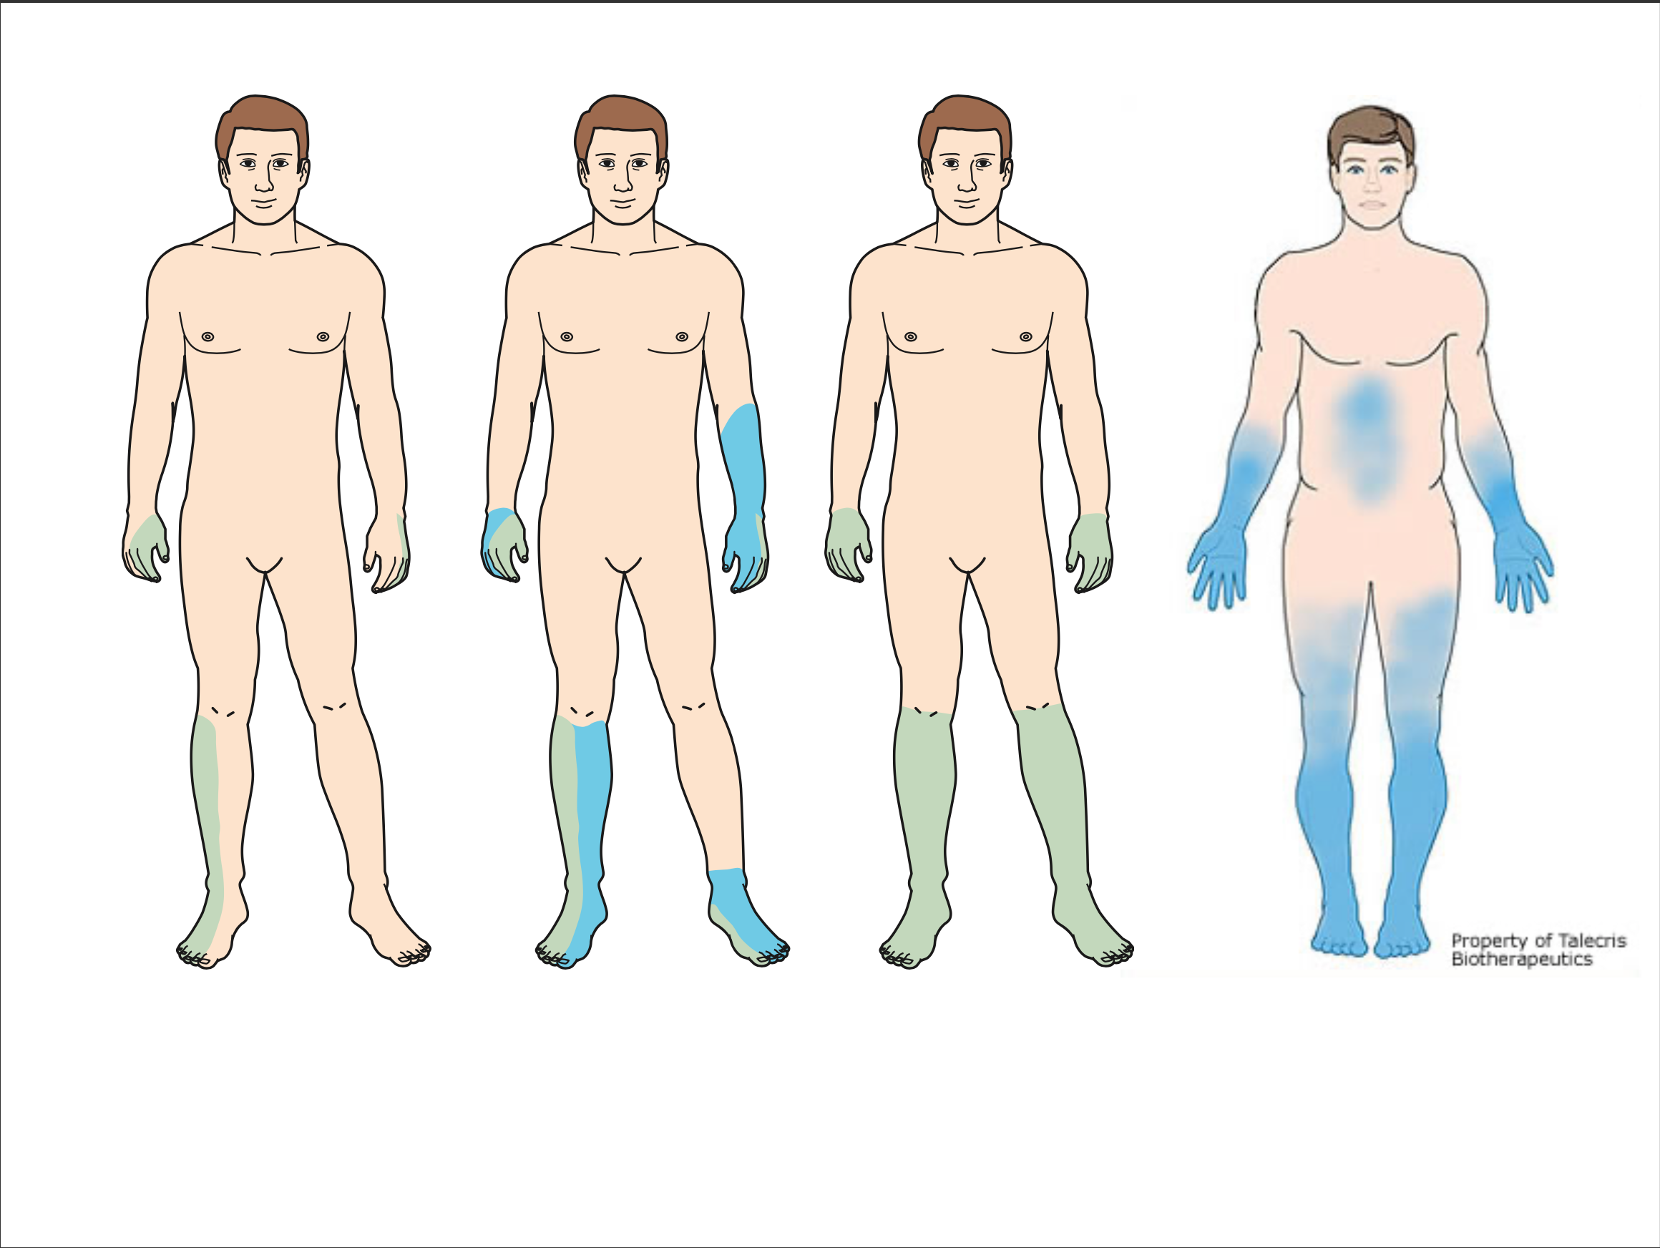
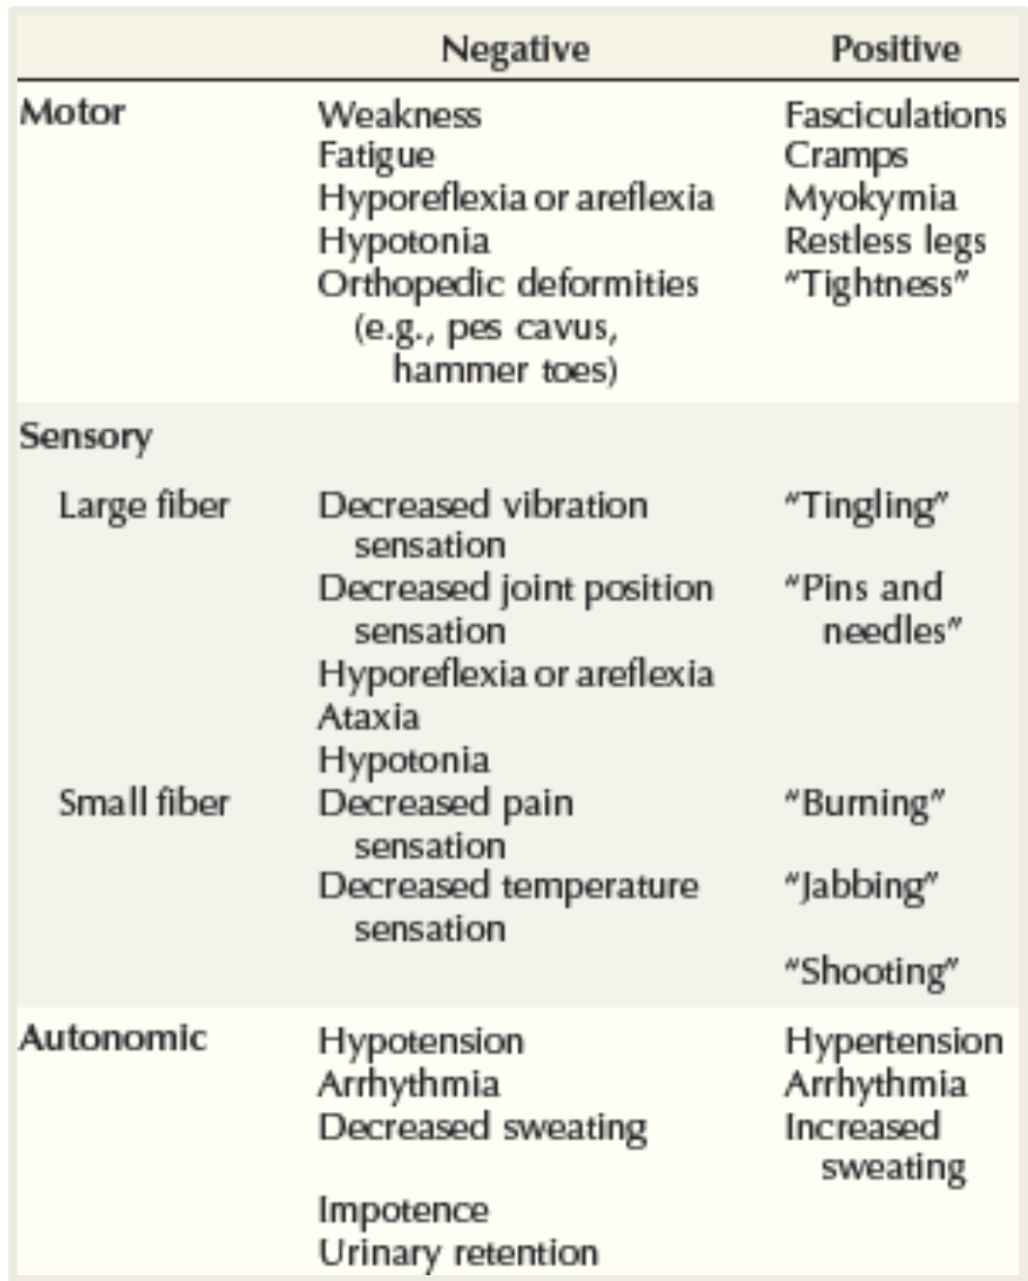
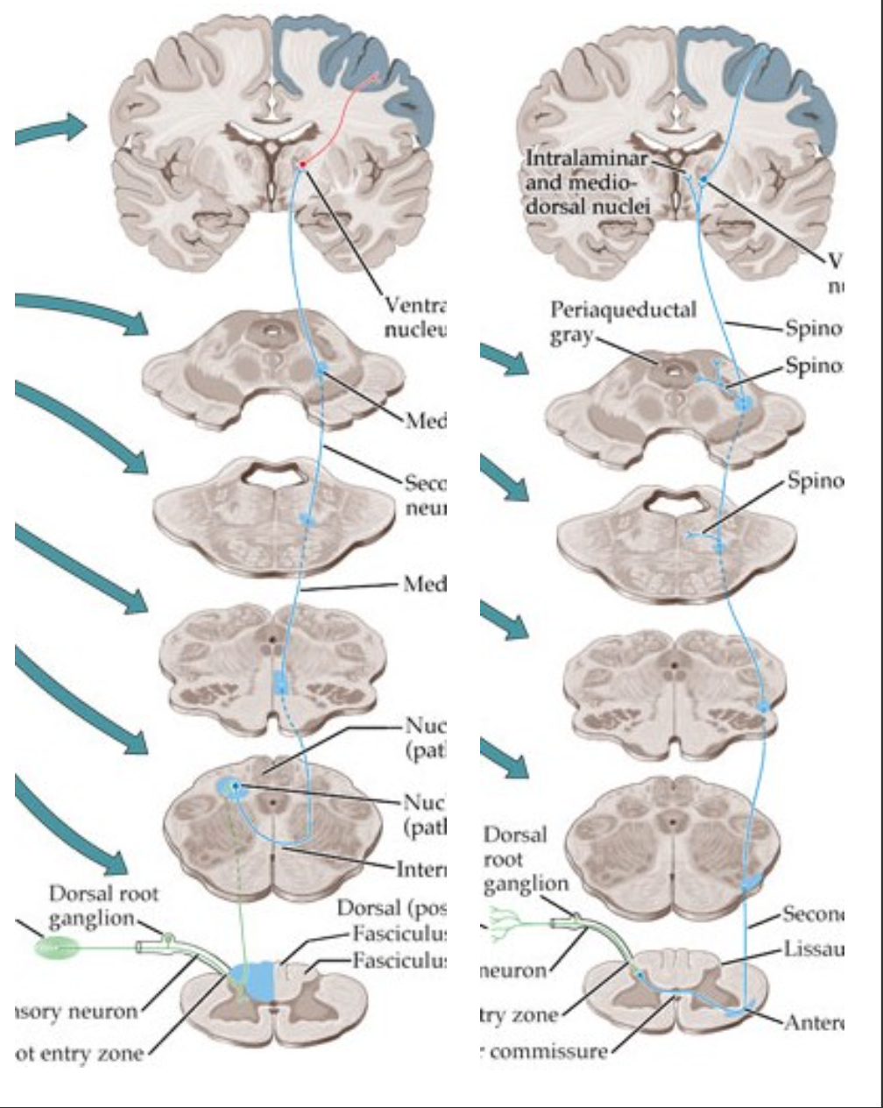
Approach
‹#›
Question 2- What is the Distribution of Weakness?
Proximal
Distal
Proximal > Distal
Distal > proximal
Focal
Multifocal
Symmetric vs Asymmetric
Asymmetric
Multifocal
Bilateral multifocal but still asymmetrical
symmetric involvement of lower and upper limb
Asymmetric/focal weakness | Symmetric weakness
Radiculopathy Plexopathy Mononeuropathy Multiple mononeuropathies Motor neuron disease Hereditary e.g. HNPP¹ (hereditary neuropathy with predisposition to pressure palsies) MADSAM² (multi-focal acquired demyelinating sensory and motor neuropathy) MMNCB² (multifocal motor neuropathy with conduction block) Infections² | GBS & CIDP Metabolic: Diabetic peripheral neuropathy, uremic, endocrine, etc. Toxic: ETOH, chemo, etc.. Infections: HIV Vitamin deficiency: B1, 6, 12, folic acid, copper, vit E, etc. Hereditary: CMT (Charcot–Marie–Tooth disease) HSAN (Hereditary sensory and autonomic neuropathy)
Question 3- What is the nature of the sensory involvement?
Is it large fiber or small fiber?
Pain (burning or stabbing) impaired PP (pinprick examination) and temperature →
small fiber (type c fibers)
Tingling, weakness, ataxia, imbalance,
impaired vibration and proprioception (joint position) also reflexes → large fiber
Most neuropathies involve both small and large fibers.
Severe proprioceptive loss
Central: dorsal column
Generally less profound proprioceptive loss
Ganglionopathy³: loss of all sensory modalities and reflexes
Dr notes:
The small fibers, when it goes into the spinal cord it crosses to the contralateral tract and ascends in the spinothalamic tract.
Large fibers ascends in the ipsilateral dorsal column until it reaches the brainstem and then it crosses to the contralateral side.
The dorsal root ganglion is the primary/first order neuron for large and small nerve fibers
So, if there is a damage to the dorsal root ganglion you will lose all of the sensations from both the small and large fibers. you will also lose the reflexes because “as you already know” it is part of the reflex arc. so patients with DRG disorders have peripheral ataxia, loss of sensations form both small and large fibers and loss of reflexes but it is asymmetric
3- "hidden cancer" paraneoplastic syndrome, Sjogren's disease , Vit B6 toxicity.
1- the majority are symmetric, this is an exception.
2- can be both symmetric or asymmetric.

Slide 10
Approach
Question 4- Is there evidence of upper motor neuron involvement?
Without sensory loss
With sensory loss
UMN without sensory involvement = Motor neuron disease
Amyotrophic lateral sclerosis (ALS)
Primary lateral sclerosis (PLS)
Sensory involvement along with UMNL signs = Cord involvement along with the peripheral nerve
B12 deficiency (myeloneuropathy)
folate deficiency
copper
vit E
Friedrich’s Ataxia (inherited disease that cause a similar picture to b12)
Preceding events, infections, drugs and toxins
Acute (days to 4 weeks)
Subacute (4–8 weeks)
Chronic (>8 weeks)
Preceding events, infections, drugs, toxins
Question 5- What is the temporal¹ evolution?
Acute
Subacute
Chronic
(days to 4 weeks)
(4–8 weeks)
(>8 weeks)
Preceding events
infections, drugs and toxins
Question 6- Is there evidence for a hereditary neuropathy?
Family history of neuropathy
Skeletal deformities
long standing history
Lack of sensory symptoms despite sensory signs. You ask the patient if he has any sensory problems and he says no, you examine him and you’d be surprised how the severe sensory loss they have. the thing is, they’re developing the symptoms over a long time so they wouldn’t know if they’re losing it or not.
1- Time

Slide 11
you will NOT be
asked “what pattern is the disease”. you just need to know
the pattern to get
the differential diagnosis
Patterns of neuropathic disorders
 | Weakness |  |  |  | Sensory symptoms | Severe proprioceptive loss | UMN signs | Autonomic symptoms/ signs | Diagnosis
 | Proximal | Distal | Asymmetric | Symmetric
Pattern 1: symmetric proximal and distal weakness with sensory loss | + | + |  | + | + |  |  |  | GBS, CIDP
Pattern 2: Distal Sensory loss with/ without weakness |  | + |  | + | + |  |  |  | CSPN¹, metabolic, drugs, hereditary: (CMT, Amyloidosis)
Pattern 3: Distal weakness with sensory loss |  | + | + |  | + |  |  |  | - Multiple: vasculitis, HNPP², MADSAM, infection (leprosy, lyme, sarcoid, HIV) - Single: Mononeuropathy, radiculopathy
Pattern 4: Asymmetric Proximal and distal weakness with sensory loss | + | + | + |  | + |  |  |  | Polyradiculopathy, plexopathy
Pattern 5 : Asymmetric distal weakness without sensory loss |  | + | + |  |  |  | ± |  | - LMN and UMN - ALS - Pure UMN - PLS - Pure LMN - MMN³. PMA⁴, BAD⁵, LAD⁶, MAMA⁷
Pattern 6 : Symmetric sensory loss and upper motor neuron signs |  | + |  | + | + | + | + |  | b₁₂ deficiency, copper deficiency, friedreich ataxia, adrenomyeloneuropathy
Pattern 7: Symmetric weakness without sensory loss | ± | + |  | + |  |  |  |  | - Proximal and distal SMA - Distal Hereditary motor neuropathy
Pattern 8: Focal midline proximal symmetric weakness | + Neck/extensor + Bulbar |  |  | + + |  |  | + + |  | ALS
Pattern 9: Asymmetric proprioceptive loss without weakness |  |  | + |  | + | + |  |  | Sensory Neuropathy (Ganglionopathy)
Pattern 10: Autonomic dysfunction |  |  |  |  |  |  |  | + | HSAN⁹, Diabetes, GBS, amyloid, poryphyria, Fabry’s
1- CSPN : cryptogenic Sensory peripheral neuropathy
2- HNPP: Hereditary neuropathy with pressure palsies
3- MMN: Multifocal motor neuropathy
4- PMA: Progressive muscular Atrophy
5- BAD: Brachial amyotrophic diplegia
6- LAD: leg amyotrophic diplegia
7- MAMA: multifocal acquired motor axonopathy
8- SMA: Spinal muscular atrophy
9- HSAN: hereditary sensory and autonomic neuropathy

Slide 12
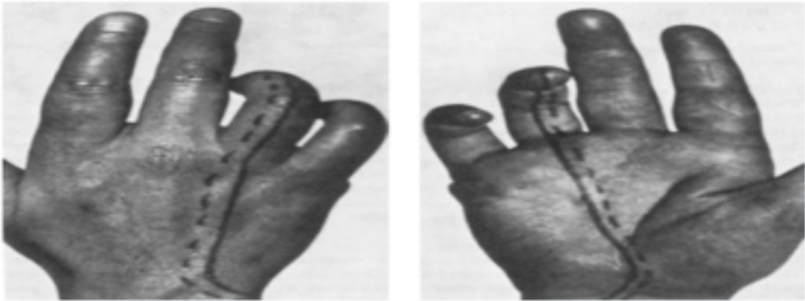
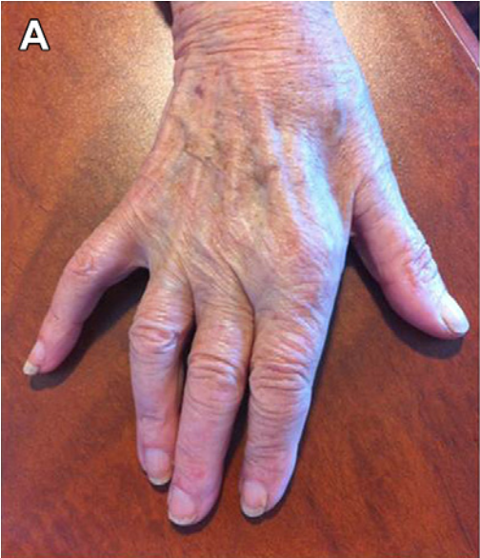
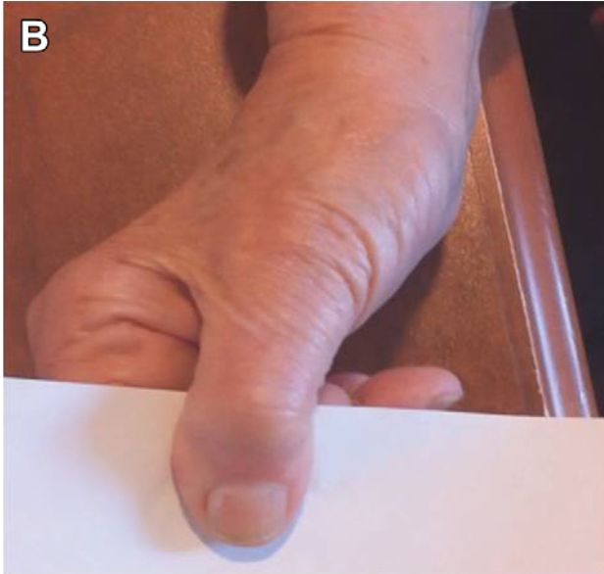
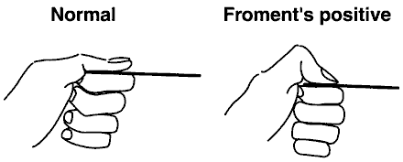
Cases by the doctor - CASE 1
Case 1
Explanation:
1. What are the systems involved? (motor, sensory or both → Sensory and motor
2. Where is the disruption of the weakness? (proximal, distal or both. Symmetrical or asymmetrical) → Asymmetrical distal.
3. What is nature of sensory involvement? → Numbness, grip weakness, and vague elbow pain.
4. Is there evidence of upper motor neuron involvement? → No, Lower motor neuron only.
5. Onset (acute, subacute, chronic) → 3 months = chronic
6. Is there any history of hereditary neuropathy? → No.
So we have Asymmetrical distal weakness with Sensory loss. What is the pattern? → Pattern 3. CASE DIAGNOSIS: Mononeuropathy (ulnar involvement)
What is diagnosis of pattern 3?
Vasculitis like (Mononeuritis multiplex) which is infarction to the nerve “nerve stroke “ severe and sudden
Mononeuropathy : focal neuropathy due to compressive lesion and the most common is carpal tunnel syndrome “compression of median nerve” + ulnar nerve compression in the elbow which causes claw hand + common peroneal neuropathy which causes foot drop
A 65-year-old woman presented with a 3- month history of right-hand numbness, grip weakness, and vague elbow pain. Examination demonstrated diminished sensation of the medial hand and fourth and fifth digits, and weakness of finger abduction and adduction, associated with intrinsic hand muscle atrophy. Froment¹ and Wartenberg² signs were evident.
Explanation:
1. What are the systems involved? (motor, sensory or both → Sensory and motor
2. Where is the disruption of the weakness? (proximal, distal or both. Symmetrical or asymmetrical) → Asymmetrical distal.
3. What is nature of sensory involvement? →Numbness, grip weakness, and vague elbow pain.
4. Is there evidence of upper motor neuron involvement? → No, Lower motor neuron only.
5. Onset (acute, subacute, chronic) → 3 months = chronic
6. Is there any history of hereditary neuropathy? → No.
So we have Asymmetrical distal weakness with Sensory loss. What is the pattern? → Pattern 3. CASE DIAGNOSIS: Mononeuropathy (ulnar involvement)
What is diagnosis of pattern 3?
Vasculitis like (Mononeuritis multiplex) which is infarction to the nerve “nerve stroke “ severe and sudden
Mononeuropathy : focal neuropathy due to compressive lesion and the most common is carpal tunnel syndrome “compression of median nerve” + ulnar nerve compression in the elbow which causes claw hand + common peroneal neuropathy which causes foot drop
Systems involved? | Sensory & Motor.
Distribution? | Asymmetrical distal.
Nature of involvement? | Right-hand numbness. Grip weakness. Vague elbow pain. Diminished sensation of the medial hand and 4th and 5th digits.
UMN involvement? | No, only LMN.
Temporal evolution? | Chronic (3 months).
Evidence of hereditary neuropathy? | No.
Diagnosis: Mononeuropathy of Ulnar nerve. How do I know that it is not a trunk lesion? Because finger extensor muscles (supplied by radial nerve) are not involved. How do I know that it is not a medial cord lesion? Because the diminished sensation is localised to the medial hand and fingers, while the antebrachial cutaneous nerve is unaffected. Could it be AHC ? no, that would be motor without sensory involvement.
Systems involved? | Sensory & Motor.
Distribution?
Nature of involvement?
UMN involvement?
Temporal evolution?
Evidence of hereditary neuropathy? | No.
 | Weakness |  |  |  | Sensory symptoms | Severe proprioceptive loss | UMN signs | Autonomic symptoms/ signs | Diagnosis
 | Proximal | Distal | Asymmetric | Symmetric
Pattern 3: Distal weakness with sensory loss |  | + | + |  | + |  |  |  | - Multiple: vasculitis, HNPP², infection (leprosy, lyme, sarcoid, HIV) - Single: Mononeuropathy, radiculopathy
1- Froment’s sign: special test of the wrist for palsy of the ulnar nerve, specifically, the action of adductor pollicis.
2- Wartenberg’s sign neurological sign consisting of involuntary abduction of the fifth (little) finger, caused by unopposed action of the extensor digiti minimi. commonly results from weakness of some of the ulnar nerve innervated.

Slide 13
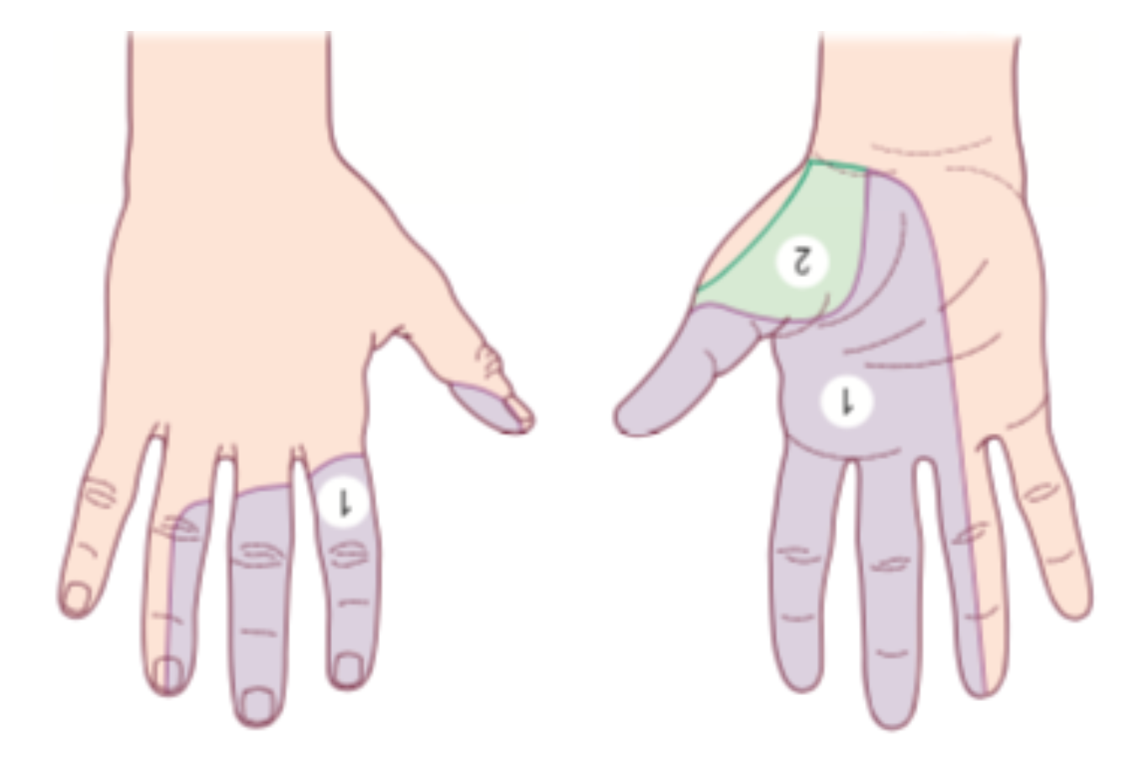
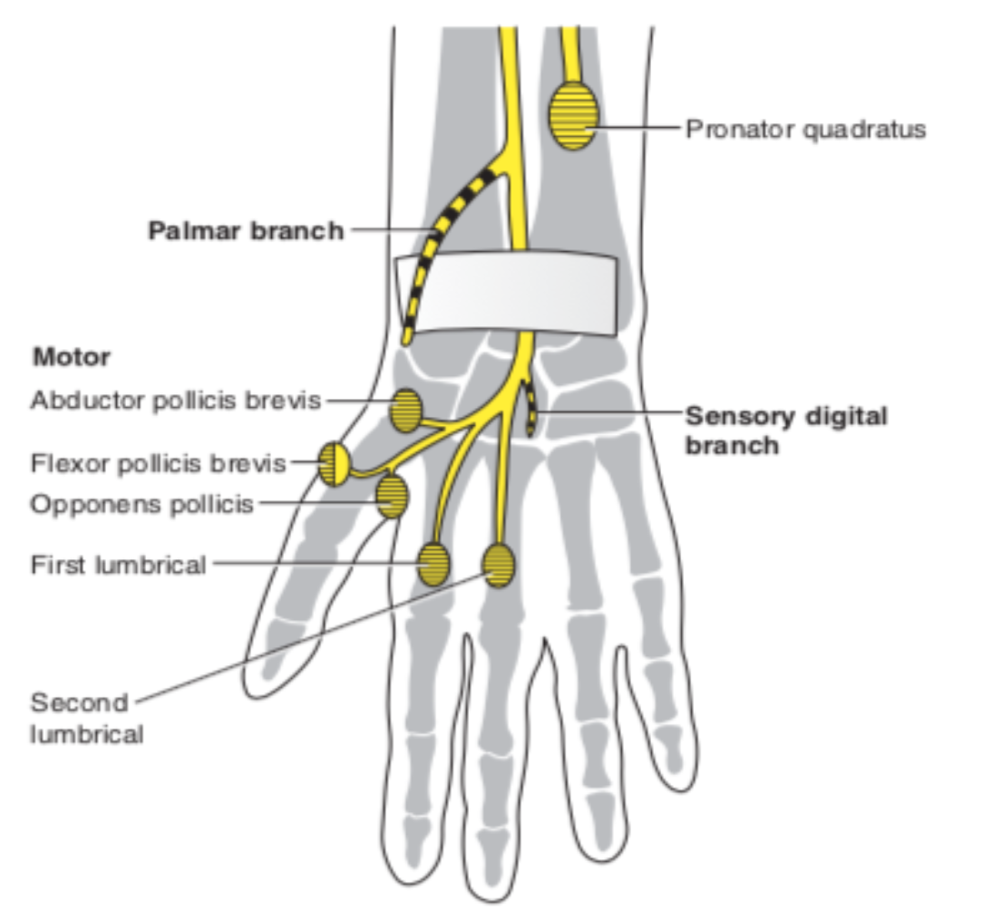
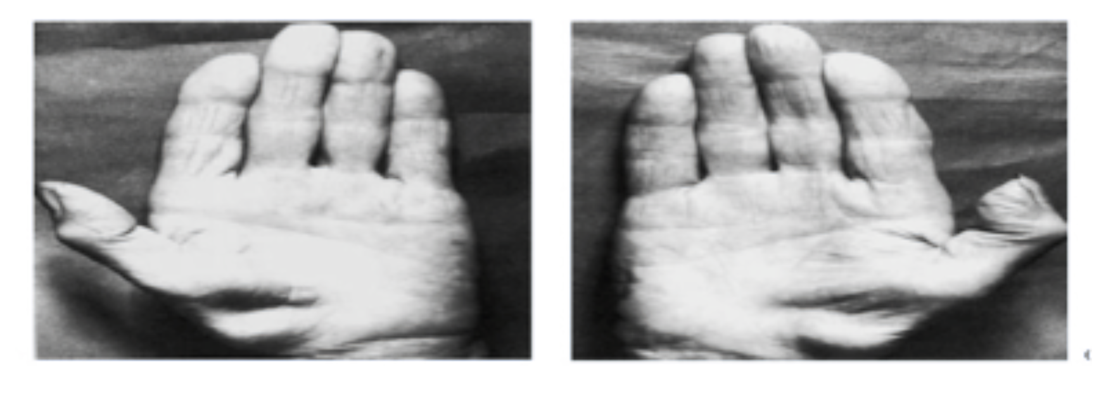
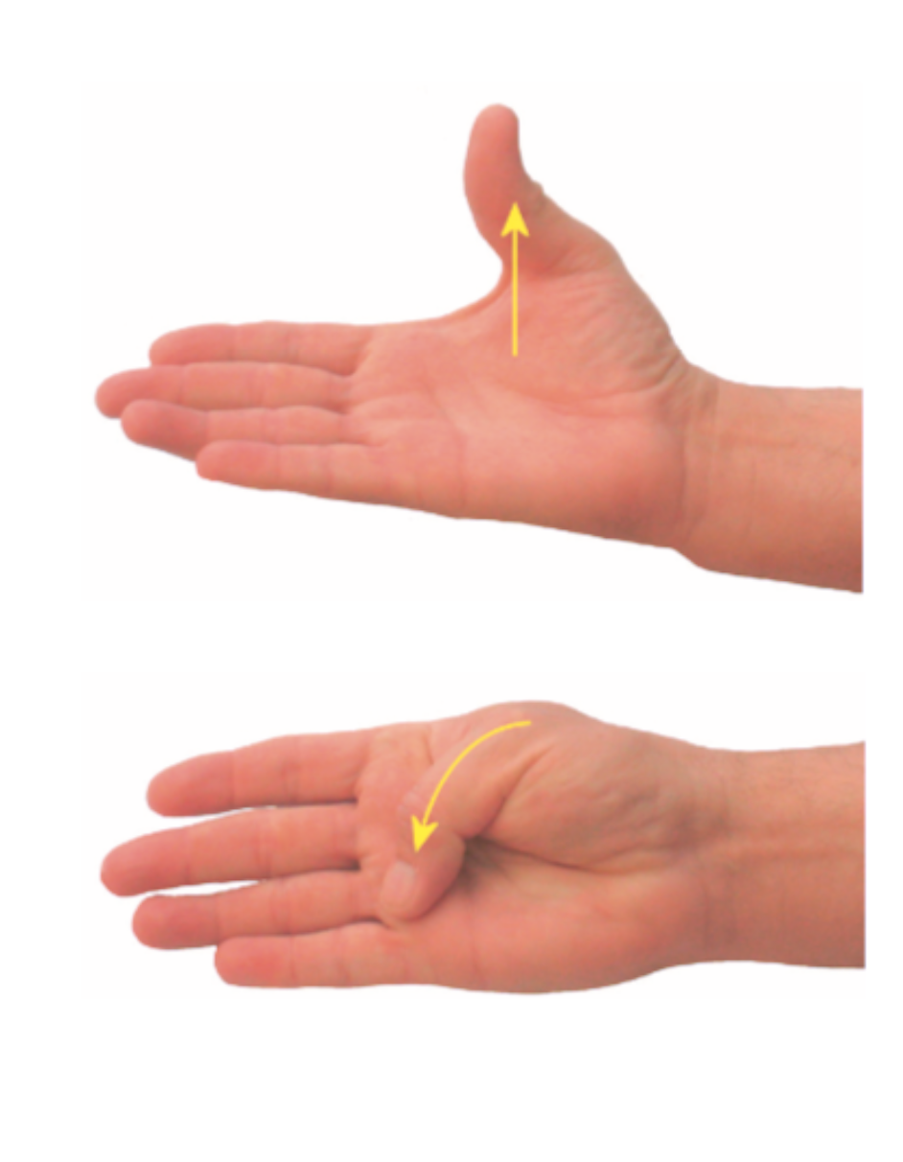
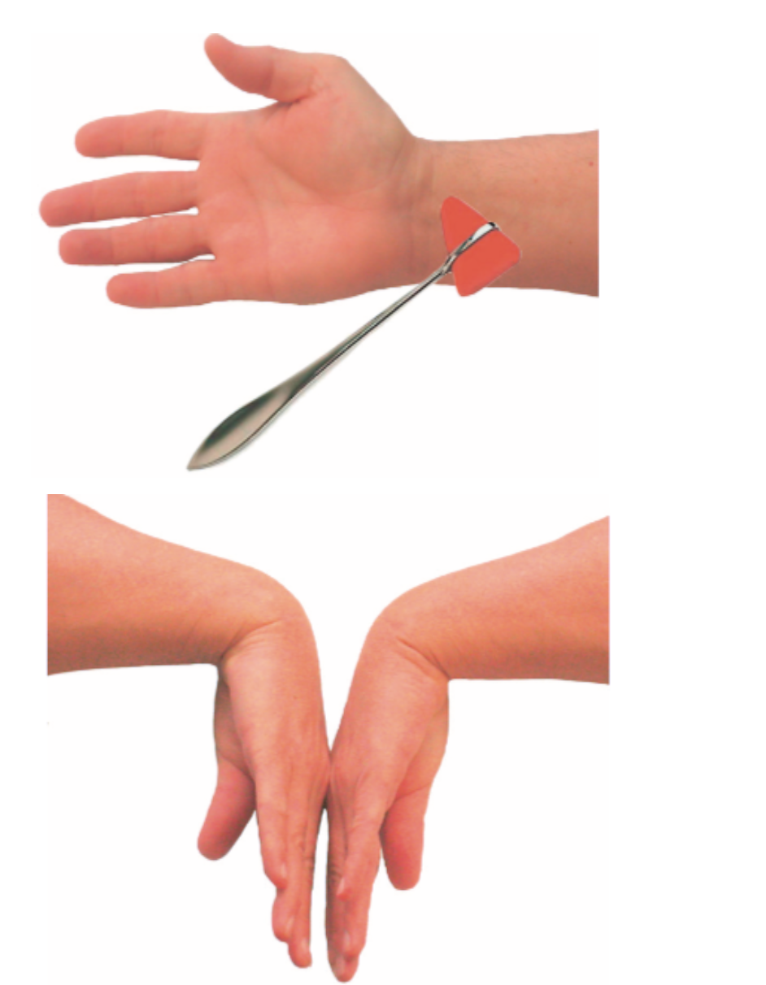
Cases by the doctor - CASE 2
A 67-year-old woman was referred for clumsiness, tingling, and pain in both hands of several months’ duration. Symptoms were most prominent at night, often awakening her from sleep, or during hand use such as driving. Examination showed slight wasting of both thenar eminences. Reflexes were normal. Thumb abduction was weak bilaterally. Sensation was slightly reduced over the finger pads of the thumb, index, middle, and ring fingers. There was no Tinel’s sign at the wrist on either side. A Phalen’s maneuver elicited tingling in the middle finger bilaterally after 30 seconds.
Explanation:
1. What are the systems involved? (motor, sensory or both → Sensory and motor
2. Where is the disruption of the weakness? (proximal, distal or both. Symmetrical or asymmetrical) → Asymmetrical distal.
3. What is nature of sensory involvement? →Numbness, grip weakness, and vague elbow pain.
4. Is there evidence of upper motor neuron involvement? → No, Lower motor neuron only.
5. Onset (acute, subacute, chronic) → 3 months = chronic
6. Is there any history of hereditary neuropathy? → No.
So we have Asymmetrical distal weakness with Sensory loss. What is the pattern? → Pattern 3. CASE DIAGNOSIS: Mononeuropathy (ulnar involvement)
What is diagnosis of pattern 3?
Vasculitis like (Mononeuritis multiplex) which is infarction to the nerve “nerve stroke “ severe and sudden
Mononeuropathy : focal neuropathy due to compressive lesion and the most common is carpal tunnel syndrome “compression of median nerve” + ulnar nerve compression in the elbow which causes claw hand + common peroneal neuropathy which causes foot drop
¹
Systems involved? | Sensory & Motor.
Distribution? | Symmetrical distal.
Nature of involvement? | Tingling & pain in both hands
UMN involvement? | No, only LMN.
Temporal evolution? | Chronic (Several months).
Evidence of hereditary neuropathy? | No.
Diagnosis: → bilateral median neuropathy at the wrist caused by carpal tunnel syndrome. The most common focal neuropathy. It is commonly bilateral and usually is asymmetrical. If left untreated, wasting of the thenar muscles will occur.
 | Weakness |  |  |  | Sensory symptoms | Severe proprioceptive loss | UMN signs | Autonomic symptoms/ signs | Diagnosis²
 | Proximal | Distal | Asymmetric | Symmetric
Pattern 3: Distal weakness with sensory loss |  | + | + |  | + |  |  |  | - Multiple: vasculitis, HNPP, infection - Single: Mononeuropathy, radiculopathy
1- the most common cause of median neuropathy is carpal tunnel syndrome, in which it will be compressed underneath the flexor retinaculum (represented by no1). no2, this area over the thenar eminence is supplied by the palmar branch of the median nerve which branches before the carpal tunnel, so to be affected it the lesion needs to be proximal 'could be in the forearm or the elbow'.
2- the sensory part of the median nerve comes from the upper plexus, the motor comes from the lower plexus so when they're both affected you can exclude plexopathy
An area for your notes or something..

Slide 14
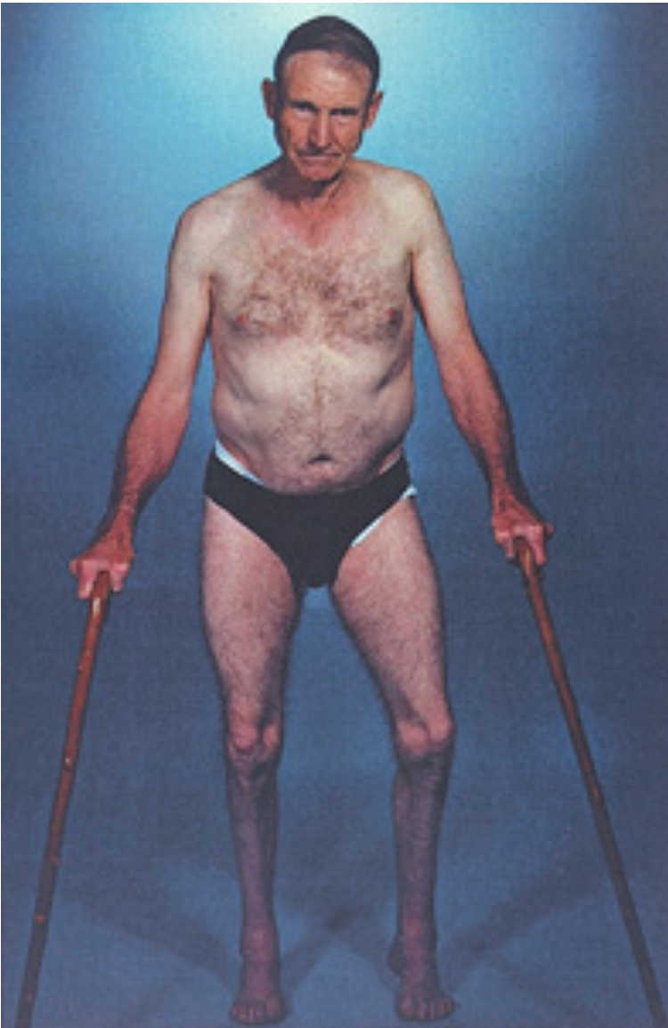
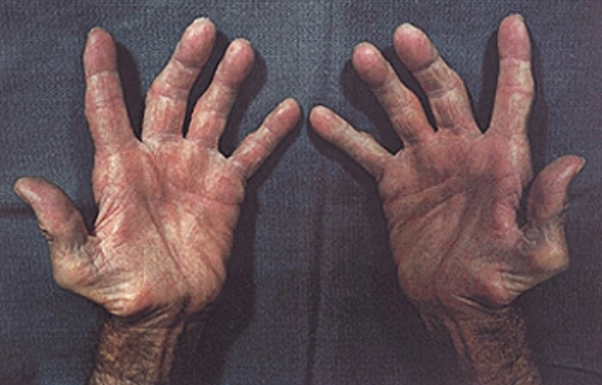
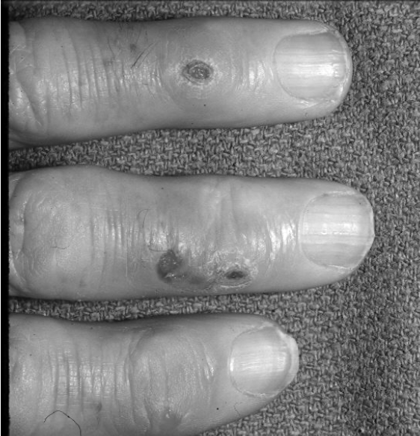
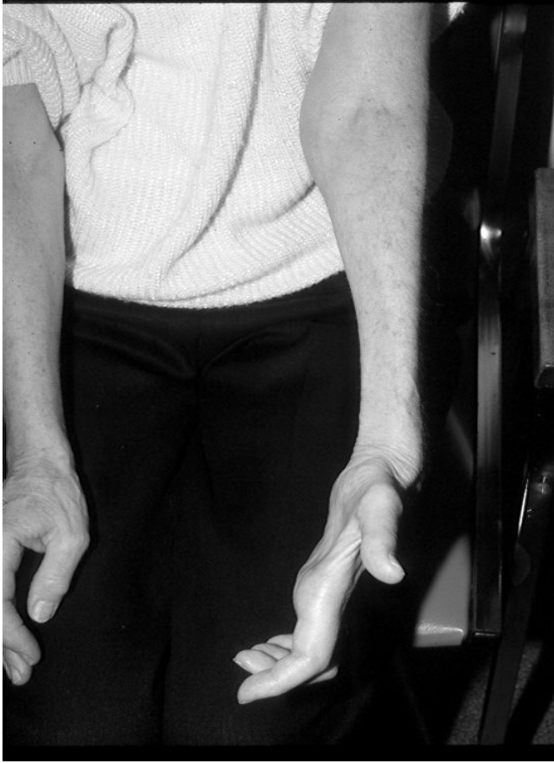
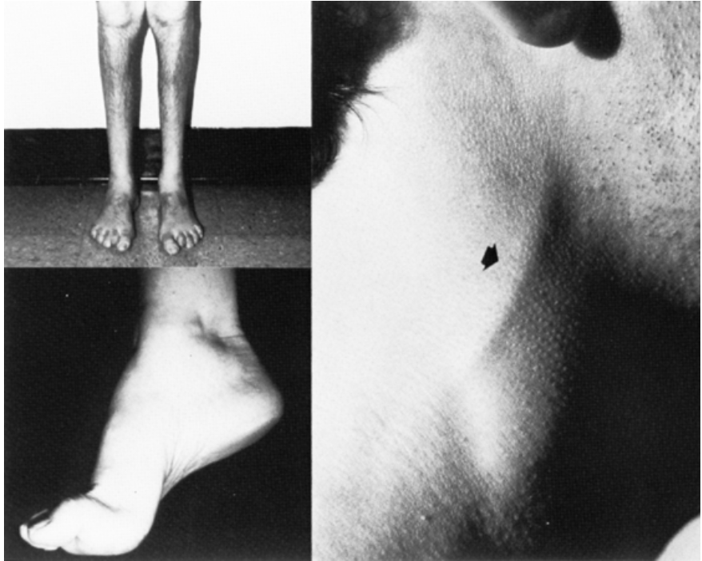
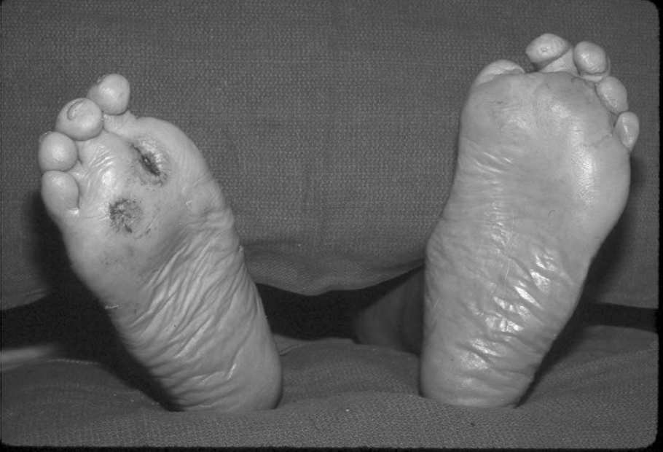
Cases by the doctor - CASE 3
Case 3
A 25-year-old man with NO family history of neuropathy had been weak early childhood. He remembers he was unable to keep up with his peers when running. He is currently only able to walk if wearing ankle-foot orthosis. He denied sensory symptoms.
Neurological examination showed symmetric severe weakness in distal leg muscles with power of 1-2/5 with bilateral drop feet. Proximal leg muscles were 4/5 as well as intrinsic hand muscles. Proximal upper limb muscles were normal.
Reflexes were absent.
Vibration and proprioception sensation were absent over the toes bilaterally and Pinprick and temperature were decreased to the knees and wrists
What are the systems involved? (motor, sensory or both) →Sensory and motor.
Where is the disruption of the weakness? (proximal, distal or both. Symmetrical or asymmetrical) → Symmetrical distal.
What is nature of sensory involvement? → Vibration and proprioception were absent + pain and temp were decreased .
Is there evidence of upper motor neuron involvement? → No.
Onset (acute, subacute, chronic) → Not mentioned by doctor or in the history.
Is there any history of hereditary neuropathy? → Yes .
What is DDx of pattern 2? → CSPN (cryptogenic neuropathy>no apparent reason) , which is most common. can also be Metabolic : diabetes , thyroid .
The DIAGNOSIS: Hereditary.
A 25-year-old man with NO family history of neuropathy had been weak early childhood. He remembers he was unable to keep up with his peers when running. He is currently only able to walk if wearing ankle-foot orthosis. He denied sensory symptoms.
Neurological examination showed symmetric severe weakness in distal leg muscles with power of 1-2/5 with bilateral drop feet. Proximal leg muscles were 4/5 as well as intrinsic hand muscles. Proximal upper limb muscles were normal.
Reflexes were absent.
Vibration and proprioception sensation were absent over the toes bilaterally and Pinprick and temperature were decreased to the knees and wrists.
What are the systems involved? (motor, sensory or both) →Sensory and motor.
Where is the disruption of the weakness? (proximal, distal or both. Symmetrical or asymmetrical) → Symmetrical distal.
What is nature of sensory involvement? → Vibration and proprioception were absent + pain and temp were decreased .
Is there evidence of upper motor neuron involvement? → No.
Onset (acute, subacute, chronic) → Not mentioned by doctor or in the history.
Is there any history of hereditary neuropathy? → Yes .
What is DDx of pattern 2? → CSPN (cryptogenic neuropathy>no apparent reason) , which is most common. can also be Metabolic : diabetes , thyroid .
The DIAGNOSIS: Hereditary.
Systems involved? | Sensory & Motor.
Distribution? | Symmetrical distal more than proximal.
Nature of involvement? | Vibration and proprioception sensation were absent over the toes bilaterally. Pinprick and temperature were decreased to the knees and wrists.
UMN involvement? | No, only LMN.
Temporal evolution? | Chronic (since childhood).
Evidence of hereditary neuropathy? | Even though the patient denies any family history of neuropathy, the fact that it began in childhood, coupled with his denial of any sensory symptoms despite them appearing in physical examination indicates that it is most likely to be hereditary¹.
Diagnosis: Most likely hereditary (CMT); as the chronicity of the patient’s condition rules out a metabolic or drug induced cause of neuropathy. Moreover, finding skeletal features (Hammer toe & distal muscle wasting wasting) alongside toe lesions, thickened nerve and scoliosis increase the likelihood of a hereditary condition. Acute onset is not a feature of hereditary neuropathy.
 | Weakness |  |  |  | Sensory symptoms | Severe proprioceptive loss | UMN signs | Autonomic symptoms/ signs | Diagnosis
 | Proximal | Distal | Asymmetric | Symmetric
Pattern 2: Distal Sensory loss with/ without weakness |  | + |  | + | + |  |  |  | CSPN², metabolic, drugs, hereditary:
1- most hereditary diseases are autosomal recessive so it may not manifest in other family members, other possibility that they may not have siblings or their siblings can have mild disease that my go unrecognized.
2- cryptogenic sensory motor polyneuropathy

Slide 15
Cases by the doctor - CASE 4
Case 3
A 25-year-old man with NO family history of neuropathy had been weak early childhood. He remembers he was unable to keep up with his peers when running. He is currently only able to walk if wearing ankle-foot orthosis. He denied sensory symptoms.
Neurological examination showed symmetric severe weakness in distal leg muscles with power of 1-2/5 with bilateral drop feet. Proximal leg muscles were 4/5 as well as intrinsic hand muscles. Proximal upper limb muscles were normal.
Reflexes were absent.
Vibration and proprioception sensation were absent over the toes bilaterally and Pinprick and temperature were decreased to the knees and wrists
What are the systems involved? (motor, sensory or both) →Sensory and motor.
Where is the disruption of the weakness? (proximal, distal or both. Symmetrical or asymmetrical) → Symmetrical distal.
What is nature of sensory involvement? → Vibration and proprioception were absent + pain and temp were decreased .
Is there evidence of upper motor neuron involvement? → No.
Onset (acute, subacute, chronic) → Not mentioned by doctor or in the history.
Is there any history of hereditary neuropathy? → Yes .
What is DDx of pattern 2? → CSPN (cryptogenic neuropathy>no apparent reason) , which is most common. can also be Metabolic : diabetes , thyroid .
The DIAGNOSIS: Hereditary.
A 42-year-old man developed numbness and tingling in the toes, progressing up to the ankles over 2 years. He describes burning pain in his feet, mainly at night. He recently started noticing symptoms of numbness and tingling in distal fingers. He denies any weakness.
Examination showed normal strength, with decreased pinprick and light touch sensations to the ankles and distal fingers. Vibration was absent at the toes and decreased at the ankles, and proprioception is normal at the toes. Reflexes are normal in the arms and at the knees but ankle reflexes are absent. Gait is normal
Systems involved? | Sensory.
Distribution? | Symmetrical distal.
Nature of involvement? | involves both small and large fibers Numbness and tingling in the toes & distal fingers Decreased pinprick and light touch sensations to the ankles and distal fingers.
UMN involvement? | No, only LMN.
Temporal evolution? | Chronic (2 years).
Evidence of hereditary neuropathy? | No.
Diagnosis: Metabolic neuropathy (Diabetic distal symmetric polyneuropathy (DSPN)). Drugs & hereditary causes were excluded from the history.
What are the systems involved? (motor, sensory or both) →Sensory and motor.
Where is the disruption of the weakness? (proximal, distal or both. Symmetrical or asymmetrical) → Symmetrical distal.
What is nature of sensory involvement? → Vibration and proprioception were absent + pain and temp were decreased .
Is there evidence of upper motor neuron involvement? → No.
Onset (acute, subacute, chronic) → Not mentioned by doctor or in the history.
Is there any history of hereditary neuropathy? → Yes .
What is DDx of pattern 2? → CSPN (cryptogenic neuropathy>no apparent reason) , which is most common. can also be Metabolic : diabetes , thyroid .
The DIAGNOSIS: Hereditary.
 | Weakness |  |  |  | Sensory symptoms | Severe proprioceptive loss | UMN signs | Autonomic symptoms/ signs | Diagnosis
 | Proximal | Distal | Asymmetric | Symmetric
Pattern 2: Distal Sensory loss with/ without weakness |  | + |  | + | + |  |  |  | CSPN, metabolic, drugs, hereditary.
An area for your notes or something..

Slide 16
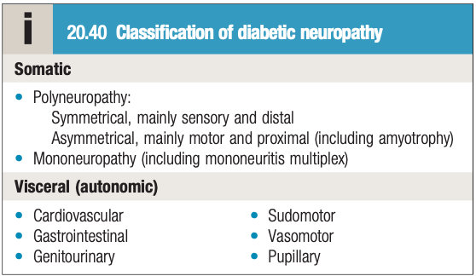
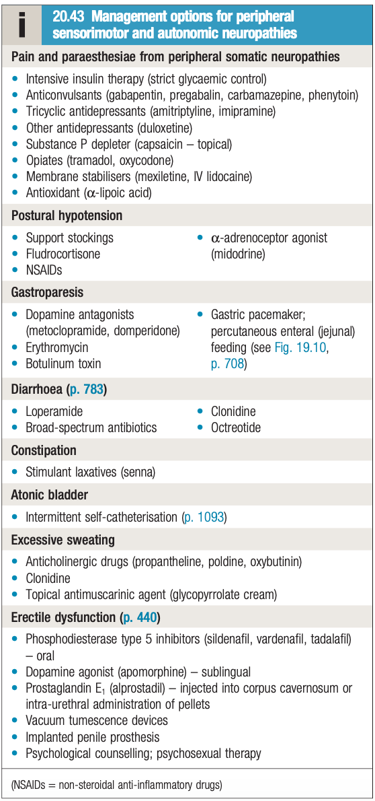
1- Symptoms depend on nerves affected and type of neuropathy
Diabetic neuropathy
Introduction
66% of patients with DM had subclinical or clinical evidence of a peripheral neuropathy
Diabetic neuropathy causes substantial morbidity and increases mortality.
It is diagnosed on the basis of symptoms and signs, after the exclusion of other causes of neuropathy.
Pathological features can occur in any peripheral nerves.
The main cause of skin ulcers of the feet which lead to osteomyelitis.
The occurrence of neuropathy correlates positively with:
Age.
Poor glycemic control.
presence of diabetic retinopathy.
presence of diabetic nephropathy.
Classification
Two thirds of diabetics have subclinical or clinical evidence of neuropathies: 50% have polyneuropathy, 25% carpal tunnel, 5% autonomic and 1% plexopathy or radiculopathy.
Asymmetric
Symmetric
Diabetic radiculoplexopathy (amyotrophy)
Truncal neuropathies (thoracic radiculopathy)
Cranial neuropathies (3rd or 6th cranial nerve)
Mononeuropathies, mostly CTS (Most common asymmetric)
Distal symmetric polyneuropathy (DSPN) (Most common symmetric)
Sensory or sensory motor
Small fiber neuropathy¹ (Common)
Autonomic neuropathy
Diabetic neuropathic cachexia
Treatment-induced diabetic neuropathy
Management
Management is dependent on the site affected.
outlined in this picture from Davidson.
When the neuropathy leads to pain, treatment is with pregabalin,
gabapentin, or tricyclic antidepressants.
1- Also it can be combined large and small.Most of the time they will present with numbness, tingling or burning pain at the toes, after long time they develop mild weakness mostly without paralysis.

Slide 17
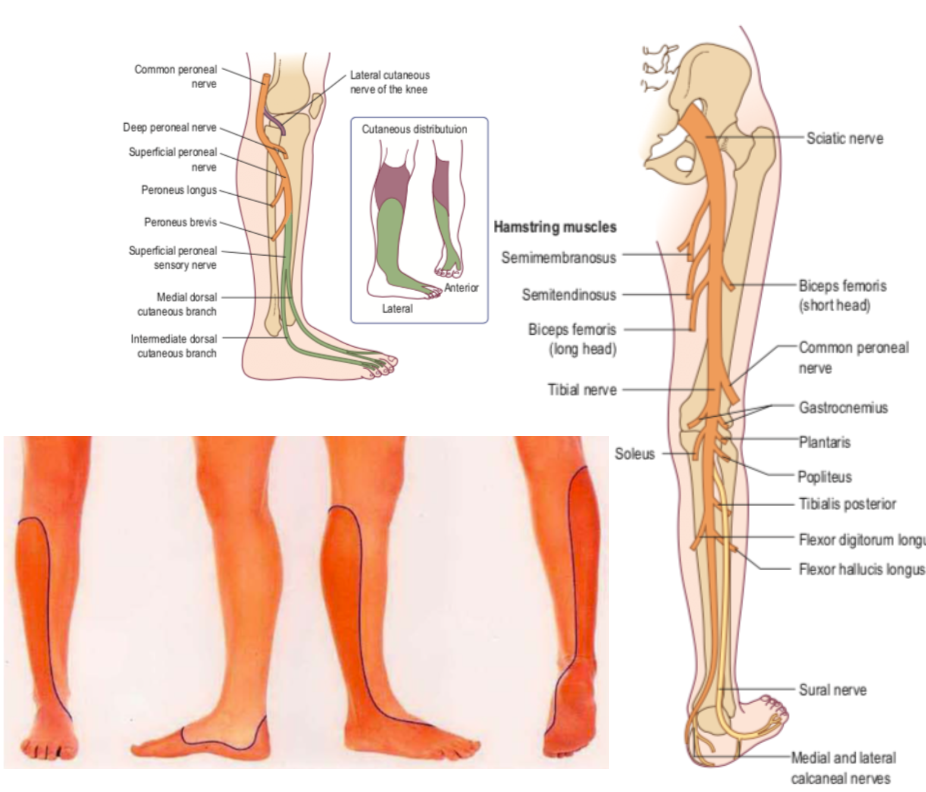
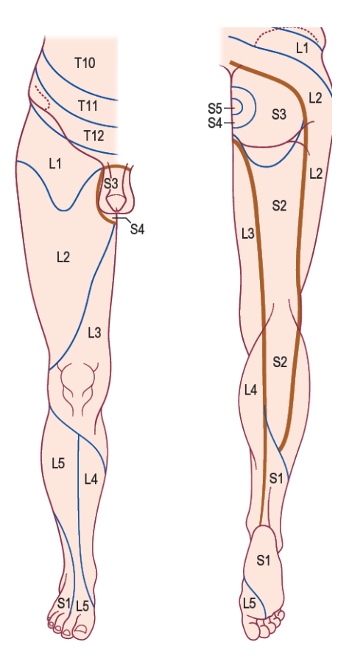
Cases by the doctor - CASE 5
Case 4
A 36-year-old man. Eight weeks ago, he had bent down to lift a chair and developed acute pain in the right back and buttock with radiating paresthesias into the calf and lateral foot.
Neurologic examination:
normal muscle bulk and tone in the lower extremities.
Straight-leg raising elicited pain and paresthesias in to the right leg at 45 degrees. Power: weakness in right hip extension, knee flexion, and ankle plantar flexion Sensory examination: mild sensory loss on the right sole and lateral foot.
DTR: right ankle reflex was absent, other DTRs were normal
A 36-year-old man. Eight weeks ago, he had bent down to lift a chair and developed acute pain in the right back and buttock with radiating paresthesias into the calf and lateral foot.
- Neurologic examination:
Normal muscle bulk and tone in the lower extremities.
Straight-leg raising elicited pain and paresthesias in to the right leg at 45 degrees.
Power: weakness in right hip extension, knee flexion, and ankle plantar flexion.
Sensory examination: mild sensory loss on the right sole and lateral foot.
Deep tendon reflexes: right ankle reflex was absent, other DTRs were normal.
What are the systems involved? (motor, sensory or both) →Sensory and motor.
Where is the disruption of the weakness? (proximal, distal or both. Symmetrical or asymmetrical) → Symmetrical distal.
What is nature of sensory involvement? → Vibration and proprioception were absent + pain and temp were decreased .
Is there evidence of upper motor neuron involvement? → No.
Onset (acute, subacute, chronic) → Not mentioned by doctor or in the history.
Is there any history of hereditary neuropathy? → Yes .
What is DDx of pattern 2? → CSPN (cryptogenic neuropathy>no apparent reason) , which is most common. can also be Metabolic : diabetes , thyroid .
The DIAGNOSIS: Hereditary.
Systems involved? | Sensory & Motor.
Distribution? | Asymmetrical proximal & distal.
Nature of involvement? | Vibration and proprioception sensation were absent over the toes bilaterally. Pinprick and temperature were decreased to the knees and wrists.
UMN involvement? | No, only LMN.
Temporal evolution? | Subacute (8 weeks).
Evidence of hereditary neuropathy? | No.
Diagnosis: S1 Radiculopathy; symptoms follow dermatomes and myotomes of S1. How did we tell? Weakness of hip extension? Gluteus maximus is supplied by inferior gluteal (S1 Root) Weakness of knee flexion? Hamstrings and biceps femoris (sciatic nerve) (S1 & L5) Weakness of ankle plantar flexion? Gastrocnemius and Soleus(tibial nerve 'branch of the sciatic')(S1&S2) Absent ankle reflex? S1 What’s the common root involved in all of them? S1 Why was it not Sciatic nerve? Motor: Sciatic nerve DOESN’T SUPPLY hip extension, it supplies knee flexion (hamstrings and biceps femoris) and all muscles below the knee. Sensory: The Sciatic nerve has the Peroneal and Tibial nerves’ sensory distribution, which is not the case here.
What are the systems involved? (motor, sensory or both) → Sensory + motor
Where is the distribution of the weakness? (proximal, distal or both) (Symmetrical or asymmetrical) → Asymmetrical proximal and distal
What is nature of sensory involvement? Pain
Is there evidence of upper motor neuron involvement? No.
Onset (acute, subacute, chronic) → 8 weeks, subacute
Is there any history of hereditary neuropathy? → No
so we have asymmetrical distal and proximal sensory loss. What is the pattern? → Pattern 4.
what is the DIAGNOSIS : S1 RADICULOPATHY , BECAUSE THE SYMPTOMS FOLLOW THE DERMATOMES + MYOTOMES OF S1
 | Weakness |  |  |  | Sensory symptoms | Severe proprioceptive loss | UMN signs | Autonomic symptoms/ signs | Diagnosis
 | Proximal | Distal | Asymmetric | Symmetric
Pattern 4: Asymmetric Proximal and distal weakness without sensory loss | + | + | + |  | + |  |  |  | Polyradiculopathy, plexopathy

Slide 18
Cases by the doctor - CASE 6
Case 5
A 56-year-old man was referred for a persistent foot drop 3 weeks after coronary artery bypass surgery. Shortly after awakening from anesthesia, the patient noted difficulty dorsiflexing his right foot and toes. In addition, there was a pins-and-needles sensation over the dorsum of the right foot. He noted that when he was walking, his right foot would slap with each step. There was no pain, and the left leg was unaffected.
On examination
muscle bulk and tone were normal and symmetric in both legs. There was marked weakness of right ankle and toe dorsiflexion (1/5) as well as ankle eversion (2/5). Foot inversion, ankle and toe plantar flexion, knee flexion, and all movements around the hip were normal.
Deep tendon reflexes were intact and symmetric.
Sensory examination
well-demarcated loss of sensation to pinprick and temperature over the dorsum of the right foot extending into the lateral calf.
Sensation over the right lateral knee was normal, as was sensation over the lateral foot, sole of the foot, and medial calf.
A 56-year-old man was referred for a persistent foot drop 3 weeks after coronary artery bypass surgery. Shortly after awakening from anesthesia, the patient noted difficulty dorsiflexing his right foot and toes. In addition, there was a pins-and-needles sensation over the dorsum of the right foot. He noted that when he was walking, his right foot would slap with each step. There was no pain, and the left leg was unaffected.
On examination, muscle bulk and tone were normal and symmetric in both legs. There was marked weakness of right ankle and toe dorsiflexion (1/5) as well as ankle eversion (2/5). Foot inversion, ankle and toe plantar flexion, knee flexion, and all movements around the hip were normal. Deep tendon reflexes were intact and symmetric.
Sensory examination showed a well-demarcated loss of sensation to pinprick and temperature over the dorsum of the right foot extending into the lateral calf. Sensation over the right lateral knee was normal, as was sensation over the lateral foot, sole of the foot, and medial calf.
notice how the lateral aspect is not affected because it is supplied by the sural nerve
What are the systems involved? (motor, sensory or both) →Sensory and motor.
Where is the disruption of the weakness? (proximal, distal or both. Symmetrical or asymmetrical) → Symmetrical distal.
What is nature of sensory involvement? → Vibration and proprioception were absent + pain and temp were decreased .
Is there evidence of upper motor neuron involvement? → No.
Onset (acute, subacute, chronic) → Not mentioned by doctor or in the history.
Is there any history of hereditary neuropathy? → Yes .
What is DDx of pattern 2? → CSPN (cryptogenic neuropathy>no apparent reason) , which is most common. can also be Metabolic : diabetes , thyroid .
The DIAGNOSIS: Hereditary.
Systems involved? | Sensory & Motor.
Distribution? | Asymmetrical distal.
Nature of involvement? | Vibration and proprioception sensation were absent over the toes bilaterally. Pinprick and temperature were decreased to the knees and wrists.
UMN involvement? | No, only LMN.
Temporal evolution? | Acute (3 weeks).
Evidence of hereditary neuropathy? | No.
Diagnosis: Common peroneal nerve damage; because the inversion and abduction are preserved. How did we know it’s common peroneal nerve? → Tibialis anterior muscle weakness = foot drop. Supplied by common peroneal nerve and L5 Hip abduction and foot inversion is supplied by → L5 Why didn’t we say sciatic? → the sciatic also gives a tibial branch which is not affected. the only distribution here that’s affected is the common peroneal. (inversion and plantar flexion are preserved) the lesion is well demarcated unlike the nerve root lesions where the sensory loss is distributed as dermatomes will not be well demarcated. this post surgical patient has been in bed a long period. where the knee was not supported and there was compression at the fibular head and it caused a damage to the common peroneal nerve. thankfully, it’s reversible
What are the systems involved? (motor, sensory or both)? → Both
Where is the disruption of the weakness? (proximal, distal or both) (Symmetrical or asymmetrical) → asymmetrical distal.
What is the nerve involve? → Common peroneal nerve. Because the inversion and abduction are preserved
How to differentiate between L5 and common peroneal nerve? → Tibialis anterior muscle weakness = foot drop. Supplied by common peroneal nerve and L5
Hip abduction and foot inversion is supplied by → L5
 | Weakness |  |  |  | Sensory symptoms | Severe proprioceptive loss | UMN signs | Autonomic symptoms/ signs | Diagnosis
 | Proximal | Distal | Asymmetric | Symmetric
Pattern 3: Distal weakness with sensory loss |  | + | + |  | + |  |  |  | - Multiple: vasculitis, HNPP², infection (leprosy, lyme, sarcoid, HIV) - Single: Mononeuropathy, radiculopathy

Slide 19
Cases by the doctor - CASE 7
Case 6
A 25 year-old woman developed numbness and tingling of the feet and hands followed by progressive leg more than arm muscle weakness over the last week. She experienced a diarrheal illness 3 weeks ago that had resolved within 10 days.
Examination :
showed marked bifacial weakness and absent muscle stretch reflexes. She had normal pinprick, light touch and proprioception but vibration was reduced at the toes.
Muscle power in the lower limbs was 2/5 and in the upper limbs 3/5, with equal proximal and distal weakness. She could not stand up or walk with assistance.
A 25 year-old woman developed numbness and tingling of the feet and hands followed by progressive leg more than arm muscle weakness over the last week. She experienced a diarrheal illness 3 weeks ago that had resolved within 10 days.
Examination showed marked bifacial weakness and absent muscle stretch reflexes. She had normal pinprick, light touch and proprioception but vibration was reduced at the toes.
Muscle power in the lower limbs was 2/5 and in the upper limbs 3/5, with equal proximal and distal weakness. She could not stand up or walk with assistance.
Systems involved? | Sensory & Motor.
Distribution? | Symmetrically proximal & distal.
Nature of involvement? | Numbness and tingling of the feet and hands Leg more than arm muscle weakness Vibration was reduced at the toes.
UMN involvement? | No, only LMN.
Temporal evolution? | Acute (over the last week)
Evidence of hereditary neuropathy? | No.
Diagnosis: GBS , peaks at week 4 . Whenever it’s acute + preceded by infection (whether gastroenteritis or respiratory) consider GBS. whenever it’s acute, distal, symmetrical, progressive (affecting distal and then proximal) it’s GBS until proven otherwise If it’s chronic more than 8 weeks we would think of CIDP
Test | Findings
CBC | Normal
vitamin B₁₂ | Normal
Serum glucose and A1c | both are normal
Specific protein electrophoresis (SPEP) | Normal
Creatine kinase (CK) | Normal
TSH | Normal
Lactate | Normal
Forced vital capacity | 2 liters Normal values in males aged 20-60 range from 4.5 to 3.5 liters, and normal values for females aged 20-60 range from 3.25 to 2.5 liters.
Cerebro spinal fluid | No white blood cells but protein was 82 mg/dl (Normal is below 50)
Test | Findings
Nerve conduction studies (NCS) | Showed 50% delayin tibial and median F wave latencies. Sensory conductions showed normal sural and absent median potentials. Motor NCS Conduction block Temporal dispersion Slowed conduction velocity Prolonged DML Absent F wave. Sensory NCS normal sural SNAPs Absent median and ulnar SNAPs
What are the systems involved? (motor, sensory or both) →Sensory and motor.
Where is the disruption of the weakness? (proximal, distal or both. Symmetrical or asymmetrical) → Symmetrical distal.
What is nature of sensory involvement? → Vibration and proprioception were absent + pain and temp were decreased .
Is there evidence of upper motor neuron involvement? → No.
Onset (acute, subacute, chronic) → Not mentioned by doctor or in the history.
Is there any history of hereditary neuropathy? → Yes .
What is DDx of pattern 2? → CSPN (cryptogenic neuropathy>no apparent reason) , which is most common. can also be Metabolic : diabetes , thyroid .
The DIAGNOSIS: Hereditary.
What are the systems involved? (motor, sensory or both) → Sensory + motor.
Where is the disruption of the weakness? (proximal, distal or both) (Symmetrical or asymmetrical) → Symmetrical proximal and distal. (Start distally then progresses to affect both Distal and Proximal)
What is natural of sensory involvement? numbness and tingling of the feet and hands
Is there evidence of upper motor neuron involvement? No.
Onset (acute, subacute, chronic) → 1 week = acute
Is there any history of hereditary neuropathy? No
So we have symmetrical proximal and distal sensory loss. What is the pattern? Pattern 1.
What is DDx of pattern 1?
The diagnosis: GBS , peaks at week 4 . Whenever it’s acute + preceded by infection (whether gastroenteritis or respiratory) CONSIDER GBS IN YOUR DDX
 | Weakness |  |  |  | Sensory symptoms | Severe proprioceptive loss | UMN signs | Autonomic symptoms/ signs | Diagnosis
 | Proximal | Distal | Asymmetric | Symmetric
Pattern 1: symmetric proximal and distal weakness with sensory loss | + | + |  | + | + |  |  |  | GBS, CIDP
An area for your notes or something..

Slide 20
Guillain-Barré Syndrome (GBS)
Acute Neuropathy
the acute neuropathies based on distribution could be focal/multifocal and they could be symmetric I don’t want you to know everything here, just that the symmetric is GBS. acute focal or multi-focal (Acute + Asymmetric) is caused by VASCULITIS (Painful mononeuropathy)
ANAN: Acute nutritional axonal neuropathy, it’s caused by Thiamine (B1 deficiency). it occurs following a bariatric surgery, has the same pattern as GBS. however, it’s Axonal unlike GBS which is usually Demyelinating
Distribution
Modality
Test | Findings
CBC | Normal
vitamin B₁₂ | Normal
Serum glucose and A1c | both are normal
Specific protein electrophoresis (SPEP) | Normal
Creatine kinase (CK) | Normal
TSH | Normal
Lactate | Normal
Forced vital capacity | 2 liters Normal values in males aged 20-60 range from 4.5 to 3.5 liters, and normal values for females aged 20-60 range from 3.25 to 2.5 liters.
Cerebro spinal fluid | No white blood cells but protein was 82 mg/dl (Normal is below 50)
Focal or multi focal
Symmetric
Motor/sensory/Both
Autonomic
1. Vasculitis(painful)
2. DLRPN (painful)
3. HNPP (painless)
1. GBS
2. ANAN
3. Porphyria
4. confluent multiple mononeuropathy
1. GBS
2. ANAN
3. Vasculitis
4. infections
5. Toxins
1. GBS
2. Toxins
3. Porphyria
4. Paraneoplastic
5. Idiopathic
The acute neuropathies based on distribution could be focal/multifocal and they could be symmetric, I don’t want you to know everything here, just that the symmetric is GBS.
Acute focal or multi-focal (Acute + Asymmetric) is caused by VASCULITIS (Painful mononeuropathy)
ANAN: Acute nutritional axonal neuropathy, it’s caused by Thiamine (B1 deficiency). it occurs following a bariatric surgery, has the same pattern as GBS. however, it’s Axonal unlike GBS which is usually Demyelinating
Clinical features of GBS
Paralysis follows 1-3 weeks after an infection
infecting organisms (usually campylobacter jejuni) induce antibody responses against peripheral nerves (Molecular mimicry)
signs and symptoms include:
weakness of the distal limb muscles and/or distal numbness. (usually symmetrical)
Low Back pain
The weakness and sensory loss progress proximally, over several days to weeks (acute)
Could be Motor, sensory, autonomic or combination
Loss of tendon reflexes
Findings in GBS patients
Test | Findings
Nerve conduction studies (NCS)
An area for your notes or something..
No need to memorize these things. just know that it shows demyelinating features like Prolonged latency (due to loss of myelin),

Slide 21
Guillain-Barré Syndrome (GBS)
Findings in GBS patients
Test | Findings
CBC | Normal
vitamin B₁₂ | Normal
Serum glucose and A1c | both are normal
Specific protein electrophoresis (SPEP) | Normal
Creatine kinase (CK) | Normal
TSH | Normal
Lactate | Normal
Forced vital capacity | Normal (2 liters in last case)
Nerve conduction studies (NCS) | No need to memorize these things. just know that it shows demyelinating features like Prolonged latency (due to loss of myelin).
Cerebrospinal fluid | Cells count = 0 “Normal” & protein is high (82 mg/dl in last case) (Normal is below 50) This is called cytoalbuminologic dissociation (in both CIDP and GBS) it’s a CSF feature of demyelinating neuropathies
Treatment and management
Treatment | Management
IVIG^{1,2} or Plasmapheresis Supportive therapy and physiotherapy Usually they improve (good prognosis) | Monitor progression and prevent and manage potentially fatal complications, especially: Regularly monitor pulmonary functions³ Regularly check for autonomic dysfunction Check for swallowing dysfunction Recognize and treat pain Prevent and treat infections and pulmonary embolism Prevent corneal ulceration due to facial weakness Prevent decubitus and contractures
1- Patients should be screened for lgA deficiency before immunoglobulin is given
2- uncommon but major side effect: Aseptic meningitis
3-The most dangerous thing that can happen with GBS is dysautonomia or involvement of the respiratory muscles. (can result in death)

Slide 22
Summary
summary from dr. slides
EXTRA: Guillain barre syndrome vs Chronic inflammatory demyelination polyneuropathy
 | GBS | CIDP
Onset | Acute (days up to 4 weeks max.) | Chronic (weeks to months)
Antecedent events (usually infectoin) | more frequent (70% have infection, vaccination or surgery approximately 4 weeks prior to to the onset) | less frequent (no more than 30%)
Cranial nerve involvement | more frequent | Less frequent
ventilator | pt. need it more frequently | less frequently
Autmnomic | labile HTN, Arrhythmias might be present | less frequent than GBS
Dermatomes and nerves map
coincides with the doctors map

Slide 23
History and examination
History | Examination
Symptoms: - sensory -motor -distal leg abnormalities - proximal abnormalities - upper extermitiy predomination - autonomic onset <4 weeks (acute) , 4-8 week (subacute), >8 weeks (chronic) Duration Progression past medical history and co-morbidities Family history Social history | Confirm localization: - LMN vs UMN - myopathy vs neuropathy Recognize pattern of neuropathy - Motor vs sensory vs sensory motor - Proximal vs distal - Symmetric vs asymmetric Recognize features of hereditary neuropathy Recognize features that narrows the differential diagnosis. - Purpura and levido reticularis Autonomic features - BP & HR supine and standing - Pupillary reaction to light and accommodation Other: - Skin: trophic changes (such as thin, shiny, and discolored skin) - ulcerations or amputations. - peripheral pulses.
Approach (6 questions)
Q1- What systems are involoved? Q2- What is the distribution of weakness? Q3- What is the nature of the sensory involvement? Q4- Is there evidence of UMN involvement? Q5- What is the temporal evolution? Q6- Is there evidence for a hereditary neuropathy?
Neuropathies
Carpal tunnel | Clinical features | pain in the hand affecting the palm, thumb, index finger, and the radial half of the ring finger with muscle atrophy of the thenar eminence. The pain is worse at night
 | Diagnosis | The most accurate diagnostic tests are electromyography and nerve conduction testing.
 | Treatment | The best initial therapy is with wrist splints to immobilize the hand in a position to relieve pressure. Surgery can be curative and is highly indicated in cases of muscle wasting
Charcot-Marie-Tooth Disease (Hereditary neuropathy) | Clinical features | Charcot-Marie-Tooth (CMT) is a genetic disorder with loss of both motor and sensory innervation leading to Distal weakness and sensory loss, Wasting in the legs, Decreased deep tendon reflexes and Tremor
 | Diagnosis | The most accurate test is electromyography
 | Treatment | there is no treatment.
Guillain barre syndrome | Clinical features | weakness in the legs that ascends, when GBS hits the diaphragm, it is associated with respiratory muscle weakness. Autonomic dysfunction with hypotension, hypertension, or tachycardia can occur.
 | Diagnosis | The most specific diagnostic test is nerve conduction studies/electromyography. CSF shows increased protein with a normal cell count.
 | Treatment | Intravenous immunoglobulin (IVIG) or plasmapheresis are equal in efficacy.

Slide 24
Q1: A65-year-old man presents to the ED with lower extremity weakness. His symptoms started 1 week prior when he noticed difficulty walking and he tripped once. He now has difficulty raising his legs off the floor and is now using a wheelchair. He denies any pain in his lower extremities but does have paresthesias in both legs. He denies weakness elsewhere. He denies dyspnea or any other associated symptoms. Prior to this he had an episode of nonbloody diarrhea a few weeks prior but that is now resolved. His only past medical history is hypertension for which he takes hydrochlorothiazide. Cardiac examination is normal. Pulmonary examination reveals non labored breathing, clear lung fields, and O2 saturation 98% on room air. Neurologic examination reveals normal speech without dysarthria and cranial nerves without deficits. Strength is 5/5 in bilateral upper extremities in shoulder/elbow/wrist flexion and extension, 1/5 dorsiflexion/plantar flexion bilateral ankles, 1/5 flexion/extension knees, 2/5 hip flexion. Achilles and patellar reflexes are absent bilaterally. Sensory examination is normal. Labs including electrolytes, renal function, and blood counts are normal. CT head is negative for stroke and shows no acute findings. Lumbar puncture is performed and analysis reveals 3 WBC/mm3, protein 100 mg/dL (normal range <50 mg/dL), Gram stain negative. What is the most appropriate therapy?
A. Prednisone.
B. IVIG.
C. Ciprofloxacin.
D. Pyridostigmine.
Q2:2. A 18 years old male presented with weakness and numbness for 5 years. On examination he had high arched feet. Reflexes was absent. Sensory examination showed abnormal sensation to pinprick and vibration. Muscle power was 2/5 distally, 4/5 proximally in lower limbs. And 3/5 distally, 5/5 proximally in upper limbs. Which one of the following is the most appropriate description for his neuropathy?
A. Diabetic Neuropathy.
B. Inherited Neuropathy.
C. Toxic Neuropathy.
D. Vitamin B12 Deficiency.
Q3: A 55-year old female presented with ascending weakness and sensory loss that started 2 weeks ago after having upper respiratory tract infection. Her neurological examination showed weakness in upper and lower limbs that was symmetric and graded as 3/5. Reflexes were diminished. She had sensory loss to pinprick, vibration and joint position in both upper and lower limbs. Which ONE of the following localizations is consistent with this pattern?
A. Anterior horn cell.
B. Diffuse peripheral nerves and nerve roots.
C. Dorsal root ganglia.
D. Neuromuscular junction.
Q4: A 31-year-old woman presents to accident and emergency with progressive difficulty walking associated with lower back pain. A few days ago she was tripping over things, now she has difficulty climbing stairs. She describes tingling and numbness in both hands which moved up to her elbows, she is unable to write. On examination, cranial nerves are intact but there is absent sensation to vibration and pin prick in her upper limbs to the elbow and lower limbs to the hip. Power is ⅗ in the ankles and 4−/5 at the hip with absent reflexes and mute plantars. Her blood pressure is 124/85, pulse 68 and sats 98 per cent on air. She has a past medical history of type I diabetes and recently recovered from an episode of food poisoning a month or two ago. What is the diagnosis?
A. MS.
B. Guillain–Barré syndrome (GBS).
D. Diabetic neuropathy.
E. Infective neuropathy.
Q5: A 28 year old man describes evolving weakness of all four limbs over 8 weeks, and most recently some dyspnoea. Blood tests are normal and lumbar puncture shows a raised CSF protein but no cells. A diagnosis of chronic inflammatory demyelinating polyneuropathy (CIDP) is made . Which of the following patterns of abnormality on nerve conduction studies and EMG is likely to be present at the time of diagnosis?
A. Delayed conduction in motor and sensory nerves with denervation on EMG.
B. Delayed conduction in sensory and motor nerves with normal EMG.
C. Normal nerve conduction studies but denervation changes on EMG.
D. Small sensory nerve and compound motor action potentials but normal EMG.
Q6: Patient presented with 2 months of Right leg pain. He also has back pain. On physical examination he had muscle power of 4/5 in dorsiflexion, eversion and inversion. And had 5/5 in ankle flexion, knee flexion and extension, hip flexion and extension, and hip adduction. And had 4/5 in hip abduction. He also showed sensory deficits with pinprick test but had normal vibration test. What is the most likely diagnosis?
A. Common peroneal injury.
B. L5 radiculopathy.
C. Femoral nerve injury.
D. Popliteal injury.
Answers: Q1:B | Q2:B | Q3:B | Q4:B | Q5:B | Q6: B

Slide 25
THANKS!!
This lecture was done by:
Abdulaziz Alshomar
Mohammed Alhumud
Females co-leaders:
Raghad AlKhashan
Amirah Aldakhilallah
Males co-leaders:
Mashal AbaAlkhail
Nawaf Albhijan
Send us your feedback:
We are all ears!

