Slide 1
Lecture 45,46
Editing file
Type 1 & 2 Diabetes Mellitus
Objectives:
By the end of the lecture the student should be able to:
Type 1 DM:
Understand diabetes epidemiology in Saudi Arabia
Demonstrate physiology of insulin action
Demonstrate pathophysiology of T1DM
Differentiate treatment options for T1DM
Type 2 DM:
Explain the nature of type 2 diabetes mellitus
Know how to make the diagnosis in adults and pregnant
Gain knowledge in the pathophysiology / females
Gain knowledge in epidemiology and prevention
Be familiar with concepts of management including pharmacotherapy
Color index:
Color index:
Original text Females slides Males slides
Doctor’s notes Textbook Important Golden notes Extra

Slide 2
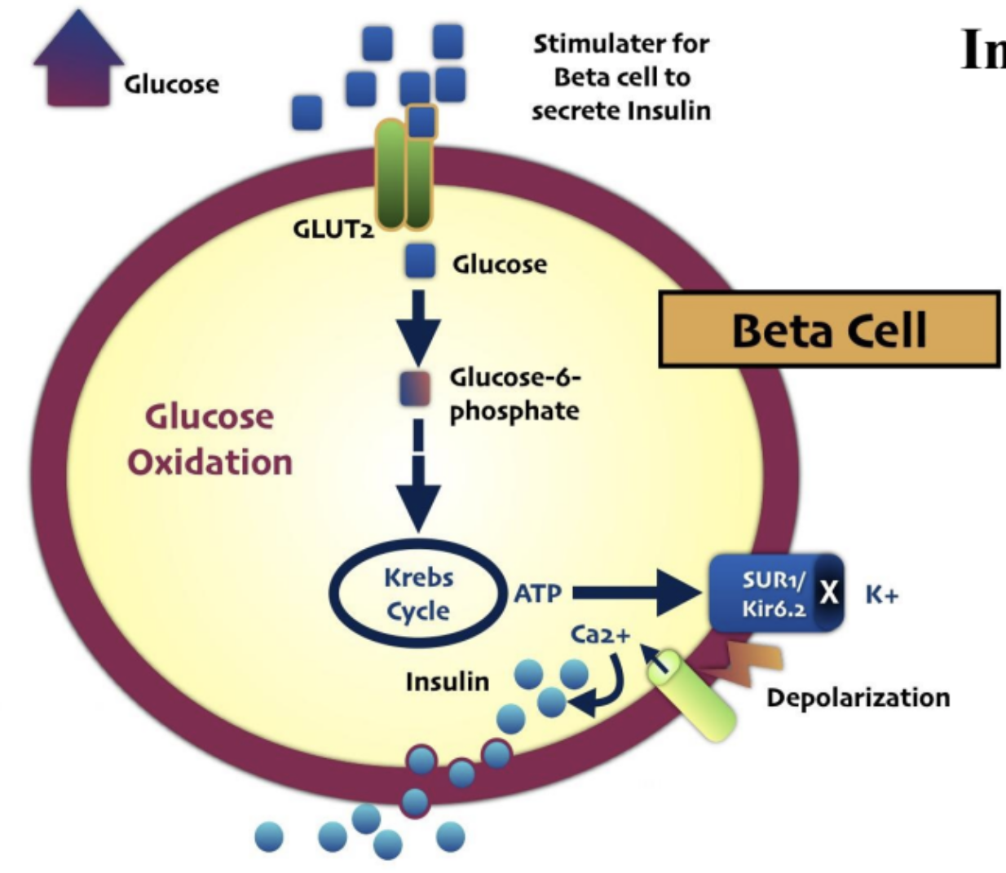
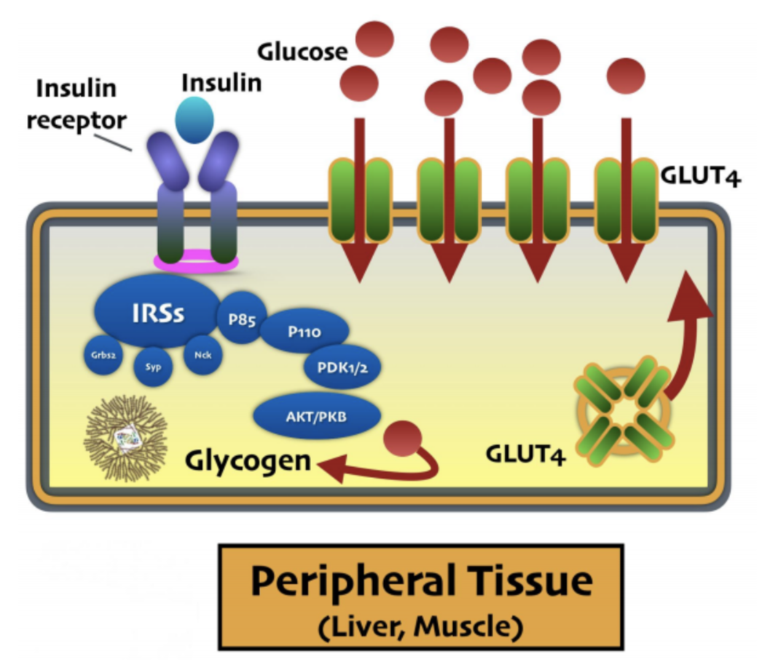
The physiology of insulin action
Blood glucose is tightly regulated and maintained within a narrow range by insulin & glucagon. This is essential for ensuring a continuous supply of glucose to the central nervous system.
Insulin: the primary regulator of glucose metabolism and storage is secreted from pancreatic
β- cells into the portal circulation in response to a rise in blood glucose.
After ingestion of a meal containing carbohydrate, normal blood glucose levels are maintained by:
Suppression of hepatic glucose production.
Stimulation of hepatic glucose uptake.
Stimulation of glucose uptake by peripheral tissues.
Insulin secretion in response to a glucose stimulus classically occurs in two phases:
The rapid first phase represents the secretion of pre-formed insulin from granules within the β cells
Prolonged second phase is a consequence of newly synthesised insulin.
Incretins are amino acids and hormones such as glucagon-like peptide 1 (GLP-1) and gastrointestinal peptide (GIP) , released from the small intestines following food intake and can augment insulin release. As a result, insulin release is greater when glucose is administered by mouth than when the same rise in plasma glucose is achieved by intravenous glucose infusion, a phenomenon termed the (incretin effect).
Insulin secretion and action
EXTRA
A.In Beta cells
1
Glucose enters Beta cell through facilitated diffusion mediated by GLUT2
1
2
Glucose get phosphorylated by glucokinase and enters Krebs cycle (Glycolysis) to produce ATP
2
3
ATP closes potassium channels that normally secrets K out
3
4
Potassium increases intracellularly which will cause Depolarization
5
4
5
Ca channel opens (Voltage gated channel), Ca enters the cell leading to the release of insulin from its vesicles by exocytosis
B.In Peripheral tissue
Insulin & insulin-like growth factor binds to receptor and according to cell needs it activate either one of two pathways:
Growth signal
Cell proliferation
Tissue development & differentiation
Metabolic signal:
Regulation of energy metabolism (Glucose)
It helps expressing GLUT4 to the cell membrane which facilitate glucose entrance.
Glucose get converted to glycogen for storage

Slide 3
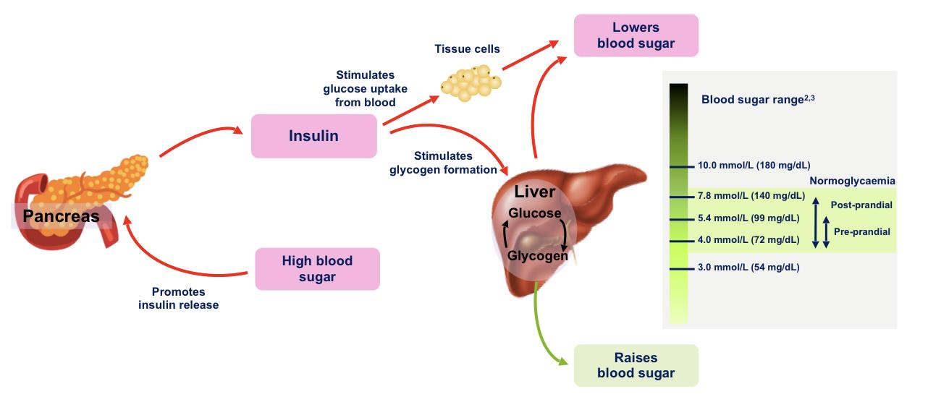
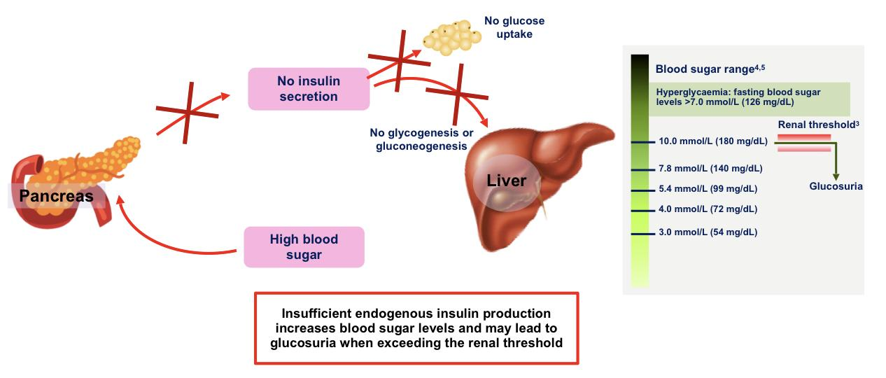
The physiology of insulin action
When The Level of Glucose is:
High
Low
- Hormone: Insulin
- ↑ glycolysis
- ↑ ion uptake especially K and PO₄³⁻
- ↓Ketogenesis
- Effect on Liver:
1. ↑ Glycogen synthesis
2. ↓ Gluconeogenesis
3. ↓ Glycogenolysis
4. ↑ lipogenesis (FA synthesis)
5. ↑ Lipoprotein synthesis
- Effect on Muscles:
1. ↑ protein synthesis
2. ↓ Proteolysis
- Effect on Adipose tissue:
1. Inhibition of intracellular
lipase > No lipolysis
2. ↑ TGs deposition
- Hormones:
1. Glucagon (Mainly)
Other Counter regulatory hormones:
2. Glucocorticoids
3. Growth hormone
4. Epinephrine
- Effect on Liver:
1. ↓ Glycogen synthesis
2. ↑ Gluconeogenesis
3. ↑ Glycogenolysis
- Effect on Muscles:
1. ↓ protein synthesis
- Effect on Adipose tissue:
1. No inhibition of intracellular lipase > ↑ lipolysis > ↑ FFA
Classification of diabetes
 | Type 1 DM | Type 2 DM
Pathogenesis | due to β- cell destruction, leading to absolute insulin deficiency | due to a progressive insulin secretory defect on the background of insulin resistance
Age and genetics | Usually <30y/o HLA-DR3 or DR4 | Usually >30y/o No HLA links
Weight | 20% may be overweight/obese | Virtually all BMI > 85%th percentile
Course | Rapid From DPT-I can be indolent | Indolent Virtually none found on screening
DKA (diabetic ketoacidosis) | 35%-40% | Ketonuria (33%) Mild DKA (5%-25%)
Relative with DM | 5% with T1DM Up to 30% may have with T2DM FH of T2 2-3Xs in person with T1 | 74%-100% - 1st–2nd degree with T2DM
Comorbid | Thyroid, adrenal, vitiligo, celiac | Increase in polycystic ovary syndrome Acanthosis nigricans
C- peptide | C-peptide can be preserved at DX , eventually it will disappear | Normal or increased (more useful in T2)
Antibody | 85% | 15% (reported as high as 30%)
Ethnicity | Whites predominate | NA, AA, HA, Asian, Pacific Islander

Slide 4
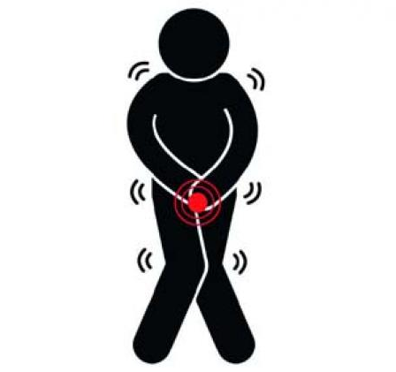
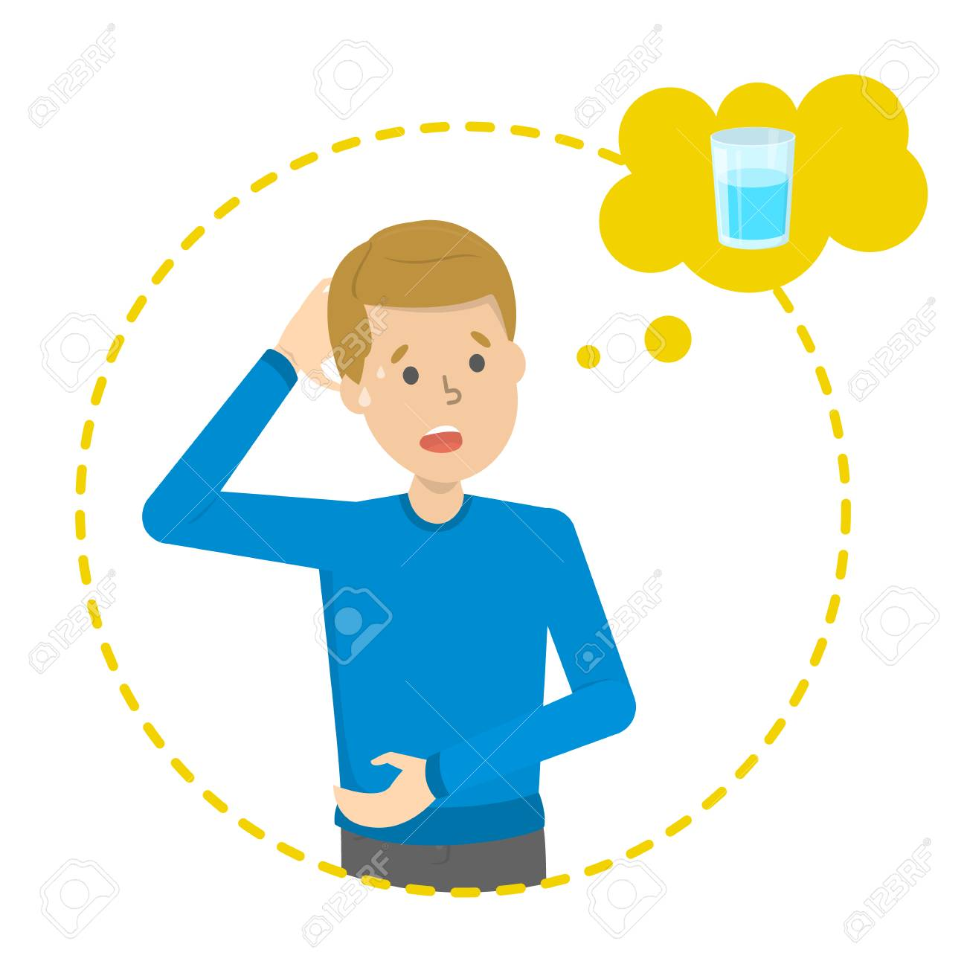
Classification of diabetes cont’
Gestational diabetes mellitus (GDM)
Diabetes diagnosed in the second or third trimester of pregnancy that is not clearly overt diabetes After delivery blood glucose will return to normal. Each time they become pregnant there will be a 10% more risk for developing permanent DM
Specific types of diabetes due to other causes:
Monogenic diabetes syndromes: Such as neonatal diabetes and maturity-onset diabetes of the young [MODY] , which develops under the age of 25 years, and neonatal diabetes that presents during first 6 months of life.
Diseases of the exocrine pancreas:
Such as cystic fibrosis
Drug or chemical induced diabetes:
Such as in the treatment of HIV/AIDS or after organ transplantation
E.g. SLE or RA due to steroids treatment (Improving the primary disease will solve the problem)
Clinical features
Acute presentation
Children and young adults often present with a 2–6-week history of the classic triad of symptoms:
Polyuria
Weight loss
due to the osmotic diuresis that results when blood glucose levels exceed the renal threshold
due to fluid depletion and accelerated breakdown of fat and muscle secondary to insulin deficiency.
Thirst and polydipsia
due to the resulting loss of fluid and electrolytes
Physiological response to diuresis to maintain plasma volume
Subacute presentation
The clinical onset may be prolonged over several months or years, particularly in older people. Thirst, polyuria and weight loss are usually present, but the individual may complain of other symptoms such as lack of energy, visual blurring secondary to swelling of lens due to osmosis caused by hyperglycemia (owing to glucose- induced changes in refraction), or pruritus vulvae or balanitis¹ due to Candida infection. Because Candida albicans thrives under increased glucose conditions
1-Balanitis is an inflammation of the glans, or the head, of the penis.

Slide 5
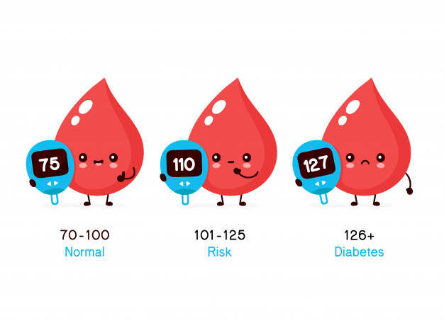
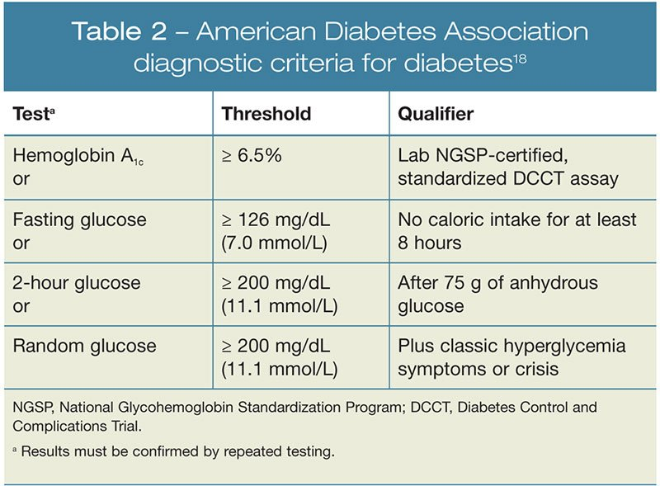
This may be by a laboratory measurement of:
fasting plasma glucose (FPG) (Specific)
random glucose (Sensitive)
2-hour plasma glucose after a 75- g oral glucose tolerance test (OGTT) (Sensitive & Specific)
The use of glycated haemoglobin (HbA1c) was introduced as an alternative method in 2011. it is also used to guide treatment decisions.
The diagnostic criteria recognize two further categories of abnormal glucose concentrations:
impaired fasting glycaemia (IFG)
impaired glucose tolerance (IGT)
Collectively these have been described as ‘pre-diabetes’ but this is not strictly accurate because the majority will never develop diabetes. (⅓ will develop DM)
Neither IFG nor IGT are clinical entities in their own right but they identify people who are at high risk of diabetes and cardiovascular disease.
Individuals with IGT have a similar risk of cardiovascular disease as those with frank diabetes, but do not develop microvascular complications.
Clinical features cont’
Complications
Complications as the presenting feature These include:
Staphylococcal skin infections
Retinopathy noted during a visit to the optician
Polyneuropathy causing tingling and numbness in the feet
Erectile dysfunction
Arterial disease, resulting in myocardial infarction or peripheral gangrene.
Asymptomatic
Asymptomatic diabetes It is estimated that approximately half of people with diabetes are unaware of their condition. up to one- third of diagnoses are made as an incidental finding and several countries have introduced screening programmes to identify those with asymptomatic undiagnosed diabetes.
Investigations
Once considered, diabetes is easy to diagnose.
The diagnostic approach is the same for both T1 & T2
This may be by a laboratory measurement of:
fasting plasma glucose (FPG) (Specific)
random glucose (Sensitive)
2-hour plasma glucose after a 75- g oral glucose tolerance test (OGTT) (Sensitive & Specific)
The use of glycated haemoglobin (HbA1c) was introduced as an alternative method in 2011. it is also used to guide treatment decisions.
The diagnostic criteria recognize two further categories of abnormal glucose concentrations:
impaired fasting glycaemia (IFG)
impaired glucose tolerance (IGT)
Collectively these have been described as ‘pre-diabetes’ but this is not strictly accurate because the majority will never develop diabetes. (⅓ will develop DM)
Neither IFG nor IGT are clinical entities in their own right but they identify people who are at high risk of diabetes and cardiovascular disease.
Individuals with IGT have a similar risk of cardiovascular disease as those with frank diabetes, but do not develop microvascular complications.
This criteria will diagnose DM but will not differentiate between T2DM and T1DM.
One abnormal laboratory value is diagnostic in symptomatic individuals; two values are needed in asymptomatic people. The glucose tolerance test is only required where there is diagnostic uncertainty and for diagnosis of cystic fibrosis-related diabetes and gestational diabetes.
IFG and IGT are associated with insulin resistance syndrome or syndrome X:
insulin resistance
Hyperinsulinemia
Obesity
Dyslipidemia (High triglycerides and\or low HDL)
Hypertension

Slide 6
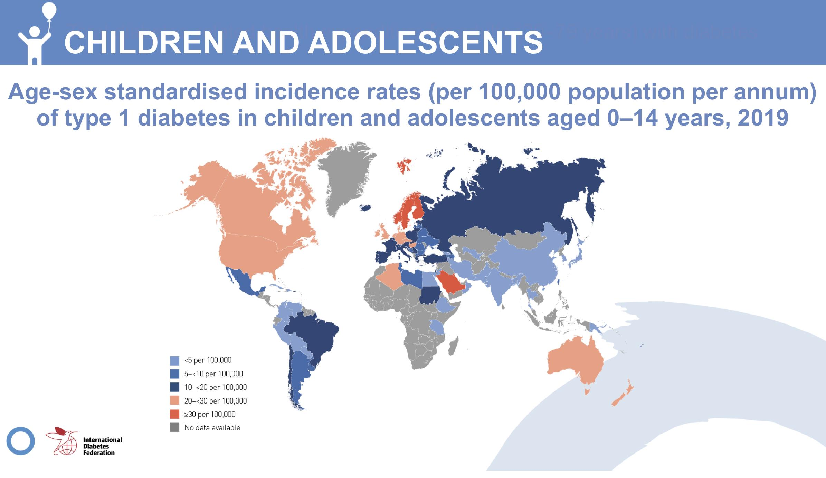
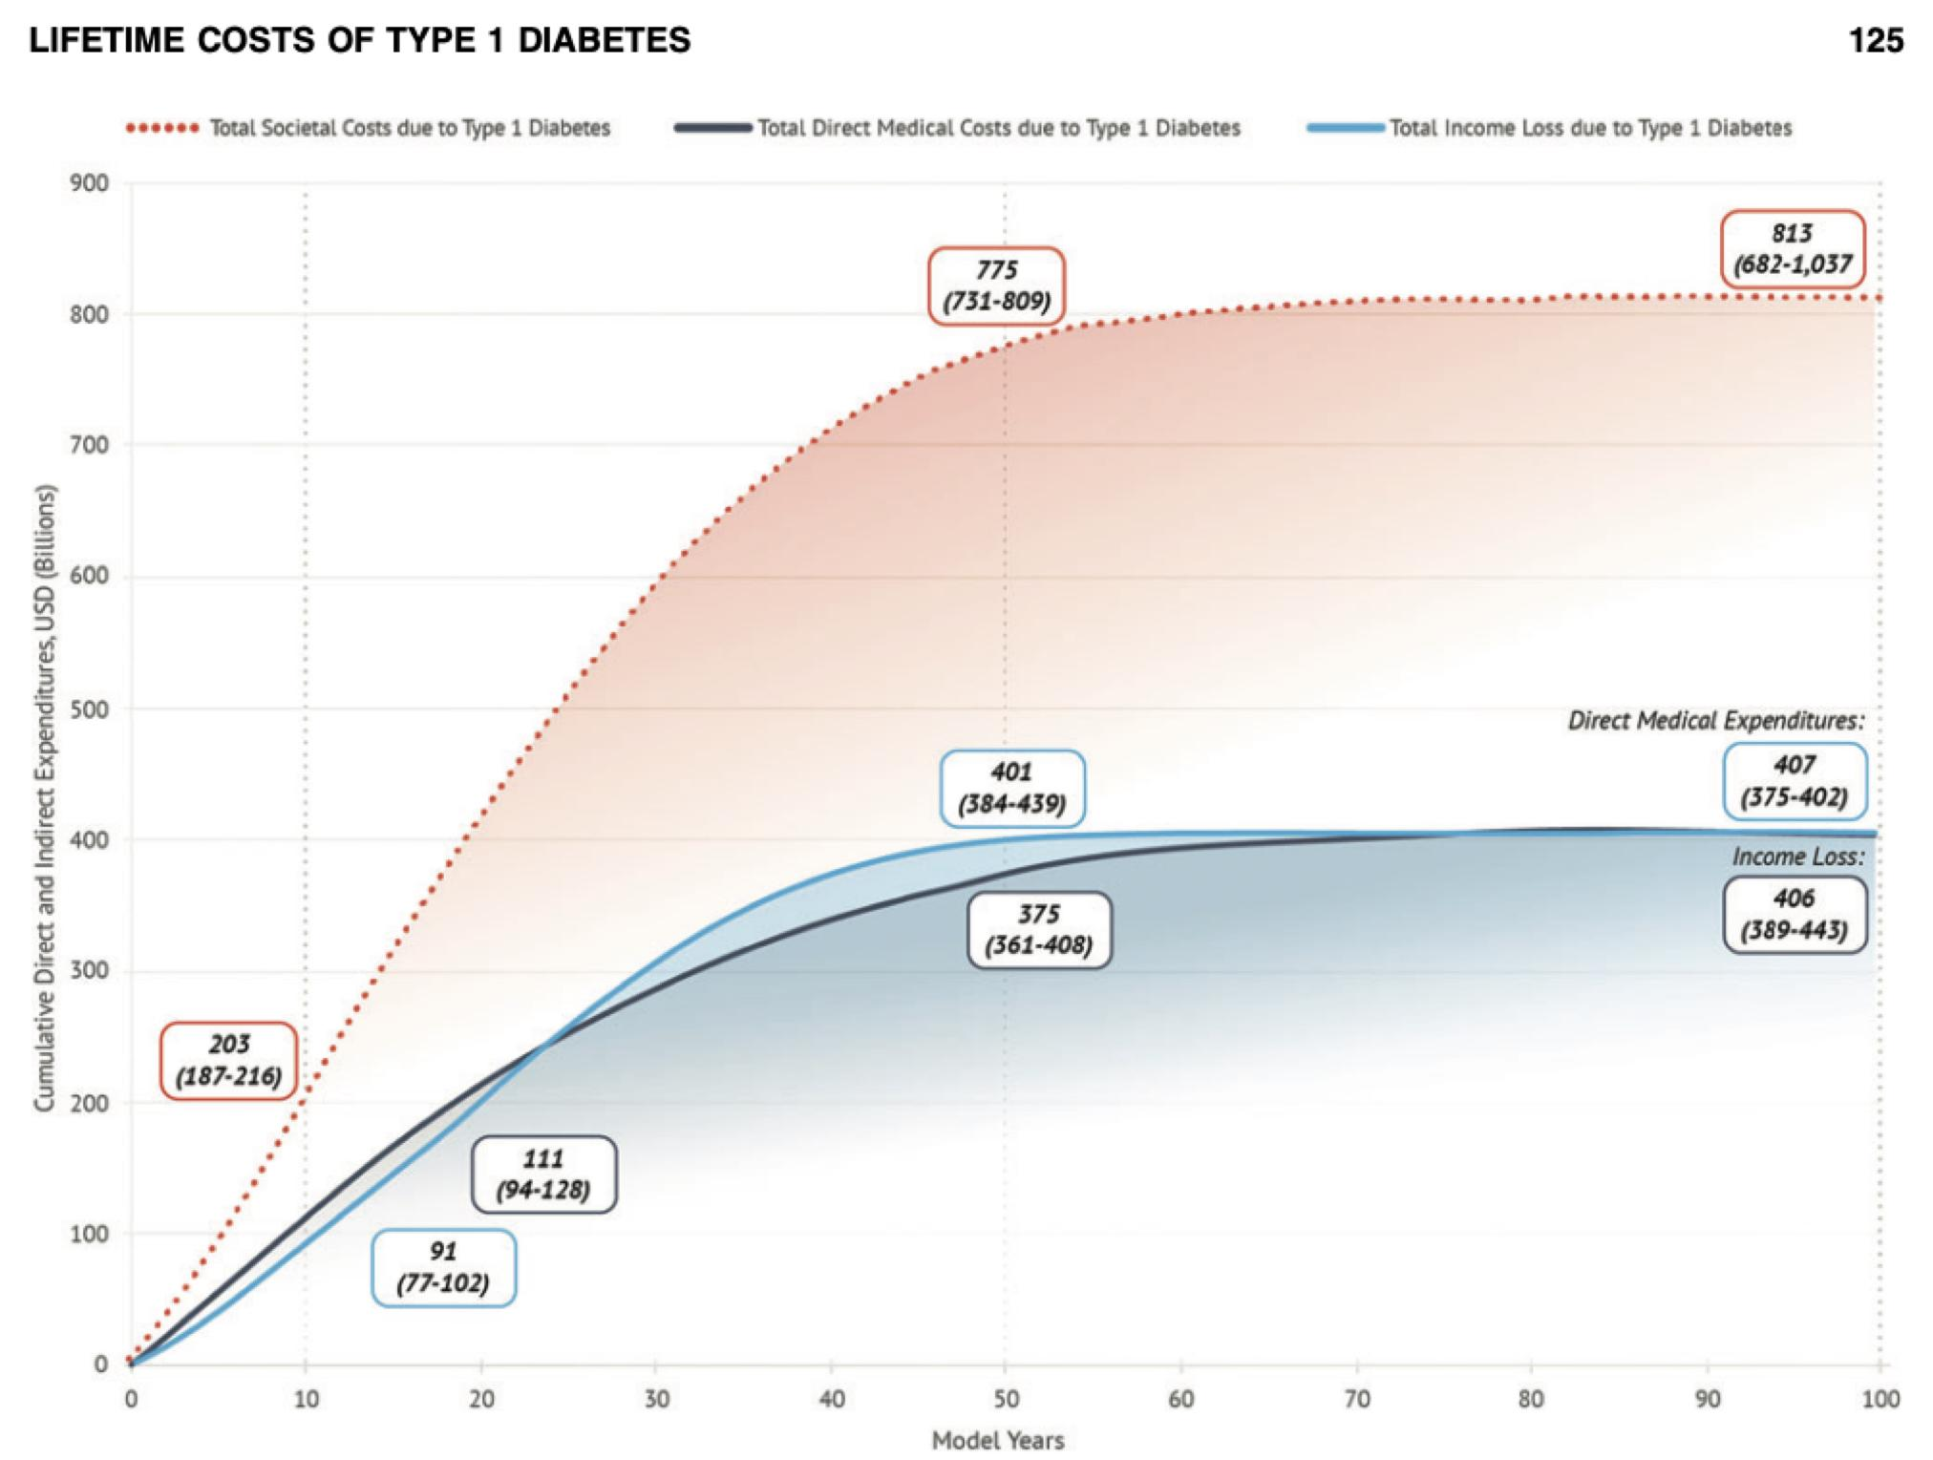
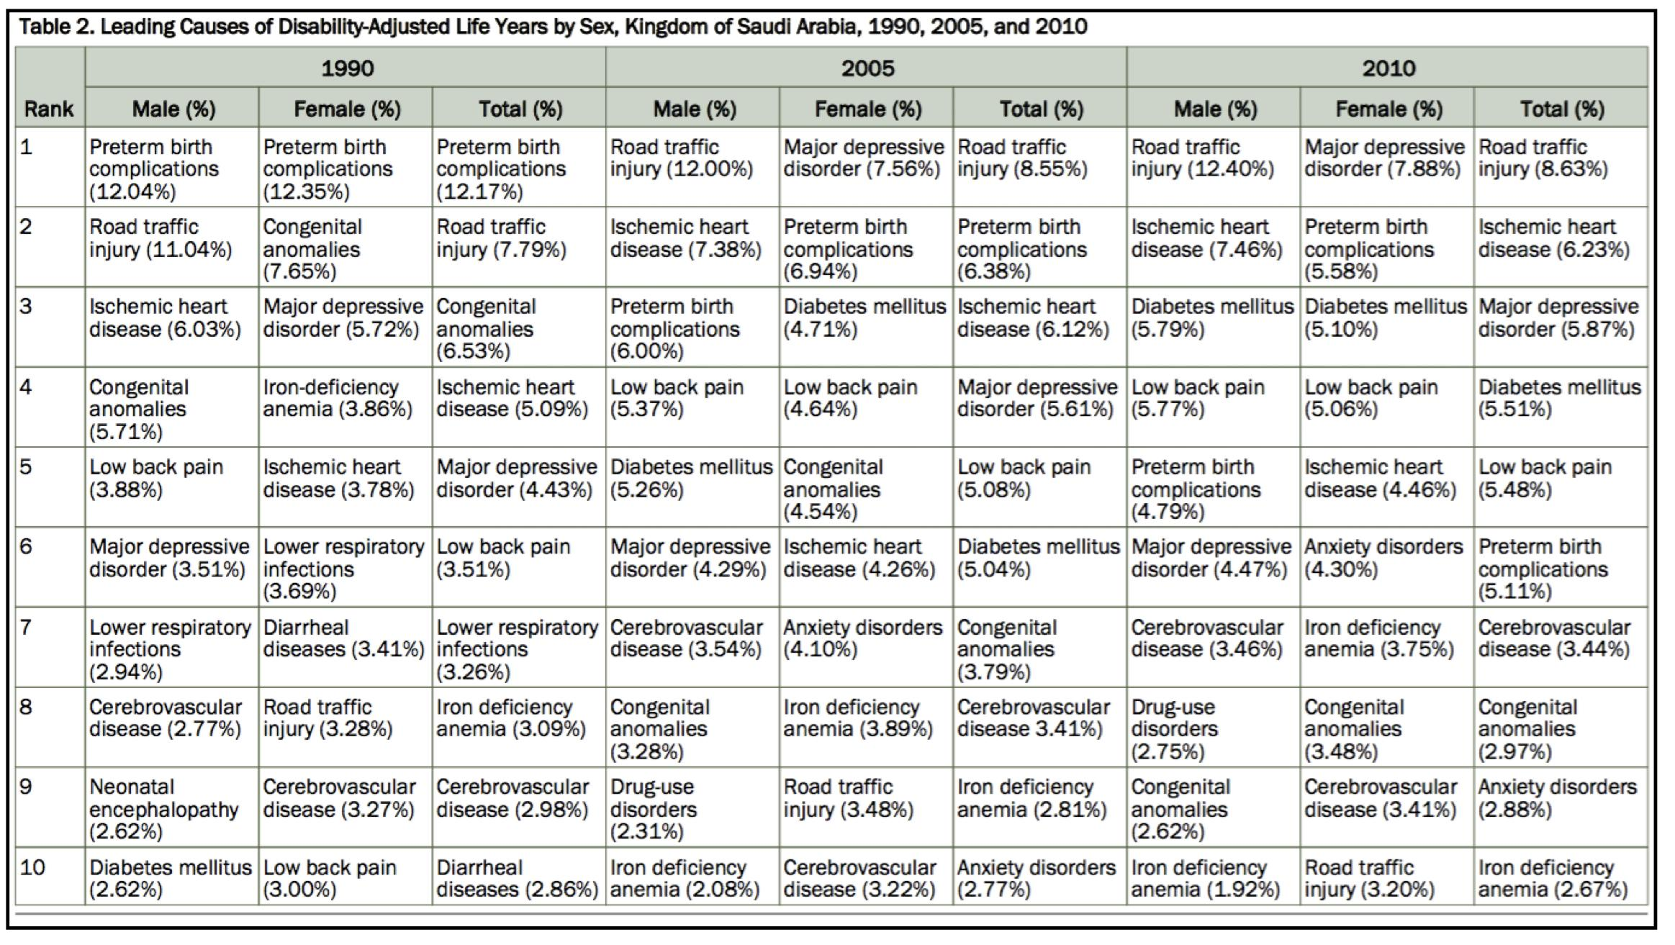
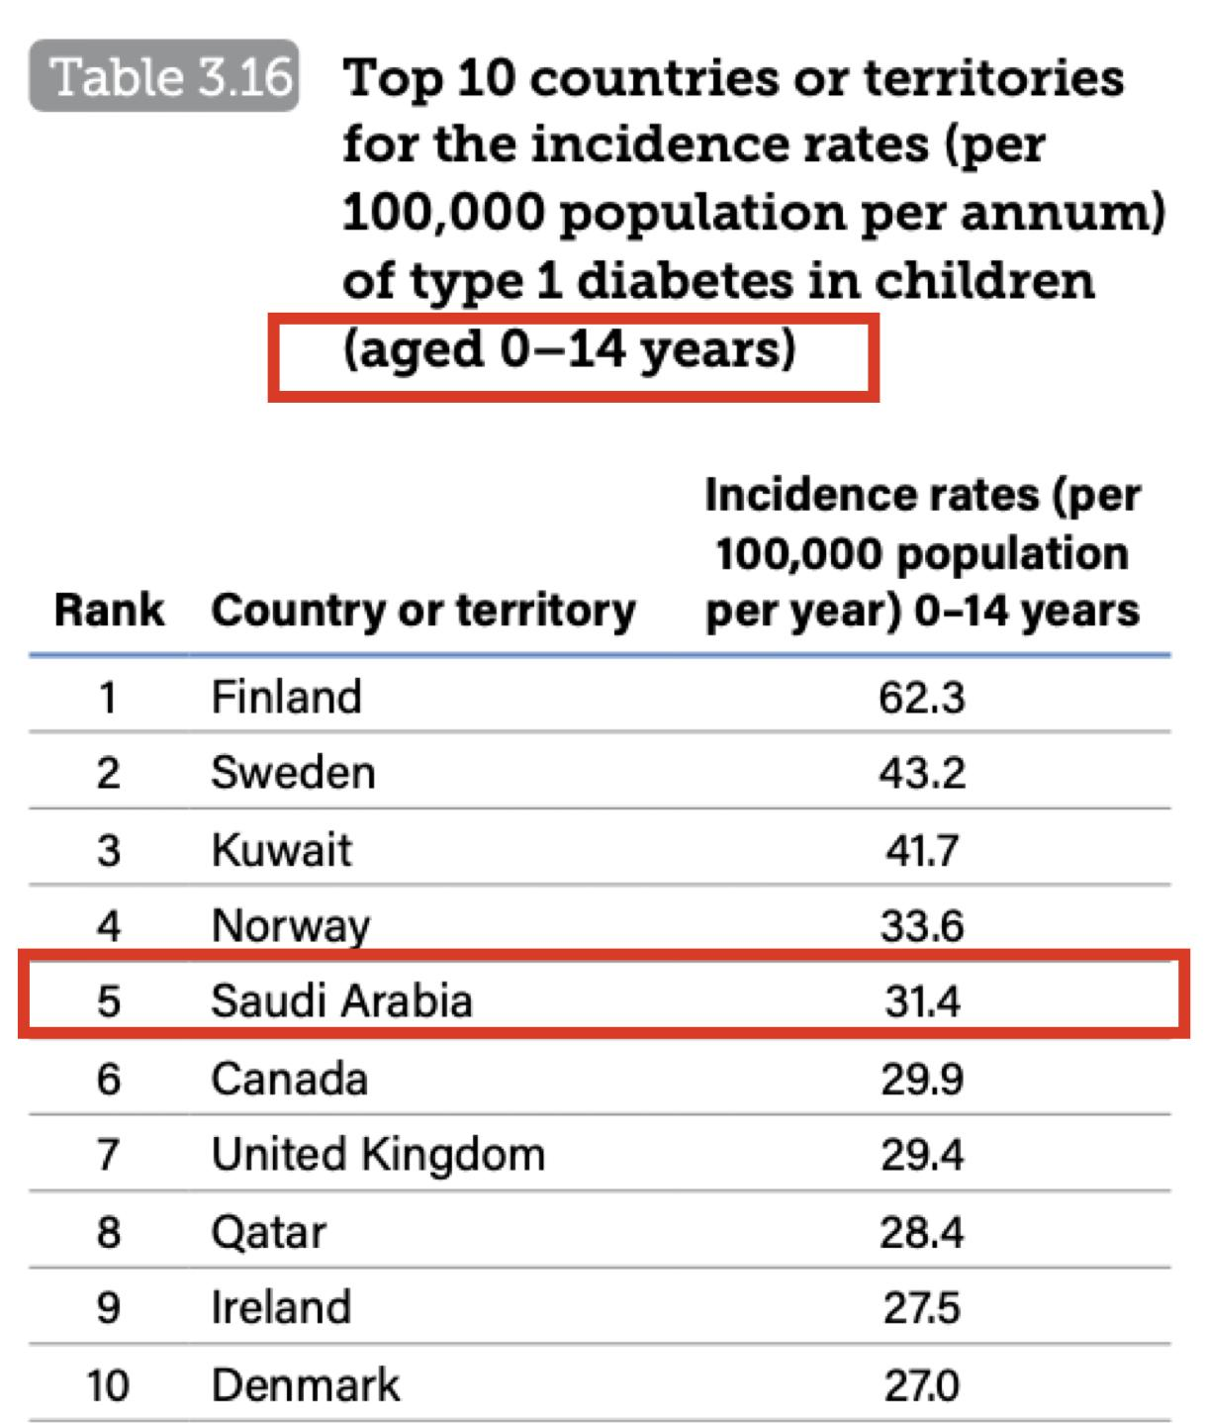
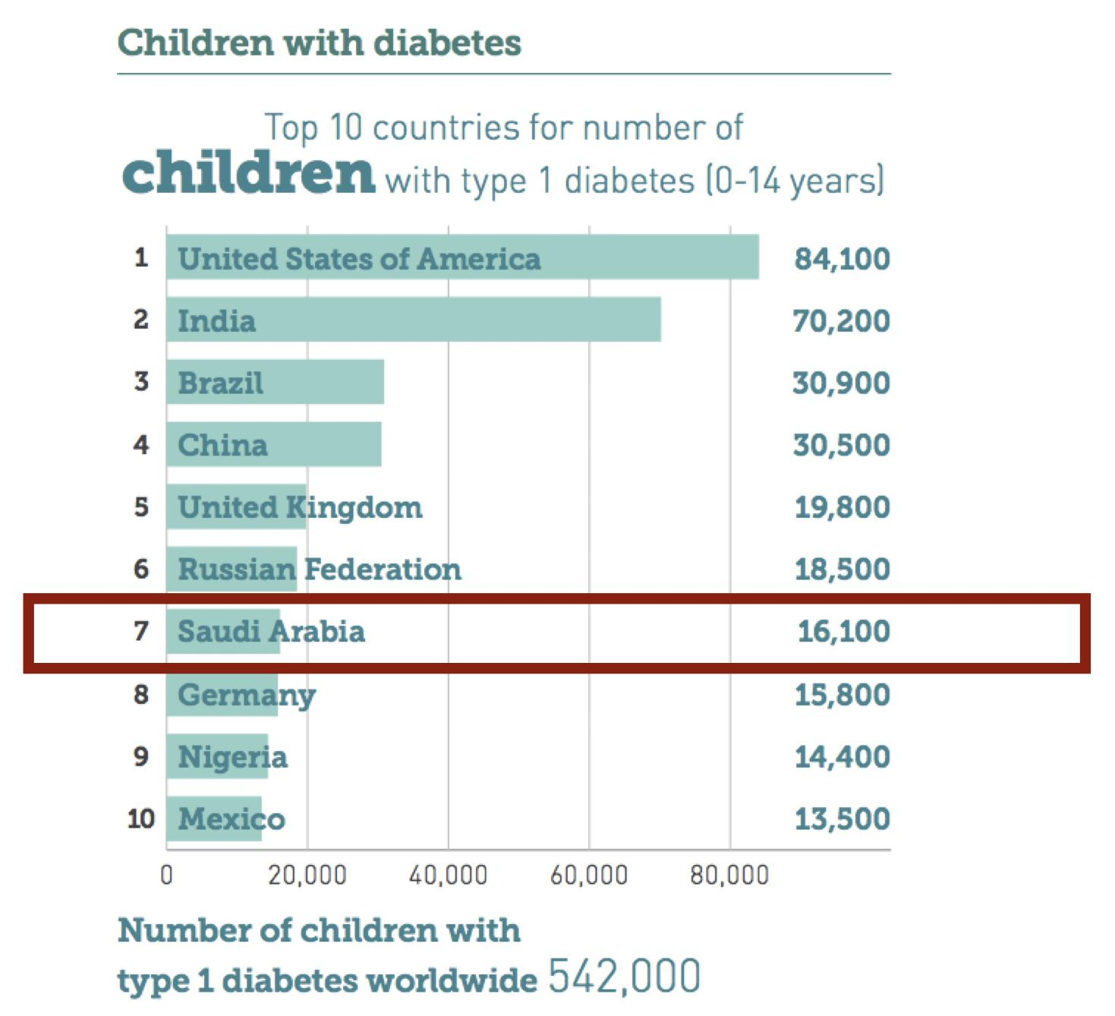
Investigations cont’
Glycosuria:
Cannot be used to diagnose diabetes, but requires further investigation.
It is commoner in older people, who have an altered renal threshold for glucose.
It may also occur in familial renal glycosuria, which is a monogenic disorder affecting function of the sodium–glucose co- transporter (SGLT2) and found in about 1 : 400 of the population.
Other investigations:
No further tests are needed to diagnose diabetes, but measurement of C- peptide and islet autoantibodies can help determine the type of diabetes.
C- peptide can be measured in blood or urine; it is often present when type 1 diabetes is diagnosed but disappears with time and is a more useful investigation in people with a duration of diabetes longer than 5 years.
Routine investigations:
include urine testing for protein, a full blood count, urea and electrolytes, liver biochemistry and random lipids.
Secondary causes:
Investigations of secondary causes of diabetes or associated autoimmune disease may be appropriate
Type 1 diabetes mellitus
What is Diabetes ?
Diabetes is a complex, chronic illness requiring continuous medical care with multifactorial risk-reduction strategies beyond glycemic control. Ongoing patient self-management education and support are critical to preventing acute complications and reducing the risk of long-term complications.
DM Epidemiology and Burden
Diabetes was the 7th leading cause of death in 2010 behind Ischemic heart disease (1st leading cause) and chronic Kidney disease (6th leading cause). Recall DM increases the risk of IHD and CKD.
Type 1 diabetes is a disease of insulin deficiency and accounts for 5–10% of all cases of diabetes. It typically presents in childhood and young adulthood, reaching a peak incidence around the time of puberty, but can present at any age.

Slide 7
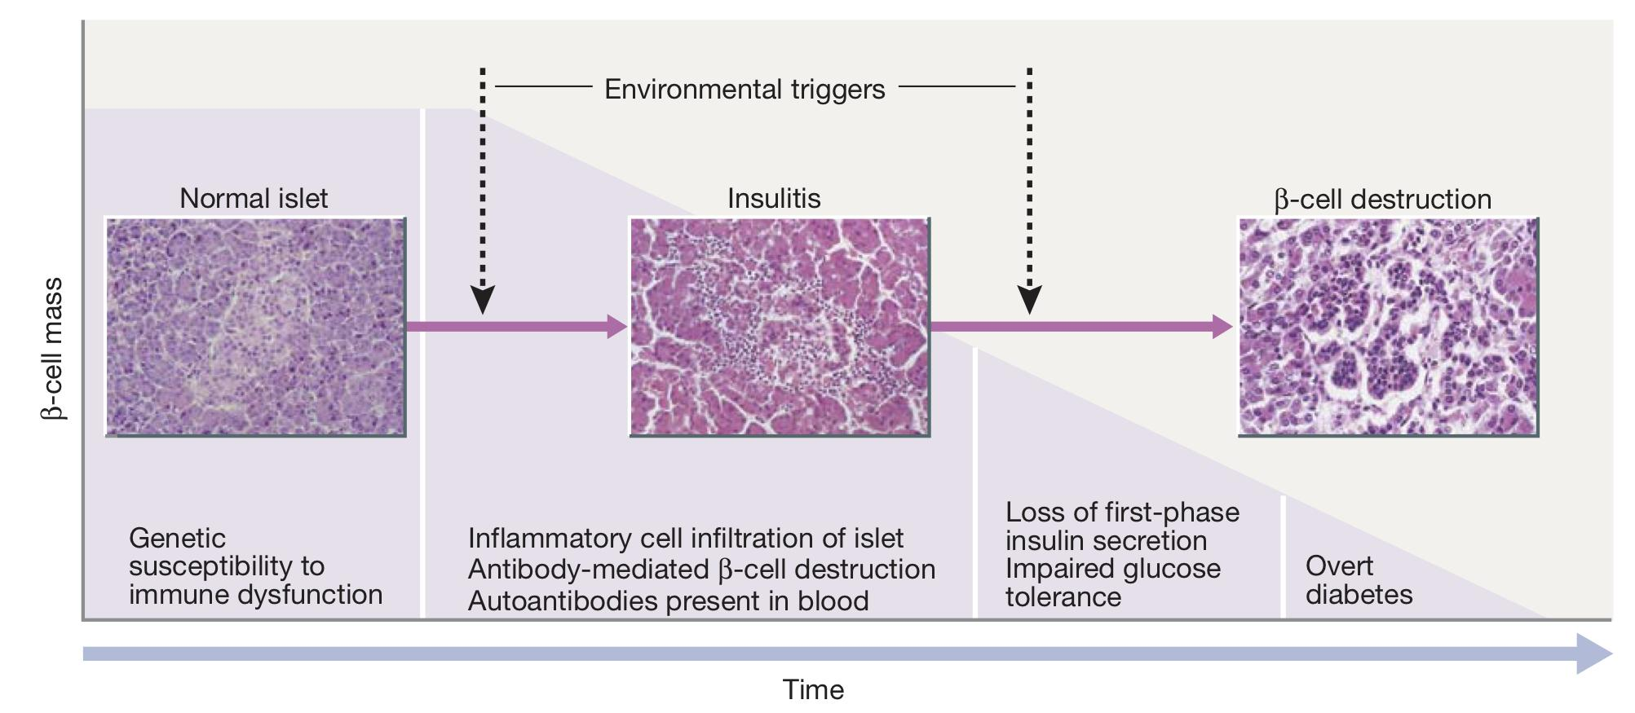
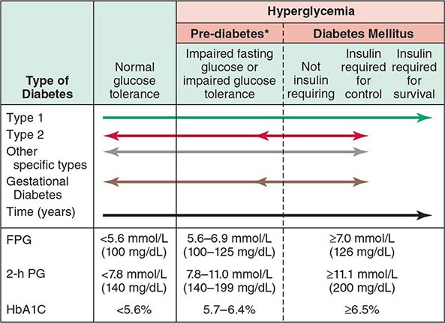
Type 1 DM
Pathogenesis
T1DM is the result of interactions of genetic, environmental, and immunological factors that ultimately lead to the destruction of the pancreatic Beta cells and insulin deficiency.
It can develop at any age, but most commonly < 30
Type 1 diabetes is associated with other organ-specific autoimmune diseases including autoimmune thyroid disease, coeliac disease, Addison’s disease and pernicious anaemia.
The precise molecular mechanisms that lead to type 1 diabetes are incompletely understood but involve the triggering of a selective autoimmune destruction (Most, but not all, individuals have evidence of islet-directed autoimmunity) of the insulin producing cells of a genetically predisposed individual.
Initially, autoantibodies directed against pancreatic islet constituents appear in the circulation and often predate clinical onset by many years.
The islet antigens include:
insulin itself, the enzyme glutamic acid decarboxylase (GAD), protein tyrosine phosphatase (IA-2, also known as ICA512), the cation transporter ZnT8 and tetraspanin 7.
This is followed by a phase of asymptomatic loss of β cell secretory capacity:
histologically, this is characterized by a chronic inflammatory mononuclear cell infiltrate of T lymphocytes and macrophages in the islets, known as insulitis . Eventually, when the remaining β cells are no longer able to produce enough insulin to meet the body’s needs, diabetes symptoms start to develop.
Note that T1DM arrow is uni-directional and has rapid onset (unlike T2DM which has indolent course). T1DM pts need insulin for SURVIVAL unlike T2DM.
An area for your notes

Slide 8
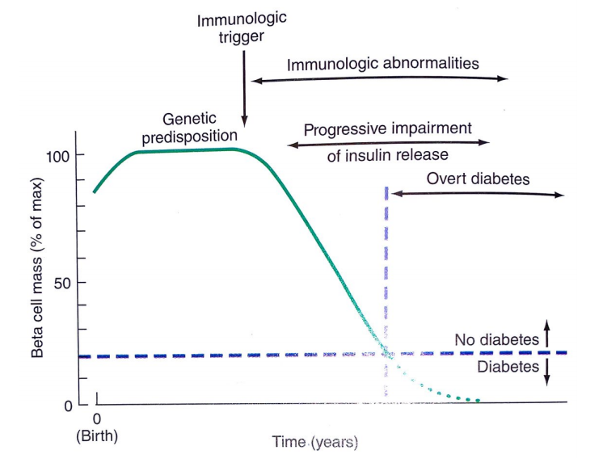
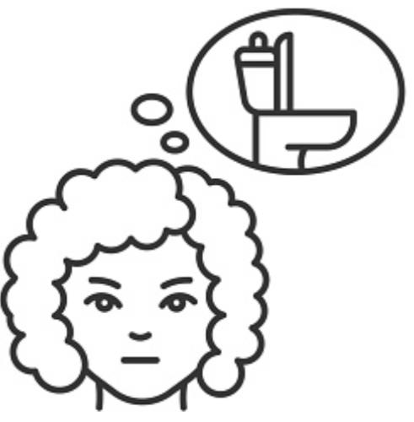
Type 1 DM
Risk factors
Genetics
Increased susceptibility to type 1 diabetes is inherited but the disease is not genetically predetermined. The identical twin of a person with type 1 diabetes has a 30–50% chance of developing the disease, which implies that non- genetic factors must also be involved.
The risk of developing diabetes by age 20 years is greater with a father with diabetes (5–7%) than with a mother with diabetes (2–5%).
If one child in a family has type 1 diabetes, each sibling has a 4–6% risk of developing diabetes.
This risk rises to about 20% in siblings with the same human leukocyte antigen (HLA) genotype as the proband.
HLA genes are highly polymorphic and modulate the body’s immune defence system.
More than 90% of people with type 1 diabetes carry HLA- DR3-DQ2, HLA- DR4-DQ8 or both, as compared with some 35–40% of the background population. By contrast, certain HLA alleles confer protective effects, for example DQB1*0602.
Environmental
Maternal factors, such as gestational infection and older age
Viral infections, including enteroviruses such as Coxsackie B4
Exposures to dietary constituents, such as early introduction of cow’s milk and relative deficiency of vitamin D
Environmental toxins e.g. alloxan, Vacor
Childhood obesity
Psychological stress.
Presentation
Click here to go back to slide 4
Blurred vision
Lack of energy and fatigue
Constant hunger
Excessive thirst
Bedwetting
Frequent Urination
Sudden weight Loss¹
Diagnosis
Click here to go back to slide 5
1-Sudden weight loss is more specific for T1DM, the reason behind this is that T1DM pts are insulin deficient (Recall that insulin has an anabolic effect). T2DM may also present with weight loss but this would occur very late, unlike T1DM which presents from the beginning.

Slide 9
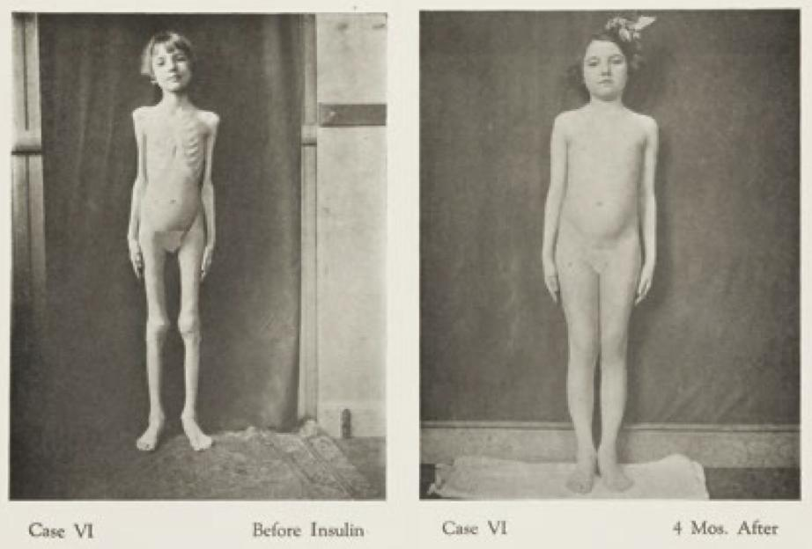
Management
Goals of the therapy through appropriate meds and education
Eliminate symptoms related to hyperglycaemia
Reduce risk or eliminate diabetes complications such as diabetic ketoacidosis and hypoglycaemia with effective management when they do occur.
Allow patient to achieve as normal lifestyle as possible
Avoidance of iatrogenic side-effects, such as hypoglycaemia.
Insulin treatment allows for a dramatic recovery in patients with Type 1 diabetes
With insulin treatment there is weight gain because of the ability of the
tissues to use glucose
Insulin is necessary for survival
Type 1 diabetes is an autoimmune disease leading to β-cell destruction, lack of insulin production and a need for life-long insulin therapy. Insulin is always indicated in people with type 1 diabetes and is often needed in those with type 2 diabetes as the condition progresses.
Until 1922, the treatment for Type 1 diabetes was a ‘starvation diet’ – reducing patients to emaciation and subjecting them to a life of misery.
Prior to discovery of insulin in 1921, the life expectancy of people with type 1 diabetes was only 3–4 months.
The work of John Macleod, Frederik Banting and Charles Best with their patient, Elizabeth Hughes (right), led to the widespread use of insulin injections as a treatment for Type 1 diabetes.
The philosophy of insulin therapy is to mimic the normal physiological secretion of insulin as closely as possible. This involves the use of both long-acting insulin to replicate the basal secretion of insulin and short-acting insulin to cover mealtimes.
Insulin deficiency
In type 1 Diabetes:
There is a loss of both first and second phase of insulin secretion.
In type 2 Diabetes:
In the early stage of the disease there is loss of the first phase of insulin secretion. Phase 2 will become wider then it will gradually reduce to reach a stage of severe insulinopenia.
Basal Insulin
-Suppresses glucose production between meals and overnight
-50% of daily needs
The basal/bolus insulin concept
Bolus Insulin (Mealtime or Prandial)
-Limits hyperglycemia after meals
-Immediate rise and sharp peak at 1 hour
-10% to 20% of total daily insulin requirement at each meal

Slide 10
Management
Types of insulin
Insulin type (trade name) | Onset | Peak | Duration | Characteristics
Bolus (preprandial or mealtime) insulins
Rapid-acting insulin analogues (clear) Insulin aspart (NovoRapid®) Insulin glulisine (Apidra®) Insulin lispro (Humalog®) U-100 U-200 Faster-acting insulin aspart (Fiasp®) | 9-20min 10-15min 10-15min 4min | 1-1.5h 1-1.5h 1-2h 0.5-1.5h | 3-5h 3.5-5h 3-4.75h 3-5h | Enter the circulation more rapidly than human soluble insulin, and also disappear more rapidly.
Short-acting insulins (clear) Insulin regular [Humulin®-R, Novolin® ge Toronto] Insulin regular (Entuzity® (U-500) | 30min 15min | 2-3h 4-8h | 6.5h 17-24h | The use of short- acting insulin analogues in people with type 1 diabetes reduces total and nocturnal hypoglycaemic episodes and improves glycaemic control as judged by postprandial glucose concentrations and HbA1c. Used for pre-meal injection in multiple dose regimens, during medical emergencies, and in patients using insulin pumps.
Basal insulins
Intermediate-acting (cloudy) Insulin neutral protamine Hagedorn (Humulin® -N, Novolin® ge NPH) | 1-3h | 5-8h | Up to 18h | Has the advantage that it can be premixed with soluble insulin to form stable mixtures (biphasic insulins). Its use is hampered by variability from one injection to another, the need to resuspend the insulin prior to injection and a peak action, which generally occurs in the middle of the night.
Long-acting insulin (clear) Insulin detemir (Levemir®) Insulin glargine U-100 (Lantus®) Insulin glargine U-300 (Toujeo®) Insulin glargine biosimilar (Basaglar®) Degludec U-100, U-200 (Tresiba®) | 90min | Not applicable | U-100 glargine 24h, detemir 16–24h U-300 glargine >30h degludec 42h | Long- acting insulin analogues reduce hypoglycaemia for people with both type 1 diabetes and type 2 diabetes, particularly at night.
Premixed insulins¹
Premixed regular insulin –NPH (cloudy) Humulin 30/70 Novolin® ge 30/70, 40/60, 50/50 | A single vial or cartridge contains a fixed ratio of insulin
Premixed insulin analogues (cloudy) Biphasic insulin aspart (NovoMix® 30) Insulin lispro/lispro protamine (Humalog® Mix25 and Mix50) | (% of rapid-acting or short-acting insulin to % of intermediate-acting insulin)
1- Not preferred for T1DM, although it may have some indication in pediatric

Slide 11
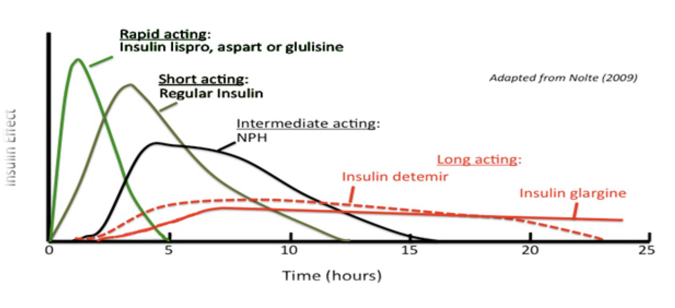
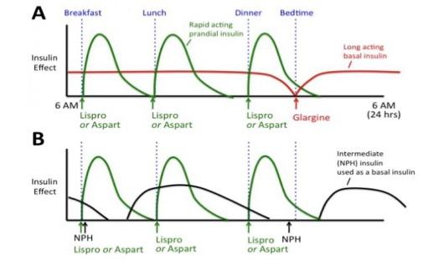
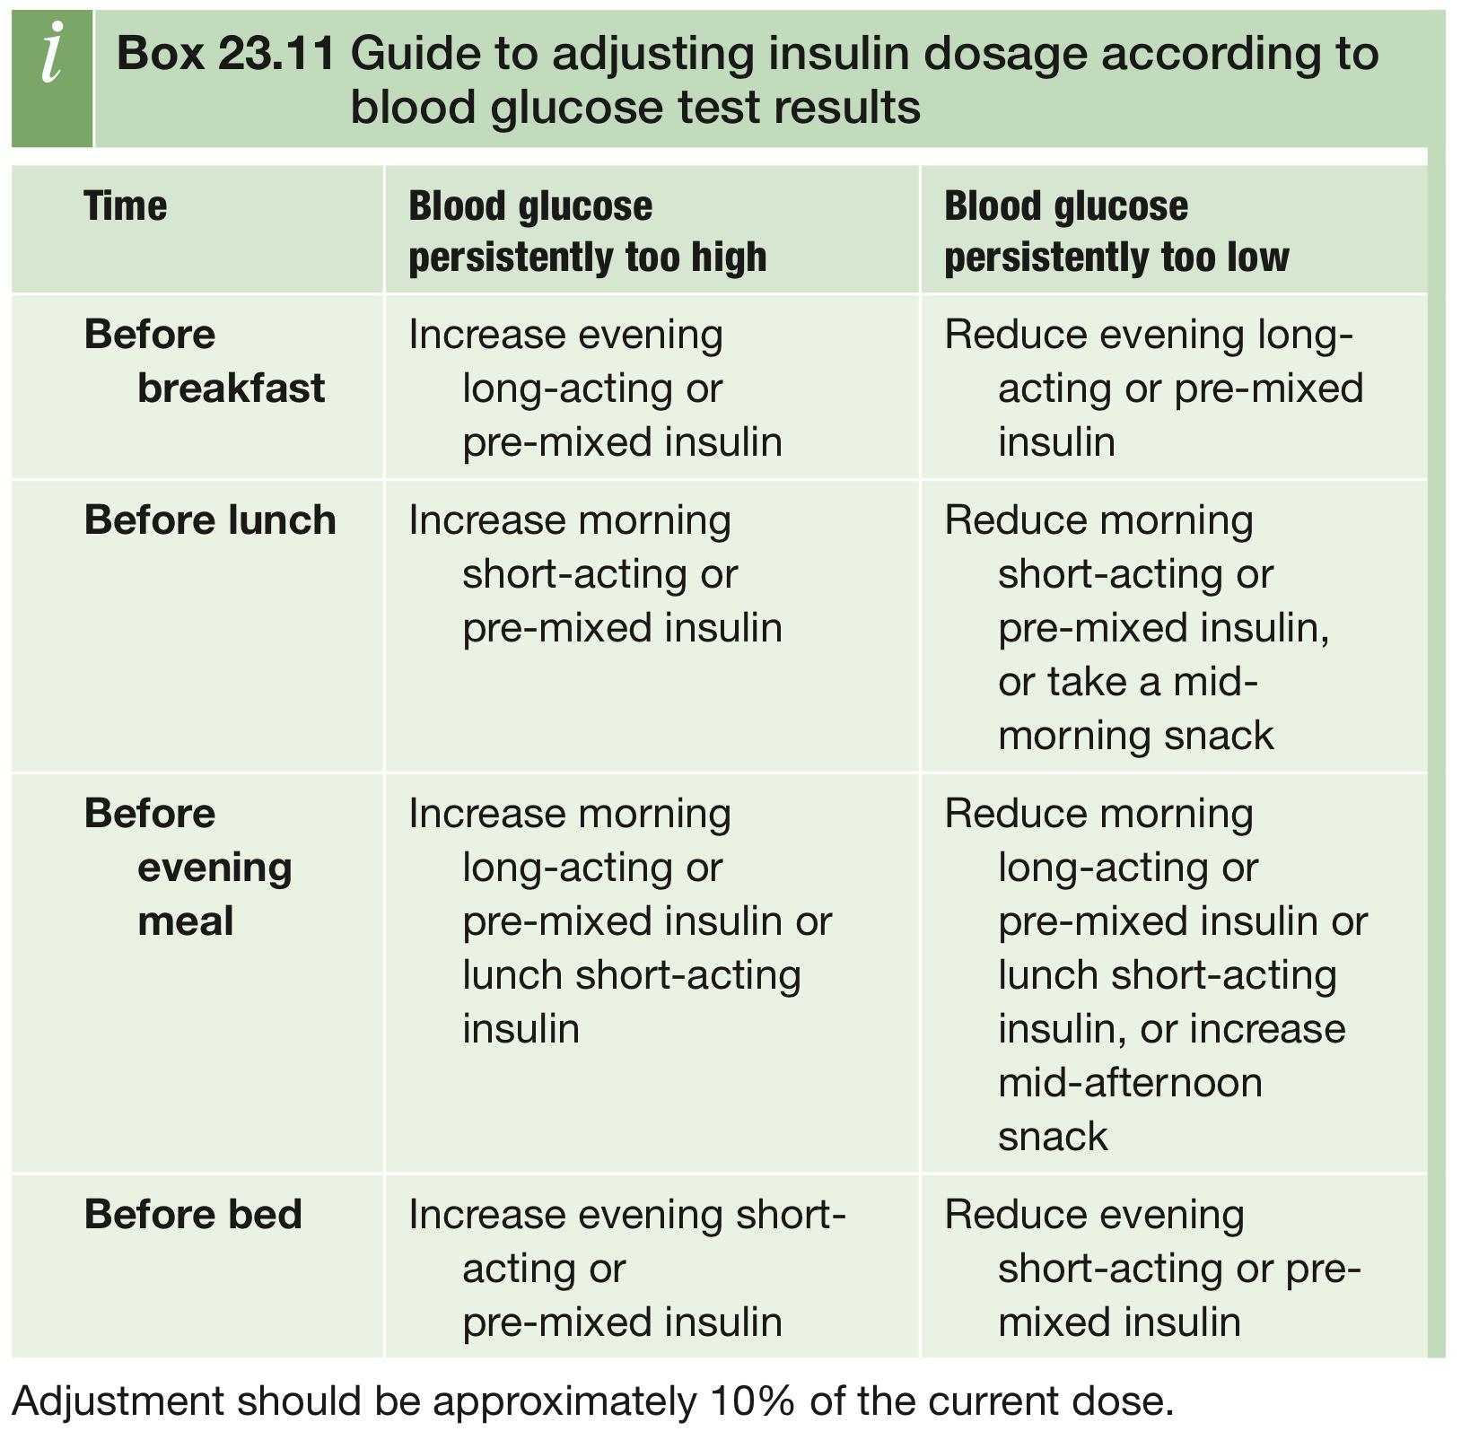
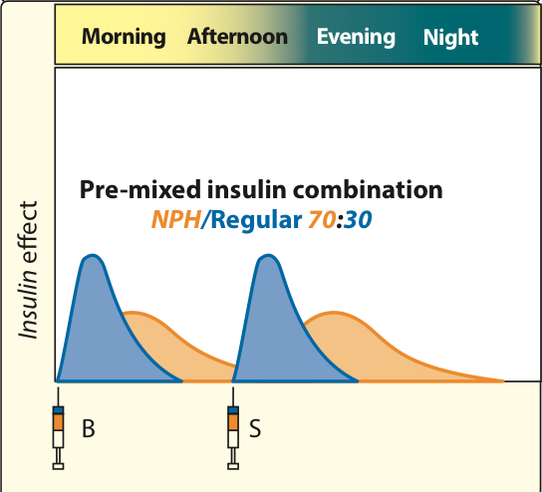
Management
Available Therapeutic Regimens
CT = Conventional Therapy (1 or 2 injections / day)
Conventional therapy is an old regimen, not recommended anymore, especially for adults (It may have some indications in pediatrics)
MDI = Multiple Daily Injections (3 – 6 injections / day)
MDI is the preferred regimen for adults
CSII = Continuous S.C Insulin infusion “insulin pump “
Prandial and basal insulin replacement
Huge thanks to 436§438 pharmacology teamwork!
(intermediate & short acting insulin)
Before meals : diabetic patients takes short acting insulin which is regular insulin used to cover the daily need of the insulin after meals.
Before sleeping : no need for strong and fast action because glucose levels before sleeping not high like after meals so, to avoid hypoglycemia and coma the patients takes instead of short acting insulin the insulin intermediate.
(intermediate & Ultra short acting insulin)
Same idea but the short acting insulin is replaced with the ultra-short acting insulin which has a rapid effect As long as the body needs the insulin as a basal level between meals , the patients take double dose of the insulin intermediate to control the glucose level for the whole day not only before meals or sleeping time.
(Insulin mixture(combination) = intermediate + short acting insulin)⁴
Is a helpful drug to reduce the use of injections for the diabetic patients and provide a basal level of insulin during the day and once the patient eat a meal short acting insulin is ready.

Slide 12
Type 1 DM
Insulin complications
Hypoglycaemia
The most common
insulin resistance
Weight gain (overcome by emphasis on the need for diet and exercise, plus addition of metformin)
Peripheral oedema (insulin treatment causes salt and water retention in the short term)
Insulin antibodies
Local allergy (rare)
Lipohypertrophy or lipoatrophy at injection sites (result of overuse of a single injection site )
The power of diabetes control
60% less neuropathy
50% less nephropathy
70-76% less retinopathy
Key messages
Basal-bolus insulin therapies (i.e. multiple daily injections or continuous subcutaneous insulin infusion) are the preferred insulin management regimens for adults with type 1 diabetes.
Insulin regimens should be tailored to the individual's treatment goals, life- style, diet, age, general health, motivation, hypoglycemia awareness status and ability for self-management.
All individuals with type 1 diabetes should be counselled about the risk, prevention treatment of hypoglycemia.
Avoidance of nocturnal hypoglycemia may include changes in insulin therapy and increased monitoring.
If glycemic targets are not met with optimized multiple daily injections, continuous subcutaneous insulin infusion may be considered. Successful continuous subcutaneous insulin infusion therapy requires appropriate candidate selection, ongoing support and frequent involvement with the health- care team.
Continuous glucose monitoring may be offered to people not meeting their glycemic targets, who wear the devices the majority of the time, in order improve glycemic control.

Slide 13
Elevated BMI (>25) is associated with an increased risk for the development of type 2 diabetes.
Prevalence of type 2 diabetes closely matches the prevalence of obesity.
The prevalence of overweight was 36.9%.
The age-adjusted prevalence of obesity was 35.5% in KSA.
Females are significantly more obese with a prevalence of 44% than males 26.4% .
The overall prevalence of DM obtained from this study is 23.7% in KSA.
The prevalence in males and females were 26.2% and 21.5%
Diabetes mellitus was more prevalent among Saudis living in urban areas of 25.5% compared to rural Saudis of 19.5%
27.9% were unaware of having DM
Diabetes kills 1 Saudi every 30 minutes, New case diagnosed every 2 MINUTES
More deaths than TB and breast cancer combined¹
Average life expectancy: 15 years less than non-diabetes population
Diabetes Mellitus Type 2
Obesity & T2DM in SA
2 Million
Etiology
Diet:
Certain dietary patterns are associated with higher or lower risks of type 2 diabetes.
Components that increase the risk include:
dietary fat, particularly saturated fat, red and processed meat, consumption of fried food, including French fries, increased intake of white rice and sugar-sweetened beverages.
The following are associated with lower rates of T2DM:
Wholegrains, increased fruit and vegetable intake, fermented dairy products, oily fish and a Mediterra- nean dietary pattern are associated with
Ageing:
Pancreatic B-cell function declines with age and the incidence of type 2 diabetes increases with age
Obesity:
Obesity increases the risk of type 2 diabetes up to 80-100-fold and accounts for 80-85% of the overall risk of developing type 2 diabetes. A central distribution of fat increases the risk of type 2 diabetes, and so for any given level of obesity, the more visceral fat an individual has, the higher the risk of type 2 diabetes.
Fetal origins of diabetes:
There is a J-shaped relationship between low weight at birth and at 12 months of age and glucose intolerance later in life, particularly in those who gain excessive weight in adulthood. The concept is that poor nutrition early in life impairs B-cell development function, predisposing to diabetes later on.
Physical inactivity:
Associated with an increased risk of diabetes.
1
2
3
4
1- But it’s not recorded in the death certificate bc it’s not the direct cause

Slide 14
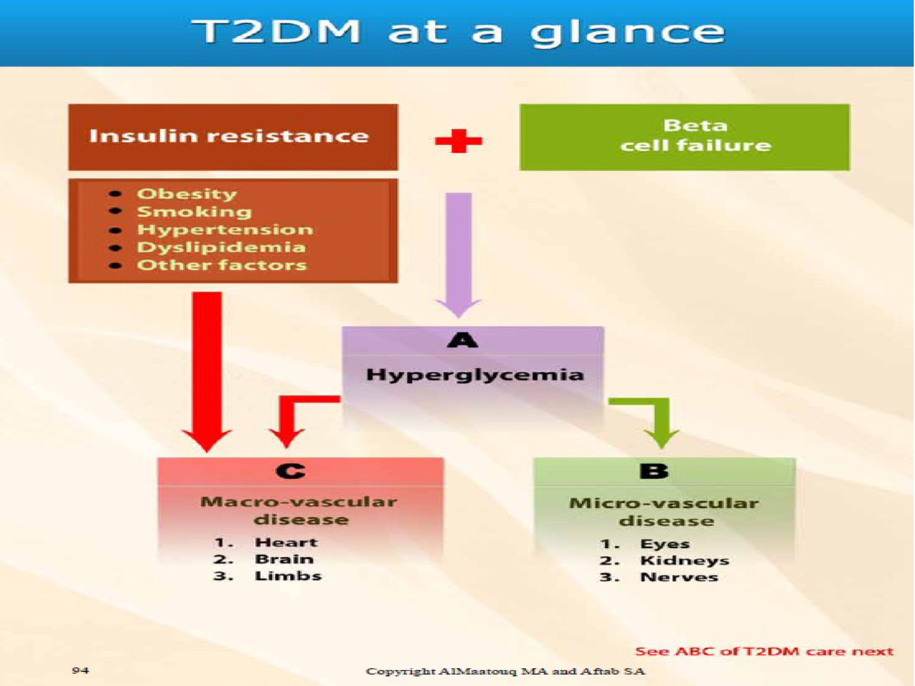
Diabetes Mellitus Type 2
Etiology cont’
Genetic susceptibility and inheritance
Identical twins of people with type 2 diabetes have more than a 50% chance of developing diabetes: the risk to non-identical twins or siblings is approximately 25%, confirming a strong inherited component to the disease.
Most of the identified genetic markers exert very modest risk and together explain less than 20% of the heritability of type 2 diabetes.
TNF-alpha may induce insulin resistance in obesity from the slides
The cytokine tumour necrosis factor - 𝞪 (TNF- 𝞪) is produced from adipose tissue, and TNF-𝞪 levels are often elevated in obesity.
Administration of TNF - 𝞪 leads to insulin resistance.
Over-expression of TNF-𝞪 in adipose and muscle of obese, insulin resistant diabetic subjects is positively corrrelated with insulin resistance.
Polymorphisms at the TNF-𝞪 locus correlate with insulin resistance.
TNF-𝞪 inhibits insulin receptor signalling in adipocytes.
TNF-𝞪 deficiency (knockout mice) prevents diet-induced insulin resistance.
Other factors
Other risk factors include urbanization, poverty, abnormal sleep patterns, environmental toxins and mental illness, High-risk ethnic or racial group, Diabetes mellitus in a first-degree relative, History of vascular disease
Pathogenesis
Both defects are necessary to develop diabetes.
1
Abnormalities of insulin action
Insulin resistance, which is defined as the inability of insulin to produce its usual biological effects at physiological concentrations. It is characterized by an impaired ability of insulin to:
Inhibit hepatic glucose output
Stimulate glucose uptake into skeletal muscle
Suppress lipolysis in adipose tissue.
The underlying mechanisms of insulin resistance are not fully understood but result from nutrient excess.
Hyperglycemia alone will lead to microvascular complications. If combined with other factors (e.g. Obesity, smoking etc.) it will lead to macrovascular complications. Microvascular complications causes morbidity and macrovascular causes mortality. You should deal with (B) and (C) not only (A), bc for example a pt with retinopathy may become blind in 10yrs, so refer to ophtha early.

Slide 15
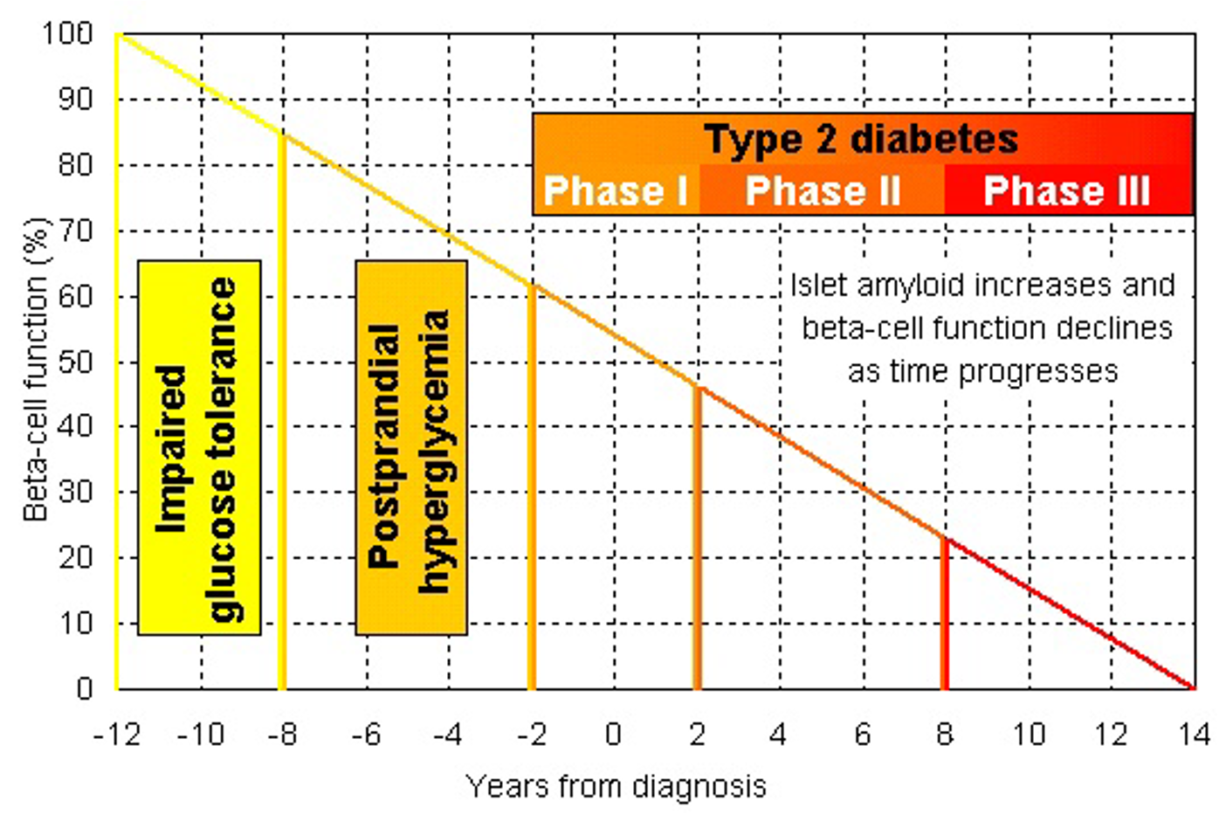
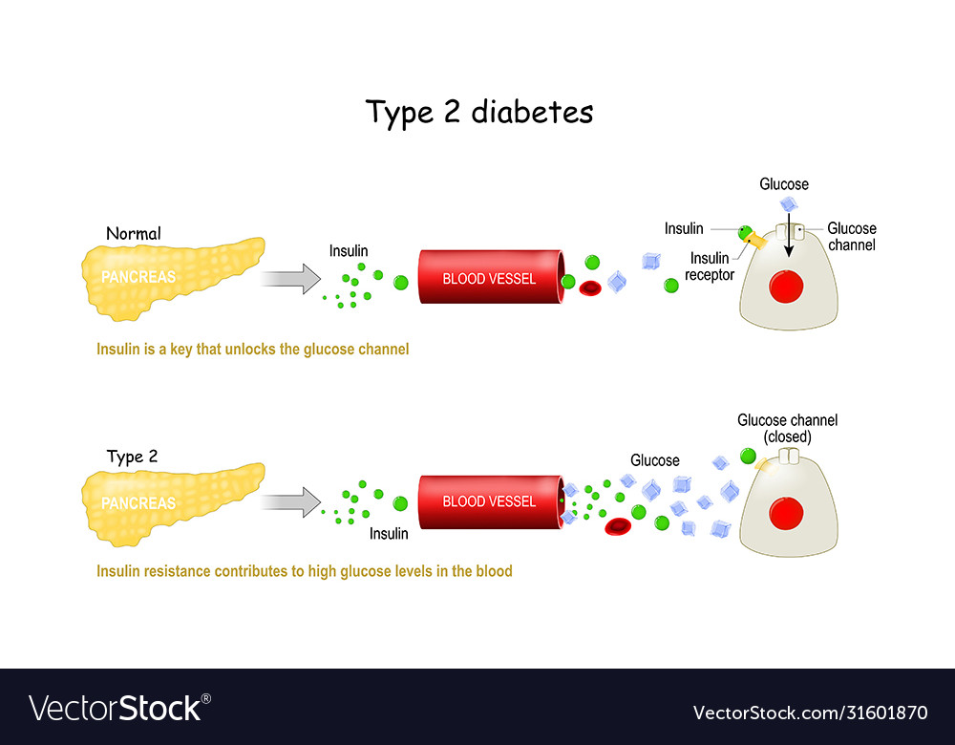
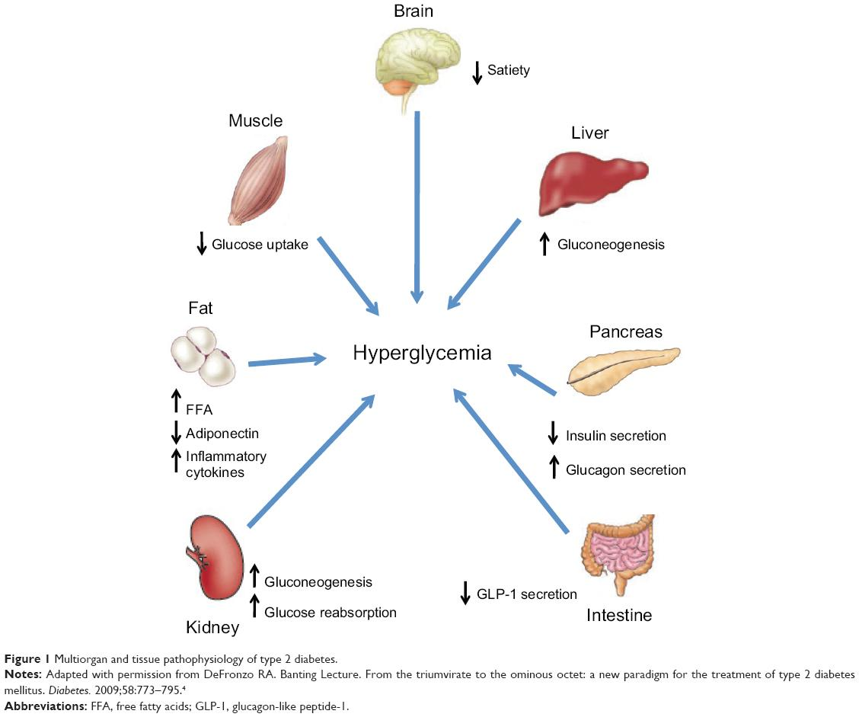
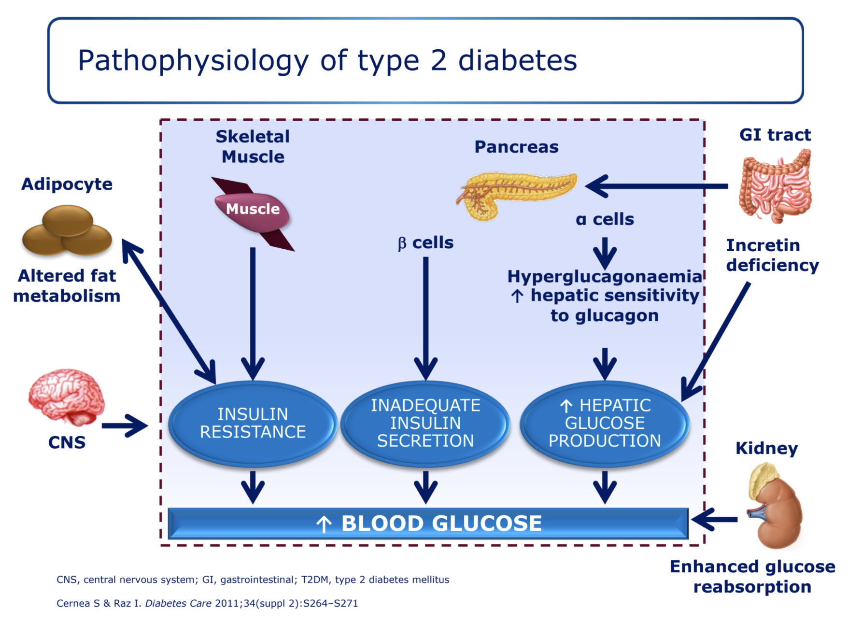
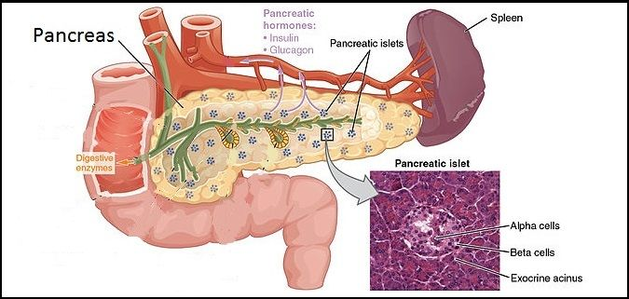
Disrupted pulsatile insulin response
↓first phase
↑Proinsulin / insulin ratio
↓𝛽-cell responsiveness to glucose
↓insulin production
↓insulin
↓insulin granules
Diabetes Mellitus Type 2
Pathogenesis cont’
2
Abnormalities of insulin secretion
01
As insulin resistance develops, the body's response is to increase insulin secretion and so
early diabetes is often associated with insulin hypersecretion.
Insulin secretory abnormalities manifest early in the course of type 2 diabetes and progress with time; an early sign is loss of the first phase of the normal biphasic insulin secretion.
Even though circulating insulin concentrations are higher than in people without diabetes, they are still inadequate to restore glucose homeostasis. By the time of diagnosis, at least 50% of B-cell mass and function has been lost.
Hyperglycaemia and lipid excess are toxic to ß cells, at least in vitro, a phenomenon known as glucotoxicity, which is thought to cause further B-cell loss and further deterioration of glucose homeostasis. With time, insulin secretion declines, an observation referred to as the 'Starling curve' of the pancreas.
02
Abnormalities of 𝛽-cell Function in
Type 2 Diabetes
Clinical features
Click here to go back to slide 4
Diagnosis
Click here to go back to slide 5
Gold standard for the diagnosis of DM is HbA1C because it is stable, accurate if done in qualified lab and has no much variability.
Retinopathy in DM is unique and can be used as a marker as it is different than other types of retinopathy like in HTN and other diseases.

Slide 16
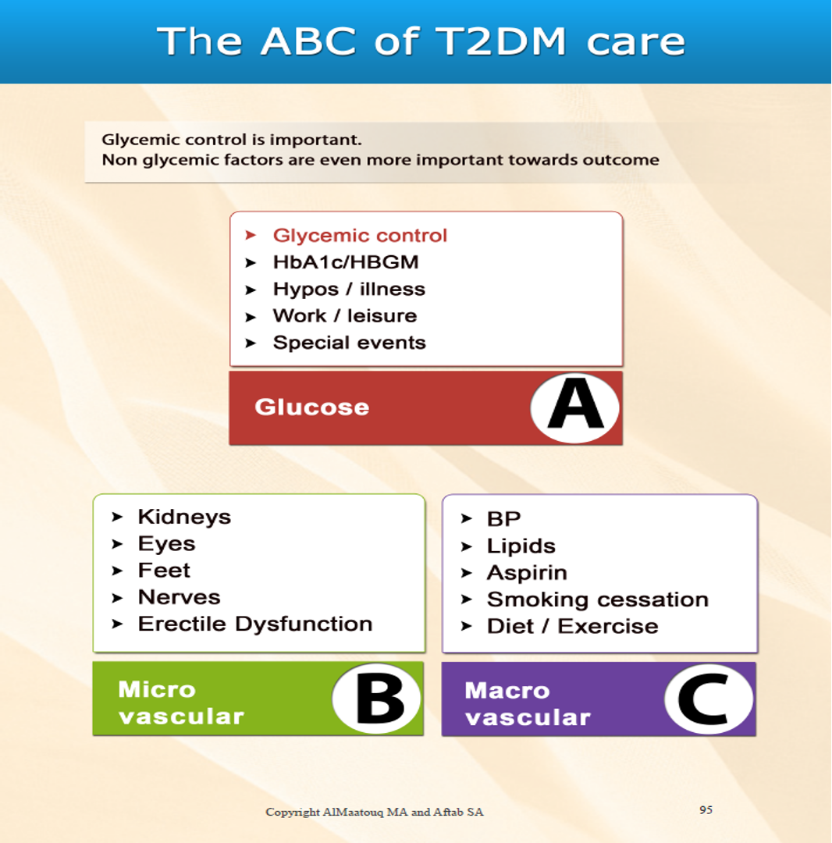
Better control means fewer complications
Every 1% reduction in HBA1C REDUCED RISK
Deaths from diabetes 21%
Heart attacks 14%
Microvascular complications 37%
Peripheral vascular disorders 43%
Management of T2DM
Diet and lifestyle changes are the key to successful treatment of type 2 diabetes. Medication should never be prescribed until lifestyle changes have been implemented.
The three main options are metformin, a sulfonylurea or a thiazolidinedione.
If control is inadequate on oral therapy, insulin therapy should be started without undue delay
DM management depends on hyperglycemia, microvascular complications and macro-vascular together.
Does it work? YES see on the right where treatment has decreased the microvascular complication by about 37% for every 1% decrease in HBA1C
Diet & lifestyle modifications:
All patients with diabetes require healthy diet therapy
Reducing alcohol consumption and stopping smoking
Weight management and regular exercise is encouraged to reduce cardiovascular risk
Exercises increase muscular insulin sensitivity
Dietary advice:
1. Salad: 1hour BEFORE the meal
2. 1⁄4 - 1⁄2 what you are used to. No cheating. 3. 1 Fruit per meal (juice is fruit)
4. 2 DATES BID (1 extra date BID)
5. No Communal eating
6. Avoid what you can live without.
Oral Hypoglycemic drugs:
HgbA1c targets:
7%: Early young without atherosclerosis (AT)
8%: Late old
In diabetic older patients with AT the target of HbA1C is 8% and there is no evidence that 7 better than 8, while in younger patients with no AT the target is 7% ( seven is heaven).
An area for your notes

Slide 17
OBJ.
Management of T2DM
Oral Hypoglycemic drugs:
Biguanides: metformin
MOA | increases insulin sensitivity, peripheral glucose utilization and reduces gluconeogenesis
Clinical use | Metformin is the best-validated treatment for type 2 diabetes and appears as the first-line pharmacological agent in all type diabetes guidelines. Metformin may be given in combination with other oral diabetes treatments as well as GLP-1 receptor agonists or insulin. It lowers fasting plasma glucose by 2-4 mmol/L (36–72 mg/dL), corresponding to a fall in HbA₁c of 11-22 mmol/ mol (1-2%). Metformin has been used alongside insulin in people with type 1 diabetes but only with limited efficacy.
Adverse effects | Gastrointestinal side-effects such as: anorexia, nausea, abdominal discomfort and diarrhoea. the most common The effects can be mitigated by starting at low dose and gradually increasing until the desired therapeutic effect is achieved. Contraindicated in: renal impairment, cardiac failure and hepatic failure because of the risk of lactic acidosis. Should be stopped temporarily around surgery or during other intercurrent illnesses that may affect lactate clearance. Should be avoided in people with a history of alcohol misuse. Should not be started in someone whose estimated glomerular filtrate (EGFR) is less than 45 mL/min per 1.73m² and should be stopped if the eGFR falls below 30 mL/min 1.73m².
Sulphonylureas
Gliclazide, Glimepiride, Glibenclamide, Glipizide, Tolbutamide
MOA | Act on the B cell to induce insulin secretion. They are ineffective in people without a functional B-cell mass and therefore have no effect in people with type 1 diabetes.
Clinical use | Most clinical guidelines recommend that sulphonylureas can be used as an alternative first-line agent where metformin is contraindicated or not tolerated. As monotherapy, sulphonylureas typically reduce fasting plasma glucose by 2–4 mmol/L (36–7 to a fall in HbA,c of 11–22 mmol/mol (1-2%). g/dL), corresponding.
Adverse effects | Weight gain, typically 1-4 kg, and hypoglycaemia are the most common side effects. The risk of hypoglycaemia is increased with longer acting sulphonylureas, excessive alcohol intake, older age and during intercurrent infection. Severe sulphonylurea-induced hypoglycaemia should be managed in hospital for up to 48 hours with glucose support until the drug has cleared from the circulation. Should be used with care in people with liver or renal disease.

Slide 18
Management of T2DM
Oral Hypoglycemic drugs:
Thiazolidinediones : pioglitazone
MOA | Reduce insulin resistance by interaction with peroxisome proliferator-activated receptor-gamma (PPAR-Y), a nuclear receptor that regulates large numbers of genes, including those involved in lipid metabolism and insulin action.
Clinical use | Can be used as monotherapy or in combination with other antidiabetic drugs, including insulin. Thiazolidinediones do not cause hypoglycemia as monotherapy. Pioglitazone may specifically benefit people with non-alcoholic fatty liver disease, a frequent co-morbidity of type 2 diabetes. As the effect on plasma glucose is indirect, thiazolidinediones may take up to 3 months to reach their maximal effect.
Adverse effects | The most common adverse effect is weight gain of 5-6 kg. Pioglitazone may cause fluid retention precipitating heart failure.
Meglitinides or post-prandial insulin releasers
Repaglinide, Nateglinide
MOA | Short-acting agents that promote insulin secretion in response to meals. Mode of action Like sulphonylureas, meglitinides act by closing the K*-ATP channel in the ß cells have a short duration of action of less than 3 hours. They were designed to restore early-phase post-prandial insulin release.
Clinical use | Meglitinides may be used to treat people with post-prandial hyperglycaemia with normal fasting glucose levels.
Adverse effects | Hypoglycaemia and weight gain are the most common adverse effects but these are generally less severe than with sulphonylureas.
Dipeptidyl peptidase-4 inhibitors or 'gliptins
Sitagliptin, Linagliptin, Vlidagliptin, Alogliptin, Saxagliptin
gliptins are one of two classes of drug that improve glycaemic control by enhancing the incretin effect
MOA | These drugs inhibit the enzyme DPP4, which prevents the rapid inactivation of glucagon-like peptide-1 (GLP-1), which in turn increases insulin secretion and reduces glucagon secretion.
Clinical use | DPP-4 inhibitors are most effective in the early stages of type 2 diabetes, when insulin secretion is relatively preserved, and are currently recommended for second-line use in combination with metformin or a sulphonylurea.
Adverse effects | Occasional reports of acute pancreatitis. Saxagliptin may increase the risk of heart failure.

Slide 19
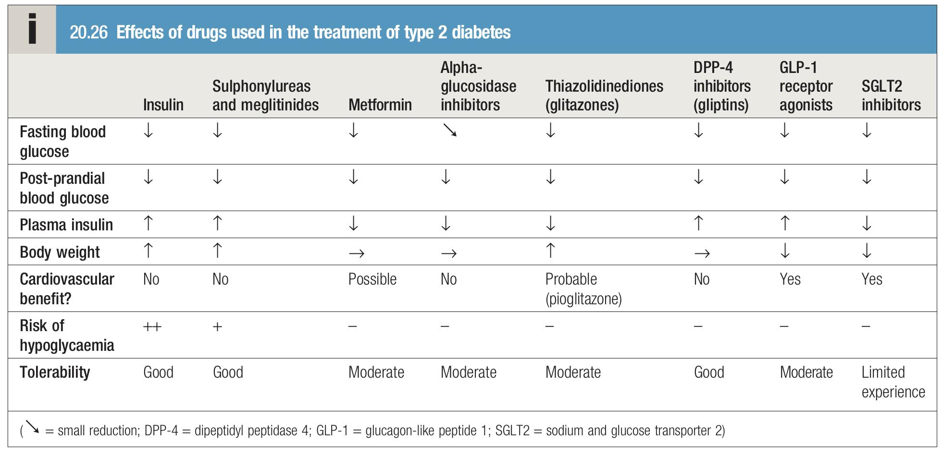
Management of T2DM
Oral Hypoglycemic drugs:
Sodium-glucose transporter 2 inhibitors ('flozins')
Dapaglilozin ,Empaglilozin, Canaglilozin
In addition to their effects on blood glucose, they lower body weight, improve renal dysfunction and reduce the risk of atherosclerotic cardiovascular events and heart failure.
MOA | Lower the renal threshold for glucose, consequently increasing urinary glucose excretion.lowering blood glucose by 7-13 mmol/mol (0.6-1.2%) and facilitating weight loss Exactly how SGLT2 inhibitors reduce the risk of myocardial infarction, stroke, cardiovascular death heart failure is uncertain.
Clinical use | can be used as monotherapy but are used more typically in combination with all other antidiabetes drugs. This class has become rapidly established in clinical practice and in type 2 diabetes guidelines because of their cardiovascular benefits, weight loss and low risk of hypoglycaemia. SGLT2 inhibitors are licensed as adjunctive therapy to insulin in type 1 diabetes.
Adverse effects | The most common adverse effects are genital candidiasis and dehydration. Rarer side effects include diabetic ketoacidosis, Fournier's gangrene and lower limb amputation.
Alpha-glucosidase inhibitors
Acarbose ,Miglitol ,Voglibose
MOA | Prevent a-glucosidase, the last enzyme involved in carbohydrate digestion, from breaking down disaccharides to monosaccharides. This slows the absorption of glucose after a meal and lowers post-prandial glucose.
Clinical use | Can be used as monotherapy or in combination with all other antidiabetes drugs, they are not widely used because of their limited efficacy and gastrointestinal side-effects.
Adverse effects | The major side-effects are gastrointestinal and include flatulence, abdominal distension and diarrhoea, as unabsorbed carbohydrate is fermented in the bowel.

Slide 20
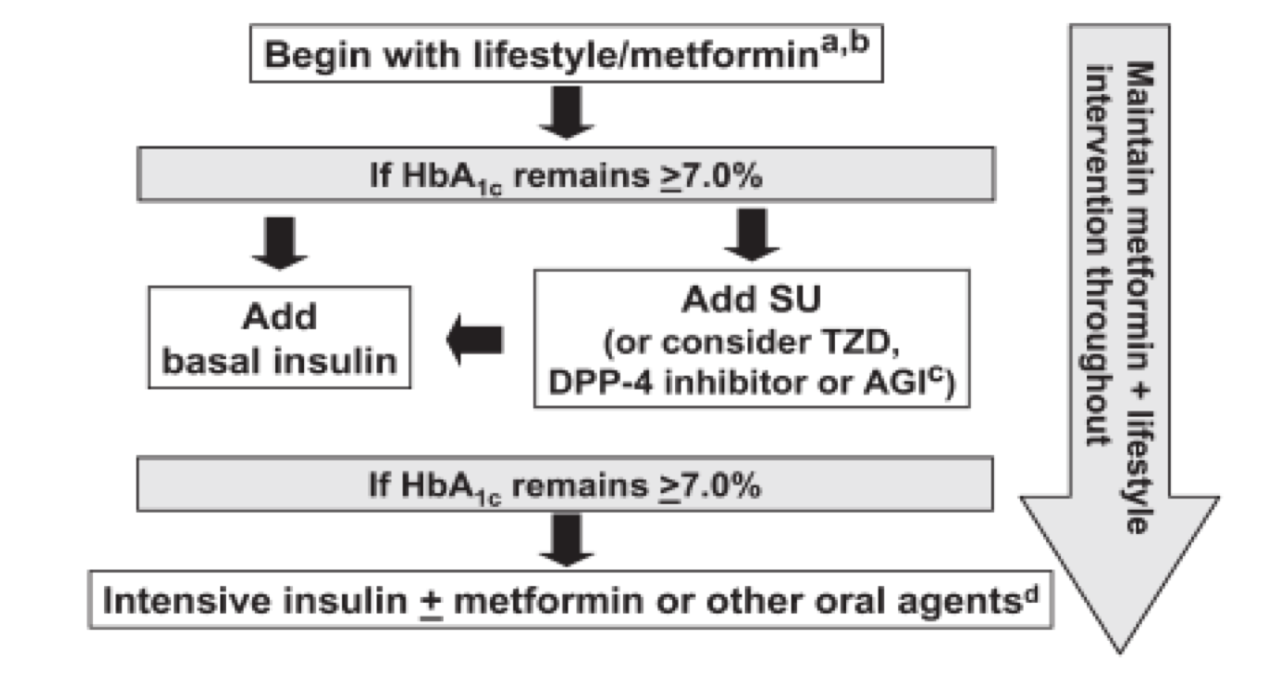
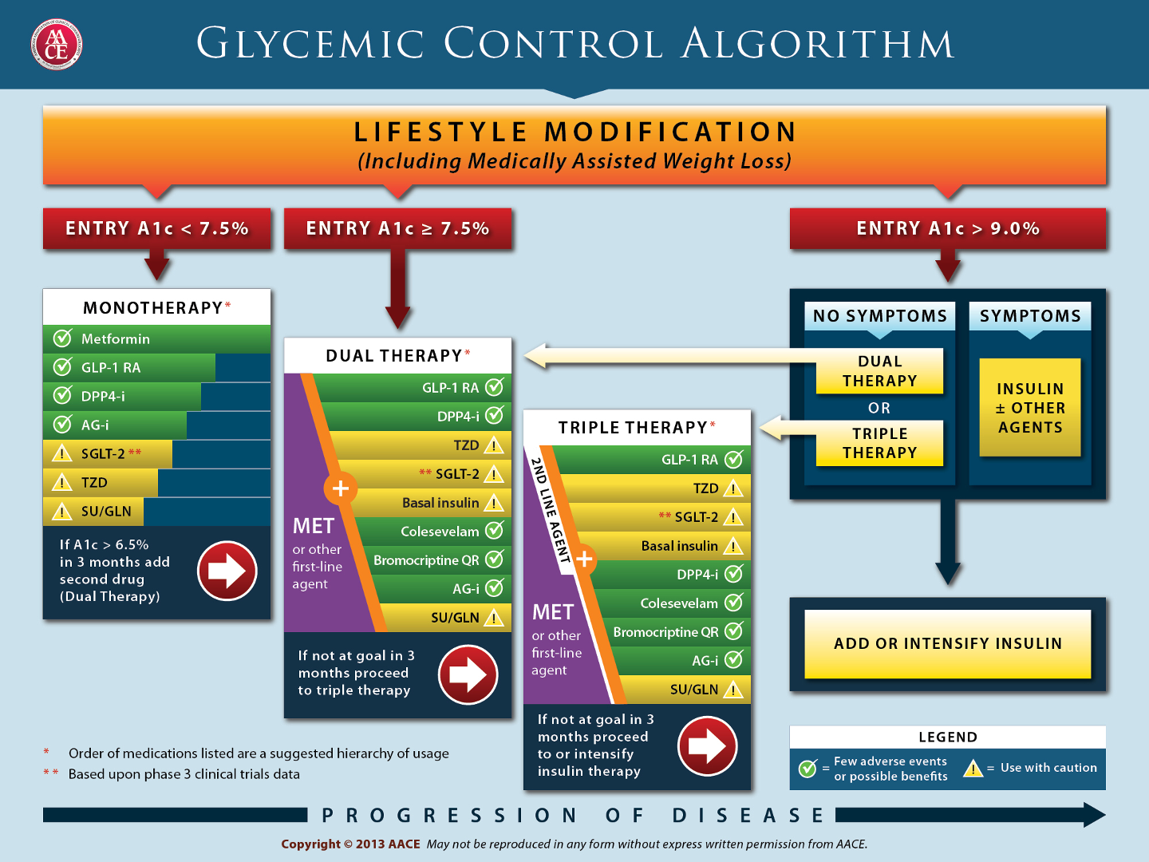
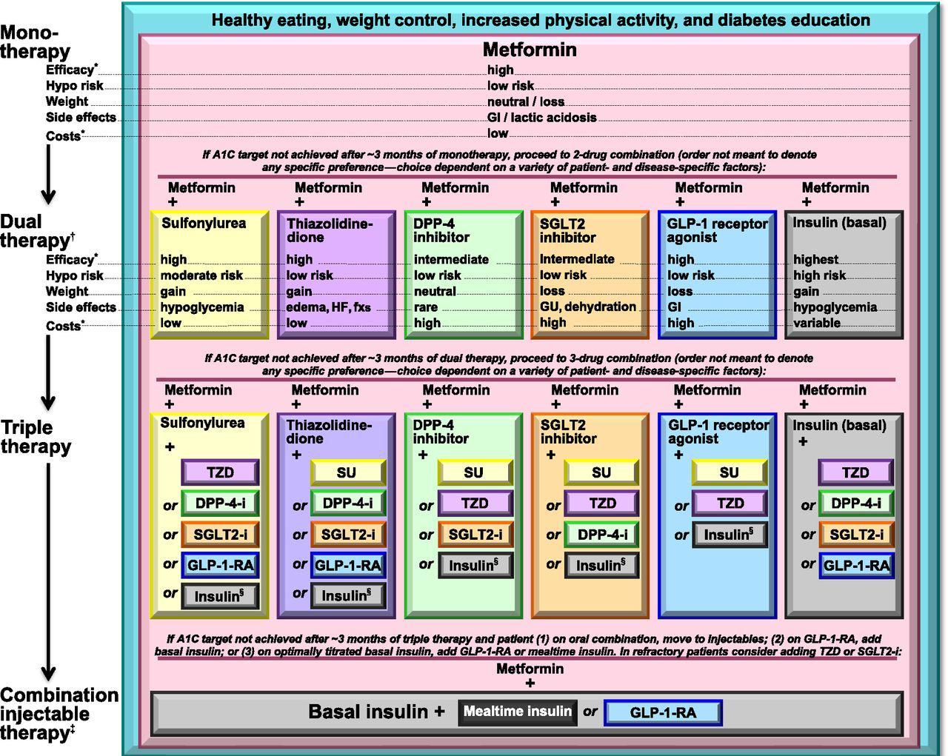
Management of T2DM
Oral Hypoglycemic drugs:
GLP-1 receptor agonist
GLP-1 receptors are a heterogeneous class of drugs that act by enhancing the incretin effect.
MOA | Unlike DPP-4 inhibitors that restore physiological GLP-1 levels, GLP-1 receptor agonists achieve pharmacological levels and are therefore more potent that DPP-4 inhibitors. In addition to their effects on the pancreas to increase insulin secretion and decrease glucagon, they also act on the hypothalamus to reduce appetite and food intake leading to weight loss. The size of effect has led to the licensing of liraglutide as an anti-obesity treatment.
Clinical use | Despite the need for injection, clinical guidelines endorse their use and GLP-1 receptor agonists are now widely used in combination with other antidiabetic agents, as second- or third-line therapies. They should not be combined with DPP-4 inhibitors as the DPP-4 inhibitor does not confer any additional benefit.
Adverse effects | The most common side-effects of GLP-1 receptor agonists are gastrointestinal and include nausea and vomiting, bloating and diarrhoea. There is a low risk of hypoglycaemia but this may occur if GLP-1 receptor agonists are combined with insulin or sulphonylureas. GLP-1 receptor agonists should not be used in people with a history of pancreatitis because of a risk of acute pancreatitis. It may also induce weight loss (approx. 3-6kg) but most pts will regain the weight once the medication is stopped
Exenatide:
Twice daily
2 doses: 5 mg- 10 mg
weight reduction
Liraglutide:
once daily
3 doses: 0.6, 1.2, 1.8 mg
HbA1c :0.8- 1.8
Lixisenatide
Dulaglutide
Semaglutide
Albiglutide
الربط مع الحياة: وحده من مشاهير السوشال ميديا أعلنت عنها وسببت ضجة كبيرة لدرجة أن هيئة الغذاء والدواء استدعوها, فكرة استخدامها للتنحيف انتشرت بالمجتمع مؤخراً
Recommend treatment Algorithm for Middle East
The choice of medication depends on a few things:
1- Socio-economic status: For example if the pt is a driver then you shouldn’t use SUs, insulin. Or if the pt is the one paying for the meds, you shouldn’t use expensive drugs. If the pt lives alone or blind then you shouldn’t give insulin
2- Presence of vascular complications: For example if you give insulin and they develop hypoglycemia → fall → break their leg, this is probably worse than DM itself.
3- Patient age
4- Disease duration
5- History of hypoglycemia
Note that in the triple therapy there are 10 drug groups, and in each group there are at least 4-5 drugs. if you were to choose 3meds from these groups, there will be 1440 possible combination (And it’s impossible to determine what fits the pt best).

Slide 21
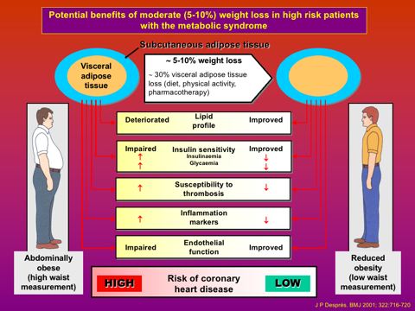
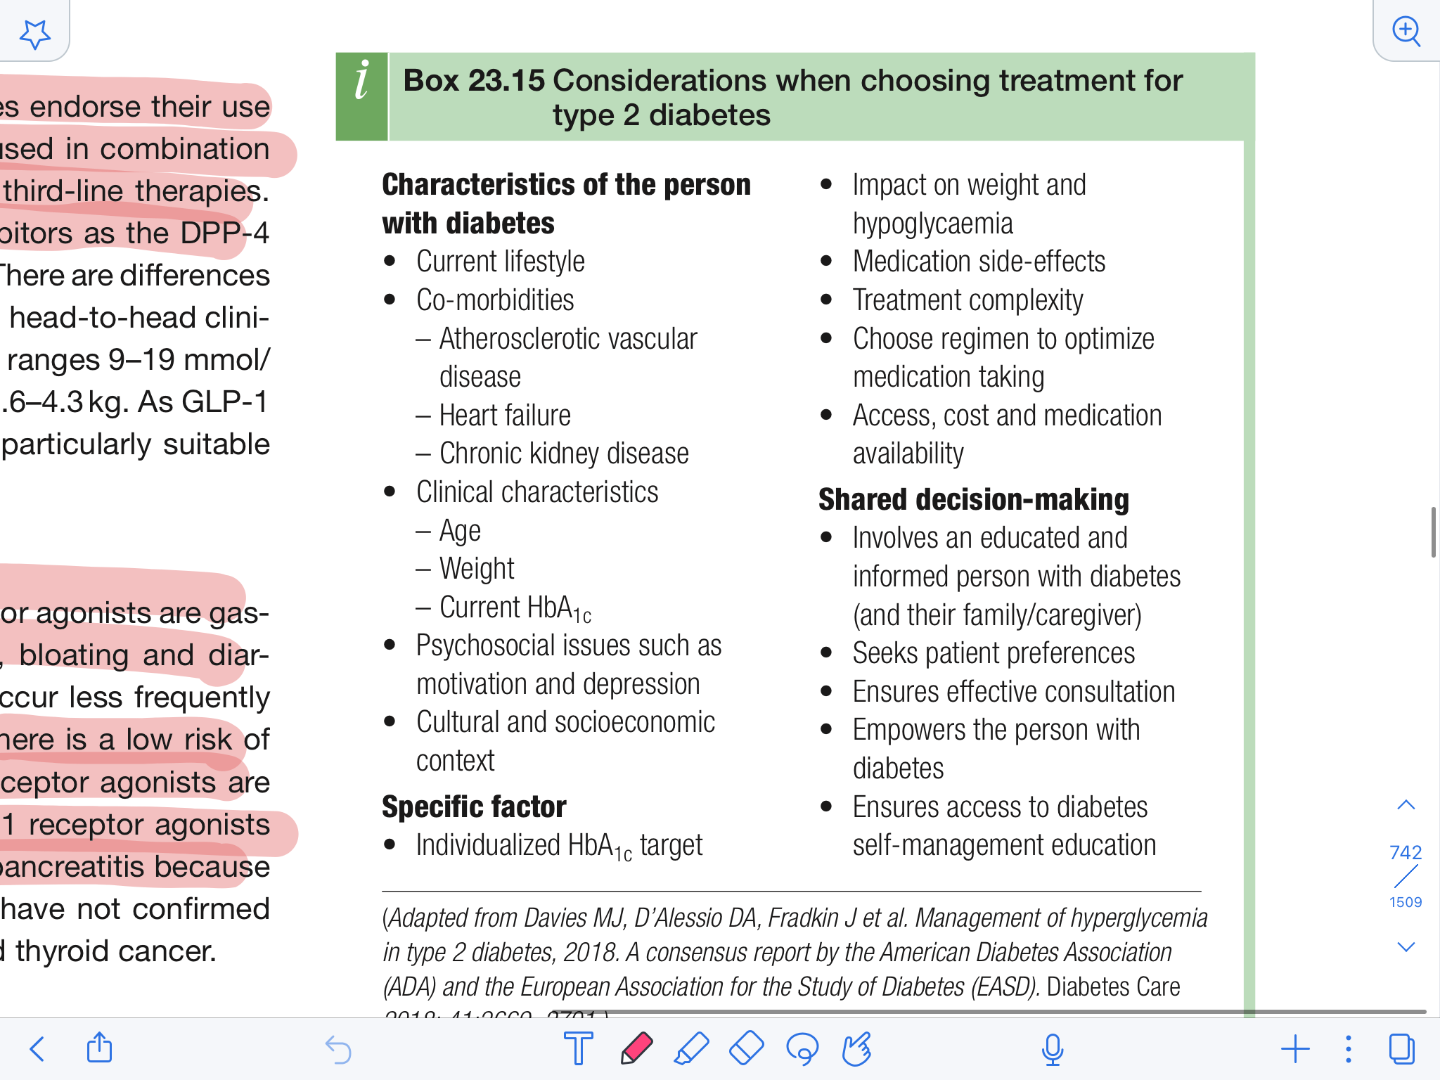
Management of T2DM
Complications of Bariatric Surgery:
Bariatric or metabolic surgery is a treatment option for people with severe obesity. The National Institute for Health and Care Excellence (NICE) recommends consideration of surgery in those with a (BMI) higher than 40 kg/m2 , or in those with a BMI of more than 35 kg/m 2 and co-morbidities, such as diabetes.
Not recommended, Why?:
Bc it’s SURGERY
In 5yrs most of the pts will regain all the weight they’ve lost.
It’s not effective in those who have been suffering from DM for a long time bc they probably already have extreme insulin deficiency
01
02
All procedures:
Atelectasis and pneumonia
Deep vein thrombosis
Pulmonary embolism
Wound infection
Gastrointestinal bleeding
Gallstones
Failure to lose weight
Intractable vomiting/kwashiorkor (B1)
Mortality (0.1%–2%)
Gastric banding procedure:
Band slippage
Band erosion
Esophageal dilatation
Band or port infections
Port disconnection
Port displacement
03
04
Gastric bypass:
Anastomotic leak with peritonitis
Stomal stenosis
Marginal ulcers
Staple line disruption
Nutrient deficiencies (iron, calcium,folic acid, vitamin B12)
Dumping syndrome
Small bowel obstruction:
Internal hernia - Adhesions
Biliopancreatic diversion:
Anastomotic leak with peritonitis
Protein-calorie malnutrition
Calcium, iron, folic acid, fat soluble vitamin (A,D,E,K) deficiencies
Dehydration
Steatorrhea
Small bowel obstruction:
Internal hernia - Adhesions
1
2
3
4

Slide 22
 | Type 1 DM | Type 2 DM
Pathogenesis | Autoimmune destruction of pancreatic Beta cells in genetically susceptible individuals and triggered by some environmental factors. Characterized by a severe deficiency of insulin. Not related to obesity | Characterized by resistance to the action of insulin and an inability to produce sufficient insulin to overcome this ‘insulin resistance’. Obesity play a major role
Risk factors | Factors that act as a trigger for the autoimmune response. E.g infection with mumps virus, coxsackie B virus Rotavirus or EBV. HLA- DR3-DQ2, HLA- DR4-DQ8 genes or both | obesity Sedentary lifestyle PCOS Metabolic syndrome Impaired glucose tolerance Impaired fasting glucose
Clinical presentation | polyuria Polydipsia Weight loss Blurred vision Fungal infections frequent urination Numbness, tingling of hands and feet
Diagnosis | fasting plasma glucose (FPG) (Specific) random glucose (Sensitive) 2-hour plasma glucose after a 75- g oral glucose tolerance test (OGTT) (Sensitive & Specific) The use of glycated haemoglobin (HbA1c) Glycosuria
Management | Bolus (preprandial or mealtime) insulins : rapid acting and short acting insulin Basal insulin : intermediate and long acting insulin Premixed insulin MDI = Multiple Daily Injections (3 – 6 injections / day) is the preferred regimen for adults | Diet and lifestyle changes The three main options are metformin, a sulfonylurea or a thiazolidinedione. If control is inadequate on oral therapy, insulin therapy should be started without undue delay

Slide 23
Q1: A 29-year-old man presents to his GP complaining of being constantly thirsty, tired and visiting the toilet more often than usual during the last 4 days. He has noticed his clothes have become more baggy and he now needs to tighten his belt. His parents both have diabetes requiring insulin therapy. A fasting plasma glucose result is most likely to be:
A. 9.0 mmol/L
B. 6.0 mmol/L
C. 16.3 mmol/L
D. 5.0 mmol/L
E. 3.0 mmol/L
Q2: A 41-year-old man has been recently diagnosed with type 2 diabetes and has been following a plan of lifestyle measures to improve his diet and increase his level of exercise. On returning to clinic, his BMI is 23, fasting plasma glucose 9.0 mmol/L, blood pressure 133/84 mmHg and HbA1c of 7.1 per cent. The most appropriate treatment option is:
A. Metformin
B. Sulphonylurea
C. Insulin
D. Exenatide
E. Further diet and exercise
Q3: Risk factors for T2DM include all of the following except :
A- Advanced age
B- obesity
C- Smoking
D- physical inactivity
Q4: Which of the following diabetic drugs acts by decreasing the amount of glucose produced by the liver ?
A- Sulfonylureas
B- Meglitinides
C- Biguanides
D- alpha glucosidase Inhibitor
Q5: A 47-year-old woman complains of weight loss. She has a family history of type 1 and type 2 diabetes but has never been diagnosed herself despite the finding of islet cell antibodies. In the last few months, however, she has noticed progressively increasing polyuria and polydipsia and 5 kg of weight loss. Her fasting plasma glucose is 8 mmol/L and urine dipstick shows the presence of ketones. The most likely diagnosis is:
A. Type 1 diabetes
B. Non-ketotic hyperosmolar state
C. Type 2 diabetes
D. Occult malignancy
E. Latent autoimmune diabetes of adults (LADA)
Q6 : Which of the following regimens offers the best blood glucose control for persons with type 1 diabetes?
A- A single anti-diabetes drugs
B- Once daily insulin injections
C- A combination of oral anti-diabetic medications
D- Three or four injections per day of different types of insulin.
Answers: Q1: A | Q2:B| Q3:C | Q4: C | Q5:E | Q6:D
Answers Explanation File!

Slide 24
THANKS!!
This lecture was done by:
Rahaf Alshabri
Razan Alzohaifi
Noura Alturki
Amirah Aldakhilallah
Quiz and summary maker:
Arwa Alemam
Note taker:
Njoud Alali
Mashal AbaAlkhail
Rema Almutawa
Females co-leaders:
Raghad AlKhashan
Amirah Aldakhilallah
Males co-leaders:
Mashal AbaAlkhail
Nawaf Albhijan
Send us your feedback:
We are all ears!

