Slide 1
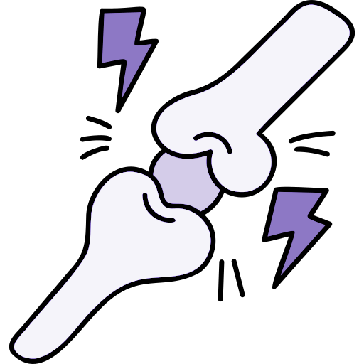
Lecture 31 31
Editing file
Rheumatoid Arthritis
Objectives:
Recognize which patient is likely to have RA
Know the different modes of presentation of RA
Develop a plan of investigation and management of RA
Color index:
Color index:
Original text Females slides Males slides
Doctor’s notes Text book Important Golden notes Extra

Slide 2
Rheumatoid arthritis is a chronic Systemic inflammatory disease mainly affects synovial joints and tendons. It can affect other systems in the body. Early recognition and treatment can prevent joint destruction and disability.
Variable expression (the severity and limitations caused by RA is variable)
RA has a worldwide distribution with a prevalence of 3 %. (Female:male ratio 3: 1)
Peak age of onset: 25-50 years but could occur at any age, even children ‘juvenile type’.
RA remains a significant cause of disability and mortality and carries a high socioeconomic cost.
Symmetrical polyarthritis ddx: RA, SLE and seronegative arthritis (We will take each in a separate lecture)
Overview
Osteoarthritis VS Rheumatoid arthritis (Extra)
We will take each disease in a separate lecture, this is just an overview to help you differentiate between them.
 | Osteoarthritis | Rheumatoid arthritis
Pathogenesis | Mechanical - wear and tear destroys articular cartilage (degenerative joint disorder) | Chronic, systemic autoimmune disease
Predisposing factors | Major risk factor is age (common after 60 years); additional risk factors include obesity and joint trauma. | Associated with HLA-DR4, classically arises in women of late childbearing age
Presentation | Pain that gets worse with movement and is relieved by rest Early morning stiffness (lasting LESS than 30min) Involves DIPJs (Heberden nodes), PIPJs (Bouchard nodes) and 1st CMC but NOT MCP Asymmetric joint involvement No systemic symptoms | Pain. Early morning stiffness (lasting MORE than 1hr) that gets better with movement Swelling in the small joints of the hands and feet. There’s spindling of the fingers caused by swelling of PIPJs and MCP but NOT DIPJs or 1st CMC Symmetric joint involvement Systemic symptoms e.g. fever, fatigue, weight loss Extraarticular manifestations are common*
Joint findings | Osteophytes (bone spurs) Joint space narrowing | Pannus (proliferative granulation tissue) Erosions, cervical subluxation, ulnar finger deviation, swan neck and boutonniere deformities
* Extraarticular manifestations include rheumatoid nodules (fibrinoid necrosis with palisading histiocytes) in subcutaneous tissue and lung (+ pneumoconiosis→ Caplan syndrome), interstitial lung disease, pleuritis, pericarditis, anemia of chronic disease, neutropenia + splenomegaly (Felty syndrome), AA amyloidosis, Sjögren syndrome, scleritis, carpal tunnel syndrome
Rheumatoid Arthritis (RA)
Introduction

Slide 3
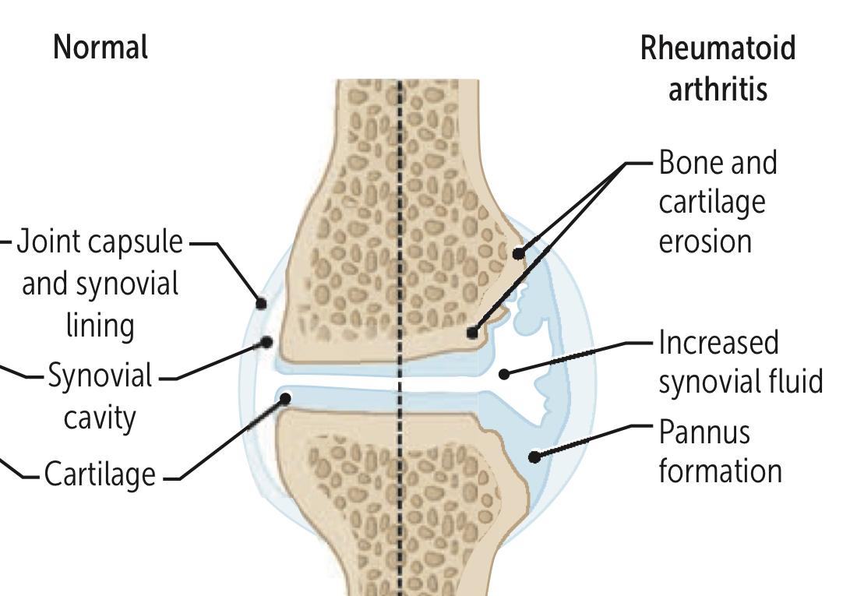
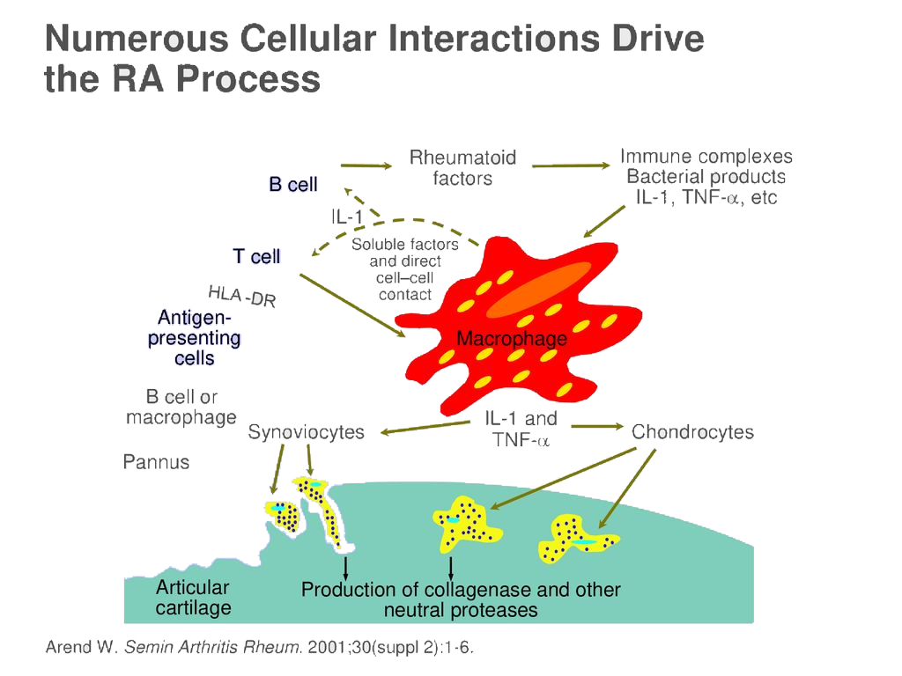
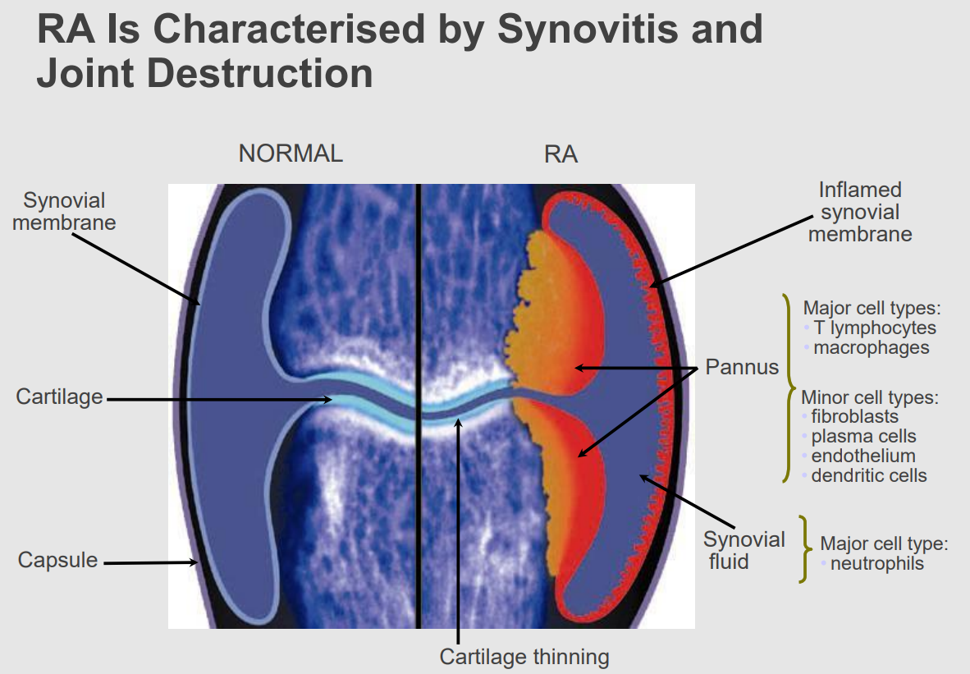
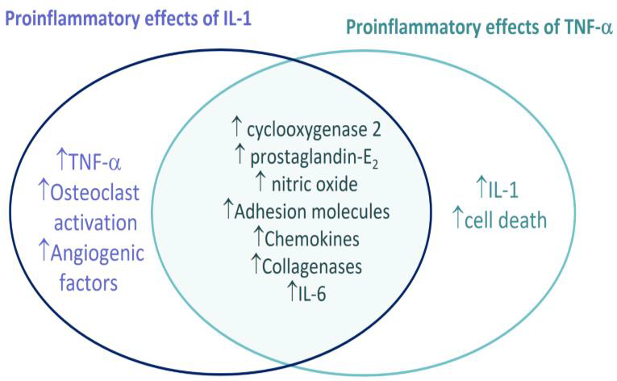
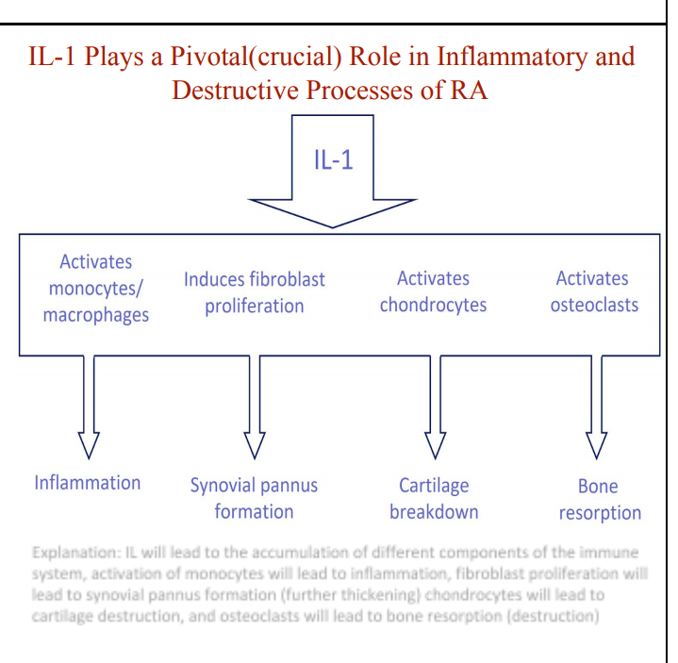
Rheumatoid Arthritis
Etiology
The exact etiology is unknown, but there are factors like genetics, environmental (smoking) & infectious components. These factors may cause modification and production of autoantigens (citrulline) by the process of citrullination, leading to the initiation of an autoimmune reaction
Autoimmune disorder, associated with IgM autoantibodies against Fc portion of IgG (rheumatoid factor)
Genetics: associated with HLA-DR4¹ and HLA-DRB1
Environmental such as smoking²
Possible infectious component, most likely viral
Pathogenesis
The pathology of RA:
Synovitis (Joints, Tendon sheaths, Bursae)
Vasculitis: widespread cutaneous vasculitis with necrosis of the skin (seen in people with very active, strongly seropositive disease)
Subcutaneous Nodules
Synovitis with thickening of the synovial lining
Infiltration by inflammatory cells
Synovium proliferates and grows out over the surface of cartilage
a tumour-like mass called ‘pannus’ is produced
Pannus destroys the articular cartilage and subchondral bone
producing bony erosions & joint destruction
The interaction between Antigen presenting Cells and HLA-DR4 will activate T cells & B cells. This will lead to the production of Autoantibodies (RF & Anti-CCP) as well as the activation of macrophages leading to the production of inflammatory cytokines (TNF-α, IL-1,6,17). This will lead to the activation of the Chondrocytes and Synoviocytes to produce collagenases and other proteases which will cause bone & cartilage destruction.
IL-1 and TNF-a Have a Number of Overlapping Proinflammatory Effects:
Major cell type in the pannus:
T lymphocytes & macrophages
Major cell type in the synovial fluid: Neutrophils
1-Having HLA-DR4 increases the susceptibility for the development of RA and is associated with a poor prognosis.
2- Environmental stress, such as smoking, is thought to promote post-translational modifications.

Slide 4
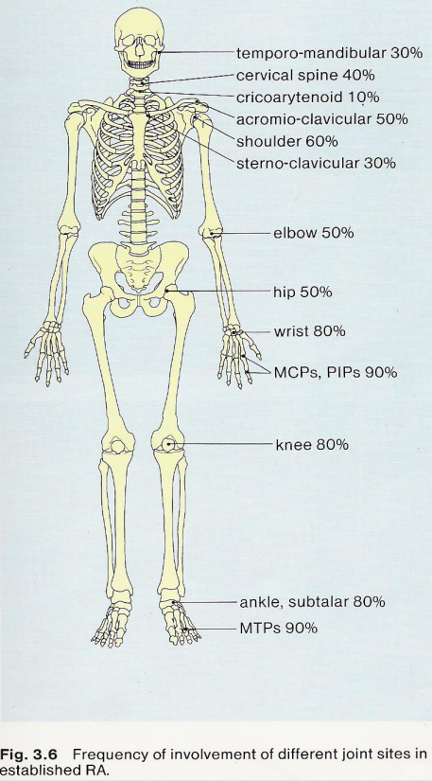
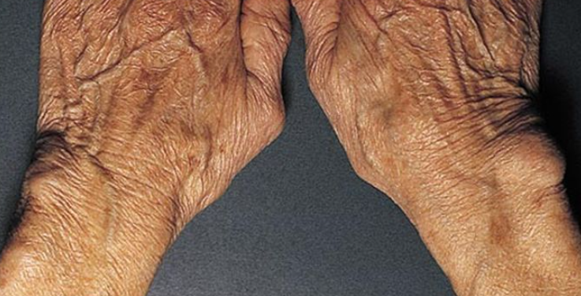
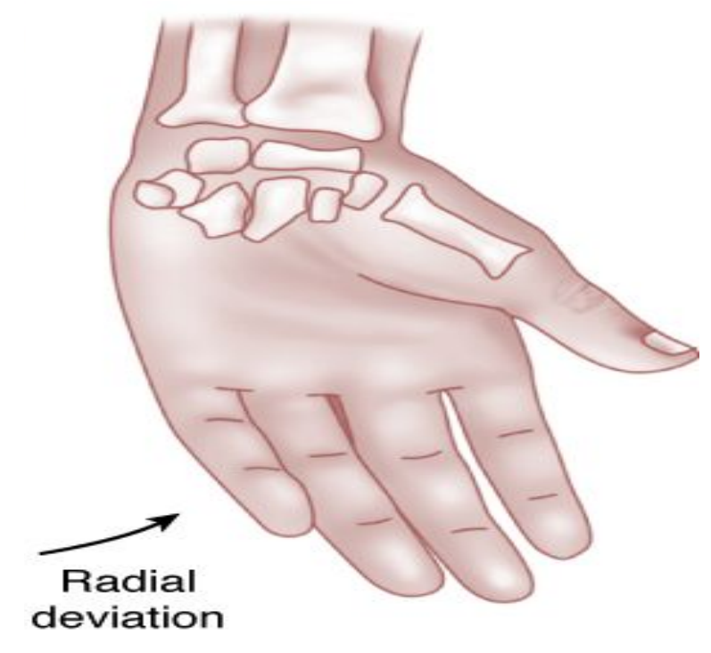
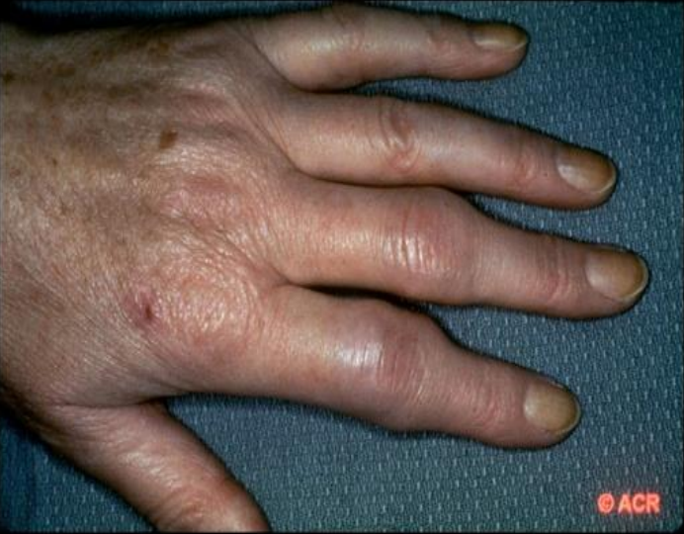
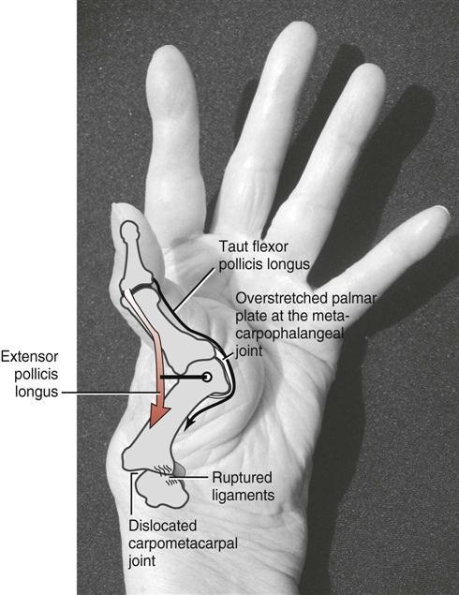
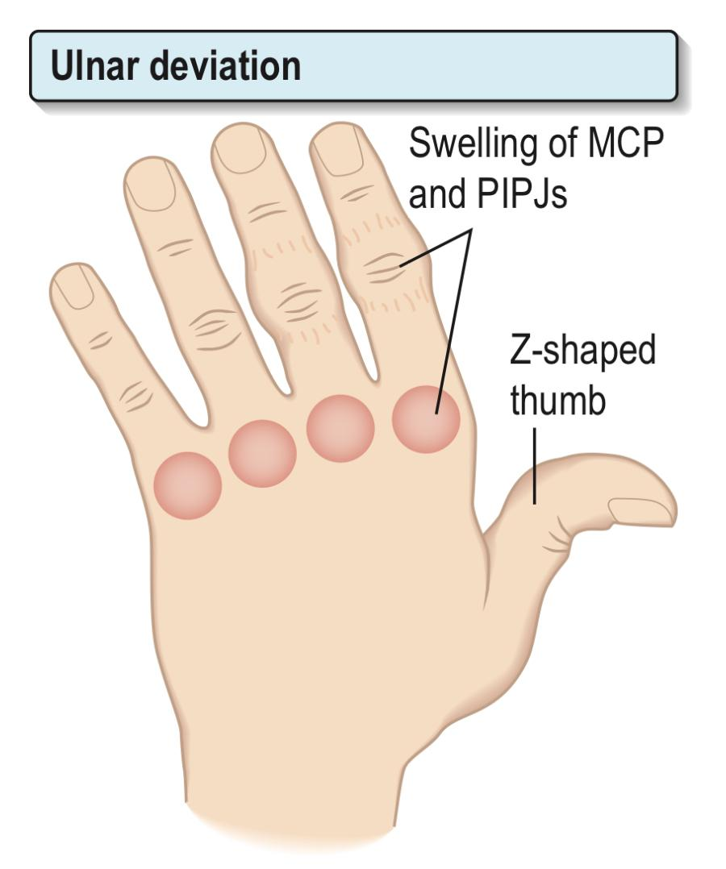
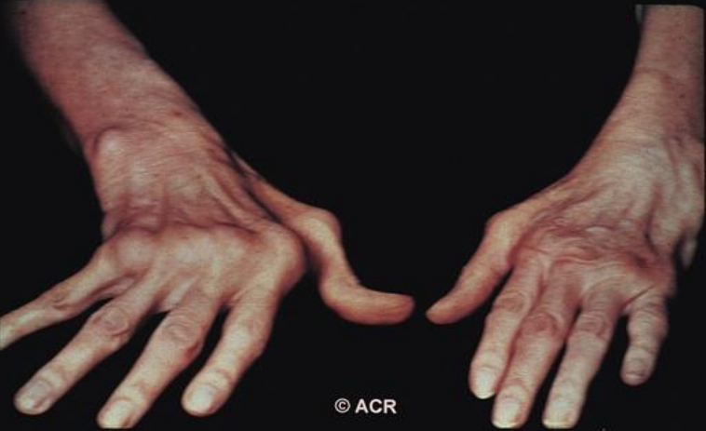
Articular features
Joint inflammation:
Warm swollen and tender joints usually in a symmetrical pattern
Early morning stiffness (lasting more than 1hr) that improves with activity
Swelling in the small joints of the hands and feet.
There’s spindling of the fingers caused by swelling of PIPJs and MCP but NOT DIPJs or 1st CMC
RA does not only affect the hands, once you suspect RA you should examine all the joints such as the temporomandibular joint, sternoclavicular joint, etc..
Baker cysts (synovial cysts in the popliteal fossa) may be present
Joint Involvement On Presentation Of RA:
75% of cases presented with Polyarticular:
60% of them have only small joints of hand & feet involvement
30% have only large joints involvement,
10% have BOTH small & large joint involvement.
25% of cases presented with monoarticular:
50% of them have Knee involvement only.
50% have: shoulder, wrist, hip, ankle, or elbow involvement.
If a patient presents with sudden monoarthritis, ALWAYS consider septic arthritis or infection like TB (in case of chronic), these must be excluded before the symptoms are attributed to a disease flare-up.
Wrist
Synovitis
Radial deviation
Subluxation and collapse of carpus²
Prominent ulnar styloid²
Proximal Interphalangeal Joints
Boutonniere/buttonhole deformity: Fixed flexion³, flexion of PIPJ and extenison of DIPJ.
Synovitis
Swan neck: Fixed extension³, hyperextension of PIPJ and flexion of DIPJ
Prominent ulnar styloid
Synovitis¹
Thumbs
Synovitis
“Z” deformity
Metacarpophalangeal Joints
Synovitis
Ulnar deviation⁴
Subluxation
Z deformity
Important: So, radial deviation at the wrist and ulnar deviation at the MCPJ
Ulnar deviation at MCPJ
Muscle wasting
Radial deviation at wrist
This appearance is called spindling of the digits (swelling of PIPJ). In case an entire finger or toe is swollen, with joint and tendon sheath involvement (Sausage digits/Dactylitis) you must consider psoriatic arthritis (seronegative arthritis) in your differential.
Swelling and dorsal subluxation of the ulnar styloid, which causes wrist pain and may cause rupture of the finger extensor tendons, leading in turn to a sudden onset of finger drop of the little and ring fingers predominantly; this needs urgent surgical repair.
These deformities cause impairment of hand function.
This change leads to unsightly deformity, but function may be preserved once the patient has learned to adapt and pain is controlled.

Slide 5
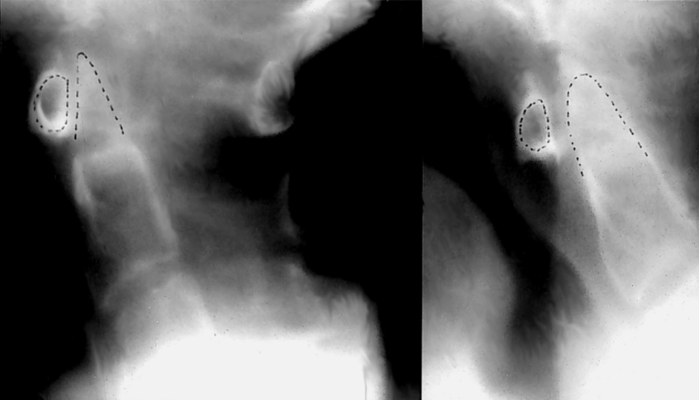
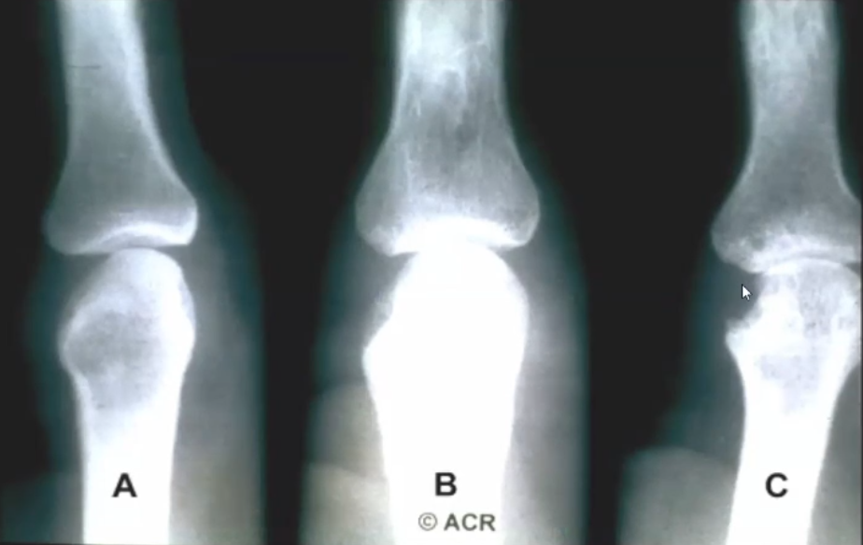
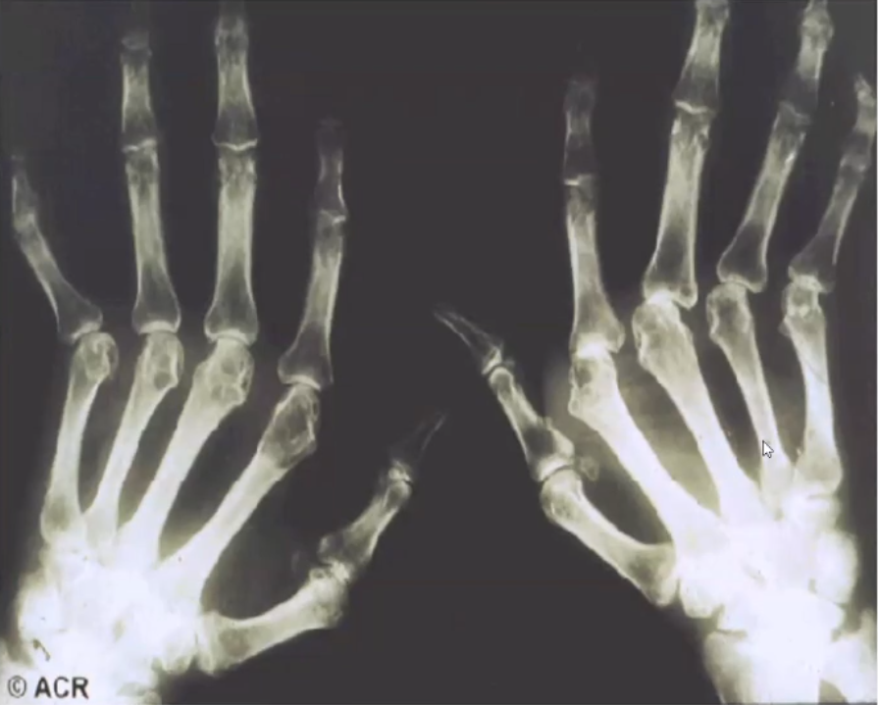
Articular features
Joint involvement & Destruction:
Cervical spine
Painful stiffness of the neck in RA is often muscular, but it may be due to rheumatoid synovitis
This synovitis leads to bone destruction, damages the ligaments and causes atlantoaxial or upper cervical vertebral instability. Particularly at C1 and C2, which can lead to subaxial subluxation
In late RA, difficulty walking that cannot be explained by articular disease, weakness of the legs or loss of control of bowel or bladder may be due to spinal cord compression and is a neurosurgical emergency.
MRI is the imaging of choice, but lateral flexed and extended neck X-rays can demonstrate instability.
X-RAY Imaging of the cervical spine in flexion and extension is recommended in patients with RA before surgery or upper GI endoscopy to check for instability (Cervical subluxation) and reduce the risk of cord injury during intubation.
A: X-ray in early disease, we can see the articular surface is intact
B: As the diseases progress, we can see some destruction.
C: The hypertrophied synovium (Pannus) will invade the bone & cartilage showing Erosion on x-ray
Subluxation (partial dislocation) & periarticular osteoporosis or osteopenia
Small erosive changes
Different presentations of RA: (Obj.)
Palindromic | Palindromic monoarticular attacks last 24-48 h; 50% progress to other types of RA.
Transient | Disease is self-limiting, lasting <12 months and leaving no permanent joint damage. It is usually seronegative for lgM RF and ACPA. Some of these patients may have undetected postviral arthritis.
Remitting | There is a period of several years during which the arthritis is active but then remits, leaving minimal damage.
Chronic, persistent | This is the most typical form; it may be seropositive or seronegative for lgM RF. The disease follows a relapsing and remitting course over many years. Seropositive (plus ACPA) patients tend to develop greater joint damage and long-term disability. They warrant earlier and more aggressive treatment with disease-modifying agents.
Rapidly progressive | The disease progresses remorselessly over a few years and leads rapidly to severe joint damage and disability. It is usually seropositive (plus ACPA), has a high incidence of systemic complications and is difficult to treat.

Slide 6
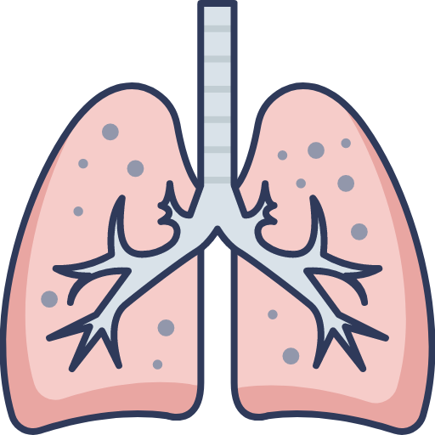
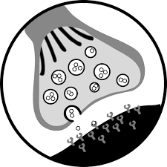
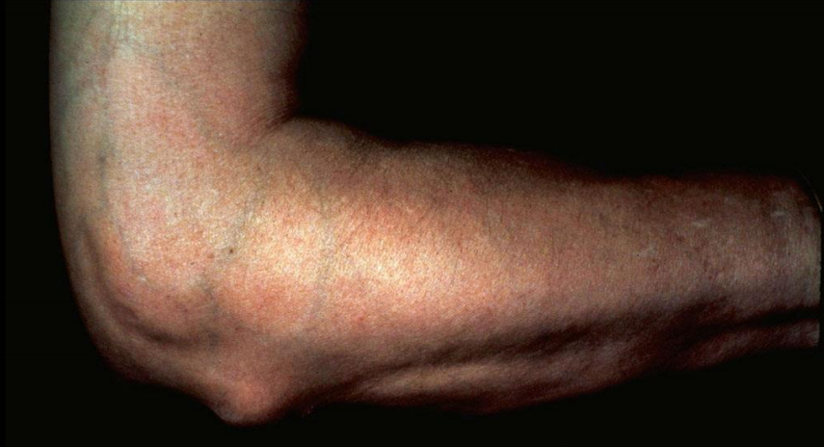
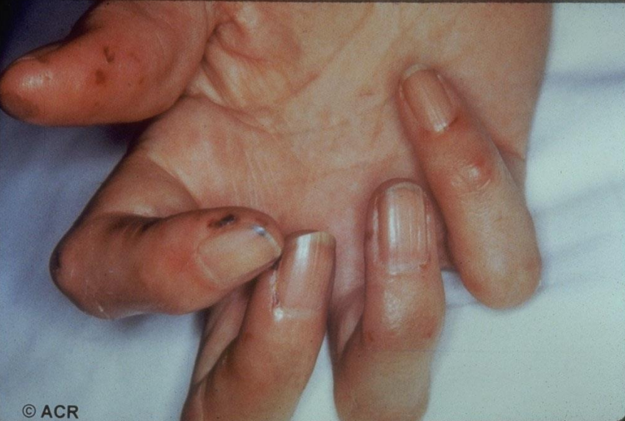
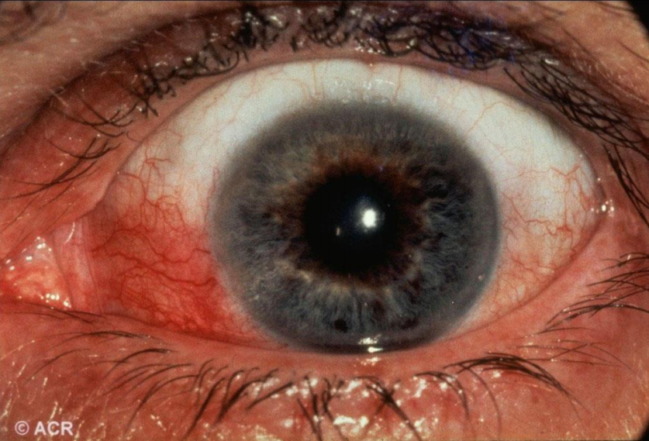
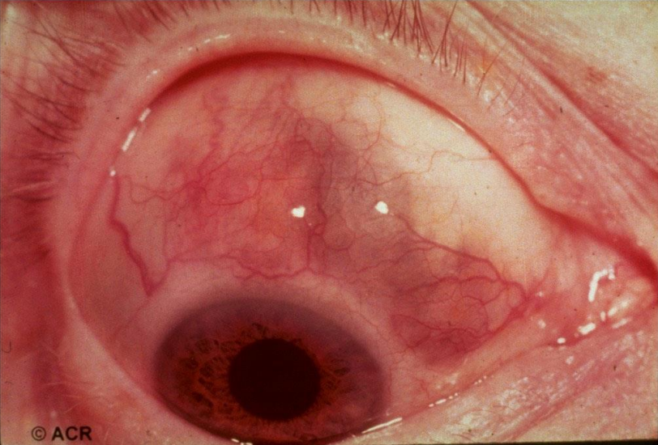
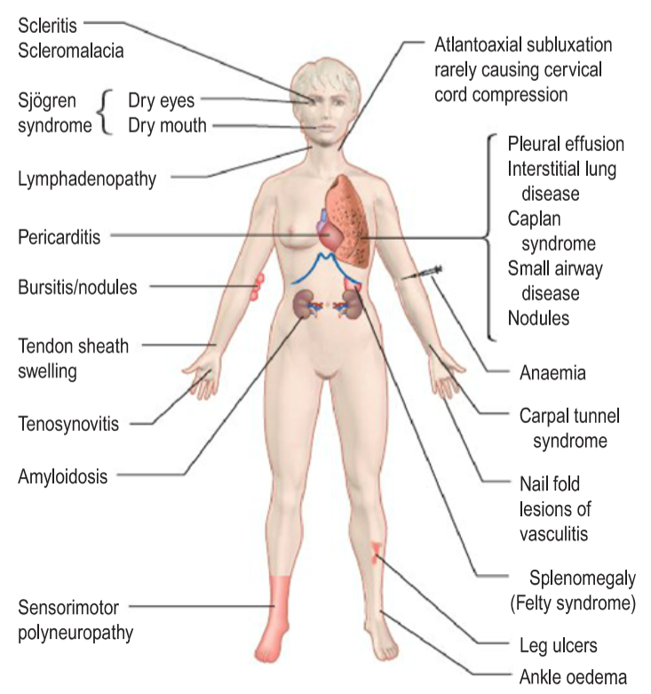
Extra-Articular features
Hematological
Felty’s syndrome: A triad of Rheumatoid Arthritis + Neutropenia + Splenomegaly
Associated with increased risk of developing non-Hodgkin lymphoma
Treatment: DMARD (Methotrexate)
Anaemia of chronic disease is almost universal and is usually normochromic and normocytic. It may be iron deficient owing to gastrointestinal blood loss from NSAID ingestion, or rarely haemolytic (Coombs positive).
There may be a pancytopenia due to hypersplenism in Felty’s syndrome or as a complication of DMARD treatment.
A high platelet count indicate an active disease. it just indicate active inflammation, not specific to Rheumatoid arthritis
Large granular lymphocyte syndrome, Lymphomas (RA patients are at high risk)
Cardiac & Pulmonary
Ocular (rare)
Cardiac¹: Pericarditis, myocarditis,
coronary vasculitis², nodules on valves or the conducting system of the heart.
Pulmonary:
Pleuritis, interstitial lung disease³, bronchiolitis obliterans, arteritis, effusions.
Peripheral, intrapulmonary nodules: asymptomatic but may cavitate, especially with pneumoconiosis (Caplan’s syndrome⁴)
Sjogren’s syndrome (Sicca syndrome): Dry eyes, Dry mouth
Episcleritis/scleritis⁵
Scleromalacia perforans (Thinning and perforation of the eye)
Choroid and retinal nodules
Peripheral ulcerative keratitis
Neuromuscular
Entrapment neuropathy
Median nerve compression is the most common and bilateral carpal tunnel syndrome can occur as a presenting feature of RA
Peripheral neuropathy
Mononeuritis multiplex: Involvement of the nerve trunk In case of rheumatoid vasculitis
Subcutaneous nodules
Small vessel vasculitis
Episcleritis
Scleritis, Episcleritis, with Scleromalacia
Others
Dermatological: Palmar erythema, Subcutaneous rheumatoid nodules over extensor surfaces (pressure areas), vasculitis
Occasional fever, weight loss, fatigue, malaise
Lymphadenopathy
Poorly controlled RA with a persistently raised CRP and high cholesterol is a cardiovascular risk factor (for IHD and CAD), independent of traditional risk factors (i.e. high cholesterol and hypertension). it is like diabetes and hypertension.
The most common cause of death in RA is coronary artery disease.
There is some evidence that the risk of pulmonary fibrosis is increased by anti-TNF therapy
Caplan syndrome: Rheumatoid Arthritis + Pneumoconiosis + Lung nodules
The eye involvement in rheumatoid is usually Episcleritis/scleritis. While in seronegative arthritis usually uveitis.

Slide 7
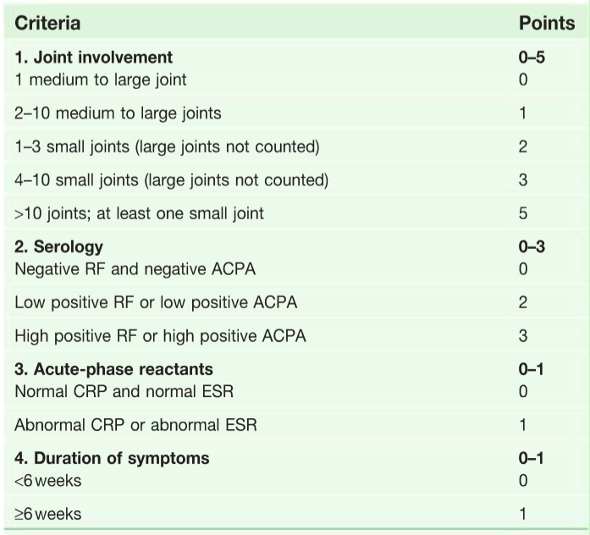
Investigations & Classification
Investigations
Hematological
CBC: Anemia of chronic disease (Normochromic normocytic anemia), thrombocytosis. You may see leukopenia if the patient is on methotrexate or iron deficiency anemia if the pt is using NSAIDs
ESR and CRP: Usually high in active disease, useful in monitoring treatment
Biochemistry
Liver function test (LFT)
Renal profile: Because the medications can cause side effects, so you should have a baseline before you start.
Aspiration of the joint may be needed if an effusion is present. The aspirate looks cloudy owing to white cells. In a suddenly painful joint, septic arthritis should be suspected.
Radiological (X-ray)¹
Joints: Do x-ray to look for any subluxations, Swelling in early disease and later joint narrowing and erosions.
Spines: Cervical spine x-ray
Chest: For lung involvement or effusion
Serology
Rheumatoid factor (RF): IgM²
Anti-citrullinated peptide antibodies (ACPA/Anti-CCP)³
Anti-CCP is more specific but still not diagnostic for RA.
High titer of RF or Anti-CCP is associated with more susceptibility to extra-articular manifestations (like lung involvement or vasculitis)
The 2010 ACR/EULAR classification criteria for rheumatoid arthritis:
In the old criteria (1987) a score of 4/7 is diagnostic, however this classification has been disregarded now. why? because it contains erosions as a criterion, but you should NEVER wait for erosion to happen, but rather try to prevent it at all costs by medications
Target population Patients (who should be tested?):
Who have at least 1 joint with definite clinical synovitis (Swelling) Not explained by other disease..
With the synovitis not better explained by another disease.
The cut-off point for RA is at ≥6 points. Patients can also be classified as having RA if they have both typical erosions and longstanding disease previously satisfying the classification criteria.
2010 criteria:
At least 1 result is needed for classification
In severe disease, extensive imaging of joints may be required. MRI is the technique of choice, especially for the knee and cervical spine
lgM RF is not diagnostic of RA and its absence does not rule the disease out; however, it is a useful predictor of prognosis. A persistently high titre in early disease implies more persistently active synovitis, more joint damage and greater disability eventually, and justifies earlier use of DMARDs. The term 'seronegative RA' is used when the standard tests for lgM RF are persistently negative. These patients tend to have a more limited pattern of synovitis.
ACPAs are usually present with RF in RA. They are better predictors of a transition from early transient inflammatory arthritis to persistent synovitis and early RA.

Slide 8
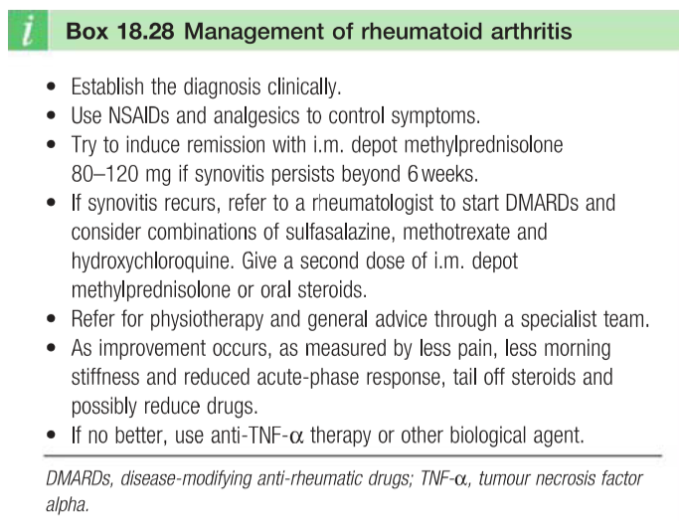
Complications and Management
Complications
Septic arthritis
(Monoarticular)
Amyloidosis
RA is the most common cause of secondary AA amyloidosis.
AL amyloidosis causes a polyarthritis that resembles RA in distribution and is also often associated with carpal tunnel syndrome and subcutaneous nodules.
Amyloidosis causing proteinuria, nephrotic syndrome and chronic kidney disease.
So, if a rheumatoid patient presented with proteinuria, edema, etc. consider amyloidosis.
In immunosuppressed patients, the affected joints may not display the typical signs of inflammation with accompanying fever found in patients with an intact immune system
It has significant morbidity and mortality (medical emergency).
Risk factors: Prosthetic joints, pre-existing joint disease
Treatment is with systemic antibiotics¹ and drainage
The most common organism is S. aureus
MSSA: Flucloxacillin + drainage
MRSA: Vancomycin + drainage
Factors predicting poor prognosis
Older age Female sex Symmetrical small joint involvement Morning stiffness >30 min >4 swollen joints Normochromic normocytic anaemia | Cigarette smoking Comorbidity C-reactive protein >20 g/dl Positive rheumatoid factor (RF) and anti-citrullinated peptide antibodies (ACPA) Early erosive damage (On x-ray, US, MRI)
Treatment
Treatment Goals:
02
Treatment approaches:
01
Relieve pain.
Reduce inflammation.
Prevent/slow joint damage.
Improve functioning and quality of life.
Lifestyle modification: such as weight reduction and smoking cessation
Rest: JUST During active phase. not prolonged rest as it is may lead to stiffness and muscle wasting.
Physical and occupational therapy
Medications & surgery (repair or replacement).
03
Rationale for the Early Treatment of RA:
03
Erosions develop early in the disease course
Destruction is irreversible.
Disease activity is strongly associated with joint destruction later in the disease course.
Early treatment can slow down or prevent radiographic progress
Disease activity must be suppressed maximally in its early stages to prevent destruction and preserve function.
Suspected Gram +ve? 1st line is vancomycin, with clindamycin or cephalosporin second line. Suspected Gram- negative? 1st line is 3rd Gen. cephalosporin with IV ciprofloxacin second line. In confirmed (MSSA) primary options include flucloxacillin alone or combined with fusidic acid or gentamicin, while penicillin-allergic patients should receive clindamycin or a 3rd Gen. cephalosporin. In cases of (MRSA), vancomycin is the drug of choice. Antibiotics should be altered according to sensitivities. Drainage of the joint and/or arthroscopic joint washouts are required in all cases.

Slide 9
Management
NSAIDs
Drug name | Aspirin Ibuprofen - Ketoprofen - Naproxen |  | Celecoxib - Etoricoxib Selective COX-2 Inhibitors (less GI side effects)
Uses | 1st line to relieve pain and inflammation. NO ROLE in preventing the progression Use in combination with a DMARD
Side effect | If GI side-effects are prominent, or the patient is over 65, add a PPI
Corticosteroids
General info | Low dose use if NSAIDs do not provide adequate pain relief or during flares Short-term treatment may be appropriate but avoid long-term use. Used as a bridge when waiting for DMARDs to take effect; DMARDs are much slower in onset of action than steroids. Sometimes if 1 or 2 joints are active, we may give local injections, provided that we excluded septic arthritis. Corticosteroids are the most common cause of secondary osteoporosis, Therefore, concomitant vitamin D and bisphosphonates are necessary to reduce fracture risk in patients expected to be on corticosteroid therapy for more than 3 months' duration.
Disease-Modifying Antirheumatic Drugs (DMARDs)
Drug name | Methotrexate
General info | Methotrexate is the 1st line & Gold standard DMARD MUST be part of the initial therapy with NSAIDS Monitoring requirement (CBC, LFTs) bc it causes liver toxicity and bone marrow suppression MOA: Inhibits DNA synthesis and cell division.
Uses | Should be initiated early (at the time of diagnosis) to control symptoms. No immediate analgesic effects. So, begin treating With NSAID while waiting for DMARDs to take effect (~6 weeks).¹ Once the effect is evident, gradually taper and discontinue NSAIDs and continue DMARDs. Can delay progression of the disease (prevent/slow joint and cartilage damage and destruction) Should not be used in pregnancy and conception should be delayed until women have been off the drug for 3-4 months (in kumar it’s 6 weeks)
Alternatives to Methotrexate | Hydroxychloroquine It requires eye examinations every 6 months because of the risk of visual loss due to retinopathy. Used in mild non-erosive disease. Sulfasalazine: used as first line in young females of reproductive age, requires blood monitoring is because of the risk of leukopenia, thrombocytopenia and bone marrow toxicity. (CBC, LFTs) Both hydroxychloroquine and sulfasalazine are safe in pregnancy. Leflunomide, Azathioprine (especially if there are severe extra-articular manifestations, like lung involvement or vasculitis. You may also use other drugs like cyclophosphamide) For both (Leflunomide & Azathioprine) monitor CBC, LFTs.
Click here for a summary of all DMARDs
In early RA, the combination of at least one swollen joint for more than 6weeks with no prior injury, no associated history or family history of spondyloarthritis or associated conditions such as psoriasis, and a positive ACPA test is the best way to select patients for earlier treatment to avoid joint damage.

Slide 10
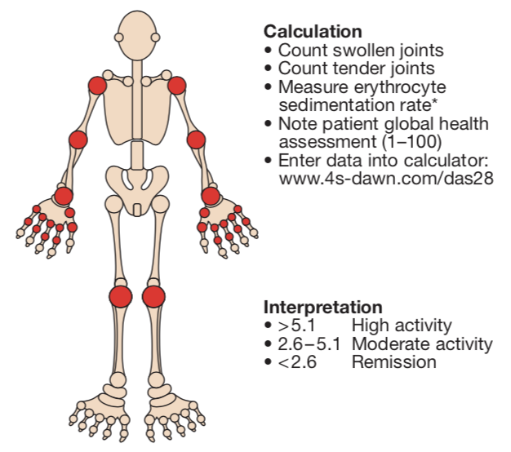
Management cont.
If not improving, use: Biologic Response Modifiers
General info | Before using any drug (especially anti-TNF) we have to exclude infections like latent TB by screening with a purified protein derivative (PPD = Mantoux test)
Drugs | - TNF Inhibitors: Etanercept, infliximab, Adalimumab. first line as DMARDs for those not responding to methotrexate or intolerant of methotrexate. They are often used initially in combination with methotrexate to prevent disease progression. Contraindicated in CHF. TNF inhibitors are safe in pregnancy. - IL-6 receptor inhibitor : Tocilizumab. - T-Cell costimulation modulator: Abatacept. - Anti-CD20: Rituximab
Others
Physiotherapy | Effective in maintaining the range of motion. Strengthening of muscles, Prevent contractures, Prevent deformities. Maintain activities of daily living.
Occupational therapy | Education of patients in the use of daily living activities Prevention of joint contractures and deformities.
Surgery | Surgery has a useful role in the long-term approach to patient management but is less frequently needed as therapeutic disease control becomes more effective. Its main objectives are prophylactic, to prevent joint destruction and deformity, and reconstructive, to restore function.
Calculation of the Disease Activity Score 28 (DAS28)
DAS28 is widely used to assess disease activity, response to treatment and need for biological therapy.
It involves counting the number of swollen and tender joints in the upper limbs and knees, and combining this with the ESR and the patient’s assessment of the activity of their arthritis on a visual analogue scale, where 0 indicates no symptoms and 100 the worst symptoms possible.
This data are entered into a calculator to generate a numerical score. The higher the value, the more active the disease

Slide 11
Rheumatoid Arthritis
Etiology | Unknown could be : 1. Genetic 2. infectious 3. environmental 4.Autoimmune
Features | Articular features: Wrist (Radial deviation) Metacarpophalangeal Joints (Ulnar deviation) Thumbs (“Z” deformity) Proximal Interphalangeal Joints (Swan neck, boutonniere deformity)) Cervical spine (Do X-ray imaging before any procedure) Extra-articular features: Felty’s syndrome (RA + Neutropenia + Splenomegaly) Cardiac: RA is a cardiovascular risk factor Pulmonary: Interstitial Lung Disease Neuromuscular: Carpal Tunnel syndrome Dermatological: Subcutaneous nodules mostly in the pressure areas
Investigations | Anti-CCP is more specific than RF
Treatment | NSAIDs 1st line to relieve pain and inflammation. NO ROLE in preventing the progression Corticosteroids During flares or if NSAIDs do not provide adequate pain relief Methotrexate Best initial and Gold standard in managing RA. it Inhibits DNA synthesis and cell division. initiated early (at the time of diagnosis) to control symptoms. No immediate analgesic effects (~6wks) Can delay progression of the disease Anti-TNF For those not responding to methotrexate or intolerant of methotrexate. Before using any drug we have to exclude infections like latent TB by screening with a PPD
Factors predicting poor prognosis | Older age Female sex Symmetrical small joint involvement Morning stiffness >30 min >4 swollen joints Normochromic normocytic anaemia | Cigarette smoking Comorbidity C-reactive protein >20 g/dl Positive rheumatoid factor (RF) and anti-citrullinated peptide antibodies (ACPA) Early erosive damage (On x-ray, US, MRI)

Slide 12
Q1: A 45-year-old woman presents to the rheumatology outpatient clinic with a three month history of stiff hands and wrists. She mentions that the pain is particularly bad first thing in the morning. On examination, the wrists, metacarpophalangeal joints and proximal interphalangeal joints are swollen and warm. A diagnosis of rheumatoid arthritis is suspected. Which of the following investigations is most specific for confirming the diagnosis?
A- X-rays
B- Rheumatoid factor levels
C- Anti-citrullinated peptide antibody (anti-CCP) levels
D- C-reactive protein
E- Erythrocyte sedimentation rate
Q2: A 40-year-old woman presents to the rheumatology outpatient clinic with a three month history of stiff hands and wrists. She mentions that the pain is particularly bad first thing in the morning. On examination, the wrists, metacarpophalangeal joints and proximal interphalangeal joints are swollen and warm. A diagnosis of rheumatoid arthritis is suspected. Blood tests for rheumatoid factor return as positive. What is the most appropriate management?
A- Non-steroidal anti-inflammatory drugs (NSAIDs)
B- Intramuscular depot injection of methylprednisolone plus NSAIDs
C- Anti-TNF therapy
D- Intramuscular depot injection of methylprednisolone plus NSAIDs and methotrexate and sulfasalazine
E- Physiotherapy
Q3: A 55-year-old woman presents to her GP with shortness of breath and dry cough. The symptoms began a few months ago and have progressed. She has a past medical history of rheumatoid arthritis, diagnosed ten years earlier. On respiratory examination, there are bibasal fine inspiratory crackles on auscultation. What is the most likely cause of her symptoms?
A- Pulmonary oedema
B- Consolidation
C- Pleural effusions
D- Pulmonary fibrosis
E- Intrapulmonary nodules
Q4: A 30-year-old woman presents to accident and emergency with worsening stiffness in the hands, wrists and feet. She mentions that the pain has been particularly bad in the mornings. On examination, there is a palpable spleen. Initial blood tests reveal a low neutrophil count and a raised C-reactive protein. The most likely diagnosis is
A- Felty’s syndrome
B- Reactive arthritis
C- Still’s disease
D- Infectious mononucleosis
E- Serum sickness
Q5: A 40-year-old woman complains of pain and swelling in both wrists and ankles for 7 weeks. She has several months of fatigue. Morning stiffness impairs her activities for approximately 2 hours. OTC naproxen provides temporary relief. On examination, the metacarpophalangeal (MCP) joints and wrists are warm and tender; there is slight tenderness to pressure over the ankles and metatarsophalangeal (MTP) joints as well. All other joints are normal. There is no alopecia, photosensitivity, kidney disease, or rash. Which of the following is correct?
A- The clinical picture suggests early rheumatoid arthritis (RA), and a rheumatoid factor and anticyclic citrullinated peptide (anti-CCP) should be obtained.
B- The prodrome of lethargy suggests chronic fatigue syndrome (CFS).
C- Lack of systemic symptoms suggests osteoarthritis.
D- X-rays of the hand are likely to show joint space narrowing and erosion.
E- An aggressive search for occult malignancy is indicated.
Answers: Q1:C | Q2:A | Q3:D | Q4:A | Q5:A
Answers Explanation File!

Slide 13
THANKS!!
This lecture was done by:
Faisal Alqifari
Jehad Alorainy
Females co-leaders:
Raghad AlKhashan
Amirah Aldakhilallah
Males co-leaders:
Mashal AbaAlkhail
Nawaf Albhijan
Send us your feedback:
We are all ears!

