Slide 1
Lecture 32
Editing file
Scleroderma Spectrum Disease
Objectives:
To recognize the pathogenesis of scleroderma spectrum diseases
To recognize the clinical findings and investigation of scleroderma spectrum diseases
To recognize the management of organ involvement of each disease
Color index:
Color index:
Original text Females slides Males slides
Doctor’s notes Textbook Important Golden notes Extra

Slide 2
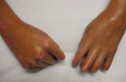
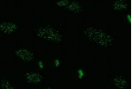
Scleroderma or systemic sclerosis (SSc)
Scleroderma spectrum diseases
A group of heterogeneous diseases that has a predominant feature and share other common features. They are rare, difficult to treat and associated with significant morbidity and mortality.
Systemic sclerosis (SSc) is a disease that is difficult to evaluate, treat and monitor. It is very heterogeneous and usually diagnosed late. There is no single drug that treats everything.
Pathogenesis in each organ involved is not the same it could be (Neurovascular / fibroproliferative / inflammatory).
A strategy should be adopted to evaluate each manifestation and organ involved on a regular basis.
Systemic sclerosis is characterized by:
Skin thickening
Vasculopathy
Autoantibody
The ACR/EULAR 2013 Criteria for the Classification of Systemic Sclerosis:
Item | Subitems | Weight
Skin thickening of the fingers of both hands extending proximal to the metacarpophalangeal joints (Sufficient criterion) | - | 9
Skin thickening of the fingers (Only count the higher score) | Puffy fingers | 2
 | Sclerodactyly of the fingers (distal to the MCP joints but proximal to the proximal interphalangeal joints) | 4
Fingertip lesions (Only count the higher score) | Digital tip ulcer | 2
 | Fingertip Pitting scars | 3
Telangiectasia | - | 2
Abnormal nailfold capillaries | - | 2
PAH and/or interstitial lung disease (Maximum score is 2) | Pulmonary arterial hypertension Interstitial lung disease | 2
Raynaud’s phenomenon | - | 3
Scleroderma related antibodies (Any of anticentromere, anti-topoisomerase-I [anti-Scl-70], anti-RNA polymerase-3). (MAX SCORE IS 3) | Anticentromere Anti-topoisomerase I Anti-RNA polymerase III | 3
To have SSc, there should be NINE points in total. For Example: If the FIRST criteria is present ALONE, that equals 9 points = SSc. (So, the first criterion alone is sufficient for the diagnosis) Sclerodactyly of the fingers + Fingertip Pitting scars + PAH = 4 + 3 + 2 = 9 = SSc

Slide 3
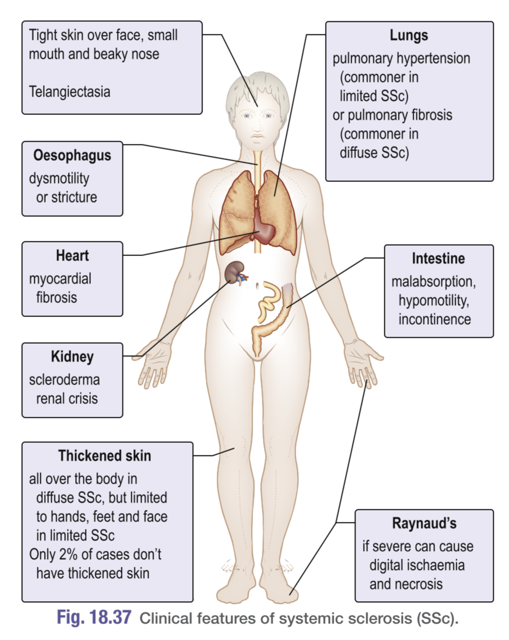
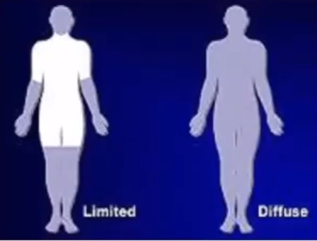
Scleroderma or systemic sclerosis (SSc)
Types of SSc
Based on Cutaneous involvement, SSc is classified into 2 types¹
Diffuse Diffuse Cutaneous Scleroderma (DcSSc) I 30% of cases | Limited Limited Cutaneous Scleroderma (LcSSc) I 70% of cases
Associated with more internal organ involvement Has a worse prognosis Anti-topoisomerase (Anti-Scl-70) RNA polymerase III antibodies. | Skin involvement restricted to sites distal to the elbow or knee (apart from the face) Often more indolent (Takes a long time before it becomes clinically apparent) Has a higher risk of pulmonary hypertension Anti-centromere antibodies.
Edematous in onset, skin sclerosis rapidly follows. Raynaud's phenomenon usually starts just before or concomitant with the edema. Diffuse swelling and stiffness of the fingers is rapidly followed by more extensive skin thickening, which can involve most of the body in the severest cases. Later, the skin becomes atrophic. | Raynaud's phenomenon starts many years (up to 15) before any skin changes. The skin is tight over the fingers and often produces flexion deformities Has a Characteristic face features: 'beak'-like nose small mouth (microstomia).
 | LcSSc also known as CREST syndrome: C - Calcinosis: calcium deposits on the pressure points of the extremities R - Raynaud’s phenomenon: spasm of the blood vessels in response to cold or stress E - Esophageal involvement: Acid reflux and decreased motility S - Sclerodactyly: Thickening and tightening of the skin on the fingers and hands. T - Telangiectasia: dilation of capillaries causing red marks on surface of skin
Pathophysiology of SSc:
T lymphocytes, especially those of the Th17 subtype, infiltrate the skin causing abnormal Fibroblast activation → collagen deposition (primarily type 1) as well as fibronectin and glycosaminoglycans. This is more apparent in the skin and lungs
Vasculopathy and autonomic neuropathy leading to vascular complications like Raynaud's phenomenon², renal crisis & pulmonary hypertension.
Autoimmunity and inflammation: development of autoantibodies that cause inflammatory manifestations such as arthritis and myositis.
There is a third type called sclerosis sine scleroderma (ssSSc). it is a very rare subset characterized by the total or partial absence of cutaneous manifestations of systemic sclerosis with the occurrence of internal organ involvement and serologic abnormalities.
Raynaud's phenomenon is seen in almost 100% of cases.

Slide 4
Scleroderma or systemic sclerosis (SSc)
AutoAntibodies
Scl-70 (topoisomerase)
Anti-centromere
RNA polymerase III
Associated with:
Diffuse subset
The development of ILD
Reduced risk of PAH
Associated with:
limited subset
Pulmonary Arterial HTN
Digital ulcer
Associated with:
Scleroderma Renal Crisis
Malignancy associated SSc
Mortality.
Scl-PM (scleroderma polymyositis): Associated with myositis overlap
Skin Involvement in SSc
Skin
Lung
GI
Kidney
Others
Skin is the Largest and Most Important Organ in SSc (and all women).
Skin involvement has been considered a reflection of internal organ involvement.
Skin involvement is seen in 99% of patients.
The level of skin involvement predicts severe disease and mortality.
Skin loosening occurs 5 years after the onset of the disease. At that time the patient may develop contracture and disability so it’s imp to detect it And treat it early.
SKIN INVOLVEMENT ALWAYS STARTS IN THE FINGERS AND TOES (distally) AND EXTENDS PROXIMALLY.
So no systemic sclerosis patient will have sparing of his hands.
Contractures of the fingers and disability are preventable with stretching exercise.
Patients should be advised to use emollients and creams at all time.
Treatment of skin involvement
Treatment is usually initiated when active skin inflammation is apparent or progressive skin thickening. Why do we treat the skin? To prevent joint contracture and disability in the hands.
Methotrexate Avoid it if the patient has interstitial lung disease or renal failure because of its toxic effect. | ➢ Mycophenolate mofetil ➢ Cyclophosphamide ➢ Rituximab | Steroids High-dose corticosteroids (above 10 mg prednisolone daily) is a significant risk factor for Scleroderma renal crisis and is best to be avoided in patients with DcSSc.

Slide 5
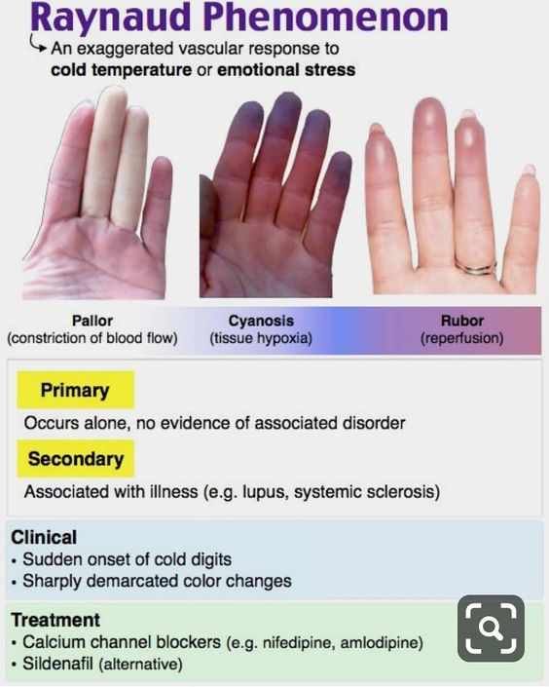
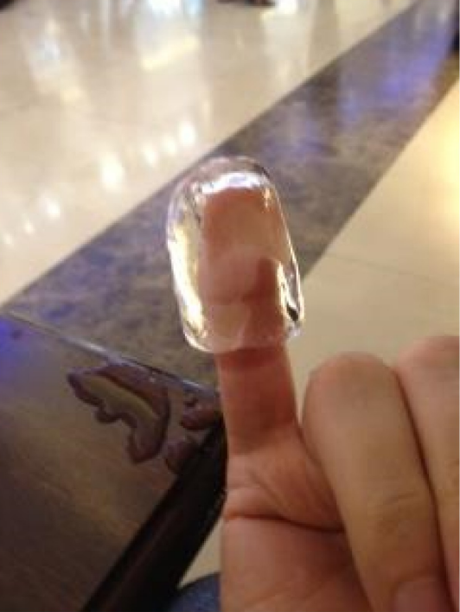
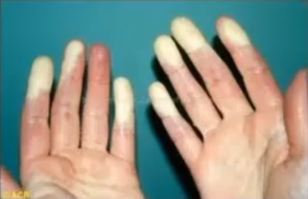
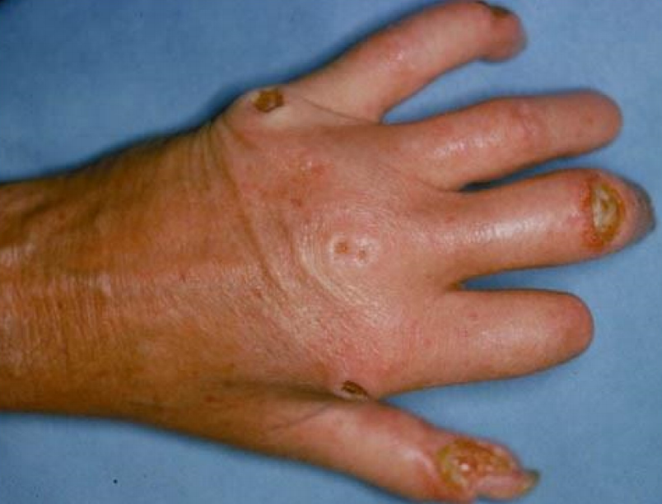
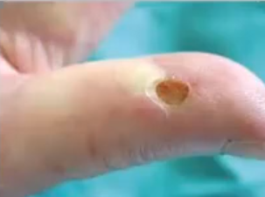
Raynaud’s Phenomenon and Digital Ulcers in SSc
Skin
Lung
GI
Kidney
Others
Raynaud’s Phenomenon (RP) and Digital Ulcers (DU) “Pain at the tip of the fingers” are 2 faces of the same coin. There is some difference between the underlying pathogenesis of both conditions.
95% and 50% of SSc have RP and DU respectively, but RP tends to occur years before the diagnosis of SSc unlike DU that usually occur in the first 5 years after the development of the non-RP manifestation.
Raynaud’s Phenomenon: is an exaggerated response to cold or stress exposure which will lead to peripheral vasoconstriction.
In normal people it last for few seconds
in patients with raynaud's phenomenon it can last for hours and days.
Raynaud’s Phenomenon in Systemic sclerosis patients can complicate into digital ulcer after developing ischemia.
Treatment modalities in secondary Raynaud’s Phenomenon | Treatment modalities in Digital Ulcer
Never underestimate non-pharmacological treatment. Patients should avoid cold by wearing gloves and warm clothes, and stop smoking. Treat pain adequately. Calcium channel blockers (FIRST-LINE) are effective in treating RP with the cost of side effects and intolerance. If the patient is not responding you can give IV prostaglandins or even Phosphodiesterase inhibitors IV iloprost better than nifedipine. Prazosin not working well. Efficacy of oral and IV prostaglandins. IV prostacyclin are used for severe disease and critical ischemia | Aim of treatment includes: healing and prevention of new ulcers at the end of the study. CCB are commonly used but no evidence in healing DU (CCB has no role in DU) Endothelin receptor antagonist (bosentan) has been shown to prevent new ulcers and is believed to be a disease modifying agent for SSc. Phosphodiesterase inhibitors (e.g. Sildenafil and tadalafil) have a positive effect on healing and preventing ulcers. IV Prostacyclin has been shown to heal DU and prevent new ulcers. it’s very painful, if a patient presented to the ER with DU secondary to RP they will usually need opioids not paracetamol. Phosphodiesterase inhibitors & IV prostaglandins: Prevent new ulcers Improve (fasten) the healing. Endothelin receptor antagonist: Only prevents new ulcers DO NOT improve the healing.

Slide 6
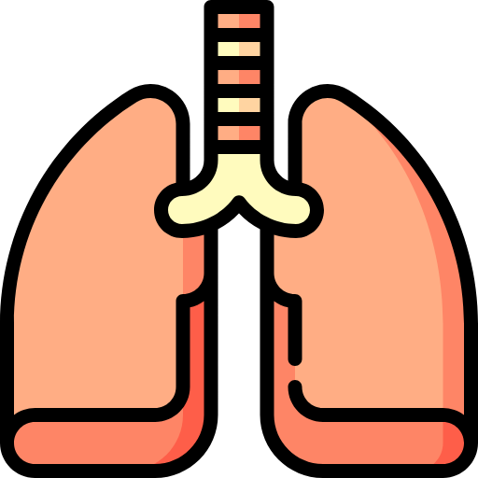
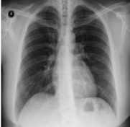
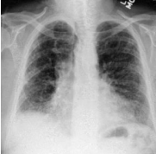
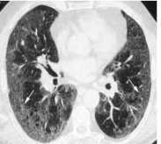
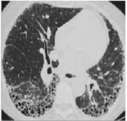
Interstitial lung disease in SSc
Skin
Lung
GI
Kidney
Others
Interstitial lung disease (ILD): a specific form of chronic, progressive fibrosing interstitial pneumonia leading to progressive loss of pulmonary function, and respiratory failure. It affect usually the bases of the lungs.
Interstitial Lung Disease is the number ONE cause of mortality in patients with SSc.
It is very common, around 70% of patients tend to develop ILD at some time of the disease course.
Common in patients with DcSSc who have topoisomerase 1 antibodies (Scl70).
Who should be screened for ILD? EVERYBODY.
Chest x-ray is not considered a good screening tool.
High-resolution lung CT is the Gold standard. it demonstrates fibrotic lung involvement.
Diagnosis is made by a combination of imaging, physical exam and pulmonary function test (PFT).
Clinical findings in ILD:
Both patients have ILD, if we didn’t perform HRCT the patient can be misdiagnosed due to normal CXR.
1) Tachypnea | 3) Cyanosis | 5) Reduced chest expansion
2) Tachycardia | 4) Clubbing | 6) Fine early inspiratory crackles
Pulmonary function test (PFT) in ILD shows:
Low forced vital capacity (FVC)
Low forced expiratory volume in one second (FEV1)
Normal or high FVC/FEV1 ratio (Restrictive pattern)
Low diffusion capacity of carbon monoxide (DLCO) due to fibrosis
Treatment Options:
Most often with cyclophosphamide or azathioprine combined with low-dose oral prednisolone.
01
Cyclophosphamide
02
Alternative could be:
is up to today the standard of care used as treatment induction in ILD
Mycophenolate mofetil (MMF) or rituximab (RTX).
Used for induction
03
Maintenance includes:
04
Steroids
Mycophenolate mofetil (MMF), Azathioprine (AZA) and Rituximab (RTX)
Steroids are a part of induction and maintenance. High doses should be avoided.

Slide 7
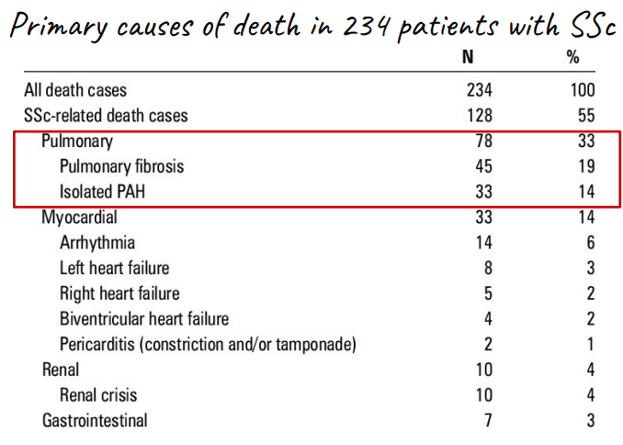
Pulmonary Arterial Hypertension in SSc
Skin
Lung
GI
Kidney
Others
It is 6 times more common in patients with LcSSc.
Affects 8-13% of SSc (RHC criteria)
PAH is defined as Pulmonary Arterial Pressure ≥ 25 mmHg with a Normal Pulmonary wedge pressure (≤ 15 mmHg) Because high PCWP indicates that the patient has heart failure
PAH has become a very important cause of mortality along with ILD they are the cause of 8%-33% of death.
PAH is the second most common cause of death.
These patients develop endothelial damage and hypertrophy → vasoconstriction → significant morbidity and mortality. So what are the solutions to Reduce PAH-related Mortality and Morbidity?
Primary causes of death in 234 patients with SSc
1
2
3
Early detection
Aggressive treatment
Early referral for lung transplant
Desaturation
Tachycardia
Palpable P2
Parasternal heave
Loud 2nd heart sound
Signs of right sided heart failure which include: JVD, lower limb edema and ascites.
PFT may show isolated low DLCO
Note: Remember you can have pulmonary hypertension secondary to ILD which makes diagnosis and management more complex. It is important to look at the lung and heart together.
Clinical findings include:
How to diagnose PAH in SSc:
The First investigation to order is echocardiography.
The Gold diagnostic tool is right sided heart catheterization.
Treatment of PAH
General info | Pulmonary hypertension is treated with oral vasodilators, oxygen and warfarin. Advanced cases should receive prostacyclin therapy (inhaled, subcutaneous or intravenous) or the oral endothelin-receptor antagonist, bosentan.
Drugs | Endothelin Receptor Antagonists: Bosentan, Ambrisentan, Macitentan, Sitaxentan | Phosphodiesterase Inhibitors Prostacyclins

Slide 8
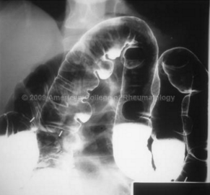
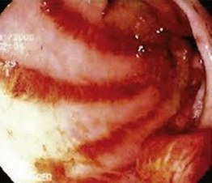
GI Involvement in SSc
Skin
Lung
GI
Kidney
Others
Gastrointestinal System Involvement:
GIT is the most common internal organ to be involved (95-99%) which includes:
Mouth | Reduced mouth opening in the mouth apparatus.
Esophagus (most common) | Dysmotility and reflux leading to strictures, they commonly present with dysphagia. Treat reflux with PPIs & lifestyle modifications. Metoclopramide or domperidone may help patients with symptoms of dysmotility/pseudo-obstruction.
Stomach | Gastroparesis, watermelon appearance with telangiectasia it is called gastric antral vascular ectasia (GAVE).
Small bowel | Blind loop syndrome complicated by bacterial overgrowth manifesting as chronic diarrhea and malabsorption. Primary treatment is sequential antibiotics but stomas and Total parenteral nutrition can be offered in advanced cases
Large bowel | Chronic constipation, fish mouth diverticula. Treatment includes laxatives
Anorectal incontinence | Fecal incontinence is a devastating complication and difficult to manage One option could be to clear bowel frequently before going out and some pelvic floor exercises
Barium enema showing white based diverticula, on endoscope they look like fish mouth
gastric antral vascular ectasia (GAVE), watermelon appearance

Slide 9
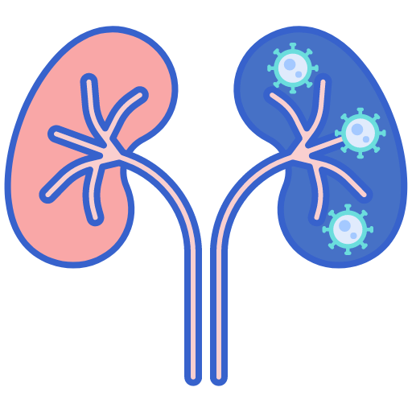
Scleroderma Renal Crisis (SRC) in SSc
Skin
Lung
GI
Kidney
Other
Mostly in patients with DcSSc.
SRC was the leading cause of death in systemic sclerosis patients till the introduction of ACE inhibitors.
Patients with SSc usually have low BP, once you see high BP, suspect SRC.
Precipitating factors include: high dose steroids, cyclosporin & pregnancy.
Anemia in SSc is usually iron deficiency because of blood loss from the bowel, telangiectasia, chronic diarrhea and reduce uptake. Once you see microangiopathic hemolytic anemia suspect SRC.
The primary histopathologic changes in the kidney are localized in the small arcuate and interlobular arteries and the glomeruli.
The characteristic finding is:
intimal proliferation and thickening that leads to narrowing and obliteration of the vascular lumen, with concentric "onion-skin" hypertrophy
This will lead to activation of the aldosterone-renin-angiotensin pathway.
Clinical lab findings
Any new onset HTN with a BP of >150/85 or 20 mmHg increase from baseline is critical to recognize.
Normotensive renal crisis can occur
Urinalysis might show proteinuria and hematuria but no RBC cast.
Casts are a feature of glomerular diseases, and renal crisis is not a glomerular disease. So if you see casts in a patient with SSc, you should put in mind that the patent may be having an overlap with either vasculitis or lupus
High creatinine is almost universal
Anemia with positive hemolytic workup points to microangiopathic hemolytic anemia
(High LDH, High bilirubin, Schistocytes on peripheral blood film, reticulocytosis, low haptoglobin)
Treatment
Treatment is control of BP by reducing it 10 mmHg every 24 hours
Best (and only) drug: Angiotensin Converting Enzyme Inhibitors (ACE inhibitors)
Even if progress to ESKD, 40% might recover and get back to near normal function.
Other organ Involvement in SSc
Skin
Lung
GI
Kidney
Others
Arthritis: similar to RA with erosions and joint destruction.
Cardiac: Myocardial fibrosis leading to conduction abnormalities, cardiomyopathy and accelerated coronary artery disease.
Myositis: manifested by weakness with no pain and high muscle enzymes.

Slide 10
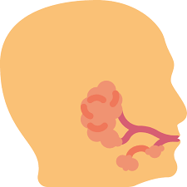
Sjogren’s Syndrome
It is a systemic chronic inflammatory disorder characterized by lymphocytic infiltrates in exocrine organs¹. Especially the lacrimal and salivary glands. There is an association with HLA-88/DR3
Most individuals with Sjögren’s syndrome present with sicca (dryness) symptoms, such as:
Xerophthalmia.
(dry eyes)
Xerostomia.
(dry mouth)
Vaginal dryness.
Loss of vaginal secretions leads to dyspareunia.
Parotid gland enlargement.
because of severe lymphocytic infiltration leading to obstruction
“keratoconjunctivitis sicca”
Others:
There is a high incidence of dental caries and high risk of dental failure.
Conjunctivitis and blepharitis are frequent, and may lead to filamentary keratitis due to binding of tenacious mucus filaments to the cornea and conjunctiva
keratoconjunctivitis sicca, are due to a lack of lubricating tears, which reflects inflammatory infiltration of the lacrimal glands. It give the feeling of “sand in the eyes”.
Diagnosis criteria of primary Sjogren’s Syndrome:
At least 4 of the criteria listed below (you MUST have number 1 or number 2)
1
Positive minor salivary gland biopsy findings showing lymphocytic infiltration.
2
Positive anti–SSA³ anti-sjogren syndrome A or anti–SSB anti-sjogren syndrome B antibody results
3
Oral signs (sialogram, scintigraphy or sialometry findings)
4
Ocular signs (Schirmer test)²
5
Oral dryness
6
Ocular dryness
The best initial test is Schirmer test, while the most accurate is a minor salivary gland (labial) biopsy.
Best initial test on blood: SS-A and SS-B. These are also called “Ro” and “La” and are each present in about 65% of patients.
Rose Bengal staining: Staining of the eyes shows punctate or filamentary keratitis.
Antinuclear antibodies are found in 80% of cases.
Rheumatoid factor is usually positive.
1. Salivary glands, lacrimal glands, skin glands, vaginal glands, etc..
2. A standard strip of filter paper is placed on the inside of the lower eyelid; wetting Of <10 mm in 5 min indicates defective tear production.
3. This antibody is of particular interest because it can cross the placenta and cause congenital heart block

Slide 11
Sjogren’s Syndrome
Extraglandular manifestations of Sjogren’s Syndrome:
1) Arthritis | 5) Pancytopenia | 9) Demyelinating disease (Eg. Multiple sclerosis)
2) Myositis | 6) Palpable purpura | 10) interstitial lung disease
3) Renal tubular acidosis type 1 | 7) Severe unexplained Fatigue | 11) Interstitial nephritis
4) Raynaud phenomenon | 8) Generalized osteoarthritis | 12) arthralgia
Treatment¹
The best initial therapy is to water the mouth.
Treatment of glandular manifestations of SS | Treatment of Extraglandular manifestations of SS
Oral hygiene Avoid sugars Florid products Parasympathomimetics (pilocarpine) will increase the secretion of salivary and lacrimal glands. Artificial eye and mouth moisturizers Creams and lotions Vaginal lubricants | Treatment of all include immunosuppressive agents: Steroids MTX (except for ILD) Azathioprine Cyclophosphamide Rituximab For Renal tubular acidosis, you just need to give NaHCO3 (Sodium bicarbonate) supplement
Complications
SS patients are at risk of developing Non-hodgkin’s B cell lymphoma 20 times more than the general population. Malignancy is the most common cause of death.
Look for persistent lymphadenopathy (LAP) or disappearance of RF and weight loss.
An area for your notes
1. You can see that the Extraglandular manifestations are the inflammatory ones and require immunosuppression, while the glandular manifestation only require supportive treatment

Slide 12
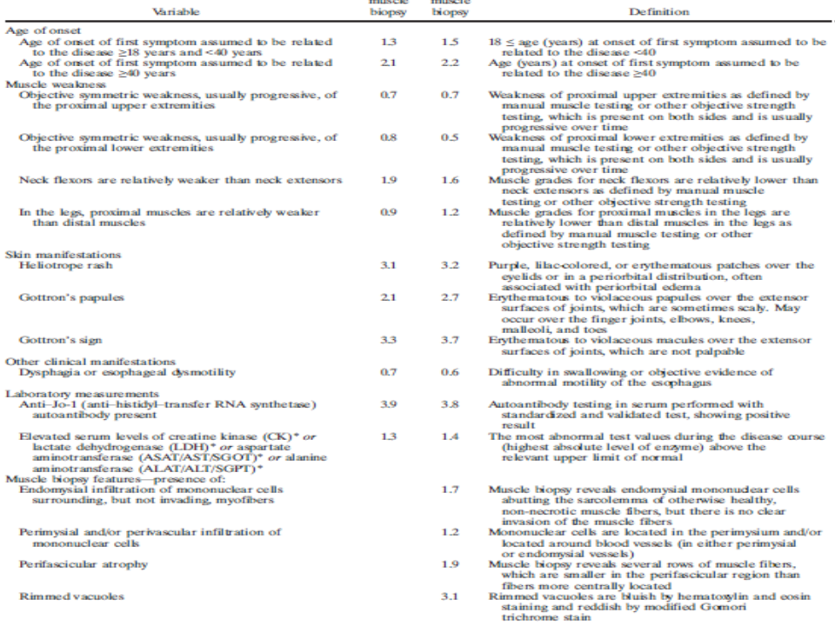
Idiopathic inflammatory Myopathies
“This topic will be discussed in details in a separate lecture”
Idiopathic inflammatory Myopathies
Are a group of autoimmune myopathies that are characterized by muscle weakness due to muscle inflammation and damage.
Mainly in the proximal muscles but it can progress to peripheral muscles.
The onset is insidious and progressive.
Organ involvement:
Pharyngeal muscle involvement can present as dysphagia and can lead to aspiration pneumonia.
Chest wall weakness can present as dyspnea and lead to type II respiratory failure.
Can affect the heart and lead to cardiomyopathy
Types of IMM¹
Diagnosis
Primary idiopathic polymyositis (PM)
Primary idiopathic dermatomyositis (DM)
Polymyositis or dermatomyositis associated with malignancy
Childhood polymyositis or dermatomyositis
Polymyositis or dermatomyositis associated with another connective-tissue disease
Inclusion body myositis extremely rare
Miscellaneous (eg, eosinophilic myositis, myositis ossificans, focal myositis, giant cell myositis) extremely rare
Diagnosis is made if the score is
Without biopsy ≥ 7.5
With biopsy ≥ 8.7
An area for your notes
1. Proximal skeletal muscle weakness = Polymyositis. Proximal skeletal muscle weakness + skin rash = Dermatomyositis

Slide 13
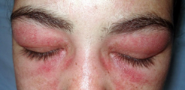
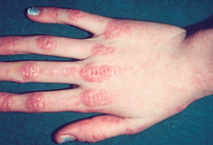
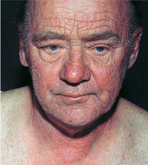
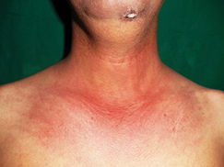
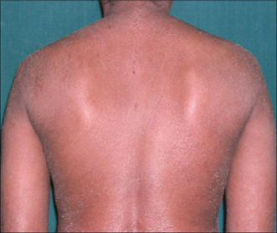
Idiopathic inflammatory Myopathies
Algorithm for IIM
Patient meets the EULAR/ACR classification criteria for IIM
Age at onset of first symptom <18
No
Yes
Heliotrope rash or Gottron's papules or Gottron's sign
Heliotrope rash or Gottron's papules or Gottron's sign
No³
Yes¹
No
Yes
Clinical features or muscle biopsy features
Objective symmetric weakness, usually progressive, of the proximal upper extremities or,
Objective symmetric weakness, usually progressive, of the proximal lower extremities or,
Neck flexors are relatively weaker than neck extensors or, In the legs proximal muscles are relatively weaker than distal muscles
No
Yes
PM
(IMNM)
IBM⁴
No
Yes
ADM²
DM
Juvenile myositis other than JDM
JDM
Rashes of DM
01
02
03
04
05
Heliotrope rash
Gottron’s papules/sign⁵
Photosensitivity
Shawl rash ⁷
Erythroderma⁶
1. If the patient has skin manifestation + features of inflammatory myopathies, this is considered as Dermatomyositis
2. Amyopathic dermatomyositis (rare). It is similar to SSc where they have skin manifestations but there is no muscle involvement
3. If the patient doesn’t have skin manifestation, but has the typical features of inflammatory myopathies, this is considered as Polymyositis
4. Inclusion body myositis.
5. Gottron’s papules: on the knuckles & PIP joint. Gottron’s sign: involves the elbows and knees
6. The most severe and serious, complete erythema of the body.
7. Around the neck and upper trunk.

Slide 14
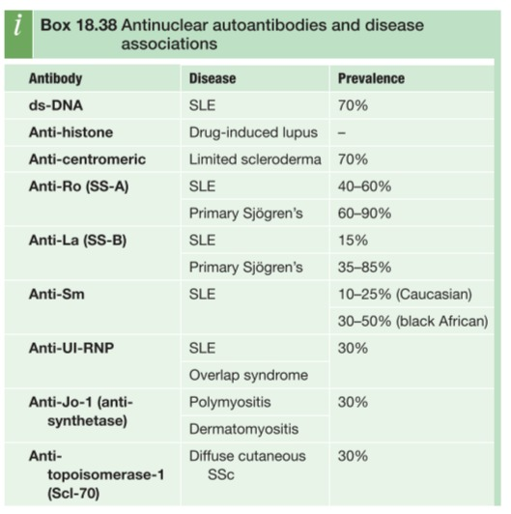
Idiopathic inflammatory Myopathies
Investigations
Muscle enzymes | CK, LD, AST, ALT, Aldolase. The best initial test is CPK and aldolase
MRI Muscle | Showing muscle edema
Muscle biopsy | Showing lymphocytic infiltration (Either CD4 or CD8, based on the subtype). Muscle biopsy is the most accurate test Establishing diagnosis and excluding other causes of myopathies.
EMG | Myopathic changes. Not very helpful
Autoantibodies | Jo-1 the most common, occurs in around 40% of patients , Non-Jo-1 antibodies, Anti-SRP, Anti-Mi2
MOST IMPORTANT: RULE OUT OTHER CAUSES OF MYOPATHIES (Eg, hypothyroidism, hyperthyroidism, diabetes, cushing syndrome, Addison disease, statins ,etc)
Extramuscular manifestations
1
Arthritis
2
Raynaud phenomenon
3
interstitial lung disease
(antisynthetase syndrome)¹
Treatment
Steroids (Oral prednisolone is the treatment of choice)
Methotrexate
Mycophenolate mofetil
Azathioprine
Rituximab
Intravenous immunoglobulins if the patient has dysphagia or chest wall involvement (Heart,
pharyngeal muscle, etc)
Conclusion
Scleroderma spectrum diseases are rare but serious diseases that are characterized by a specific organ involvement and many other common features.
Therapies used to treat inflammatory manifestations are similar for all conditions.
Morbidity and mortality are due to internal organ damage.
1: antibodies to tRNA synthetase enzymes. These people are more likely to develop pulmonary interstitial fibrosis, Raynaud's phenomenon, arthritis, and hardening and fissuring of skin over the pulp surface of the fingers (mechanic's hands).

Slide 15
Diffuse SSc | Associated with more internal organ involvement Has a worse prognosis Anti-topoisomerase / RNA polymerase III antibodies.
Limited SSc | Often more indolent (has a longer disease duration before diagnosis) Has a higher risk of pulmonary hypertension Anti-centromere antibodies.
AutoAntibodies in SSc | Anti-Scl-70 (topoisomerase) Diffuse subset The development of ILD Reduced risk of PAH | Anti-centromere limited subset Pulmonary Arterial HTN Digital ulcer | RNA polymerase III Scleroderma Renal Crisis Malignancy associated SSc Mortality.
Skin Involvement | Skin is the Largest and Most Important Organ in SSc The level of skin involvement predicts severe disease and mortality. SKIN INVOLVEMENT ALWAYS STARTS IN THE FINGERS AND TOES (distally) AND EXTENDS PROXIMALLY.
Raynaud’s Phenomenon | Calcium channel blockers (FIRST-LINE) CCB has not role in Digital ulcer
Interstitial Lung Disease | Interstitial Lung Disease is the number ONE cause of mortality. High-resolution lung CT is the Gold standard. Restrictive pattern with low DLCO Treated with cyclophosphamide
Pulmonary Arterial Hypertension | PAH is defined as Pulmonary Arterial Pressure ≥ 25 mmHg with a Normal Pulmonary wedge pressure (≤ 15 mmHg.) The First investigation to order is echocardiography. The Gold diagnostic tool is right sided heart catheterization.
Scleroderma Renal Crisis | Patients with SSc usually have low BP, once you see high BP suspect SRC. Precipitating factors include: high dose steroids, cyclosporin & pregnancy. Best (and only) drug: Angiotensin Converting Enzyme Inhibitors (ACE inhibitors)
Sjogren’s Syndrome | Xerophthalmia, Xerostomia , Vaginal dryness, Parotid gland enlargement The best initial test is Schirmer test, while the most accurate is a minor salivary gland (labial) biopsy. Best initial test on blood: SS-A and SS-B. Risk of developing Non-hodgkin’s B cell lymphoma 20 times more

Slide 16
Q1: A 45-year-old woman presents to the rheumatology clinic with a three-month history of itchy, dry eyes and a persistently dry mouth. She also mentions that her fingers have been extremely cold, occasionally turning blue after going outside in the morning. Schirmer’s test is positive. What is the most likely diagnosis?
A- Systemic sclerosis
B- Raynaud’s disease
C- SLE
D- Primary Sjögren’s syndrome
E- Secondary Sjögren’s syndrome
Q2: A 24-year-old woman presents to her GP complaining of cold hands and feet. This has been ongoing for the past three months and is especially bad when she goes out in the mornings and may last for hours. On further questioning, she mentions that her hands sometimes turn blue or red and that gloves are unhelpful. She has otherwise been feeling well and has no past medical history. What is the most appropriate treatment?
A- Propranolol
B- Aspirin
C- Nifedipine
D- Subcutaneous injection of low molecular weight heparin
E- Prednisolone
Q3: A 42-year-old woman presents to accident and emergency with retrosternal discomfort. She was diagnosed with systemic sclerosis a year ago. Which of the following statements is true about systemic sclerosis?
A- Microstomia is only seen in diffuse cutaneous systemic sclerosis
B- Skin involvement is limited to face, hands and feet in limited cutaneous systemic sclerosis
C- Oesophageal dysmotility is only seen in limited cutaneous systemic sclerosis
D- Anti-double stranded DNA antibodies are normally detected in patients with systemic sclerosis
E- Raynaud’s phenomenon occurs as a result of skin fibrosis (scleroderma)
Q4: A 60-year-old woman complains of dry mouth and a gritty sensation in her eyes. She states it is sometimes difficult to speak for more than a few minutes. There is no history of diabetes mellitus or neurologic disease. The patient is on no medications. On examination, the buccal mucosa appears dry and the salivary glands are enlarged bilaterally. Which of the following best describes the pathophysiology of the condition?
A- Previous exposure to group A streptococcal organisms have stimulated an autoimmune response that leads to cross-reactivity between host and organism with tissue destruction and reduced tear and saliva production.
B- T cells infiltrate exocrine glands and B cells become hyper-reactive. Auto-antibodies ensue including anti-Ro/SSA and anti-La/SSB. Both pro- and anti-apoptotic messages are sent to ductal and acinar epithelial cells.
C- Activated T cells and monocytes accumulate in the skin leading to induration for unknown reasons. This infiltration leads to structural abnormalities in various tissues and organs hence a reduction in normal functioning. Anti-topoisomerase-I and anti-centromere autoantibodies are commonly present.
D- Immune complexes form and deposit in vessel walls. Vasoactive amines including histamine, bradykinin, and leukotrienes are released, and vessel permeability is increased. Complement activation occurs and mononuclear cells are attracted causing infiltration and decreased gland function.
E- Necrotizing vasculitis of small arteries and veins leads to granuloma formation and decreased exocrine function of salivary and lacrimal glands.
Q5: The patient in the previous question has read extensively on the Internet about her probable diagnosis and wonders if more testing can be done to confirm the diagnosis. She is aware of the Schirmer test (quantitative tear production test) and has already had that done by her optometrist. She is on cyclosporine eye drops with some improvement in the gritty eye symptoms. What more could be done at this point to further confirm the diagnosis?
A- Give a therapeutic trial of prednisone 20 mg/d for 1 month.
B- Obtain a detailed family history of rheumatologic conditions in first-degree family members.
C- Biopsy the patient’s lip and check autoantibody levels in the serum.
D- Check IgG and IgM antibodies against mumps.
E- Diagnostic/therapeutic trial of hard candy, sugarless gum, and warm soaks to the parotid glands for 1 month.
Q6: A 45-year-old woman has pain in her fingers on exposure to cold, arthralgias, and difficulty swallowing solid food. She has a few telangiectasias over the chest but no erythema of the face or extensor surfaces. There is slight thickening of the skin over the hands, arms, and torso. What is the best diagnostic workup?
A- Rheumatoid factor and anti-CCP antibodies
B- Antinuclear, anti-Scl-70, and anticentromere antibodies
C- Creatine kinase (CK) and antisynthetase antibodies (such as anti-Jo-1)
D- BUN and creatinine
E- Reproduction of symptoms and findings by immersion of hands in cold water
Answers: Q1:D | Q2:C | Q3:B | Q4:B | Q5:C | Q6:B
Answers Explanation File!

Slide 17
THANKS!!
This lecture was done by:
Jehad Alorainy
Females co-leaders:
Raghad AlKhashan
Amirah Aldakhilallah
Males co-leaders:
Mashal AbaAlkhail
Nawaf Albhijan
Send us your feedback:
We are all ears!

