Slide 1
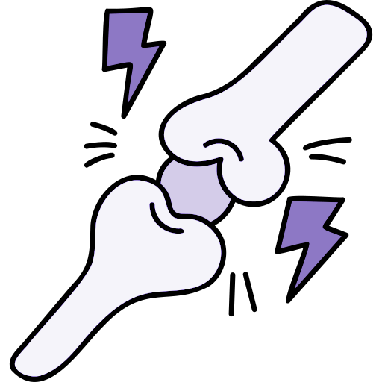
Lecture 33 31
Editing file
Seronegative Spondyloarthropathies (SpA)
Objectives:
Understand the basic of Spondyloarthritis.
To differentiate between inflammatory and mechanical back pain.
To be able to take full detailed history and examination related to spondyloarthritis.
To understand the basic lab and genetics for SpA.
Basics therapy for spondyloarthritis.
To know the extra-articular features for SpA.
Color index:
Color index:
Original text Females slides Males slides
Doctor’s notes Text book Important Golden notes Extra

Slide 2
Back pain
EXAM Q
Introduction
80% of the population will experience back pain during their lifetime.
More than 85% cannot attribute it to a specific disease or spinal abnormality.
Up to one third (1/3) of patients report persistent back pain of at least moderate intensity 1 year after an acute episode.
There are 2 types of back pain:
Mechanical: Symptomatic herniated disc, Spinal stenosis, Compression fracture.
Inflammatory: Ankylosing spondylitis (3%)
Others: Cancer, spinal infection
Inflammatory back pain | Mechanical back pain
<40y/o | any age
Insidious onset: Slowly progressive | Variable onset: can be acute
Pain improves with exercise | Pain may worsen with movement
Pain does not improve with rest | Pain often improves with rest
Significant early morning stiffness >30min | Onset often sudden and precipitated by lifting or bending
Criteria for diagnosing IBP
ASAS inflammatory back pain criteria by experts (chronic back pain; n=648): (IPAIN)
1
Insidious onset
Dactylitis
Others
2
Pain at night (with improvement upon getting up)
3
Age at onset <40 years
4
Improvement with exercise
5
No improvement with rest
Inflammatory back pain is present if at least 4 out of 5 parameters are fulfilled

Slide 3
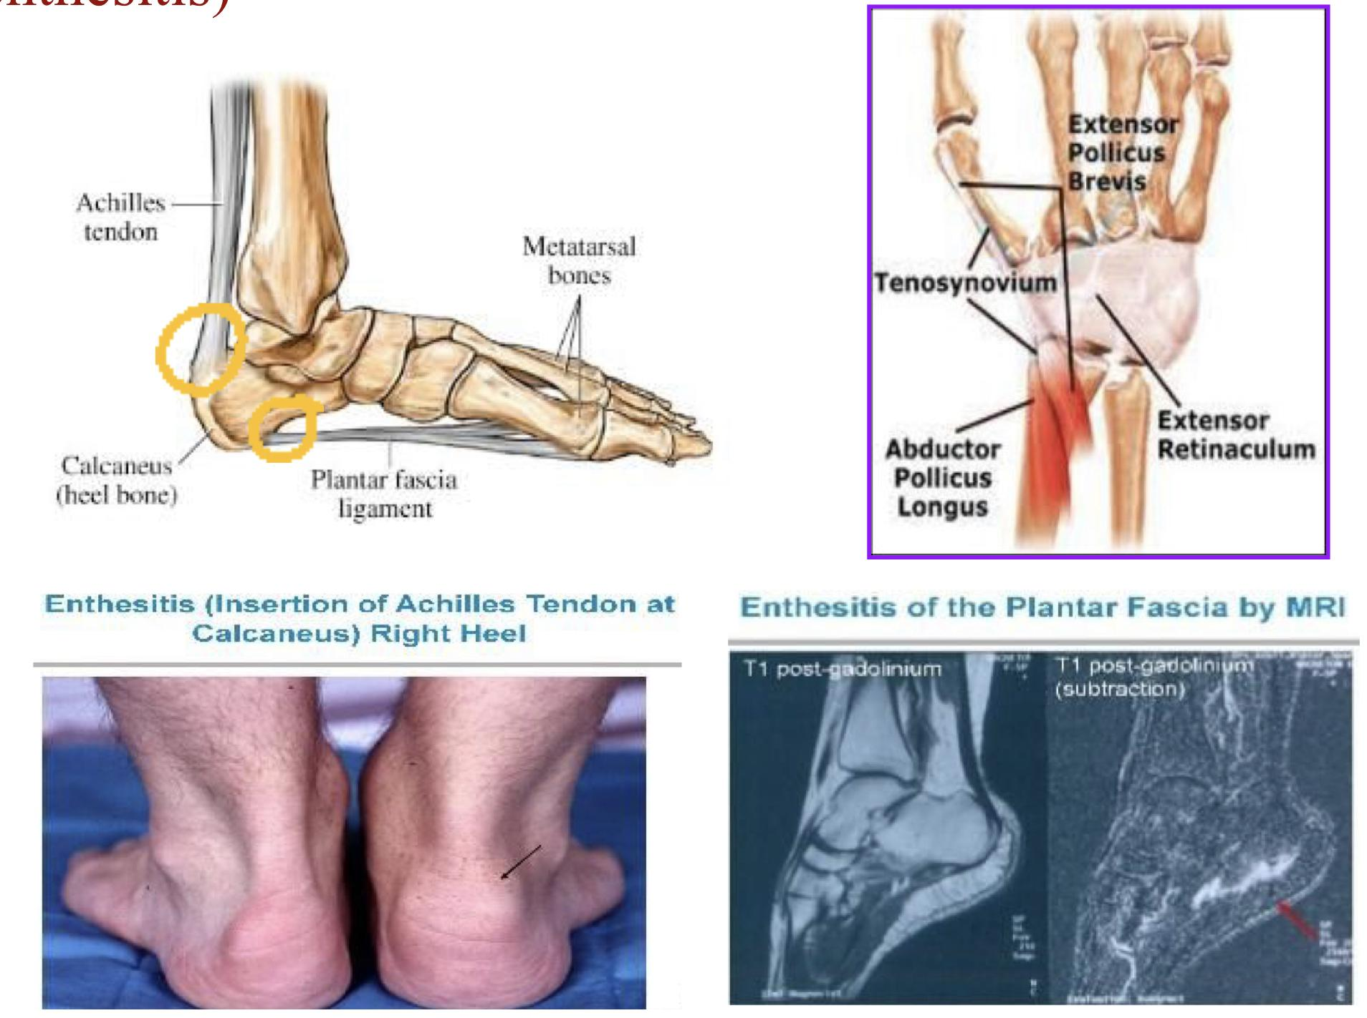
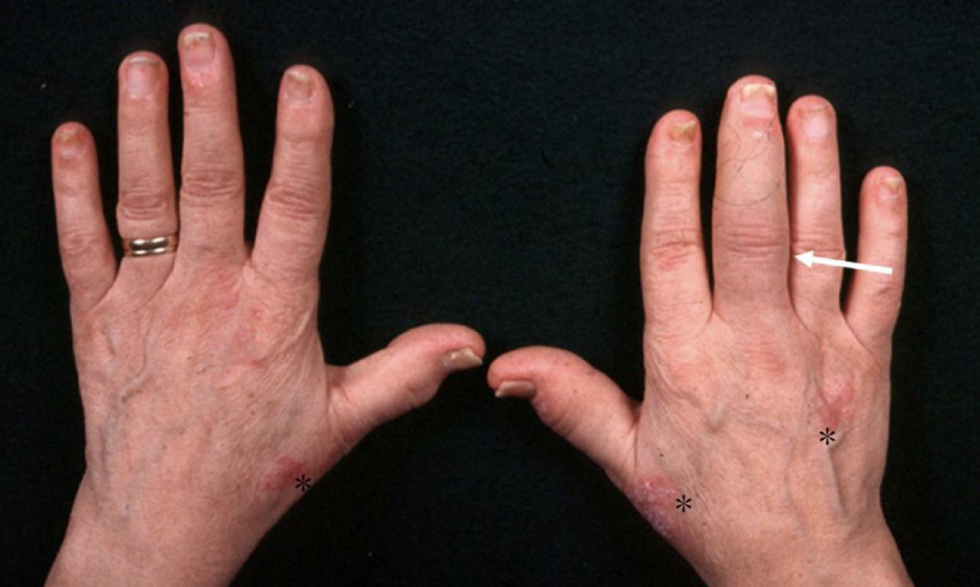
Introduction
What are Spondyloarthropathies (SpAs)?
Spondyloarthropathies (SpAs) aka Seronegative Spondyloarthropathies comprise a group of related inflammatory musculoskeletal diseases that show overlap in their clinical features and have a shared immunogenetic association with HLA-B27. They include:
1
2
3
Ankylosing spondylitis (AS)
Psoriatic arthritis (PsA)
Reactive arthritis (ReA)
4
5
6
Enteropathic spondyloarthritis
(IBD + Arthritis)
Non-radiographic Axial spondyloarthritis (nr-axSpA)
Undifferentiated peripheral SpA
7
Juvenile SpA
In axial spondylitis and ankylosing spondylitis, the axial skeleton (i.e. the central core skeleton) is predominantly affected. Based on this concept, SpAs can be classified into:
Predominantly axial SpA (Spine or Chest or Hip Joints): nr-axSpA and AS
Predominantly peripheral SpA (Fingers or Knees or Toes): All SpAs except AS and nr-axSpA
Features common to SpAs
In contrast to RA, in the SpAs there are frequent and notable non-synovial musculoskeletal lesions – mainly inflammatory in nature – of ligaments, tendons, periosteum and other bone lesions.
Enthesitis
Enthesitis= Inflammation at the site of a ligament or tendon insertion into bone.
Causes severe pain and tenderness.
Relatively specific to SpA
Most common sites: Achilles tendons (heel enthesitis, most common), plantar fascia ligament into the calcaneus, lateral epicondyles, tenosynovitis enthesitis and gluteus medius insertion
Can also happen in the chest (Costochondritis)
Dactylitis
Others
Dactylitis
Unlike synovitis, in which swelling is confined to the joints, with dactylitis, the entire digit is swollen.
Known as sausage toe/digit/finger.
Usually seen in:
Psoriatic arthritis
Occasionally reactive arthritis
Dactylitis is not specific for SpA and may also be seen in: Tuberculosis, Syphilis, Sarcoidosis, Sickle cell disease, Tophaceous gout.
*Psoriasis plaque lesions
circle: Onycholysis

Slide 4
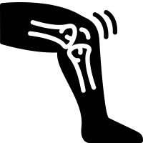
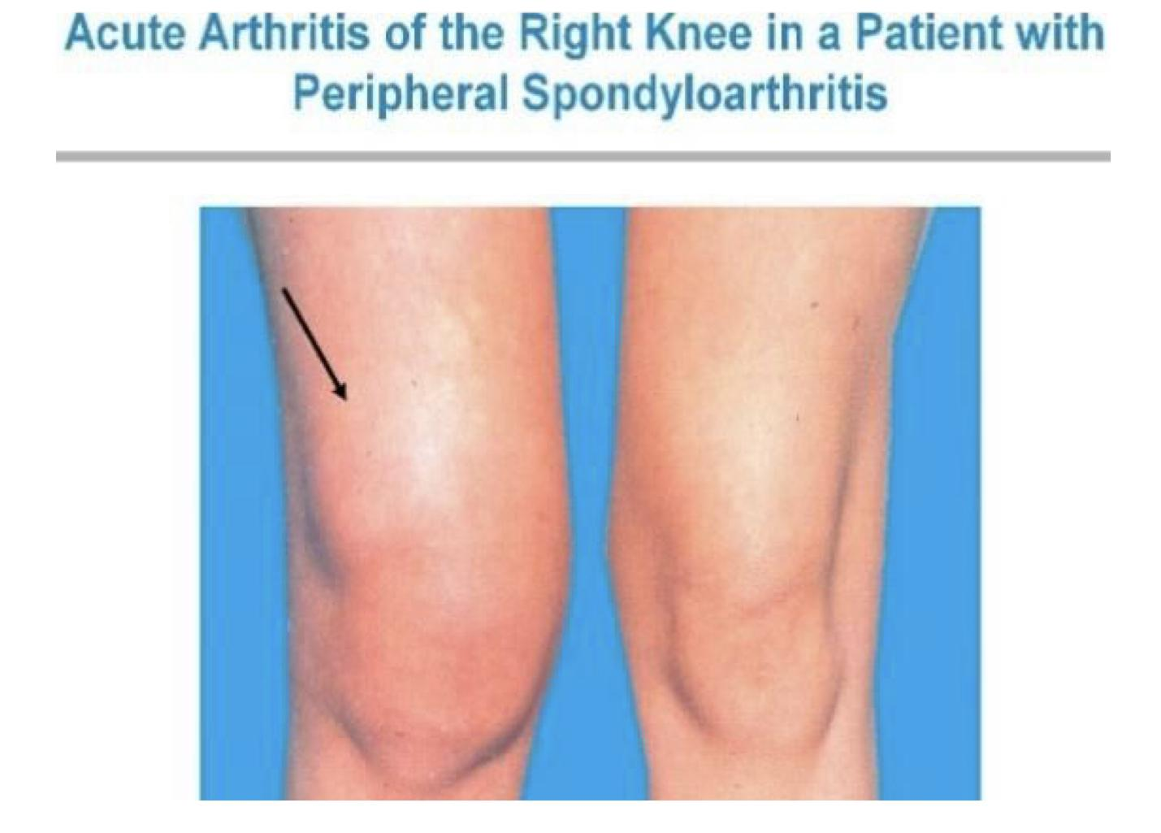
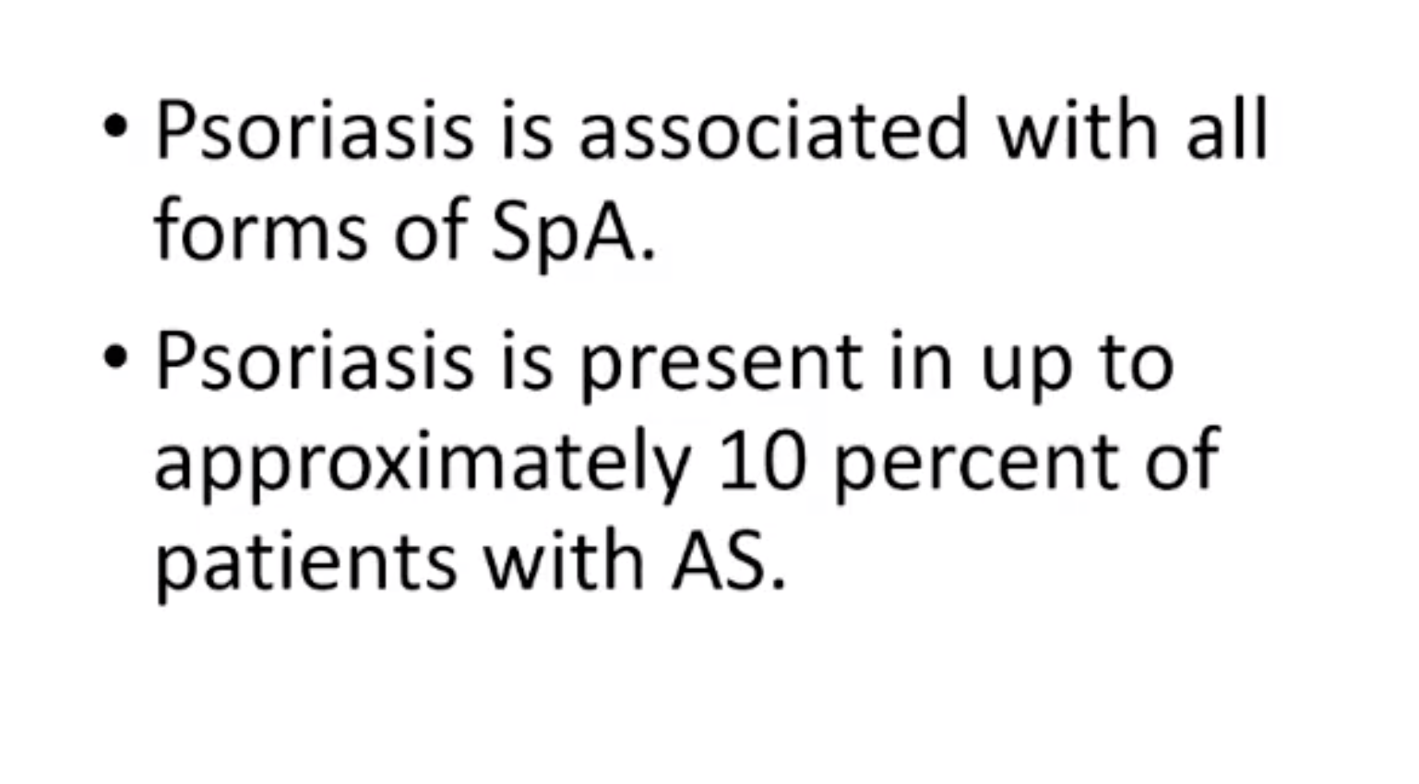
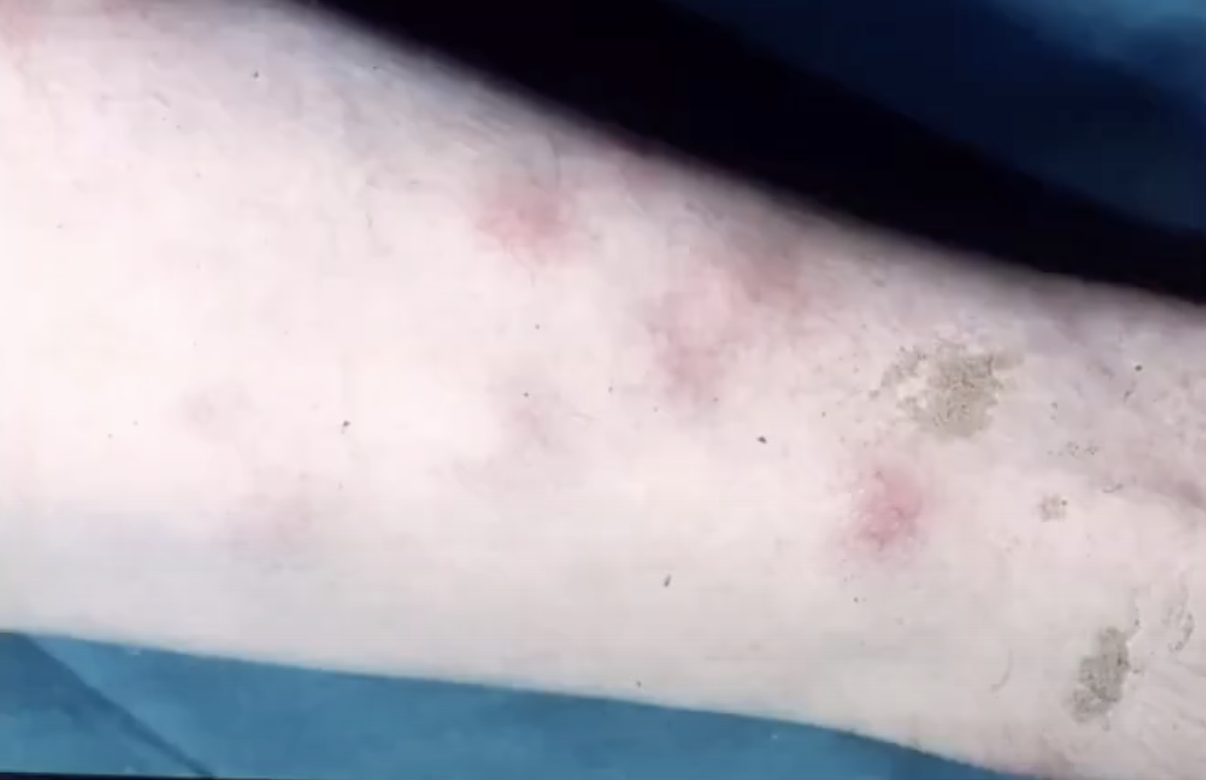
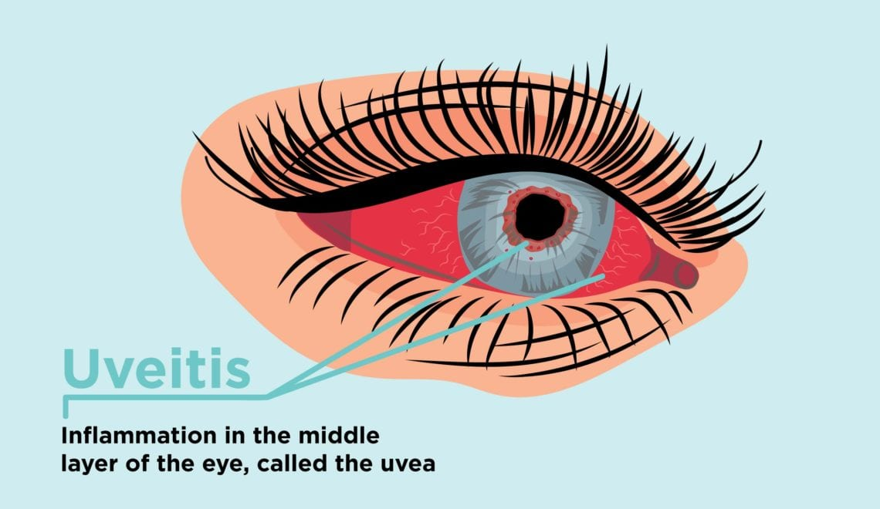
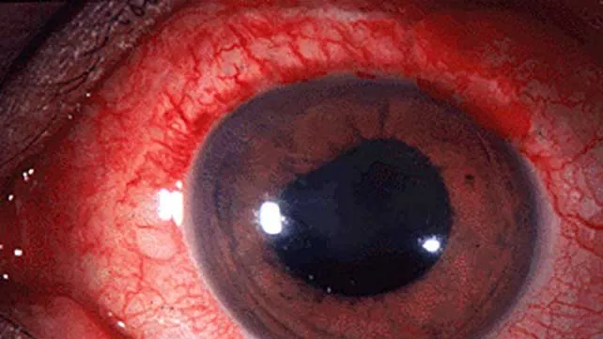
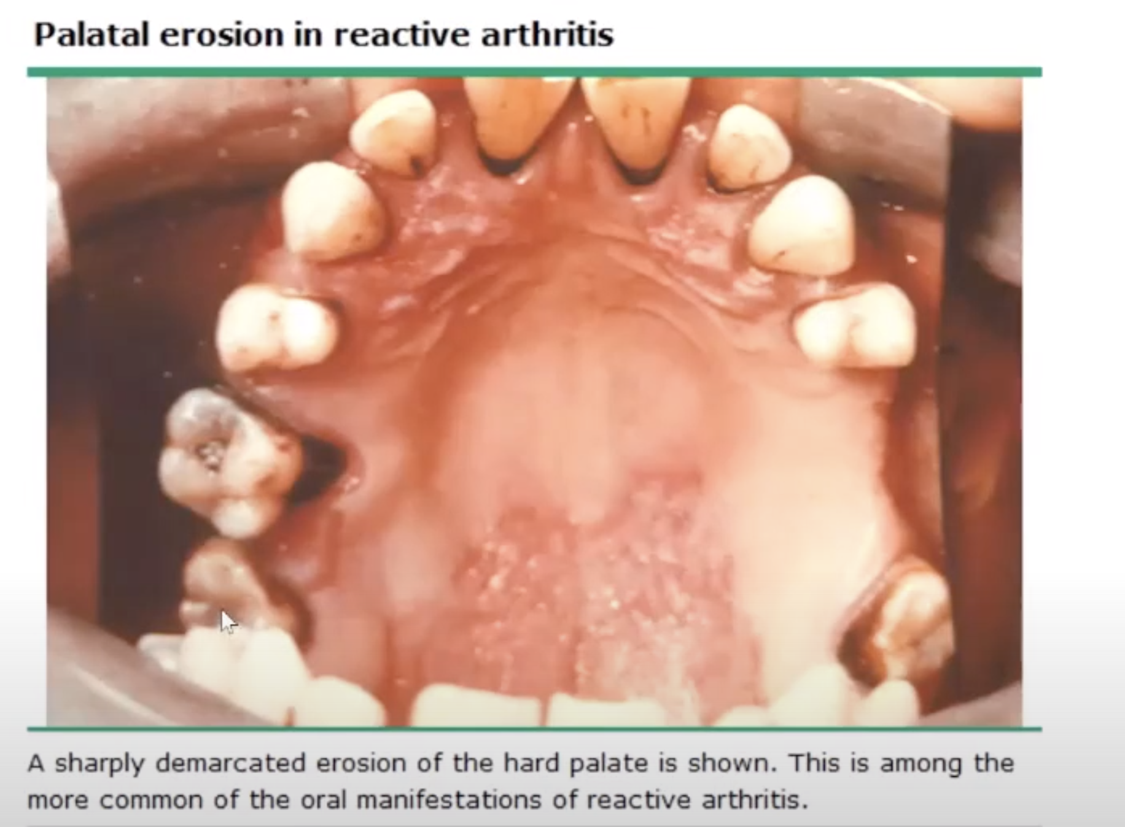
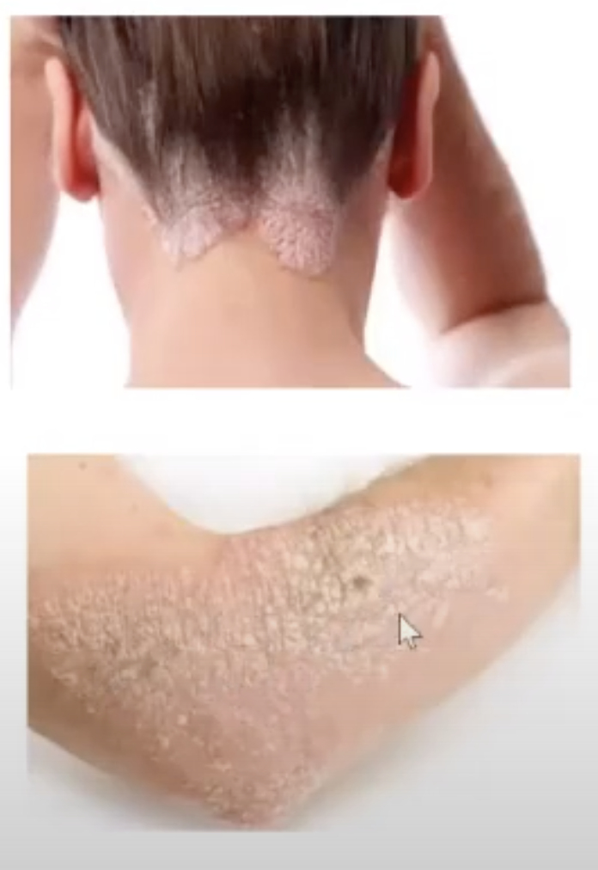
Introduction cont.
Features common to SpAs cont.
Peripheral arthritis
Predominantly involves the lower extremities (Hip, knee and ankle).
Arthritis is frequently ​ASYMMETRICAL inflammatory Mono/Oligoarthritis (affects only one to three joints)
The severity ranges from mild to disabling.
The presence of ​asymmetrical ​oligoarthritis is very suggestive of SpA. But, it’s absence would not be helpful in excluding this possibility.
Peripheral arthritis associated with IBD
Type 1 arthropathy | Type 2 arthropathy
Acute, pauciarticular The knee is the joint most commonly affected Early in the course of the bowel disease Self-limiting, nonerosive May occur prior to the onset of IBD → flares of the bowel disease | Polyarticular disease (MCP) joints being particularly involved Episodes of exacerbations and remissions may continue for years Articular involvement rarely preceded the diagnosis of IBD Joint symptoms may occur prior to the onset of IBD symptoms, and this form of arthritis is often associated with flares of the bowel disease
Other features
Pyoderma Gangrenosum
Erythema nodosum
History of inflammatory back pain
Sacroiliitis and spinal osteitis
Tendency for familial aggregation
Skin: Psoriasis (associated with all forms of SpA), Erythema nodosum, Pyoderma gangrenosum and Keratoderma blenorrhagicum
Uveitis
Sterile urethritis and/or prostatitis
Inflammatory bowel disease
Aortic root lesions (aortic incompetence, conduction defects)
Dactylitis
Others
Palatal erosion in reactive arthritis. A sharply demarcated erosion of the hard palate is shown. This is among the more common of the oral manifestations of reactive arthritis
Moderate to severe nail changes in patient with Psoriasis
Circinate balanitis characterized by shallow ulcers on the glans penis and the shaft of the penis (arrows). The lesions are generally asymptomatic.
Mild nail changes in a patient with psoriasis
Psoriasis. Scaly patches and plaques
Keratoderma Blenorrhagicum

Slide 5
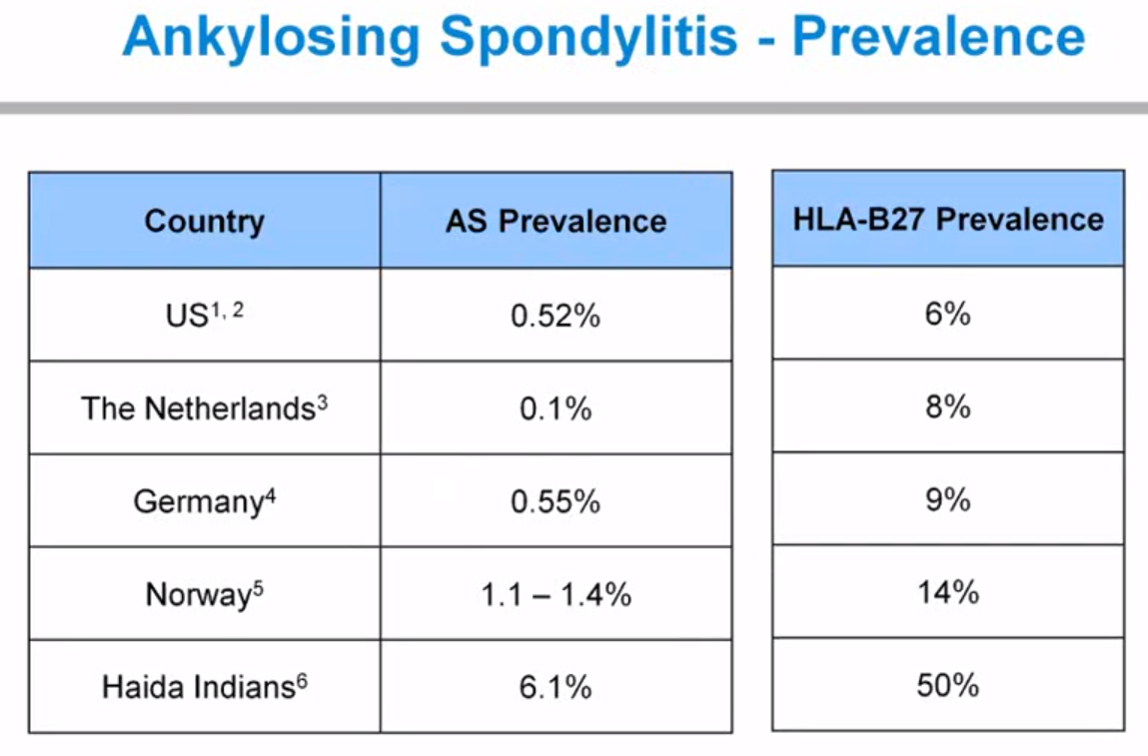
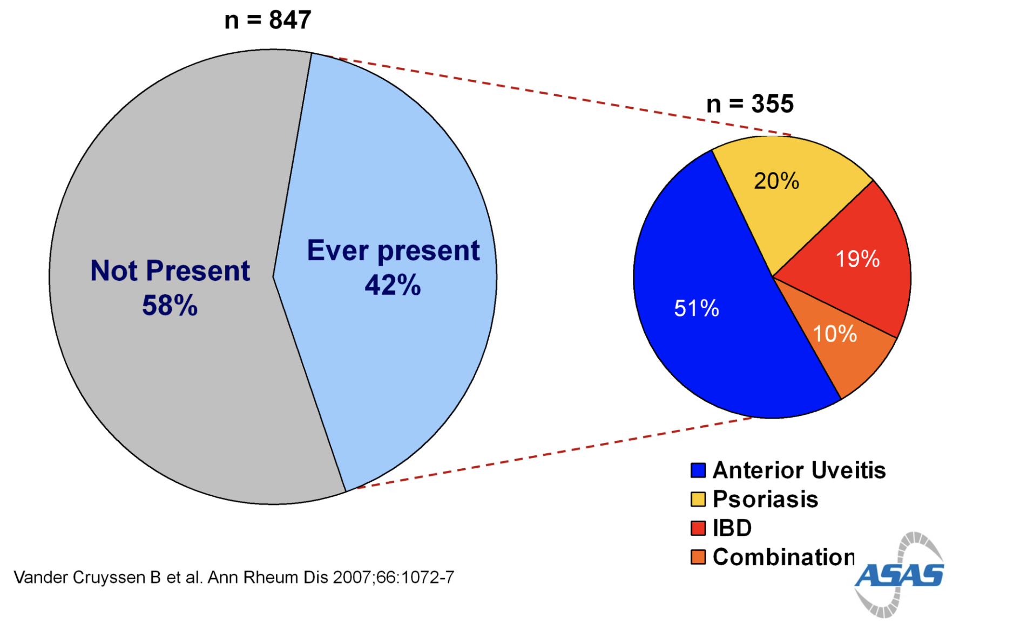
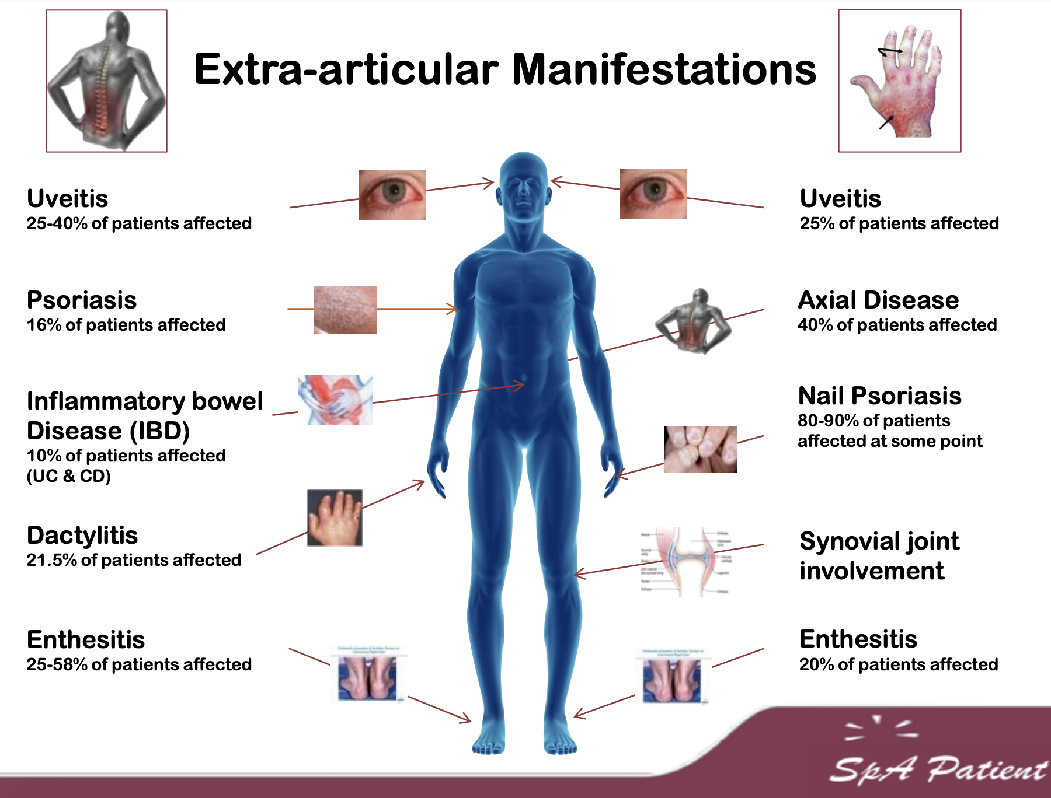
1- Ankylosing spondylitis (AS)
What is ankylosing spondylitis?
This is an inflammatory disorder of the spine, affecting mainly young adults.
Ankylosing spondylitis (AS) is defined by the presence of sacroiliitis on X-ray and other structural changes on spine X-rays, which may eventually progress to bony fusion of the spine. What if the changes (sacroiliitis) were only seen on MRI? then the term used is ‘Non-radiographic Axial spondyloarthritis (nr-axSpA)’ NOT ankylosing spondylitis.
In general, MRI is much more sensitive than X-ray in detecting sacroiliitis. In X-ray, changes will not appear until the disease is advanced, while in MRI you can sometimes see the changes as early as a day after the symptoms develop..
In the past, with the use of X-ray only, they used to say that AS is more common in males. But after MRI has been introduced this has changed:
Female gender generally >50% of non-radiographic axial SpA (detected by MRI or HLA-B27)
Male gender more common in AS study population
AS can affect any part of the spine, but most commonly affects the Sacroiliac (SI) joint. It also affects big joints like the knees and ankles.
Main features:
Loss of ​lumbar lordosis ( lumbar inward inversion) and increased kyphosis of the dorsal and cervical spine that may interfere with forward vision² Limitation of lumbar spine mobility. (Reduced spinal flexion is demonstrated by the​ ​Schober test​)
Extra-articular features
Acute anterior uveitis | Other features
Most common extra-articular manifestation of AS. Occasionally precedes joint disease. It’s unilateral with Acute onset Spontaneous remission Does NOT correlate with disease activity Recurrent & Related to HLA-B27. | Psoriasis (Present in up to 10% of pts with AS) Enthesitis:​ Achilles tendonitis and plantar fasciitis Tenderness​ around the pelvis and chest wall Transient ​peripheral arthritis​ of knees, hips, and shoulders (50%) Reduction in chest expansion​ (due to costovertebral joint involvement).
Etiology
The cause of AS is not completely understood, but there are theories that genetics is the major player in the pathogenesis of this disease.
Genome-wide studies have NOT revealed strong insights on the pathogenesis of new bone formation on AS. (Genetic influences, Microbes effects, Biochemical stress)
Many genes are involved but the major gene product associated with AS and the other forms of SpA is HLA-B27.
HLA-B27 is present in about 80 to 95% of patients with AS in most ethnic groups.
6% of the general population have the gene. Fewer than 5% of HLA-B27 carriers in the general population develop disease.
Familial predisposition: First, second, and third-degree relatives of patients with AS have markedly increased risks of developing the disease (relative risks of 94, 25, and 4, respectively).
Arthritogenic peptide hypothesis: (They simply injected the gene into a rat and it developed SpA)
HLA-B27-transgenic rats.
Microinjection of fertilized 1-cell rat eggs with DNA fragments containing both HLA-B*2705
Spontaneously developed several SpA-like disease manifestations beginning at age 10 weeks
The most common persistent manifestation: Diarrhea, Arthritis of the hind limbs, dystrophy of the nails and hyperkeratosis of the tail.
Dactylitis
Others
Clinical features
AS typically evolves slowly, with fluctuating symptoms of spinal inflammation; ankylosis develops in many patients over a period of many years.¹
Typical presentation
Young man (late teens, early 20s) who presents with ​low back pain and early morning stiffness with radiation to the buttocks or posterior thighs. Pain and stiffness improve with exercise, hot shower and worsen with rest. There is a ​progressive​ loss of spinal movement
AS patient with disappearance of the lordosis of the lumbar spine
1- Even if severe ankylosis develops, functional limitation may not be marked, as long as the spine is fused in an erect posture. In AS, spinal fusion varies in its extent and in most cases does not cause a gross flexion deformity.

Slide 6
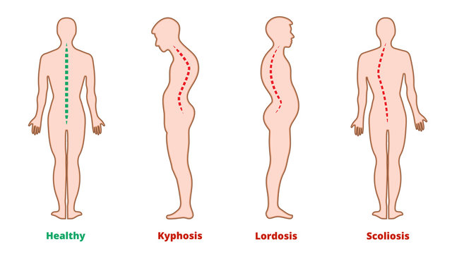
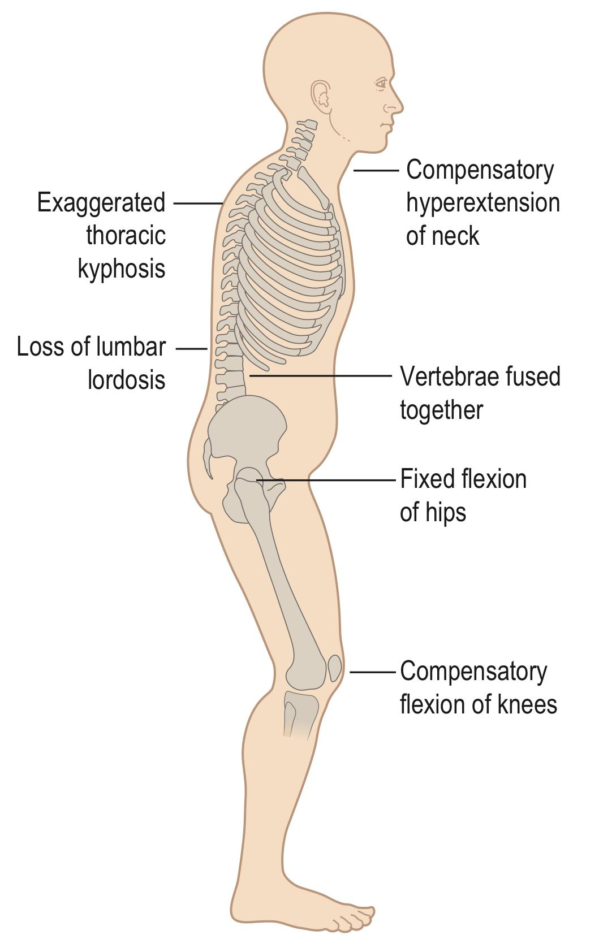
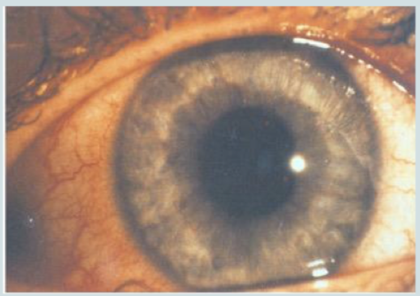
1- Ankylosing spondylitis (AS) cont.
Clinical features cont.
Articular features
Spine features | Other features
Loss of ​lumbar lordosis (lumbar inward inversion) and increased kyphosis of the dorsal and cervical spine that may interfere with forward vision¹ Limitation of lumbar spine mobility. (Reduced spinal flexion is demonstrated by the​ ​Schober test²​) | Enthesitis:​ Achilles tendonitis and plantar fasciitis Tenderness​ around the pelvis and chest wall Transient ​peripheral arthritis​ of knees, hips, and shoulders (50%) Reduction in chest expansion​ (due to costovertebral joint involvement).
That’s why early diagnosis is essential, to prevent such damage. Final stage can only be corrected by surgery
AS patient with disappearance of the lordosis of the lumbar spine (Early stage)
Final stage of AS with severe kyphosis of thoracic and cervical spine. Unable to look ahead while walking (patient cannot see the sun)
Extra-articular features
Acute anterior uveitis | Other features
Most common extra-articular manifestation of AS. Occasionally precedes joint disease. It’s unilateral with Acute onset Spontaneous remission Does NOT correlate with disease activity Recurrent Related to HLA-B27. Unlikely to cause vision changes (Usually presents with eye pain, redness) | Psoriasis (present in up to 10% of pts with AS) Fatigue, anaemia Prostatitis (80% of men) and sterile urethritis Inflammatory bowel disease (up to 50% have IBD lesions) Osteoporosis Cardiovascular disease (aortic valve disease 20%) Amyloidosis (rare) Atypical upper lobe pulmonary fibrosis (very rare)
Dactylitis
Others
1- This may prove incapacitating, especially when associated with fixed flexion contractures of hips or knees.
2- Spinal stiffness can be measured by Schober's test; the skin over the midline of the spine is marked 5 cm below and 10 cm above the dimples of Venus and the increase in distance between those marks during flexion is recorded. An increase of <5 cm implies spinal stiffness.

Slide 7
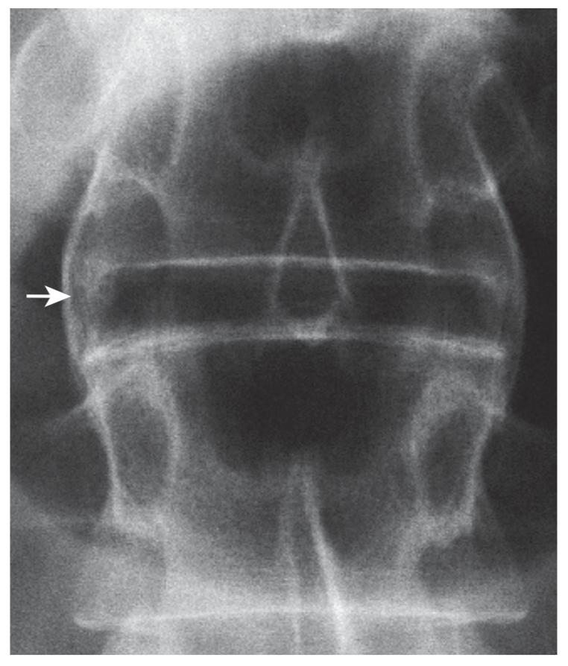
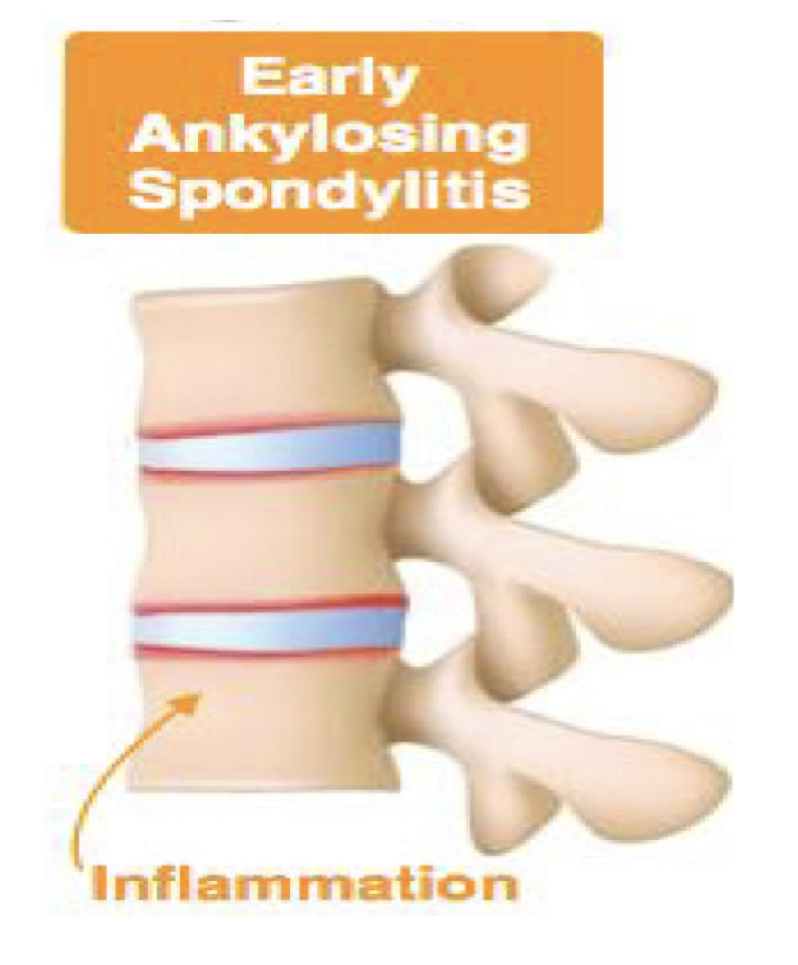
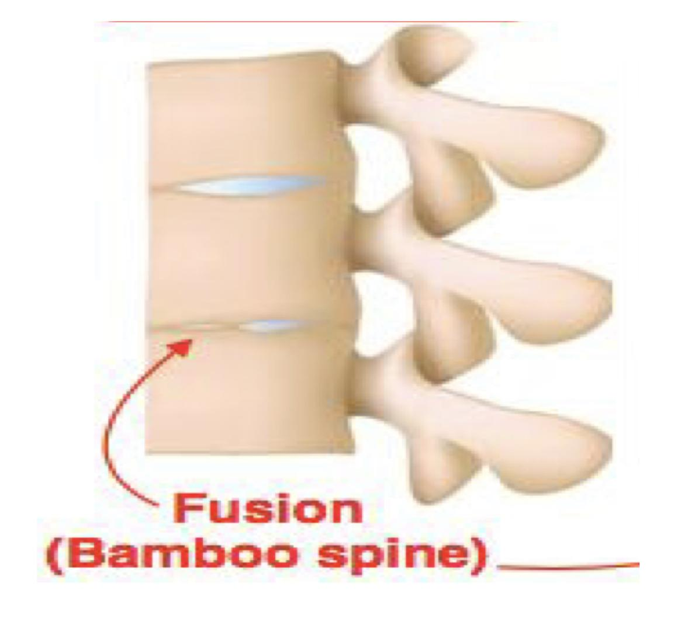
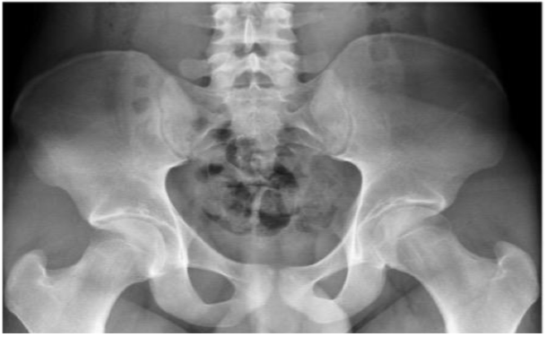
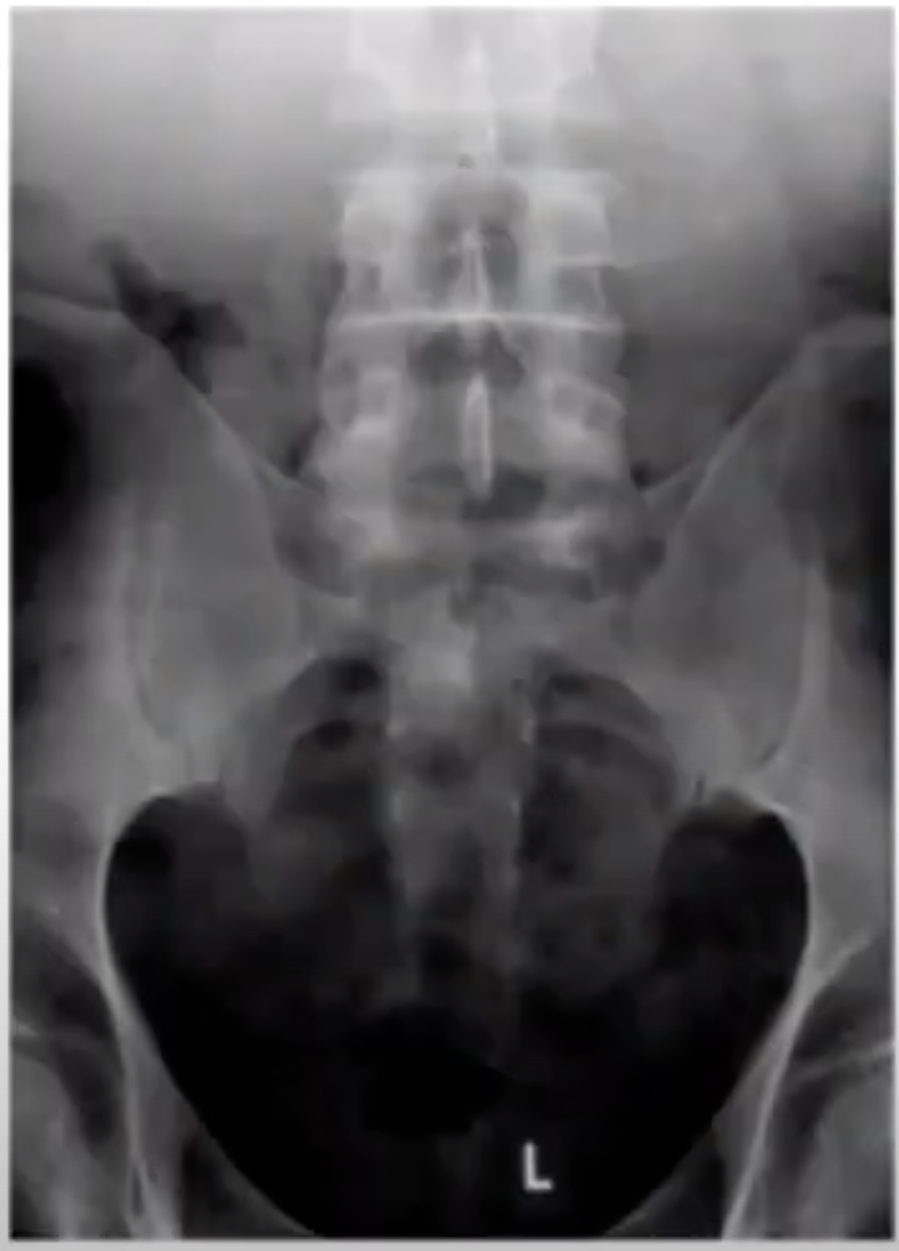
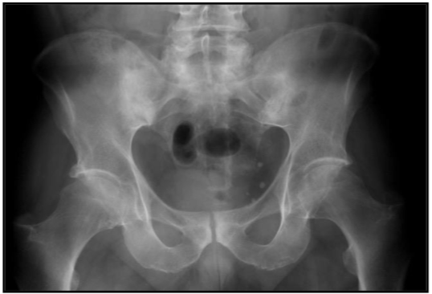
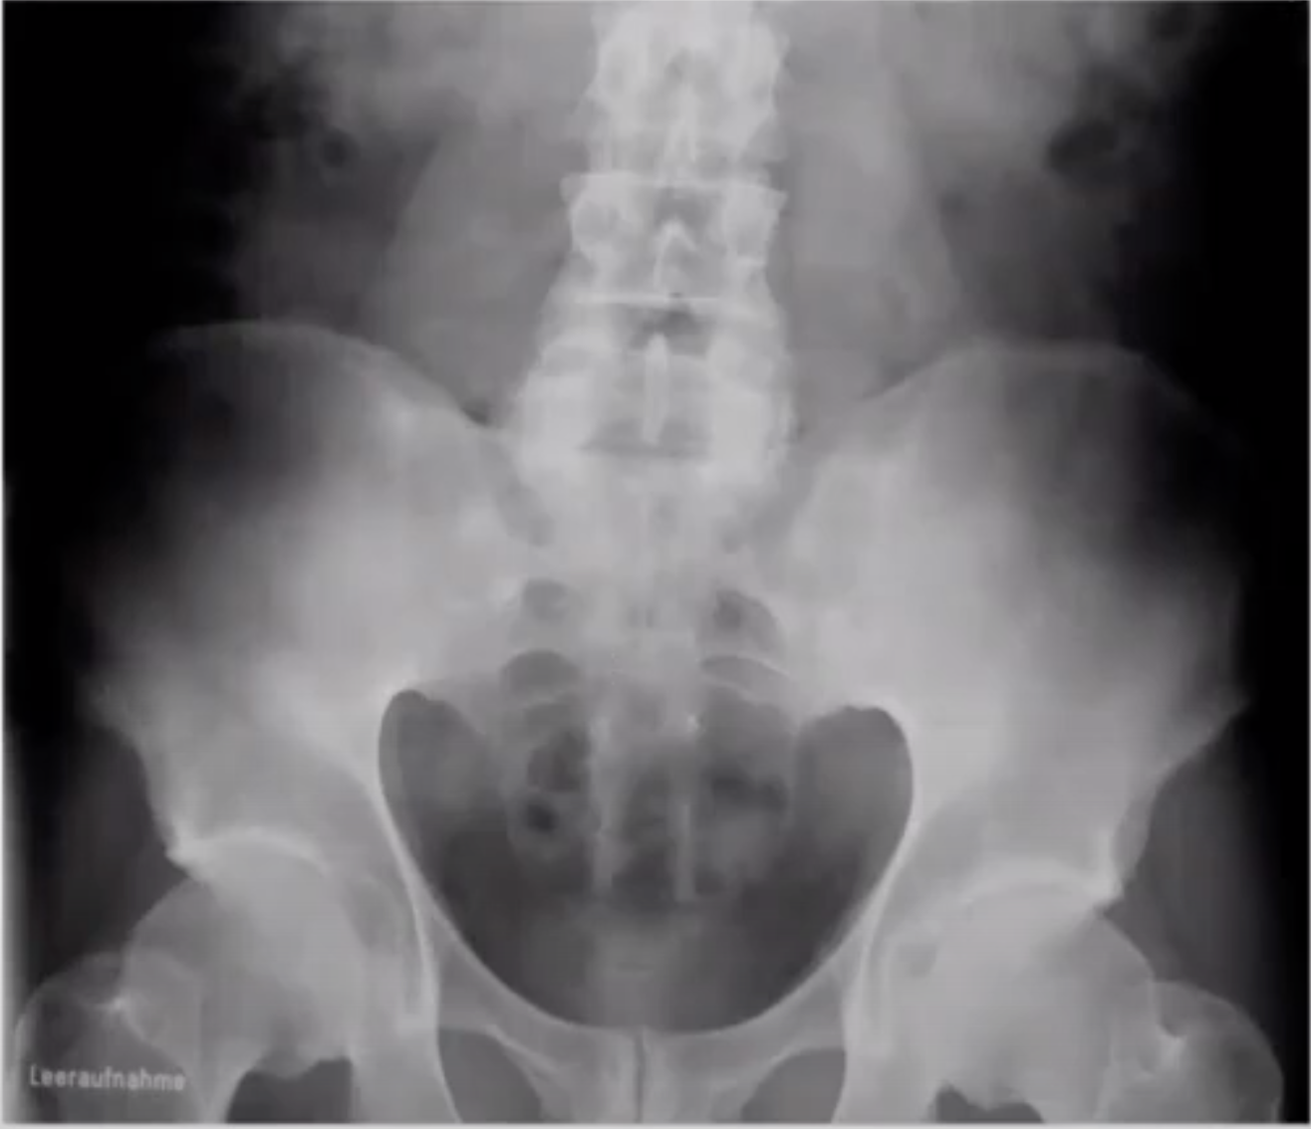
1- Ankylosing spondylitis (AS) cont.
Investigations
Fine symmetrical marginal syndesmophytes typical of ankylosing spondylitis (arrow)
X-ray (Best initial)
In AS, X-rays of the sacroiliac joint show irregularity and loss of cortical margins, widening of the joint space and subsequently sclerosis, joint space narrowing and fusion.
Lateral thoracolumbar spine X-rays may show anterior ‘squaring’ of vertebrae due to erosion and sclerosis of the anterior corners and periostitis of the waist.¹
Bridging syndesmophytes may also be seen.
A syndesmophyte is bony growth originating inside a ligament, commonly seen in the ligaments of the spine, specifically the ligaments in the intervertebral joints leading to fusion of vertebrae.
In advanced disease, ossification of the anterior longitudinal ligament and facet joint fusion may also be visible.
Calcification of the intervertebral ligaments and fusion of the spinal facet joints and syndesmophytes leads to what is often called a 'bamboo' spine
Erosive changes may be seen in the symphysis pubis, ischial tuberosities and peripheral joints.
Grading of Radiographic Sacroiliitis (1966)
Grade 0 | Normal
Grade 1 | Suspicious changes (MRI should be performed)
Grade 2 | Minimal abnormality: Small localized areas with erosion or sclerosis, without alteration in the joint width
Grade 3 | Unequivocal abnormality: Moderate or advanced sacroiliitis with one or more of: erosions, evidence of sclerosis, widening, narrowing, or partial ankylosis “Partial Fusion”
Grade 4 | Severe abnormality: Total ankylosis “Total Fusion”
Dactylitis
Others
Grade 0 (Normal) | Grade 1,2
Grade 3 | Grade 4
You can see the SI joint clearly
Grade 2 right, Grade 1 left
Bilateral, you will not be able to see the sacroiliac joint (Total fusion)
1- The earliest radiological appearances in the spine X ray are (blurring)​ of the upper or lower vertebral rims at the thoracolumbar junction (best seen on a lateral X-ray), caused by an enthesitis at the insertion of the intervertebral ligaments.

Slide 8
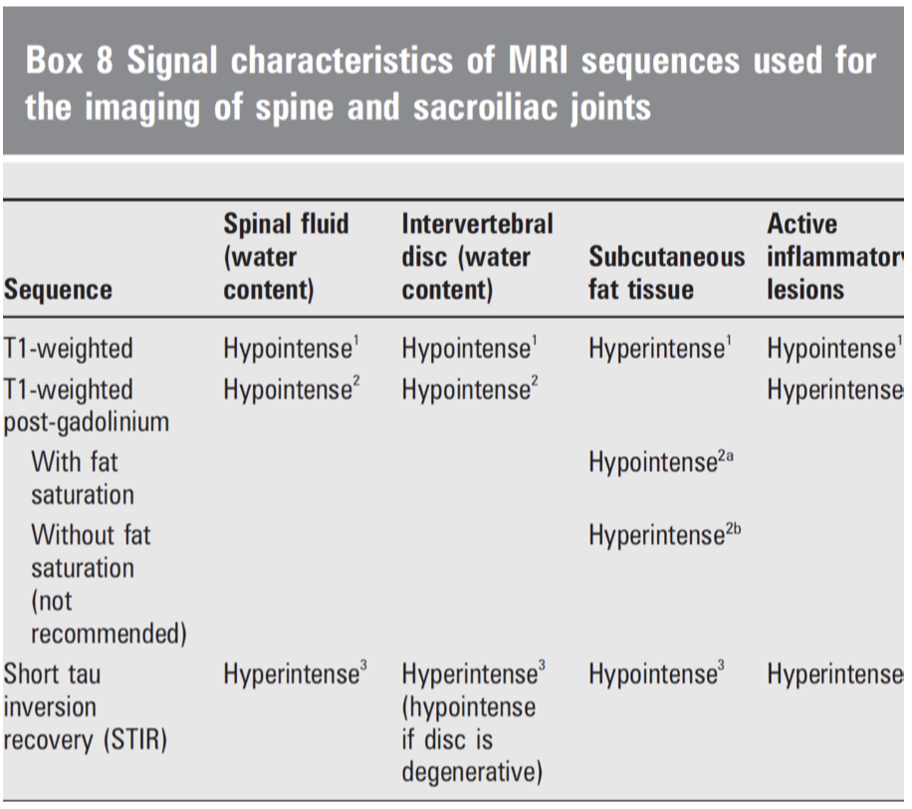
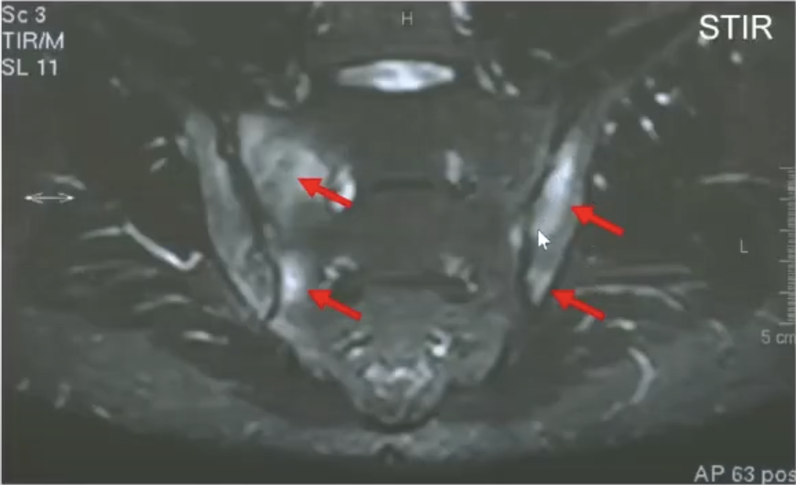
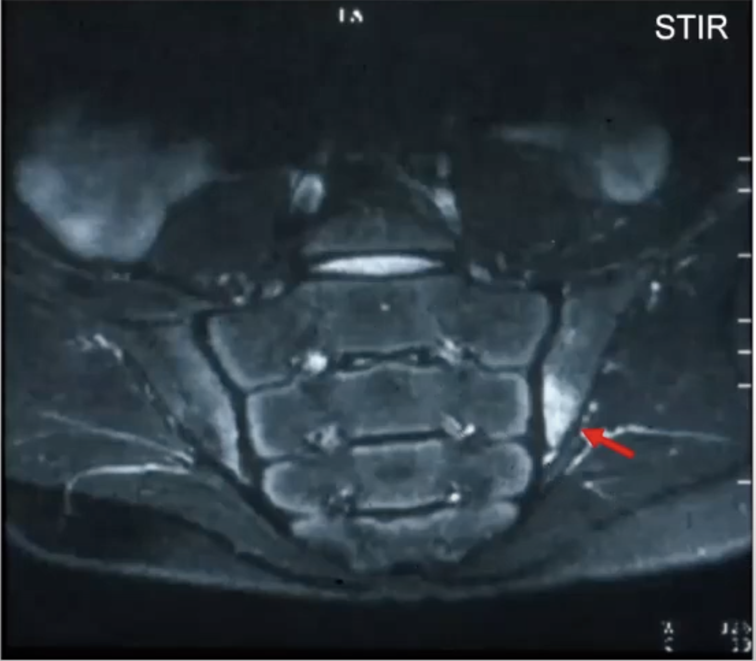
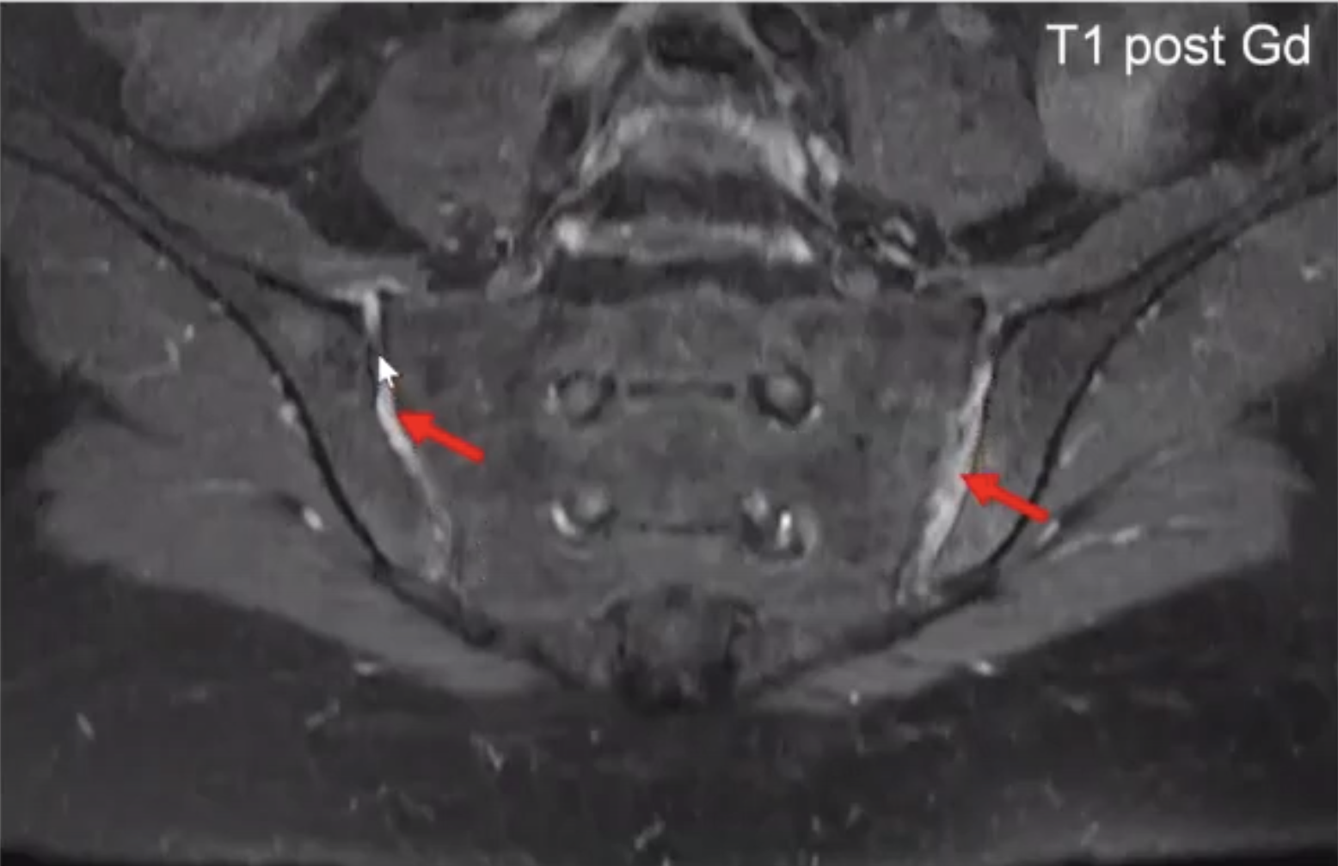
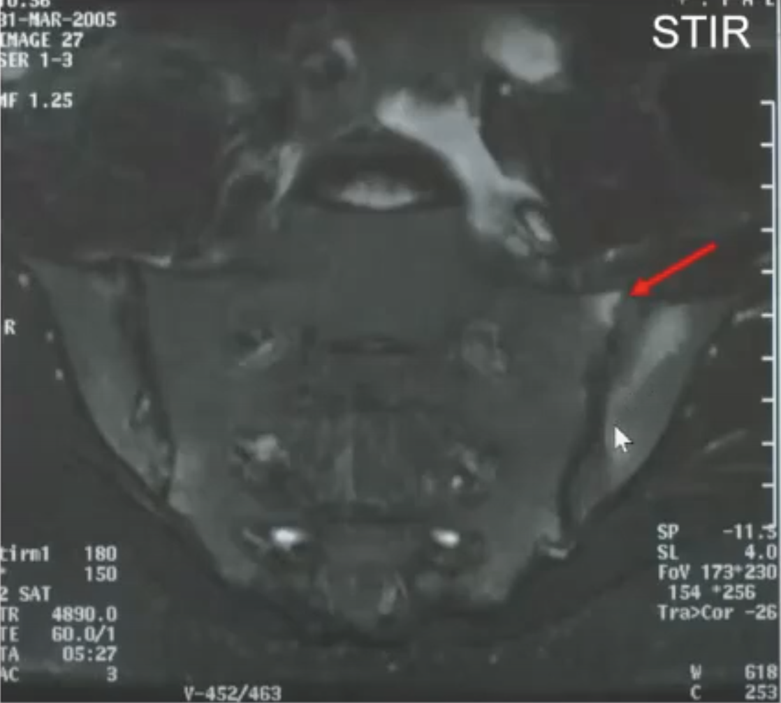
1- Ankylosing spondylitis (AS) cont.
EXTRA
Investigations cont.
MRI (Most accurate)
MRI with gadolinium is more sensitive for detection of early sacroiliitis than X-rays and can also detect inflammatory changes in the lumbar spine, as well as persistent enthesitis.
Definition of positive MRI-SI joint:
Subchondral bone marrow edema
Acute bilateral sacroiliitis
Early (limited) sacroiliitis (Bone marrow edema). Normal SI joint but there's inflammation surrounding it (red arrow)
Synovitis of sacroiliac joint
Bone marrow edema (BME)/Osteitis:
Bone marrow edema may be associated with structural changes such erosions
In the past , diagnosis was based on x-ray only which is not really sensitive and can’t detect early changes in the disease leading to a lot of misdiagnosed cases. This has changed in the new criteria (2008), in which MRI and HLA-B27 testing has been introduced
Dactylitis
Others
Lab tests
Acute phase response (ESR & CRP):
Increased in between 35-50% of patients with axial SpA.
Elevated levels of CRP are also a predictor of radiographic progression and for a good response to tumor necrosis factor(TNF)-blocker therapy.
If ESR or CRP is normal this doesn’t exclude AS.
HLA-B27:
Positive in 90% of AS patient. (also positive in 6% of general population)
50-70% of patients with other forms of SpA
A positive HLA-B27 by itself is not diagnostic of SpA (criteria will be discussed next page)
Serology:
Autoantibodies, such as RF, ACPA and ANA, are negative.
T1 shows: Bone (structural) changes “Erosion or fusion” T2 shows: Bone marrow inflammation

Slide 9
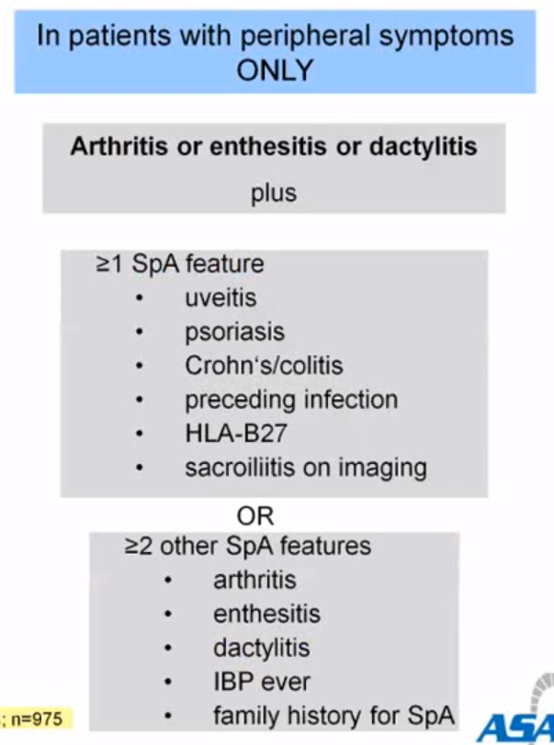
1- Ankylosing spondylitis (AS) cont.
EXAM Q
ASAS criteria
ASAS classification criteria for axial spondyloarthritis (SpA):
This criteria only applies to:
Patients with ≥ 3 months back pain and age at onset <45 years¹
Criteria
Sacroilitis on imaging*
+
≥ 1 SpA feature
Or
+ve HLA-B27
+
≥ 2 other SpA features
* Sacroilitis on imaging:
Active (acute) inflammation on MRI highly suggestive of sacroiliitis associated with SpA
Definite radiographic (x-ray) sacroiliitis according to mod NY criteria (See the pic below)
SpA features
Dactylitis (Sausage digit)
Psoriasis
Positive family history for SpA
Inflammatory back pain
Good response to NSAIDS
Enthesitis (heel)
Arthritis
Crohn’s/colitis
HLA-B27
Uveitis (Eye)
Elevated CRP
SPINE-ACHE
Q: Can we diagnose AS without imaging? Yes, by positive HLA-B27 + ≥ 2 other features
If the pt has only peripheral symptoms, use this criteria:
Others
1- Because AS starts early, 16-45 y/o (But be careful, if a pt presents in his 50s this does not necessarily mean that he doesn’t have the disease, you should ask him/her when did the symptoms start, this is a more accurate way, bc it might have started in his 30s but the pt presented to you in his 50s.)

Slide 10
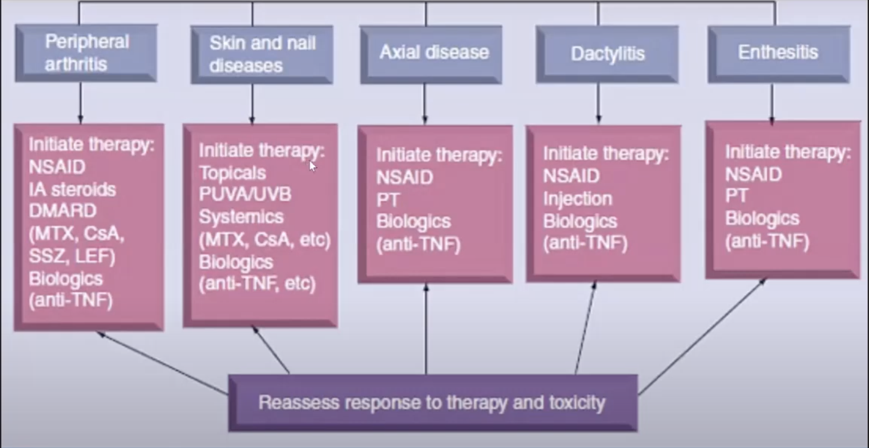
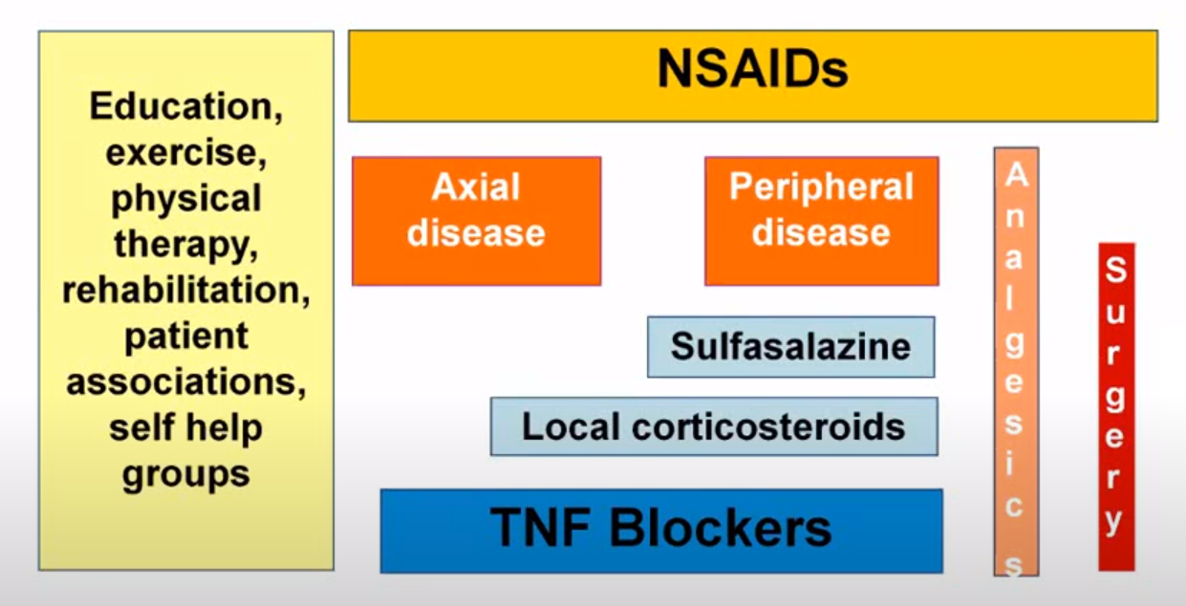
1- Ankylosing spondylitis (AS) cont.
Treatment
Aims and outcomes of therapy in AS:
Decrease signs and symptoms (Disease activity, pain, morning stiffness, fatigue)
Improve spinal mobility, activity, participation, productivity and quality of life
Prevent osteoproliferative and osteodestructive changes in the axial skeleton and peripheral joints and entheses
ASAS/EULAR Recommendations for the Management of Ankylosing Spondylitis:
Education, Exercise, Physical therapy, Rehabilitation, Patient association, Self help groups
NSAIDS
Axial disease
Peripheral disease
Analgesics
NSAIDS
Sulfasalazine
+ Local corticosteroids
Surgery
Axial disease
Peripheral disease
Sulfasalazine
skipped by dr
TNF blockers
Analgesics
Local corticosteroids
Surgery
TNF blockers
Explanation:
First line: NSAIDs (e.g. Diclofenac, Ibuprofen) to relieve symptoms
Second line: (To prevent further damage)
Axial (spine) AS: Biologic therapy (Anti-TNF or IL-17 inhibitors)
Peripheral (e.g. knee) AS: Sulfasalazine ± Local corticosteroids, didn’t work? → Anti-TNF or IL-17 inhibitors
Sulfasalazine & Local corticosteroids are NOT used for axial AS! Anti-TNF can treat axial and peripheral arthritis, it can also treat all the associated features e.g. uveitis, enthesitis and skin psoriasis
Drug names
TNF-blockers:
Adalimumab (the best)
Infliximab
Etanercept
Golimumab
Certolizumab
IL-17 inhibitors:
Secukinumab
Ixekizumab
Put a new title and start PsA here
2- Psoriatic Arthritis (PsA)
Definition
Dactylitis
Others
Arthritis associated with psoriasis, which is a scaly rash, most frequently occurring on the elbows, knees, and scalp
Has 2 main identifying features:
Psoriasis
Other manifestations such as: Peripheral arthritis, Spondylitis, tenosynovitis, enthesitis and dactylitis.
Note: Psoriatic plaques typically precede development of the arthritic component.
20-30% of psoriasis patients will develop psoriatic arthritis
Ankylosing spondylitis and PsA are very similar, there are two key features to differentiate between them:
In ankylosing spondylitis: patient develops back pain FIRST, then it may progress to develop psoriasis. While in psoriasis arthritis the patient presents with Psoriasis FIRST, then slowly develops back pain
The arthritis in AS involves the large joints, mainly lower extremity. While in PsA the arthritis involves the joints of the hands, mainly small joints.

Slide 11
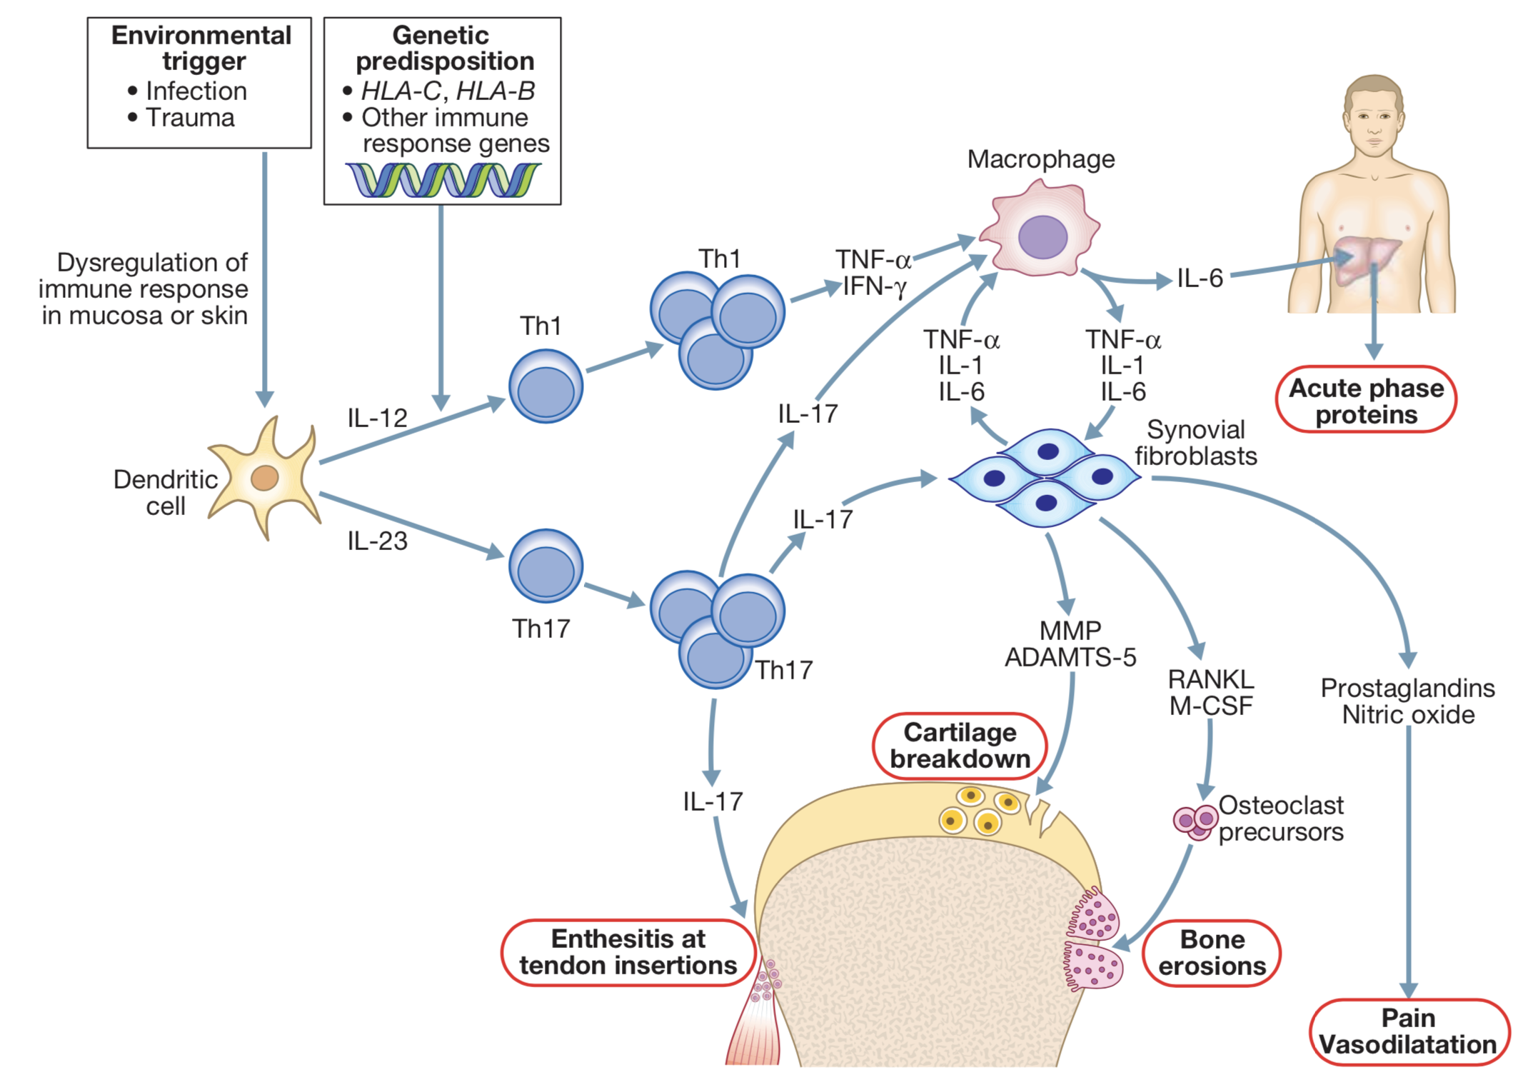
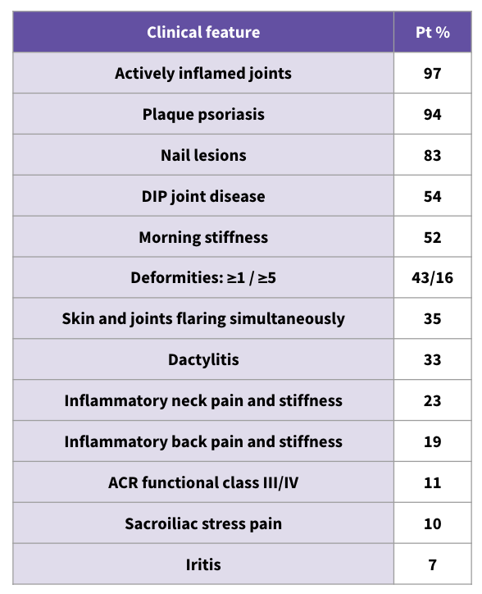
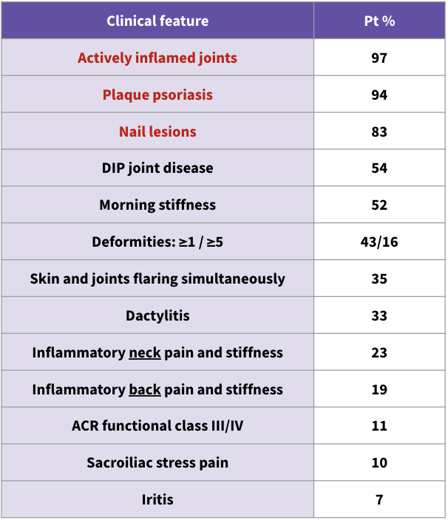
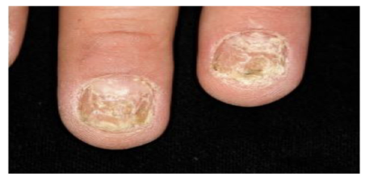
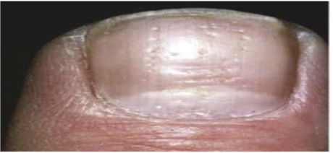
OBJ.
2- Psoriatic Arthritis (PsA) cont.
Clinical feature | Pt %
Actively inflamed joints | 97
Plaque psoriasis | 94
Nail lesions | 83
DIP joint disease | 54
Morning stiffness | 52
Deformities: ≥1 / ≥5 | 43/16
Skin and joints flaring simultaneously | 35
Dactylitis | 33
Inflammatory neck pain and stiffness | 23
Inflammatory back pain and stiffness | 19
ACR functional class III/IV | 11
Sacroiliac stress pain | 10
Iritis | 7
Pathogenesis of PsA
PsA is a chronic progressive disease. Genetic factors have an important role in PsA and family studies have suggested that heritability may exceed 80%. Variants in the HLA-B and HLA-C genes are the strongest genetic risk factors.
Synovial hyperplasia and cellular infiltration:
Pannus formation
Cartilage erosion
Prominent role for cytotoxic (CD8+) T cells
Increased levels of TNFα found in joint:
Pro-inflammatory effect
Stimulation of proteases
Associated enthesitis present.
Skin changes
Swelling
Affected nails
Mutations
Time/Years
Clinical features of PsA
The presentation is with pain and stiffness affecting joints, tendons, spine and entheses. Joints are typically not swollen; however, several patterns of joint involvement are recognised (see next page).
Dactylitis
Others
Plaque psoriasis: Scaly rash, most frequently occurring on the scalp, elbows and knees
Moderate to severe nail changes in patient with Psoriasis
Fingernail pitting

Slide 12
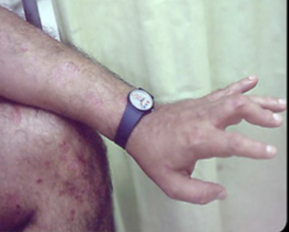
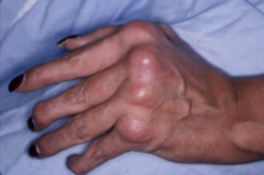
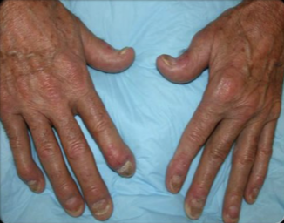
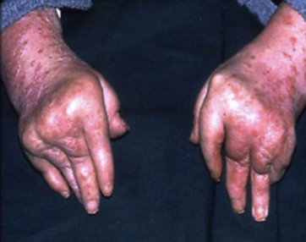
OBJ.
2- Psoriatic Arthritis (PsA) cont.
Patterns of joint involvement in PsA
Some features are common to nearly all patterns of PsA:
Morning stiffness
Nail disease which are onycholysis, ridging and pitting.
Joint pain
Pattern | Features | Rate
Asymmetrical oligoarthritis | Usually involves small joints, less frequently involves large joints It occurs most characteristically in the hands and feet, when synovitis of a finger or toe is coupled with tenosynovitis, enthesitis and inflammation of intervening tissue to give a ‘sausage digit’ or dactylitis Normally oligoarthritis (≤4 joints) Asymmetric psoriatic arthritis does not affect matching pairs of joints on opposite sides of the body. Arthritis onset usually develop after the psoriasis. | 47%
Symmetrical polyarthritis | Involves small joints and large joints Symmetric psoriatic arthritis affects the same joints -- usually in multiple matching pairs -- on opposite sides of the body. Symmetric psoriatic arthritis can be disabling, causing varying degrees of progressive, destructive disease and loss of function in 50% of people with this type of arthritis More common in women May be RF positive (clinically similar to RA)¹ Arthritis onset may develop concurrently with psoriasis | 25%
Psoriatic Spondylitis | SIJ and vertebrae affected asymmetrically More common in men This type presents with inflammatory back or neck pain and prominent stiffness symptoms May coexist with peripheral PsA Enthesitis prevalent. Coarse, asymmetrical non-marginal syndesmophytes. Arthritis onset usually develop after the psoriasis | 23%
DIP synovitis | Restricted to only DIP joints.² Distal interphalangeal predominant psoriatic arthritis involves primarily the small joints in the fingers and toes closest to the nail. With nail dystrophy in the affected digit. DIP psoriatic arthritis is sometimes confused with osteoarthritis, a chronic disease that causes the deterioration of joint cartilage and bone at the joints. Associated with dactylitis Associated with psoriatic nail disease
Arthritis mutilans | This is a deforming destructive erosive arthritis targeting the fingers and toes closest to the nails (Joint lysis) Prominent cartilage and bone destruction results in marked instability. The encasing skin appears invaginated and ‘telescoped’ (‘main en lorgnette’) and the finger can be pulled back to its original length. | 5% (rare)
Dactylitis
Others
1- Nodules and other extra-articular features of RA are absent and arthritis is generally less extensive and more benign.
2- Both rheumatoid arthritis and psoriatic arthritis affect the hands. However, in psoriatic arthritis patients have psoriasis and Distal interphalangeal joint ​(DIP) involvement.​ In contrast, ​DIP joint is spared in RA.

Slide 13
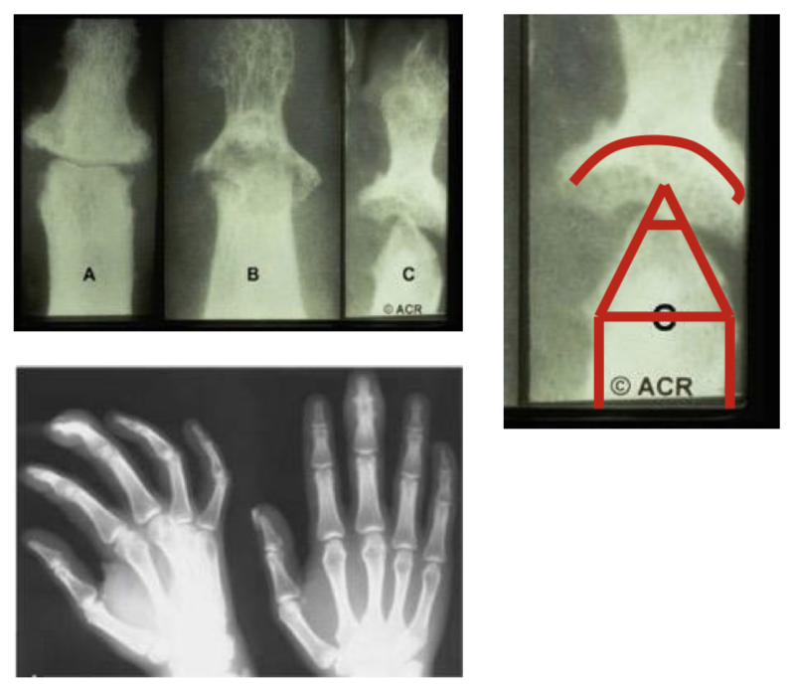
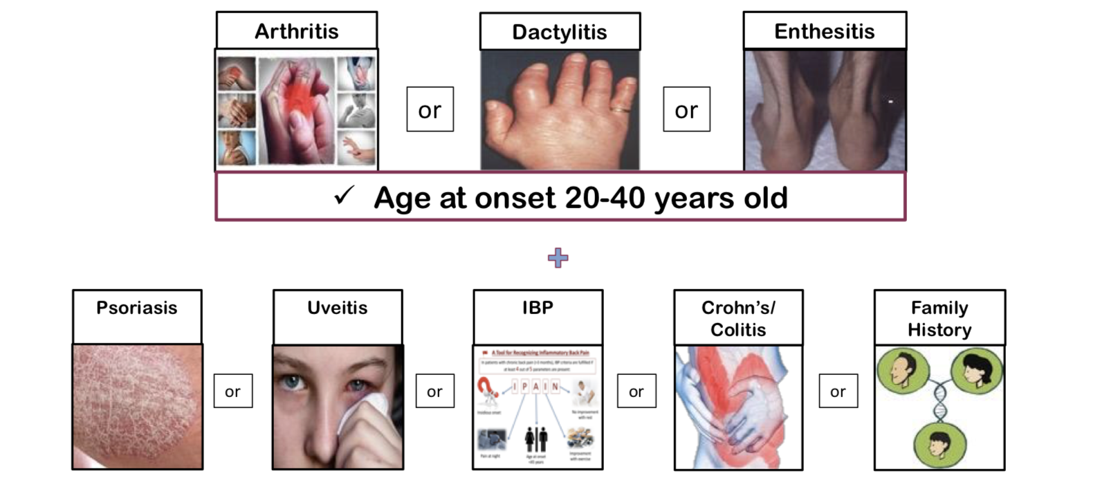
OBJ.
2- Psoriatic Arthritis (PsA) cont.
Investigations
Arthritis in the presence of psoriasis is the key to clinical diagnosis.
The onset of arthritis depends on the subtype:
Delayed after psoriasis onset: Asymmetrical, Spondylitis.
Concurrent with psoriasis: Symmetrical.
Diagnosis is clinical and radiographic.
1
Blood tests
Autoantibodies are generally negative
Acute phase reactants, such as ESR and CRP, are raised in only a proportion of patients with active disease but are often normal.
2
X-Ray
(Best initial)
Characteristic peripheral joint destruction progresses to cause a “pencil in cup” appearance
Radiologically, psoriatic arthritis is erosive but the erosions are central in the joint, not juxta-articular.
In spondylitis subtype, may also see sacroiliitis and changes in the spine.
3
MRI and US
MRI and ultrasound with power Doppler are increasingly employed to detect synovial inflammation and inflammation at the entheses.
Dactylitis
Others
Diagnosis algorithm
Start confirmation
Involved joints in X-ray
HLA B27
Present?
Connect to Rheumatologist

Slide 14
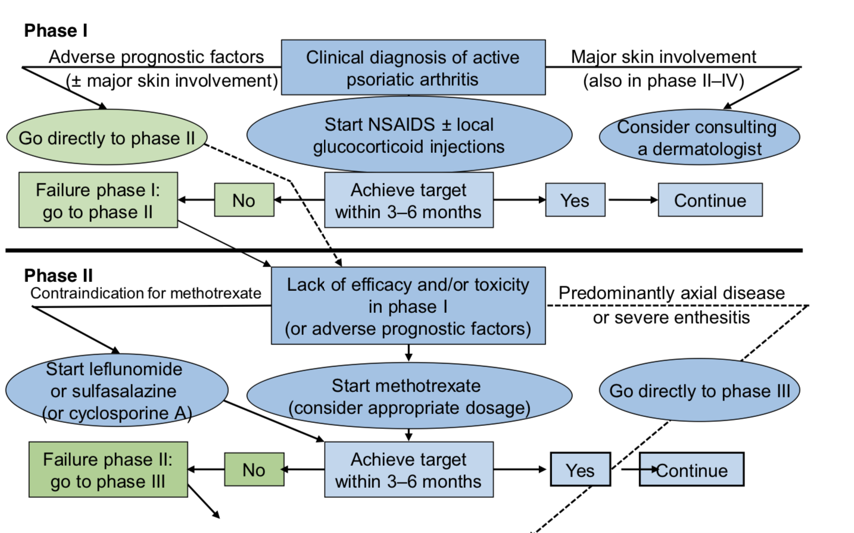
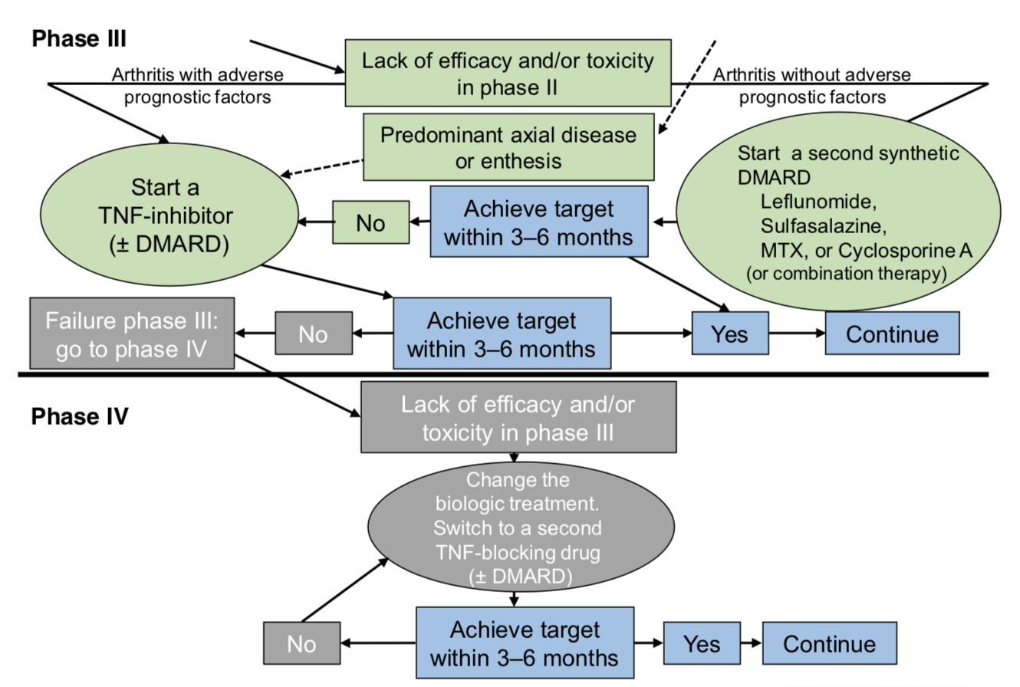
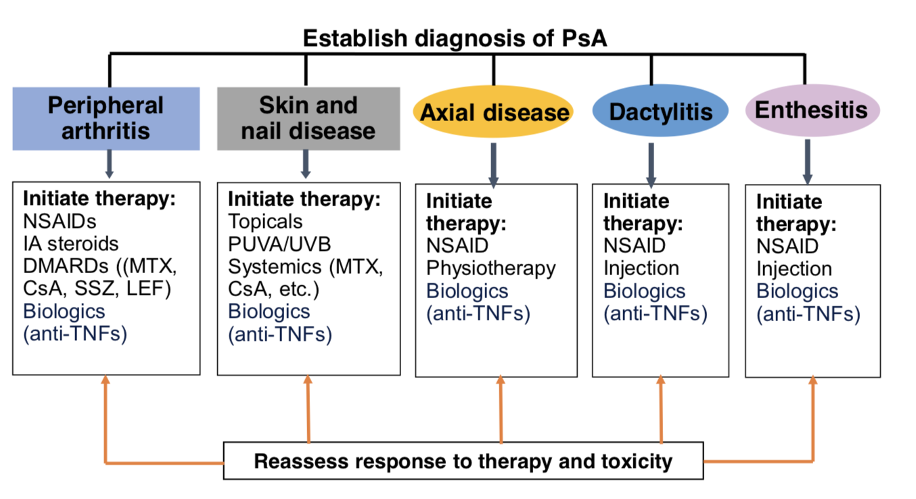
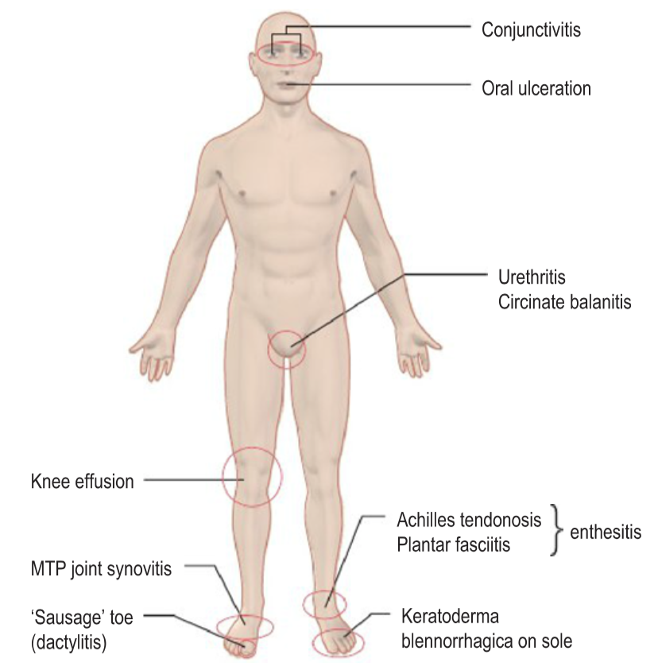
2- Psoriatic Arthritis (PsA) cont.
Treatment
EULAR Treatment Algorithm for PsA
Same as AS, except that we start with methotrexate instead of sulfasalazine (Oral corticosteroids may destabilize skin disease; they are best avoided. Local synovitis responds to intra-articular CS injections.)
First line: NSAIDs
Second line: Methotrexate (Only treats peripheral disease). If MTX fails, start them on sulfasalazine. if sulfasalazine fails then give biologic therapy.
Third line: Biologic Therapy (TNF blockers/IL-17 Inhibitors) (If Axial, use biologic therapy as 2nd line instead of MTX and sulfasalazine)
3- Reactive arthritis (ReA)
Definition
Reactive (spondylo)arthritis (ReA) is a ‘reaction’ to a number of bacterial triggers with clinical features in keeping with all SpA conditions. It’s simply sterile synovitis, which occurs following an infection.
Formerly called Reiter syndrome, classic triad: Conjunctivitis, Urethritis, Reactive Arthritis
GRAPPA Treatment Recommendations for PsA (2009)
Etiology
Preceding enteric infection (i.e. diarrhea)
Salmonella of various serovars
Shigella, especially Shigella flexneri, but also dysenteriae and sonnei.
Yersinia including Yersinia enterocolitica 0:3 and 0:9 and Yersinia pseudotuberculosis
Campylobacter especially campylobacter jejuni
Clostridium difficile
Preceding genitourinary infection (i.e. urethritis)
Chlamydia trachomatis
Note: The arthritis associated with rheumatic fever is also an example of a reactive arthritis that is not associated with HLA-B27.
Clinical features
Dactylitis
Others
The typical case is a young man who presents with an acute arthritis shortly (within 4 weeks, it never occurs in the first 2 weeks) after an enteric or sexually acquired infection.
The onset is typically acute, with an inflammatory enthesitis, oligoarthritis and/or spinal inflammation.
Lower limb joints and entheses (Achilles insertional enthesitis) are predominantly affected in an asymmetrical pattern.
Low back pain and stiffness due to enthesitis and osteitis are common and 15–20% of patients develop sacroiliitis.
Circinate balanitis, which starts as vesicles on the coronal margin of the prepuce and glans penis, later rupturing to form superficial erosions with minimal surrounding erythema, some coalescing to give a circular pattern
keratoderma blennorrhagica, which begins as discrete waxy, yellow–brown vesico-papules with desquamating margins, occasionally coalescing to form large crusty plaques on the palms and soles of the feet
Nail dystrophy

Slide 15
OBJ.
3- Reactive arthritis cont.
Investigations
The diagnosis is usually made clinically but joint aspiration may be required to exclude crystal arthritis and articular infection.
Joint aspirate: Aspirated synovial fluid is sterile, with a high neutrophil count.
ESR and CRP are raised, urethritis may be confirmed in the ‘two-glass test’ by demonstration of mucoid threads in the first-void specimen that clear in the second.
High vaginal swabs may reveal Chlamydia on culture.
Except for post-Salmonella arthritis, stool cultures are usually negative by the time the arthritis presents but serology may help confirm previous dysentery.
Serology: RF, ACPA and ANA are negative.
Radiology:
In contrast to AS, radiographic sacroiliitis is often asymmetrical and sometimes unilateral, and syndesmophytes are predominantly coarse and asymmetrical, often extending beyond the contours of the annulus (‘non-marginal’).
Radiographic changes in the peripheral joints and spine are identical to those seen in psoriasis.
Treatment
Acute ReA → rest, NSAIDs and analgesics.
Monarticular synovitis → Intra-articular glucocorticoids
Polyarticular disease → Systemic glucocorticoids
If chlamydial urethritis is diagnosed, it should be treated empirically with a short course of doxycycline or a single dose of azithromycin.
Relapsing cases, persistent marked symptoms, recurrent arthritis or severe keratoderma blennorrhagica. → Treatment with DMARDs (usually sulfasalazine or methotrexate)
Anterior uveitis is a medical emergency requiring topical, subconjunctival or systemic glucocorticoids.
For DMARD-recalcitrant cases, anti-TNF therapy should be considered.
Note: There is no convincing evidence for the use of antibiotics unless a triggering infection is identified.
Dactylitis
Others

Slide 16
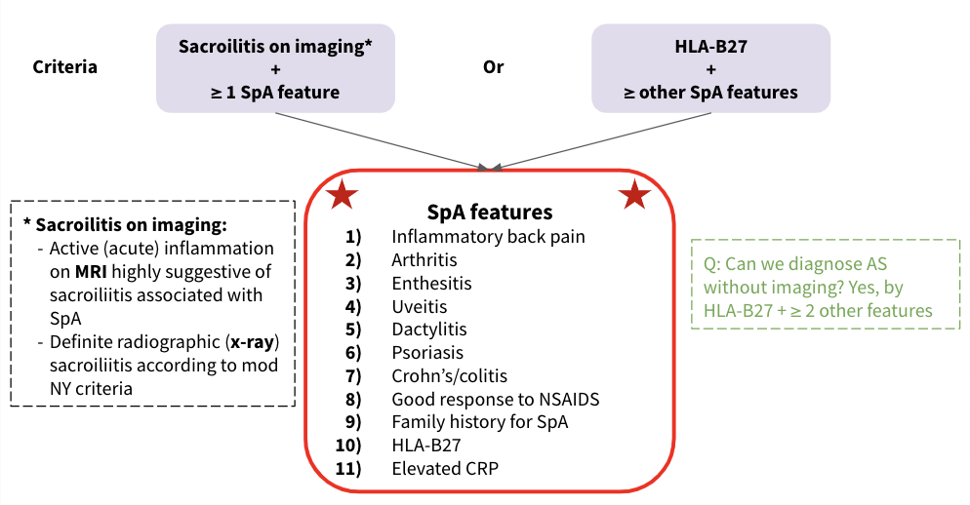
Ankylosing spondylitis
Definition | Ankylosing spondylitis (AS) is defined by the presence of sacroiliitis on X-ray and other structural changes on spine X-rays, which may eventually progress to bony fusion of the spine. SI joint is the most common to be affected.
Association | HLA-B27
Typical presentation | Young man (late teens, early 20s) who presents with low back pain and early morning stiffness with radiation to the buttocks or posterior thighs. Pain and stiffness improve with exercise, hot shower and worsen with rest. There is a progressive loss of spinal movement
Other features | Anterior uveitis Loss of Lordosis Kyphosis
Investigations | X-ray (Best initial) Sacroiliac joint show irregularity and loss of cortical margins, widening of the joint space and subsequently sclerosis, joint space narrowing and fusion. MRI (most accurate) More sensitive than x-ray
Criteria
Treatment | First line: NSAIDs (e.g. Diclofenac, Ibuprofen) to relieve symptoms Second line: Axial AS: Biologic therapy (Anti-TNF or IL-17 inhibitors) Peripheral AS: Sulfasalazine, failed? → Local corticosteroids, failed? → Anti-TNF or IL-17 inhibitors NOTE: Sulfasalazine & Local corticosteroids are NOT used for axial AS! Anti-TNF can also treat all the associated features e.g. uveitis, enthesitis, peripheral arthritis, skin psoriasis

Slide 17
Q1: A 23-year-old man presents to the rheumatology clinic with lower back and hip pain. These have been occurring every day for the past two months. Pain and stiffness are worse in the mornings. He also mentions that his right heel has been hurting. He is previously fit and well, but had occasions of lower back pain when he was a teenager. His symptoms have stopped him from playing tennis. Recent blood tests organized by his GP have shown a raised C-reactive protein (CRP) and erythrocyte sedimentation rate (ESR). What is the most appropriate treatment?
A- NSAID and spinal exercises
B- NSAID and bed rest
C- Oral prednisolone
D- Methotrexate plus sulfasalazine
E- Bed rest
Q2: A 20-year-old man presents to accident and emergency with sudden onset pain in the right eye, with associated blurred vision and discomfort when gazing at the lights. He has a history of back pain and has recently been diagnosed with ankylosing spondylosis. What is the most likely cause of his eye pain?
A- Conjunctivitis
B- Retinal detachment
C- Anterior uveitis
D- Corneal ulceration
E- Acute glaucoma
Q3: A 55-year-old man presents to his GP with a 2-week history of pain in his hands. The pain is particularly bad in his right hand. On examination, brown discoloration of the nails with onycholysis is noted and the distal interphalangeal joints are tender on palpation. What is the most likely diagnosis?
A- Rheumatoid arthritis
B- Dermatomyositis
C- Reactive arthritis
D- Osteoarthritis
E- Psoriatic arthritis
Q4: A 30-year-old man presents to his GP with a 1-week history of painful, swollen knees and a painful right heel. Further history reveals that he has been experiencing burning pains while urinating for the past 2 weeks and that his eyes have become red and itchy. What is the most likely diagnosis?
A- Septic arthritis
B- Gout
C- Ankylosing spondylitis
D- Enteropathic arthritis
E- Reactive arthritis
Q5: A 22-year-old man develops the insidious onset of low back pain improved with exercise and worsened by rest. There is no history of diarrhea, conjunctivitis, urethritis, rash, or nail changes. On examination, the patient has loss of mobility with respect to lumbar flexion and extension. He has a kyphotic posture. Which test or group of tests would be most supportive of your suspected diagnosis?
A- MRI of the lumbosacral spine showing spinal compression fractures associated with bony destruction
B- An elevated sedimentation rate, a mild anemia on CBC, positive HLA-B27 in blood and sclerosis
of the sacroiliac joints on plain films of the back.
C- A positive rheumatoid factor, anti-CCP, and an elevated C-reactive protein level
D- Lumbosacral x-rays showing vertebral joint space narrowing and osteophyte formation at various
levels.
E- A colonoscopy with biopsy results consistent with Crohn disease.
Explanation:
Q1: This is a difficult question as it requires knowledge of the diagnosis and then knowledge of the treatment. The case presented is of a patient with ankylosing spondylosis. The diagnosis is clinical, with involvement of the sacroiliac joint as the earliest manifestation. The disease course is variable and may progress to a marked kyphosis of the spine. Other features include enthesitis (such as the Archilles tendon enthesitis in this case), costochondritis, peripheral joint involvement (usually asymmetrical and involving the large joints), aortic regurgitation, apical pulmonary fibrosis and amyloidosis. The ESR and CRP are usually raised. Initial x-rays may be unremarkable. However, later in the disease, syndesmophytes (bony spurs due to inflammatory enthesitis) may be seen between vertebrae resulting in the characteristic bamboo spine appearance. Ankylosing spondylosis is managed with exercises, not bed rest. NSAIDs are given, unless there are contraindications, for the management of pain. Therefore, NSAID and spinal exercises (A) is the correct answer and NSAID and bed rest (B) and bed rest (E) are incorrect. Local steroid injections may be used for pain relief, particularly for peripheral arthritis and enthesitis. However, oral prednisolone (C) is not normally used. Methotrexate and sulfasalazine (D) may be given to patients with peripheral arthritis, but do not help the back pain, making this answer incorrect.
Q2:Anterior uveitis (C) is associated with ankylosing spondylosis and may
occur in up to one-third of patients. The symptoms described in this patient with ankylosing spondylosis means anterior uveitis is the correct answer. Conjunctivitis (A) is associated with ankylosing spondylosis but would present with red, itchy eyes without blurred vision or photophobia, making this answer incorrect. Retinal detachment (B) is not associated with ankylosing spndylosis and usually presents with flashes of light in the affected eye and increase in the number of floaters followed by visual loss. Therefore, this answer is incorrect. Corneal ulceration (D) is not associated with ankylosing spondylosis and presents with redness and eye pain without visual loss, making it the wrong answer. Acute glaucoma (E) may present with eye pain but is not associated with ankylosing spondylosis, making this answer incorrect. Patients would present with a red eye, sudden onset eye pain, decreased visual acuity and nausea or vomiting.
Q3: Approximately 5 per cent of patients with psoriasis develop arthritis. The
pattern of arthritis is variable but most commonly affects the distal interphalangeal joints and is asymmetrical. Nail or skin changes of psoriasis are usually present, but may develop after the arthritis. It is also important to note that psoriatic arthritis may present as a symmetrical polyarthritis, resembling rheumatoid arthritis. A small number of patients with psoriatic arthritis may develop arthritis mutilans, where peri-articular osteolysis and bone shortening occur, producing marked deformity. The pattern of asymmetrical arthritis affecting the distal interphalangeal joints with nail changes should indicate that psoriatic arthritis (E) is the correct answer. The distal interphalangeal joints are usually spared at onset of rheumatoid arthritis (A) and the asymmetrical pattern described with nail changes mean that this is the incorrect answer. Dermatomyositis (B) presents with symmetrical proximal muscle weakness with characteristic skin changes. It does not cause a polyarthritis of the hands, thus making this answer incorrect. Reactive arthritis (C) is an asymmetrical lower limb arthritis, making this answer wrong. Osteoarthritis (D) may affect the distal interphalangeal joints, but does not cause nail changes, making this answer incorrect as well.
Q4: Reactive arthritis (E) is a sterile arthritis, which follows an attack of
dysentery (caused by Campylobacter, Salmonella, Shigella or Yersinia spp.) or urethritis (caused by Chlamydia or Ureaplasma spp.). Clinical features of reactive arthritis are an acute, asymmetrical lower limb arthritis occurring 1–4 weeks following an infection. Other features of reactive arthritis include conjunctivitis (as described by this case), enthesitis (which may result in plantar fasciitis or Archilles tendonitis), circinate balanitis (painless superficial ulceration of glans penis), keratoderma blenorrhagica (painless, red plaques on the soles and palmes), nail dystrophy, mouth ulcers and, rarely, aortic incompetence. The triad of urethritis, arthritis and conjunctivitis is known as Reiter’s disease. Treatment of reactive arthritis is with NSAIDs and local steroid injection for symptomatic control. Any underlying infection should be treated but is unlikely to influence the course of the arthritis. Individuals who develop recurrent attacks of arthritis can be considered for therapy with sulfasalazine or methotrexate. Septic arthritis (A) is a monoarthritis, presenting as a hot, swollen, tender joint. Therefore this is the incorrect answer. Gout (B) also usually presents as an acute monoarthritis and does not cause conjunctivitis or urethritis, making this answer incorrect. Ankylosing spondylosis (C) does not affect the knees or cause urethritis, although it can cause conjunctivitis. Enteropathic arthritis (D) is an asymmetrical lower limb arthritis, associated with inflammatory bowel disease. The absence of bowel symptoms in this patient means this is the incorrect answer.
Q5: The answer is b. As indicated in the question, insidious back pain occurring in a young male and improving with exercise suggests one of the spondyloarthropathies—ankylosing spondylitis, reactive arthritis (formerly termed Reiter syndrome), psoriatic arthritis, or enteropathic arthritis. In the absence of symptoms or findings to suggest one of the other conditions, laboratory tests that show a mild anemia, a positive HLA-B27 (present in 90% of patients with ankylosing spondylitis), an elevated sedimentation rate, and symmetrical sacroiliitis on x-ray would all be very supportive of the diagnosis of ankylosing spondylitis. The prognosis in ankylosing spondylitis is generally good, with only 6% dying of the disease itself. While pulmonary fibrosis and restrictive lung disease can occur, they are rarely a cause of death (cervical fracture, heart block, and amyloidosis are leading causes of death as a result of ankylosing spondylitis). The MRI described in answer a would be more suggestive of spinal tuberculosis (Pott disease) or metastatic cancer. Rheumatoid factor is negative in all the spondyloarthropathies as would be the anti-CCP test, although the C-reactive protein level could be elevated in any inflammatory condition. Joint space narrowing and osteophytes are the hallmarks of osteoarthritis which would be unusual in a young man. While Crohn disease can cause an enteropathic arthritis, which may precede the GI manifestations, this diagnosis is far less likely in this case than ankylosing spondylitis.
Answers: Q1:A | Q2:C | Q3:E | Q4:E | Q5:B
Answers Explanation File!

Slide 18
THANKS!!
This lecture was done by:
Mashal AbaAlkhail
Females co-leaders:
Raghad AlKhashan
Amirah Aldakhilallah
Males co-leaders:
Mashal AbaAlkhail
Nawaf Albhijan
Send us your feedback:
We are all ears!

