Slide 1
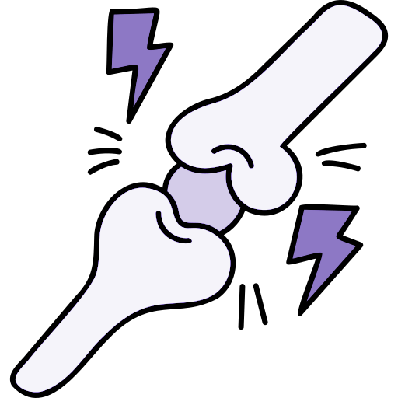
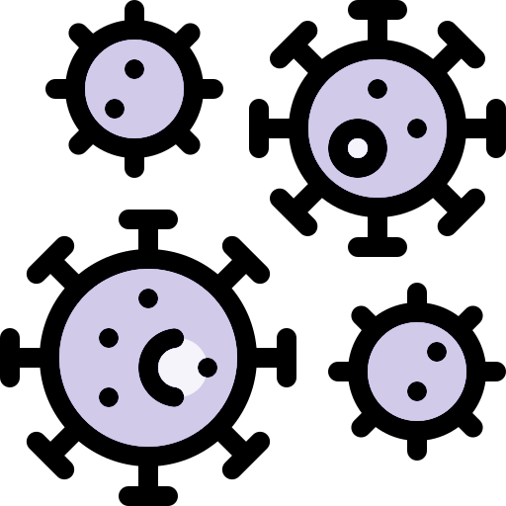
Filled by the lecture leader
Lecture 36
Editing file
Tuberculosis
Disclaimer: the doctor added more slides during the presentation. However, upon asking him for it; he told us to stick to the ones uploaded to BlackBoard.
Objectives:
By the end of this lecture, students should know the following about Tuberculosis:
Overview of Tuberculosis (TB) Epidemiology.
Transmission and Pathogenesis of TB.
Testing for TB Infection and Disease.
Diagnosis of TB Disease.
Treatment for Latent TB Infection.
Treatment for TB Disease.
TB Infection Control.
Color index:
Color index:
Original text Females slides Males slides
Doctor’s notes Textbook Important Golden notes Extra

Slide 2
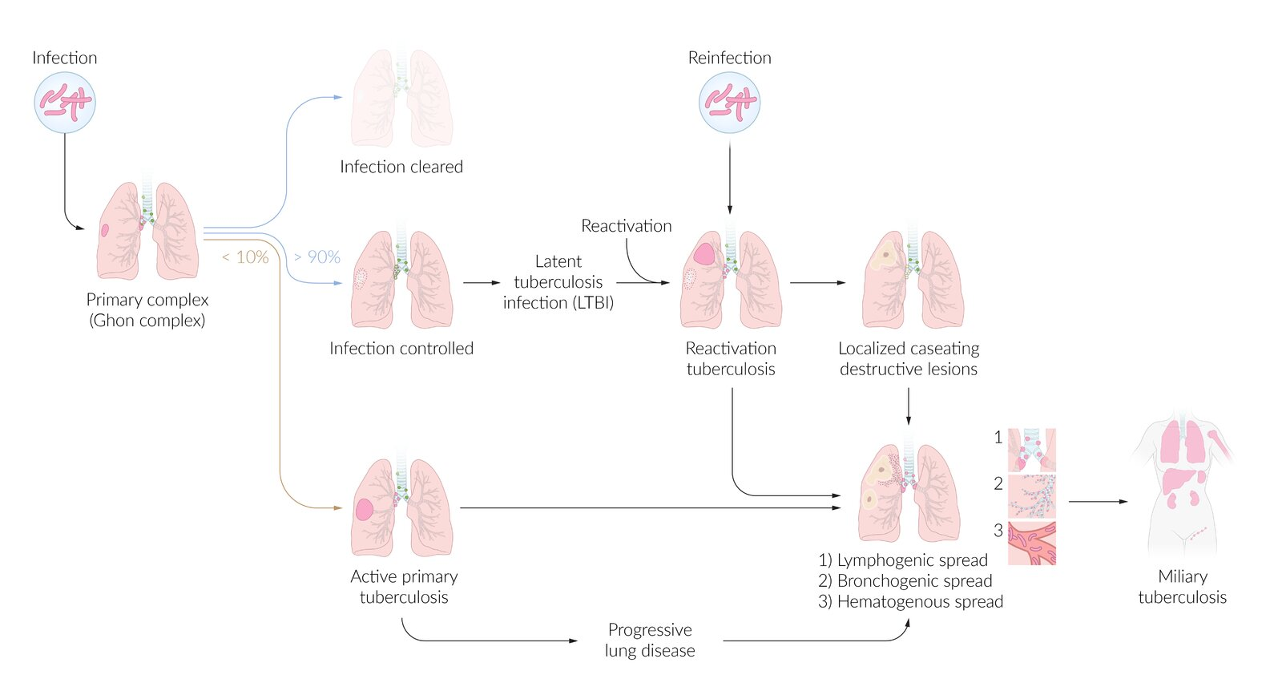
EXTRA
Overview of Tuberculosis
Microbiology of Mycobacterium tuberculosis:
Characteristics:
Culture mediums for growth
Facultative intracellular
rod-shaped bacteria.
Spreads via aerosol droplet nuclei.
Löwenstein Jensen medium.
Middlebrook medium.
Rapid automated broth culture.
Special stains³ (because it doesn’t stain well with Gram Stain):
Mechanism of resistance
Ziehl-Neelsen stain: acid-fast bacilli appear pink.
Auramine-rhodamine stain.
Remains viable in airborne droplet nuclei and soil.
Able to survive in acidic conditions.
Types of Tuberculosis¹
Not all those who are infected develop active disease.
 | Primary tuberculosis (primary infection)²
 | Latent tuberculosis infection (LTBI) | Active primary tuberculosis
Definition | A state of constant immune response stimulation due to M. tuberculosis antigens, with no signs of active TB. | Active TB disease occurring after first-time exposure to M. tuberculosis (only in 1–5% of cases).
Features | Asymptomatic. Not contagious. The risk of reactivation is 5–10% during the course of a lifetime. | Symptomatic. Contagious. Progressive primary tuberculosis is a severe form of disease seen in individuals with impaired immune systems (e.g., HIV, malnutrition) or immature immune systems (e.g., young children).
Diagnostics | Tuberculin skin test (TST) interferon-γ release assay (IGRA) | Bacteriological: acid-fast staining, PCR, and culture. Radiographic: chest x-ray.
Treatment | Preferred regimens: Isoniazid PLUS rifapentine weekly for 3 months. OR rifampin daily for 4 months. OR isoniazid PLUS rifampin daily for 3 months. Alternative regimen: isoniazid daily for 6 or 9 months. | Intensive phase: rifampin PLUS isoniazid, pyrazinamide, and ethambutol for 2 months. Continuation phase: rifampin PLUS isoniazid for 4 months.
1- secondary infection is when there is reactivation of TB or an exogenous reinfection. the pt. will be symptomatic and contagious.
2- ‘Primary TB’ describes the first infection with TB. When the bacteria reach the alveolar macrophages, they are ingested and the subsequent inflammatory reaction results in tissue necrosis and formation of a granuloma. These granulomatous lesions consist of a central area of necrotic material called caseation, surrounded by epithelioid cells and Langhans giant cells.
3- Auramine–rhodamine staining is more sensitive (though less specific) than Ziehl–Neelsen; as a result, it is more widely used.

Slide 3
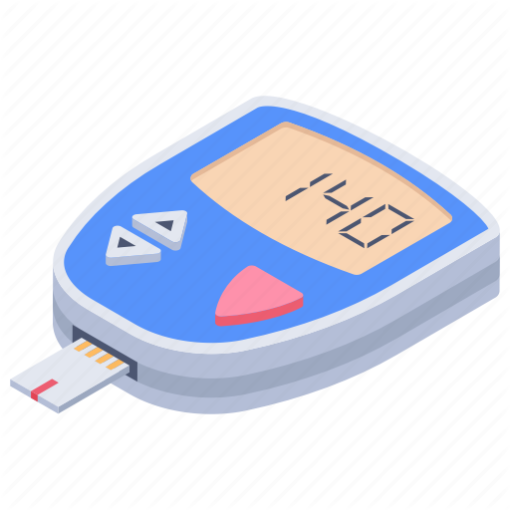
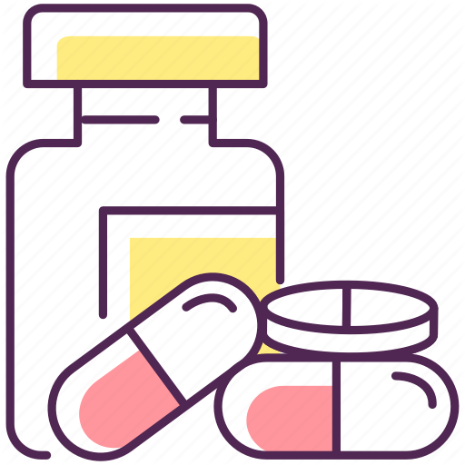
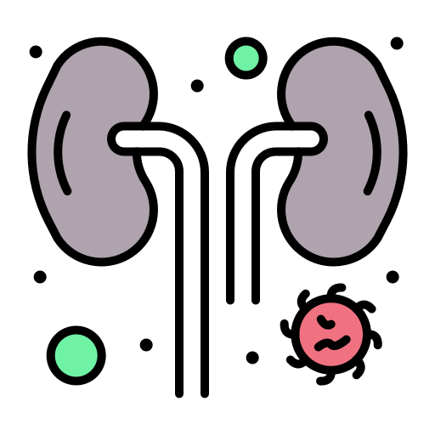
Tuberculosis (TB)
Overview of TB epidemiology
After exposure to TB the patient will either present with an active TB or will just remain in a dormant latent phase of TB.
Whether the patient had the infection or developed latent TB, TST or IGRA will be positive.
The rate of progression from latent TB to active disease:
Non-HIV patients is 5-10% lifetime. (Especially in the first two years after developing latent TB)
HIV positive patients: 5-10% per year.
Risk factors for TB infection
1
3
5
Exposure to TB cases
From TB endemic area
Works in a healthcare or corrections facility
2
4
6
Homelessness
Incarceration
(imprisonment)
Injection drug use
Risk factors for progression to TB disease
 | Recent infection (in the first 2 years of exposure) (The most important risk factor). |  | Diabetes
 | HIV infection. |  | Silicosis.
 | TNF alpha inhibitors ( e.g. infliximab, rituximab). |  | CXR showing fibrotic lesions consistent with prior TB.
 | Immunosuppression. |  | Intestinal bypass, gastrectomy or chronic malabsorption. (anything that causes malnourishment)
 | End stage renal disease. |  | Cancer of the head or neck, Hodgkin, leukemia.

Slide 4
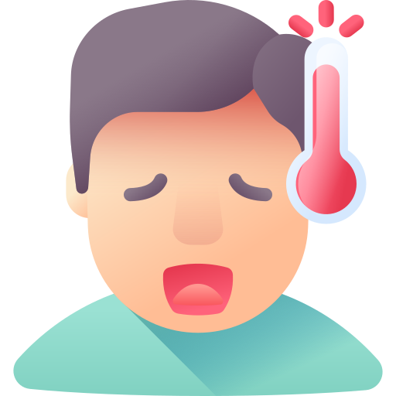
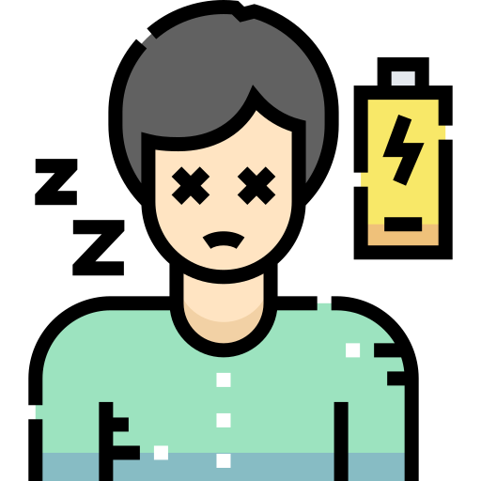
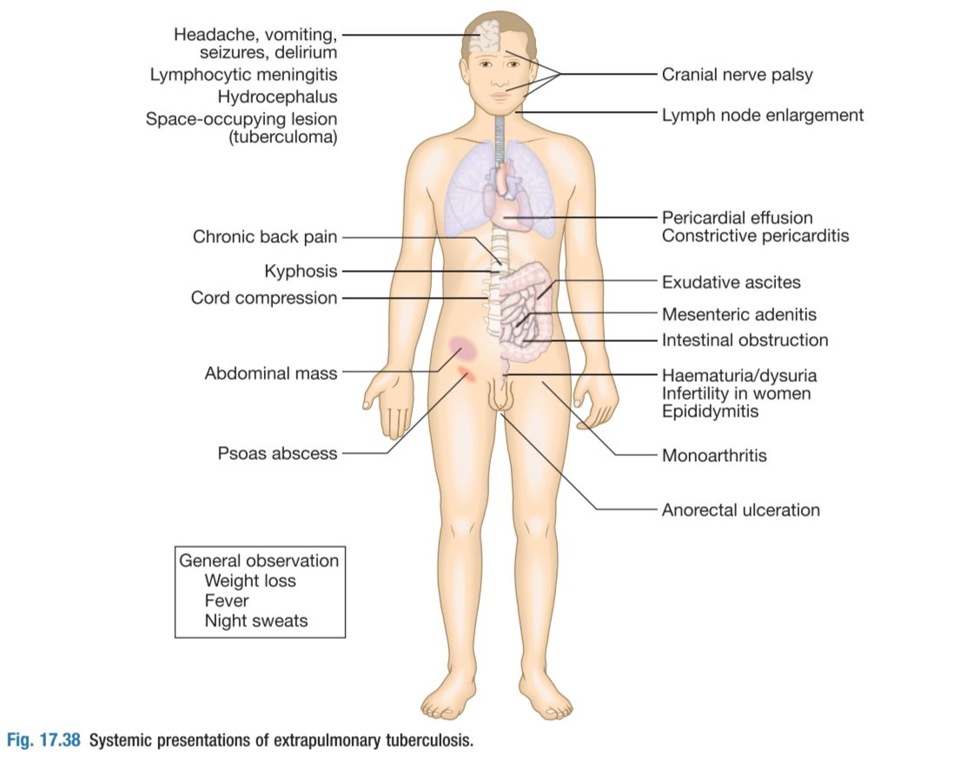
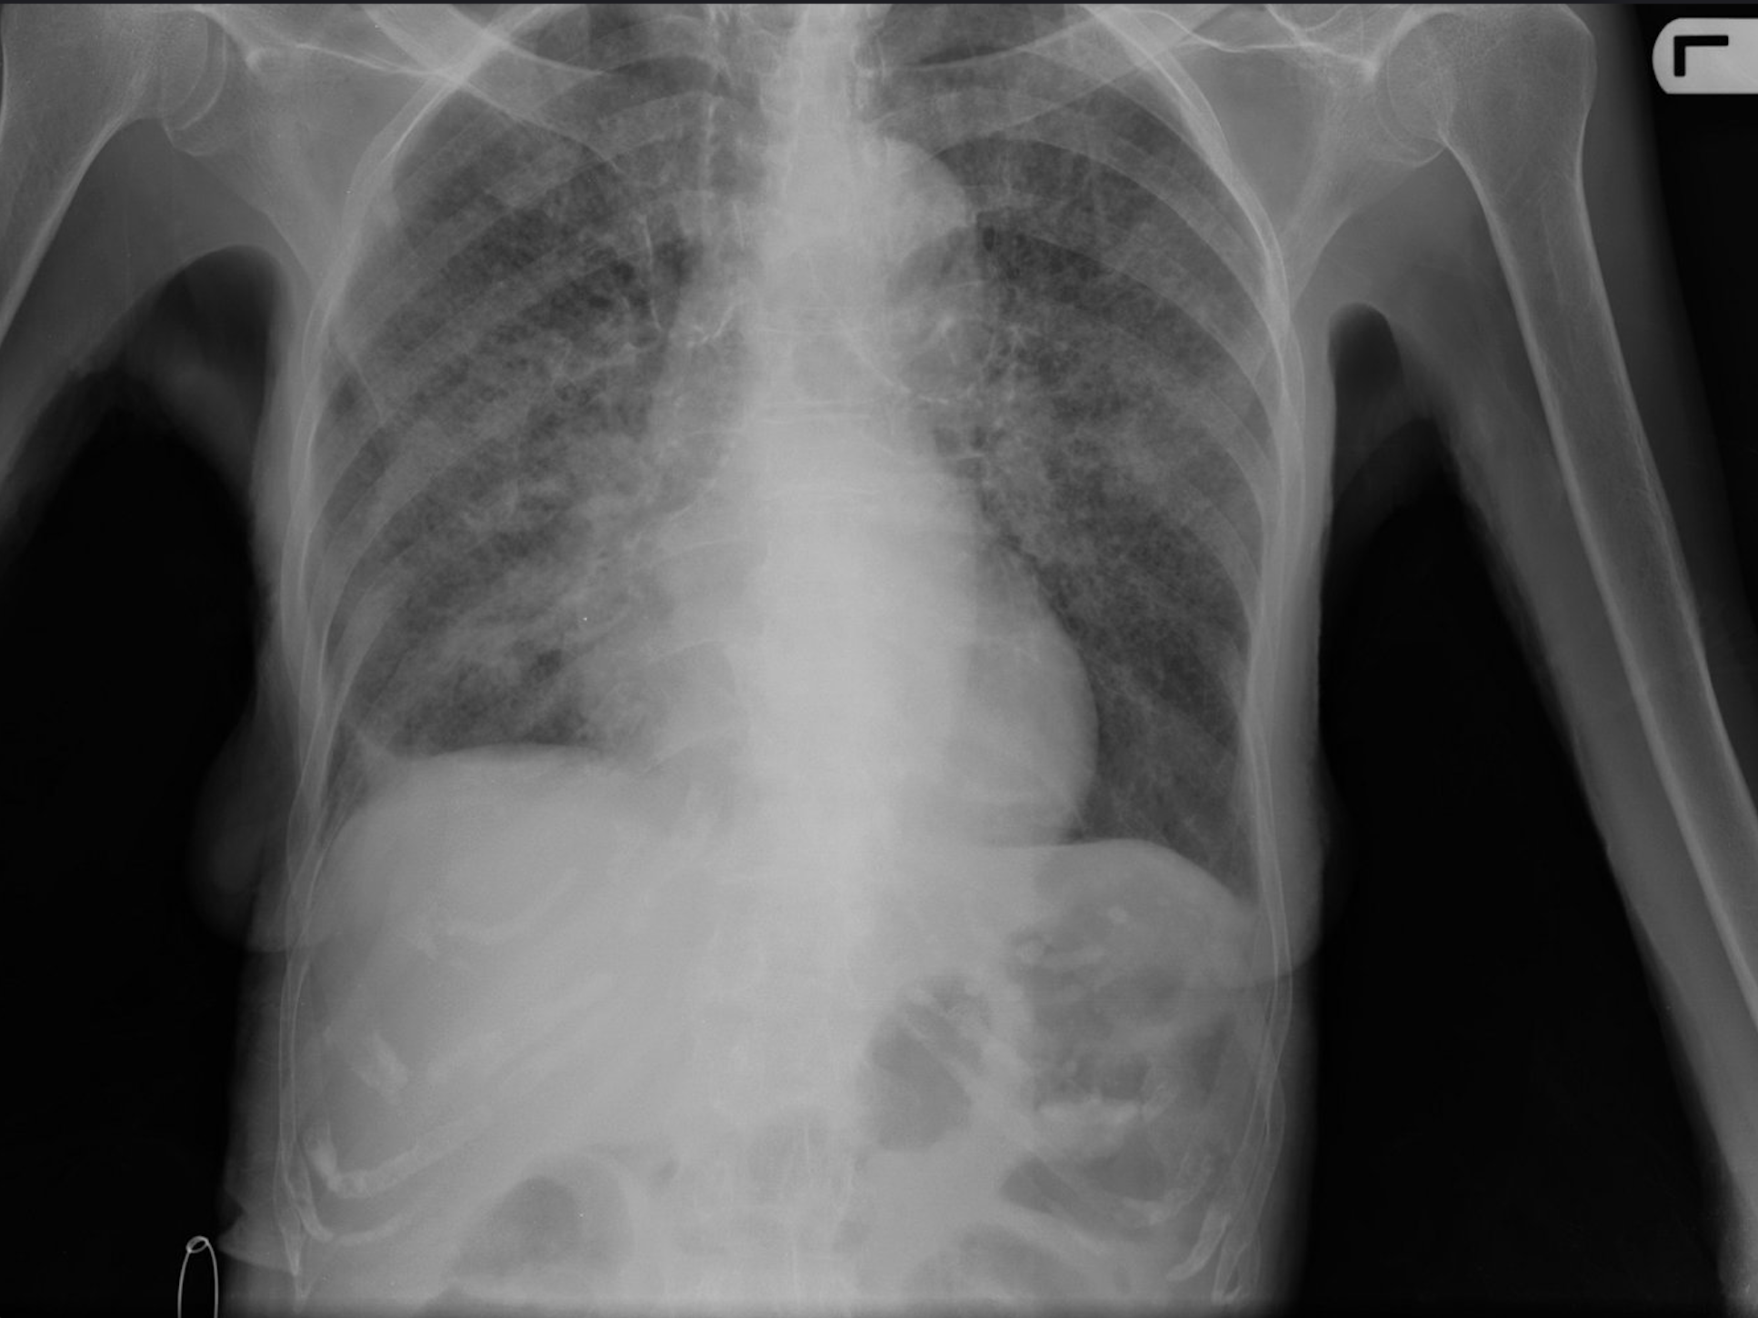
Active TB Clinical presentation
General symptoms
Usually develops over weeks or months especially the malaise and weight loss with an average of 3-6 months .
Fever
Sweats
Weight loss
Malaise
Decreased appetite
Pulmonary TB
Cough with purulent sputum that is occasionally blood-streaked (hemoptysis) in cases of cavitation (However, the absence of hemoptysis should not exclude TB as it usually develops if there was a cavitary lesion).
Shortness of breath, Pleuritic chest pain.
Subacute in onset
Can be acute in immunocompromised patients.
Extra-Pulmonary TB
TB can virtually affect any organ and any system.
It is reasonable to think about when patients do not respond to the typical therapy.
It is important to obtain clinical specimens from the site affected for mycobacteriological cultures, PCR, smears and pathology.
CNS
Lymphadenitis
Bone and joint
Meningitis, focal tuberculomas.
(Cervical, thoracic or abdominal)
Vertebral (Thoracic -most common-, lumbar, anterior wedging + psoas abscess). Osteomyelitis and arthritis.
Pleural
Abdomina (GI)
Pelvic (GU)
Pleuritis
A great mimicker for inflammatory bowel disease (it can cause pancolitis).
Sterile pyuria, can cause infertility
Disseminated (Miliary) TB
Miliary TB is a hematogenous spread TB.
Clinical features:
Can present with an acute sepsis-like syndrome, especially in heavily immunocompromised patients.
Mostly nonspecific, could include lymphadenopathy or hepatosplenomegaly.
Diagnosis:
Obtain mycobacterial blood cultures and respiratory specimens.
Chest x-ray: multiple small nodules (< 2 mm) with an appearance resembling millet seeds.
All patients should have brain imaging (MRI), to look for evidence of cerebral disease, which can present as an asymptomatic brain tuberculoma.
Miliary TB

Slide 5
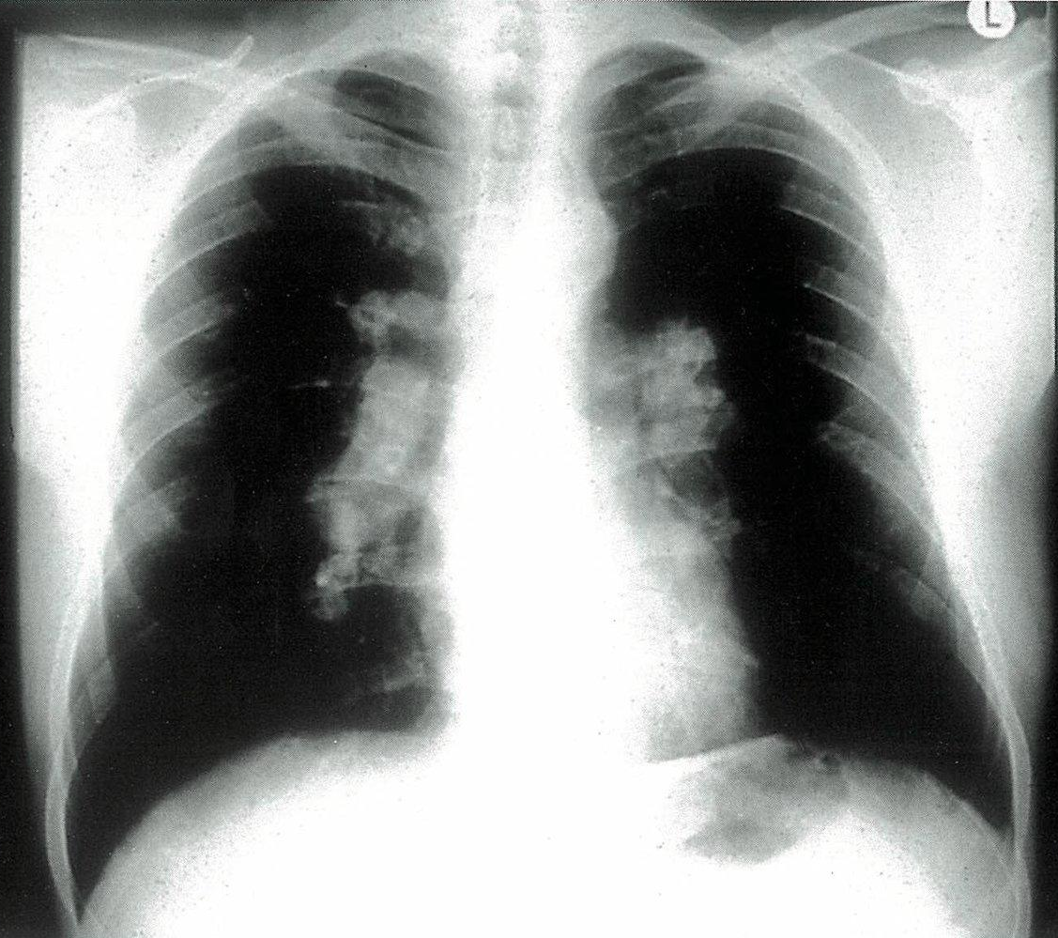
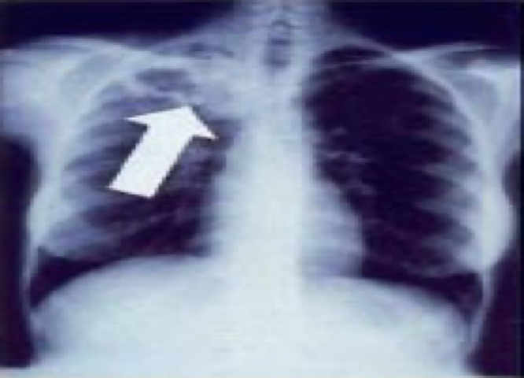
Active TB Diagnosis
Smear microscopy | Sensitivity: Has a low sensitivity overall around 50-60% sensitivity in pulmonary TB. Less sensitive in advanced HIV (30-50%). Specificity: Not specific for MTB (Most mycobacteria look alike). Good Positive Predictive Value (PPV) in TB endemic regions. In pulmonary TB the yield of test is increased with multiple specimens; that is why we usually ask for 3 different specimens to increase the yield to 80-90% Needs 10,000 cfu/ml. cfu=colony forming units A negative smear does not exclude the diagnosis of active TB.
Rapid MTB PCR | Specificity: High specificity for MTB Needs 100 cfu/ml for detection. PCR based tests are designed to be specific mycobacterial TB and rifampicin resistance, but does not detect other mycobacteria nor predict resistance to other anti TB medications. Once the rapid MTB/RIF (Rifampicin) test is reported as MTB detected RIF undetected; this is by definition NOT a multidrug resistant TB. The test is validated to be done on sputum but can be done on non-sputum specimen (However can have false negative tests for the presence of inhibitors). A negative test does not rule out TB.
Culture | Sensitivity: Has the highest sensitivity. Needs 1-10 cfu/ml. Mycobacterial culture is the most sensitive however it is a slow method (3-6 weeks). The median time for positivity is around 21 days. Once positive, additional tests need to be done to identify the species. The majority of the developed world uses liquid/broth culture of mycobacteria in addition to solid media (Lowenstein–Jensen slopes or Middlebrook agar). Considered the gold standard: Pulmonary TB: 90-95% sensitive. Extrapulmonary TB: much less sensitive.
Histopathology | Typically cause a caseating granuloma with a ZN stain for bacilli. The granuloma formation requires a good immune system to form; therefore this histopathological feature may not be present in immunocompromised hosts.
PPD and IGRA | Do not distinguish latent from active TB. Negative test does not rule out active disease.
Chest Imaging | Upper lobe/Apical cavity is typical with surrounding infiltrate + lymphadenopathy.
hilar lymphadenopathy
Apical cavity

Slide 6
Active TB Treatment
First line treatment
General rules:
Daily regimen is more efficacious than intermittent (2 or 3 times a week).
IN HIV positive, intermittent treatment is associated with Rifampin resistance.
Treatment should be commenced immediately in any patient who is smear-positive, and in those who are smear-negative but with typical chest X-ray changes and no response to standard antibiotics.
Directly observed therapy (DOT) is essential for assuring completion of TB treatment.
Patients with active TB must be isolated until sputum is negative for AFB.
01
02
Induction phase(2 months): (RIPE)
Rifampicin
Isoniazid (Use B6 (pyridoxine) to prevent neurotoxicity of INH)
Pyrazinamide
Ethambutol
02
02
Continuation phase(4 months):
Rifampicin + INH for four more months.
03
Extend the continuation phase in the following situations
Pulmonary disease
CNS TB
Bone and joint TB
If cavitation and culture positive at the end of the second month of treatment or or bilateral extensive disease; extend to a total of 9 months.
Usually 9-12 months total duration.
6-9 months total duration.
02
Corticosteroids indicated in:
TB meningitis: improved morbidity and mortality.
TB pericarditis: Previously recommended but recent trials showed no difference in outcome. Can be considered in cases of inflammatory fluid analysis.
04

Slide 7
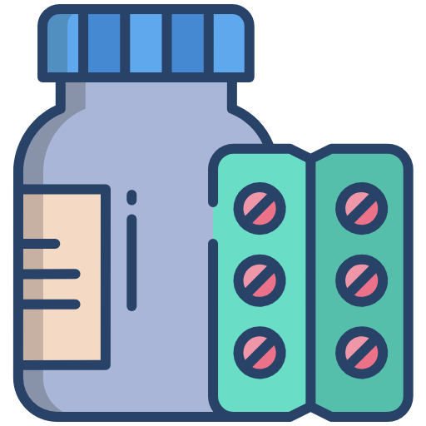
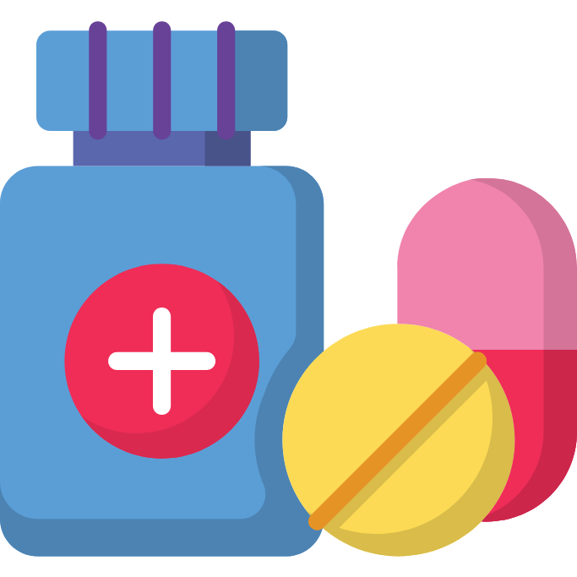
Active TB Treatment
ATT side effects¹
Hepatotoxicity:
Main ATT: INH, Rif, PYZ.
INH and pyrazinamide are more hepatotoxic than rifampicin. Ethambutol is the least hepatotoxic of all 4 anti TB. Rifampicin mostly causes cholestatic liver derangement.
This is a particular problem when liver function tests become deranged and there is concern about a drug- induced hepatitis, in which case it is often necessary to stop all four drugs and re- introduce one at a time. The drug should be stopped only if the serum bilirubin becomes elevated or if transferases are more than three times elevated
Rifampicin:
A potent enzyme inducer and decreases the level of other drugs of particular importance warfarin, antriretroviral therapy (Integrase inhibitor, protease inhibitors (PI) , Nucleotide and nucleoside reverse transcriptase inhibitors (NNRTI)) hormonal contraceptives, corticosteroids.
Of the four anti TB drugs, Rifampicin is the most important and if it was dropped for side effect or intolerance short course (6 months therapy) can no longer be used.
Pyrazinamide:
Its most common side- effects are Arthralgias, itching and rash, it reduces the renal excretion of urate and may precipitate hyperuricaemic gout.
Ethambutol:
retrobulbar neuritis (Color vision is the first affected, visual acuity will later be affected, unlikely to occur with the doses and duration of therapy given in TB).
Rifampicin:
A potent enzyme inducer and decreases the level of other drugs of particular importance warfarin ART (Integrase inhibitor, PI, NNRTI) hormonal contraceptives, corticosteroids.
Of the four anti TB drugs, Rifampicin is the most important and if it was dropped for side effect or intolerance short course (6 months therapy) can no longer be used.
PYZ:
Arthralgias
its most common side- effects are itching, rash and arthralgia, pyrazinamide reduces the renal excretion of urate and may precipitate hyperuricaemic gout.
Aminoglycosides:
Ototoxicity, vestibular toxicity, nephrotoxicity.
Bedaquiline:
A novel drug with a novel mechanism of action targeting (MTB ATP synthase). Approved for pulmonary drug resistant TB when effective therapy cannot be provided.
QT prolongation is a serious adverse effect of the medication.
Has a long half-life 4 months.
Ethambutol:
Retrobulbar neuritis (Color vision is the first affected, visual acuity will later be affected, unlikely to occur with the doses and duration of therapy given in TB).
Aminoglycosides:
Ototoxicity, vestibular toxicity, nephrotoxicity.
Bedaquiline:
A novel drug with a novel mechanism of action targeting (MTB ATP synthase). Approved for pulmonary drug resistant TB when effective therapy cannot be provided.
QT prolongation is a serious adverse effect of the medication.
Has a long half-life 4 months.
1- The most common side-effects of quadruple TB therapy are nausea, vomiting, rash and itching.

Slide 8
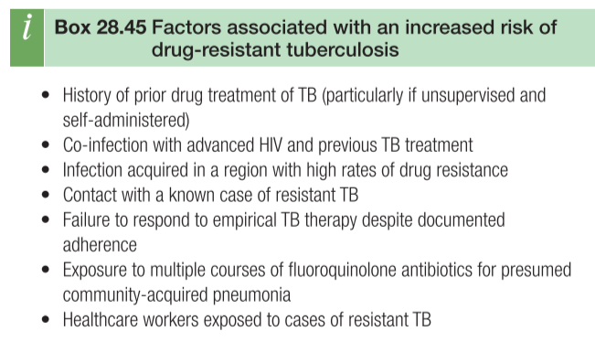
Active TB Treatment & Resistance
Summary of ATT mechanism of action/resistant/ common side effect
Drug/Dose | Mechanism of action | Mechanism of resistance | Side effect
Isoniazid 5 mg/kg/day Maximum dose: 300 | - Inhibits mycolic acid synthesis. - Penetrates well even to the brain | - Loss of katG overexpression. - Alteration in inhA encoded reductase | - Hepatotoxicity. - Peripheral neuropathy (tingling, pricking, chilling, burning and numbness of the hand)
Rifampin 10mg/kg/day Maximum dose: 600 | - Inhibits DNA dependent RNA polymerase, blocking RNA transcript | - rpoB (RNA polymerase subunit beta) mutation. | - Rash. Hepatoxicity. - Thrmobocytopenia. - Potent enzyme inducer. - Red color of body secretions.
Ethambutol 15mg/kg/day | - Inhibits arabinosyl transferase enzyme which will inhibit cell wall arabinogalactan and lipoarabinomannan. | - embB gene mutation causing enzymatic alteration in ethambutol binding site. | - Peripheral neuritis. - (Optic neuritis) - Hepatotoxicity.
Pyrazinamide 20mg/kg/day | - Unknown. - Pyrizinoic acid lowers the PH below the level necessary for mycobacterial growth. | - pncA gene mutation. M. Bovis and M. Leprae are intrinsically resistant. | - Hepatotoxicity. - Asymptomatic hyperuricemia. - Arthralgias (Polyarthralgia).
Bedaquiline 400 mg daily for 14 days followed by 200 mg thrice weekly to complete 24 weeks. | - Inhibits ATP synthetase by binding to subunit c. - Prevents mycobacterium from ATP synthesis and eventually lead to cell death. | - Point mutation in the atpE gene, efflux pump. mmpR mutation. | - QTc prolongation.
Risk factors for drug resistant TB
1
Contact with a known case of drug resistant TB.
2
Previous history of treatment especially if the patient was non adherent.
3
Travel to an area known to have drug resistant TB
(Eastern Europe, South Africa).
Resistance Definitions
VS
Multidrug-Resistant (MDR)
Extensively Drug-Resistant (XDR)
Resistance to both Rifampicin and INH.
MDR plus resistance to fluoroquinolones plus at least one of the injectable 2nd line drugs (Amikacin, kanamycin, capreomycin).

Slide 9
HIV and TB considerations
HIV increases the risk of progression from latent to active TB.
CD4 influences the severity and clinical manifestations of TB.
TB can increase HIV viral load.
TB is associated with more rapid progression of HIV.
In HIV patients it is less likely to see a cavitary lung disease.
With advancing immunosuppression; there is increased risk for:
Smear negative pulmonary TB.
Extrapulmonary TB + Pulmonary disease.
CNS TB.
Widely disseminated TB/ Mycobacteremia.
A negative CXR and a negative smear does not exclude TB.
Extrapulmonary TB, CNS TB and widely disseminated TB are the usual forms in advanced HIV.
HIV-TB Treatment
Despite the drug-drug interaction rifampicin cause, a rifamycin based therapy is still the preferred regimen.
ART guidelines recommend efavirenz based combination with higher doses of integrase inhibitors.
Rifampin
Rifabutin
- Accelerates clearance of PI, NNRTI, INSTI ¹, CCR5 inhibitors.
- Integrase inhibitor: Need to give BID dosing.
- TAF ²: If used need to closely monitor HIV viral load while on therapy.
- Should not combine PI with Rifampin.
- Weaker enzyme inducer than rifampin.
- A CYP450 substrate (Rifabutin metabolism affected by NNRTI and PIs).
- If a PI based ART will be used decrease the Rifabutin dose to 150 mg daily or 300 mg every other day.
When to start ART
CD4< 50 | CD4< 50 | HIV infected pregnant women with active TB | TB meningitis
Within 2 weeks of starting TB treatment. | Within 8 weeks of starting TB treatment. | should be started on ART as soon as feasible (For maternal health and prevention of mother to child transmission). | ART should not be given until after 8 weeks of anti TB medications.
1- Integrase strand transfer inhibitor
2- Tenofovir alafenamide

Slide 10
IRIS & Special TB considerations
Immune reconstitution inflammatory syndrome (IRIS)
Two forms:
Paradoxical worsening of TB when ART is started after TB treatment.
Unmasking TB when ART started in setting of not yet recognized TB.
Typically occurs 2 weeks to 3 months after starting ART.
Risk Factors:
CD4< 50.
High pre-ART viral load.
Severe TB
Short interval between initiation of TB treatment and ART.
Protean manifestation:
Fever, new lesion, extension of prior lesions.
Management approach in IRIS:
Deal promptly with any limited space issue: CNS inflammation, obstructing adenopathy), corticosteroid, surgery if needed. Consider other differential diagnosis:
Give NSAID in mild cases.
Give corticosteroids in more severe and refractory cases: Prednisone 1.5 mg/kg/day for two weeks then 0.75 mg/kg/day for two weeks.
Continue both TB plus ART.
Forms | Two forms: Paradoxical worsening of TB when ART is started after TB treatment. Unmasking TB when ART started in setting of not yet recognized TB. Typically occurs 2 weeks to 3 months after starting ART.
Risk Factors | CD4< 50. High pre-ART viral load. Severe TB Short interval between initiation of TB treatment and ART.
Protean manifestation | Fever, new lesion, extension of prior lesions.
Management approach in IRIS | Deal promptly with any limited space issue: (CNS inflammation, obstructing adenopathy), corticosteroid, surgery if needed. Consider other differential diagnosis Give NSAID in mild cases. Give corticosteroids in more severe and refractory cases: Prednisone 1.5 mg/kg/day for two weeks then 0.75 mg/kg/day for two weeks. Continue both TB plus ART.
TB in transplant recipients
Transplant associated immunosuppression increases the risk of active TB disease if the person is infected.
Presents atypically and therefore diagnosis is delayed:
One third to half is disseminated or extrapulmonary.
The ability of granuloma formation is lost by immunosuppression and therefore patients are unable to contain the infection and they rapidly progress and disseminate.
4% are thought to be donor derived.
Can rapidly progress and carry high mortality.
Small proportion are donor derived.
Drug-Drug interactions
An area for your notes
MTOR inhibitors (Sirolimus/everolimus).
Calcineurin inhibitors (Cyclosporin, tacrolimus).
Frequent drug levels of calcineurin and MTORs is advised.
Corticosteroid and hence they are at risk for graft rejection.
Rifabutin based regimen is preferred to minimize interaction.
TB and TNF alpha inhibitor inhibits
TNF alpha inhibitors markedly increase the risk of active TB if infected.
Can present with atypical TB (e.g., non-cavitary pulmonary disease, extrapulmonary disseminated).
Increased TB morbidity and mortality.
Full monoclonal IgG1 monoclonal antibody most potent (i.e., infliximab, adalimumab, golimumab).
It is recommended to do a PPD or IGRA prior to starting anti TNF:
If any is positive, patient should be started on latent TB management before starting therapy
(2 -8 weeks).

Slide 11
Diagnosis of Latent TB
Tuberculin skin test (TST)
An intradermal inoculation of a mix of antigens causing a delayed type IV hypersensitivity reaction.
The induration caused by the reaction is measured at 48-72 hours (positive reaction lasts a few days).
Only induration is counted toward a positive test. Erythema is irrelevant.
It is an adjunctive in the diagnosis of TB.
False positive results may be seen with Nontuberculous mycobacteria (NTM) or prior BCV vaccine.
False negative (anergic) tuberculin skin tests (TSTs) are common in patients with immunosuppression due to HIV infection (CD4+ <200/mm3), those taking immunosuppressant medications (chemotherapy, anti-TNF therapy, steroids), those at the extremes of age and those with active disease.
A booster effect can be mistaken for positive PPD test:
TST maybe initially negative if there is a remote history of infection. However, TST stimulates immune response to MTB antigens and a subsequent TST can be positive and mistaken for seroconversion.
For that, a 2 step TST for individuals who may be tested periodically (e.g., HCW). However, if the first test is positive, a second test is not necessary.
An intradermal inoculation of a mix of antigens causing a delayed type IV hypersensitivity reaction.
The induration caused by the reaction is measured at 48-72 hours (positive reaction lasts a few days).
Only induration is counted toward a positive test. Erythema is irrelevant.
It is an adjunctive in the diagnosis of TB.
False positive results may be seen with Nontuberculous mycobacteria (NTM) or prior BCV vaccine.
False- negative (anergic) tuberculin skin tests (TSTs) are common in patients with immunosuppression due to HIV infection (CD4+ <200/mm3), those taking immunosuppressant medications (chemotherapy, anti- TNF therapy, steroids), those at the extremes of age and those with active disease.
A booster effect can be mistaken for positive PPD test:
TST maybe initially negative if there is a remote history of infection. However, TST stimulates immune response to MTB antigens and a subsequent TST can be positive and mistaken for seroconversion.
For that, a 2 step TST for individuals who may be tested periodically (e.g., HCW). However, if the first test is positive, a second test is not necessary.
Cutoffs are based on likelihood of true exposure, risk of progression to active TB if infected (5 mm; 10 mm; 15 mm)
Latent TB infection (LTBI): Classification of Tuberculin Skin Test (TST) Results:
>5 mm is Positive in: | >10 mm is Positive in: | >15 mm is Positive in:
HIV Infected. Recent TB contact. CXR with fibrotic changes. Organ transplantation. Prednisone ≥ 15mg/d x1 month or more. TNF alpha antagonists. | Recent arrival (within 5 years) from TB high prevalence area. Injection drug use. Residents and employees of high risk settings (HWC, corrections & home shelters). Myobacteriology lab staff. Children <5 years old. Medical conditions: Diabetes, silicosis, end stage renal disease, gastrectomy or small bowel bypass, solid organ transplant, CA head and neck. | Persons with no known risk factors for TB.
Interferon gamma release assays- IGRA
Two tests are currently available:
QuantiFERON-TB
T-SPOT.TB.
Blood based, in vitro stimulation of WBC with protein antigens specific for M. TB.
The advantage of IGRA over PPD is that there is no cross reactivity with BCG vaccine.
IGRA is as sensitive as PPD but more specific.
False Positive: caused by M. Kansasii and M. Marinum.
False Negative: in immunocompromised.
The test does not differentiate between active and latent infection.
TST remains the first choice in children, while IGRA represents the first choice for individuals with HIV.

Slide 12
Management of Latent TB & BCG Vaccine
Management of latent TB¹
Excluding active TB is a key component of the diagnosis of latent TB infection:
Review of system: Fever, weight loss, cough, night sweats, focal signs/symptoms that could be associated with extrapulmonary TB).
Chest X-ray to exclude occult pulmonary TB.
Previous BCG has no effect on the following recommendations.
Preferred Regimens for latent TB include:
01
Rifampin daily for 4 months.
02
INH + Rifapentine once weekly for 12 doses .
03
INH + Rifampin daily for 3 months.
Alternative: INH daily for 6 or 9 months.
Rifampin + PYZ is NO longer used because of the risk of hepatotoxicity.
Perform LFTs prior to treatment in adults with risks for hepatotoxicity (Ethanol, risk for viral hepatitis, other hepatotoxic medications).
Monthly review of systems for adverse effects:
Peripheral neuropathy if on INH (Can be avoided by B6 supplements).
Hepatotoxicity (Nausea/vomiting, abdominal discomfort, jaundice).
BCG vaccine
Live attenuated vaccine (from M. Bovis).
It should not be administered to those who are immunocompromised (e.g. HIV) or pregnant
Neonatal vaccination
Immunotherapy for
bladder cancer
Decreases the incidence of severe forms of childhood TB.
No to very limited impact on adult TB.
Regional lymphadenitis can occur after vaccination, typically no treatment is indicated.
Disseminated infection can occur in immunocompromised (Treatment is needed).
Intravesicular administration.
Complications:
Contemporaneous with BCG treatment or up to years later.
Granulomatous prostatitis, Hepatitis, Epididymitis-orchitis, Spondylitis, psoas abscess, military pulmonary, disseminated/sepsis.
Treatment:
Inherent resistance to PZA; treat with
rifampin + INH + Ethambutol.
1- In certain groups with latent TB infection, chemoprophylaxis is offered to reduce the risk of active infection:
Household and close workplace contacts of patients with pulmonary and laryngeal TB, health workers, recent new migrant entrants from high-risk countries, patients who are immunocompromised (e.g. HIV infection), those about to commence treatment with biologic agents (such as infliximab), those due to have stem cell or solid organ transplants.

Slide 13
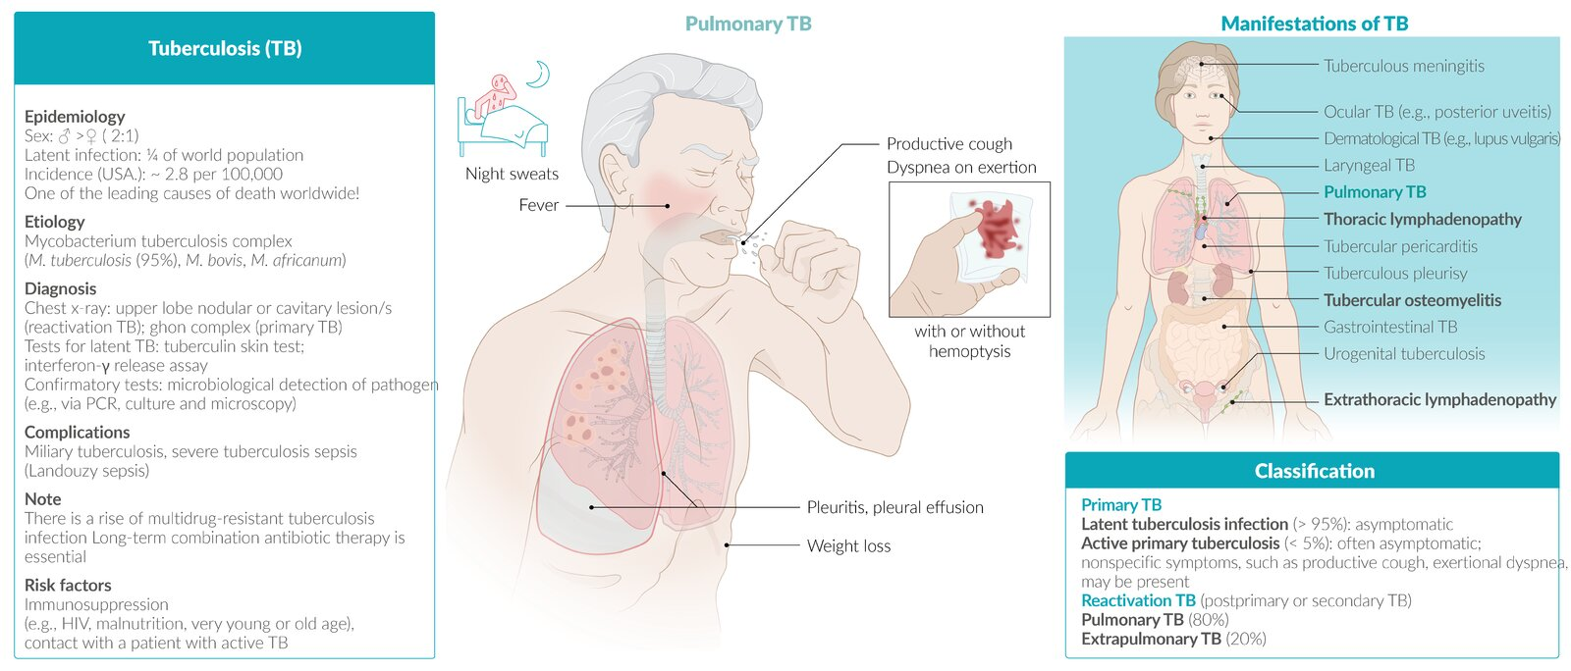
“From Step Up”
Tuberculosis Summary
Overview | - Tuberculosis is a bacterial infection caused by Mycobacterium tuberculosis - Mycobacteria are acid-fast bacilli (AFB)—considered slow growing but hardy organisms. - It is a world wide disease, infecting more than 1.7 billion causing 3 million deaths per year.
Transmiss-ion | - By inhalation of aerosolized droplets containing the active organism. - Only those people with active TB are contagious (e.g., by coughing, sneezing).
Pathophy-siology | Primary TB: - Bacilli are inhaled and deposited into the lung, then ingested by alveolar macrophages - Surviving organisms multiply and disseminate via lymphatics and the bloodstream. - Granulomas form and “wall off” the mycobacteria. - After the resolution of the primary infection, the organism remains dormant within the granuloma. - Only 10% of individuals with primary TB will develop active disease in their lifetime. Secondary TB (reactivation): - Occurs when the host’s immunity is weakened (e.g., HIV infection, malignancy, Immunosuppressants, substance abuse, poor nutrition). - Usually manifests in the most oxygenated portions of the lungs (Apical/Posterior segments). - Produces clinical manifestations of TB. - Can be complicated by hematogenous or lymphatic spread, resulting in miliary TB. Extrapulmonary TB: - Individuals with impaired immunity may not be able to contain the bacteria at either the primary or the secondary stage of the infection. - This may result in active disease throughout the body (TB lymphadenitis (25%), Pleural TB, Skeletal TB, TB meningitis)
Risk factors | - HIV-positive patients - Recent immigrants - Prisoners | - Close contacts of someone with TB - Diabetics - Healthcare workers | - Glucocorticoid use - Hematologic malignancy - Alcoholics & Injection drug users
Clinical features | Primary TB: Usually asymptomatic Pleural effusion may develop | Secondary (active) TB: Constitutional symptoms: Cough, fever, night sweats, weight loss, and malaise. - Cough progresses from dry cough to purulent sputum. - Hemoptysis suggests advanced TB | Extrapulmonary TB: May involve any organ. (eg. lymph nodes, pleura, genitourinary tract, spine, intestine, and meninges ). Miliary TB refers to hematogenous dissemination (Common in HIV patients).
Diagnosis | Must have a high index of suspicion, depending on patient’s risk factors and presentation.
 | Chest X-Ray (CXR): - Classic findings are upper lobe infiltrates with cavitations - Other possible findings: - Pleural effusion(s) - Ghon complex and Ranke complex: evidence of healed primary TB - Atypical findings common in immunocompromised patients | Sputum studies: - Definitive diagnosis is made by sputum culture (takes 4 to 8 weeks) - three morning sputum specimens - PCR can detect DNA more rapidly - Diagnosis is sometimes made by AFB on microscopic examination, but not definitive | Tuberculin skin test (PPD test): Not for diagnosis of active, if +, a chest x-ray is used to diagnose active TB Measure induration 48-72 hours ≥15 mm in patients with no risk factors. ≥10 mm in for risk groups. ≥5 mm for + HIV, steroid users, organ recipients, close contacts of those with ACTIVE TB, or radiographic evidence of primary TB.
Treatment & Prevention | First line therapy: 4 drug regimen: (2 months) - isoniazid (INH) - Rifampin Pyrazinamide - Ethambutol or - Streptomycin Then INH & Rifampin (4 months) | Prophylactic treatment for latent TB (i.e., +PPD skin test): INH for 9 months - active TB has been excluded (negative CXR, sputum, or both). | Drug failure: - Non compliance. - Inappropriate drug. - Drug resistance.

Slide 14
Q1: A 56-year-old woman who immigrated from China 3 years ago comes to the emergency department because of substantial hemoptysis . Initial work up includes a chest x-ray which shows several cavitary lesions in the upper lung fields bilaterally. Further testing confirms a diagnosis of tuberculosis . Proper airborne precautions are initiated and the patient is placed in isolation . Which of the following is the most appropriate initial treatment , assuming the TB strain is not multi-drug resistant?
A- Administration of isoniazid
B- Administration of rifampicin and isoniazid
C- Combination therapy with rifampicin, isoniazid and ethambutol
D- Combination therapy with rifampicin, isoniazid, ethambutol and pyrazinamide
Q2: An 18-year-old man presents to the urgent care clinic. He has recently immigrated and has been experiencing back pain for a few weeks. He slipped on ice and had a minor fall onto his backside around the time that the pain began, but he does not believe it was severe enough to have caused serious damage. The pain radiates from the lower back to the gluteal muscles, back of the upper thigh, posterior lower limb, and feet. He has fever (38.5oC) and has noticed recent weight loss. What is the most likely explanation for this condition?
A- Mycobacterium tuberculosis co-infection with HIV
B- Infection of lower thoracic and upper lumbar vertebrae
C- Infection of the cervical spine
D- Herniated disc and Pott's fracture of the ankle as a result of the fall
Q3: A 57-year-old woman comes to the clinic because of persistent coughing productive of blood-tinged sputum . She has had night sweats and chills for the past week. She is a nurse working on the infectious disease unit of the hospital. Her temperature is 37.5°C (99.5°F), pulse is 82/min, respirations are 18/min, and blood pressure is 120/80 mm Hg . A blood sample is drawn for quantiferon testing. Chest x-ray shows right hilar lymphadenopathy . Which of the following is most likely present in the affected lymph nodes of the lung??
A- Fibrinoid necrosis
B- Liquefactive necrosis
C- Caseous necrosis
D- Coagulative necrosis
Q4: A 24-year-old woman comes to the office because she forgot to take appropriate precautions while volunteering at a hospital and interacting with an HIV-positive patient being treated for active infection with Mycobacterium tuberculosis . Her past medical history is noncontributory and she is a healthy medical student. Physical examination shows the patient is anxious with no other abnormalities. A PPD is placed. Two days later, she calls, saying her arm has 6 mm of induration around the injection site, and she is horrified because she remembers that the patient had initially presented with only 5 mm of induration. Which of the following most accurately describes the criteria for tuberculin positivity in this student?
A- PPD+ if induration ≥10 mm
B- PPD+ if induration ≥15 mm
C- PPD+ if induration ≥5 mm
D- PPD+ if induration ≥6 mm
Q5: A 36-year-old man comes to the emergency room complaining of a mass on the right side of his neck which has been growing over the past 3 months. He has also experienced a heavy cough for the same period of time . On examination, the mass is fluctuant, non-tender, and cold to touch. His temperature is 38.7°C (101.6°F), pulse is 83/min, respirations are 18/min, and blood pressure is 110/72mmHg. His past medical history includes HIV , for which he is on anti-viral treatment. Fine-needle aspiration of the cervical mass allows for staining, which shows acid-fast bacilli and granulomatous cells with caseous necrosis . Which of the following is the most likely cause of his cervical mass?
A- Tuberculous lymphadenitis
B- Nasopharyngeal carcinoma
C- Papillary thyroid cancer
D- Branchial cleft cyst
Quiz explanations:
Question 1:
The correct answer is X. Explanation
Question 2:
The correct answer is X. Explanation
Question 3:
The correct answer is X. Explanation
Question 4:
The correct answer is X. Explanation
Question 5:
The correct answer is X. Explanation
Answers: Q1:D | Q2:B | Q3:C | Q4:C | Q5:A
Answers Explanation File!

Slide 15
THANKS!!
This lecture was done by:
Abdulaziz Alshoumar
Mohammed Alhumud
Note taker:
Khalid Alharbi
Females co-leaders:
Raghad AlKhashan
Amirah Aldakhilallah
Males co-leaders:
Mashal AbaAlkhail
Nawaf Albhijan
Send us your feedback:
We are all ears!

