Slide 1
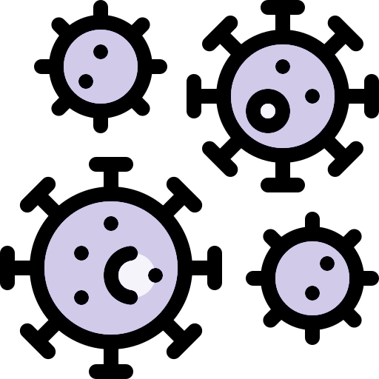
Lecture 37
Editing file
Malaria & Travel medicine
Objectives:
By the end of the lecture the student should be able to:
Learn the epidemiology and etiology of malaria
Know the clinical presentation
Know Risks to travelers
Know Malaria and pregnancy
Know Diagnostic work up
Learn the treatment and prophylaxis
Color index:
Color index:
Original text Females slides Males slides
Doctor’s notes Textbook Important Golden notes Extra

Slide 2
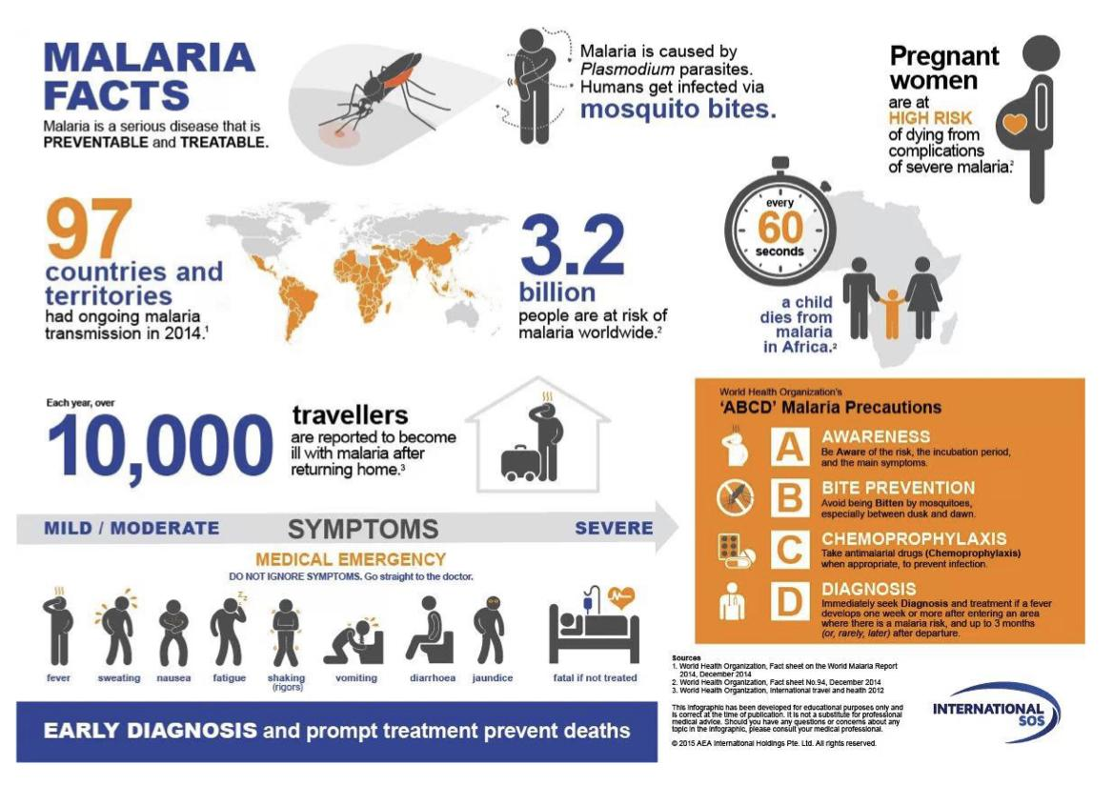
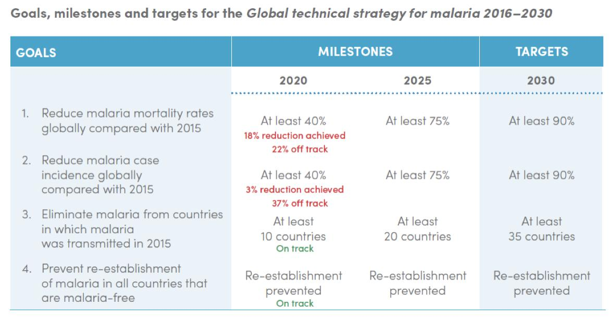
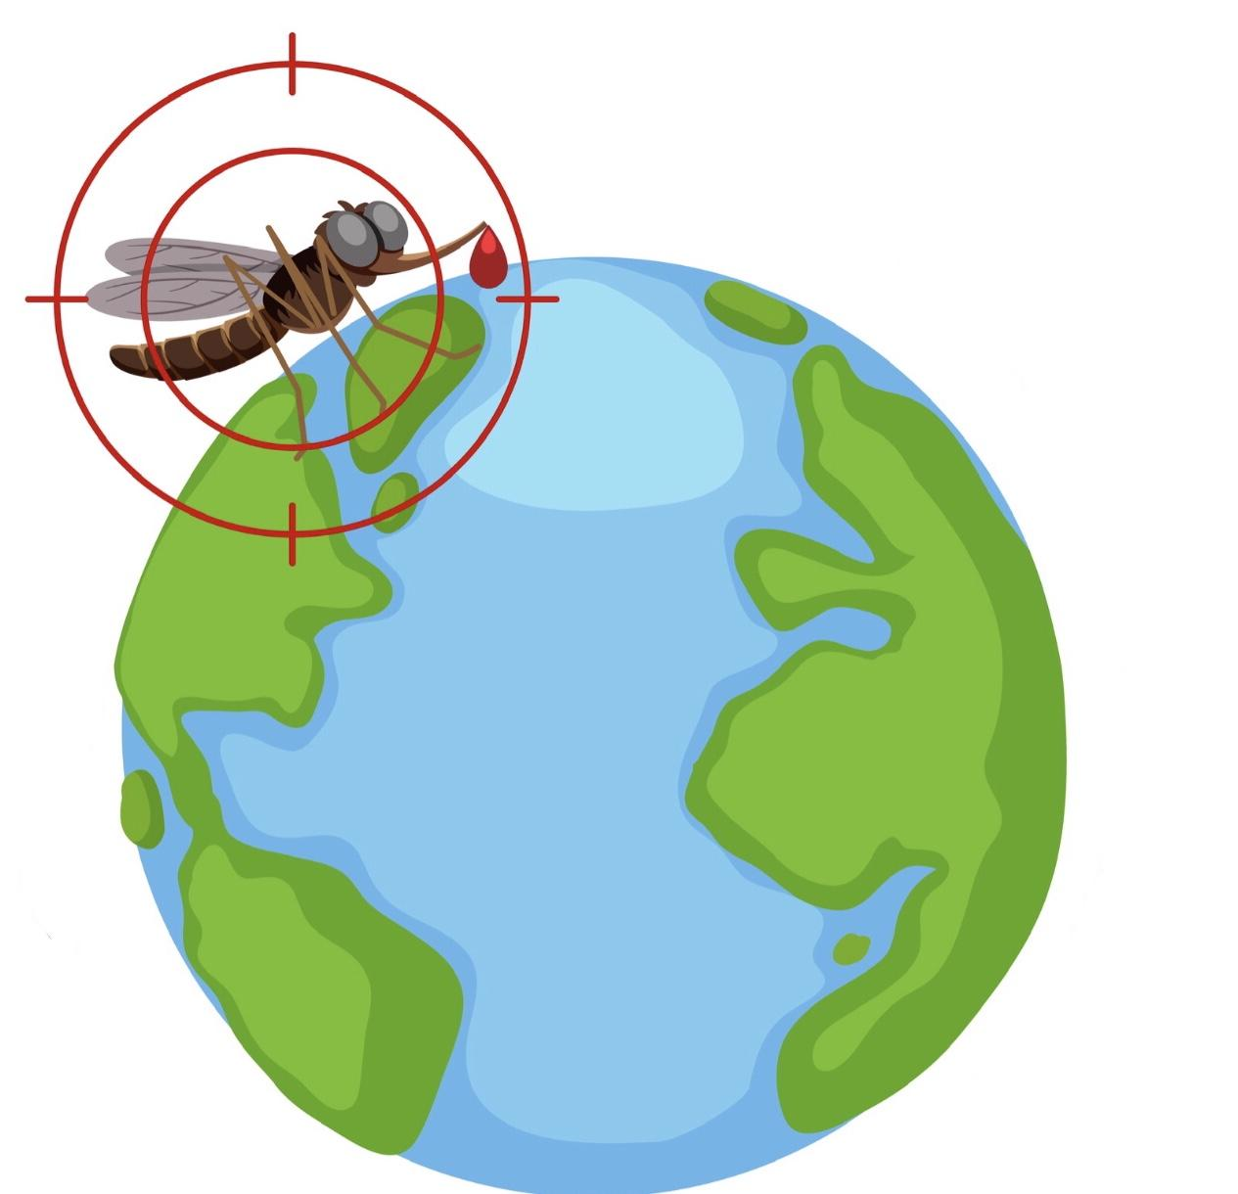
Malaria
Definition
Malaria is a protozoal infection caused by a few plasmodium species that spread by mosquito, once it enters the bloodstream it infects and destroys mainly liver cells and RBCs causes a variety of symptoms.
World facts
97 countries have malaria.
216 million malaria cases worldwide in 2018.
445,000 malaria deaths worldwide in 2018.
10,000 world travelers become infected every year.
Global technical strategy for malaria 2016-2030.
Malaria in Travelers
Non-immune travelers exposed to mosquito bites between dusk and dawn.
This includes previously semi-immune travelers who have lost or partially lost their immunity during stays of 6 months or more in countries or areas of no risk.
Travelers who have migrated to countries and areas of no risk are at particular risk when they travel to malarious areas to visit friends and relatives. Those travelers used to live in malaria endemic areas and got malaria during their childhood and think they have immunity against malaria and don't take proper precautions but there immunity is gone and they often get severe malaria when they get infected again.
Most cases of falciparum malaria in travelers occur because of poor adherence or inappropriate prophylactic malaria drug regimens and failure to take adequate precautions against mosquito bites.
Adherence to chemoprophylaxis can be improved if travelers are informed of the risk of infection and believe in the benefit of prevention strategies.
Late-onset vivax and ovale malaria may occur despite effective prophylaxis.
Stable transmission:
including much of sub- Saharan Africa, transmission occurs consistently year round. The bulk of the mortality is seen in children, while those who survive to adulthood acquire significant immunity; low- grade parasitaemia is still present but causes few symptoms.
Unstable transmission:
occurs when there is erratic, seasonal or low- level transmission (e.g. in the Sahel belt, where mosquitoes feed only in the rainy season). Little protective immunity develops and symptomatic malaria occurs at all ages. Changes in environmental or social conditions in such areas can lead to epidemics with substantial mortality in all age groups.
Epidemiology

Slide 3
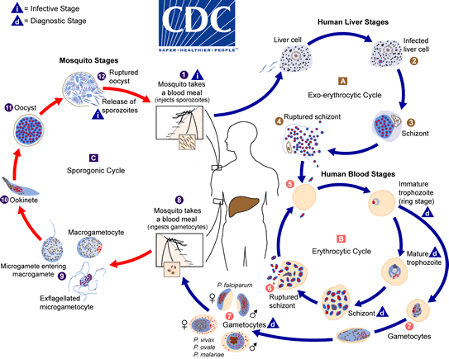
Malaria
Incubation period & Life cycle
Sporozoites reach the liver within 1-2 hours following Female Anopheles mosquito bite.
Pt. asymptomatic for 12-35 days until RBCs stage of parasite life cycle.
Huge thanks to Microbiology teamwork!
Explanation for the picture:
Malaria is mainly carried by female anopheles mosquito.
The infected mosquito will bite and inject sporozoites from it salivary gland into the bloodstream of human.
Which then will travel through blood until it reaches the liver and enter the hepatocytes where it will multiply asexually to form merozoites inside the schizont (Exoerythrocytic schizont).
When the hepatic schizont rupture the merozoites will be released into blood, then it will enter the erythrocytes forming immature trophozoites (ring stage) which will have 2 pathways:
First pathway:
It goes through the erythrocytic cycle starting from ring stage then into Mature trophozoites, then the merozoites will multiply inside the RBCs forming schizont (Erythrocytic schizont), which will rupture (hemolysis) and release the merozoites into the bloodstream (Clinical attack of malaria is due to this stage) and the cycle will repeat over and over again.
Second pathway:
Some immature trophozoites will become gametocytes (male and female) those gametocytes will be ingested by another mosquito; in the mosquito:
There are Micro(Male) and Macro(Female) gametocytes, the microgametocytes will enter into the macrogametocytes in which they will form Ookinete then it will develop into Oocyst which will rupture releasing sporozoites in mosquito, then the cycle will go over and over again.
Pathogenesis
The pathology of malaria is related to anaemia, cytokine release and, in the case of P. falciparum, widespread organ damage due to impaired microcirculation. The anaemia seen in malaria is multifactorial . In P. falciparum malaria, red cells containing schizonts adhere to the lining of capillaries in the brain, kidneys, gut, liver and other organs. As well as causing mechanical obstruction, these schizonts rupture, releasing toxins and stimulating further cytokine release.
Causes of anemia : Haemolysis of infected red cells ,Haemolysis of non-infected red cells (blackwater fever) , Dyserythropoiesis , Splenomegaly and sequestration ,Folate depletion.

Slide 4
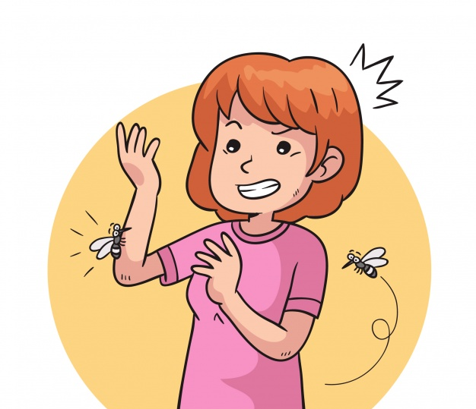
Malaria
Modes of Transmission
1
Human to Human by anopheles mosquito (between dusk and dawn)
2
3
Blood transfusion
4
Contaminated needles
Congenital
Predisposing factors:
Protective factors:
non- immune individuals:
- children in any area
-adults in areas of unstable transmission
- visitors from a non- malarious region.
People living near airports in Europe have acquired malaria from accidentally imported mosquitoes.
Certain genetic traits:
P. falciparum : sickle cell, thalassaemia, G6PD deficiency and HLA-B53, does not grow well in red cells that contain haemoglobin F, C or especially S. Haemoglobin S heterozygotes (AS) are protected against the lethal complications of malaria.
P. vivax: People who lack the Duffy antigen¹ (a common finding in West Africa).
P. Vivax (Pv)
P. Malariae (Pm)
01
02
03
04
05
Plasmodium Falciparum (Pf):
The most serious and common
P. Ovale (Po)
Zoonotic malaria:
P. Knowlesi (Pk),
P. Simium (Ps)
P. vivax and P. ovale may persist in liver cells as dormant forms, hypnozoites, capable of developing into merozoites months or years later. Thus the first attack of clinical malaria may occur long after the patient has left the endemic area, and the disease may relapse after treatment if drugs that kill only the erythrocytic stage of the parasite are given.
P. falciparum and P. malariae have no persistent exo-erythrocytic phase but recrudescence
The Duffy blood group antigen serves not only as blood group antigen, but also as a receptor for a family of proinflammatory cytokines termed chemokines, and as a receptor for Plasmodium vivax malaria parasites.

Slide 5
Malaria
1
Plasmodium Falciparum¹
General Information:
Most highly pathogenic species.
Resistant to many antimalarial drugs.
The species that causes the most morbidity and mortality worldwide.
Represents the major cause of malaria in tropical countries.
Responsible for the sporadic great regional pandemics that sometimes occur in subtropics.
Pathogenesis:
The pre-erythrocytic cycle starts immediately after injection of the sporozoites by the mosquito.
Infects mature and young erythrocytes. The surface of erythrocytes infected with late stage trophozoites or schizonts is altered so they stick to endothelial cells in various tissues (cytoadherence) causing multi-organ failure.
Schizogony is particularly prolific in all stages (pre-erythrocytic, erythrocytic and sporogony) that may be the cause of its success as a species and its virulence.
Characteristics
Infection in the peripheral blood is characterized by the presence of ring forms and gametocytes, whereas late trophozoites and schizonts are only seen exceptionally.
The level of parasitaemia may be high and multiple infection in a single erythrocyte is common.
The gametocytes are characteristically crescent-shaped and unlike the gametocytes of other species, are very slow to reach maturity (up to 10 days) and early forms of gametocytes are sequestered.
A
A: rings in peripheral blood thin film of P.Falc showing double dotted ring and multiple parasites invading one RBC. These findings are characteristic for P.Falciparum .
2
Plasmodium Vivax
General Information:
Occurs throughout most of the temperate zones as well as large areas of the tropics (but is mainly absent from tropical West Africa).
It causes ‘benign’ tertian malaria.
Polymorphic and the subspecies status proposed for some strains may be justified.
Characteristics :
Restriction of erythrocyte invasion to reticulocytes bearing Duffy blood group determinants (explains why RBCs infected with trophozoites of P. vivax are sometimes described as larger than normal).
The presence of caveolar structures on the surface of the infected erythrocyte membrane take up stain, and are described as Schüffner’s dots.
After invading the hepatocyte some of the sporozoites may transform into hypnozoites, then remain latent for months or years and be responsible for subsequent relapses.
B: Co-infection with p.falc and p.vivax.
B
The fever has no particular pattern. Jaundice is common due to haemolysis and hepatic dysfunction. The liver and spleen enlarge and may become tender. Anaemia develops rapidly, as does thrombocytopenia.

Slide 6
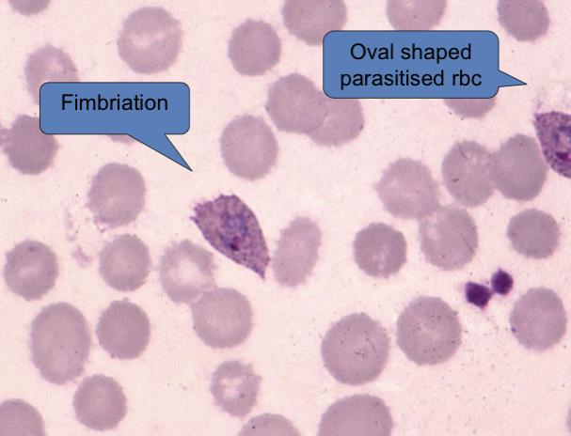
Malaria
3
Plasmodium Ovale
General Information:
Distinct from P. vivax in minor morphological differences, antigenic and molecular differences. Most of the biological and clinical features are identical.
The major biological difference is that P. Ovale can infect Duffy negative reticulocytes, whereas P. Vivax cannot.
A
4
Plasmodium Malariae¹
General Information:
Differs from the other three human malaria parasites in its slow development and its longer asexual cycle.
Development is slow in both the vector and the human host because of less efficient schizogony.
The asexual cycle is 72 hours instead of 48 hours – hence ‘quartan malaria’ – because fever paroxysms occur every 4th day (according to the Roman custom of regarding day 0 as day 1).
Characteristics:
Infects old erythrocytes, explaining why infected cells are often described as ‘smaller’ by microscopic.
The presence of ‘knobs’ at the surface of infected erythrocytes, which are similar to P. Falciparum, but the cells do not exhibit any cytoadherence (and so no sequestration).
The surface of infected erythrocytes does not exhibit any caveolar/vesicle complexes and Schüffner’s dots are absent.
Sporozoites of P. Malariae do not transform into hypnozoites, and so there are no relapses.
P. malariae can survive for a very long time in the peripheral blood (10 years or more) at a very low level of parasitaemia occasionally producing detectable peaks with a recrudescence of clinical symptoms.
B
5
Plasmodium
Knowlesi & Simium
General Information:
Simian Monkey to Human transmission (zoonotic malaria)
P. Knowlesi: in South East Asia, it looks like P. Malariae.
P. Simium: in South America, it looks like P. Vivax.
Need PCR for diagnosis.
Can cause severe disease
In children, P. malariae infection is associated with glomerulonephritis and nephrotic syndrome.

Slide 7
Malaria
Malaria Paroxysm (attack) 437 dr slides
3 successive stages:
1st.
2nd.
3rd.
Rigors, Headache associated with pale COLD skin (1-2 Hr).
Delirium, Tachypnoea, HOT Skin Fever (Several hours).
Fever
(SWEATING & fatigue).
Notes Regarding Malaria Paroxysm:
Paroxysms associated with synchrony of merozoite release.
Between paroxysms temperature is normal and patient feels well and Asymptomatic.
Falciparum may not exhibit classic paroxysms. (continuous fever)
Classically the attacks (Periodicity):
Occur every 48 hours with (P. vivax, and P. ovale) “tertian parasites”.
Occur every 72 hours with (P.malariae) “quartan parasite”.
Whereas (P.falciparum) show IRREGULAR attacks , or hectic (especially in non-immune).
History
Travel to malaria endemic area
P. Falciparum: up to 1 year from travel (usually first 3 months).
P. Malariae: up to 10 years.
The main symptom that is usually present is fever which is non specific.
Non specific: Fever
Sweats, chills
Myalgia
Headache
Diarrhea
Cough
Jaundice, dark urine
Confusion, Seizures
Signs
01
Fever, HR tachycardia, low BP, low O2
03
Evidence of seizures
05
Jaundice
02
Level of consciousness
04
Splenomegaly the most common clinical sign
06
Anemia
Does this patient have malaria?
Acquired during travel: | Living in endemic region:
Fever +LR 5.1 Splenomegaly +LR 6.5 Hyperbilirubinemia +LR 7.3 Thrombocytopenia +LR 5.6 | Splenomegaly +LR 3.3 Hepatomegaly +LR 2.4

Slide 8
Malaria
Malaria clinical spectrum:
Most fever or flu-like illness
Fatalities with (Pf) (occasionally with splenic rupture).
Cerebral malaria (Pf) - may be focal or generalized symptoms.
RISK FACTORS FOR POOR PROGNOSIS IN CEREBRAL MALARIA: High bilirubin, High creatinine, Hight lactase.
Hypoglycemia - from disease and treatment (quinine leads to insulin release).
Risk Acute Respiratory Distress Syndrome (Pf) due to capillary leak - need to limit fluids.
Acute renal failure (Pf) - common complication of severe malaria.
WHO Criteria – Severe Malaria
EITHER
AND
Any one or more of the following 11 features:
History of recent possible exposure and no other recognized pathology.
Asexual forms of (Pf) on blood smear.
01 |
02 |
03 |
04 |
05 |
06 |
07 |
08 |
09 |
10 |
11 |
Impaired consciousness or coma.
Severe normocytic anemia.
Renal failure.
Pulmonary edema or adult respiratory distress syndrome (ARDS).
Hypoglycemia.
Circulatory collapse, shock
Spontaneous bleeding/disseminated intravascular coagulation.
Repeated generalized convulsions.
Acidemia/acidosis.
Hemoglobinuria.
Parasitemia of > 5% (> 250 000/microlitre) in non-immune individuals.
Pregnancy & Malaria
The extra is from 437 dr slides.
01 |
Mortality, Abortion, Stillbirth.
02 |
Anemia, hypoglycemia, pulmonary edema: more common.
03 |
Premature delivery high infant mortality.
04 |
Low birth weight ,Placental insufficiency.
05 |
High parasitemia? placenta favorable site for P. Falciparum.
06 |
Primigravidae , more susceptible to placental malaria

Slide 9
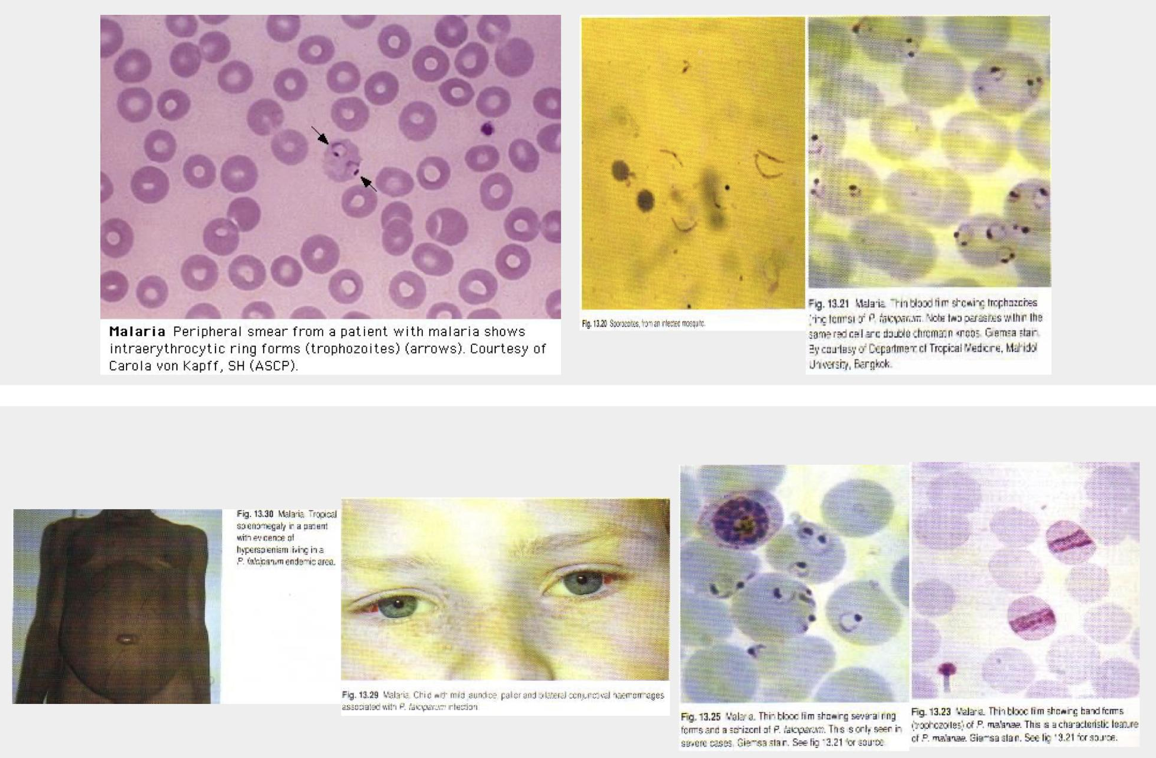
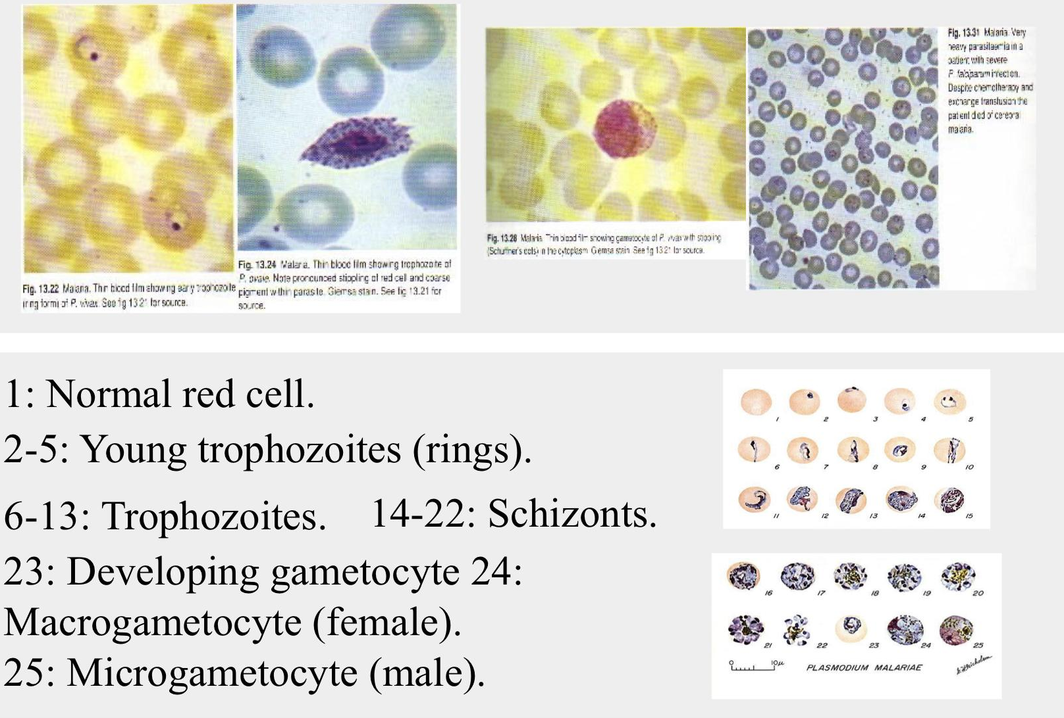
Malaria
Diagnosis
Detailed targeted history including travel history and clinical examination together with High Index of Suspicion (HIS).
Thin and Thick films¹ | Urea and Creatinine | ABG
CBC, Coagulation profile | LFT, Bilirubin | CXR
Random Blood glucose | Lactic acid | Urine analysis
01.
Blood film
Extra from 437 dr slides
Giemsa stain or wright’s stain.
Correct identification of malarial Species is essential for treatment because of P. Falciparum is resistant to Chloroquine & others.
On Giemsa stain:
Cytoplasm: light blue, Nucleus: dark blue.
In P. Falciparum:
Only ring stage asexual parasite and gametocytes seen in Peripheral Blood.
While RBC with Trophozoites or Schizonts stage sequestered in peripheral microvasculature, and NOT circulating Peripheral Blood.
In P. Vivax, Ovale & malariae:
All asexual erythrocytic stages circulate in peripheral blood, thus seen on Blood Smear.
Acutely ill patients | DDX: P.F. vs P. Vivax, because:
P. Ovale – Vivax – clinical, morphological.
P. malariae - ch. Infection
Differential diagnosis of malaria in acutely ill patients based on peripheral blood smear:
Findings | P. Falciparum | P. Vivax & P. Ovale
Multiple infected RBCs | Common | Rare
Mature (trophozoite & schizont) parasites | Absent | Common
RBC enlargement with later parasite stages | Absent | Common
Mature (trophozoites & schizont) stage P. falciparum typically sequestered in the peripheral microvasculature.
RBC enlargement in P. vivax typically occurs with later stage parasites that do NOT circulate in
P. falciparum infection.
In the thick film, erythrocytes are lysed, releasing all blood stages of the parasite. This, as well as the fact that more blood is used in thick films, facilitates the diagnosis of low-level parasitaemia.
A thin film is essential to confirm the diagnosis, to identify the species of parasite and, in P. falciparum infections, to quantify the parasite load (by counting the percentage of infected erythrocytes).

Slide 10
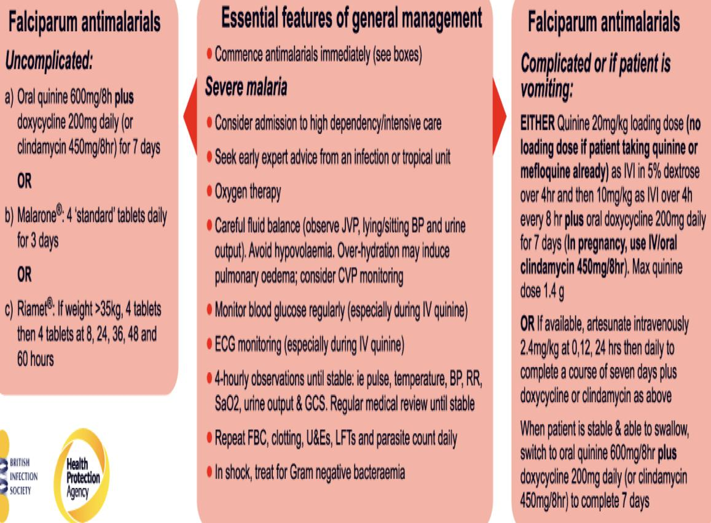
Malaria
02.
Serology
Extra from 437 dr slides
NOT useful in managing acutely ill patient.
03.
DNA probe (PCR)¹
Limited utility for the diagnosis of acutely ill patients in the standard healthcare setting
Most useful for confirming the species of malarial parasite after the diagnosis has been established by either smear microscopy or RDT.
Management
Basic Principles of Malaria Management:
Think of the diagnosis and do thick and thin blood films.
Ask lab about species of malaria – falciparum versus non-falciparum (vivax, ovale, malariae).
Ask about percent parasitemia
– If told greater than 1% parasitemia – think PF!.
Verify no evidence of severe or complicated malaria (no need for parenteral therapy).
Medical Emergency.
Consider admission to hospital (especially for falciparum) at least observe tolerance of meds in ER.
FOLLOW UP.
Drug of choice: Artesunate based therapy.
Oral therapy:
Artemether-Lumefantrine²
Atovaquone / Proguanil (Malarone)
Quinine plus Doxycycline³ / Clindamycin
* Avoid Mefloquine for treatment.
Parenteral therapy
Artesunate
Quinine (or quinidine): needs telemetry.
All trimesters: Artesunate
DNA detection (PCR) is used mainly in research and is useful for determining whether a patient has a recrudescence of the same malaria parasite or a re-infection with a new parasite.
P. falciparum is now resistant to chloroquine and sulfadoxine-pyrimethamine (Fansidar) almost world-wide, so an artemisinin-based treatment is recommended.
We usually avoid doxy in pregnancy, we don’t use it in malaria as often as we used to. Artesunate is the main therapy

Slide 11
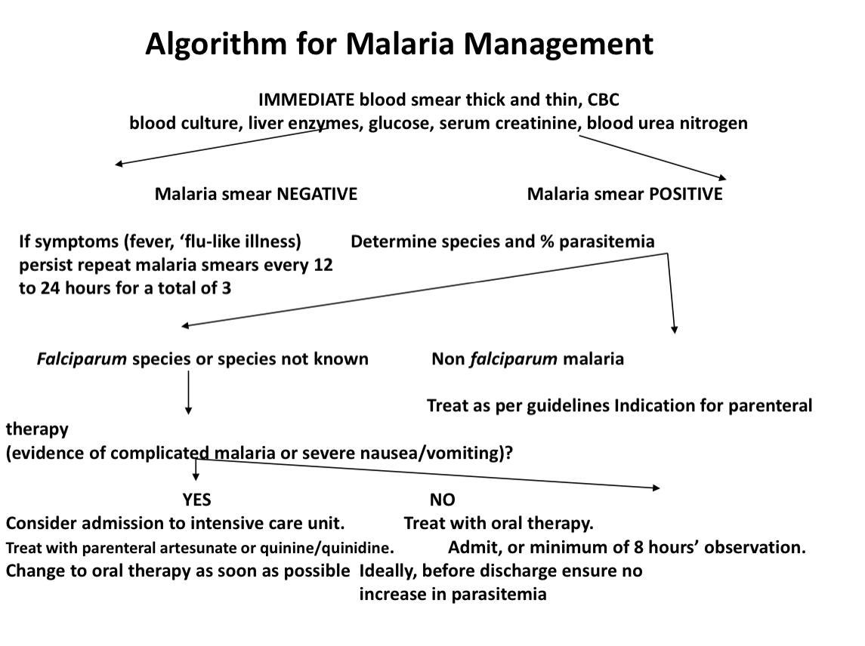
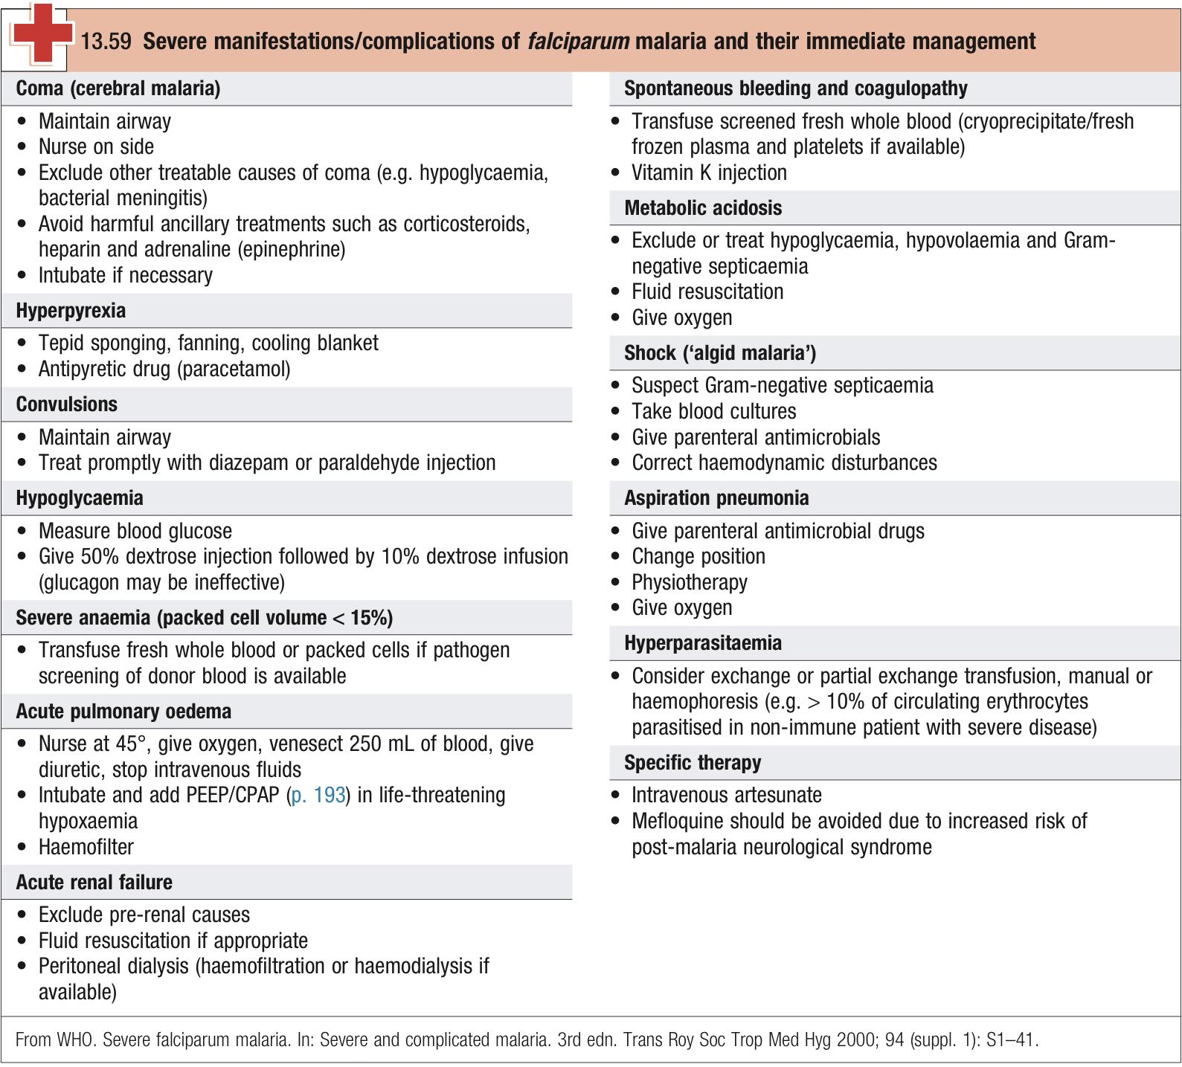
Malaria
Management cont.
Non-P. Falciparum:
Chloroquine (base) 600mg followed by 300mg at 6, 24 and 48 hours.
primaquine (30mg base/day for vivax, 15 mg/day for ovale) for 14 days in vivax and ovale after treatment of acute infection use to eradicate liver parasites; G6PD must be measured before primaquine is given – seek expert advice if low.
Drug toxicity
Quinine:
Hypoglycemia, arrhythmias, bitter taste , GIT upset , nausea, vomiting , tinnitus, high tone deafness.
Doxycycline:
GI upset, vaginal candidiasis.
Mefloquine¹:
Neuropsychiatric symptoms (mood changes), encephalopathy… transient.
Artemether-Lumefantrine:
H/A, anorexia, dizziness, arthralgia and myalgia.
Contraindicated in the first trimester of pregnancy, lactation, cardiac conduction disorders, epilepsy, psychiatric disorders.

Slide 12
Malaria
Prevention
When travelling to malaria endemic areas:
Avoid mosquito bites .
Wear long sleeved shirts and long trousers.
Sleep in well–screened or air-conditioned rooms.
Permethrin impregnated bed nets.
Use bednetting of good quality with small mesh that is not damaged and impregnated with permethrin.
Apply insect repellent containing no more than 30% DEET, or use 20% or greater Picaridin.
At dusk, spray aerosolized insecticides (such as those containing pyrethrins) in living and sleeping areas.
Chemoprophylaxis.
Chemoprophylaxis¹:
Start 2 days pre-travel, continue 7 days after return:
Atovaquone/ Proguanil² (Malarone): 1 tab/d ( 250 mg atovaquone /100 mg proguanil)
One or 2 weeks pre-travel, continue 4 weeks after return: less preferred
Mefloquine 250 mg once/wk.
Doxycycline 100 mg daily.
Primaquine 30 mg base daily.
Chloroquine³ sensitive areas: 500 mg (300 mg base) : once/wk.
Choice of regimen is determined by area to be visited, length of stay, level of malaria transmission, level of drug resistance, presence of underlying disease in the traveler concomitant medication taken.
Pregnant and lactating women may take proguanil or chloroquine safely. Avoid Malarone in pregnancy.
Chloroquine should not be taken continuously as a prophylactic for more than 5 years without regular ophthalmic examination, as it may cause irreversible retinopathy.
Malaria Vaccine: skipped by the dr
RTS,S/AS01 (Mosquirix).
Engineered from T-cell epitope in the pre-erythrocytic circumsporozoite protein (CSP) of PF malaria parasite and the envelope protein of HBsAg with an adjuvant AS01.
Efficacy of 25-50% in infants and young children.

Slide 13
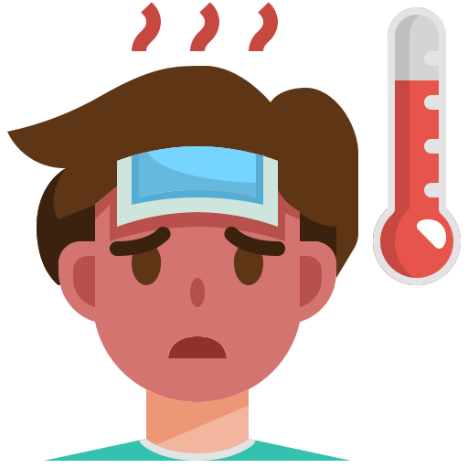
Travel
Fever in Returning Travelers
The most common etiologies of fever in returning travelers are listed first:
01
Dengue (flavivirus):
4-7 day incubation, widespread in tropics (increasing in Africa), vector borne (Aedes).
Diagnosis: PCR, NS1 antigen; IgM only after day 4.
02
Malaria (Plasmodia sp.):
07
Leptospirosis:
7-30 day incubation for P. falciparum, widespread but very high risk in Africa, vectorborne. (Anopheles).
Diagnosis: blood smear, PCR, malaria RDT (rapid diagnostic test).
Incubation 2-29 days, South and South Asia, South America, transmitted from urine of infected rodents.
Diagnosis: IgM only after day 5; PCR earlier.
03
Typhoid fever
(Salmonella sp.):
08
Rickettsial disease:
Incubation 6-30 days, mostly South and Southeast Asia, fecal-oral transmission.
Diagnosis: blood culture. Avoid Widal test can give a false -ve or false +ve.
Scrub typhus:
Incubation 6-20 days, Asia and northern Australia, chigger mites. Murine typhus worldwide.
Diagnosis: PCR (blood or eschar), IgM.
Spotted fever group:
Incubation 2-14 days, widespread but highest risk with R. Africae in southern Africa, mostly ticks.
Diagnosis: PCR (blood or eschar), IgM/IgG.
04
Chikungunya virus:
4-7 day incubation, widespread in tropics, vector borne (Aedes)
Diagnosis: PCR; IgM only after day 4.
05
Zika virus:
09
Rabies:
Incubation 3-14 days, mostly Southeast Asia, little risk in Americas and Caribbean since 2016, vector borne (Aedes).
Diagnosis: PCR of blood or urine, IgM (high false-positive rate), Viral Neutralization is definitive, no testing available in someone with previous flavivirus infection of any kind.
Incubation 20-60 days most common, widespread, animal or bat bite.
Diagnosis: PCR of saliva or skin, serum antibody detection.
06
COVID-19 (SARS-CoV-2):
10
East African trypanosomiasis:
Incubation most commonly 3-7 days, present in almost all countries, can be acquired in-flight or after return.
Diagnosis: PCR more sensitive than antigen, very sensitive during febrile phase.
Incubation 7-21 days, eastern and southern African game parks, tsetse fly.
Diagnosis: microscopy of blood films, lymph node aspirate, or chancre.

Slide 14
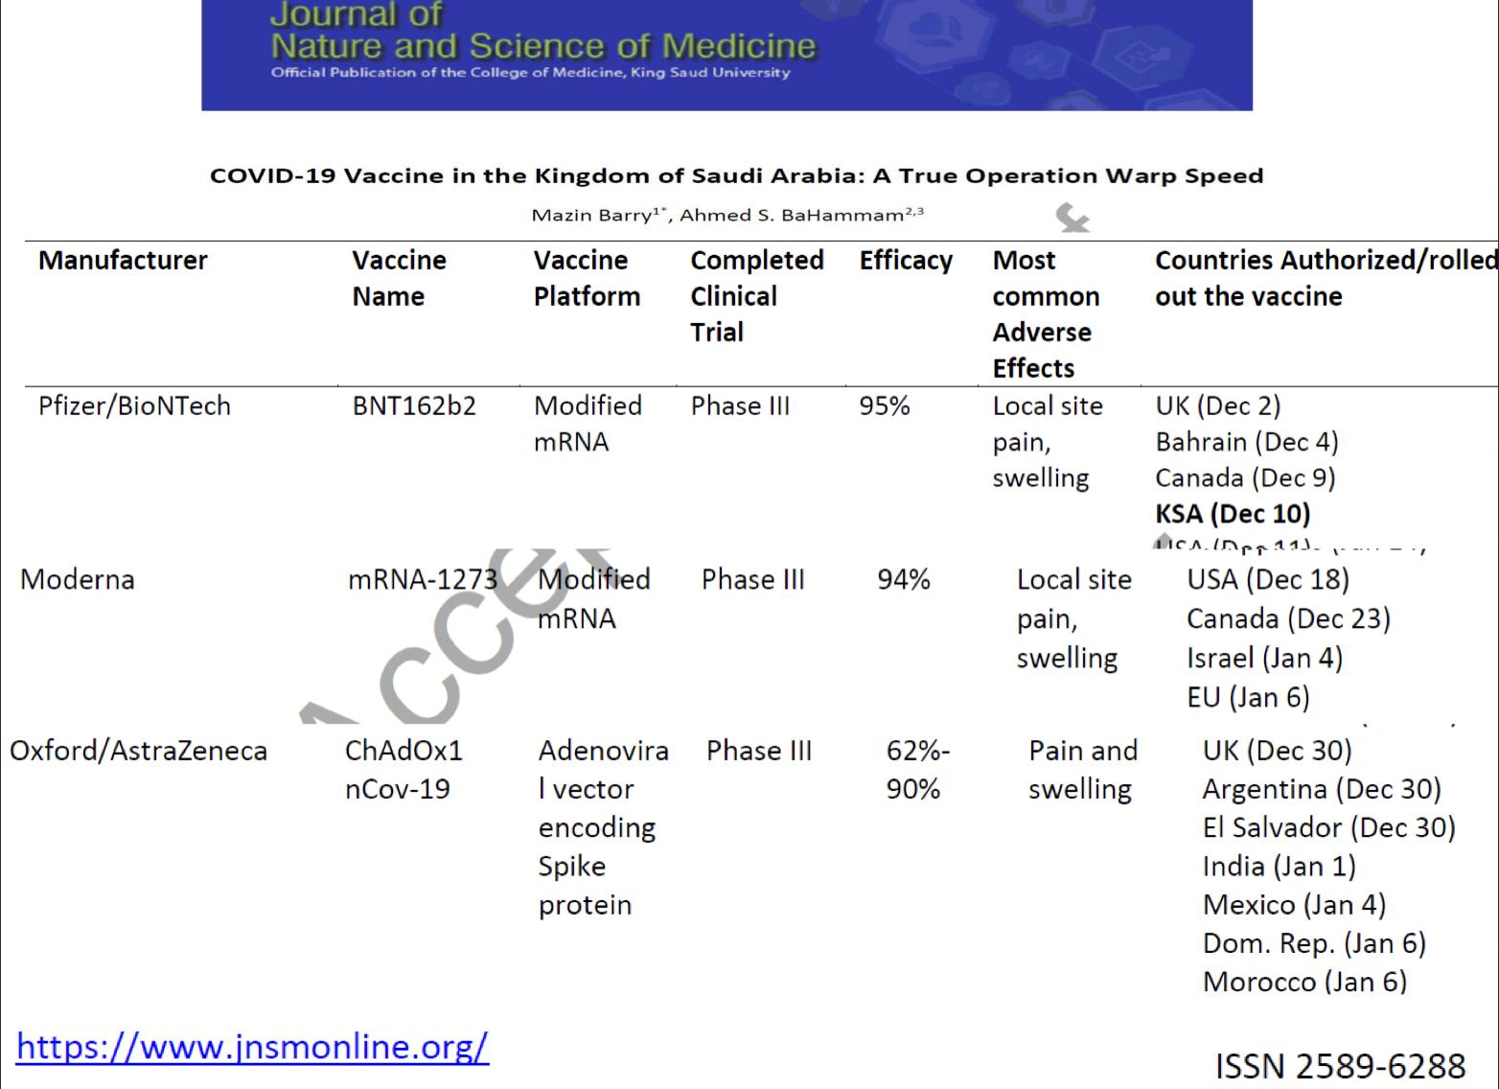
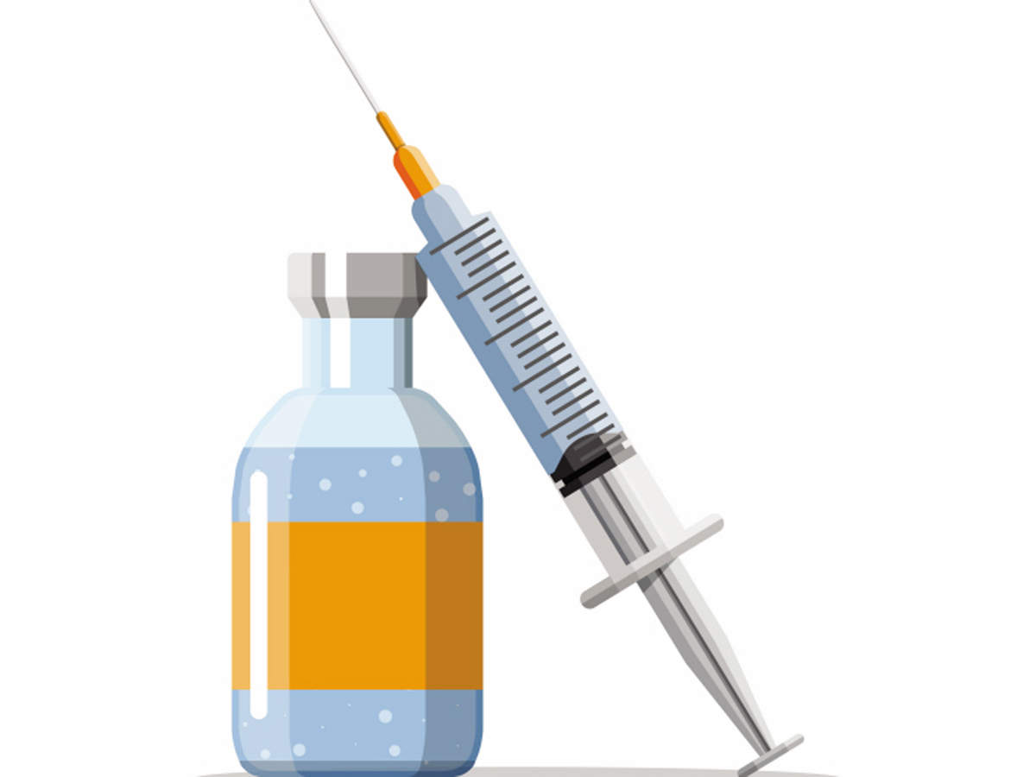
Travel
Fever in Returning Travelers
Other frequent diseases in travelers:
influenza A (seasonal).
Acute HIV
Mononucleosis.
Measles.
Varicella.
Tuberculosis.
Infrequent diseases in travelers to consider:
Avian influenza (H5N1 & H7N9).
African hemorrhagic fevers (Ebola incubation is 8-12 days).
CCHF (Crimean-Congo haemorrhagic fever).
Yellow fever.
Japanese encephalitis.
Monkeypox (Nigeria and neighbors).
Relapsing fever.
Acute toxoplasmosis.
Arboviruses including Ross River.
Tickborne encephalitis.
West Nile virus (emerging in Europe).
Hantavirus (both hantavirus cardiopulmonary syndrome and hemorrhagic fever with renal syndrome).
Vaccines
Required:
Yellow Fever in Africa.
Meningococcal, for all non saudies to enter SA.
COVID-19 soon, for international travel.
Recommended :
Polio
Influenza
Hepatitis A/B
Measles
Tetanus/Diphtheria/Pertussis
Typhoid
Rabies
Japanese Encephalitis
Tick-borne Encephalitis
* How Do You Know What Vaccines are Needed for Travel? The CDC’s Health Information Website for Clinicians and Travelers (Published every 2 years, The “yellow book”) Available online.

Slide 15
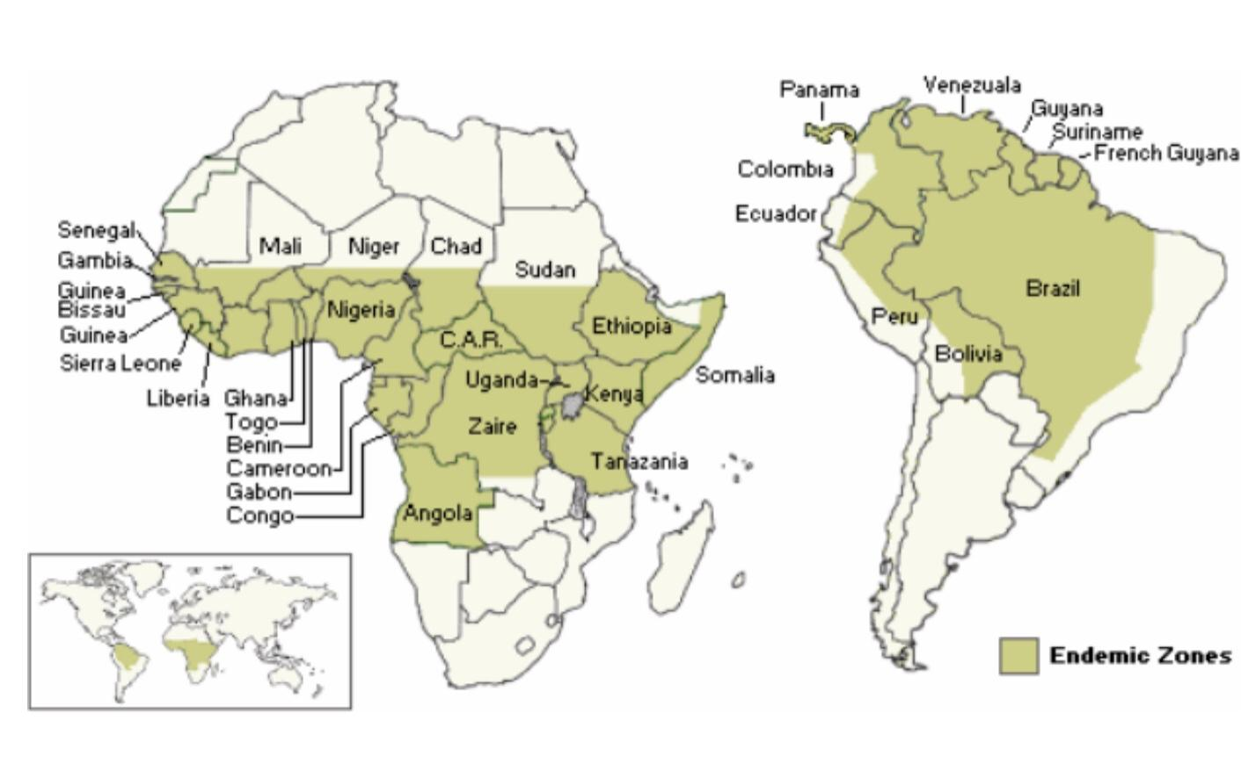
Yellow Fever
Yellow fever¹
Mosquito-borne hemorrhagic fever caused by a flavivirus.
Rare fatalities in travelers since vaccine introduction.
Epidemiology:
~200,000 cases per year, 90% in Africa.
Indigenous case fatality rates vary 20-60% .
Stages
Has 3 stages:
Infection
(3-4 days)²
Remission
(48 hours)
Intoxication³
Fever, malaise, leukopenia.
Abatement of symptoms, 15% progress.
Return of symptoms, organ dysfunction, hemorrhage.
Transmission
Disease Prevention
1
Avoid mosquito bites: DEET, Clothing, Mosquito nets, Eliminate standing water.
From primates or humans
2
Mosquito vector
Vaccination
Yellow Fever Vaccine
Live-attenuated vaccine. Developed in 1936.
Seroconversion >95%.
Single 0.5ml subcutaneously.
Revaccination at 10-year intervals required by World Health Organization.
Protection from one vaccine. However, may last 30 or more years.
Contraindications
Age <9 months old
(Can consider at 6-9 months old during outbreaks).
Pregnant women
(Yellow fever can cross placenta).
Severe egg allergies.
Severe immunocompromise.
Immunomodulatory drugs.
Diagnosis of yellow fever can be confirmed by viral isolation from blood in the first 24 days of illness, the presence of IgM or a fourfold rise in IgG antibody titre. Leucopenia is characteristic.
Humans are infectious during the viraemic phase, which starts 3–6 days after the bite of the infected mosquito and lasts for 4–5 days.
In more severe disease, fever recrudescence is associated with lower back pain, abdominal pain and somnolence, prominent nausea and vomiting, bradycardia and jaundice. Liver damage and DIC lead to bleeding with petechiae, mucosal haemorrhages and gastrointestinal bleeding. Shock, hepatic failure, renal failure, seizures and coma may ensue.

Slide 16
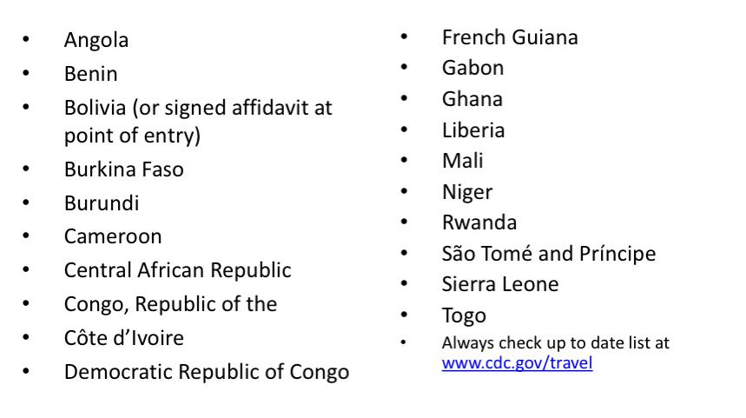
Yellow Fever
Yellow Fever Vaccine
Side Effects
Adverse Reactions (10-30%):
Local soreness, Mild fever, Headache, Myalgia.
Rare Severe Reactions
Anaphylaxis:
Risk 1/131,000.
Yellow fever associated neurotropic disease (YEL-AND):
Risk 1:150,000 - 200,000.
Multiple neurologic conditions:
Encephalitis (esp. infants <9 months), Guillian-Barre, Bell’s Palsy.
Onset 2-28 days after vaccination.
Rarely fatal.
Yellow fever associated viscerotropic disease (YEL-AVD):
Mimics severe yellow fever infection.
Major organ system failure occurs:
Hepatic, renal, circulatory failure.
50% or greater fatality rate.
Occurs 1-8 days (average 3 days) after initial vaccination.
Risk 1:200,000 - 300,000 (Greater risk if over age 60).
Certification of vaccination required:
International Certificate of Vaccination or Prophylaxis for Yellow Fever form (ICVP).
Must be signed by licensed physician or designee.
Waiver form for medical contraindication to vaccine (e.g. pregnancy).
Yellow Fever Vaccination Proof Required for Entry

Slide 17
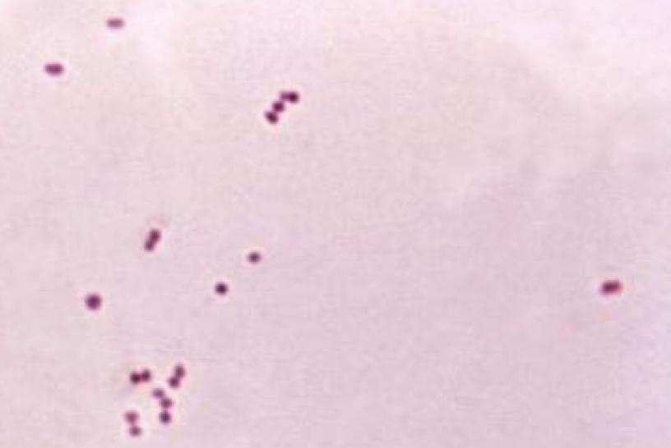
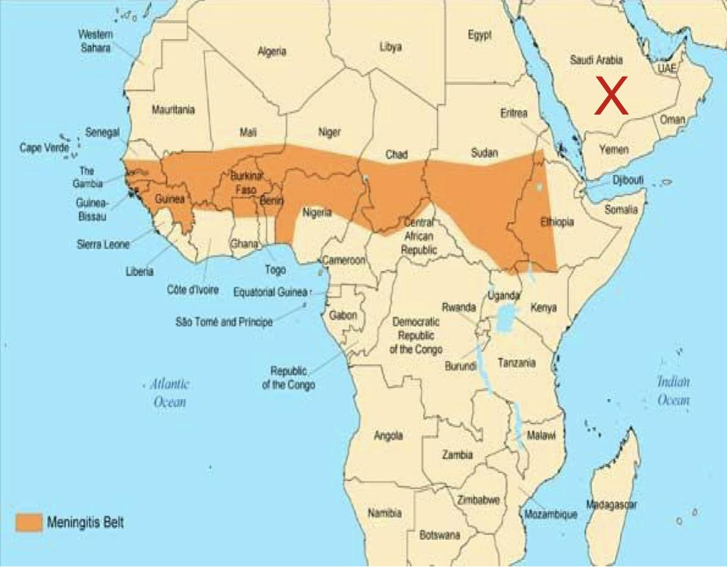
Meningococcal
Meningococcal Disease
1st Picture: Neisseria Meningitidis (Gram negative diplococci).
2nd Picture: Sub-Saharan Africa.
Youngest children = highest risk.
Epidemiology:
Greatest risk: dry season (Dec. - June).
Hajj pilgrimage to Saudia Arabia associated with outbreaks.
0.5-10/100,000 in non-epidemic areas.
Risk of travelers: 0.4/100,000.
Up to 1,000/100,000 in epidemic areas.
Meningococcal vaccine
Vaccine required to attend the Hajj (annual pilgrimage to Mecca)
If under age 15, polio vaccination needed also.
Available vaccines:
Revaccination: If high-risk (epidemic area or travel).
MCV4
(Menactra™)
Quadrivalent meningococcal polysaccharide–protein conjugate vaccine.
2-55 years old.
Preferred in <11 year olds.
MPVS4
(Menomune®)
Quadrivalent meningococcal polysaccharide vaccine
2 years and older.
Use for >55 years old.
MenACWY-CRM
(Menveo®)
Quadrivalent meningococcal oligosaccharide diphtheria CRM197 Conjugate Vaccine.
11-55 years old.
If vaccine given at 2-6 years old: Repeat after 3 years, then every 5 years.
If vaccine given >6 years old:
Repeat every 5 years.
An area for your notes

Slide 18
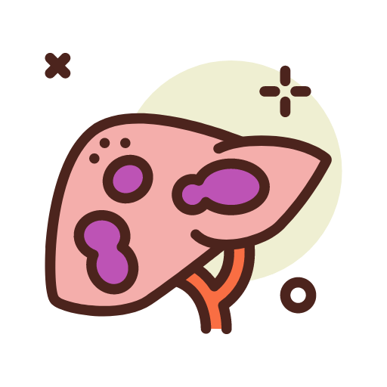
Hepatitis A
Hepatitis A
Worldwide prevalence.
Adults often contract from asymptomatic children.
Incubation 28 days (range 15-50 days).
Viral shedding 2 weeks before to 1 week after symptoms.
Usually self-limited disease.
Mode of transmission:
Fecal/oral transmission ( Associated poor hygiene or sanitation).
Symptoms include:
Jaundice
Fatigue
Abdominal pain
Anorexia
Nausea
Hepatitis A Vaccine
Inactivated Hep A virus (Havrix® or Vaqta®).
Combined with Hepatitis B (Twinrix®).
Travel vaccine indications:
Anyone >1 year old traveling anywhere other than to:
U.S. and Canada, Western Europe, Scandinavia, Japan, Australia and New Zealand.
For healthy patients <40 years old, one dose before travel confers adequate protection.
Havrix®
01
Dose at 0 and booster at 6-12 months.
Vaccines
Vaqta®
02
Dose at 0 and booster at 6-18 months.
Twinrix®
03
Combination of Inactivated Hepatitis A with Recombinant Hepatitis B.
Indicated for 18 years old and older.
Better choice if both vaccines are indicated
3-dose series:
0, 1, 6 months.
4-dose accelerated series:
0, 7 days, 21-30 days and 12 months.
Hepatitis A treatment
Consider immunoglobulin treatment for patients:
Leaving in less than two weeks.
Older.
Immunocompromised.
Chronic medical conditions.
Under 12 months of age.

Slide 19
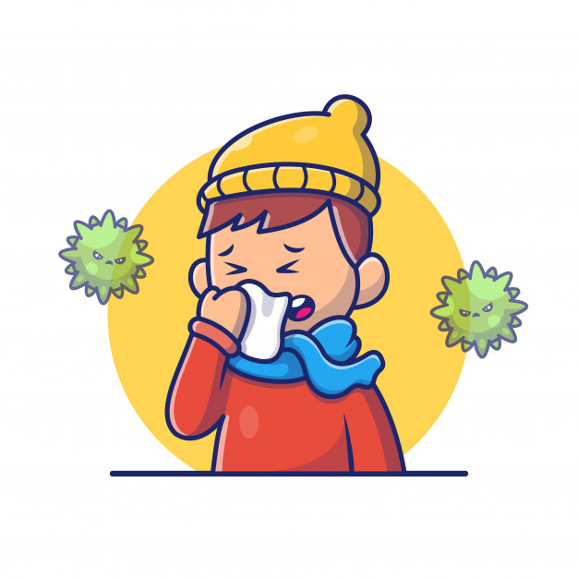
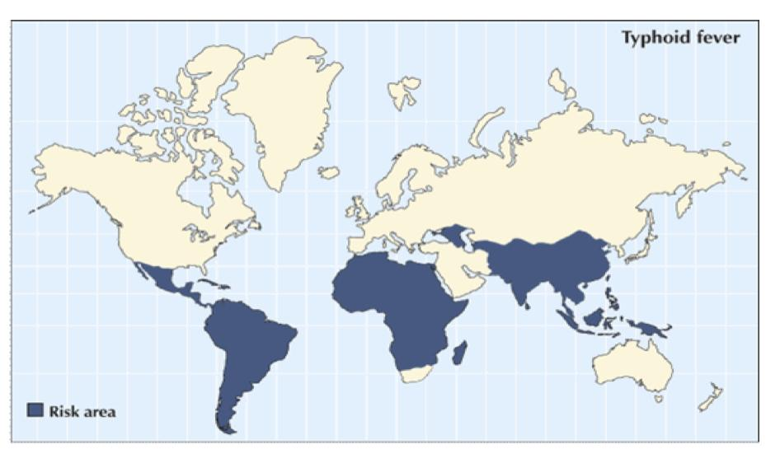
Influenza
Skipped by the dr
Risk factors
Risk depends on timing and destination:
Tropics: year round risk.
Temperate climates: risk generally April-September.
Avian subtype risks:
Visiting poultry farms.
Visiting open markets where live poultry are present.
Eating undercooked poultry products (eggs, meat, etc.).
Preventative measures
Hygiene: washing hands.
Annual vaccination.
Typhoid Fever
Definition
Acute life-threatening illness.Caused by Salmonella typhi¹.
Epidemiology
22,000,000 cases worldwide/year.
200,000 deaths.
Risk area:
Southeast Asia
6-30 times more common.
Highest risk of FQ (Fluoroquinolones) drug resistance.
Africa, Caribbean, Central and South America.
Length of stay = increased risk.
Mode of transmission
Humans – only source:
Acquired through fecal contamination of food and water.
After a few days of bacteraemia, the bacilli localise, mainly in the lymphoid tissue of the small intestine, resulting in typical lesions in the Peyer’s patches and follicles. These swell at first, then ulcerate and usually heal. After clinical recovery, about 5% of patients become chronic carriers (i.e. continue to excrete the bacteria after 1 year); the bacilli may live in the gallbladder for months or years and pass intermittently in the stool and, less commonly, in the urine.

Slide 20
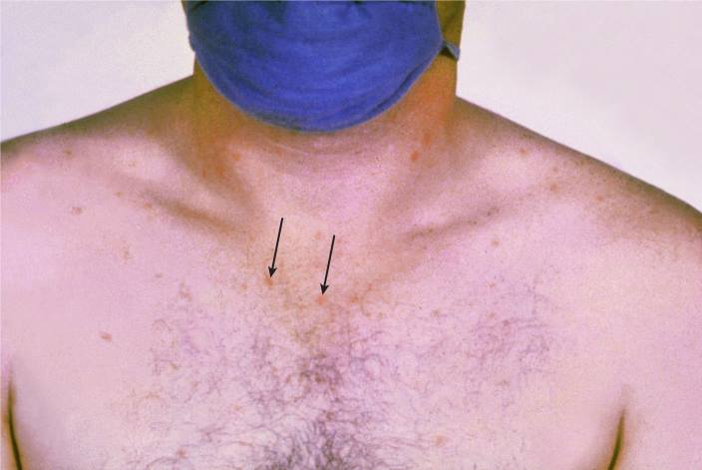
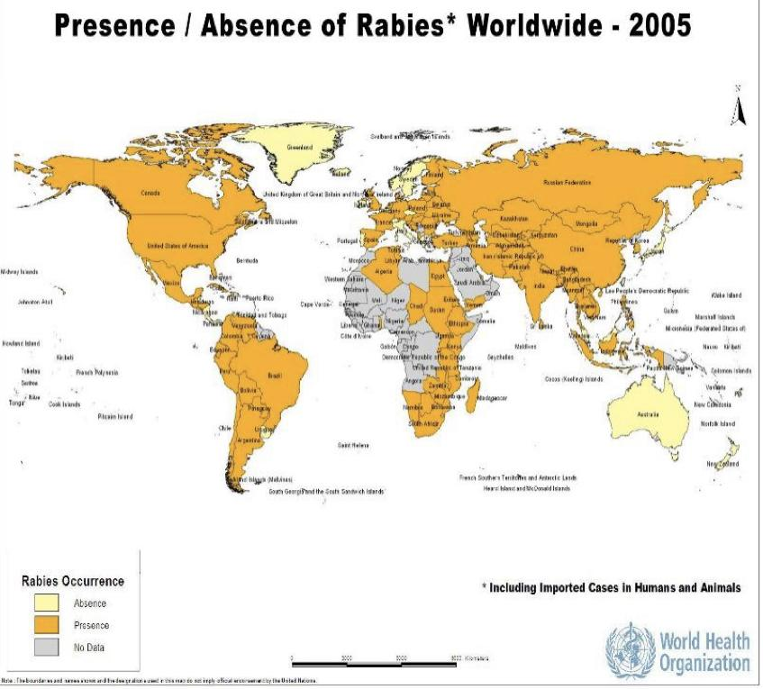
Typhoid Fever
Signs & symptoms¹
Incubation period: 6-30 days.
Headache.
Malaise.
Fever.
Increasing in severity.
Low-grade septicemia.
“Rose spots” on trunk.
Complications
Rose spots on the chest in a patient with typhoid.
At the end of the first week, a rash may appear on the upper abdomen and on the back as sparse, slightly raised, rose-red spots, which fade on pressure.
Serious complications (2-3 weeks):
Hepatosplenomegaly.
Intestinal hemorrhage/perforation.
Treatment
Prevention
Oral rehydration.
Antibiotics:
3rd generation cephalosporin (10-14 days).
Azithromycin Ciprofloxacin only if no resistance (7-10 days).
Steroids in severe cases.
Avoid contaminated food and water.
Hygiene.
Local cuisine.
Vaccines
2 available vaccines:
Vivotif®
Oral, live-attenuated.
Ages 6 and older.
50-80% protection.
4 pills – one every other day.
Completed 1 week before potential exposure.
Revaccination every 5 years.
Typhim Vi®
Capsular polysaccharide (IM).
Ages 2 and older
50-80% protection.
Single 0.5ml injection.
2 weeks before exposure.
Booster every 2 years.
Rabies²
Found globally.
Consider vaccination:
If potential exposure to wild animals (especially dogs).
Prolonged exposure where endemic.
Pre-exposure prophylaxis³
Post-exposure
Series of 3 at 0, 7 and 21-28 days.
2 vaccines available:
Imovax®
Rabavert®
Rabies Immunoglobulin (RIG) plus vaccine:
RIG days 0, 4.
Vaccine days 0, 3, 7,14.
If had vaccine:
No RIG needed.
Vaccine days 0 and 3.
The temperature rises in a stepladder fashion for 4 or 5 days with malaise, increasing headache, drowsiness and aching in the limbs. Constipation may be caused by swelling of lymphoid tissue around the ileocaecal junction, although in children diarrhoea and vomiting may be prominent early in the illness.
Rabies is caused by a rhabdovirus that infects the central nervous tissue and salivary glands of a wide range of mammals, and is usually conveyed by saliva through bites or licks on abrasions or on intact mucous membranes. Humans are most frequently infected from dogs and bats.
Pre-exposure prophylaxis is required by those who handle potentially infected animals professionally, those who work with rabies virus in laboratories and those who live at special risk in rabies-endemic areas.

Slide 21
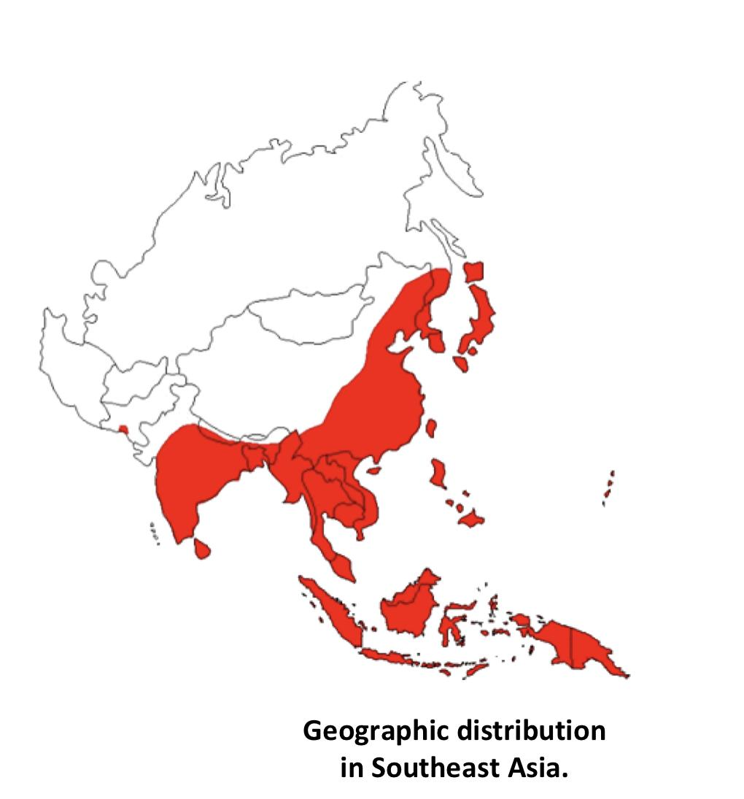
Japanese Encephalitis
Japanese Encephalitis Virus (JEV)
Most common cause of encephalitis in Southeast Asia.
Carried by mosquitoes
Risk:
Little risk in urban areas.
Mostly rural areas.
Not recommended for short-term travel to urban area.
Signs & symptoms¹
Incubation 5-15 days.
Most infections asymptomatic, <1% develop clinical disease:
Headache, fever, vomiting, diarrhea.
Most recover in 1 week.
1:300 severe symptoms with 30% fatality:
Mental status changes.
Focal neurological deficits.
Parkinsonian syndrome.
Seizures (especially children).
vaccine
Inactivated Vero cell culture (JE-VC):
For people over 17 years old.
Duration of protection unknown.
Need for boosters undetermined.
Pregnancy Category B.
Travelers’ Diarrhea Self-treatment
Antibiotic +/- loperamide
Quinolones: single dose, max 3 days.
Giardiasis (giardia duodenalis):
rotten eggs burping, diarrhea.
Azithromycin: single dose of 500mg max 3
days or one time dose of 1000 mg.
Metronidazole: 250 mg po TID 7 d.
Rifaximin
Nitazoxanide: 500 mg po bid 3 days
.
Initial systemic illness with fever, malaise and anorexia is followed by photophobia, vomiting, headache and changes in brainstem function. Neurological features other than encephalitis include meningitis, seizures, cranial nerve palsies, flaccid or spastic paralysis, and extrapyramidal features. Mortality with neurological disease is 25%.

Slide 22
Advice for Acclimatization
Tell climbers to avoid abrupt ascent to altitudes above 9850 ft.
Spend 2-3 nights at 8200-9850 ft before further ascent.
Add an extra night of acclimatization for every 2000-3000 ft of ascent.
Make day trips to higher elevation with return to lower elevation for sleep.
Avoid alcohol and sedatives for the first 2 nights at altitude.
Moderate exercise (Extreme exercise at altitude may be harmful).
acetazolamide 125-250 mg bid starting 24 hours before ascent and continue for 48 hrs at maximum altitude.
Side effects: paresthesias, polyuria, nausea, drowsiness, impotence, myopia, bitter taste.
Sexually transmitted illnesses and Travel
Greatest risk age 15-29, and in SE Asia and Gulf countries.
01
02
All travellers do more risk-taking behaviours while travelling. Sexual tourism is a big problem.
Limit consumption of alcohol, drugs.
06
03
Education: safe sex practices, especially use of condoms.
Use high quality condoms.
05
04
Abstain from sexual activity.

Slide 23
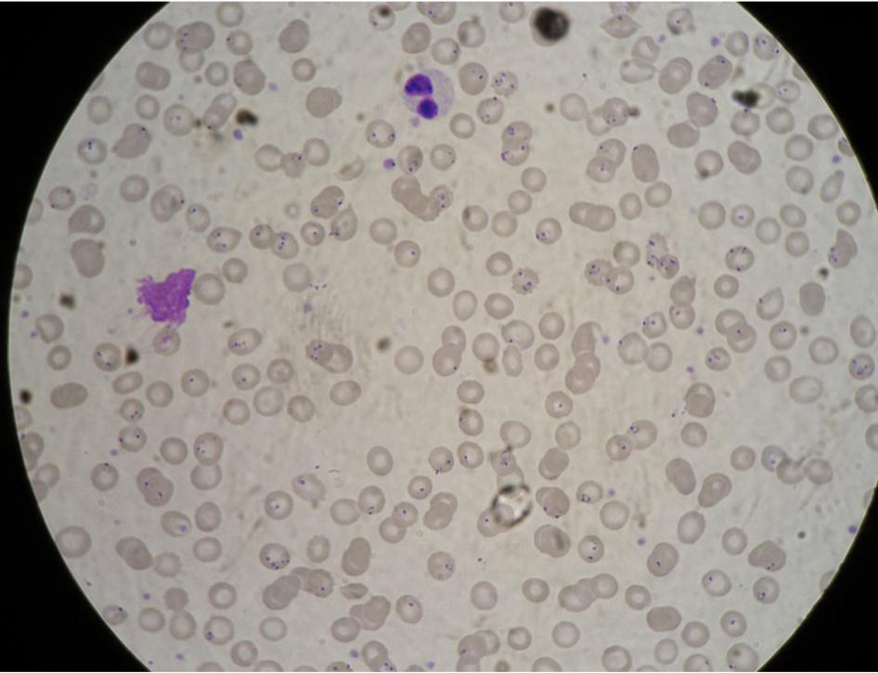
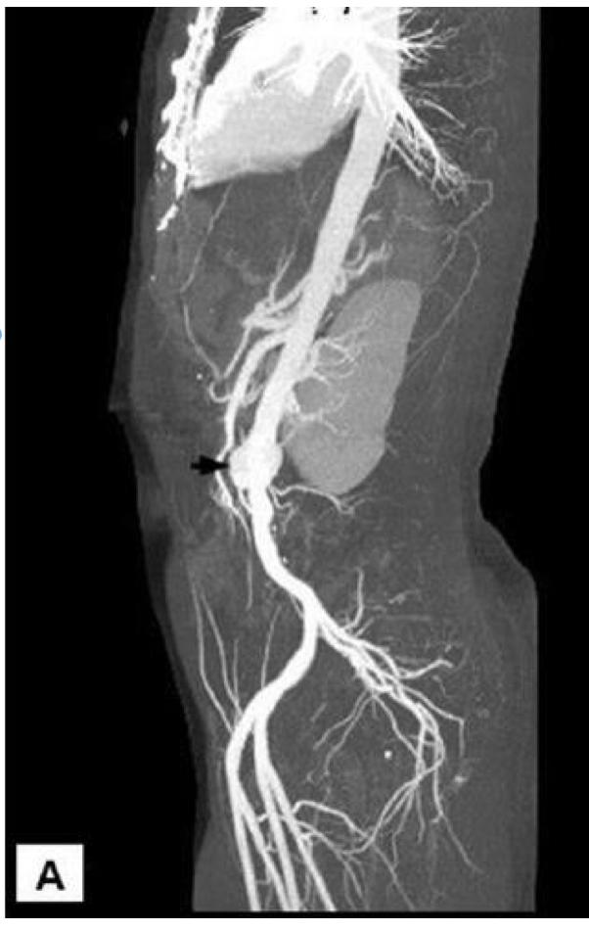
Dr slides
Cases
Case study 1:
18 year old pregnant woman returned from Jazan one week ago. Fever and headache for 3 days.
Physical examination: Pale, Temp. 39°C Spleen enlarged.
Investigations: WBC 8, Hb 9.0, MCV 93, Plt 90, bilirubin 52
What is your diagnosis?
P.falc malaria showing double chromatin dotted ring and multiple invasions in one RBC
What are the risks in her condition?
Severe disease.
Primigravidae.
Risk of low birth & abortion.
Risk of low glucose , pulmonary oedema.
Case study 2:
42 Saudi Man with continuous fever for one month Chills, rigors, weight loss 2 weeks of mid-back pain radiating to flanks 1 month prior to onset of fever traveled to Thailand, visited rice fields. He diagnosed with Melioidosis.
What do you see in the picture?
Infrarenal abdominal aortic pseudoaneurysm.
What do you expect to see in the blood culture?
Burkholderia pseudomallei causative agent of melioidosis.

Slide 24
Epidemiology | Stable transmission: including much of sub- Saharan Africa, transmission occurs consistently year round. The bulk of the mortality is seen in children, while those who survive to adulthood acquire significant immunity; low- grade parasitaemia is still present but causes few symptoms. Unstable transmission: seasonal or low- level transmission (e.g. in the Sahel belt, where mosquitoes feed only in the rainy season). Little protective immunity develops and symptomatic malaria occurs at all ages.
Pathogenesis | RBCs invasion. , Microvascular pathology, Renal failure, Deep coma, Pulmonary edema , Immune-complex Nephrotic syndrome.
Plasmodium Falciparum | Resistant to many antimalarial drugs. Most morbidity and mortality. Infects mature and young erythrocytes. Cytoadherence. Schizogony is particularly prolific in all stages. Infection in the peripheral blood > ring forms and gametocytes “crescent-shape”. Travel history up to 1 year (usually first 3 months), may present as continuous fever.
p.Vivax | Benign’ tertian malaria. Restriction of erythrocyte invasion to reticulocytes bearing Duffy blood antigen Schüffner’s dots. Hypnozoites > remain latent responsible for subsequent relapse.
p.Ovale | Can infect Duffy negative reticulocytes. Late-onset vivax and ovale malaria may occur despite effective prophylaxis. Hypnozoites >remain latent responsible for subsequent relapse.
P. Malariae | Slow development. The asexual cycle is 72 hours ‘quartan malaria’. Infects old erythrocytes >‘smaller’ infected cells. Do not transform into hypnozoites > no relapses. The peripheral blood (10 years or more) at a very low level of parasitaemia >detectable peaks with a recrudescence of clinical symptoms. Travel history up to 10 years.
Treatment | Oral therapy: Artemether-Lumefantrine. Atovaquone / Proguanil (Malarone). Quinine plus Doxycycline/Clindamycin -Avoid Mefloquine for treatment. - Parenteral therapy: Artesunate. Quinine (or quinidine): needs telemetry.
Chemoprophylaxis | start 2 days pre-travel, continue 7 days after return: Atovaquone/ Proguanil (Malarone): 1 tab/d. One or 2 weeks pre-travel, continue 4 weeks after return: Mefloquine: once/wk. Doxycycline: 100 mg daily. Primaquine: base daily. Chloroquine: sensitive areas.
Non-P. Falciparum:
Chloroquine at 6, 24 and 48 hours.
Primaquine for 14 days: In vivax and ovale after treatment of acute infection use to eradicate liver parasites; G6PD must be measured before primaquine.

Slide 25
Q1: The region with the greatest morbidity and mortality from malaria in the world is?
A. Africa.
B. Southeast Asia.
C. South America.
D. Oceania.
Q2: A young American adult consults with you before travel to Kenya. Appropriate regimens for the prevention of malaria in travelers from a developed country to areas with chloroquine-resistant P. falciparum malaria include
A. Malarone, meloquine, or artemisinin.
B. Malarone, meloquine, or doxycycline.
C. Coartem, Malarone, or doxycycline.
D. quinine, artemisinin, or Fansidar.
Q3: A child from Ghana is admitted with fever, altered consciousness, acute renal failure, and 7% parasitemia with P. falciparum. Severe malaria should be treated with:
A. Oral artemisinin-based combination therapy
B. Malarone or meloquine
C. Quinine or quinidine
D. Intravenous artesunate, if available, and as a back-up intravenous quinine or quinidine
Q4: Reasons for the predilection for P.falciparum to cause severe malaria include all of the following excepT
A. cytoadherence of P. falciparum–infected erythrocytes to vascular endothelium.
B. infection of erythrocytes of all ages.
C. a high prevalence of resistance to available antimalarial drugs.
D. increasing pathogenicity with increasing age of the patient.
Q5: A 55-year-old woman presented in May with fever and headache of 1 day’s duration. She returned 7 days earlier from a 3-week trip to game parks in Tanzania, East Africa. On examination, her temperature is 40° C, blood pressure is 120/85 mm Hg, heart rate is 120 beats per minute, and respiratory rate is 18 breaths per minute. She has no rash, her neck is supple, chest is clear to auscultation and percussion, and abdomen is soft and nontender with normal bowel sounds. he laboratory technician on call has never done a malaria smear, and the hospital does not offer rapid diagnostic tests. Results from a reference laboratory will be available in 24 hours. Which of the following would be the best course of action?
A. Treat with meloquine
B. Treat if parasites are identified at the reference laboratory
C. Treat with chloroquine
D. Treat with artemether/lumefantrine (Coartem)
Q6: The region with the most highly resistant malaria parasites in the world is:
A. Africa
B. Southeast Asia
C. South America
D. Oceania
Quiz explanations:
Question 1:
The correct answer is A . The greatest morbidity and mortality from malaria is in Africa, likely because of many factors, including a preponderance of P. falciparum malaria, particularly competent anopheline mosquito vectors, and limited medical infrastructure.
Question 2:
The correct answer is B .These three drugs are all listed as first-line regimens for the prevention of malaria in travelers. Artemisinin and artemisinin-based combination therapy (Coartem) are not appropriate because of the short half-lives of artemisinins. Quinine is not appropriate because of a short half-life and poor tolerability.
Question 3:
The correct answer is D .The new international standard-of-care for the treatment of severe malaria is intravenous artesunate. Oral therapy should be avoided in very ill individuals. Intravenous quinine or quinidine is highly effective, but intravenous artesunate was superior to intravenous quinine in randomized trials of Asians and Africans with severe malaria.
Question 4:
The correct answer is D . Major contributors to the pathogenesis of P. falciparum malaria include cytoadherence of P.falciparum–infected erythrocytes to vascular endothelium, infection of erythrocytes of all ages, and high prevalence of resistance to available antimalarial drugs. P. falciparum malaria does not generally show increasing pathogenicity with increasing age. Rather, the disease is typically most severe in young children because of their lack of prior exposure to the pathogen and thus lack of antimalarial immunity and possibly other factors.
Question 5:
The correct answer is D . Fever in a returning traveler from Africa is malaria until proved otherwise! A delay in treatment can result in death, and therapy should not be delayed. he fastest acting drug for acute malaria is the fixed combination artemether/lumefantrine. Chloroquine cannot be used because of widespread chloroquine-resistant Plasmodium falciparum in East Africa. High-dose meloquine has the risk for neurologic toxicity and would be used only if other antimalarial drugs were not available. Doxycycline does not act rapidly enough to be used alone for the treatment of acute malaria.
Question 6:
The correct answer is B. The greatest prevalence of parasites resistant to available antimalarial drugs is in Southeast Asia. Resistance to chloroquine, antifolates, meloquine, and quinine is seen in this area, and new data dem-
onstrate decreasing efficiency cacy of artemisinins, manifested as delayed clearance of parasites ater treatment with artesunate or artemisinin-based combination therapies.
Answers: Q1:A | Q2:B | Q3:D | Q4:D | Q5:D| Q6:B
Answers Explanation File!

Slide 26
THANKS!!
This lecture was done by:
Nouf Alhumaidhi
Maha Alnahdi
Quiz and summary maker:
Sarah Alfarraj
Note taker:
Amirah Aldakhilallah
Females co-leaders:
Raghad AlKhashan
Amirah Aldakhilallah
Males co-leaders:
Mashal AbaAlkhail
Nawaf Albhijan
Send us your feedback:
We are all ears!

