Slide 1
Lecture 40
Editing file
Common endemic infections
in the Middle East
Objectives:
Common terminology describing Endemicity.
Common Endemic disease in KSA: especially typhoid, Brucella.
Viral hemorrhagic fever (Dengue, RVF, KHV).
Leishmaniasis, MERS-COV, Malaria
For each endemic diseases: Epidemiology, Pathogenesis, Clinical features, Complications, Diagnostic workup, Differential diagnosis, Treatment & prevention.
Color index:
Color index:
Original text Females slides Males slides
Doctor’s notes Textbook Important Golden notes Extra

Slide 2
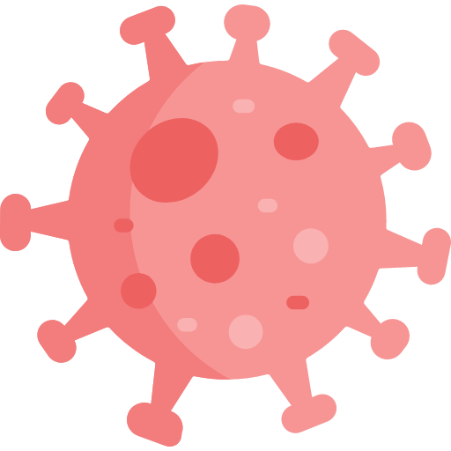
Introduction
Definitions
Baseline or endemic level
The amount of a particular disease that is usually present in a community is referred to as baseline or endemic level
Sporadic
Is a disease that occurs infrequently and irregularly.
Endemic
refers to the constant presence and/or usual prevalence of a disease or infectious agent in a population within a geographic area.
Hyperendemic
Refers to persistent, high levels of disease occurrence
Epidemic
Refers to an increase, often sudden, in the number of cases of a disease above what is normally expected in that population in that area.¹
Outbreak
Carries the same definition of epidemic, but is often used for a more limited geographic area ( e.g. in a hospital or ICU)².
Pandemic
Refers to an epidemic that has spread over several countries or continents, usually affecting a large number of people (e.g. Covid-19).
In Saudi Arabia:
Bacterial
infections
Viral
infections
Parasitic
infections
Brucellosis
Enteric Fever (Typhoid fever).
MERS-COV
Dengue fever
COVID-19.
Visceral Leishmaniasis
1- for example, there are 100 cases of malaria recorded each year, but if there was an increase to 500 in a year it would be called an epidemic
2- for example, outbreak of helicobacter in the ICU of a hospital (it’s a very limited area, unlike endemic infections)

Slide 3
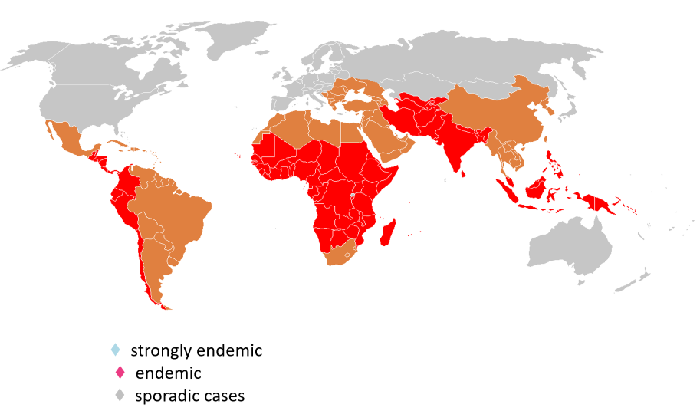
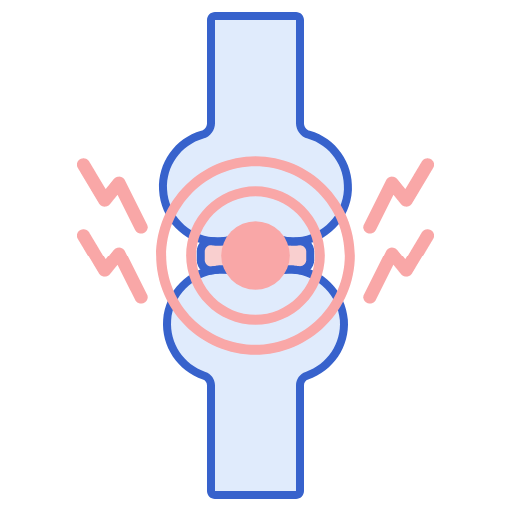
Enteric (Typhoid) Fever
Introduction
Definition: Enteric fever is characterized by severe systemic illness with fever and abdominal pain.
It is an acute febrile disease, caused by Salmonella typhi and Salmonella. paratyphi A, B or C
Humans are the only reservoir for S. Typhi and Infection.
Persons with typhoid fever carry the bacteria in their bloodstream
and intestinal tract.
Carriers recovering from typhoid fever shed S. Typhi in their feces.
It is transmitted through direct contact with an infected individual or indirect contact via contaminated food or water.¹
Paratyphoid fever is associated with a milder and shorter illness, and complications are uncommon.
Epidemiology of Typhoid fever
- More common in children and young adults
- Worldwide, enteric fever is most prevalent in overcrowded areas with poor access to sanitation.
- Incidence More than 100 cases per 100,000 person-years in : South-central Asia, Southeast Asia, and southern Africa.
Pathogenesis
organisms are ingested and survive exposure to gastric acid before gaining access to the small bowel, where The organisms penetrate ileal mucosa
(invade the small bowel wall via peyer’s patches)
Reach mesenteric lymph nodes, multiply there and invade blood stream.
(disseminate via the lymphatic or haematogenous route)
Infect (reticuloendothelial tissues) : Liver, Gallbladder,, spleen, Kidney, Bone marrow.
These intracellular organisms are likely sources for relapsing infection.
After 7-10 days bacilli pass into blood stream (secondary bacteremia)
Differential diagnosis
 | Brucellosis |  | Lymphoma
 | Tuberculosis |  | Adult Still's disease
 | Infective endocarditis |  | Malaria
1- We are not an endemic area of typhoid fever , most cases we see are immigrants . Citizens get the infection from food contamination by infected restaurant workers.

Slide 4
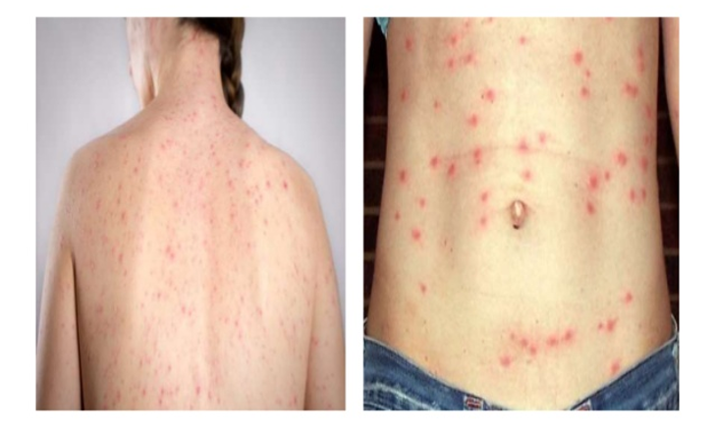
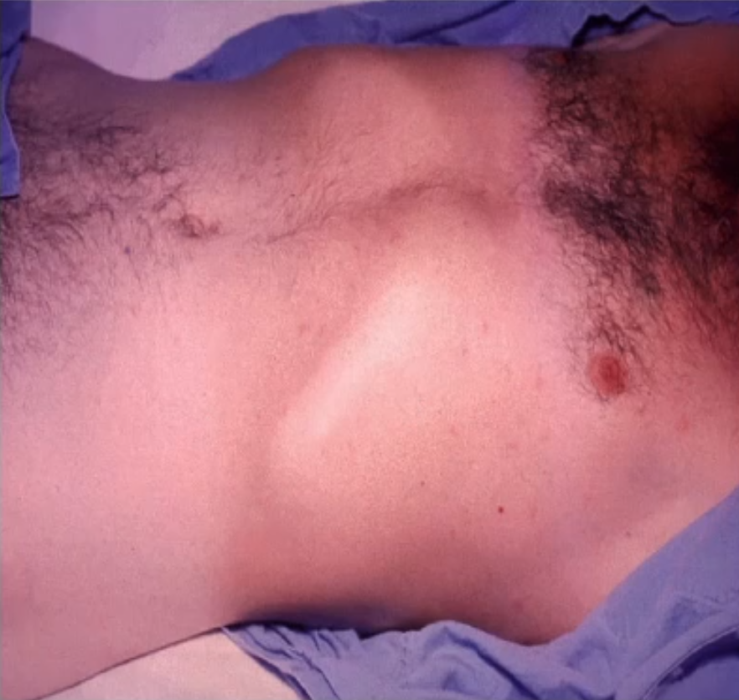
Enteric (Typhoid) Fever
Clinical presentation
Incubation period of 5 to 21 days.
Diarrhea and constipation appear to occur with approximately equal frequency.
Headache is a frequent symptom.
1st week of illness
2nd week of illness
3rd week of illness
Rising ("stepwise") fever reaching >40°C and bacteremia develop.
While chills are typical, frank rigors are rare.
Relative bradycardia¹ or pulse-temperature dissociation may be observed.
Abdominal pain develops
Macular Rash "Rose Spots" (faint salmon colored macules on the trunk and abdomen) may be seen, not always present but if a febrile pt presented with rose spots this is highly suggestive of typhoid fever.
Hepatosplenomegaly
Intestinal bleeding
Perforation due to ileocecal lymphatic hyperplasia of the Peyer's patches may occur
Together with secondary Bacteremia and peritonitis
Septic shock or an altered level of consciousness may develop
first week of illness
second week of illness
third week of illness
- rising ("stepwise") fever and bacteremia develop.
- While chills are typical, frank rigors are rare.
- relative bradycardia¹ or pulse-temperature dissociation may be observed.
- abdominal pain develops
- "rose spots" (faint salmon colored macules on the trunk and abdomen) may be seen.
- hepatosplenomegaly
- intestinal bleeding
- perforation due to ileocecal lymphatic hyperplasia of the Peyer's patches may occur
- Together with secondary Bacteremia and peritonitis
-Septic shock or an altered level of consciousness may develop
Rash in typhoid
Rose spots: 2 -4 mm in diameter raised discrete irregular blanching pink maculae’s found on the chest, trunk and abdomen
Appear in crops of up to a dozen at a time
Fade after 3 – 4 days
Carriers
Rose spots
Complications
Pneumonia, meningitis, osteomyelitis.²
Severe intestinal hemorrhage and intestinal perforation (necrosis of the Peyer's patches) usually occurs in the ileum during the third week.
If not treated can be fatal.
Chronic Salmonella carriage: Excretion of the organism in stool or urine >12 months after acute infection.
5% (1-6%) of the survivors (Asymptomatic) continue to excrete the organism for months.
Chronic carriers represent an infectious risk to others, particularly in the setting of food preparation.
Important to keep in mind the food handlers, screening may be done for health check up every 6 months, and there are vaccines for salmonella that can be given.
In carriers, the bacteria remain in the gallbladder and are shed into the intestine (in chronic carriers, there is an increased risk for gallbladder Cancer).
In parts of the Middle East and Africa where urinary schistosomiasis is prevalent, chronic carriage of S. typhi in the urinary bladder is also common.
Fluoroquinolone therapy (eg, ciprofloxacin 500 to 750 mg orally twice daily for 14 - 28 days eliminated carriage in 90 to 93 percent of cases.)
1- Normally, increase in the temperature will increase the HR(1c° → ↑HR by 10 - 15 beats per minute) , however, if a patient is febrile (39°) and his heart rate is 70-80 and he’s not on rate controlling drugs (e.g Beta blockers) then this is called relative bradycardia

Slide 5
Enteric (Typhoid) Fever
Diagnosis
Febrile patient living in, traveling from, or visiting from an endemic area.
WBC (sometimes there is leukopenia, if bone marrow is involved there will be pancytopenia)
ESR (high)
Blood culture: Most important diagnostic tool at disease onset.
Bone marrow culture: the most sensitive culture but is invasive procedure
Stool cultures: Positive in 30 to 40 % .often positive in the second and third weeks.
Widal test (commonly ordered) and is basically USELESS. DO NOT ORDER IT (serum agglutination test). It has cross reactions– false positives. Also false negatives. Limited clinical utility in endemic areas because positive results may represent previous infection.
In many cases the diagnosis of enteric fever is made presumptively in patients with protracted fever without alternative explanation.
Blood Culture
Bacteremia occurs early in the disease, Blood Cultures are positive in:
1st week in 90%
2nd week in 75%
3rd week in 60%
4th week in 25% (bone marrow cultures are preferred in this stage)
Treatment and prevention
Treatment | Prevention & control (WHO 2009)
Fluoroquinolones (e.g: ciprofloxacin) are the drugs of choice for empiric therapy. 3rd generation cephalosporins are effective, like Ceftriaxone 2gm Twice daily. (2nd choice) ESBL (Extended Spectrum Beta-Lactamase) in Pakistan Fever may continue for several days after starting antibiotics The majority are cured with antibiotics. 10% may relapse. (typically occurs two to three weeks after resolution of fever.) | Food and water safety: avoid ingestion of contaminated food or water Access to fresh water, prioritization of sanitation and hygiene Control measures: Health education Antibiotic treatment Excluding disease carriers from food handling. A vaccine is available recommended for travelers to high risk areas. It does not provide full protection None are completely effective against S. Typhi and none have been demonstrated to provide protection against paratyphoid fever caused by S. Paratyphi A.
Chronic Salmonella carriage: Excretion of the organism in stool or urine >12 months after acute infection.
Rates of chronic carriage after S. Typhi infection range from 1 to 6 percent.
Chronic carriers represent an infectious risk to others, particularly in the setting of food preparation.
Fluoroquinolone therapy (eg, ciprofloxacin 500 to 750 mg orally twice daily for 14 - 28 days eliminated carriage in 90 to 93 percent of cases.
Complications
Pneumonia, meningitis, osteomyelitis.
Severe intestinal hemorrhage and intestinal perforation (necrosis of the Peyer's patches) usually occurs in the ileum during the third week.
If not treated can be fatal.
1- in patients with sickle cell disease

Slide 6
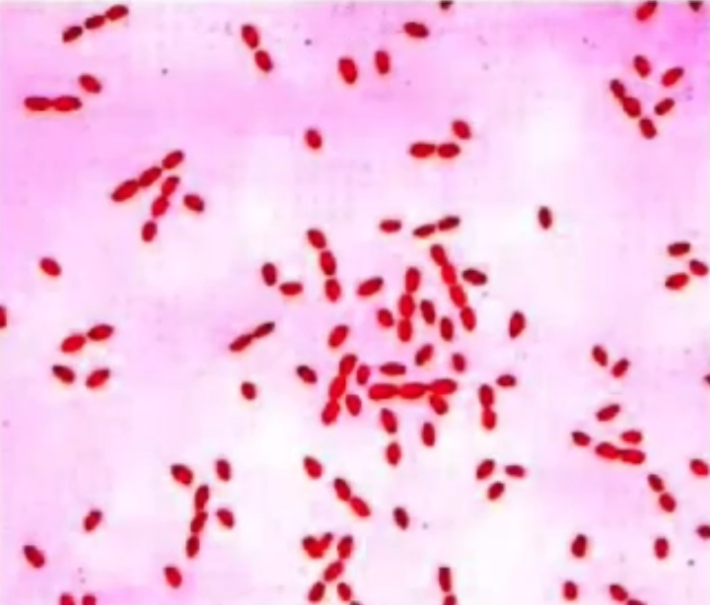
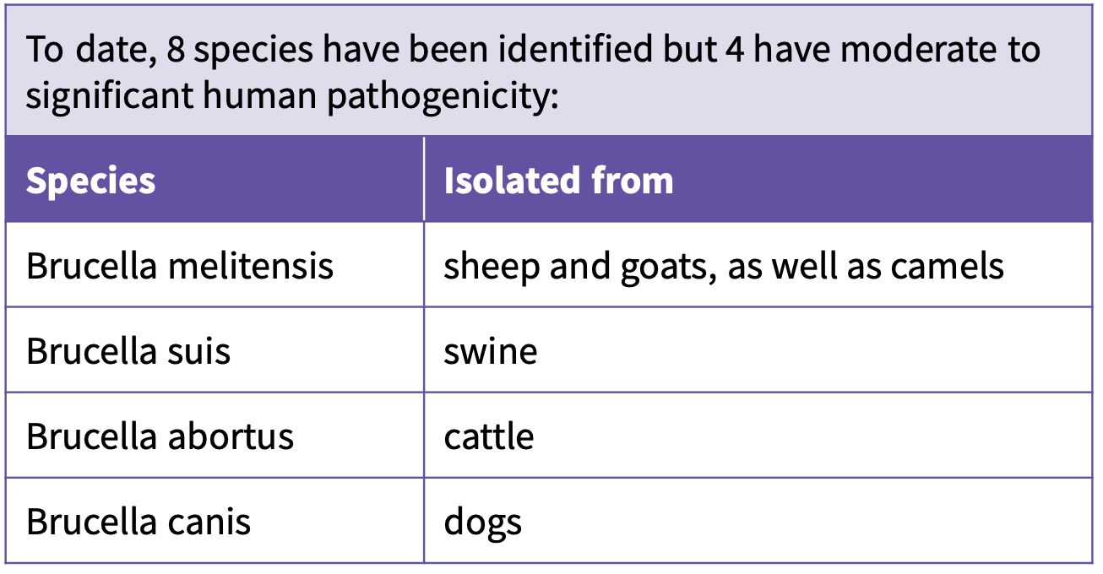
Brucellosis
Brucellosis (Mediterranean Fever, Malta Fever, Undulant Fever).
Systemic febrile illness.
Caused by the bacterial genus called Brucella
Small aerobic intracellular¹ Gram negative coccobacilli
B. melitensis and B. abortus are the most frequent. (there
are many types however these are the most common here).
Localize in the reproductive organs of host animals, causing abortions.
They are shed in large numbers in the animal’s milk, placental fluid, and other fluids.
Epidemiology
It occurs worldwide.
The heaviest disease burden lies in countries of :
The Mediterranean basin and Arabian Peninsula,
Also common in India, Mexico, and South and Central America.
60% of cases of brucellosis occurred in individuals aged 13-40 years
Brucellosis is generally uncommon in infants.
Very rare in developed countries and if you detect a case , most likely the pt will be an immigrant coming from endemic areas.
Transmission
Brucellosis is a zoonotic infection that are transmitted from animals :
Contact with fluids (vets and people in contact with animals when they give birth) or meat from infected animals (sheep, cattle, goats, pigs, camels or other animals)
The Infection is transmitted to humans through:
Direct contact with an infected animal, or inhalation of aerosols: slaughterhouse workers, farmers and shepherds become inoculated with brucellae through aerosolization of fluids, contamination of skin abrasions, and splashing of mucous membranes.
1
2
Consumption of unpasteurized dairy products: can stay viable for 90 days , (especially raw milk, soft cheese, butter, and ice cream) is the most common means of transmission) or partially cooked liver.
3
Laboratory workers with exposure to infected specimen during processing specimens (aerosols) without special precautions.
Need biosafety level 4 for culture (Bioterrorism), In our hospital we don't culture brucella because it transmit very fast if you try to grow it, it needs very strict infection control measures including negative pressure room and other control measures.
1-Two facts about intracellular organisms :
Spontaneous recovery is the rule
Relapses can happen

Slide 7
Brucellosis
Pathogenesis
The organism enters the body → goes to the lymph nodes → to the bloodstream → to the reticuloendothelial system → blood → any organ.
Brucella bacteria:
Is a systemic disease and can involve almost every organ system.
Can gain entry into the human body through:
Gastrointestinal (GI) tracts (Ingestion).
Break in the skin.
Conjunctival exposure through eye splash, and inhalation are the most common routes of entry.
Possess a unique ability to invade both phagocytic and nonphagocytic cells and to survive in the intracellular environment.
Once within the bloodstream, the organisms quickly become intracellular pathogens contained within circulating polymorphonuclear cells (PMNs) and macrophages.
After ingestion by phagocytes, Brucellae that survive are transported to and may replicate in any organ causing both localized and systemic infection: liver, spleen, central nervous system, heart, joints, and genitourinary system.
Development of cell-mediated immunity is the principal mechanism of recovery.
What is the natural history of brucellosis ? Spontaneous recovery
The host response to infection with B abortus is characterized by the development of tissue granuloma.
In contrast, infection with B melitensis and B suis (the more virulent species) more commonly results in visceral micro abscesses.
Clinical manifestations
A careful history is the most helpful tool in the diagnosis of brucellosis.
You should always have a high suspicion because we’re living in an endemic area.
Ask about risk factors: Contact with animals and ingesting unpasteurized milk.
The incubation period is 1–4 weeks, occasionally, it maybe take few months.
Symptoms (insidious onset) | Signs (Physical findings)
Undulant Fever (rising and falling like a wave) Night sweats (drenching) Fatigue Anorexia Weight loss Arthralgia Low back pain (especially sacroiliac joint) Depression Headaches & Cough | Variable and nonspecific: Arthritis hepatomegaly, splenomegaly and/or Painful Lymphadenopathy Hepatosplenomegaly

Slide 8
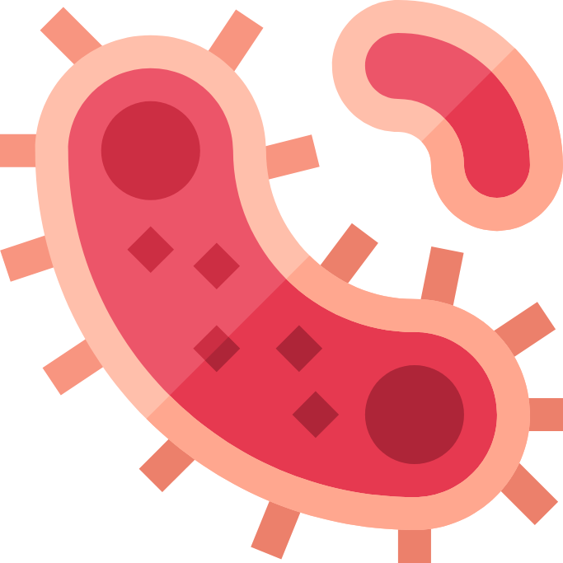
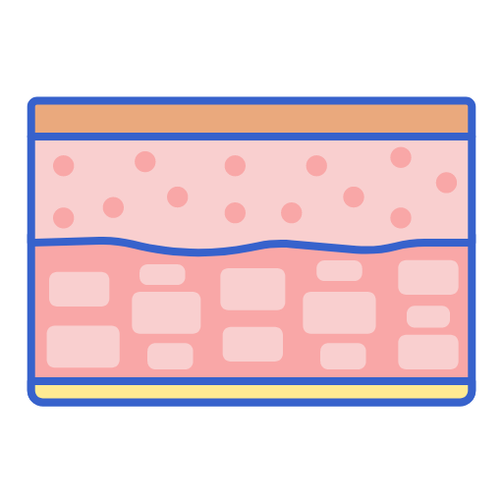
Brucellosis
Localized brucellosis (Complications)
Osteoarticular disease
Neurobrucellosis ¹
Other
Osteoarticular disease is the most common form of focal brucellosis:
1- Sacroileitis (usually 2-3 weeks after the onset of symptoms)
Radiography: blurring of articular margins and widening of the sacroiliac spaces.
2- Vertebral spondylitis: lumbar vertebrae ( L4) are involved more frequently than the thoracic and cervical vertebrae.
3- large joints arthritis.
Can cause abcesses in the back, osteomyelitis and septic arthritis.
- Usually presenting as meningitis (acute or chronic), encephalitis, radiculopathy.
- The most serious complication
- Occurs in undiagnosed pt for long time, leads to irreversible brain damage
Genitourinary: especially orchitis and/or epididymitis.
Abscesses:
involving the liver, spleen and abdomen.
Cardiovascular: Endocarditis is the main cause of death attributable to brucellosis
Differential diagnosis
Investigations
Definitive diagnosis of brucellosis is based on serologic techniques, culture or both:
Blood cultures:
Gram-negative coccobacilli (usually positive even in relapse).
Slow growth = 2 weeks (notify the lab that you are suspecting Brucellosis so that they don’t dispose of the culture after 5 days like they normally do).
Sensitivity depends source of specimen:
Blood (15%-70%) |
Bone marrow (80%-90%).
Serology:
Standard Agglutination Test (SAT) positive in recent infection:
Cut off limit 1:640 or 1:320 with symptoms and risk factor ( it can be negative in meningitis)
Titers higher than 1:320 are considered to be diagnostic, especially in endemic areas
Sensitivity 95.6% & Specificity 100.0%.
WBC (Pancytopenia is common in brucellosis due to what we call hemophagocytosis; it goes to the bone marrow and cause such kind of complication.
ESR, CRP (high)
Radiological assessment if needed especially for localized joint involvement to rule out osteomyelitis.
 | Typhoid fever |  | Lymphoma
 | Tuberculosis |  | Collagen vascular disease
 | Infective endocarditis
1- Could present as acute or chronic meningitis. in acute meningitis the pt. will present with very bad features of meningitis. the serology will be negative most of the time (in acute presentation, only 30% will be positive for CSF samples) so in diagnosing these patients, the history and risk factors are very important. in chronic, it will have chronic features of chronic meningitis (low sugar, high protein and lymphocytes)

Slide 9
Brucellosis
Treatment
General principles of brucellosis treatment include:
Use of antibiotics with activity in acidic intracellular environments (such as doxycycline and rifampin)
Use of combination therapy (given high relapse rates with monotherapy)
Prolonged duration of treatment.
Uncomplicated Brucellosis | Complicated Brucellosis
1st line: Doxycycline (oral) for 6 weeks + Streptomycin (Parenteral) for the first 14 -21 days or gentamicin (7 Days) + Doxycycline 100 mg BID for 6 weeks 2nd line : Rifampicin + Doxycycline for 6 weeks. Other drugs that can cover brucellosis: ciprofloxacin, TMP/SMX and Ceftriaxone (preferable 3rd agent in meningitis) | - Endocarditis, meningitis, osteomyelitis - No uniform agreement. - Usually 3 anti brucella drugs for 3 or more months (might extend to 6 months) For example: Aminoglycoside, Doxycycline and rifampicin or we add bactrim or ciprofloxacin
Dr notes: Contraindications of streptomycin: Patient more than 65 of age, Renal impairment, Diabetic. So we use Rifampicin and Doxycycline, however, be aware of the drug-drug interactions as it can cause elevated LFT Doxycycline can cause esophagitis, instruct the patient to sit in upright position for at least 30 mins and drink a lot of water, you can give PPIs as will. The lowest relapse rate is with aminoglycoside + doxycycline, second lowest relapse rate is with rifampicin + doxycycline
Relapse vs Re-infection
About 10% of patients relapse after therapy.
Most relapses occur within three months following therapy and almost all occur within six months.
Relapse should prompt assessment for a focal lesion, especially hepatosplenic abscess
Most relapses can be treated successfully with a repeat course of a standard regimen
Prevention
To avoid contact with possibly infected animals.
Avoid drinking raw milk (pasteurizing milk / boiling milk 60 degree for 10 min.
Eating processed meat,
Regular check-up of animals, and their vaccinations.
Taking care of health safety when dealing with infected animals,
Health safety during work in laboratories dealing with Brucella spp.
Relapse
Failure of therapy
Re-infection
pt. received the proper treatment
For example: pt has osteomyelitis and you treat for only 6 weeks so they relapse again
- Because of ongoing risk factor

Slide 10
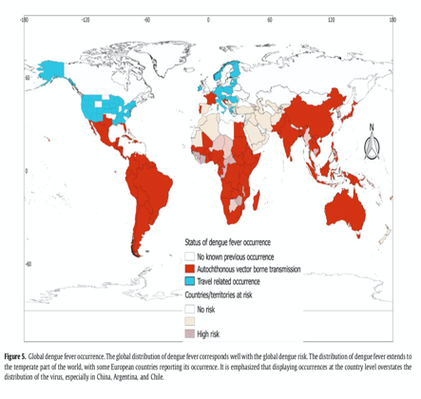
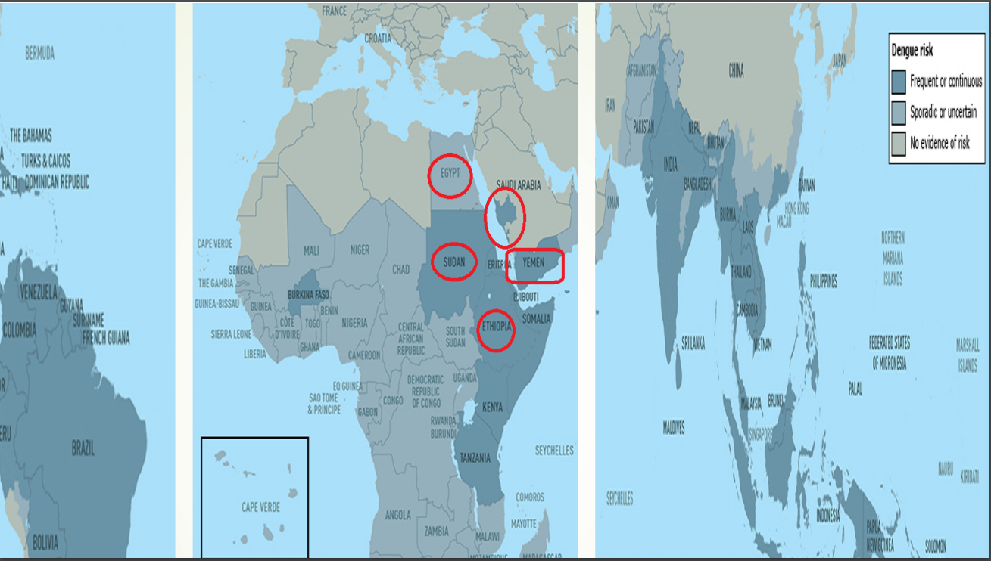
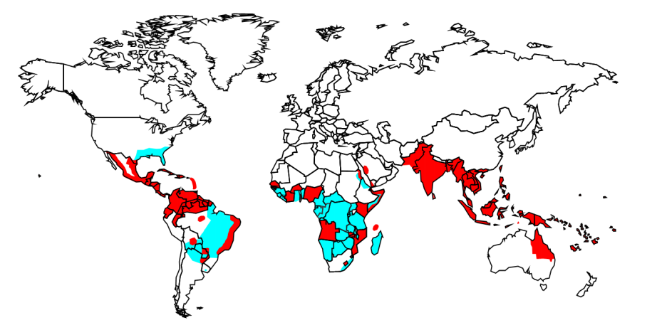
Viral hemorrhagic fevers (dengue fever)
Epidemiology
Aedes aegypti mosquitoes are widely distributed in tropical and subtropical areas from latitude 45ºNorth to 35ºSouth. (high humidity and a hot climate). After rainy seasons
Asia: (incidence of dengue infection is increasing).
China , Thailand, Vietnam, Indonesia, India, Pakistan, and SriLanka.
Africa and Eastern Mediterranean: in most of sub Saharan Africa and the Middle East.
North America: present in most areas of Mexico and in the south-eastern United States
Dengue is also common in more than 100 countries around the world with where 50 million DF occur annually, out of which 22,000 deaths affect mostly children
in Saudi, it’s present in Makkah, Jeddah, Jizan and najran)
Epidemiology of hemorrhagic fevers
(in Saudi, it’s present in Makkah, Jeddah, Jizan and najran)
Dengue fever in Saudi Arabia:
Dengue fever in Saudi Arabia:
The first experience of 289 confirmed cases of virus isolation during a DF outbreak
The DF Virus was isolated were isolated.
Cases were isolated
Jeddah 1997
Jeddah 2005, 2006
Jeddah 1994:
Jeddah & Mecca 2004
Al-Madinah 2008
Emergence of DF occurred and identified during the rainy season
Cases were isolated
MOH reported a total of 3350 cases of DF in the Kingdom and estimated the case fatality rate to be 4.6/1000.
Dengue Virus
Causes dengue and dengue hemorrhagic fever.
Dengue is a febrile illness caused by infection with one of four dengue viruses
Has 4 serotypes (DEN-1, 2, 3, 4)
Is an arbovirus. (family Flaviviridae, genus Flavivirus .)
Composed of single-stranded RNA.
Transmitted by : Aedes Aegypti female mosquitoes. All dengue viruses are mosquito-borne human pathogens
Infection may be, Asymptomatic (90%) or present with a broad range of clinical manifestations including: Mild febrile illness OR Life-threatening shock syndrome.
Dengue Clinical Syndromes
Note: The fever subsides after 3-4 days, the temperature returns to normal for a couple of days and then the fever returns, together with the features already mentioned, but milder. This biphasic or 'saddleback' pattern is considered characteristic.
Undifferentiated fever
Classic dengue fever
Dengue hemorrhagic fever
Dengue shock syndrome.

Slide 11
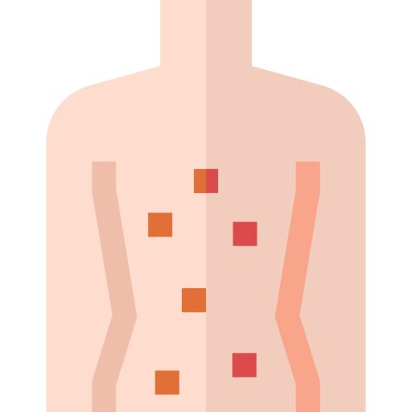
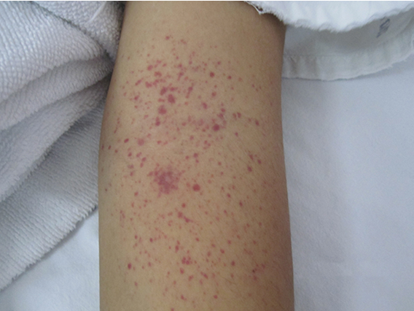
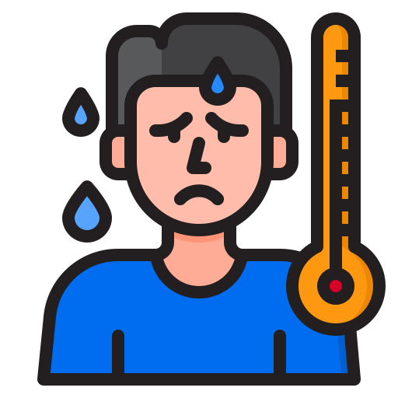
1-a rare type of hepatic encephalopathy that is associated with aspirin use for viral illness in children < 19 years. To memorize the symptoms of Reye syndrome, remember that “It’s never Rainy (Reye) in CHILE”: Coma, Hepatomegaly/Hypoglycemia, history of viral Infection, Liver failure, Encephalopathy.
Viral hemorrhagic fevers (dengue fever)
Clinical characteristics of classic dengue fever
The incubation period is 3 to 14 days, symptoms typically develop between 4 and 7 days after the bite of an infected mosquito
It is an acute febrile illness defined by the presence of fever and two of the followings:
Headache & Retro-orbital or ocular pain¹, Myalgia and/or bone pain & Arthralgia Rash and blood test might shows Leukopenia.
 | Fever (abrupt onset) |  | Generalized Lymphadenopathy
 | headache (Mainly retro-orbital that worsens with Eye movements) |  | Muscle and joint pain (bone breaking fever)
 | Nausea/Vomiting |  | Conjunctival suffusion
 | Rash (maculopapular, measles-like exanthem) |  | Severe backache (most prominent symptom)
 | Hemorrhagic manifestations
Dengue haemorrhagic fever (DHF)
Hemorrhagic manifestations of Dengue:
Skin hemorrhages: petechiae, purpura, ecchymoses.
Gingival bleeding (gum bleeding)
Nasal bleeding (epistaxis)
Gastrointestinal bleeding: hematemesis, melena.
Hematuria.
Increased menstrual flow. (vaginal bleeding)
Plasma leakage due to increased vascular permeability leading to ascites and pleural effusion in addition to features of Dengue fever .
Positive tourniquet test ²
Microvascular fragility may be demonstrated by a positive "tourniquet test"
Dangerous signs in Dengue hemorrhagic fever
Dengue shock syndrome:
Abdominal pain - intense and sustained.
Persistent vomiting
DHF with marked plasma leakage that leads to circulatory collapse (shock) as evidenced by:
1
2
3
Abrupt change from fever to hypothermia, with sweating and prostration.
Restlessness or somnolence
Cold, clammy skin and restlessness.
Narrowing pulse pressure or hypotension
Rapid and weak pulse.
1- Febrile pt with ocular or retro orbital pain and travel history to endemic area? Dengue should be one of you differentials.
2- This test is performed by inflating a blood pressure cuff on the upper arm to midway between diastolic and systolic blood pressures for 5 minutes. The results are considered to be positive if more than 20 petechiae per square inch are observed on the skin in the area that was under pressure.

Slide 12
Viral hemorrhagic fevers (dengue fever)
Dengue shock syndrome:
Dangerous signs in Dengue hemorrhagic fever
DHF with marked plasma leakage that leads to circulatory collapse (shock) as evidenced by:
Abdominal pain - intense and sustained.
Persistent vomiting
1
2
3
Cold, clammy skin and restlessness.
Narrowing pulse pressure or hypotension
Rapid and weak pulse.
Abrupt change from fever to hypothermia, with sweating and prostration.
Restlessness or somnolence
Diagnosis
Who to suspect?
Definite tests
Any febrile individuals with typical clinical manifestations and relevant epidemiologic exposure [residence in or travel within the past two weeks to an area with mosquito-borne transmission of DENV infection]
Provisional diagnosis of DENV infection is usually established clinically.
RT-PCR¹: Detection of viral nucleic acid BY reverse-transcriptase polymerase assay,
Detection of viral antigen has high specificity but is more labor intensive and costly.
Serology test: to detect presence of Immunoglobulin : IgM or IgG. (unreliable in vaccinated patient)
Treatment
Symptomatic treatment.
Hydration.
Avoid NSAIDS or Aspirin (especially in children to avoid Reye syndrome²).
Only acetaminophen for fever, headache or arthralgia.
Platelet transfusion only if platelets <10-20.
Prevention
Elimination & destruction of mosquitos and larval habitat (cornerstone of prevention):
Space Spraying of insecticide is not usually effective.
Spraying residual insecticides in-door.
Larval source reduction : Cover water holding containers.
Personal protection against mosquito biting:
Screening
Protective clothing
Repellents
Centralized, vertically-structured programs with military-type organization, strict supervision, high level of discipline.
Vaccine not yet available, though human trials conducted
1- If you have the resources you should go with the highest evidence which is PCR, in poor countries if they suspect a dengue fever case based on the clinical features discussed before they will treat accordingly
2- A rare type of hepatic encephalopathy that is associated with aspirin use for viral illness in children < 19 years. To memorize the symptoms of Reye syndrome, remember that “It’s never Rainy (Reye) in CHILE”: Coma, Hepatomegaly/Hypoglycemia, history of viral Infection, Liver failure, Encephalopathy.

Slide 13
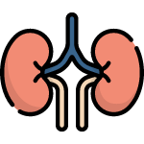
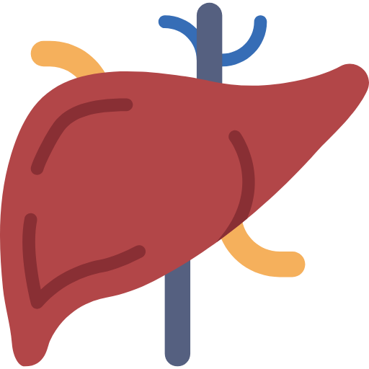
Rift valley fever
Rift valley fever
Rift Valley fever (RVF) is an acute, fever-causing viral Zoonotic disease that affects domestic (Ruminant) animals (such as cattle, buffalo, sheep, goats, and camels) and humans.
The disease was first reported among livestock by veterinary officers in Kenya in the early 1900s
The disease is named after the Rift Valley of East Africa, where the etiologic virus was first isolated in 1930 among infected sheep on a farm in the Rift Valley in Kenya.
RVF is most commonly associated with mosquito-borne epidemics during years of unusually heavy rainfall.
The disease is caused by the RVF virus, a member of the genus Phlebovirus in the family Bunyaviridae.
Several Outbreaks and epidemics of RVF were limited to the African continent until 11 September 2000, the Ministry of Health (MOH) of the Kingdom of Saudi Arabia (Riyadh) received reports of unexplained severe hepatitis in 7 patients (5 died) from the Jizan region at the southwestern border of Saudi Arabia, then Tehama, and Al-Qunfuda.
A team from the MOH started investigations within 24 h after notification
Next outbreak was reported in Yemen
Now Rift valley fever is considered to be at a low level of endemicity in Saudi Arabia.
Transmission:
Bites from infected mosquitoes
Close contact with infected mammals (more frequently).
Transmission
A] Bites from infected mosquitoes
B] Close contact with infected mammals (more frequently).
Clinical manifestations
 | Low-to-moderate–grade fever |  | Renal failure
 | Abdominal pain |  | Diarrhea
 | Nausea/Vomiting |  | Encephalopathy or Encephalitis
 | Elevated liver enzyme levels progressing to liver failure |  | Bleeding & disseminated intravascular coagulation (DIC) RVF is one of the causes of viral hemorrhagic fever, if a pt presented to you with fever and reported bleeding from several sites including gum and nose, you should consider RVF.
 | Malaise and Headache |  | muscle pain, back pain, and joint pain
Diagnosis and management
Diagnosis | Management
Polymerase chain reaction (PCR) for detection of viral RNA Enzyme-linked immunosorbent assay (Elisa) for detection of IgM antibodies against RVF virus | Treatment is symptomatic. Vaccines for veterinary use are available.

Slide 14
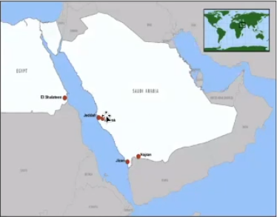
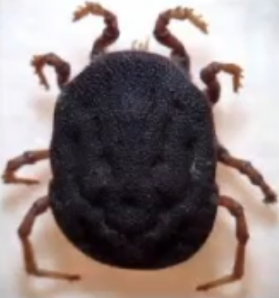
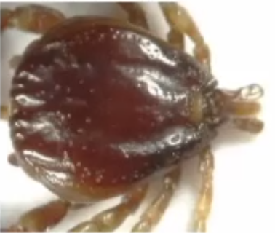
Males
slides
Alkhurma hemorrhagic fever
Alkhurma hemorrhagic fever
Alkhurma hemorrhagic fever (AHF) is caused by Alkhurma hemorrhagic fever virus (AHFV),
a tick-borne virus of the Flavivirus family.
The virus was initially isolated in 1995 from a patient in Saudi Arabia. Subsequent cases of AHF have been documented in tourists in Egypt, extending the geographic range of the virus and suggesting that geographic distribution of the virus is wide and that infections due to AHFV are underreported.
Epidemiology
AlKhurma is a city in East Taif. it started there, and after that, cases were reported in Jeddah, Makkah, Jizan and Najran. also in the borders of Egypt and Sudan
Transmission
Transmission is not well understood.
AHFV is a zoonotic virus
its described tick hosts (the soft tick Ornithodoros savignyi and the hard tick Hyalomma dromedari) are widely distributed.
People can become infected through a tick bite or when crushing infected ticks. or dealing with contaminated blood, and this is how it happened in the first cases, butchers were exposed to blood of infected animals.
Epidemiologic studies indicate that contact with domestic animals or livestock may increase the risk of human infection.
No human-to-human transmission of AHF has been documented.
Although livestock animals may provide blood meals for ticks, it is thought that they play a minor role in transmitting AHFV to humans.
No transmission through non-pasteurized milk has been described, although other tick-borne flaviviruses have been transmitted to humans through this route.
Ornithodoros Savignyi
Hyalomma dromedarii

Slide 15
Males
slides
Alkhurma hemorrhagic fever
Signs and symptoms
after an incubation period that could be as short as 2-4 days
No repeated or chronic symptoms have been reported following recovery.
Evidence suggests that a milder form may exist, where hospitalization is not required.
We had an outbreak a couple of years ago but the mortality wasn’t high
Initially (first phase)
second phase
non-specific flu-like symptoms, including fever
anorexia (loss of appetite)
general malaise
diarrhea
vomiting
a second phase has appeared in some patients
includes neurologic and hemorrhagic symptoms in severe form.
Multi-organ failure precedes fatal outcomes.
Risk of exposure
Contact with livestock with tick exposure are risk factors for humans, as is contact with infected ticks, whether through crushing the infected tick with unprotected fingers or by a bite from an infected tick.
Slaughtering of animals which may acutely but asymptomatically infected may also be a risk factor, as it is possible that infected animals develop a viremia without obvious clinical signs.
Diagnosis
Clinical diagnosis could be difficult due to similarities between AVHF, Crimean-Congo Hemorrhagic fever (CCHF), and Rift Valley fever (RVF) , which occur in similar geographic areas . Laboratory diagnosis of AHF can be made in the early stage of the illness by molecular detection by PCR or virus isolation from blood. Later, serologic testing using enzyme-linked immunosorbent serologic assay (ELISA) can be performed
Treatment | Prevention
- There is no standard specific treatment for the disease. - Patients receive supportive therapy, which consists of balancing the patient's fluid and electrolytes, maintaining oxygen status and blood pressure, and treatment for any complications. - Mortality in hospitalized patients ranges from 1-20% | - Given that no treatment or specific prophylaxis is presently available,prevention and increased awareness of AHFV are the only recommended measures. Complete control of ticks and interruption of the virus life cycle is impractical; in endemic regions, it is important to avoid tick-infested areas and to limit contact with livestock and domestic animals. - Individuals should use tick repellants on skin and clothes and check skin for attached ticks, removing them as soon as possible. Tick collars are available for domestic animals, and dipping in acaricides is effective in killing ticks on livestock. - People working with animals or animal products in farms or slaughterhouses should avoid unprotected contact with the blood, fluids, or tissues of any potentially infected or viremic animals.

Slide 16
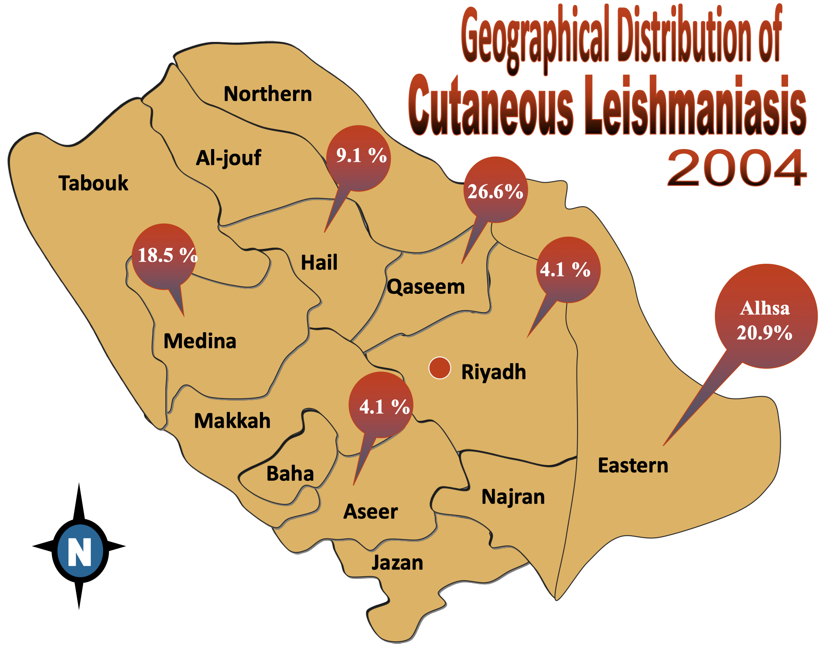
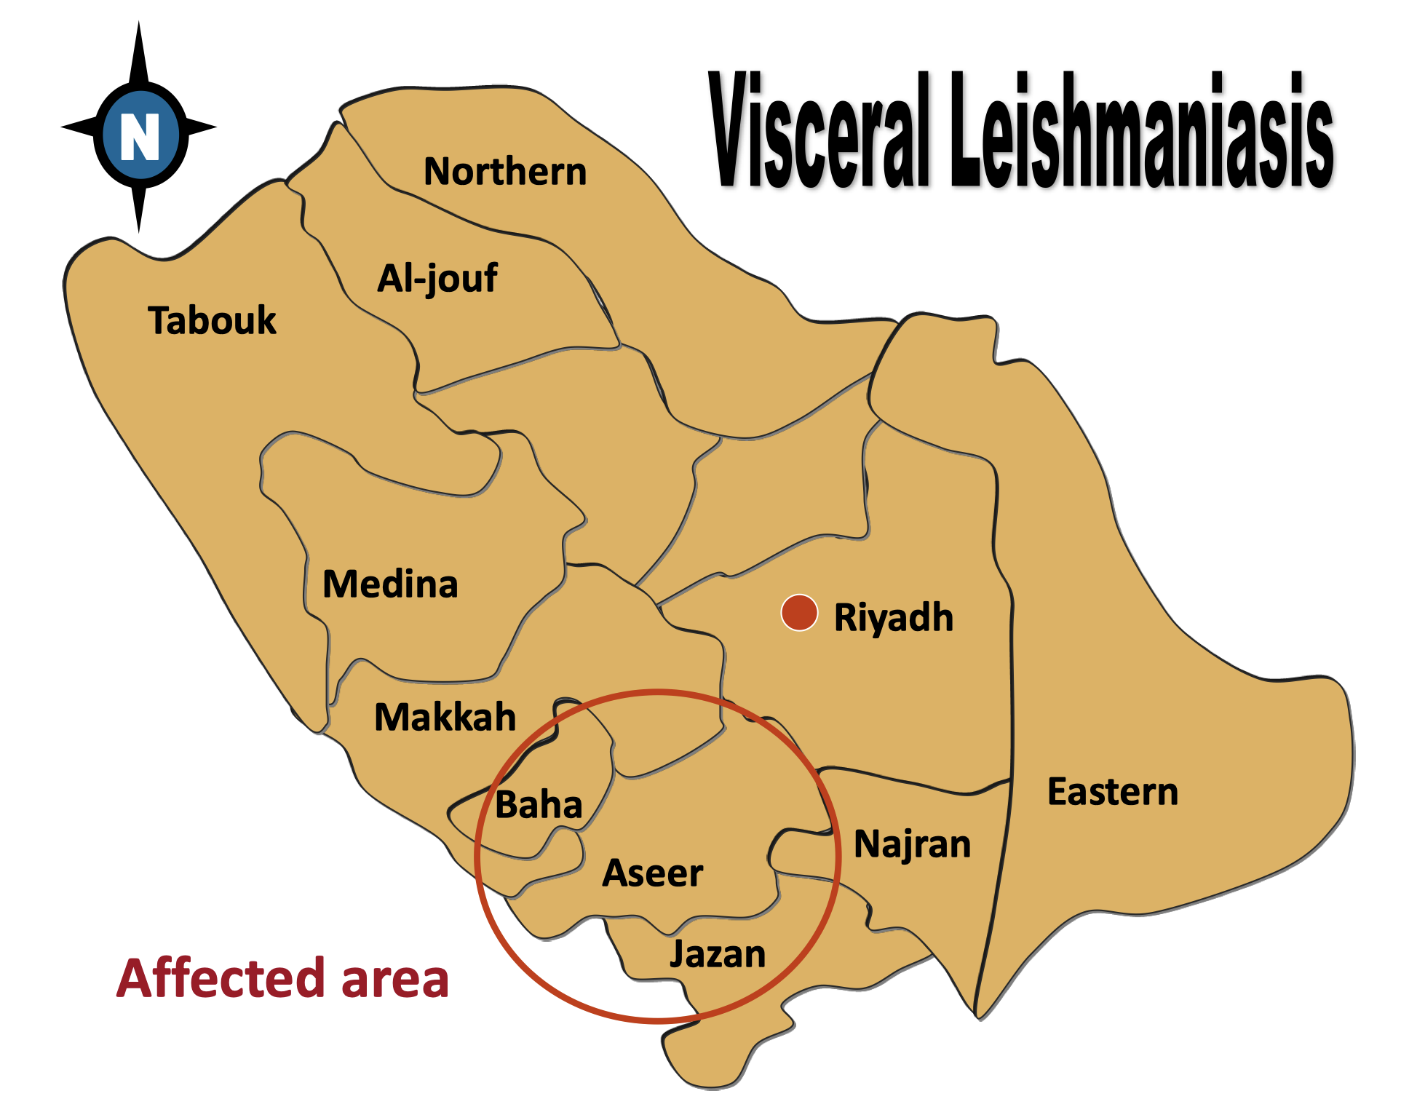
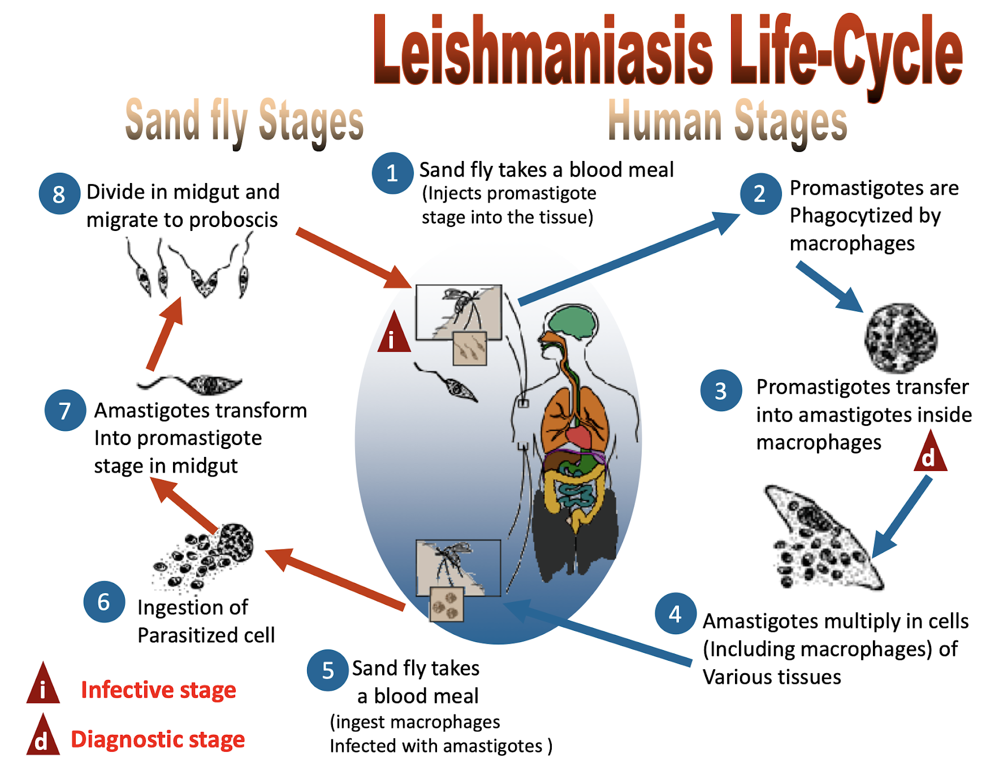
Leishmaniasis
Introduction
leishmaniasis is a protozoal disease caused by Leishmania parasite
Transmitted by the bite of infected female phlebotomine sand fly (Phlebotomus Papatasi)
Relapse is seen in Patients who become immunocompromised.
Leishmaniasis is of three types:
Cutaneous Leishmaniasis
(most common)
Muco-cutaneous leishmaniasis
Visceral
leishmaniasis (kala-azar) (most serious)
Epidemiology of Leishmaniasis in Saudi Arabia
Cutaneous Leishmaniasis
Visceral Leishmaniasis
Leishmaniasis Life Cycle:
1
The parasites are found as oval amastigotes (Leishman- Donovan bodies).
These bodies multiply inside the macrophages and cells of the reticuloendothelial system and are then released into the circulation as the cells rupture.
2
3
Parasites are taken by sandfly where they can be inoculated into a new host.

Slide 17
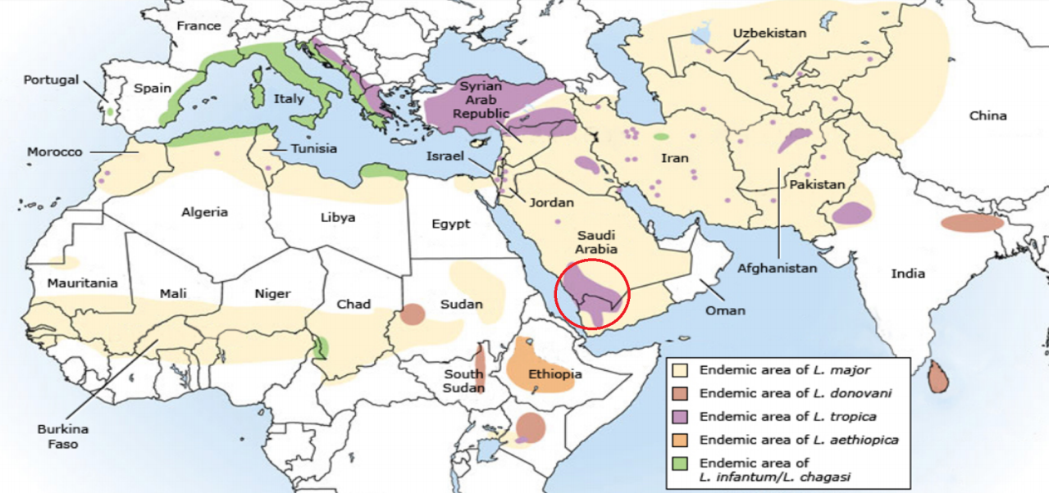
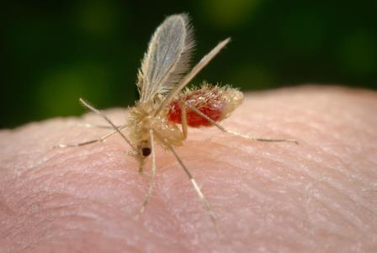
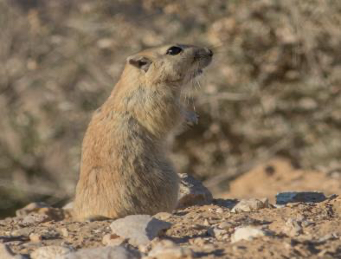
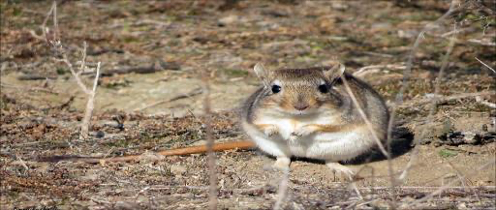
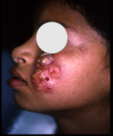
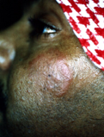
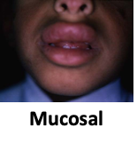
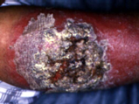
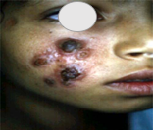
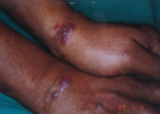
Cutaneous Leishmaniasis
Cutaneous Leishmaniasis
Cutaneous lesions tend to occur on exposed areas of the skin, face is the most commonly affected site, and ulcerative pattern accounts for 90% of lesions.
begins as a pink-colored papule that enlarges and develops into a nodule (often with central softening), leading to a painless ulceration with an indurated border.
Multiple lesions may be present.
The main causative species are:
Leishmania major (L. major) infection.
Leishmania tropica (L. tropica) infection.
Cutaneous Leishmaniasis in Saudi Arabia
The disease is endemic in many parts of KSA, with the majority of cases concentrated in six regions, including Al-Qaseem, Riyadh, Al-Hassa, Aseer, Ha’il, and Al-Madinah.
Leishmania major (L. major) and Leishmania tropica (L. tropica) are the main dermotropic species, and Phlebotomus papatasi (vector of L. major) and Phlebotomus sergenti (vector of L. tropica) are the proved vectors of the disease.
Psammomys obesus and Meriones libycus have been defined as the principal reservoir hosts of zoonotic Cutaneous Leishmaniasis in Al-Hassa oasis, Al-Madinah, and Al-Qaseem provinces.
Clinically, males are affected more than females, and there is no variation between the Saudis and expatriates in terms of number of reported cases, but the disease tends to run a more severe course among non-Saudis.
Phlebotomus papatasi
Psammomys obesus
Meriones libycus
Types of Cutaneous leishmaniasis
Hyperkeratotic
Recidivans
Mucosal
Erysipeloid
Plaque

Slide 18
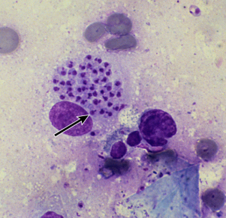
Cutaneous Leishmaniasis
Diagnosis of Cutaneous leishmaniasis
Definitive diagnosis requires demonstration of the parasite in a clinical specimen (usually skin) by:
Histopathology
Culture | Typical liquid media consists of Schneider's drosophila media supplemented with calf serum, or Novy, MacNeal, Nicolle (NNN) media.
Molecular techniques | Polymerase chain reaction is one of the most sensitive diagnostic tests for CL.
Giemsa staining is typically used, the Leishmania amastigote is an oval to round organism
The cytoplasm is blue, the nucleus violet-blue, and the kinetoplast red to violet ( diagnostic characteristic)
Differential Diagnosis of Cutaneous leishmaniasis
01
02
03
04
Sporotrichosis
Mycobacterial infection
Leprosy
Skin cancer
Treatment & Prevention of Cutaneous leishmaniasis
Treatment:
Cutaneous leishmaniasis (CL) is not life-threatening but it can have disfiguring lesions and devastating effects on local communities
Small lesions usually require no treatment
Many CL infections eventually resolve with spontaneous healing occurring over months to years. Most patients will not wait for spontaneous resolution because the ulcer is usually on an exposed area
CL due to L. major may heal spontaneously within 4–6 months in 50– 75% of cases and almost in all patients at 8 months,
While in L. tropica spontaneous healing occurs within 1 year or longer
Therapeutics for CL consist of local/topical:
Cryotherapy immediately followed by intralesional pentavalent antimony.
Topical paromomycin ointment (may be used for treatment of ulcerative lesions due to L. major.), imidazole ointment.
Local infiltration of lesion with antimonials (sodium antimony gluconate; Pentostam).
Parenteral sodium stibogluconate (SSG)
Prevention:
NO pre or post exposure prophylaxis.
Effective prevention requires health education regarding risk of infection and epidemiology of transmission.
Covering skin with clothing is helpful as sand fly mouthparts do not penetrate clothing (in contrast, mosquito mouthparts do penetrate clothing).
Clothing can be impregnated with an insecticide such as permethrin.
An insect repellent such as DEET (NN-diethyl-3-methylbenzamide) can be applied to exposed skin areas.
Use of fine mesh insecticide-treated bednets may also be helpful.

Slide 19
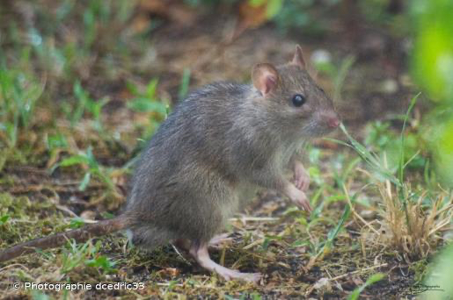
Visceral Leishmaniasis
Visceral Leishmaniasis
Visceral leishmaniasis (VL), also known as kala-azar , is a disease caused by: Leishmania donovani & L. infantum that is transmitted by phlebotomine sandflies.
The most important clinical manifestation of VL is the syndrome known as kala-azar (Hindi for "black fever").
The incubation period is usually two to six months but can range from a few weeks to several years. Most cases are detected in the south, the pt will mention that s/he traveled to Jizan a few months ago.
Onset of symptoms is usually insidious or subacute
Parasites replicate in the reticuloendothelial system, very high parasite loads accumulate in the spleen, liver (Causing hepatosplenomegaly) , and bone marrow.
Hemophagocytic lymphohistiocytosis (HLH) is a systemic disorder of excess immune activation that can be triggered by certain infections it is an uncommon complication of VL
Clinical Features
Symptoms
Laboratory Findings
Splenomegaly
Asymptomatic infection or slow progression of malaise, fever, weight loss
Severe anemia , Leukopenia, Thrombocytopenia,
Hypergammaglobulinemia
Hypoalbuminemia, and edema.
Splenomegaly with or without hepatomegaly [The spleen is usually firm] over a period of weeks to months
Kala-azar
Immunosuppression
Kala-azar ("black fever") refers to darkening of the skin, which is a common symptom in South Asia but not elsewhere.
Kala-azar is nearly always fatal without treatment.
Immunosuppression increases risk for secondary bacterial infections.
The spleen is enlarged reaching up to the Suprapubic area
Visceral Leishmaniasis in Saudi Arabia
Visceral Leishmaniasis in KSA caused by L.Donovani and the Rattus rattus is the reservoir.

Slide 20
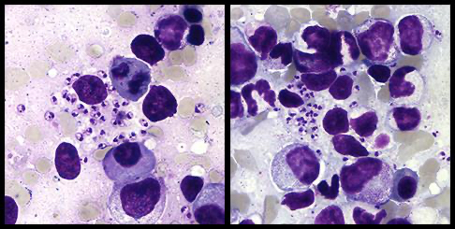
Visceral Leishmaniasis
Diagnosis of Visceral leishmaniasis
Diagnostic tools of Visceral leishmaniasis
Histopathology (bone marrow or spleen aspirations) | Bone marrow aspirates are generally safer than splenic aspirates. Diagnosis requires visualization of amastigotes [spherical or ovoid bodies that measure 1- 5 microns long by 1 - 2 microns wide within macrophage] under microscope.
Culture | Typical liquid media consists of Schneider's drosophila media supplemented with calf serum, or Novy, MacNeal, Nicolle (NNN) media.
Molecular techniques | Polymerase chain reaction is one of the most sensitive diagnostic tests for VL
Treatment
Liposomal amphotericin B is the drug with the highest therapeutic efficacy and the most favorable safety profile monotherapy (total dose 20 to 21 mg/kg
The pentavalent antimonial drugs sodium stibogluconate (SSG) and meglumine antimoniate, are still widely used; however, monotherapy with antimonial agents is no longer a first-line treatment for VL.
Two new drugs have been added paromomycin and miltefosine.
Nutritional support.
Response to treatment is generally assessed clinically, based on resolution of fever, decrease in spleen size, and weight gain.
Pregnancy: VL infection in the setting of pregnancy has been associated with congenital infection and fetal death.
Liposomal amphotericin B is the drug of choice for treatment of VL in pregnancy.
An area for your notes

Slide 21
MERS-CoV
Middle East Respiratory Syndrome Coronavirus (MERS-CoV)
Emerged in Saudi Arabia
South Korea : large outbreak (the index case was an individual who had traveled to the Arabian Peninsula )
2014
March-April
2015
2012
Increased dramatically in Arabian Peninsula → declined sharply in ensuing months → still detected cases
2015
May-early July
Large outbreak began in a hospital in Riyadh, Saudi Arabia
September 2012, a case of novel coronavirus infection was reported in Saudi Arabia involving a man who was admitted to a hospital with pneumonia and acute kidney injury in June 2012.
Subsequent cases and clusters of infections have been reported
Mortality rate is high (34%), whereas for SARS it is 10% , for COVID-19 it will reach 3% maximally.
 | March and April 2014 | May 2015 | Feb –Aug 2015 | Early 2019
Countries | Saudi Arabia United Arab of emirate | South Korea. | Saudi Arabia | Oman
No. of cases | More than 500 cases | Large outbreak | Outbreak: 153 cases | 13 cases
Where does the virus come from?
MERS-COV is a betacoronavirus found in humans and camels that is different from the other human beta coronaviruses (severe acute respiratory syndrome coronavirus)
Partial sequence found in bat in Saudi Arabia near location of human case.
Growing evidence that camels play an important role in transmission across the region.
Virus has been detected in dromedary camels (especially young camels <2 years) in:
Saudi Arabia, Egypt and Qatar.
Exposure to the mucous membrane of young camels is the most common mood of transmission between camels and humans
Antibodies have been found in camels in: (? Cross reactivity !! )
Jordan, Tunisia, Ethiopia, Nigeria, Egypt, Saudi Arabia, Canary Islands, UAE.
MERS-CoV likely widespread in camels throughout region.
Transmission likely occurring from camel to human. However, human to human transmission is common and it is the cause of most cases of MERS-CoV.

Slide 22
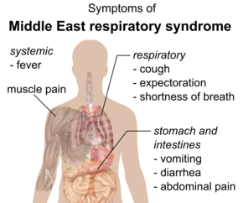
MERS-CoV
Possible sources and transmission
Human-to-human transmission
Case clusters in the United Kingdom, Tunisia, and Italy and in healthcare facilities in Saudi Arabia.
In South Korea, a total of 186 cases were reported as a result of a single imported case.
Camels
Appear to be the primary animal host for MERS-CoV
Study has shown that 55% of infected patients had direct contact with camels in the 14 days preceding their illness.
Case Definition and surveillance guidance
Suspect case (patients who should be tested for MERS-CoV) -any of the following-:
I
II
III
IV
A person with fever and community-acquired pneumonia or acute respiratory distress syndrome based on clinical or radiological evidence.
A hospitalized patient with healthcare associated pneumonia based on clinical and radiological evidence.
A person with 1) acute febrile (>38oC) illness, AND 2) body aches, headache diarrhea or nausea/vomiting, with or without respiratory symptoms, AND 3) unexplained leucopenia (WBC<3.5x109/L) and thrombocytopenia (platelets <150x109/L)
A person (including healthcare workers) who had protected or unprotected exposure to a confirmed or probable case of MERS-CoV infection and who present with upper or lower respiratory illness within 2 weeks after exposure.
Clinical features
Like any other infection the symptoms are nonspecific but you should remember that the majority of patients are febrile.
The median incubation period was 5 days, symptoms included:
1 | asymptomatic infection | 2 | Fever (>38°C) 98% | 3 | Shortness of breath
4 | Cough – 83% | 5 | Abdominal pain | 6 | Myalgia
7 | Sore throat | 8 | Vomiting & Diarrhea

Slide 23
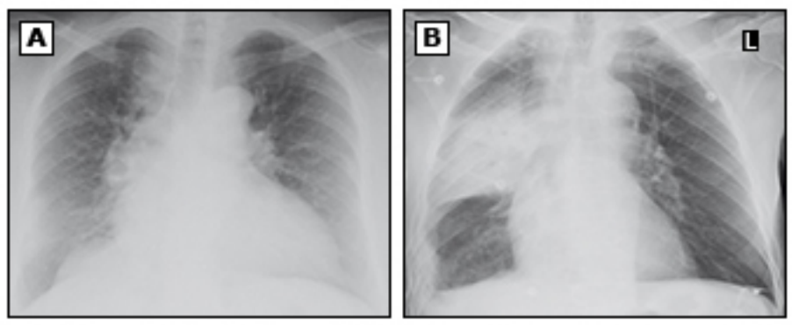
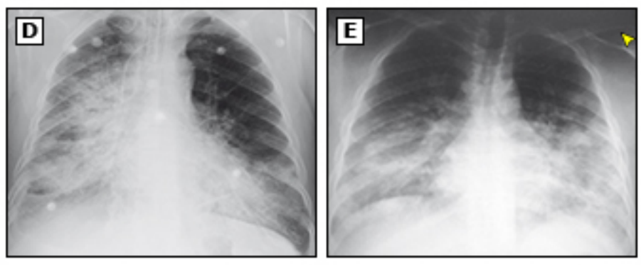
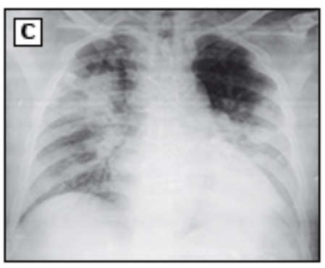
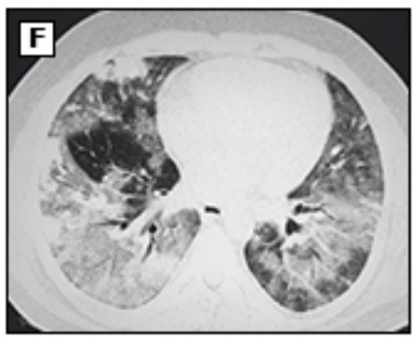
MERS-CoV
Laboratory and imaging findings
CBC | Leukopenia, lymphopenia, lymphocytosis, thrombocytopenia.
LFT | Elevated enzymes and LDH. (very serious)
Renal function | Rising blood urea nitrogen and creatinine (some patients). (very serious)
Imaging findings | Ground-glass opacity in a peripheral location (most common). Airspace opacities, patchy infiltrates or consolidation.
Diagnosis
Real-time reverse-transcriptase polymerase chain reaction (rRT-PCR) for respiratory secretions.
Nasopharyngeal swab specimen but Lower respiratory tract specimens: Sputum, endotracheal aspirate, or Broncho-alveolar lavage) are more sensitive.
Treatment
Treatment is mainly supportive.
No effective antiviral therapy is available
Experimental Treatment:
- Convalescent plasma - IVIG
- Corticosteroids - IFN
- Combination therapy - Ribavirin
- Nitazoxanide - Cyclosporin A
- Protease Inhibitor used in HIV infection
Lopinavir / Ritonavir (Kaletra) and Ribavirin have shown to be promising in a recent study.
Convalescent plasma is used with a variable response.
Prevention
No vaccine available yet, although KAIMRC are in phase 2 or 3 for a MERS-CoV Vaccine study.
Use of standard, contact, and airborne precautions for the management of hospitalized patients with known or suspected MERS-CoV infection.
Avoiding camels.

Slide 24
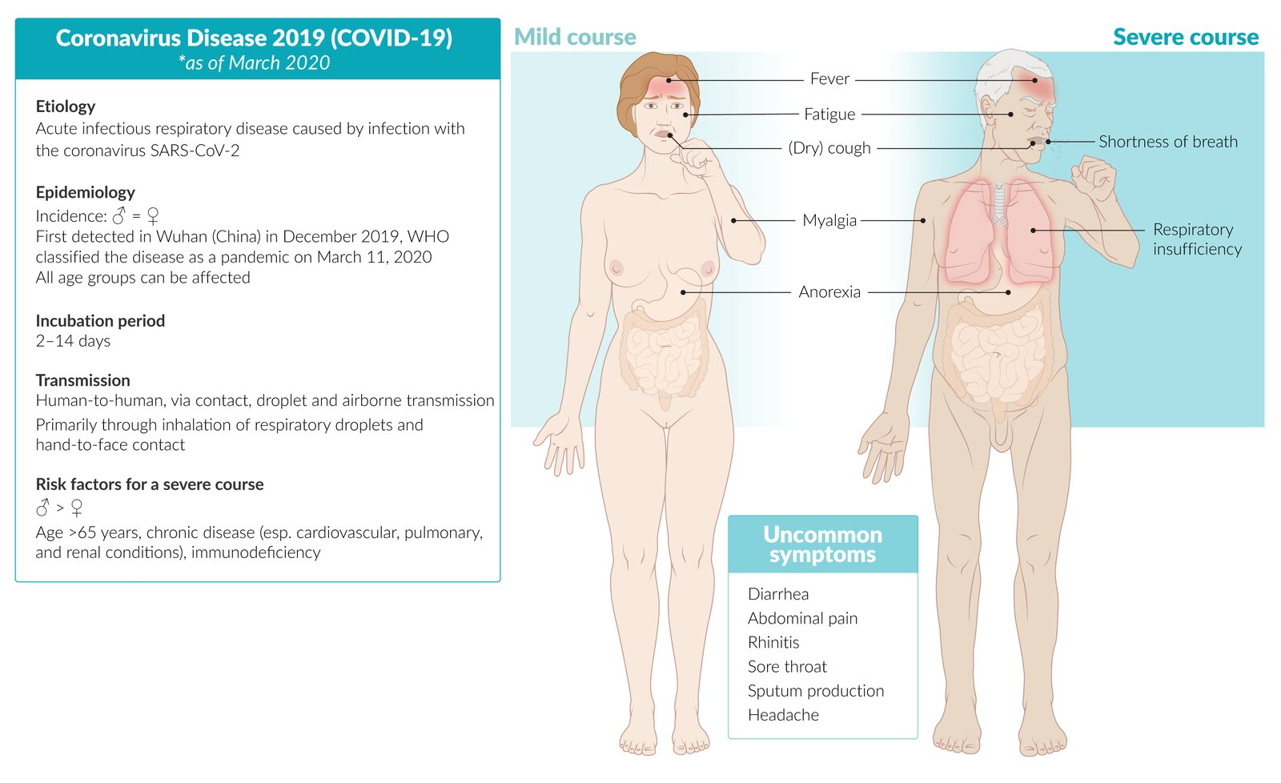
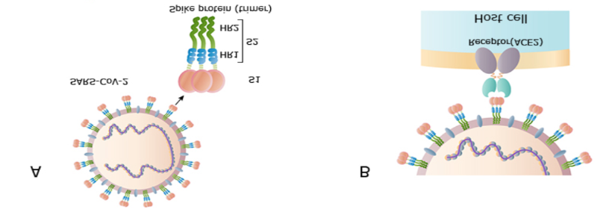
COVID-19
Introduction
Coronaviruses are important human and animal pathogens.
At the end of 2019, a novel coronavirus was identified as the cause of a cluster of pneumonia cases in Wuhan, a city in China.
It rapidly spread, resulting in an epidemic throughout China, followed by a global pandemic.
In February 2020, the World Health Organization designated the disease COVID-19.
The virus that causes COVID-19 is designated (SARS-CoV-2).
Coronavirus virology: Coronaviruses are enveloped positive-stranded RNA viruses.
EPIDEMIOLOGY: Globally, over 100 million confirmed cases of COVID-19 have been reported.
Transmission: Primarily ia respiratory droplet (sneezing and coughing).
Incubation period: 2-14 days.
Common presenting symptoms: Fever, upper respiratory symptoms (esp. dry cough and often dyspnea. However, asymptomatic courses and certain other symptoms can also occur.
Diagnosis: Confirmed by RT-PCR of SARS-CoV-2 RNA isolated from patient specimen, preferably a nasopharyngeal swab.
Management:
In mild clinical courses, patients should self-isolate with supportive care and monitoring at home.
Patients with clinical manifestations of severe courses (i.e., dyspnea, cyanosis, chest discomfort, or mental status change), signs of respiratory distress (SpO2 ≤ 93%, respiratory rate > 22/min), or possibly at high-risk for severe course (≥ 65 years or certain underlying conditions) should be admitted. Hospitalized patients should receive supportive and oxygen therapy while being regularly monitored with supporting laboratory and imaging studies
Intensive care and airway management are indicated for patients displaying signs of respiratory failure (e.g., dyspnea with hypoxemia, respiratory rate > 30/min). Endotracheal intubation should be initiated early, preferably by rapid-sequence induction.
Prognosis: The overall mortality rate ranges from ∼ 0.5–3%, and greatly increases for elderly (∼ 15% for > 80 years) as well as those with certain underlying conditions (e.g., cardiac, pulmonary, diabetes mellitus).
Genome sequencing and analysis
Full-genome sequencing and analysis indicated that SARS-CoV-2 is a betacoronavirus in the same subgenus as:
Severe acute respiratory syndrome (SARS) virus
Several bat coronaviruses.
The closest RNA sequence similarity is to two bat coronaviruses, and it appears likely that bats are the primary source. But intermediate host is unknown.
The host receptor for SARS-CoV-2 cell entry is the angiotensin-converting enzyme 2 (ACE2).
SARS-CoV-2 binds to ACE2 through the receptor-binding gene region of its spike protein.
Transmission
1
Person-to-person: respiratory transmission occur mainly through close-range contact (within approximately six feet or two meters) via respiratory particles;
When infected patient coughs, sneezes, or talks, the virus is released in the respiratory secretions which might infect another person if it is inhaled or makes direct contact with the mucous membranes.
2
A person's hands are contaminated by secretions from contaminated surfaces.
3
Airborne transmission: inhalation of particles that remain in the air over time and distance). still in doubt .
What is the most likely mode of transmission of COVID-19 ?
Respiratory particles “air droplets” directly from an infected person.

Slide 25
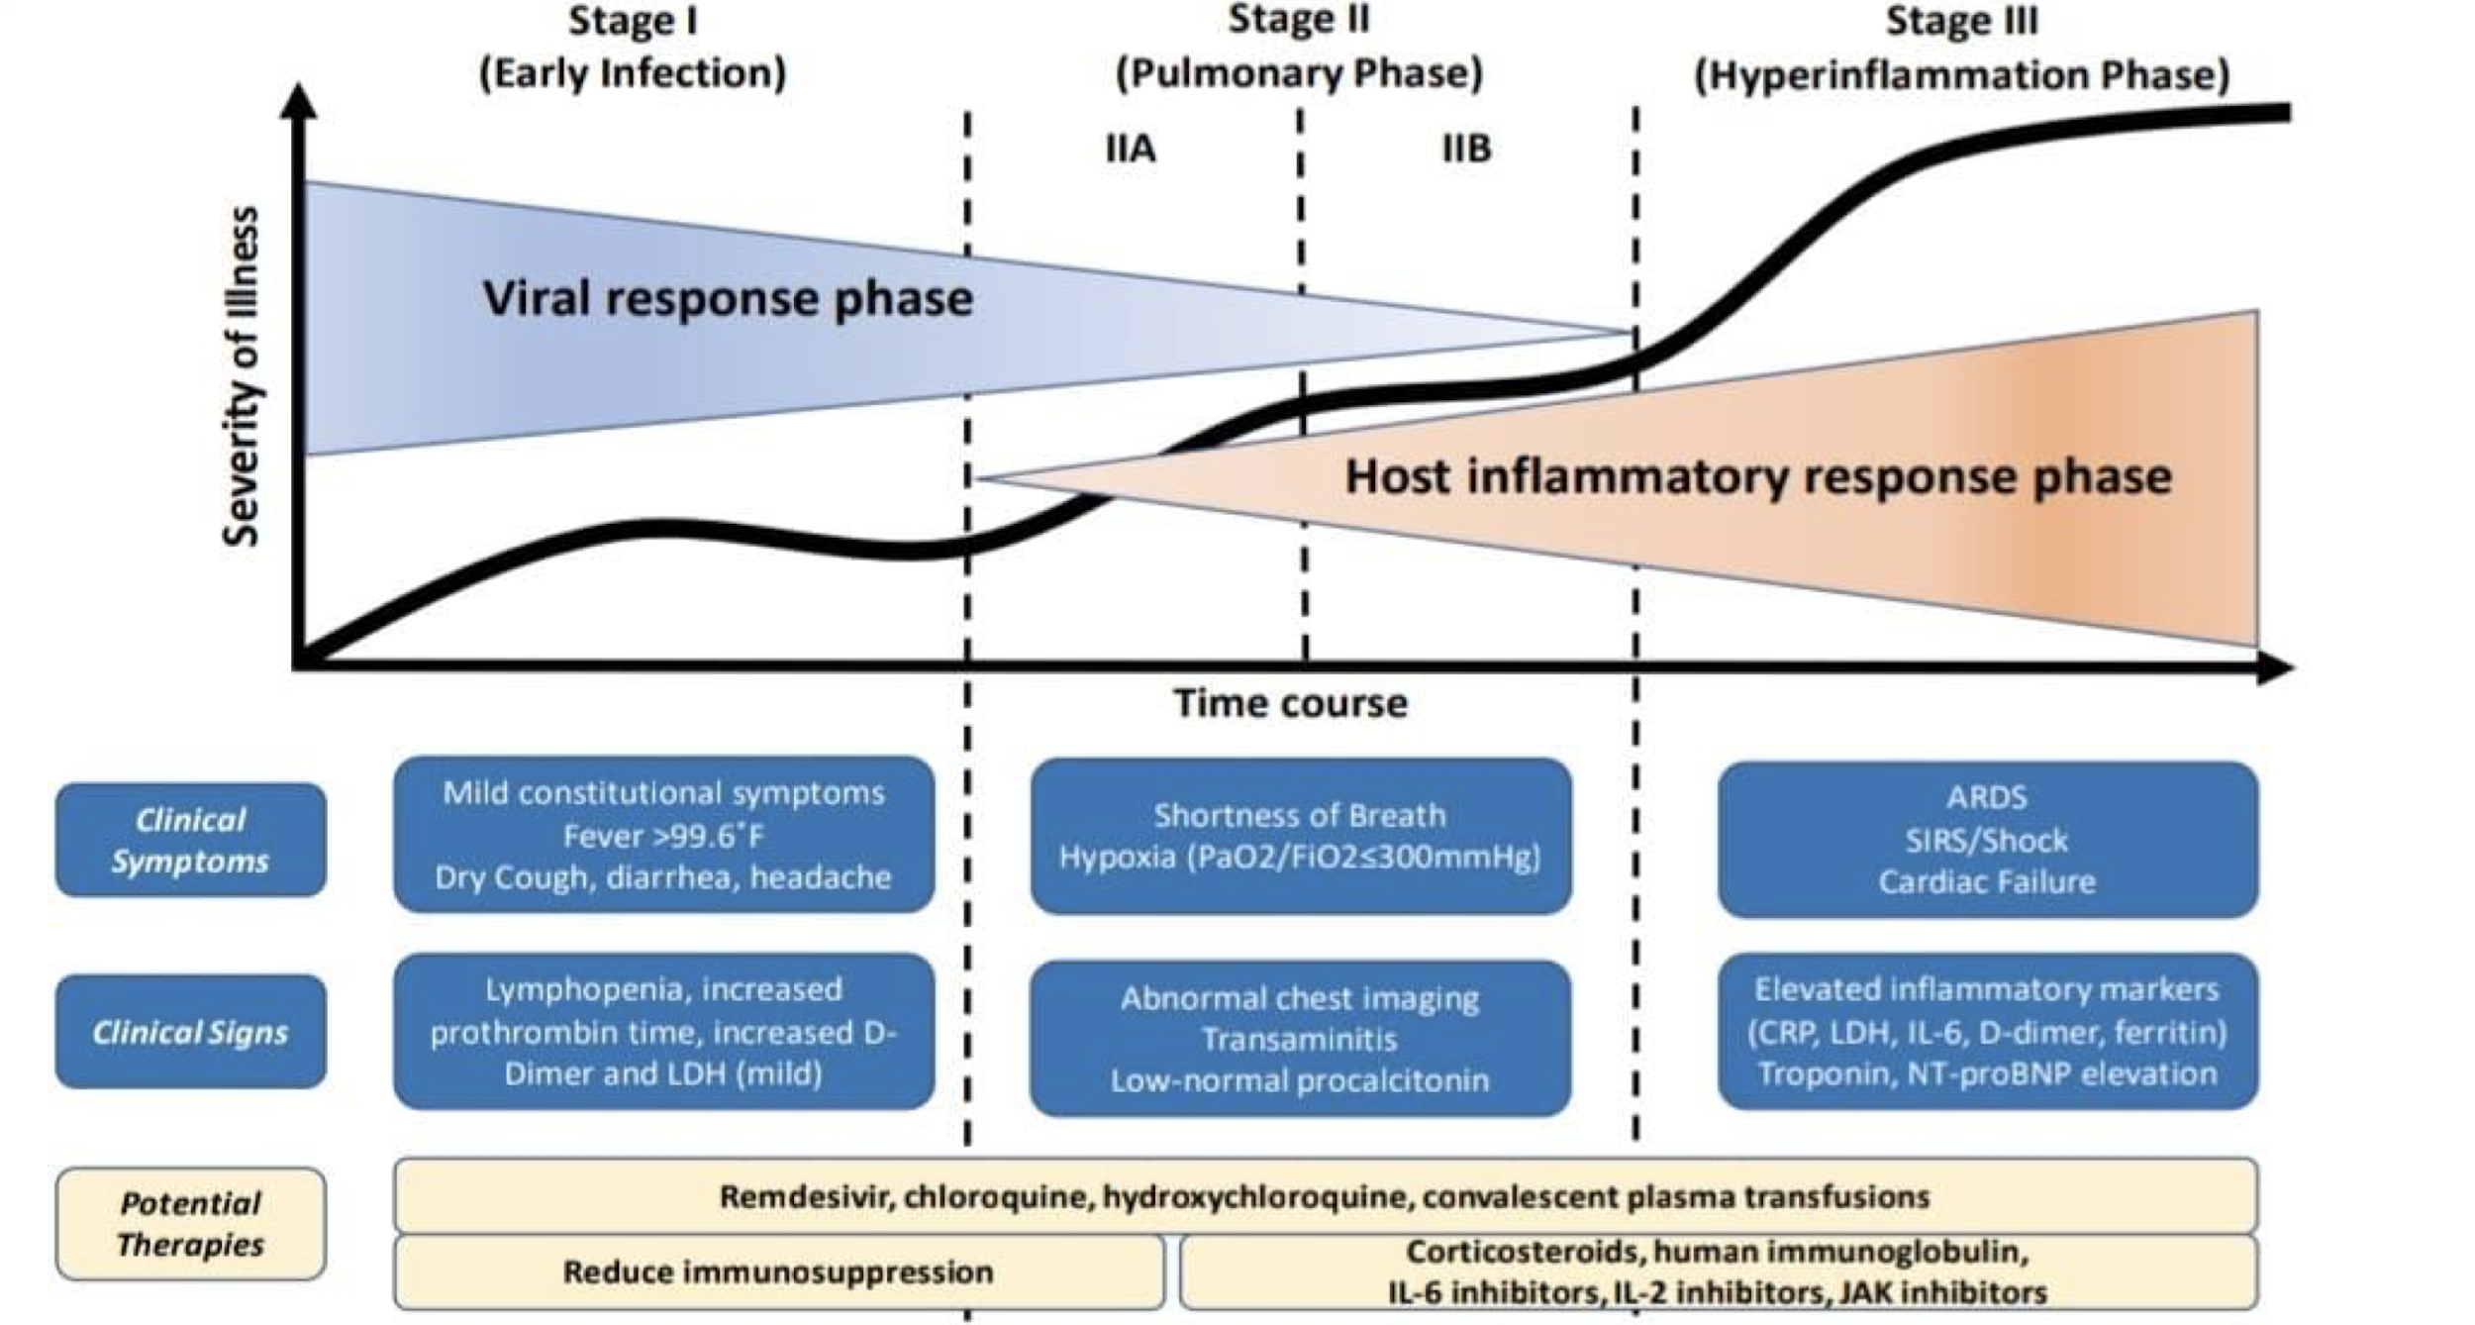
COVID-19
Clinical Manifestations of COVID-19
The incubation period is within 14 days following exposure (most cases 4 -5 days).
The spectrum of illness associated with COVID-19 is wide, ranging from asymptomatic infection to life-threatening respiratory failure:
Asymptomatic infection, the majority and most dangerous because they will spread the infection.
Symptomatic infection:
Mild cases (80% of Patients):
Fever, fatigue, and dry cough.
Headache, rhinorrhea, and sore throat are less common.
Smell and taste disorders have also been reported.
Gastrointestinal symptoms are not frequently reported but may be the presenting feature. (abdominal pain, vomiting, diarrhoea)
Severe cases (20 to 30% of patients -five to eight days after symptoms-:
They will develop pneumonia and a minority around 1-2% of the whole infected people will need ICU admission and ventilator.
Respiratory failure: Dyspnoea which might Progress to acute respiratory distress syndrome (ARDS) rapidly requiring mechanical ventilation (10 – 20%). Thus, the onset of dyspnoea is generally an indication for hospital evaluation and management. The majority on ventilators will recover
Cardiac complications: arrhythmias, acute cardiac injury.
Neurologic complications: Encephalopathy is a common esp. among critically ill patients. A few cases presented primarily with encephalopathy and then turned to be covid19 positive, a rare manifestation.
Thromboembolic complications: pulmonary embolism and acute stroke
Transmission: Primarily ia respiratory droplet (sneezing and coughing).
Incubation period: 2-14 days.
Common presenting symptoms: Fever, upper respiratory symptoms (esp. dry cough and often dyspnea. However, asymptomatic courses and certain other symptoms can also occur.
Diagnosis: Confirmed by RT-PCR of SARS-CoV-2 RNA isolated from patient specimen, preferably a nasopharyngeal swab.
Management:
In mild clinical courses, patients should self-isolate with supportive care and monitoring at home.
Patients with clinical manifestations of severe courses (i.e., dyspnea, cyanosis, chest discomfort, or mental status change), signs of respiratory distress (SpO2 ≤ 93%, respiratory rate > 22/min), or possibly at high-risk for severe course (≥ 65 years or certain underlying conditions) should be admitted. Hospitalized patients should receive supportive and oxygen therapy while being regularly monitored with supporting laboratory and imaging studies
Intensive care and airway management are indicated for patients displaying signs of respiratory failure (e.g., dyspnea with hypoxemia, respiratory rate > 30/min). Endotracheal intubation should be initiated early, preferably by rapid-sequence induction.
Prognosis: The overall mortality rate ranges from ∼ 0.5–3%, and greatly increases for elderly (∼ 15% for > 80 years) as well as those with certain underlying conditions (e.g., cardiac, pulmonary, diabetes mellitus).
Dr notes:
It has different stages of infection:
Viral response phase, high viral replication.
Pulmonary phase where there will be a decrease in viral replication and an increase in the host’s immune reaction.
Hyperinflammation phase where the immune
reaction is high and is associated with ARDS,
shock and complications from the chemokine storm.

Slide 26
COVID-19
Diagnostics
Laboratory Evaluation
Chest
Imaging
Diagnostic Testing
Transmission: Primarily ia respiratory droplet (sneezing and coughing).
Incubation period: 2-14 days.
Common presenting symptoms: Fever, upper respiratory symptoms (esp. dry cough and often dyspnea. However, asymptomatic courses and certain other symptoms can also occur.
Diagnosis: Confirmed by RT-PCR of SARS-CoV-2 RNA isolated from patient specimen, preferably a nasopharyngeal swab.
Management:
In mild clinical courses, patients should self-isolate with supportive care and monitoring at home.
Patients with clinical manifestations of severe courses (i.e., dyspnea, cyanosis, chest discomfort, or mental status change), signs of respiratory distress (SpO2 ≤ 93%, respiratory rate > 22/min), or possibly at high-risk for severe course (≥ 65 years or certain underlying conditions) should be admitted. Hospitalized patients should receive supportive and oxygen therapy while being regularly monitored with supporting laboratory and imaging studies
Intensive care and airway management are indicated for patients displaying signs of respiratory failure (e.g., dyspnea with hypoxemia, respiratory rate > 30/min). Endotracheal intubation should be initiated early, preferably by rapid-sequence induction.
Prognosis: The overall mortality rate ranges from ∼ 0.5–3%, and greatly increases for elderly (∼ 15% for > 80 years) as well as those with certain underlying conditions (e.g., cardiac, pulmonary, diabetes mellitus).
RT-PCR for SARS-CoV-2 is the primary test used to diagnose active COVID-19.
The test is performed primarily on upper respiratory specimens: (Nasopharyngeal swabs, nasal swabs, and saliva).
Lower respiratory tract samples can also be taken using a bronchoscope.
The optimal time to test for COVID-19 following exposure is uncertain; five to seven days following exposure.
Serology: Measure antibodies to SARS-CoV-2 (indicate past infection).
Lymphopenia (up to 90%).
Elevated AST & ALT.
Elevated LDH.
Elevated inflammatory markers (eg, ferritin,, C-reactive protein, and erythrocyte sedimentation rate).
Chest x-ray: Consolidation and ground-glass opacities, with bilateral, peripheral, and lower lung zone distributions.
CT- SCAN: (more sensitive than chest radiograph)
Treatment
Supportive.
No specific and effective medication
Many medications have been tried, however none showed to be effective except for steroids, which are now the standard of care.
Low dose dexamethasone: we use it now , it is thought to decrease the transfer for ICU.
As for Remdesivir, it showed no difference in the WHO study, although in some reports it showed to be effective in around 30%.
None of the used drugs has been proven to decrease mortality. They only decrease the
duration of febrile illness.
Treatment
Supportive.
No specific and effective medication
Prognosis
The overall case fatality rate is estimated to be between 2 and 3%.
Risk factors for poor outcome:
Increased age.
Presence of chronic illnesses : CVS, Pulmonary, diabetes mellitus, kidney disease, and cancer.
Recovery and long-term sequelae — The time to recovery from COVID-19 is highly variable:
Mild infection: recover relatively quickly ( within 2 weeks).
Severe disease: have a longer time to recovery ( 2 - 3 months).
The most common persistent symptoms include
fatigue, dyspnea, chest pain, cough, and cognitive deficits..

Slide 27
COVID-19
Definition of COVID-19 Suspected Cases
Clinical Presentation | Criteria
Patient with acute respiratory illness (sudden onset of at least one of the following: fever (measured or by history), cough, or shortness of breath. | Not required
Patient with sudden onset of at least one of the following: headache, sore throat, rhinorrhea, nausea, diarrhea or loss of smell or taste. AND in the 14 days prior to symptom onset, met at least one of the following criteria. | Had contact with a confirmed COVID-19 case. OR Working in or attended a healthcare facility where patients with confirmed COVID-19 were admitted.
Any admitted Adult patient with unexplained severe acute respiratory infection(SARI), either Community Acquired Pneumonia (CAP) or Hospital Acquired Pneumonia (HAP). | Not required
Definition of COVID-19 Confirmed Cases
Patient status | Description | Instructions
Severe infection | Patients who are hospitalized at noncritical wards with laboratory confirmed COVID-19. | Isolation should last until all of the following criteria are fulfilled: - At least 10 days have passed since the onset of symptoms AND recorded fever in the last 3 days without the use of antipyretics AND improvement of other symptoms (Cough, SOB and GI symptoms). - Patients can be discharged before recovery based on clinical criteria, per evaluation of the treating physician, home isolation should be continued until fulfilled the recovery criteria.
 | Immunocompromised and critical cases (ICU admitted patients). | Isolation should last until one of the following criteria fulfilled: - At least 21 days after symptoms onset AND resolution of fever at least 3 days. AND clinical improvement of symptoms other than fever (Cough, SOB and GI symptoms). OR - At least 3 days have passed since recovery (resolution of the fever without using fever reducing medication and symptoms improvement (Cough, SOB and GI symptoms) AND followed by 2 negative respiratory samples in 24 hours apart.
Mild confirmed cases | Confirmed COVID-19 patients never hospitalized due to mild symptoms or asymptomatic presentation. | These patients can end self-isolation 10 days after the onset of symptoms AND resolution of fever for at least 3 days AND clinical improvement of other symptoms. For asymptomatic lab-confirmed cases 10 days have passed since the date of collection of the respiratory sample with the first positive PCR result.

Slide 28
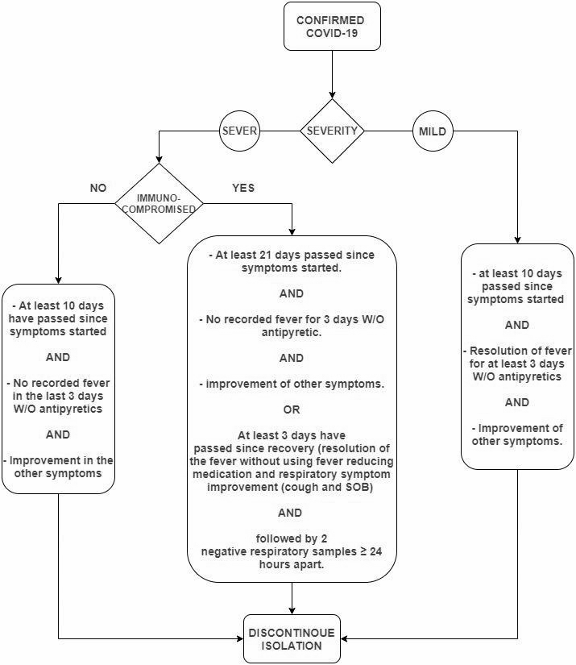
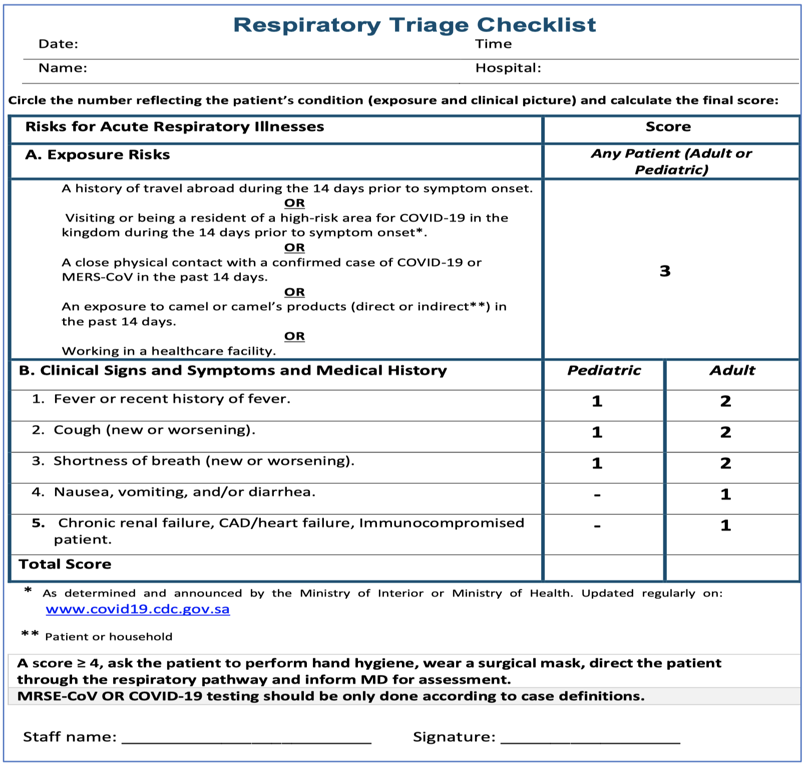
COVID-19
Discontinuation of Isolation algorithm & Triage checklist
skipped by the doctor
(Excluding HCWs)
This is the latest isolation algorithm, recovery and cessation of isolation is after 10 of the onset of symptoms, provided the patient had at least 3 days without symptoms.
An area for your notes

Slide 29
Enteric (Typhoid) fever | Clinical features | fever,Malaise, headache, abdominal pain, constipation or diarrhoea (Bloody), rose-colored spots on the chest (skin rash), enlarged spleen and liver.
 | Diagnosis | The best initial test is for blood and/or fecal leukocytes
 | Treatment | Fluoroquinolones, like ciprofloxacin are also effective (treatment of choice)
brucellosis | Clinical features | Fever, Night sweats, Fatigue, Anorexia, Weight loss, Arthralgia, Low back pain, Depression
 | Diagnosis | Diagnose with culture of blood, CSF, urine, marrow
 | Treatment | Streptomycin (10 days) + Doxycycline for 6 weeks.
Dengue fever | Clinical features | Fever (abrupt onset), headache, Nausea/Vomiting, Rash, Hemorrhagic manifestations
 | Diagnosis | PCR, ELISA
 | Treatment | Symptomatic treatment.
Rift valley fever | Clinical features | low-to-moderate–grade fever, Abdominal pain, Vomiting, Diarrheaelevated liver enzyme levels progressing to liver failure, encephalopathy or encephalitis, (DIC), renal failure
 | Diagnosis | -
 | Treatment | Treatment is symptomatic.
Visceral Leishmaniasis | Clinical features | Fever is common (first sign of infection) The liver and especially the spleen become enlarged The skin becomes rough and pigmented. profound pancytopenia develops
 | Diagnosis | Specific diagnosis is made by demonstrating the parasite in stained smears of aspirates of bone marrow, lymph node, spleen or liver.
 | Treatment | pentavalent antimony salts (e.g. sodium stibogluconate and meglumine antimoniate).
Cutaneous Leishmaniasis | Clinical features | Single or multiple painless nodules
 | Diagnosis | The diagnosis can often be made clinically in a patient who has been in an endemic area.
 | Treatment | Large lesionss can be treated locally by curettage or topical antiparasitic agents.
MERS-coV | Clinical features | pneumonia or acute febrile illness
 | Diagnosis | (rRT-PCR
 | Treatment | Supportive
COVID-19 | Clinical features | Fever & upper respiratory Sx
 | Diagnosis | RT-PCR
 | Treatment | Mainly Supportive, Steroids

Slide 30
Q1: A 14-year-old girl is brought to the physician by her father because of fever, chills, abdominal pain, and profuse non-bloody diarrhea. Her symptoms began one week ago, when she had several days of low-grade fever and constipation. Her temperature is 39.3°C (102.8°F). Examination shows diffuse abdominal tenderness and mild hepatosplenomegaly. There is a faint salmon-colored maculopapular rash on her trunk and abdomen. Which of the following is the most likely causal organism?
A. Shigella
B. Salmonella Typhi
C. Complicated Brucellosis
D. Viral hemorrhagic Fever
Q2: A 51-year-old man presents to accident and emergency with a lesion on his forearm. He mentions that he has spent the past three months travelling around South America and only returned home 3 days ago. While his lesion has been present for a few weeks he was reluctant to see a doctor in South America. On examination, there is a 3 × 3 cm erythematous ulcer on the left forearm with a raised edge. What
is the most likely diagnosis?
A. Leishmaniasis
B. African trypanosomiasis
C. Herpes zoster
D. Schistosomiasis
Q3: A 40 year old man from Turkey presents with a history of chronic back pain and fever. On examination an MRI scan shows sacroiliitis. He has a long history of consuming unpasteurised milk and the initial work-up includes testing with a serum agglutination test, which comes back positive at high titre. What would be an appropriate initial antimicrobial regimen?
A- Streptomycin and Doxycycline
B- Rifampicin and isoniazid
C- Chloramphenicol
D- Metronidazole
Q4: A previously healthy 32-year-old man comes to the emergency department because of a high-grade fever and malaise for 3 days. He has severe generalized joint and body pains refractory to acetaminophen. He also has a severe stabbing pain behind his eyes. He returned from a trip to Taiwan 1 week ago. He is sexually active and uses condoms inconsistently. His temperature is 38.7°C (101.7°F), pulse is 102/min, and blood pressure is 100/70 mm Hg. Examination shows nontender inguinal lymphadenopathy. There is a maculopapular rash over the trunk and extremities with some sparing of the skin over his back and groin. Abdominal examination shows no abnormalities. Urinalysis is normal. Which of the following measures is most likely to have prevented this patient’s condition?
A- Vaccination
B- pasteurizing the milk before drinking it
C- Mosquito repellent
D- prophylaxis with doxycycline
Q5: A 24 year old female student presents with fever and diffuse abdominal pain. She has not had diarrhoea. On examination, pulse is 56 beats/min, BP 97/54 mmHg and temperature 39.4°C. She has a tender right iliac fossa and small faint spots on her abdomen but no other skin lesions. What is the likeliest diagnosis?
A. Brucellosis
B. Dengue
C. Scrub typhus
D. Typhoid
Quiz explanations:
Question 1:
The correct answer is X. Explanation
Question 2:
The correct answer is X. Explanation
Question 3:
The correct answer is X. Explanation
Question 4:
The correct answer is X. Explanation
Question 5:
The correct answer is X. Explanation
Answers: Q1:B | Q2:A | Q3:A | Q4:C | Q5:D
Answers Explanation File!

Slide 31
THANKS!!
This lecture was done by:
Abdulaziz Alshoumar
Mohammed Alhumud
Abdulrahman Bedaiwi
Note taker:
Abdulaziz Alshomar
Mohammed Alhumud
Females co-leaders:
Raghad AlKhashan
Amirah Aldakhilallah
Males co-leaders:
Mashal AbaAlkhail
Nawaf Albhijan
Send us your feedback:
We are all ears!

