Slide 1
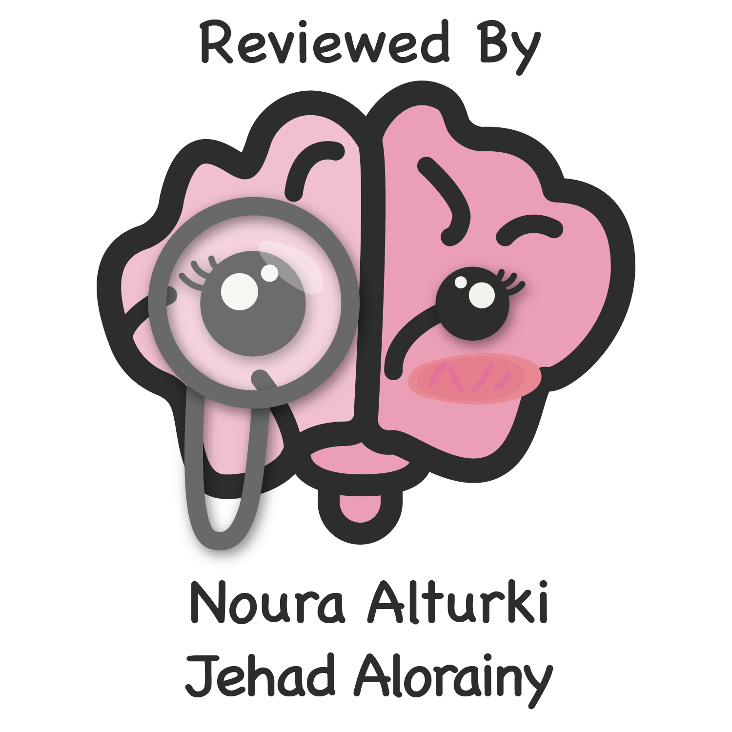
Lecture 44
Editing file
Pituitary disorders
Objectives:
Introducing the concept of negative feedback mechanism
Outline the physiology of the hypothalamic pituitary axis
Outline Hypothalamic hormones and their role
Discussing Ant. Pituitary hormones and their stimuli
Discussing Posterior pituitary hormones esp. ADH
Causes of hyperprolactinemia
Management of hyperprolactinemic states
Discussing acromegaly , its clinical manifestations and treatment
Discussing hypopituitarism, its clinical presentation, causes and management.
Introducing the subject of diabetes insipidus and the syndrome of
inappropriate ADH secretion.
color index:
Color index:
Original text Females slides Males slides
Doctor’s notes Text book Important Golden notes Extra

Slide 2
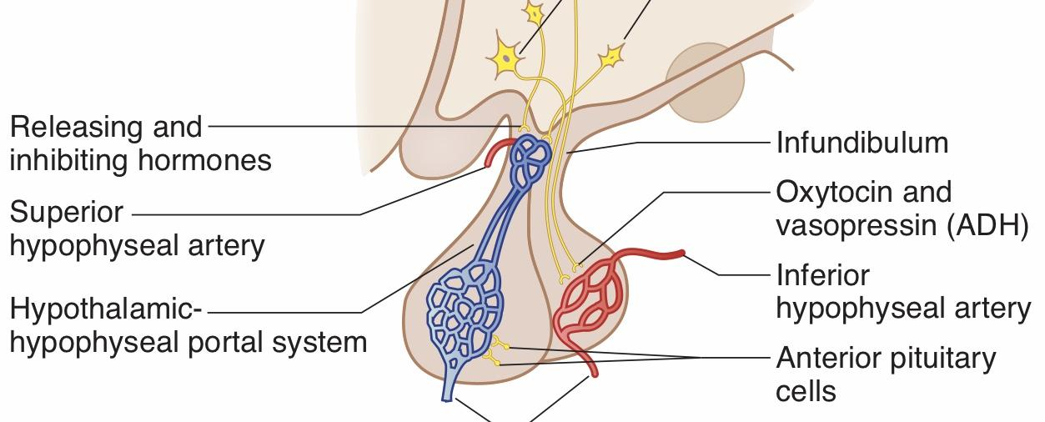
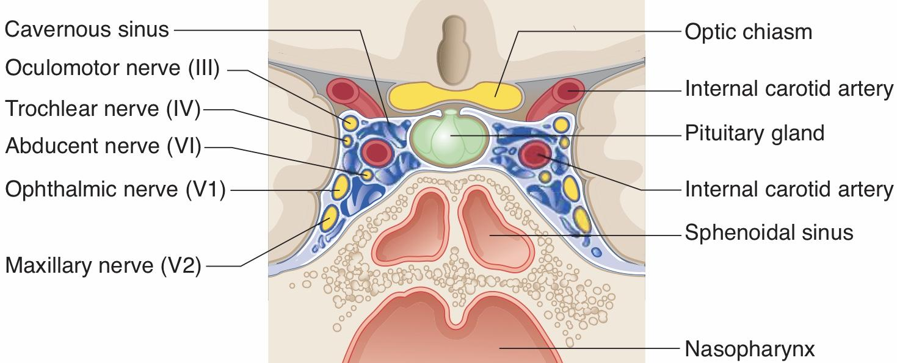
Review of the basics
Anatomy of pituitary gland
The gland is composed of two lobes, anterior and posterior, and is connected to the hypothalamus by the infundibular stalk (Pituitary stalk) below the 3rd ventricle. Infundibular stalk has portal vessels carrying blood from the median eminence of the hypothalamus to the anterior lobe (hypophyseal portal system) and Axons of supraoptic & paraventricular cells to the posterior lobe (hypothalamo-hypophyseal tract).
Pituitary stalk in midline joins the pituitary gland with hypothalamus that is below 3rd ventricle
Development of pituitary cells is controlled by a set of transcription growth factors like Pit-1, Prop-1, Pitx2
Anatomical relations
Has an opening for passage of infundibulum (pituitary stalk) and its blood vessels.
Superiorly: Diaphragma sellae (Fold of dura mater)
Inferiorly: Sphenoidal air sinuses (Extension of a pituitary adenoma into the sphenoidal air sinus might lead to leakage of CSF through the nose. A transsphenoidal approach is used by surgeons when operating in the pituitary)
Anteriorly: Optic chiasm (growth of pituitary adenoma upward leads to visual defect)
Posteriorly: Mammillary bodies
Laterally: Cavernous sinuses which contain the 3rd, 4th, 5th (V1,V2) and 6th cranial nerves and the internal carotid arteries (adjacent to temporal lobes¹).
Note: Optic chiasm lies 10 mm above the gland and anterior to the stalk. Pituitary and hypothalamic space-occupying lesions, (whether it is hormonally active or not) can cause symptoms by pressure on, or infiltration of:
The visual pathways,with field defects and visual loss (most common, bitemporal hemianopia)
The cavernous sinus, with III, IV, V (V1,V2) and VI cranial nerve lesions²
Bony structures and the meninges surrounding the fossa, causing headache
hypothalamic centres: altered appetite, obesity, thirst, somnolence/wakefulness or precocious puberty.
1- if a pituitary adenoma compresses the temporal lobe, may lead to seizures
2- Outpouching of pituitary adenoma into the cavernous sinus might lead to cranial nerve palsy

Slide 3
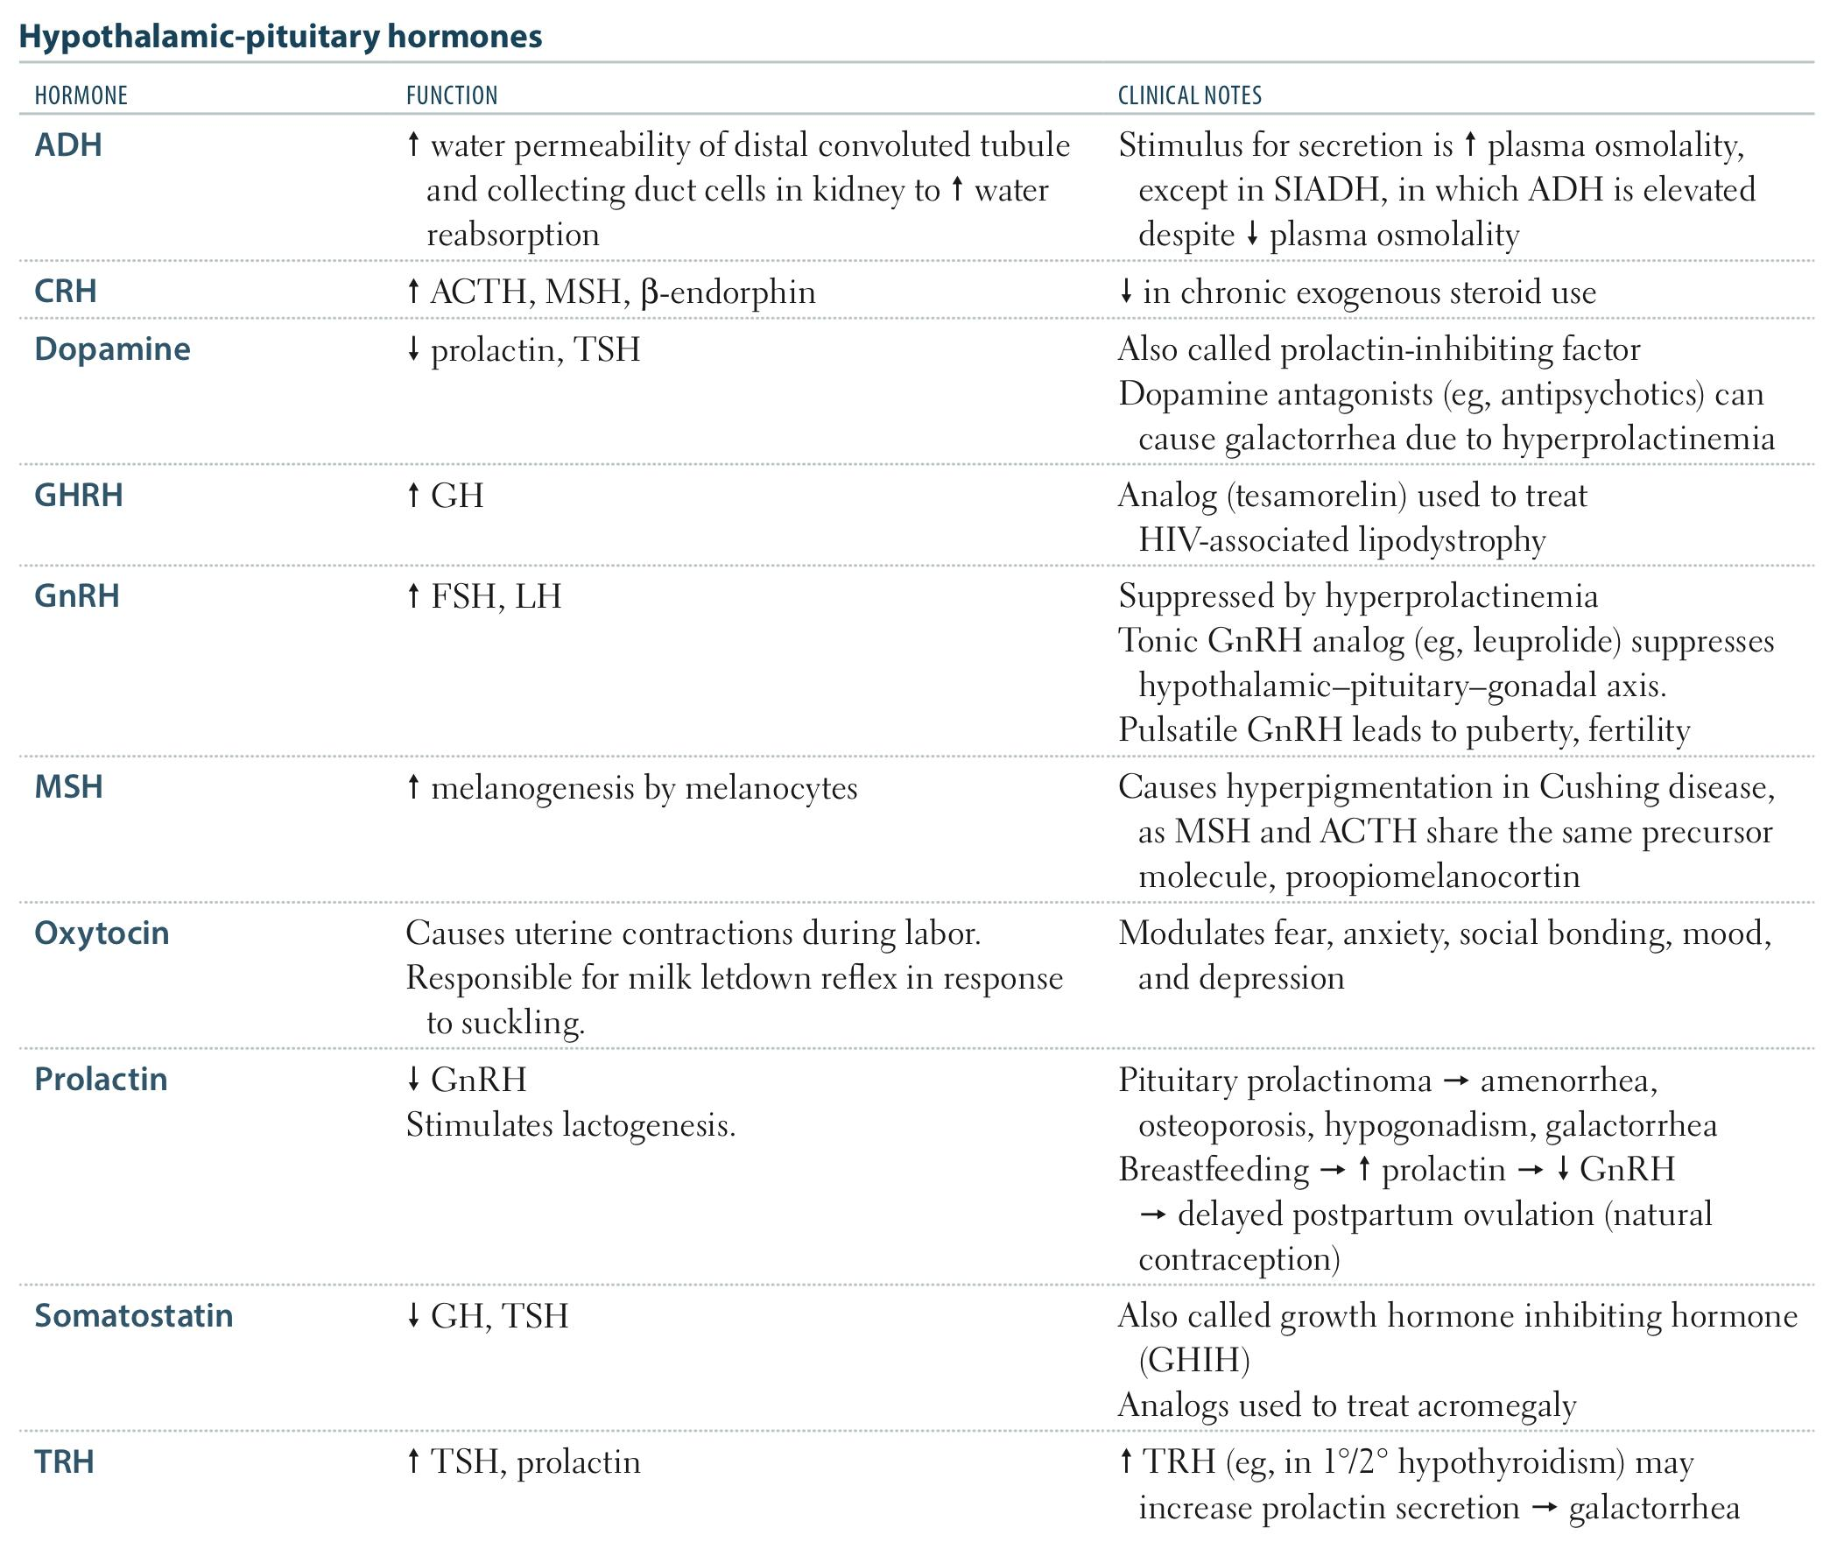
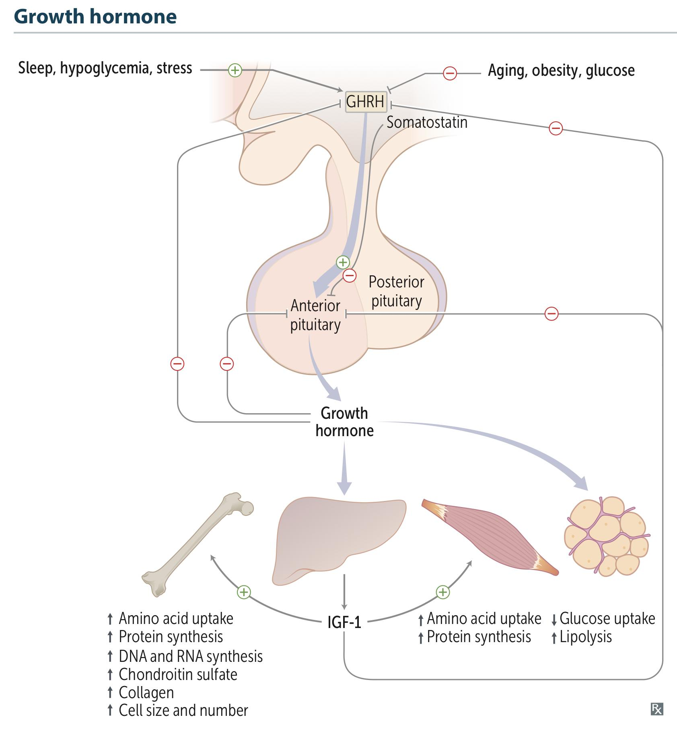
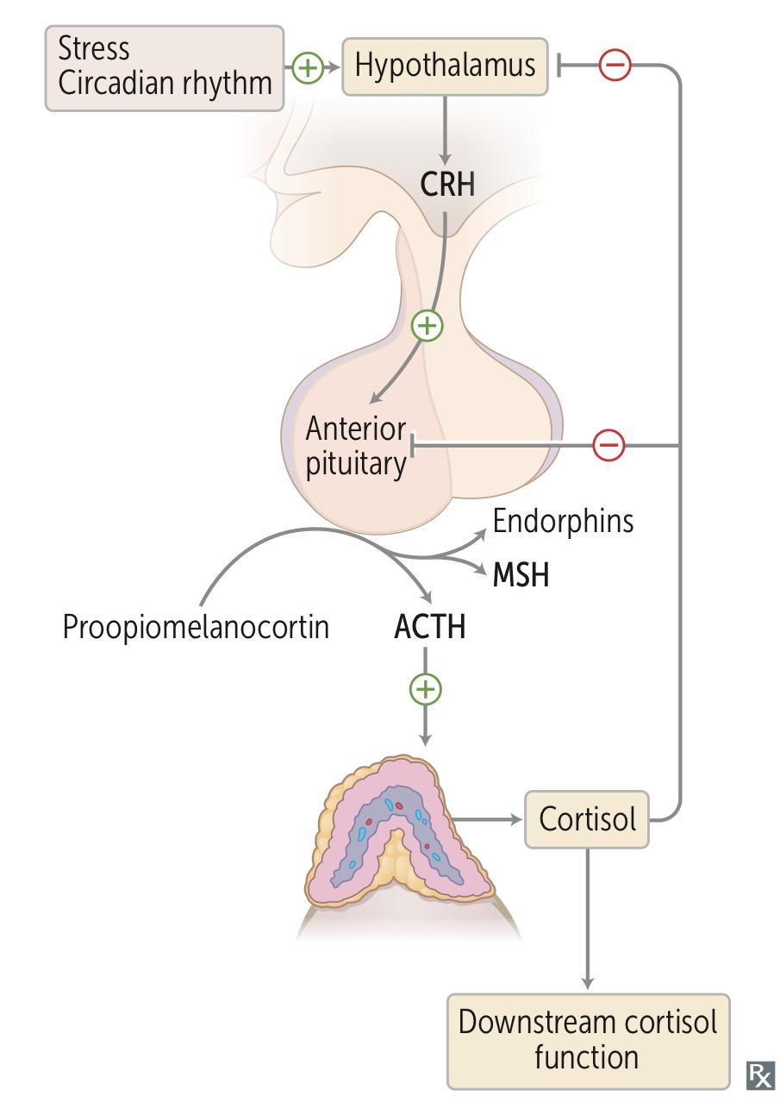
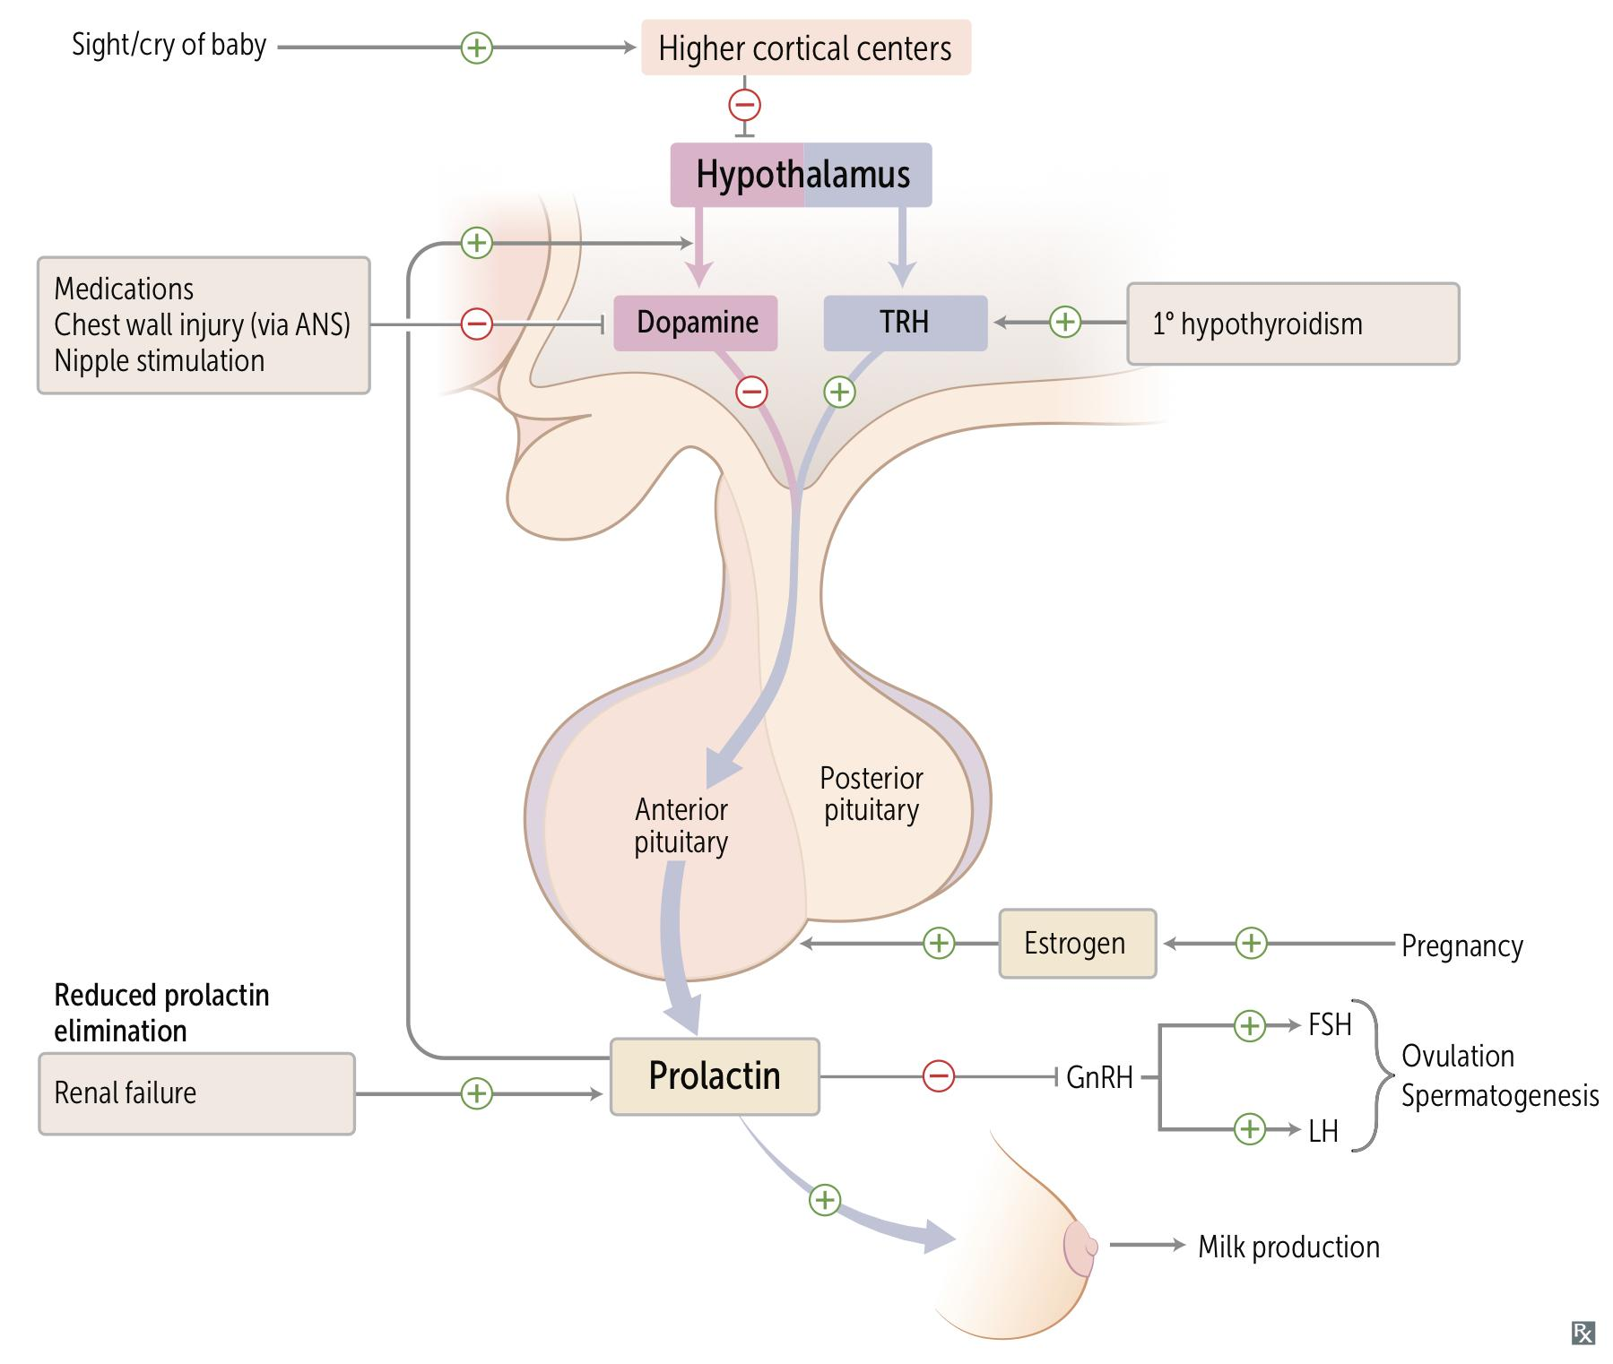
Review of the basics cont.
Lobes of the pituitary
 | Anterior (Adenohypophysis)¹ | Posterior (Neurohypophysis)
Origin | Rathke’s pouch (Ectodermal evagination of oropharynx)^{2.} Recognizable by 4- 5th wk of gestation and full maturation by 20th wk. Portion of Rathke’s pouch→ Intermediate lobe | Down growth of hypothalamic neural tissue (as a 2 outpouching from the floor of 3rd ventricle)
Hormones released | GH , LH, FSH, TSH, ACTH, Prolactin (Go Look For The Adenoma Please) *A compressive adenoma in will impair hormone production in this order | Oxytocin, ADH
Hormones synthesis | Hormones are Synthesized and Secreted in anterior pituitary. | Synthesized in the hypothalamus and Stored in the posterior pituitary.
Arterial supply (Internal carotid) | Superior hypophyseal | Inferior hypophyseal
Venous drainage | hypophyseal veins drain into cavernous sinuses, To superior and inferior petrosal sinuses to jugular vein.
Hypothalamic control | Hormonal signals (releasing and inhibitory Neural signals control hormones) | Neural signals
Has an opening for passage of infundibulum (pituitary stalk) and its blood vessels.
For more details regarding anterior pituitary hormones Stimulus,Inhibitors and their trophic effect click HERE
1-The majority of anterior pituitary hormones are under predominantly positive control by the hypothalamic releasing hormones; the exception is prolactin, which is under tonic inhibition by dopamine.
2- When the pituitary does not ascend fully during embryological development, an ectopic/pharyngeal pituitary may be found

Slide 4
Review of the basics cont.
Hypothalamus
The hypothalamus is the coordinator of Endocrine system.
It receives signals from cortical brain, autonomic function, environment cues like light and temp.
It affects function of thyroid gland, adrenal, gonads, growth, milk production and water balance.
It has Non-endocrine functions such as: temperature regulation, regulate the activity of the autonomic nervous system, control of appetite.
Terminals of hypothalamic neurons are in the median
eminence carrying the hormones through capillary
plexus to the pituitary gland
Paraventricular and supraoptic nuclei produce ADH to
control poster pituitary function
(Very important for survival )
Functions
Release all the hormones to control the pituitary
function beside neuroendocrine function
Hypothalamic-Pituitary Hormones
 | Hypothalamic hormones | Pituitary hormones
Stimulatory | CRH - 41 amino acids; released from paraventricular neurons as well as supraoptic and arcuate nuclei and limbic system | ACTH - basophilic corticotrophs represent 20 percent of cells in anterior pituitary; ACTH is product of proopiomelanocortin (POMC) gene
 | GHrH - two forms, 40 and 44 amino acids | GH - acidophilic somatotrophs represent 50 percent of cells in anterior pituitary
 | GnrH - 10 amino acids; mostly released from preoptic neurons | LH and FSH - gonadotrophs represent about 15 percent of anterior pituitary cells
 | TRH - three amino acids; released from anterior hypothalamic area | TSH - thyrotropes represent about five percent of anterior pituitary cells
 | Prolactin-releasing factors - include serotonin, acetylcholine, opiates, and estrogens | Prolactin - lactotrophs represent 10 to 30 percent of anterior pituitary cells
Inhibitory | Somatostatin - 14 amino acids | Inhibits the release of growth hormone
 | Prolactin-inhibiting factors - includes dopamine | Major prolactin control is inhibitory
Disorders of pituitary:
Hyperpituitarism (eg: Hyperprolactinemia, Acromegaly, Cushing’s Disease)
Hypopituitarism (eg: Central hypoadrenalism, hypogonadism, hypothyroidism or GH deficiency, Panhypopituitarism (≥3 hormone affected), Sheehan syndrome)

Slide 5
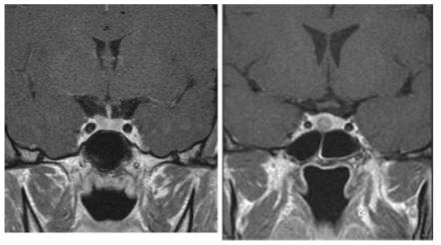
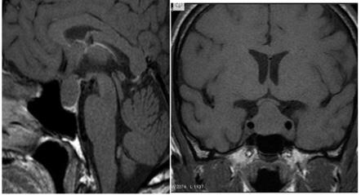
Pituitary Masses
Etiology of Pituitary-Hypothalamic Lesions
Anterior Pituitary
Hormone excess
Hyperprolactinemia (Prolactinoma)
Acromegaly (GH Adenoma)
Cushing disease (ACTH adenoma)
hyperthyroidism (Thyrotropinoma)
Other mixed endocrine active adenomas
1
Tumours
Hormone deficiency
hypopituitarism (GH deficiency,Hypoadrenalism)
Posterior Pituitary
Hormone excess
Syndrome of inappropriate antidiuretic hormone (SIADH)
Hormone deficiency
Central diabetes insipidus
2
Pituitary cyst
4
Miscellaneous
Rathke's cleft cyst
Mucoceles
Empty sella syndrome¹
Pituitary abscess: e.g. TB
Carotid aneurysm²
3
Non-Functioning tumours³
Malignant pituitary tumors:⁵ Functional and non-functional pituitary carcinoma
Lymphocytic hypophysitis (antibodies attacking the pituitary)
sarcoidosis
Metastases in the pituitary
(breast, lung, stomach, kidney)
They affect hormones release indirectly by comprising parts of the pituitary glands
Evaluation of Pituitary Masses
 | Functional adenoma | Non-functional adenoma (incidentaloma)
Epidemiology | 10 % of all pituitary lesions Genetically-related to MEN-1, Gs-alpha mutation, PTTG gene, FGF receptor-4) Or idiopathic | 1.5 -31% in autopsy (prevalence) 10% by MRI most of them < 1 cm
Clinical ( History and Examination) | Function (oversecretion or hyposecretion) Mass ( headache,visual symptoms ) | Asymptomatic Incidentaloma by imaging. Mass-effect (Bitemporal hemianopia) Gonadal hypersecretion
Biochemical | Screen Test, Confirmatory Test | GH, LH, FSH, TSH, ACTH: not high. PRL could be: low, high or normal.
Anatomy | MRI of sella turcica (MRI is superior to CT)
Treatment | Surgical >Medical >Radiation or Medical >Surgical >Radiation (Depend on the type) | Surgery if indicated Observation Adjunctive therapy⁴
1- An ‘empty sella’ is sometimes reported on pituitary imaging. This is sometimes due to a defect in the diaphragma and extension of the subarachnoid space (cisternal herniation), or may follow spontaneous infarction or regression of a pituitary tumour.
2- May masquerade as pituitary tumours and must be diagnosed before surgery.
3- Most intrasellar tumours are pituitary macroadenomas (most commonly non-functioning adenomas), whereas suprasellar masses may be craniopharyngiomas. The most common cause of a parasellar mass is a meningioma.
4- eg: Radiation therapy, Dopamine agonist, Somatostatin analogue.
5- they are aggressive, invades the bone

Slide 6
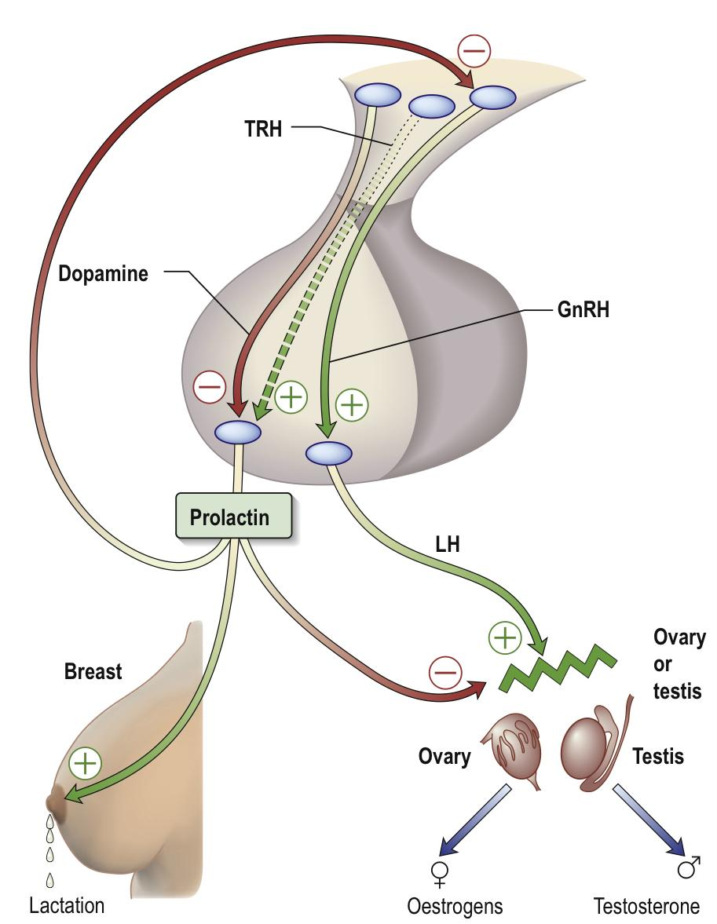
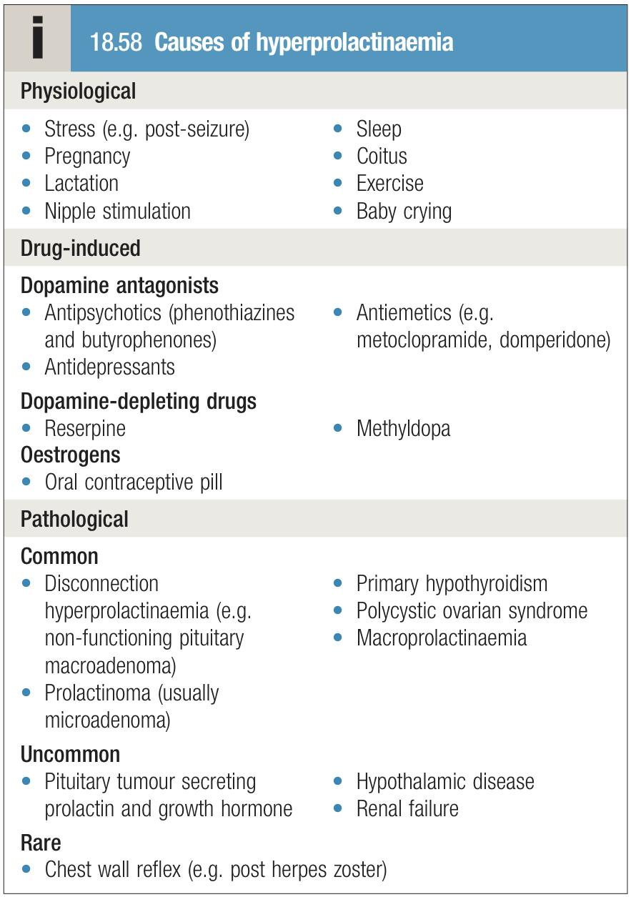
1- Prolactinomas
Introduction
Function of prolactin: Stimulates milk production in breast; inhibits ovulation in females and spermatogenesis in males by inhibiting GnRH synthesis and release.
Regulation of prolactin: Prolactin release is under tonic inhibition by dopamine from the hypothalamus and factors that increase prolactin secretion (e.g. TRH) are probably of less relevance. There is a physiological increase in serum prolactin during pregnancy, lactation and severe stress.
Prolactinomas are the most common of functional pituitary adenomas
25-30% of all pituitary adenomas
Some GH-producing tumors also co-secrete PRL (and vice versa).
PRL is the only pituitary hormone that is inhibited by hypothalamus
Prolactinomas lose TRH response
Causes of Hyperprolactinemia
Pathological
The most common cause is a prolactin secreting pituitary adenoma (prolactinoma).
Disruption of dopamine (tumor,trauma, infiltrative lesions)
Other causes are Renal failure (returns to normal after transplant), Liver failure, primary hypothyroidism (high TRH levels stimulate prolactin).
Drugs which interfere with dopamine:(Phenothiazines, Domapine receptor antagonists metoclopramide, a-methyldopa, verapamil, H2 blocker, estrogen, opiates, reserpine).
Physiological
Mildly increased serum prolactin levels may be physiological and asymptomatic, could be due to:
Asleep, stress
Pregnancy (Estrogen increases, most common)
Lactation
Chest wall stimulation (Burns, chest wall surgery) causing neuronal effect like suckling
Trauma.
Note: When you have elevated prolactin, do not jump into thinking of adenoma, always consider other factors first (drugs, surgeries of chest wall, pregnancy)
Clinical features
Premenopausal women:
Hyperprolactinemia stimulates milk production in the breast producing galactorrhoea (nipple discharge), and inhibits GnRH causing oligo or amenorrhoea (Therefore, lactating can be used as a natural way for contraception) & infertility, disturbed menstruation. 90% present with microprolactinomas (<10mm)
Men:
Decreased libido, subfertility, erectile dysfunction, galactorrhoea and gynecomastia. 60% present with macroprolactinomas (>10mm)
It may have mass effect → Bitemporal hemianopia
Note: Why is it that men are discovered late? Because in a female, minor elevations in prolactin lead to disturbance of their menstrual cycle, leading them to seek medical attention early, while in males no symptoms appear until the adenoma grows in size and start causing problems such as decreased libido and ED.

Slide 7
1- Prolactinomas cont.
Investigations
Biochemical (hormonal):
Serum prolactin level: At least 3 measurements should be taken, Very high level suggests prolactinoma (>5000mU/L).
Pituitary hormones: GH, LH, FSH, TSH, ACTH: normal or low.
Thyroid function test: TSH must be tested to rule out primary Hypothyroidism.
IGF-1 must be tested to rule out acromegaly co-secretion.
Pregnancy test: Always exclude pregnancy first
Also check LFT and RFT, because renal and liver failure may cause elevated prolactin
Anatomical (Imaging):
CT or MRI of the pituitary .
< 1 cm (microadenoma), > 1cm (macroadenoma)
Others: Visual fields (clinical assessment and perimetry)
Treatment
Treat only if symptomatic (HA, vision changes)
Medical (First line)
Dopamine agonist drugs (e.g. Bromocriptine,Cabergoline (Drug of choice), Quinagolide) are first-line therapy for the majority of patients especially in those with macroprolactinomas. However, it is not recommended for breastfeeding moms. If intolerant with nausea give vaginally. 1.25mg qhs 1 wk, then BID.
Causative drugs should be withdrawn if possible and hypothyroidism treated.
Ergot-derived dopamine agonists (bromocriptine and cabergoline) can bind to 5-HT2B receptors in the heart and elsewhere and have been associated with fibrotic reactions, particularly tricuspid valve regurgitation, when used in high doses in patients with Parkinson’s disease. Systematic screening for cardiac fibrosis is unnecessary in low doses, but if dopamine agonist therapy is prolonged, periodic screening by echocardiography or use of non-ergot agents (quinagolide) may be indicated.
There’s limited data on safety in pregnancy for Cabergoline and Quinagolide. Bromocriptine is the longest-established therapy and therefore preferred if pregnancy is planned
The only pituitary tumor that can be treated medically
Always medical in case of pregnancy never surgical
Surgery and radiation
If the tumor is causing pressure symptoms or if medical therapy failed
Surgical removal of the tumour via a transsphenoidal approach*, combined with post-operative radiotherapy for large tumours, often restores normoprolactinaemia but there is a high rate of late recurrence (50% at 5 years)
*Access to the pituitary is achieved through the nasal cavity, sphenoid sinus and sphenoid bone.

Slide 8
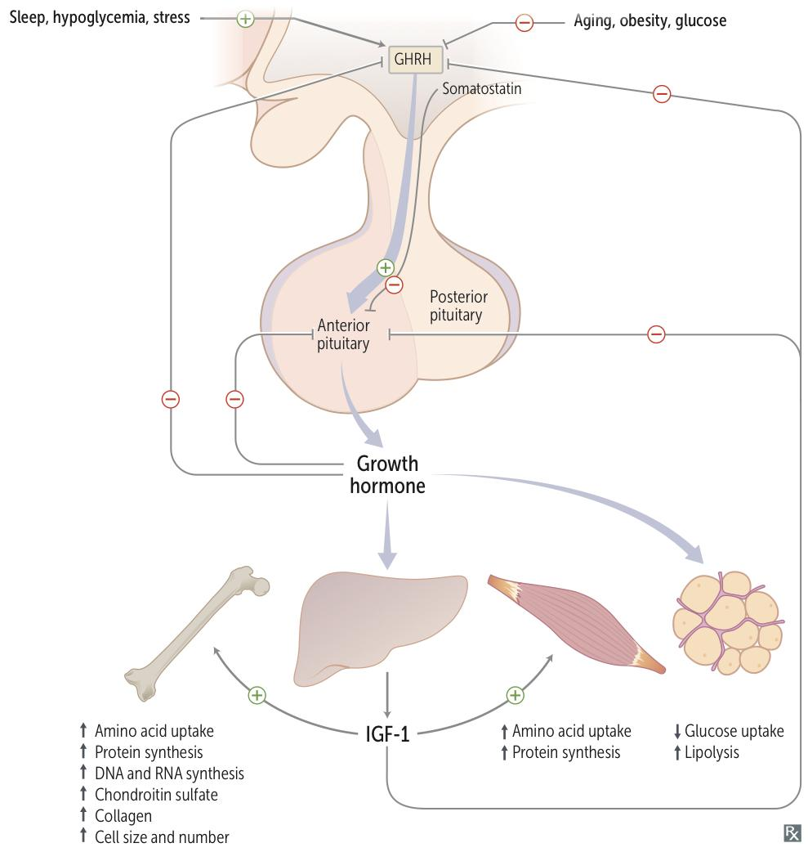
2- Growth hormone deficiency
Growth hormone
A polypeptide hormone that is released from the somatotrophs of anterior pituitary
Action is mediated by IGF-I which is produced by the liver
Half life is 20-50 mins and has a binding protein (GHBPs)
Pulsatile secretion: variable level in the blood
Binds to its receptor on cell- surface: cytokine receptor
Lack intrinsic enzyme activity
GHRH stimulates it, somatostatin inhibits.
Has similar receptor structure to others: leptin, IL-2, PRL
Controlled by HP and peripheral factors.
Growth Hormone Changes
Increase
Decrease
Physiologic:
sleep¹, exercise, stress, fasting (hypoglycemia)
Physiologic:
↑glucose, ↑ FFAs.
Pathologic:
Liver cirrhosis, AN, CRF, starvation
Pathologic:
↑ or ↓in T4, Obesity
Pharmacologic:
Estrogen, ACTH, ADH, GHRH,Ghrelin.
dopamine agonist.
K infusion, serotonin arginine and Insulin.
Pharmacologic:
Somatostatin, GH,GC, PG
Growth hormone deficiency
Clinical Features | In Children: will present with short stature² | In Adults: will lead to metabolic syndrome (dyslipidemia, hypertension, risk of CVD, truncal obesity) so it is important for its complications
Investigations | GH, IGF-I level (screening³). Dynamic testing: clonidine⁴ stimulation test, glucagon stimulation, exercise testing, arginine-GHR, insulin tolerance testing. MRI pituitary to rule out pituitary adenoma. X-ray of hands: delayed bone age (Diagnostic)
Management | Growth Hormone replacement therapy (only given for pediatrics & after excluding other causes of GH deficiency such as adenoma. adults are usually not given replacement therapy unless they have low bone density (osteoporosis))
1- This is thought to be the reason why infants sleep for many hours (to grow).
2- The commonest cause for short stature is familial “genetics”, not growth hormone deficiency.
3- when screening the hormones, always go for IGF-1 because its levels are constant, while GF has diurnal rhythm, thus not reliable, also, why do we need stimulation tests after screening IGF-1? Because IGF-1 is affected by nutrition (malnourished people and uncontrolled diabetes lead to low IGF-1)
4- Anti-Hypertensive drug with growth hormone stimulating properties.

Slide 9
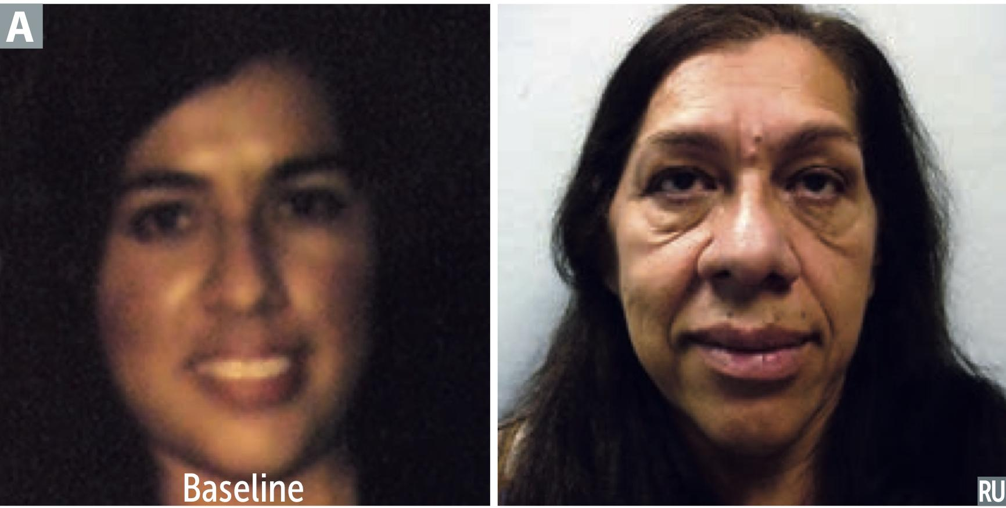
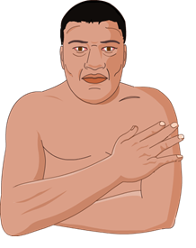
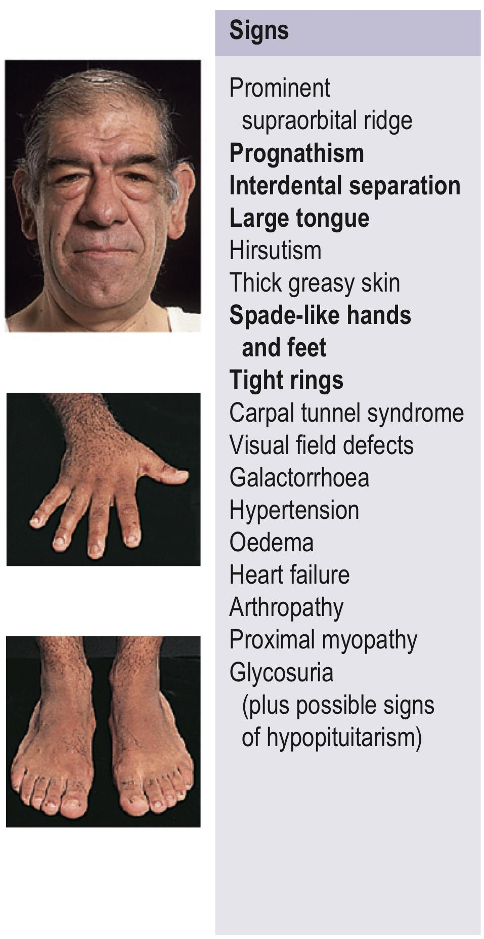
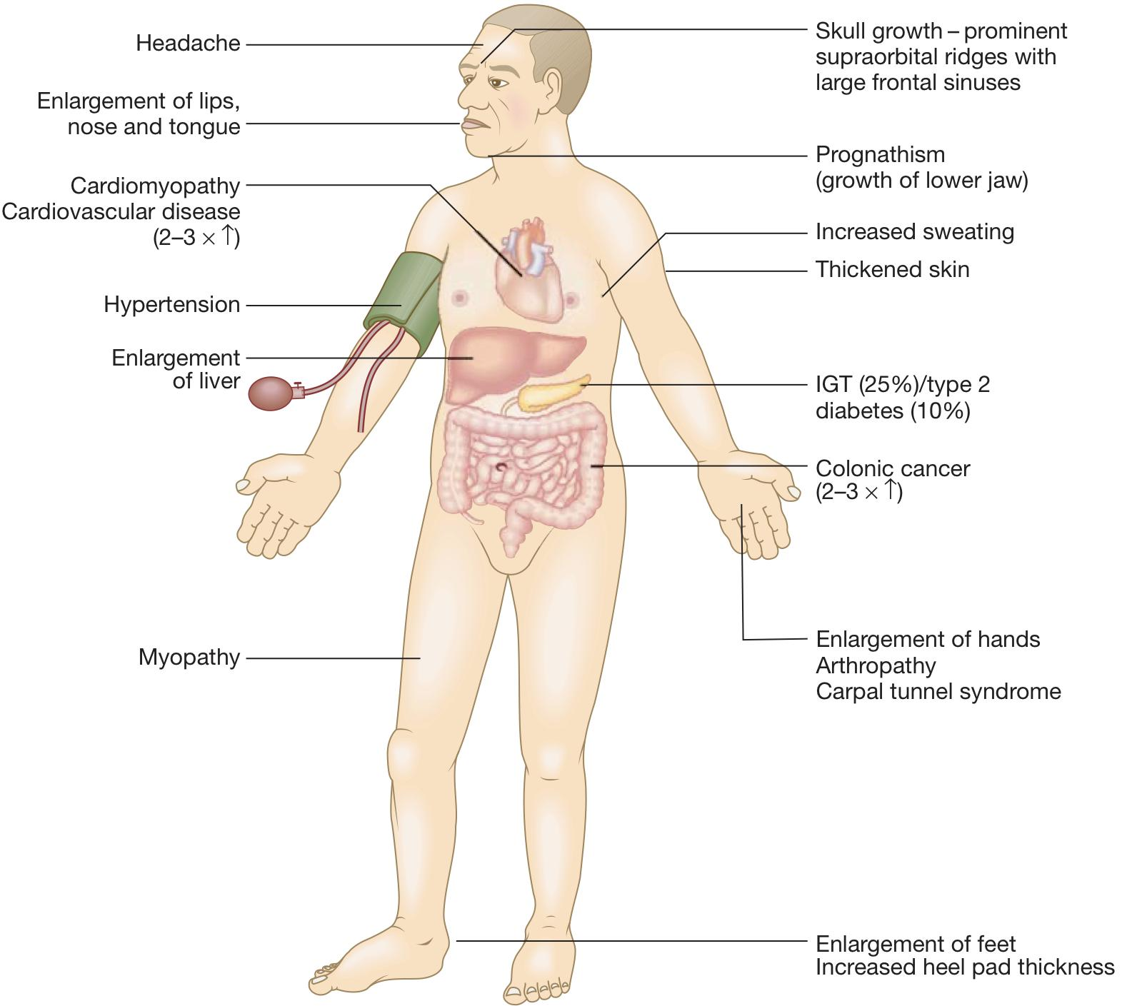
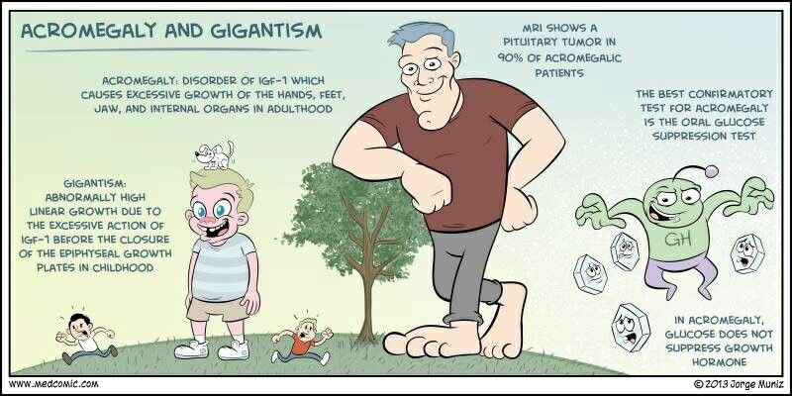
3- Growth hormone excess
(Acromegaly/Gigantism)
Introduction
Excessive GH production leads to gigantism in children (if occured before fusion of the epiphyses of the long bones) and acromegaly in adults.
98% of cases are due to GH pituitary adenoma
⅓ of all functional adenomas are GH adenomas.
Stimulates growth of skin, connective tissue, cartilage, bone, and viscera.
Induce Nitrogen retention, insulin antagonism, and lipogenesis.
Can be caused by Exogenous abuse of Growth hormone.
Clinical features
Old photographs of the patient may be useful to demonstrate a change in appearance and physical features. The onset is insidious with many years between onset of symptoms and diagnosis. (See pic A)
The most common complaints are headache and sweating.
irreversible cardiovascular effect: (major cause of death)
Cardiomegaly and CHF with Diastolic dysfunction being an early sign of cardiomyopathy.
HTN in 40%, LVH in 50% and they present with Obstructive sleep apnea (due to Neck enlargement )
Impaired glucose tolerance → Diabetes Type 2
Carpal tunnel syndrome (Median nerve compression)
Hypertension(Due to CVS complications + enlarged kidney)
There’s an increased risk of tumors such as leiomyomata and colon polyps
Acral enlargement: large thick hands & feet with osteoarthritis
gross features of acromegaly: Face gross features, enlarged tongue, and jaw
Galactorrhea (Due to co-secretion of prolactin from the tumor)
Gingiva enlargement, constipation and deep voice
May have mass effect → Bitemporal hemianopia (mechanical pressure → visual field defect), hypopituitarism
Reduced overall survival by an average of 10 years

Slide 10
3- Growth hormone excess cont.
(Acromegaly/Gigantism)
Investigations
Biochemical (hormonal):
Initial test (screen): Measure IGF-1. (Will be high in acromegaly)
Confirmatory Test: 75g OGTT for GH suppression; serum GH should be measured 2 hours after an oral glucose load, in normal subjects, plasma GH suppresses to below 0.5 μg/L (approximately 2 mIU/L). In acromegaly, GH does not suppress and in about 30% of patients there is a paradoxical rise.
Random GH level is not useful due to the wide physiologic fluctuation of GH levels
Fasting and random blood sugar, HbA1c, Lipid profile
Pituitary Function (LH,FSH.PRL, TSH, ACTH, cortisol, testosterone, T4).
Anatomical (Imaging):
MRI or CT for the pituitary
Echo: Diastolic dysfunction as an early sign of cardiomyopathy
X-ray: thick heel pad ≥22mm
Colonoscopy: Screening for colonic neoplasms, there is an increase in deaths due to neoplasia, particularly large bowel tumours; guidance advocates regular colonoscopy to detect and remove colonic polyps in order to reduce the risk of colonic cancer is indicated.
Treatment
Goal: Lower the serum insulin-like growth factor to normal for age/gender.
Surgery (1st line)
Transsphenoidal surgical resection is the treatment of choice.
Complications: hypopituitarism, diabetes insipidus, CSF rhinorrhoea and infection.
Medical (2nd line)
Normally used when surgery alone has failed to reduce GH and IGF-I levels to normal.
Somatostatin analogues (octreotide, lanreotide or pasireotide).
Dopamine agonist (bromocriptine or cabergoline) “especially if associated with prolactin excess”
Didn’t work? use GH receptor antagonist (Pegvisomant)
Radiotherapy (3rd line)
Used after surgical excision is incomplete and in combination with medical treatment as the response is slow (10 years or more).
Complications: hypopituitarism

Slide 11
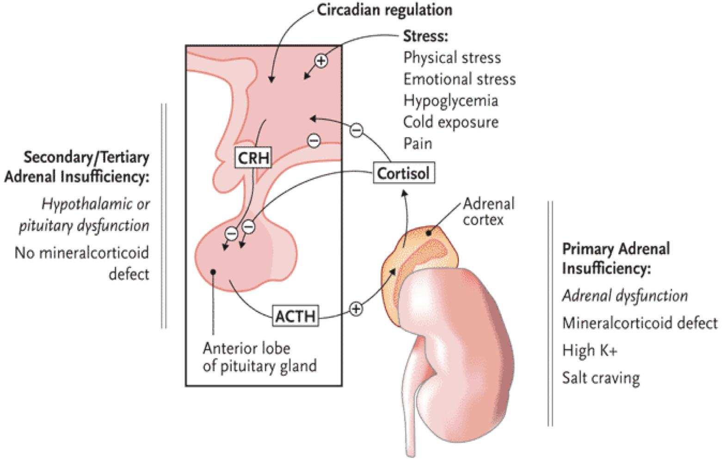
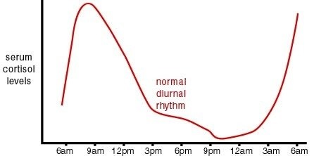
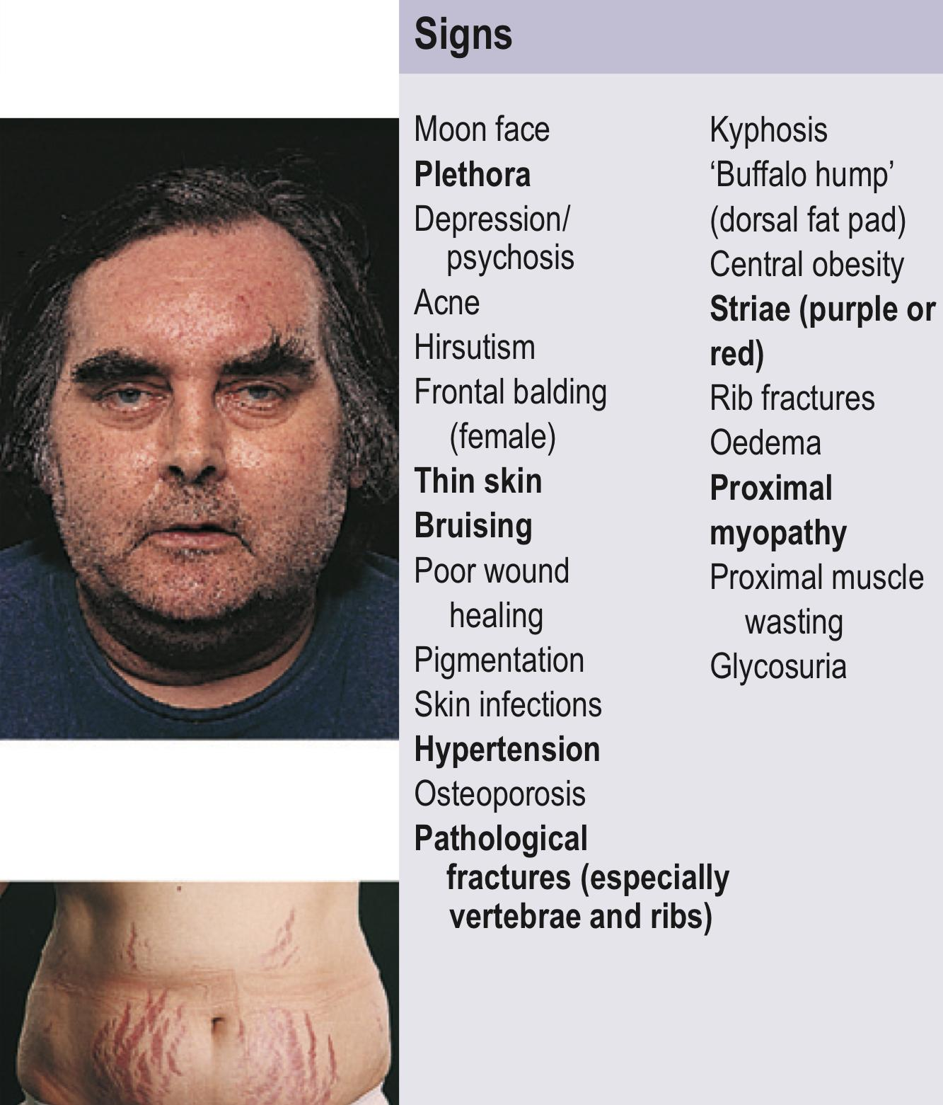
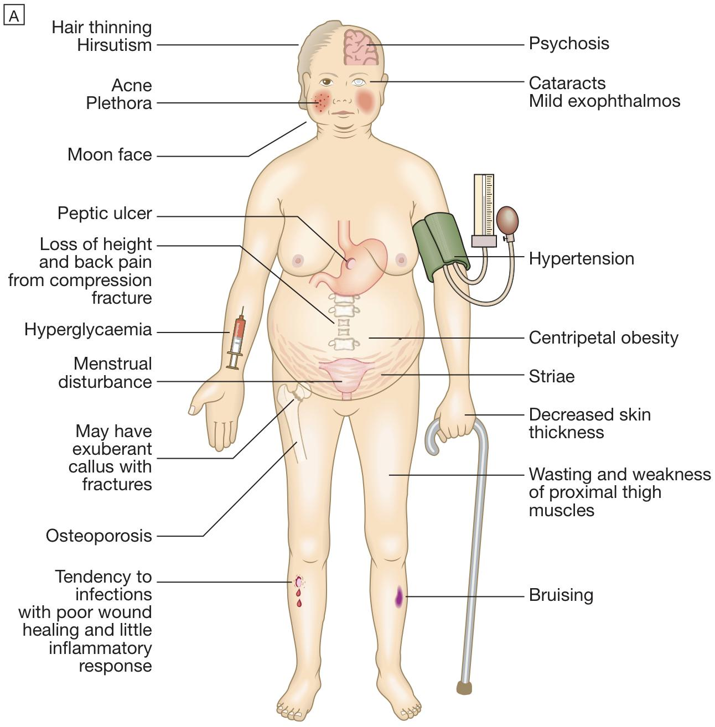
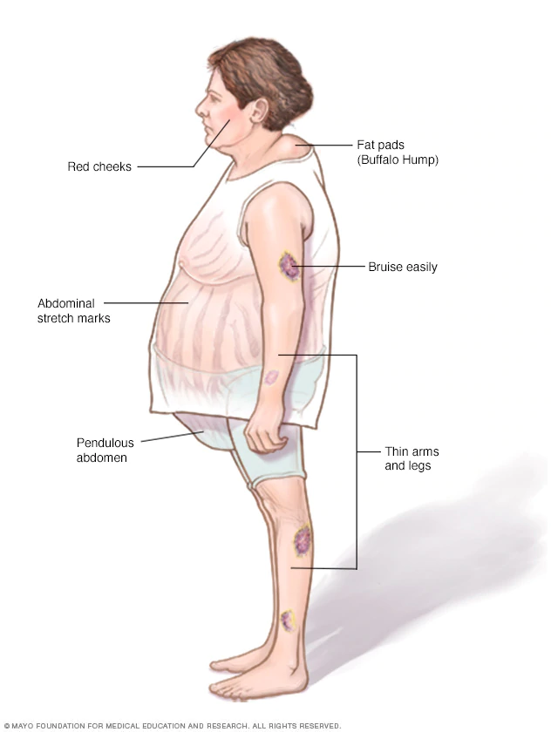
4- Cushing disease
Introduction
Cortisol and ACTH normally have a stable circadian rhythm (8-9am) which can be altered by: Physical stress, Psychological stress, CNS and pituitary disorder, liver and renal failure. has the highest level at 5am (+500).
In Cushing’s Disease there’s an abnormally high level of ACTH.
Cushing’s Disease is more common in females by 3-8 times than in males, yet it’s still not that common (5-25 per million).
Cushing’s disease must be distinguished from Cushing’s syndrome. The latter is a general term which refers to the abnormalities resulting from a chronic excess of glucocorticoids whatever the cause, whereas Cushing’s disease specifically refers to excess glucocorticoids resulting from inappropriate ACTH secretion from the pituitary
Clinical features
Moonface with buffalo hump, purple striae (wide >1cm) and supraclavicular fat pad
Glucose intolerance (60%) (cortisol has anti-insulin effect)
Central obesity characterized by thin limbs and striae
Hirsutism (Only in cushing’s disease) and virilization
Osteoporosis with cutaneous fungal infection and vertebral fractures → admitting to OR (50%), 20% with fractures
Hypertension (80%) with hypokalemia
proximal muscle weakness & thin extremities (complain of difficulty when performing prayers and climbing stairs)
ECG: high QRS voltage, inverted T-wave
Diastolic dysfunction, interventricular septal hypertrophy, LVH
Depression with other psychological disorders and oligo or amenorrhea
OSA (33% mild, 18% severe), Needs respiratory assessment and careful use of sedative during surgery.
Thin skin → difficult IV cannulation, poor wound healing, visible blood vessels
Glaucoma with Acne, easy bruising, depression, ecchymosis, and infertility

Slide 12
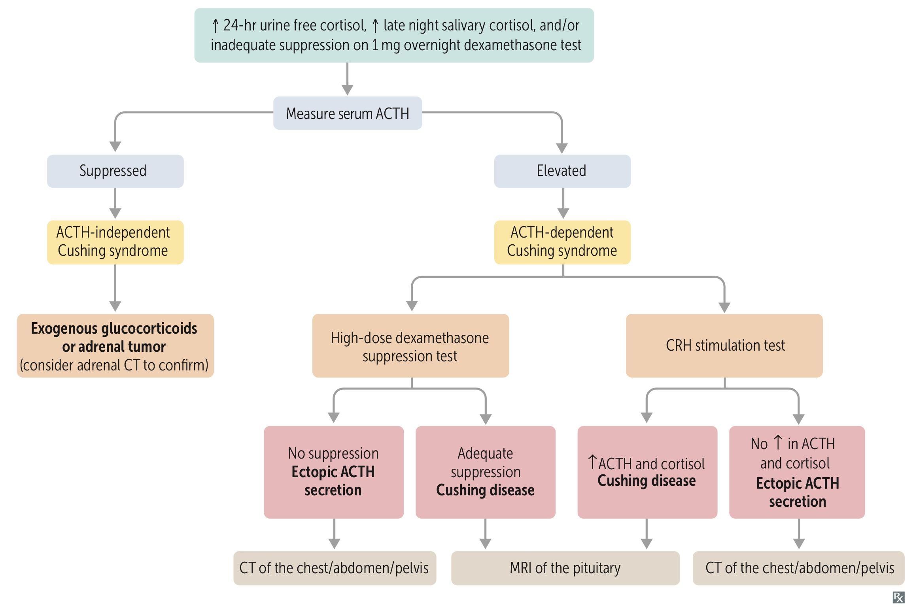
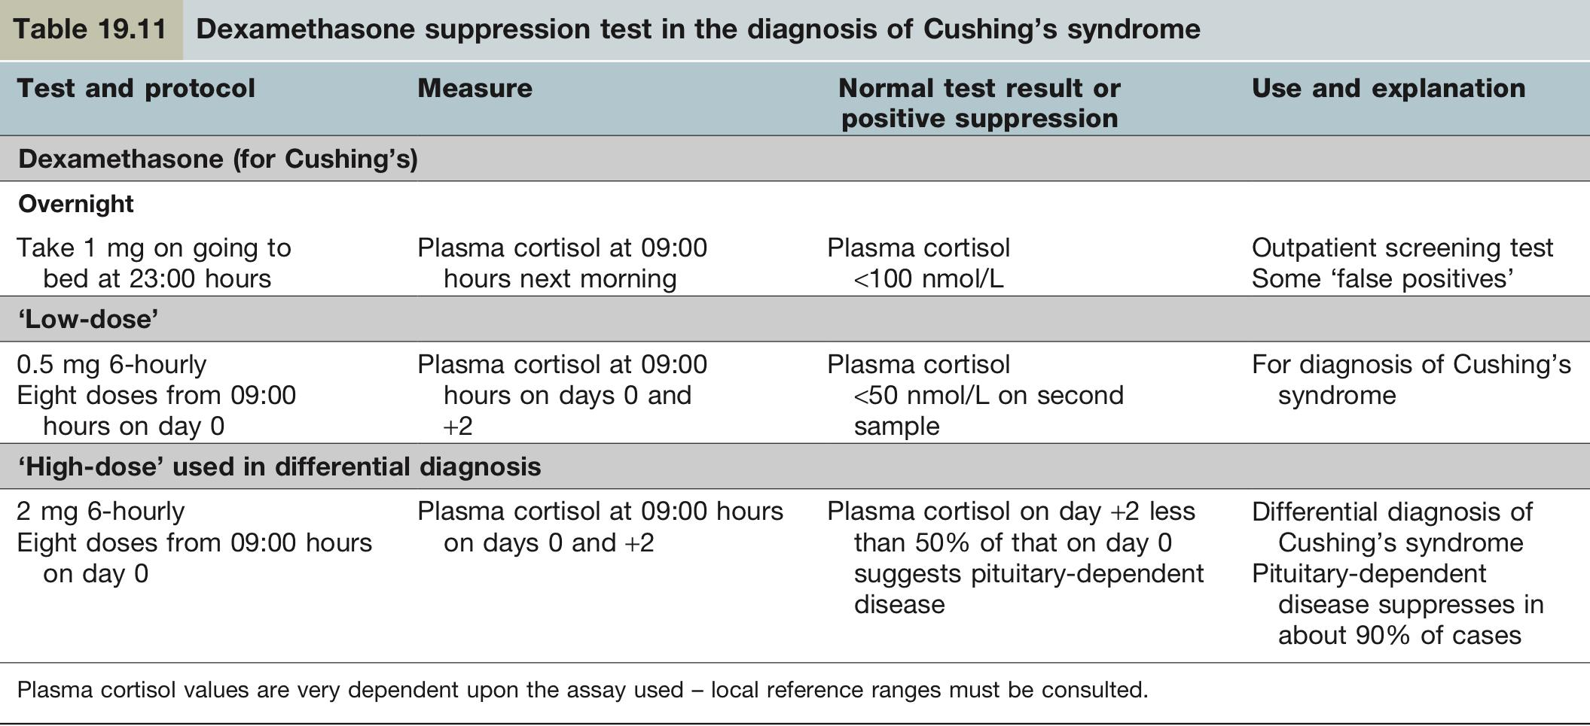
4- Cushing disease cont.
Investigations
Biochemical (hormonal):
Best initial: 24- hour urinary free cortisol measurements: It is simple but less reliable. However,repeatedly normal values render the diagnosis unlikely, but some people with Cushing’s syndrome have normal values on some collections (approximately 10%).
2nd: Overnight 1mg dexamethasone (low dose) suppression testing (outpatient screening test): is slightly simpler, but has a higher false-positive rate.
3rd: ACTH circadian rhythm: Show loss of the normal circadian fall of plasma cortisol at 24:00 h in patients with Cushing’s syndrome (normal rhythm change in people with night shifts).
48-hour low-dose dexamethasone test (Most sensitive, >97%): Normal individuals suppress plasma cortisol to less than 50nmol/L. People with Cushing’s syndrome fail to show complete suppression of plasma cortisol levels (although levels may fall substantially in a few cases)
Midnight salivary cortisol: Can be collected at home for the diagnosis and surveillance of Cushing’s, removing the need for a hospital stay.
Anatomical (Imaging):
MRI pituitary for pituitary adenoma. In Cushing’s disease, the pituitary tumour is usually a microadenoma (< 10 mm in diameter); hence other features of a pituitary macroadenoma (hypopituitarism, visual failure or disconnection hyperprolactinaemia) are rare.
High-dose (2mg) dexamethasone suppression test is used to differentiate between pituitary based and ectopic based ACTH cushing's. Test failure of significant plasma cortisol suppression suggests an ectopic source of ACTH(eg:Lung SCC) or an adrenal tumour.
Treatment
First line: Transsphenoidal surgery¹ (treatment of choice)
Second line: Pituitary irradiation¹ (if entire adenoma couldn’t be resected)
Last resort: Laparoscopic bilateral adrenalectomy may cause Nelson’s syndrome² which is characterized by increased pigmentation due to high levels of ACTH.
Treatment for pregnant women
1st Trimester: Surgery
2nd Trimester: Adrenal Enzyme Inhibitors or surgery
3rd Trimester: Early delivery, enzyme inhibitors until lung maturity.
Prognosis
Untreated Cushing’s syndrome has a very poor prognosis, with death from venous thromboembolism, hypertension, myocardial infarction, infection and heart failure.
1- Cortisol hypersecretion should be controlled prior to surgery or radiotherapy using metyrapone,ketoconazole, or etomidate infusion.
2- Enlargement of intrasellar pre-existing ACTH–secreting pituitary adenoma after bilateral adrenalectomy for refractory Cushing disease → high ACTH (hyperpigmentation), mass effect (headaches, bitemporal hemianopia). Treatment: transsphenoidal resection, postoperative pituitary irradiation for residual tumor.

Slide 13
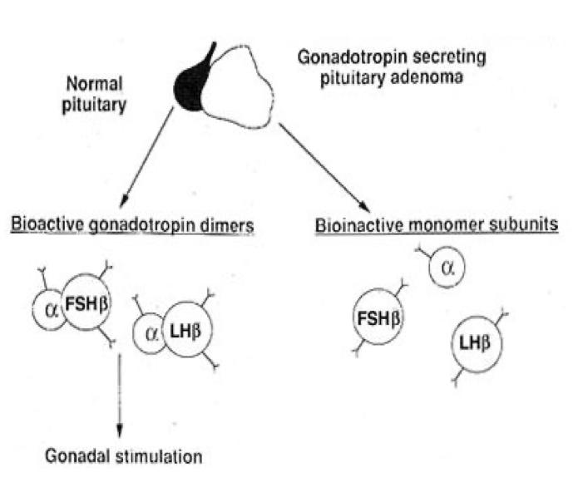
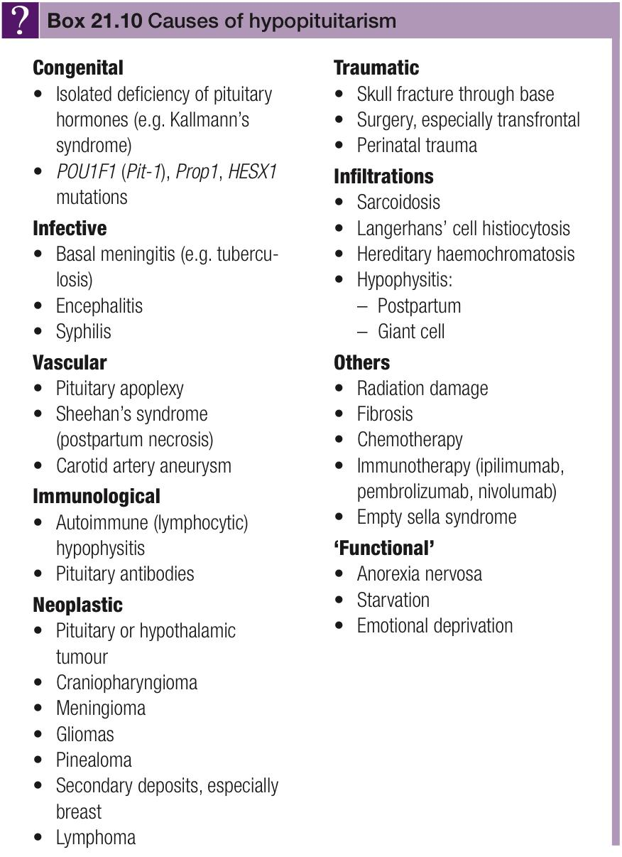
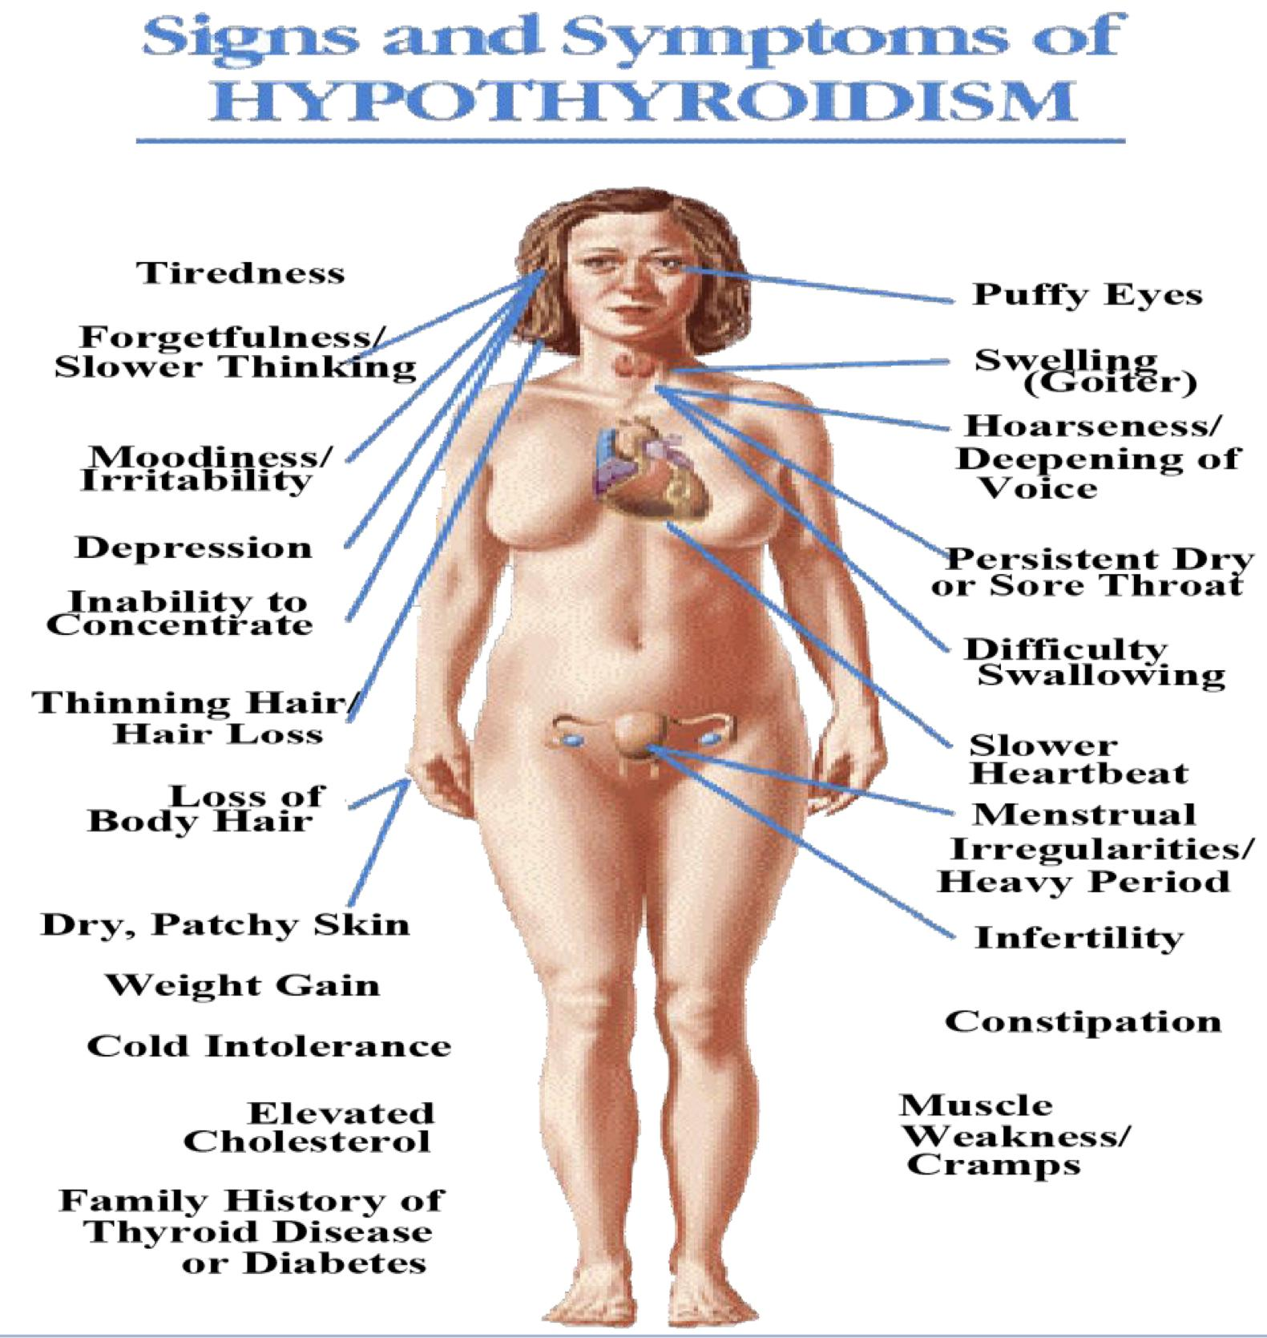
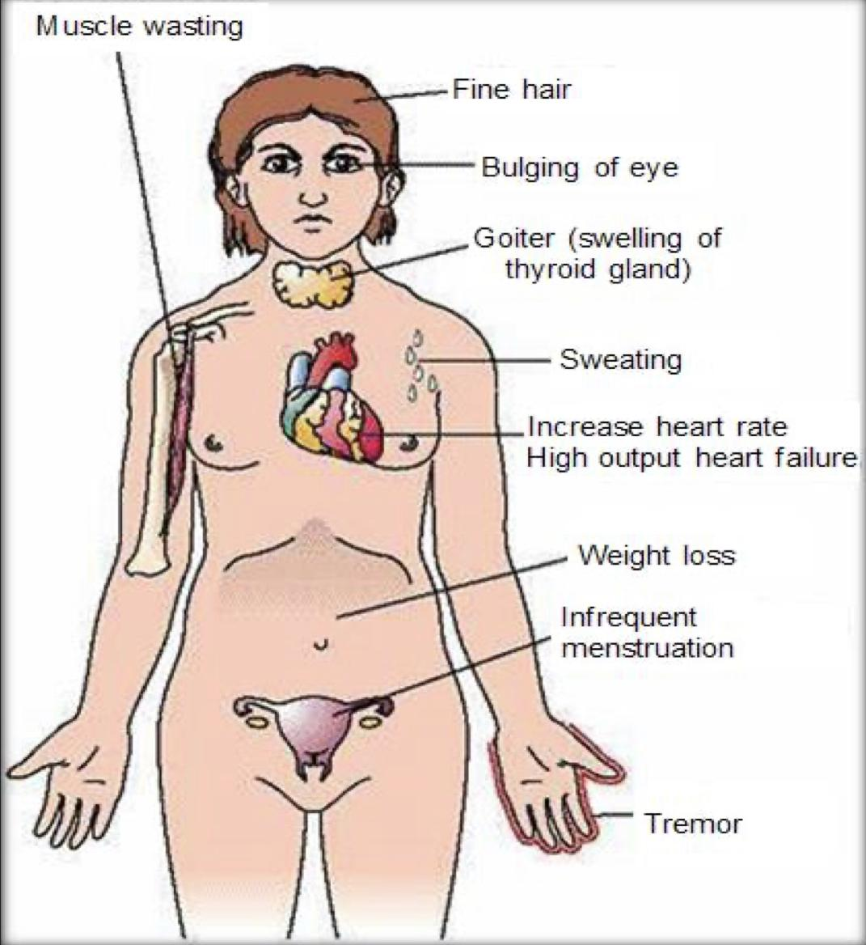
Other etiologies
Gonadotrophic adenoma:
Usually considered non-functioning adenoma (Secrete inefficiently and variably).
Present with neurological symptoms (vision most commonly).
Very rare and difficult to diagnose:
Rule out other adenomas
Prepubertal girls → Breast development, vaginal bleeding
Premenopausal → olig, Amenorrhea
Hormonal findings:
High FSH and low LH, which is often accompanied by
hypersecretion of FSH alpha-subunit (see the fig)
Less often by hypersecretion of LH.
High estradiol, FSH, thickened endometrium and polycystic ovaries
Treat it by: Trans-sphenoidal surgery if large with or without radiation
Note: (How to know whether high FSH is a result of menopause or gonadotrophic adenoma in women? in gonadotroph adenoma there will be in addition to high FSH, high estradiol, thickened endometrium and\or polycystic ovaries)
01
“Skipped by the males doctor”
Central hypothyroidism:
Low TSH, Low free T4 and T3
S&S:
Fatigue, weight gain, irregular menses, dry skin, depression, cold intolerance, increase sleep, slow thinking
Obesity, Depressed face, eyebrow, hair loss, constipation.
Diagnosis:
Biochemical: Low T4 and Low TSH
Anatomical: MRI
02
Treatment:
Thyroxine replacement
Surgical removal of pituitary adenoma if large
2 and 3 will be discussed in details in a separate lecture
Hyperthyroidism:
Very rare < 2.8 %
S&S:
Goitre, palpitations, twitching or trembling, warm skin and excessive sweating, red palms of your hands, loose nails, urticaria
patchy hair loss or thinning , diarrhea.
weight loss – often despite an increased appetite.
Diagnosis:
Biochemical: High TSH, FT4, FT3
Anatomical: MRI
Treatment:
Medical therapy: Somatostatin Analogue
Surgical resection of adenoma
03

Slide 14
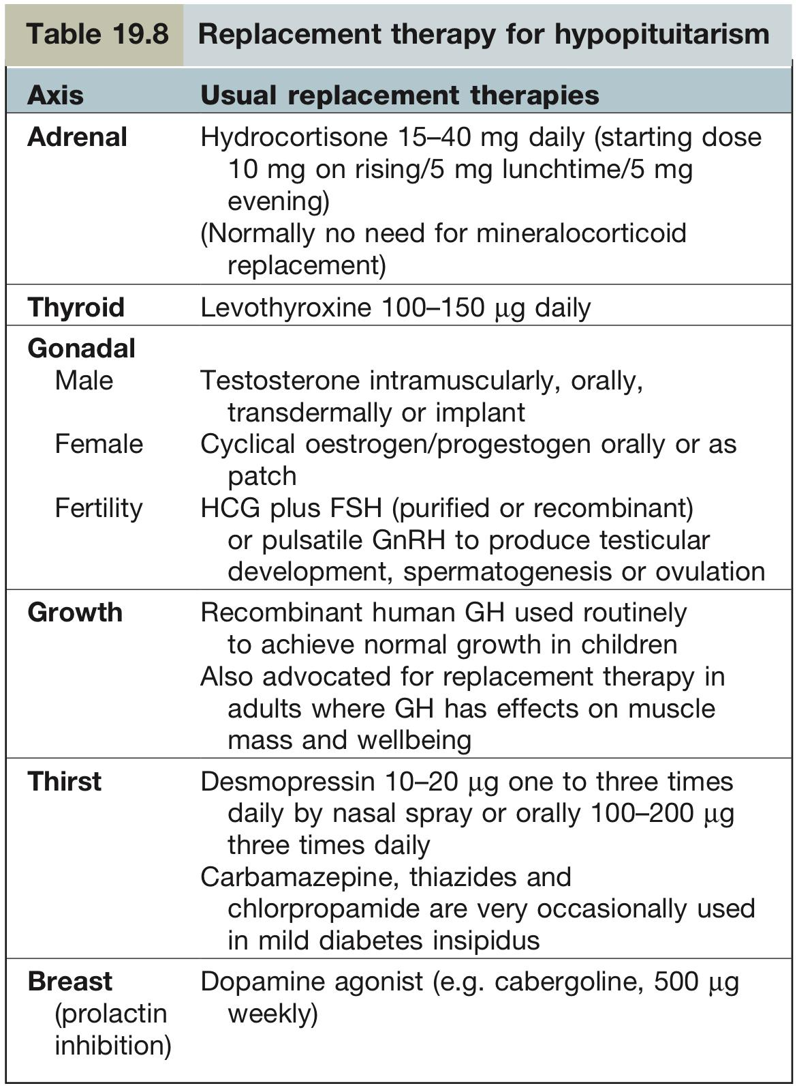
Other etiologies cont.
04
Hypopituitarism¹:
There is generally a progressive loss of anterior pituitary function. GH and gonadotropins are usually firstly affected. Hyperprolactinaemia, rather than prolactin deficiency, occurs relatively early because of loss of tonic inhibitory control by dopamine. TSH and ACTH are usually last to be affected.
76% caused by a tumor or treatment of tumor
Mass effect of adenoma on other hormones.
Surgical resection of non-adenomatous tissue or Radiation of pituitary (Hormones have to be checked 6 Months after then yearly).
13% caused by extra-pituitary tumors eg: craniopharyngioma² (most common childhood tumor that causes hypopituitarism),8% unknown , 1% sarcoidosis, 0.5% Sheehan’s syndrome (caused by excess blood loss (hemorrhage) or extremely low blood pressure during or after labor leading to infarction of pituitary gland)
Sheehan syndrome: ischemic infarct of pituitary following postpartum
bleeding; pregnancy-induced pituitary growth → Increase susceptibility
to hypoperfusion. Usually presents with failure to lactate, absent
menstruation, cold intolerance
Clinical features of hypopituitarism:
Symptoms of secondary hypothyroidism and adrenal failure
Gonadotrophin and thus gonadal deficiencies, Hyperprolactinaemia
GH deficiency, Weight may increase
Classic picture of pallor with hairlessness (‘alabaster skin’).
Treatment: hormone replacement therapy (CS, thyroxine³, sex steroids, GH) (See table)
Cortisol low (hypoadrenalism):
Could be primary adrenal insufficiency (caused by TB, malignancy, etc.) or secondary/central adrenal insufficiency (adenoma)
S&S: Nausea, Vomiting, abdominal pain, Diarrhea Dizziness and weakness, Tiredness, Muscle ache, hypotension, weight loss.
Investigation: measure ACTH, cortisol, dynamic testing (short synacthen)
Management: Cortisol replacement, surgical removal of adenoma if central.
05
Infiltrative Lesions:
Hereditary Hemochromatosis
Caused by Iron deposition in pituitary(haemochromatosis) or Gonadotropin deficiency(most common)
Treatment: repeat phlebotomy.
Pituitary Apoplexy
Sudden hemorrhage seen on MRI into pituitary “urgent condition” with severe, severe sudden headache, diplopia, hypopituitarism with sudden ACTH def (Is life-threatening hypotension)
Treatment: surgical decompression.
06
1-Panhypopituitarism refers to deficiency of all anterior pituitary hormones; it is most commonly caused by pituitary tumours, surgery or radiotherapy. Vasopressin (ADH) will only be significantly affected if the hypothalamus is involved by a hypothalamic tumour or major suprasellar extension of a pituitary lesion, or if there is an infiltrative/inflammatory process. Posterior pituitary deficiency with diabetes insipidus is rare in an uncomplicated pituitary adenoma.
2-benign non-functioning childhood tumours that develop in cell rests of Rathke’s pouch, and may be located within the sella turcica, commonly in the suprasellar space. clinical features include hyperphagia and obesity, loss of the sensation of thirst and disturbance of temperature regulation.
3- Thyroid replacement should not commence until normal glucocorticoid function has been demonstrated or replacement steroid therapy initiated, as an adrenal ‘crisis’ may otherwise be precipitated.

Slide 15
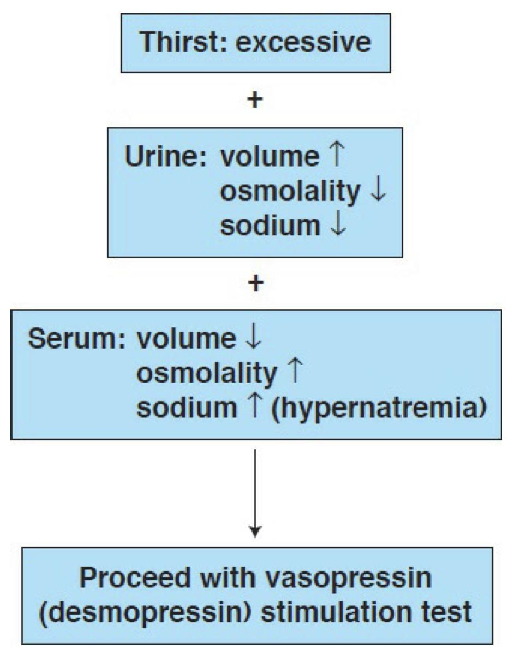
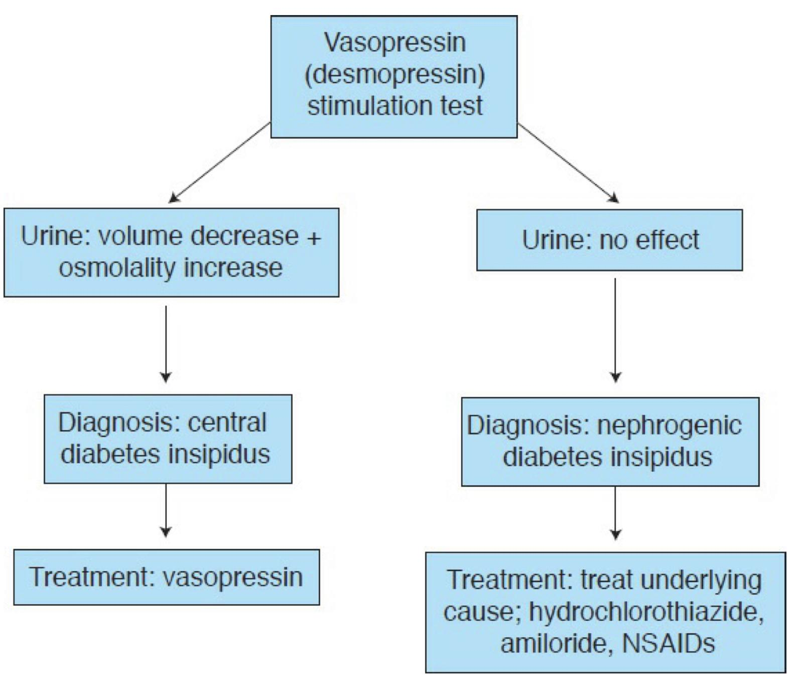
Posterior Pituitary Disorders
Diabetes Insipidus
Types¹ | Central DI: Deficiency of vasopressin (ADH), caused by a hypothalamic disorder (adenoma of pituitary does not cause it because it is only stored there) Nephrogenic DI: Renal resistance to ADH action Psychogenic DI: is an excessive water intake seen in some patients with mental illnesses such as schizophrenia.
Causes² | Central DI: Abrupt onset, 30-50% are idiopathic (Dec. production by hypothalamus). Neurosurgery or head trauma Primary or secondary tumours. Infiltrative disease (sarcoidosis, histiocytosis). Vascular disease e.g. Stroke, hpoxia iatrogenic: cut of the stalk during surgery Rare with sheehan’s (Mild, undetectable) | Nephrogenic DI: ↓K or↑Ca. Lithium. Renal tubular acidosis. Sickle cell disease. Familial mutation in ADH receptor. Chronic pyelonephritis Amyloidosis Myeloma
Symptoms | Abrupt onset of polyuria (1st manifestation), polydipsia (2nd manifestation) and thirst
Investigations | Urine: ↑urine volume (2 – 15 L/day ), ↓urine osmolality, ↓specific gravity . Serum Na+: usually high (Because ADH cause fractional excretion of Na in urine so lack of ADH result in high serum Na) → Neurological symptoms. High or high-normal plasma osmolality (in primary polydipsia, plasma osmolality tends to be low). Water deprivation test (To differentiate between CDI,NDI and PDI) Restrict P.O(oral) fluids or administer hypertonic saline to increase serum osmolality to 295-300 mosmol/kg (normal: 275-290). Central DI: urine osmolality will still low (Before giving vasopressin) and returns to normal after administer vasopressin. Nephrogenic DI: exogenous vasopressin does not alter urine osmolality much. Psychogenic DI: Urine will be become concentrated as they aren’t really a problem with either the pituitary nor the kidney.
Treatment | Central DI: DDAVP (Desmopressin Acetate) Synthetic analog of ADH Not catabolized by vasopressinase →No vasopressor action Administered intranasally or orally Titrate 10-20ug qd or bid Safe in pregnancy and breastfeeding. | Nephrogenic: Correct underlying cause. Hydrochlorothiazide³ used to sensitize the renal tubules to endogenous vasopressin. Primary Polydipsia: Psychiatric management.
Assessment of Pituitary Function
Baseline: TSH, FT4(T4), LH+FSH with Testosterone or Estradiol, Prolactin, GH, IGF-I ACTH, cortisol and electrolyte.
MRI of the brain + Neuro-ophthalmic for evaluation of visual field.
Cardiac and respiratory assessment with ENT for Endonasal evaluation for surgical approach.
Anesthesiologist for airway and perioperative monitoring
Neurosurgeon
Preop hormonal replacement: maybe need to be covered with stress dose of HC
1- Patients with Central DI and Nephrogenic DI can't fast Ramadan (they lose so much fluids without it being replaced due to fasting).
2-DIDMOAD (Wolfram’s) syndrome is a rare autosomal recessive disorder comprising diabetes insipidus, diabetes mellitus, optic atrophy and deafness, and is caused by mutations in the WFS1 gene on chromosome 4. MRI may show an absent or poorly developed posterior pituitary.
3- in addition to carbamazepine (200–400 mg daily) and chlorpropamide (200–350 mg daily) but these are rarely used.

Slide 16
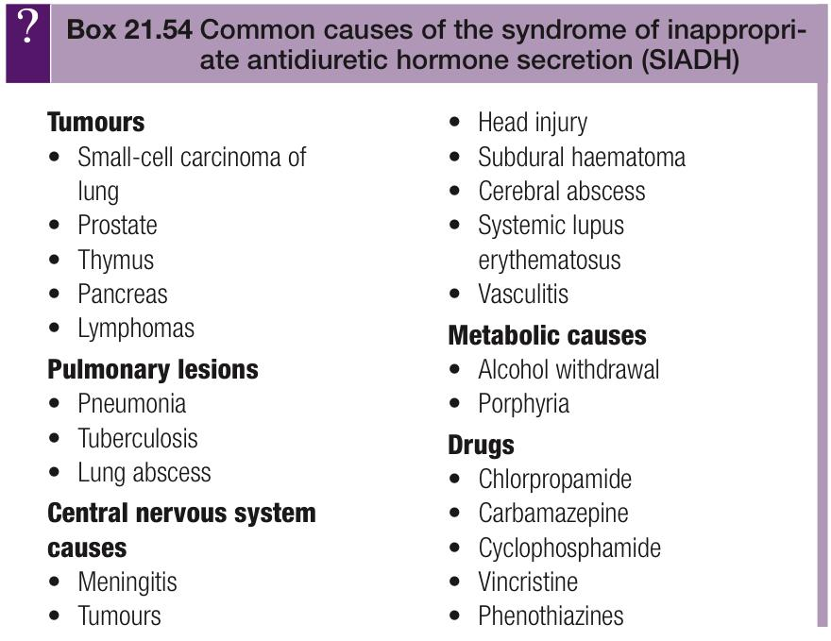
Posterior Pituitary Disorders cont.
Syndrome of inappropriate antidiuretic hormone secretion(SIADH)
Inappropriate secretion of ADH (also called vasopressin) leads to retention of water and hyponatraemia.
Clinical Features | The presentation is usually vague, with confusion, nausea, irritability and, later, fits and coma. There is no oedema. Mild symptoms usually occur with plasma sodium levels below 125 mmol/L and serious manifestations are likely below 115 mmol/L. The elderly may show symptoms with mild abnormalities. This syndrome must be distinguished from dilutional hyponatremia due to excess infusion of glucose/water solutions or diuretic administration
Investigations | Dilutional hyponatremia(most common) due to excessive water retention euvolemia (in contrast to hypovolaemia of sodium and water depletion states) Low plasma osmolality with ‘inappropriate’ urine osmolality >100 mOsm/kg (and typically higher than plasma osmolality) Continued urinary sodium excretion >30 mmol L (lower levels suggest sodium depletion or ‘hypovolaemic hyponatraemia’, and should respond to 0.9% saline infusion) Absence of hypokalemia (or hypotension) Normal renal and adrenal and thyroid function. ACTH deficiency can give a very similar biochemical picture to SIADH; therefore it is necessary to ensure that the hypothalamic–pituitary–adrenal axis is intact, particularly in neurosurgical patients, in whom ACTH deficiency may be relatively common.
Treatment | The underlying cause should be corrected where possible. Symptomatic relief can be obtained by the following measures: Fluid intake should be restricted to 500–1000 mL daily. If tolerated and complied with, this will correct the biochemical abnormalities in almost every case. Demeclocycline (600–1200 mg daily) is given if water restriction is poorly tolerated or ineffective; this inhibits the action of vasopressin on the kidney, causing a reversible form of nephrogenic diabetes insipidus. However, it often causes photosensitive rashes. Hypertonic saline may be indicated when the syndrome is very severe (i.e. acute and symptomatic), but this is potentially dangerous and should only be used with extreme caution. Vasopressin V2 antagonists, e.g. tolvaptan 15 mg daily, are being used with good results.
Causes of SIADH

Slide 17
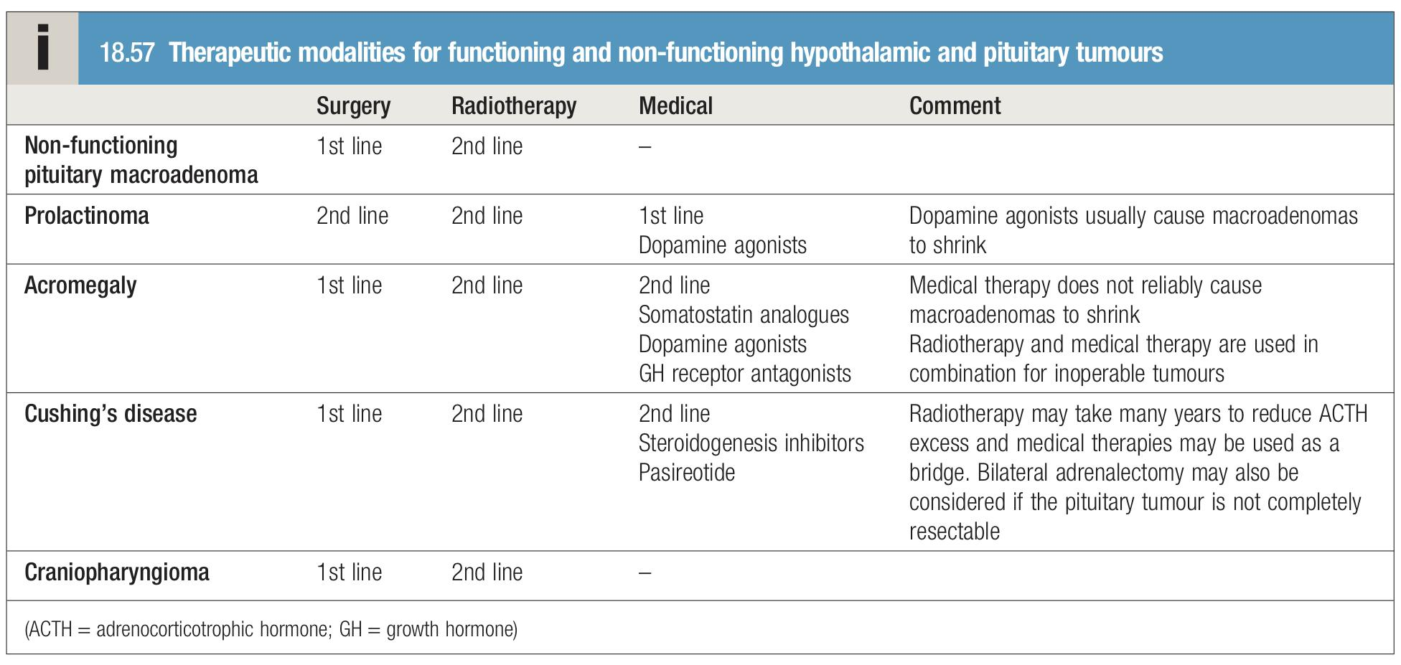
Summary
 | Anterior Pituitary Disorders | Hypothalamus & Posterior Pituitary Disorders
Hypersecretion | 1- Prolactinoma: High prolactin level . Presents with galactorrhea, decrease lipido and amenorrhea. Tx: Medically (Bromocriptine). 2- GH Secreting Adenoma: High IGF-1. Causes acromegaly (in adults), gigantism (in children). Presents with DM, facial changes, CVD and Acral enlargement. Tx: Surgery (1st line) | Syndrome Of Inappropriate Antidiuretic Hormone (SIADH): Caused by disordered hypothalamic–pituitary secretion or ectopic production of ADH. Causes low serum Na and osmolality, also high urine Na and osmolality. Tx: Treating the underlying cause and fluid restriction.
 | 3- ACTH secreting adenoma: Result in Cushing DISEASE. High cortisol, high ACH. Presents with typical cushing features. Tx: Surgery followed by radiation.
Hyposecretion | Deficiency of hypothalamic-releasing hormones or pituitary hormones Causes: (Seven I’s) Invasive: pituitary tumors. Infarction: Sheehan’s syndrome. Iatrogenic: surgery. Infiltration: Sarcoidosis, hemochromatosis. Injury: trauma. Infections: TB. Idiopathic. Tx: remove the cause and start HRT. | Diabetes insipidus: Decreased the amount of ADH. Manifest polydipsia and polyuria. Serum Na is high, ↑ urine volume, and ↓ urine osmolality. Tx: medically (Desmopressin Acetate) Synthetic analog of ADH if the cause centrally due to pituitary source.
4- Gonadotropin secreting adenomas:
Hypersecretion of FSH, which is often accompanied by hypersecretion of FSH alpha-subunit
Present with neurological symptoms
Summary of treatment
Assessment of Pituitary Function:
Baseline: TSH, FT4(T4), LH+FSH with Testosterone or Estradiol, Prolactin, GH, IGF-I ACTH, cortisol and electrolyte.
MRI of the brain + Neuro-ophthalmic for evaluation of visual field.
Cardiac and respiratory assessment with ENT for Endonasal evaluation for surgical approach.
Anesthesiologist for airway and perioperative monitoring
Neurosurgeon
Preop hormonal replacement: maybe need to be covered with stress dose of HC

Slide 18
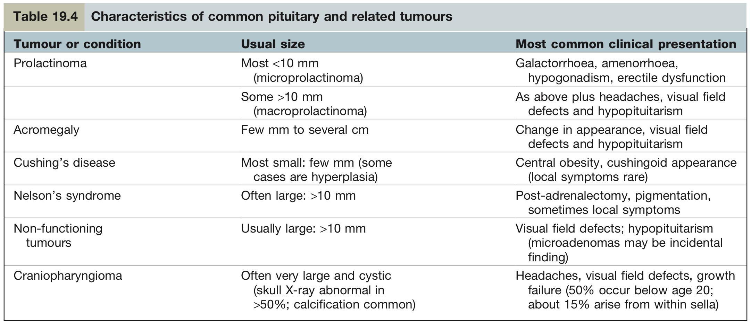
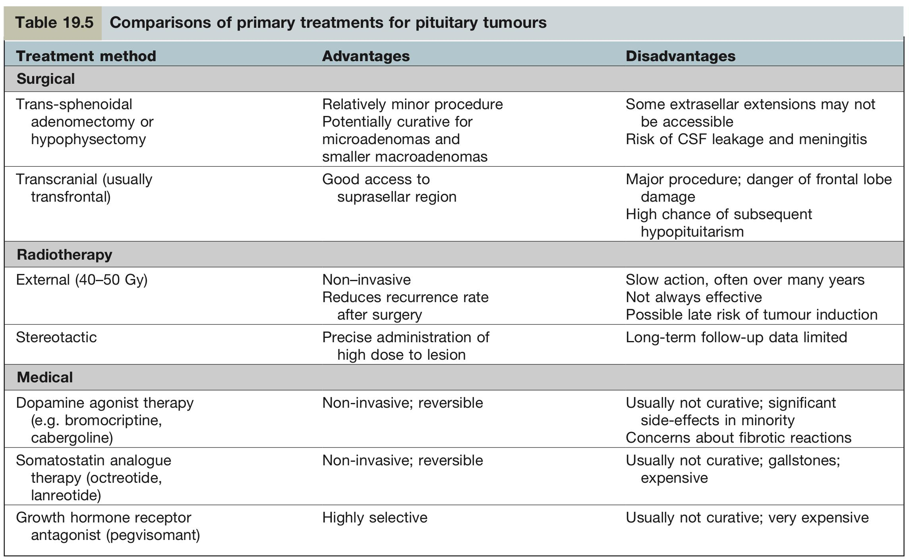
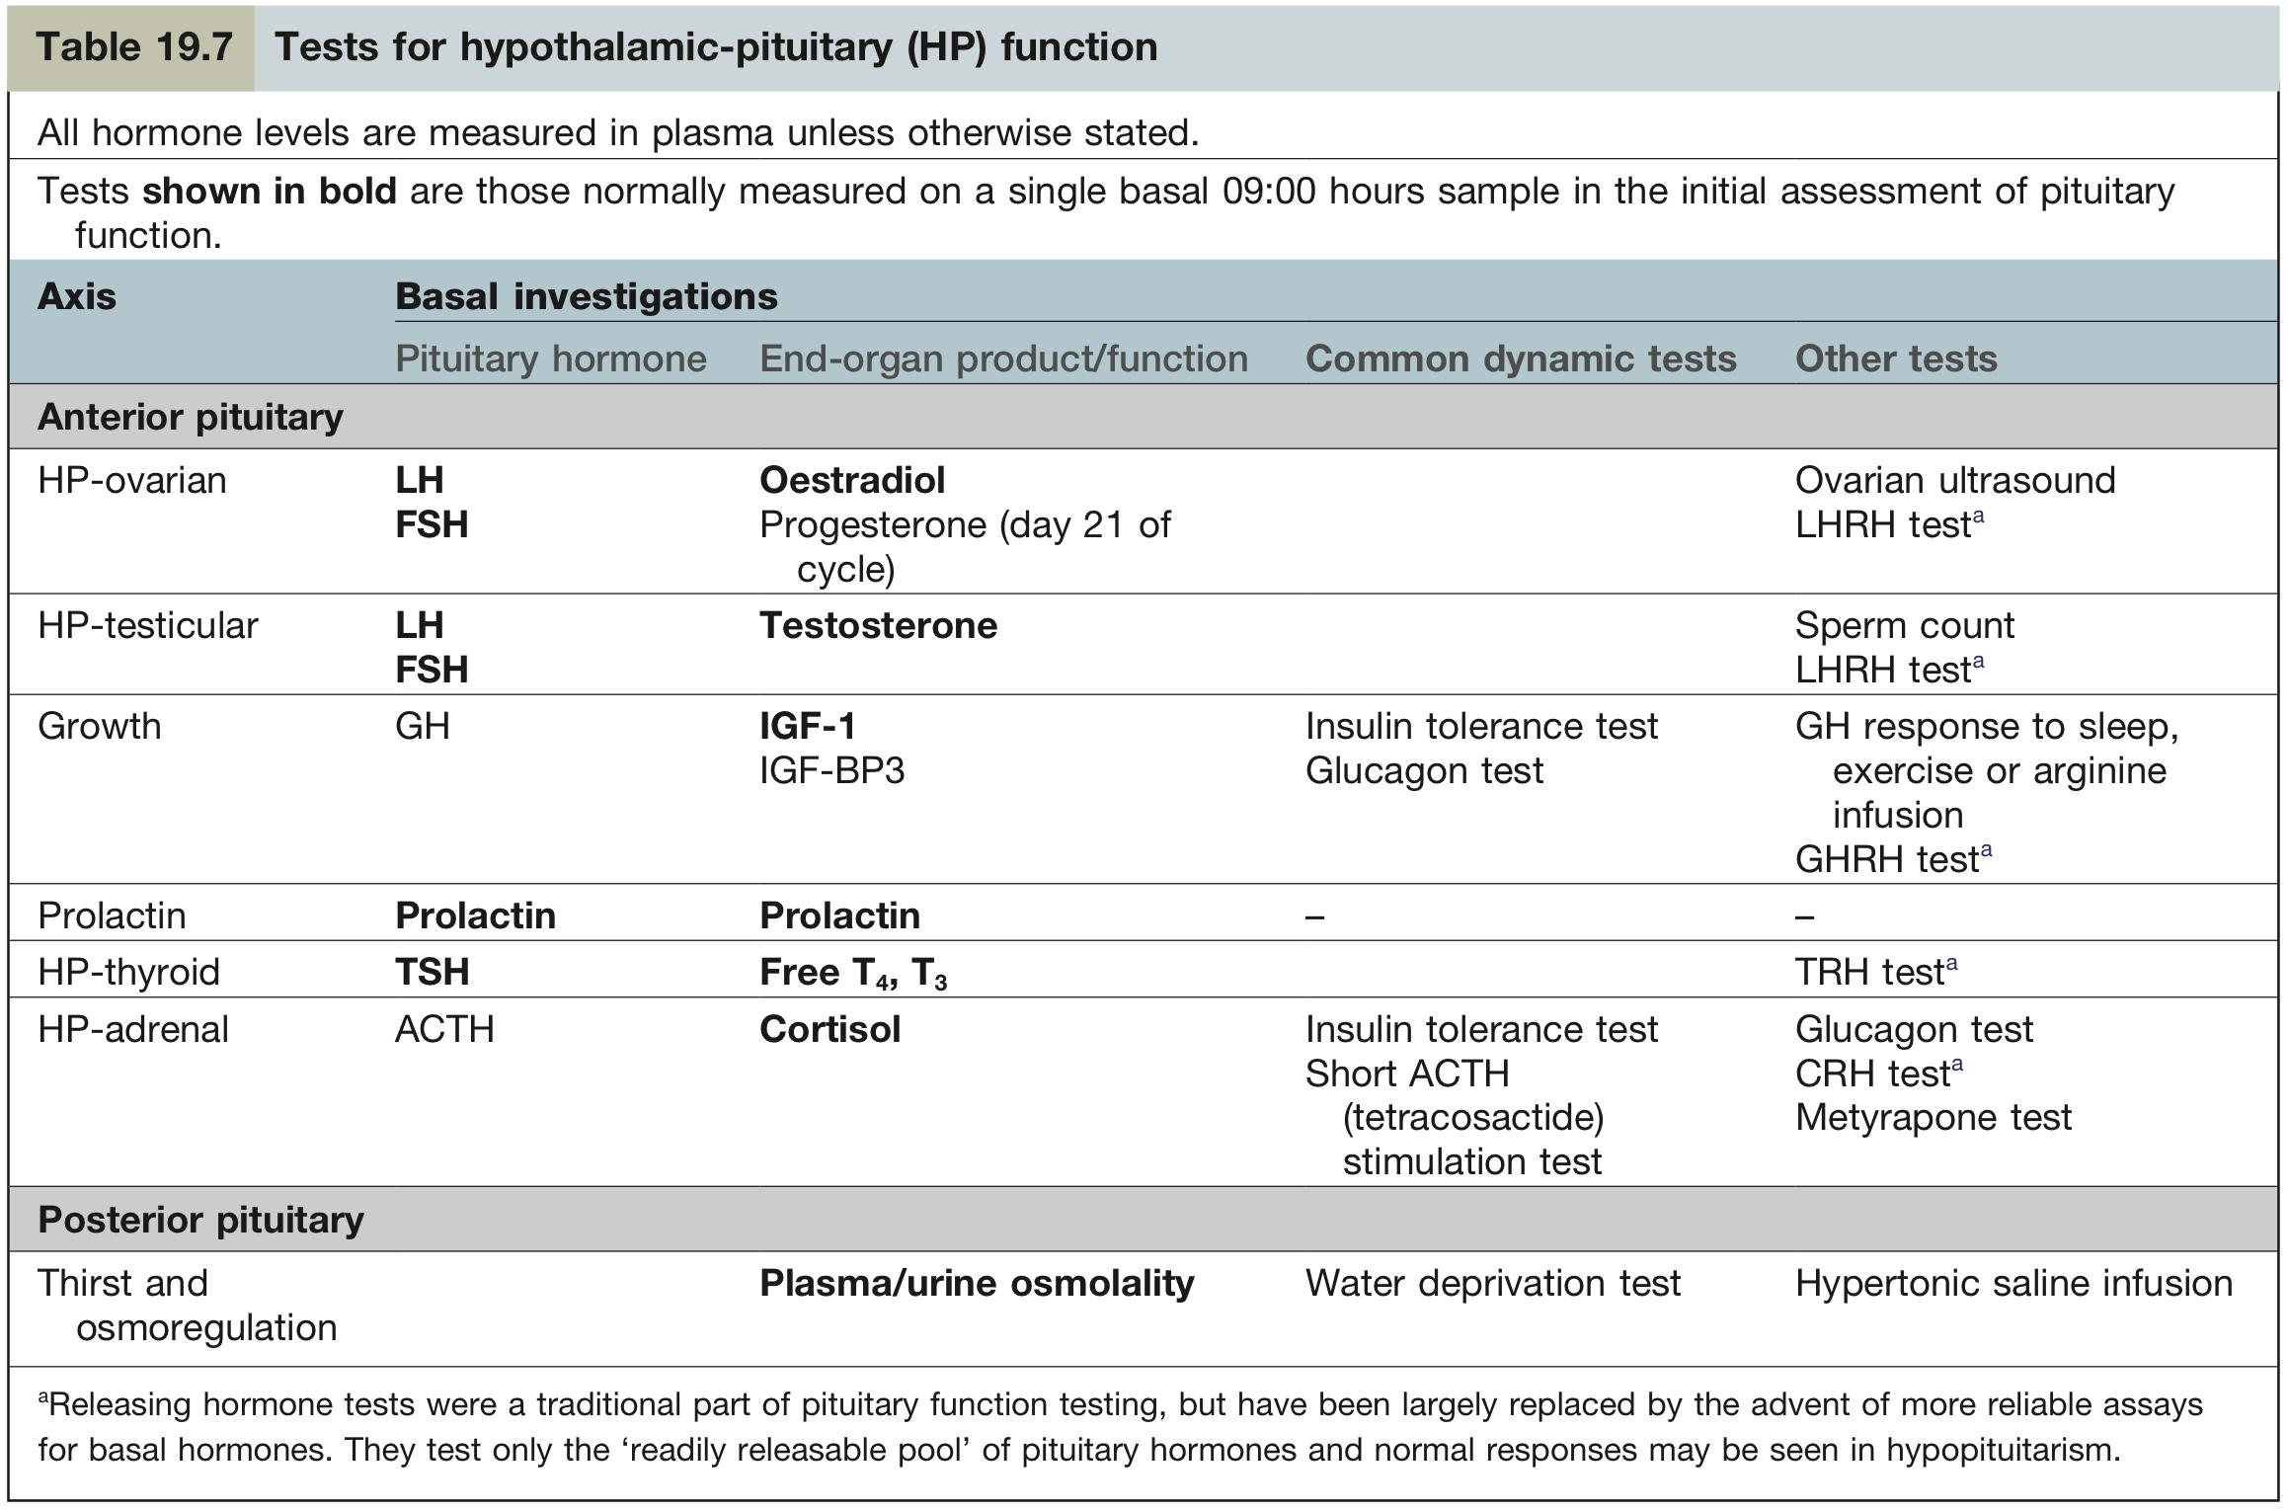
Summary from Kumar

Slide 19
Explanation
1-C: The patient appears to be suffering from cushingoid symptoms. After ahistory to exclude causes such as high-dose steroid intake, the main differential diagnoses include an adrenal tumour, an ectopic tumour producing ACTH (Cushing’s syndrome) or a pituitary tumour (Cushing’s disease). Although a 24-hour urinary free cortisol level measurement (C) does not confirm the exact diagnosis, it does indicate if there is a pathological excess of cortisol (levels can vary up to 700 nmol/L in the morning to 280 nmol/L at midnight). A low dose (0.5 mg) dexamethasone test (A) involves measuring ACTH after dexamethasone administration. In Cushing’s disease and syndrome, there is no suppression of ACTH. A high- dose dexamethasone test (B) will differentiate between Cushing’s disease and Cushing’s syndrome since only in the former is there suppressed ACTH production after high-dose dexamethasone administration. A CT scan (D) can be used to identify a pituitary tumour if requiring surgical management. Urinary catecholamine
2-Acromegaly (D) is most commonly due to a pituitary tumour, usually
identified on MRI scan. Patients most frequently present with changes in appearance followed by visual defects and headaches. Sleep apnoea, due to weight gain, is often a common complaint among patients. Other manifestations include large hands and feet, hirsutism, prominent and coarse facial features, carpal tunnel syndrome, hypertension, diabetes and heart failure, among others. The glucose tolerance test is diagnostic for suspected acromegaly, GH levels can be measured directly, although elevated findings are not sufficient for diagnosis. Hyperthyroidism (A) produces symptoms that are usually secondary to an elevation in metabolic rate, such symptoms include diarrhoea, goitre, sweating and intolerance to the temperature, whereby the patient consistently feels hot irrespective of the true environmental temperature. Sleep apnoea is not usually a complaint among patients since they often lose weight despite an increased appetite. Cushing’s disease (B) results from a pituitary tumour producing excess ACTH, excess cortisol levels result in symptoms such as striae, bruising, thin skin, weight gain, particularly abdominally, and often a dorsocervical fat pad (buffalo hump). Hypothyroidism (C) features include tiredness, depression, cold intolerance, constipation and weight gain. Patients do not tend to sweat more and the disease does not coarsen facial features.
3-Graves’ disease (B) is the most common cause of hyperthyroidism. The
condition is due to IgG antibodies binding to the TSH receptor, this in turn causes excess production of thyroid hormone. The antibodies also bind to other areas of the body such as the extraocular muscles leading to gaze abnormalities, the shins causing raised lesions known as ‘pretibial myxoedema’ and rarely the fingers causing clubbing known as ‘thyroid acropachy’. These collective signs are only seen in Graves’ disease, hence it is the only correct answer. De Quervain’s thyroiditis (A) is a transient thyroid state most likely due to a viral infection. The patient usually complains of a fever and painful neck with some signs of hyperthyroidism, such as tachycardia, as well as raised ESR levels. A few weeks later, the patient suffers from transient hypothyroid symptoms before returning to a euthyroid state. Phaeochromocytomas (C) are malignancies of the sympathetic nervous system, 90 per cent arise in the adrenal medulla and produce excess catecholamines. The symptoms of a phaeochromocytoma are often similar to hyperthyroidism and include anxiety, palpitations and headache. However, these symptoms are usually intermittent and the main risk to patients is from cardiovascular compromise.A thyroid storm or crisis (D) is a rapid deterioration in patients suffering from hyperthyroidism, often stimulated by a stressor such as infection. Patients present with acute-onset, severe tachycardia, distress and hyperpyrexia.
4-Pituitary apoplexy (C) is characterized by a sudden headache, vomiting. The cause is most commonly due to the abrupt growth of a pituitary adenoma or pituitary infarction. The headache in apoplexy is usually very abrupt and can be mistaken for a subarachnoid haemorrhage, although usually not as severe. The presentation can be unilateral or generalized. Visual defects are most commonly of the superior quadrant bitemporally. Visual disturbances, such as loss of vision and opthalmoplegia affecting cranial nerves III, IV and VI, help differentiate apoplexy from other intracranial pathology. Hypopituitarism can also follow an apoplexy although this is dependent on degree of damage and often patients present feeling very tired or nauseous. Kallman syndrome (A) is characterized by gonadotrophin deficiency and congenital anosmia. Septo-optic dysplasia (B) is a congenital disorder characterized by the triad of optic nerve hypoplasia, hypopituitarism and forebrain abnormalities. Sheehan syndrome (D) is also called postpartum hypopituitarism and is most commonly a rare complication of pregnancy. Patient’s present with agalactorrhoea, amenorrhoea and hypothyroidism after pregnancy.
5- A. Diabetes symptoms with polyuria, polydipsia and weight loss occur due to the osmotic diuresis that results from elevated blood glucose. In symptomatic patients, a single abnormal glucose reading is adequate and this may be a fasting plasma glucose ≥7.0 mmol/L or a random plasma glucose of ≥11.1 mmol/L, hence the most appropriate answer is (C) while answer (A) is most likely to occur in a patient with significant symptoms with a random plasma glucose measurement. Asymptomatic patients require two abnormal readings, such as two fasting or two random plasma glucose measurements ≥7.0 mmol/L. while answer (D) is hypoglycaemia. Answer (B) is mildly impaired fasting plasma glucose which is unlikely in a patient who is symptomatic.
6-A Left untreated, acromegaly patients succumb to cardiovascular related morbidities, such as hypertension and heart failure, as well as an increased incidence of colon cancer. Trans-sphenoidal surgery (A) is first line therapy and is particularly effective against microadenomas. Pituitary radiotherapy (D) usually follows unsuccessful surgery, it is also more useful as an adjunct to other medical treatments as response to radiotherapy alone is often slow. Octreotide (B) is a somatostatin receptor agonist which is effective in reducing growth hormone levels and are often used for short-term treatment, but are not definitively used as first-line therapy. Bromocriptine (C) is a dopamine agonist and is primarily used to reduce the size of tumours before more definitive treatment such as surgery. This is useful since high GH levels are a poor prognostic markers prior to surgery.
Q1: You see a 28-year-old woman has noticed a change in her appearance; most notably her clothes do not fit properly and are especially tight around the waist. Her face appears flushed and more rounded than usual, despite exercising regularly and eating healthily her weight has steadily increased over the last 3 weeks. On visiting her GP, he notices her blood pressure has increased since her last visit and she has bruises on her arm. She is especially worried about a brain tumour. The most appropriate investigation would be:
A- Low-dose dexamethasone test
B- High-dose dexamethasone test
C- Urinary free cortisol measurement
D- Computed tomography (CT) scan
Q2: A 38-year-old woman presents to clinic complaining of changes in her appearance and weight gain. She has recently been through a divorce and attributed her weight gain to this. However, despite going to the gym her clothes are still tight, especially around her waist, her face seems puffy and flushed. The most likely diagnosis is:
A- Hyperthyroidism
B- Cushing’s disease
C- Hypothyroidism
D- Acromegaly
Q3: A 42-year-old woman presents with visual disturbances. She reports having double vision which was intermittent initially but has now become much more frequent. In addition, she becomes breathless very easily and experiences palpitations. On examination, raised, painless lesions are observed on the front of her shins and finger clubbing. The most likely diagnosis is:
A- De Quervain’s thyroiditis
B- Graves’ disease
C- Pheochromocytoma
D- Thyroid storm
Q4: A 37-year-old man presents with symptoms of an acute headache, vomiting, malaise and visual disturbance. A neurological examination reveals a bitemporal superior quadrantanopia. A CT scan shows a hyperdense area within the pituitary gland. The most likely diagnosis is:
A. Kallmann's syndrome
B. Septo-optic dysplasia
C. Pituitary apoplexy
D. Sheehan’s syndrome
Q5: A 29-year-old man presents to his GP complaining of being constantly thirsty, tired and visiting the toilet more often than usual during the last 4 days. He has noticed his clothes have become more baggy and he now needs to tighten his belt. His parents both have diabetes requiring insulin therapy. A fasting plasma glucose result is most likely to be:
A- 16.3 mmol/L
B- 6.0 mmol/L
C- 9.0 mmol/L
D- 3.0 mmol/L
Q6: A 19-year-old woman presents with concerns about changes to her facial appearance, in particular her nose and jaw seem quite large, she is also quite sweaty and despite using antiperspirants is finding it difficult to control and is afraid of embarrassment at university. A glucose tolerance test is performed and found to be raised. The most appropriate management would be:
A. Trans-sphenoidal surgery
B. Octreotide
C. Bromocriptine
D. Pituitary radiotherapy
Answers: Q1:C | Q2:D | Q3:B | Q4:C | Q5:C | Q6:A
Answers Explanation File!

Slide 20
THANKS!!
This lecture was done by:
Khalid Alharbi
Note takers:
Raghad AlKhashan
Khalid Alharbi
Females co-leaders:
Raghad AlKhashan
Amirah Aldakhilallah
Males co-leaders:
Mashal AbaAlkhail
Nawaf Albhijan
Send us your feedback:
We are all ears!

