Slide 1
Lecture 47
Editing file
Diabetic Complications
Objectives:
Acute Diabetic Complications
Diabetic Ketoacidosis
Hyperglycemic Hyperosmolar State
Hypoglycemia
Chronic Diabetic Complications
Diabetic Retinopathy
Diabetic Nephropathy
Diabetic Neuropathy
Cardiovascular Disease
How to Screen and Prevent Diabetes Complications
Color index:
Color index:
Original text Females slides Males slides
Doctor’s notes Textbook Important Golden notes Extra

Slide 2
Introduction
Diabetes complications
Acute
Chronic
Diabetic KetoAcidosis
Diabetic Retinopathy
Hyperglycemic Hyperosmolar State
Diabetic Nephropathy
Hypoglycemia
Diabetic Neuropathy
Other Complications of Diabetes
Gastroparesis
Dental diseases
Osteoporosis
Psychological disorders
Recurrent Infections
Hearing loss
Fatty Liver Disease
more common these days
Glycated haemoglobin (HbA_{1c})
Is a measure of an individual's average blood glucose concentration over the previous 6-8 weeks. The glycation occurs as a two-step reaction,the rate at which this reaction occurs is related to the prevailing glucose concentration.HbA_{1C}, is expressed as a percentage of the normal haemoglobin or as the mmol concentration of HbA_{1C} per mol of normal haemoglobin (standardized range 4-6%; 20-42 mmol/mol).The result may be misleading if the lifespan of the red cell is altered.
How to Reduce the Risk of Diabetes Complications?
Early Diagnosis & Routine Screening Tests for complications
Maintain a good glucose control (A1C around 7%)
Maintain a good BP control (ACEI or ARB) (< 140/90)
Maintain a good control of lipid (statin) when indicated
Smoking cessation
Aspirin (The use for primary prevention is controversial and recommended only in patient with high CVD risk)
Physical activity

Slide 3
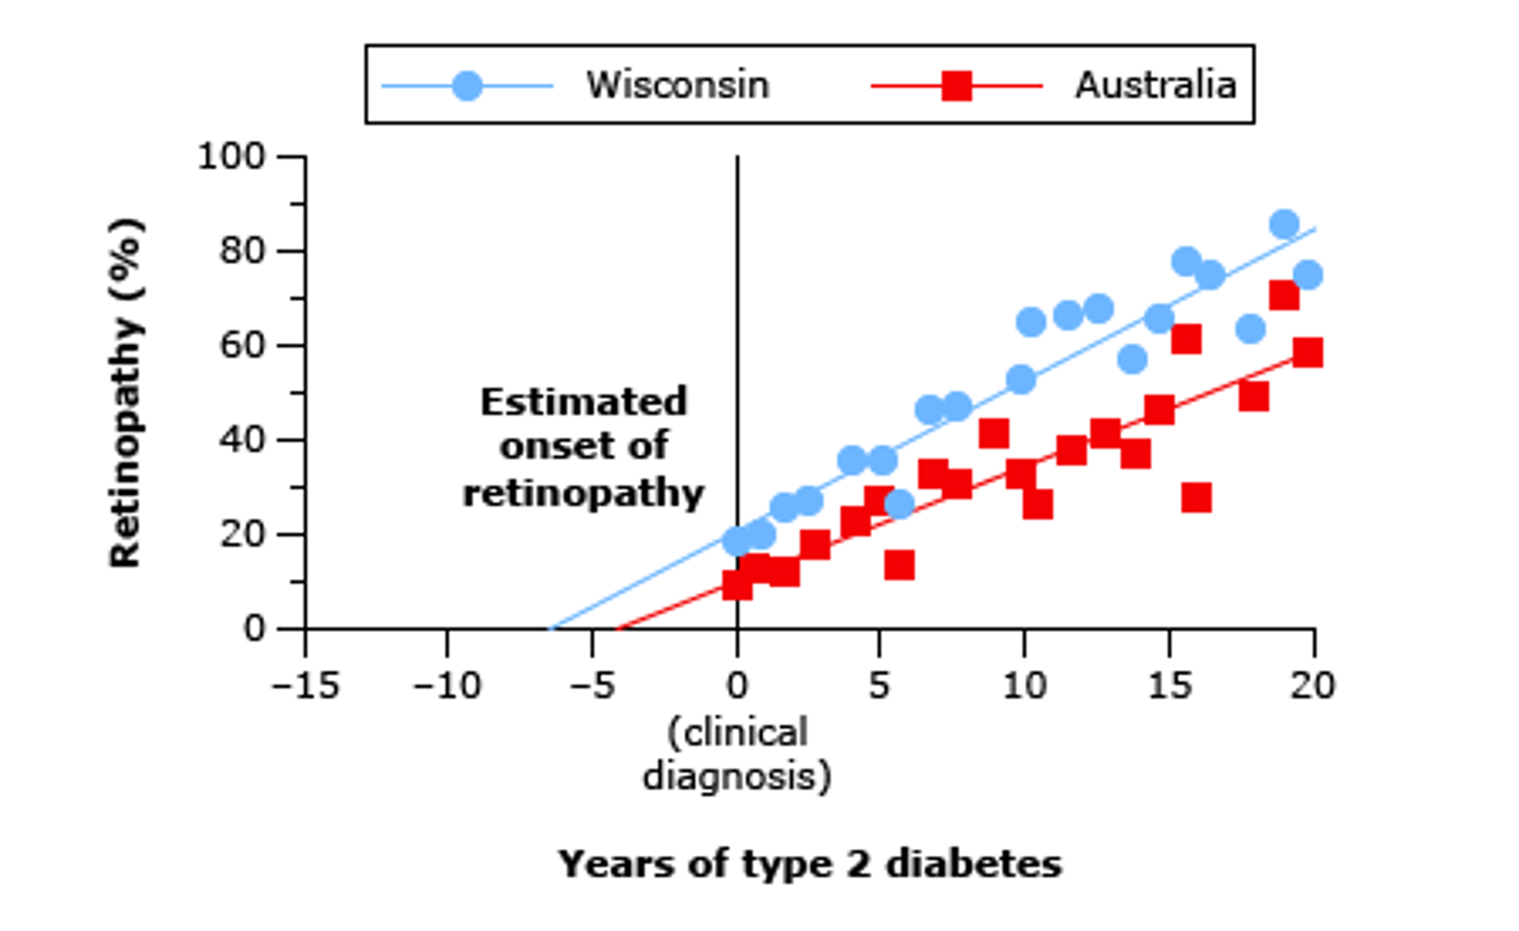
Studies about diabetes complications
UKPDS: Type 2 diabetes complications
A study done in multiple centers in UK from 1977 – 1997
Does intensive glucose control reduce risk of vascular complications?
Is there going to be a difference in the incidence of diabetes complications if we lower A1C down to 7% versus if we keep it at 8%?
Intensive glucose therapy (lowering A1C to 7%) lowered risk of:
Microvascular complications by 25% (after 15 years)
Microalbuminuria by 33% after 12 years
Any diabetes-related endpoint by 12%
There was a direct relationship between the glucose level and risk of vascular complications
So we learned from this study that Intensive glucose control is essential in lowering the risk of diabetes complications
Tight Blood Pressure control (144/82 mmHg) in patients with type 2 diabetes lowered the risk of:
Death by 32%
Stroke by 44%
Microvascular complications by 37%
Heart Failure by 56%
Retinopathy progression by 34%
Any diabetes-related endpoint by 24%
T2D: Start screening for complications at time of diagnosis: →They might have unrecognized diabetes for years thus when they are diagnosed they will have other complications(at least 10 years before diagnosis)
Yearly Dilated Eye Exam
Yearly Albumin:Cr ratio & Serum Creatinine¹
Yearly foot exam (ask the patient to examine feet, routinely)
Other screening tests if clinically indicated
T1D: (because they present early) The same but start screening 5 years after the time of diagnosis
DCCT: Type 1 Diabetes & Complications
Similar to UKPDS but in patients with T1D
Would glucose control ameliorate the long-term complications of diabetes?
Chronic Complications of Diabetes (T1D)
1. The urine of all people with diabetes should be checked regularly for the presence of microalbuminuria. The albumin : creatinine ratio is less than 2.5mg/mmol in healthy men and less than 3.5 mg/mmol in healthy women. If microalbuminuria is detected, the test should be repeated twice because false-positive readings are common.

Slide 4
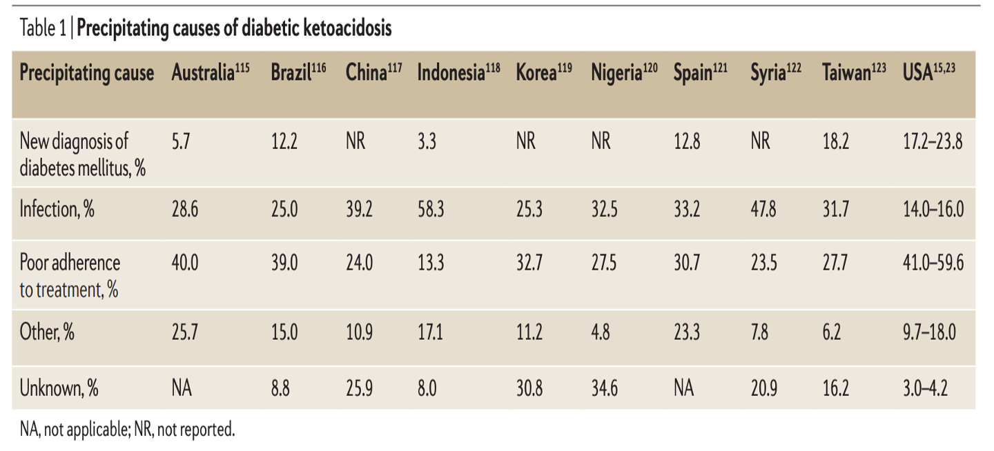
Diabetic Ketoacidosis
1
Diabetic Ketoacidosis (DKA)
Status of metabolic acidosis due to absolute (or relative) insulin deficiency in association with increased levels of glucagon and other counter-regulatory hormones resulting in increased ketone production.
Mostly occurs in people with type 1 diabetes but may occasionally present in people with type 2 diabetes
It occurs more frequently in younger people but the mortality is higher in older people
Precipitating Causes of DKA
It is usually seen in the following circumstances:
Previously undiagnosed diabetes
Non compliance with insulin therapy
The most common
The stress of intercurrent illness and infection
Drugs: Corticosteroids, sympathomimetics, atypical anti-psychotics, SGLT-2 inhibitors
Pathophysiology of DKA
Severe Insulin deficiency¹ & Increased glucagon
Increased activity of the hormone-sensitive lipase in adipose tissue
Triglycerides → glycerol & fatty acids (Liver) accumulate in the liver
increased glucose production in the liver
Decreased glucose uptake in muscles
Severe Insulin deficiency
& Increased glucagon
In the liver:
Free fatty acids→ Ketones²
Hyperglycemia
Metabolic Acidosis
Glucosuria &
osmotic diuresis
Altered mental status
Kussmaul Breathing
Shock
Polyuria
Polydipsia
Hypovolemia
Weight loss
1. Marked insulin deficiency is a necessary precondition for DKA since very little insulin is needed to inhibit hepatic ketogenesis and the breakdown of adipose triglycerides to non-esterified fatty acids (NEFAs).
2-The most important biochemical abnormality in is the uncontrolled lipolysis due to increased activity of hormone-sensitive lipase in adipose tissue and uncontrolled ketogenesis in the liver.

Slide 5
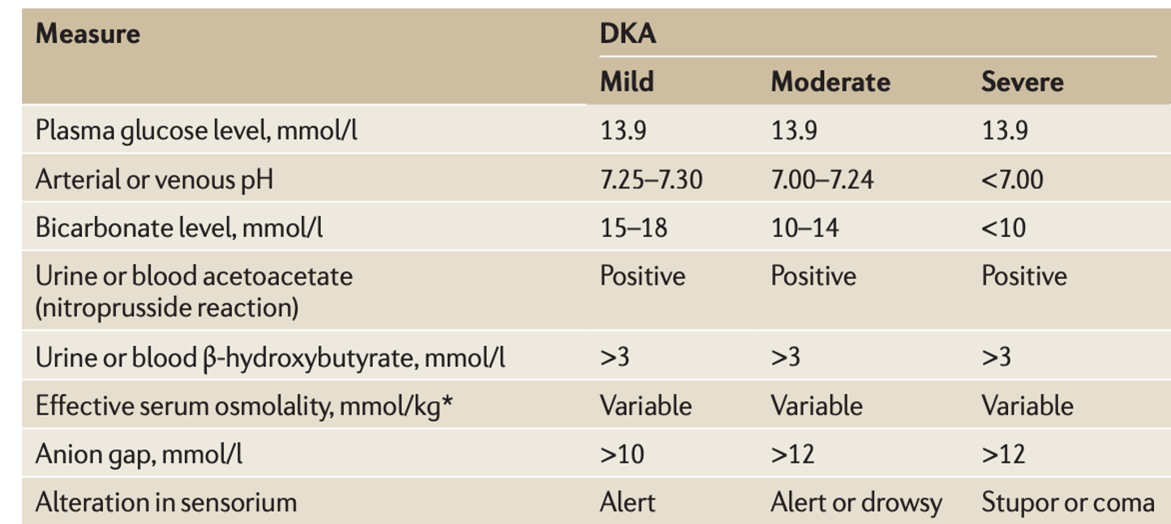
DKA
The features of ketoacidosis are those of uncontrolled diabetes with acidosis.
Polyuria |  | Polydipsia
weight loss |  | abdominal pain
hypothermia¹ |  | change in mental status¹
Nausea and Vomiting: Ketone bodies are nauseating and many people will vomit, worsening the dehydration and electrolyte loss further. |  | Deep labored breathing(Kussmaul respiration¹ ) Although hyperventilation may be present, it becomes less marked in very severe acidosis, owing to respiratory depression.
Dehydration ¹:Occurs during ketoacidosis as a consequence of two parallel processes. Hyperglycemia results in osmotic diuresis, and hyperketonemia results in acidosis and vomiting. Renal hypoperfusion then occurs and a vicious circle is established as the kidney becomes less able to compensate. |  | Odur: The excess ketones are excreted in the urine but also appear in the breath, producing a distinctive smell similar to that of acetone. Smell of ketones on the breath allows an instant diagnosis to be made by those able to detect the odour.
1.In severe cases
Clinical Features of DKA
1
2
3
Polyuria
Polydipsia
Weight loss
4
5
6
abdominal pain
Hypothermia¹
change in mental status¹
7
8
Nausea and Vomiting
Ketone bodies are nauseating and many people will vomit, worsening the dehydration and electrolyte loss further.
Deep labored breathing
(Kussmaul respiration¹ )
Although hyperventilation may be present, it becomes less marked in very severe acidosis, owing to respiratory depression.
9
10
Dehydration ¹
Occurs during ketoacidosis as a consequence of two parallel processes.
Hyperglycemia results in osmotic diuresis, and hyperketonemia results in acidosis and vomiting.
Renal hypoperfusion then occurs and a vicious circle is established as the kidney becomes less able to compensate.
Odur
The excess ketones are excreted in the urine but also appear in the breath, producing a distinctive smell similar to that of acetone. Smell of ketones on the breath allows an instant diagnosis to be made by those able to detect the odour.
Laboratory Findings in DKA
Hyperglycemia >250mg/dL + Hyperketonemia (or heavy ketonuria) +High anion gap (> 12 mmol\l) metabolic acidosis<18mEq/L
Other investigations:
ECG: Cardiac rhythm should be monitored in severe DKA because of the risk of electrolyte-induced cardiac arrhythmia.
Infection screen: full blood count, blood and urine culture, C-reactive protein, chest X-ray. Although leucocytosis invariably occurs in DKA, this represents a stress response and does not necessarily indicate infection.
Blood electrolytes should be assessed as potassium abnormalities occur frequently (will be discussed in another slide)
Based on the laboratory findings you can classify the cases into : mild, moderate or severe
1.In severe cases

Slide 6
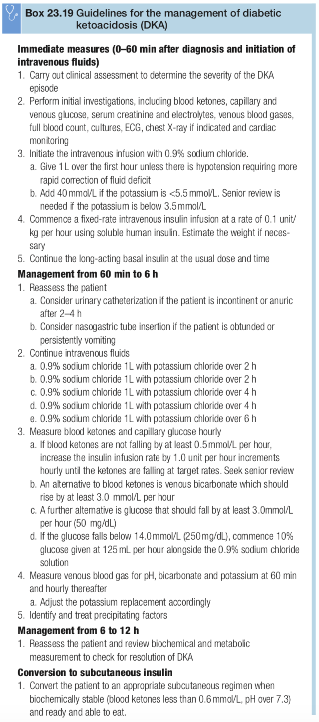
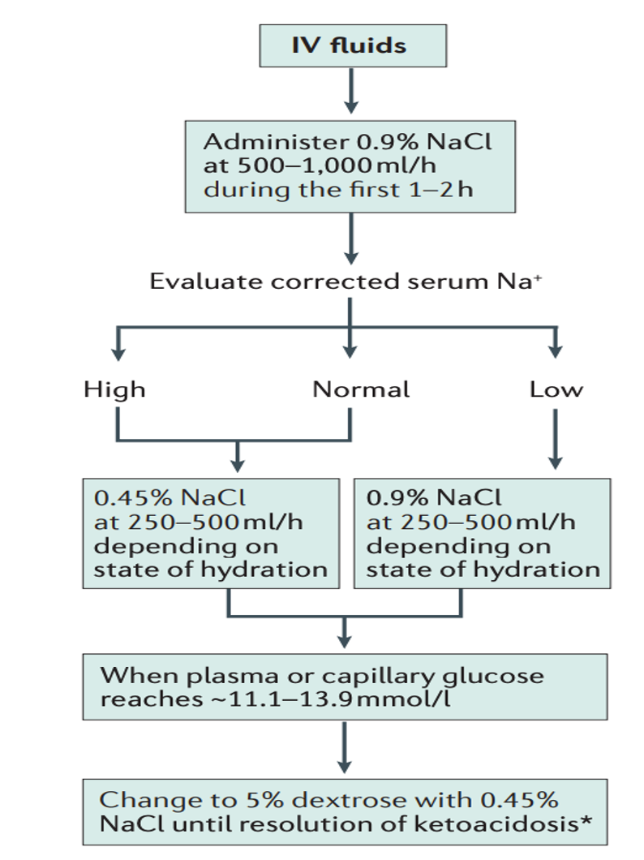
DKA
Management of DKA
Management
Replacement of the fluid losses
The replacement fluid of choice is 0.9% sodium chloride but Hartmann's solution is an acceptable alternative (potassium cannot added to Hartmann's solution).
The aim of the first few litres of fluid is to correct any hypotension, replenish the intravascular deficit, and counteract the effects of the osmotic diuresis with correction of the electrolyte disturbance. Over-rapid fluid replace- may lead to cerebral oedema. The rate and volume of fluid replacement need to be modified in older people and in those with renal or heart failure.
Replacement of the electrolyte losses
After the initiation of treatment with insulin, potassium levels can fall rapidly as insulin promotes potassium uptake by the cells. Commercially, 0.9% sodium chloride is available with premixed potassium chloride mmol/L (0.3%) allowing the potassium to be replaced safely.
Hypokalaemia and hyperkalaemia are potentially life-threatening conditions during the management of DKA and so potassium levels should be monitored frequently.
Hyperchloraemic acidosis may develop during treatment since large variety of negatively charged electrolytes are lost in DKA, which are replaced with chloride.
Restoration of the acid-base balance
In most cases, once the circulating volume is restored, the metabolic acidosis will rapidly compensate. Bicarbonate is seldom indicated because it is implicated in the development of cerebral oedema and may cause a paradoxical increase in CSF acidosis. It is used only if the pH is <7.0 ([H*] >100 nmol/L).
Insulin replacement
Insulin should be given by an intravenous infusion using a fixed rate 0.1 units/kg per hour (typically 6-10 units per hour). This modest insulin dose is sufficient to suppress ketogenesis, lower the glucose and correct the electrolyte disturbance.
As the intravenous insulin should be continued until the keto- sis has resolved, intravenous glucose alongside the 0.9% sodium chloride is often needed to prevent hypoglycaemia; 10% glucose is recommended once the blood glucose falls below 14.0mmol/L (250 mg/dL) and should be continued until the person is eating and drinking normally.
Seeking the underlying cause
Physical examination may reveal a source of infection.
Two common markers of infection are misleading: fever is unusual, even when infection is present; and polymorpholeucocytosis is present, even in the absence of infection.
Relevant investigations include a chest X-ray, urine and blood cultures, and an electrocardiogram (to exclude myocardial infarction).
If infection is suspected, broad-spectrum anti- biotics are started once the appropriate cultures have been taken.
Other measures
if no urine is passed within 2-4 hours of admission, the insertion of a urinary catheter should be considered.
The dehydration, increased blood viscosity and coagulability DKA increase the risk of a potentially fatal thromboembolism and so thromboprophylaxis with low-molecular-weight heparin should be considered in older or high-risk individuals unless contraindicated.
Aggressive rehydration + Lowering glucose + Cessation of ketogenesis + Correcting electrolyte imbalances.
Most patients with DKA are treated in ICU, it is associated with increased mortality.
The aim of treatment:
lower the blood ketone concentration by 0.5 mmol/L per hour
increase the venous bicarbonate by 3.0 mmol/L per hour
reduce capillary blood glucose by 3.0 mmol/L per hour (50mg/dL per hour)
Maintaining potassium between 4.0 and 5.5mmol/L.
1
1
Rehydration
IVF is the most critical step.
Water deficit is ~ 100ml/kg of body weight equivalent to 7.5 litres in a 75kg adult. Considered a large deficit.
Isotonic saline (0.9% sodium chloride) @ 500-1000 ml/hr during the 1st 2-4 h, Followed by isotonic saline 250—500 ml/h.
Once the plasma glucose is ~250 mg/dl, switch IVF to D5% IVF. If the plasma sodium is greater than 155 mmol/L, 0.45% saline may be used initially.
Hartmann's solution is an acceptable alternative,(potassium cannot added to Hartmann's solution).
The aim of the first few litres of fluid is to correct any hypotension, replenish the intravascular deficit, and counteract the effects of the osmotic diuresis with correction of the electrolyte disturbance.
Over-rapid fluid replace- may lead to cerebral oedema. The rate and volume of fluid replacement need to be modified in older people and in those with renal or heart failure.
2
3
Start with normal saline and after 1-2 hours evaluate serum NA⁺
low? continue with normal saline.
High or normal? shift to half normal saline.
In both cases continue IVF until the blood glucose reaches 250 mg/dL, now change to 5% dextrose with half normal saline as maintenance fluid .
We don’t want to overcorrect hyperglycemia and cause hypoglycemia.

Slide 7
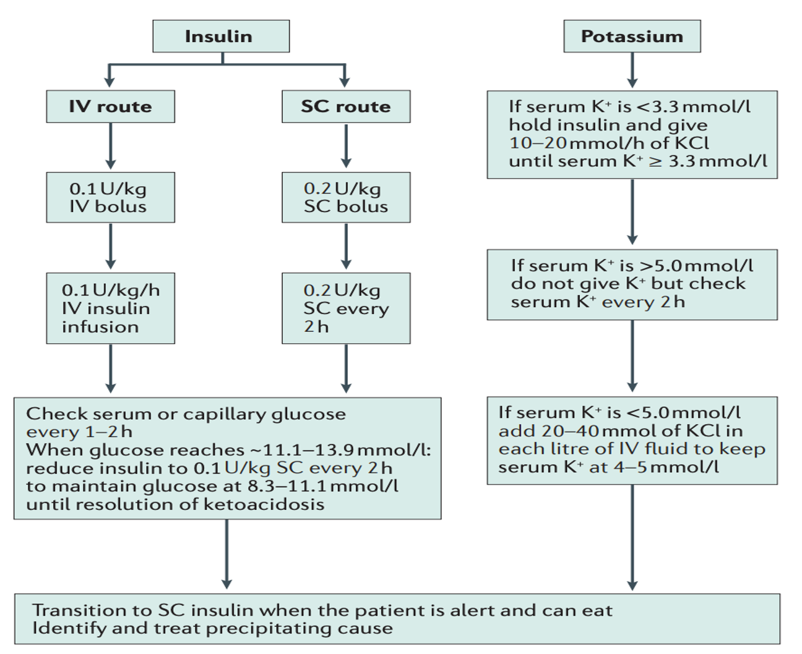
DKA
Management of DKA (cont)
2
Insulin
Insulin is the next step after IVF
Reduces serum glucose, suppresses ketogenesis, and correct the electrolyte disturbance.
Most of the time: we use IV insulin infusion
Mild DKA can be treated with subcutaneous insulin (rarely)
Most protocols: IV insulin bolus → 0.1 unit/kg/hour
Followed by: IV insulin infusion → 0.1 unit/kg/h
A rapid decrease in blood glucose should be avoided, as this might precipitate hypoglycaemia and the serious complication of cerebral oedema, particularly in children.
Failure of blood glucose to fall within 1 hour of commencing insulin infusion should lead to a re-assessment of insulin dose.
Should be continued until the ketosis has resolved.
Once the person is able to eat and keep food down,
subcutaneous insulin treatment should be resumed or
initiated.
We add k to the IV fluid even when serum k is normal (it should be high due to the shifting so don’t miss this!) (it is not a reflection of total body k). Because when we give them insulin the levels may drop.
3
Electrolytes
DKA is associated with total-body K+ deficit
Serum K+ is often normal or high (do not get fooled!) .
K+ Shift from intracellular to extracellular compartment with acidosis (serum K+ looks falsely normal). Metabolic acidosis causes hyperkalaemia as potassium is exchanged for hydrogen ions moving into the cell. As insulin promotes the co-transport of potassium along with glucose into cells. Although serum potassium may be elevated, there is a severe whole-body potassium deficiency as significant quantities of potassium are lost in vomit and urine.
Insulin therapy moves K+ back into the cells (watch for a drop in K+).
After the initiation of treatment with insulin, potassium levels can fall rapidly. So commercially, 0.9% sodium chloride is available with premixed potassium chloride (40mmol/L (0.3%) allowing the potassium to be replaced safely.
We add k to the IV fluid even when serum k is normal (it should be high due to the shifting so don’t miss this!) as it is not a reflection of total body k.
K+ replacement starts early (when K+ is normal), and the rate of K infusion depends on K+ level and eGFR.
Phosphate replacement is almost never required
Hyperchloraemic acidosis may develop during treatment since a large variety of negatively charged electrolytes are lost in DKA, which are replaced with chloride.

Slide 8
DKA
Management of DKA
4
Restoration of the acid-base balance
Consider bicarbonate infusion if pH <7
In most cases, once the circulating volume is restored, the metabolic acidosis will rapidly compensate. Bicarbonate is seldom indicated because it is implicated in the development of cerebral oedema and may cause a paradoxical increase in CSF acidosis.
5
Seeking the underlying cause
Physical examination may reveal a source of infection.
Two common markers of infection are misleading:
fever is unusual: even when infection is present
polymorpholeucocytosis is present: even in the absence of infection.
Relevant investigations include a chest X-ray, urine and blood cultures, and an electrocardiogram (to exclude myocardial infarction).
If infection is suspected, broad-spectrum antibiotics are started once the appropriate cultures have been taken.
6
Other measures
it is unlikely that they will pass urine for several hours after the initiation of fluid replacement. However, if no urine is passed within 2–4 hours of admission, the insertion of a urinary catheter should be considered.
Dehydration, increased blood viscosity and coagulability of DKA increase the risk of a potentially fatal thromboembolism and so thromboprophylaxis with low-molecular-weight heparin should be considered in older or high-risk individuals unless contraindicated.
Hyperglycemic Hyperosmolar State
2
Hyperglycemic Hyperosmolar State (HHS)
Status of severe hyperglycemia due to insulin resistance (not absolute insulin deficiency) & relative insulin deficiency resulting in increased serum osmolality.
Severe hyperglycemia develops without significant ketosis, is the characteristic metabolic emergency of uncontrolled type 2 diabetes.
Although typically occurring in older patients, HHS is increasingly seen in younger adults.
People present in middle or later life, often with previously undiagnosed diabetes.
Precipitating factors include consumption of glucose-rich fluids, concurrent medication such as thiazide diuretics or steroids.
Evidence of underlying illness, such as pneumonia or pyelonephritis, may be present.

Slide 9
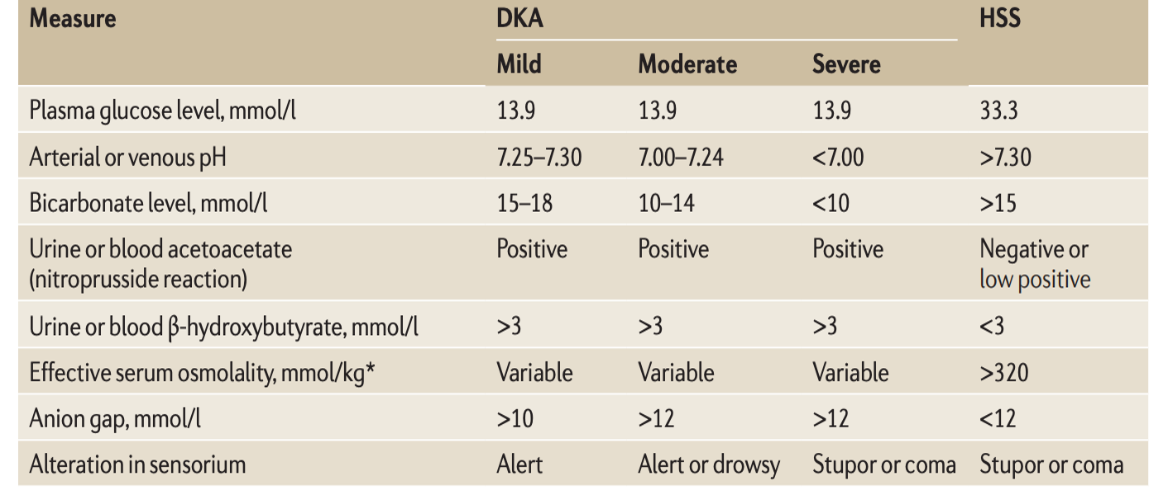
the most important aspect of management is luid replacement; 0.9% sodium chloride is the treatment of choice, but 0.45% sodium chloride may be considered if the osmolality is not declining despite adequate luid balance. The rate of fall of plasma sodium should not exceed 10 mmol/L in 24 hours because the resultant change in osmolality may cause cerebral damage.
Fluid replacement is often enough to lower the glucose but insu-
lin (0.05 units/kg per hour) should be used if the glucose is no longer falling with luids alone or if the patient develops signiicant keto-
naemia, when the diagnosis should be reconsidered. Many patients are extremely sensitive to insulin and the glucose concentration may fall rapidly with the initiation of insulin. In order to prevent cerebral damage, the fall in blood glucose should be no more than 5 mmol/L per hour (90 mg/dL per hour).
Prophylactic low- molecular- weight heparin should be given.
HHS
hyperglycemic hyperosmolar state:
severe hyperglycaemia develops without significant ketosis, is the characteristic metabolic emergency of uncontrolled type 2 diabetes.✅
Although typically occurring in older patients, HHS is increasingly seen in younger adults.✅
People present in middle or later life, often with previously undiagnosed diabetes.✅
precipitating factors include consumption of glucose-rich fluids, concurrent medication such as thiazide diuretics or steroids.✅
ketogenesis is minimal because small amount of insulin is released to blunt counterregulatory hormone release (glucagon) and thus ketones are not produced in excess as they are in DKA✅
The biochemical differences may partly be explained as follows:✅
Age. Old people experience thirst less acutely and become dehydrated more readily. In addition, the mild renal impairment associated with age results in increased urinary losses of fluid and electrolytes.
The degree of insulin deficiency. This is less severe in the hyperosmolar hyperglycaemic state. Endogenous insulin levels are suficient to inhibit hepatic ketogenesis but insuficient to inhibit hepatic glucose production.
clinical feature: ✅
G
Evidence of underlying illness, such as pneumonia or pyelonephritis, may be present,
investigation:
hypovolaemia
severe hyperglycaemia (> 30 mmol/L (600 mg/dL))
hyperosmolality (serum osmolality >320 mOsmol/kg)
without significant ketonaemia (<3 mmol/L) or acidosis (pH >7.3 (H+ <50 nmol/L), bicarbonate >15 mmol/L).
glycosuria, leading to an osmotic diuresis with loss of water, sodium, potassium and other electrolytes..
How HHS differs from DKA?
~ 10 times higher mortality than DKA
Slower development (over several days)
No ketosis or minimal ketosis
The degree of insulin deficiency is less severe. Endogenous insulin levels are sufficient to inhibit hepatic ketogenesis but insufficient to inhibit hepatic glucose production.
Higher serum glucose level than DKA
More severe dehydration & higher plasma osmolality than DKA
Old people experience thirst less acutely and become dehydrated more readily.
In addition, the mild renal impairment associated with age results in increased urinary losses of fluid and electrolytes.
Gradual worsening of polydipsia, polyuria, & weight loss
Impaired consciousness is more common than DKA
Dehydration, and stupor or coma. Impaired consciousness is directly related
to the degree of hyperosmolality
Pathophysiology of HHS
Results from relative insulin deficiency (there is some detectable insulin)
Less activation of the hormone-sensitive lipase in adipose tissues & less free fatty acid production compared to DKA
No ketones production but higher serum glucose than in those with DKA
Severe dehydration and plasma hyperosmolality lead to impaired consciousness
Laboratory Findings in HHS
Severe hyperglycemia (> 30 mmol/L (600 mg/dL)
Hyperosmolality (serum osmolality >320 mOsmol/kg)
Without significant ketonaemia (<3 mmol/L) or acidosis (pH >7.3 (H+ <50 nmol/L), bicarbonate >15 mmol/L)
Glycosuria, leading to an osmotic diuresis with loss of water, sodium, potassium and other electrolytes
Hypovolemia
normal
Frank pus is termed empyema
high
1
2
blood is haemothorax
3
chyle is a chylothorax following trauma or infiltration by carcinoma.

Slide 10
HHS
Management of HHS
Management of HHS is similar to that of DKA
The aims are to normalise osmolality, replace fluid and electrolyte losses, and normalise blood glucose, at the same time as preventing complications such as arterial or venous thrombosis, cerebral oedema and central pontine demyelinosis.
Historically management of HHS has followed DKA guidelines, but increasing recognition of the differences between HHS and DKA has led to new approaches in HHS.
The most important aspect of management is fluid replacement; 0.9% sodium chloride is the treatment of choice, but 0.45% sodium chloride may be considered if the osmolality is not declining despite adequate fluid balance.
The rate of fall of plasma sodium should not exceed 10mmol/L in 24 hours because the resultant change in osmolality may cause cerebral damage.
Fluid replacement is often enough to lower the glucose but insulin (0.05 units/kg per hour) should be used if the glucose is no longer falling with fluids alone or if the patient develops significant ketonaemia, when the diagnosis should be reconsidered.
In order to prevent cerebral damage, the fall in blood glucose should be no more than 5 mmol/L per hour (90 mg/dL per hour)
Prophylactic low-molecular-weight heparin should be given.
Hypoglycemia
3
Hypoglycemia
Plasma glucose <3.9 mmol/L (<70 mg/dl)
Severe hypoglycemia: need for assistance from another person to correct glucose
Most frequent & serious adverse effect of glucose-lowering therapies
What is the most common adverse effect of insulin therapy ? Hypoglycemia.
Mainly due to Insulin & less frequently sulfonylureas.
Uncommon in people without diabetes but relatively frequent in people with diabetes
Hypoglycemia in a patient with diabetes is almost always due to glucose-lowering therapies
Major barrier to achieving desirable glucose control
Occurs in 30-40% of patients with T1DM
Occurs in 10-30% of patients with insulin-treated T2D

Slide 11
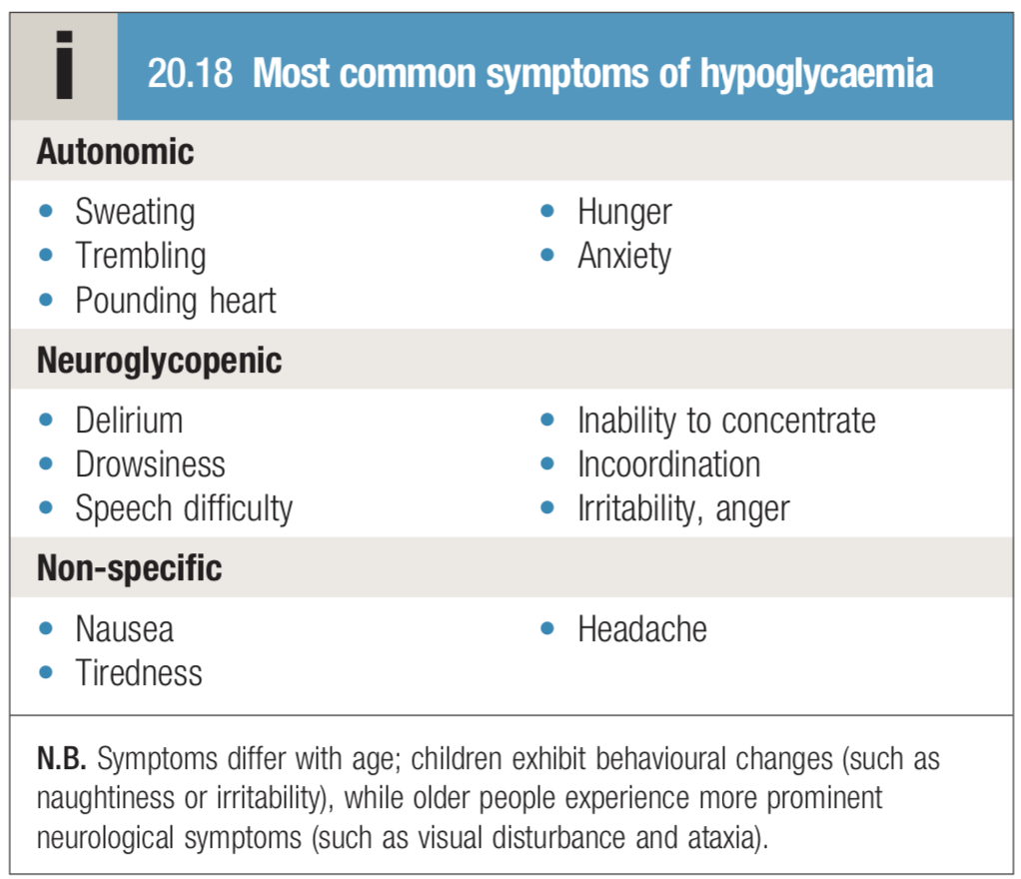
Hypoglycemia
Clinical features
‏Box 2 Factors contributing to hypoglycaemia
Symptoms of hypoglycaemia are idiosyncratic, differing with age and duration of diabetes,and also depending on the circumstances in which hypoglycemia occurs.
They comprise two main group:
those related to acute activation of the autonomic nervous system
those secondary to glucose deprivation of the brain (neuroglycopenia).
Hypoglycemia also affects mood, inducing a state of increased tension and low energy.
Factors contributing to hypoglycaemia
Insufficient patient education
Medications ( insulin , sulfonylureas , glinides , quinolones
Aggressive treatment protocols targeting normoglycaemia
Poor coordination of insulin administration and food delivery
Abrupt changes in nutritional intake
Abrupt discontinuation of parenteral or enteral nutrition among insulin - treated patients
Decline in renal or hepatic function
Severe illness
Tapering of steroid doses without appropriate reductions in insulin
Inappropriate insulin dosing
Counter - regulatory hormone deficiencies
Impaired awareness of hypoglycaemia
Dementia
Age > 65 years
Sepsis
Treatment: (Rule of 15)
Give 15 grams of carbohydrates
4 glucose tablets
½ cup of fruit juice or regular soda
1 tablespoon of sugar or honey
Oral carbohydrate usually suffices if hypoglycemia is recognised early. If parenteral therapy is required, then as soon as the patient is able to swallow, glucose should be given orally.
Wait 15 minutes and re-check glucose
Repeat the same if glucose is still less than 70 mg/dl
If glucose is above 70 mg/dl, have the patient eat a regular meal
or a snack that contains protein (e.g. nuts, cheese, chicken, meat, etc)
Remember, the patient should not be driving with hypoglycemia or (within 1 hour after treating hypoglycemia)

Slide 12
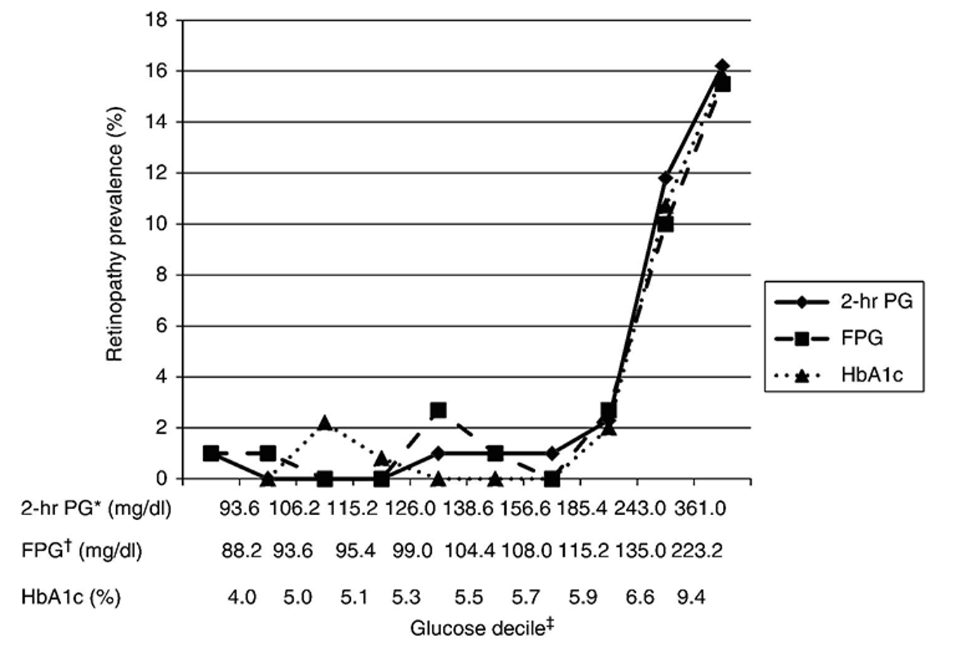
Chronic Diabetic Complications
Micro-: Retinopathy, Neuropathy, and Nephropathy.
Macro-: Ischemic Heart Disease (IHD),Cerebrovascular events, Peripheral Vascular Disease (PVD)
Mortality
Complications of Type 2 Diabetes:
Diabetes is the leading cause of: Blindness, Renal failure, and Non-traumatic lower extremity amputation
The presence of DM complication tremendously increases medical care cost
Usually present after long period of hyperglycemia
Fortunately, they can be delayed/prevented by early DM detection and better glucose control
The definition of Diabetes is based on risk of Retinopathy
a.
Complications of Type 2 Diabetes:
Diabetic retinopathy
2. Some of these new vessels are inside the retina and give the appearance of intraretinal microvascular abnormalities (IRMAs), sometimes vessels induced to grow on the pupil margin (rubeosis) and give rise to a rapid increase in intraocular pressure (rubeotic glaucoma).
Retinopathy
Most commonly diagnosed diabetes-related complication, prevalence increases with the duration of diabetes
Approximately 20% of people with type 1 diabetes will have retinal changes after 10 years, rising to 90% after 20 years ; 20–30% of people with type 2 diabetes have retinopathy at diagnosis.
Non-proliferative (earliest change) | Usually appears in the 1st decade of the disease or early 2nd decade. Characterized by retinal vascular microaneurysms, blot hemorrhage, and cotton-wool spots
Proliferative | Hypoxemia & neovascularization leading to virtuous hemorrhage, fibrosis, and retinal detachment Some of these new vessels are inside the retina and give the appearance of intraretinal microvascular abnormalities (IRMAs), sometimes vessels induced to grow on the pupil margin (rubeosis) and give rise to a rapid increase in intraocular pressure (rubeotic glaucoma).
Macular edema | can occur in non proliferative or proliferative stage

Slide 13
Retinopathy
Other ways in which DM can affect the eye:
Cataract: caused by the denaturation of the protein and other components of the lens of the eye, which renders it opaque.
Refractory defects: result of osmotic changes within the lens (the absorption of water into the lens causes temporary hypermetropia). This presents as fluctuating difficulty in reading but people should be reassured that this resolves with better metabolic control of the diabetes.
External ocular palsies
Glaucoma: open angle glaucoma
Blindness
Treatment of Diabetic Retinopathy
Prevention (most effective treatment) → easier than treating
Glycemic & BP control will slow the progression
Laser Photocoagulation
Ocular injection (Anti-VEGF therapy for macular edema)
Yearly Screening (Dilated Eye Exam) for all patients
laser photocoagulation
To treat new vessels of proliferative retinopathy
Although laser treatment prevents blindness, the main adverse effects result from the destruction of retinal tissue. The visual field becomes permanently smaller and there is reduced dark adaptation. In essence, peripheral vision is sacrificed to maintain central vision.
Vitreoretinal surgery
used if bleeding is recurrent and preventing laser therapy.
It is also employed to try to salvage some vision if an intravitreal haemorrhage fails to clear and to treat fibrotic traction retinal detachment in advanced retinopathy.
ocular injection (intravitreal injection)
Repeated injections of anti-VEGF drugs, such as bevacizumab, aflibercept and ranibizumab.
therapy for macular edema, can control proliferative diabetic retinopathy and sight-threatening maculopathy.

Slide 14
Diabetic nephropathy
Nephropathy
Characterized by gradually increasing urinary albumin excretion and blood pressure as the glomerular filtration rate falls insidiously towards end-stage renal disease. Glomerular hyperfiltration → microalbuminuria→ macroproteinuria→ progression to CKD.
Always think about the other risk factors e.g HTN
Patients with diabetic nephropathy, almost ALWAYS, have evidence of diabetic retinopathy
If your patient with diabetes has nephropathy but no retinopathy; it is very likely that the nephropathy is NOT due to diabetes
Manifests 15–25 years after the diagnosis of diabetes but affects 25–35% of people diagnosed under the age of 30 years. It is the leading cause of premature death in young people with diabetes.
Other ways in which DM can damage the kidney:
ischaemic lesion: Arteriolar lesions, with hypertrophy and hyalinization of the vessels, can occur
urinary tract infection: more common in women with diabetes, but not in men.
Investigations
Screen with Urinary Albumin: Creatinine & eGFR
The urine of all people with diabetes should be checked regularly (at least annually) for the presence of microalbuminuria.
Albuminuria (Albumin: Cr >30 mg/g)
Once proteinuria is present, other possible causes should be considered, but once these are excluded, a presumptive diagnosis of diabetic nephropathy can be made.
Clinical suspicion of a non- diabetic cause of nephropathy may be provoked by an atypical history, the absence of diabetic retinopathy and the presence of red-cell casts in the urine.
Renal biopsy (Kimmelstiel-Wilson nodules) should be considered in such cases but is rarely necessary or helpful.
Plasma creatinine level and eGFR should be measured regularly.

Slide 15
Nephropathy
Treatment of Diabetic Nephropathy
Prevention (most effective treatment)
Aim is to slow the disease progression (or reverse it)
Glucose & BP (target BP <130/80 mmHg) control is key.
ACEI (or ARBs) are recommended to treat nephropathy.
SGLT-2 inhibitors can be used, decrease the risk and progression of diabetic nephropathy.
Remember to change doses (or stop) medications that are renally cleared if eGFR is low Oral antidiabetes agents, partially excreted via the kidney (e.g. glibenclamide and metformin), should be avoided. As insulin clearance is reduced in advanced renal disease, insulin dosage is usually reduced.
ESRD management: chronic ambulatory peritoneal dialysis may be preferable to haemodialysis, The failure rate of renal transplants is somewhat higher than in people without diabetes.
Diabetic neuropathy
Neuropathy
Treat with preventive foot care
 | Most common form is distal symmetric polyneuropathy Usually affects sensory nerves in a “stocking/glove pattern”—Typically begins in feet, later involves hands (longest nerves affected first). Tingling, numbness loss of sensation leads to the following: ulcer formation (patients do not shift their weight) with subsequent ischemia of pressure point areas; Charcot joints. Loss of fine touch, proprioception, and vibration. Loss of ankle deep reflex Painful diabetic neuropathy—hypersensitivity to light touch; severe “burning” pain, especially at night, that can be difficult to tolerate. Treatment is with gabapentin, tricyclic antidepressants, or pregabalin.
 | Dysfunction of cranial or peripheral nerves less common Most often involves CN III, but may also involve CN VI and IV. Diabetic third nerve palsy: eye pain, diplopia, ptosis, inability to adduct the eye; but the pupils are spared. Median nerve neuropathy, ulnar neuropathy, common peroneal neuropathy. Diabetic lumbosacral plexopathy—severe, deep pain in the thigh; atrophy and weakness in thigh and hip muscles; recovery takes weeks to months. Diabetic truncal neuropathy—pain in distribution of one of the intercostal nerves.
 | Impotence in men (most common presentation) Neurogenic bladder—retention, incontinence Gastroparesis—chronic nausea and vomiting, early satiety. Give metoclopramide or erythromycin Constipation and diarrhea (alternating) Postural hypotension
Polyneuropathy
Mononeuropathies
Autonomic neuropathy

Slide 16
 | Pathogenesis: Status of metabolic acidosis due to absolute (or relative) insulin deficiency in association with increased levels of glucagon and other counter-regulatory hormones resulting in increased ketone production. Clinical features: polyuria , polydipsia , nausea , vomiting,weight loss, hypothermia, change in mental status, dehydration, Kussmaul respiration Investigations: Hyperglycemia >250mg/dL + Hyperketonemia (or heavy ketonuria) +High anion gap (> 12 mmol\l) metabolic acidosis<18mEq/L Management: Aggressive rehydration + Lowering glucose + Cessation of ketogenesis + Correcting electrolyte imbalances.
 | Pathogenesis: Status of severe hyperglycemia due to insulin resistance (not absolute insulin deficiency) & relative insulin deficiency resulting in increased serum osmolality. without ketone body production Clinical features: Gradual worsening of polydipsia, polyuria, & weight loss , impaired consciousness Investigation: Severe hyperglycemia (> 30 mmol/L (600 mg/dL) , Hyperosmolality (serum osmolality >320 mOsmol/kg) Without significant ketonaemia (<3 mmol/L) or acidosis (pH >7.3 (H+ <50 nmol/L), bicarbonate >15 mmol/L) , Glycosuria, osmotic diuresis with loss of water, sodium, potassium and other electrolytes, Hypovolemia Management: Management of HHS is similar to that of DKA
 | Pathogenesis : Plasma glucose <3.9 mmol/L (<70 mg/dl) , Mainly due to Insulin & less frequently sulfonylureas. Clinical features : sweating , hunger, anxiety, headache, nausea, tiredness, speech difficulty, delirium Management : (Rule of 15 ) Give 15 grams of carbohydrates and Wait 15 minutes and re-check glucose . Repeat the same if glucose is still less than 70mg/dL
Diabetic ketoacidosis
Hyperglycemic hyperosmolar state
Hypoglycemia
Non-proliferative | Characterized by retinal vascular microaneurysms, blot hemorrhage, and cotton-wool spots
Proliferative | Hypoxemia & neovascularization leading to virtuous hemorrhage, fibrosis, and retinal detachment
Macular edema | can occur in non proliferative or proliferative stage
Retinopathy
 | Pathogenesis: Characterized by gradually increasing urinary albumin excretion and blood pressure as the glomerular filtration rate falls insidiously towards end-stage renal disease Investigation: Screen with Urinary Albumin: Creatinine & eGFR Albuminuria (Albumin: Cr >30 mg/g) Renal biopsy (Kimmelstiel-Wilson nodules) should be considered in such cases but is rarely necessary or helpful. Plasma creatinine level and eGFR should be measured regularly. Management: ACEI (or ARBs) are recommended to treat nephropathy ,SGLT-2 inhibitors can be used
Nephropathy
 | Most common form is distal symmetric polyneuropathy Tingling, numbness, loss of sensation leads to the following: ulcer formation (patients do not shift their weight) with subsequent ischemia of pressure point areas; Charcot joints. Loss of fine touch, proprioception, and vibration. Loss of ankle deep reflex
 | Dysfunction of cranial or peripheral nerves Most often involves CN III, but may also involve CN VI and IV. Diabetic third nerve palsy: eye pain, diplopia, ptosis, inability to adduct the eye; but the pupils are spared. Median nerve neuropathy, ulnar neuropathy, common peroneal neuropathy. Diabetic lumbosacral plexopathy—severe, deep pain in the thigh; atrophy and weakness in thigh and hip muscles; recovery takes weeks to months. Diabetic truncal neuropathy—pain in distribution of one of the intercostal nerves.
 | Impotence in men (most common presentation) Neurogenic bladder—retention, incontinence Gastroparesis—chronic nausea and vomiting, early satiety. Give metoclopramide Constipation and diarrhea (alternating) Postural hypotension
Polyneuropathy
Mononeuropathies
Neuropathy
Autoimmune neuropathy

Slide 17
Q1: A 29-year-old woman is found unconscious by her partner and rushed to accident
and emergency. She is a type 1 diabetic and has maintained excellent glucose
control using insulin injections. Blood biochemistry results demonstrate a
moderately raised level of insulin, no detectable C-peptide and very low blood
glucose. Her partner mentions she is a lawyer and has been working particularly
hard in the last week, eating quick meals and occasionally missing meals. The most
likely diagnosis is:
A. Hyperosmolar coma
B. Diabetic ketoacidosis
C. Insulin overdose
D. Hypoglycaemic coma
Q2: A 55-year-old diabetic woman presents with altered sensations in her hands and
feet. She finds it difficult to turn pages of books and discriminating between
different coins. When walking, the floor feels different and she likens the sensation
to walking on cotton wool. The most likely diagnosis is:
A. Autonomic neuropathy
B. Diabetic amyotrophy
C. Acute painful neuropathy
D. Symmetrical sensory neuropathy
E. Diabetic mononeuropathy
Q3:A 49-year-old woman presents to her physician’s office with a long-standing history of polydipsia, polyuria, central obesity, and hyperlipidemia. She is currently taking metformin, a sulfonylurea, and an angiotensin-converting enzyme (ACE) inhibitor. ACE inhibitors are most beneficial in preventing or slowing the progression of which of the following diabetic complications?
A. Diabetic ketoacidosis
B. Diabetic nephropathy
C. Diabetic neuropathy
D. Diabetic retinopathy
E. Peripheral vascular disease
Q4: What is the most common adverse event of insulin in type 1 diabetes?
A. Hypoglycemia
B. Lipohypertrophy
C.Skin allergy
D.Anxiety or depression
Question 1:
The correct answer is D. In this case, the most likely answer is a hypoglycaemic coma (D) history indicates that the patient has been missing meals but adheres to her insulin regime. The raised insulin level and absent C-peptide indicates no endogenous insulin production (which would produce insulin and C-peptide) but exogenous insulin. The patient has therefore not eaten sufficiently to maintain an adequate glucose level despite taking a recommended dose of insulin. This differs from an insulin overdose (C) where an excess level of insulin is injected causing an abnormally low glucose level. A diabetic ketoacidosis (B) occurs due to the body’s attempt to compensate for the perceived lack of glycogen stores due to insulin deficiency. Therefore, by definition, serum insulin levels would be low or absent. A hyperosmolar coma (A) affects type 2 diabetics whereby the hyperglycaemic state causes hyperosmolarity causing polyuria and dehydration. The glucose, however, is low in this case. Diabetic neuropathy can cause a myriad of symptoms due to autonomic dysfunction (E) including urinary incontinence, constipation and postural hypotension. However, there is usually a collection of such symptoms rather than an isolated event. Patients affected also tend to have poor diabetic control
Question 2:
The correct answer is D. Diabetic neuropathy is likely to occur through various pathways, occlusion
of the vasa nervorum may explain mononeuropathies (E) that occur in isolation and not symmetrically as in this patient. Diffuse symmetrical neuropathies produce more variable presentations and are likely to be due to metabolic damage. The build up of sorbitol and fructose in Schwann cells due to hyperglycaemia is a popular theory. Symmetrical sensory neuropathy (D) is characterized by early loss of vibration, pain and temperature sense in a glove and stocking pattern. In advanced disease, patients often lose their balance and complain of altered sensations. Painful neuropathies (C) are less common and patients typically present with burning sensations or painful parasthesia of their feet, shins or thighs. Diabetic amyotrophy (B) is characterized by painful wasting of the patients’ quadriceps muscles and is usually asymmetrical. Control of glucose levels over time usually resolves the condition. Autonomic neuropathy (A) is rarely symptomatic, but can present with a number of different problems of the sympathetic and parasympathetic system. This includes vagal neuropathy causing tachycardia at rest, gastroparesis which rarely can lead to vomiting, erectile dysfunction and atonic bladder
Answers: Q1:D | Q2:D | Q3:B | Q4:A |
Answers Explanation File!

Slide 18
THANKS!!
This lecture was done by:
Shahad Selayem
Taif Alotaibi
Quiz and summary maker:
Arwa Alemam
Note taker:
Danah Alhalees
Females co-leaders:
Raghad AlKhashan
Amirah Aldakhilallah
Males co-leaders:
Mashal AbaAlkhail
Nawaf Albhijan
Send us your feedback:
We are all ears!

