Slide 1
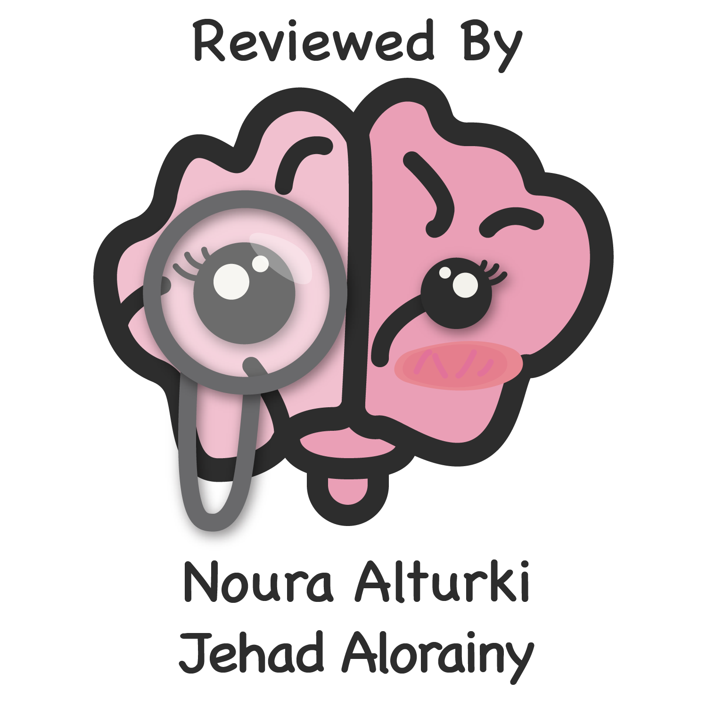
Lecture 48
Editing file
Adrenal Disorders
Objectives:
Understand physiology/diseases and management of Hypoadrenalism.
Understand physiology/diseases and management of Cushing syndrome.
Understand physiology/diseases and management of Hyperaldosteronism.
Understand physiology/diseases and management.
Know the Pheochromocytoma.
Understand anatomy, physiology and biochemistry of adrenal glands.
Understand clinical approach and management of adrenal disorders, function, hyper and hypo-secretion.
Color index:
Color index:
Original text Females slides Males slides
Doctor’s notes Textbook Important Golden notes Extra

Slide 2
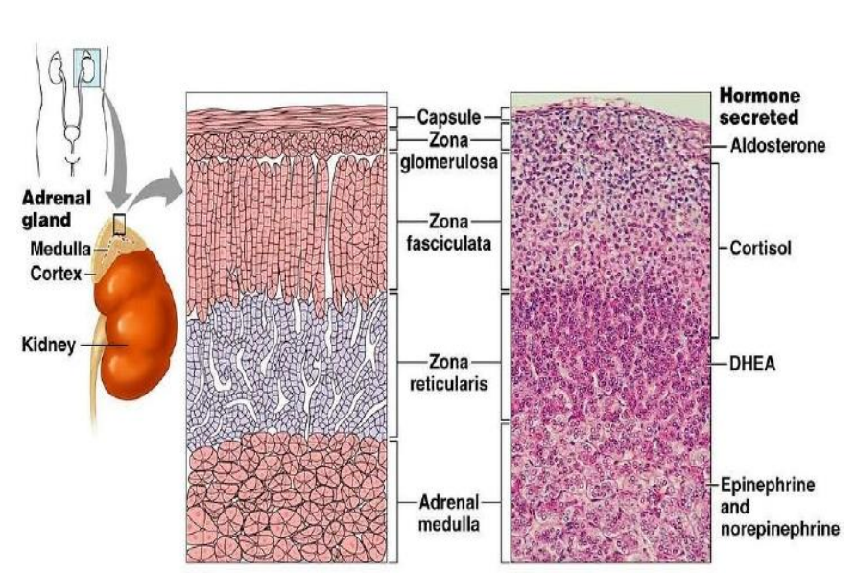
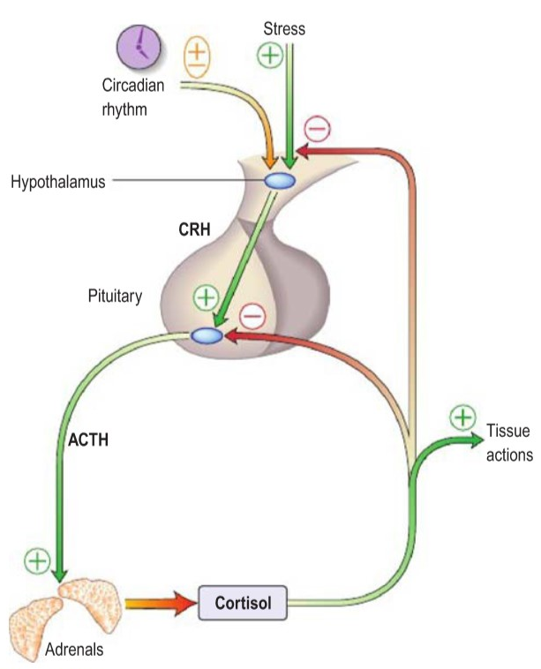
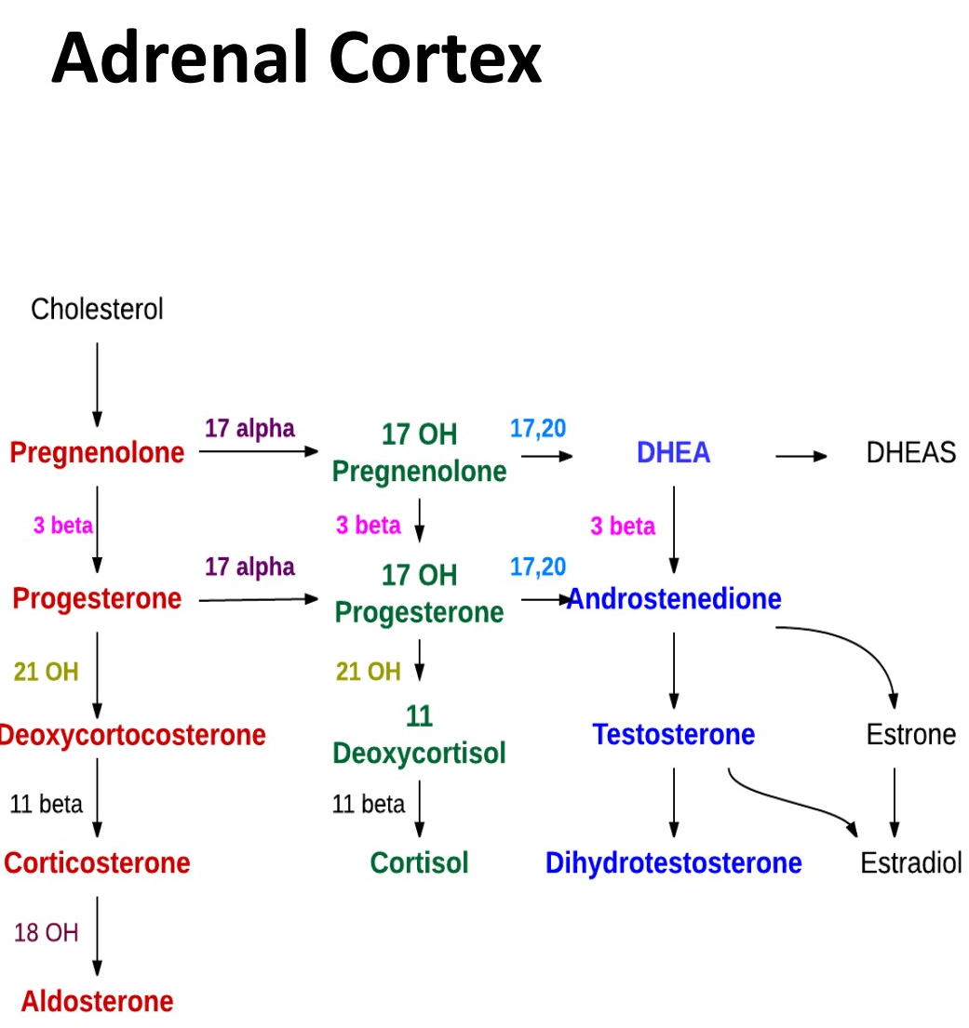
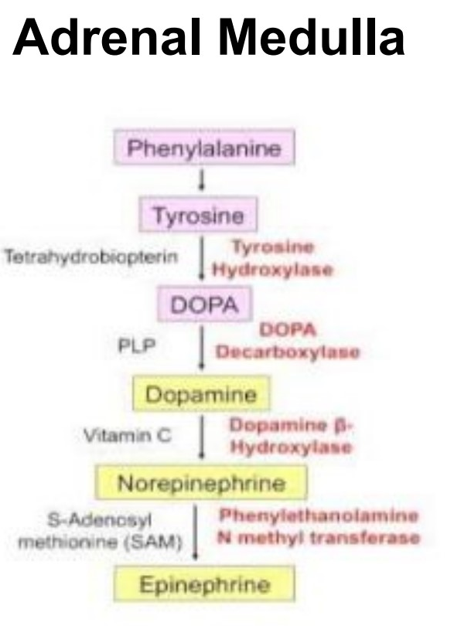
Basic Review of Adrenal Gland
Anatomy of the adrenal glands:
The adult adrenal glands weighs 8-10 gm and lie in the retro-peritoneum above and medial to the upper poles of the kidneys.
A fibrous capsule surrounds the gland. The yellowish outer cortex comprises 90% of the adrenal weight and the inner medulla about 10%.
The outer cortex has three zones:
Zona glomerulosa
Zone fasciculata
Zona reticularis
The inner two zones function as one unit, both producing cortisol and androgens while the zona glomerulosa produces mineralocorticoids.
The zona fasciculata and reticularis are regulated by ACTH, excess or deficiency of this hormone alters the structure and function of the zones i.e. both zones atrophy when ACTH is deficient and when ACTH is present in excess, hyperplasia and hypertrophy of these zones occur.
Physiology of the adrenal glands:
Tissue Area | Hormones | Effect | Regulation
Zona Glomerulosa | Salt Mineralocorticoids (aldosterone) | Kidney: Maintain intravascular volume and electrolytes by: - increase reabsorption of Na+ and water | angiotensin II (RAAS), ACTH, K+ ؛Na+
Zona Fasciculata | Sweet Glucocorticoids (cortisol) | Lipolysis Increase blood sugar | ACTH (from pituitary gland)
Zona Reticularis | Sex Androgens | It is the main source of androgen in human But it is important in the disorders
Medulla (fight or flight) | Catecholamines (Epinephrine,Norepinephrine, Dopamine) | Most of the time activate sympathetic fibers and increase ( BP, HR, blood sugar) But could present with activations of parasympathetic as pathologic disorders | -
Biochemistry of the adrenal glands:
Adrenal Cortex
Zona glomerulosa:
produces aldosterone and lacks 17 hydroxylase activity and cannot synthesize cortisol and androgens.
The synthesis of aldosterone is primarily regulated by the renin angiotensin system and by potassium, others include ACTH and Neural Components of the adrenergic and dopaminergic systems.
Zona fasciculata and reticularis:
Produce cortisol, androgens and small amounts of estrogens and they do not contain the enzymatic system necessary for production of aldosterone.
All adrenal cortex hormones are originating from Cholesterol.
All adrenal medulla hormones are originating from amino acid Tyrosine
Adrenal Medulla

Slide 3
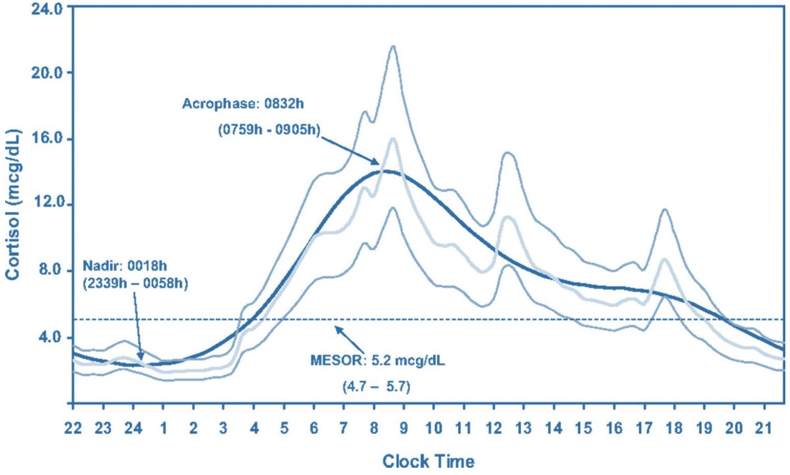
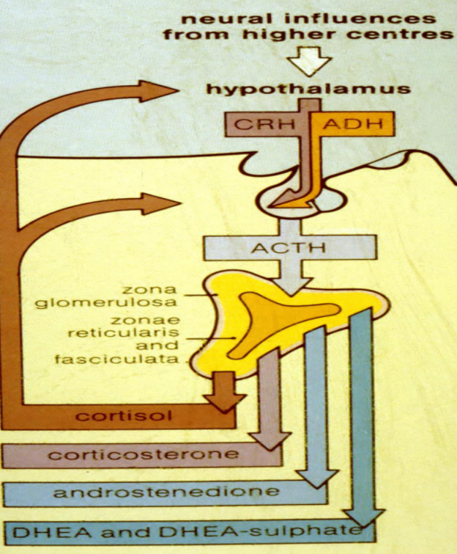
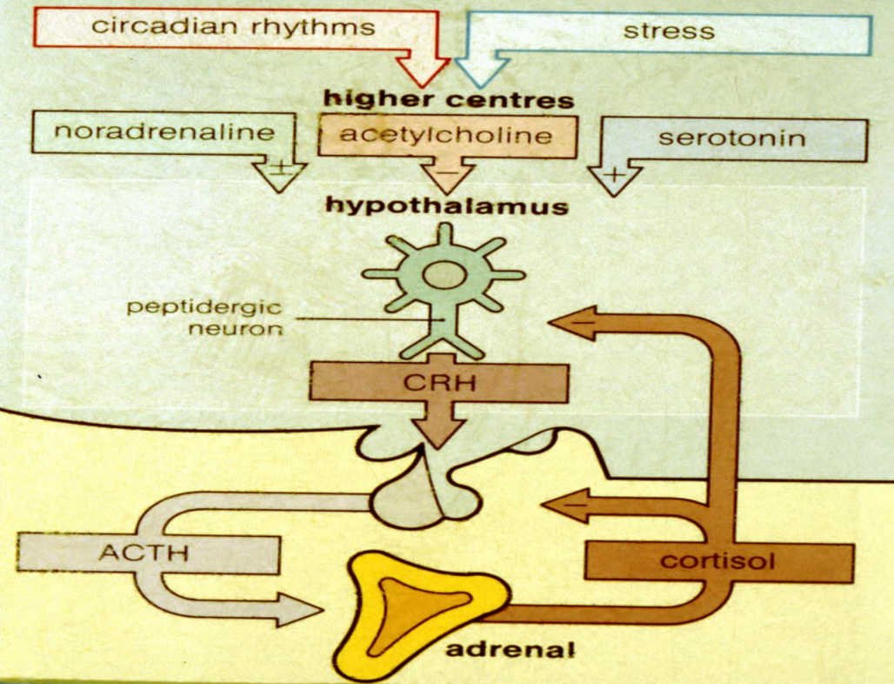
Introduction
Regulation of Secretion:
Circadian Rhythm: Affected by psychological or physiological factors.
Regulates both the magnitude and the number of CRH and ACTH secretory episodes.
Cortisol secretion is low in the late evening and high in the early morning where we need it the most.
This rhythm is changed by:
Changes in Sleep pattern¹ | Light-dark exposure | Feeding times | Psychological stress | CNS and pituitary disorders
Cushing syndrome | Liver disease² | Chronic renal failure² | Alcoholism | Certain Drugs e.g. cyproheptadine
The circadian rhythm of cortisol secretion could help you in diagnosis, Cortisol reaches peak levels in the early morning (8 or 10 am), and the lowest level is at night (12am).
If a patient has some clinical features of adrenal disorder and we measured his cortisol level at 12PM and was very high then this is abnormal, but if it’s high in the morning then this is the normal
If we measure cortisol in the morning and it was very low then this is abnormal
Physiological cortisol circadian rhythm
2) Stress:
e.g. surgery and hypoglycemia. It causes ACTH and cortisol to be secreted within minutes of the onset of stress and this is mediated by increased CRH secretion.
This is abolished by prior high dose glucocorticoid administration and in Cushing’s syndrome.
3) Feedback inhibition:
It occurs by glucocorticoids both at the pituitary and hypothalamus inhibiting CRH and ACTH production and thus further synthesis of glucocorticoids
Circulation of Cortisol & Adrenal Androgens:
Cortisol and the adrenal androgens circulate bound to plasma proteins.
The plasma half life of cortisol is short (70-90 min) and is determined by the extent of plasma binding and by the rate of metabolic inactivation.
Cortisol binds mainly to CBG (cortisol binding globulin or transcortin ) = 75% and to a lesser extent to albumin = 15% and about 10% of circulating cortisol is free and it is this biologically active cortisol which is regulated by ACTH.
Androgens except for testosterone bind weakly to albumin. However, testosterone is bound extensively to a specific globulin, sex hormone binding globulin (SHBG).
free cortisol level measurement is not available at all hospitals, we use total cortisol instead. So it’s imp to know the factors that affect CBG , Because you don’t know wether the increase is caused by free cortisol or CBG.
1- people who stay up late or have night shifts
2- all chronic diseases can affect the pituitary circadian rhythm.

Slide 4
Introduction
Circulation of Cortisol & Adrenal Androgens cont.
can be affected by physiological or psychological factors. any condition affecting total body proteins will affect CBG levels.
Cortisol binding globulin increase and decrease in:
Increase In |  | Decrease In
1 | Pregnancy | 1 | Familial deficiency states
2 | Oral contraceptives (OCP) users | 2 | Protein deficiency states
3 | Hyperthyroidism | 3 | Hypothyroidism
4 | Diabetes mellitus | 4 | Nephrotic syndrome
5 | Certain hematological disorders | 5 | Severe liver disease
6 | Genetic familial condition | - | -
Adrenal Disorders
Adrenal Disorders
Function:
Hypersecretion
Hyposecretion
Primary and Secondary
Structural:
Adenoma
Hyperplasia
Bilateral vs unilateral
Adrenal vs extra-adrenal
Evaluation of Adrenal disorders:
Clinical (History and Examination):
function (hypersecretion or hyposecretion)
Structural (headache, visual symptoms)
Biochemical: (To proof if he has high or low levels of that hormone).
Screening Test
Confirmatory Test
Anatomical:
CT or MRI adrenal if needed (adenoma, hyperplasia, uni or bilateral, adrenal , extra-adrenal, benign or malignant)
Then Treatment
Adrenocortical hypofunction:
1
Adrenal insufficiency
2
Congenital Adrenal Hyperplasia

Slide 5
Primary adrenocortical insufficiency
(Addison’s disease)
Causes:
Causes
Major | Idiopathic atrophy (autoimmune) 80%: DR. Thomas Addison in 1849, TB was the commonest cause, now autoimmune is the most common cause. Addison’s disease is more common in women 2.6:1. It is usually diagnosed in the 3rd to 5th decade. Idiopathic addison’s disease is frequently accompanied by other immunological and autoimmune endocrine disorders e.g. hyperthyroidism, hypothyroidism, hashimoto, anemia and gonadal failure. One or more of these disorders is usually present in 40-53% of patients with idiopathic addison’s disease. Often positive adrenal antibodies ,Could be an isolated problem or associated with other autoimmune diseases: Type I (APECED) : affects children: Adrenal insufficiency, hypoparathyroidism, pernicious anaemia, chronic candidiasis, chronic active hepatitis, and hair loss) Type II (Schmidt's syndrome) usually affects young adults : hypothyroidism, adrenal insufficiency and diabetes mellitus, vitiligo Tuberculosis 20%
Other | Infection (fungal: Histoplasmosis, CMV HIV, Syphilis, ..etc) Infiltration (lymphoma, Hemochromatosis, Amyloidosis, Sarcoidosis, malignancy) Iatrogenic (Surgical adrenalectomy, Anticoagulation and hemorrhage) Medications: ketoconazole, rifampin, phenytoin, Phenobarbital, Mitotane(Cytotoxic drugs), Metyrapone(Enzyme inhibitor), Aminoglutethimide. Hereditary and Congenital diseases: enzyme defects, hypoplasia, congenital adrenal hyperplasia,adrenal unresponsiveness to ACTH, adrenoleukodystrophy, adrenomyeloneuropathy, Refsum disease, Wolman disease) Miscellaneous: Triple A syndrome= Allgrove syndrome Adrenal hemorrhage and infarction Radiation therapy
Pathophysiology:
The disease progression is usually gradual and patients will present with nonspecific symptoms.
There’s destruction of adrenal cortex (3 layers)
Gradual adreno-cortical destruction causes decrease adrenal reserve with normal basal steroid secretion in the initial phase but failure to respond to stress.
Acute crises can be precipitated by stresses of surgery, trauma or infection which require increased corticosteroid secretion.
With further loss of cortical tissue, even basal secretion of mineralocorticoids and glucocorticoids become deficient leading to the manifestation of chronic adrenocortical insufficiency when more than 90% of both adrenal cortices occur.
About 25% of cases present with a crises or an impending one at the time of diagnosis

Slide 6
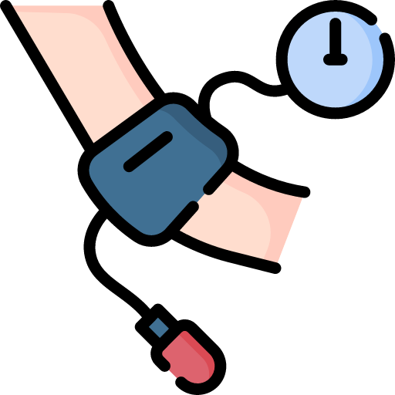
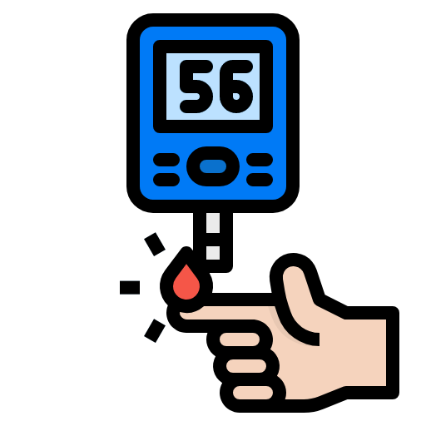
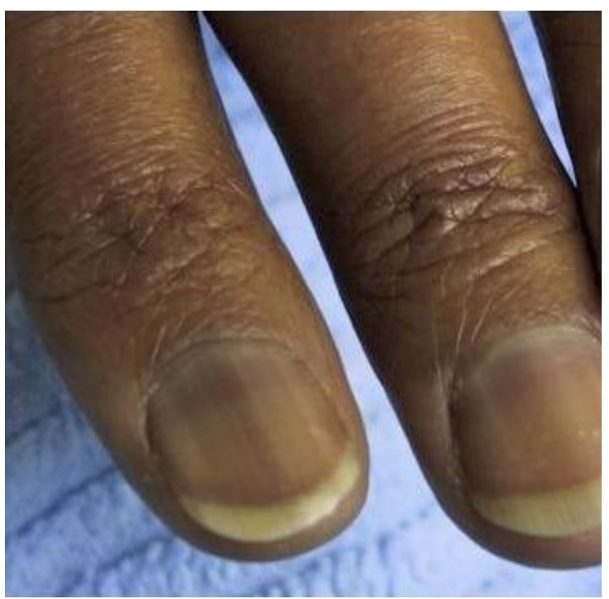
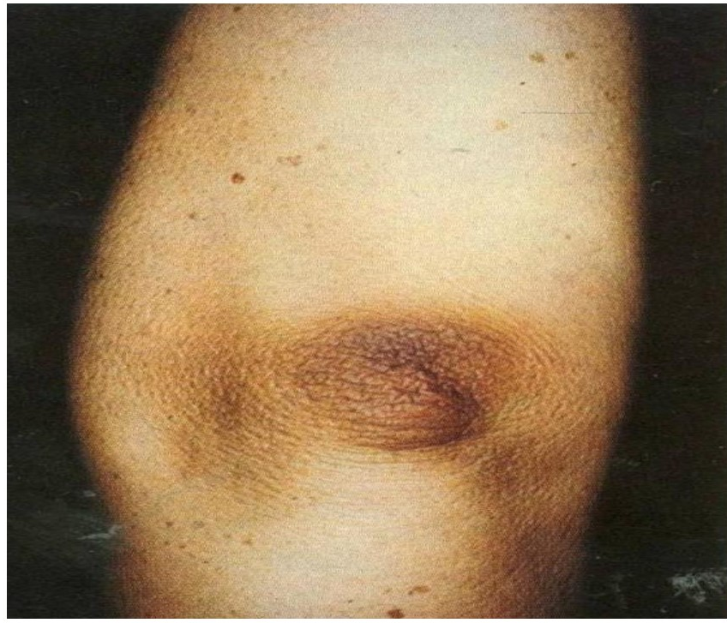
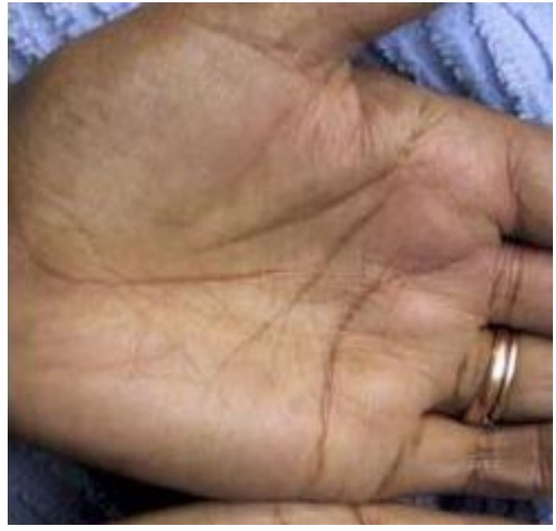
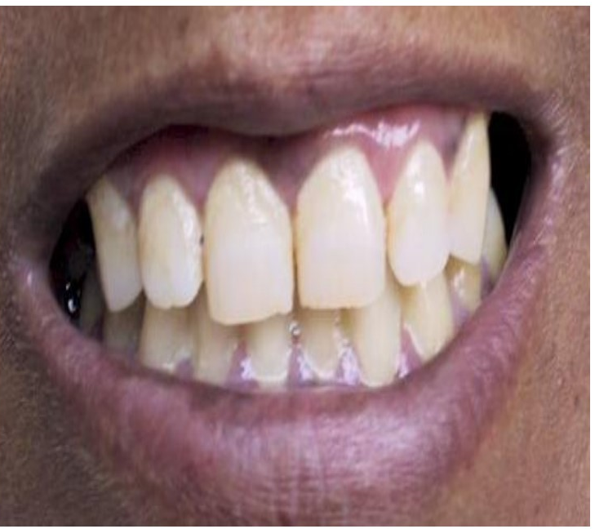
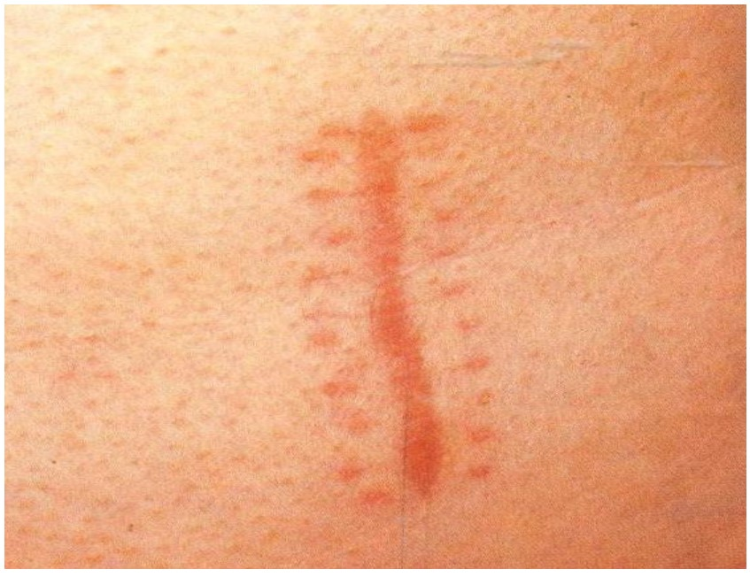
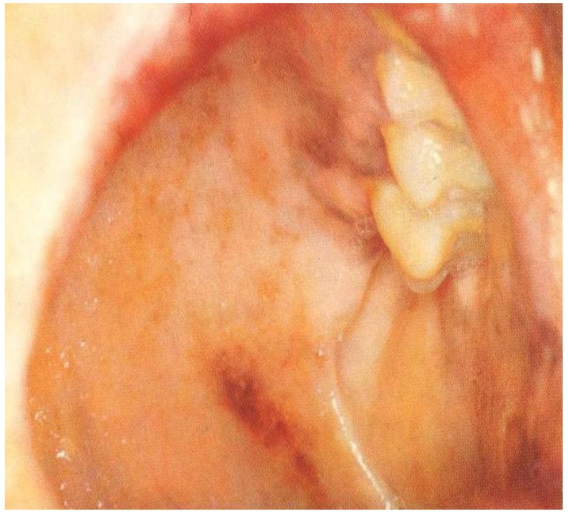
Primary adrenocortical insufficiency
(Addison’s disease)
Clinical features:
The chief symptoms of chronic primary adrenocortical insufficiency are hyperpigmentation, weakness and fatigue, weight loss, anorexia, and gastrointestinal disturbances.
Hyperpigmentation (present in 92% of patients):
Due to secondary increase in ACTH and BLPH because of decrease negative feedback inhibition
The generalized hyperpigmentation of the skin and mucous membranes is the earliest manifestation and is increased in sun exposed areas and accentuated over pressure areas (elbows) , palmar creases, nail beds, nipples, areolae, and peri-vaginal and peri- anal mucosae as well as gums and buccal mucosa.
Scars formed after the onset of ACTH excess become hyperpigmented.
only in Primary adrenal insufficiency due to melanocyte stimulating hormone (MSH) from pro-opiomelanocortin (POMC) Not ACTH
Abdominal Disturbances (present in 56% of patients):
Especially nausea and vomiting occur in most patients.
Abdominal pain and constipation.
Diarrhoea is less frequent.
Hypotension (present in 88-90% of patients):
BP and HR, Standing and supine.
Think about Adrenal insufficiency if not respond to IVF and initial management, or when he come with typical presentation (abdominal pain, nausea, vomiting and dark pigmentation “his relatives say he became darker in color in the past weak”)
Causes orthostatic symptoms (present in 12% of patients).
Can cause syncope and in severe cases shock and death.
Hypoglycemia:
Severe hypoglycaemia is uncommon in adults but can be provoked by fasting, fever, infection or nausea and vomiting. More common in secondary.
Salt craving (present in 19% of patients):
occurs because of sodium wasting secondary to mineralocorticoid deficiency which can also lead to dehydration, hyponatremia, hyperkalemia, and acidosis.
Other:
General weakness, fatigue, malaise, anorexia and weight loss are invariable features (present in 100% of patients).
Amenorrhoea¹ is common and can be due to weight loss and chronic illness or associated ovarian failure.
Loss of body hair can occur secondary to deficient adrenal androgens secretion.
1- can be due to primary gonadal failure or secondary to chronic diseases. always ask about the regularity of the cycle since it can be affected by many conditions.

Slide 7
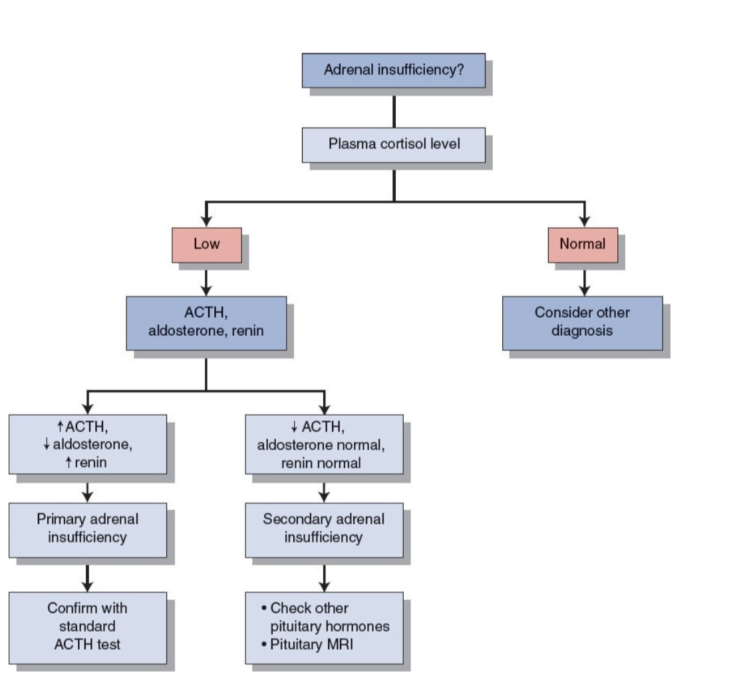
Primary adrenocortical insufficiency
(Addison’s disease)
Laboratory Findings
Hyponatremia and hyperkalemia are classical in primary adrenal insufficiency, less prominent in secondary
There might be normocytic anaemia (cortisol and thyroxine are imp for normal bone marrow function and hematopoiesis), neutropenia, eosinophilia and relative lymphocytosis
Azotaemia and increased serum creatinine is due to volume depletion and dehydration.
Mild acidosis is frequently present
Mild to moderate hypercalcemia
Biochemical Evaluation:
Measure a.m. cortisol (little value)
If high ( >550 nmol/L) : rule out
If very low : diagnosis (random cortisol below 100 nmol/L during the day is highly suggestive)
If borderline result : proceed for confirmatory test (Rapid ACTH stimulation test):
After a baseline cortisol sample is obtained a synthetic ACTH called Tetracosactrin (Synacthen) is given in a dose of 0.25mg IM. Or IV. and additional cortisol samples are obtained at 30 and 60 min following the injection.
Absent or impaired cortisol response confirms the presence of hypoadrenalism but does not differentiate Addison’s disease from ACTH deficiency or iatrogenic suppression by steroid medication.
In hyperfunctional diseases we will try to suppress the gland while in this case we will try to stimulate it and assess it's response.
Measure ACTH Plasma levels:
It differentiates between primary and secondary states being high in the primary form and low normal or low in secondary forms.
 | Primary | Secondary
ACTH | high | low
cortisol | low | low
Androgen (adrenal) | Low (High in CAH) | low
Aldosterone | low | Normal (N.B: RAS)
K | high | Normal/high
Na | low | Low/ normal
Glucose | low | low
Hb | Normal or low | low
Anatomical Evaluation:
Adrenal insufficiency is clinical and biochemical diagnosis
No indications to do imaging unless clinically indicated such as:
Patient on anticoagulation
Malignancy with metastasis
Other infiltrative disease
Abdominal radiograph reveal adrenal calcification in half the patients with tuberculosis adrenilitis and in some patients with other invasive or hemorrhagic causes of adrenal insufficiency

Slide 8
Secondary/ Tertiary adrenal insufficiency
Causes:
The commonest cause of ACTH deficiency is exogenous glucocorticoid administration.
Pituitary/hypothalamic tumors are the most common causes of naturally occurring pituitary ACTH hyposecretion.
Panhypopituitarism (congenital / acquired):
Tumors, surgery, radiation therapy
Hypothalamic / pituitary disorders
Isolated ACTH deficiency
Inadequate glucocorticoid replacement
Infant born to steroid-treated mother
Surgical removal of ACTH-producing adenoma of the pituitary gland (Cushing's disease)
Pathophysiology of Secondary Adrenocorticol Insufficiency:
ACTH deficiency is the primary event and leads to decrease cortisol and adrenal androgen secretion. Aldosterone secretion remains normal¹ except in few cases
Basal ACTH and cortisol may be normal but ACTH reserve is impaired and the response to stress is subnormal.
With chronicity there is atrophy of zona fasciculate and reticularis and therefore basal cortisol secretion is decreased.
At this stage, the pituitary adrenal axis is impaired and will not respond to stress and to exogenous ACTH.
Clinical features:
The clinical features may be non-specific initially unless an acute crisis occur in an undiagnosed patient, Hypoglycemia is occasionally the presenting feature.
The hyperpigmentation is absent because of deficient ACTH and beta lipotropic hormone (BLPH) and the mineralocorticoid secretion is usually normal, Otherwise the symptoms may be similar to primary.
- Electrolytes abnormalities are usually absent
- Hypotension is usually not present except in acute presentations.
Hyponatremia may occur because of water retention and inability to excrete a water load with no hyperkalaemia.
1- Zona glomerulosa is spared and stimulated by RAAS.

Slide 9
Treatment of Adrenocortical Insufficiency
Treatment of Adrenocortical Insufficiency:
Once Addison’s disease is suspected, investigation is urgent. If the patient is seriously ill or hypotensive, hydrocortisone 100 mg should be given intravenously or intramuscularly together with intravenous 0.9% saline. Ideally this should be done immediately after a blood sample is taken for later measurement of plasma cortisol.
Full investigation should be delayed until emergency treatment has improved the patient’s condition.
IVF: dextrose and salt for rehydration and to restore intravascular volume, especially if it comes as an emergency case
Electrolytes replacement
Patients with Addison’s disease require life long therapy usually with both glucocorticoids and mineralocorticoids.
Steroid Replacement
Primary Adrenocortical Insufficiency | Glucocorticoids (by hydrocortisone) a dose of 25-30 mg/d. It is usually given as twice per day but can be given once daily or three times daily as suitable for the well being and normal energy level for each patient. Mineralocorticoids (by Fludrocortisone) Fludrocortisone is the mineralocorticoid of choice. Given in 0.05-0.1 mg/day dose in the morning
secondary Adrenocortical Insufficiency | Glucocorticoids (by hydrocortisone only) In secondary hypoadrenalism fludrocortisone is rarely required.
NB: Hydrocortisone has some Mineralocorticoids activity, so if you use hydrocortisone in high IV dose, stop Fludrocortisone.
An area for your notes

Slide 10
Acute Adrenal Crisis
Definition
A state of acute adrenocortical insufficiency occurring in patients with Addison’s disease who are exposed to the stress of infection, trauma, surgery or dehydration.
Shock and coma may rapidly lead to death in untreated patients
Clinical Features
1 | Weakness, apathy | 5 | Nausea, vomiting, anorexia
2 | Hypotension and shock vascular collapse | 6 | Fever
3 | Abdominal Pain | 7 | depressed mentation
4 | Hypoglycemia | 8 | Dehydration and volume depletion
Treatment
It should be started as soon as possible once diagnosis suspected.
If oral therapy cannot be taken because of vomiting or diarrhea, then medical assistance should be sought for parenteral therapy.
The patient should be informed about life-long therapy and the need to increase the dose of steroids during illness (should be at least doubled for minor illnesses) and if symptoms continue, a physician should be called.
Whenever they are under stress they should double the dose, this may include : acute viral illness.They can increase the dose for 3-5 days until the stress is gone then go back to usual dose.
Parenteral cortisol is commonly used and it has sufficient mineralocorticoid activity so additional treatment is not required.
The dose is 100 mg every 6 hrs, and the dose is gradually tapered when condition is stable.
Maintenance therapy with oral cortisol with or without a mineralocorticoid is then given.
Intravenous fluids including glucose and saline are required to correct volume depletion, hypotension and hypoglycemia as well as the acidosis and hyperkalemia but the shock may not respond to vasopressors unless glucocorticoids are administered.
Prevention
Adrenal crisis can be prevented in an already diagnosed patient by proper education on dosage of drugs during illness.

Slide 11
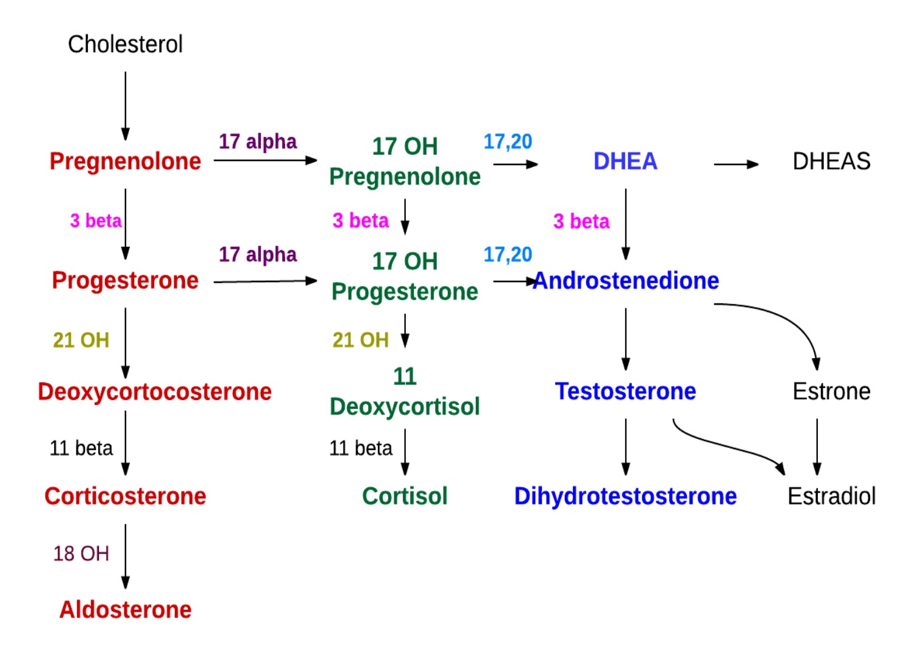
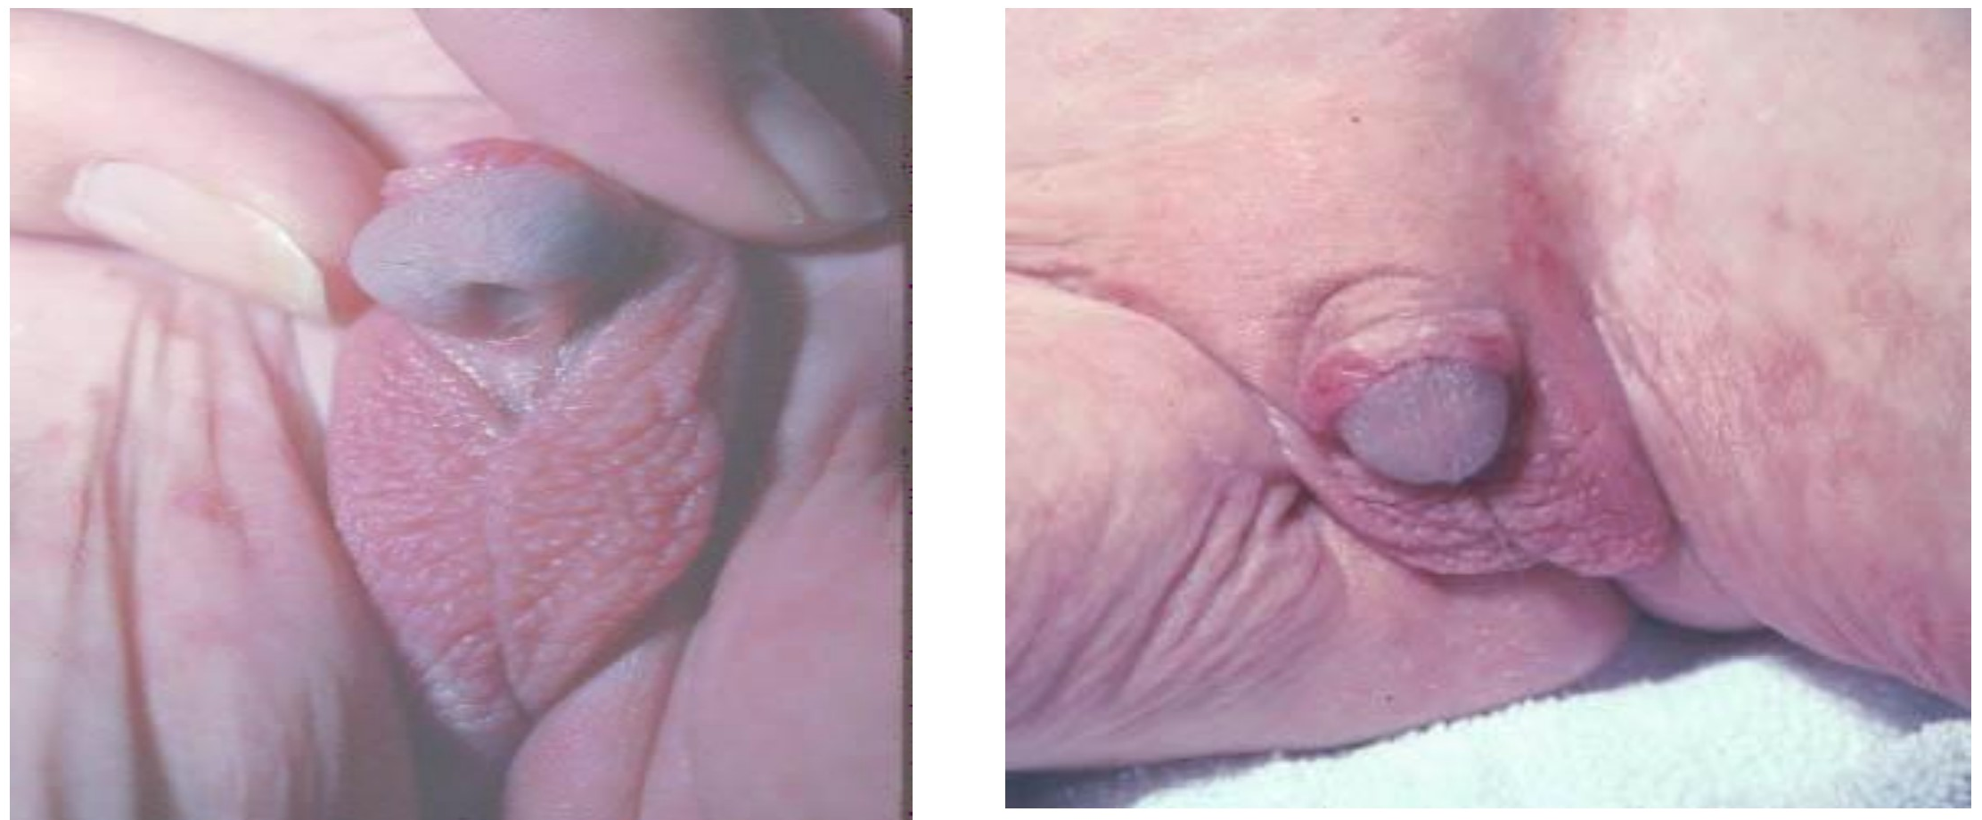
Congenital Adrenal Hyperplasia
Congenital Adrenal Hyperplasia
Classic CAH (congenital adrenal hyperplasia ) is an autosomal recessive disorder with an incidence of 1 in 7,000-15,000
Non-Classic CAH is less severe and effects 1 in 500-1000 individuals
90–95% of CAH cases are caused by deficiency of 21-hydroxylase enzyme, which catalyses the synthesis of cortisol and aldosterone from cholesterol
Ambiguous genitalia ( Female)
Failure to thrive
Dehydration & Shock ( usually male)
Salt-loss presentations with electrolytes imbalance:
Hyponatremia, Hyperkalemia, Hypoglycemia.
Hyperpigmentation
Is it a boy or a girl?
Diagnosis:
Clinical severity depends on degree of 21-hydroxylase deficiency, good genotype phenotype correlations.
Clinical | History and examination (B.P) Classical CAH: Simple Virilising: Ambiguous genitalia in females Salt Wasting: Dehydration, vomiting and diarrhoea. If untreated can prove fatal Non-classical CAH: Milder than classical CAH – Androgen excess can cause precocious puberty in either sex, Males are often undiagnosed/asymptomatic
Biochemical | Serum electrolytes & glucose: Low Na & high K, Fasting hypoglycemia Elevated serum urea due to associated dehydration Elevated plasma Renin & ACTH levels Low Cortisol High 17 – OHP High androgens especially testosterone level Low Aldosterone ( in salt losing types only)
Management:
Hydrocortisone: 10-20 mg/m2/day divided into three doses. Adult usually 10-5-5 mg
Glucocorticoids which suppress ACTH, are used to reduce the levels of adrenal sex steroids in the blood
Fludrocortisone 0.05 - 0.2 mg/day
Individuals with salt wasting CAH also require mineralocorticoids and sodium chloride supplements
During adrenal crisis intravenous hydrocortisone 50-100 mg Q 6-8hrs
IVF D5 0.9% saline
During fever or sickness 2-3 fold increment in hydrocortisone dose, aslo the patient should have a card or a bracelet indicating that he have adrenal insufficiency,
In vomiting or diarrhea, parental therapy is indicated
Medical Alert: bracelet
Surgery on virilised females, Growth monitoring to detect over and under treatment.
Dexamethosone can be used to prevent/reduce prenatal virilisation. Side effects for the mother include weight gain, irritability and oedema

Slide 12
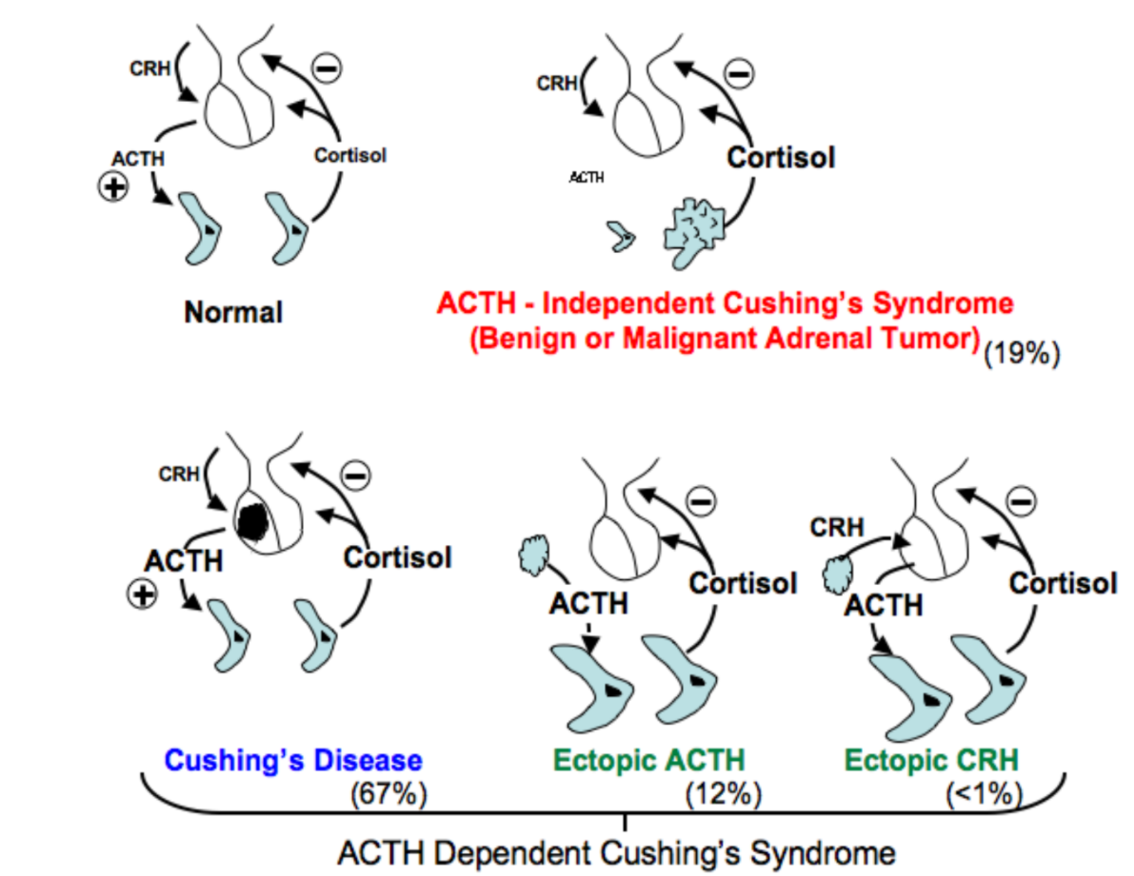
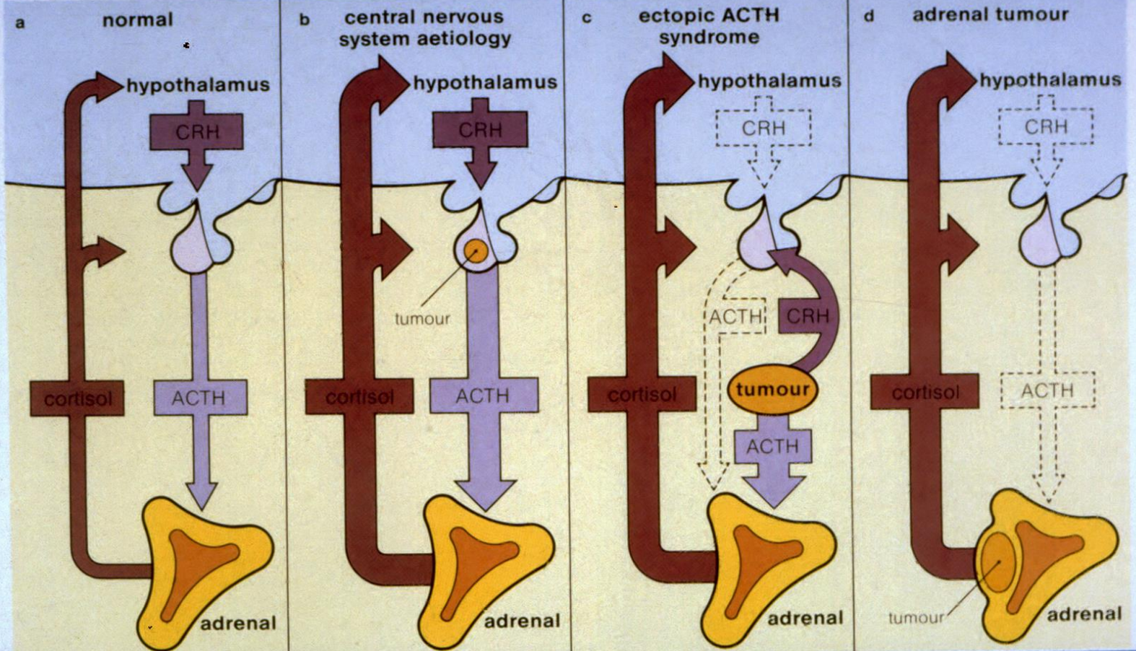
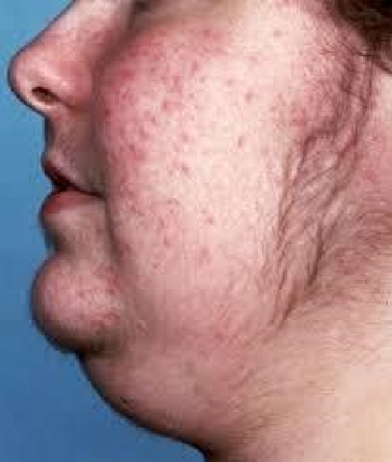
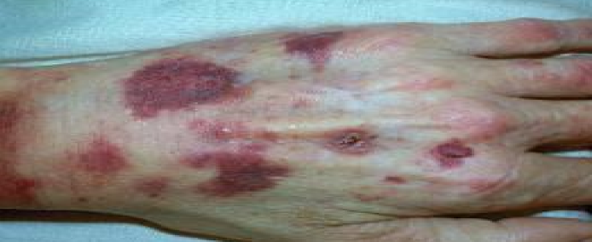
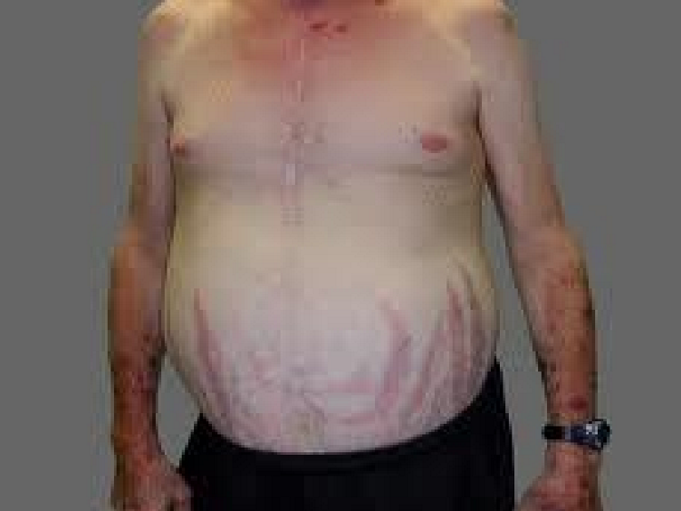
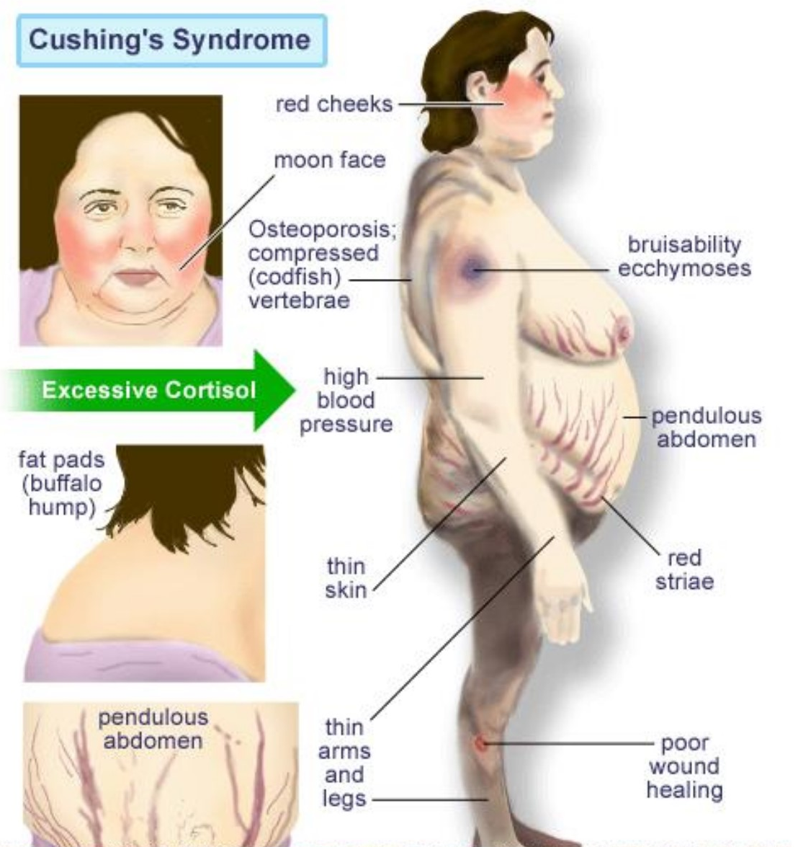
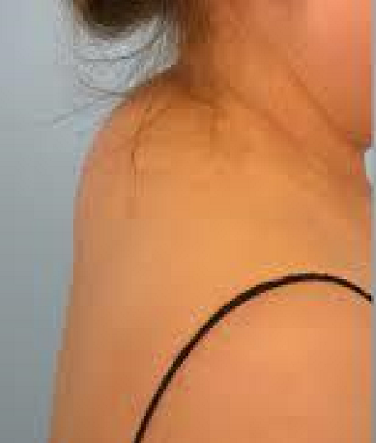
Adrenocortical Hyperfunction
Adrenocortical Hyperfunction:
Hypercortisolism (Cushing syndrome):
Chronic glucocorticoid excess whatever the cause leads to a constellation of symptoms and physical features known as Cushing’s syndrome, first described by Cushing in 1932.
The most common cause is iatrogenic i.e. secondary to chronic steroid ingestion. Others causes are:
ACTH dependent (Cushing’s disease 68% or Ectopic ACTH syndrome 15%)
ACTH independent (Iatrogenic, adrenal adenoma 9% or carcinoma 8%)
Hyperaldosteronism
Hypercortisolism (Cushing Syndrome)
introduction
Cushing’s disease:
Is defined as the specific type of Cushing's syndrome due to excessive pituitary ACTH secretion (commonly secondary to an adenoma).
Women to men ratio is 8:1 and the age of diagnosis is usually between 20-40 yrs.
Ectopic ACTH syndrome:
Non-pituitary tumors secrete biologically active ACTH. It is more common in men, female to male ratio is 1:3 with the peak incidence at the age of 40-60 years. It is most common with oat-cell carcinoma of the lung (50% of the cases) but other tumors, e.g. pancreatic cell tumors, carcinoid tumors, etc. can cause it.
Glucocorticoid producing adrenal adenomas and carcinomas:
Arise spontaneously and they are autonomous and not under pituitary hypothalamic control.
Signs & Symptoms:
Obesity | The most common manifestation and is classically central (truncal) affecting mainly the face (moon faced) with a plethoric appearance, neck, trunk, and abdomen with relative sparing of the extremities. supraclavicular and dorsal cervical fat pads "buffalo hump“
Skin Changes | There is thinning of the skin because of atrophy of the epidermis and underlying connective tissue and facial plethora. They also have striae which are classically red to purple may appear on the abdomen and are due to loss of connective tissue support as well as easy bruising. Minor wound heal slowly and they have frequent mucocutaneous fungal infections. Hyperpigmentation is common in the ectopic ACTH.
Hirsutism | Facial hirsutism is most common but it can occur anywhere in the body. It is due to the hypersecretion of adrenal androgens. Acne and seborrhea usually accompany the hirsutism. Virilism is rare and occur in adrenal carcinoma.

Slide 13
Hypercortisolism (Cushing Syndrome)
Signs & Symptoms Cont.
Hyper- tension | It is a classical feature in Cushing’s syndrome and its complications contribute greatly to the morbidity and mortality in the disease.
Gonadal Dysfunction | This is very common as a result of elevated androgens and cortisol, e.g. amenorrhoea, infertility, decreased libido.
Psychological Disturbances | Symptoms range from mild irritability to anxiety, depression, poor memory and concentration to euphoria and mania as well as sleep disorders. Severe depression and psychosis as well as hallucinations and paranoia can occur.
Muscle wasting and weakness | Commonly proximal and more prominent in the lower limbs. Distal extremities and fingers are slender
Osteoporosis | A common complication presenting with back pain, and pathological fractures can occur in severe cases.
Renal Calculi | Occur secondary to hypercalcuria and renal colic may occasionally be a presenting complaint.
Thirst and Polyuria | Occur secondary to development of diabetes mellitus but asymptomatic glucose intolerance is much more common.
Diagnosis
Clinical:
Function : Hirsutism, acne, easy bruising, DM, HTN, irregular period, proximal weakness, recurrent infections, depression
O/E: hirsutism, acne, moon face, central obesity, stria, proximal weakness, supraclavicular fat pad.
Laboratory:
High normal hemoglobin and hematocrit are usual with lymphocytopenia and depressed eosinophils count.
Hypokalemic alkalosis may occur in the setting of ectopic ACTH production. Most patients have secondary
Hyperinsulinism and abnormal glucose tolerance tests while some have fasting hyperglycemia or clinical diabetes mellitus

Slide 14
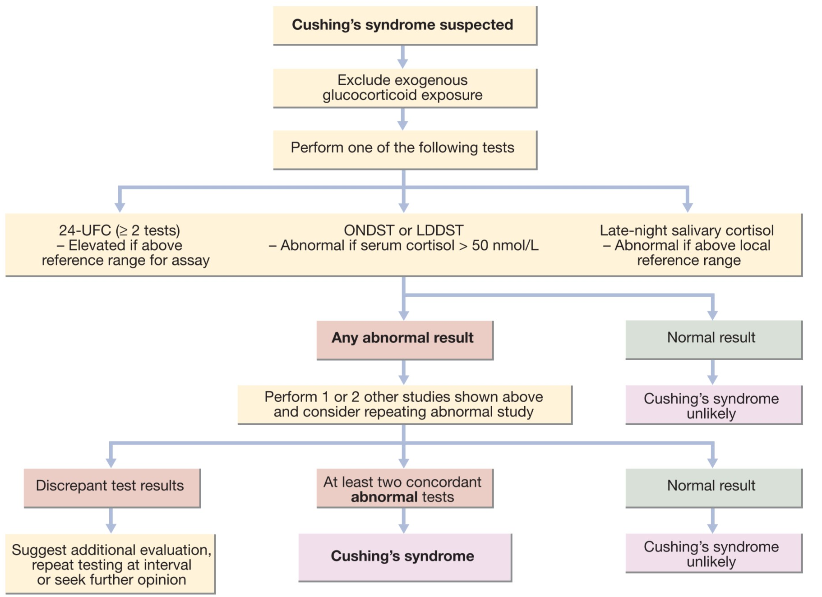
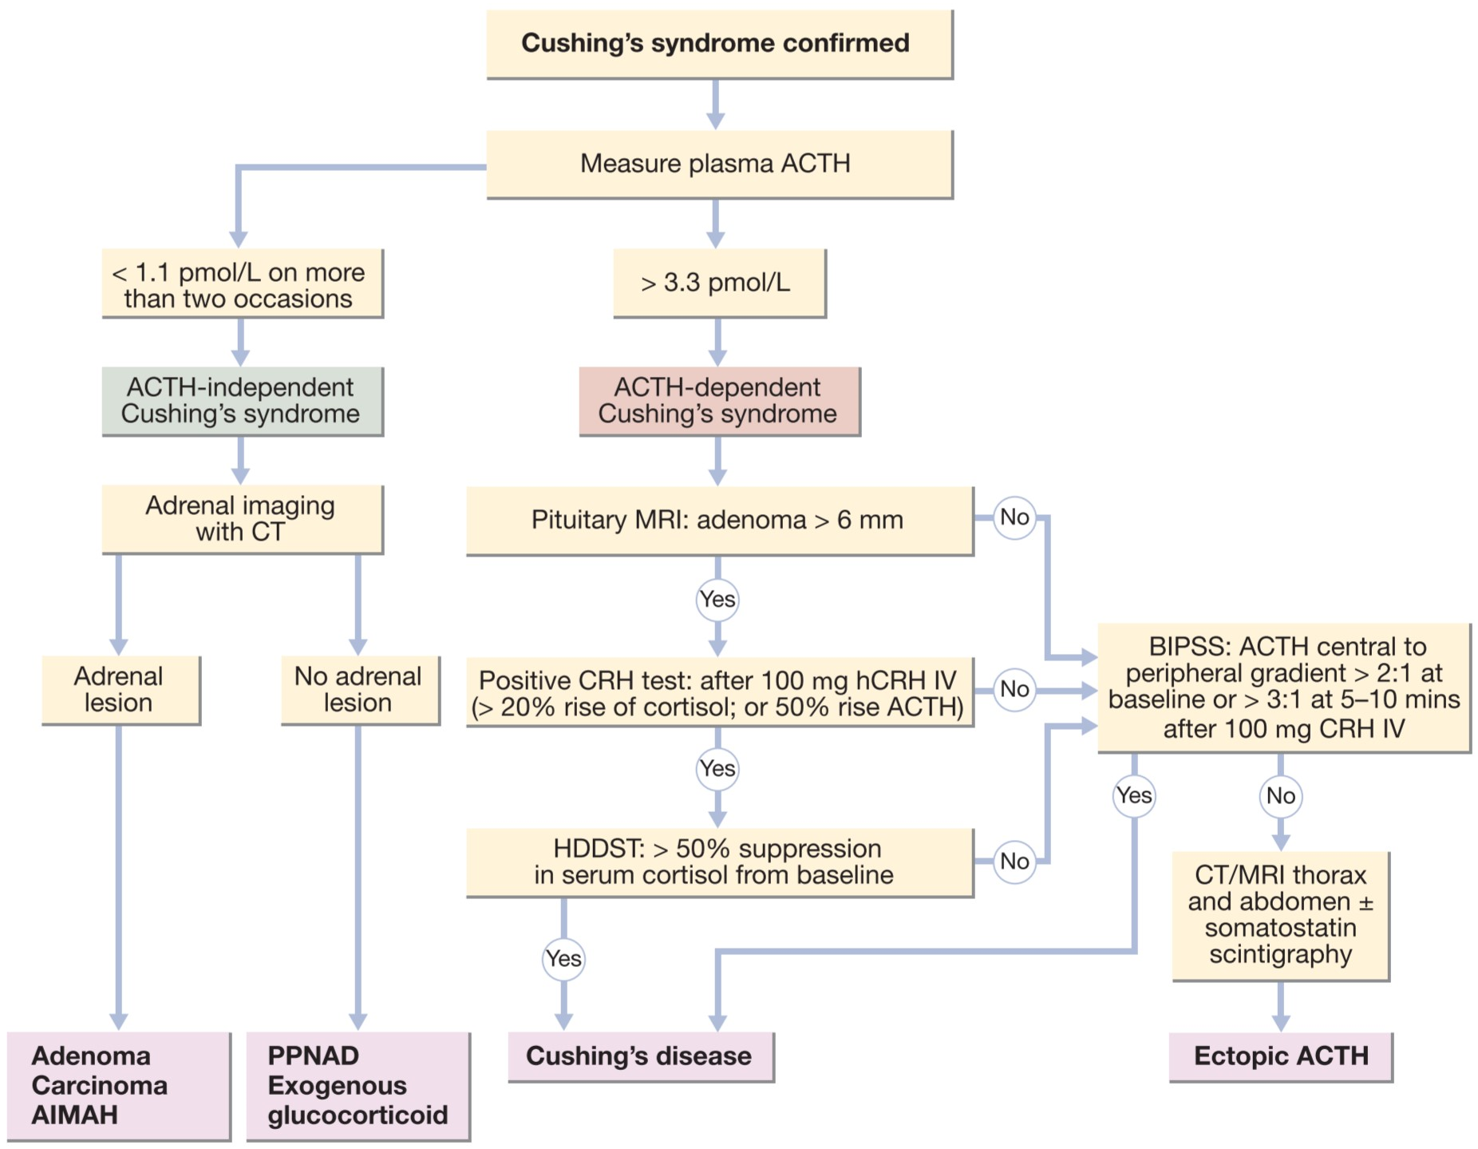
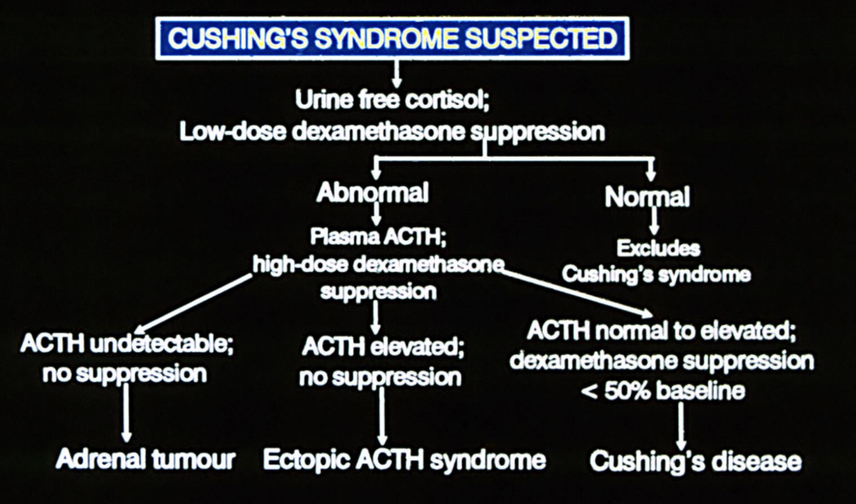
Hypercortisolism (Cushing Syndrome)
Diagnosis Cont.
Biochemical:
Cortisol & ACTH | High cortisol which is random and episodic with loss of normal circadian rhythm . High ACTH (ACTH dependent) and low if (non-ACTH dependent). In Cushing’s disease, ACTH is normal or modestly elevated while in the ectopic syndrome, it is markedly elevated. In adrenal tumors, ACTH is undetectable.
24- hour urinary free cortisol (UFC) | is an excellent method for diagnosis of Cushing’s syndrome and in differentiating it from other forms of hypercortisolism, e.g. obesity.
Midnight salivary cortisol | -
Dexamethasone Suppression Tests | Overnight 1 MG Dexamethasone suppression test (A screening test): If the test is positive in the absence of conditions causing false positive results. e.g. alcoholism, depression, and drugs, then the diagnosis should be confirmed by other tests.
 | LOW DOSE TEST: Dexamethasone 0.5 mg is given every 6 hours for two days. Plasma cortisol level should suppress after the last dose
 | Overnight high dose Dexamethasone suppression test: A simple fast test – The AM cortisol after 8 mg of Dexamethasone given the night before should reduce to less than 50% of the baseline value
 | TWO-DAY HIGH DOSE TEST: Dexamethasone 2 mg every 6 hours is given for two days Serum and urine cortisol should suppress to less than 50% the baseline values.
(establish the presence of a Cushing’s syndrome regardless of the cause. It assesses feedback inhibition of the hypothalamic pituitary adrenal axis which is abnormal in Cushing’s syndrome).
Anatomical:
If ACTH:
high: MRI pituitary
low: history then CT adrenals
CT scanning will help in localizing pituitary and adrenal tumors and in some instances, ectopic ACTH production.
Small tumors may be difficult to detect and selective venous sampling may be needed. In some cases, more detailed isotope scanning and arteriography or venography may be needed.

Slide 15
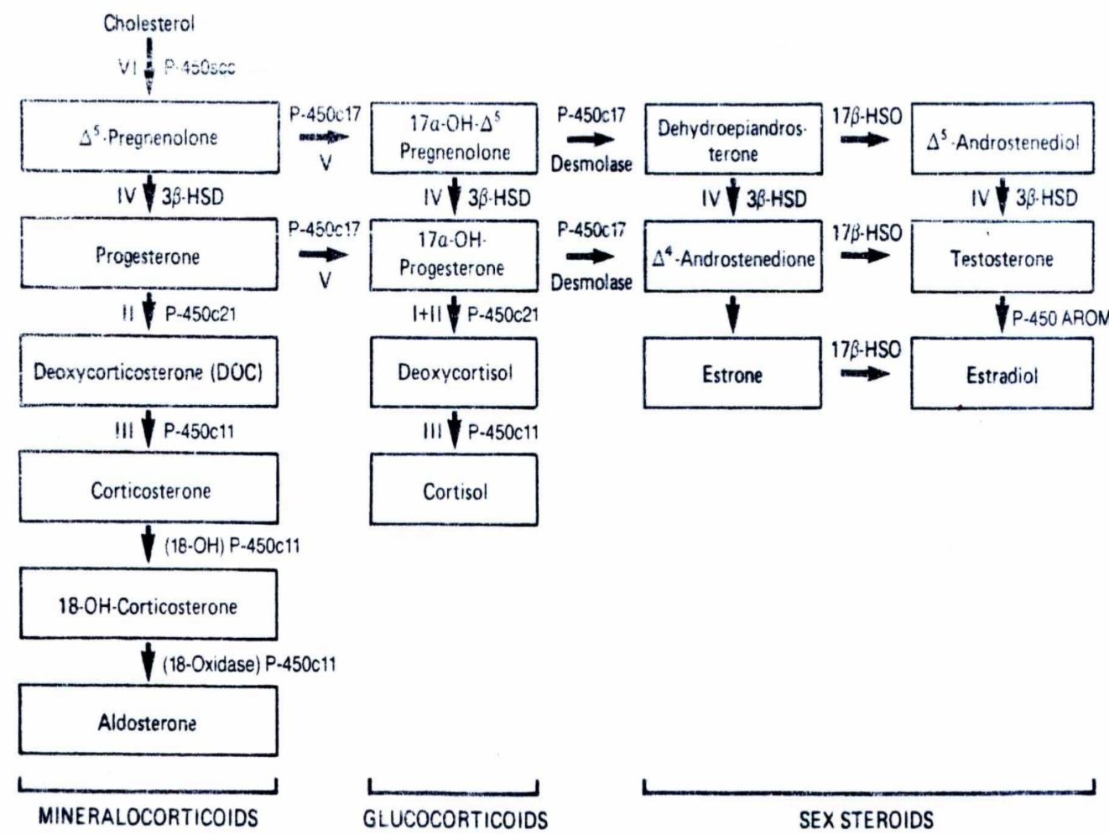
Hypercortisolism (Cushing Syndrome)
Treatment:
Surgical:
Hypercortisolism has a lot of complications and can be fatal if left untreated.
Adrenal tumours:
Adenomas are successfully treated by adrenalectomy while this treatment for carcinoma is usually unsuccessful and medical therapy can control hypercortisolism in these patients
Ectopic ACTH syndrome:
Therapy is directed at removal of the tumour which is only successful in the benign tumours otherwise drugs that block steroid synthesis can be used, e.g. Metyrapone and mitotane with steroid replacement if necessary.
Cushing’s disease:
Treatment is directed at control of ACTH hypersecretion by the pituitary and available methods include:
Microsurgery -Trans-sphenoidal surgery with selective removal of the adenoma is the treatment of choice.
Radiotherapy
Pharmacological inhibition of ACTH secretion
Medical:
Drug | Mechanism Of Action
Mitotane | acts by inhibiting cortisol synthesis through inhibiting the P450 enzyme responsible for 11B hydroxylation.
Metyrapone | The usual drug , also blocks cortisol synthesis by inhibiting 11B hydroxylase action and also the cholesterol side-chain cleavage.
Ketocenazole | is a potent inhibition of the P450 enzymes with a principle effect on the 17-20 lyase enzymes but it also inhibits 11B hydroxylase, 18 hydroxylase and cholesterol side-chain cleavage.
When hypercortisolism cannot be cured with surgery, give mifepristone. Mifepristone inhibits cortisol receptors throughout the body.
When adrenal cancer cannot be fully resected or there is metastatic disease that can’t be identified, give mitotane.

Slide 16
Hyperaldosteronism
Causes of mineralocorticoid excess:
Cause | Renin | Aldosterone | Example
Primary hyperaldosteronism | Low | High | Conn’s syndrome, Idiopathic bilateral adrenal hyperplasia
Secondary hyperaldosteronism | High | High | Inadequate renal perfusion (diuretic therapy, cardiac failure, liver failure, nephrotic syndrome, renal artery stenosis)
Non-aldosterone-dependent activation of mineralocorticoid pathway | Low | Low | Ectopic ACTH syndrome
Conn's Syndrome
Causes:
Primary hyperaldosteronism
Adenoma, usually unilateral, of the glomerulosa cells of the adrenal cortex
rarely, adrenal carcinoma
Bilateral adrenal hyperplasia; idiopathic AH
Indeterminate hyperaldosteronism, Dexamethasone suppressible hyperaldosteronism.
Clinical Features:
1
2
3
The clinical picture may mimic CAH from of 11 α-hydroxylase deficiency
Expansion of the extracellular fluid volume and Secondary HTN
Patient usually come to medical attention because of symptoms of hypokalemia or detection of previously unsuspected hypertension.
If potassium depletion is severe with alkalosis, there is increased thirst and polyuria and maybe paresthesia (secondary to hypokalemia).
Headache is a frequent complaint.
4
5
There are no characteristic symptoms and often nonspecific complaints, e.g. tiredness, lethargy, weakness, nocturia and symptoms of potassium depletion.
Blood pressure can range from borderline to severe hypertensive levels.
Cases from doctor notes:
80 year old came to the hospital and he has a BP of 150/100, must likely he has essintial HTN.
if a 20 year old has high BP then i must rule out secondary causes of HTN e.g. hyperaldosteronism
if a 70 year old has HTN and didn’t respond to multiple medications then i must rule out secondary causes of HTN e.g. hyperaldosteronism.

Slide 17
Conn's Syndrome
Clinical Features Cont.
6
7
8
Accelerated/malignant hypertension is rare and a postural fall in blood pressure without reflex tachycardia is observed in severe potassium depletion because of blunting of the baroreceptors.
A positive trousseau or chevostek sign may suggest alkalosis with severe potassium depletion.
Retinopathy is mild with hemorrhages being rare.
The ECG shows signs of modest LVH and potassium depletion.
Laboratory Findings:
Because aldosterone biosynthesis is intensified, the entire biosynthetic pathway becomes activated and precursors like DOC, corticosterone, and 18-hydroxycorticosterone are present in increased amount in person with an aldosterone producing tumor.
There is no abnormalities in cortisol production, plasma cortisol levels or cortisol metabolism.
Diuretics should be stopped three weeks prior to potassium measurement.
A high serum sodium in the presence of reduced haematocrit value (due to increased extracellular fluid and plasma volume from sodium retention).
There is also failure to concentrate urine.
High Chloride
Alkalosis
High Aldosterone.
Increased total body sodium content that leads to suppression of renin production.
Potassium depletion occur decreasing the total body and plasma concentration of potassium and producing alkalosis.
low K ( episodic weakness, Paresthesias, transient paralysis, tetany, nephropathy with polyuria and polydipsia)
With moderate potassium depletion. There is decreased carbohydrate tolerance and resistance to antidiuretic hormone.
If hypokalemia is documented, the next step is to assess the renin angiotensin system by doing a random plasma renin activity level and if normal or high in the absence of diuretics therapy, then primary aldosteronism is very unlikely but if it is suppressed, then primary aldosteronism is a likely diagnosis.

Slide 18
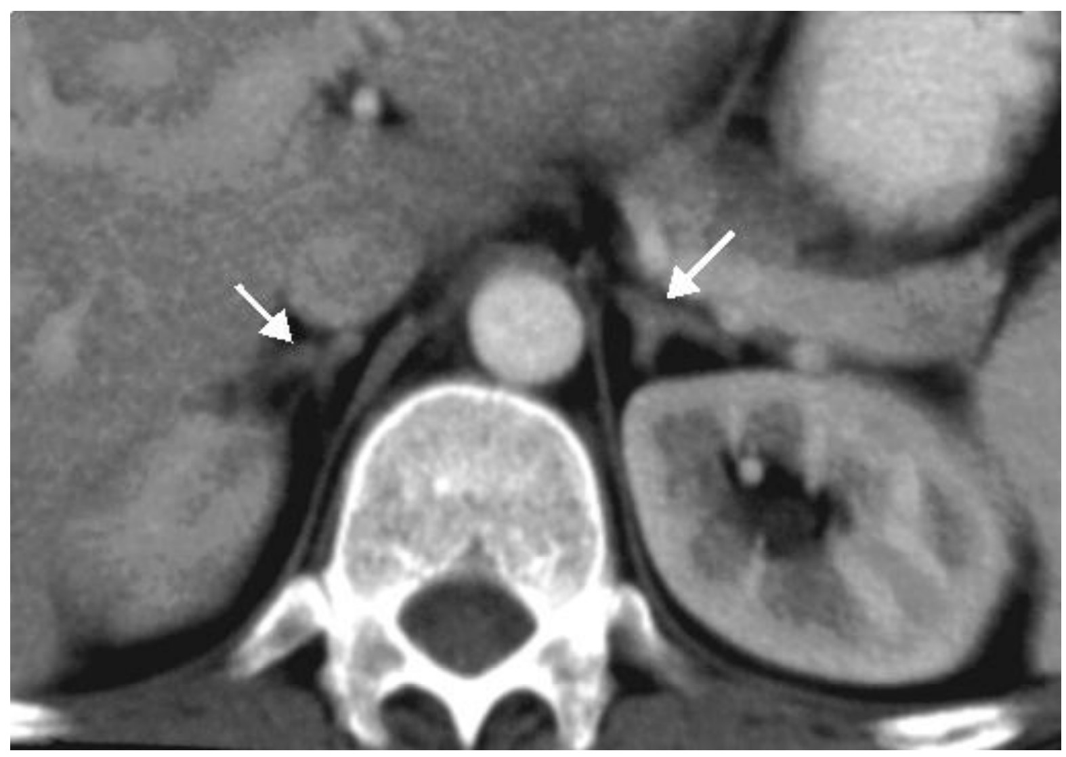
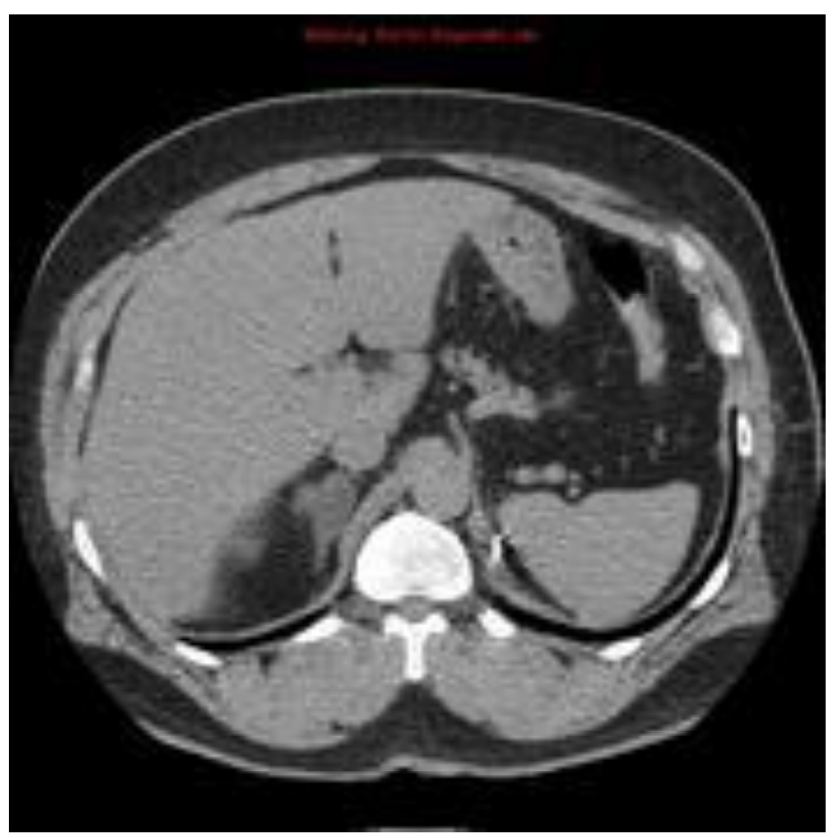
Conn's Syndrome
Laboratory Findings Cont.
Screening test | Confirmatory test
aldosterone/renin ratio If high: do confirmatory test If low: look for secondary causes | Saline infusion test Oral salt loading test Captopril test Fludrocortisone suppression test
Measurement of Aldosterone (both plasma and urinary): Very sensitive
Aldosterone measurement should be performed while the patient is taking a high salt diet with sodium chloride supplementation.
Assessment of aldosterone production can be best done by measurement of urinary aldosterone excretion over 24 hour period and it is superior to plasma aldosterone measurement in detecting abnormal production of aldosterone but cannot discriminate between adenoma and hyperplasia. While the plasma levels can differentiate between the two conditions in most cases.
Radiological Findings:
Localization of Adenoma/Carcinoma | Anatomical (CT Adrenal)
Scanning using I.V. Administered 1³ iodocholesterol locates tumour in 80% of the cases depending on the size of the tumour.
NP59 scan is another scan which consumes less time.
CT scanning is also useful with less radiation hazard.
MRI
Other methods include adrenal venography, adrenal vein catheterization and bilateral sampling of blood for aldosterone measurements.
Mercedes sign or inverted Y-shape
Tumor in the adrenal gland (adenoma secreting aldosterone and we will do surgery for it)
Treatment:
Adrenal hyperplasia (if bilateral) → Spironolactone
antihypertensive medication should be given as surgery will not ameliorate the hypertension.
Adenoma (if unilateral) → unilateral adrenalectomy
adequate potassium replacement and adequate extracellular volume expansion with adequate control of BP before surgery all of which can be achieved by spironolactone with or without other medications which should be given for some time before surgery.
The surgical cure of hypertension associated with adenoma is excellent as is reported to be over 50% in many series with reduction of hypertension in the remainder.

Slide 19
Pheochromocytoma
Definition
Pheochromocytomas are tumors arising from the chromaffin cells in the sympathetic nervous system.
They release epinephrine or norepinephrine (or both) and in some cases, dopamine into the circulation.
Characteristics:
Adenoma of adrenal medulla and activates sympathetic nervous system.
50% are silent. ( NO symptoms)
Pheochromocytoma may occur as a heritable disorder either alone or in combination with other endocrine tumours, e.g. MEN type II A – hyperparathyroidism, pituitary adenoma and medullary thyroid carcinoma or MEN Type II B – pheochromocytoma with mucosal neuroma.
Secondary HTN
Only 0.1% of hypertensive patients have pheochromocytoma but recognition is important because it can be fatal during delivery or surgery if unrecognized and not properly treated.
Episodic (spells): sweating, palpitation, headache
The role of 10:
10%
10%
10%
10%
bilateral
Familial
Malignant
Extra adrenal
Common extra adrenal sites and near the kidneys and the organ of Zuckerkandl.
They can also occur in the posterior mediastinal region.
When you should think about Pheochromocytoma ?
Typical symptoms (tachycardia, palpitations, sweating, headache and high blood pressure)
Secondary HTN:
Young age < 40
3 anti-HTN medications
Resistant HTN
Accelerated HTN
If there’s any adrenal mass in image: adrenal incidentaloma You should rule out:
pheochromocytoma
Cushing
If there is HTN ,you should R/O hyperaldosteronism also

Slide 20
Pheochromocytoma
Clinical Manifestation:
General | Most patients have symptoms that vary in intensity and are perceived to be mainly episodic or paroxysmal by about half the patients. Patients with persistently secreting tumors and chronic symptoms usually experience the symptoms complex in response to transient increases in the release of catecholamines. In addition, they have increased metabolic rate with heat intolerance, increased sweating with weight loss. There is also hyperglycemia and glucose intolerance.
Frequency of attacks | The attacks in pheochromocytoma in those patients with paroxysmal symptoms occur several times a week or oftener and last 15 minutes or less but they may occur at intervals of months or as often as 25 times a day and may last minutes to days. With time the attacks usually increase in frequency but do not change much in character.
Precipitating factors | They are usually precipitated by activities that compress the tumor, e.g. changes in position, exercise lifting, defecation or eating and by emotional distress or anxiety, even coughing or sneezing.
Hypertension | Most patients with persistent hypertension also have superimposed paroxysms and only few patients are entirely free of symptoms and hypertension between attacks and give no evidence of catecholamine excess during these intervals.
Symptoms during or following paroxysms:
In the attack the symptoms resemble those produced by injection of epinephrine or norepinephrine.
1 | Fatigue or exhaustion | 7 | Forceful heartbeat with or without tachycardia
2 | Tremor | 8 | Sweating
3 | Visual disturbances | 9 | cold hands and feet
4 | Abdominal or chest pain | 10 | Anxiety or fear of impending death
5 | Headache | 11 | Nausea and vomiting
6 | Increased sweating | 12 | weight loss, constipation

Slide 21
Pheochromocytoma
Symptoms Between paroxysms:
1
2
When there’s a metabolic derangement like diabetes and hypertension you should suspect secondary cause and look for hormonal disturbance including hypercortisolism , pheochromocytoma or conn's disease.
The intense alpha-recepto-mediated peripheral vasoconstriction causes cool, moist hands and feet and facial pallor.
This combination of increased cardiac output and vasoconstriction causes marked elevation of the blood pressure. The decreased heat loss and increased metabolism cause a rise in temperature and flushing and leads to reflex sweating which may be profuse and usually follows the cardiovascular effects.
3
4
The increased glycolysis and alpha receptor mediated inhibition of insulin release cause an increase in blood sugar levels.
Hypertension is usually present and characteristically there is wide fluctuations and an episode of marked hypertension might be followed by hypotension and shock.
The blood pressure typically does not respond to commonly used antihypertensive medications.
Chronic constriction of the arterial and venous beds leads to reduction in plasma volume and the inability to further constrict the bed upon arising causes the postural hypotension that is characteristically observed.
5
6
7
Patients with persistent symptoms and hypertension may develop hypertensive retinopathy or nephropathy as well as the other sequelae of hypertension.
A mass is felt in the neck or abdomen and palpation may produce a typical paroxysm.
CVA, CCF and MI are all observed. A significant number were found to have myocarditis post partum.
Other causes of increased sympathetic activity
Other causes of increased sympathetic activity must be thought of:
1 | Angina due to coronary vasospasm | 4 | Severe anxiety state
2 | Hypertension, Thyrotoxicosis | 5 | Menopausal hot flushes
3 | Hypertensive crises associated with: Paraplegia, Tabesansalis, Lead poisoning, Acute porphyria

Slide 22
Pheochromocytoma
Diagnosis
The diagnosis of pheochromocytoma should be considered in the following patients:
Patients with paroxysmal symptoms
Children with hypertension
Adults with severe hypertension not responding to therapy.
Hypertensive patients with diabetes or hyper-metabolism.
Hypertensive patients with symptoms resembling the symptom complex described above or can be evoked by exercise position change .. ect. or certain antihypertensive medications.
Patients who become severely hypertensive or go into shock during anesthesia, surgery or obstetric delivery,
Patients who have disorders sometimes associated with pheochromocytoma, e.g. neurofibromatosis, mucosal adenomes, medullary carcinoma of thyroid or those who have first degree relatives who have pheochromocytomas or other manifestations of MEN.
Ganglioneuromas and neuroblastomas can produce catecholamines with dopamine being the major product leading to a similar picture resembling pheochromocytoma.
Laboratory Diagnostic Test:
In patients with continuous hypertension or symptoms, levels of plasma or urinary catecholamines and their metabolites are usually clearly increased, the difficulty arises in patients having brief and infrequent paroxysms with symptom-free intervals and in such cases, sampling of blood or urine should be done during a carefully observed episode to confirm the diagnosis.
COMPOUND | Characteristic
Metanephrin Normetanephrin (Blood /Urine) | The best initial test is the level of free metanephrines in plasma. 24 hr urine collection of Metanephrines(2X) (Confirmatory Test). Make sure about medications that affect the result of the test (false positive ) Increased by catecholamines, MAOI and others. high levels are diagnostic for pheochromocytoma
Vanilly Mandelic Acid (VMA) (Urine) | Increased by catecholamines and food that contain vanillin or L-dopa. Decreased by Clofibrale and MAOI.
Catecholamines (Blood/Urine) | -
Epinephrine Norepinephrine Dopamine (Urine) | May be increased with highly fluorescent compounds, e.g. tetracycline, quinidine as well as food and drugs containing catecholamines, e.g. bananas and other drugs, e.g. methyldopa, ethanol.

Slide 23
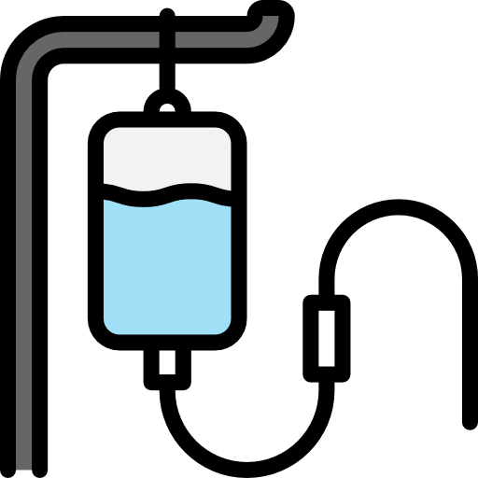
Pheochromocytoma
Anatomical Evaluation:
Once the diagnosis has been established, the tumor must be located prior to surgical removal.
CT scanning gives better results than sonography or other radiological tests. (CT scan = MRI).
MRI is evolving as very specific and excellent technique for detecting pheochromocytomas.
Analysis of blood samples obtained for venous drainage can be of great value in locating small tumours in unusal locations.
MIBG (meta-iodo-benzyl-guanidine) can detect even the smallest tumour but not all pheochromocytomas produce detectable images and other tumors e.g. neuroblastoma give positive images, MIBG if:
Paraganglioma
Young
Large size
malignant features
Genetic Tests:
N.B: 30-40% of Pheochromocytoma and Paraganglioma Have positive genetic test. ( not 10% )
Treatment
Treatment is directed toward:
1
Reduction of symptoms
2
3
Amelioration of paroxysms
Lowering of BP
Therapy with alpha adrenergic antagonists should be instituted. Such treatment will allow expansion of the vascular bed and plasma volume.
Agents commonly used include phentolamine and phenoxybenzamine, small doses of propranolol maybe required for marked tachycardia or arrhythmia prior or during surgery.
Therapy with phenoxybenzamine can be used as a diagnostic test in the occasional patient in whom the chemical tests are inconclusive. A good response in the nature and frequency of attacks as well as on BP indicates the need for re-evaluation of the patient with a strong suspicion for pheochromocytoma.
Patients should be fully prepared medically prior to surgery to avoid intra and postoperative complications.
Once the tumor is removed, the blood pressure usually falls and I.V. fluids and / or blood might be needed to restore circulatory volume.
Persistence of high BP after surgery should alert physician to look for other causes, e.g. renal vascular hypertension.
Surgery
Before the patient goes to surgery we need to:
Control HTN:
α-blocker² then B-Blocker (10-14 days before operation)
Ca-blockers: can be used
Salt loading¹:
Oral NaCl: 3 days
Or IVF 0.9% saline 1-2 days before surgery
Surgical removal
Surgical tumor resection with early ligation of venous drainage is the treatment of choice.
Ligation lowers the possibility of catecholamine release/crisis by tying off drainage.
1- the only case where sodium is given for HTN, because if you remove the tumor there will be vasodilation and this will lead to hypovolemia
2- Phenoxybenzamine is an alpha blocker that is the best initial therapy of pheochromocytoma. Calcium channel blocker and beta blockers are used afterward.

Slide 24
Primary adrenocortical insufficiency (Addison’s disease)
Causes | Major: Autoimmune (The most common cause) Type I (APECED) : affects children: Adrenal insufficiency, hypoparathyroidism, pernicious anaemia, chronic candidiasis, chronic active hepatitis, and hair loss) Type II (Schmidt's syndrome) usually affects young adults : hypothyroidism, adrenal insufficiency and diabetes mellitus, vitiligo Tuberculosis Minor: Infection, Infiltration, Iatrogenic, Medications, Hereditary, Miscellaneous.
Evaluation | Clinical | Biochemical | Anatomical
 | Weakness, Tiredness, Fatigue. Nausea, Vomiting, Constipation, Abdominal pain, Diarrhea and weight loss, Hyperpigmentation, Fasting hypoglycemia, Hypotension, Shock and death.
Measure a.m. cortisol:
If high: rule out
If very low : diagnosis
If borderline result : proceed for confirmatory test (ACTH stimulation test)
No indications to do imaging unless clinically indicated such as:
Patient on anticoagulation
Malignancy with metastasis
Other infiltrative disease
Treatment |  |  | Steroid replacement for secondary adrenocortical insufficiency: hydrocortisone only
Secondary/ Tertiary adrenal insufficiency
Causes | Panhypopituitarism (congenital / acquired), Isolated ACTH deficiency, Withdrawal from glucocorticoid therapy, Inadequate glucocorticoid replacement, Infant born to steroid-treated mother, Surgical removal of ACTH-producing adenoma of the pituitary gland.
Congenital Adrenal Hyperplasia
IVF: dextrose and salt
Electrolytes replacement
Steroid replacement for primary adrenocortical insufficiency:
hydrocortisone
Fludrocortisone
Clinical Features | 90–95% of CAH cases are caused by 21- OHD Ambiguous genitalia ( Female) Failure to thrive Dehydration & Shock ( usually male) |  | Salt-loss presentations with electrolytes imbalance: Hyponatremia Hyperkalemia Hypoglycemia Hyperpigmentation
Diagnosis | Clinical: History and examination (B.P) Biochemical: Low Na & high K, fasting hypoglycemia, elevated serum urea, elevated plasma Renin & ACTH levels, low Cortisol, High 17 – OHP, High androgens especially testosterone level, Low Aldosterone ( in salt losing types only).
Treatment | Hydrocortisone, Fludrocortisone, During adrenal crisis (intravenous hydrocortisone), IVF D5 0.9% saline, In vomiting or diarrhea (parental therapy is indicated), Medical Alert: bracelet.

Slide 25
Hypercortisolism (Cushing Syndrome)
Signs & Symptoms | Rounded "moon" facies with a plethoric appearance, truncal obesity with prominent supraclavicular and dorsal cervical fat pads "buffalo hump“, distal extremities and fingers are slender, muscle wasting and weakness, the skin is thin and atrophic, with poor wound healing and easy bruising, purple striae may appear on the abdomen, hypertension, renal calculi and osteoporosis.
Investigation | Clinical | Biochemical | Anatomical
Treatment | Surgical or Medical
Conn's Syndrome
Clinical Features | Primary hyperaldosteronism, Adenoma, usually unilateral, of the glomerulosa cells of the adrenal cortex, rarely, adrenal carcinoma, Hyperplasia, The clinical picture may mimic CAH from of 11 α-hydroxylase deficiency. Secondary HTN, High Na, high Cl, high Aldosterone, Alkalosis and low K ( episodic weakness, Paresthesias, transient paralysis, tetany, nephropathy with polyuria and polydipsia)
Function : Hirsutism, acne, easy bruising, DM, HTN, irregular period, proximal weakness, recurrent infections, depression
O/E: hirsutism, acne, moon face, central obesity, stria, proximal weakness, supraclavicular fat pad,
High cortisol
High ACTH (ACTH dependent) and low if (non-ACTH dependent).
24hrs for UFC
1MG DST
Midnight salivary cortisol
If ACTH:
high: MRI pituitary
low: history then CT adrenals
Screening test:
aldosterone/renin ratio
If high: do confirmatory test
If low: look for secondary causes
Confirmatory test:
Saline infusion test
Oral salt loading test
Captopril test
Fludrocortisone suppression test
Biochemical Investigation
Treatment | Adenoma → Surgical resection |  | Adrenal hyperplasia → Spironolactone
Pheochromocytoma
Clinical Features | 50% are silent. ( NO symptoms), Isolated or part of MEN type II A or MEN type II B, Episodic (spells): sweating, palpitation, headache, Typical symptoms are (Secondary HTN, Young age < 40, 3 anti-HTN medications, Resistant HTN and Accelerated HTN.
Investigation | Biochemical: 24 hr urine collection of Metanephrines, Plasma Metanephrines Anatomical: CT scan = MRI MIBG if: Paraganglioma, Young, Large size, malignant features Genetic Tests
Management | Control HTN: α-blocker2 then B-Blocker, Ca-blockers: can be used Salt loading: Oral NaCl for 3 days Or IVF 0.9% saline 1-2 days before surgery Surgical removal

Slide 26
Q1: Which of the following conditions from the list below is not associated with cutaneous hyperpigmentation?
A- Hypopituitarism
B- Addison’s disease
C- Cushing’s syndrome
D- Pregnancy
Q2: A 65-year-old woman complains of panic attacks. She has recently retired as a school teacher, but 2–3 times a week she suffers extreme anxiety, becomes short of breath and sweats excessively. Elevated catecholamines are detected in the urine. The most appropriate medical treatment is:
A- Phenoxybenzamine alone
B- Prolopanolol alone
C- Phenoxybenzamine followed by propanolol
D- Sodium nitroprusside
Q3: A 28-year-old woman has noticed a change in her appearance; most notably her clothes do not fit properly and are especially tight around the waist. Her face appears flushed and more rounded than usual, despite exercising regularly and eating healthily her weight has steadily increased over the last 3 weeks. On visiting her GP, he notices her blood pressure has increased since her last visit and she has bruises on her arm. She is especially worried about a brain tumour. The most appropriate investigation would be:
A- Low-dose dexamethasone test
B- High-dose dexamethasone test
C- Computed tomography (CT) scan
D- Urinary free cortisol measurement
Q4: A 22-year-old woman complains of dizziness and feeling light-headed. She works in an office and most frequently experiences this when standing up to visit the toilet. She has never fainted. The patient has lost 5 kg, but attributes this to eating more healthily. She has noticed a recent scar on the back of her hand which has started to turn very dark. The most appropriate investigation is:
A- Synacthen test
B- Low-dose dexamethasone test
C- Cortisol measurement
D- Urinary free cortisol measurement
Q5: A 57-year-old woman, who has recently returned from a holiday in America, presents with dull grey-brown patches in her mouth and the palms of her hand which she has noticed in the last week. She has also noticed she gets very dizzy when rising from a seated position and is continually afraid of fainting.The most likely diagnosis is:
A- Addison’s disease
B- SIADH
C- Conn’s syndrome
D- 17-hydroxylase deficiency
Answers: Q1:A | Q2:C | Q3:D | Q4:A | Q5:A
Answers Explanation File!

Slide 27
THANKS!!
This lecture was done by:
Nawaf Albhijan
Quiz and summary maker:
Nawaf Albhijan
Note taker:
Nawaf Albhijan
Amirah Aldakhilallah
Special thanks to..
Females co-leaders:
Raghad AlKhashan
Amirah Aldakhilallah
Males co-leaders:
Mashal AbaAlkhail
Nawaf Albhijan
Send us your feedback:
We are all ears!

