Slide 1
Lecture 49
Editing file
Parathyroid disorders
Objectives:
Understand the metabolism of Vitamin D
Know the disorders of Parathyroid glands
Define the Osteoporosis
Define the Osteomalacia
Understand Calcium and related hormones physiology
Understand hyperparathyroidism
Color index:
Color index:
Original text Females slides Males slides
Doctor’s notes Text book Important Golden notes Extra

Slide 2
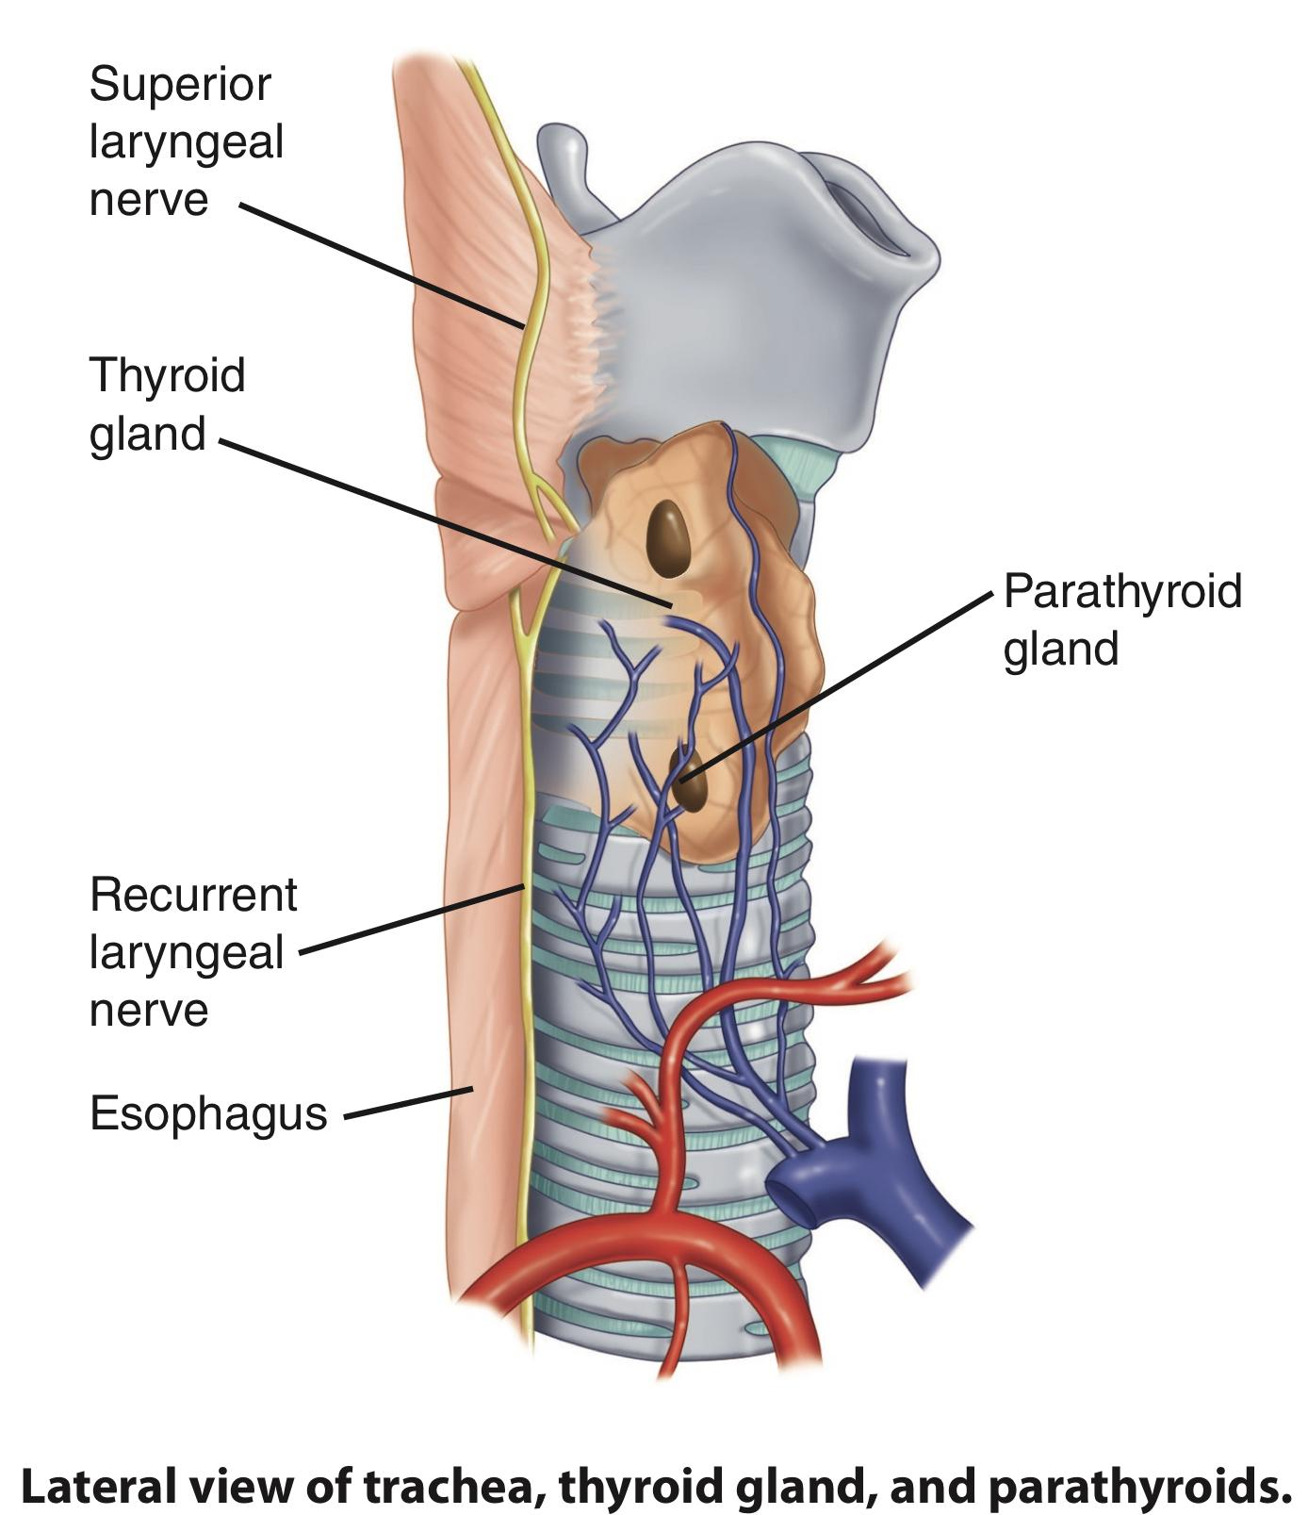
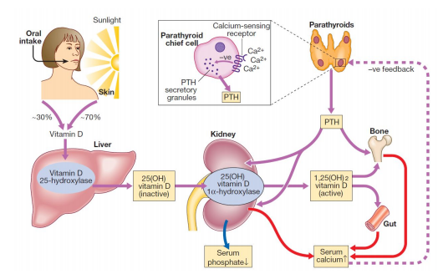
Review of the basics
Anatomy of parathyroid glands
The parathyroid glands are four small, pea-sized structures attached to the posterior aspect of the thyroid gland, external to the fibrous thyroid capsule
The glands are anatomically separated into two superior and two inferior parathyroids.
Both sets are supplied by the inferior thyroid arteries with venous drainage through the thyroid plexus of veins.
Calcium and phosphate homeostasis
Calcium plays an important role in numerous physiologic processes, ranging from muscle contraction to neuronal impulse transmission and bone mineralization.
Extracellular calcium concentrations are tightly regulated to protect against large fluctuations, it has a very narrow range ( 2.1-2.5 mmol/l).
Only 0.1% of total body calcium is found in the extracellular fluid (ECF). The vast majority of the remaining calcium, approximately 99%, is stored within bone
Recall from endocrine block:
40% of serum calcium is bound to plasma proteins (Increase in pH leads to increased calcium affinity.
10% of serum calcium is complexed with anions such as phosphate and citrate.
50% serum calcium is in a free, ionized form. (Only this one is biologically active)
Like calcium, a very small quantity (1%) of total body phosphate is found in the extracellular space; most phosphate is in bone.
Hormones that regulate Ca and PO4
These hormones regulate the flow of minerals in and out of the extracellular fluid compartments through their actions on intestine, kidneys, and bones.
Hormone | Action
PTH (Polypeptide) | Source: Chief cells of parathyroid Action: The PTH acts directly on the bones and kidneys and indirectly on the intestine through its effect on the synthesis of 1,25 (OH)2D3, Increases serum Ca, decreases serum phosphate, increases urine phosphate, and increases 1,25-(OH)₂D₃ (calcitriol) production by activating 1α-hydroxylase in PCT Regulation: Stimulate PTH secretion: Low Ca, High PO4 or Low Mg (if Mg is severely low it will suppress PTH) Inhibit PTH secretion: The opposite
Vitamin D (Called vitamin but it is steroid hormone) | Source: Skin of animals, including humans (Endogenous, 90%) or plants (Exogenous) Action: Increase intestinal absorption of Ca2+ and PO4, increases bone mineralization at low levels and increases bone resorption at higher levels. Regulation: High PTH, Low Ca2+, Low PO4 → Increases 1,25 - (OH)₂D₃ production. Also, 1,25 - (OH)₂D₃ feedback inhibits its own production.
Calcitonin (Polypeptide) | Source: Parafollicular cells (“C” cells) of thyroid Action: Decrease bone resorption by inhibiting osteoclasts (Opposes actions of PTH), it also inhibits Ca reabsorption in renal tubular cells, but in general it’s not important in the normal Ca Homeostasis, may be used for treatment of hypercalcemia. Regulation: Secretion stimulated by High Ca and inhibited by Low Ca

Slide 3
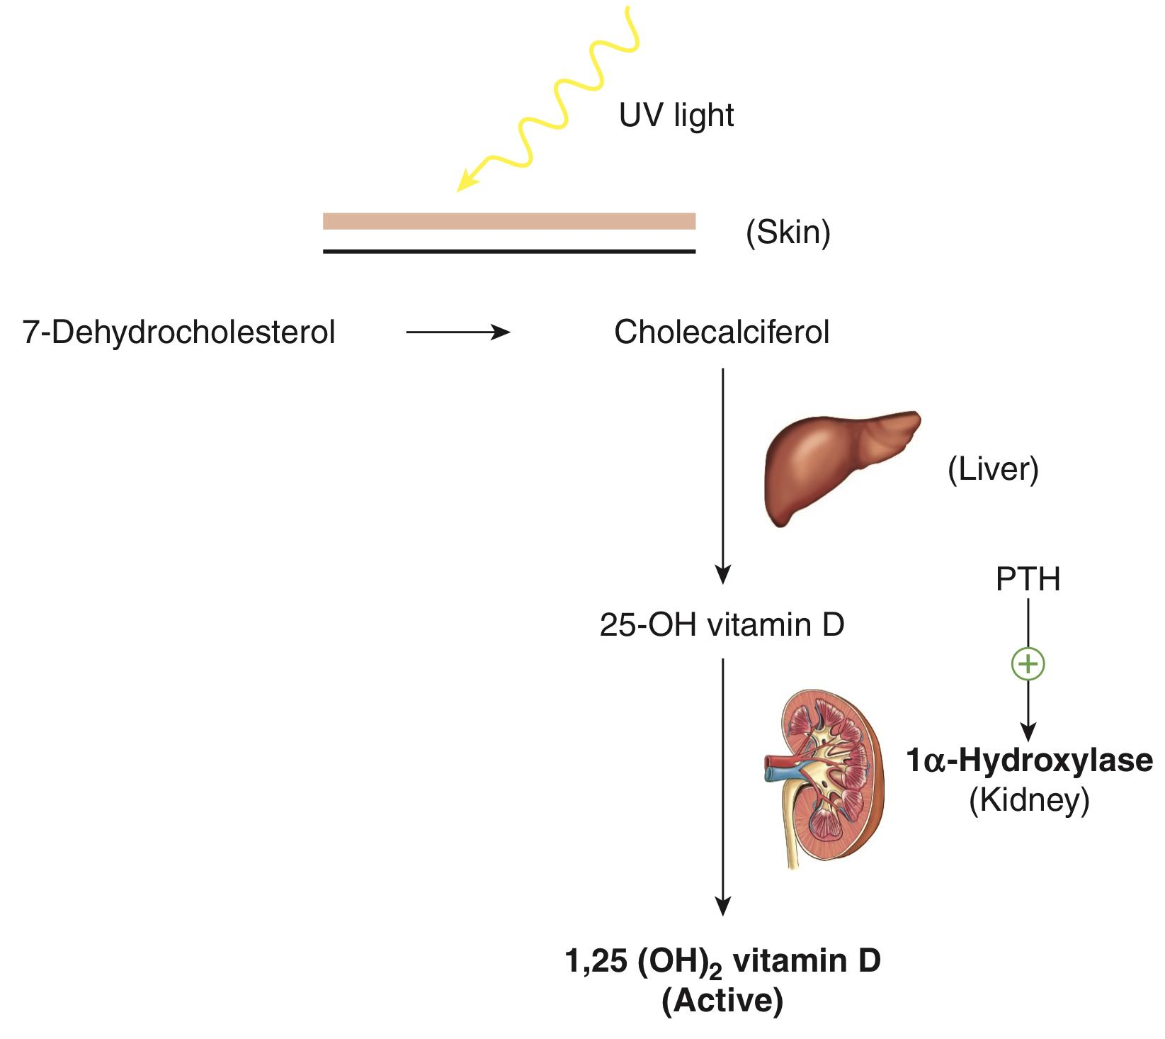
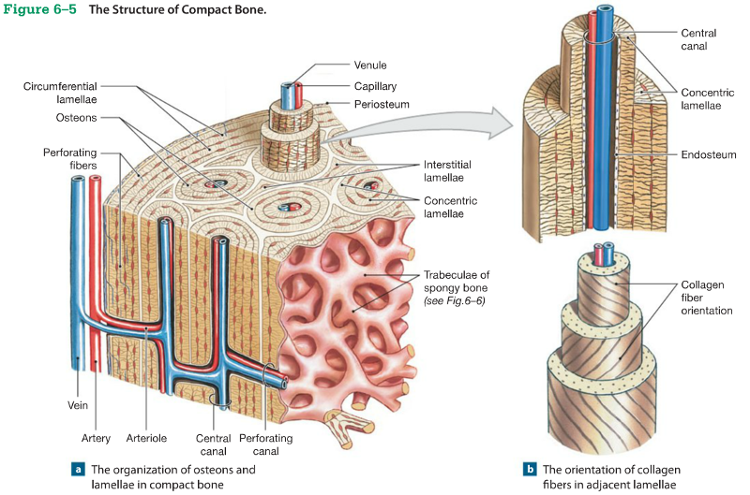
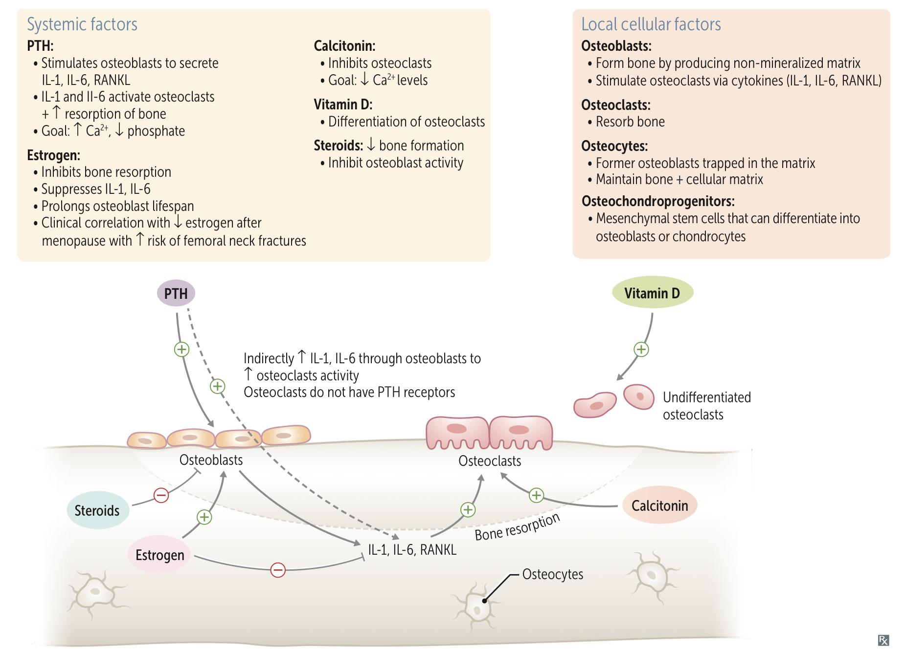
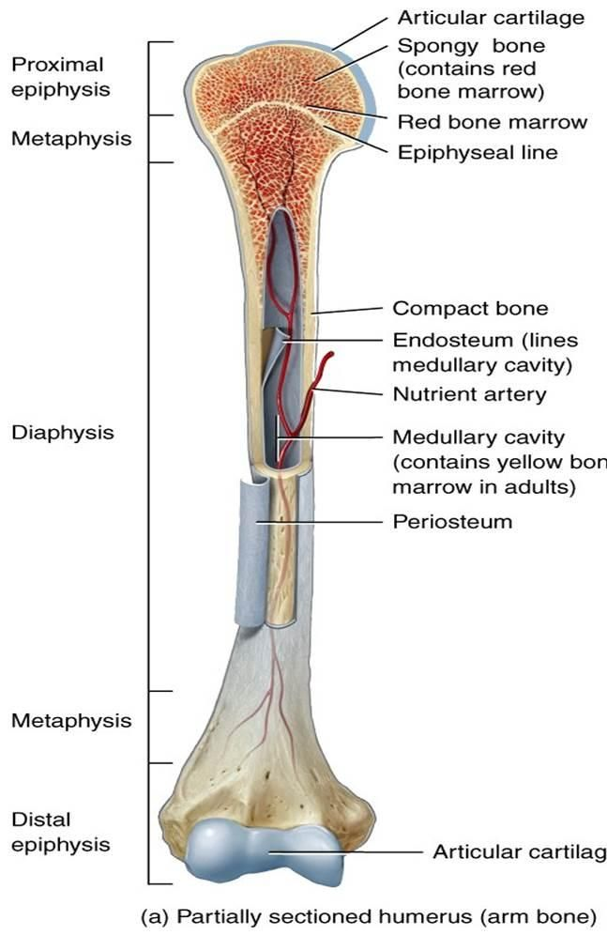
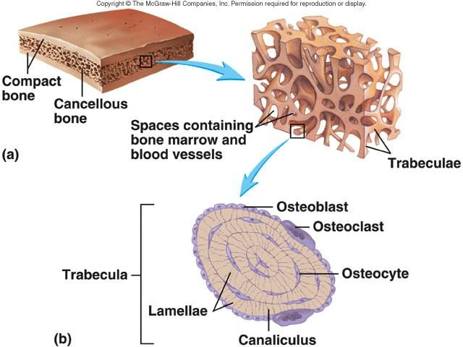
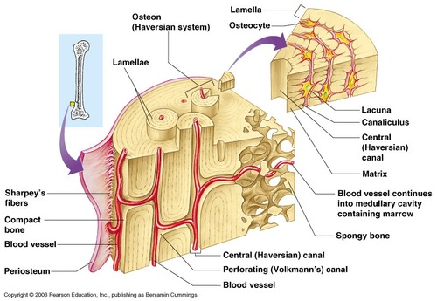
Review of the basics cont.
Vitamin D metabolism
How is Vitamin D formed?
Specific wavelengths of UV light at a particular angle react with 7-dehydrocholesterol to produce vitamin D3 (Cholecalciferol).
Cholecalciferol is first hydroxylated in the liver to form 25-hydroxycholecalciferol. This is the storage form of vitamin D. It is also the level measured in clinical lab tests.
In the kidney, 25-hydroxycholecalciferol undergoes a second hydroxylation reaction catalyzed by 1α-hydroxylase. The product of this reaction, 1,25-dihydroxycholecalciferol [1,25-(OH)2 vitamin D], is the active form of vitamin D, also referred to as calcitriol. This is the form used in treating Vitamin D deficiency.
Best time for sun exposure in Riyadh:
Summer: 9 am - 10:30 & 2-3 pm (ultraviolet rays are perpendicular to ground)
Winter: 10 am -2 pm
Note: The time is different from a country to another bc it depends on the angle of the UV light that hits our skin. The exposure to sunlight has to be direct (Not through window/glass)
Normal bone physiology
Bone has 3 major functions:
Provide rigid support to extremities and body cavities containing vital organs.
Provide efficient levers and sites of attachment of muscles which are all crucial to locomotion.
Provide a large reservoir of ions such as calcium, phosphorus, magnesium and sodium which are critical for life and can be mobilized when the external environment fails to provide them
There are 2 types of bone:
Cortical bone: The compact bone of Haversian system such as in the shaft of long bones.
Trabecular bone: The lattice – like network of bone found in the vertebrae and the ends of long bones.
The different pattern of bone loss affecting trabecular and cortical bone results in two different fracture syndrome. Defective cortical bone → Fractures of long bones. Defective trabecular bone → Vertebral or pelvic fractures.
Bone are highly active, the skeleton completely regenerate every 9 years.
In the past, it was thought that osteocytes only function as precursors of osteoblasts, but now we know that they play an important role in the signaling process of osteoblasts and osteoclasts

Slide 4
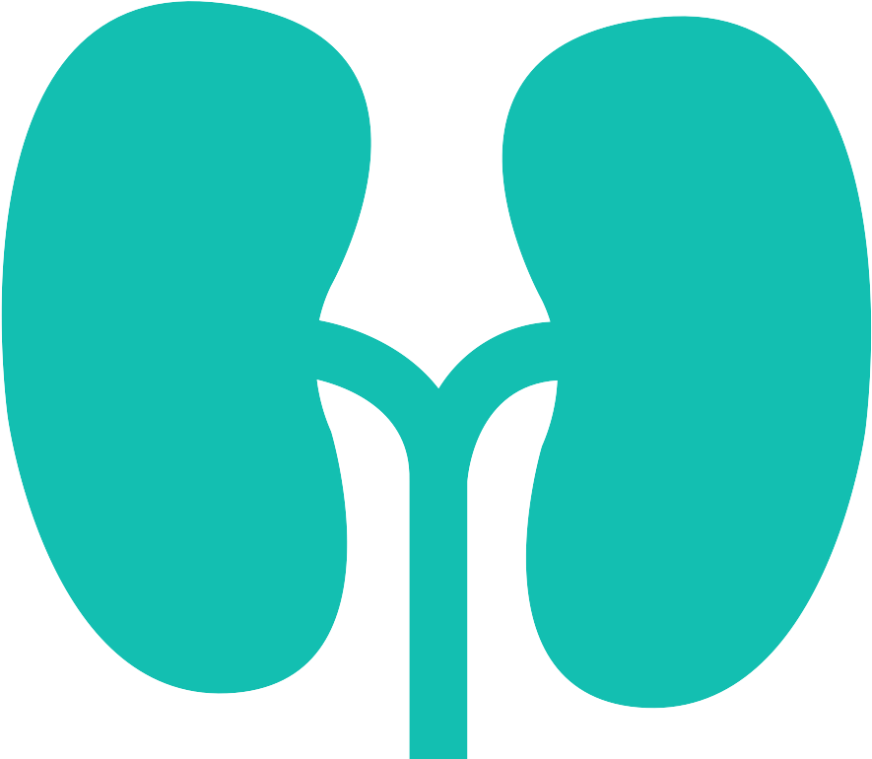
Primary Hyperparathyroidism
Definition
Primary hyperparathyroidism is due to excessive production of PTH by one or more of hyperfunctioning parathyroid glands. This leads to hypercalcemia which fails to inhibit the gland activity in the normal manner.
Etiology
The cause of primary hyperparathyroidism is unknown, a genetic factor may be involved.
The clonal origin of most parathyroid adenomas suggests a defect at the level of the gene controlling the regulation and/or expression of parathyroid hormone.
The incidence of the disease increases dramatically after the age of 50 and it is 2-4 folds more common in women.
A single adenoma occurs in about 80% of patients with primary hyperparathyroidism.
Four glands hyperplasia account for 15-20% of cases.
A parathyroid carcinoma could be the etiology in a rare incidence of less than 1% but should always be considered as a differential.
Clinical features
Classic presentation: Stones, Bones, Abdominal groans and Psychic moans
The most common presentation: Asymptomatic hypercalcemia, nowadays almost 90% of diagnosed cases in the developed countries are picked up by routine screening for calcium level using the new automated machines. early on, patients usually present with very vague manifestations.
The two major sites of potential complications are the bones and the kidneys. Nowadays such complications are seen less commonly and around 20% of patients or less show such complications.
Neuromuscular
Fatigue, lethargy, weakness
Cardiovascular Hypertension (Mechanism is unclear), ventricular hypertrophy
Other manifestations
peptic ulcer (late), pancreatitis, gout and pseudogout, anemia, constipation, Corneal calcification (sign of longstanding hyperCa)
Bone
Osteoporosis and fractures, osteitis fibrosa cystica*
Neuropsychiatric
Depressed mood, psychosis
Kidney
Nephrocalcinosis (diffuse deposition of calcium- phosphate complexes in the parenchyma) and Nephrolithiasis (ca oxalate stones)
*Osteitis fibrosa cystica (In advanced disease) is a cystic bone spaces filled with brown fibrous tissue (“ brown tumor” consisting of osteoclasts and deposited hemosiderin from hemorrhages; causes bone pain).
Osteitis fibrosa cystica could occur with subperiosteal resorption of the distal phalanges, distal tapering of the clavicles, a “salt and pepper” appearance of the skull as well as bone cysts and brown tumors of the long bones.

Slide 5
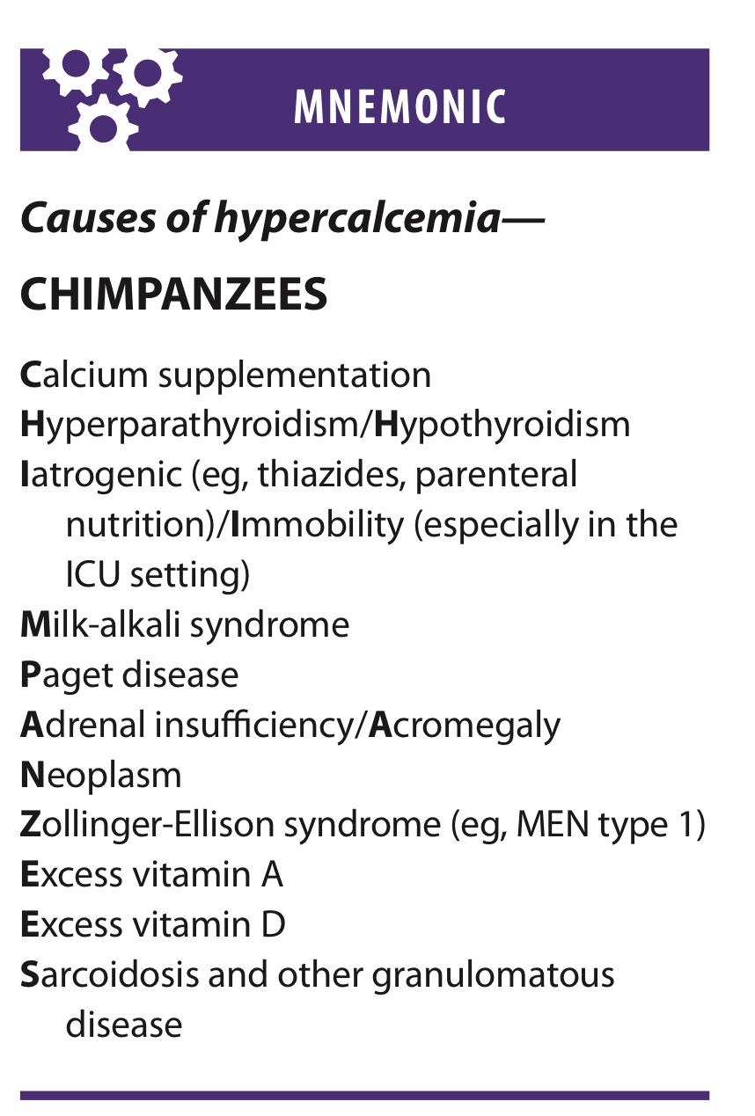
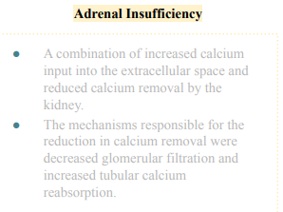
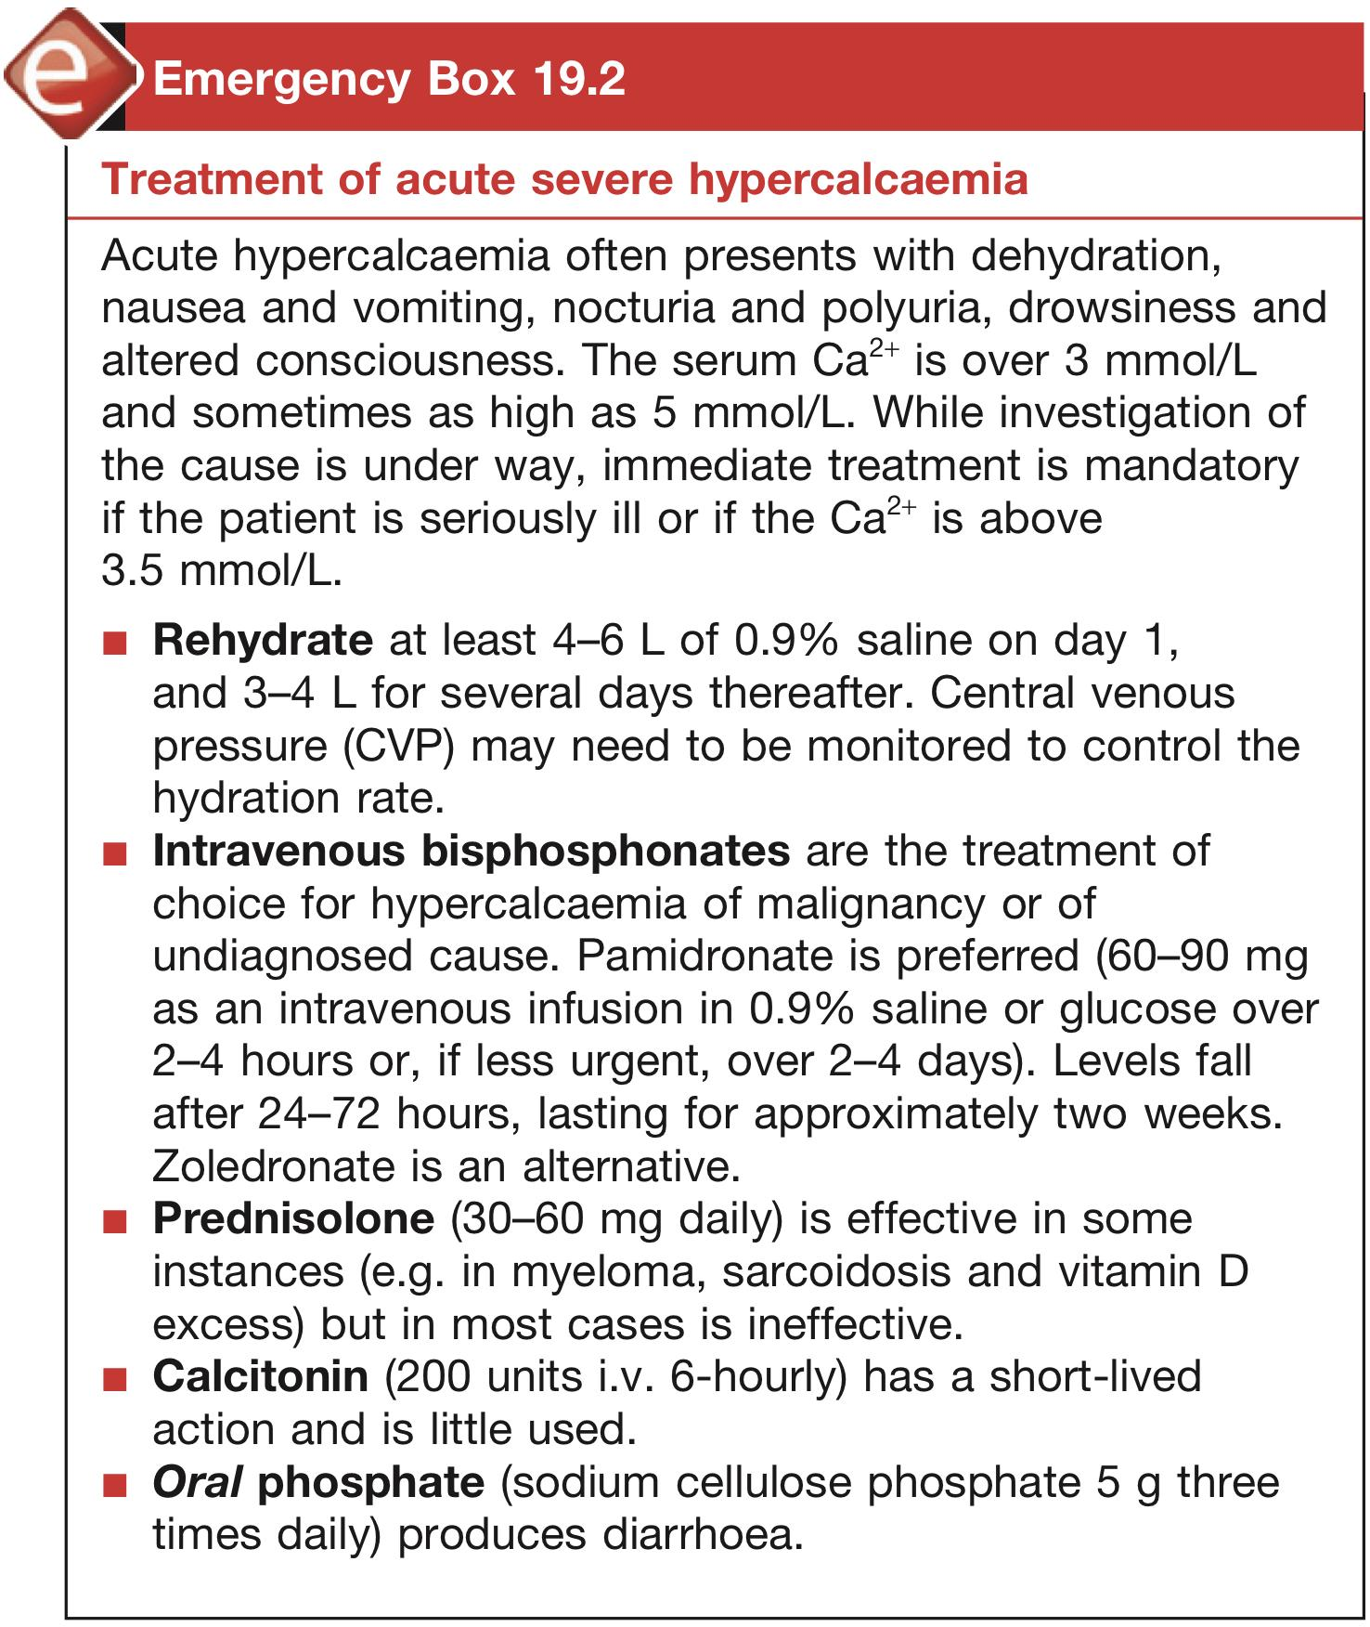
Primary Hyperparathyroidism cont.
DDx of hypercalcemia
Parathyroid-related
Vitamin D- related
normal PTH levels
Malignancy-related
Primary hyperparathyroidism:
Solitary adenomas
Multiple endocrine neoplasia
Lithium therapy
Familial Hypocalciuric Hypercalcemia
Autosomal dominant
Usually asymptomatic
PTH is normal
Mild hypercalcemia
Hypocalciuria
Mg high normal or high.
Vitamin D intoxication
↑ 1,25(OH)2D: Sarcoidosis and other granulomatous diseases
Idiopathic hypercalcemia of infancy
Note: Sarcoidosis is a non-caseating chronic granulomatous disease
Increased PTHrp: commonest cause (BREAST CANCER)
MULTIPLE MYELOMA: production of osteoclast activating factor
Solid tumor with humoral mediation of hypercalcemia (lung, kidney)
↑ 1,25(OH)2D: Lymphoma
Leukemia
Note: PTH is normal in malignancy induced hypercalcemia
The condition demonstrates increased renal reabsorption of calcium despite hypercalcaemia. PTH levels are normal or slightly raised and urinary calcium is low. It is caused by loss of function mutations in the gene on the long arm of chromosome 3 encoding for the calcium-ion-sensing G-protein coupled receptor in the kidney and parathyroid gland. Parathyroid surgery is not indicated as the course appears benign. This diagnosis can be differentiated from hyperparathyroidism in an isolated case by the calcium creatinine ratio in blood and urine.
Associated with high bone turnover
Associated with renal failure
Adrenal Insufficiency
Hyperthyroidism
Immobilization (Esp. in ICU)
Thiazides: increase renal calcium reabsorption
Vitamin A intoxication
Severe secondary hyperparathyroidism
Aluminum intoxication
Milk alkali syndrome
-
Medical treatment of Hypercalcemia (Females slides only)
In acute severe forms the mainstay of therapy is adequate hydration with saline and forced diuresis by diuretics to increase the urinary excretion of calcium rapidly along with sodium and prevent its reabsorption by the renal tubules.
Glucocorticoids | Mythramycin
In hypercalcaemia associated the hematological malignant neoplasms | A toxic antibiotics which inhibit bone resorption and is used in hematological and solid neoplasms causing hypercalcaemia.
Calcitonin | Bisphosphonates
Also inhibit osteoclast activity and prevent bone resorption | They are given intravenously or orally to prevent bone resorption.
Phosphate | Estrogen
Oral phosphate can be used as an antihypercalcaemic agent and is commonly used as a temporary measure during diagnostic workup. | It also decrease bone resorption and can be given to postmenopausal women with primary hyperparathyroidism using medical therapy

Slide 6
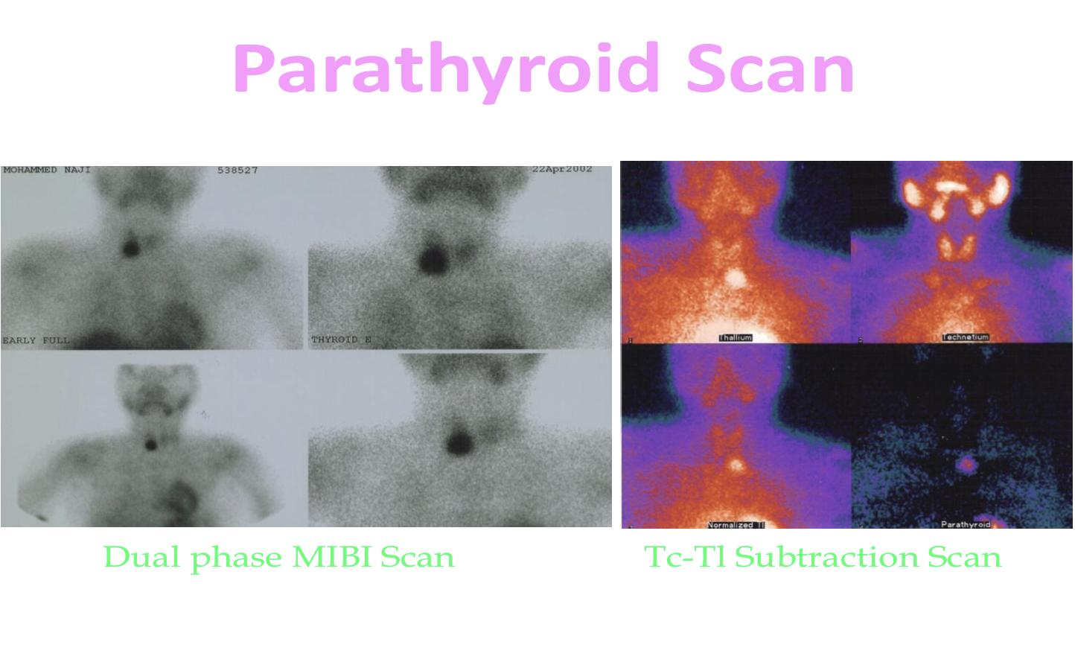
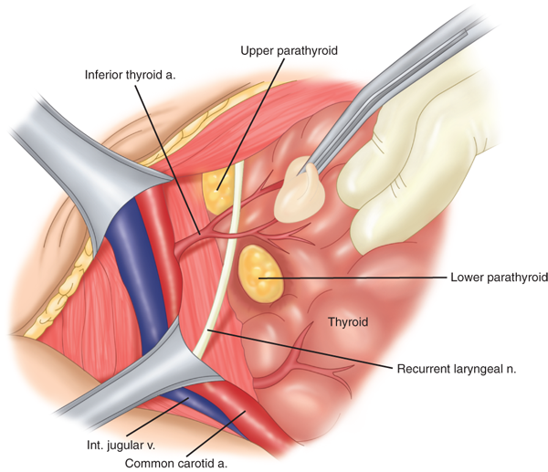
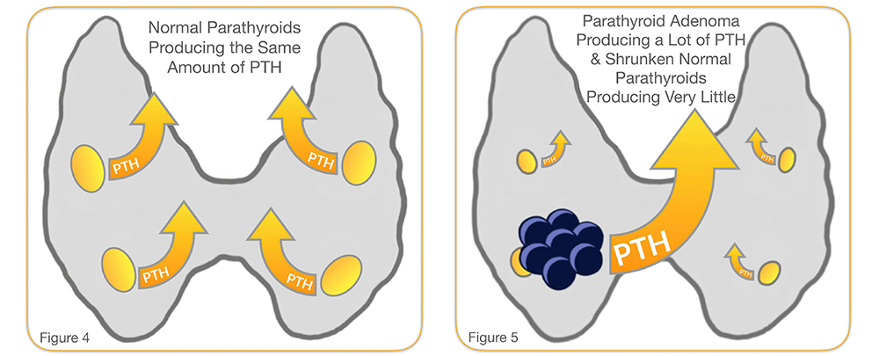
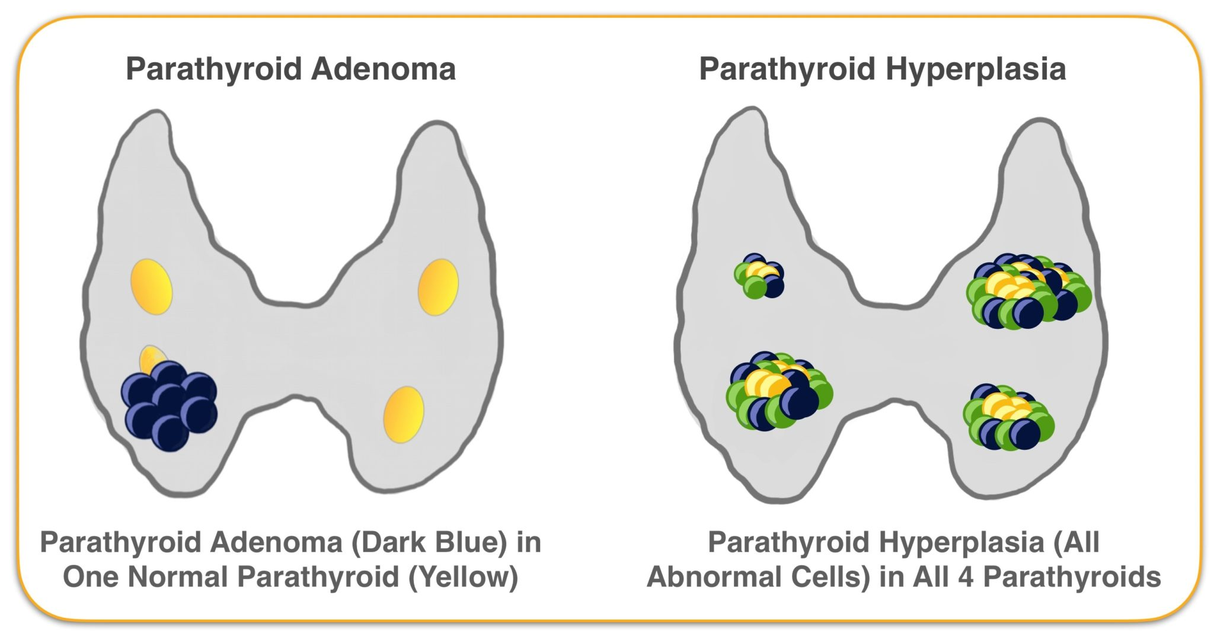
Primary Hyperparathyroidism cont.
Diagnosis
Lab tests
The presence of established hypercalcaemia in more than one serum measurement accompanied by elevated immunoreactive PTH is characteristic (iPTH).
Serum phosphate is usually low but may be normal.
Blood alkaline phosphatase (of bone origin) is raised.
Summary: ↑ Calcium, ↓ Phosphorus, ↑ PTH; when this combination is present in an asymptomatic patient then further investigation is usually unnecessary.
Hypercloreaemic acidosis (Often mild)
24-hour urinary calcium or single calcium creatinine ratio should be measured in a young patient with modest elevation in calcium and PTH to exclude familial hypocalciuric hypercalcaemia
Protein electrophoresis/immunofixation: to exclude myeloma
Hydrocortisone suppression test: hydrocortisone 40 mg three times daily for 10 days leads to suppression of plasma calcium in sarcoidosis, vitamin D-mediated hypercalcaemia and some malignancies.
Imaging
Plain X-ray of hands can be diagnostic showing subperiosteal bone resorption usually on the radial surface of the distal phalanx with distal phalangeal tufting as well as cysts formation and generalized osteopenia. Abdominal X-ray may show stones.
Preoperative localization of the abnormal parathyroid gland(s):
Ultrasonography
MRI
CT: usually done after sestamibi scan for further localization of the adenoma
Thallium 201 – Tehcnichum99m scan (subtraction study) and sestamibi scan (85-95% sensitivity)
Treatment
Surgical treatment (Parathyroidectomy) should be considered in all cases with established diagnosis of primary hyperparathyroidism.
while waiting for surgery, patient should be kept hydration, sometimes given diuretics to increase calcium excretion.
If patient is symptomatic (lithiasis, osteoporosis, pancreatitis) surgery is indicated:
Bilateral neck exploration
Or Focused parathyroid exploration if adenoma is localized preoperatively
During surgery the surgeon identifies all four parathyroid glands (using biopsy if necessary) followed by:
The removal of the enlarged parathyroid, not all the 4 glands (In case of adenoma)
Or 3 1⁄2 glands in case of multiple glandular hyperplasia. (You can easily live with half a parathyroid gland)
Intraoperative PTH monitoring
Endoscopic parathyroidectomy
Minimal access surgery is used, and some centres measure PTH levels intra-operatively to ensure the adenoma has been removed.
Medical treatment: cinacalcet (Calcimimetic agent) can be used if patient has high surgical risk e.g. elderly and dialysis patients

Slide 7
Secondary & Tertiary Hyperparathyroidism
Secondary hyperparathyroidism:
Secondary :
01
An increase in PTH secretion which is adaptive and unrelated to intrinsic disease of the parathyroid glands is called secondary hyperparathyroidism.
Physiological compensatory hypertrophy of all parathyroids because of chronic hypocalcaemia.
Causes: chronic kidney disease (Most common), vitamin D deficiency or malabsorption
PTH levels are raised but calcium levels are low or normal, and PTH falls to normal after correction of the cause of hypocalcaemia where this is possible.
Chronic renal disease causing hypocalcemia “The most important cause as the body loses the active conversion of vit D to the most biological active form of vit D that shows the majority of its effect”.
Severe vitamin D deficiency
Malabsorption
Tertiary Hyperparathyroidism:
Tertiary Hyperparathyroidism occurs after long standing secondary hyperparathyroidism,such as CKD
02
Tertiary hyperparathyroidism:
The development of apparently autonomous parathyroid hyperplasia after long-standing secondary hyperparathyroidism, most often in renal failure.
Plasma calcium and phosphate are both raised, the latter often grossly so. (cf. 1ry hyperparathyroidism)
Parathyroidectomy is necessary at this stage.
Summary of Hyperparathyroidism
Type | Calcium | PTH | Vitamin D | Phosphate
Primary | High | High | Normal | Low
Secondary | Low | High | Low | High or Low
Tertiary | High | High | Low | High
An area for your notes

Slide 8
Hypoparathyroidism
Definition
Secondary :
Deficient secretion of PTH which manifests itself biochemically by hypocalcaemia, hyperphosphatemia diminished or absent circulating iPTH and clinically the symptoms of neuromuscular hyperactivity.
Chronic renal disease causing hypocalcemia “The most important cause as the body loses the active conversion of vit D to the most biological active form of vit D that shows the majority of its effect”.
Severe vitamin D deficiency
Malabsorption
Etiology
The most common causes are autoimmune or post-surgery (Thyroidectomy)¹
Tertiary Hyperparathyroidism:
Tertiary Hyperparathyroidism occurs after long standing secondary hyperparathyroidism,such as CKD
1- Surgical hypoparathyroidism (The commonest):
After anterior neck exploration for thyroidectomy, abnormal parathyroid gland removal², excision of a neck lesion.
It could be due to the removal of the parathyroid glands or due to interruption of blood supply to the glands.
2- Functional hypoparathyroidism:
In patients who have chronic hypomagnesaemia of various causes.
Magnesium is necessary for the PTH release from the glands and also for the peripheral action of the PTH.
Severe diarrhea, malabsorption or other conditions that might cause hypomagnesemia.
Magnesium is like the fuel for parathyroid glands. So, if you have a patient with hypocalcemia, you have to check or check Mg.
3- Idiopathic hypoparathyroidism:
A form occurring at an early age (genetic origin) with autosomal recessive mode of transmission “multiple endocrine deficiency autoimmune-candidiasis (MEDAC)syndrome”
“Juvenile familial endocrinopathy”
“Polyglandular autoimmune syndrome Type 1 (AKA “Hypoparathyroidism – Addison's disease – mucocutaneous candidiasis (HAM) syndrome”)”: In children (2-4y/o) and In this sequence (moniliasis “mucocutaneous candidiasis” → hypoparathyroidism →hypoadrenalism)
Circulating antibodies for the parathyroid glands and the adrenals are frequently present.
Associated disease:
Pernicious anemia
Ovarian failure
Autoimmune thyroiditis
Diabetes mellitus
The late onset form occurs sporadically without circulating glandular autoantibodies
1- A good surgeon should be aware and take caution of the recurrent laryngeal and parathyroid gland when performing thyroid surgery
2- The major danger after operation is hypocalcaemia, which is more common in patients who have significant bone disease and/or vitamin D deficiency– the ‘hungry bone’ syndrome. Pre-treat such patients, with alfacalcidol 2 µg daily from 2 days preoperatively for 10–14 days, and routine vitamin D replacement (preferably without calcium) is always indicated if deficiency is diagnosed.

Slide 9
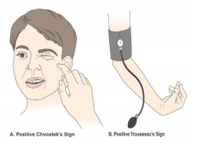
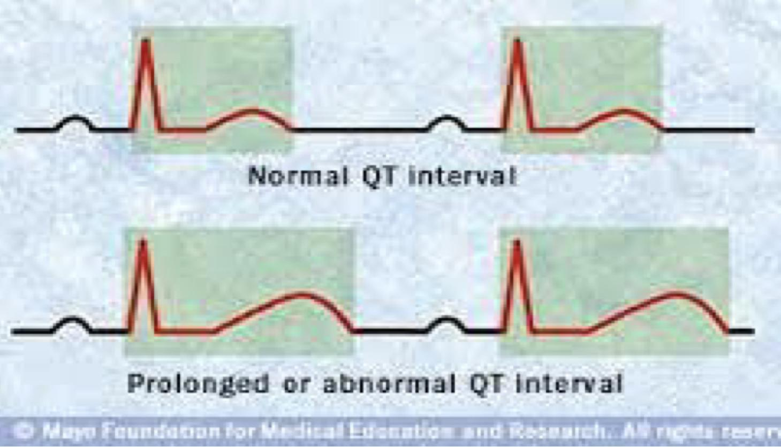
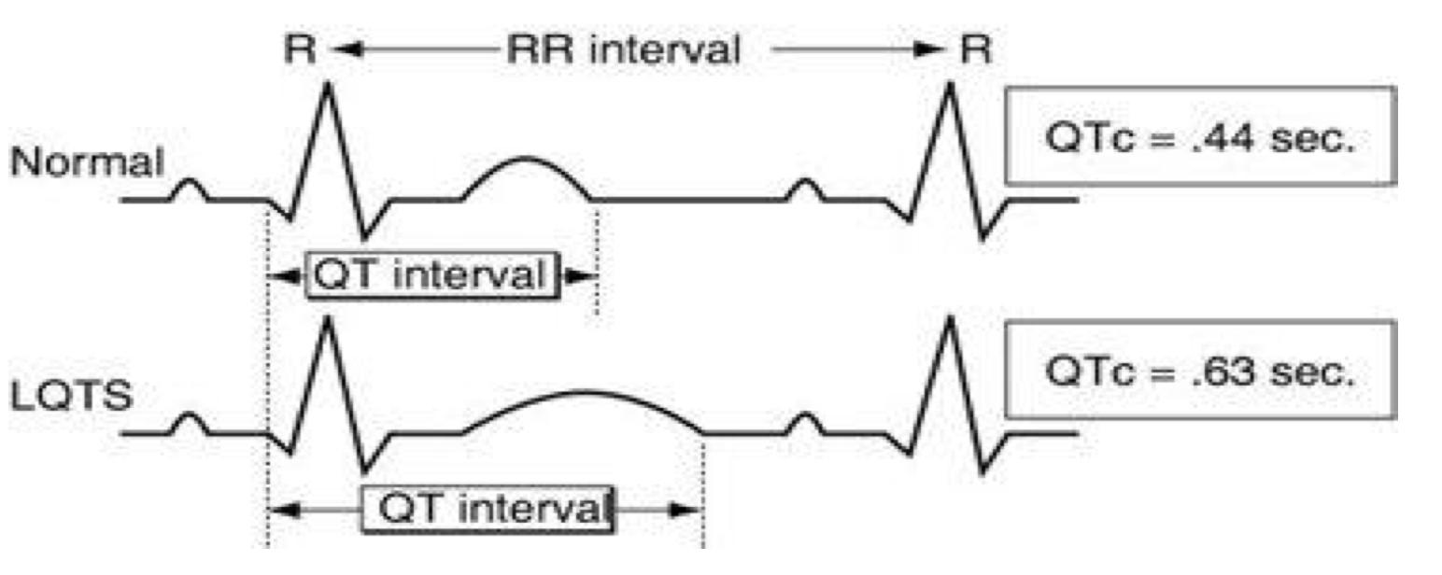
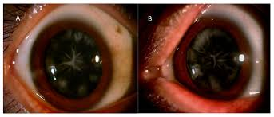
Hypoparathyroidism cont.
Clinical Presentation of Hypoparathyroidism
Neuromuscular
Increased PTHrp: commonest cause (BREAST CANCER)
MULTIPLE MYELOMA: production of osteoclast activating factor
Solid tumor with humoral mediation of hypercalcemia (lung, kidney)
↑ 1,25(OH)2D: Lymphoma
Leukemia
Note: PTH is normal in malignancy induced hypercalcemia
The rate of decrease in serum calcium is the major determinant for the development of neuromuscular complications.
When nerves are exposed to low levels of calcium they show abnormal neuronal function which may include decrease threshold of excitation, repetitive response to a single stimulus and rarely continuous activity
Paresthesia and numbness around mouth, hands and feet and laryngeal stridor
Tetany (if severe acute hypocalcemia, usually post-surgical)
Hyperventilation and carpopedal spasm (Adduction of thumb and hyperextension of the fingers)
Adrenergic symptoms
Convulsion (More common in young people and it can take the form of either generalized tetany followed by prolonged tonic spasms or the typical epileptiform seizures)
Signs of latent tetany :
Chevostek sign: Contraction of facial muscles on tapping on zygomatic arch
Trousseau sign: Carpopedal spasm when inflating sphygmomanometer 20 mmHg above systolic BP
Extrapyramidal signs (due to basal ganglia calcification): Parkinsonism usually occur in old individuals, if a young pt presented with Parkinsonism suspect hypocalcemia
Adrenal Insufficiency
Cardiac manifestation
Eyes
Prolonged QT interval in the ECG
Resistance to digitalis
Hypotension
Refractory heart failure with cardiomegaly can occur
Posterio-lenticular cataract in long standing hypocalcemia due to deposition of calcium phosphate.
↓ Calcium ↑ Phosphorus ↓ PTH
Dental manifestation
Malabsorption syndrome
Abnormal enamel formation with delayed or absent dental eruption and defective dental root formation
Presumably secondary to decreased calcium level and may lead to steatorrhoea with long standing untreated disease. low calcium also decreases magnesium absorption → further aggravate hypocalcemia

Slide 10
Hypoparathyroidism cont.
DDx of hypocalcemia with high PTH
1
2
3
Deficiency of vitamin D (commonest cause) or calcium.
Severe hypomagnesemia
(Here there will be LOW PTH)
Renal impairment
(chronic renal failure → High phosphate)
Major causes of chronic hypocalcemia other than hypoparathyroidism:
● Deficiency of vitamin D or calcium.
● Decreased intestinal absorption of vitamin D or calcium due to primary small bowel disease,
short bowel syndrome, and postgastrectomy syndrome.
● Drugs that cause rickets or osteomalacia such as phenytoin, phenobarbital, cholestyramine, and
laxative.
● Vitamin D dependent rickets:
○ 1-alpha-hydroxylase deficiency and hereditary resistance to to vitamin D
● States of tissue resistance to vitamin D
● Excessive intake of inorganic phosphate compounds
● Pseudohypoparathyroidism: Receptors defect
○ Type 1A autosomal dominant (resistance to PTH + somatic features)
○ Type 1B (isolated resistance, PTH IS HIGH)
● Severe hypomagnesemia
● Renal impairment
The ones highlighted cause hypocalcemia with high PTH !
4
Excessive intake of inorganic phosphate compounds
5
States of tissue resistance to vitamin D
6
Vitamin D dependent rickets: 1-alpha-hydroxylase deficiency and hereditary resistance to to vitamin D
7
Malabsorption
Decreased intestinal absorption of vitamin D or calcium due to primary small bowel disease,short bowel syndrome, postgastrectomy syndrome and acute pancreatitis
8
Drugs that cause rickets or osteomalacia such as phenytoin, phenobarbital, cholestyramine, and
laxative
9
Pseudohypoparathyroidism
(Resistance to PTH)¹
Type 1A autosomal dominant (resistance to PTH + somatic features)
Type 1B (isolated resistance, PTH IS HIGH)
Bile Acid induced diarrhea: Ileal bile acid malabsorption.
Diagnosis
In the absence of renal failure the presence of hypocalcaemia with hyperphosphatemia is virtually diagnostic of hypoparathyroidism.
Undetectable serum iPTH confirms the diagnosis or it can be detectable if the assay is very sensitive.
Parathyroid antibodies: Present in idiopathic hypoparathyroidism
PTH will be high but ineffective, it will lead to hypocalcemia and hyperphosphatemia. Associated with Albright hereditary osteodystrophy (may have shortened fourth and ifth metatarsal or metacarpal bones).
We don’t give PTH because it is only injectable and expensive.
Rather we give Calcium and Vit D
1
6
7
Treatment
Calcium: 1-2 gm daily
2
Acute and severe with tetany (emergency)
Reduction of mucosal surface area by surgery or disease.
Vitamin D analogs: calcitriol or alfacalcidol
Give 10 cc of 10% calcium gluconate parenterally slowly and under ECG monitoring (careful in patients on digoxin )
After obtaining adequate serum calcium level, vitamin D supplementation with oral calcium should be initiated.
3
If severe and acute with tetany:
give 10 cc of 10% calcium gluconate Intravenously slowly (careful in patients on digoxin)
9
4
Chronic hypocalcemia
The mainstay of treatment is a combination of oral calcium (1-2gm daily) with pharmacological doses of vitamin D (Calcitriol or alfacalcidol) or its potent analogues.
Phosphate restriction in diet may also be useful with or without aluminum hydroxide gel to lower serum phosphate level. always give active vitamin D because low PTH leads to decreased conversion of vitamin D to its active form at the kidney level.
Note: Can we give PTH? Not really, because it’s only injectable and expensive, it also has a short half life, so you will need multiple injections to maintain a normal Ca level.
1- PTH will be high but ineffective, it will lead to hypocalcemia and hyperphosphatemia. Associated with Albright hereditary osteodystrophy (may have shortened fourth and fifth metatarsal or metacarpal bones and short stature). Pseudo-pseudohypoparathyroidism describes the phenotypic defects but without any abnormalities of calcium metabolism.

Slide 11
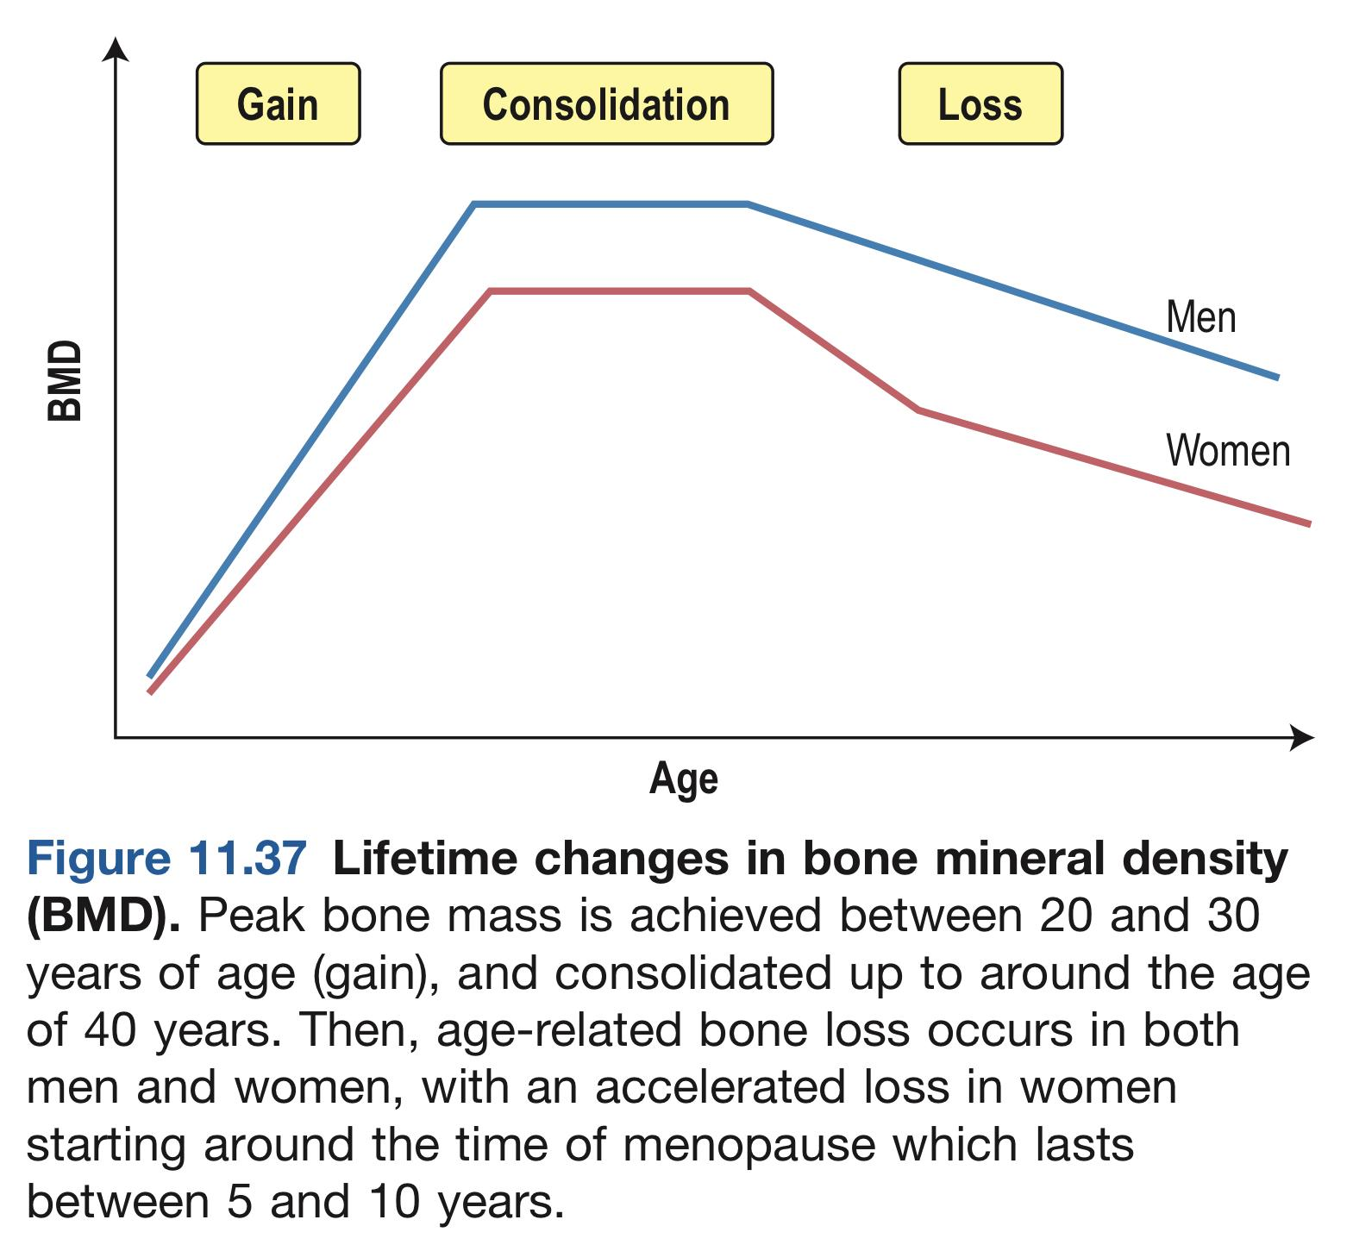
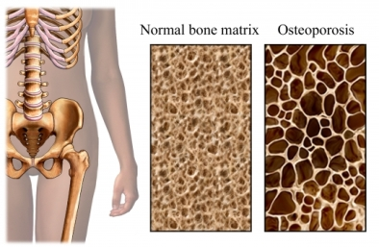
Osteoporosis
“The silent thief”
Low bone mass with micro-architectural disruption resulting in fracture from minimal trauma
Generally patients are asymptomatic.
It is impossible that osteoporosis can cause pain, the pain is secondary to bone fractures, osteoarthritis or others.
Hip fractures are bad, 20% patients with hip fracture die within the year. Besides,
she/he might lose self-esteem and develop depression.
Introduction
Decrease in bone mass¹ and strength with micro-architectural disruption resulting in fracture² from minimal trauma
Generally patients are asymptomatic until fractures occur
It is impossible that osteoporosis cause pain, the pain is secondary to bone fractures, osteoarthritis or others.
The first manifestation of reduced bone mass is usually a wrist fracture or a vertebral crush fracture caused by a small amount of force which produces severe localized pain.
Subsequent vertebral fractures³ may contribute to chronic back pain.
In well established osteoporosis, dorsal Kyphosis and loss of height occurs. (‘Widow’s stoop’)
Hip fractures with its fatal complications also occur commonly as osteoporosis become more severe.
Extra:
Introduction to Osteoporosis—Decreased Bone
Matrix
Osteoporosis is the most common of all bone
diseases in adults, especially in old age. It is
different from osteomalacia and rickets because
it results from diminished organic bone matrix
rather than from poor bone calcification.
In persons with osteoporosis the osteoblastic
activity in the bone is usually less than normal,
and consequently the rate of bone osteoid
deposition is depressed. Occasionally, however,
as in hyperparathyroidism, the cause of the
diminished bone is excess osteoclastic activity.
Types of osteoporosis
Causes
 | Type 1 osteoporosis (Post-menopausal) | Type 2 osteoporosis (Senile)
Age | Usually affects woman within 15 years of menopause | >70y/o of both genders
Type of bone loss | Mainly trabecular | Trabecular and cortical
Rate of bone loss | Accelerated | Not accelerated
Fracture sites | Distal radius (Colle’s fracture⁴), vertebra (Crush and wedge fractures) | Hip⁵ and femur neck fractures
Menopause
Old age
Calcium and vitamin D deficiency
Estrogen deficiency in women and androgen deficiency in men
Use of steroids
Exclude secondary causes especially in younger individuals and men:
Hyperparathyroidism (primary or secondary)
Vitamin D inadequacy
Chronic lung disease
Note: Age related bone loss particularly trabecular bone in the spine begins in women before menopause
Other causes: Ca and Vitamin D deficiency, Estrogen deficiency in women, androgen deficiency in men and the use of steroids (Those treated for myasthenia gravis, SLE etc.)
Exclude secondary causes especially in younger individuals and men:
Hyperparathyroidism (1ry/2ndary), Vitamin D inadequacy
Malabsorption state (e.g. celiac disease, inflammatory bowel disease, short gut syndrome)
Hypercalciuria, hyperthyroidism, chronic lung disease and rheumatoid arthritis
Malignancy (e.g. myeloma, bony metastasis) and hepatic insufficiency
Malabsorption state (e.g. celiac disease, IBD, short gut syndrome)
Malignancy (e.g. myeloma, bony metastasis)
Hypercalciuria
Hyperthyroidism
Rheumatoid arthritis
Hepatic insufficiency
1- Mineralization is not affected
2- Fractures increase morbidity and mortality; so the goal is to prevent them
3- Sudden onset of severe pain in the spine, often radiating around to the front, suggests vertebral crush fracture.
4- Colles’ fractures typically follow a fall on an outstretched arm.
5- Due to mainly cortical bone loss

Slide 12
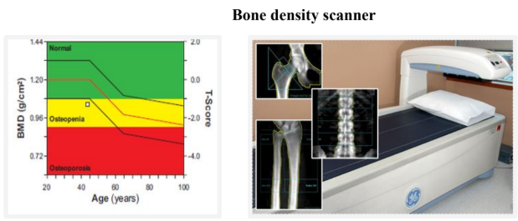
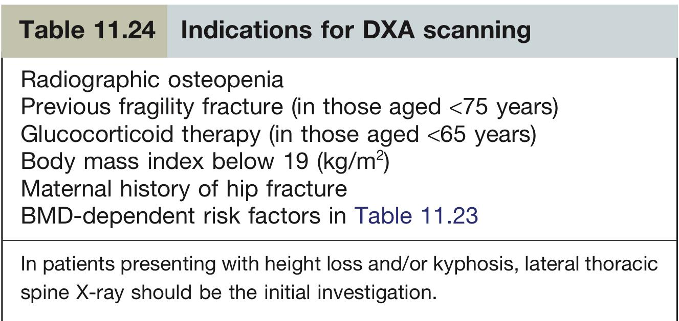
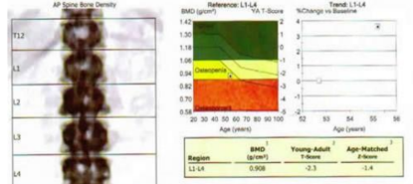
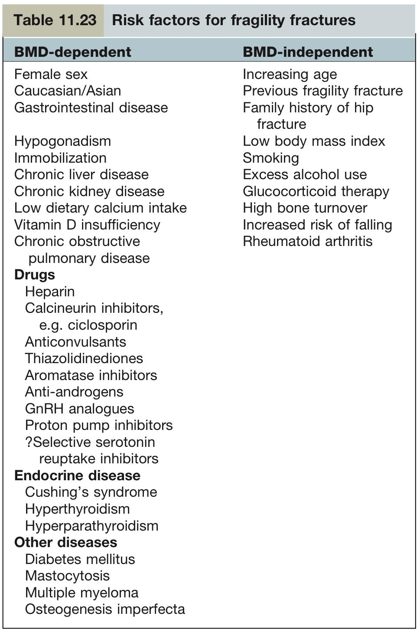
Osteoporosis cont.
Diagnosis
ALP and PTH are within normal range in patients with osteoporosis due to sex hormones deficiency and aging.
X-rays of skeleton do not show a decrease in osseous density until at least 30% of bone mass has been lost.
Available bone assessment methods:
Single-Photon absorptiometry (SPA)
Dual-Photon absorptiometry (DPA)
Computed Tomography (CT)
Dual-Energy X-ray Absorptiometry (DEXA) (Gold standard)
Measures bone mineral density (BMD, aka T-score) usually of the lumbar spine and proximal femur and comparing it to BMD of a healthy woman, very sensitive to bone mass reduction but cannot tell you the cause (osteomalacia or osteoporosis)
More than -2.5 SD below average → osteoporosis
Measure bone mass by the ability of the tissue to absorb the photons emitted from the radionuclide source or the X-ray tube.
Dual-energy x-ray absorptiometry (DEXA) measuring bone mineral density (BMD)and comparing it to BMD of a healthy woman
More than -2.5 SD below average: osteoporosis
It measures bone mass by the ability of the tissue to absorb the photons emitted from the radionuclide source or the
X-ray tube.
DEXA is what we use to diagnose osteoporosis. Other methods are not used anymore for osteoporosis diagnosing.
Bones density cannot be measured by an absolute number. To diagnose osteoporosis, you have to compare a patient’s bone density
with the bone density of her or his age group.
Scan:
Lumbar spine “L1 to L4”
Femoral neck
If there is osteoporosis in one site, the patient will be labeled as osteoporotic
WHO osteoporosis criteria 1994, definition based on BMD:
Normal | Greater than or equal to – 1 SD
Osteopenia | Between – 1 and – 2.5 SD
Osteoporosis | Less than or equal to – 2.5 SD
Severe osteoporosis | Osteoporosis with 1 or more fragility fractures
1-“In case of severe osteoporosis that causes multiple fractures. We will give teriparatide
intermittently not continuously which is PTH”

Slide 13
Osteoporosis cont.
Management
It is appropriate to begin to look for risk factors that predispose a person to osteoporosis and develop a rational prevention program tailored to person’s risk before the menopause. e.g., Women with thin light frame, history of low calcium intake, decreased physical activity, high alcohol or caffeine consumption, smoking, family history of osteoporosis, history of prior menstrual disturbances or history of drug like antiepileptics or steroids are all high risk groups and in the presence of one or more of such risk factors measurement of BMD provides further information to the risk of fractures.
Strategy: Prevent Osteoporosis, detect and treat early to decrease further progression and limit disability and provide rehabilitation as well as raising public awareness.
Dual-energy x-ray absorptiometry (DEXA) measuring bone mineral density (BMD)and comparing it to BMD of a healthy woman
More than -2.5 SD below average: osteoporosis
It measures bone mass by the ability of the tissue to absorb the photons emitted from the radionuclide source or the
X-ray tube.
DEXA is what we use to diagnose osteoporosis. Other methods are not used anymore for osteoporosis diagnosing.
Bones density cannot be measured by an absolute number. To diagnose osteoporosis, you have to compare a patient’s bone density
with the bone density of her or his age group.
1
The Adolescent Female (Peak bone mass attainment)
Peak bone mass: the highest bone mass a person reach in their life, usually in their early 20s.
Adequate calcium intake of 1200 mg/day is recommended, to maximize peak bone mass
Adequate sun exposure or vit D supplementation to ensure adequate level.
A reasonable exercise program is recommended.
Genetic influence on peak bone mass attainment.
2
The Premenopausal Female (Maintenance of bone mass)
Adequate calcium intake; 1000-1500 mg/day disease.
Adequate sun exposure or vit D supplementation
A reasonable exercise program is recommended, but not to the point of amenorrhea.
Avoidance of osteopenia-producing conditions/medications/lifestyles:
Smoking & excessive alcohol intake, excessive caffeine/protein intake.
Amenorrhea/oligomenorrhea → make sure the menstrual cycle is regular
Cortisone, excessive thyroid hormone replacement (?), loop diuretics, prolonged heparin exposure.
3
The Immediately Postmenopausal Female (Prevention of bone mass loss)
Consideration of estrogen replacement therapy
If intact uterus, consideration of medroxyprogesterone
Other modalities of therapy:
Bisphosphonates, SERMS (Selective estrogen receptor modulators) e.g., Evista, Livial,
Protelos ( strontium ranelate) → old drug, Forteo (Teripratide) or Prolia ( Denosumab) → the only bone building drugs (anabolic)
all of these cannot be used for life (only for 5-10 yrs), hence why we try to delay them as much as possible
1-“In case of severe osteoporosis that causes multiple fractures. We will give teriparatide
intermittently not continuously which is PTH”
4
The elderly postmenopausal female with low bone mass but no compression fractures (Prevention of bone mass loss & restoration of bone mass previously lost)
Skipped by Dr
Adequate calcium intake: 1000-1500 mg/day and Adequate supply of vit D (1000-2000IU)
A reasonable exercise program with physical therapy instruction in paraspinous muscle group strengthening exercise.
Avoidance of osteopenia-producing conditions/medications/lifestyles:
Smoking & excessive alcohol intake, excessive caffeine/protein intake.
Cortisone, excessive thyroid hormone replacement (?)
Other modalities: Same as NO. 3 above

Slide 14
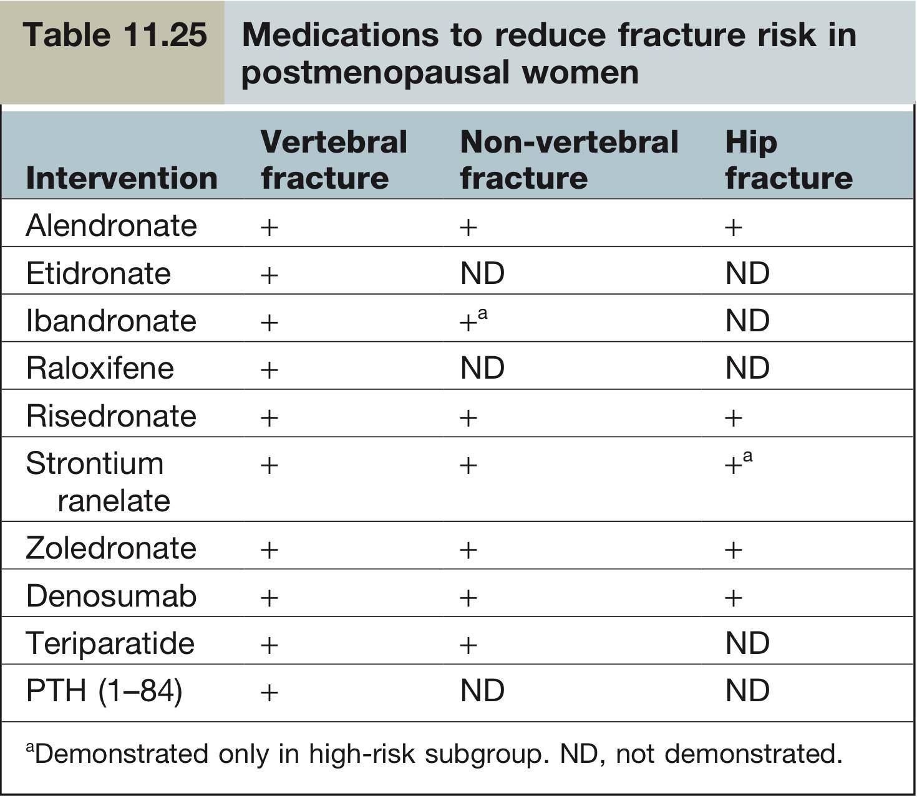
Osteoporosis cont.
Management cont.
Skipped by Dr
5
The male or female with corticosteroid induced osteopenia (Prevention of bone mass loss & restoration of bone mass previously lost)
Steroids for several days causes bone loss more on axial bones ( 40 %) than on peripheral bones (20%). Steroids may also cause Muscle weakness
Prednisolone more than 5 mg /day for long time may lead to osteopenia → osteoporosis
Bone mass measurement if possible to identify bone mass loss
Shortest duration and Lowest possible dose of corticosteroids: ? Deflazacort
A program of reasonable calcium intake (1000- 1500 mg daily, depending upon urinary calcium), exercise, & avoidance of other osteopenia-producing situations is indicated.
Adequate intake of vit D ( 1000-2000 IU)
Other modalities of therapy:
Estrogen (Females), testosterone (males)
Bisphosphonates (Reduces bone breakdown), ?PTH (Teriparatide, in case of severe osteoporosis that causes multiple fractures. Teriparatide should be given intermittently not continuously)
Forteo
6
The elderly (age>62) post menopausal female with fractures (spine &/hip) (Prevention of further fractures.)
An area for your notes
Summary of osteoporosis management from Kumar
Prevention and treatment
New vertebral fractures require bed rest for 1–2 weeks and strong analgesia, muscle relaxants (e.g. diazepam 2 mg three times daily), or intravenous pamidronate (single dose 60–90 mg) are also given for pain relief. Non-spinal fractures are treated by conventional orthopaedic means. Daily intakes of 800–1000 mg of calcium and 400–800 IU of vitamin D are recommended, throughout life.
Pharmacological intervention
Bisphosphonates e.g. alendronate, risedronate, zoledronate
Are first-line treatment in most patients with osteoporosis. They inhibit bone resorption through inhibition of osteoclast activity, increase bone mass at the hip and spine, and most have been shown to reduce fracture incidence. Oral bisphosphonates should be taken in the fasting state with a large drink of water, while the patient is standing or sitting upright. The patient should subsequently remain upright and avoid food and drink for at least 30 min. Generally well tolerated but may be associated with upper gastrointestinal side-effects such as oesophagitis, particularly if the dosing instructions are not closely followed. Osteonecrosis of the jaw is rarely seen following high dose i.v. nitrogen-containing bisphosphonate in patients who have malignant disease
1-“In case of severe osteoporosis that causes multiple fractures. We will give teriparatide
intermittently not continuously which is PTH”

Slide 15
Osteoporosis cont.
Summary of osteoporosis management from Kumar cont.
Strontium ranelate (2 g daily)
Is a useful alternative to oral bisphosphonates particularly in the frail elderly who have difficulty in complying with the dosage regimen. Its mechanism of action is uncertain.
Denosumab (fully human monoclonal antibody to RANKL)
Administered as a single subcutaneous injection every 6 months. Fracture risk reduction is equivalent to bisphosphonates. In addition to promoting osteoclastogenesis, RANKL has a role in the immune system and denosumab has been associated with exacerbations of eczema and a small increase in severe cases of cellulitis.
Raloxifene (60 mg daily), a selective oestrogen-receptor modulator (SERM)
Activates oestrogen receptors on bone while having no stimulatory effect on endometrium (cf: hormone replacement therapy [HRT]). It has been shown to reduce BMD loss at spine and hip, though fracture rates are reduced only in the spine. Side-effects are leg cramps, flushing, increased risk of thromboembolism (similar to HRT) and stroke.
Recombinant human parathyroid hormone peptide 1–34 (teriparatide) and recombinant human parathyroid hormone 1–84
Anabolic agents that stimulate bone formation. They are indicated for severe cases of osteoporosis or in women who are intolerant of, or fail to respond to other therapies. A side-effect is transient hypercalcaemia. Non-osteoporotic bone diseases such as osteomalacia should be excluded prior to treatment. Neither agent should be used in people with skeletal metastases or osteosarcoma.
Oestrogen therapy
Because of adverse effects on breast cancer and cardiovascular disease risk, HRT is a second-line option for osteoporosis except in early postmenopausal women at high fracture risk who also have perimenopausal symptoms.
Testosterone
Given to men with biochemical evidence of hypogonadism.
Glucocorticoid-induced osteoporosis
Individuals requiring continuous oral glucocorticoid therapy for 3 months or more (at any dose) should be assessed for co-existing risk factors (age, previous fracture, hormone status). Postmenopausal women, men aged over 50 years and any individuals who have sustained a fragility fracture should receive treatment without waiting for DXA scanning. For these individuals, bisphosphonates and teriparatide are the approved agents. Calcium and vitamin D supplementation should also be given.
An area for your notes
1-“In case of severe osteoporosis that causes multiple fractures. We will give teriparatide
intermittently not continuously which is PTH”

Slide 16
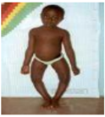
Osteomalacia
Definition
Failure of organic matrix (osteoid) of bone to mineralize normally. A number of factors are critical for normal bone mineralization. An absence or a defect in any one of them may lead to osteomalacia, the most common biochemical causes are a decrease in the product of concentrations of calcium and phosphate in the extracellular fluid so that the supply of minerals to bone forming surfaces is inadequate.
Called rickets if it occurs in children (during bone growing)
Etiology
1- Vitamin D deficiency (Most common cause)
Inadequate sunlight¹ exposure without dietary supplementation. | Gastrointestinal diseases that interrupts the normal enterohepatic recycling of vit. D & its metabolites, resulting in their fecal loss.
House- or institution bound people. Atmosphere smog. Long term residence in far northern & far southern latitudes. Excessive covering of body with clothing. | Chronic steatorrhea (pancreatic) Malabsorption (gluten-sensitive enteropathy) Surgical resection of large parts of intestine. Bariatric surgery Formation of biliary fistulas.
Impaired synthesis of 1,25(OH)2D3 by the kidney. | Target cell resistance to 1,25(OH)2D3
Nephron loss, as occurs in chronic kidney disease Functional impairment of 1,25(OH)2D3 hydroxylase (eg. In hypoparathyroidism) Congenital absence of 1,25(OH)2D3 hydroxylase (vit. D-dependency rickets type I). Suppression of 1,25(OH)2D3 production by endogenously produced substance (cancer). | e.g. absent, or diminished number of 1,25(OH)2D3 receptors, as in vit.D-dependency rickets type II. extremely rare
Causes
Vitamin D deficiency (commonest cause)
Ca deficiency
Phosphate deficiency
Liver disease
Renal disease
Malabsorption (Celiac disease)
Hereditary forms
(Intestinal and gastric surgery): bariatric surgery 1
Drugs: anti epileptic drugs2
Clinical Presentation:
Two thirds of patients are asymptomatic
Incidental radiological finding
Unexplained high alk phosph
Large skull, frontal bossing, bowing of legs, deafness, erythema, bony tenderness
Fracture tendency: vertebral crush fractures, tibia or femur (Healing is rapid)
Bony aches and pains
Muscle weakness
Waddling gait, that is due to the proximal muscle weakness and to the pain and discomfort during movements of the limbs.
Some have severe muscular hypotonia and paradoxically brisk deep tendon reflexes
2- Phosphate deficiency
Skipped by Dr
Dietary | Impaired renal tubular reabsorption of PO4
Low intake of phosphate. Excessive ingestion of aluminum hydroxide. | X-linked hypophosphataemia. Adult-onset hypophosphataemia. Other acquired & hereditary renal tubular disorders associated with renal phosphate loss (Fanconi’s syndrome, Wilson’s disease). Tumor-associated hypophosphataemia
3- Systemic acidosis
Skipped by Dr
Chronic renal failure, Distal renal tubular acidosis
Ureterosigmoidoscopy, Chronic acetazolamide & ammonium chloride administration
Other causes:
Drug induced Osteomalacia (Anti-epileptic drugs), liver disease and Ca deficiency
1: which normally provides 90% of vitamin D, while the other 10% is from the diet.

Slide 17
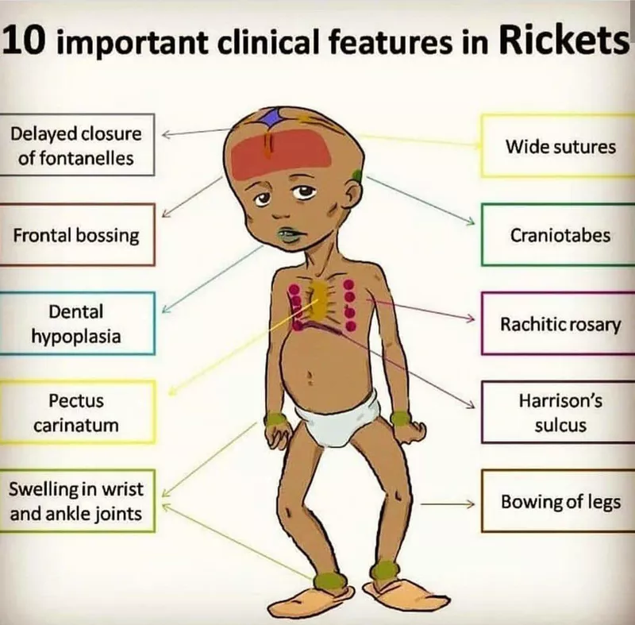
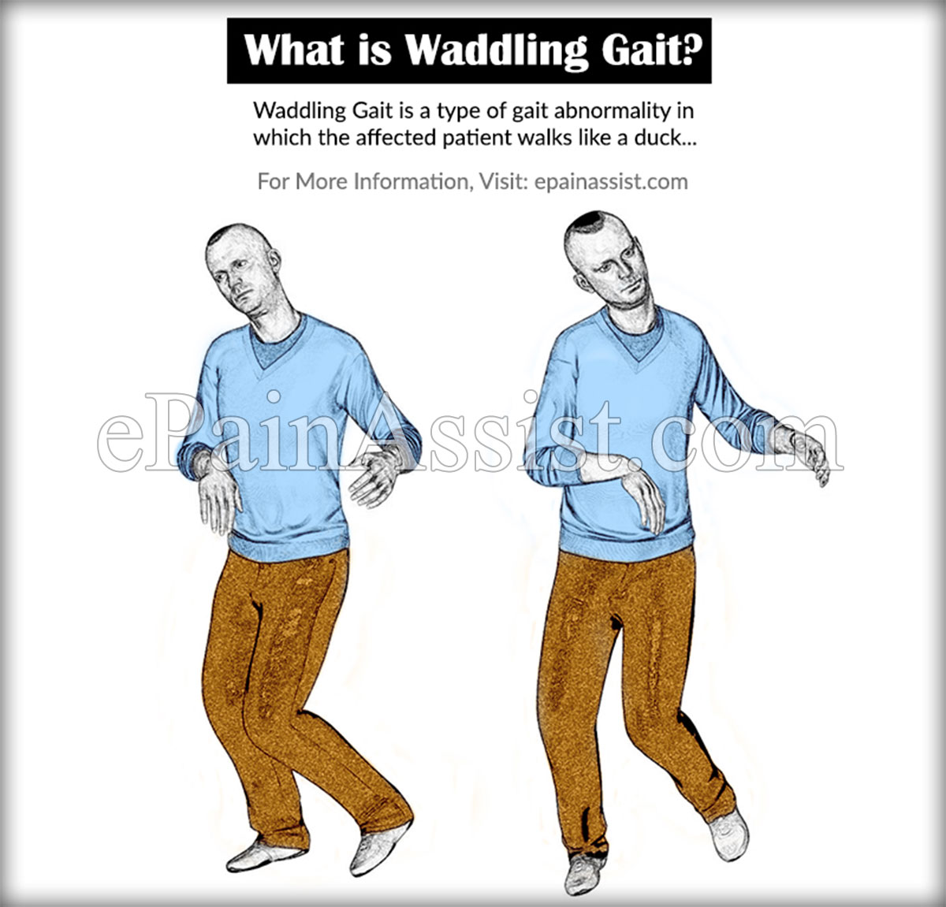
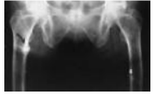
Osteomalacia cont.
Clinical features
Two thirds of patients are asymptomatic, incidental radiological finding, unexplained high alk phosph.
Large skull, frontal bossing, bowing of legs (Permanent, will not resolve with treatment), deafness, erythema, bony tenderness
Fracture tendency: verteberal crush fractures, tibia or femur. Healing is rapid.
The clinical manifestations of osteomalacia in adults usually go unrecognized because of the non-specific skeletal pain and muscular weakness. Only when the disease is extensive, deformities occur with fractures of ribs, vertebrae and long bones.
Clinically patients with osteomalacia have a characteristic waddling gait, that is due to the proximal muscle weakness and to the pain and discomfort during movements of the limbs.
Some patients have severe muscular hypotonia and paradoxically brisk deep tendon reflexes.
Diagnosis
Patients with osteomalacia go through phases of developments characterized by unique changes in the serum concentration of calcium, phosphate, PTH and vit D3 levels and the radio graphically assessed bone lesions.
The underlying defect leading to these changes is the decrease in the production of 1,25(OH)2D3 which is due to diminished availability of the major circulating metabolites of vit D 25OHD3.
The decreased 1,25(OH)2D3 results in decreased intestinal calcium absorption, decreased bone resorption, hypocalcaemia, increased PTH secretion and hypophosphataemia
The decreased Ca x Pho. Product in serum is insufficient for the normal mineralization of bone and the osteomalacic process is initiated. There will also be high alkaline phosphatase.
The increased PTH secretion and hypophosphataemia occur at the expense of osseous demineralization caused by hyperparathyroidism.
Lab tests
Patients with osteomalacia go through phases of developments characterized by unique changes in the serum concentration of calcium, phosphate, PTH and vit D3 levels and the radio graphically assessed bone lesions.
The underlying defect leading to these changes is the decrease in the production of 1,25(OH)2D3 which is due to diminished availability of the major circulating metabolites of vit D 25OHD3.
The decreased 1,25(OH)2D3 results in decreased intestinal calcium absorption, decreased bone resorption, hypocalcaemia, increased PTH secretion as an adaptive response and hypophosphataemia
The decreased Ca x Pho. Product in serum is insufficient for the normal mineralization of bone and the osteomalacic process is initiated. There will also be high alkaline phosphatase.
The increased PTH secretion and hypophosphataemia occur at the expense of osseous demineralization caused by hyperparathyroidism.
X-ray: growing bones vs mature bones, Subperiosteal resorption, looser's zones (pathognomonic)
Incomplete fractures.
Pseudofractures
Paget’s Disease
Imaging
Incomplete pseudofractures
X-ray: growing bones vs mature bones, Subperiosteal resorption,
looser's zones (pathognomonic)
Treatment:
:
Calcium and vitamin D supplements
Sun exposure
Results of treatment is usually very good.
Correcting underlying cause “Such as celiac disease that might affect Vit D intestinal absorption. So, correct the cause”.
Treatment
Patients with osteomalacia due to simple dietary deficiency of vit D or lack of exposure to sunlight will respond well to small daily doses of vit D, calcium and sun exposure.
Administration of oral doses of ergocalciferol(D2) or cholecalciferol (D3)(2000 IU daily) for several months will heal the bone disease and restores biochemical and hormonal values to normal in most cases.
1,25(OH)2D3 (active form (calcitriol)) has also been successful in the treatment of simple osteomalacia, but not usually used
It is important to administer calcium to provide adequate calcium for bone mineralization (1-2 gm of elemental calcium daily).
Serum ALP and PTH decrease slowly over several weeks but improvement in radiological appearances may take several months.
Other forms of osteomalacia may need different preparations and doses of treatment e.g., osteomalacia secondary to malabsorption may require huge doses of vit D (200,000 IU orally) because of the poor absorption of the drug or even I.V./I.M. vit D (40,000-80,000 IU).

Slide 18
Primary hyperparathyroidism
Most cases (80%) are caused by a single hyperfunctioning adenoma, with the rest (15%) resulting from parathyroid hyperplasia and, rarely (5%), parathyroid carcinoma. Hypercalcemia is associated with “stones, bones, moans, groans, and psychiatric overtones.” HyperCa treatment: Administer IV Fluids (first-line) and calcitonin. Add bisphosphonates if malignancy.
Secondary hyperparathyroidism
Physiological compensatory hypertrophy of all parathyroids because of chronic hypocalcaemia. Causes: chronic kidney disease (Most common), vitamin D deficiency or malabsorption PTH levels are raised but calcium levels are low or normal, and PTH falls to normal after correction of the cause of hypocalcaemia where this is possible.
Tertiary hyperparathyroidism
The development of apparently autonomous parathyroid hyperplasia after long-standing secondary hyperparathyroidism, most often in renal failure. Plasma calcium and phosphate are both raised, the latter often grossly so. (cf. 1ry hyperparathyroidism) Parathyroidectomy is necessary at this stage.
Osteoporosis
A common metabolic bone disease characterized by low bone mass. It most often affects thin postmenopausal women with risk doubling after 65 years of age. Men are also at risk for osteoporosis, but the diagnosis is often overlooked. Commonly asymptomatic until fractures occur. Exam may reveal hip fractures, vertebral compression fractures (loss of height and progressive thoracic kyphosis), and/or distal radius fractures (Colles fracture) following minimal trauma Diagnostic test: DEXA (Osteoporosis: Bone mineral density (T-score) is 2.5 standard deviations (SDs) less than normal. Osteopenia: T-score between 1 and 2.5 SDs below normal.) Lifestyle modifications: Adequate calcium and vitamin D intake (supplementation can be used for prevention), smoking cessation, avoiding heavy alcohol use, and weight-bearing exercises. Best initial treatment: Bisphosphonates (eg, alendronate, risedronate, ibandronate, zoledronic acid) are used in the treatment of osteoporosis, not osteopenia.
 | Type 1 osteoporosis (Post-menopausal) | Type 2 osteoporosis (Senile)
Age | Usually affects woman within 15 years of menopause | >70y/o
Type | Mainly trabecular | Trabecular and cortical
Rate | Accelerated | Not accelerated
Fracture sites | Distal radius (Colle’s fracture), vertebra (Crush and wedge fractures) | Hip and femur neck fractures
Summary of Hyperparathyroidism
Type | Calcium | PTH | Vitamin D | Phosphate
Primary | High | High | Normal | Low
Secondary | Low | High | Low | High/Low
Tertiary | High | High | Low | High

Slide 19
Lecture Quiz
Q1:A 65-year-old female is recently diagnosed with a compression fracture of the second lumbar vertebra. She was diagnosed with osteoporosis 3 years ago with T-score of –2.6 on bone densitometry. Her mother and sister were both treated for breast cancer. Her medical history includes hypertension and a deep venous thrombosis. Current medications include lisinopril, omeprazole, calcium, and vitamin D. Physical examination is normal except for midline tenderness over the lower back. In addition to continuing calcium and vitamin D and advising weight bearing exercise, which of the following is the most appropriate management for this patient’s osteoporosis?
A- Alendronate
B- Calcitonin
C- Raloxifene
D- Estradiol
E- No additional treatment
Q2: A 54-year-old woman presents to her GP complaining of a change in her breathing sound. She first noticed numbness, particularly in her fingers and toes, three months ago but attributed this to the cold weather. Her partner now reports hearing a high pitched, harsh sound while she is sleeping. Her BMI is 27. While measuring blood pressure, you notice the patient’s wrist flexing. The most likely diagnosis is?
A- Obstructive sleep apnoea
B- Hypocalcaemia
C- DiGeorge syndrome
D- Guillain–Barré syndrome
Q3: A 70-year-old woman with a history of vertebral crush fractures presents to the osteoporosis outpatient clinic. Which of the following investigations is most useful to assess the extent of her osteoporosis?
A- Spinal x-rays
B- MRI scan
C- Full blood count, bone and liver biochemistry blood tests
D- Vitamin D levels
E- DEXA scan
Q4: A 58-year-old postmenopausal woman presents to your office on suggestion from an urologist. She has passed three kidney stones in the past 3 years. She is taking no medications. Her basic laboratory work shows the following:
Na: 139 mEq/L K: 4.2 mEq/L HCO3 : 25 mEq/L Cl: 101 mEq/L
BUN: 19 mg/dL Creatinine: 1.1 mg/dL Ca: 11.2 mg/dL
A repeat calcium level is 11.4 mg/dL; Po 4 is 2.3 mmol/L (normal above 2.5). Which of the following tests will confirm the most likely diagnosis?
A. Serum ionized calcium
B. Thyroid function profile
C. Intact parathormone (iPTH) level
D. Liver function tests
E. 24-hour urine calcium
Q5:A 46-year-old woman comes to the physician for a routine health examination. She was last seen by a physician 3 years ago. She has been healthy aside from occasional mild flank pain. Her only medication is a multivitamin. Her blood pressure is 154/90 mm Hg. Physical examination shows no abnormalities. Serum studies show:
Sodium:141 mEq/L Potassium: 3.7 mEq/L Calcium:11.3 mg/dL Phosphorus: 2.3 mg/dL
Urea nitrogen: 15 mg/dL Creatinine: 0.9 mg/dL Albumin: 3.6 g/dL
Subsequent serum studies show a repeat calcium of 11.2 mg/dL, parathyroid hormone concentration of 890 pg/mL, and 25-hydroxyvitamin D of 48 ng/mL (N = 25–80). Her 24-hour urine calcium excretion is elevated. An abdominal ultrasound shows several small calculi in bilateral kidneys. Further testing shows normal bone mineral density. Which of the following is the most appropriate next step in management?
A.Refer to surgery for parathyroidectomy
B.Perform percutaneous nephrolithotomy
C.Order CT scan of the chest and abdomen
D.Begin cinacalcet therapy
Answers: Q1:A | Q2:B | Q3:E | Q4:C| Q5:A
Answers Explanation File!

Slide 20
THANKS!!
This lecture was done by:
Mashal AbaAlkhail
Naif Alhussaini
Note taker:
Mashal AbaAlkhail
Raghad AlKhashan
Females co-leaders:
Raghad AlKhashan
Amirah Aldakhilallah
Males co-leaders:
Mashal AbaAlkhail
Nawaf Albhijan
Send us your feedback:
We are all ears!

