Slide 1
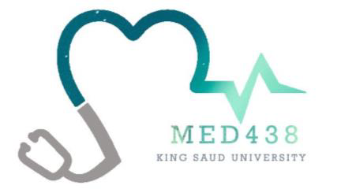
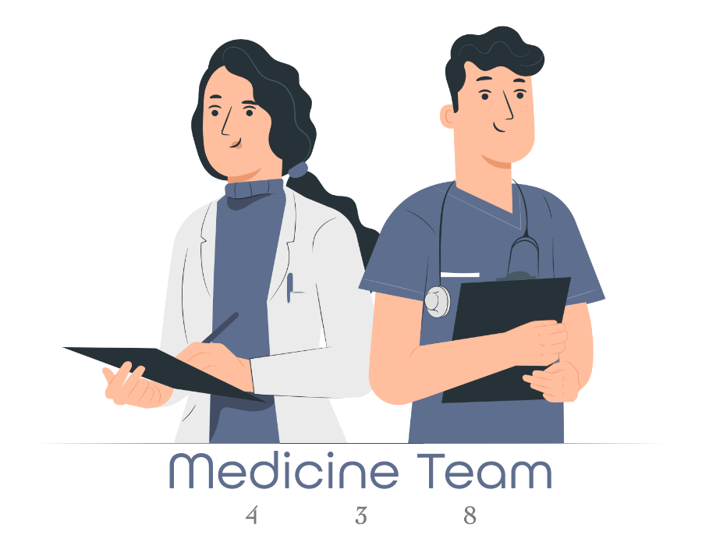
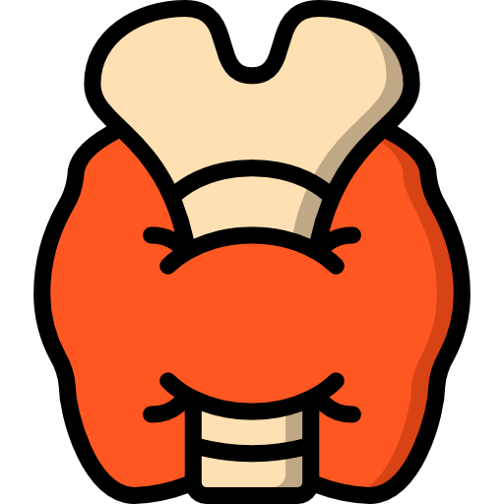
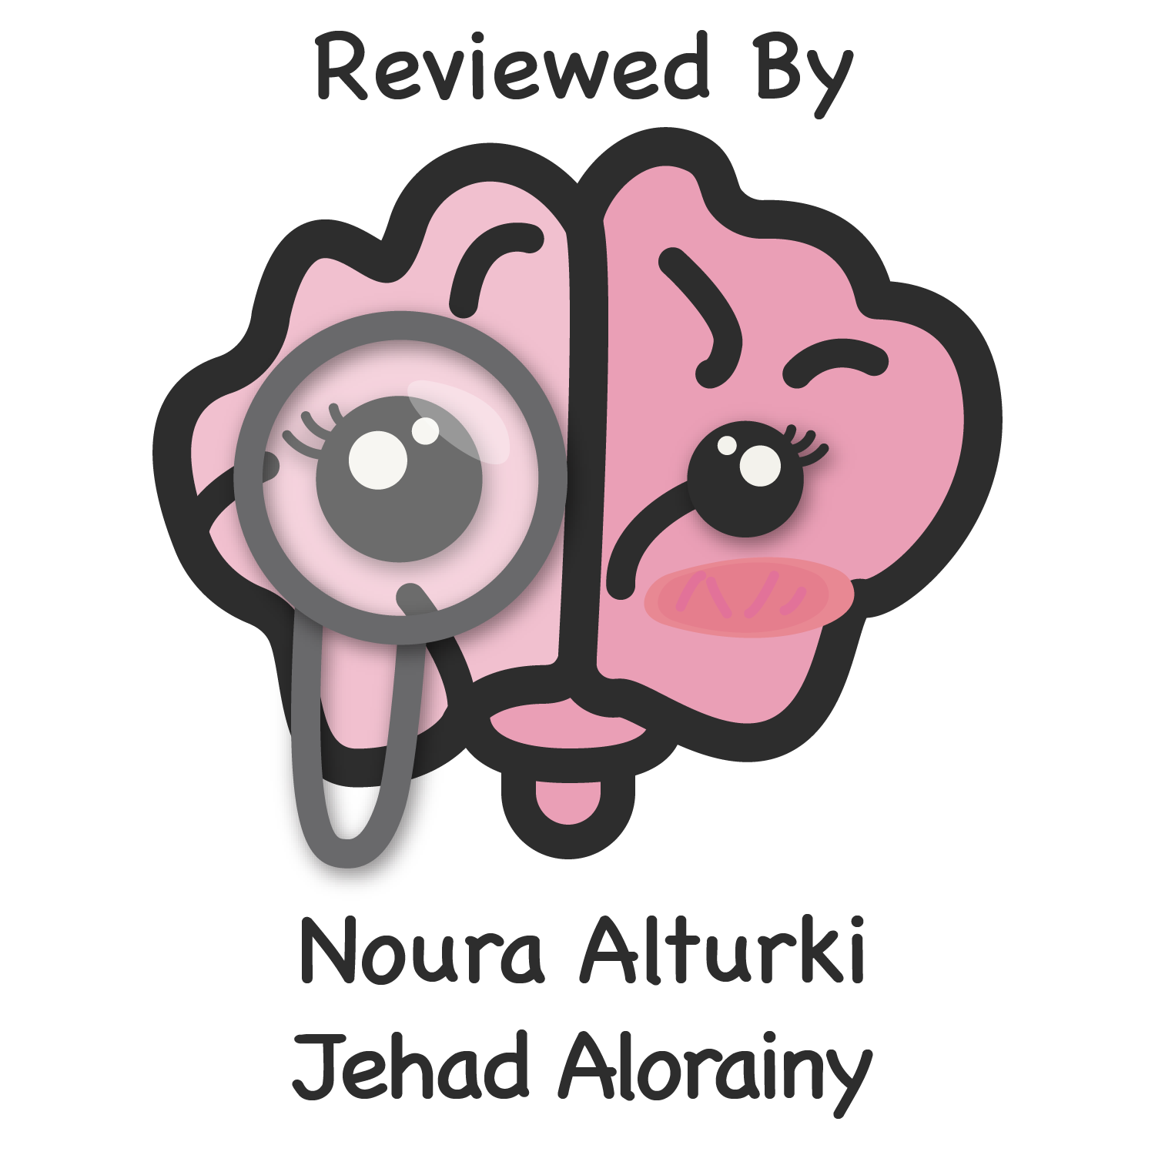
Lecture 51
Editing file
Thyroid disorders
Objectives:
Thyroid anatomy and physiology
Action of thyroid hormones
Thyroid function
How to evaluate a patient with thyroid disease
Goiter
Hypothyroidism and Hyperthyroidism: causes,pathogenesis,diagnosis and treatment
Other thyroid disorders
Color index:
Color index:
Original text Females slides Males slides
Doctor’s notes Textbook Important Golden notes Extra

Slide 2
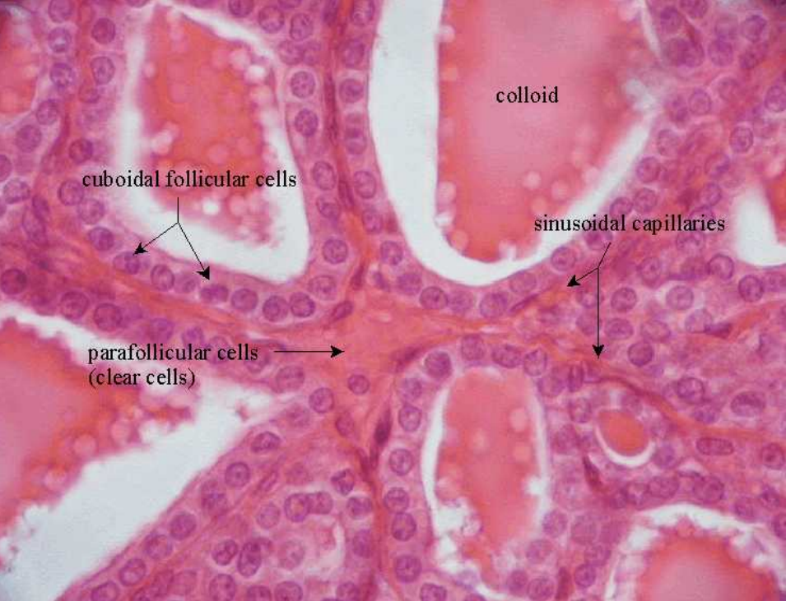
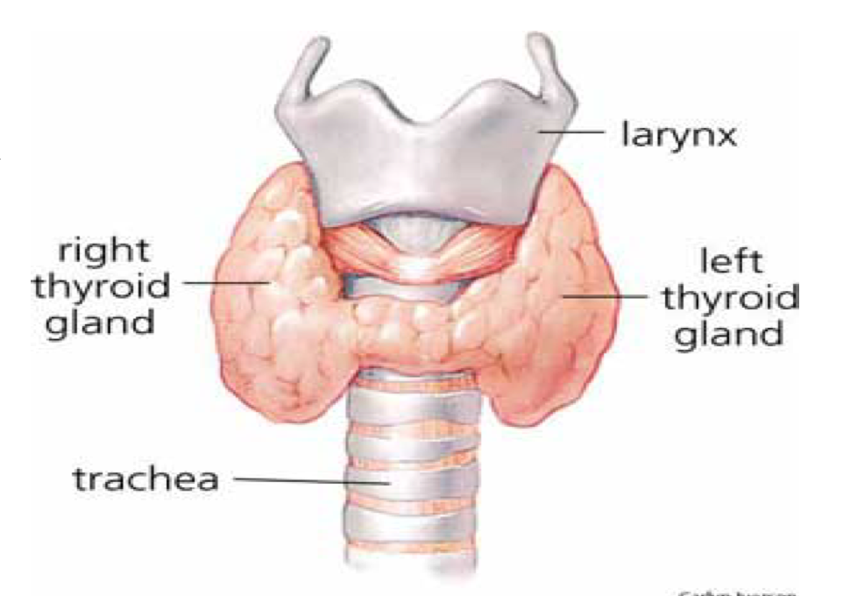
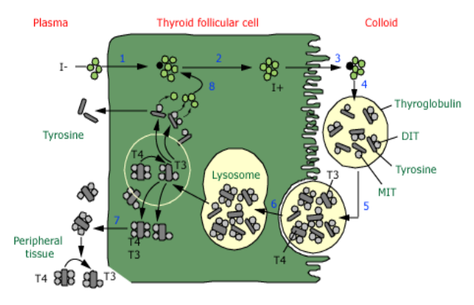
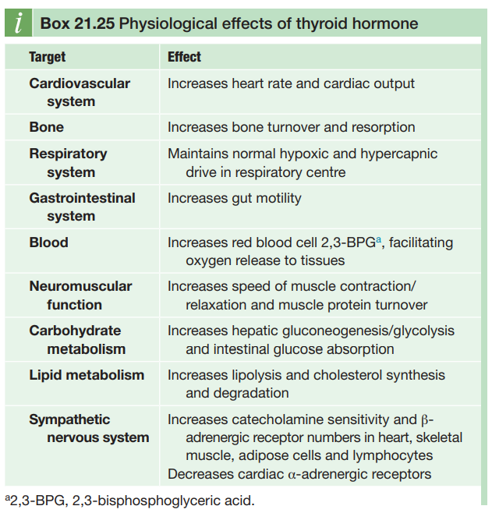
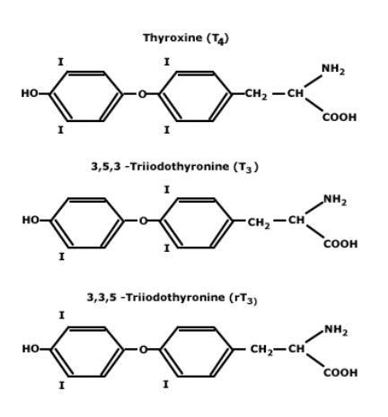
Female slides
Introduction
Thyroid Anatomy
Thyroid gland is made up of follicles
Has 2 lobes and connected by the isthmus
Weigh 20 g, more volume in men,
increase with age and body weight and decrease with iodine intake
Located in front of larynx and moves on swallowing.
Thyroid Hormone
1
2
Somatic development in adults
Brain development in infants
Fetal thyroid functions at 10-12 weeks of gestation
Maternal T4 reaches the fetus during development
if mother has hypothyroidism this may lead to preterm delivery, miscarriage, cognitive impairment of infant
Main action of thyroid hormones is done by T3¹ and 80 % from peripheral conversion and 20 % produced by the thyroid itself
Follicular cells of the thyroid is the main site of hormones synthesis Mainly T4 and small amount of T3
Iodine is needed to produce thyroid hormones
Average adult requirement of iodine is 150 mcg a day, 220 mcg for pregnants, 290 mcg for lactating
3
4
Source of iodine: dairy and seafood products
Stored in the thyroglobulin² in follicular cells of the thyroid gland 99.9%³ of T4 and T3 are bound to protein in the blood: TBG, albumin, lipoprotein
T4 and T3 synthesis and secretion is regulated by pituitary TSH. TSH is inhibited by T4 and T3, stimulated by TRH
Extrathyroidal conversion of T4 to T3 is regulated by nutrition, illness, hormonal factors
Thyroid hormone synthesis
1- iodine is taken up by follicular cells
2- iodine is oxidized to I⁺
3- I⁺ moves to colloid
4- I⁺ binds to thyroglobulin
5- now thyroglobulin contains T3 and T4 → taken up by follicular cells
6- broken down by lysosome → free T3 and T4
7- Release of T3 and T4 into peripheral tissues
Thyroid Action and Function
Thyroid hormone action:
Thyroid hormones act on the bone and bone development
Low thyroid hormone in children:
delayed growth and epiphyseal growth
In brain: cognitive impairment
Thyroid hormone in adults mainly affects the metabolism (body weight, fat tissue
( lipolysis and lipogenesis)
Act on cardiac muscle: tachy and bradycardia
Regulate metabolic rate and little change in bodyweight
Thyroid hormone Function
TSH • Free T4, Free T3 • TRH⁴ • TBG⁵
Thyroid antibodies:
(microsomal antibodies, TSH receptor antibodies, thyroglobulin antibodies)
Radiological imaging of thyroid function
US neck (to check the shape), Radioactive uptake scan (to check the function), CT neck sometimes for retrosternal goiter → usually in areas of endemic iodine deficiency
1- produced mainly by the conversion of T4 to T3
2- reflects the thyroid reserve
3- the 0.01% that is free is the active thyroid hormone
4- usually not available
5- done when thyroid hormone level abnormalities is suspected (to check bound thyroid)

Slide 3
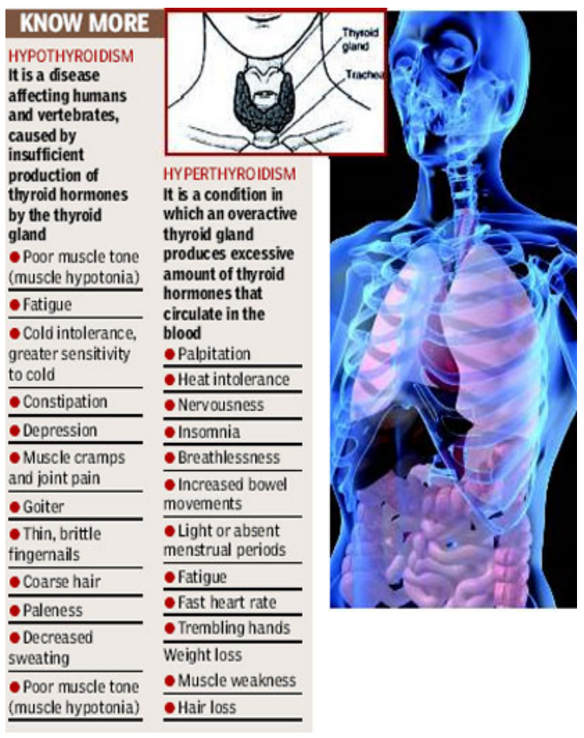
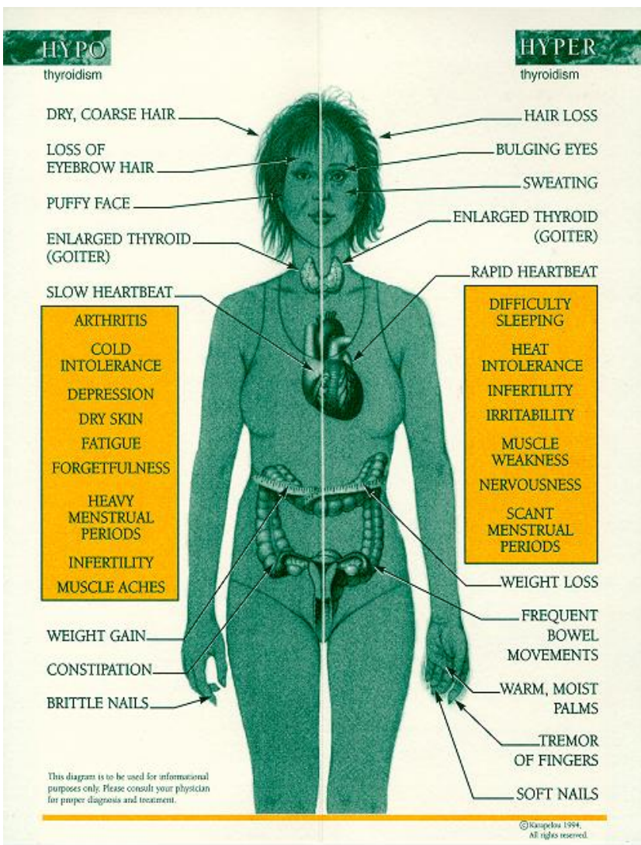
Males
slides
Patients with thyroid disease
Introduction
Thyroid enlargement (goiter): diffuse or nodular
Symptoms of hypothyroidism or hyperthyroidism
Complications of a specific form of hyperthyroidism- Graves’ disease-which may present with:
Striking prominence of the eyes (exophthalmos)
Thickening of the skin over the lower leg (thyroid dermopathy)
Thyroid diseases are amongst the most prevalent antibody mediated autoimmune diseases and are associated with other organ-specific autoimmunity .
Autoantibodies may produce inflammation and destruction of thyroid tissue, resulting in hypothyroidism, goitre (in Hashimoto’s thyroiditis) or sometimes even transient thyrotoxicosis (‘Hashitoxicosis’), or they may stimulate the TSH receptor to cause thyrotoxicosis (in Graves’ disease).
There is overlap between these conditions, since some patients have multiple autoantibodies.
History
Exposure to ionizing radiation
Iodide ingestion:
- Kelp
- Iodide-containing cough preparation
- IV Iodide-containing contrast media
Lithium carbonate
Residence in an area of low dietary iodide
Family history
Thyroid disease
Immunologic disorders:
Diabetes, Rheumatoid disease
Pernicious anemia
Alopecia, Vitiligo
Myasthenia gravis, MEN 2A
Physical Exam¹
Helpful video
Observe the neck, especially as the patient swallows
Examine from the front, rotating the gland slightly with one thumb while palpating the other lobe with the other thumb
Examine from behind, using three fingers and the same technique
Determine the size of the thyroid lobes, consistency, presence of nodules
Also check for any bruit, lymph nodes or extension of the goiter behind the clavicle which might cause obstruction (Eg. Pemberton's sign for thoracic outlet obstruction).

Slide 4
Hypothyroidism
Primary Causes:
Hashimoto’s thyroiditis | Iatrogenic
Chronic autoimmune thyroiditis, Could be with goiter. Could present as “Idiopathic” thyroid atrophy: presumably end-stage autoimmune thyroid disease, following either: Hashimoto’s thyroiditis or Graves’ disease Neonatal hypothyroidism due to placental transmission of TSH-R blocking antibodies | Results from prior treatments of hyperthyroidism: Radioiodine therapy or External irradiation thyroidectomy Excessive iodine intake (radiocontrast dyes) Drugs: thionamides, lithium, amiodarone, interferon-alfa, interleukin-2, perchlorate.
Transient hypothyroidism | Other
Painless (silent, lymphocytic) thyroiditis Subacute granulomatous thyroiditis Postpartum thyroiditis Subtotal thyroidectomy for Graves’ disease or nodular goiter following radioiodine therapy for Graves’ hyperthyroidism following withdrawal of suppressive doses of thyroid hormone in euthyroid patients | Iodine deficiency or excess Infiltrative diseases (hemochromatosis, sarcoidosis and fibrous thyroiditis) Inborn errors of thyroid hormone synthesis, Transient hypothyroidism, congenital hypothyroidism, dysgenesis or defect in hormone synthesis.
Secondary, Tertiary & other causes:
Secondary | Tertiary | Other
Hypopituitarism (TSH deficiency) due to Pituitary adenoma Pituitary ablative therapy Pituitary destruction | Hypothalamic dysfunction (TRH deficiency) (rare) | Peripheral resistance of the action of thyroid hormone
An area for your notes
1-Hypothyroidism is almost always from a single cause: failure of the thyroid gland from burnt-out Hashimoto thyroiditis. The acute phase is rarely perceived. one of the causes of Hypothyroidism is postpartum hypothyroidism (it's a transient phenomena following pregnancy usually self-limitnig)
2-a condition in which clinically euthyroid patients with nonthyroidal systemic illness have low serum levels of thyroid hormones. In this condition, T3 is low and reverse T3 (rT3) is high. T4 can also be low. The mechanism of this abnormality is that T4 is converted to rT3, which is inactive. The key is that TSH does not rise, so it is not real hypothyroidism. Treatment is directed toward the underlying illness. No Thyroid hormone replacement.
3-The thyroid axis is normal but the issue is on tissues’ receptors.

Slide 5
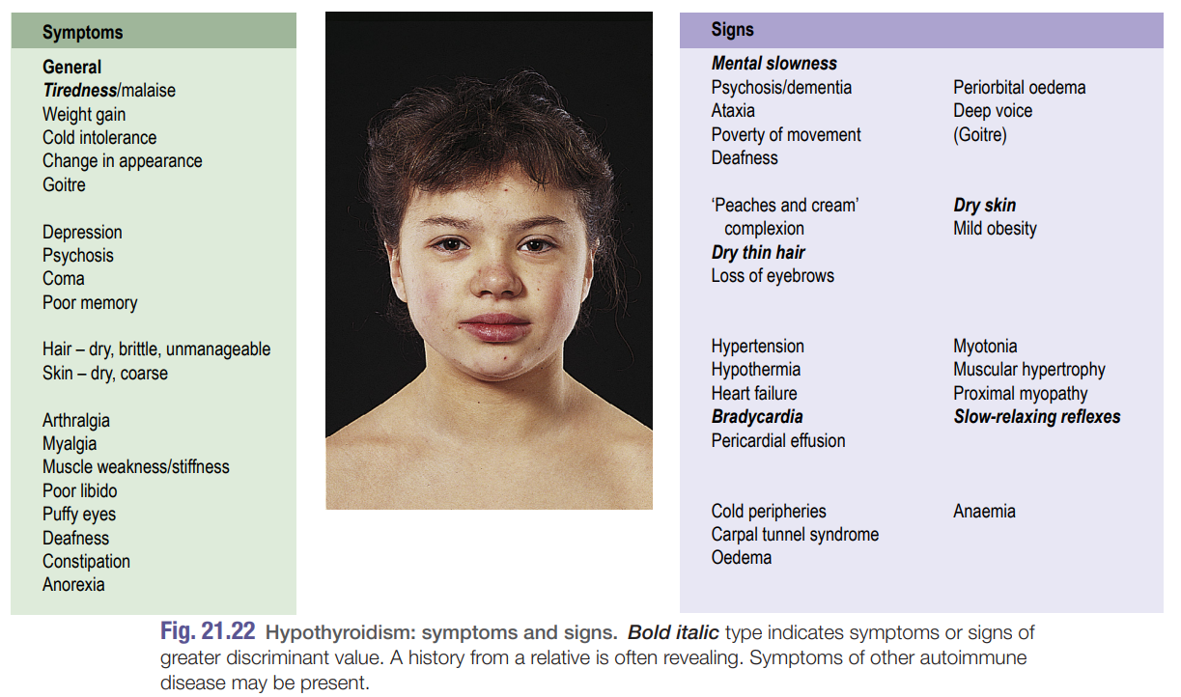
Hypothyroidism
Pathogenesis:
Thyroid hormone deficiency affects every tissue in the body, so that the symptoms are multiple
Accumulation of glycosaminoglycans (mostly hyaluronic acid) in interstitial tissues
due to reduced breakdown (not elevated synthesis)
Increase capillary permeability to albumin causes Interstitial edema evident in the skin, heart muscles and striated muscles.
Children with hypothyroidism
May not show classic features but often have a slow growth velocity
Poor school performance
Sometimes arrest of pubertal development.
Clinical presentations and findings (in adults):
Mechanism | Symptom | Sign
Slowing of metabolic processes | Fatigue and weakness Cold intolerance Dyspnea on exertion Weight gain Cognitive dysfunction Growth failure Mental retardation (infants) constipation growth failure | Slow movement and slow speech delayed relaxation of tendon reflexes bradycardia yellowish skin discoloration caused by excess carotenemia that is metabolized by the thyroid hormone
Accumulation of matrix substances | Dry skin hoarse husky voice Edema | coarse skin Puffy face and hands loss of eyebrows periorbital edema enlargement of the tongue
Others | Decreased hearing Myalgia Depression Menorrhagia Arthralgia Pubertal delay | diastolic hypertension pleural and pericardial effusion ascites galactorrhea cool skin

Slide 6
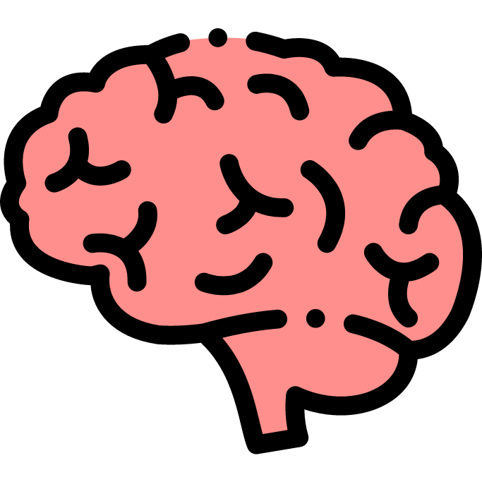
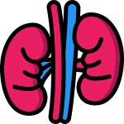
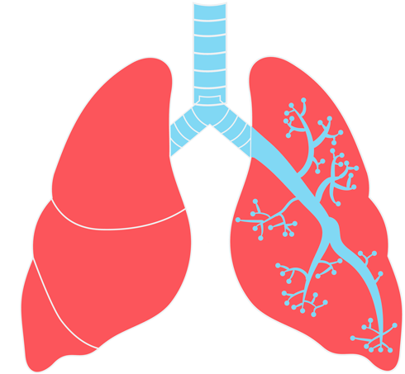
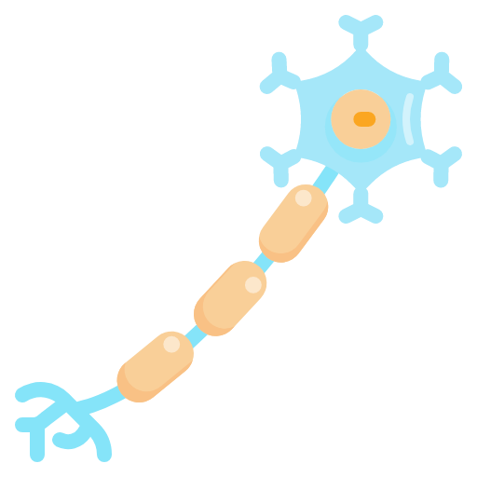
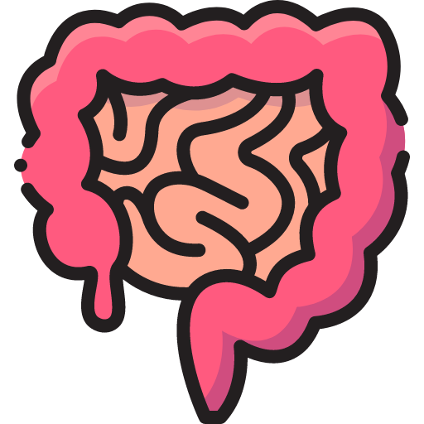
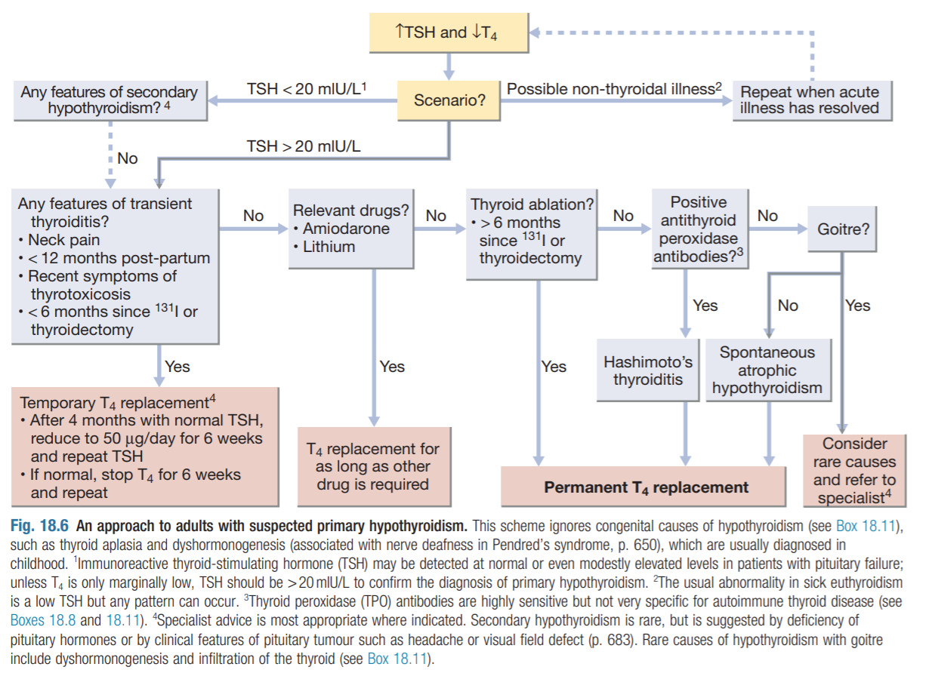
Hypothyroidism
Clinical presentations and findings (in adults) Cont.
Cardiovascular
Anemia
CNS¹
Bradycardia
Decreased cardiac output
Low voltage ECG (due to pericardial effusion)
Cardiomegaly
Pericardial effusion
Impaired hemoglobin synthesis
Iron deficiency
Folate deficiency
Pernicious anemia, with B12 deficiency megaloblastic anemia
Chronic fatigue
Lethargy
Decreased concentration
Anovulatory cycles and infertility
Menorrhagia
Depression, Agitation
Renal function
Pulmonary function
Neuromuscular system
GI
Impaired GFR
Water intoxication
Shallow and slow respiration
Respiratory failure
Severe muscle cramps
Paresthesias
Muscle weakness
Carpal tunnel syndrome
Chronic constipation
Ileus
Diagnosis:
Serum TSH is the investigation of choice; a High TSH, level confirms primary hypothyroidism.
A low free T4 level confirms the hypothyroid state (and is also essential to exclude TSH deficiency if clinical hypothyroidism is strongly suspected and TSH is normal or low).
Low T3, unhelpful since they do not discriminate reliably between euthyroidism and hypothyroidism.
TRH stimulation test (old, not used)
Positive TPO antiboidies
Other abnormalities include the following:
Anaemia, which is usually normochromic and normocytic in type but may be macrocytic (sometimes this is due to associated pernicious anaemia) or microcytic (in women, due to menorrhagia or undiagnosed coeliac disease)
Low Na due to an increase in ADH and impaired free water clearance (dilutional hyponatremia due to fluid retention).
increased serum aspartate transferase levels, from muscle and/or liver
increased serum creatine kinase levels, with associated myopathy
High cholesterol, mainly hypertriglyceridemia
Confusion, loss of memory, problems in concentration are common presentations especially in the elderly.

Slide 7
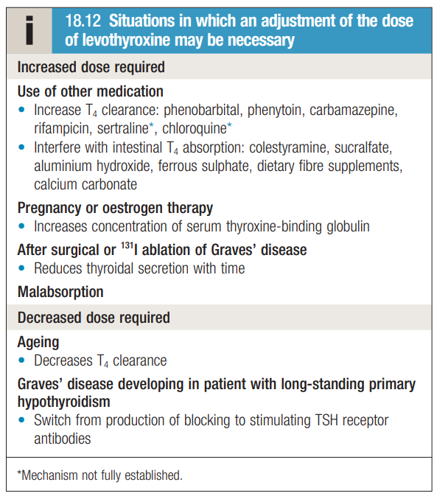
Males
slides
Hypothyroidism
Treatment:
Hypothyroidism
Lifelong Levothyroxine (T4). Follow serum Free T4 and TSH Take dose in AM Do blood test fasting before taking the daily dose Adults: 1.7-2 ug/kg/d, but lower in elderly (1.6 ug/kg/d) For TSH suppression (nodular goiters or cancer): 2.2 ug/kg/d Increase dose of T4 in malabsorptive states or concurrent administration of aluminum preparations, cholestyramine, calcium, or iron compounds. make sure to separate them at least 4 hours apart Increase dose of T4 in pregnancy and lactation The t1/2 of levothyroxine is 7 days
Toxic effects of levothyroxine therapy
Myxedema with heart disease
No allergy has been reported to pure levothyroxine.
If FT4 and TSH are followed and T4 dose is adjusted, no side effects are reported
If FT4 is higher than normal: hyperthyroidism symptoms may occur:
Cardiac symptoms
Osteopenia
Osteoporosis
Start treatment slowly in long standing hypothyroidism and in elderly patients particularly those with known cardiovascular disease
25 ug/d x 2 weeks, increase by 25 ug every 2 weeks until a daily dose of 100-125 ug is reached
Hypothyroidism in pregnancy
Women with hypothyroidism usually require an increased dose of levothyroxine in pregnancy.
Inadequately treated hypothyroidism in pregnancy has been associated with impaired cognitive development in the fetus.
Complications:
1
Myxedema coma.
2
Myxedema and heart disease
3
Hypothyroidism and neuropsychiatric disease

Slide 8
Males
slides
Myxedema coma
Clinical features
Myxoedema coma is a medical emergency and treatment must begin before biochemical confirmation of the diagnosis. it is The end stage of untreated hypothyroidism.
Associate illnesses and precipitating factors: Pneumonia, MI, cerebral thrombosis, GI bleeding, ileus, excessive fluid administration, and administration of sedatives and narcotics.
Three main issues:
CO2 retention and hypoxia
Fluid and electrolyte imbalance
Hypothermia.
Clinical presentation
Cardinal symptoms: impaired mental status, hypothermia, and concurrent myxedema
Progressive Weakness, stupor hypoventilation, hypoglycemia, hyponatremia, water intoxication, shock, death.
Treatment
IV combination of levothyroxine and liothyronine plus IV hydrocortisone
1 | Acute medical emergency | 6 | Avoid excessive hydration
2 | Monitor blood gases | 7 | Assess adrenal function and treat if needed
3 | Patient may need intubation and mechanical ventilation | 8 | Active rewarming of the body in contraindicated
4 | Treat associated medical problems | 9 | Be cautious in patients with coronary artery disease
5 | In pituitary myxedema, glucocorticoid replacement is essential | 10 | IV levothyroxine: loading 300-400 ug, daily maintenance 50 ug
Recommendations for the treatment of myxedema coma
Hypothyroidism | large initial intravenous dose of 300-500 µg T4; if no response within 48 hours, add T3 | Hypocortisolemia | intravenous hydrocortisone 200-400 mg daily
Hyponatremia | mild fluid restriction | Hypoglycemia | glucose administration
Hypotension | Cautious volume expansion with crystalloid or whole blood | Hypothermia | blankets, no active rewarming
Hypoventilation | don’t delay intubation and mechanical ventilation too long | Precipitating event | identification and elimination by specific treatment (liberal use of antibiotics)

Slide 9
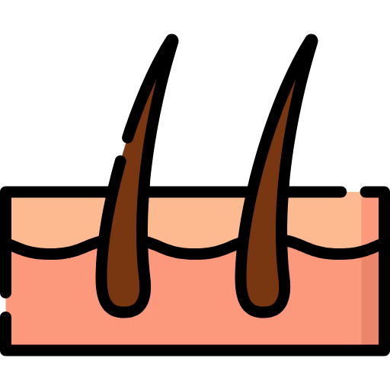
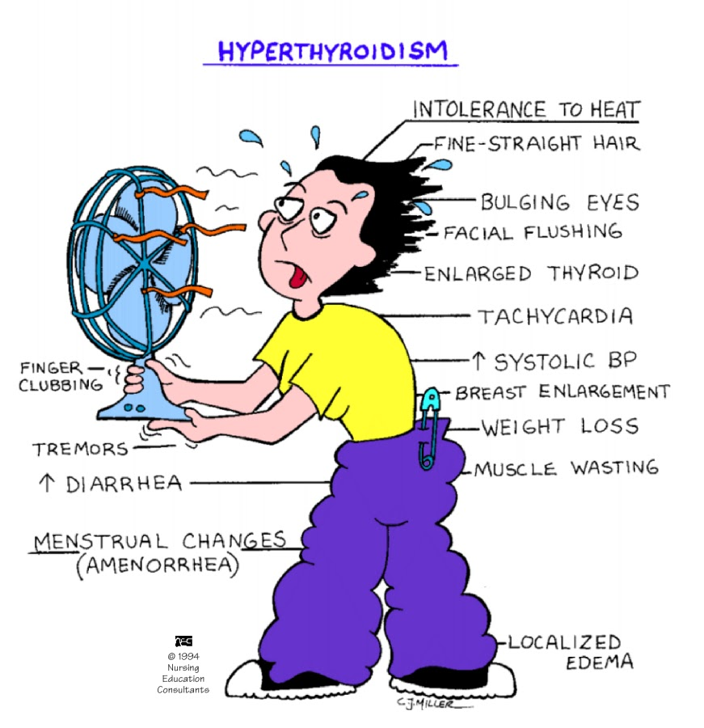
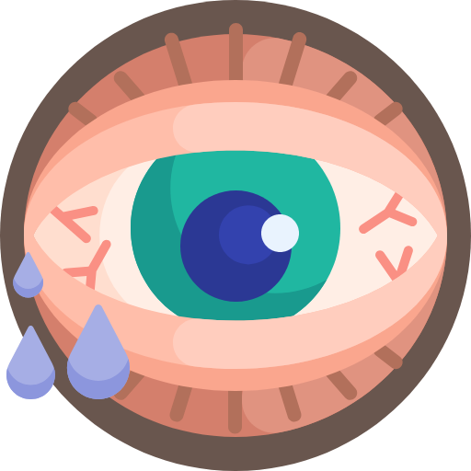
Hyperthyroidism & Thyrotoxicosis
Definition
Thyrotoxicosis: is the clinical syndrome that results when tissues are exposed to high levels of circulating thyroid hormone
Hyperthyroidism: is the hyperactivity of the thyroid gland
Conditions associated with thyrotoxicosis
Diffuse toxic goiter (Graves’ disease)
Toxic adenoma (Plummer’s disease)
Toxic multinodular goiter
Subacute thyroiditis
Hyperthyroid phase of Hashimoto’s
Thyrotoxicosis factitia
Other rare causes:
most common cause of hyperthyroidism.
Result of IgG antibodies binding to TSH receptor.
autonomous thyroid nodule overproduces thyroid hormones leading to hyperthyroidism → decrease in pituitary TSH secretion. Solitary, hot nodule
multiple hyperfunctioning (hot) nodules.
Painful goiter. Features of hyperthyroidism due to leakage of hormone from inflamed thyroid followed by features of hypothyroidism
transient hyperthyroidism.
The T4 :T3 ratio (typically 30 : 1 in conventional thyrotoxicosis) is increased to above 70 : 1
ovarian struma
metastatic thyroid carcinoma (follicular),
hydatidiform mole,
TSH secreting pituitary tumor,
pituitary resistance to T3 and T4
Clinical features of hyperthyroidism
Cardio&Respa
Skin
GI
Dyspnoea & tachycardia
Atrial fibrillation¹ in 10-20 %
High output cardiac failure
Wide pulse pressure
hypertension
Thyroid function tests are mandatory in any patient with atrial fibrillation
Warm, excessive sweating
Onycholysis & clubbing
hyperpigmentation
Pruritus, vitiligo, alopecia, thinning of the hair²
Pretibial myxedema³
Weight loss
diarrhoea
increase liver enzyme
Eyes
Others
Sympathetic overactivity
Common only in graves’ disease
Extraocular muscles dysfunction⁴: diplopia, proptosis, lid retraction, corneal ulceration⁵, optic neuropathy and blindness
Periorbital swelling and conjunctival edema
Bone:
increased turnover: osteoporosis
Neuropsychiatry:
Behavioral and personality changes: irritability, depression, anxiety, restlessness and psychosis
Thromboembolic vascular complications are particularly common in thyrotoxic 4. why do these happen? the eye muscles contain TSH
atrial fibrillation so that anticoagulation is required, unless contraindicated. receptors → autoimmunity against these receptors leads to
due to autoimmunity hypertrophy of the muscles
Characteristically seen in graves. 5. due to inability to close the eyes

Slide 10
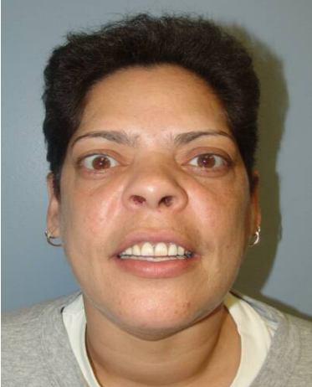
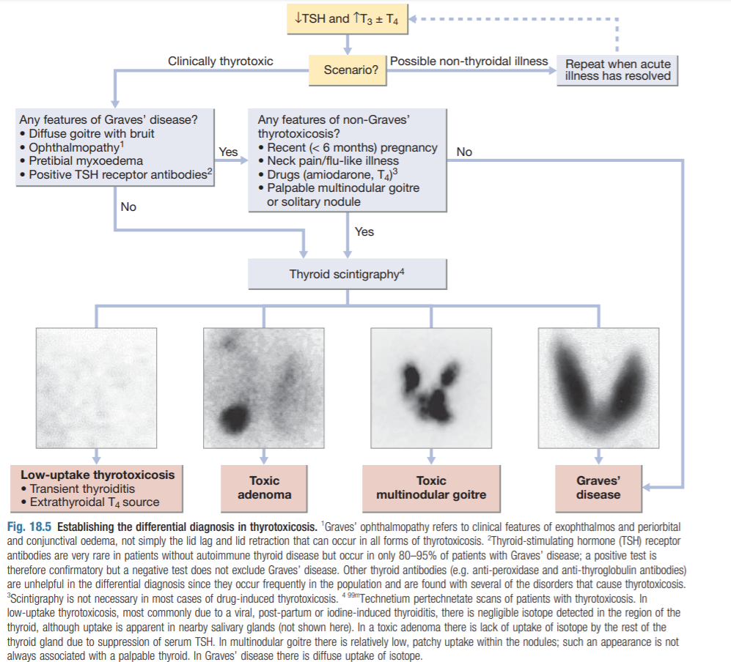
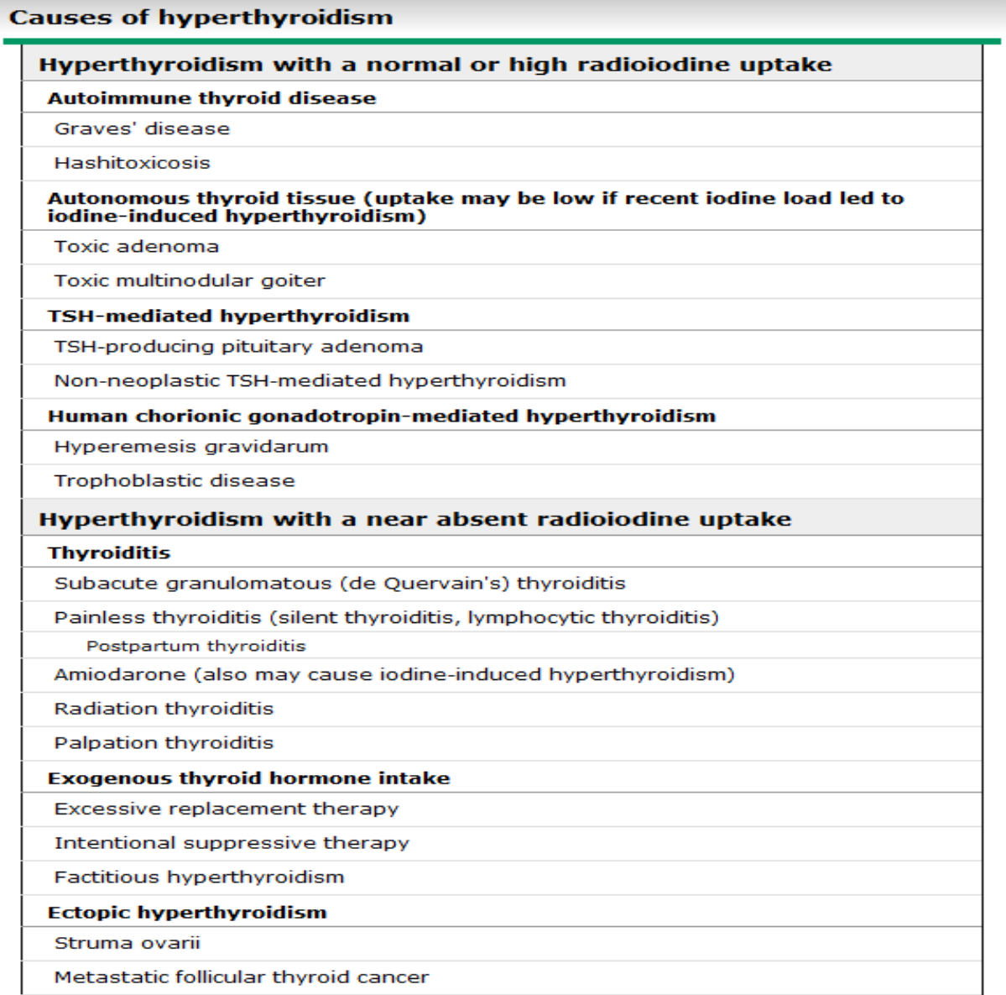
Hyperthyroidism
Diffuse Toxic Goiter (Graves’ disease):
Graves disease is an Autoimmune disease of unknown cause. It is the most common form of thyrotoxicosis. Affects Females more than Males. Peak incidence in the 20- to 40- year age group.
There is a strong familial predisposition
There is an association with HLA-88, DR3 and DR2
Features include:
Thyrotoxicosis
Goiter
Orbitopathy* (exophthalmos)
Dermopathy* (pretibial myxedema) (rare)
Pathogenesis
Inflammatory reaction due to local viral infection¹
Production of IFN-g and other cytokines by non-thyroid-specific infiltrating immune cells
Will induce the expression of HLA class II molecules on the surface of thyroid follicular cells.
Subsequently, thyroid specific T-cells will recognize the antigen presented on the HLA class II molecules and will be activated
The activated thyroid-specific T-cells stimulate B cells to produce TSH receptor-stimulating antibodies
* specific for graves
Hyperthyroidism
Diagnosis
+Ve
This is graves disease, No further test needed.
Elevated FT4
Suppressed TSH
The first-line investigations are serum T3(↑) , T4(↑) and TSH(↓)
Eye signs?
(Eg. exophthalmos)
-Ve
Do Thyroid scan “Radioactive uptake”
(next slide)
Other labs:
Increased Free T3:
You order FT3 especially when TSH is suppressed & normal T4. To check for T3 thyrotoxicosis.
1
2
3
TSH receptor stimulating antibodies:
Especially in pregnancy
They are specific for Graves' disease.
4
Yersinia enterocolitica, Escherichia coli and other Gram-negative organisms contain TSH-binding sites. This raises the possibility that the initiating event in the pathogenesis may be an infection with possible 'molecular mimicry' in a genetically susceptible individuals
Happens in early pregnancy due to increased HCG, which is structurally similar to TSH, which leads to transient gestational hyperthyroidism that resolves on its own by the 3rd trimester.
Why? Because it is only an inflammation (excessive intake, URTI, or ectopic production)
Caused by upper respiratory tract infection

Slide 11
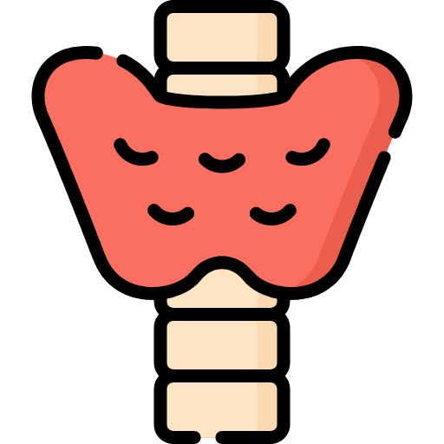
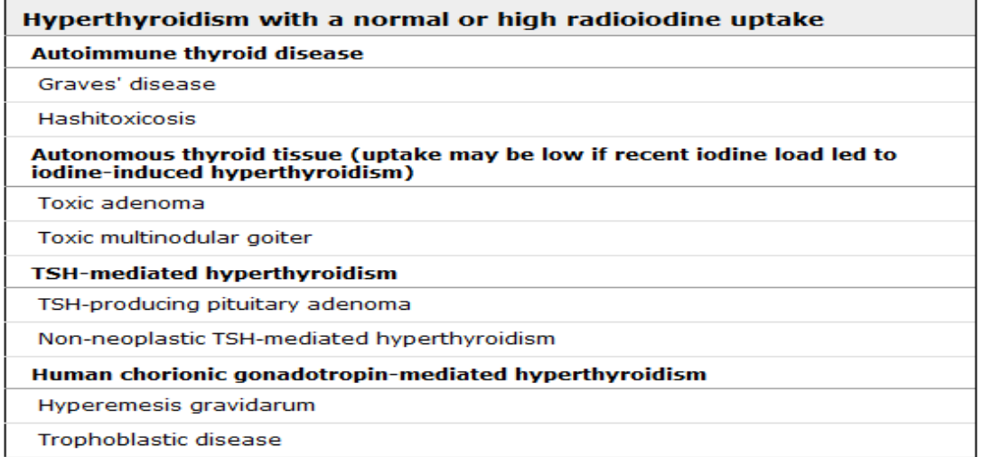
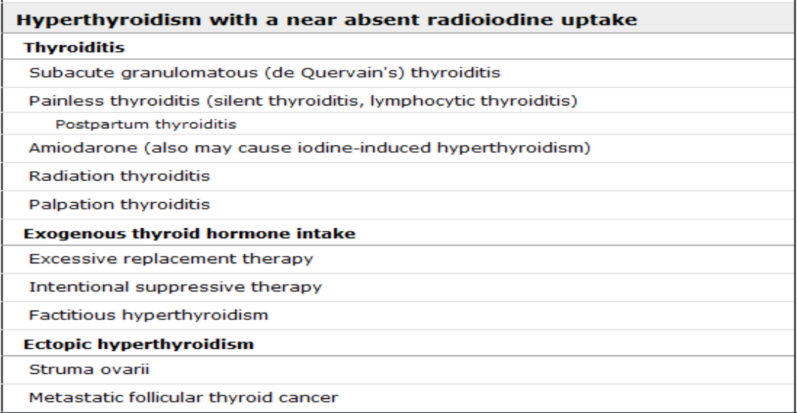
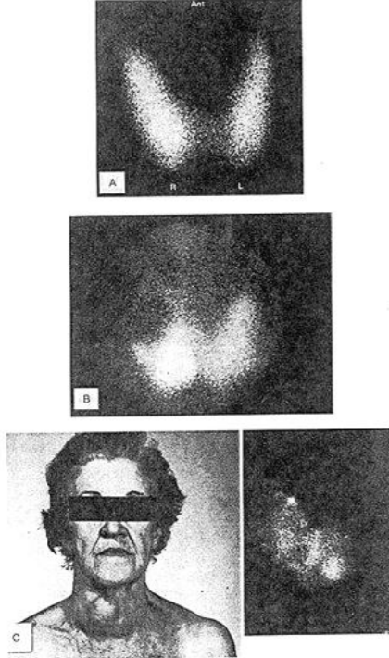
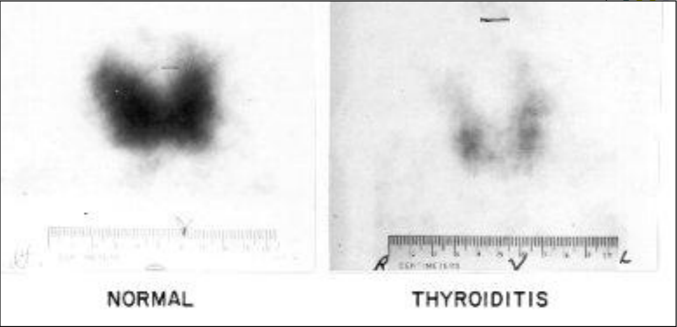
Diffuse Toxic Goiter (Graves’ disease)
Thyroid scan:
A Technetium or Radioiodine uptake scan:
Graves disease: The gland is hyperactive → Will take more iodine → Hot gland on imaging (Increased uptake)
Thyroiditis: The gland is NOT hyperactive because it is destroyed due to inflammation → Cold gland on imaging
Elevated uptake in:
Low uptake in:
Graves’ disease
Toxic Multinodular goiter
Spontaneous resolving hyperthyroidism
Subacute thyroiditis
Thyrotoxic phase of Hashimoto’s thyroiditis
Iodine loaded patients
Patients on LT4 therapy
Struma ovarii
TSH-R Ab [stim] is best initial
Free T3
Atypical presentations:
Thyrotoxic periodic paralysis
Thyrocardiac disease
Apathetic hyperthyroidism
Familial dysalbuminemic hyperthyroxinemia
Atypical presentation:
Thyrotoxic periodic paralysis | Because of thyrotoxicosis and hypokalemia
Thyrocardiac disease | Try to treat cardiac pts early to prevent IHD aggravation
Apathetic hyperthyroidism | Especially in the elderly they might have Hyperthyroidism without its characteristic signs and symptoms, they might present only with weight loss (or clinical picture more like that of hypothyroidism.)
Familial dysalbuminemic hyperthyroxinemia | Rare condition.
Figure 6-6. Thyroid Scans.
a. Normal thyroid imaged with 123I.
b. Cold nodule in the right lobe imaged by 99mTc.
c. Elderly woman with obvious multinodular goiter and the corresponding radioiodide scan on the right.
Complications:
Thyrotoxic crisis (thyroid storm)
Orbitopathy
Predisposing conditions such as stress, infection or surgery in an unprepared patient. Clinical features:
Fever, agitation, Altered mental status
Atrial fibrillation, Heart failure, liver dysfunction
Extreme restlessness
Treatment:
Antithyroid drugs
Steroids: Prevent the conversion of T4 to T3
BB and IV fluid
Ipodate sodium: inhibits the release of thyroid hormone + reduces the conversion of T4 to T3
First it needed to be managed medically with steroids (best initial) to avoid dryness.
If the patient is cured from graves but still have exophthalmos, this could be corrected surgically.

Slide 12
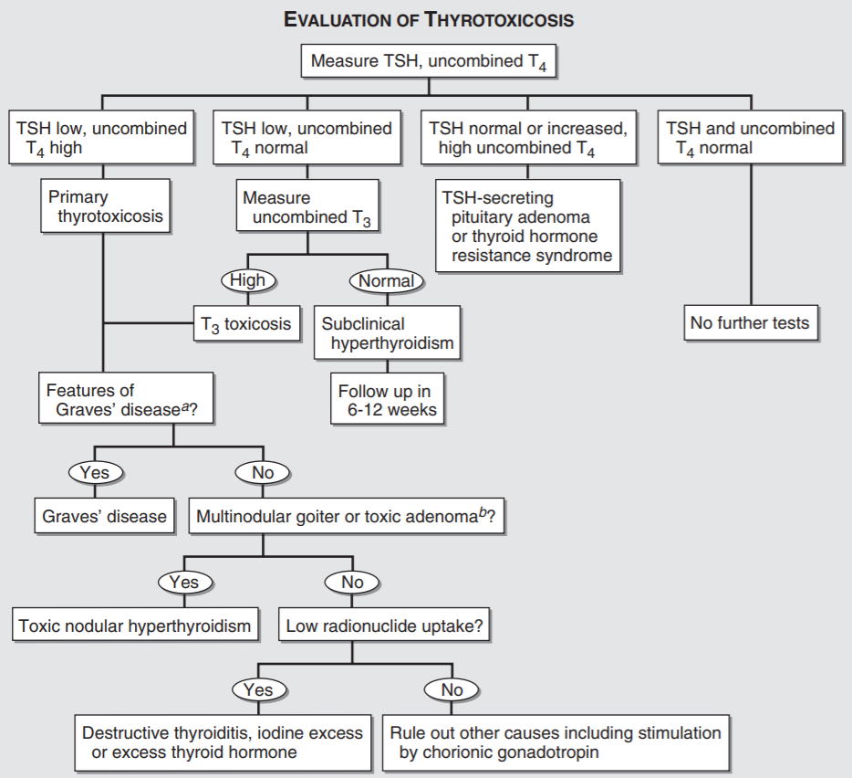
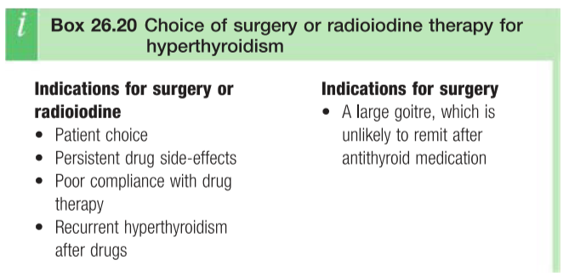
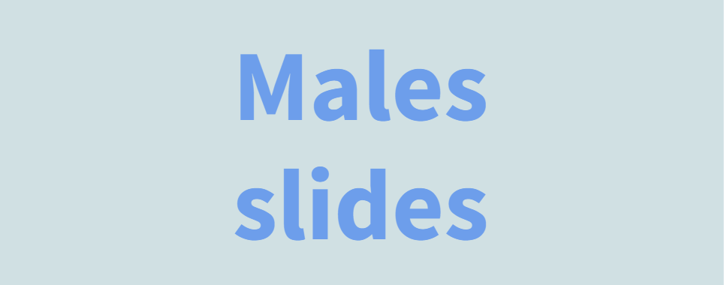
Treatment of Graves’ disease
Antithyroid drug therapy:
Thionamides: Propylthiouracil, methimazole, or carbimazole Inhibit the production of the thyroid hormone, Good for short term treatment (Duration of treatment 6 months – years) It is important to start Antithyroid drugs before Radioactive iodine or surgery in patients with severe graves, because it may precipitate thyroid storm. Spontaneous remission 20-40%. Relapse 50-60%. Reactions to antithyroid drugs are rare
Advantages | Chance of permanent remission, some patients avoid permanent hypothyroidism, lower cost
Dis- advantages | Risk of fetal goiter and hypothyroidism if pregnant. Requires more frequent monitoring. Major side effects: agranulocytosis, vasculitis (Lupus-like syndrome), hepatitis, bone marrow suppression Minor side effects: rash, hives, arthralgia, transient granulocytopenia, GI symptoms
Radioactive iodine therapy
Given to patients of all ages, although it is contraindicated in pregnancy and while breastfeeding. ¹³¹Iodine is most commonly used. Dose: 131I (uci/g) x thyroid weight x 100/ 24-hr RAI uptake.
Advantages | Permanent resolution of hyperthyroidism. There is no increased risk of malignancy after RAI.
Dis- advantages | Permanent hypothyroidism. Patient must take radiation precautions for several days after treatment, avoiding contact with young children and pregnant women. Patient concerns about long-term effect of radiation. Rare radiation thyroiditis.
Surgical treatment:
When? Either for big goiter or failure of the previous two modalities . Subtotal thyroidectomy Preparation for surgery: control HR,BP, thyroxine levels Complications: Permanent Hypothyroidism/ hypoparathyroidism and hypocalcemia Recurrent laryngeal nerve injury, hoarseness When to start thyroxine therapy after removal of the gland? IMMEDIATELY!
Advantages | Rapid, permanent cure of hyperthyroidism
Others:
Symptomatic treatment | Beta-blockers: used to provide rapid partial symptomatic control; they also decrease peripheral conversion of T4 to T3 Super saturated potassium Iodine (SSKI)
Thyrotoxicosis & Pregnancy: | Treat with Propylthiouracil in first trimester, and then you can switch to carbimazole, it is recommended in the second and third trimesters, as liver problems are more frequently described on PTU. Make sure to keep T4 level at the upper normal range (12-20) to prevent hypothyroidism in the fetus.

Slide 13
Hyperthyroidism
Treatment of other forms of thyrotoxicosis:
Toxic adenoma
toxic multinodular goiter
Amiodarone
Antithyroid medications
Radioactive iodine (It will treat it, but it won’t reduce the size of the nodule to zero)
Surgery (Best if there are no contraindications)
Same approach.
Antithyroid medications
Radioactive iodine
Surgery
If the patient’s arrhythmia is controlled with amiodarone and they have thyroid problems. The best is to remove the gland, DO NOT stop the medication.
Subacute thyroiditis:
Thyrotoxicosis factitia
Strauma ovarii
Symptomatic treatment
Thyrotoxic phase: Give BB
Hypothyroid phase: short duration of thyroxine therapy
thyrotoxicosis caused by the ingestion of exogenous thyroid hormone
To diagnose and treat this condition; you need to take a good and detailed history.
Rare disease; Exogenous thyroxine production
Treated surgically.
Other thyroid disorders
Nontoxic goiter: if the function is normal, no malignancy, no compression symptoms? Just observe
Subacute thyroiditis (De Quervain’s): Symptomatic therapy
Chronic thyroiditis: Usually they end up with hypothyroidism, so treat it as hypothyroidism
Acute thyroiditis: VERY painful, give pain medications and BB
Thyroid cancer
Thyroid nodules:
Anybody with thyroid nodule, do FNA. Unless the TSH is low (so the patient might have toxic nodule) which the risk of malignancy is very low. in this case you do thyroid scan.
In ANY thyroid problem, you need to remember and assess THREE principals:
Anatomy (The size):
Big gland causing compression symptoms, regardless of the biochemistry (Hyper/Hypo) and pathology (Benign/Malignant). The ideal is to remove the gland.
Biochemistry
Normal size, No pathology, but the function is abnormal (Hyper/Hypo) then you treat accordingly.
Pathology
Normal size, the function is completely normal. But has one nodule, you did FNA and came to be malignant; so the gland need to be removed

Slide 14
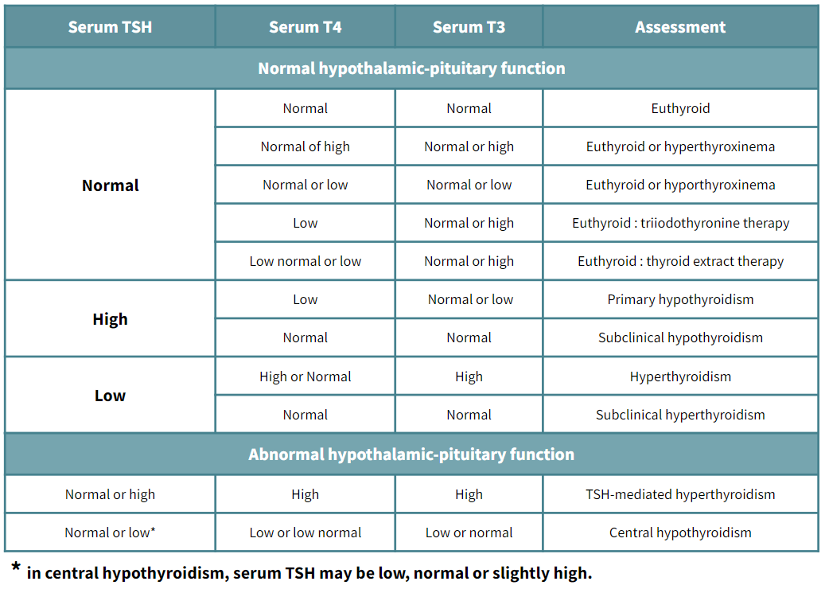
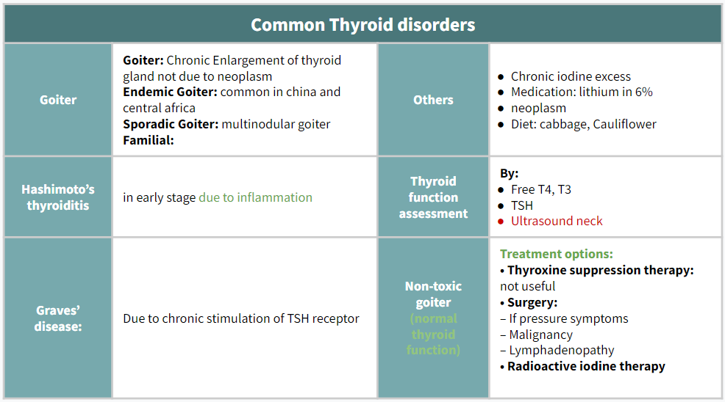
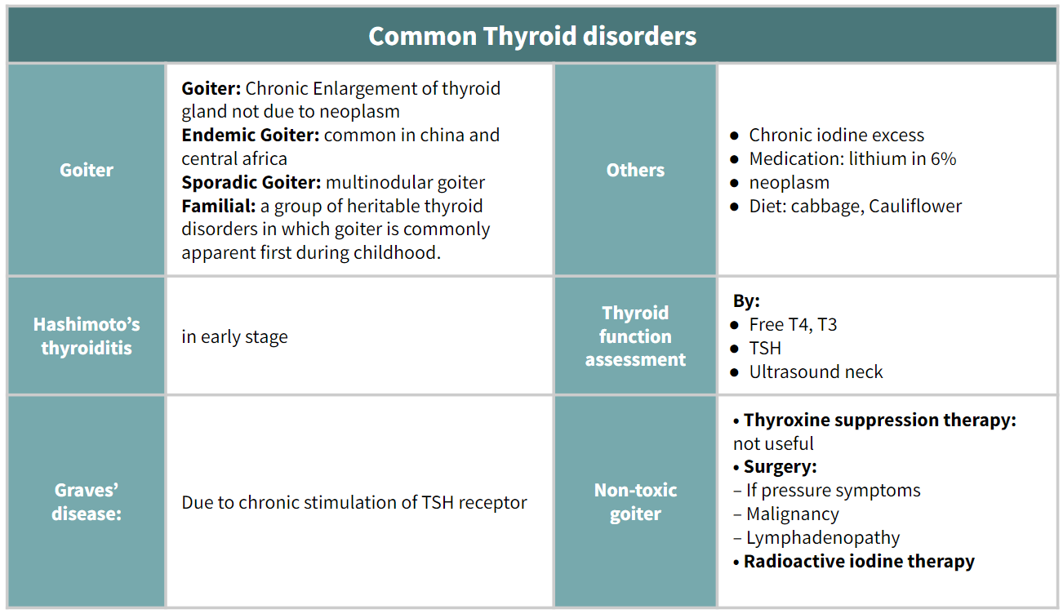
Hyperthyroidism & Hypothyroidism
Case from the doctor
A 29 year old female came to the clinic complaining of fatigue, increased sleepiness, not feeling well . Nothing significant on examination. Her TSH is 1 mU/L (normal 0.4 and 4.0mU/L), FT4 is normal, high antithyroglobulin antibodies and high antithyroperoxidase antibodies. What should you do?
Apply the three principles;
Size? normal
Function? Normal
Pathology? No nodules
So just follow up the patient.
Patterns of thyroid function test during assessment of thyroid function
Goiter:
Common Thyroid disorders
Goiter | Goiter: Chronic Enlargement of thyroid gland not due to neoplasm Endemic Goiter: common in china and central africa Sporadic Goiter: multinodular goiter Familial: | Others | Chronic iodine excess Medication: lithium in 6% neoplasm Diet: cabbage, Cauliflower
Hashimoto’s thyroiditis | in early stage due to inflammation | Thyroid function assessment | By: Free T4, T3 TSH Ultrasound neck
Graves’ disease: | Due to chronic stimulation of TSH receptor | Non-toxic goiter (normal thyroid function) | Treatment options: • Thyroxine suppression therapy: not useful • Surgery: – If pressure symptoms – Malignancy – Lymphadenopathy • Radioactive iodine therapy
Unique features of thyroid diseases
Significance of thyroid antibodies
Diagnosis | Unique feature
Graves disease | Eye (proptosis) (20%–40%) and skin (5%) findings
Subacute thyroiditis | Tender thyroid
Painless “silent” thyroiditis | Nontender, normal exam results
Exogenous thyroid hormone use | Involuted gland is not palpable
Pituitary adenoma | High TSH level
Antibody | Significance
Thyroglobulin | Detects recurrence of thyroid cancer
Thyroid-stimulating immunoglobulin (TSI) | - Confirms Graves disease - Not positive in toxic multinodular goiter
Thyroperoxidase antibody (TPO) | Confirms presence of Hashimoto thyroiditis

Slide 15
Female slides
Drugs affecting thyroid function
Drugs causing Hypothyroidism
Inhibition of thyroid hormone synthesis and\or release
Thionamides , lithium , perchlorate , aminoglutethimide , thalidomide , and iodine and iodine containig drugs including amiodarone , radiographic agents , expectorants ( organidin , combid ) , kelp tablets , potassium idoine solutions (sski) , betadine douches , topical antiseptics
Decreased absorption of T4
Cholestyramine , colestipol , colesevelam , aluminum hydroxide , calcium carbonate , surcraflate , iron sulfate , raloxifene , omeprazole , lansoprazole , and possibly other medications that impair acid secretion , sevelemer , lanthanum carbonate , and chromium , malabsorption syndrome can also diminish T4 absorption
Immunedysregulation
Suppression of TSH
interferon-alfa , Interleukin-2
dopamine
Possible destructive thyroiditis
Increased T4 clearance and suppression of TSH
sunitinib
bexarotene
Drugs causing Hyperthyroidism
Stimulation of thyroid hormone synthesis and\or release:
Iodine
Amiodarone
Immunedysregulation:
Interferon-alfa
Interleukin-2
Denileukin diftitox
Drugs affecting Thyroid function or Tests without thyroid dysfunction:
Low serum TBG | Androgens - danazol , glucocorticoids , slow release niacin ( nicotinic acid) , I,aspraginase
High serum TBG | High serum TBG , estrogen , tamoxifen , raloxifene , methadone , 5-fluouracil , clofibrate, heroin, mitotane
Decreased T4 binding to TBG | Decreased T4 binding to TBG - salicylate , salsalate , furosemide, heparin , ( via free fatty acids) , certain NSAIDs
Increased T4 clearance | Increased T4 clearance - phenytoin , carbamazepine , rifampicin , phenobarbital
Suppression of TSH secretion | Suppression of TSH secretion - dobutamine , glucocorticoids ,octeoride
Impaired conversion of T4 to T3 | Impaired conversion of T4 to T3 - amiodarone , glucocorticoids , contrast agents for oral cholecystography (iopanoic acid ) , propylthiouracil , propranolol , Nadol

Slide 16
 | Hyperthyroidism | Hypothyroidism
Causes | Diffuse toxic goiter (Graves’ disease) Toxic adenoma (Plummer’s disease) Toxic multinodular goiter Subacute thyroiditis Hyperthyroid phase of Hashimoto’s thyroiditis Iodine-induced hyperthyroidism Thyrotoxicosis factitia ovarian struma | 1-primary: Hashimoto disease (chronic thyroiditis) most common cause of primary hypothyroidism. Iatrogenic—second most common cause of primary hypothyroidism; results from prior treatments of hyperthyroidism, including: Radioiodine therapy Thyroidectomy Medications (e.g., lithium) 2-secondary: due to pituitary disease(low TSH) 3-tertiary: (due to hypothalamic disease (low TRH)
Clinical manifestations: | Tachycardia, palpitations, arrhythmia (atrial fibrillation) Diarrhea (hyperdefecation) Weight loss Anxiety, nervousness, restlessness Hyperreflexia Heat intolerance Fever | Bradycardia Constipation Weight gain Fatigue, lethargy, coma Decreased reflexes Cold intolerance Hypothermia (hair loss, edema)
Diagnosis: | All thyroid disorders are best tested first with a TSH. If the TSH level is suppressed, measure free T4 levels. TSH levels are markedly elevated if the gland has failed.
 | Biochemical: Clinical Hyperthyroidism: FT4 high, FT3 high, TSH low Subclinical Hyperthyroidism: FT4 normal, FT3 normal, TSH low. TSH Mediated Hyperthyroidism : FT4 high, FT3 high, TSH high. Radiological: Thyroid Scan Serology: Thyroid antibodies, TSH Receptor antibodies. | -Biochemical: Primary Hypothyroidism : High TSH, Low T4 Secondary Hypothyroidism : Low TSH, Low T4 -Serology: Thyroid antibodies -ECG
Treatment | Radioactive iodine therapy Anti-thyroid medications: Propylthiouracil methimazole Beta Blockers Thyroidectomy | Replacing thyroid hormone with Levothyroxine (T4) is sufficient
Complications: | Thyrotoxic crisis (thyroid storm): Fever / Agitation Altered mental status Atrial fibrillation / Heart failure | Myxedema coma heart disease neuropsychiatric disease

Slide 17
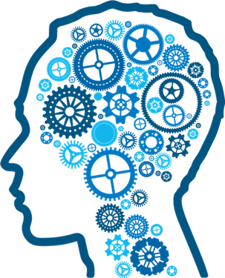
Q1:A 33-year-old obese woman complains of tiredness. She has recently given birth to a healthy baby boy and is enjoying being a mother. However, she is becoming more reliant on her partner for support as she always feels exhausted and often becomes depressed. The patient has a poor appetite and often does not finish her meals, despite this she has gained 5 kg in the last 2 weeks. The most likely diagnosis is:
A- Oral glucose tolerance test
B- Eating disorder
C- Hyperthyroidism
D- Hypothyroidism
Q2:A 16-year-old girl presents to her GP complaining of a swelling in her neck which she has noticed in the last 2 weeks. She has felt more irritable although this is often transient. On examination, a diffuse swelling is palpated with no bruit on
auscultation. The most likely diagnosis is:
A- Hyperthyroidism
B- Simple goitre
C-Thyroid carcinoma
D- Riedel’s thyroiditis
Q3:A 47-year-old woman is referred to the endocrine clinic complaining of a twomonth history of tiredness. Despite wearing several items of clothing, the patient appears intolerant to the room temperature. She has noticed an increase in weight,
particularly around her waist. The most appropriate investigation is:
A- Radioiodine scan
B- Thyroid stimulating hormone (TSH)
C- Total tetraiodothyronine level (T4)
D- Tri-iodothyronine level (T3)
Q4: A 58-year-old woman presents with an acutely painful neck, the patient has a fever, blood pressure is 135/85 mmHg and heart rate 102 bpm. The patient explains the pain started 2 weeks ago and has gradually become worse. She also notes palpitations particularly and believes she has lost weight. The symptoms subside and the patient presents again complaining of intolerance to the cold temperatures. The most likely diagnosis is:
A- Thyroid papillary carcinoma
B- Plummer’s disease
C- De Quervain’s thyroiditis
D- Hyperthyroidism
Q5: A 60-year-old woman comes to the emergency room in a coma. The patient’s temperature is 32.2°C (90°F). She is bradycardic. Her thyroid gland is enlarged. There is diffuse hyporeflexia. BP is 100/60. Which of the following is the best next step in management?
A- Await results of T4 and TSH.
B-Obtain T4 and TSH; begin intravenous thyroid hormone and glucocorticoid.
C- Begin rapid rewarming.
D- Obtain CT scan of the head.
E- Begin intravenous fluid resuscitation.
Answers: Q1:D | Q2:B | Q3:B | Q4:C | Q5:B |
Answers Explanation File!

Slide 18
THANKS!!
This lecture was done by:
Abdullah Alghamdi
Note taker:
Jehad Alorainy
Special thanks to..
Jehad Alorainy
Females co-leaders:
Raghad AlKhashan
Amirah Aldakhilallah
Males co-leaders:
Mashal AbaAlkhail
Nawaf Albhijan
Send us your feedback:
We are all ears!

