Slide 1
Lecture 52
Editing file
Obesity
Objectives:
Know why do we study obesity.
Learn what is obesity.
Know what is the impact of obesity in Saudi Arabia.
Know the Body weight regulations
Know how to manage an obese individual
Learn the effective preventive strategies for obesity
Color index:
Color index:
Original text Females slides Males slides
Doctor’s notes Textbook Important Golden notes Extra

Slide 2
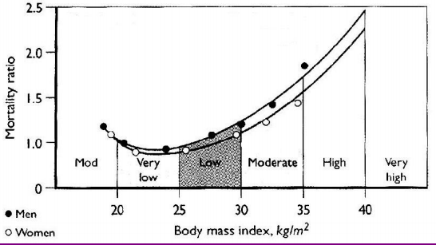
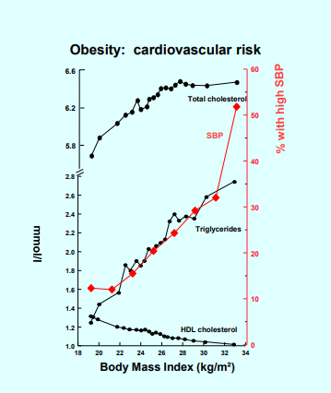
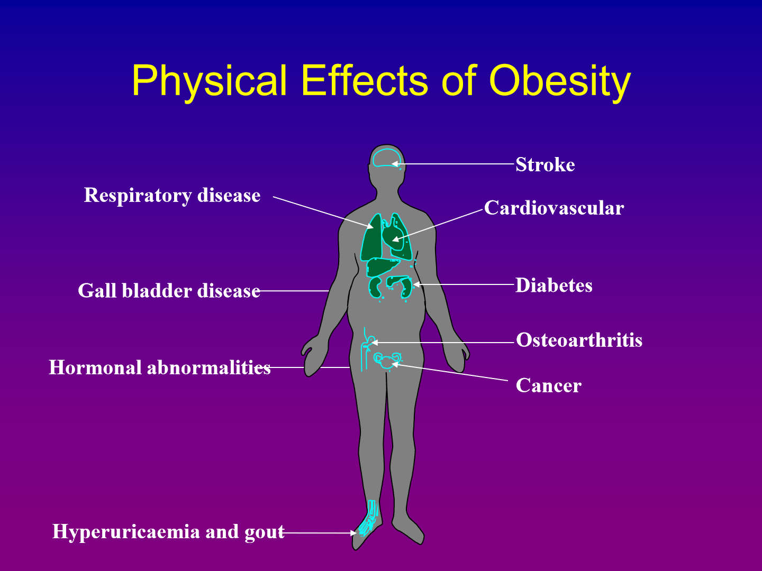
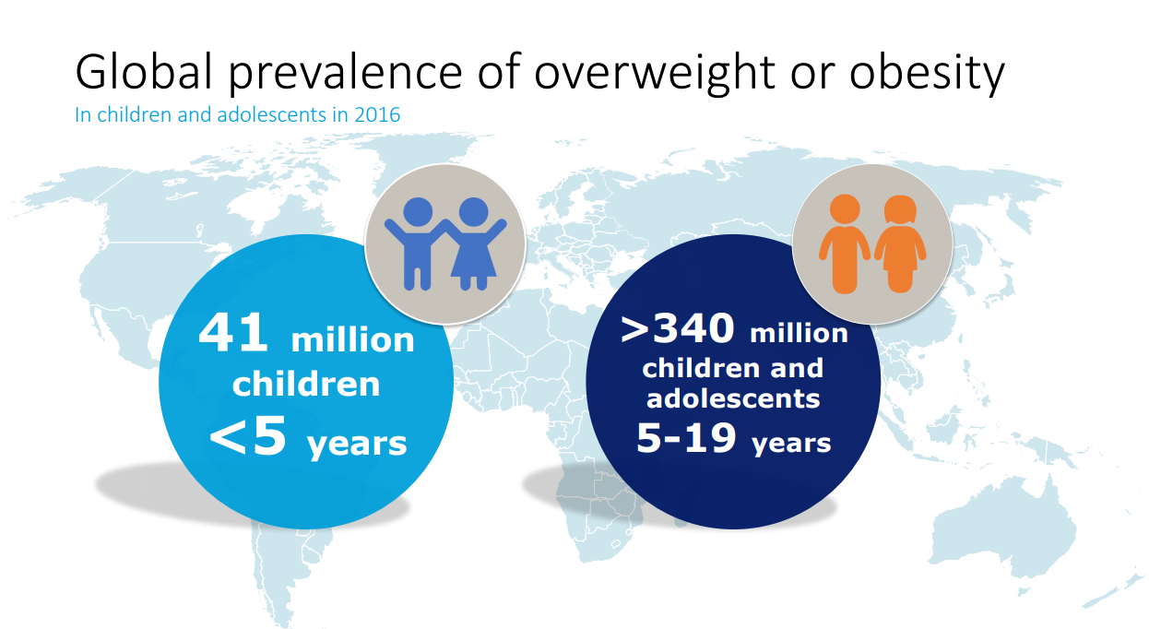
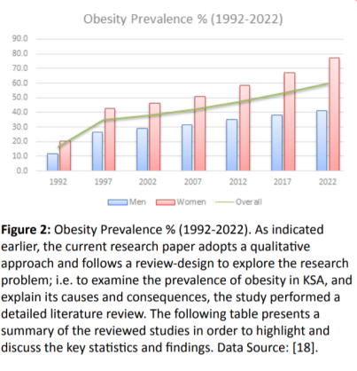
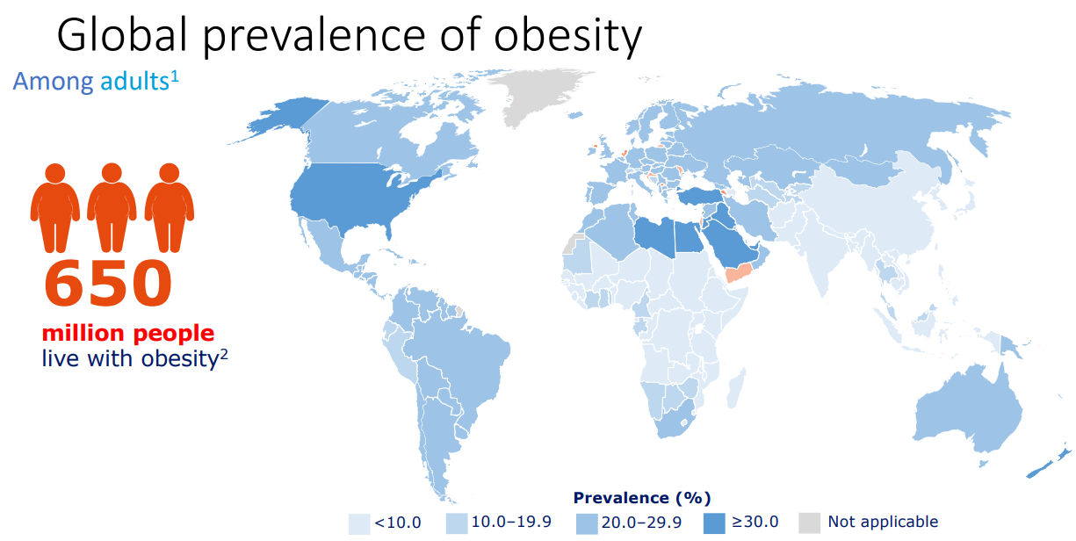
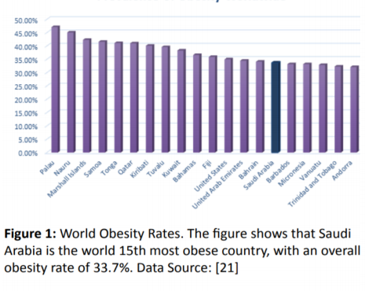
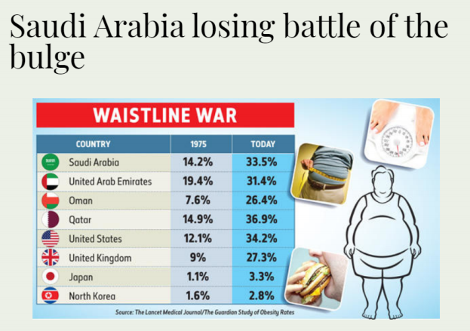
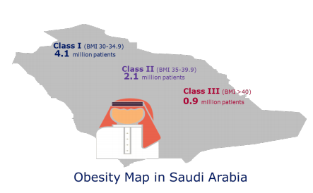
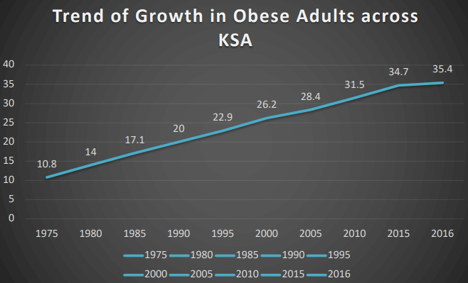
Introduction
‹#›
Definition
Abnormal or excessive fat accumulation in adipose tissue, to the extent that health is impaired (WHO)
Presence of an abnormal absolute amount or relative proportion of body fat.
Not all obese people eat more than the average person, but all obviously eat more than they need.
Obesity is a chronic disease¹ and health issue
Obesity is one of the five most important health concerns worldwide, the present obesity epidemic is mainly due to changes in lifestyle behaviour
³
“ABCD” Diagnostic term
“ABCD” Diagnostic term for obesity as a chronic disease state:
Obesity : Adiposity Based Chronic Disease
Mechanical complications e.g. obstructive sleep apnea, osteoarthritis
Cardiometabolic complications including:
hypertension, dyslipidemia, hyperglycemia
Psychological changes
The neuroendocrine and metabolic causes of accumulation of excess fat mass
The development of adipose tissue dysfunction
The metabolic and neuroendocrine complications of obesity
Prevalence
Globaly
Saudi Arabia²
1: because it is associated with CVS and psychological complications
2: highest rates of obesity, higher in women. Rates are expected to increase to 59% by 2022
3- classical "J" shape, on the Y access is the mortality rate and on the X access is the BMI, if the BMI is very low or High (>30) patient will have increase in mortality rate

Slide 3
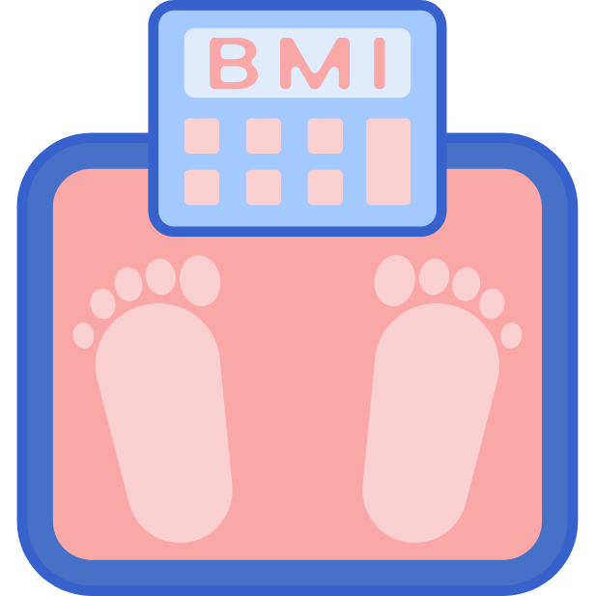
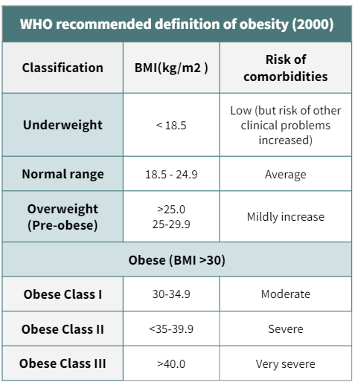
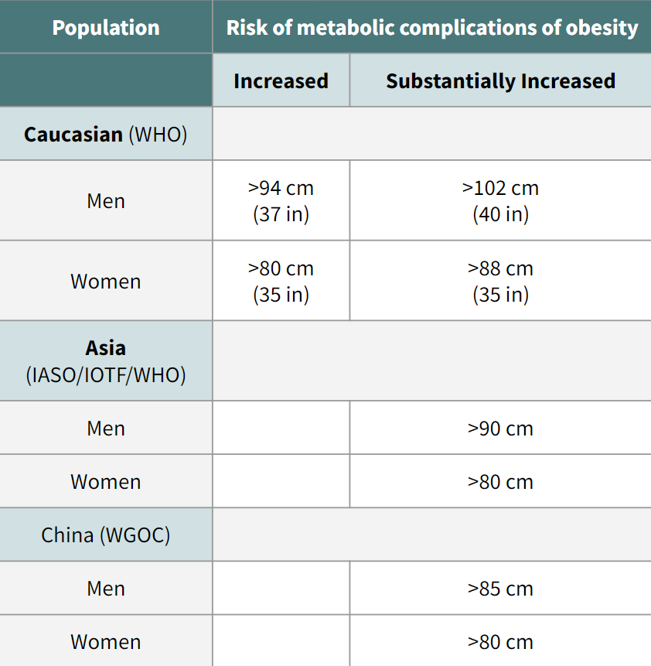
Introduction cont.
Surrogate measures of adiposity
Measurement of adiposity in human body
We can measure fat in our body by different ways and some of them are possible, difficult, time consuming, expensive, inappropriate to use in this field.
01
02
03
04
BMI
It is the practical thing to use, but not the best.
Ideal body weight
Anthropometric measures
Weight
Body Mass index (BMI):
Body Mass index (BMI):
Body mass index (BMI) is a simple index of weight-for-height that is used to classify obesity in adults: BMI ≥ 30kg/m².
Recommended by WHO
Relatively reliable except in:
Extremes of age or height
Very fit individuals with muscular build
Production of ethnic-specific cut-points is very important for BMI, buddy fatness, morbidity and mortality
Additional interim cut-point of BMI of 23 kg/m 2 or greater to indicate overweight in Asian populations and a BMI of 25 kg/m 2 to represent a higher level of risk equivalent to obesity
WHO recommended definition of obesity (2000)
Classification | BMI(kg/m2 ) | Risk of comorbidities
Underweight | < 18.5 | Low (but risk of other clinical problems increased)
Normal range | 18.5 - 24.9 | Average
Overweight (Pre-obese) | >25.0 25-29.9 | Mildly increase
Obese (BMI >30)
Obese Class I | 30-34.9 | Moderate
Obese Class II | <35-39.9 | Severe
Obese Class III | >40.0 | Very severe
Population | Risk of metabolic complications of obesity
 | Increased | Substantially Increased
Caucasian (WHO)
Men | >94 cm (37 in) | >102 cm (40 in)
Women | >80 cm (35 in) | >88 cm (35 in)
Asia (IASO/IOTF/WHO)
Men |  | >90 cm
Women |  | >80 cm
China (WGOC)
Men |  | >85 cm
Women |  | >80 cm
¹
Waist circumference (measure of visceral obesity)
Waist circumference:
The easiest way to assess obesity is by measuring the narrowest circumference midway between the lower border of the ribs and the upper border of the iliac crest, taken from the side, it’s even considered to be one of the vitals signs to measure in patients with metabolic diseases
Waist circumference helps to screen health risks of obesity and overweight
This risk goes up with a waist size that is greater than 35 inches for women or greater than 40 inches for men
Variable depending on the race
²
1- cutoff points depend on the ethnicity, in this table the cutoff points are from the west. In japan, china, south korea the cutoff points are lower than those mentioned. We use this in KSA but we need more studies to make sure that we follow the correct cut-off points
2- we follow this one

Slide 4
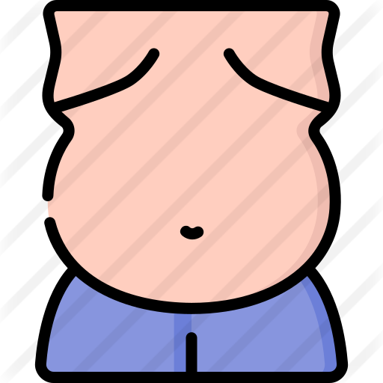
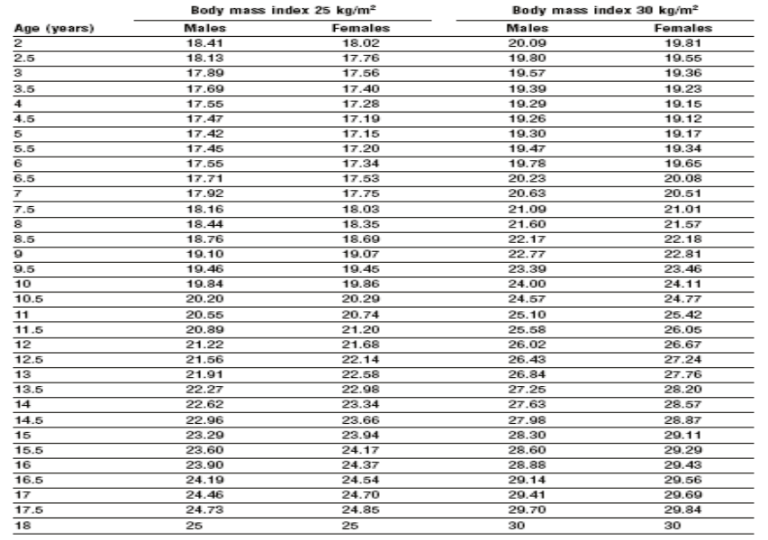
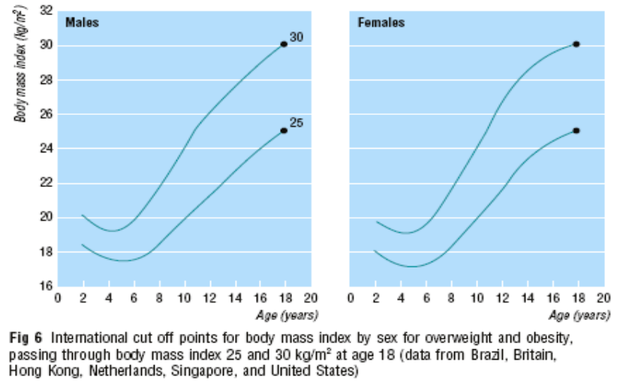
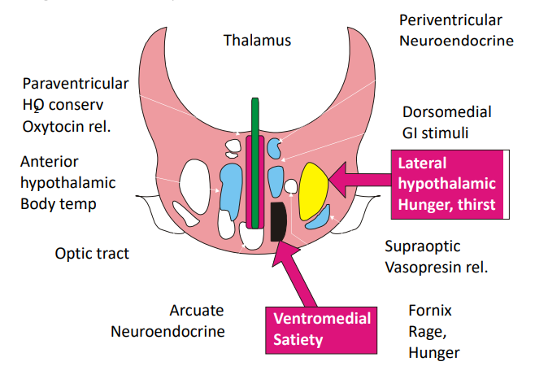
Introduction cont.
Central Obesity
Central or visceral obesity is associated with more metabolic disease and complications:
DM2
Hypertension
Dyslipidemia
We can measure central or visceral obesity by:
MRI
Dual X-ray absorptiometry (DEXA)
Single CT slice L4/L5
Waist: hip ratio
Waist circumference
A central distribution of body fat (a waist/hip circumference ratio of >1.0 in men and >0.9 in women) is associated with a higher risk of morbidity and mortality than is a more peripheral distribution of body fat (waist/hip ratio <0.85 in men and <0.75 in women).
This is because fat located centrally, especially inside the abdomen, is more sensitive to lipolytic stimuli, with the result that the abnormalities in circulating lipids are more severe.
Obesity in children
Assessing obesity in children is an issue due to the presence of a 3rd factor (Growth hormone) that affect children weight, for that growth charts are created, though it is not that accurate, it can give a close representation of the expected weight that a child may get in certain age.
Growthcharts
BMI-for-age reference charts
“International standard”BMI-for-age :- -
Cole et al. (BMJ 2000; 320:1240-1243) - Combined sample of seven countries
By tracking the percentile representing a BMI of 25 kg/m2 and 30 kg/m2 at 18 years back through to birth.
It’s use will provide a standard definition and enable meaningful comparisons to be made between countries.
Mechanism of Obesity
Food intake and utilization is regulated by
Hormones
CNS
(Hypothalamus)
Neurotransmitters
1
2
Signals from peripheries are carried out by neurotransmitters and hormones to CNS in presence or absence of food
Signal from fat by hormone leptin to hypothalamus to reduce food intake and increased sympathetic activity and energy expenditure
Role of hypothalamus in mediation of hunger and satiety
6
3
4
Sympathetic activity from food thermogenesis leads to reduce food intake
Gastric distension and contraction send signal for satiety and hunger
Fall in blood sugar send signals to CNS for hunger. Sympathetic activity from food thermogenesis leads to reduce food intake

Slide 5
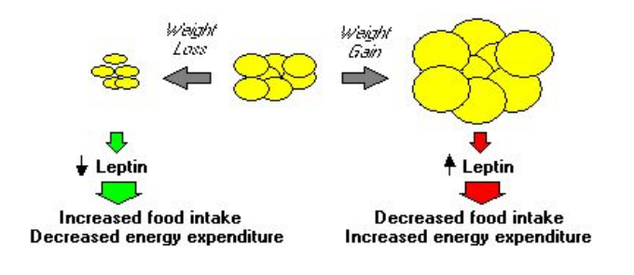
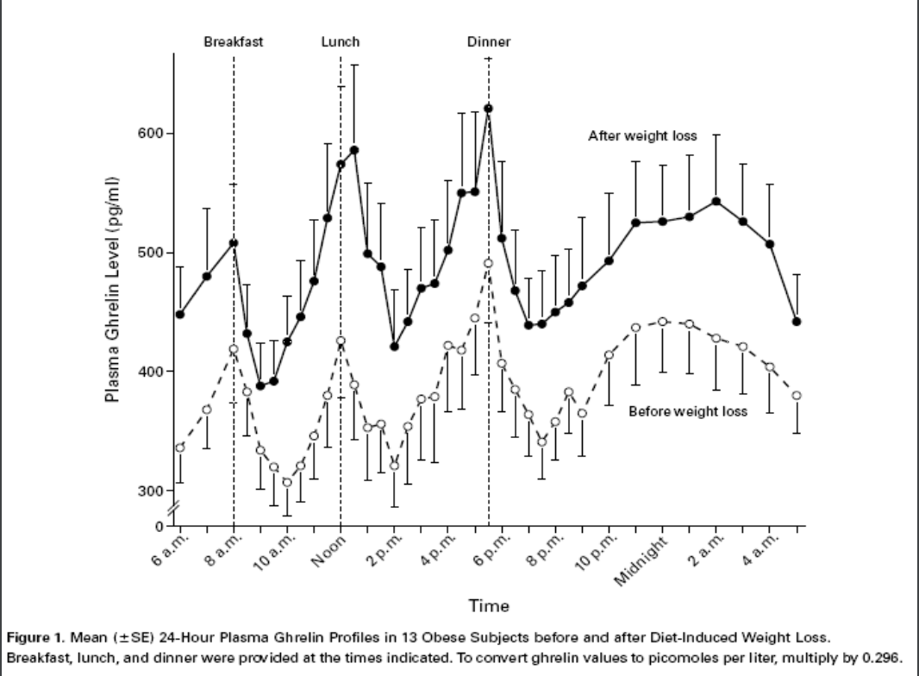
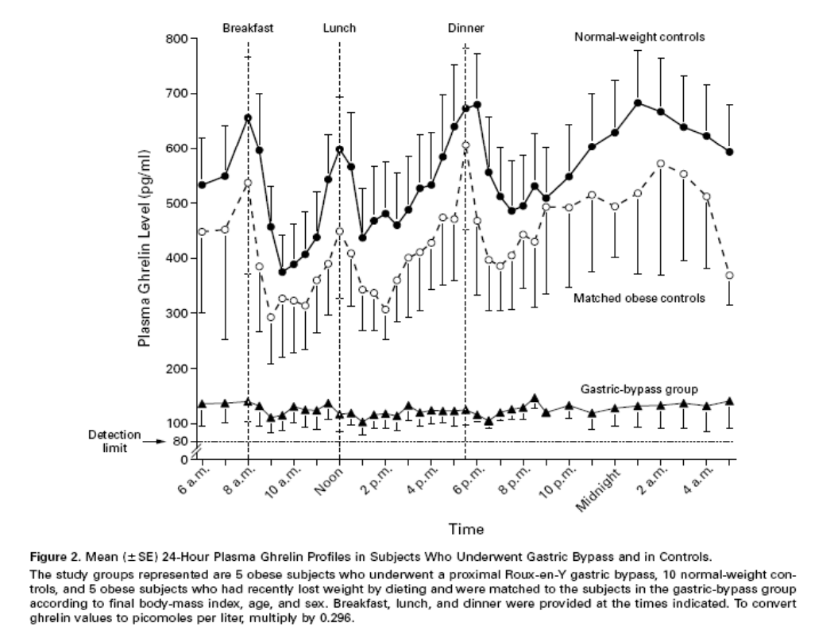
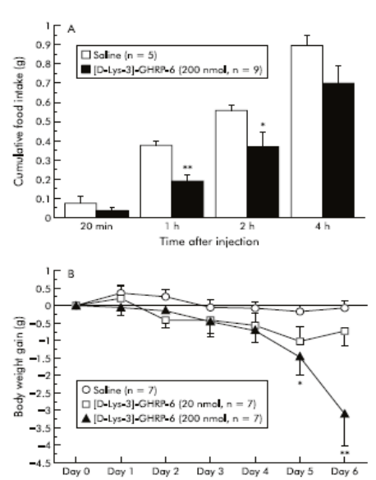
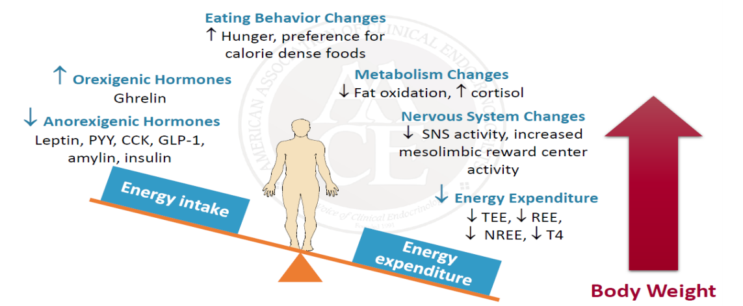
Mechanism of obesity
Hypothalamic modulators of food intake
Gut to brain signaling (hormones):
Leptin
Orexigenic (Increase Appetite) | Anorexigenic (Decrease Appetite)
NPY | CART
AGRP | CCK
MCH | CRH
Galanin | a-MSH
Orexin | Insulin
Ghrelin The hormone of hunger | GLP-1¹
Noradrenaline | PYY 3-36
Endocannabinoids | Leptin
m, к Opioids | Urocortin
Neurotransmitters | Bombesin
Leptin from adipocytes acts on hypothalamus to decrease food intake and stimulate energy expenditure
Plasma levels of leptin are very high, correlating with the BMI.
Weight loss due to food restriction decreases plasma levels of leptin.
Deficiency or resistance to leptin leads to obesity
Ghrelin
Ghrelin is a recently discovered orexigenic hormone (an obesity hormone) .
Increase with hunger decrease with eating
Secreted primarily by the stomach and duodenum, and acts on hypothalamus to stimulate appetite
Has been implicated in both mealtime hunger and the long-term regulation of body weight.
Adaptations to weight loss (obesity protects obesity)
1- Famously known hormone that decrease food intake, on of the medications used to treat obesity is Liraglutide (Saxenda) which is a GLP-1 agonist.
2- The ob gene is found on chromosome 7 and produces a 16 kDa protein called leptin. In the ob ob mouse, a mutation in the ob gene leads to production of a non-functioning protein. Administration of normal leptin to these obese mice reduces food intake and corrects the obesity. A similar situation has been described in a very rare genetic condition causing obesity in humans, in which leptin is not expressed.

Slide 6
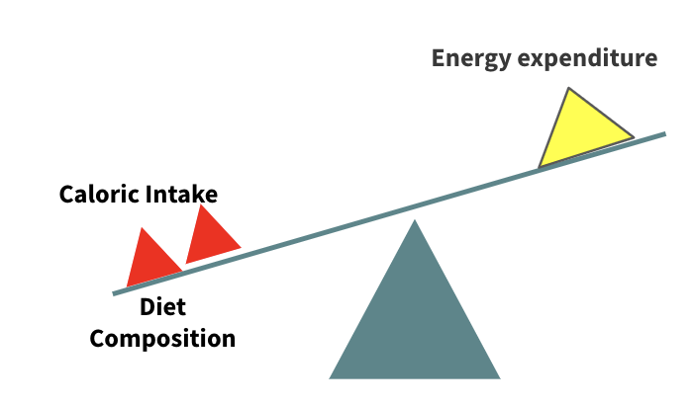
Etiology and pathogenesis
‹#›
Energy expenditure
Caloric Intake
Etiology & Pathogenesis
Diet Composition
Multifactorial
Biochemical/Dietary/behavioral pathways.
Some individuals eat more during periods of heavy exercise or during pregnancy and are unable to get back to their former eating habits. The increase in obesity in social class 5 can usually be related to the type of food consumed (i.e. food containing sugar and fat). Psychological factors and how food is presented may override complex biochemical interactions.
Imbalance between energy intake and energy expenditure
Energy balance is determined by several variables, including basal metabolic rate (BMR)¹, appetite, diet and physical activity².
It has been shown that obese patients eat more than they admit to eating, and over the years, a very small daily excess of intake over expenditure can lead to a large accumulation of fat.
Body weight and composition regulation:
Central Nervous System³
Afferent signals (nutrients, leptin, etc.)
Intake
Efferent signals (SNS, hormones, etc.)
Nutrient utilization & thermogenesis
Adipose tissue
Obesity: How does it happen?
1
Calories consumed not equal calories used over a long period of time
2
Due to combination of several factors:
Individual behaviors ( 10 % to BMI)
Psychosocial factors
Environmental factors
Genetic ( 40 % to BMI and adiposity)
Acting through several physiological mediators of food intake and energy expenditure
1- BMR in obese subjects is higher than in lean subjects, which is not surprising since obesity is associated with an increase in lean body mass.
2- Obese patients tend to expend more energy during physical activity as they have a larger mass to move. On the other hand, many obese patients decrease their amount of physical activity.
3- Obesity can be considered as a neuroendocrine disorder because a lot of the afferent and efferent signals that control appetite are regulated by the CNS which will decide if you need to eat or not.

Slide 7
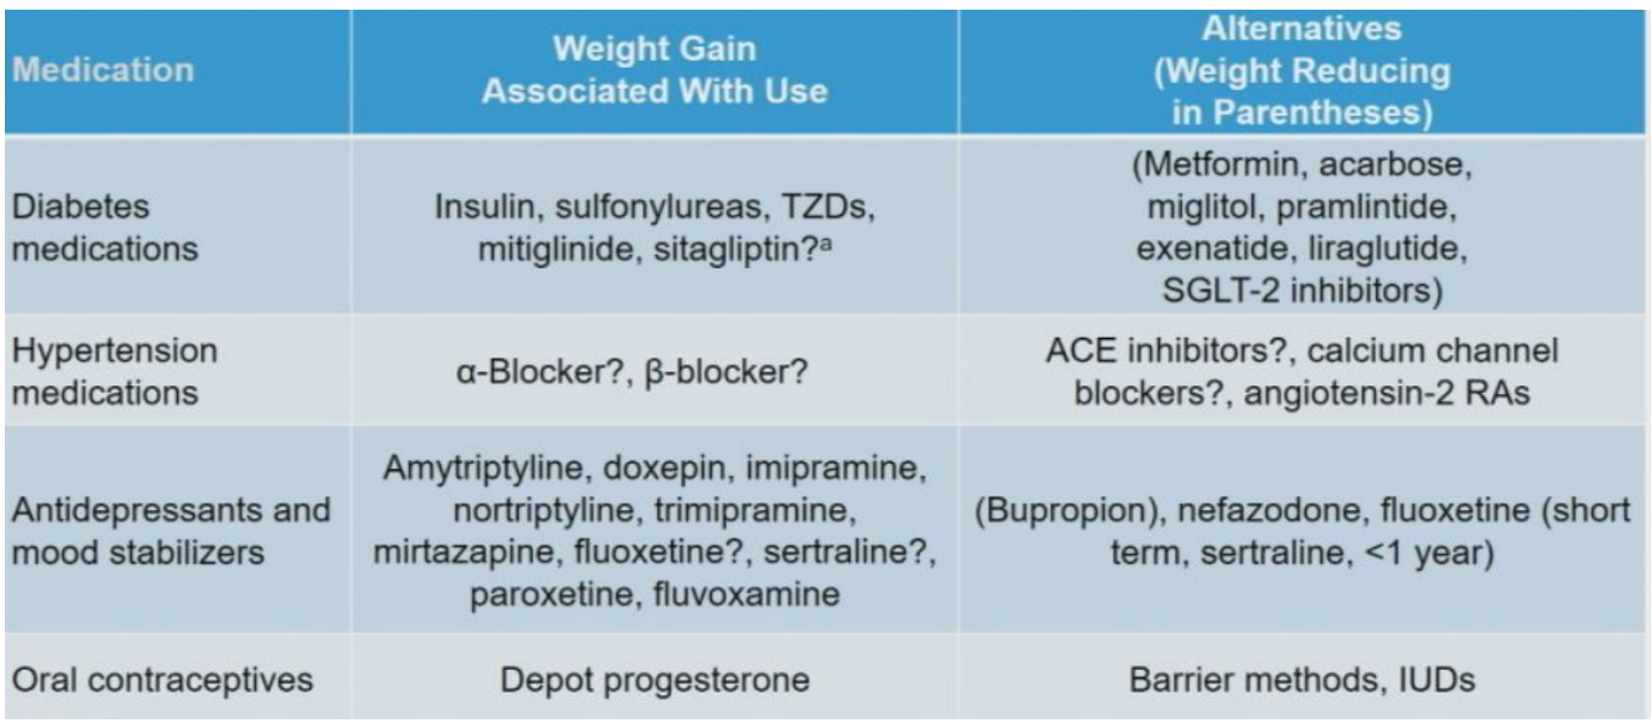
Etiology and pathogenesis cont.
Etiological classification of obesity
1
Neuroendocrine disease
Ventromedial hypothalamus damage:
Tumors e.g. Insulinoma
Inflammatory lesions
Other hypothalamic disease, especially head trauma which affect the centers in hypothalamus
hypothalamic obesity: caused by neuroendocrine tumor, radiation¹ to the hypothalamus or pituitary gland and infiltrative disease to the neuroendocrine glands.
Cushing disease, Hypothyroidism and Polycystic ovary syndrome
2
Drug-induced
Hyperinsulinism
Insulin
Sulfonylureas e.g.(Glibenclamide, Diamicron)
Antidepressants
Antiepileptics (phenytoin)
Neuroleptics
Corticosteroids
Females slides
Category | Drugs that cause weight gain | Possible alternatives
Conventional antipsychotics | Thioridazine | Haloperidol
Atypical antipsychotics | Olanzapine, Clozapine, Quetiapine and Risperidone | Ziprasidone, Aripiprazole
Lithium | Lithium carbonate
TCA | Amitriptyline, Clomipramine, Doxepin. Imipramine, Nortriptyline | Protriptyline
SSRI | Paroxetine | Other SSRIs (e.g. Fluoxetine (Short term, Sertraline, <1yr)
Atypical antidepressants | Mirtazapine | Bupropion, Nefazodone
Anticonvulsant drugs | Valproate, Carbamazepine and Gabapentin | Topiramate, Lamotrigine, Zonisamide
Antidiabetic drugs | Insulin, Sulfonylureas, Mitiglinide and Thiazolidinediones, sitagliptin? | Metformin, Alpha-glucosidase inhibitors (e.g. acarbose, miglitol), Liraglutide, SGLT-2 inhibitors
Serotonin and histamine antagonist | Pizotifen
Antihistamines | Cyproheptadine
Beta blockers | Propranolol, Atenolol and Metoprolol | ACEI?, CCB?, Angiotensin-2 RAs
Steroid hormones | Glucocorticoids
 | Progestins: Megestrol acetate, OC¹ (Medroxyprogesterone acetate aka depot progesterone) | Barrier methods, IUDs
3
The Immediately Postmenopausal Female (Prevention of bone mass loss)
Consideration of estrogen replacement therapy
If intact uterus, consideration of medroxyprogesterone
Other modalities of therapy:
Bisphosphonates, SERMS (Selective estrogen receptor modulators) e.g., Evista, Livial,
Protelos ( strontium ranelate) → old drug, Forteo (Teripratide) or Prolia ( Denosumab) → the only bone building drugs (anabolic)
all of these cannot be used for life (only for 5-10 yrs), hence why we try to delay them as much as possible
4
The elderly postmenopausal female with low bone mass but no compression fractures (Prevention of bone mass loss & restoration of bone mass previously lost)
Adequate calcium intake: 1000-1500 mg/day and Adequate supply of vit D (1000-2000IU)
A reasonable exercise program with physical therapy instruction in paraspinous muscle group strengthening exercise.
Avoidance of osteopenia-producing conditions/medications/lifestyles:
Smoking & excessive alcohol intake, excessive caffeine/protein intake.
Cortisone, excessive thyroid hormone replacement (?)
Other modalities: Same as NO. 3 above
1- Patient was lean and was diagnosed with germinoma which required surgery on the brain + radiation to the hypothalamus and pituitary which results in gaining weight after radiation and also complicated with diabetes.

Slide 8
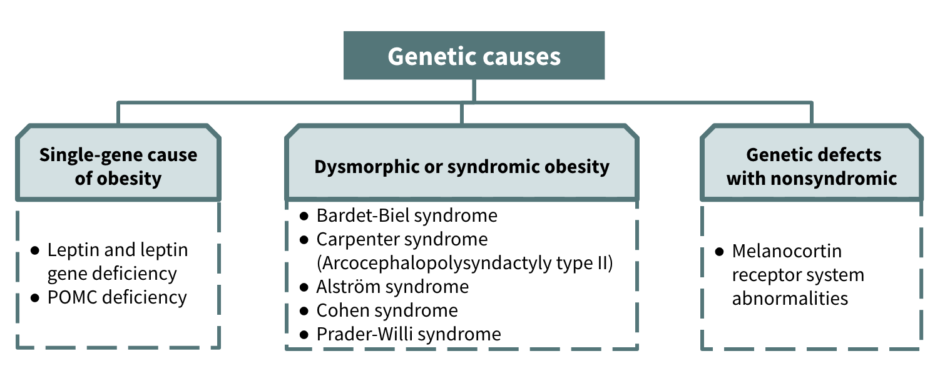
Etiology and pathogenesis cont.
Etiological classification of obesity cont.
3
Dietary obesity
Change in BMI (kg/m2 ) from 1989 to 1991
High carbohydrate diet
This one is mainly responsible for obesity in Riyadh
High fat diet
4
Energy expenditure
Resting metabolism:
800 to 900 kcal/m2/24hr
Females <Males
Declines with age
Physical exercise: this one you can control
~ 1/3 of daily energy expenditure
Most easily manipulated
Dietary thermogenesis (thermic effect of food):
Energy expenditure which follow the ingestion of meal
May dissipate ~ 10% of the ingested calories
In the obese, the thermic effects of food are reduced (especially in patients with diabetes) and post-obese subjects.
Adaptive thermogenesis:¹
With acute over – or underfeeding
Shift in overall metabolism as large as 20%
Resting metabolism:
800 to 900 kcal/m2/24hr
Females <Males
Declines with age
Physical exercise: this one you can control
~ 1/3 of daily energy expenditure
Most easily manipulated
Dietary thermogenesis (thermic effect of food):
Energy expenditure which follow the ingestion of meal
About 10% of ingested energy is dissipated as heat and is unconnected with physical activity. This dietary induced thermogenesis has been reported to be lower in obese and post-obese subjects than in lean subjects.
Adaptive thermogenesis:¹
With acute over – or underfeeding
Shift in overall metabolism as large as 20%
5
Genetic factors in obesity
Genetic susceptibility to obesity:
If both parents are obese ~ 80% of the offspring will be obese
If only one parent ~ 10% of the offspring will be obese
Studies with identical twins: - Hereditary factors account ~ 70%
Environmental (diet, physical inactivity, or both) account ~ 30% of the variation in the body weight
The notion that obesity is a genetic disorder is misleading:
The prevalence of obesity has increased markedly, world-wide, in recent years, yet genes have not changed.
Changes occur within population when migration occurs.
Phenotypic expression of genes for obesity are environment specific
Obesity is a disorder of gene-environment interaction
1- Brown adipose tissue in animals, when stimulated by cold or food, dissipates the energy derived from ingested food into heat. This can be a major component of overall energy balance in small mammals but the effect is likely to be very small, and of doubtful clinical significance in adult humans, even though brown adipose tissue is found in humans.

Slide 9
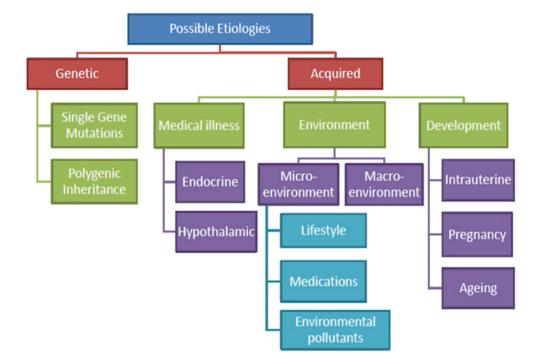
Females slides
Etiology and pathogenesis
Other factors predisposing to obesity:
01
Lifestyle
02
Diet
Sedentary lifestyle lowers energy expenditure
52 % of Saudi women are inactive, < 19 % doing regular physical activity
Prolonged TV watching
Overeating, frequency of eating, high fat meal, fast food ( > 2 fast food/wk)
Night eating syndrome:
if > 25 %of intake in the evening
03
Cessation of smoking
04
Social influences
Average weight gain is 4 kg
Due to nicotine withdrawal
Can be prevented by calories restriction and exercise program
Obese parents most likely to have obese children
Obese individuals are surrounded by obese friends
05
Sleep deprivation
< 7 hours of sleep → obesity
↓ sleep → ↓ leptin, ↑↑ Ghrelin → ↑appetite and CHO eating at night
Contributors to obesity
01
Sociocultural
02
Environmental
Preference for foods high in fat and/or carbohydrate
Large portion sizes (value meals)
Work-life circumstances :
Sedentary occupations and leisure activities
Heavy time commitments to work,social, and family obligations
Sleep deprivation
Community design infrastructure not conducive to physical activity:
Lack of safe, convenient areas for outdoor activities
Distances between home and work/shops too far for walking
Lack of public transportation
Ubiquity of escalators, elevators, etc
Weather

Slide 10
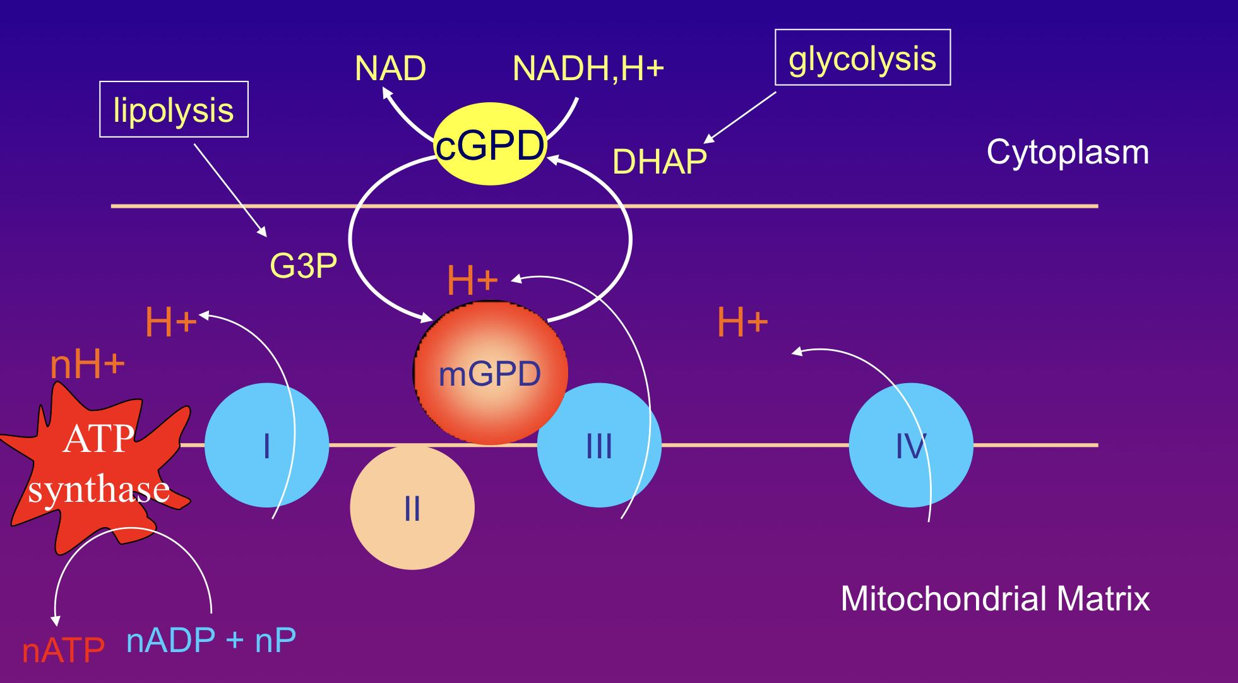
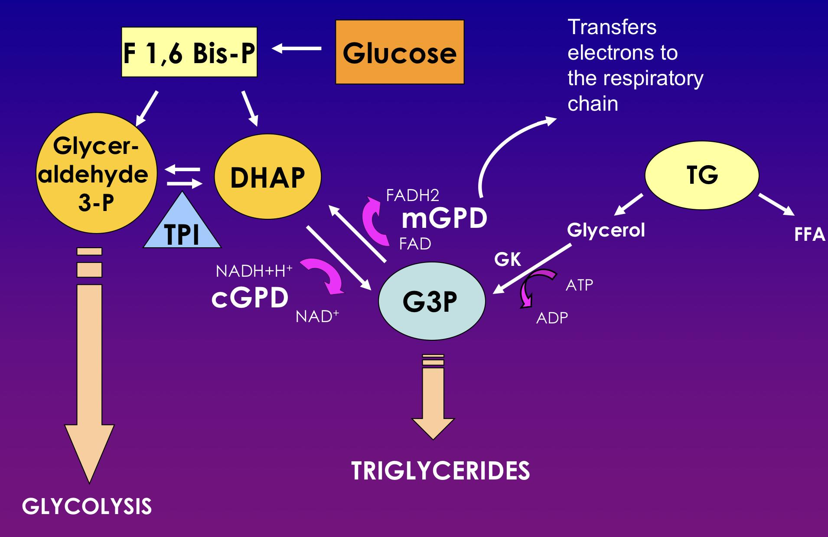
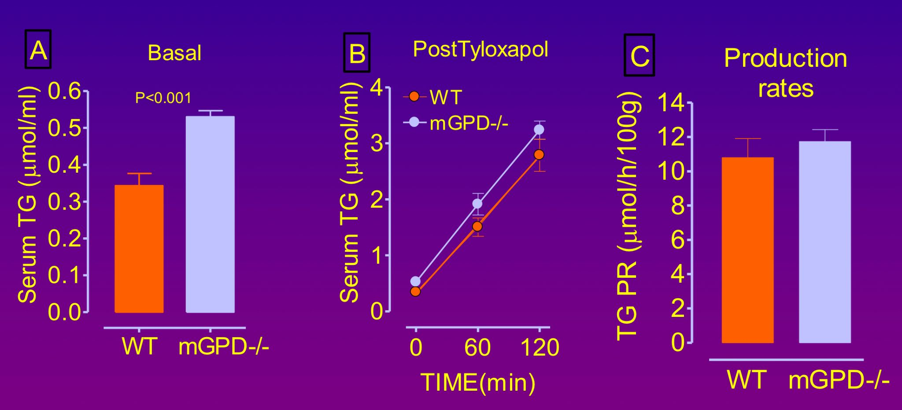
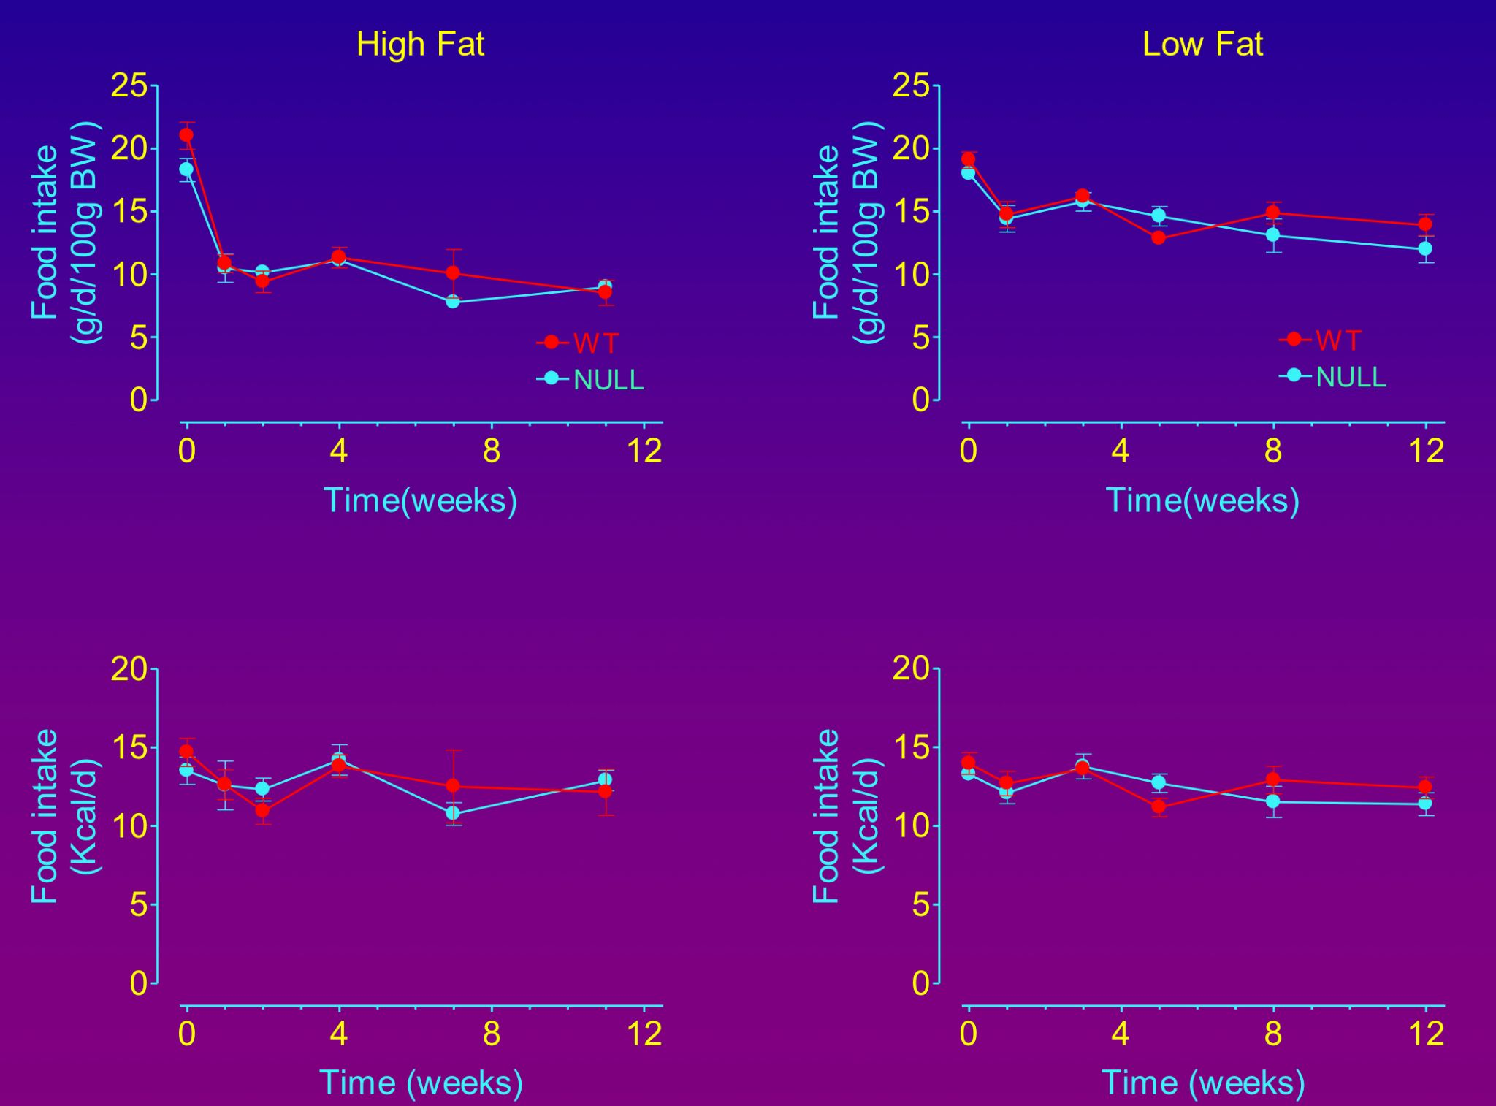
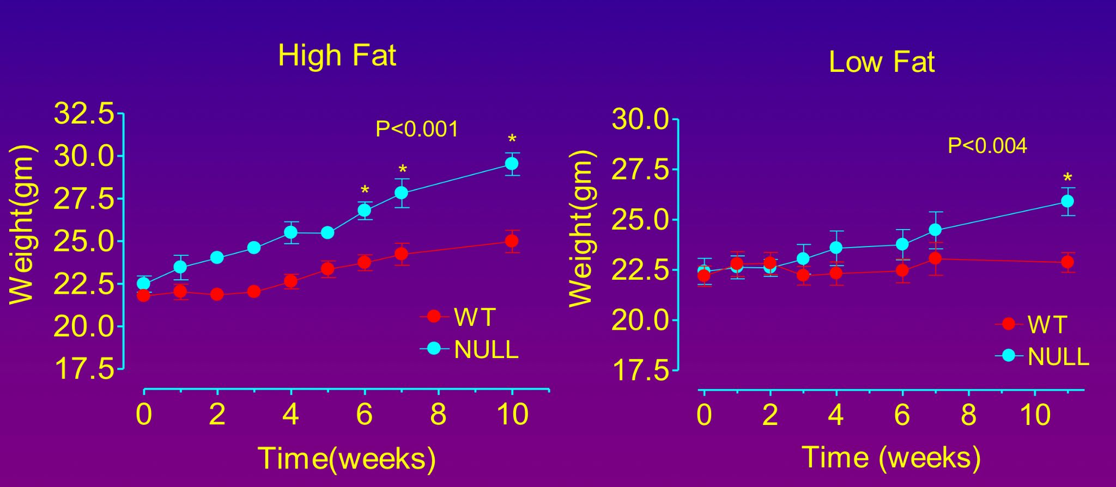
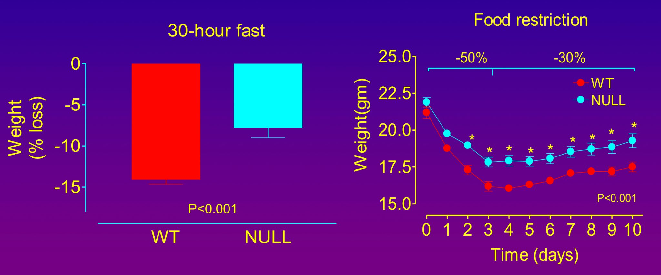
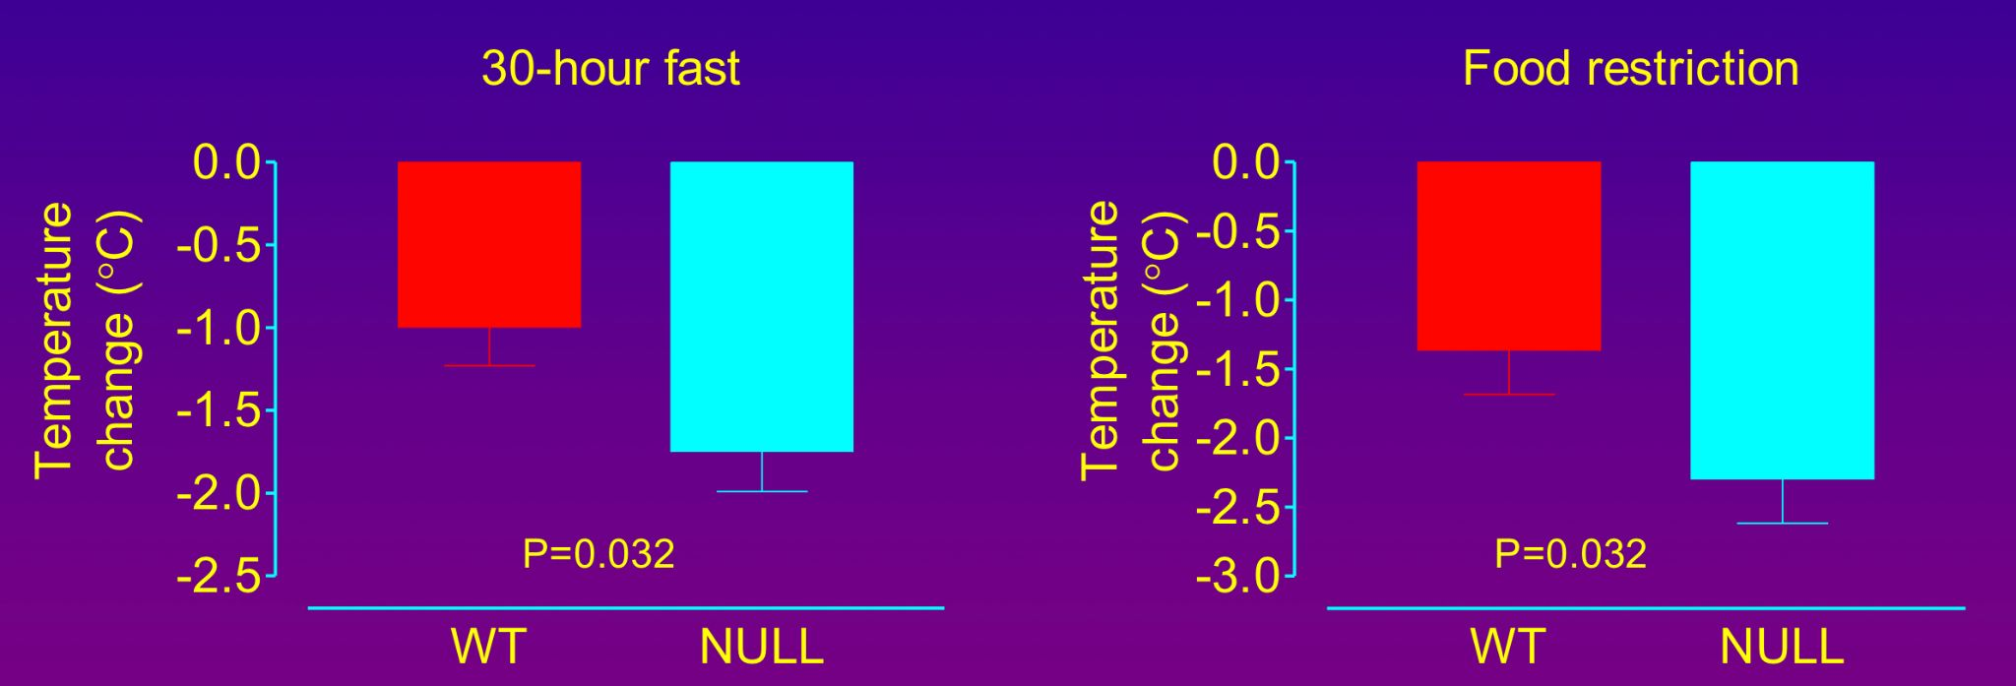
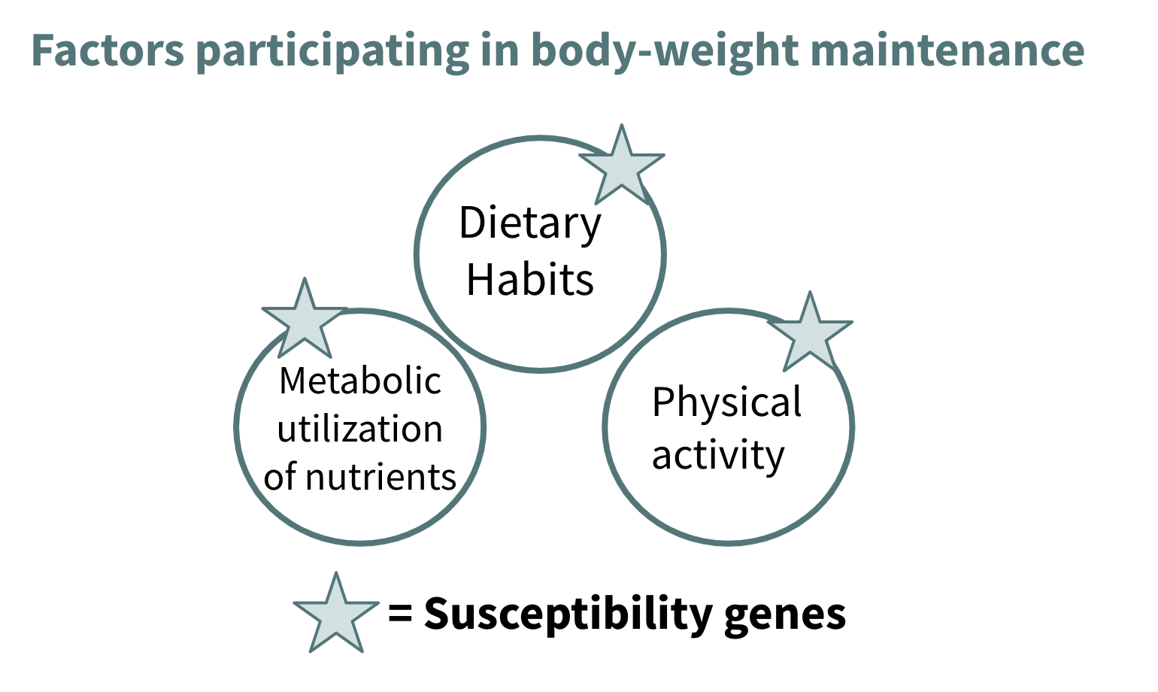
Males slides
Dr’s study on G3PD gene
Title and objectives of the study
Title:
Metabolic consequence of deleting the mitochondrial Glycerol 3-phosphate dehydrogenase gene in mice
Objectives:
We studied the consequences of deleting the mGPD gene regarding:
Responses to fat- or carbohydrate-rich diets.
Tolerance and responses to caloric restriction and fasting.
The NADH Glycerol 3-Phosphate Shuttle¹
Results
Serum Triglycerides | Food intake | Body weight
Weight loss | Change in energy expenditure | Core temperature change at 22C
Conclusion
The mGPD can be considered a spendthrift enzyme² that significantly contributes to obligatory thermogenesis
The mGPD gene may play a role in the development of obesity if we consider the readiness with which some weight when undergoing a low calorie diets
1- NADH glycerol 3-phosphate shuttle is present in the mitochondria, it's responsible for the end ATP synthase and the generation of ATP.
2- Is an enzyme that help in storing fat or carbs, when the intake is reduced it will help in to reduce calorie expenditure by reducing body temperature making the mice feel cold.

Slide 11
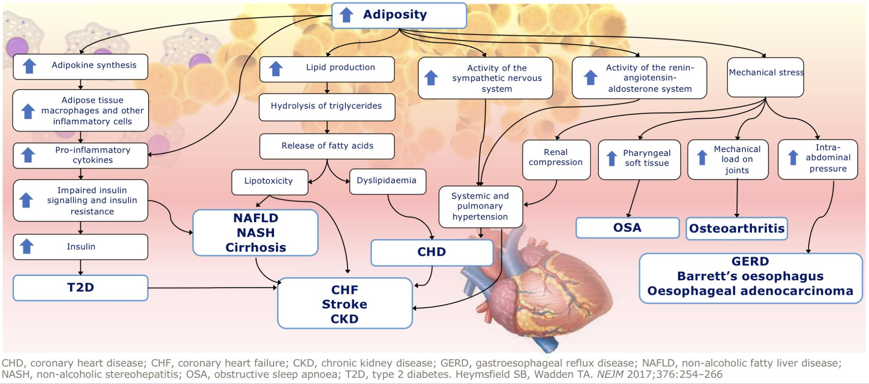
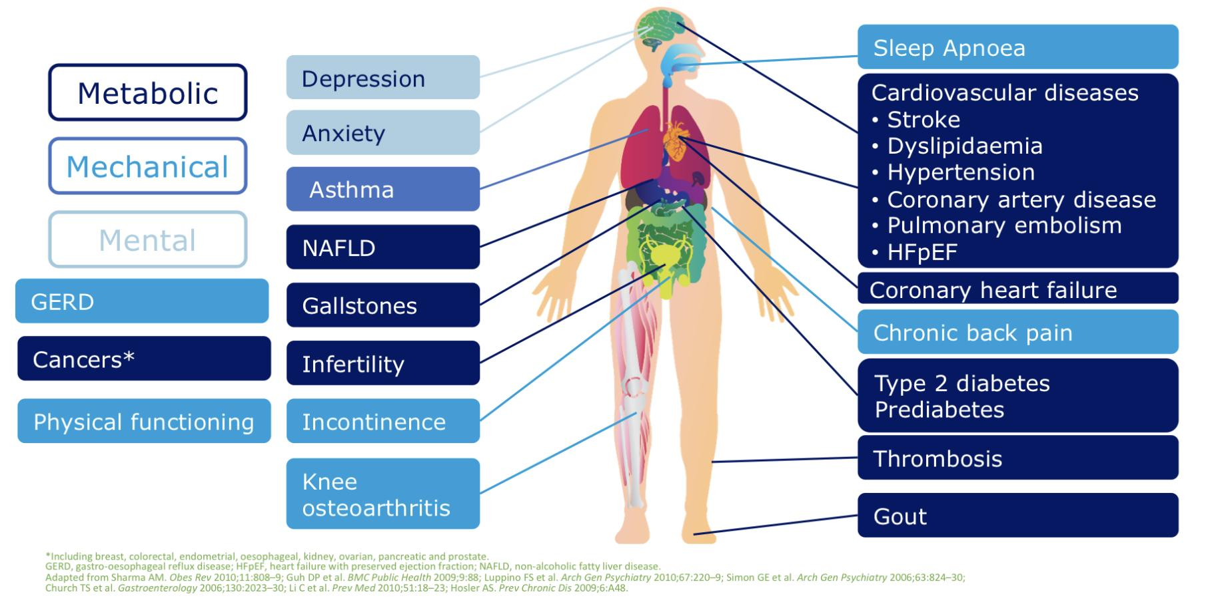
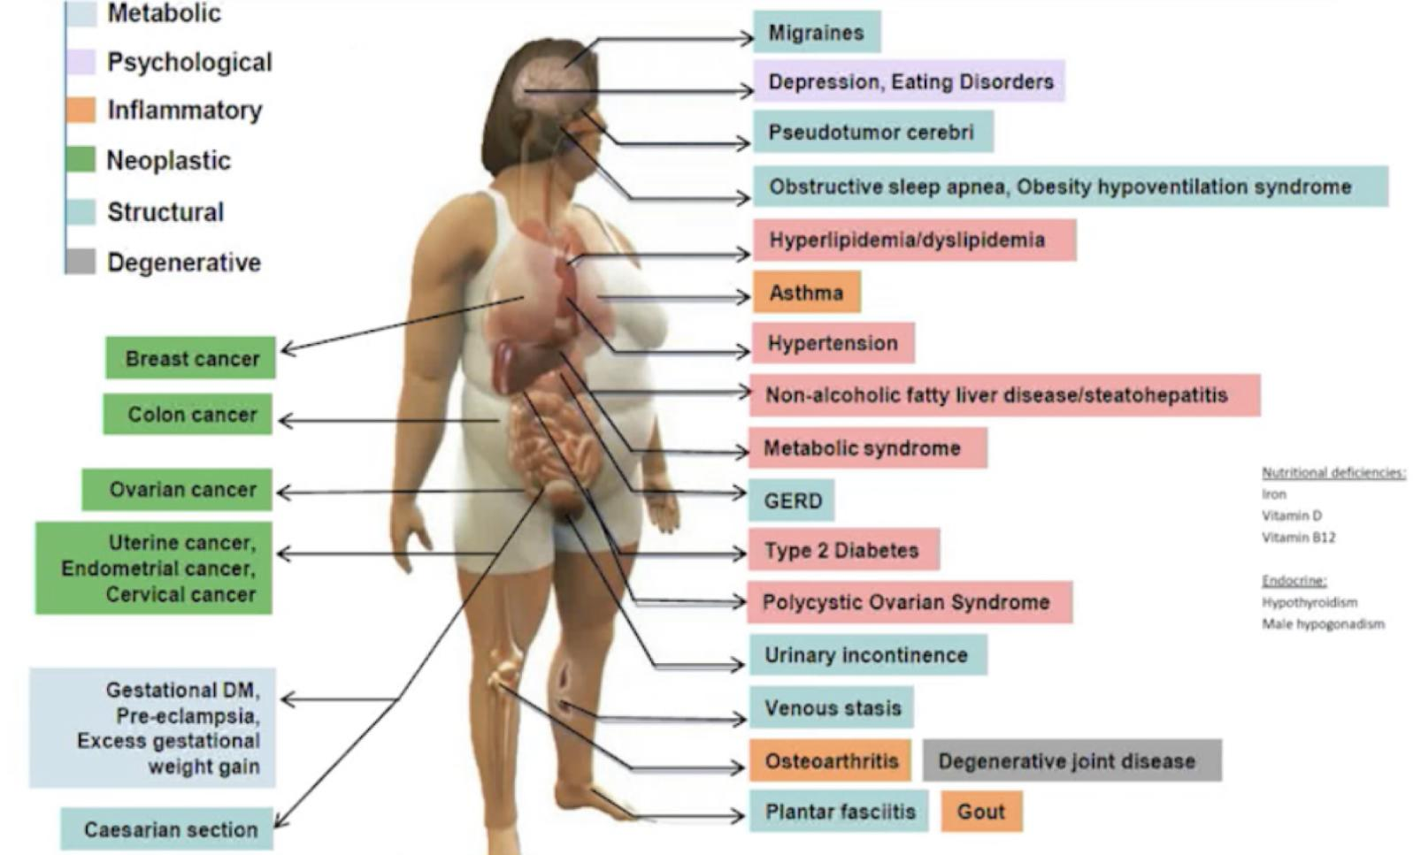
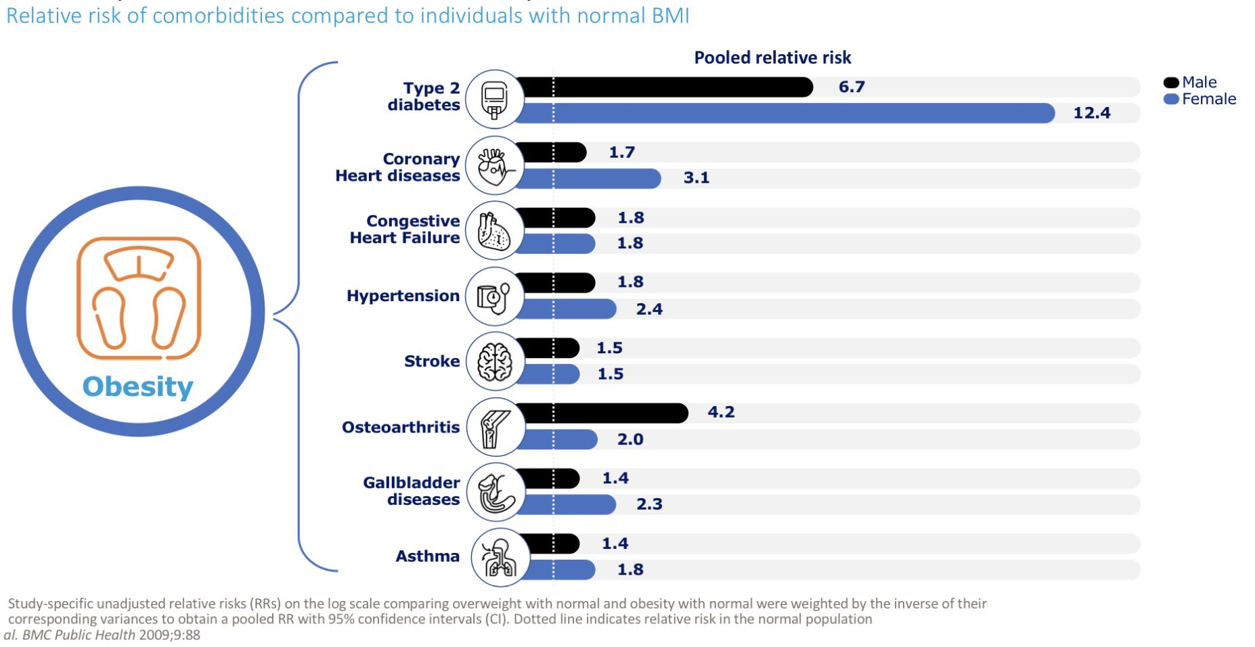
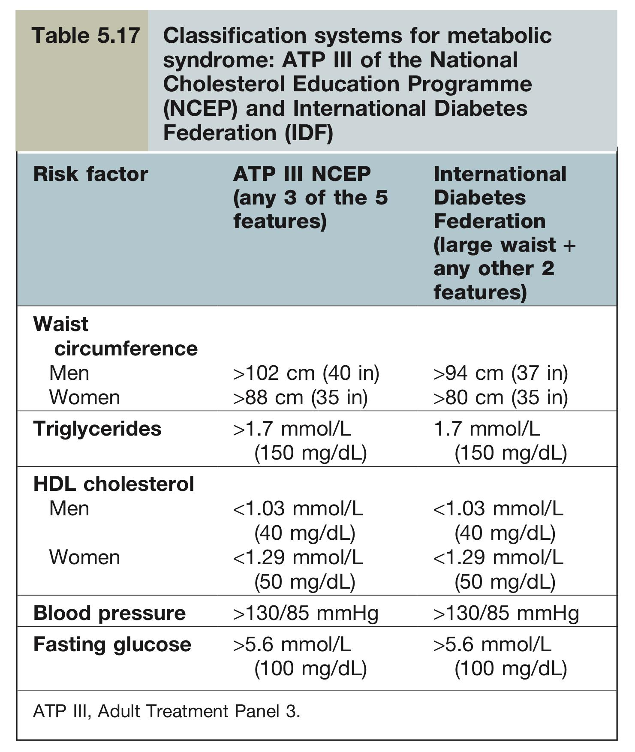
Females slides
Complication of obesity
Health consequences of obesity
Excess adiposity leads to major risk factors and common chronic diseases
Metabolic syndrome
Overweight/central obesity and insulin resistance, which causes glucose and lipid disturbances, seem to form the basis of many features of the metabolic syndrome.
There are two classification systems which are shown in Table 5.17. The differences are:
A large waist is an absolute requirement for the International Diabetes Federation (IDF), but not in the ATP III NCEP.
The IDF criteria use lower cut-off values for waist circumference (close to values of people with a BMI of 25 kg/m2) and lower fasting blood glucose concentrations.
This means that the prevalence of metabolic syndrome will be higher using the IDF criteria and the IDF criteria will identify at-risk patients at an earlier stage. This could lead to further investigations following on from the initial screening, and earlier institution of preventative as well as therapeutic measures.

Slide 12
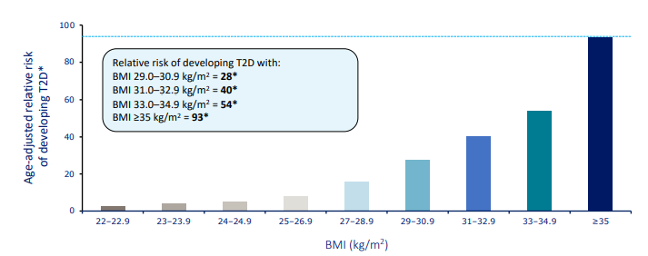
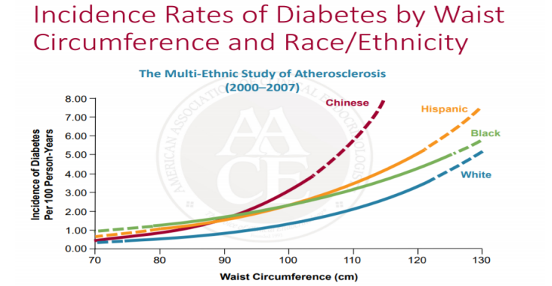
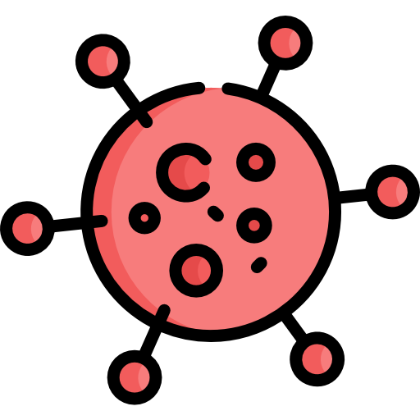
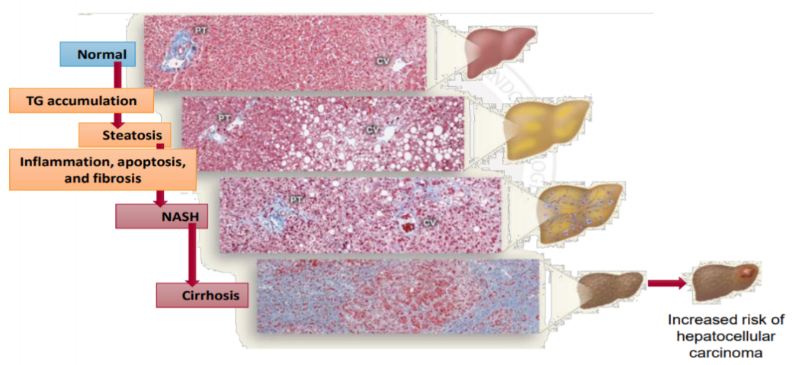
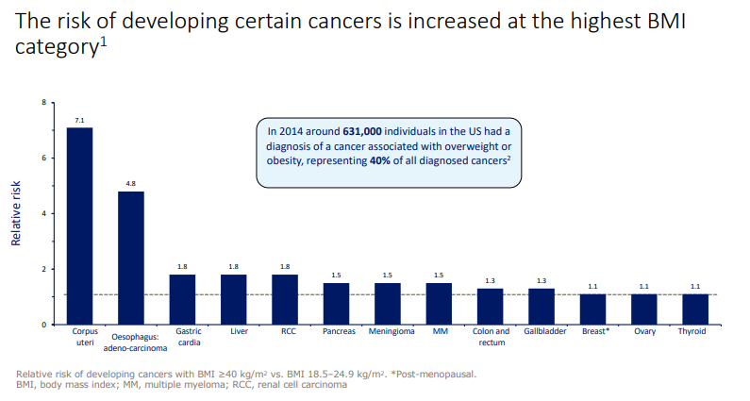
Females slides
Complication of obesity
Complications of obesity
◆ Complications of obesity can be classified into three categories:
1
Metabolic
Cardiovascular
Type 2 diabetes
Obesity and overweight are linked to several factors that increase risk for CVD (Coronary artery disease and stroke):
High blood lipids, especially high triglycerides, LDL cholesterol, and total cholesterol and low HDL cholesterol
High blood pressure: can be challenging to accurately measure blood pressure in obese patient
Impaired glucose tolerance or type-2 diabetes
Metabolic syndrome (Mets)
Enlarged left ventricle (increased risk for heart failure)
AACE recommends weight loss of 5% to 10% to reduce CVD risk
Greater risk of developing T2D with higher BMI
Consequences of obesity in Diabetes :
Increase risk of cardiovascular comorbidities:
Hypertension
Dyslipidemia
Atherosclerosis
May limit ability to engage in physical activity
increase insulin resistance
Worse glucose tolerance
Necessitates higher exogenous insulin doses
Change neuroendocrine signaling and metabolism
Reduce quality of life
Goal: 5%-10% weight loss
NAFLD
Other complications
Progression of NALFD
Cancers: For both men and women, increasing BMI was associated with higher death rates due to the following cancers:
Esophagus, Colon and rectum
Liver, Gallbladder, Pancreas and Kidney
Non-Hodgkin lymphoma
Multiple myeloma
Infertility
Gout
Thrombosis
Gallstones

Slide 13
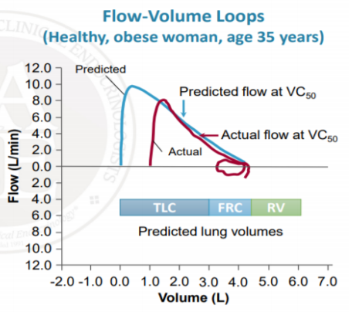
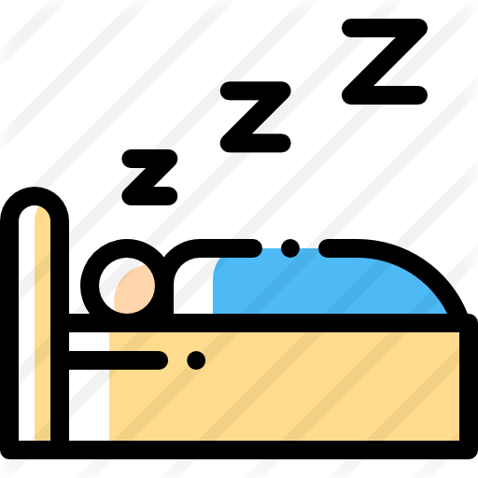
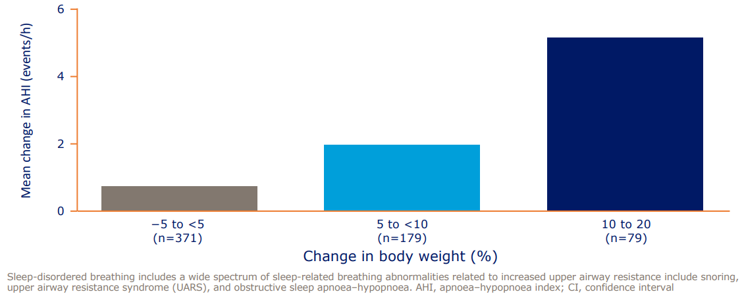
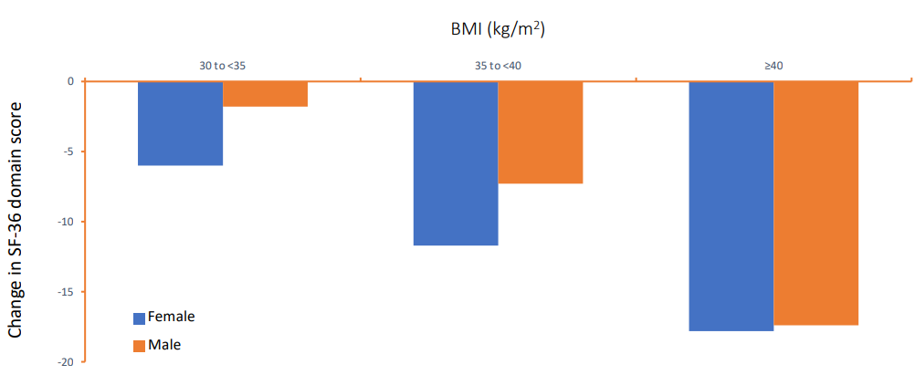
Females slides
Complication of obesity
Mechanical
2
Lung function
Digestive disorder (GERD)
Stiffening of total respiratory system
Reduced lung and chest wall compliance
Reduced tidal volume and short, rapid breathing pattern
Reduced lung volume and vital capacity
Increased risk of airway closure and ventilation distribution abnormalities leading to pulmonary hypertension
Obesity is associated with significant increased risk of Gastroesophageal reflux disease (GERD) symptoms and GERD-related due to increased intraabdominal pressure and fat
Complications:
Barrett’s esophagus
Erosive esophagitis
Esophageal adenocarcinoma
Central\Abdominal obesity more closely related to GERD against BMI
Obstructive sleep apnea
Physical function
Weight gain increases severity of obstructive sleep apnoea
Longitudinal study data:
Obesity is associated with impaired physical function (When compared with normal weight (BMI 18.5–<25 kg/m2)
They also have increased risk of infection due to decreased hygiene (they cannot take care of themselves)

Slide 14
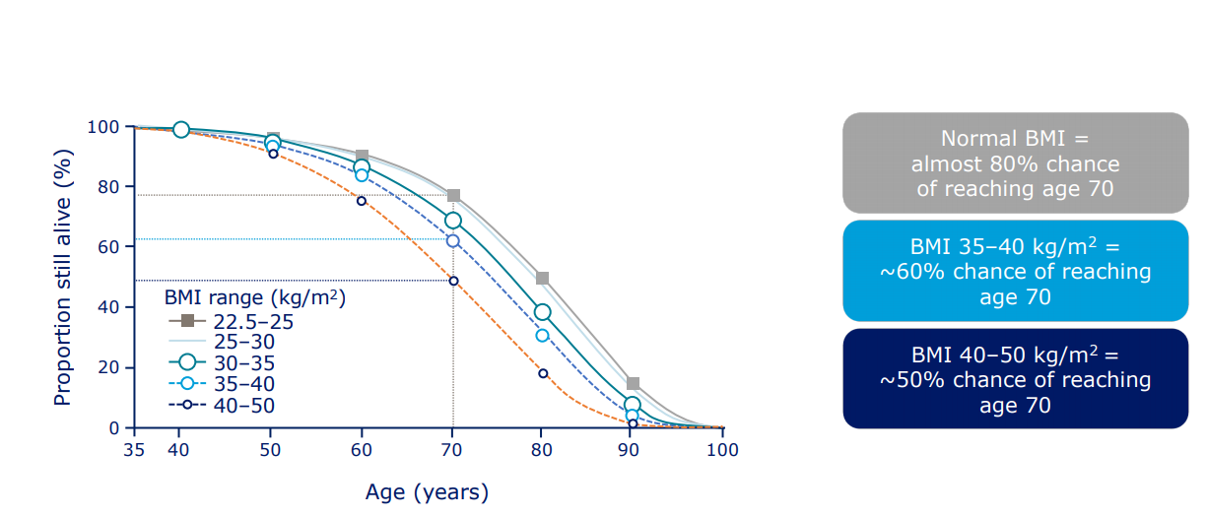
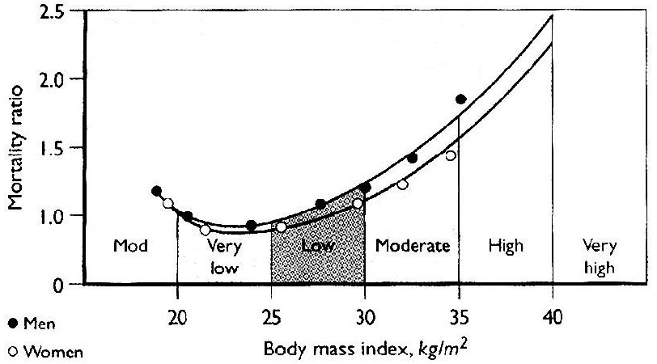
Females slides
Complication of obesity
Mental
3
Psychological and psychiatric consequences
Obesity negatively affects physical, psychological and sexual aspects of life
Weight stigma also increase the risk of:
Anxiety
Depression: depressed individuals
Tend to eat more = even more weight Gain
Suicidality
Low self-esteem
Avoidance of physical activity
Avoidance of health care services
Increased risk of weight gain
Social consequences
Public view obesity as a personal problem of bad choices
The misconception about “fat shaming” shaming people with obesity about their weight, will help the individual lose weight, specially in school-age children
Many symptoms are related to psychological problems or social pressures, such as the woman who cannot find fashionable clothes to wear.
Weight discremntiantion usually manifests directly as testing, bullying, or being socially ignored
Weight stigma - a negative response to someone based on their weight
Is the fourth most common form of social discrimination amongest adults - after age, gender and race
Is the only form of discrimination still widely deemed to be socially acceptable
Sociocultural and environmental contributors to obesity
Sociocultural
Environmental
Obesity and mortality
Preferences for food high in fat and/or carbohydrate
large portion sizes (value meals)
Work-life circumstances
sedentary occupations and leisure activities
Heavy time commitments to work, social and family obligations
sleep deprivation
Community design and infrastructure not conductive to physical activity
lack of safe, convenient areas for outdoor activities
Distance between homes and work/shops too far for walking
Lack of public transportation
ubiquity of escalators, elevators, etc
Life expectancy decreases as BMI increases.
Obese patients are at risk of early death, mainly from diabetes, coronary heart disease (Major cause) and cerebrovascular disease.
Weight reduction reduces this mortality and therefore should be strongly encouraged
Bariatric’ surgery is by far the most effective long-term treatment for obesity and is the only anti-obesity intervention that has been associated with reduced mortality.

Slide 15
Females slides
Assessment, screening and treatment goal
Assessment and screening
1
BMI measurement
Reliable, easy, correlated with percentage of body fat
Guide for selection of therapy
Varies among different races
Recent WHO classification applied to whites, hispanics and black
Asians are different: overweight BMI 23-24.9 kg/m2 and obesity by BMI > 25 kg/m2
2
Waist circumference
Associated with increased risk of morbidity and mortality
Measurement of central adiposity and reflects visceral adiposity
Increase risk of heart disease, DM, hypertension, dyslipidemia
Important in identifying the risk in BMI 25-34.9 kg/m2
Risk increase with WC > 88 cm in women, 102 cm in men
Not useful if BMI > 35 kg/m2
In Asian population risk starts with WC > 80 cm in Asian women and > 90 cm in Asian man
3
Identify the aetiology
Medical history is important
Age at onset of obesity, course of it
Eating habits, activity habits
Past medical history
Medications
Cessation of smoking history
Ethnic background
Family history of obesity
4
Assessment of risk status
Identify risk factors:
After BMI and WC, history
BP measurement
Fasting lipid profile
Fasting blood sugar
Identify comorbidity:
Help to classify the risk of mortality.
Presence of atherosclerosis, DM2, HTN ,dyslipidemia
Sleep apnoea, GI, osteoarthritis, gout, GERD.
CVD risk factors that would affect mortality risk:
HTN, Smoking
DM2 ( fasting blood glucose 110-125 mg/dl)
Dyslipidemia ( low HDL < 35 or high LDL> 130)
Family history of premature CAD
Physical inactivity
Other risk factors:
Age of onset of obesity
Diagnosis: (Step-Up)
◆ All adults should be screened by measuring height, weight and calculating body mass index (BMI).
◆ BMI = body weight (kg)/height² (meters)
◆ Overweight and obese patients should be further screened with waist circumference to assess abdominal
◆ Waist circumference of > 40 inches in men and >35 in women is considered elevated and corresponds with .
Treatment Goal
Prevention of further weight gain
Weight loss to achieve a realistic, target BMI
Long-term maintenance of a lower body-weight
obesity.
an increased risk for heart disease, diabetes, hypertension dyslipidemia and
nonalcoholic fatty liver disease (NAFLD)
Treatment of Obesity
Lifestyle (Diet,Exercise)
Pharmacotherapy
Surgery

Slide 16
Management of obesity
Lifestyle
Most important recommendation:
Diet, Physical activity, Behavior change (decrease social gatherings)
1st
Diet
Life style
Exercise
1st
1
Lifestyle goals
2nd
Lifestyle
Initial goal: 10% weight loss
Significantly decreases risk factors
Rate of weight loss:
1-2 pounds (0.5-1kg) per week
Reduction of calories intake 500-1000 calories/day
importance of weight training and other exercises with diet induced weight loss to minimize risk of losing muscle strength.
Slow weight loss is preferred approach
Rapid weight loss is almost always followed by rapid weight gain
Rapid weight loss is associated with gallstones and electrolytes abnormalities
Aim for 4-6 months for weight loss
Average is 8-10 kg loss
It is relatively easy for most people to lose the first few kilograms, but long-term success in moderate obesity is poor (no more than 10%). Weight loss will be greater initially owing to accompanying protein and glycogen breakdown and consequent water loss. After 3–4 weeks, further weight loss may be very small because only adipose tissue is broken down and there is less accompanying water loss.
After 6 months, weight loss is difficult
Ghrelin and leptin effect
Energy requirement decreased as weight decreases
Set goals for weight maintenance for next 6 months then reassess
Pharmacotherapy
3rd
Surgery
Lifestyle goals:
Initial goal: 10% weight loss
Significantly decreases risk factors
Rate of weight loss:
1-2 pounds (0.5-1kg) per week
Reduction of calories intake 500-1000 calories/day
importance of weight training and other exercises with diet induced weight loss to minimize risk of losing muscle strength.
Slow weight loss is preferred approach
Rapid weight loss is almost always followed by rapid weight gain
Rapid weight loss is associated with gallstones and electrolytes abnormalities
Aim for 4-6 months for weight loss
Average is 8-10 kg loss
It is relatively easy for most people to lose the first few kilograms, but long-term success in moderate obesity is poor (no more than 10%). Weight loss will be greater initially owing to accompanying protein and glycogen breakdown and consequent water loss. After 3–4 weeks, further weight loss may be very small because only adipose tissue is broken down and there is less accompanying water loss.
After 6 months, weight loss is difficult
Ghrelin and leptin effect
Energy requirement decreased as weight decreases
Set goals for weight maintenance for next 6 months then reassess
Diet therapy:
Indicated for all with BMI > 30 and those with BMI 25- 30 with comorbidities.
Teaching about food composition ( fat, CHO, protein), Calories contents of food by reading labels, Type of food to buy and to prepare
Careful Training in :
Selection of lower fat, lower carb foods Modified food guide pyramid
Increase fruits & vegetables
Lower fat preparation techniques Estimation of portion size
Atkins diet:
Physical activity:
Start slowly:
Change of daily living activities
Avoid injury
Increase intensity and duration gradually
Exercise alone will usually produce little long-term benefit. On the other hand there is evidence to suggest that in combination with dietary therapy, it can prevent weight being regained
Long –term goal: 30-45 min or more of physical activity daily, 5 or more days per week, Burn 1000+ calories per week
2
Physical Activity
Start slowly:
Change of daily living activities , Avoid injury
Increase intensity and duration gradually
Exercise by it self will not cause weight loss unless it's heavy exercise, it is important for:
increase body fitness and improve cardiopulmonary function, reduce stress, also maintain weight loss and prevent weight regain
Long –term goal: 30-45 min or more of physical activity daily, 5 or more days per week, Burn 1000+ calories per week
1
Lifestyle
Ventromedial hypothalamus damage:
Tumors e.g. Insulinoma
Inflammatory lesions
Other hypothalamic disease, Especially head trauma which affect the centers in hypothalamus
Radiation
Cushing disease, Hypothyroidism and Polycystic ovary syndrome
6 months result (good)
24 months result (Bad)
Dangers of atkins diet
High saturated fat and cholesterol: CVD
High protein: decline in renal function, urinary calcium losses (osteoporosis)
Lack of fiber: increase colon cancer risk
Avoidance of carbs results in decreased intakes of essential vitamins (thiamin, folate,B6) and anti-oxidant phytochemicals
3
Diet therapy
Indicated for all with BMI > 30 and those with BMI 25- 30 with comorbidities.
Teaching about food composition ( fat, CHO, protein), Calories contents of food by reading labels, Type of food to buy and to prepare
Careful Training in :
Selection of lower fat, lower carb foods Modified food guide pyramid
Increase fruits & vegetables
Lower fat preparation techniques Estimation of portion size
Atkins diet:
This type of diet is good for the short term under the supervision of a physician, it’s not perforable for long term.
BMI 42.9,40% diabetic. TG, insulin, glucose;p<0.01.
33 each group; 1/3 dropouts; no diabetics, BMI 33; G HDL
6 months result (good)
24 months result (Bad)
Dangers of atkins diet:
High saturated fat and cholesterol: CVD
High protein: decline in renal function, urinary calcium losses (osteoporosis)
Lack of fiber: increase colon cancer risk
Avoidance of carbs results in decreased intakes of essential vitamins (thiamin, folate,B6) and anti-oxidant phytochemicals

Slide 17
Management of obesity
Pharmacotherapy
1
Indications
BMI > 30
BMI 27-30 with comorbidities
Should not be used for cosmetic weight loss
Used only when 6 months trial if weight andexercise fail to achieve weight loss
Metformin is not approved for use in obesity
Note: Drugs can be used in the short term (up to 3 months) as an adjunct to the dietary regimen, but they do not substitute for strict dieting.
2
Liraglutide
GLP-1 receptor agonist
Used to treat obesity
It will decrease food intake and help in long term weight maintenance, It can decrease body weight 15-18% maximum.
3
Simaglutide
Long acting GLP-1 receptor agonist more effective than liraglutide, weight loss could reach up to 20-22%
Taken once weekly 2.4mg
4
Orlistat
A lipase inhibitor, reduces the absorption of dietary fat
Lowers Cholesterol (4-11%) & LDL (5-10%)
Weight regain occurs after the drug is stopped.
It's weaker than liraglutide as it decrease body weight by 8-10% maximum and most people will loss only 5%, it has more side effects than liraglutide e.g. diarrhea
People do not continue on this drug because when they eat fat food they will have greasy stool and sometimes they can not control it
Major C/I:
Chronic malabsorption syndrome, Cholestasis, Pregnancy and breastfeeding
Dose: 120 mg/ immediately before, during, or up to 1 hour after each main meal (up to max. 360 mg/day)
Max period of treatment is 2 year
1
What interventions should we add to weight reducing diets in adults with obesity?
A systematic review of randomized controlled trials of adding drug therapy, exercise, behaviour therapy or combinations of these interventions
For those who don’t lose weight, what should be done?
Reassess:
Understanding and compliance with diet, physical activity, and drug regimen
Accuracy of weight recordings, Possible Fluid retention (salt intake, etc)
Changes in medical condition , Motivation for change, Social and personal stress
Is the provider of health care the root of the problem ?
For Those Who Don’t Lose Weight and There is no Cause Except Noncompliance with Diet & Exercise, what should be done?
An area for your notes
Consider changing medication
Consider referral to:
Dietitian, Behavioral counselor, Exercise professional
Reconsider goal: i.e. simple maintenance or a rest from weight loss efforts
Discuss surgical options if medically or psychologically indicated

Slide 18
Management of obesity
Bariatric surgery
Indications:
Well-informed and motivated patients, and no psychological illnesses.
Acceptable risk of surgery
Failed previous non-surgical method
Have BMI > 40
BMI > 35 with comorbidities like
diabetes, sleep apnea, osteoarthritis, cardiomyopathy
BMI 25-29.9 with WC > 102 cm in male and >88 cm in women
Age 18-60
Psychologically stable
Types:
Note: It can be used as a first-line option for individuals with a BMI >50 kg/m².
The number of bariatric surgeries is increasing worldwide and it's because the obesity is also increasing and it has become more safe for the patient to do the surgery, it's considered the most effective way in treating patients with obesity if done properly and patient have proper follow up because weight regain is possible.
Surgery is not always considered as the last option, it can be first, second.. it depends, It can be used as a first-line option for individuals with a BMI >50 kg/m².
1
Restrictive-type of surgery
Which restrict the ability to eat, for example:
Adjustable gastric banding
Vertical banded gastroplasty
Sleeve gastroplasty
gastric bypass causes more weight loss than sleeve gastrectomy, but sleeve gastrectomy is faster to do and with less malabsorption complications
Follow up is crucial, The first year of bariatric surgery is the golden year of treatment, for that every patient must have a 1 year follow up plan. As a physician, you have to make sure that during that year a strict diet and exercise have to be made and followed by patient as their weight will remain as it is and will reach a plateau after few years.
2
Malabsorptive and restrictive
Which reduce the ability to absorb nutrients, for example:
Roux-en-Y gastric bypass
Biliopancreatic diversion
The malabsorptive procedures cause nutrient deficiencies, malnutrition and in some cases, anastomotic leaks and the dumping syndrome (e.g. with the duodenal switch).
3
Restrictive plus malabsorptive procedures
What is the best procedure?
The procedures all have advantages and disadvantages, and there is controversy about the procedure of choice for specific groups of patients.
The restrictive procedures are more straightforward than the complex bypass procedures.
The adjustable gastric banding procedure, although attractive in concept, especially since it can be undertaken laparoscopically with a lower perioperative mortality (<0.3%) than the other procedures (~1%), can be associated with erosion and slippage of the band, as well problems with the port, making repeat operations a frequent requirement (>10% of cases).
The sleeve gastrectomy is associated with heartburn and greater risk of weight regain, but a biliary pancreatic diversion (duodenal switch) can be added at a later time.
e.g. Duodenal switch, Intragastric balloon
Follow up:
Follow up is crucial, It's important to have at least 1 year follow up in this critical period.
Classical figure of most of bariatric surgery, the initial year is the golden year where they lose weight and after that they start to regain weight but they should stop weight regain, if they don't they will go back to their usual weight which is a very bad outcome
Make sure to support the patient in the beginning with dietary supplementation and make sure they don't have any dietary deficiencies.
After that you should support them by telling them this is the usual physiology, the weight will increase a little bit but keep exercising and good dietary habit.
In the end you should tell them to keep a healthy lifestyle and they shouldn't be back to their baseline
If done properly and follow up properly, surgery could reverse complications, people could be cured from diabetes, HTN, hyperuricemia.

Slide 19
Management of obesity
What interventions should we add to weight reducing diets in adults with obesity?
A systematic review of randomized controlled trials of adding drug therapy, exercise, behaviour therapy or combinations of these interventions
For those who don’t lose weight, what should be done?
Reassess:
Understanding and compliance with diet, physical activity, and drug regimen
Accuracy of weight recordings, Possible Fluid retention (salt intake, etc)
Changes in medical condition , Motivation for change, Social and personal stress
Also setting goals and objectives is very important
Is the provider of health care the root of the problem ?
For Those Who Don’t Lose Weight and There is no Cause Except Noncompliance with Diet & Exercise, what should be done?
Consider changing medication
Consider referral to:
Dietitian, Behavioral counselor, Exercise professional, psychologist.
Reconsider goal: i.e. simple maintenance or a rest from weight loss efforts
Discuss surgical options if medically or psychologically indicated
Metabolic benefits of weight loss
1
Decreased insulin resistance
3
Decreased cholesterol
2
Decreased
blood glucose
4
Decrease in fatty liver

Slide 20
Obesity is a chronic relapsing progressive disease defined by abnormal or excessive adiposity that may impair health. Improved ability to engage in activities of daily living such as improved mobility and reduction in symptoms of joint pain, bladder incontinence and obstructive sleep apnea. Several metabolic benefits of weight loss including decreased insulin resistance, blood glucose, cholesterol and fatty liver.
Etiological classification | 1- Neuroendocrine 2- Drug-induced 3- Dietary obesity 4- Reduced energy expenditure 5- Genetic factor
Risk factors | 1. Lifestyle 2. Sleep deprivation → less than 7 hours → ↓ leptin, ↑↑ Ghrelin → ↑ appetite 3. Cessation of smoking → due to nicotine withdrawal 4. Social influence 5. Diet
complications | gallbladder disease sex-hormone related disorders (polycyctic ovary disease, female infertility and male hypogonadism Pulmonary disorder: obstructive sleep apnea asthma/reactive airway disease biomechanical disorder osteoarthritis urinary stress incontinence GERD weight loss ameliorated all of these conditions
Screening | 1. BMI measurement 2. Waist circumference 3. Evaluation of overall medical risks
Management | 1. Lifestyle intervention: - Diet, exercise - Initial goal 10% weight loss - Slow weight loss is preferred 2. Pharmacotherapy: - Indication: BMI above 30, BMI 27-30 with comorbidities. - Types: Sympathomimetics (sibutramine), Pancreatic lipase inhibitor (Orlistat), antidepressants, antiepileptic, diabetic drugs (metformin) 3. Surgical intervention: - Indication: BMI above 40, BMI above 35 with comorbidities. - Types: - Restrictive (via a small stomach reservoir): Vertical banded-gastroplasty, and gastric banding. - Malabsorptive and restrictive (via decreasing small bowel length:Roux-en-Y gastric bypass (most common procedure), -Biliopancreatic diversion

Slide 21
Q1: 42-year-old man sees you because of obesity. He played football in high school and at age 18 weighed 250 lb. He has gradually gained weight since. Many previous attempts at dieting have resulted in transient weight loss of 10 to 15 lb, which he then rapidly regains. He has been attending weight watchers for the past 3 months and has successfully lost 4 lb. Recent attempts at exercise have been limited because of bilateral knee pain and swelling. On examination height is 6 ft 0 in, weight 340 lb, BMI 46. Blood pressure with a large cuff is 150/95. Baseline laboratory studies including CBC, biochemical profile, thyroid-stimulating hormone, and lipids are normal with the exception of fasting serum glucose, which is 145 mg/dL. What is the best next step?
A- Discuss bariatric surgery with the patient
B- Refer to a commercial weight-loss program
C- Recommend a 1000-calorie per day diet
D- Recommend a low-fat diet
Q2: A 54-year-old male with type 2 diabetes mellitus reports 3 months of exertional chest pain. His physical examination is notable for obesity with a body mass index (BMI) of 32 kg/m2, blood pressure of 150/90, an S4, no cardiac murmurs, and no peripheral edema. Fasting glucose is 130 mg/dL, and serum triglycerides are 200 mg/ dL. Which of the following is most likely in this patient?
A- Elevated high-density lipoprotein (HDL) cholesterol
B- Insulin resistance
C- Larger than normal LDL particles
D- Reduced serum endothelin level
Q3: A 27 year old woman presents to clinic for the first time. She has no known medical history and takes no medications, but complains of lethargy and fatigue. She weighs 97 kg and has a body mass index (BMI) of 32 kg/m² . She states that her weight has been climbing over the past few years, more rapidly over the past few months. On examination, her temperature is 36.8°C, pulse is 70beats/min, and blood pressure is 128/78 mmHg. She has no conjunctival pallor, sclera are anicteric, examination of her neck is normal, there is no lymphadenopathy, and no cardiac murmurs are heard. Her abdomen is obese without ascites and there is no peripheral oedema. Which of the following is the best next step in management?
A- Check serum thyroid-stimulating hormone (TSH)
B- Measure triceps skinfold thickness
C- Prescribe orlistat
D- Recommend a very-low-calorie diet
Q4: A 34 year old woman with obstructive sleep apnoea and diabetes is referred to general surgery for a Roux-en-Y gastric bypass procedure. Her BMI is 41 kg/m and she has been unsuccessful in achieving weight loss with multiple attempts at lifestyle modification and pharmacological therapy. Which of the following statements would be most appropriate in counselling this patient?
A- It will likely take years to see improvement in diabetes control
B- She is at low risk for post-surgical complications such as wound infection
C- She should wait at least 2 years before considering pregnancy
D- She will likely experience amenorrhoea post-operatively
Quiz explanations:
Answers: Q1:A | Q2:B | Q3:A | Q4:C
Answers Explanation File!

Slide 22
THANKS!!
This lecture was done by:
Sami Aljuhani
Note taker:
Khalid Alharbi
Raghad Alkhashan
Females co-leaders:
Raghad AlKhashan
Amirah Aldakhilallah
Males co-leaders:
Mashal AbaAlkhail
Nawaf Albhijan
Send us your feedback:
We are all ears!

