Slide 1
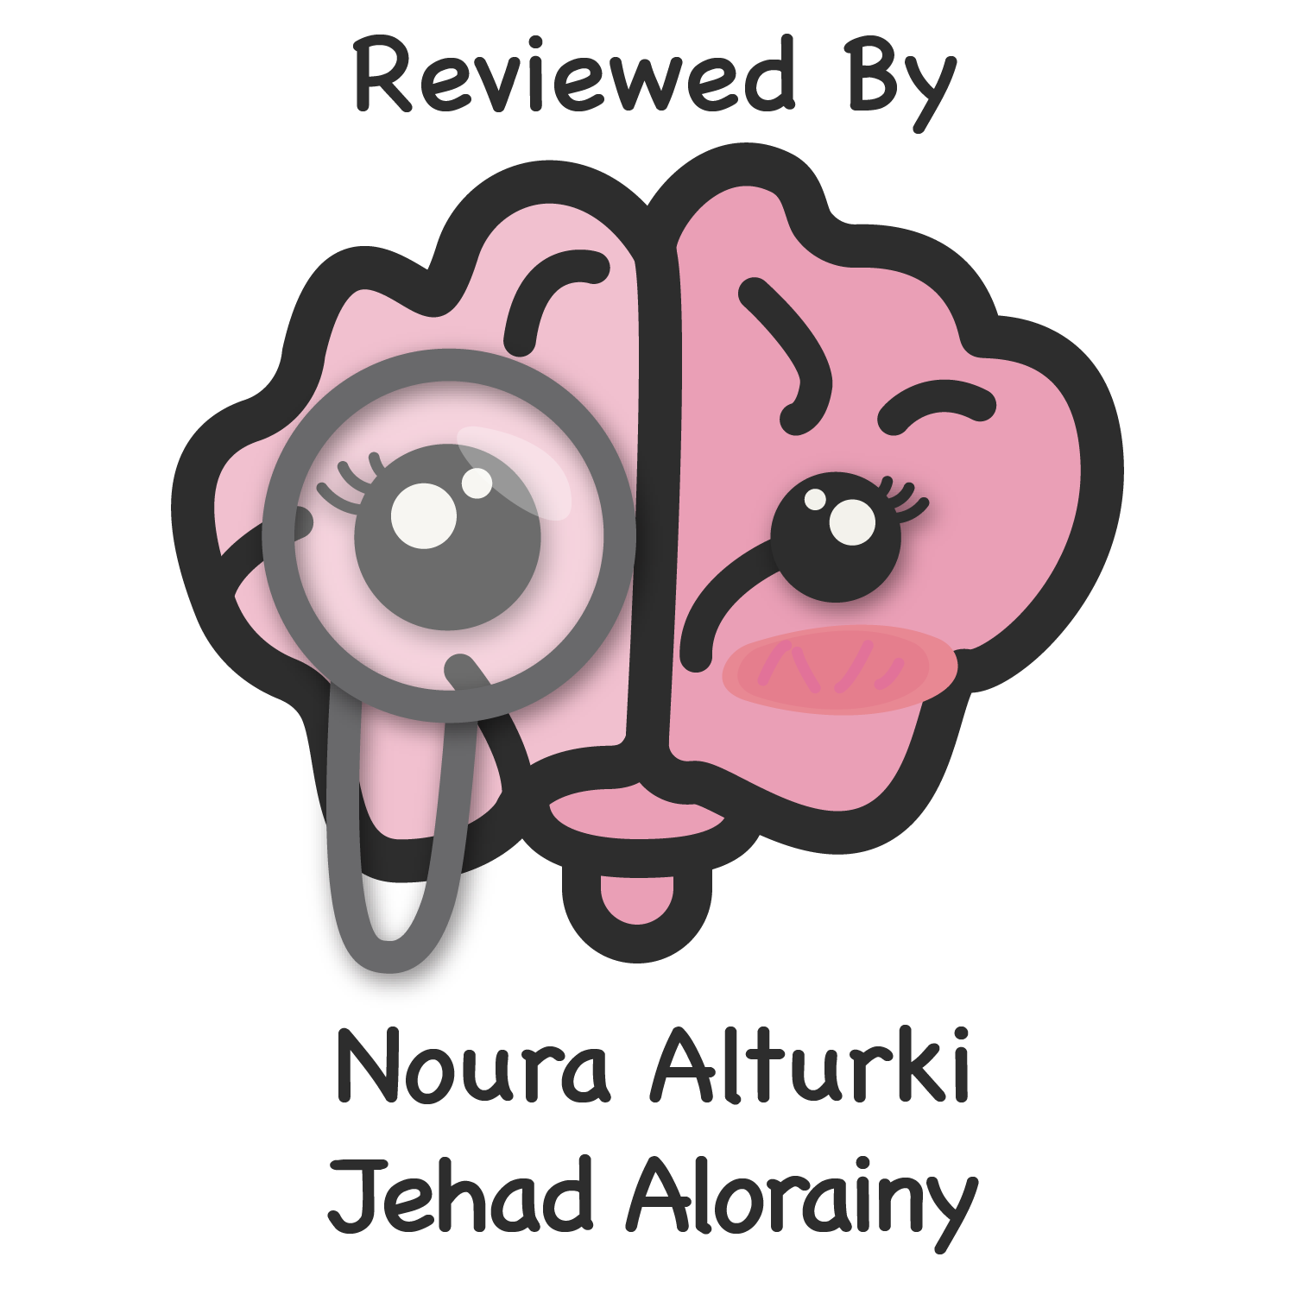
Lecture 53
Editing file
CNS Infections
Objectives:
To be familiar with the most common CNS infections world-wide and in Saudi Arabia.
To understand the approach for meningitis treatment.
To be familiar with the different investigations for CNS infections.
To understand the prognosis and outcomes of the most common CNS infections.
Color index:
Color index:
Original text Females slides Males slides
Doctor’s notes Textbook Important Golden notes Extra

Slide 2
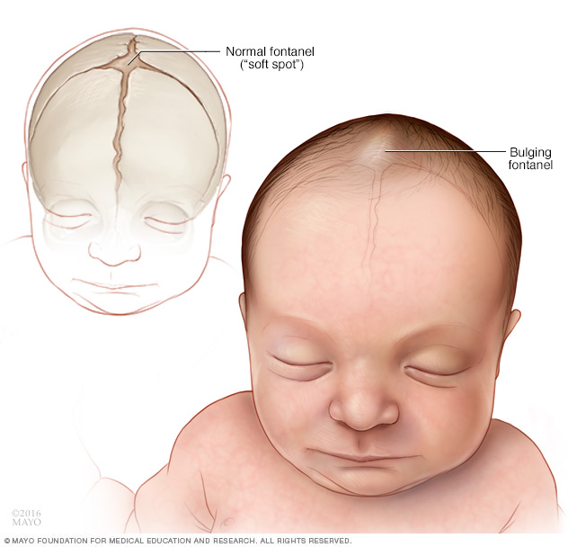
Introduction to meningitis
Definition
Meningitis:¹ inflammation of the (meninges) pia mater and the arachnoid mater (dura mater is usually spared),with suppuration of the cerebrospinal fluid. Because CSF is located between the two inflamed layers of the meninges.
Leptomeninges: the arachnoid and the pia mater
Causes of meningitis
CSF is under the arachnoid mater (Subarachnoid space)
Infectious²
Non-infectious:
Viral
Bacterial
Mycobacterial
Brucella (common in SA)
fungal³
Aseptic meningitis⁴
Malignancy e.g. lymphoma
Sarcoidosis
Behcet disease
SLE
Mollaret’s syndrome⁵
Symptoms | Signs
Early meningitis symptoms may mimic the flu (influenza). Symptoms may develop over several hours or over a few days. Possible signs and symptoms: Sudden high fever Stiff neck Severe headache Headache with nausea or vomiting Confusion (usually with encephalitis) or difficulty concentrating Seizures Sleepiness or difficulty waking Sensitivity to light (Photophobia) No appetite or thirst Skin rash (sometimes, such as in meningococcal meningitis) | No focal neurologic deficits in the majority of cases. Focal neurologic signs Isolated cranial nerve abnormalities (principally of cranial nerves III, IV, VI, and VII). Focal cerebral signs as a result of ischemia from vascular inflammation and thrombosis. Nuchal rigidity Papilledema Examination for nuchal rigidity The Kernig sign, Brudzinski sign Not very sensitive but very specific. Most useful Sign: Jolt accentuation maneuver: ask patient to rapidly rotate his or her head horizontally: Headache worsens Sensitivity of 100%, specificity of 54%, positive likelihood ratio of 2.2, and negative likelihood ratio of 0 for the diagnosis of meningitis
S&S of Acute Bacterial Meningitis (ABM)
Classic triad: fever, neck stiffness and confusion.
The usual presenting features are:
Severe Headache
Drowsiness
High grade sudden fever
Neck stiffness
Vomiting
Seizures, rash
Bulging fontanel in infants, sometimes with hydrocephalus.
Altered level consciousness and irritability
Photophobia (intolerance of light) and Phonophobia (intolerance to loud noises) can be specific to bacterial meningitis.
Progressive drowsiness, lateralizing signs and cranial nerve lesions indicates the existence of a complication, e.g. venous sinus thrombosis, severe cerebral oedema or cerebral abscess.
Note: When accompanied by sepsis, presenting signs may evolve rapidly, with abrupt onset of obtundation due to cerebral oedema.
Clinical symptoms
Absence of all 3 signs of the classic triad of fever, neck stiffness, and an altered mental status virtually eliminates a diagnosis of meningitis, we can’t eliminate completely but bacterial meningitis would be unlikely, could be viral.
1- Sometimes it’s difficult to differentiate between meningitis and encephalitis as they occur together usually. Focal neurologic deficit and seizures are more common in encephalitis.
2- Microorganisms reach the meninges either by direct extension from the ears, nasopharynx, cranial injury or congenital meningeal defect, or by bloodstream spread.
3- Fungal meningitis (especially cryptococcosis)usually occurs in patients who are immunosuppressed and is a recognised complication of HIV infection.
The CSF findings are similar to those of tuberculous meningitis, but the diagnosis can be confirmed by microscopy or specific serological tests.
4- Aseptic can be infectious (caused by viral) or noninfectious (caused by drugs)
5- In which the recurrent meningitis is associated with epithelioid cells in the spinal fluid (‘Mollaret’ cells). Recent evidence suggests that this condition may be due to herpes simplex virus type 2 and is therefore infective after all.

Slide 3
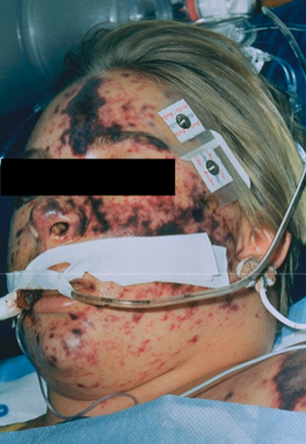
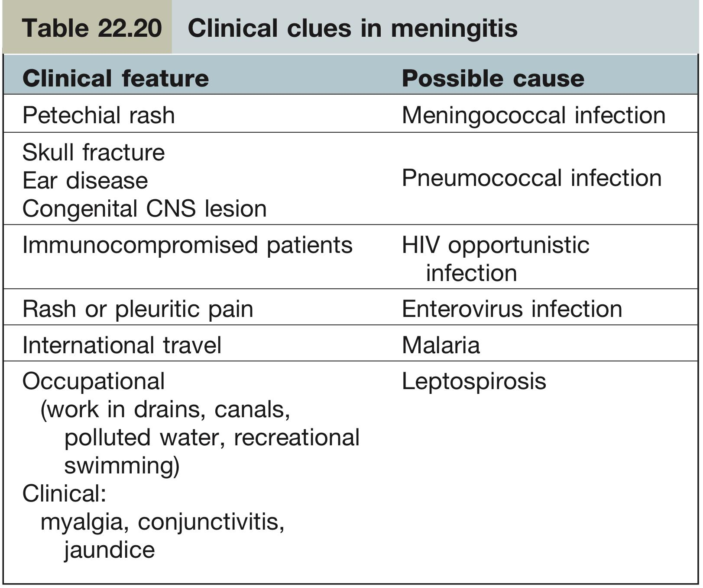
Bacterial meningitis
S&S of Acute Bacterial Meningitis (ABM) cont.
Vital signs: Fever
Papilledema due to increased ICP
Nuchal rigidity
Neurological deficit esp when there’s pus.
Don’t forget source of infection: ears, sinuses, chest..etc
Petechiae, ecchymosis¹ In pediatrics, esp with N.meningitidis
Changes in mental status are more common in bacterial than viral meningitis
Bacterial infections are more severe than viral
Focal neurologic signs
Isolated cranial nerve abnormalities (principally of cranial nerves III, IV, VI, VII and VIII).
Focal cerebral signs as a result of ischemia from vascular inflammation and thrombosis. depends on location affected.
Clinical Signs
Kernig's sign² | Brudzinski's neck sign
While patient is lying supine, with the hip and knee flexed to 90 degrees pain limits passive extension of the knee. | Flexion of the neck causes involuntary flexion of the knee and hip.
Symptoms | Signs
Early meningitis symptoms may mimic the flu (influenza). Symptoms may develop over several hours or over a few days. Possible signs and symptoms: Sudden high fever Stiff neck Severe headache Headache with nausea or vomiting Confusion (usually with encephalitis) or difficulty concentrating Seizures Sleepiness or difficulty waking Sensitivity to light (Photophobia) No appetite or thirst Skin rash (sometimes, such as in meningococcal meningitis) | No focal neurologic deficits in the majority of cases. Focal neurologic signs Isolated cranial nerve abnormalities (principally of cranial nerves III, IV, VI, and VII). Focal cerebral signs as a result of ischemia from vascular inflammation and thrombosis. Nuchal rigidity Papilledema Examination for nuchal rigidity The Kernig sign, Brudzinski sign Not very sensitive but very specific. Most useful Sign: Jolt accentuation maneuver: ask patient to rapidly rotate his or her head horizontally: Headache worsens Sensitivity of 100%, specificity of 54%, positive likelihood ratio of 2.2, and negative likelihood ratio of 0 for the diagnosis of meningitis
Note:
In both tests you’re stretching the meninges so the pt will flex the neck or the knee to minimize the stretch.
These signs were useful in the past when they didn’t have LP and CT-scan etc. So they used to depend on these classic signs. However, these signs occur late in the course of the disease, so they are rarely seen nowadays, usually happens in a pt with untreated bacterial meningitis for days or weeks but nowadays we put patients on antibiotics from the first day.
(Low sensitivity, High specificity)
What’s the most useful sign?
Jolt accentuation maneuver: ask patient to rapidly rotate his or her head horizontally: Headache worsens, In healthy individuals it might be uncomfortable but a pt with meningitis will avoid doing it.
Sensitivity of 100%, specificity of 54% (Low, unlike kernig and Brudzinski signs), positive likelihood ratio of 2.2, and negative likelihood ratio of 0 for the diagnosis of meningitis
1- In meningococcal septicaemia there is a non-blanching petechial and purpuric skin rash and signs of shock.
2- Patient with spontaneous intracranial hypotension can have chronic headache and one of the treatments is subdural blood patch, this can cause irritation of the meninges usually at the lumbosacral area so they can have a +ve Kernig’s sign

Slide 4
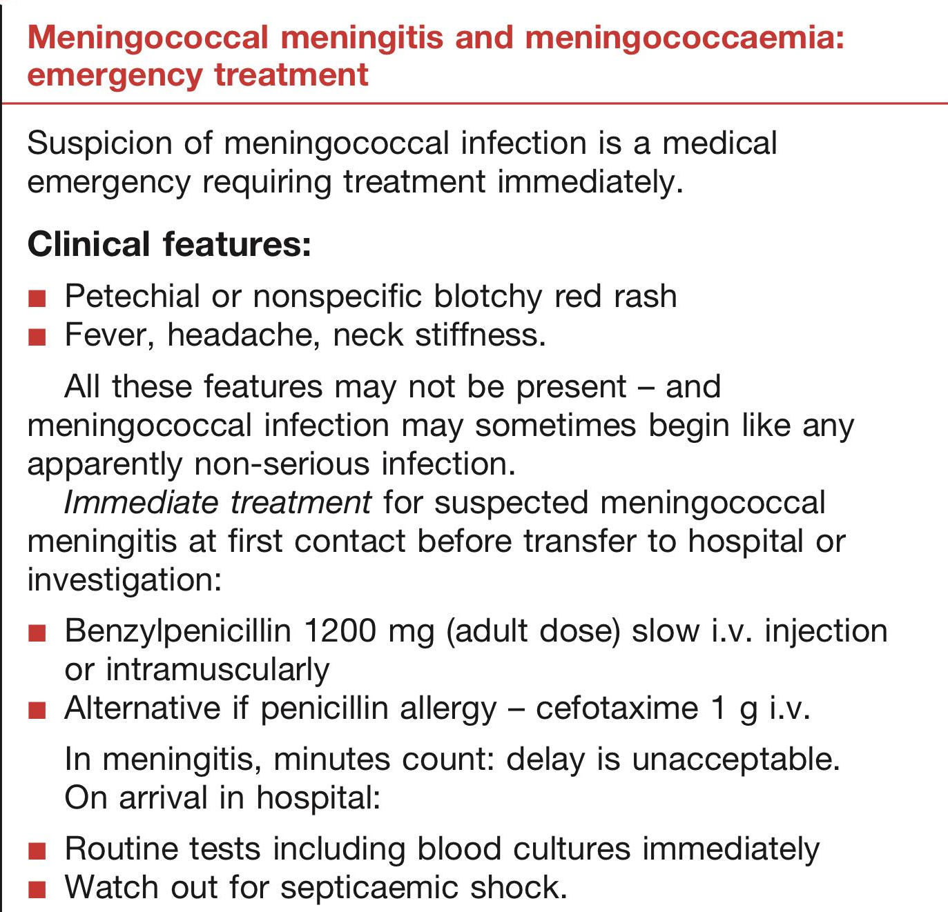
Bacterial meningitis cont.
Chronic Bacterial Meningitis
Tuberculous meningitis (TBM) and cryptococcal meningitis commence typically with vague headache, lassitude, anorexia and vomiting.
Acute meningitis can occur but is unusual.
Meningitic signs often take some weeks to develop.
Drowsiness, focal signs (e.g. diplopia, papilloedema, hemiparesis) and seizures are common. Syphilis, sarcoidosis and Behçet’s also cause chronic meningitis.
In some cases of chronic meningitis, an organism is never identified.
Bacterial pathogens
Neonates
Group B Streptococci (MOST COMMON, and occurs ONLY in neonates) 49%
Gram-negative bacilli (Escherichia coli, Proteus)
Enterococci
Klebsiella
Enterobacter
Salmonella
Serratia
Listeria monocytogenes
Symptoms | Signs
Early meningitis symptoms may mimic the flu (influenza). Symptoms may develop over several hours or over a few days. Possible signs and symptoms: Sudden high fever Stiff neck Severe headache Headache with nausea or vomiting Confusion (usually with encephalitis) or difficulty concentrating Seizures Sleepiness or difficulty waking Sensitivity to light (Photophobia) No appetite or thirst Skin rash (sometimes, such as in meningococcal meningitis) | No focal neurologic deficits in the majority of cases. Focal neurologic signs Isolated cranial nerve abnormalities (principally of cranial nerves III, IV, VI, and VII). Focal cerebral signs as a result of ischemia from vascular inflammation and thrombosis. Nuchal rigidity Papilledema Examination for nuchal rigidity The Kernig sign, Brudzinski sign Not very sensitive but very specific. Most useful Sign: Jolt accentuation maneuver: ask patient to rapidly rotate his or her head horizontally: Headache worsens Sensitivity of 100%, specificity of 54%, positive likelihood ratio of 2.2, and negative likelihood ratio of 0 for the diagnosis of meningitis
Neisseria meningitidis* (subtypes B, C, Y, W)
S. pneumoniae (Most common)
M.tuberculosis Less common
H. influenzae (Less common than before)
Older infants and children
*Meningococcal meningitis and meningococcaemia
(Medical emergency)
Fulminate meningococcemia with purpura:
Overwhelming sepsis, DIC
Classic: Meningitis with rash (Petechiae) + Headache + Fever
Meningitis without rash
Mortality 3 - 10 %
Lumbar puncture should not be performed if meningococcal sepsis
is suspected because coning of the cerebellar tonsils may follow – the
organism is confirmed by blood culture.
Treatment and prophylaxis:
Droplet Isolation: 48h post Abx
Treatment: Ceftriaxone or Pen G 7 days
Eradicate nasopharyngeal carriage:
House hold contact
Health care providers who examined patient closely
Prophylaxis (Not done routinely): Rifampin 600 mg for 2 d or Ciprofloxacin 500mg once or Ceftriaxone 125mg I.M once
Recall: Ceftriaxone is C.I in neonates, give cefotaxime instead.

Slide 5
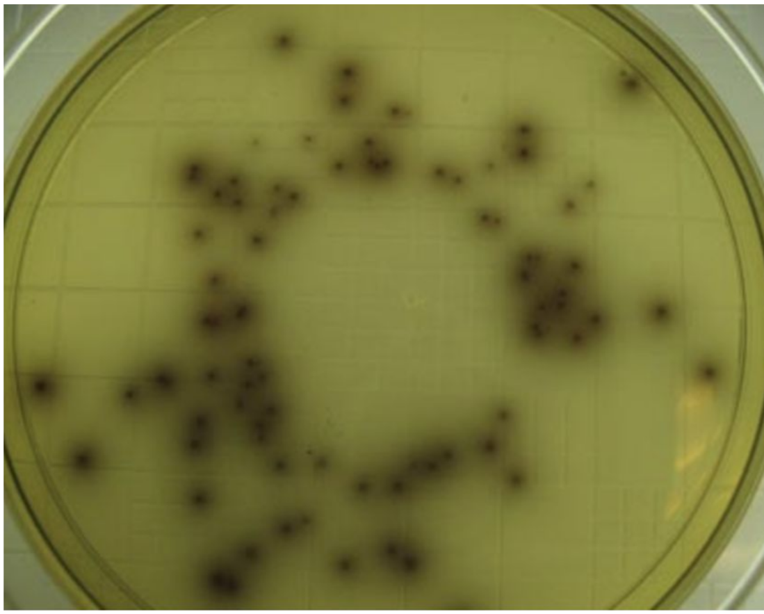
Bacterial meningitis cont.
Bacterial pathogens cont.
Adults
Streptococcus pneumonia (MOST common).......37%
Neisseria meningitidis (subtypes B, C, Y, W) .....13%
Listeria monocytogenes ....10%
Other strept.species....7%
Gram negative…...4%
Haemophilus influenzae ......4%
TB, Brucella ( common in saudia arabia )
Keep in mind:
Global emergence and prevalence of Penicillin- Resistant Streptococcus pneumoniae
Dramatic Reduction in invasive Haemophilus influenzae disease secondary to use of conjugate Haemophilus Type B- vaccine.
Group B – Streptococci: previously in neonate: now emerging as disease of elderly
Pneumococcal meningitis
Symptoms | Signs
Early meningitis symptoms may mimic the flu (influenza). Symptoms may develop over several hours or over a few days. Possible signs and symptoms: Sudden high fever Stiff neck Severe headache Headache with nausea or vomiting Confusion (usually with encephalitis) or difficulty concentrating Seizures Sleepiness or difficulty waking Sensitivity to light (Photophobia) No appetite or thirst Skin rash (sometimes, such as in meningococcal meningitis) | No focal neurologic deficits in the majority of cases. Focal neurologic signs Isolated cranial nerve abnormalities (principally of cranial nerves III, IV, VI, and VII). Focal cerebral signs as a result of ischemia from vascular inflammation and thrombosis. Nuchal rigidity Papilledema Examination for nuchal rigidity The Kernig sign, Brudzinski sign Not very sensitive but very specific. Most useful Sign: Jolt accentuation maneuver: ask patient to rapidly rotate his or her head horizontally: Headache worsens Sensitivity of 100%, specificity of 54%, positive likelihood ratio of 2.2, and negative likelihood ratio of 0 for the diagnosis of meningitis
The most common cause
Highest mortality 20 – 30%
May be associated with other Focus:
Pneumonia, Otitis Media, Sinusitis
Head Trauma & CSF Leak
Splenectomy and Sickle cell disease
Global emergence of Penicillin – Resistant
Listeria Monocytogenes meningitis
Pathology: It causes brain stem, cerebellum inflammation (Rhombencephalitis) and meningitis
Risk groups:
Age <1y or >50y
Alcoholics
Pregnancy: up to 30%
Immunocompromised 70 %
Routes of transmission:
Mainly food borne: survives refrigeration
linked to poultry, hotdogs, cold cuts, coleslaw, ice-cream
Cheeses, particularly soft cheeses, have been implicated in listeriosis outbreaks worldwide.
Transplacental /vertical
Cross contamination(nursery)
Inoculation(skin) farmers
Colo/ sigmoidoscopy → bacteremia / meningitis (up to 5% healthy: Normal flora)
Inform micro lab: special media (Mueller-Hinton agar)
Note: Whenever you see a pt with changing signals in brain stem and cerebellum MRI , think of Listeria.
Treatment:
Ampicillin 2gm IV Q4h +/- Gentamicin 2mg/kg loading dose then 1.7mg/kg Q8h
21 day duration
Penicillin allergy patients: TMP-SMX or Meropenem

Slide 6
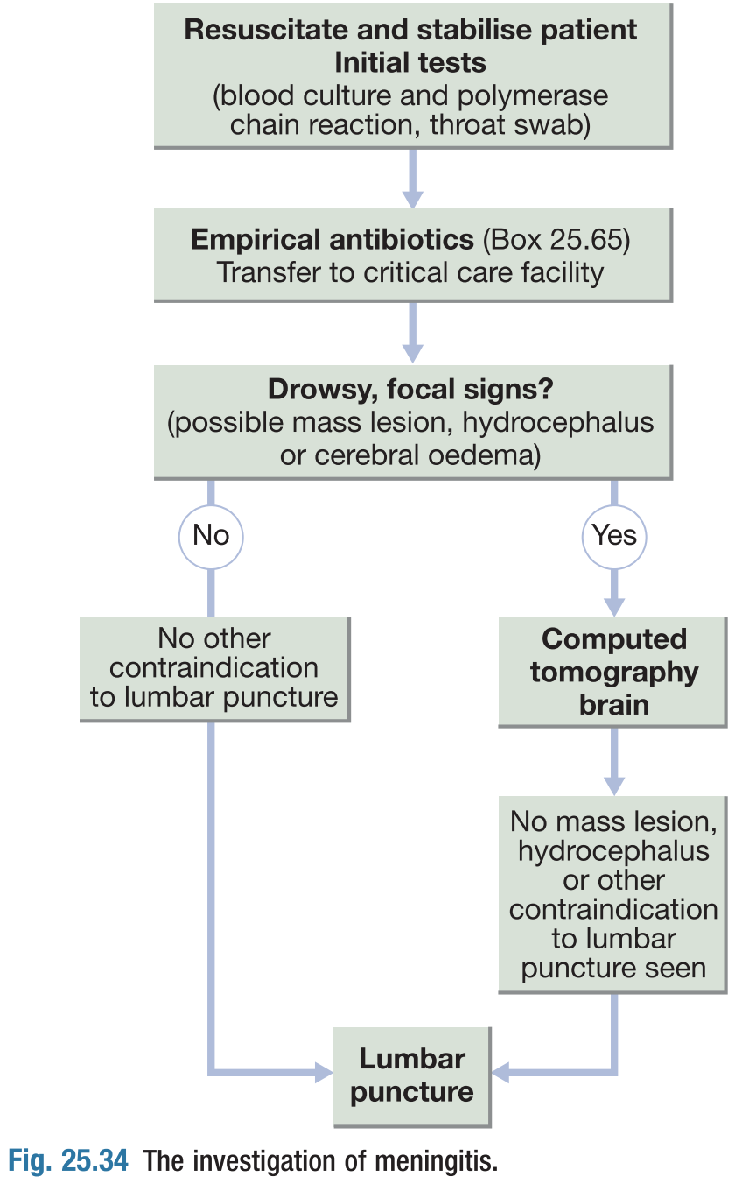
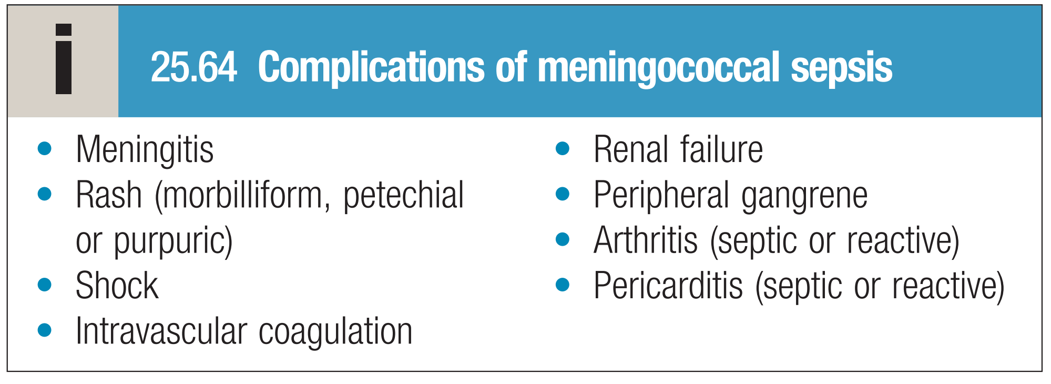
Bacterial meningitis cont.
Investigations:
LP¹ delayed if there is contraindication e.g. Skin infection near the site or raised ICP or bleeding tendency. (rule out high ICP by fundoscopy and CT, Ask for use of Anticoagulants before doing an LP)
CSF analysis (unless there is evidence of a space-occupying lesion), Remember to be careful:
Increased ICP may increase risk of herniation Lowering of CSF pressure from withdrawal of CSF could precipitate herniation of the brain.
Cellulitis at area of lumbar puncture
Bleeding disorder
Start empirical antibiotics³ on suspicion and don't wait for the results of LP! If lumbar puncture is deferred or omitted, it is essential to take blood cultures and to start empirical treatment.
CBC, Creatinine, electrolytes: Na
Blood Culture
CXR
CT Head: Should be performed before LP If the patient:
Has altered consciousness
Has focal neurological signs
Has seizures
Has papilledema or cranial nerve palsies
Immunosuppressed, has undergone recent neurosurgery or has suffered a head injury,
Note: if the signs mentioned above are present, it is wise to obtain a CT to exclude a mass lesion (such as a cerebral abscess) before lumbar puncture because of the risk of coning
How to manage a patient with meningitis?
Step 1: Give empirical therapy!! Whenever you suspect meningitis or encephalitis, start empirical therapy! (In real life the pt will be started on empirical therapy in the ER, before you see him)
Step 2: CT (To exclude herniation, supratentorial tumor, bleeding, pus collection (Subdural empyema) before doing LP bc it may kill the pt). NEVER do LP before CT.
Step 3: LP.
Contraindications to LP: Herniation, Infection at the site of LP (e.g. Cellulitis), bleeding disorders, Low platelet count <100, anticoagulants . If one of these contraindication is present you can delay LP but NEVER delay the treatment
1
Radiological
CXR (To look for the source bc sometimes the pt may have pneumonia → Sepsis → Meningitis)
CT Head Without contrast : Generally, patients with suspected meningitis require brain imaging before the LP, warning signs that mandate an image:
Has altered consciousness
Has focal neurological signs
Has seizures
Has papilledema¹ or cranial nerve palsies
Immunosuppressed, has undergone recent neurosurgery or has suffered a head injury.
2
Lumbar puncture
Start empirical antibiotics on suspicion and don't wait for the results of LP! If lumbar puncture is deferred or omitted, it is essential to take blood cultures and to start empirical treatment.
CSF analysis, remember to be careful:
Increased ICP may increase risk of herniation Lowering of CSF pressure from withdrawal of CSF could precipitate herniation of the brain.
Cellulitis at area of lumbar puncture
Bleeding disorder
Complications | Sequelae
Hydrocephalus (in pediatrics) Seizures SIADH (present with persistent hyponatremia) Subdural effusions & empyema Septic sinus or cortical vein thrombosis Arterial ischemia / infarction (inflammatory vasculitis²) CN Palsies (esp deafness) Septic shock / multi-organ failure from bacteremia (esp meningococcus & pneumococcus) Risk of adrenal hemorrhage with hypo-adrenalism (Waterhouse-Friderichsen syndrome) | Deafness Brain damage Hydrocephalus sequela is very specifically something that is leftover after a disease
Algorithm from Dr slides
3
Other
CBC, Creatinine, electrolytes: Na
Blood Culture
1- Swelling of optic disc due to elevated intracranial pressure, can present with loss of visual acuity due to enlargement of blind spot. Do fundoscopy, you will see edematous, poorly defined, prominent optic disc with blurry margins, widened blind spot and radial hemorrhage around the disc margin.

Slide 7
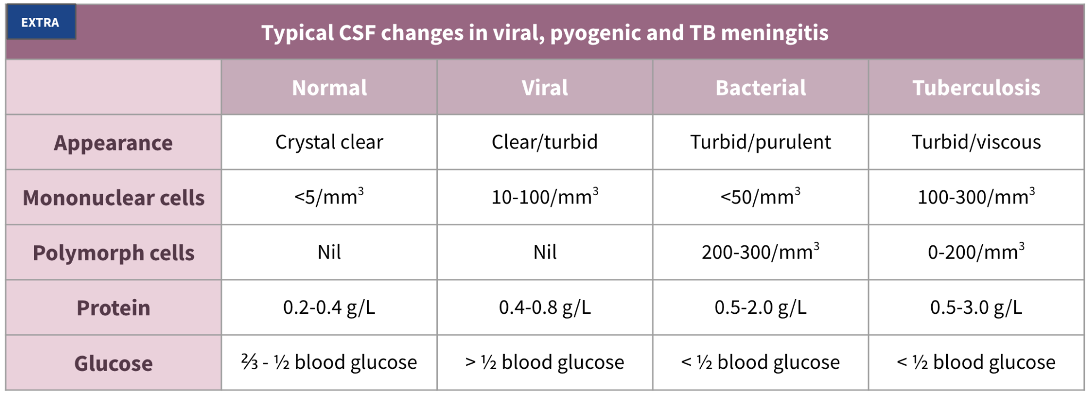
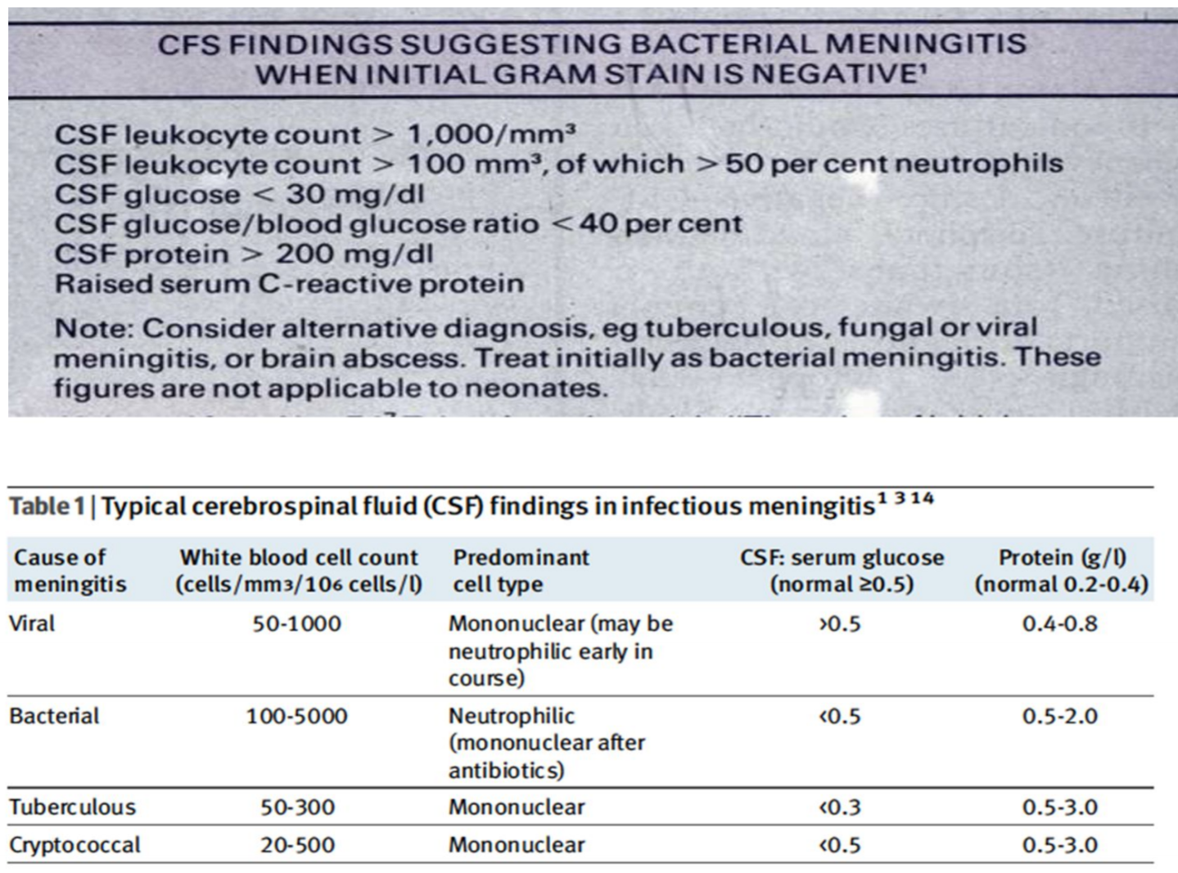
Bacterial meningitis cont.
CSF analysis
Tests from 1-6 are the standard tests, the rest are ordered based on suspicion. Although, in real life we ask for all of them.
1
2
3
4
Appearance, opening pressure¹
Cell count with differential
Glucose, protein
CSF appearance
5
6
7
8
Gram stain
Culture
TB AFB smear PCR and culture
Brucella serology and PCR
Imp in our area
9
10
11
HSV PCR
If you suspect encephalitis
Multiplex viral PCR for enterococcus
Cryptococcus antigen in DM and immunocompromised
In partially treated meningitis there will be elevated white cells (mainly neutrophils), but glucose and protein may be normal or near borderline (Can be confusing with viral meningitis). How to differentiate between partially treated bacterial meningitis and viral meningitis? By history (e.g. if the pt has visited a hospital recently and taken abx considered partially treated meningitis) or by gram stain, you may get positive results in partially treated meningitis
Typical CSF changes in viral, pyogenic and TB meningitis
 | Normal | Viral | Bacterial | Tuberculosis
Appearance | Crystal clear | Clear/turbid | Turbid/purulent | Turbid/viscous
Mononuclear cells | <5/mm³ | 10-100/mm³ | <50/mm³ | 100-300/mm³
Polymorph cells | Nil | Nil | 200-300/mm³ | 0-200/mm³
Protein | 0.2-0.4 g/L | 0.4-0.8 g/L | 0.5-2.0 g/L | 0.5-3.0 g/L
Glucose | ⅔ - ½ blood glucose | > ½ blood glucose | < ½ blood glucose | < ½ blood glucose
In bacterial meningitis the predominant cells will be neutrophils while in viral it will be lymphocytes.
Protein can be high in other inflammatory causes such as MS. It is not specific.
No need to remember the numbers as they vary from reference to another, just understand the picture
Bacterial meningitis the predominant cells will be neutrophils
Viral meningitis: it will be lymphocytes.
Partially treated meningitis: there will be elevated white cells (mainly neutrophils but may have elevated lymphocytes as well), but glucose and protein may be normal or near borderline (Can be confusing with viral meningitis).
How to differentiate between partially treated bacterial meningitis and viral meningitis? By history (e.g. if the pt has visited a hospital recently and taken abx considered partially treated meningitis) or by gram stain, you may get positive results in partially treated meningitis
Protein: can be high in other inflammatory causes such as MS. It is not specific.
No need to remember the numbers as they vary from reference to another, just understand the picture
Treatment of pyogenic meningitis of unknown cause
Empirical Treatment for Gram negative bacterial meningitis
The best initial treatment for bacterial meningitis is:
Ceftriaxone (2gm IV Q12h)
High CSF levels
Vancomycin (500-750mg IV Q6h): Given to cover highly penicillin resistant pneumococcus
Dexamethasone (0.15mg/kg IV Q6h) for 2-4 days :
1 st dose 15-20 min prior to or con-comitant with1st dose Abx to block TNF production
It might improve the outcome
Ampicillin (for listeria) Listeria is resistant to all cephalosporins but sensitive to penicillins. You must add ampicillin to ceftriaxone and vancomycin if the case describes risk factors for Listeria.
Acyclovir: can be added if you suspect that it may have a viral component or encephalitis.
The best initial treatment for bacterial meningitis is:
Ceftriaxone (2gm IV Q12h)
High CSF levels
Vancomycin (500-750mg IV Q6h): Given to cover highly penicillin resistant pneumococcus
Dexamethasone (0.15mg/kg IV Q6h) for 2-4 days :
1 st dose 15-20 min prior to or con-comitant with1st dose Abx to block TNF production
Listeria is resistant to all cephalosporins but sensitive to penicillins. You must add ampicillin to ceftriaxone and vancomycin if the case describes risk factors for Listeria.
If you suspect that it may have a viral component or encephalitis you can add acyclovir
Details next page
1- Not useful in meningitis, but helpful in cases of idiopathic intracranial hyper/hypotension

Slide 8
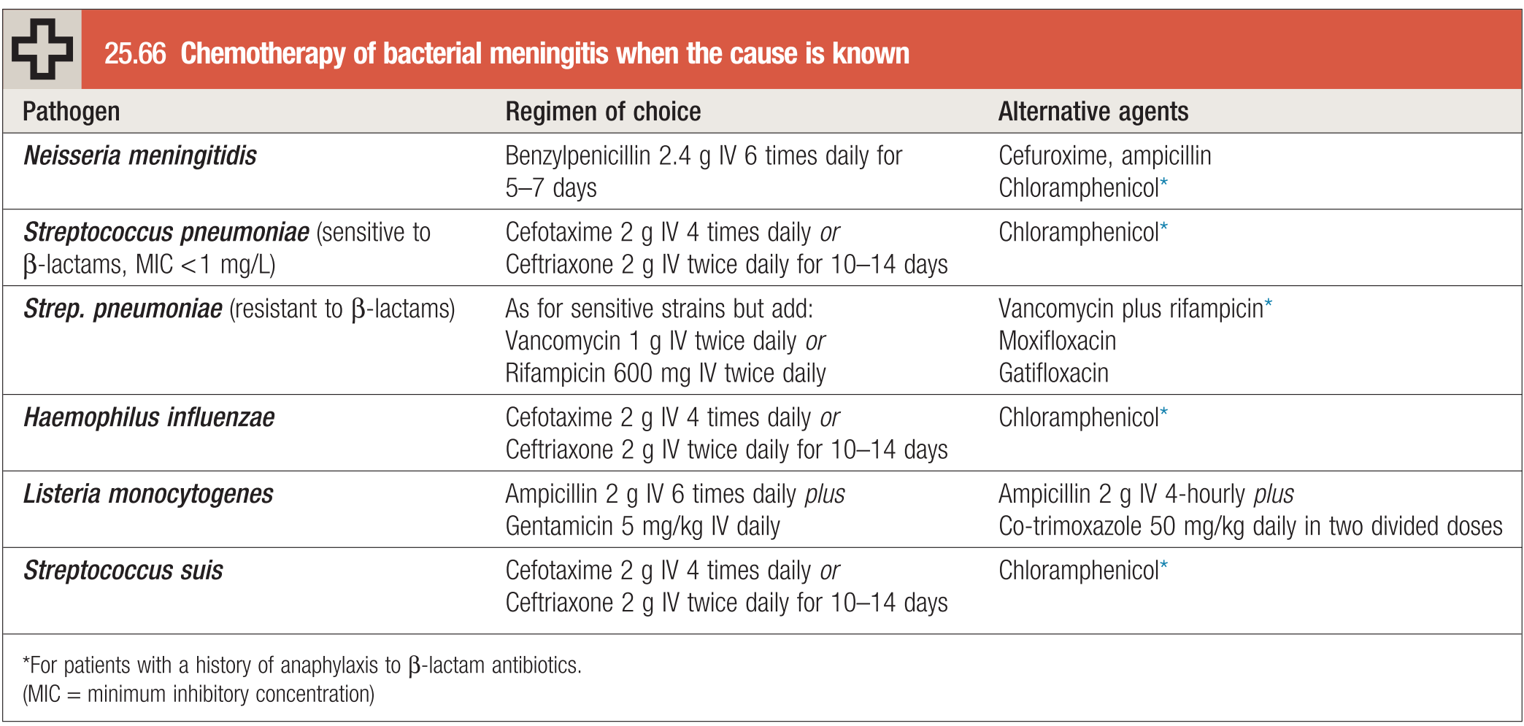
EXTRA
Management¹ cont’
Algorithm from Dr slides
Bacterial Meningitis - Empiric Treatment of unknown cause (Gram stain Negative)
Ceftriaxone and vancomycin should always be administered
Comment | Recommended Treatment
Adults aged 18–50 years with or without a typical meningococcal rash | Cefotaxime 2g IV QID or Ceftriaxone 2g IV Q12h (High CSF levels)
Patients in whom highly penicillin resistant pneumococcus is suspected , or in areas with a significant incidence of penicillin resistance in the community | As for (1) but add: Vancomycin 500-750 mg IV Q6h or Rifampicin 600 mg IV twice daily
Adults aged > 55 years and If Listeria suspected (brainstem signs, immunosuppression, diabetic, alcoholic) | As for (1) but add: Ampicillin 2 g IV 6 times daily or Co-trimoxazole 5 mg/kg IV daily in two divided doses
Patients with a clear history of anaphylaxis to β-lactams | Chloramphenicol 25 mg/kg IV QID plus Vancomycin 1 g IV twice daily
Adjunctive treatment (see pg7 management) | Dexamethasone (to suppress acute inflammation not used in chronic) (0.15mg/kg IV Q6h) for 2-4 days:
- Management of ↑ICT : mannitol, glycerine, acetazolamide. - Tt of Seizures, pyrexia. - Treat shock, DIC if present. - Add Acyclovir for herpes Encephalitis. - Add amphotericin B or fluconazole for fungal infections.
Bacterial Meningitis - Empiric Treatment (Gram stain Negative)
(no need to know the doses)
Ceftriaxone 2gm IV Q12h
– High CSF levels
Vancomycin 500-750 mg IV Q6h (for highly penicillin resistant pneumococcus)
Dexamethasone (to suppress acute inflammation not used in chronic (0.15mg/kg IV Q6h) for 2-4 days:
1st dose 15-20 min prior to or concomitant with 1st dose antibiotic to block TNF production
Ampicillin IV if Listeria suspected (age >55 yrs, immunosuppressed)
Management of ↑ICT : mannitol, glycerine, acetazolamide
Tt of Seizures, pyrexia
Treat shock, DIC if present
Add Acyclovir for herpes Encephalitis
Add amphotericin B or fluconazole for fungal infections
Vaccination:
Vaccinate all adults >65 years for S. pneumoniae.
Vaccinate asplenic patients for S. pneumoniae, N. meningitidis, and H.
influenzae (encapsulated organisms).
Vaccinate immunocompromised patients for N. meningitidis.
Prophylaxis (e.g., rifampin or ceftriaxone)—for all close contacts of patients with meningococcus.
Chemotherapy of bacterial meningitis when the cause is known
Pathogen | Regimen of choice | Alternative agents
Neisseria meningitidis | Benzylpenicillin 2.4 g IV 6 times daily for 5–7 days | - Cefuroxime, ampicillin - Chloramphenicol²
Streptococcus pneumoniae (sensitive to β-lactams, MIC < 1 mg/L) | Cefotaxime 2 g IV QID or Ceftriaxone 2 g IV twice daily for 10–14 days | - Chloramphenicol²
Strep. pneumoniae (resistant to β-lactams) | As for sensitive strains but add: Vancomycin 1 g IV twice daily or Rifampicin 600 mg IV twice daily | - Vancomycin + rifampicin² - Moxifloxacin - Gatifloxacin
Haemophilus influenzae | Cefotaxime 2 g IV QID or Ceftriaxone 2 g IV twice daily for 10–14 days | - Chloramphenicol²
Listeria monocytogenes | Ampicillin 2 g IV 6 times daily plus Gentamicin 5 mg/kg IV daily | - Ampicillin 2 g IV 4-hourly plus - Co-trimoxazole 50 mg/kg daily in two divided doses
Streptococcus suis | Cefotaxime 2 g IV 4 times daily or Ceftriaxone 2 g IV twice daily for 10–14 days | - Chloramphenicol²
1- Early endotracheal intubation and mechanical ventilation protect the airway and may prevent the development of the acute respiratory distress syndrome.
Adverse prognostic features include: hypotensive shock, a rapidly developing rash, a haemorrhagic diathesis, multisystem failure and age over 60 years.
2- For patients with a history of anaphylaxis to β-lactam antibiotics.

Slide 9
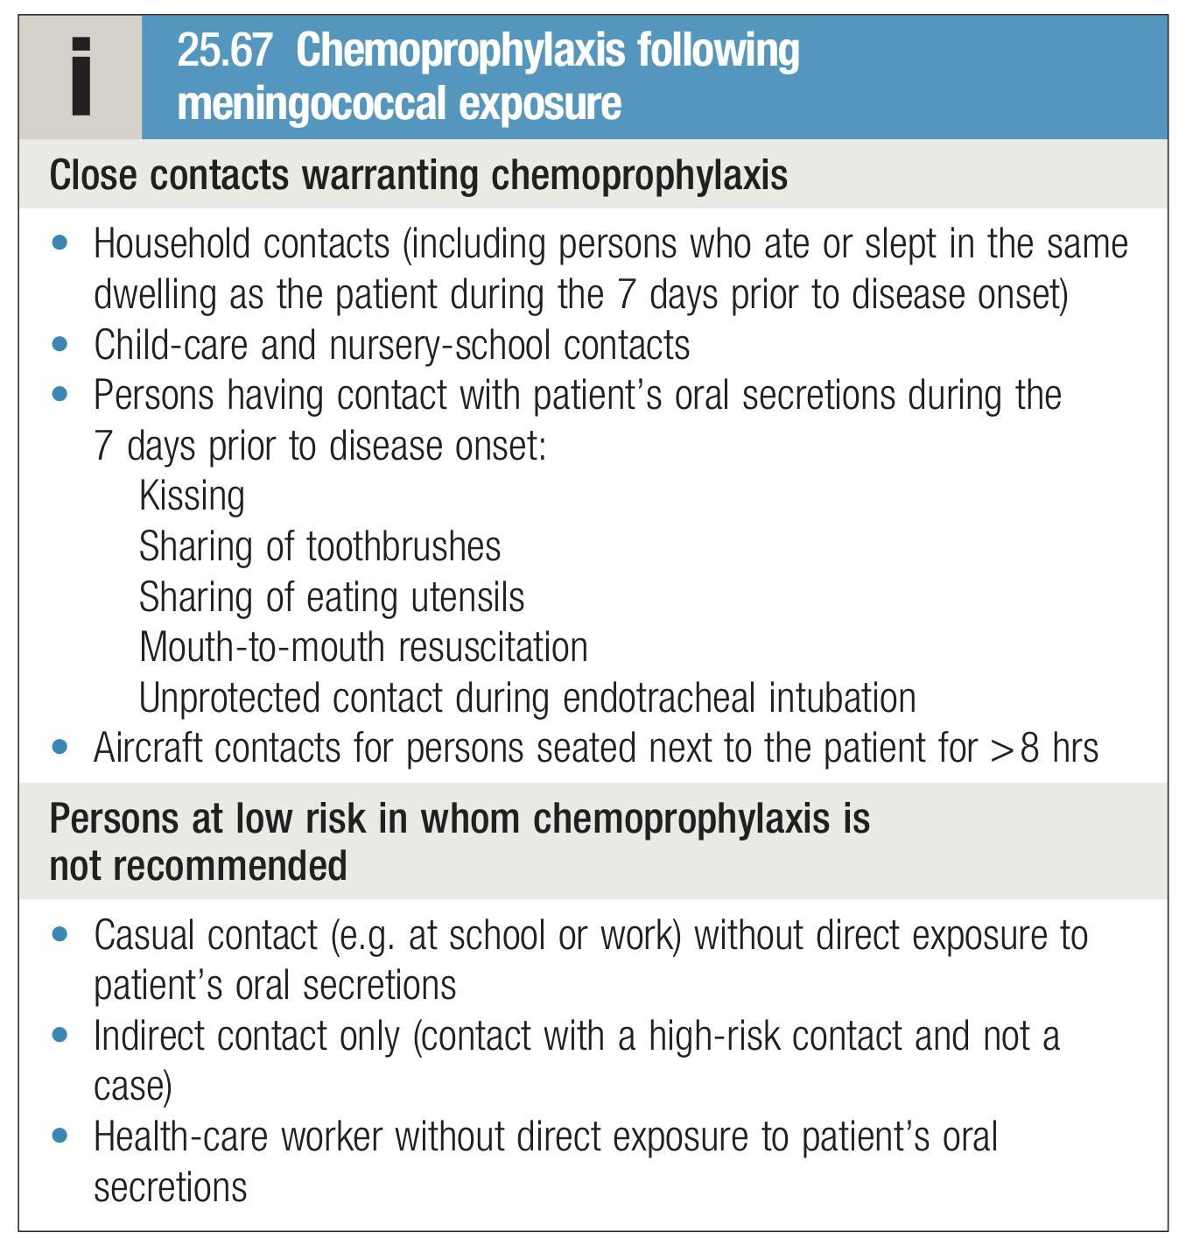
Management cont’
Neurobrucellosis
General info:
Brucellosis is an enzootic infection (i.e. endemic in animals) caused by Gram-negative bacilli.
Infected animals may excrete Brucella spp. in their milk for prolonged periods and human infection is acquired by ingesting contaminated dairy products (especially unpasteurised milk), uncooked meat or offal.
B. melitensis causes the most severe disease; B. suis is often associated with abscess formation.
Treatment:
Doxycycline 100mg IV/po bid
Plus Rifampin 600-900mg po od
Plus Ceftriaxone 2gm IV q12h
Duration?
Continue until CSF is normal (3-12 months); duration vary based on symptoms and MRI changes
Complications | Sequelae
Hydrocephalus (in pediatrics) Seizures SIADH (present with persistent hyponatremia) Subdural effusions & empyema Septic sinus or cortical vein thrombosis Arterial ischemia / infarction (inflammatory vasculitis²) CN Palsies (esp deafness) Septic shock / multi-organ failure from bacteremia (esp meningococcus & pneumococcus) Risk of adrenal hemorrhage with hypo-adrenalism (Waterhouse-Friderichsen syndrome) | Deafness Brain damage Hydrocephalus sequela is very specifically something that is leftover after a disease
Prevention of meningitis
Vaccination
Vaccinate all adults >65 years for S. pneumoniae. Vaccinate asplenic patients for S. pneumoniae, N. meningitidis, and H. influenzae (encapsulated organisms). Vaccinate immunocompromised patients for N. meningitidis. Vaccines are available for most meningococcal subgroups but not group B, which is one of the most common serogroups isolated in many countries.
Complications of meningitis
Hydrocephalus (in pediatrics)
Seizures
Syndrome of inappropriate ADH secretion (SIADH)
present with refractory hyponatremia)
Subdural effusions & empyema
Septic sinus or cortical vein thrombosis
Arterial ischemia / infarction (inflammatory vasculitis)
VZV and aspergillus infections can cause stroke + meningitis or encephalitis.
Most common: CN Palsies (esp. deafness)
Septic shock / multi-organ failure from bacteremia (esp meningococcus & pneumococcus)
Risk of adrenal hemorrhage with hypo-adrenalism (Waterhouse-Friderichsen syndrome)
VZV and aspergillosis fungal infections can cause stroke + meningitis or encephalitis.
An area for your notes

Slide 10
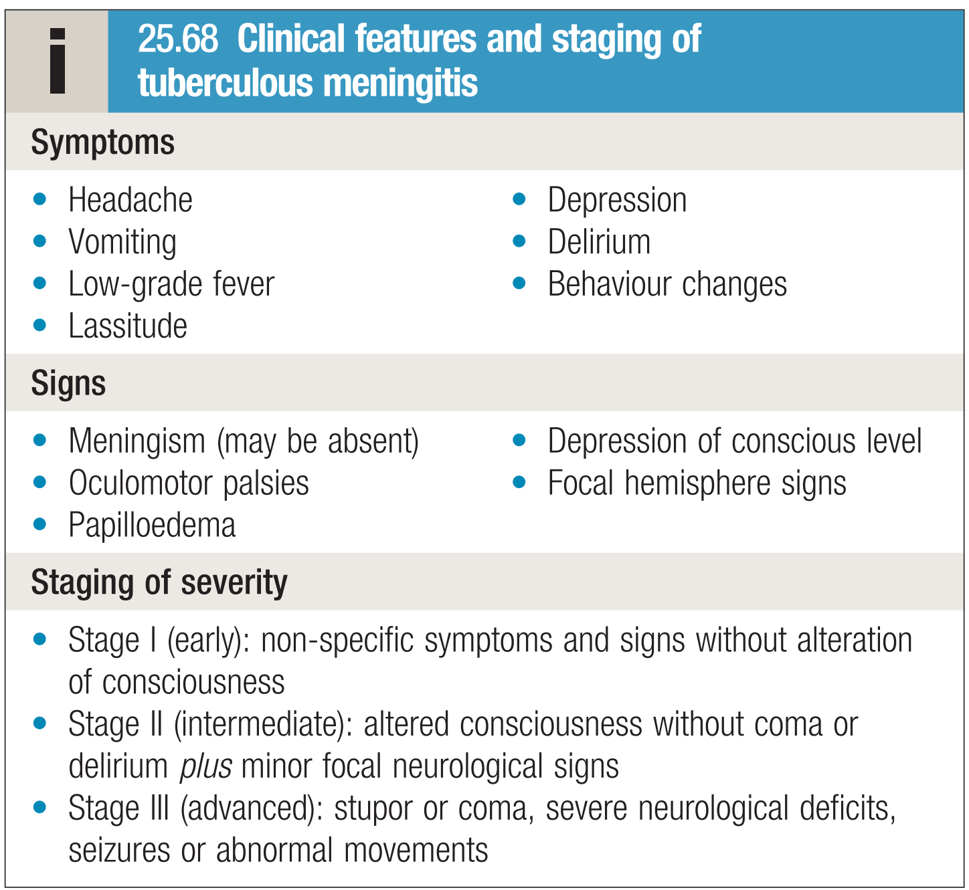
Tuberculous meningitis
Introduction
Most dreaded and dangerous form of TB
Tuberculous meningitis is now uncommon in developed countries except in immunocompromised individuals, although it is still seen in those born in endemic areas and in developing countries. It is seen more frequently as a secondary infection in patients with the acquired immunodeficiency syndrome (AIDS).
Risk factors:
Young age
Household contact
Recent infection
Measles
Clinical features
Onset is much slower than in other bacterial meningitis – over 2–8 weeks.
If untreated, tuberculous meningitis is fatal in a few weeks
but complete recovery is usual if treatment is started at stage I
When treatment is initiated later, the rate of death or serious neurological deficit may be as high as 30%.
Pathophysiology:
Primary infection → bacillemia → hematogenous seeding of meninges (Rich’s foci) → rupture.
Thick exudates in basal cisterns
Arteritis
Tuberculous meningitis most commonly occurs shortly after a primary infection in childhood or as part of miliary tuberculosis.
The usual local source of infection is a caseous focus in the meninges or brain substance adjacent to the CSF pathway.
The brain is covered by a greenish, gelatinous exudate, especially around the base, and numerous scattered tubercles are found on the meninges.
Risk Factors:
Young age
Household contact
Recent infection
Measles
Clinical features of tuberculous meningitis¹
•3 stages
–Stage 1: prodromal stage with nonspecific symptoms 1-4 weeks
–Stage 2: neurological manifestations – seizures, deficits, meningeal signs
–Stage 3: coma
•Decerebrate posturing, cranial nerve palsies, optic atrophy, extrapyramidal signs, hydrocephalus (communicating or obstructive) more common
Symptoms:
Headache, Vomiting, Low-grade fever, Lassitude.
Depression, Delirium, Behaviour changes
Decerebrate posturing, cranial nerve palsies, optic atrophy, extrapyramidal signs, hydrocephalus (communicating or obstructive) more common
Signs:
Meningism (may be absent), Oculomotor palsies, Papilloedema
Depression of conscious level, Focal hemisphere signs
Staging of severity:
Stage I (early): prodromal stage with nonspecific symptoms 1-4 weeks (without alteration of consciousness)
Stage II (intermediate): altered consciousness without coma or delirium plus neurological manifestations – seizures, deficits, meningeal signs
Stage III (advanced): stupor or coma, severe neurological deficits, seizures or abnormal movements
1- Onset is much slower than in other bacterial meningitis – over 2–8 weeks. If untreated, tuberculous meningitis is fatal in a few weeks but complete recovery is usual if treatment is started at stage I When treatment is initiated later, the rate of death or serious neurological deficit may be as high as 30%.

Slide 11
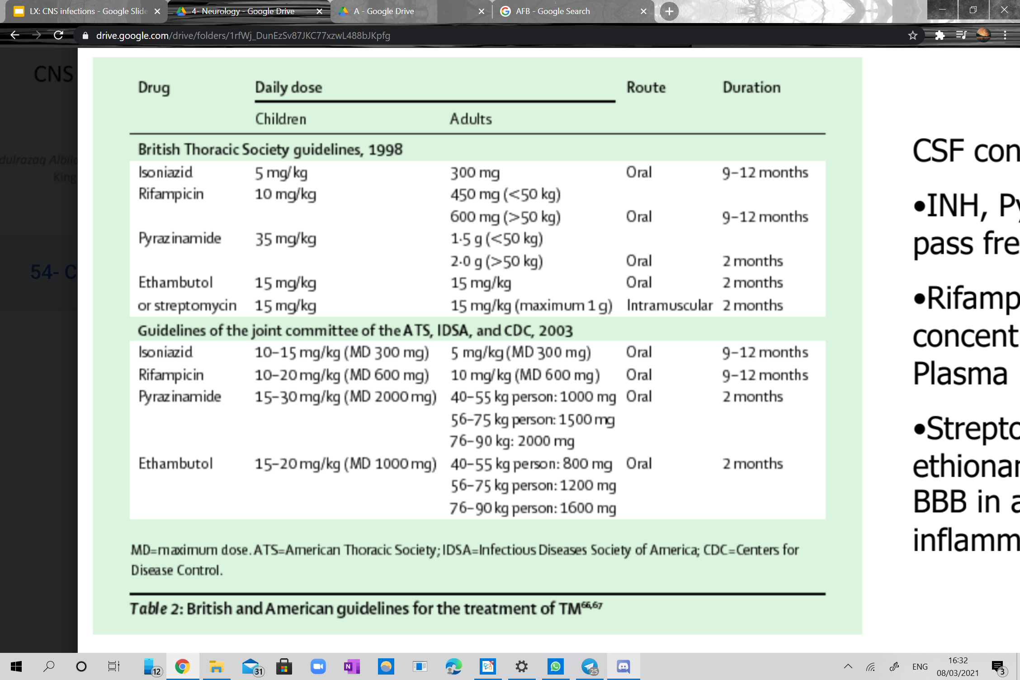
Tuberculous meningitis cont,
Diagnosis
Lumbar puncture should be performed if the diagnosis is suspected.
The CSF is under increased pressure. It is usually clear but, when allowed to stand, a fine clot (‘spider web’) may form. The fluid contains up to 500 × 106 cells/L, predominantly lymphocytes, but can contain neutrophils. There is a
rise in protein and a marked fall in glucose.
The tubercle bacillus may be detected in a smear of the centrifuged deposit from the CSF but a negative result does not exclude the diagnosis.
The CSF should be cultured but, as this result will not be known for up to 6 weeks.
treatment must be started without waiting for confirmation.
Brain imaging may show hydrocephalus, brisk meningeal enhancement on enhanced CT or MRI, and/or an intracranial tuberculoma.
CSF¹² examination:
↑pressure³, cells up to 500 /cu mm, mostly lymphocytes but can contain neutrophils.
↑protein, sugar ↓upto ½ of concomitant blood sugar (marked fall in glucose).
AFB
Culture⁴
CXR
Brain imaging may show hydrocephalus, brisk meningeal enhancement on enhanced CT or MRI
and/or an intracranial tuberculoma.
Skin test Newer Tests:
Tuberculostearic acid
Adenosine deaminase test
Bromide partition test
NBT
ELISA for antibody/antigen
PCR
Interferon gamma release assays
1
CSF¹² examination
3
Brain imaging
↑pressure³, cells up to 500 /cu mm, mostly lymphocytes but can contain neutrophils.
↑protein, sugar ↓upto ½ of concomitant blood sugar (marked fall in glucose).
may show hydrocephalus, brisk meningeal enhancement on enhanced CT or MRI
and/or an intracranial tuberculoma.
2
Skin test , Newer Tests
4
Other
Tuberculostearic acid
Adenosine deaminase test
Bromide partition test
NBT
ELISA for antibody/antigen
PCR: NAAT sensitivity %56 percent and specificity 98%
Interferon gamma release assays
Tuberculin test
AFB: diagnostic yield increase to 87% when four serial specimens examined
Use last fluid & large volume (10-15mL)
Culture⁴ : gold standard
CXR
Treatment⁵
4 anti TB drugs for initial 2 months then 2 drugs for 9-12 months
Know that it’s the same treatment as pulmonary TB but prolonged for up to a year.
CSF concentrations:
INH, Pyrazinamidine, pass freely into the CSF
Rifampin has 10% the concentration as in Plasma
Streptomycin or ethionamide do not pass BBB in absence of Inflammation.
*Supplemental Pyrodoxine with INH Therapy
Give steroids initially for 6 weeks as it improves
Shunt surgery for hydrocephalus
What Other Tests?
An area for your notes
1- Lumbar puncture should be performed if the diagnosis is suspected.
2-The tubercle bacillus may be detected in a smear of the centrifuged deposit from the CSF but a negative result does not exclude the diagnosis.
3- usually clear but, when allowed to stand, a fine clot (‘spider web’) may form.
4- The CSF should be cultured but, as this result will not be known for up to 6 weeks.
5- treatment must be started without waiting for confirmation.

Slide 12
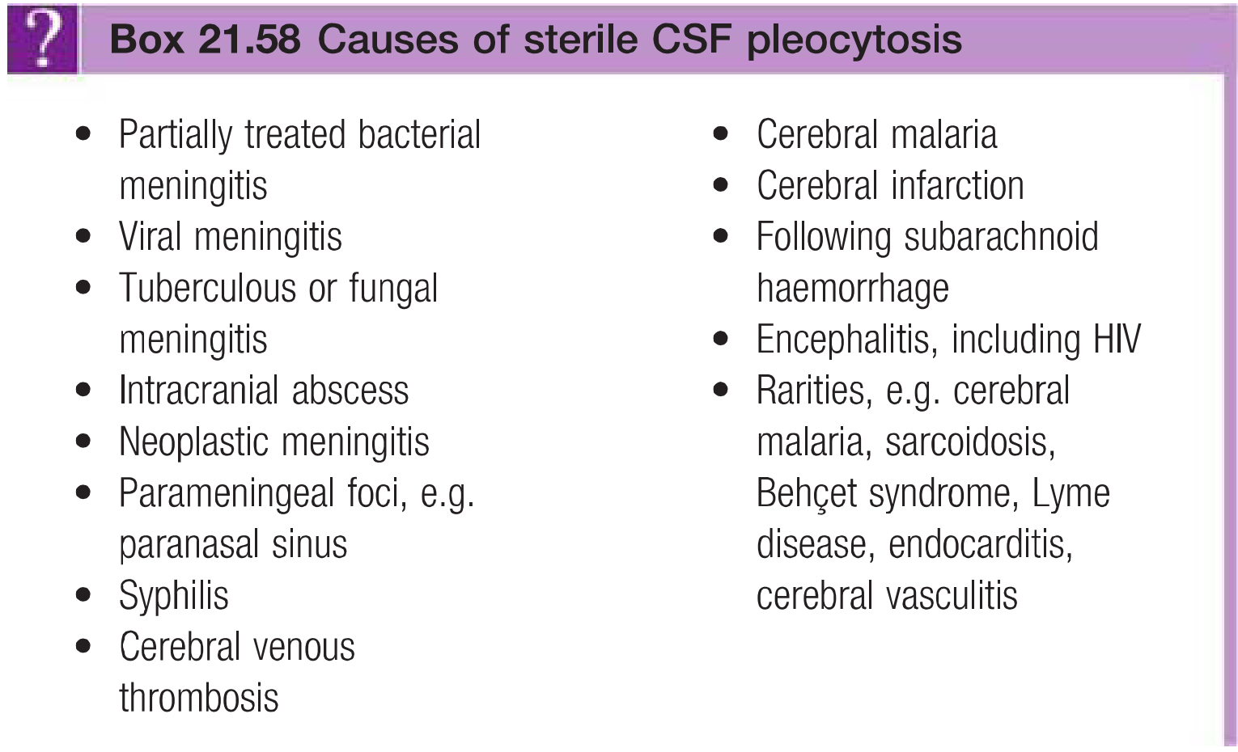
EXTRA
Viral meningitis
Introduction
Aseptic Meningitis
is most commonly caused by a variety of non bacterial pathogens, Viruses are the most common cause of meningitis, usually resulting in a benign and self-limiting illness requiring no specific therapy.
It is much less serious than bacterial meningitis unless there is associated encephalitis.
A number of viruses can cause meningitis, the most common being enteroviruses.
Where specific immunisation is not employed, the mumps virus is a common cause.
Aseptic meningitis is most commonly caused by a variety of non bacterial pathogens, frequently viruses such as enterovirus and herpes simplex virus (HSV). It can also be caused by certain bacteria, parasites, and fungi.
CSF: pleocytosis 100s, Normal Glucose, Protein
normal or slightly elevated, Neg Culture
Enteroviruses: most common cause 80%
HSV-2 (HSV-1 can cause it but it usually causes encephalitis)
HIV
Dengue, Zika (can also cause PNS infections), Chikungunya,
yellow fever
Partial Rx Bacteria (Patient takes Abx thus
delaying LP for 3-4 days and when you get the
results they will be confusing as you will see lymphocytes
and other features not consistent with bacterial meningitis)
Drugs: Metronidazole, TMP-SMX, NSAIDs, carbamazepine, IVIG
Rare: leptospirosis (spirochaete)
Clinical features
acute onset of headache
irritability
the rapid development of meningism.
There may be a high pyrexia but focal neurological signs are rare.
Viral Pathogens
Viral meningitis occurs mainly in children or young adult
children And young adults
Enteroviruses (echo, Coxsackie, polio)
Mumps
Influenza
Herpes simplex (usually causes encephalitis)
Varicella zoster
Epstein–Barr
HIV
Lymphocytic choriomeningitis
Mollaret’s meningitis (herpes simplex virus type 2)
Investigations
The diagnosis is made by lumbar puncture.
CSF usually contains an excess of lymphocytes.
While glucose and protein levels are commonly normal, the latter may be raised.
It is important to verify that the patient has not received antibiotics (for whatever cause) prior to the lumbar puncture, as CSF lymphocytosis can also be found in partially treated bacterial meningitis.

Slide 13
Viral meningitis cont.
Management
There is no specific treatment and the condition is usually benign and self-limiting.
The patient should be treated symptomatically in a quiet environment.
Recovery usually occurs within days, although a lymphocytic pleocytosis may persist in the CSF.
Meningitis may also occur as a complication of a systemic viral infection such as mumps, measles, infectious mononucleosis, herpes zoster and hepatitis.
Whatever the virus, complete recovery without specific therapy is the rule.
Aseptic Meningitis
Definition:
Inflammation of meninges with sterile CSF
CSF: pleocytosis 100s, Normal Glucose, Protein normal, Neg Culture
Note: Pleocytosis is the hallmark of aseptic meningitis, since it’s sterile inflammation usually it has neutrophilic pleocytosis (there might be some lymphocytes, but the main cells are neutrophils)
Causes:
Enteroviruses: most common cause 80%
HSV-2 (HSV-1 can cause it but it usually causes encephalitis)
HIV
Dengue, Zika (can also cause PNS infections), Chikungunya, yellow fever.
Partially treated bacteria (Think of it when the pt has taken abx in the past 2-3 days. When you suspect viral meningitis it is important to verify that the patient has not received antibiotics (for whatever cause) prior to the lumbar puncture, as CSF lymphocytosis can also be found in partially treated bacterial meningitis.)
Drugs: Metronidazole, TMP-SMX, NSAIDs, carbamazepine (Given to epileptic pts), IVIG- headache is very common (Given to pts with myasthenia gravis and Guillain barre syndrome (GBS))
Rare: leptospirosis (spirochaete)
Clinical Features:
Fever
Headache
Irritability
Vomiting
Convulsion (rare)
Meningeal signs
Treatment:
No specific therapy other than supportive care is required. The disease is self-limited.
Analgesics and fever reduction may be appropriate.
Treatment
Pyrimethamine 200mg once po then 75mg od
Sulfadiazine 1.5 gm po Q6h
Folinic acid 25 mg po od
Duration? Minimum 6 wks after resolution of signs/symptoms
Prophylaxis
Primary Prophylaxis
TMP-SMX-DS 1 tab po od
Sulfa allergy:
Dapsone and pyrimethamine and folinic acid
Atovaquone 1500 mg po od
Can stop if CD4 > 200 for 3 months
Chronic Suppression (secondary prophylaxis):
Sulfadiazine 2-4gm po divided in 2-4 doses/day
Pyrimethamine 25-50mg po od
Folinic acid 10-25mg po od
When to stop? CD4 > 200 for 6 months

Slide 14
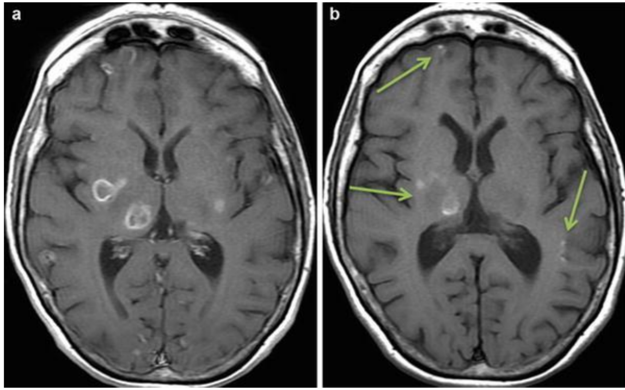
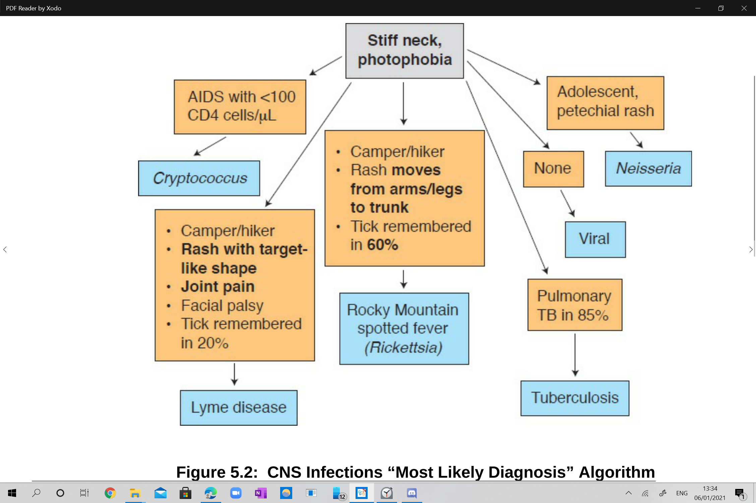
CNS Toxoplasmosis in HIV/AIDS
Toxoplasmosis is the leading cause of focal central nervous system (CNS) disease in AIDS. It tends to cause brain abscess. CNS toxoplasmosis in HIV-infected patients is usually a complication of the late phase of the disease. Happens with CD4 less than 100, on CT it will have a ring enhancement Appearance.
Can happen in pregnancy
Infective
In some areas, meningitis may be caused by spirochaetes (leptospirosis, Lyme disease and syphilis, rickettsiae (typhus fever)or protozoa (amoebiasis).
Non-Infective
Treatment | Prophylaxis
Pyrimethamine 200mg once po then 75mg od Sulfadiazine 1.5 gm po Q6h Folinic acid 25 mg po od Duration? Minimum 6 wks after resolution of signs/symptoms | Primary prophylaxis
 | TMP-SMX-DS 1 tab po od Sulfa allergy: Dapsone and pyrimethamine and folinic acid Atovaquone 1500 mg po od Can stop if CD4 > 200 for 3 month
 | Secondary prophylaxis
 | Chronic Suppression (secondary prophylaxis): Sulfadiazine 2-4gm po divided in 2-4 doses/day Pyrimethamine 25-50mg po od Folinic acid 10-25mg po od When to stop? CD4 > 200 for 6 months
Parenchymal viral infections
Introduction
Encephalitis: means acute infection/inflammation of brain parenchyma, and is often seen simultaneously with meningitis, usually viral.
Meningoencephalitis: inflammation of brain + meninges
In viral encephalitis, fever (90%) and meningism are usual; in contrast to meningitis, however, the clinical picture is dominated by brain parenchyma inflammation.
Personality and behavioural change is a common early manifestation, which progresses to a reduced level of consciousness and even coma.
Seizures (focal and generalized) are very common and focal neurological deficits, such as speech disturbance, often occur (especially in herpes simplex encephalitis).

Slide 15
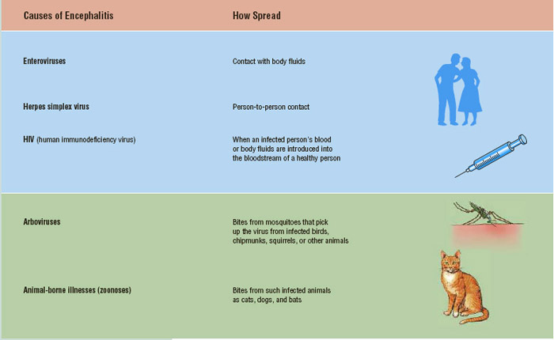
Parenchymal viral infections cont.
subtitle
Viral encephalitis Causes
Most common: Herpes simplex¹ (Either type 1 or 2):
How to confirm? Perform LP and PCR. MRI is also helpful (The limbic system and the medial temporal are its favourable place)
Treat with Acyclovir
Varicella zoster
Rabies
Arboviruses²: e.g dengue
Zika virus
HIV ³
Nonviral infectious causes:
Toxoplasmosis
Cerebral aspergillosis
Rare: Listeria, cat scratch disease, amebic
Introduction
Encephalitis: means acute inflammation of brain parenchyma, and is often seen simultaneously with meningitis, usually viral.
In viral encephalitis, fever (90%) and meningism are usual; in contrast to meningitis, however, the clinical picture is dominated by brain parenchyma inflammation.
Personality and behavioural change is a common early manifestation, which progresses to a reduced level of consciousness and even coma.
Seizures (focal and generalized) are very common and focal neurological deficits, such as speech disturbance, often occur (especially in herpes simplex encephalitis).
This pt probably had encephalitis, MRI showing an old insult appearing dark. Usually we look for hyper intensity.
Case of viral encephalitis: Elderly coming with new onset focal seizure and personality changes.
When we say encephalitis we usually refer to HSV encephalitis as is the most common cause.
Pathophysiology
The infection provokes an inflammatory response that involves the cortex, white matter, basal ganglia and brainstem.
The distribution of lesions varies with the type of virus.
For example, in herpes simplex encephalitis, the temporal lobes are usually primarily affected, whereas cytomegalovirus can involve the areas adjacent to the ventricles (ventriculitis).
Inclusion bodies may be present in the neurons and glial cells, and there is an infiltration of polymorphonuclear cells in the perivascular space.
There is neuronal degeneration and diffuse glial proliferation, often associated with cerebral oedema.
Viral meningioencephalitis (VME) (NOT IMP, SKIP)
Encephalitis and meningitis are 2 ends of the spectrum
Neurotropic & non neurotropic viruses can cause VME:
Arbo: JE/ west nile/ dengue
Entero
Herpes: HSV1, EBV, CMV, HHV-6, Varicella zoster
Myxo
Paramyxo
Adeno
Rhabdo
An area for your notes
1- Is the most serious cause of viral encephalitis In Europe ,which probably reaches the brain via the olfactory nerves.
2- viruses transmitted by mosquitoes and ticks
3- may cause encephalitis with a subacute or chronic presentation but occasionally has an acute presentation with seroconversion.

Slide 16
EXTRA
Parenchymal viral infections cont.
subtitle
Clinical features
Viral encephalitis presents with:
acute onset of headache
fever
focal neurological signs (aphasia and/or hemiplegia, visual field defects)
and seizures.
Disturbance of consciousness ranging from drowsiness to deep coma supervenes early and may advance dramatically.
Meningism occurs in many patients.
Investigations
1
Radiological
CT scan may show low-density lesions in the temporal lobes.
But MRI is more sensitive in detecting early abnormalities.
2
Lumbar puncture
Should be performed once imaging has excluded a mass lesion.
The CSF usually contains excess lymphocytes but polymorphonuclear cells may predominate in the early stages.
The CSF may be normal in up to 10% of cases.
Some viruses, including the West Nile virus, may cause a sustained neutrophilic CSF.
The protein content may be elevated but the glucose is normal.
Virological investigations of the CSF, including PCR, may reveal the causative organism but treatment initiation should not await this.

Slide 17
EXTRA
Parenchymal viral infections cont.
subtitle
3
EEG
is usually abnormal in the early stages, especially in herpes simplex encephalitis, with characteristic periodic slow wave activity in the temporal lobes.
Management
Optimum treatment for herpes simplex encephalitis (aciclovir 10 mg/kg IV 3 times daily for 2–3 weeks) has reduced mortality from 70% to around 10%.
This should be given early to all patients suspected of having viral encephalitis.
Some survivors will have residual epilepsy or cognitive impairment.
Antiepileptic treatment may be required and raised intracranial pressure may indicate the need for dexamethasone.
Brainstem encephalitis
This presents with ataxia, dysarthria, diplopia or other cranial nerve palsies.
The CSF is lymphocytic, with a normal glucose.
The causative agent is presumed to be viral.
However, Listeria monocytogenes may cause a similar syndrome with meningitis (and often a polymorphonuclear CSF pleocytosis) and requires specific treatment with ampicillin (500 mg 4 times daily)
Cerebral abscess
Definition
Bacteria may enter the cerebral substance through penetrating injury, by direct spread from paranasal sinuses or the middle ear, or secondary to sepsis. Untreated congenital heart disease is a recognised risk factor.
Initial infection leads to local suppuration followed by loculation of pus within a surrounding wall of gliosis, which in a chronic abscess may form a tough capsule.
Haematogenous spread may lead to multiple abscesses.
Organisms:
Streptococci (60-70%), Bacteroides (20-40%), Enterobacteriacea (25-33%), S.Aureus (10-15%), S.Milleri.
Rare: Nocardia, Listeria

Slide 18
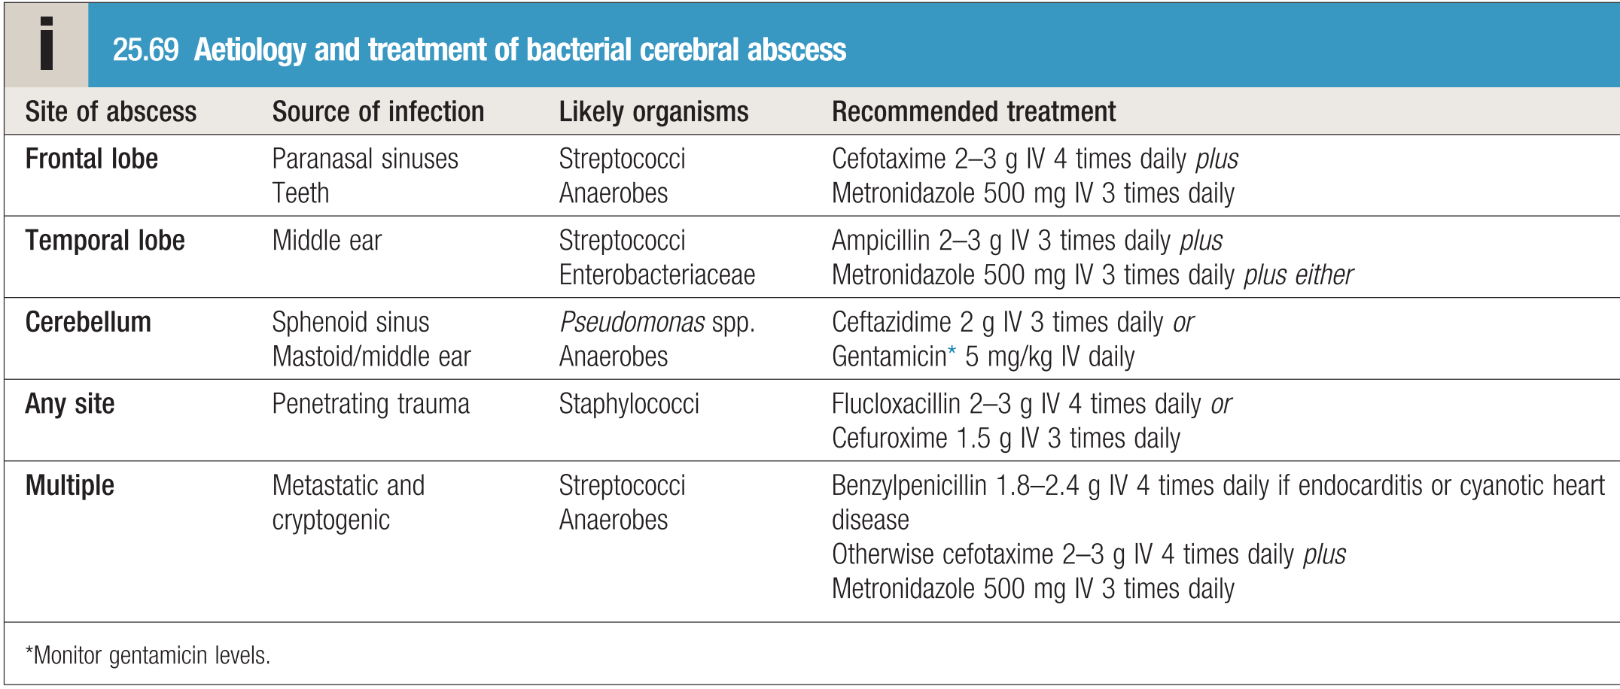
Cerebral abscess cont.
Clinical features
The usual presenting features are:
Fever
Headache
Meningism
Drowsiness
But more commonly presents over days or weeks as a cerebral mass lesion with little or no evidence of infection.
Seizures, raised intracranial pressure and focal hemisphere signs occur alone or in combination.
Note: Distinction from a cerebral tumour may be impossible on clinical grounds.
Neurobrucellosis
Clinical symptoms
Neurobrucellosis is an endemic zoonotic infection caused by bacterial genus Brucella.
It is transmitted to humans by infected animals (sheep, cattle, goats, pigs, and dogs) urine, milk, and other fluids.
Additional Clinical History: Had a pet cow; often drank unpasteurized milk
Investigations
Lumbar puncture is potentially hazardous in the presence of raised intracranial pressure and CT should always precede it.
CT with contrast: reveals single or multiple low-density areas, which show ring enhancement with contrast and surrounding cerebral oedema
CT brain: If abscess more than 2.5cm then surgical drainage. And if patient neurologically unstable or decrease LOC drain regardless of size
Clinical Presentation:
The symptoms of neurobrucellosis may include symptoms like headache, fever, or muscle or joint pain, along with neurologic symptoms such as confusion, meningoencephalitis, myelitis, peripheral and cranial neuropathies, and psychiatric manifestations.
Diagnosed by CSF PCR.
Management
Antimicrobials: empirically Ceftriaxone with metronidazole, otherwise according to susceptibility . Start antimicrobial therapy and refer the pt to neurosurgery.
Duration until response by neuroimaging
Treatment
Doxycycline 100mg IV/po bid
Rifampin 600-900 mg po od
Ceftriaxone 2gm IV q12h
Duration? Continue until CSF is normal (3-12 months)

Slide 19
Other parenchymal bacterial infections
Subdural Empyema
This is a rare complication of frontal sinusitis, osteomyelitis of the skull vault or middle ear disease. A collection of pus in the subdural space spreads over the surface of the hemisphere, causing underlying cortical oedema or thrombophlebitis.
In adults 60-90% are extension of:
Sinusitis
Otitis media
Clinical features:
Patients present with severe pain in the face or head and pyrexia, often with a history of preceding paranasal sinus or ear infection. The patient then becomes drowsy, with seizures and focal signs such as a progressive hemiparesis.
Diagnosis:
The diagnosis rests on a strong clinical suspicion in patients with a local focus of infection.
Careful assessment with contrast-enhanced CT or MRI may show a subdural collection with underlying cerebral oedema.
Treatment:
Surgical emergency: Must drain; requires aspiration of pus via a burr hole and appropriate parenteral antibiotics (Abx same as brain abscess)
If it’s small and not causing seizures or cognitive impairment it will be absorbed by the body with time “no need for surgery”
Is an intracranial focal collection of purulent material located between the dura mater and the arachnoid mater.
In adults 60-90% are extension of:
Sinusitis
Otitis media
Surgical emergency: must drain
Antibiotics same as brain abscess
Spinal Epidural abscess (OBJ.)
Definition | An infection that forms in the space between the bones of your spine and the lining membrane of your spinal cord Main risk factor: IV drug misuse
Clinical features | The characteristic clinical features are pain in a root distribution (Back pain) and progressive transverse spinal cord syndrome with paraparesis, sensory impairment and sphincter dysfunction.
Diagnosis | X-ray changes occur late, if present, so MRI (Gold standard) or myelography should precede urgent neurosurgical intervention. Decompressive laminectomy with abscess drainage relieves the pressure on the dura. Organisms may be grown from the pus or blood. N.B LP is contraindicated in spinal epidural abscesses
Treatment | Surgery, together with appropriate antibiotics, may prevent complete and irreversible paraplegia.
Clinical Features: Patient will present with BACK PAIN, fever, with sensory and motor loss in the lower limbs.
Investigations: MRI with or without gadolinium (Gold standard) or CT with contrast, to locate the abscess for surgical drainage.
Risk factors: Old age, IV drug use (most imp risk factor), concurrent infections like cellulitis for example.
Treatment: Surgical drainage and Antibiotics. - N.B LP is contraindicated in spinal epidural abscesses!

Slide 20
Summary
Bacterial meningitis
Definition | Inflammation of the (meninges) pia mater and the arachnoid mater (dura mater is usually spared),with suppuration of the cerebrospinal fluid
Signs and Symptoms | Classic triad: fever, neck stiffness and confusion. Severe Headache, Photophobia (intolerance of light) and Phonophobia (intolerance to loud noises) can be specific to bacterial meningitis. Bulging fontanel in infants, sometimes with hydrocephalus What’s the most useful sign? Jolt accentuation maneuver: ask patient to rapidly rotate his or her head horizontally: Headache worsens, In healthy individuals it might be uncomfortable but a pt with meningitis will avoid doing it. Sensitivity of 100%, specificity of 54% (Low, unlike kernig and Brudzinski signs),
Management (Based on Dr notes) | How to manage a patient with meningitis? Step 1: Give empirical therapy!! Whenever you suspect meningitis or encephalitis, start empirical therapy! (In real life the pt will be started on empirical therapy in the ER, before you see him) Step 2: CT (To exclude herniation, supratentorial tumor, bleeding, pus collection (Subdural empyema) before doing LP bc it may kill the pt). NEVER do LP before CT. Step 3: LP. Contraindications to LP: Herniation, Infection at the site of LP (e.g. Cellulitis), bleeding disorders, Low platelet count <100, anticoagulants . If one of these contraindication is present you can delay LP but NEVER delay the treatment What antibiotics should be given? Ceftriaxone + Vancomycin (to cover highly penicillin resistant pneumococcus) Add ampicillin if there’s suspicion of listeria Note: Dexamethasone should be given concomitant with 1st dose Abx to block TNF production
Kernig's sign | Brudzinski's neck sign
While patient is lying supine, with the hip and knee flexed to 90 degrees pain limits passive extension of the knee. | Flexion of the neck causes involuntary flexion of the knee and hip.

Slide 21
Summary (cont.)
Special cases of bacterial meningitis
Meningococcal meningitis (Emergency) | Fulminate meningococcemia with purpura caused by Neisseria meningitidis Overwhelming sepsis, DIC Classic: Meningitis with rash (Petechiae) + Headache + Fever Lumbar puncture should not be performed if meningococcal sepsis is suspected because coning of the cerebellar tonsils may follow – the organism is confirmed by blood culture. Treatment and prophylaxis: Droplet Isolation: 48h post Abx Treatment: Ceftriaxone or Pen G 7 days Eradicate nasopharyngeal carriage: House hold contact Health care providers who examined patient closely Prophylaxis (Not done routinely): Rifampin 600 mg for 2 d or Ciprofloxacin 500mg once or Ceftriaxone 125mg I.M once
Listeria Monocytogenes meningitis | Pathology: It causes brain stem, cerebellum inflammation (Rhombencephalitis) and meningitis Risk groups: Age <1y or >50y Alcoholics Pregnancy: up to 30% Immunocompromised 70 % Routes of transmission: Mainly food borne: survives refrigeration linked to poultry, hotdogs, cold cuts, coleslaw, ice-cream Cheeses, particularly soft cheeses, have been implicated in listeriosis outbreaks worldwide. Inform micro lab: special media (Mueller-Hinton agar) Note: Whenever you see a pt with changing signals in brain stem and cerebellum MRI , think of Listeria. Treatment: Ampicillin 2gm IV Q4h +/- Gentamicin 2mg/kg loading dose then 1.7mg/kg Q8h 21 day duration Penicillin allergy patients: TMP-SMX or Meropenem
Neuro Brucellosis | Treatment: Doxycycline Plus Rifampin Plus Ceftriaxone 2gm IV q12h
Recall: Ceftriaxone is C.I in neonates, give cefotaxime instead.
What’s the most common organism in neonates?
Group B Streptococci (occurs ONLY in neonates)
What’s the most common organism in older infants and children?
Streptococcus pneumonia
What’s the most common organism in adults?
Streptococcus pneumonia
What’s the most common complication?
CN palsies (esp. deafness)

Slide 22
Summary (cont.)
Aseptic meningitis
Definition | Inflammation of meninges with sterile CSF CSF: pleocytosis 100s, Normal Glucose, Protein normal, Neg Culture Note: Pleocytosis is the hallmark of aseptic meningitis, since it’s sterile inflammation usually it has neutrophilic pleocytosis (there might be some lymphocytes, but the main cells are neutrophils)
Causes | Enteroviruses: most common cause 80% HSV-2 (HSV-1 can cause it but it usually causes encephalitis) Partially treated bacteria (Think of it when the pt has taken abx in the past 2-3 days. When you suspect viral meningitis it is important to verify that the patient has not received antibiotics (for whatever cause) prior to the lumbar puncture, as CSF lymphocytosis can also be found in partially treated bacterial meningitis.) Drugs: Metronidazole, TMP-SMX, NSAIDs, carbamazepine (Given to epileptic pts), IVIG- headache is very common (Given to pts with myasthenia gravis and Guillain barre syndrome (GBS))
Viral encephalitis
General info | Encephalitis: means acute infection/inflammation of brain parenchyma, and is often seen simultaneously with meningitis, usually viral. Meningoencephalitis: inflammation of brain + meninges In viral encephalitis, fever (90%) and meningism are usual; in contrast to meningitis, however, the clinical picture is dominated by brain parenchyma inflammation. Personality and behavioural change is a common early manifestation, which progresses to a reduced level of consciousness and even coma. Seizures (focal and generalized) are very common and focal neurological deficits, such as speech disturbance, often occur (especially in herpes simplex encephalitis). What’s the most common organism? Most common: Herpes simplex (Either type 1 or 2): How to confirm? Perform LP and PCR. MRI is also helpful (The limbic system and the medial temporal are its favourable place) Treat with Acyclovir
Cerebral abscess
General info | Bacteria may enter the cerebral substance through penetrating injury, by direct spread from paranasal sinuses or the middle ear, or secondary to sepsis. Untreated congenital heart disease is a recognised risk factor. Initial infection leads to local suppuration followed by loculation of pus within a surrounding wall of gliosis, which in a chronic abscess may form a tough capsule. Organisms: Streptococci (60-70%), Bacteroides (20-40%), Enterobacteriacea (25-33%), S&S: Fever, Headache, Meningism, Drowsiness Seizures, raised intracranial pressure and focal hemisphere signs occur alone or in combination.
Management | Lumbar puncture is potentially hazardous in the presence of raised intracranial pressure and CT should always precede it. CT with contrast: reveals single or multiple low-density areas, which show ring enhancement with contrast and surrounding cerebral oedema CT brain: If abscess more than 2.5cm then surgical drainage. And if patient neurologically unstable or decrease LOC drain regardless of size Antimicrobials: empirically Ceftriaxone with metronidazole, otherwise according to susceptibility
S&S:
Fever, Headache, Meningism, Drowsiness
Seizures, raised intracranial pressure and focal hemisphere signs occur alone or in combination.

Slide 23
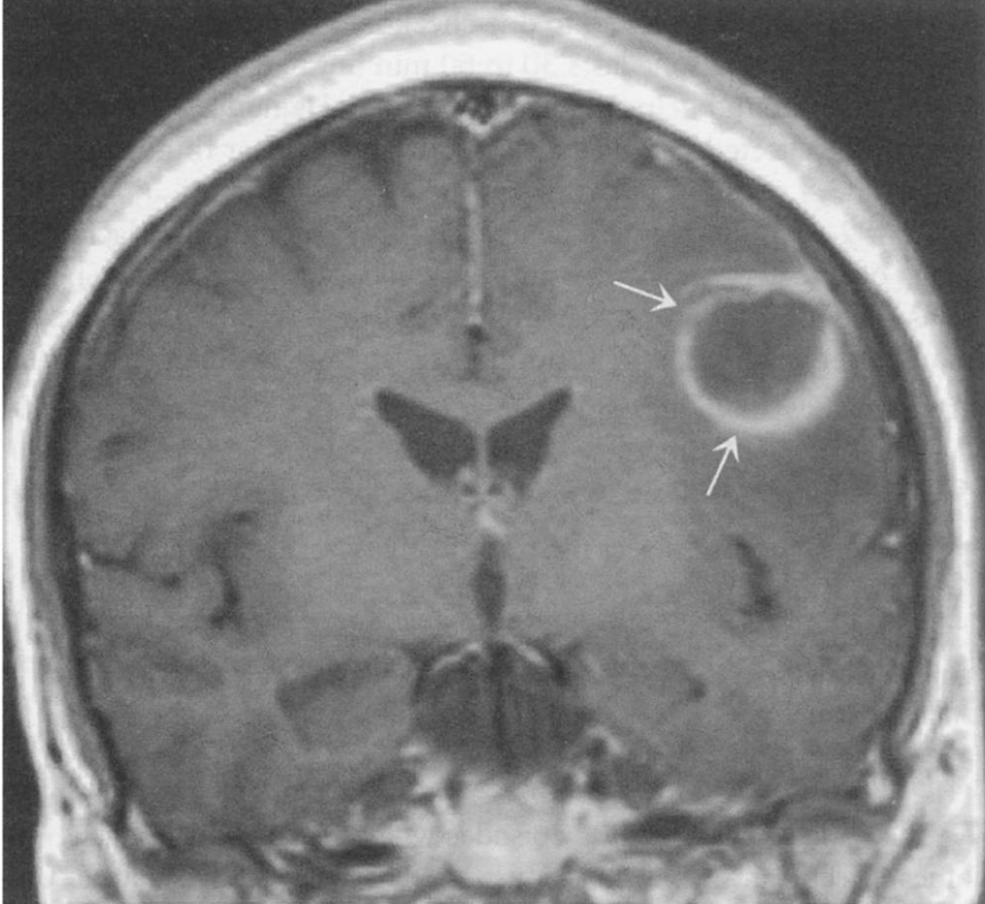
Answers
1- Answer: A. When there is a contraindication to an immediate LP, the most important step is to initiate treatment. Ceftriaxone or steroids alone would not be sufficient. This patient’s presentation is clear for meningitis. Although antibiotics may decrease the sensitivity of the CSF culture, it is more important to prevent neurological damage from untreated meningitis than it is to have a specific microbiological diagnosis. You can also still use the Gram stain and bacterial antigen detection methods to establish a diagnosis after the start of antibiotics, although they cannot tell sensitivity patterns. A head CT is important for this patient because of focal neurological deficits, but it is more important to initiate therapy. In addition, if the head CT shows a mass lesion, you may never be able to perform an LP.
2-Answer: E CSF infections can present with meningeal inflammation, parenchymal involvement, or both. The patient in question 378 has both meningitis (fever, nuchal rigidity, CSF pleocytosis) and focal brain involvement (temporal lobe signs). The combination of high lymphocyte count in the CSF with cortical brain dysfunction indicates encephalitis. The most common cause of sporadic (ie, nonepidemic) encephalitis is herpes simplex encephalitis; prompt diagnosis and treatment with intravenous acyclovir can decrease permanent brain damage and improve survival. The commonest cause of seasonal encephalitis in the United States is now West Nile virus infection. Viral (aseptic) meningitis causes a similar lymphocytic pleocytosis with normal CSF glucose level but is not associated with brain dysfunction such as
3-Answer: C with focal findings and a history of pyogenic lung infection has a brain
abscess. Organisms can gain access to the pulmonary veins and then be spread hematogenously to various organs of the body, bypassing the normal sieving effect of the pulmonary capillaries. Lumbar puncture is contraindicated in the presence of mass effect, but would usually show only a small number of white blood cells, a high protein, and elevated CSF pressure. Bacterial meningitis (due to the pneumococcus or Listeria monocytogenes, for instance) almost
always causes a neutrophilic pleocytosis and low CSF glucose due to phagocytosis of the proliferating organisms by polymorphonuclear leukocytes. CSF glucose will also be low (<2/3 of simultaneous blood glucose) in fungal, tuberculous, and carcinomatous meningitis, but these conditions can easily be separated from bacterial meningitis by their subacute to chronic onset and the predominance of lymphocytes (rather than neutrophils) in the CSF. Cryptococcal meningitis, fungal meningitis seen in patients with T-cell dysfunction such as AIDS, presents with chronic to subacute symptoms and a very high CSF protein level; India ink stain and elevated cryptococcal antigen levels will be diagnostic. Cerebral cysticercosis (due to Taenia solium infection) is often associated with calcified or
multiple small cystic lesions, which serve as a seizure focus, although hydrocephalus and chronic meningitis can occasionally occur. Almost all patients acquire the tapeworm infection in emerging nations, where meat inspection and sanitation practices are less well developed. History and CNS imaging will usually distinguish pyogenic brain abscess from cysticercosis.
4- Answer: A. This is a classic scenario with rapidly evolving clinical disease where it is important to treat first and think later! The rapid development of meningococcal sepsis is a severe threat to life and limb and requires immediate treatment. Investigation with imaging, bloods and, if necessary, a lumbar puncture can be carried out in due course, but only once the serious underlying sepsis has been addressed.
5- Answer: E. Acute bacterial meningitis (unless already treated with antibiotics) will cause a rise in neutrophils in CSF. Bacterial infection will usually raise protein and lower glucose. Viral encephalitis will cause a rise in CSF lymphocytes and often have little effect on protein and glucose. A raised CSF protein and no effect on white cells is characteristic of inflammatory processes such as Guillain–Barré syndrome.
6- Answer: E. A raised neutrophil count in CSF is strongly associated with a bacterial infection, although the very earliest stages of a viral encephalitis may cause neutrophils to rise. Infections by mycobacteria, viruses, or partially treated bacterial meningitis may be associated with lymphocytic CSF. Where there has been a large subarachnoid haemorrhage, the irritant effect of blood on the meninges may cause a lymphocytic CSF, but would more likely have an abrupt onset and mild (or no) pyrexia.
Q1: A 23-year-old male complaining of fever and headache. Examination shows temp 38 and neck stiffness. Neural examination and funduscopic examinations are normal. Which one of the following is the appropriate step?
A- CT scan if normal Do LP if CSF abnormal start combination antibiotics
B- Urgent LP if abnormal CSF start combination antibiotics.
C- Urgent LP and start combination antibiotics.
D- Start antiviral therapy
Q2: An 18-year-old with a 1-week history of fever, headache, increasing confusion, and lethargy presents to the emergency room. His physical examination is normal, and he has no focal neurologic signs. The CT scan of his head is negative.
An LP reveals a WBC count of 250/mm3, with 78% lymphocytes and red blood cells (RBCs) 500/mm3 in tube 1 and 630/mm3 in tube 2, respectively. No organisms are seen on Gram stain. Which of the following is the best next step?
A- Intravenous ceftriaxone, acyclovir, and vancomycin
B- Intravenous fluconazole
C- Intravenous azithromycin
D- Careful observation with no antibiotics
Q3: A 55-year-old man with a long history of alcohol abuse presents with a 3-week history of progressive confusion and stupor. On examination he is afebrile, but he has a new right sixth cranial nerve palsy and tremulousness of all four extremities. His CSF has 250 WBCs/mm3, with 68% lymphocytes. There are 300 RBCs/mm3 Protein levels are high, and the ratio of CSF to serum glucose is very low. He is started on ceftriaxone, vancomycin, and acyclovir. A purified protein derivative (PPD) placed on admission is positive, and bacterial cultures are negative at 48 hours. Which of the following would help to confirm the diagnosis?
A- Gram stain of throat scrapings
B- CT of the head with contrast
C- MRI of the head
D- Repeat LP after 48 hours of therapy
E- Herpes simplex virus PCR
Q4: A 20 years old previously healthy male is admitted with bacterial meningitis. He is empirically started immediately on vancomycin and high dose of ceftriaxone for bacterial Meningitis. Which one of the following reasons vancomycin was added to the treatment regimen of the patient?
A- Meningitis with Listeria monocytogenes resistant to ceftriaxone
B- Meningitis with methicillin resistant staphylococcus aureus (MRSA)
C- Penicillin and cephalosporin resistance in meningococci
D- Penicillin and cephalosporin resistance in Pneumococcus
Q5: A 65-year-old man with colon cancer on chemotherapy presents with a fever and headache of 3-day duration. An LP is performed, and Gram stain reveals gram-positive rods. Which of the following therapies is most likely to treat the organism?
A- Vancomycin
B- Metronidazole
C- Ampicillin
D- Gentamicin
E- Ceftriaxone
1- A man comes to the emergency department with fever, severe headache, neck stiffness, and photophobia. On physical examination he is found to have weakness of his left arm and leg. What is the most appropriate next step in the management of this patient?
A- Ceftriaxone, vancomycin, and steroids.
B- Head CT.
C- Ceftriaxone.
D- Neurology consultation.
E- Steroids.
2- A 52-year-old previously healthy woman presents with behavioral abnormalities and aphasia. Her husband reports that her symptoms began 3 days ago with fever and headache. On examination, she has a temperature of 38.4°C (101°F), mild nuchal rigidity, and agitation. When questioned, she repeats the question or responds with nonsense words. CT scan shows mild temporal hypodensity on the right; CSF examination shows 354 WBC with 75% lymphocytes. The CSF protein is elevated at 167 mg/dL, but the CSF glucose is normal at 112 (simultaneous peripheral glucose 142).
A- Pneumococcal meningitis
B- Cryptococcal meningitis
C- Coxsackievirus (aseptic) meningitis
D- Listeria monocytogenes meningitis
E- Herpes simplex encephalitis
3- A 28-year-old alcoholic has recently been treated for lung abscess. Three days before this admission, the patient develops headache, fever, and mild right-sided weakness. His MRI scan is shown in the following figure.
A- Pneumococcal meningitis
B- Coxsackievirus (aseptic) meningitis
C- Pyogenic brain abscess
D- Herpes simplex encephalitis
E- Cerebral cysticercosis
4- An 18 year old male student has been home from university for 3 days, during which time he has become increasingly drowsy. He is able to be roused but is disorientated. He has a temperature of 39°C, has marked neck stiffness and a positive Kernig’s sign. He has developed a spotting, non-blanching rash over his anterior chest wall. He has no focal neurological deficit. What is the most appropriate next course of
action?
A. Administer intravenous (IV) benzylpenicillin
B. Arrange for a computed tomography (CT) brain scan
C. Carry out a lumbar puncture
D. Puncture one of the purpuric lesions for microscopic analysis
E. Take blood for viral polymerase chain reaction (PCR) test
5- With regard to the patient in Question 4, IV benzylpenicillin has now been administered and his cerebral imaging has been shown to be normal. A lumbar puncture has been carried out. What is the most likely pattern of abnormality
to emerge in cerebrospinal fluid (CSF)?
A- Normal white cells, normal protein, low glucose
B- Normal white cells, raised protein, normal glucose
C- Raised white cells (90% lymphocytes), raised protein, low glucose
D- Raised white cells (90% neutrophils), normal protein, normal glucose
E- Raised white cells (90% neutrophils), raised protein, low glucose
6- A 35 year old female presents with a 6-day history of delirium and disorientation. She is pyrexial but aside from being unable to answer questions or follow direction, exhibits no neurological deficit. After normal imaging has been carried out, a lumbar puncture is done, which shows the following results: white cell count 35 × 109/L; blood film – 90% lymphocytes; CSF protein 0.65 g/L; CSF glucose 4.2 mmol/L (76 mg/dL); serum glucose 6.0 mmol/L (108 mg/dL) (normal CSF glucose is > 60% of contemporary serum glucose). Which process would be a likely cause of this?
A- Brainstem encephalitis
B- Meningococcal meningitis
C- Subarachnoid haemorrhage
D- Tuberculous meningitis
E- Viral encephalitis
Answers: Q1:A | Q2:E | Q3:C | Q4:A | Q5:E | Q6:E
Answers Explanation File!

Slide 24
THANKS!!
This lecture was done by:
Mohammed Ajarem
Note taker:
Khalid Alharbi
Amirah Aldakhilallah
Females co-leaders:
Raghad AlKhashan
Amirah Aldakhilallah
Males co-leaders:
Mashal AbaAlkhail
Nawaf Albhijan
Send us your feedback:
We are all ears!

