Slide 1
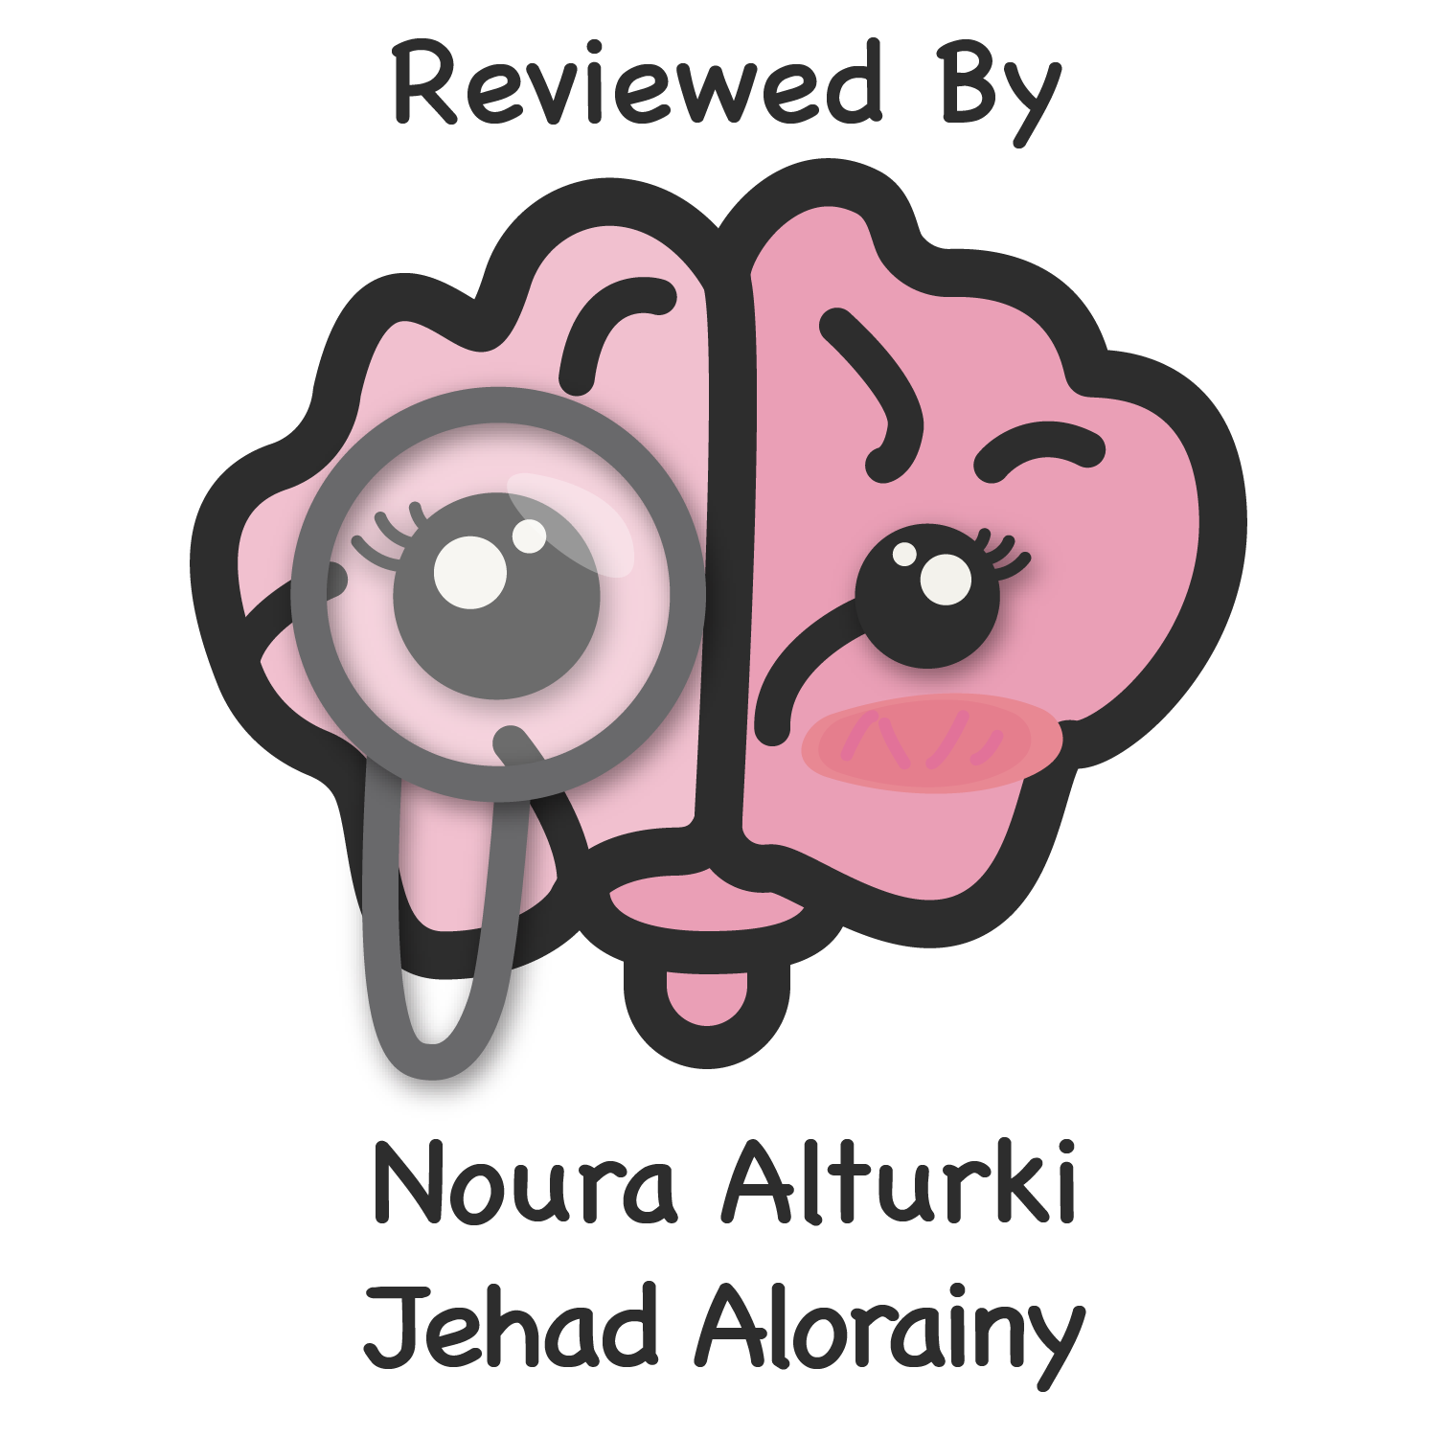
Lecture 58
Editing file
Dementia
Objectives:
Differentiate delirium from dementia
Differentiate MCI from Dementia
Become familiar with common dementia syndromes
Color index:
Color index:
Original text Females slides Males slides
Doctor’s notes Textbook Important Golden notes Extra

Slide 2
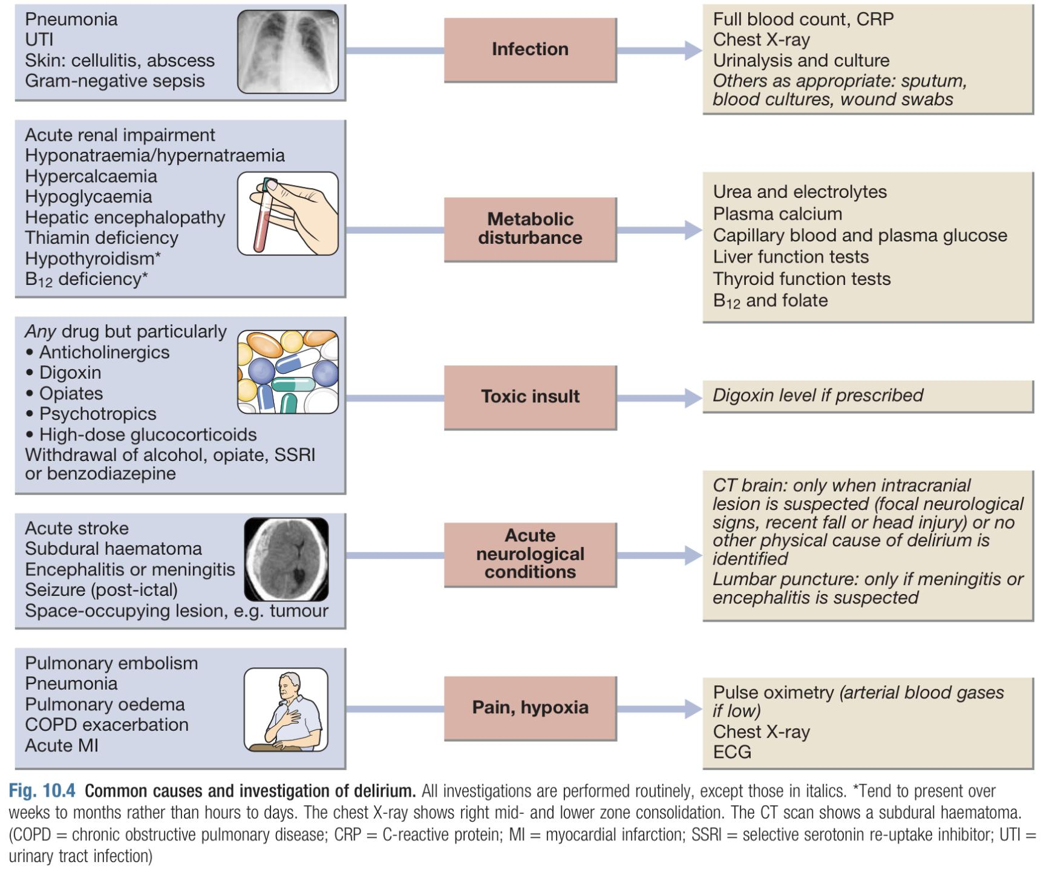
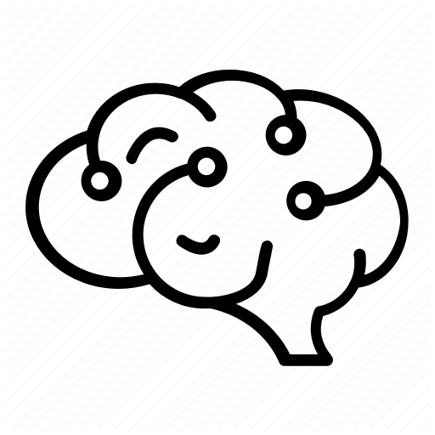
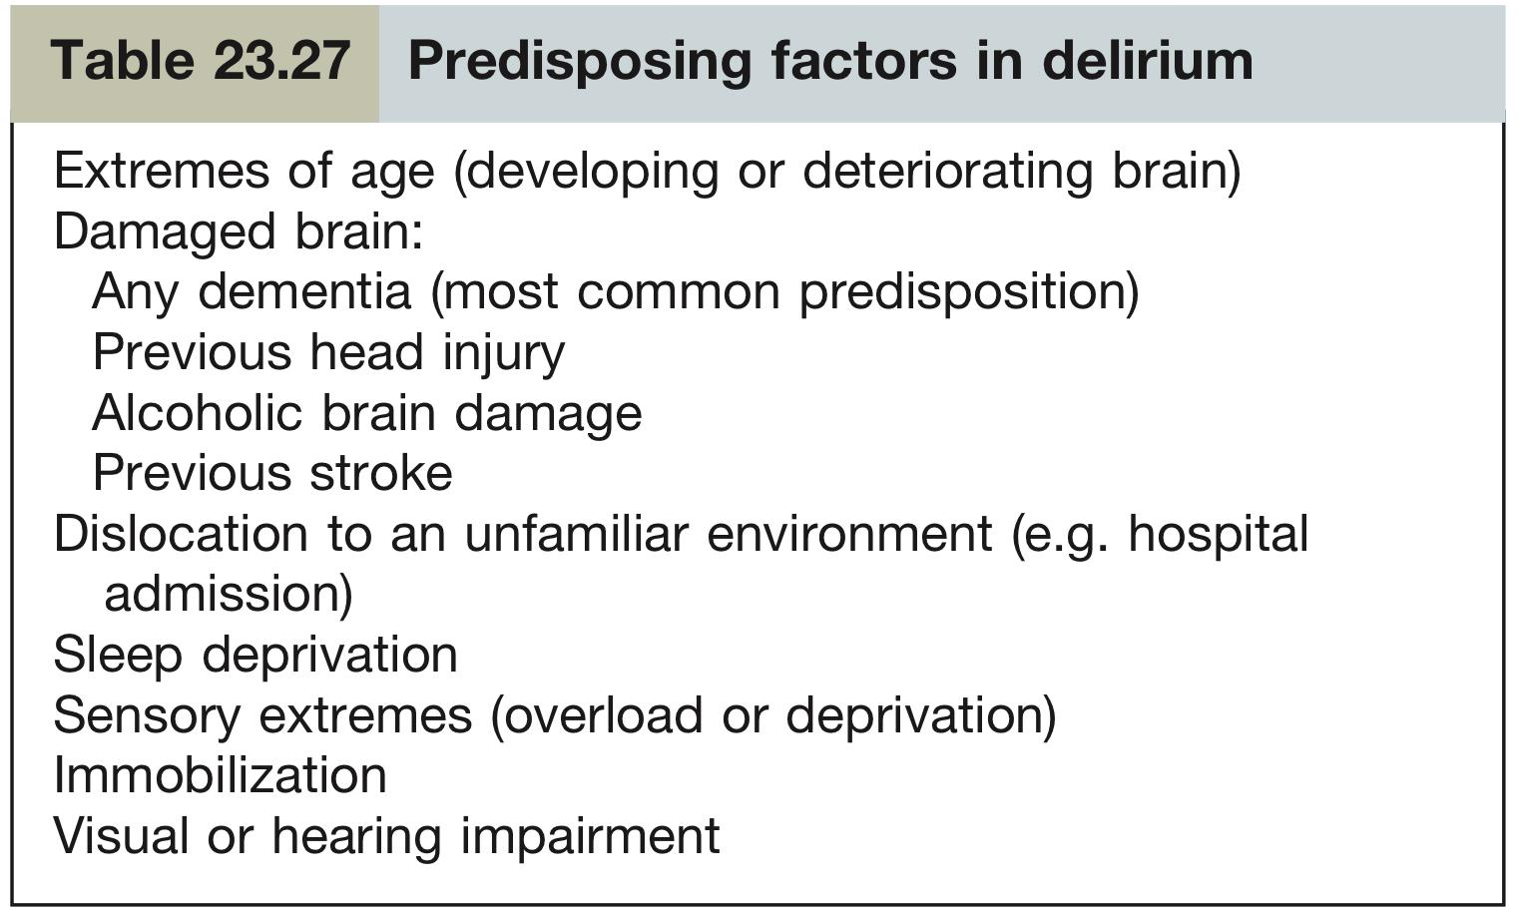
Delirium
Definition
Delirium is a syndrome of transient, reversible cognitive dysfunction that is more common in old age. It is the most common psychosis seen in the general hospital setting.
Delirium, usually encompasses:
Acute toxic confusional state
Encephalopathy
It is not normal to have delirium, while this statement is obvious, patients’ who have symptoms of delirium are dismissed as being sleepy, tired, or just age related changes.
BEING OLD ≠ Being confused or mentally impaired; It’s unacceptable to consider delirium normal in old patients, delirium indicates that there’s an underlying condition.
Causes of Delirium
Metabolic
Toxic
Infectious
Dehydration
Hyponatremia
Hypocalcemia
Abnormal thyroid functions
Liver and/or renal impairments
Hypoglycemia
ETOH
Drugs of abuse
UTI
Pneumonia, or infections that result in systemic manifestations (Especially fever)
Drugs/Surgery
CNS disorders
Side effects of drugs: Antihistamines could cause confusion in elderly.
The abrupt discontinuation of certain drugs like benzodiazepines.
Post surgery (anesthetics, pain)
Large strokes
Post-seizures
Infections
An area for your notes

Slide 3
Delirium cont.
Clinical features of Delirium
Delirium manifests as a disturbance of arousal with global impairment of mental function, causing drowsiness with disorientation, perceptual errors and muddled thinking.
The three broad subtypes of delirium: (can be differentiated on the basis of psychomotor changes)
Hypoactive:
Hypoactive delirium can present as lethargy and sedation, and is frequently misdiagnosed as depression or dementia
Hyperactive:
Patients with hyperactive delirium are often agitated and restless
Mixed
Fluctuation is typical and delirium is often worse at night, when delirious patients can present significant management difficulties.
Emotional disturbance (anxiety, irritability or depression) is common.
During the acute phase, thought and speech are incoherent, memory is impaired and misperceptions occur.
Page title :
Font- alegreya
Font size- 26
Subtitle:
Font- alegreya
Font size- 22
Text :
Should be always in black
Font- mada
Font size- 12
Important clues to recognize delirium
1
Patient will not be able to give you a history, every effort should be made to obtain a collateral history from a close friend or relative
2
Rapid development of symptoms (hours or days). (Acute)
3
Change in level of consciousness
4
When the patient appears awake, assess level of attention
5
Poor content of conversation (no complete sentences, just one or two word) and/or other cognitive deficits (memory loss, disorientation, abnormal language), neuropsychiatric symptoms such as hallucinations (visual, auditory somatosensory…etc) and delusions¹ of harm.
Note: The opposite of delirium is hypervigilance (state of increased alertness), may occur in substance withdrawal (eg: alcohol or sedative).
What’s the difference between hallucinations and delusions? Delusions are false beliefs firmly maintained in spite of indisputable and obvious proof to the contrary (not shared with other members of patient's culture/subculture) e.g. thinking the CIA is spying on you. Hallucinations are perceptions in the absence of external stimuli e.g. hearing sound when no sound is present
1- delusions are abnormal beliefs (e.g. believing that everyone is aiming to harm them)

Slide 4
Delirium cont.
Diagnostic criteria for delirium
The Diagnostic and Statistical Manual of Mental Disorders, Fifth Edition (DSM-5) diagnostic criteria for delirium is as follows:
Disturbance in attention (ie, reduced ability to direct, focus, sustain, and shift attention) & awareness.
Change in cognition (eg, memory deficit, disorientation, language disturbance, perceptual disturbance) that is not better accounted for by a preexisting, established, or evolving dementia.
The disturbance develops over a short period (usually hours to days) and tends to fluctuate during the course of the day. (While dementia usually develops over a long period (months to years))
There is evidence from the history, physical examination, or laboratory findings that the disturbance is caused by a direct physiologic consequence of a general medical condition, an intoxicating substance, medication use, an infection, or more than one cause.
Who can look like delirium? (DDx)
Non-convulsive seizures
Sundowning behaviour
Dementia
Changes in level of consciousness without the motor manifestations of a seizure (e.g. jerking)
It’s not considered a delirium, but it’s related to it. It’s a phenomena in old individuals (sometimes those who have dementia) where they suddenly become hypervigilant, alert and agitated at night. It is due to a disturbed circadian rhythm (disturbed sleep cycle)
Unlike delirium it has an insidious onset (In delirium it’s rapid) and it does NOT affect the level of consciousness (In delirium the level of consciousness is altered)
Psychiatric disorders
Aphasias
Transient global amnesia
Certain psychiatric conditions, such as depressive pseudo-
dementia, dissociative disorder, and schizophrenia can easily be mistaken for delirium.
It’s a sudden loss of the ability to speak or start speaking incoherently (may be confused with delirium)
Uncommon. It’s a sudden amnesia that lasts <24hr without clear stimulus (sometimes by sexual intercourse, severe cold or a minor head injury, and it’s usually a single event). Patient will be confused and repeating the same Qs every 5-10 mins, later it resolves
Management of Delirium
Treat the underlying disease. If severe delirium, give haloperidol.
The patient should be carefully nursed and rehydrated in a quiet single room with a window that does not allow exits
Delirium is recognized
Exhaustive search for etiology
Directly treat the etiology once found
The choice of the investigations should be guided by your history and clinical examination findings. There many causes of delirium, so an initial investigation may include (but not limited to) the following: (Check the figure in page 2)
CBC, electrolytes, urea, creatinine, LFT, ESR, TSH +/- Auto-immune evaluation
Arterial blood gases
Urinalysis and toxicology screen
Chest X-ray (For pneumonia), EKG (Acute MI can present like delirium)
CT head, EEG, Lumbar Puncture

Slide 5
Dementia
Definition
Dementia is a clinical syndrome characterised by a loss of previously acquired intellectual function in the absence of impairment of arousal (cf. Delirium). It is defined as a global impairment of cognitive function and is typically progressive and non-reversible.
It affects 5% of those over 65 and 20% of those over 85.
Diagnostic criteria for Dementia
In DSM-5, a major neurocognitive disorder is defined by the following:
1
Evidence of significant cognitive (Intellectual function) decline from a previous level of performance in one or more cognitive domains:
Learning and memory
Language
Executive function
Involves immediate memory, recent memory (free recall, cued recall and recognition memory) and long term memory¹
Involves expressive language (naming, fluency, grammar and syntax) and receptive language²
Involves planning, decision making, working memory, responding to feedback, error correction, overriding habits and mental flexibility³
Complex attention
Perceptual-motor
Social cognition
Tasks that requires multiple steps. Involves sustained attention, divided attention, selective attention and information processing speed⁴
It is how one interacts with the environment. Patient has significant difficulties with previously familiar activities (using tools or, driving a motor vehicle) and navigating in familiar environments
Involves recognition of emotions and behavioural regulation, social appropriateness in terms of dress, grooming and topics of conversation⁵
2
The cognitive deficits interfere with independence in everyday activities
3
The cognitive deficits do not occur exclusively in the context of a delirium. (If delirium is suspected in the context of dementia, one should wait until the delirium resolves to be able to diagnose dementia)
4
The cognitive deficits are not better explained by another mental disorder (eg, major depressive disorder, schizophrenia)
1- Patient repeats self in conversation, often with the same conversation. Cannot keep track of short list of items when shopping or of plans for the day. Requires frequent reminders to orient task at hand, confusion about time and place, and repetitive behaviour.
2- Often uses general terms such as 'that thing' and 'you know what I mean'. With severe impairment may not recall names of closer friends and family
3- Patient is unable to perform both familiar and complex tasks and projects (at work and at home). Needs to rely on others to plan instrumental activities of daily living or make decisions. Has problems with abstract thinking, displays loss of initiative as well as poor/decreased judgement. For example: the ability to buy a ticket, travel to another city, reserve a hotel, use a taxi etc.
4- Patient has increased difficulty in environments with multiple stimuli (TV, radio, conversation). Has difficulty holding new information in mind (recalling phone numbers or addresses just given or reporting what was just said)
5- Patient may have changes in behaviour (shows insensitivity to social standards, or make decisions without regard to safety). Patient usually has little insight into these changes. Becomes socially withdrawn or isolated. For example: the ability to predict what other ppl would feel when a positive/negative sentence is said

Slide 6
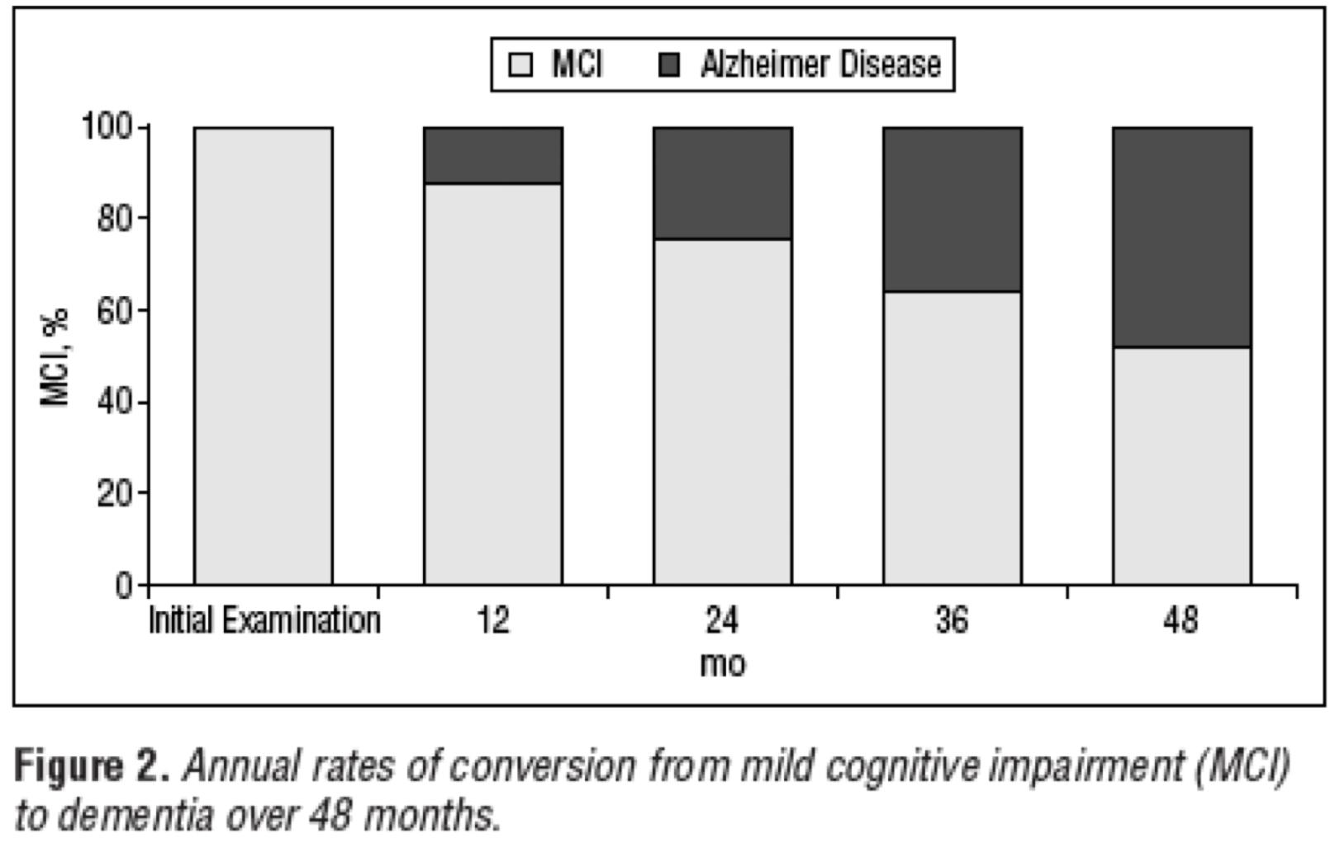
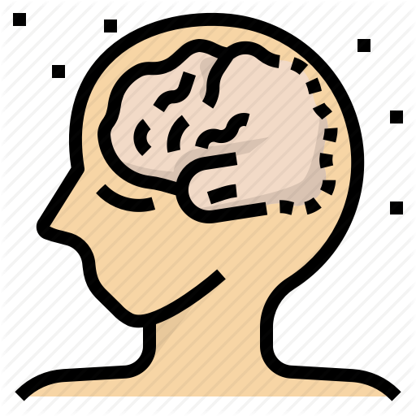
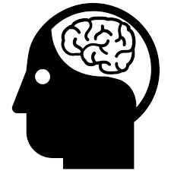
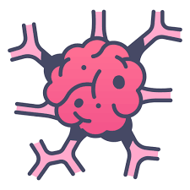
Dementia cont.
What’s the difference between dementia and delirium?
Acute presentation with altered level of consciousness¹
(See criteria)
Delirium
Cognitive complaints
(Memory problems, language problems or disorientation)
Normal consciousness, non-acute presentation
Non-delirious
(Dementia)
Note: consciousness is not just awake/not awake, it is a spectrum (e.g. drowsy, opens eyes when talked to ...etc.)
Consciousness and acuteness are key factors to tell you weather it is delirium or dementia
Mild cognitive impairment (MCI)
Patients will not turn from normal to dementia right away, it’s a slow and gradual process. Dementia is preceded by a period called mild cognitive impairment (MCI) in which the pt will have a bit of memory trouble but it doesn’t affect their independence (In dementia, their will be impaired independence).
Do all patients with MCI develop dementia eventually? NO, only half of the patients will end up with dementia in 4yrs
How to differentiate between dementia and MCI?
NO functional impairment
= patient is independent
Mild cognitive impairment
(Non-dementia)
Functional impairment: e.g.the family will be worried that the pt may get lost when he/her goes out alone.
Cognitive complains
Apparent on clinical assessment
Functional impairment present
Dementia
Subtypes and causes of dementia
Vascular
Neurodegenerative
Infective
Diffuse small-vessel disease
Amyloid angiopathy
Multiple emboli
SLE (If left untreated)
Alzheimer’s Disease
Lewy Body Dementia
Parkinson’s Disease Dementia
Frontotemporal Dementia
Huntington’s Disease
Secondary to infection or systemic illness e.g. Syphilis (After decades), HIV
Toxic/nutritional
Traumatic
Hydrocephalus
Many of the primary degenerative diseases that cause dementia have characteristic features that may allow a specific diagnosis during life. Creutzfeldt–Jakob disease, for example, is usually quickly progressive (over months) and is associated with myoclonus. The more slowly progressive dementias are more difficult to distinguish during life, but fronto-temporal dementia typically presents with signs of temporal or frontal lobe dysfunction, whereas Lewy body dementia may present with visual hallucinations. The course may also help to distinguish types of dementia. Gradual worsening suggests Alzheimer’s disease, whereas stepwise deterioration is typical of vascular dementia.
Vitamin B12 deficiency
Alcohol → Wernicke-Korsakoff syndrome² characterized by confabulations to compensate for amnesia
Chronic subdural hematoma
Post-head injury
Punch-drunk syndrome
Normal pressure hydrocephalus
Communicating/non- communicating
Inflammatory
Neoplastic
Prion disease
Multiple sclerosis
Sarcoidosis
Secondary deposits
Primary cerebral tumor
Creutzfeldt–Jakob disease (CJD) or Kuru
1- + you find a triggering factor (e.g. pneumonia)
2- Because of Vit B1 deficiency, another cause of wernicke-Korsakoff is bariatric surgery (those who don’t take their required nutritional supplements and in the same time develop severe diarrhea or another illness that may cause encephalopathy)

Slide 7
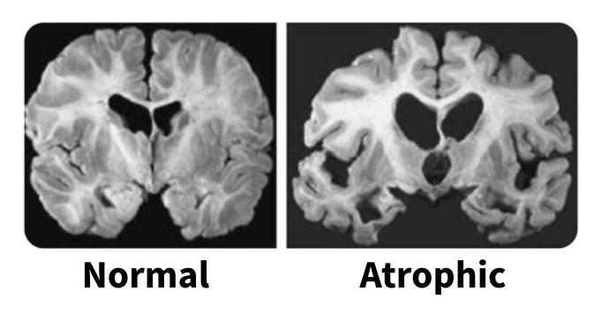
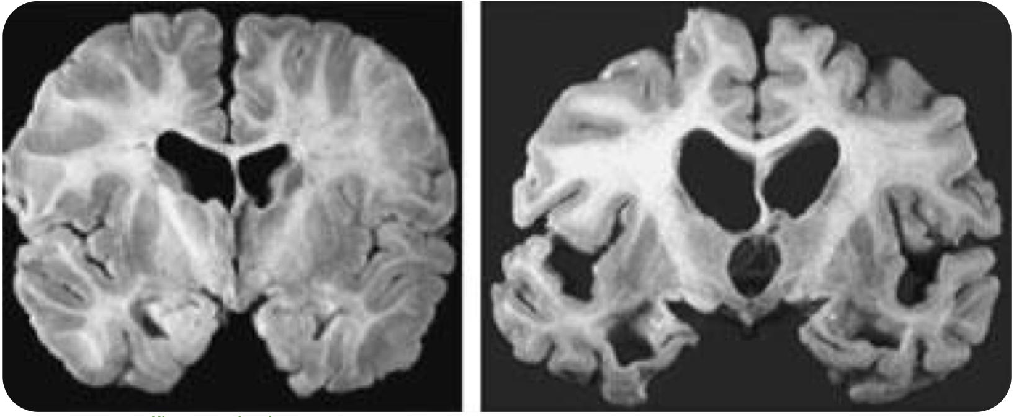
Alzheimer’s disease (AD)
Introduction
Alzheimer’s disease is the most common form of dementia (50%). It increases in prevalence with age and is uncommon in people under 60 years.
Risk factors:
Major risk factors:
Increasing age (Main risk factor)
(APOE ε4) The E4 allele for Apolipoprotein E on chromosome 19¹
Down Syndrome (Almost 100% of them will get alzheimer by the age of 40 (bc APP is located on chromosome 21))
Specific inherited types (1st-degree relative with AD confers a doubled lifetime risk of AD.)
Mid-life vascular risk factors (DM, HTN, Hyperlipidemia, Lack of exercise)
Repetitive Brain trauma
Pathogenesis
The brain in Alzheimer’s disease is macroscopically atrophic, particularly the cerebral cortex and hippocampus. Histologically, the disease is characterised by the presence of senile plaques and neurofibrillary tangles in the cerebral cortex. Tangles and plaques are pathological hallmarks in Alzheimer’s disease.²
Normal
Atrophic
Defects in the mechanisms for clearing amyloid beta results in its accumulation and form senile plaques
Abnormal accumulation of hyperphosphorylated tau protein results in accumulation and the formation of neurofibrillary tangles.
The resultant loss of neurons and synapses is responsible for
the clinical profile
(Synapses are lost first)
The neuronal loss in the basal forebrain region is responsible
for a cholinergic deficit.³
Clinical features
Decreased memory⁴ and new learning is the hallmark of the condition. Hence, patients present with gradual impairment of memory, usually in association with disorders of other cortical functions.
Language impairment: Word finding difficulties with circumlocution and anomia.
Executive dysfunction (Inability to use tools or instruments)
Apraxia (inability to perform learned (familiar) movements on command), Unawareness of illness,
Visual-spatial impairments
Passivity, apathy (لا مبالاة) > agitation (e.g. at a funeral they may not show any emotions)
Delusions (Abnormal thoughts/ideas e.g. they will think that someone is trying to get in the house and kill them)
Depression, Circadian rhythm disturbances (sundowning), Weight loss
In the early stages of the disease, patients may notice these problems, but as the disease progresses it is common for patients to deny that there is anything wrong (anosognosia). Occasionally, patients become aggressive, and the clinical features can be made acutely worse by intercurrent physical disease. Patients typically present with subjective memory loss, sometimes getting lost in familiar locations.
1- The inheritance of one of the alleles of apolipoprotein ε (apo ε4) is associated with an increased risk of developing the disease (2–4 times higher in heterozygotes and 6–8 times higher in homozygotes). Its presence is, however, neither necessary nor sufficient for the development of the disease and so genetic testing for ApoE4 is not clinically useful because it does not predict AD.
2- Histochemical staining demonstrates significant quantities of amyloid in the plaques; these typically stain positive for the protein ubiquitin, which normally is involved in targeting unwanted or damaged proteins for degradation.
3- The brain isn’t able to produce the usual levels of Acetylcholine (which is essential for normal cognition), because tangles and plaques accumulate in the basal forebrain which is the main site for Ach. It’s not just Ach, abnormalities of noradrenaline (norepinephrine), 5-HT, glutamate and substance P have also been described.
4- Short and long-term memory are both affected but defects in the former are usually more obvious. This is not ‘short-term memory loss’ which technically refers to loss of working memory, e.g. digit span, which is preserved in AD.

Slide 8
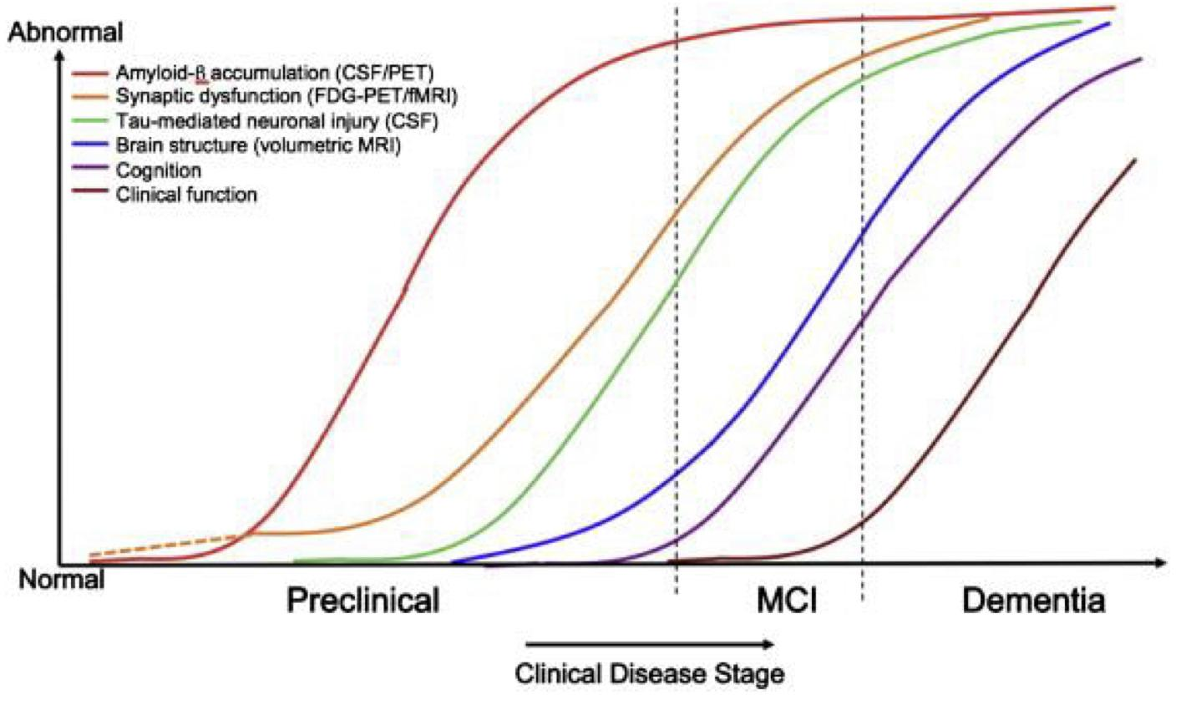
Alzheimer’s disease (AD) cont.
Diagnosis
Diagnosis is clinical, although technically a definitive diagnosis can only be made by histopathology
Rely on history and cognitive/neuropsychological assessments that demonstrates a slowly progressing cognitive disorder which causes impairments in daily life.
Brain structure on MRI may demonstrate medial temporal atrophy bilaterally (where the hippocampus is)→ brain volume may decrease even before any symptom could manifest.
PET scans can demonstrate decreased metabolism in temporal and parietal regions
Cerebrospinal fluid might show low Amyloid beta, and elevated Tau (not specific, but highly suggestive) (Not done usually)
Pathology starts early (30-40yrs), but dementia only manifests decades later
Interestingly, many ppl have amyloid deposition but never develop dementia
Treatment will be discussed at the end of the lecture
Atrophic
Lewy body dementia (LBD)
Definition
This neurodegenerative disorder is clinically characterised by dementia and signs of Parkinson’s disease.
Second most common cause of “degenerative” dementia.
It is often inherited and mutations in the α-synuclein and β-synuclein genes have been identified in affected patients.
Pathology and clinical features
Pathologically there are intracytoplasmic “Lewy Bodies” present in neurons, which are the result of abnormal α-synuclein protein accumulation in association with other proteins, including ubiquitin.
Core clinical features includes visual hallucinations, parkinsonism (Tremor¹, rigidity, bradykinesia, and gait abnormalities), and fluctuations in cognitive ability and level of consciousness. Sometime they are misdiagnosed with delirium bc of the fluctuations in cognitive ability and level of consciousness → patients need to be monitored to exclude delirium
Other symptoms include:
Visual spatial impairment which is more common than short term memory impairment
Sensitivity to neuroleptics (Develop severe parkinsonism when given antipsychotic drugs (such as haloperidol), avoid them in pts with LBD)
REM sleep behavior disorder (the absence of physiological sleep paralysis that happens during REM sleep, leading to the patient acting out their dream (e.g. yelling or punching during sleep))
Autonomic dysfunction: Erectile dysfunction, severe constipation, urinary incontinence, and postural hypotension
1- The tremor of parkinsonism is rarely present in LBD.

Slide 9
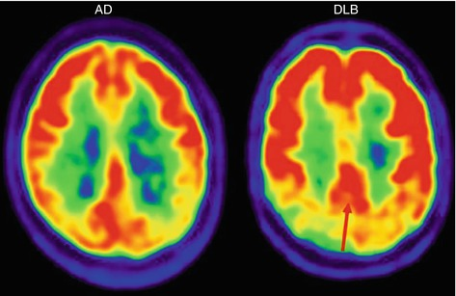
Lewy body dementia (LBD) cont.
Diagnosis
Treatment will be discussed at the end of the lecture
Diagnosis is primarily clinical
PET scan may show decreased occipital lobe metabolism, however, it is not sensitive.
Myocardial scintigraphy may be abnormal due to abnormal cardiac sympathetic innervation → abnormal autonomic supply
Parkinson’s Disease Dementia (PDD) is similar to LBD. The difference is that a clear history of PD with NO cognitive impairment precedes the development of dementia by at least a year in PDD.
LBD: Parkisonian (motor) symptoms are present after or <1 year before the onset of cognitive symptoms
PDD: If Parkinson disease has been diagnosed or has been present for ≥1 year before cognitive symptoms are seen.
So, to differentiate between them, ask which set of symptoms (body or brain) appeared first and the timeline.
Fronto-temporal dementia (FTD)
Definition
Atrophic
Fronto-temporal dementia encompasses a number of different syndromes characterised by behaviour abnormalities and impairment of language.
Symptoms usually occur before the age of 60 (Mean age of onset is 58 (younger patients than other forms of dementia)). A family history in a first-degree relative is a major risk factor.
Preferentially involves the frontal and temporal lobes, symptoms depend on the region (lobe) involved, therefore there are variants.
Common pathological inclusions include hyperphosphorylated tau protein, TDP-43 protein (43 kD transactive response (TAR) DNA binding protein, or FUS (Fused in sarcoma) protein
In contrast to Alzheimer’s disease, memory is relatively preserved in the early stages.
Pick disease is a type of FTDs (Pick bodies are found in the neocortex and the hippocampus).
Subtypes/Variants
Subtype | Description
Behavioral Variant (predominantly social cognition impairment) | Behavioral variant is associated with personality changes, inappropriate social behaviors (disinhibited e.g. ask very rude/embarrassing questions to another person, older men may approach women (Sexual disinhibition)), lack of insight (No idea about the consequences of their actions), Binging on certain foods (e.g. Carbohydrates), emotional blunting (very apathetic, e.g. The inability to appreciate how serious the situation is), rigid and cannot adopt to new situations, along with decreased attention modulation. MRI shows atrophy in the frontal lobes (may be asymmetric).
Primary Progressive Aphasia | Slowly progressive non-fluent aphasia: Patients present first with a non-fluent type of aphasia (similar to a Broca’s lesion), then they will develop full dementia, but in the beginning there’s only aphasia, everything else is normal. MRI may show focal left frontal atrophy (where the language center is).
Semantic Dementia (temporal variant of FTD) Semantic=Meaning | Usually have intact fluency, but comprehension is impaired and decreased naming ability. They will lose their ability to know the meaning of words, and not just words they even don’t know what the things they used to know are e.g. if you show them a telephone they won’t know what it is nor how to use it. MRI may show focal left temporal atrophy.

Slide 10
Other causes of dementia
Vascular dementia
Occurs secondary to A single stroke in a region important to cognition such as hippocampus or thalamus, or a large stroke that affects multiple lobes. Recurrent strokes that accumulate over time, there is a step-wise development of cognitive deficits. Slowly progressing cognitive deficits due to subclinical progressing of small vessel disease Associated with vascular risk factors (HTN, DM, Hyperlipidemia, & smoking) Frequently coexists with Alzheimer's disease (since both have the same vascular risk factors)
Normal pressure hydrocephalus (NPH) (Rare)
NPH describes a syndrome of enlarged lateral ventricles in elderly patients. The term is a misnomer, as it is a low-grade hydrocephalus with intermittently raised ICP. Classic triad: Gait impairment (WOBBLY), urinary incontinence (WET) along with the dementia (WACKY). However these features are not unique to NPH. (Order of symptoms: WOBBLY → WET → WACKY) Dementia is of a subcortical type, where there is executive dysfunction, and psychomotor slowing first. Other features of cognitive impairment develop later on. The typical gait has been described as “magnetic”, the patient may shuffle their feet on the ground with a normal or wide base, some may have some features of parkinsonism. How is it different from parkinson gait? Here it’s just like if gravity increased suddenly and they can’t raise their legs from the ground, they will have a shuffling gait with their legs being far apart (Broad/wide based gait). Whereas in parkinson disease the leg will be close to each other (narrow based gait). It usually results from impaired CSF absorption at the level of the arachnoid villi. In Secondary NPH, there is usually a history of a previous meningitis, inflammatory disoder, or subarachnoid hemorrhage. Idiopathic NPH is when there is no preceding explanation for the condition. Patients who present with gait impairment > cognitive impairments have better prognosis if identified early. Some patients will improve after a lumbar puncture that removes 30-50 cc of CSF (good test to diagnose NPH). If this test is positive, than a CSF shunting procedure is performed. The MRI brain may also show dilated ventricles (however CSF pressure is normal).
Creutzfeldt-Jakob Disease (CJD) (Rare, 1 in a million)
It is a prion disorder and can be transmitted (transmissible spongiform encephalopathy) but not infectious It’s not a virus, it’s just a protein, it’s not transmitted by sneezing or coughing etc., to be transmitted it has to be implanted (By surgical instruments). Prions are abnormally formed proteins that induce pathological transformations in other proteins leading to leading to spongiform pathology in brain (Vacuoles and holes) It has been transmitted (person-to-person) after the use of surgical equipment or growth hormones (how? in the past GH used to be donated) (Prions are resistant to sterilization) CJD presents as a rapidly progressing dementia, disease duration usually 6 months. Myoclonic jerks may occur. Any picture of cognitive impairment may occur, as may other neurological symptoms like parkinsonism, ataxia, field defects, spasticity, hyperreflexia, and + Babinski. CSF Analysis: ↑ 14-3-3 protein MRI may show abnormal signal intensity in the basal ganglia and cortical ribbon (may also be normal) EEG shows characteristic periodic sharp wave complexes No treatment, patients die within a year. The bovine variant CJD (mad cow disease) has been linked to consumption of beef (UK outbreak in the 90s)
Atrophic
Many of the primary degenerative diseases that cause dementia have characteristic features that may allow a specific diagnosis during life. Creutzfeldt–Jakob disease, for example, is usually quickly progressive (over months) and is associated with myoclonus. The more slowly progressive dementias are more difficult to distinguish during life, but fronto-temporal dementia typically presents with signs of temporal or frontal lobe dysfunction, whereas Lewy body dementia may present with visual hallucinations. The course may also help to distinguish types of dementia. Gradual worsening suggests Alzheimer’s disease, whereas stepwise deterioration is typical of vascular dementia.

Slide 11
Treatment of dementia
Treatment
Drugs such as Donepezil, rivastigmine and galantamine which increase the presence of central nervous system acetylcholine help with cognitive and behavioral symptoms in Alzheimer’s dementia. They are also helpful in PDD, LBD and vascular dementia, but they are NOT helpful in frontotemporal dementia, NPH and CJD. (Kumar says it’s also not effective in vascular dementia)
The acetylcholinesterase inhibitors used in dementia are similar in mechanism to the ones used for myasthenia gravis. However, the drugs used in myasthenia gravis act on peripheral ach while these act centrally, hence why these drugs are not used for myasthenia gravis and vise versa.
Does not stop disease progression (The disease will keep getting worse), but may provide transient clinical stability
NMDA receptor antagonist, memantine, is helpful in moderate to advanced alzheimer’s disease
No pharmacological treatment available for MCI (Just monitor, healthy food and exercise)
Not a treatment, but education and physical activity (Most beneficial) protect from cognitive decline
Note: An ECG should be performed to exclude cardiac conduction deficits before starting therapy.
Case study:
Atrophic
73 year old male retired judge. Presents with 1 year history of cognitive concerns; Trouble recalling names, He can completely forget a discussion, Forgets the location of previously placed tools, Only recalls fragments of a previous doctor visit 2 weeks earlier. Does not follow the dates as accurately as he used to and indicates that this is because he is retired. Sometimes he is repetitive with questions. Confusion about how to do things especially when tired. His ability to use household appliances is also affected. Tried putting on his shirt while still on the hanger.
What is your diagnosis? Alzheimer’s disease
Why AD? The pt has memory impairment and Impaired complex attention/Executive function.
An area for your notes

Slide 12
Characteristic | Delirium | Dementia
Level of attention | Impaired (fluctuating) | Usually alert
Onset | Acute | Gradual
Course | Fluctuating from hour to hour (waxing and waning) | Progressive deterioration
Consciousness | Clouded | Intact
Hallucinations | Present (often visual or tactile) | Rare, only in highly advanced disease
Prognosis | Reversible | Irreversible
Treatment | Treat the underlying cause | Cholinesterase inhibitors
Disease | Clinical features | Pathophysiology | Risk factors | Management
Alzheimer’s Disease | Decreased memory and new learning Language impairment Apraxia Unawareness of illness Delusions Passivity Delusions | Accumulation of amyloid beta and forming senile plaques Formation of neurofibrillary tangles | Increasing age APOE ε4 Down Syndrome DM, HTN, Hyperlipidemia Lack of exercise Brain trauma | Diagnosis is clinical MRI: medial temporal atrophy bilaterally PET scans: decreased metabolism in temporal and parietal regions
LBD | Visual hallucinations Parkinsonism Fluctuations in cognitive ability and level of consciousness. REM sleep behavior disorder Sensitivity to neuroleptics | α-synuclein protein accumulation in association with other proteins, | - | Diagnosis is primarily clinical PET scan: decreased occipital lobe metabolism Abnormal myocardial scintigraphy
Vascular Dementia | Frequently coexists with Alzheimer's disease | Recurrent strokes in cognitive area | Hypertension Hyperlipidemia DM Smoking | -
Frontotempol Dementia | Behavioral Variant Primary Progressive Aphasia Semantic Dementia | Inclusions of hyperphosphorylated Tau protein, TDP-43 protein, or FUS protein | - | MRI: focal left frontal atrophy
Normal Pressure Hydrocephalus | Classically triad of: Gait impairment (apraxia) Dementia Urinary incontinence | Impaired CSF absorption at the level of the arachnoid villi | - | MRI: dilated ventricles (CSF pressure is normal) Improvement after removal 30-50 cc of CSF

Slide 13
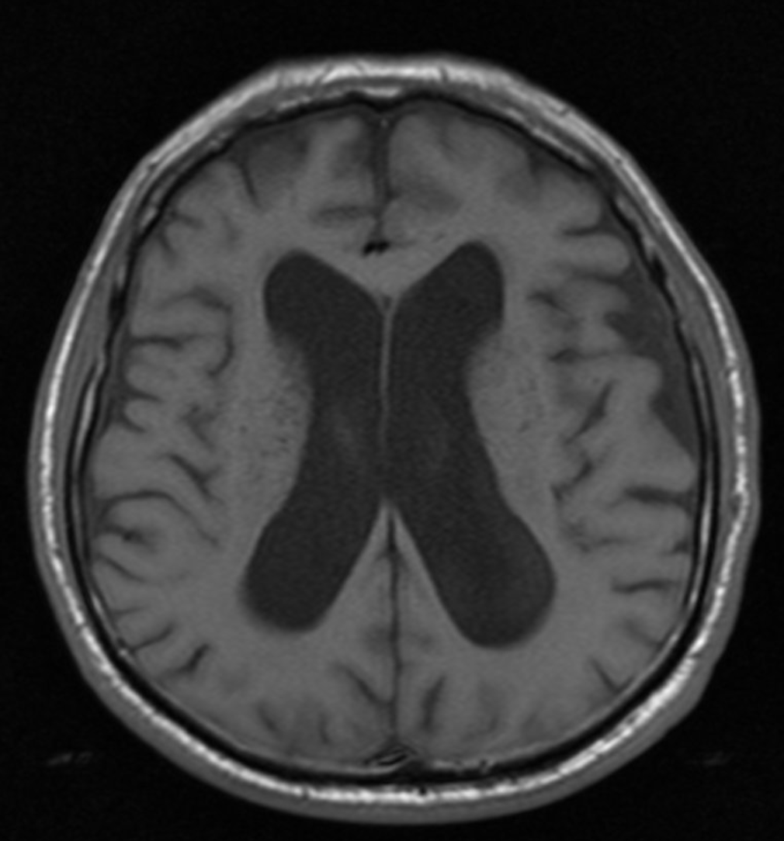
Q1:
A broad-based gait is a clumsy, irregular pattern of walk in which small steps are taken and the legs are spread wide. Gait dysfunction, dementia, and urinary incontinence make up the pathognomonic triad (“wet”, “wacky”, “wobbly”) of normal pressure hydrocephalus (NPH).
Q1: A 74-year-old man is brought to the physician by his wife for progressively worsening confusion and forgetfulness. Vital signs are within normal limits. Physical examination shows a flat affect and impaired short-term memory. An MRI of the brain shows marked dilation of the lateral ventricles.. Further evaluation of this patient is most likely to show which of the following findings?
A- Broad based gait
B- Papilledema
C- Startle myoclonus
D- Postural instability
E- Pill rolling tremor
Q2: A 74-year-old woman is brought to the physician by her daughter for worsening memory for the past 1 month. She can no longer manage her bills and frequently forgets the names of her children. Her daughter is also concerned that her mother has a urinary tract infection because she has had increased urinary urgency and several episodes of urinary incontinence. Vital signs are within normal limits. Physical examination shows poor short-term memory recall and a slow gait with wide, short steps. Which of the following is most likely to improve this patient's condition?
A- Cerebral shunt replacement
B- Bromocriptine therapy
C- Donepezil therapy
D- Physical therapy referral
E- vaginal pessary placement
Q3: A 55-year-old man is brought to the physician because of inappropriate behavior for the past 6 months. He has been making inappropriate comments and jokes while talking to friends and family members. He was arrested 3 weeks ago while trying to kiss strangers on the street. He has no interest in talking to his daughter or playing with his grandchildren. During this period, he has developed a strong desire for chocolate pudding and potato chips and has gained 10 kg (22 lb). He appears unkempt. Vital signs are within normal limits. Physical examination is unremarkable. Mental status examination shows apathy and a blunt affect. He avoids answering questions and instead comments on the individuals he saw in the waiting room. Mini-Mental State Examination score is 28/30. A complete blood count and serum concentrations of glucose, creatine, and electrolytes are within the reference range.
A- Alzheimer disease
B- Frontotemporal dementia
C- Parkinson disease
D- Wilson disease
E- Creutzfeldt-Jakob Disease
Q4: A 57-year-old man is brought to the physician for worsening mental status over the past 2 months. His wife reports he was initially experiencing lapses in memory and over the past 3 weeks he has begun having difficulties performing activities of daily living. Yesterday, he became lost heading to the post office down the street. He has hypertension treated with lisinopril and hydrochlorothiazide. Vital signs are within normal limits. He is alert but verbally uncommunicative. Muscle strength is normal. Reflexes are 2+ in bilateral upper and lower extremities. He has diffuse involuntary muscle jerking that can be provoked by loud noises. Mental status examination shows a blunt affect. A complete blood count and serum concentrations of glucose, creatine, and electrolytes are within the reference range.
A- Alzheimer disease
B- Frontotemporal dementia
C- Parkinson disease
D- Wilson disease
E- Creutzfeldt-Jakob Disease
Q5: A 66-year-old man comes to the physician because of difficulty walking for the past year. He reports that his gait has become slower and that initiating steps has become more challenging. During the past 6 months, his family has noticed that he is starting to forget important family meetings and holidays. On a number of occasions, he has not been able to get to the bathroom in time in order to urinate. He has hypertension treated with hydrochlorothiazide. His father died of Parkinson's disease at the age of 63 years. The patient had smoked one pack of cigarettes daily for 40 years, but quit 10 years ago. His vital signs are within normal limits. On mental status examination, he is confused and has short-term memory deficits. He has a wide-based, shuffling gait. Muscle strength is normal. Deep tendon reflexes are 2+ bilaterally. An MRI of the head is shown. Which of the following is the most likely underlying cause of this patient's symptoms?
A- Increased Cerebrospinal fluid production
B- Frontotemporal atrophy
C- Obstructed passage of Cerebrospinal fluid
D- Decreased Cerebrospinal fluid absorption
E- Degeneration of cholinergic Neurons in the Temporal lobe
Q2:
Normal pressure hydrocephalus presents a risk of permanent neurological damage, due to compression of periventricular white matter from ventricular distention. Even removal of a small amount of CSF via a lumbar puncture can be helpful but the definitive treatment of normal pressure hydrocephalus usually involves the drainage of excess CSF via a cerebral shunt, usually into the peritoneum (e.g., VP shunt).
Q3:
Personality changes, inappropriate behavior, and overeating (particularly of sweet foods) in a middle-aged adult with intact cognitive function is highly suspicious for frontotemporal dementia. This condition has a rapid progression compared to other dementias (e.g., Alzheimer's disease), with patients surviving an average of six years after symptom onset. In later stages, parkinsonism is also common.
Q4:
Rapidly progressing mental decline combined with myoclonus and mutism, as seen in this patient, are typical clinical findings in patients with Creutzfeldt-Jakob disease. The disease has a rapid course that often leads to death within 12 months
Answers: Q1:A | Q2:A | Q3:B | Q4:E | Q5:D
Answers Explanation File!
Q5 explanation:
Impaired CSF absorption (either idiopathic or due to dysfunction of the arachnoid villi) is the suspected underlying pathophysiologic mechanism of normal pressure hydrocephalus. Impaired resorption of CSF leads to transiently elevated intracranial pressure, which causes ventricular enlargement and compression of cerebral structures (e.g., corona radiata). Once the ventricles enlarge, a new approximate homeostasis between CSF production and resorption is established and intracranial pressure normalizes.

Slide 14
THANKS!!
This lecture was done by:
Tariq Aloqail
Mashal AbaAlkhail
Abdulaziz Alshomar
Note taker:
Mashal AbaAlkhail
Raghad AlKhashan
Females co-leaders:
Raghad AlKhashan
Amirah Aldakhilallah
Males co-leaders:
Mashal AbaAlkhail
Nawaf Albhijan
Send us your feedback:
We are all ears!

