Slide 1
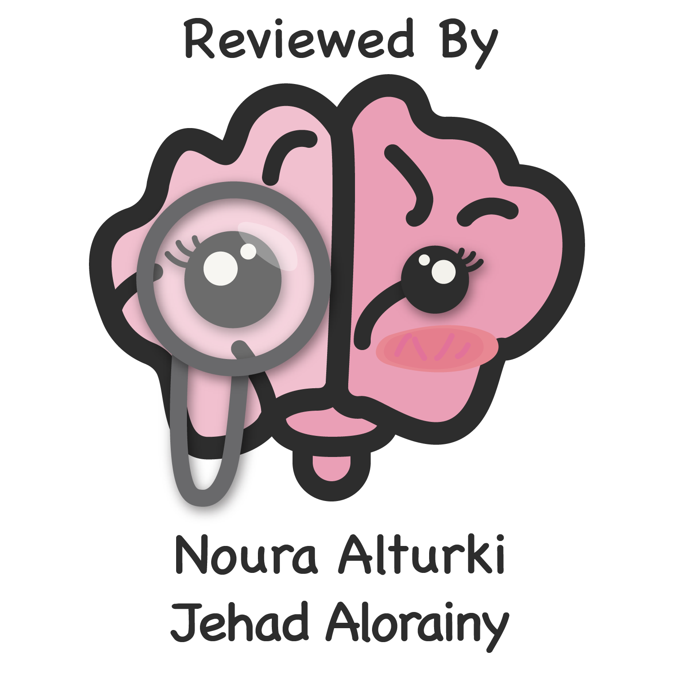
Lecture 59
Editing file
Parkinson’s disease & movement disorders
Objectives:
By the end of the lecture the student should be able to:
Become familiar with various abnormal movements
Differentiate rest from action tremor
Become able to recognize common movement disorders based on type of movements
Color index:
Color index:
Original text Females slides Males slides
Doctor’s notes Textbook Important Golden notes Extra

Slide 2
Introduction
Movement disorders
Abnormality of movement (types )
Hypokinesias
characterized by slowed movements with increased tone
Hyperkinesias
excessive involuntary movements
Disorders of movement divide broadly into two categories:
Hypokinesias – characterized by slowed movements with increased tone (Parkinsonism)
Akinesia: when hypokinesia is really severe/there’s no movement
Hyperkinesias – excessive involuntary movements.
Both types may co-exist, for example in Parkinson’s disease where there are both slowed movements and tremor.Many of these disorders (not all) relate to dysfunction of the basal ganglia.
Bradykinesia: involuntary slowness of movement
Akinesia: severe hypokinesia/when there’s no movement
Myoclonus, Tremor, Dystonia, Chorea and others
Both types may co-exist, for example in Parkinson’s disease where there are both slowed movements and tremor.
Many of these disorders (not all) relate to dysfunction of the basal ganglia.
Parkinsonism
is a clinical syndrome characterised primarily by bradykinesia, with associated increased tone (rigidity), tremor and loss of postural reflexes. There are many causes but the most common is parkinson’s disease.
Idiopathic Parkinson’s disease
Pathophysiology
pathological hallmarks of PD are the presence of neuronal inclusions called Lewy bodies and loss of the dopaminergic neurons from the pars compacta of the substantia nigra in the midbrain that project to the striatum of the basal ganglia
Lewy bodies contain tangles of α-synuclein and ubiquitin, and become gradually more widespread as the condition progresses, spreading from the lower brainstem to the midbrain and then into the cortex.
Degeneration also occurs in other basal ganglia nuclei.
The extent of nigrostriatal dopaminergic cell loss correlates with the degree of akinesia.
Etiology
causes of idiopathic PD are still not fully understood.

Slide 3
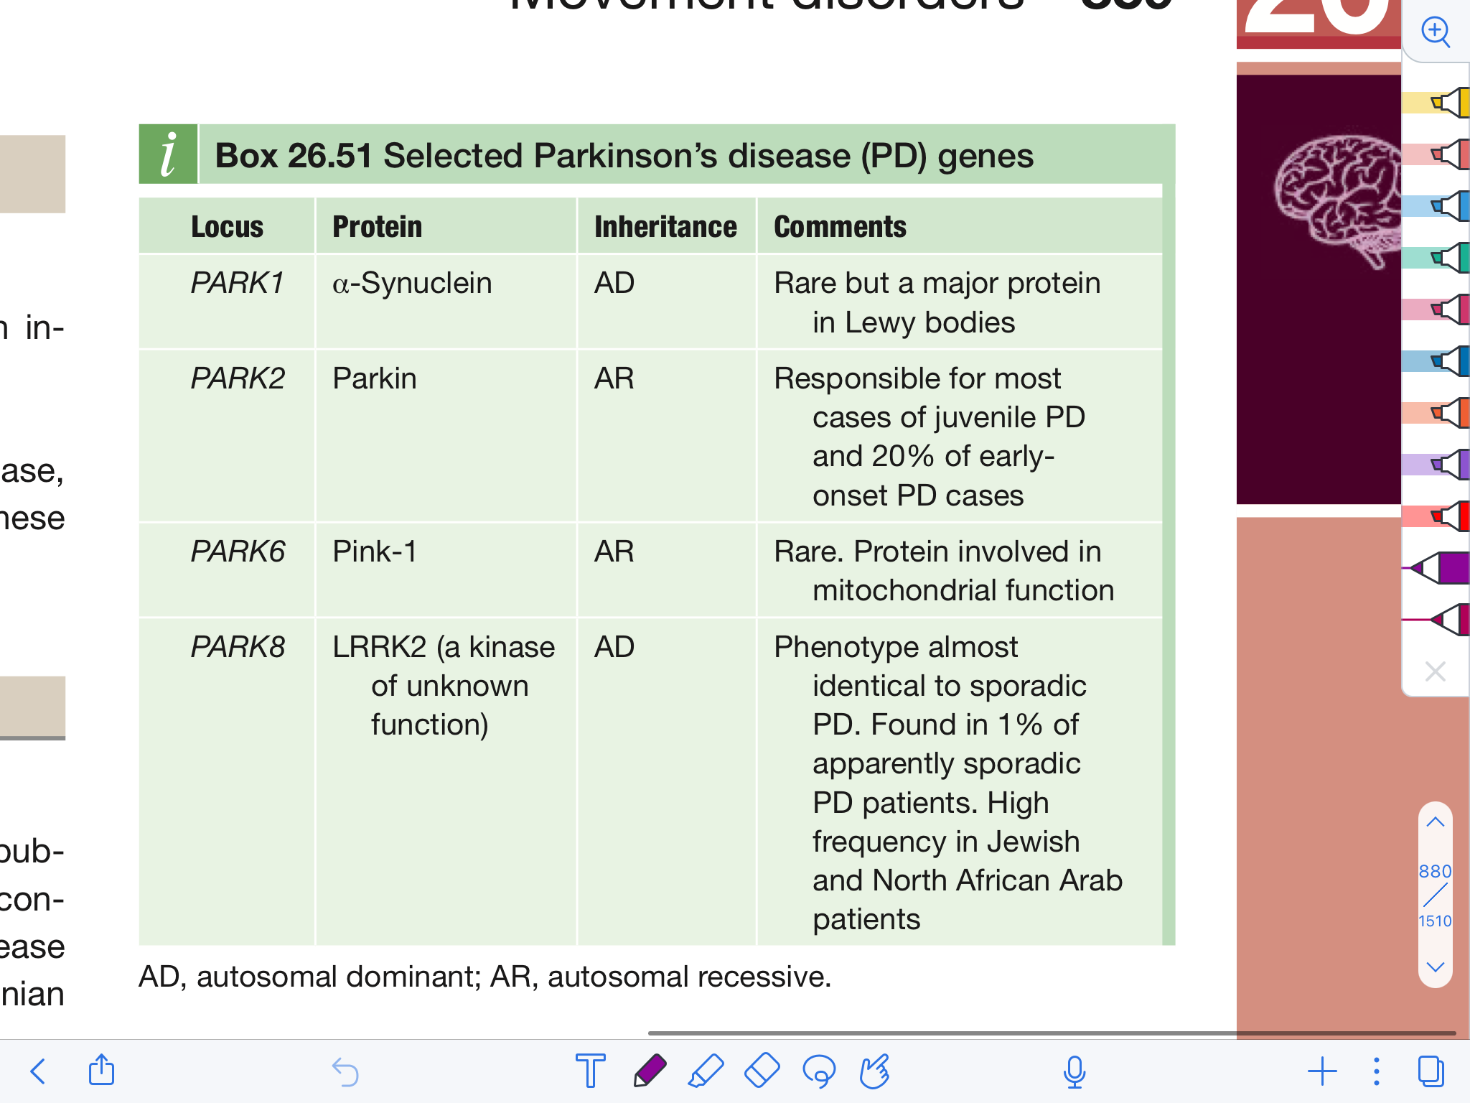
Parkinson’s disease
Risk factors
Age and gender:
Prevalence increases sharply with age, particularly over 70 years. Ageing changes are likely to be an important factor in causation.
Prevalence is higher in men (1.5 : 1 male to female).
Environmental factors:
small increased risk with rural living and drinking well water
Pesticide exposure has been implicated and pesticide-induced rodent models of PD exist
The chemical compound methyl-phenyl tetrahydropyridine (MPTP), a potent mitochondrial toxin, causes severe parkinsonism, leading to suggestions that oxidative stress may be a factor leading to neuronal cell death in idiopathic PD
Studies consistently show that non-smokers have a higher risk of PD than smokers.
Genetics:
Not usually familial but twin studies show there is a significant genetic component in early-onset PD (onset before 40)
Most of these are rare but together they account for a large proportion of early-onset and familial PD, and a small proportion (perhaps 1–2%), of sporadic late-onset cases.
Main significance of the PARK genes is that they provide insights into the pathophysiological mechanisms underlying PD that may be relevant to sporadic cases.
Clinical features
Almost always presents with the typical motor symptoms of tremor and slowness of movement but it is likely that the pathological process starts many years before these symptoms develop.
By the time of first presentation, on average 70% of dopaminergic nigrostriatal cells have already been lost.
Prodromal pre-motor symptoms
Patients develop a variety of non-specific non-motor symptoms during the approximately 7 years, sometimes longer, before the motor symptoms become manifest. including:
Ansomia a slowly progressive loss of smell which might happen decades before Parkinson’s develops (olfactory bulb is one of the first structures to be affected).
REMBD “Rapid Eye Movement Behavior Disorder” - normally, while someone is sleeping & having dreams, their body paralyzes so they do not act out these dreams. Sometimes, REMBD even precedes Parkinsonism, & the patient starts to physically act out their dreams in bed, so their partner in bed might complain about that person yelling/punching them in sleep.
Autonomic dysfunction such as postural hypotension, erectile dysfunction, urinary incontinence, & constipation (constipation is usually chronic in these patients even before the disease starts)
Depression/anxiety (50%)

Slide 4
Parkinson’s disease
Clinical features cont’
Motor symptoms
These develop slowly and insidiously, and are often initially attributed to ‘old age’ by patients.
Idiopathic PD is almost always more prominent initially on one side, a purely symmetrical tremor is probably something else but it can happen in Parkinson's disease.
Akinesia (bradykinesia):
The cardinal clinical feature of parkinsonism and the main cause of disability.
Slowness of initiation with progressive reduction in speed and amplitude of repetitive action
What distinguishes it from slowness of movement from other causes is a progressive fatiguing and decrement in amplitude and speed of repetitive movements. In finger tapping test: after about 5-10 seconds, you’ll notice that the tapping kind of slows down or gets progressively smaller. In addition, the overall appearance of the patient e.g. moving slow, takes them long time to get up from the chair or changing their clothes or slowness in chewing food.
There is difficulty initiating movement
Upper limb is usually affected first and is almost always unilateral for the first years.
Facial immobility gives a mask-like semblance of depression.
Frequency of spontaneous blinking diminishes, producing a serpentine stare.
Tremor:
An involuntary rhythmic oscillatory movement around a joint axis, example: if it’s a hand tremor & you draw a line (the axis), then the hand will go above & below that line, usually at a similar amplitude & at a specific frequency.
Parkinsonian tremor:
The presenting symptom in 70% of patients, 4-6 Hz per second.
Typically starts in the fingers or hand and is unilateral initially, spreading later to the leg on the same side and, after some years, to the opposite side.
Predominantly at rest, and reduces or stops completely when the hand is in motion.
Re-emergence with maintained posture; if you ask the patient to rise their hands and hold it out stretched, after few seconds you might see the tremor "re-emergence of tremor", it's different from action tremor where it comes out immediately as soon as hand is elevated, but if it has a latency "few seconds" its called re-emergence tremor.
Described as pill-rolling because the patient appears to be rolling something between thumb and forefinger. It’s made worse by emotion, stress, or mental concentration
Rigidity:
Abnormally increased resistance to movement that is independent of the velocity of the movement,It is present throughout the range of movement. Contrary to spasticity which is a velocity dependent finding, it could be missed on exam if the limb wasn’t moved quickly.
Some people tend to describe rigidity as either “lead-pipe” (stiffness throughout passive limb movement) or “cogwheel” (intermittent interruptions when you’re doing the tone assessment that happen.
Rigidity is related to extrapyramidal disorders, which means it doesn’t involve the pyramidal system, but structures such as the basal ganglia.
Postural and gait changes:
A stooped posture is characteristic. Gait gradually becomes shuffling with small stride length, slow turns, freezing and reduced arm swing.
Postural stability eventually deteriorates, leading to falls, but this is a late-stage feature that should arouse suspicion of an alternative diagnosis if present during the first 5 years

Slide 5
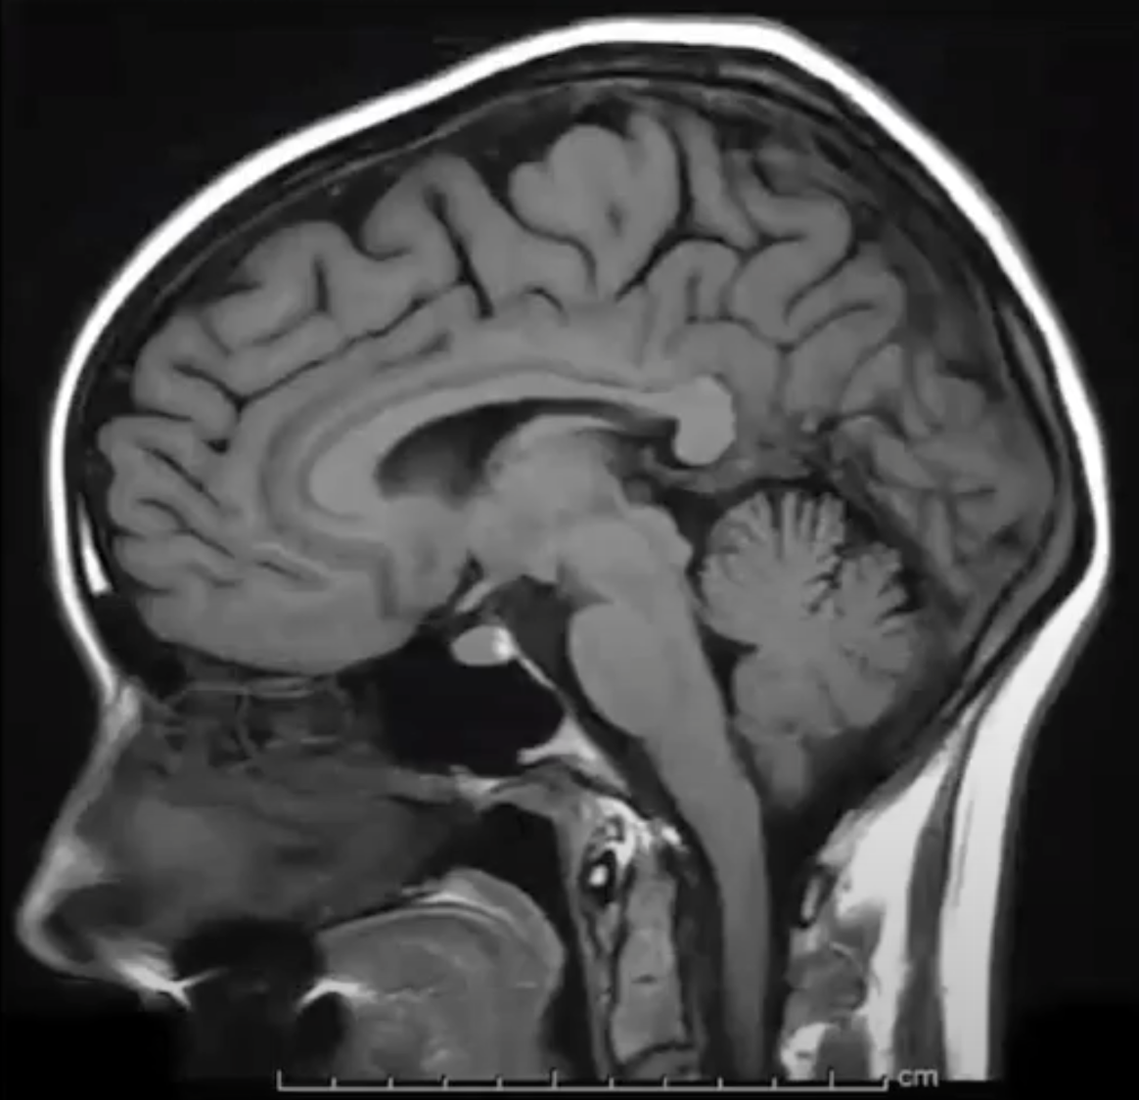
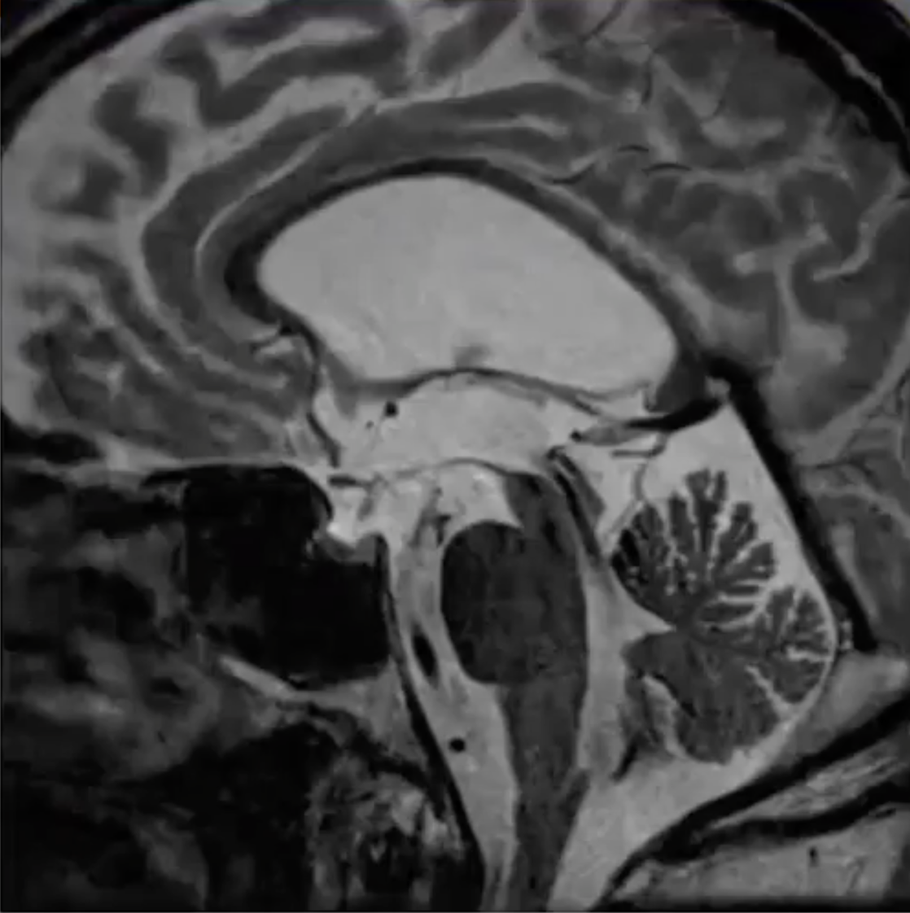
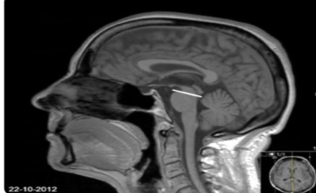
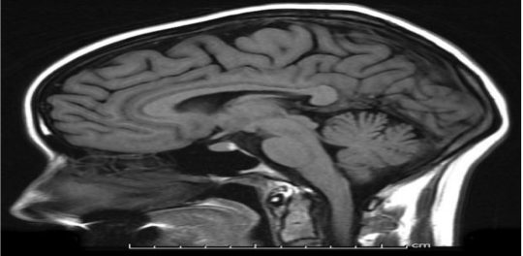
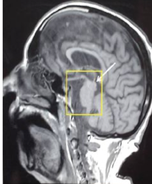
Parkinson’s disease
Clinical features cont’
speech and swallowing
Speech becomes quiet, indistinct and flat. Drooling may be an embarrassing problem and swallowing difficulty is a late feature that may eventually lead to aspiration pneumonia as a terminal event.
Cognitive and psychiatric changes
Cognitive impairment is now recognized to be common in late stage PD (80%) and may develop into dementia.
if cognitive impairment happens in the beginning or before the motor symptoms then it's probably lewy body dementia, but in Parkinson's disease the cognitive impairment happen at least after 1 year of pure Parkinson's disease which it will be called Parkinson's disease dementia.
Hallucinations; especially visual hallucinations that usually happen later on in the disease. If they occur early, you could think of Lewy Body dementia. Sometimes, the hallucinations could be a side effect of medications.
Diagnosis is (clinical) made by recognizing physical signs and distinguishing idiopathic PD from other parkinsonian syndromes.
Investigations and Imaging is normal in typical PD. However, in vascular Parkinson’s you might see signs of vascular disease (stroke)
Normal brain.
Line: midbrain
Diagnosis
Patients with suspected PD should be referred to a specialist without initiation of treatment.
Shrunken midbrain which has a similar appearance to a hummingbird - hence it’s called the “hummingbird sign” -- it’s seen in progressive supranuclear gaze palsy because the gaze center is in the midbrain
Dopamine transporter (DAT) imaging using SPECT or PET makes use of a radiolabeled ligand binding to dopaminergic terminals to assess the extent of nigrostriatal cell loss. it is abnormal even in the early stages , but does not differentiate between the different forms of degenerative parkinsonism and so is not specific for PD

Slide 6
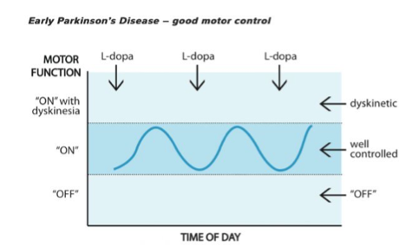
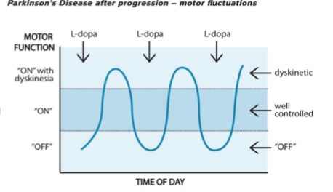
Parkinson’s disease
Management
Treatment of non-motor symptoms, such as depression, constipation, pain and sleep disorders, is also necessary and significantly improves quality of life.
Dopamine replacement with levodopa or a dopamine agonist improves motor symptoms and is the basis of pharmacological therapy.
01
02
03
04
05
Dopamine replacement may not always be needed in early-stage PD and is only started when symptoms begin to cause disability.
Drugs for PD should not be stopped abruptly, as this can precipitate malignant hyperthermia
Education about the condition is necessary and physical activity is beneficial and should be encouraged.
Pharmacological therapy
Levodopa/Carbidopa (LD/CD)
Mainstay of treatment most effective form of treatment and all patients with PD will eventually need it. most effective for relieving akinesia and rigidity; tremor response is often less satisfactory and it has no effect on many motor (posture, freezing) and non-motor symptoms. Levodopa is the active agent, while Carbidopa prolongs the duration of levodopa by delaying its metabolism. When administered orally, more than 90% is decarboxylated to dopamine peripherally in the gastrointestinal tract and blood vessels, and only a small proportion reaches the brain. To avoid this,It is combined with a dopa decarboxylase inhibitor – benserazide (co-beneldopa) or carbidopa (co-careldopa) – to reduce the peripheral adverse effects (e.g. nausea and hypotension)
When you treat a patient with Levodopa, the medication has a fluctuating course known as “ON-OFF” phenomenon. ON time is when the drug is working well & symptoms are controlled. OFF time is when it is wearing off, & symptoms such as tremor, rigidity, & slow movement re-emerge. “ON with dyskinesia” happens when the levels of L-dopa are too high, leading to excessive movements (dyskinesia) as a side effect. These symptoms typically improve after the next dose is taken.
In early disease it’s usually well controlled
In advanced disease, when the patient take the medication their levels peaks very quickly beyond the well controlled line where it start to give side effects which are (abnormal excessive movement "dyskinesia"), then it quickly drops and patient goes to an “OFF” phase as if there are not on any drug. That happens because the regulation becomes impaired in the nervous system, there is more neuronal loss and less receptors, & the absorption of the drug becomes more erratic.

Slide 7
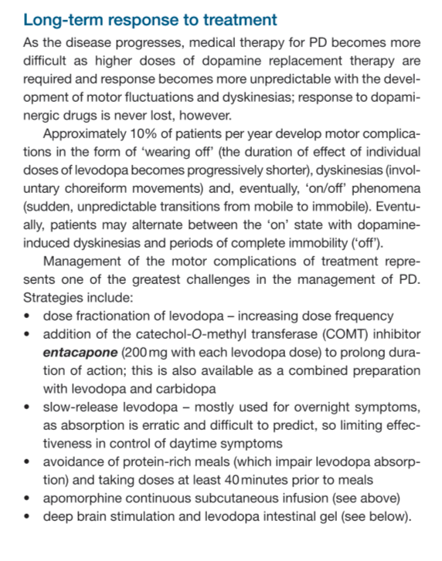
Parkinson’s disease
Dopamine agonists (Pramipexole, rotigotine)
May be used in combination with levodopa or as initial monotherapy in younger patients (below age 65–70) with mild to moderate impairment Originally introduced in the hope of delaying the initiation of LD and thus delaying motor complications Although less efficacious in symptom control than levodopa( Their role in the management of PD remains uncertain)and generally less well tolerated, DAs are associated with fewer motor complications over a 5-year period. Apomorphine: a potent, short-acting DA administered subcutaneously, It is used in advanced PD. With the exception of apomorphine, all the agonists are considerably less effective than LD in relieving parkinsonism, have more adverse effects (nausea, vomiting, disorientation and hallucinations, impulse control disorders) and are more expensive. Non-ergot DAs (pramipexole, ropinirole, rotigotine, or apomorphine via transdermal patch) are used in preference to ergot-derived drugs, which may be associated with fibrotic reactions, including cardiac valvular fibrosis. Domperidone is used as an antiemetic when initiating DA therapy (other antiemetics should not be used, as they may worsen symptoms by blocking central dopamine receptors).
other drugs
Monoamine oxidase (MAO)-B inhibitor: Selegiline , Rasagiline reduces catabolism of dopamine in brain. It has a mild symptomatic effect. COMT inhibitors : Entacapone Prolongs activity of LD in blood, Not an agent by itself Amantadine: (not used as frequently as before) has a mild, usually short-lived effect on bradykinesia and is rarely used unless patients are unable to tolerate other drugs more commonly employed as a treatment for LD-induced dyskinesias in advanced disease. Adverse effects include livedo reticularis, peripheral oedema, delirium and other anticholinergic effects. Anticholinergic: (e.g. orphenadrine, procyclidine, trihexy-phenidyl) may help tremor but are rarely used in PD except in younger patients. They have a high propensity to cause confusion and cognitive impairment in older patients.
Strategies to manage motor complications
Dose fractionation of levodopa increasing dose frequency
Addition of the catechol-O-methyl transferase (COMT) inhibitor entacapone (200 mg with each levodopa dose) to prolong duration of action; this is also available as a combined preparation with levodopa and carbidopa
Slow-release levodopa mostly used for overnight symptoms, as absorption is erratic and difficult to predict, so limiting effectiveness in control of daytime symptoms
Avoidance of protein-rich meals (which impair levodopa absorption) and taking doses at least 40minutes prior to meals
Apomorphine continuous subcutaneous infusion
Deep brain stimulation and levodopa intestinal gel (discussed in the next slide)

Slide 8
Parkinson’s disease
Abnormality of movement (types )
Deep brain stimulation (DBS)
Disorders of movement divide broadly into two categories:
Hypokinesias – characterized by slowed movements with increased tone (Parkinsonism)
Akinesia: when hypokinesia is really severe/there’s no movement
Hyperkinesias – excessive involuntary movements.
Both types may co-exist, for example in Parkinson’s disease where there are both slowed movements and tremor.Many of these disorders (not all) relate to dysfunction of the basal ganglia.
Used in (LD/CD responsive patients only) as an adjunct to treatment, it doesn’t replace medications, it helps in controlling the signs & symptoms.
Stereotactic insertion of electrodes into the brain (they implant a device) has proved to be a major therapeutic advance in selected patients (usually under age 70) with disabling dyskinesias and motor fluctuations not adequately controlled with medical therapy.
Targets include:
Subthalamic nucleus – response similar to levodopa with reduction in dyskinesia
Globus pallidus – improves dyskinesia but levodopa still required for motor symptoms
Thalamus – for tremor only.
L-dopa intestinal gel infusion
Continuous infusion of this gel into the small intestine via a jejunostomy using a patient-operated pump is effective for selected patients with severe motor complications. At present, it is used only where apomorphine or DBS are contraindicated, partly because of high costs.
Tissue transplantation
Transplantation of embryonic mesencephalic dopaminergic cells directly into the putamen has produced mixed results but is potentially promising with research ongoing to refine the technique. Stem cells and gene therapy approaches are in development.
Physiotherapy, OT and physical aids
Physiotherapy, occupational therapy and speech therapy all have a role to play in managing PD and reducing disability, speech and swallowing problems and falls. Walking aids are often a hindrance early on, but later a frame or a tripod may help. A variety of external cueing techniques may help with freezing.

Slide 9
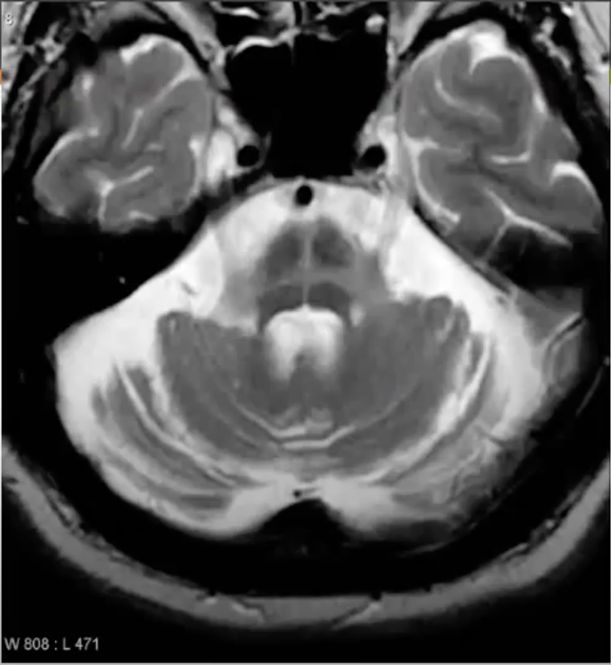
Other akinetic-rigid syndromes
(Conditions that mimic Parkinson’s disease)
Drug induced Parkinsonism
ALWAYS ask about medication history, eg: metoclopramide, simply by stopping the offending drug, you help the patient. It is the most important thing to ask about. Dopamine blocking or depleting drugs, particularly neuroleptics e.g. haloperidol (with the exception of clozapine), induce Parkinsonism or worsen symptoms in affected patients, and may precipitate symptoms in elderly patients in the presymptomatic phase.
Progressive Supranuclear Gaze Palsy (Steele-Richardson-Olszewski's syndrome)
Impaired vertical gaze; so the patient presents with Parkinsonism + the inability to look up & down (because there is degeneration in the part of the midbrain that is responsible for vertical gazing) whereas their ability to look right & left remains intact, postural instability with early falls, pseudobulbar palsy and dementia. Shrunken midbrain which has a similar appearance to a hummingbird - hence it’s called the “hummingbird sign” Tau deposition is seen pathologically in the substantia nigra, subthalamic nucleus and midbrain.
Multiple System Atrophy:
Involvement of other neurological systems (cerebellar signs, the extrapyramidal system and severe early autonomic dysfunction) Pathologically α-synuclein positive glial cytoplasmic inclusions occur. This is the pons. It has a cross passing through it, which is an abnormal finding, giving it the appearance of a bread bun which is why it’s called the “hot cross bun sign” - this sign is due to the degeneration of fibers going through the pons. It’s seen in multiple system atrophy. They might also have CB findings, probably due to the CB’s connections to the brainstem.
Notes:
Deep brain Stimulation-Used in (LD/CD responsive patients) in which they implant a device as an adjunct to treatment to help control the signs & symptoms.

Slide 10
Other akinetic-rigid syndromes
Vascular Parkinsonism
Patients might have upper motor neuron signs on exam Vascular parkinsonism, similar to vascular dementia, results from multiple strokes in multiple areas leading to parkinsonian features
Corticobasal degeneration
Cortical Impairment (of the higher functions of the brain) Sensory; here, we are talking about the non-elemental sensations that take multiple sensory components in order for them to be interpreted into an image in the mind (for reference, elemental sensations include pin-prick, vibration, & position sense). Non-elemental sensations include: Astereognosis: when you place an object in the patient’s hands & ask them to identify it without looking at it - just by moving it around. Agraphesthesia: when you draw something on the patient’s hand (ex: a number) & ask them to guess what it is. Apraxia: they lose their ability to use tools/their hands to do stuff, so for example they can no longer use a hammer or a pen.
Wilson’s disease
Copper deposition occurs in the basal ganglia, the cornea and liver , where it can cause cirrhosis. All young patients (below age 50) with an akinetic-rigid syndrome or any hyperkinetic movement disorder, or with liver cirrhosis should be screened for Wilson’s disease (check serum copper and ceruloplasmin). Neurological damage is reversible with early treatment
Parkinson plus syndromes Disorders that mimic Parkinson’s disease
When there are additional features along with bradykinesia, tremor, & rigidity, you will be a bit more cautious & say maybe this isn’t typical PD, but one of the other Parkinsonian syndromes
Red Flags:
If present, suspect conditions other than Parkinson's disease.
Neuroleptic or anti-emetic drug use. Most important red flag.
Early/prominent autonomic dysfunction → think of: multiple system atrophy
Limited eye movements → think of: progressive supranuclear gaze palsy
Pyramidal, cerebellar or sensory symptoms → these could all be vascular parkinsonism, but it could be:
multiple system atrophy or vascular if there were pyramidal symptoms
multiple system atrophy if there were cerebellar symptoms
and corticobasal if there were sensory symptoms.
Cognitive impairment → especially if it happens later on after well-established Parkinson’s disease (Parkinson’s disease dementia), however if it happens early we could think of Lewy body dementia
Symmetrical presentation and absence of tremor
Levodopa unresponsiveness (or poor response)
Early falls (within first year)
Additional neurological features.

Slide 11
Hyperkinetic disorders
the content starting from this point is from 436 slides
There are five hyperkinetic movement disorders. These can sometimes be difficult to separate from one another and may occur in combination.
1. Essential Tremor:
What is it? Hereditary, autosomal dominant, not associated with any brain/thyroid pathology or medications, therefore it is essentially a benign condition but impairing.
Character:
Slowly progressive, bilateral, fast, low amplitude tremor, asymmetric mainly in the upper limbs action tremor, that disappears at rest
The head and voice are occasionally involved.
It is an important differential for Parkinson’s, but there is no bradykinesia, rigidity, or dystonia.
You have to be careful with the cerebellar exam because a cerebellar tremor could look exactly like an essential tremor, so unless a person presents with a longstanding (~10 years) progressive history, we should do imaging to exclude any cerebellar lesions (such as strokes) that could cause this.
Aggravating factors: Physical activity, caffeine, stress, anxiety, Sympathomimetics (e.g. salbutamol)
Relieving factors: May temporarily improve after alcoholic beverages
Treatment:Treatment?
Propranolol (B-blockers are prescribed, they are used when needed and they significantly improve the tremor)
Movement Disorders:
What is it? | Hereditary, autosomal dominant, not associated with any brain/thyroid pathology or medications, therefore it is essentially a benign condition but impairing.
Character? | Slowly progressive, bilateral, fast, low amplitude tremor, asymmetric mainly in the upper limbs action tremor, that disappears at rest The head and voice are occasionally involved. It is an important differential for Parkinson’s, but there is no bradykinesia, rigidity, or dystonia. You have to be careful with the cerebellar exam because a cerebellar tremor could look exactly like an essential tremor, so unless a person presents with a longstanding (~10 years) progressive history, we should do imaging to exclude any cerebellar lesions (such as strokes) that could cause this.
Worse with? | Physical activity, caffeine, stress, anxiety, Sympathomimetics (e.g. salbutamol)
Relieved by ? | May temporarily improve after alcoholic beverages
Treatment? | Propranolol (B-blockers are prescribed, they are used when needed and they significantly improve the tremor), primidone or gabapentin may help - Stereotactic thalamotomy and thalamic DBS are used in severe cases.
2. Dystonia:
Could be generalized or focal, could be lesional, drug or idiopathic
a movement disorder characterized by sustained or intermittent muscle contractions causing abnormal, often repetitive, movements, postures, or both. In a nutshell, it’s the same movement happening persistently or repetitively, usually there’s contraction of both agonist + antagonist muscles at the same time
Dystonia is most usefully classified by aetiology, into:
Primary dystonias – where dystonia is the only, or main, clinical manifestation (usually genetic)
Secondary dystonia – due to brain injury (trauma or stroke) , cerebral palsy or drugs for example
Heredo-degenerative dystonia – as part of a wider neurodegenerative disorder
Paroxysmal dystonias – rare, mostly genetic, attacks of sudden involuntary movements with elements of dystonia and chorea.
Ballismus :
A large amplitude choreiform movement, seen after subthalamic strokes usually
Hemiballismus describes violent swinging movements of one side caused usually by infarction or haemorrhage in the contralateral subthalamic nucleus.
Treatment is difficult but botulinum toxin injections or DBS may be useful.

Slide 12
Hyperkinetic disorders
3. Chorea:
Involuntary movements with no predictable course, resulting from a continuous flow of random muscle contractions (‘dance-like’)
Can occur in “Sydenham’s Chorea” and in Huntington's disease (HD). HD is an autosomal dominant disorder with progressive chorea, cognitive impairment and psychiatric features develop.
4. Myoclonus:
Involuntary single quick contraction of a muscle group (or its inhibition). Can be
repeated but not rhythmic. seen during encephalopathies or drug related, hereditary disorders
There are different types of myoclonus, some involve the entire body, others just parts of it. An example of physiological myoclonus that many of us have experienced before is when we are just about to go into sleep, & we get a strange dream of falling, so we suddenly wake up & our whole body jerks.
Primary myoclonus
Cortical myoclonus is usually distal (hands and fingers especially) and stimulus sensitive (spontaneous but also triggered by touch or loud noises) and caused by a wide variety of pathologies affecting the cerebral cortex; spinal and brain- stem myoclonus are caused by localized lesions affecting these structures.
5. Tics:
stereotyped movements or vocalizations (may be temporarily suppressed)

Slide 13
from Step up
Parkinson’s disease (General information) : Parkinson disease is the most common hypokinetic movement disorder Onset is usually after age 50 years. Parkinson Disease Is Essentially A Clinical Diagnosis Lewy bodies (hyaline inclusion bodies) are a key neuronal finding in the brains of patients with Parkinson disease. Patients with tremor as a major symptom of Parkinson disease have a better prognosis than those who have bradykinesia as a predominant finding.
Clinical features:
Pill-rolling tremor at rest(worsens with emotional stress) Tremor goes away when performing routine tasks. Bradykinesia—slowness of voluntary movements Rigidity is characteristic.“Cogwheel Rigidity”refers to ratchet-like jerking, which can be elicited by testing the tone in one limb while the patient clenches the opposite fist. Poor Postural Reflexes;difficulty initiating the first step,andwalking with small shuffling steps; stooped posture Masked(expressionless)facies;decreased blinking. Dysarthria and Dysphagia,micrographia(small handwriting). Impairment Of Cognitive Function(dementia)in advanced disease. personality changes present in early stages.
Management
No cure—goals are to delay disease progression and relieve symptoms. Carbidopa-levodopa (Sinemet)—drug of choice for treating parkinson's symptoms. show an“on–off”phenomenon(over the course of the day) during treatment, which leads to fluctuations in symptoms. This is due to dose– response relationships. It often occurs in advanced disease. Dopamine-receptor agonists(bromocriptine,pramipexole). May control symptoms and delay need for levodopa for several years. Initiate one of the seagents when you have established the diagnosis.You may use levodopa and one of these agents at the same time. Pramipexole Is The Most Commonly Used. These can be useful for sudden episodesofhesitancyorimmobility(described as “freezing”) Anticholinergic Drugs. Trihexyphenidyl And Benztropine. These may be particularly helpful inpatients withtremor as amajor finding.Do not use in older patients or demented patients. Selegiline Inhibits monoamine oxidase B activity(increased dopamine activity) and reduces metabolism of levodopa An adjunctive agent, and is often used in early disease. It has mild symptomatic benefit. Side Effects. Dyskinesias (involuntary, often choreic movements) can occur after 5 to 7 years of therapy. This is a major concern, and may warrant delay in initiating carbidopa-levodopa for as long as possible. Nausea/vomiting, anorexia, HTN, hallucinations

Slide 14
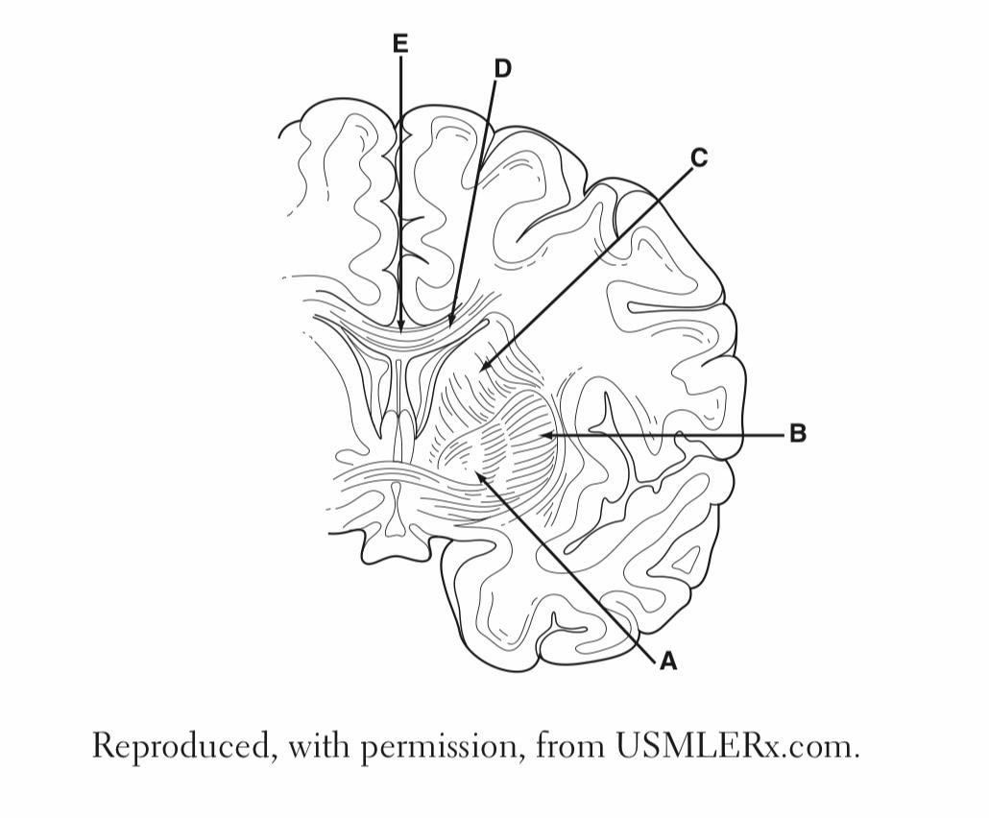
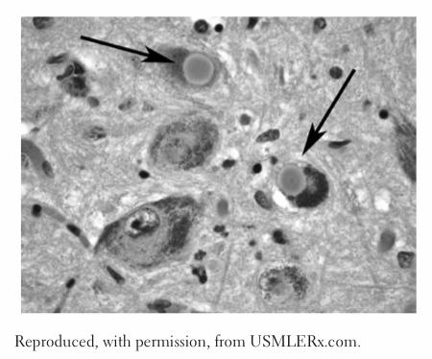
Q1: A left-handed 79-year-old man presents with a troublesome resting tremor of his left hand. The tremor is evident in his writing. He has also noticed his writing is smaller than it used to be. He complains he has difficulty turning in bed to get comfortable and his wife complains that he sometimes kicks her in the middle of the night. When he gets out of bed in the morning he feels a little woozy, but this resolves after a while. On examination, he blinks about three times a minute and his face does not show much emotion. Glabelar tap is positive. He has a slow, shuffling gait. He has difficulty stopping, starting and turning. He holds his feet slightly apart to steady himself. When you pull him backwards, he is unable to right himself and stumbles back. Which of the signs and symptoms is not commonly associated with parkinsonism?
A, Posturalinstability
B. Rapid eye movement (REM) sleep disturbance
C. Hypomimia
D. Broad-basedgait
E. Autonomicinstability
Q2: A 55-year-old woman has received treatment for years to manage a chronic, progressive disease. Since her mid-40s the patient has had difficulty initiating movements. She has a shuffling gait, an expressionless face, and tremor in her hands and fingers at rest. Over the years she has tried many medications but with little relief of her symptoms, and instead has experienced severe adverse effects. She is referred for possible ablation surgery. The neurosurgeon explains the different pathways involved in initiation and inhibition of movement, the foundation of her disease. The neurosurgeon explains that by nullifying or accentuating some of the pathways, some of her symptoms may be alleviated. The introduction of an ablative lesion into which structure labeled in the image would be expected to improve this patient’s bradykinesia?
A- A
B- B
C- C
D- D
Q3: The high-power micrograph shown in the image demonstrates a key histologic finding obtained from the brain of a 75-year-old man at autopsy. In the years leading up to his death, the patient had exhibited the gradual onset of motor symptoms including bradykinesia, resting tremor, shuffling gait, and stooped posture. His medical history was otherwise unremarkable. Which of the following best describes the pathology underlying this patient’s disease process?
A- Cortical atrophy associated with b-amyloid plaques, neurofibrillary tangles, and decreased cholinergic activity
B- Defective copper transport leading to the accumulation of copper in tissues
C- Loss of γ-aminobutyric acidergic neurons causing atrophy of the caudate nucleus
D- Loss of pigmented dopaminergic neurons in the substantia nigra
E- Malignant tumor cells derived from the neural crest leading to metastatic disease of the brain
Q4: What is the most common cause of parkinsonism?
A- Idiopathic
B- Drug-induced Parkinsonism
C- Vascular Parkinsonism
D- Dementia with Lewy bodies
Q5: Which migraine drugs worsen Parkinson disease?
A- Prochlorperazine
B- Metoclopramide
C- Chlorpromazine
D- All the above
Quiz explanations:
Question 1:
The correct answer is X. Explanation
Question 2:
The correct answer is X. Explanation
Question 3:
The correct answer is X. Explanation
Question 4:
The correct answer is X. Explanation
Question 5:
The correct answer is X. Explanation
Answers: Q1:D | Q2:A | Q3:D | Q4:A | Q5:D
Answers Explanation File!

Slide 15
THANKS!!
This lecture was done by:
Ghalia Alnufaei
Taif Alotaibi
Quiz and summary maker:
Lama Alassiri
Special thanks to the amazing note taker: Haifa Alwaily
Females co-leaders:
Raghad AlKhashan
Amirah Aldakhilallah
Males co-leaders:
Mashal AbaAlkhail
Nawaf Albhijan
Send us your feedback:
We are all ears!

