Slide 1
Lecture 60
Editing file
Myopathies
Objectives:
By the end of the lecture the student should be able to:
Recognize and identify symptoms of myopathic disorders.
Understand the role of laboratory and radiological investigations in myopathy.
Discuss clinical and pathological features of selected myopathic disorders.
Discuss the management of inflammatory myopathies, dystrophic myopathy, malignant hyperthermia and selected drug-induced myopathies (statin and steroid-induced)
Color index:
Color index:
Original text Females slides Males slides
Doctor’s notes Textbook Important Golden notes Extra

Slide 2
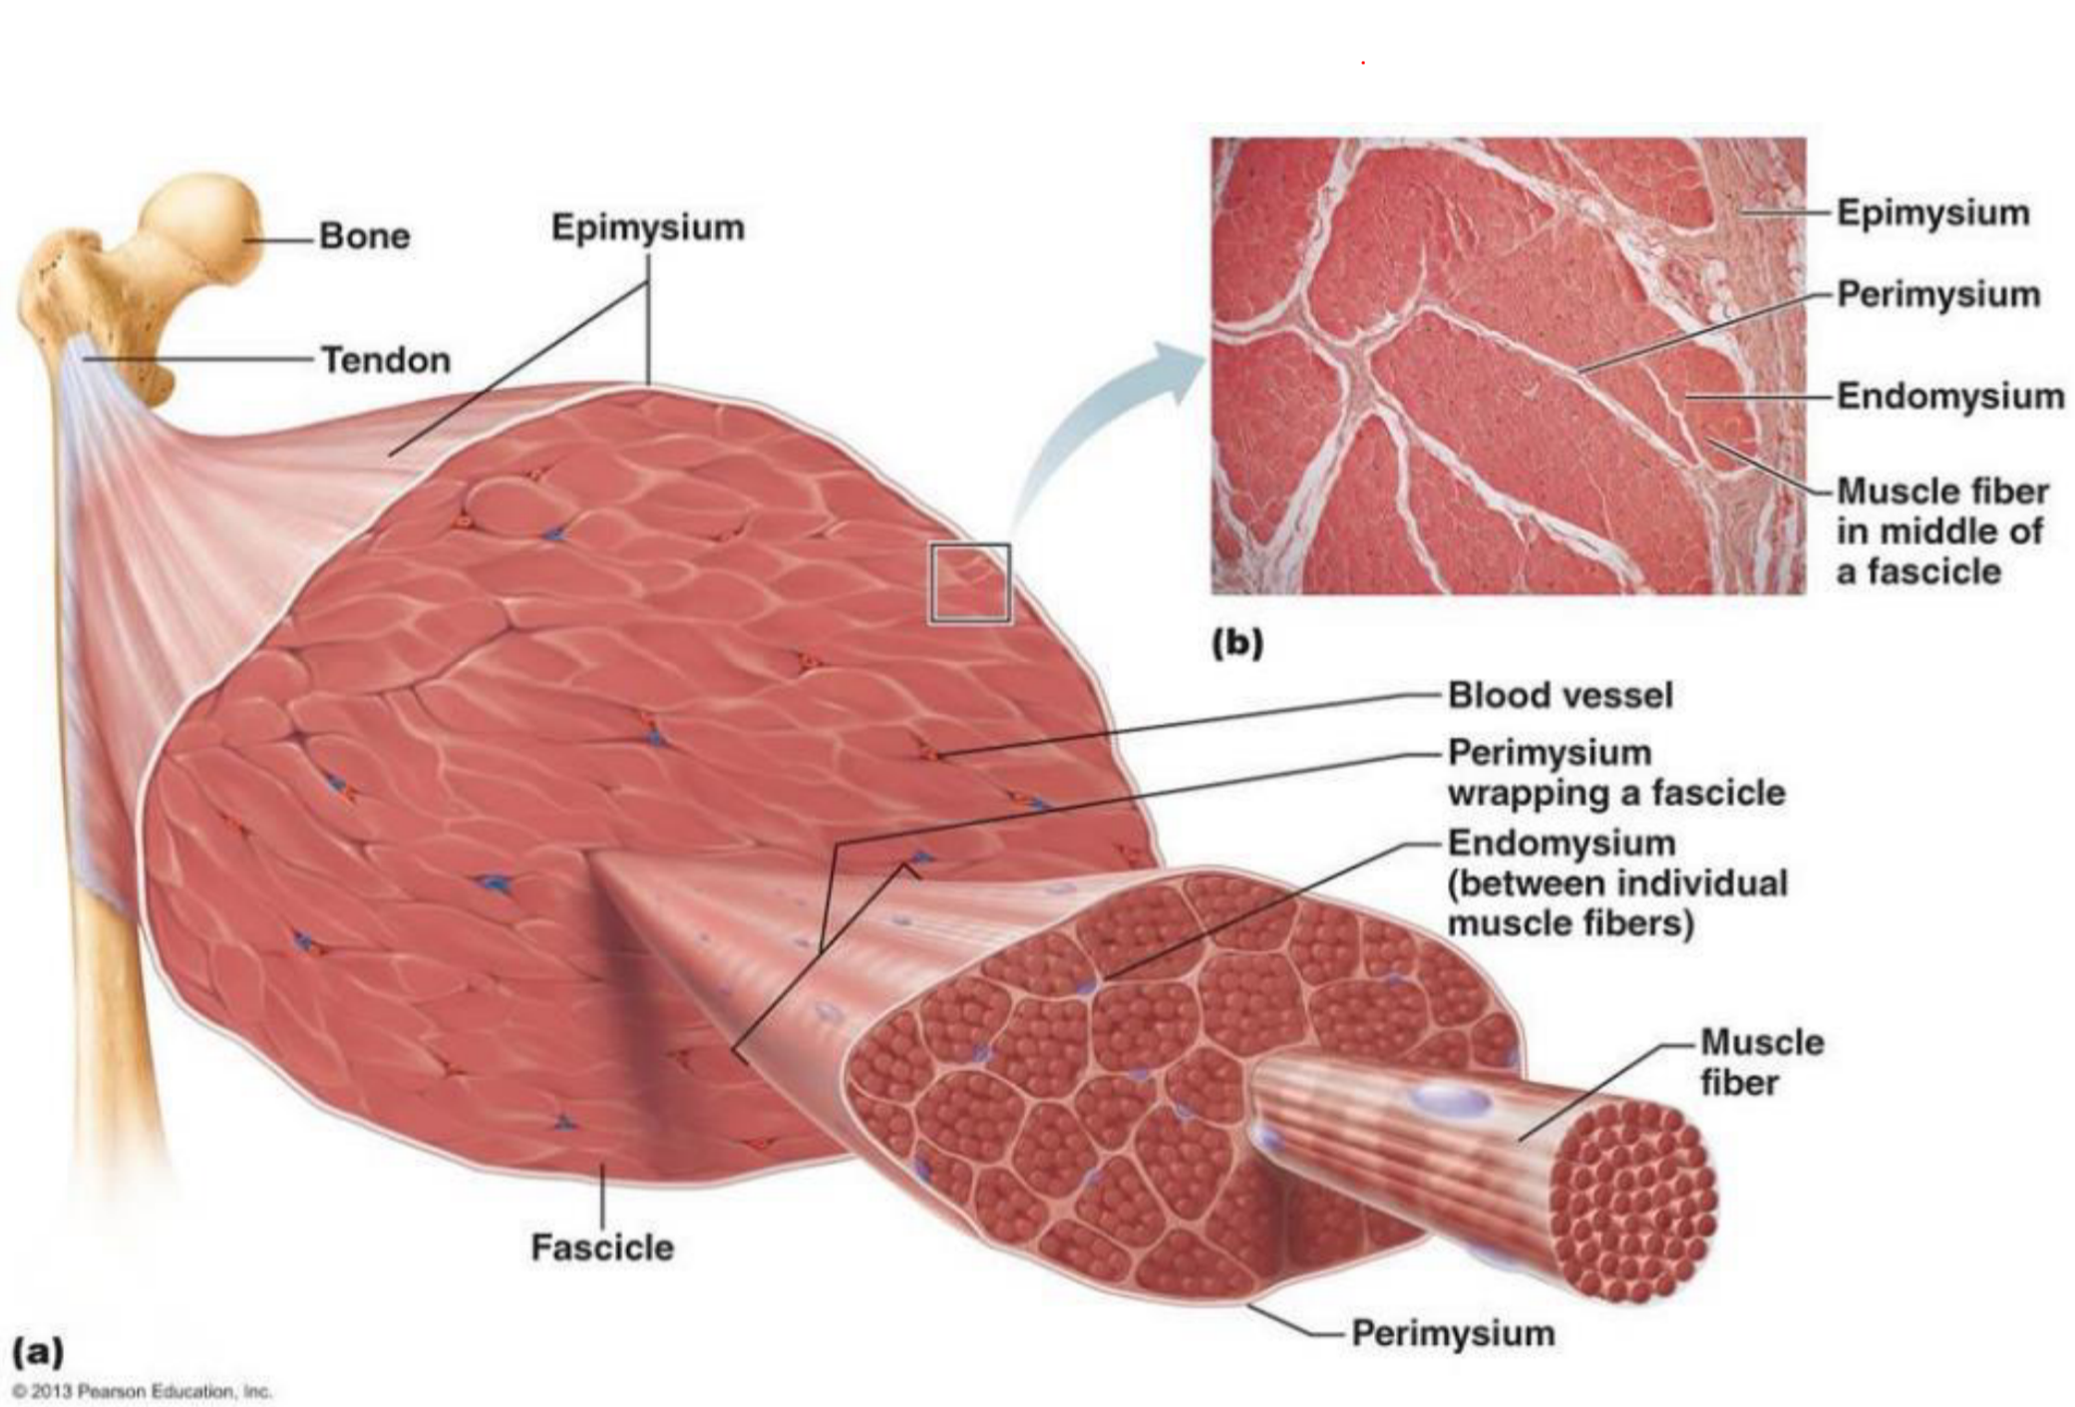
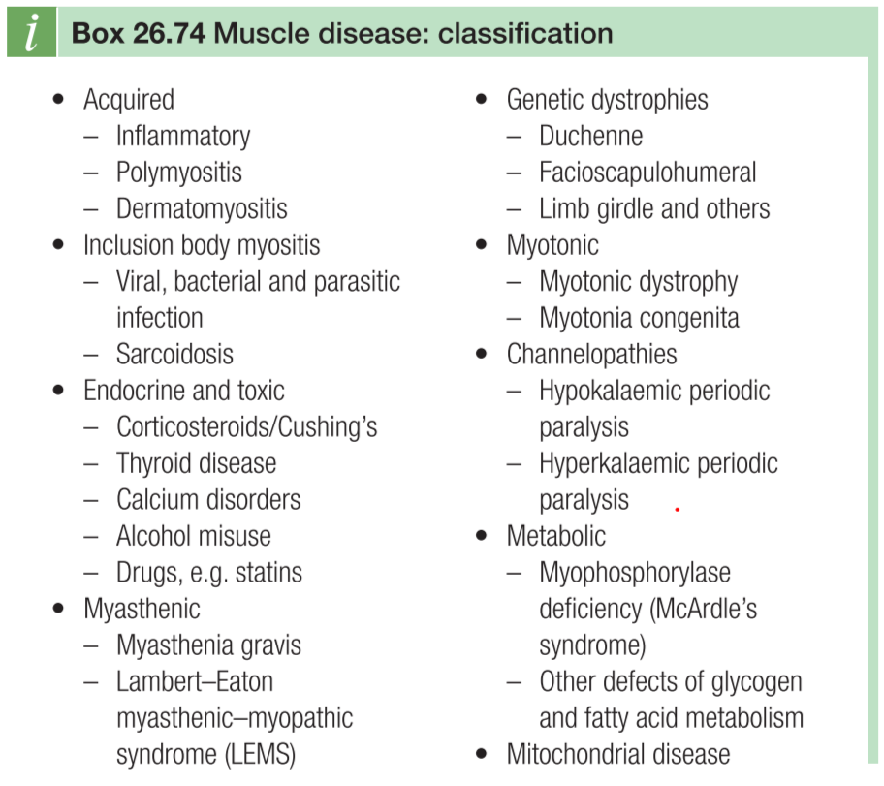
Normal Muscle Physiology & Histology
Introduction
around the muscle is a connective tissue sheath called epimysium, within the muscle we have groups of fascicles surrounded by perimysium, within the fascicles are muscle fibers surrounded by endomysium
Myopathies: Myo (muscle) pathos (Suffering)
A disorder in which there is a primary functional or structural impairment of skeletal muscle
Muscle Fibers
TYPE 1: Slow twitch, red | TYPE 2: Fast twitch, white
Aerobic Generating force over a more protracted interval. Fatigue slowly More dependent on a steady supply of O2 ++++ myoglobin → redder Contain more lipid and mitochondria than fast-twitch fibers | Anaerobic Generating large amounts of force quickly . Fatigue easily Contain more glycogen and myofibrillar ATPase Less myoglobin → white
Extra
Classification of myopathies
Acquired | Hereditary
Inflammatory myopathies Dermatomyositis Polymyositis Inclusion body myositis (IBM) Immune-mediated necrotizing myopathy | Muscular Dystrophies Dystrophinopathies Duchenne Becker Limb-girdle muscular dystrophies Myotonic dystrophies
Drug-induced myopathies Statin Penicillamine Steroids Chloroquine | Congenital Myopathies
Toxic myopathies (Alcohol, Cocaine & Heroin) | Mitochondrial myopathies
Endocrine myopathies Steroid Hypothyroidism Hypoparathyroidism | Metabolic storage myopathies
Infectious myopathies (Parasite, Virus) | Channelopathies
Myopathies associated with other systemic illness | Myotonias

Slide 3
Female Slide
Approach - 6 Questions
Approach
First goal in approaching patients with a suspected muscle disease is to determine the correct site of the lesion:
Proximal muscle weakness with preservation of sensation doesn’t always equal myopathy. it could be from NMJ, AHC, roots, motor nerves.
Confirmed site as muscle? then :
Identify whether the myopathy is caused by:
defect in the muscle channel
Abnormal muscle structure
dysfunction in muscle metabolism.
Determine the cause of the myopathy
Determine management:
Treatable?
Frequency of cardiac/respiratory surveillance? Most of the time you would screen for cardiac and respiratory function, even with mild myopathy symptoms.
Counselling¹: exercise? Precautions on rhabdomyolysis²
Approach - 6 Questions
6 Questions
Q1
Q2
Q3
Q4
Q5
Q6
Which Negative and/or Positive Symptoms do patients demonstrate?
What is the temporal evolution?
Is there a family history of:
- Myopathic disorder?
- Cardiac disease?
Are there precipitating factors that trigger episodic weakness or stiffness?
Are there associated systemic symptoms or signs?
What is the distribution of weakness?
Q1: Which Negative and/or Positive Symptoms do patients demonstrate?
What are the negative/positive symptoms?
Negative symptoms:
Exercise intolerance
Fatigue
Muscle atrophy
Weakness
Dysphagia, dysarthria
SOB
Positive symptoms³:
Cramps
Contractures
Muscle hypertrophy
Myalgias
Myoglobinuria
Stiffness
Rippling muscle
Tremor
1- Specific for rare serious complication of certain type of genetic muscular disorder, ex: pts with RYR1 mutation can have malignant hyperthermia when exposed to volatile anesthetic agents.
2- Any pt with genetic muscular disorder have a risk of developing rhabdomyolysis which is the breakdown of muscles. which can cause renal impairment if not treated with adequate hydration. Educate the pts.
3- fasciculation is a specific form of abnormal muscle movement usually involve Anterior horn cells. A clonus usually means UMN lesion involvement.

Slide 4
Approach - 6 Questions
Symptoms of Myopathies
I. Fatigue
Much less useful negative symptom → may be a result of patients’ overall health, cardiopulmonary status, level of conditioning, sleeping habits, or emotional state.
Define intensity and duration of exercise that provokes fatigue (They will tell you, after lifting 2kg weights for x times, I feel fatigued.) → metabolic and mitochondrial myopathies.
II. Exercise intolerance
Problem with energy utilization.
Intolerance for short exercise → carbohydrate disorder
Intolerance for long exercise → lipid disorder
III. Limb muscle weakness & atrophy
Proximal muscle weakness is the cardinal symptom of myopathy, most of muscle diseases present with bilateral muscle weakness.
E.g. difficulty combing hair (due to deltoid weakness), washing hair in shower, climbing stairs (you need to have good proximal thigh muscles), squatting, waddling gait.
Shoulder girdle → scapular winging (patient will say “i feel something is coming out of my back”)
Other muscles;
Eye muscles → ophthalmoplegia (patient will not be able to move their eyes), ptosis.
Facial weakness → difficulty closing eyes, whistling, using straw.
Bulbar muscles → dysphagia, choking, nasal speech due to palatal muscle weakness.
Respiratory muscles → dyspnea, orthopnea², it can lead to death if it’s acute.
Cardiomyopathy → heart failure, arrhythmias
IV. Myalgias (Muscle pain)
Myalgias are Vague aches and muscle discomfort that happen with or without exercise.
If the neuromuscular examination is normal and laboratory studies (CK) are also normal, then it is unlikely to be muscle in origin
Episodic → metabolic myopathies.
Nearly constant → inflammatory or metabolic myopathies.
1- the most important symptom, distal muscle can be involved but for the sake of teaching you just need to know that if someone has a proximal muscle weakness you should think of muscle disease, not nerve, spinal cord or brain disease.
2- Traditionally you think of cardiac causes e.g. heart failure, but muscle weakness especially diaphragm can cause it (when you lay flat the diaphragm cannot go down by the gravity so it will push on the lung causing almost a constrictive type of lung movement.

Slide 5
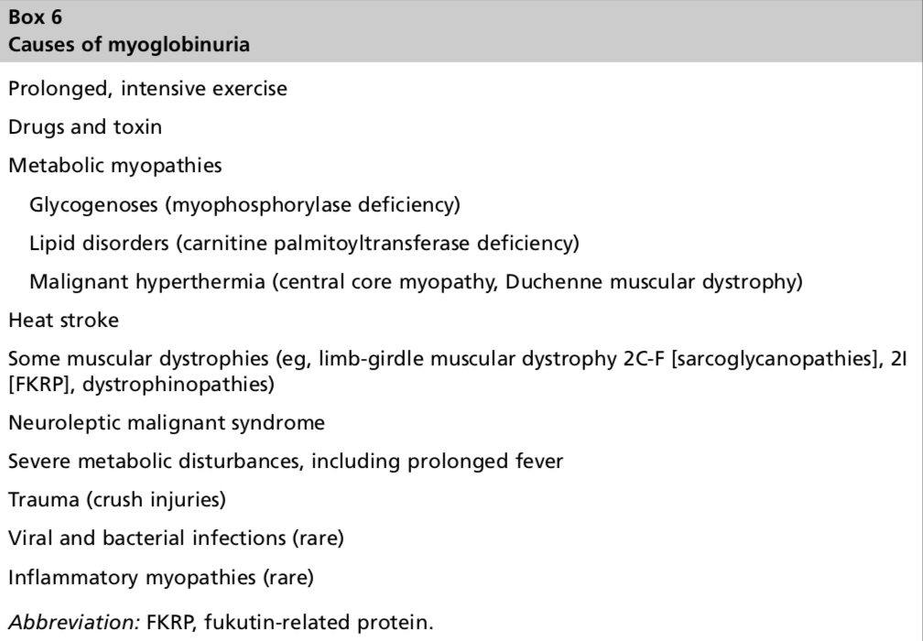
Approach - 6 Questions
Symptoms of Myopathies cont.
V. Muscle Cramps
Specific type of muscle pain.
Usually localized to a particular muscle region, typically the calves.
EMG: Rapidly firing motor unit discharge
Involuntary contractions of muscle (seconds-minutes).
It’s a common sensation especially if you don’t have a good exercise function at baseline.
Most are benign, not related to an underlying disease process, but they can be a symptoms of muscle disease when they are persistent, frequent, and happen in exercise.
Can occur in MND, chronic neuropathies, etc
Risk factors: old age, dehydration, prolonged sitting, diuretics (they alter electrolytes), low Mg, hypoT4, DM.
Other causes: Dehydration, Hyponatremia, Azotemia (renal impairment), Myxedema (hypothyroidism) & disorders of the nerve or motor neuron (ALS”Amyotrophic lateral sclerosis”).
VI. Muscle contractures
Uncommon but can superficially resemble a cramp.
Typically provoked by exercise in patients with glycolytic enzyme defects (metabolic myopathy)
Last longer than cramps (This is one way to differentiate it from cramps)
EMG: silent (Unlike cramps)
Do not confuse with fixed contractures of tendons
VII. Myotonia
Impaired relaxation after sustained voluntary contraction
Caused by repetitive depolarization of the muscle fibers or membrane, due to a genetic dysfunction of the channels that move sodium, potassium and sometimes chloride in and out of the cell.
Eyelids (When they try to open their eyes it will take a long time)
Hand grip (Opening the hand after making a fist will take much time)
Myotonia can be tested clinically:
Tapping the muscle (percussion myotonia)
Voluntary contractions of muscle groups (action myotonia)
Worsens with cold.
Improves with repeated exercise.
VIII. Myoglobinuria
Excess release of myoglobin during periods of excessive muscle breakdown (muscle necrosis) causing dark urine
Severe episodes: acute tubular necrosis (ATN) → renal failure, what we fear the most.
Isolated episodes following strenuous unaccustomed exercise: commonly idiopathic
What are the common muscle disorders that causes myoglobinuria? Metabolic myopathies
Also mitochondrial disorder, less common.
VI.

Slide 6
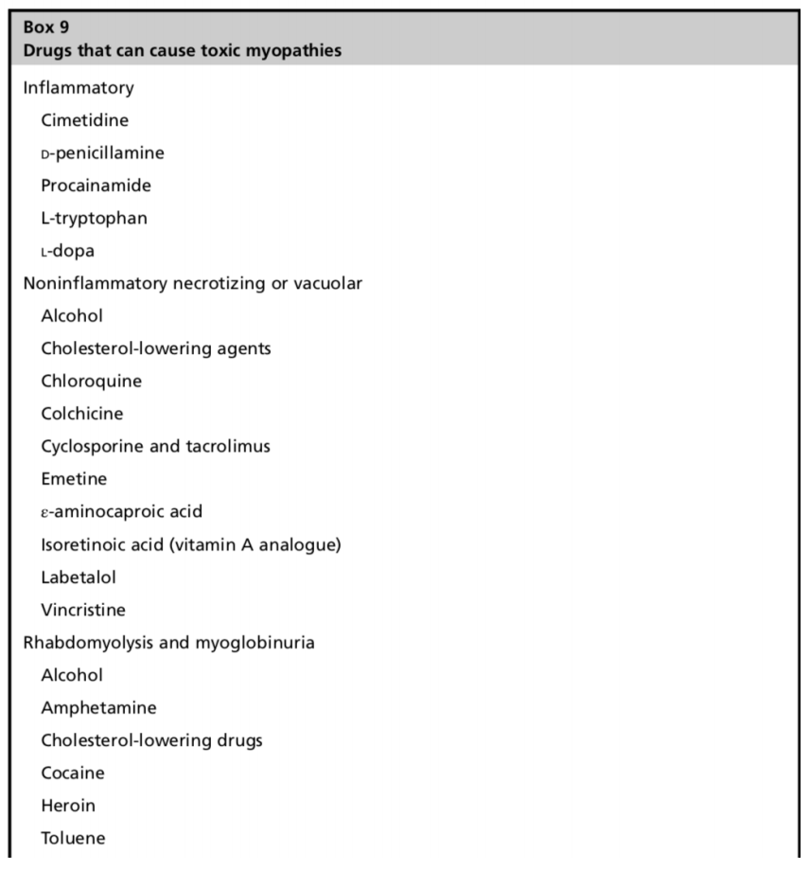
Female Slide
Approach - 6 Questions
Q2: What is the temporal evolution?
Childhood: Duchenne. lots of disorders not only Duchenne.
Adolescence or later: FSHD, LGMD
Adults: inflammatory, toxic & also genetic.
After 50 yrs: Inclusion body myositis (IBM)
Onset
Episodic with normal strength interictal: metabolic or Periodic paralysis
Acute or subacute progression --> inflammatory myopathies (DM/PM)
chronic slow progression over years (most muscular dystrophies)
non-progressive weakness with little change over decades (congenital myopathies).
Tempo
Q3: Is there a family history of a myopathic disorder?
Questions:
Diagnosis of myopathy based on pattern of inheritance
X-linked | Becker muscular dystrophy, Duchenne muscular dystrophy, Emery-Dreifuss muscular dystrophy.
Autosomal dominant | Centre core myopathy, FSH, limb-gridle muscular dystrophy type 1, oculopharyngeal MD, myotonic dystrophy, paramyotonia congenita, periodic paralysis, thomsen disease.
Autosomal recessive | Becker myotonia, limb-gridle muscular dystrophy type 2, metabolic myopathies.
Maternal transmission | Mitochondrial myopathies.
If you get a positive family history; you should have a Pedigree of at least three generations so that you can get an idea about the pattern, is it X-linked, Autosomal dominant, Autosomal recessive or Maternally inherited.
Use of canes or wheelchairs?
Skeletal deformities?
Functional limitations? walking, jumping
Sudden deaths? due to involvement of cardiac muscle
Pacemakers?
Early onset cataracts? Myoclonic dystrophy very common to have cataract.
Deaths/complications from anesthesia? think about malignant hyperthermia-related genes.
Early onset dementia/Paget’s disease of bone?
Q4: Are there precipitating factors that
trigger episodic weakness or stiffness?
Fever, Fasting → carnitine palmitoyltransferase (CPT) deficiency “metabolic myopathy (Lipid-storage myopathies)”
> carnitine palmitoyltransferase (CPT) deficiency
Carbohydrates followed by rest --> Periodic paralysis
Toxic
checkpoint inhibitors, statin → Immune mediated

Slide 7
Female Slide
Approach - 6 Questions
Q5: Are there associated systemic symptoms or signs?
DM = myotonic dystrophy, not diabetes
Cardiac | please don't miss on asking about these symptoms Dystrophinopathy Myotonic dystrophy 1, Myotonic dystrophy 2 LGMD: emery - dreifuss, sarcoglycanopathies, fukutin
Respiratory | Dermatomyositis Acid maltase (adult pompe) CNM, nemaline
Fatty liver | CPT
Cataracts, frontal balding | Myotonic dystrophy
Rash | Dermatomyositis
Early contractures | laminopathy or Emery – dreifuss muscular dystrophy
Systemic organ disease | amyloid, sarcoid, mitochondrial
Q6: What is the distribution of weakness?
1- Inspection:
Exposure
periscapular muscle Atrophy → Facioscapulohumeral dystrophy (FSHD)
Asymmetric quadriceps/forearm flexors → Inclusion body myositis
Hypertrophy? → calf in Duchenne, sarcoglycan, fukutin, sarcoid, amyloid infiltrating the muscles
Abnormal movements(rippling)/myotonia
2- Positions in testing:
Neck flexors supine position, you always want to apply resistant.
Neck extensors prone position
Knee extension & hip flexion seated position
knee flexion prone
Hip abduction lateral decubitus position.
3- Signs:
Scapular winging: FSHD, Pompe (It is a genetic disorder and there's a treatment for it to prevent the progression (enzyme replacement therapy) thus, it’s imp to identify it), Laminopathy, calpain & SLONM
Waddling gait: inflammatory or LGMD
Impaired toe walking (Weakness of calf muscles). “not imp”: dysfrelin, ANO-5
Pointing finger sign: MYH7 “not imp”
Anteverted axillary line, protuberant abdomen, facial and scapular weakness: FSHD
“ very characteristic”

Slide 8
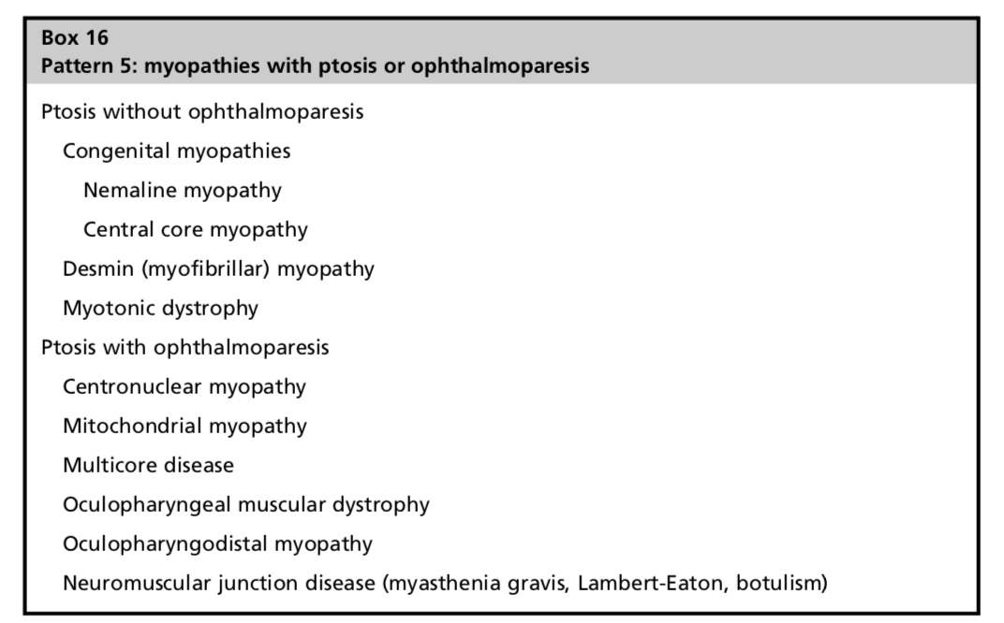
Female Slide
Patterns
Patterns
Pattern 1 - Proximal (Shoulder and/or Pelvic) limb girdle:
Most common
Frequent involvement of neck flexor/extensor
Least specific (the ddx is broad)
Pattern 2 - Distal Weakness:
involves the distal muscles of the upper or lower extremities or both (anterior or posterior compartment muscle groups)
Usually symmetric.
Asymmetric posterior compartment : ANO-5, dysferlinopathy
Anterior compartment with sparing of quadriceps: GNE myopathy, it has some occurrences in the middle east, So pay attention to it, because it is one of the rare diseases that have sparing of quadriceps.
Finger flexor & quadriceps: IBM
Finger extensor: TIA1 (Welander) rare, don’t worry about it.
Rule out neuropathy! localize first then think about aetiology
Pattern 3 - Proximal Arm/Distal Leg Weakness (Scapuloperoneal):
Can be very asymmetric
When associated with facial weakness your #1 DDx will be : FSHD (Especially when it is slowly prgressive)
Laminopathies (emery dreifuss) frequently associated with cardiac arrhythmias , VCP, calpain.
Pattern 4 - Distal Arm/Proximal Leg Weakness:
Distal forearm muscles (wrist and finger flexors) + proximal leg (quadriceps)
Facial muscles typically spared
Usually Asymmetric: IBM
Symmetric: IBM, myotonic dystrophies
Pattern 5 - Ptosis with or Without Ophthalmoparesis:
Ocular involvement: ptosis and ophthalmoparesis
Usually (not always) occurs without diplopia bc it's usually so slow Pt won't develop diplopia, just amblyopia of one eye
Facial weakness: not uncommon (usually you don’t see it)
Extremity weakness : variable, depending on the diagnosis.
Ptosis, ophthalmoparesis without diplopia, and dysphagia → Oculopharyngeal muscular dystrophy (OPMD)
Ptosis + ophthalmoparesis without prominent pharyngeal
Involvement > mitochondrial myopathies.

Slide 9
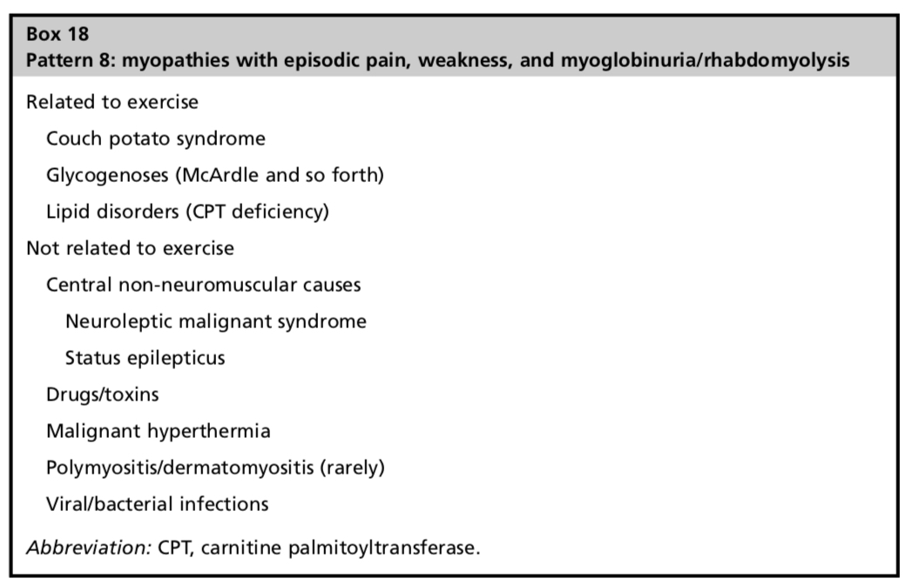
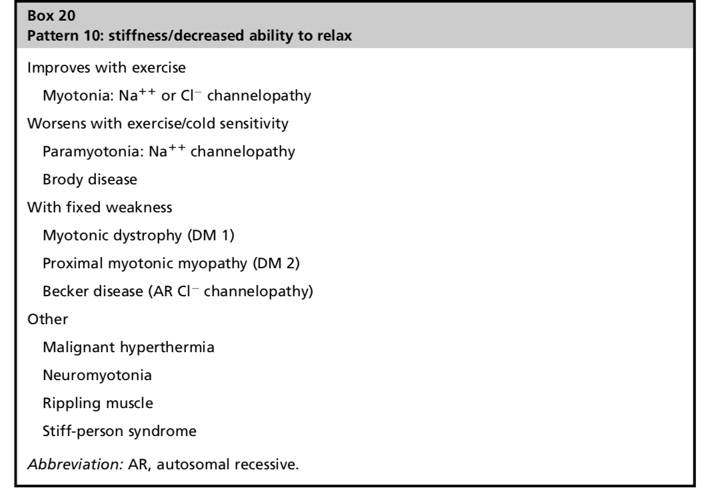
Female Slide
Patterns
Patterns cont.
Pattern 6 - Prominent Neck Extensor Weakness:
Severe weakness of the neck extensor muscles → Dropped head syndrome
or mild that they complain of difficulty stabilizing the neck while running.
Limb and neck flexor involvement : variable
Rule out ALS or Myasthenia gravis
Pattern 7 - Bulbar Weakness:
Tongue and pharyngeal weakness
Acquired: sarcoid, pompe, necrotizing autoimmune myositis (NAM), inflammatory myopathy
Hereditary: OPMD, myotilin
Pattern 8 - Episodic Pain, Weakness, and Myoglobinuria:
Episodic pain, weakness, +/- myoglobinuria
May be related to a variety of conditions (non muscle)
Triggered by exercise à metabolic myopathy likely
Pattern 9 - Episodic Weakness Delayed or Unrelated to Exercise:
Periodic Paralysis: genetic AD and secondary (thyrotoxicosis)
Rule out NMJ can present with episodic weakness that exacerbated with exertion or infection
Pattern 10 - Stiffness and Decreased Ability to Relax:
Dystrophic and non-dystrophic myotonia
An area for your notes or something..

Slide 10
EXTRA
Summary of Patterns
 | Weakness |  |  |  | Episodic | Trigger | Diagnosis
 | Proximal | Distal | Asymmetric | Symmetric
Pattern 1: Limb girdle | + |  |  | + |  |  | Most myopathies, hereditary and acquired
Pattern 2*: Distal |  | + |  | + |  |  | Distal myopathies (also neuropathies)
Pattern 3: ProximaL arm / distal leg scapuloperoneal | + Arm | + Leg | + (FSH) | + (Others) |  |  | FSH, Emery-Dreifuss, acid maltase, congenital scapuloperoneal
Pattern 4: Distal arm/proximal leg | + Leg | + Arm | + |  |  |  | IBM Myotonic dystrophy
Pattern 5 : Ptosis/ Ophthalmoplegia | + |  | + (MG) | + (Others) |  |  | OPD, MG, myotonic dystrophy, mitochondria
Pattern 6*: Neck, extensor | + |  |  | + |  |  | INEM, MG (also ALS)
Pattern 7*: Bulbar (tongue, pharyngeal) | + |  |  | + |  |  | MG, LEMS, OPMD (also ALS)
Pattern 8: Episodic weakness/Pain/rhabomyolysis + trigger | + |  |  | + | + | + | McArdle’s, CPT, drugs, toxins
Pattern 9: Episodic weakness Delayed or unrelated to exercise | + |  |  | + | + | +/- | Primary periodic paralysis Channelopathies: - Na++ - Ca++ - Secondary periodic paralysis
Pattern 10: Stiffness/ inabilty to relax |  |  |  |  | + | +/- | Myotonic dystrophy, channelopathies, rippling muscle (other: stiff-person, neuromyotonia)
Abbreviations: ALS, amyotrophic lateral sclerosis; CPT, carnitine palmityl transferase; FSH, facioscapulohumeral muscular dystrophy; LEMS, lambert-eaton myasthenic syndrome; MG, myasthenia gravis; OPMD, oculopharyngeal muscular dystrophy; PROMM, proximal myotonic myopathy. * Overlap pattern with neuropathy/motor neuron disease.
An area for your notes or something..

Slide 11
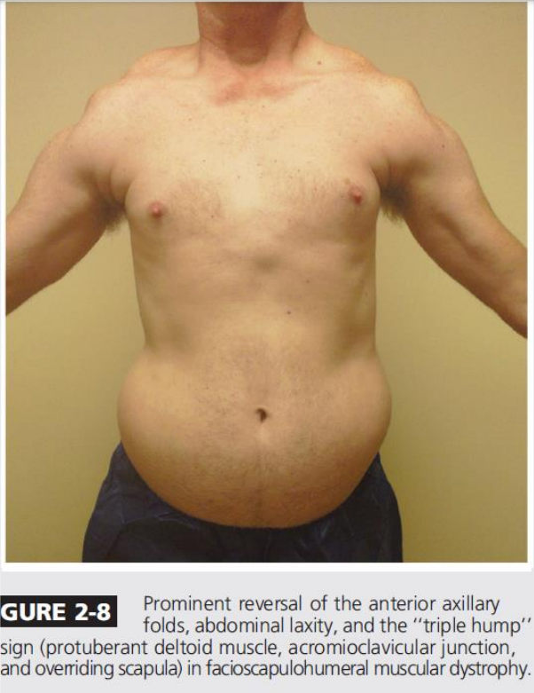
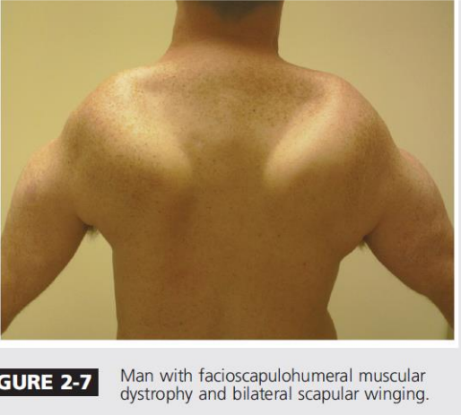
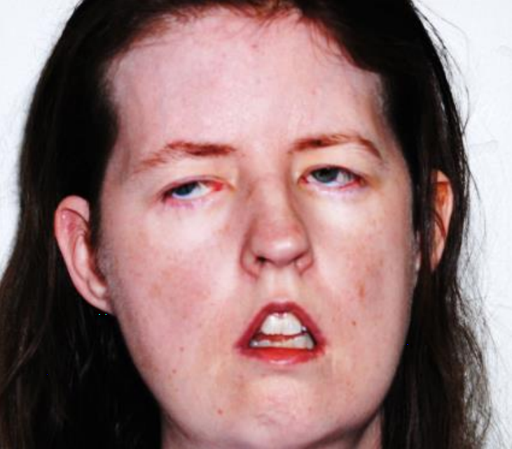
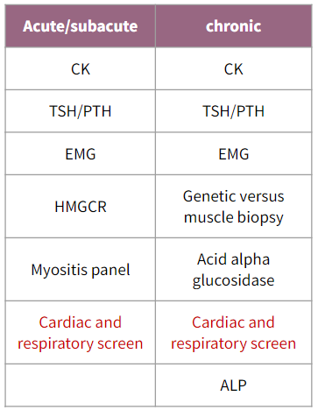
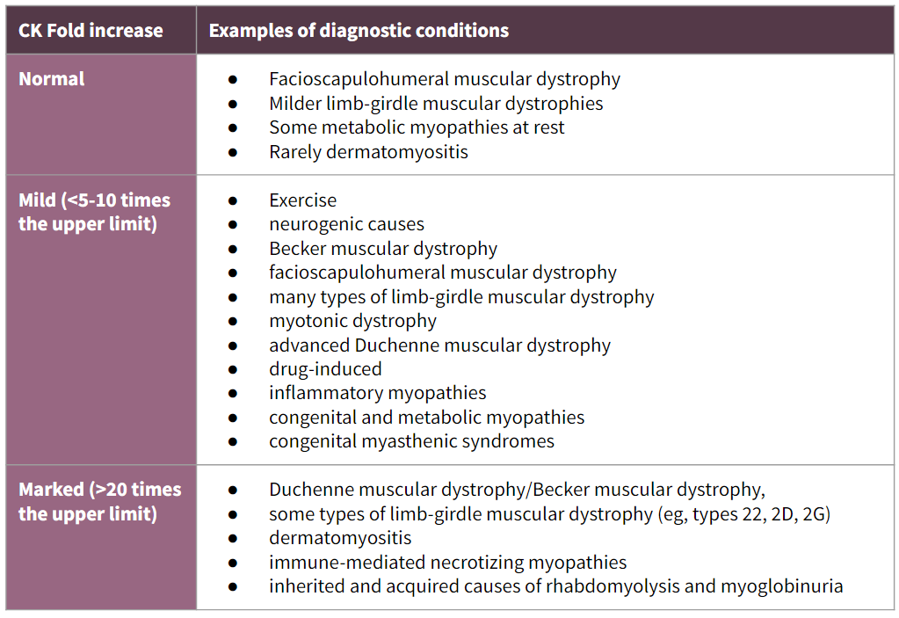
Physical exam & Labs
Physical examination
General: wasting, myopathic facies
Vital signs: bradycardia, irregular due to involvement of cardiac muscle.
Specific pattern of weakness and atrophy:
limb-girdle “commonest”, weakness in the proximal UL and LL.
scapuloperoneal (scapular or leg muscles)
distal “rare”
facioscapulohumeral
ocular, etc
Gait examination:
Waddling or trendelenburg gait is indicative of proximal muscle weakness (it’s not specific for muscle disease).
Functional testing
Systemic examination
Cardiac: heart failure
Respiratory: fibrosis, respiratory distress
Myopathic facies:
- flattening of frontalis muscle, ptosis in both eyes, tented mouth (due to weakness of the facial muscles)
- it indicates chronic long standing myopathy
Acute/subacute | chronic
CK | CK
TSH/PTH | TSH/PTH
EMG | EMG
HMGCR | Genetic versus muscle biopsy
Myositis panel | Acid alpha glucosidase
Cardiac and respiratory screen | Cardiac and respiratory screen
 | ALP
Investigations
Muscle Enzymes | Serum Creatinine Kinase
Other investigations | MRI: Shows pattern of muscle involvement and features of inflammation, Can’t identify the exact etiology Muscle biopsy: Essential for the diagnosis of inflammatory myopathies Genetic testing: for specific syndromes ELECTROMYOGRAPHY (EMG) Normally we see motor unit potential Small units with early recruitment May see and hear myotonic discharges NERVE CONDUCTION STUDIES (NCS)
For acute, you want to rule out the immune disorders. So, do immune myositis panel and HMGCR.
Serum Creatinine Kinase
CK is an enzyme composed of muscle (M) and brain (B) monomers, resulting in MM, MB, and BB isoenzymes
What we usually look for is MM, also in the lab we can measure total CK (including MM,MB,BB)
Elevated CK may be seen with:
Muscle disease (not all muscle diseases cause elevated CK e.g. facioscapulohumeral has normal CK)
Nerve, and motor neuron disorders
Strenuous exercise
intramuscular injections, seizures or muscle trauma

Slide 12
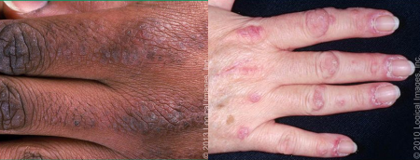
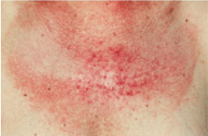
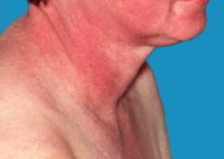
Inflammatory Myopathies
Dermatomyositis (DM)
Idiopathic inflammatory myopathy
A form of small vessel vasculitis, affects any age (children & adults) with more incident in females (2:1)
Proximal muscle weakness more than distal,
Usually affecting the lower limbs (legs) more than the upper limbs (arms)
The weakness start acutely (over several weeks) or insidiously (over months)
Difficulties in swallowing, chewing, and speaking occur in⅓
DM is primarily distinguished from PM by the characteristic rash.
The characteristic cutaneous findings occur in children and adults
Signs & symptoms:
Gottron’s Papule
- Pathognomonic for DM
- Violaceous scaly papules overlying the joints on the dorsal hand.
- Pathognomonic for DM
- Violaceous eruption on the upper eyelids, sometimes associated with periorbital edema
Heliotrope Rash
• Increased risk of cancer (up to 40% of adults)
• Breast (mammogram), ovarian, lung, pancreatic, NHL, stomach, colorectal, melanoma, GI.
PM is also Associated with malignancy, but less than DM.
•can also predate the onset of myositis, particularly in males with DM.
Malignancy
Shawl sign
- Erythematous rash covering the upper arms and shoulders or a V-shaped rash affecting sun-exposed surfaces on the upper chest.
Eruptions
Others
Eruptions on:
predominantly on photo-exposed surfaces
along the eyelid margins, with or without periorbital edema
the dorsal hands, particularly over the knuckles
the upper outer thighs
Pruritus of skin lesions, sometimes intense enough to disturb sleep
Erythema of the mid-face
Changes in the nailfolds of the fingers
Scaly scalp or diffuse hair loss

Slide 13
Inflammatory Myopathies
DM most frequently affects the skin and muscles but may also affect the
joints;
Esophagus causing Dysphagia and delayed gastric emptying
Lungs (Respiratory muscle weakness “dyspnea and orthopnea”)
less commonly, the heart (Cardiomyopathy).
Systemic features of fever, weight loss and fatigue are common
Periungual nail-fold capillaries are often enlarged and tortuous.
Polyarthritis, Raynaud's phenomenon
interstitial lung disease (antisynthetase syndrome)
Non-Skeletal Manifestations :
Antisynthetase syndrome:
Some people with PM or DM have antibodies to tRNA synthetase enzymes. These people are more likely to develop:
Pulmonary interstitial fibrosis
Raynaud's phenomenon
arthritis
Hardening and fissuring of skin over the pulp surface of the fingers (mechanic's hands).
This variant of PM/DM is sometimes called anti-synthetase syndrome and often has a poor outcome. Respiratory muscles are affected in PM/DM and this compounds the effects of interstitial fibrosis. Dysphagia is seen in about 50% of patients owing to esophageal muscle involvement.
Polymyositis (PM)
The clinical picture is dominated by inflammation of striated muscle, causing proximal muscle weakness. When the skin is involved, it is called 'dermatomyositis
Presents mainly in adults (> 20 years), women > men. it can be Acute or insidious (weeks-months).
The shoulder and pelvic girdle muscles become wasted but are not usually tender
As the disease progresses, involvement of pharyngeal, laryngeal and respiratory muscles can lead to dysphonia and respiratory failure.
Can have malaise, Dysphagia, fever, weight loss and anorexia, NO skin rash.
Extraocular, facial and distal limb muscles are spared
Associated with malignancy (less than DM)
Cardiac myositis (arrhythmia, heart failure)
Polyarthritis in 45%, positive ANA in 40%

Slide 14
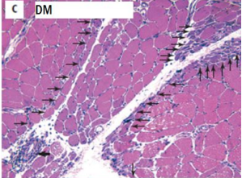
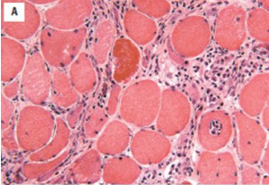
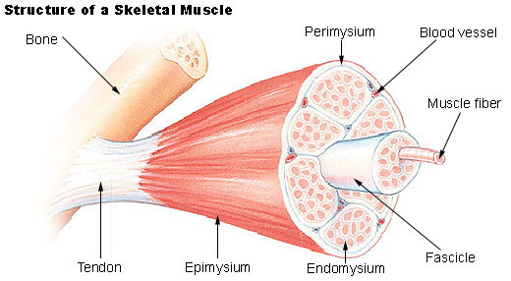
Inflammatory Myopathies
Diagnosis of PM & DM
Serum Creatine kinase
The best initial test is CPK and aldolase Serum CK in DM: Can be elevated or normal Serum CK in PM: Should always be elevated (x5 folds) Serum CK is a useful measure of disease activity, although a normal levels does not exclude the diagnosis
Muscle biopsy & MRI
Muscle biopsy is the pivotal investigation (most accurate test)! it is indicated to confirm diagnosis MRI should be used to identify areas of abnormal muscle for biopsy. Muscle MRI: Edema, inflammation, fibrosis, calcification or fatty replacement of muscle tissue.
Dermatomyositis |  | Polymyositis
Antibodies-mediated
Perifascicular atrophy:
● Pathognomonic.
● Sublethal myofiber stress and ischemia at the interface of the muscle fascicle and the perimysium.
Inflammation:
● Inflammation in perimysial blood vessels
● CD4+ plasmacytoid dendritic cells.
● Complement activation (MAC) and deposition on capillaries.
In DM, Perimysial and perivascular infiltration of CD4+ cells, and because of that:
We see skin changes in DM but not in PM
Biopsy:
Peripheral atrophy
the center of the muscle is preserved, unlike PM where there is necrosis!
Cellular-mediated
Inflammatory cells (CD8+ T cells) invading non-necrotic, healthy muscle fibers.
Invaded muscle fibers express MHC-1
No perifascicular atrophy.
No immunoglobulin deposition
No complement deposition.
In PM, Intrafascicular, Endomysial infiltration of CD8+ T cells, and because of that:
We DO NOT see skin changes in PM
Biopsy:
Central Necrosis

Slide 15
Inflammatory Myopathies
Diagnosis of PM & DM (Cont..)
Autoantibodies
Others
Anti–synthetase antibodies: commonest anti-Jo-1 ( associated with dermatomyositis), also anti-PL-7, anti-PL-12, etc.
interstitial lung disease is strongly associated with the presence of antisynthetase (Jo-1) antibodies
Myositis-specific antibodies: Anti–Mi-2, anti-MDA5 (CADM-140), anti p155/140 or anti-MAS
ANA can be positive
↑ Other enzymes
Aldolase B
AST and ALT
EMG: Myopathic pattern
Short-duration spiky polyphasic muscle action potentials are seen. Spontaneous fibrillation is occasionally recorded.
Management of PM & DM
Steroids (Oral prednisolone is the treatment of choice)
high-dose intravenous methylprednisolone may be required in patients with respiratory or pharyngeal weakness
Some require high dose for long time.
There is risk of opportunistic infections (PCP), osteoporosis, cataract, weight gait, etc
Monitor blood glucose, serum potassium levels, BP, and eyes
One risk of treatment is glucocorticoid-induced myopathy. If the initial response to treatment is poor, further biopsy then shows type II fibre atrophy in glucocorticoid myopathy (compared with fibre necrosis and regeneration in active myositis).
Steroid-sparing therapy: Methotrexate, azathioprine, mycophenolate, etc
Although most patients respond well to glucocorticoids, many need additional immunosuppressive therapy.
Methotrexate and MMF are the first choices of many but azathioprine and ciclosporin are also used as alternatives
In clinical practice, rituximab is an option for use with glucocorticoids, to maintain an early glucocorticoid-induced remission.
Intravenous immunoglobulin (IVIg) may be effective in refractory cases.
Mepacrine or hydroxychloroquine has been used for skin predominant disease
Screening for underlying malignancy should be undertaken routinely (full examination, chest X-ray, serum urine and protein electrophoresis, colonoscopy, CT of chest/abdomen/ pelvis, or PET scan; prostate-specific antigen should be included in men, and mammography in women), CA-125 and CA-19-9
Exclude cardiac and pulmonary involvement (PFTs with diffusion capacity, ECG, esophageal manometry)
Physical therapy & Occupational therapy
Evaluate coexisting autoimmune disorders (ANA)
PM & DM can be part of an overlap syndrome:
Associated with another well-defined connective tissue disorder
Scleroderma, mixed CTD, Sjögren, SLE, or RA.

Slide 16
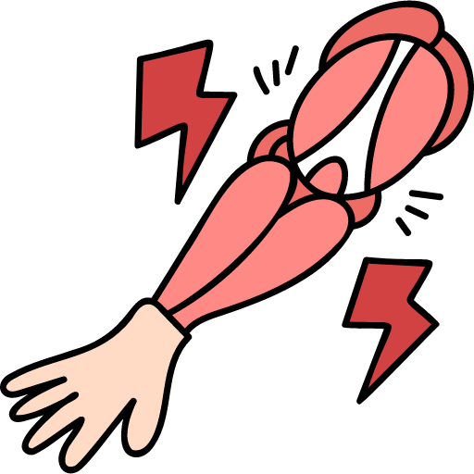
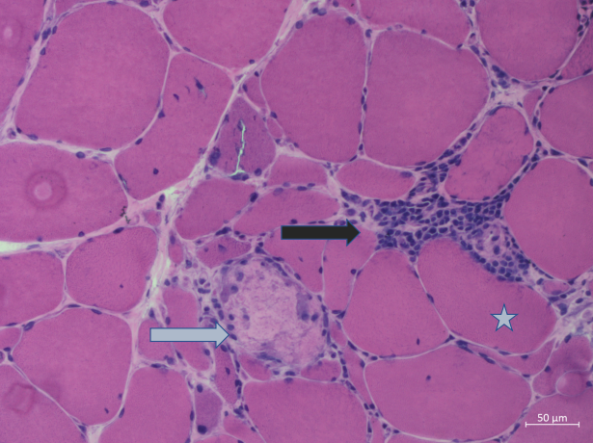
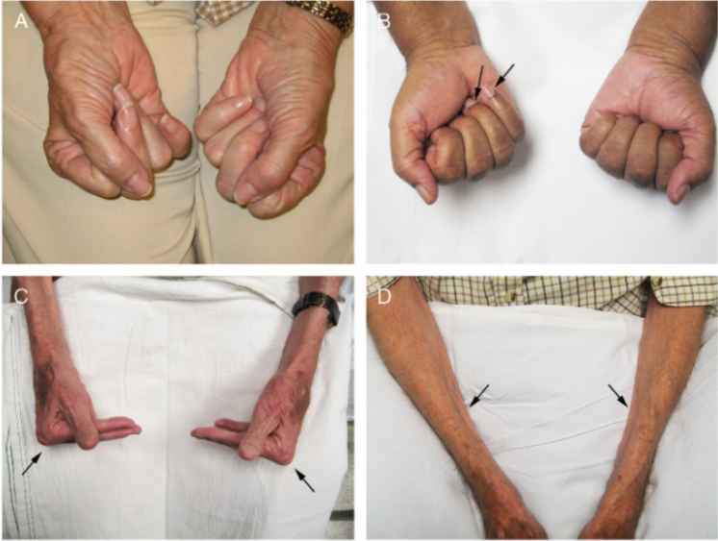
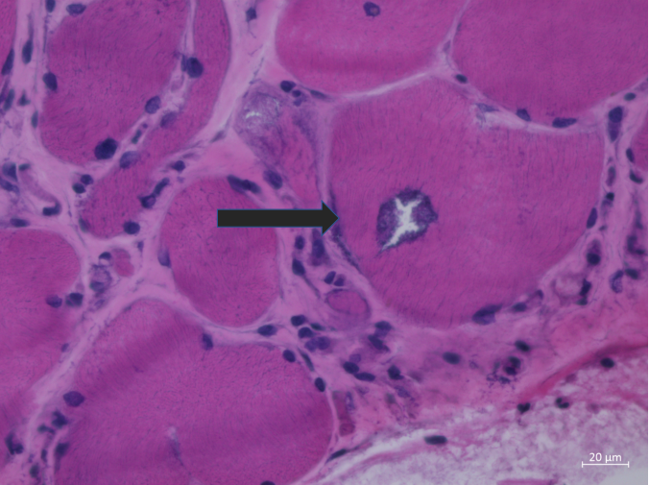
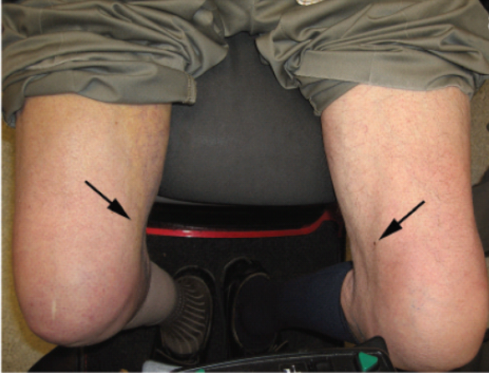
Inflammatory Myopathies
Inclusion Body Myositis (IBM)
Common after age 50, (prevalence:35-71/1000000 ) with M:F → 2:1
It is a slowly progressive Asymmetric inflammatory/degenerative myopathy
Weakness of mainly distal muscles
Unique clinical and pathological features
Treatment:
Supportive.
Relentless progression, lacks effective therapies
Clinical presentation
Quadriceps muscle weakness (Thigh): knees lack support → frequent falling
Usually spares rectus femoris muscle
+/- long finger Finger flexors: difficulties gripping, e.g., shopping bags or a briefcase
Paraspinal muscles: Camptocormia or dropped head syndrome
Severe Oropharyngeal dysphagia: 40–86% (upper esophageal sphincter dysfunction)
Heart muscle: usually unaffected.
Biceps, foot dorsiflexors
Thigh & finger flexors weakness is a common pattern in IBM!
Inflammatory cells invading non-necrotic muscle fibers
Finger flexion
Rimmed vacuoles
Asymmetric atrophy of the quadriceps,
EMG shows irritable myopathy.
both myopathic and neuropathic changes.
Biopsy suggestive of IBM (most accurate test):
- Endomysial inflammation
- Rimmed vacuoles.
- Inflammatory cells invading non-necrotic muscle fibers.
Definitive diagnostic feature is
Filamentous inclusions and vacuoles
Inclusion body myositis is the “oddball of inflammatory myopathies” for the following reasons:
Affects male patients more than female patients
Absence of autoantibodies
Distal muscle involvement,
CK is only slightly elevated or normal; prognosis is poor.
On MRI, the changes are often more distal but can be similar to those of polymyositis

Slide 17
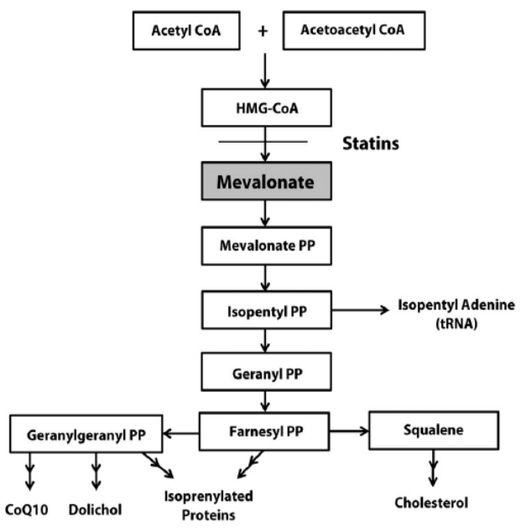
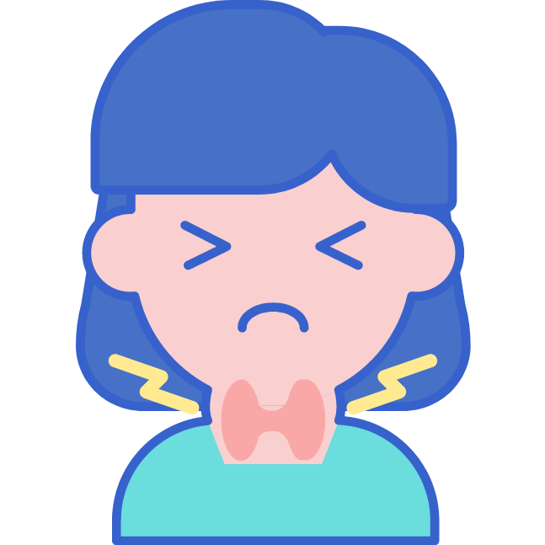
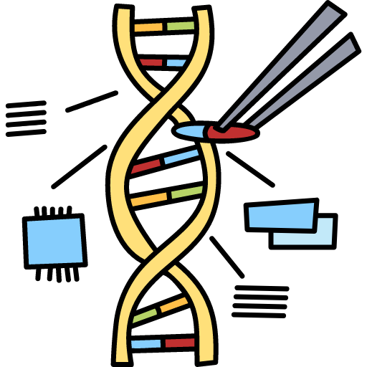
Males Slide
Drug Induced Myopathies
Steroid myopathy
Cause
Investigations
Mechanism
Chronic exposure to high-dose oral steroids.
As short as few weeks of proximal weakness.
CK: normal.
EMG: normal or it might show myopathic features.
Biopsy: type 2 fiber atrophy and lipid accumulation in type 1 fibers.
↓protein synthesis.
↑ protein degradation.
Alterations in carbohydrate metabolism.
Mitochondrial dysfunction.
↓ reduced sarcolemmal excitability
Statin Induced Myopathy
Mild statin-associated myalgia or cramps
Myopathic weakness
In most cases, both mild and severe side effects are self-limiting
Severe myotoxicity or rhabdomyolysis, rare
Statins inhibit HMG-CoA reductase, rate-limiting enzyme of cholesterol biosynthesis. Can cause:
Rarely, statins can cause an Immune-Mediated Necrotizing Myopathy with very high CK and antibodies to Anti-HMG CoA-reductase
Discontinuation of the statin → resolution of symptom
Mechanism (not important)
↓Mevalonate → ↓ farnesyl pyrophosphate and geranylgeranyl pyrophosphate → ↓ protein prenylation
Reduced prenylation of proteins causes:
impaired ubiquinone synthesis → mitochondrial dysfunction.
Impairment GTPases that promote cell survival →cell death.
Impairment of the process of Nglycosylation → defective proteins → muscle cells damage.
Risk factors
Older Age
Obesity
Type & Dose of statin:
fluvastatin and pravastatin are worse than rosuvastatin
Hypothyroidism
Genetic susceptibility: SLCO1B1 gene.
Preexisting liver disease → reduce metabolism of statin
Liver enzyme inhibitors → increase levels of statins

Slide 18
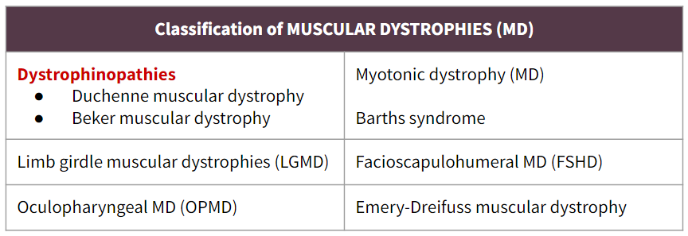
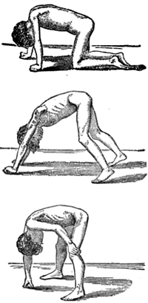
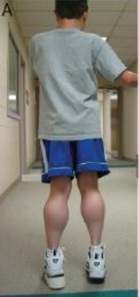
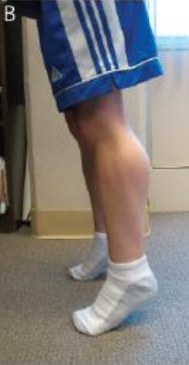
Muscular Dystrophies
Inherited myopathies caused by mutation in genes that are important in maintaining the structure of muscle fibers
Progressive degeneration of the muscles with connective tissue or fat replacing muscle fibers. Variable age at onset
Systemic involvement
Screening for an associated cardiac abnormality (cardiomyopathy or dysrhythmia) is important.
Dystrophinopathies: DMD & BMD
They are x-linked recessive disorders (manifest in males). Duchenne (early age) and becker (late age).
Mutation in the dystrophin gene (Xp21) → absent (in duchenne) or reduced (in becker) Dystrophin protein → loss of mechanical reinforcement to the sarcolemma and instability of the glycoprotein complex → Degeneration of muscle fibers.
Duchenne is the Most common dystrophy
Duchenne Muscular Dystrophy (DMD)
Features:
Symmetrical progressive (Proximal > distal) muscle weakness (Legs & Arms)
Course: Onset age 2 to 5 yrs, There is reduction in the motor function by 2 to 3 years with a steady decline in strength after 6 to 11 years.
Can’t jump or climb at 5-6 years
Wheelchair at 10 (13) years of age
Gower’s sign: Standing up with the aid of hands pushing on knees (because the weakness in the proximal lower extremity muscles makes it difficult to arise without support.)
Loss of ambulation at age 9-13 years. Later resolved with: Steroid treatment. (Prednisone)
Weak knee extensors → toe walking.
Muscle hypertrophy: Especially calf. It starts with true muscle hypertrophy at first, followed by pseudo- hypertrophy as fat & CT replaces muscle, muscles are degenerated and replaced
It may be generalize and increases with age.
There is Sparing of the cranial muscles !
Death: 15-30(25) years.
Typical presentation: A boy who noticed to have difficulty running and rising to his feet; he uses his hands to climb up his legs (Gowers' sign}. There is initially a proximal limb weakness with calf pseudohypertrophy. The myocardium is affected. Severe disability is typical by the age of 10
Complications:
Dilated cardiomyopathy: common after age 15
Respiratory failure
Malignant Hyperthermia like reactions with rhabdomyolysis
Kypho-Scoliosis because of the weakness
Exaggerated lumbar lordosis
Cognitive impairment, Mental retardation, learning disabilities,
Contractures
Gower’s sign

Slide 19
Dystrophinopathies: DMD & BMD
Duchenne Muscular Dystrophy (DMD) (Cont..)
Investigations:
CK: very high, usual is 100 X ULN (Initial test)
Muscle biopsy: variation in muscle fibre size, necrosis, regeneration and replacement by fat. on immunochemical staining, absent dystrophin staining.
Genetic testing is gold standard: Detect dystrophin gene mutation
Management: Glucocorticoids !
Steroids slow the progression of the disease.
Patient usually die at the age of 15 but they can live up to the age of 30 years with steroids.
Stabilizes sarcolemma
Increases strength, muscle, and pulmonary functions
Anabolic action in contrast to its catabolic action on normal skeletal muscle in unaffected people.
Reduces cardiomyopathy and lowers mortality
Other Management:
Screening and treatment of cardiac, respiratory, gastrointestinal, and orthopedic complications.
Screening for osteoporosis
Physical therapy, occupational therapy and bracing
Avoidance of anesthesia and sedation if possible
BECKER Muscular Dystrophy (BMD)
01
Midler form, Older age at onset, Muscle weakness starts from > 7 yrs.
Investigations:
02
Proximal > Distal; Symmetric; Legs & Arms. Maybe especially prominent in quadriceps or hamstrings.
High CK: 2000 to 20,000
Muscle biopsy: decreased staining patterns rather than complete absence of dystrophin ( Partial loss of dystrophin staining )
Genetic testing is gold standard.
03
The severity & onset age correlate with muscle dystrophin levels.
04
Slowly progressive. “Becker is Better.”
Loss of ambulation usually in the 4th decade.
Failure to walk 16 - 80 years.
05
they usually have myalgias and Muscle hypertrophy: Especially calf.
Calf pain on exercise.
Cardiomyopathy may occur before weakness.

Slide 20
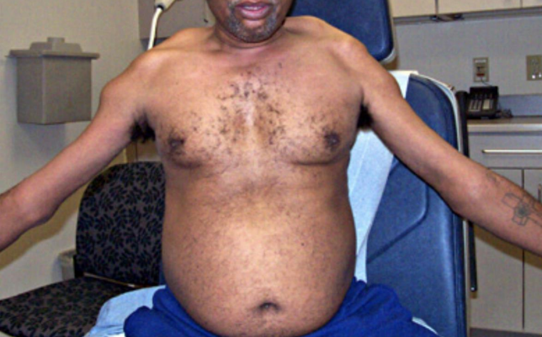
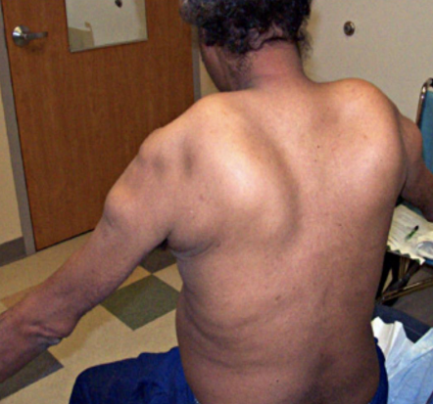
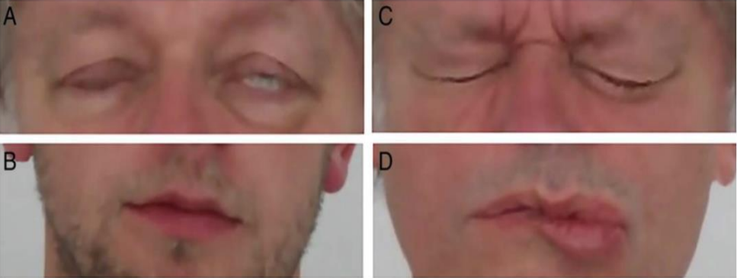
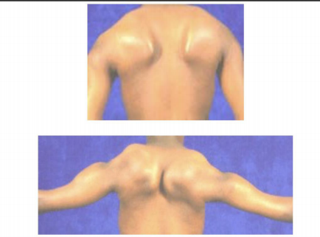
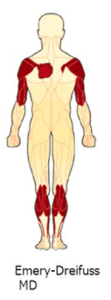
Female Slide
Muscular Dystrophies
Facioscapulohumeral dystrophy
The 3rd most common dystrophy in adult (Autosomal dominant).
Manifestations are Asymmetrical
Face: Initial manifestation, 95% you will detect it at the age of 30 with examination
Eyes: Often early in disease course
Lid closure: Incomplete
Sleeping: With eyes partially open
Shoulder: Pain in shoulder girdle, scapular winging, triple humb
Ear: deafness
Bulbar dysfunction: eg. inability to use straws, blowing a balloon
Using straws - blowing up balloons
Protuberant abdomen
Screen for:
Hearing loss
Retinal vascular disease
No screening for cardiac needed unless symptomatic
Cardiorespiratory involvement rare
Emery – dreifuss muscular dystrophy
Autosomal dominant or recessive With more than 7 subtypes with various genes.
Age: Neonatal hypotonia to 3rd decade; Mean in teens.
Function: Difficulty walking or climbing stairs.
Weakness: Humeroperoneal
Bilateral
Symmetrical
Arms: Biceps & triceps; Deltoids spared.
Scapular winging
Legs: Involved later on.
Face: Mild weakness or normal
Contractures occurs before weakness and it is often more limiting to function than weakness.
in elbow, achilles tendon
Spine:
Posterior neck (extension)
Lower back: Usually later onset, but may present with rigid spine syndrome.
Testing:
CK, EMG
Cardiac screening for arrhythmia and cardiomyopathy
A lot of doctors would put them on prophylactic pacemakers, even if they don't have anything. because cardiac involvement may lead to death
Humeroperoneal
weakness
(EXTRA)

Slide 21
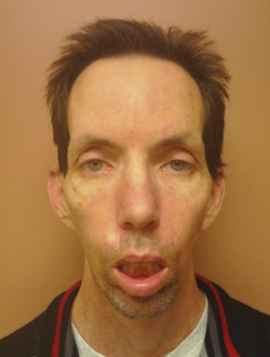
Muscular Dystrophies
Myotonic Dystrophy
The most prevalent inherited neuromuscular disease in adults (Autosomal dominant).
Tandem repeats¹ at DMPK gene² (Anticipation phenomenon)
Every generation will have earlier onset
Characterized by progressive symmetrical muscle wasting and weakness
Weakness is usually proximal, except in myotonic dystrophy type 1, when it is distal.
Prolonged muscle contractions (myotonia) and are not able to relax certain muscles after use (percussion and grip myotonia).
difficulty releasing hand grip on a doorknob or handle.
Slurred speech or temporary locking of their jaw
Frontal balding,
Cardiorespiratory weakness:
arrhythmias, heart failure, sudden death, conduction defects & orthopnea
Endocrine: NIDDM, hypothyroidism, male hypogonadism
GIT: dysmotility (and aspiration), constipation and diarrhea
Others: Cataracts, cognitive impairment & Low IQ
³
LABS
CK: Usually elevated
EMG: myopathic plus myotonic discharges.
ECG, echo: to look for arrhythmias
Genetic testing (confirmatory test): type 1 and type 2.
Type of myotonic dystrophy | Genetics Autosomal dominant | Muscles affected | Other features
Type 1 (Age: Any) | Expanded triplet repeat chromosome 19q | Face (including ptosis) sternomastoids Distal limb Generalised later | Myotonia Cognitive impairment Cardiac conduction abnormalities Lens opacities Frontal balding Hypogonadism
Type 2 (Age: 8-50 yrs) | Quadruplet repeat expansion in Zn finger protein 9 gene chromosome 3q | Proximal, especially thigh Sometimes muscle hypertrophy | As for DM1 but cognition not affected Muscle pain
1- when you have a mutation in the gene that causes excessive transcription of that gene, so instead of having on copy you will have multiple copies, and each generation you will have more and more copies leading to “Anticipation”, the fathers will have the phenotype and the sons will have even worse phenotype and so on…
2- important for stabilizing muscle membrane.
3- features of myopathic facies with ptosis, frontal balding, wasting of the temporalis muscle & other muscles of mastication, bilateral facial muscle weakness and tented mouth.

Slide 22
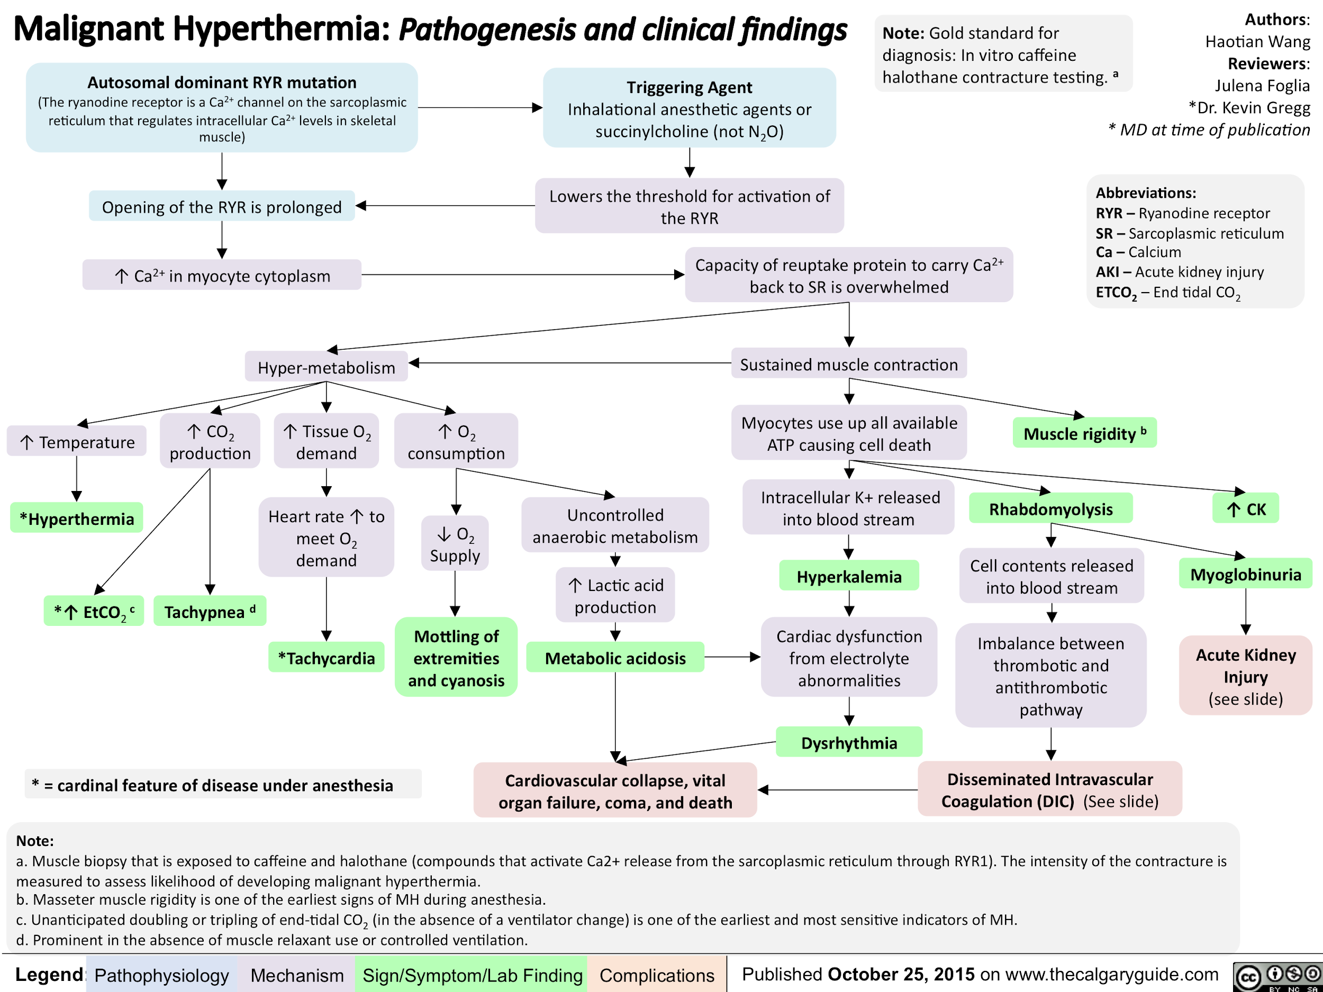
Males Slide
Malignant Hyperthermia (MH)
Uncontrollable contraction of skeletal muscle that leads to a life-threatening hypercatabolic state and increase in body temperature
Genetic mutations → calcium accumulation
due to a genetic defect in the sarcoplasmic reticulum calcium release channel of the muscle ryanodine receptor, RyR1.
Triggered:
Anesthetics
Depolarizing neuromuscular blocking agents
CAN BE FATAL! (most common cause of death during general anaesthetic)
Accumulation of Ca
Sustained muscle contraction
Depletion of O2, anaerobic metabolism, acidosis
Rhabdomyolysis
Clinical features
Tachypnea, tachycardia
Rigidity
Acidosis
Hyperkalemia
Rhabdomyolysis
High CK
Hyperthermia.
Extra
Treatment
Remove anesthetic agent.
Core cooling
Dantrolene sodium: An inhibitor of calcium release from the sarcoplasmic reticulum.

Slide 23
Rhabdomyolysis
Definition
Acute Syndrome of muscle necrosis due to extensive injury of skeletal muscle with release of intracellular muscle materials into the circulation.
Causes
Most common causes | Exercise Drugs Alcohol | Common etiologies | Metabolic myopathy: Glycogen, lipid, mitochondrial Statins Muscular dystrophy: baseline ck high Malignant hyperthermia !
More likely hereditary etiology: | Rhabdomyolysis on minimal exertion or fasting Family history Multiple episodes
Presentation & Complications
Clinical features
Complications
Muscle Pain, Swelling
Muscle Weakness (Proximal > Distal)
Cola or tea color “dark” urine (Myoglobinuria)
Elevated blood and urine myoglobin
Fever, leukocytosis
Markedly elevated CK (1500 to >100,000) usually >30000
Might be asymptomatic
↑ K+ → arrhythmia → death
Myoglobin can block the tubules in the kidney causing Acute kidney injury.
↑PO4. ↓Ca. ↑Uric acid
Metabolic acidosis due to kidney injury.
Compartment syndrome
if the muscle is severely damaged it will be swollen and this will lead to compartment syndrome causing ischemia to the muscle.
Management
IV hydration to avoid acute tubular necrosis (ATN) and renal failure !!!
Correct electrolyte
Monitoring for potassium complications
Other treatment according to underlying etiology.

Slide 24
Inflammatory Myopathies | Polymyositis (PM): inflammatory myopathy affecting the proximal skeletal muscles Dermatomyositis (DM): inflammatory myopathy that presents similarly to polymyositis, with the addition of skin involvement Inclusion body myositis (IBM):
 | Skin features (Specific for DM): Gottron papules, heliotrope rash, and the shawl sign Malignancies are associated with DM > PM Patients with IM typically complain of muscle weakness with difficulties reaching overhead, climbing the stairs, and/or standing up. Advanced disease may present with dysphagia and aspiration because of oropharyngeal muscle involvement, or even respiratory failure if breathing muscles are affected. DM is primarily distinguished from PM by the characteristic rash. The best initial test is CPK and aldolase Muscle biopsy is the pivotal investigation (most accurate test)! DM: Perifascicular atrophy PM: No Perifascicular atrophy interstitial lung disease is strongly associated with the presence of antisynthetase (Jo-1) antibodies Management: Steroids & screen for underlying malignancies
Inclusion body myositis | Inclusion body myositis (IBM): inflammatory myopathy affecting both the proximal and distal skeletal muscles (mainly Distal). Common after age 50 Quadriceps muscle weakness (Thigh): knees lack support → frequent falling Usually spares rectus femoris muscle +/- long finger Finger flexors: difficulties gripping, e.g., shopping bags or a briefcase Severe Oropharyngeal dysphagia Biopsy (most accurate test): Inflammatory cells invading non-necrotic muscle fibers, Rimmed vacuoles. Relentless progression, lacks effective therapies
Drug Induced Myopathies | Steroid myopathy: due to chronic exposure to steroids Biopsy: type 2 fiber atrophy and lipid accumulation in type 1 fibers. Statin Induced Myopathy: Statins inhibit HMG-CoA reductase, rate-limiting enzyme of cholesterol biosynthesis. Can cause: Discontinuation of the statin → resolution of symptom
Dystrophinopathies | They are x-linked recessive disorders (manifest in males). Duchenne (early age) and becker (late age). Mutation in the dystrophin gene (Xp21) → absent (in duchenne) or reduced (in becker) Dystrophin DMD: Symmetrical progressive (Proximal > distal) muscle weakness (Legs & Arms) Course: Onset age 2 to 5 yrs, Wheelchair at 10/ Gower’s sign, Loss of ambulation at age 9-13 years, Muscle hypertrophy: Especially calf Dilated cardiomyopathy: common after age 15 (usually the cause of death) Becker: Older age at onset, Muscle weakness starts from > 7 yrs. Slowly progressive. “Becker is Better.” Loss of ambulation usually in the 4th decade Investigations & Management: Muscle biopsy: absent dystrophin staining (DMD). Partial loss of dystrophin staining (BMD)

Slide 25
Facioscapulohumeral dystrophy | Manifestations are Asymmetrical Face: Initial manifestation, 95% you will detect it at the age of 30 with examination Eyes: Often early in disease course Lid closure: Incomplete Sleeping: With eyes open Shoulder: Pain in shoulder girdle, scapular winging, triple humb Ear: deafness Screen for: Hearing loss Retinal vascular disease No screening for cardiac needed unless symptomatic
Emery – dreifuss muscular dystrophy | Weakness: Humeroperoneal Bilateral, Symmetrical Arms: Biceps & triceps; Deltoids spared. Scapular winging Legs: Late Face: Mild weakness or normal Contractures occurs before weakness and it is often more limiting to function than weakness. in elbow, achilles tendon Spine: Posterior neck (extension), Lower back: Usually later onset, but may present with rigid spine syndrome. Testing: CK, EMG, Cardiac screening for arrhythmia and cardiomyopathy (leads to sudden death)
Myotonic Dystrophy | The most prevalent inherited neuromuscular disease in adults (Autosomal dominant). Tandem repeats at DMPK gene (Anticipation phenomenon) difficulty releasing hand grip on a doorknob or handle. Frontal balding, Cardiorespiratory weakness EMG: myopathic plus myotonic discharges. Genetic testing (confirmatory test)
Malignant Hyperthermia | Triggered: Anesthetics, Depolarizing neuromuscular blocking agents Clinical features: Tachypnea, tachycardia, Rigidity, Acidosis ,Hyperkalemia Rhabdomyolysis, High CK, Hyperthermia. Treatment: Remove anesthetic agent, Dantrolene sodium
Rhabdomyolysis | Acute Syndrome of muscle necrosis due to extensive injury of skeletal muscle with release of intracellular muscle materials into the circulation. What is the commonest muscle disorder that causes myoglobinuria? Metabolic myopathies Clinical features: Cola or tea color “dark” urine (Myoglobinuria) Elevated blood and urine myoglobin Fever, leukocytosis Markedly elevated CK Complications: ↑ K+ → arrhythmia → death Management: IV hydration to avoid acute tubular necrosis (ATN) and renal failure !!!
click here for patterns summary

Slide 26
Q1: A 60-year-old woman presents to her GP with a two-month history of lethargy and weakness. She mentions that she is finding it increasingly difficult to climb the stairs and do the housework. On examination, there is wasting and weakness of the proximal muscles in the upper and lower limbs. What is the most likely diagnosis?
A- Dermatomyositis
B- Polymyositis
C- Polymyalgia rheumatica
D- Kawasaki’s disease
Q2: A 45-year-old woman presents to her physician with a 6-week history of gradually increasing limb weakness. She first noticed difficulty climbing stairs, then problems rising from a chair, and, finally, lifting her arms above shoulder level. Aside from some difficulty swallowing, she has no ocular, bulbar, or sphincter problems and no sensory complaints. Family history is negative for neurological disease. Examination reveals significant proximal limb and neck muscle weakness with minimal atrophy, normal sensory findings, and normal deep tendon reflexes. Affected muscles are slightly tender; there is no skin rash. What is the likely pathogenesis of her condition?
A- B- and T-cell mediated attack against muscle autoantigens
B- Anterior horn cell degeneration in the spinal cord
C- Antibodies to the acetylcholine receptor at the neuromuscular junction
D- Abnormal trinucleotide repeat in the DMPK gene
Q3: A 4-year-old boy is brought to the emergency department for a right ankle injury sustained during a fall earlier that morning. His parents report that he is 'clumsy' when he runs and has fallen multiple times in the last year. He has reached most of his developmental milestones but did not walk until the age of 17 months. He is an only child and was adopted at age 1. He appears tearful and in mild distress. His temperature is 37.2°C (98.9°F), pulse is 72/min, respirations are 17/min, and blood pressure is 80/50 mm Hg. His right ankle is mildly swollen with no tenderness over the medial or lateral malleolus; range of motion is full with mild pain. He has marked enlargement of both calves. Patellar and Achilles reflexes are 1+ bilaterally. Strength is 4/5 in the deltoids, knee flexors/extensors, and 5/5 in the biceps and triceps. Babinski sign is absent. When standing up from a lying position, the patient crawls onto his knees and slowly walks himself up with his hands. Which of the following is the most likely underlying mechanism of this patient's condition?
A- SMN1 gene defect
B- Loss of the ATM protein
C- Myotonin protein kinase defect
D- Absence of dystrophin protein
Q4: A 35-year-old woman comes to the physician for the evaluation of fatigue over the past 6 months. During this period, she has also had fever, joint pain, and a recurrent skin rash on her face. She has smoked one pack of cigarettes daily for the past 15 years. Her temperature is 38.5°C (101.3°F), pulse is 90/min, and blood pressure is 130/80 mm Hg. Physical examination shows a facial rash that spares the nasolabial folds and several oral ulcers. Joints of the upper and lower extremities are tender with no reddening or swelling. Laboratory studies show anti-dsDNA antibodies. The patient is diagnosed with systemic lupus erythematosus and treatment of choice is initiated. Eight months later, the patient has weakness in her shoulders and hips. Examination shows slight weakness of the proximal muscles. Deep tendon reflexes are 2+ bilaterally. Laboratory studies show normal erythrocyte sedimentation rate and creatine kinase. Which of the following is the most likely underlying cause of this patient's symptoms?
A- Autoantibodies against postsynaptic acetylcholine receptors
B- Dystrophin gene mutation
C- Adverse effect of medication
D- Autoantibodies against myelin
Q5: A 3-year-old boy is brought to the physician by his parents because of a 6-month history of worsening mobility issues. During this period, his parents noticed that he had occasional falls and increasing difficulties climbing stairs and running. The boy had a normal development up until then; he was able to walk by the age of 15 months. There is no personal or family history of serious illness. He is at the 10th percentile for height and 25th percentile for weight. Vital signs are within normal limits. Musculoskeletal examination shows enlarged calf muscles bilaterally. Deep tendon reflexes are 1+ on the lower extremities and 2+ on the upper extremities. He has a waddling gait and when asked to get up from the floor, he supports himself with his hands on his legs to get to an upright position. Which of the following is the most appropriate initial step in diagnosis?
A- Serum creatine kinase concentration
B- Muscle biopsy
C- Genetic analysis
D- Electromyography
Answers: Q1:B | Q2:A | Q3:D | Q4:C | Q5:A
Answers Explanation File!

Slide 27
Q6: A 20-year-old woman is brought to the emergency department because of severe muscle soreness, nausea, and darkened urine for 2 days. The patient is on the college track team and has been training intensively for an upcoming event. One month ago, she had a urinary tract infection and was treated with nitrofurantoin. She appears healthy. Her temperature is 37°C (98.6°F), pulse is 64/min, and blood pressure is 110/70 mm Hg. Cardiopulmonary examination shows no abnormalities. The abdomen is soft and non-tender. There is diffuse muscle tenderness over the arms, legs, and back. Laboratory studies show:
Hemoglobin 12.8 g/dL
Leukocyte count 7,000/mm3
Platelet count 265,000/mm3
Serum
Creatine kinase 22,000 U/L
Lactate dehydrogenase 380 U/L
Urine
Blood 3+
Protein 1+
RBC negative
WBC 1–2/hpf
This patient is at increased risk for which of the following complications?
A- Metabolic alkalosis
B- Acute kidney injury
C- Myocarditis
D- Hemolytic anemia
Q7: A 4-year-old boy is brought to the pediatrician for evaluation of frequent falls. His mother says that for the past 6 months he seems to be moving more slowly than usual, and he can’t run as quickly and can’t climb stairs. The boy was born at 39 weeks’ gestation via normal spontaneous vaginal delivery with no complications. He has been otherwise healthy and achieved all of his appropriate motor and speech milestones. Family history is significant for a maternal uncle who died at age 20 years from respiratory failure. On physical examination the patient has hyperlordosis of the spine. His calves are very prominent bilaterally. When asked to lie on his back and stand up, he first rolls over onto his stomach and then uses his hands to climb up his legs until he is standing. He has 3/5 strength in his shoulders and thighs bilaterally, but 5/5 strength in his hands, calves, and feet. The rest of the neurologic examination is unremarkable. Serum creatine kinase level is 1500 U/L. How was this boy’s disorder most likely inherited?
A- Autosomal dominant
B- Autosomal recessive
C- Mitochondrial
D- X-linked recessive
Q8: A 50-year-old man complains of weakness. His symptoms began as difficulty with buttoning his shirt and using keys to open doors about 2 years ago. He was treated empirically with nonsteroidal anti-inflammatory medications for arthritis, but responded only minimally. His symptoms have slowly progressed to the point where he has weakness in both hands and feet. He avoids going outside because of frequent falls. On examination, he has weakness and atrophy of the foot extensor and finger flexors. Proximal muscle strength is normal. Reflexes are normal, and sensation is intact. He is able to rise out of a chair, but the Romberg test is not able to be performed due to weakness once standing. Cranial nerves are intact. Serum creatine kinase is 600 U/L. Complete blood count, differential, electrolytes, and thyroid-stimulating hormone (TSH) are normal. Based on the clinical presentation, what is the most likely diagnosis?
A- Dermatomyositis
B- Eosinophilic myofasciitis
C- Inclusion body myositis
D- Polymyositis
Answers: Q6:B | Q7:D | Q8:C
Answers Explanation File!

Slide 28
THANKS!!
This lecture was done by:
Jehad ALorainy
Note taker:
Nawaf Albhijan
Sara Alfarraj
Special thanks to..
Mohammed Alhumud
Females co-leaders:
Raghad AlKhashan
Amirah Aldakhilallah
Males co-leaders:
Mashal AbaAlkhail
Nawaf Albhijan
Send us your feedback:
We are all ears!

