Slide 1
Lecture 61
Editing file
Multiple sclerosis
Objectives:
Know the definition and types of CNS demyelinating diseases.
Know when to suspect multiple sclerosis in a patient presenting with neurological deficit.
Identify the similarities and differences between MS and other demyelinating diseases.
Color index:
Color index:
Original text Females slides Males slides
Doctor’s notes Textbook Important Golden notes Extra

Slide 2
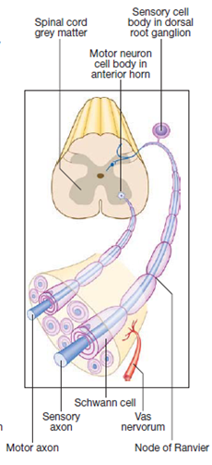
Introduction
Myelin
It’s a lipid dense layer that surrounds the axon of the neurons.
insulates the axons and allows continuous propagation of the electrical impulse.
Myelin is essential for the speed of conduction and the level of myelination differs from a fiber to another depending on their function, for instance the fibers that conduct vibration and proprioception are usually more heavily myelinated than those that conduct pain and crude touch.
Myelin is produced by:
Schwann cells: Peripheral nerves.
Oligodendrocytes: CNS.
Acquired Demyelinating Diseases
How? Damage of the myelin. Depends on the site:
Central nervous system disease (CNS) :
Multiple sclerosis (MS) most common
acute disseminated encephalomyelitis (ADEM), usually in pediatrics
neuromyelitis optica spectrum disorder (NMOSD). it’s common, and can mimic MS
Peripheral nervous system (PNS):
Acute inflammatory demyelinating polyneuropathy (Guillain Barre syndrome), it’s very common, and usually after infection, rarely after vaccination. typically presents as ascending weakness start from the legs, and develops in a few days
Chronic inflammatory demyelinating polyneuropathy (CIDP).
Note: It’s very rare to see CNS and PNS involvement in the same person
Demyelinating Diseases
Hereditary demyelinating disease
Rare disease and very specific, it is outside the scope of medical student
Example:
Alexander disease
Canavan disease
Krabbe disease

Slide 3
Introduction to Multiple sclerosis (MS)
Definition
Multiple sclerosis (MS) is a chronic autoimmune, T-cell- mediated, inflammatory disorder of the CNS.¹
MS is the most common chronic inflammatory, demyelinating and neurodegenerative disease of the CNS in young adults .
The most common DISEASE causing disability is MS, and it is the second most common cause of disability after trauma in the young
It is a heterogeneous, multifactorial, immune mediated disease that is caused by complex gene environment interactions. but the exact etiology is still unknown
Three factors are in effect:
1
2
3
Population genetics
The interplay between genes and geographically determined physical environment.
Socioeconomic structure.
Risk factor
EBV Infection: most common
History of infectious mononucleosis (EBV) is associated with higher risk of MS.
Antibodies to EBV were higher in people who developed MS than in control samples (Studies showed that 100% of MS patients are seropositive to EBV)
Vitamin D:
Sunlight may be protective (ultraviolet radiation or vitamin D), some say it is the Vit D that is protective, other say even if you take supplemental Vit D it will not be protective, suggesting that the UV rays themselves are the protective factor.
Sun exposure & serum vitamin D are inversely related to risk/prevalence of MS.
Vitamin D levels are inversely related to MS disease activity.
Smoking: also increase the severity of MS
A higher risk of MS in ever-smokers than in never-smokers, but stopping smoking is still decreases MS risk
Smoking may also be a risk factor for disease progression
Obesity:
In adolescence or early adulthood is associated with increased risk for MS, because obesity in youth increase the number of adeposite, while obesity later in life causes increase in the side only.
How? leptin increases the proliferation of auto-aggressive cells responsible for myelin damage.
Genetics:
Variations in some 60 different genes have been identified so far as conferring an increased risk of MS; 80% of these are genes relating to immune system function and regulation, including HLA and MHC polymorphisms.
1- The clinical course of MS is unpredictable: a high MR lesion load at initial presentation, high relapse rate, male gender and late presentation are poor prognostic features but not invariably so.

Slide 4
Epidemiology
Epidemiology of MS
of patients experience their initial demyelinating event during childhood¹ or adolescence.
The risk of familial occurrence in first-degree relatives²
10%
0.1%
2-4%
30%-50%
Is the risk in the general population.
Monozygotic twins have a concordance rate²
The life expectancy of patients is reduced by 7–14 years.
MS is the main cause of death in more than 50% of patients. Mostly due to MS complications e.g. aspiration pneumonia or Neurogenic bladder ( → Infections → sepsis)
Suicide is particularly substantially increased in MS (Depression is more common in MS pts).
The prevalence of MS has increased since the 1950s, especially in women.
The female to male ratio of MS, has increased to ~3:1, previously was 2:1
Why did the ratio change? This suggests a possible role of environmental risk factors:
Occupation.
Increased cigarette smoking.
Obesity.
Birth control and
childbirth.³
01
02
03
04
Prevalence By Country
MS is mainly found in individuals of European descent and is rare in Asian, black, Native Americans and Māori individuals.
Prevalence varies greatly, being highest in North America and Europe and Australia (areas indicated in yellow stars) and lowest in Sub-Saharan Africa and East Asia. more common in white women who live in colder climates. Some theories as to why these certain areas have higher prevalence include:
Further away from the equator → Less sun exposure.
Higher socioeconomic status → better hygiene → less exposure to pathogen in childhood → more autoimmune diseases
The most striking epidemiological characteristic is the apparent uneven distribution of the disease across the world
In KSA, the prevalence of MS is 60 per 100000
1- at five years or even younger
2- suggesting genetic susceptibility
3- The more women give childbirth the lower risk of MS (Just a theory) & there are conflicting data on the role of birth controls in MS

Slide 5
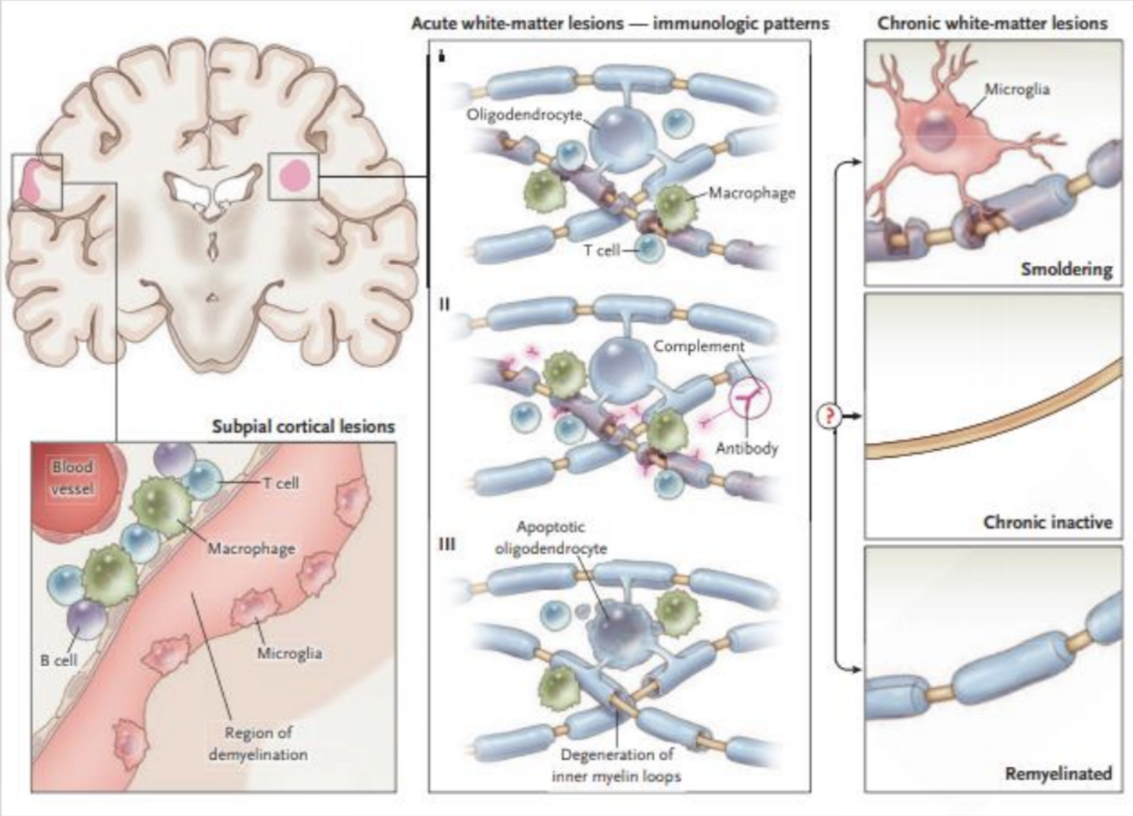
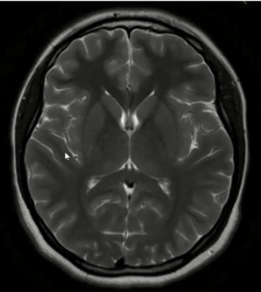
Pathogenesis of MS
Pathophysiology
These recognise myelin-derived antigens on the surface the microglia, and undergo clonal proliferation.
The resulting inflammatory cascade releases cytokines and initiates destruction of the oligodendrocyte–myelin unit by macrophages
01
02
03
Initial CNS inflammation in MS involves entry of activated T lymphocytes across the blood– barrier.
Characterized by breakdown of the blood—brain barrier (BBB), which introduces inflammatory cells into the CSF (1st change in MS)
Most easily recognized in the white matter as focal areas of demyelination, inflammation, and glial (astrocytes) reaction → Plaques
the earliest stages of white-matter demyelination are heterogeneous and evolve over the course of months.
Recurrent relapses lead to permanent myelin and axonal damage and oligodendrocytes loss. ¹
Pathology
Plaques of demyelination, 2–10 mm in size, are the cardinal features.
Lesions are most easily recognized in the white matter. There has to be multiple lesions, if only one then it’s not MS.
Demyelination also involves gray matter. it’s usually a white matter disease but can also involve gray matter.
Cortical lesions are less inflammatory than their white-matter counterparts and have substantially less permeability of BBB.
Plaques occur anywhere in CNS white matter but most commonly sites:
Optic nerves
Periventricular region
Corpus callosum
The brainstem and its cerebellar connections
Cervical cord (corticospinal tracts and posterior columns)
Right pic: An MRI showing a (focal plaque) arrows ²
Left pic: the area in brown is normal white matter (normal staining dark brown) compare it to the areas of arrowheads (light brown) because it’s devoid of myelin, no enough myelin to take the stain. In the middle (the white thing) is an area of axonal loss.
Right pic: normal brain MRI
Left MRI pic: MRI shows multiple plaques (white dots)
This lesion involves both the gray and the white matter.
1- If only demyelination occurs, the oligodendrocytes can repair some the myelin that’s lost but if axonal damage occurs they will develop SPMS (irreversible)
2- Remember in MRI, the GREY color is the WHITE matter, WHITE color is the GREY matter

Slide 6
Clinical Patterns of MS
Clinically isolated syndrome (Pre-MS)
CIS is the first clinical episode that is suggestive of MS
Why don’t we classify them under MS? Bc it’s only one episode and not all of them develop MS (Many ppl in their 20s may get this attack and then live normal for the rest of their lives)
A second clinical event indicative of a new lesion in a different anatomical location allows the diagnosis of MS to be confirmed. Alternatively, a repeat MRI brain scan at least 1 month later showing either a new lesion or a gadolinium enhancing lesion is sufficient to show dissemination in time and space and confirm the diagnosis even in the absence of new symptoms.
Characterized by:
1
Monophasic episode with symptoms and objective findings that reflect inflammatory demyelinating event in the CNS.
2
Acute or subacute (2-3wks), lasting for at least 24 hrs. (If less than 24hrs then it’s NOT an MS attack)
3
Occurs in the absence of fever or infection. (Why? Fever can precipitate pseudo-relapse (Pseudo-exacerbations) due to physiological slowing in the conduction across the axons that will lead to certain manifestations)
4
Resembles a typical MS relapse (attack) but occurs in a patient not known to have MS such as optic neuritis, weakness in one limb, symmetrical tingling.
Four main clinical pattern
1
2
3
4
Relapsing-remitting (RRMS)
Secondary progressive SPMS
Primary progressive (PPMS)
Relapsing-progressive RPMS
1
Relapsing-remitting MS (RRMS) (85–90%)
The typical and most common pattern of MS¹
RRMS has an onset between 20-35 years.
A purely RRMS is characterized by the absence of worsening neurological function outside of individual relapses
About one third of RRMS patients may never develop a progressive disease course. About two thirds will develop SPMS.
Symptoms occur in attacks (relapses) with a characteristic time course: onset over days and typically recovery, either partial or complete, over weeks.
On average, patients have one relapse per year but occasionally many years depending on the activity of the disease.
Patients may fully recover from a relapse, or may accumulate disability over time if they do not recover fully after relapses. However, the disability is constant through our the “remitting” phase.
the majority will eventually enter a secondary progressive phase, The median time to conversion to SPMS is 21 years and median age at onset is 54.
1- Usually the patient is well and healthy, then they have a relapse, the relapse will cause disability and then they improve completely or sometimes there will be residual disability (sometimes the relapses resolve without treatment) (Recall if only one relapse (episode) occured then it’s CIS NOT RRMS.) Acute relapses are caused by focal inflammation causing myelin damage and conduction block. Recovery follows as inflammation subsides and remyelination occurs. When damage is severe, secondary permanent axonal destruction occurs. Progressive axonal damage is the pathological basis of the progressive disability seen in progressive forms of MS.

Slide 7
Clinical Patterns of MS cont.
2
Secondary progressive (SPMS)
Worsening irreversible neurological function, preceded by RRMS that cannot be explained purely by worsening associated with ongoing relapses (Some studies suggest that up to 60% of those with RRMS, develop SPMS eventually)
This late stage of MS consists of gradually worsening disability progressing slowly over years.
Periods of plateau may happen or no further disability is developing, but existing disabilities never get better.
Some 75% of patients with relapsing–remitting MS will eventually evolve into a secondary progressive phase by 35 years after onset.
Relapses may sometimes occur in this progressive phase (relapsing–progressive MS).
Starting early treatment in RRMS can delay the onset of SPMS and hopefully even prevent it.
3
Primary progressive (PPMS) (10-15%)
Irreversibly continuous worsening neurological function, without preceding relapses
PPMS begins at 40 years of age
Patients older at onset or with PPMS have shorter survival.
It typically presents later and is associated with fewer inflammatory changes on MRI.
Example: a 40 years old lady presenting with slowly progressing weakness in the lower limb. At first she was able to walk independently, then she depended on a cane to help her walk for months, afterwards she noticed that she needs a walker (bilateral support) to walk, which she kept using for a few months to years, and now she needs a wheelchair.
Example: a 40 years old lady presenting with slowly progressing weakness in the lower limb. At first she was able to walk independently, then she depended on a cane to help her walk for months, afterwards she noticed that she needs a walker (bilateral support) to walk, which she kept using for a few months to years, and now she needs a wheelchair.
4
Relapsing–progressive MS (<5%).
This is the least common form of MS.
It is similar to PPMS but with occasional supra-added relapses on a background of progressive disability from the outset.

Slide 8
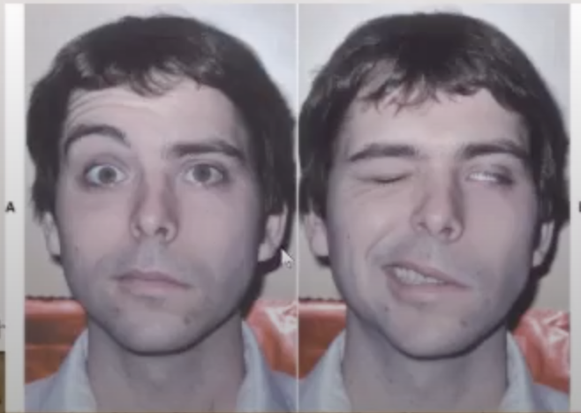
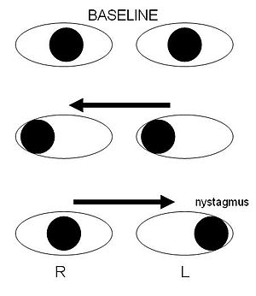
Clinical feature of MS
MS clinical features symptoms
MS Symptoms
Optic Neuritis
Brain Stem Related Symptoms
Cerebellum Related Symptoms
Brain And Spinal Cord Symptoms
Uhthoff’s Phenomena
Transverse Myelitis
1
Optic Neuritis
Optic neuritis is one of the most common causes of subacute visual loss. Symptoms may vary from a mild fogging of central vision with colour desaturation to a dense central scotoma, but very rarely complete blindness.
Optic neuritis is not specific to MS, it can also happen with: IDAM, NMOSD, SLE, TB, Behcet.
The patient usually had :
Blurred vision usually in one eye. NOT double vision, seeing black dots, can’t see clear in the dark.
Pain exacerbated by eyes movement.
Reduced perception of colors. (red desaturation, the color will be pale in the affected eye)
Flashes of light on moving the eyes.
Enlarged blind spot. because the optic nerve is inflamed and swollen
Note: Blurred vision in one eye + Pain on eye movement = Almost always optic neuritis
1
2
Brain Stem Related Symptoms
Any area of the brain stem can be affected
Diplopia if the nucleus of 3rd,4th and 6th nerves affected (the CNs themselves aren’t affected, what’s affected is their nucleus)
Trigeminal neuralgia: is a severe pain that happen when one of the divisions of V CN distribution is touched and lasts for a few seconds, happens if involve trigeminal nerve (sensory).
Vertigo (spinning sensation) and nystagmus, happens if there is a plaque in the cerebellum
A typical picture is sudden diplopia, and vertigo with nystagmus, but without tinnitus or deafness. Bilateral internuclear ophthalmoplegia is pathognomonic of MS
Facial numbness and weakness: if the facial nerve is involved. Note in pic (A);
The pt has left sided facial weakness (LMN lesion not UMN), there’s flattening
of the frontalis muscle, the left eye is slightly bigger with mouth drooping. On
the right pic, note that he couldn’t close his left eye and his smile went to
the right side.
A
Internuclear ophthalmoplegia (INO):
Internuclear ophthalmoplegia (INO) is a specific gaze abnormality, characterized by impaired horizontal eye movement with weak adduction of the affected eye and abduction nystagmus of the contralateral eye. An INO is one of the most localizing brainstem syndromes, resulting from a lesion in the medial longitudinal fasciculus in the dorsomedial brainstem tegmentum of either the pons or the midbrain. The medial longitudinal fasciculus coordinates eye movements between the nuclei of the abducens and oculomotor nuclei to align lateral gaze. When attempting a left gaze, the right MLF sends fibers from the left abducens nucleus to the right oculomotor nucleus. This stimulates the right medial rectus, thus causing adduction of the right eye(right eye gazes left). If it is damaged, the right eye cannot adduct to the left when attempting a left gaze. The left eye (the functioning eye) will exhibit nystagmus. The opposite is true when attempting a right gaze.
IF you see it in young patient almost always MS (If elderly, think stroke)

Slide 9
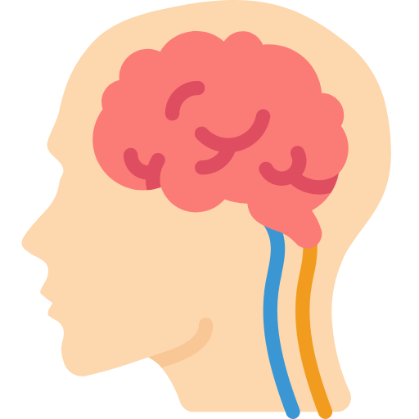
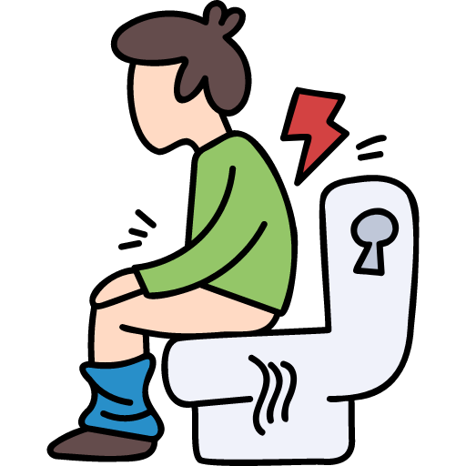
Clinical feature of MS cont.
MS clinical features symptoms cont.
3
Cerebellum Related Symptoms
Oscillopsia
(A visual disturbance in which the object in the visual field appears to oscillate due to nystagmus)
Dysarthria
(Slurred speech)
Imbalance
(Wide-based gait)
4
Brain And Spinal Cord Symptoms
Weakness (monoparesis, paraparesis, quadriparesis).
Sensory loss/numbness/pain
Sphincter dysfunction. urine incontinence, neurogenic bladder and stool incontinence, commonly seen if there is spinal cord lesion
Lhermitte’s sign: electric like sensation induced by neck flexion, very serious almost always indicate spinal cord lesion (any cervical cord lesion, not specific to MS)
Cognitive dysfunction: memory, concentration, processing speed. (Uncommon in MS,and usually does not happen with the first attack)
5
Transverse Myelitis
A general term that indicates inflammation of the spinal cord with cord swelling and loss of function. Typically, one or two spinal segments are affected with part or all of the cord area at that level involved ¹
Spinal cord related motor, sensory &/or autonomic dysfunction. transverse in the name means involve more than one area of the spinal cord
Could be caused by MS, infections, connective tissue diseases, behcet
Sensory level, means the is loss of sensation in a specific level eg. patient has complete loss of sensation from mid abdomen and below, this sign indicate a spinal cord lesion
Unilateral or bilateral.
6
A
Uhthoff phenomenon
Temporary worsening of pre-existing symptoms with increases in body temperature, e.g. after exercise or a hot bath
Neurological dysfunction. Stereotyped.
Less than 24 h, Reversible if last for more than 24h think about relapse
Related to fluctuations in axonal conduction properties due to increasing body temperature.
It does not indicate that there’s ongoing damage, it only indicates that there was an area of inflammation and demyelination, so the conduction is slower than normal ppl, and with exposure to high temperatures the conduction becomes even slower. However, it doesn’t affect the course of disease or anything, it’s just annoying to some pt
1- Clinically, a myelopathy evolves over days, and recovery (often partial) follows over weeks or months. MRI is sensitive and shows cord swelling and oedema with gadolinium enhancement at the affected level(s). Usually, images are also taken of the brain to look for evidence of demyelination.

Slide 10
Diagnosis of MS
To diagnosis of MS you must have both:
Dissemination in time
&
Dissemination in space
History of at least two attacks separated by at least one month.
if 2 attacks occur in the same month it’s counted as 1
For example: a pt presents with optic neuritis and it resolved, after 6mo he developed optic neuritis again. In this pt there’s dissemination in time ONLY.
Clinical evidence of involvement of two CNS sites OR of one lesion with historical evidence of another site being affected.
For example: A pt presents with lesions in the optic nerve, cerebellum and cerebrum, but he didn’t have any attacks later on (only one attack). In this pt there’s dissemination in space ONLY. Dx? CIS
Example: patients comes to you with what seems to be a first episode of MS (optic neuritis) , after further history the patient describes to you an incidence that happened years ago where she had a right upper limb numbness, she was prescribed vitamin B12 by her family physician who said that it must be what is deficient. One month after taking supplementation the numbness disappeared. Does that mean the patient actually had a B12 deficiency? Definitely NOT. B12 deficiency will not be unilateral, and this spontaneous improvement is due to the remitting-relapsing nature of MS. This example shows dissemination in space and time
Mc Donald’s MS diagnostic criteria
Females Dr: Only know the name of the criteria, no need for any details
Attacks | Number of lesions with objective clinical evidence | Additional data needed for a diagnosis of multiple sclerosis
≥2 clinical attacks | ≥2 | none
≥2 clinical attacks | 1(as well as clear-cut historical evidence of a previous attack involving a lesion in a distinct anatomical location) | none
≥2 clinical attacks | 1 | Dissemination in space demonstrated by an additional clinical attack implicating a different CNS site or by MRI
1 clinical attack | ≥2 | Dissemination in time demonstrated by an additional clinical attack or by MRI§ OR demonstration of CSF-specific oligoclonal bands
1 clinical attack | 1 | Dissemination in space demonstrated by an additional clinical attack implicating a different CNS site or by MRI‡ AND Dissemination in time demonstrated by an additional clinical attack or by MRI§ OR demonstration of CSF-specific oligoclonal bands
Notes:
The diagnosis of MS requires two or more attacks affecting different parts of the CNS, i.e. dissemination in time and space.
However, the presence of multiple lesions on MRI (dissemination in space) or the demonstration of additional clinical attacks on MRI (by showing lesions of different densities (dissemination in time)) fulfills the criteria for MS despite the presence of one attack in the patient's history

Slide 11
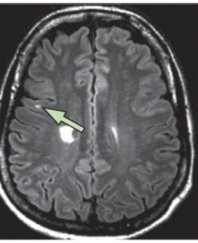
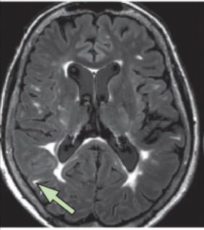
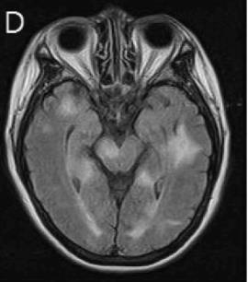
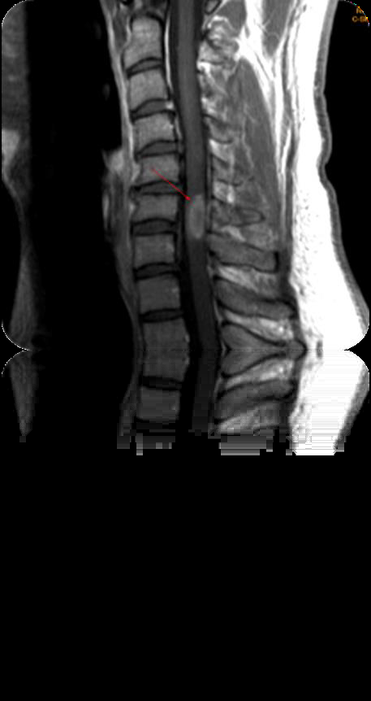
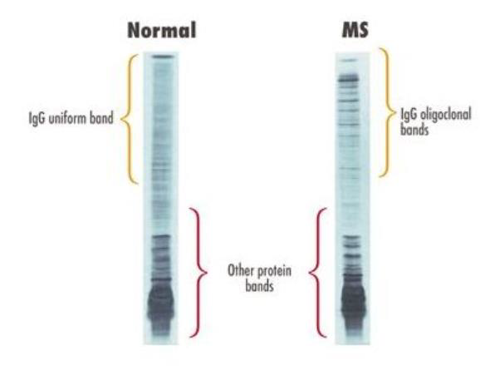
Diagnosis of MS cont.
01
History & Exam
When taking a history at the time of initial presentation, it is essential to ask about previous episodes of neurological symptoms, often years previously, that may represent episodes of unrecognized demyelination: for example, a severe episode of vertigo lasting weeks or loss of vision in one eye that gradually recovered.
02
Imaging: MRI of the brain and spinal cord
MRI is both the best initial test and the most accurate test.
MRI of brain and cord is the definitive investigation, as it demonstrates areas of demyelination with high sensitivity. Multiple scattered plaques are usually seen, demonstrating dissemination in space. Acute lesions show gadolinium enhancement for 6–8 weeks.
Plaques are rarely visible on CT.
MRI shows multiple plaques in different area. If you see multiple lesions this confirm dissemination in space. To confirm dissemination in time, check the enhancing (take up gadolinium) and nonenhancing lesions, enhancing are new, non-enhancing are old.
Red circle: brain stem lesion
Spinal lesions:
In MS: short and peripheral (visualized on axial images)
In NMO: long and central or circumferential.
Note the segment is short unlike pts with NMO
Green arrow: juxtacortical lesion (MS specific)
Red circle: non-specific
Red circle: periventricular lesion (MS specific)
03
Lumbar puncture and CSF analysis
if you not sure about the diagnosis another way to confirm it is to do lumbar puncture and look for oligoclonal IgG bands, BUT with presence of relapse and remitting symptoms. Rarely used anymore
The CSF may show a lymphocytic pleocytosis in the acute
phase and unique (i.e. absent from the serum) oligoclonal bands
of IgG in 70–90% of patients but these are not specific for MS.
An area for your notes

Slide 12
Diagnosis of MS cont.
04
Evoked responses
is a measurement of the electrical signal recorded at the scalp over the occipital cortex in response to light stimulus. can be used to confirm damage to visual pathway
e.g. visual-evoked responses in optic nerve lesions, may demonstrate clinically silent lesions. However, since the advent of MRI, they are less used in diagnosis
The limitations of this test for the diagnosis of MS is that many other neurologic diseases can give an abnormal result.
05
Blood tests
are used to exclude other inflammatory disorders such as sarcoidosis or SLE, or other causes of paraparesis, e.g. adrenoleukodystrophy, HIV, human T-cell lymphotropic virus 1 (HTLV-1) and vitamin B12 deficiency.
Management of MS
Investigations in a patient suspected of having MS:
Acute treatment of relapses
area for your notes
Symptomatic Management
Disease Modifying treatments.
Acute treatment of relapses
1
Steroids (IV or orally Methylprednisone 1g/day) for 3 -5 days. very high dose, They speed recovery but do not influence long-term outcome.
Most of the time relapses resolve on their own but steroids shorten the relapse episode.
Only given when relapse is significant or affecting their life (e.g. a pilot comes with blurred vision = needs immediate attention = use steroids)
Prophylaxis to prevent glucocorticoid-induced osteoporosis should be considered in patients requiring multiple courses of glucocorticoids.
2
Plasma exchange is used for those who don’t respond to steroids

Slide 13
Management of MS cont.
Disease modifying treatments¹
1
Reduction of number of relapses per year.
2
Reduction of number of new MRI lesions.
3
Prolongation of time to development of secondary progressive disease
4
Reduction of long term disability.
1990 s
2010 s
2019
Disease modifying therapies (interferons & glatiramer acetate).
Oral medications now available (Fingolimod, teriflunomide, dimethyl fumarate
Siponimod was approved for SPMS
01
02
03
04
05
06
1980 s
2000 s
2017
Steroids for relapses only.
Mitoxantrone² AND Natalizumab.
for aggressive MS
first approved treatment for PPMS: Ocrelizumab.
Males Dr: You only need to know Natalizumab and interferon beta, no need to get into the details
Drug | Route | Side effect
Interferon beta | S/C, IM Alternate-day or weekly | In widespread use for reducing relapse rate
Glatiramer acetate | Alternate-day S/C | Similar efficacy to interferon-beta
Teriflunomide | Daily oral | May cause diarrhoea, alopecia, hepatotoxicity Highly teratogenic
Fingolimod | oral | Superior efficacy to interferon-beta in randomised trials Cardiac conduction defects, especially with first dose
Dimethyl fumarate | oral | May cause flushing and gastrointestinal disturbance Risk of Progressive multifocal leukoencephalopathy (PML)
Natalizumab³ | i.v. monthly | Rarely, Progressive multifocal leukoencephalopathy PML (fatal) Hypersensitivity reactions
Alemtuzumab | i.v. once and repeat at 1 year | May precipitate autoimmune reactions, e.g. thyroid disease, ITP
Ocrelizumab | IV
1- Why do we even give lifelong disease modifying agents and make patients endure their side effects if patients stay healthy for long time? Because after multiple episodes the oligodendrocytes will no longer be able to replace the myelin → exposed axon → future episodes will lead to loss of axons which is irreversible → SPMS (which we are trying to prevent)
2- Not used anymore because it causes leukemia
3-MCA blocks α-4 integrin vascular adhesion molecule. Prevents T cells entering CNS

Slide 14
Management of MS cont.
Disease modifying treatments cont.
Management Depends on the patient: Age, comorbidities, severity of MS
Old management:
First line: interferon . Second line: fingolimod 3rd line: ocrelizumab, rituximab
Now:
Low efficacy DMT (eg: interferon, teriflunomide) vs high efficacy DMT (eg: natalizumab)
Examples:
Patient with depression: do not give interferon as it worsens depression
Patient with cardiac condition: do not give fingolimod - causes heart block and seriously arrhythmias
Patient came with only tingling, no residual disabilities after the attack, few lesions on MRI→ give low efficacy DMT (interferon or teriflunomide)
Patient with only numbness, but had a previous relapse in which she described ataxia and difficulty walking, do we give her low efficacy DMT? No (if u check MRI, you might find extensive lesions, multiple on spinal cord (very bad prognostic sign)) → start on fingo (medium efficacy DMT) or Natalizumab (high efficacy DMT)
Symptomatic treatment
Symptoms | Treatment
Spasticity | Self-management, including stretching, physiotherapy, splinting Skeletal muscle relaxants: baclofen, tizanidine, clonazepam Gabapentin Botulinum toxin type A for focal spasticity Cannabis: oromucosal spray Intrathecal baclofen pump Intrathecal phenol – destructive procedure in advanced disease with paraplegia
Pain | Trigeminal neuralgia – carbamazepine, lamotrigine Lhermitte’s – carbamazepine
Fatigue | Fatigue management programme treat depression with antidepressants and CBT Amantadine (often ineffective)
Erectile dysfunction | sildenafil, tadalafil or vardenafil
Tremor | Beta-adrenoceptor- blocking drugs Botulinum toxin type A injections (head or arms) Deep brain stimulation for severe Holmes tremor
Urinary symptoms | Antimuscarinics, e.g. oxybutynin, tolterodine, solifenacin, trospium Desmopressin spray ± antimuscarinic Intermittent self-catheterization (ISC) Botulinum toxin type A intravesical injections (usually also require ISC) Bladder training exercises Indwelling catheter
Impaired mobility | Physiotherapy ± walking aids Treat spasticity Fampridine – selected patients

Slide 15
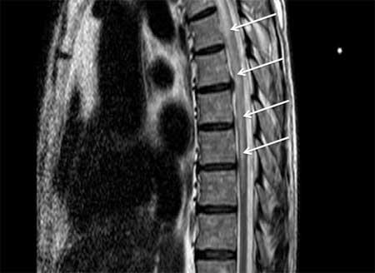
Other Demyelinating Diseases
01
Neuromyelitis Optica Spectrum Disorder , Also known as Devic’s disease.
This is a distinct inflammatory relapsing demyelinating disorder, previously thought to be a variant of MS. It is characterized by longitudinally extensive transverse myelitis (>3 segments) and bilateral or recurrent optic neuritis. NMOSD causes necrosis from the first attack.
1
More common in females ( 9:1
2
Mean age is 10 years later than MS.
3
More common in Asian and African populations.
4
Affects mainly the optic nerves and the spinal cord¹.
5
More severe attacks than in MS.
Presenting with nausea, vomiting and hiccups are important red flags in NMO
6
Usually negative OCB in the CSF. While 90% of MS has positive OCB
7
More likely to have pleocytosis in the CSF.
8
Serum antibodies to aquaporin-4 water channels on astrocytes are diagnostic
9
Spinal MRI scans show lesions that are typically longer than three spinal segments
Pathology
Astrocytopathy
Targets aquaporin 4 (a water channel) rich areas (aquaporin 4 abd in 70%). Target aquaporin 4 confirms the diagnosis of NMO and should be done for every suspected case
Vasculocentric and rosette pattern deposition of immunoglobulin and complement.
Lesions are longer compared to MS
Acute treatment of relapses
steroids or plasma exchange.
more severe than MS most of them need plasma exchange
MANAGEMENT
Disease Modifying treatments
chronic immunosuppression with azathioprine, Rituximab,mycophenolate mofetil….
MS treatments may worsen NMO²
1- unlike MS. However, NMOSD can still affect any area of the CNS
2- except rituximab (works for both MS and NMO) so if you have a patient whose presentation is confusing (not sure is it MS or NMO) give rituximab. However, rituximab may worsen MOG disease (subtype of NMO)

Slide 16
Other Demyelinating Diseases
02
Acute Disseminated Encephalomyelitis
This is an acute monophasic demyelinating condition in which areas of perivenous demyelination are widely disseminated throughout the brain and spinal cord. The illness may arise spontaneously but often occurs a week or so after a viral infection, especially measles or chickenpox, or following vaccination,
suggesting that it is immunologically mediated.
1
CNS inflammatory demyelinating disease.
2
Frequently preceded by vaccination or infection.
3
More common in children.
4
Equal males to females ratio
5
Affects all ethnicities.
6
Usually a monophasic illness (no relapses).
Pathology
Wide spread white and gray matter peri venous ‘‘sleeves’’ of inflammation and
Axons are relatively spared
unlike MS and NMO.
Symptoms
Encephalopathy¹ (lethargy, stupor, coma, seizure).
Headache, vomiting, pyrexia, delirium and meningism
Multifocal neurological deficit (visual symptoms, ataxia, TM..).
May fluctuates over a 3 months period for one single attack (If more than 3 months, it’s not ADEM)
Acute treatment of relapses
Steroids, plasma exchange and intravenous immunoglobulins
using the same regimen as for a relapse of MS, is recommended.
MANAGEMENT
Disease Modifying treatments
no need for DMT because it’s not relapsing disease, REMEMBER monophasic illness
1-Helps you differentiate between MS and ADEM. ADEM patients usually come in a very bad shape and are admitted to ICU

Slide 17
Other Demyelinating Diseases
03
Behçet’s disease
Behçet’s principal features are recurrent oral and/or genitalulceration, inflammatory ocular disease (uveitis) and neurological syndromes.
Brainstem and cord lesions, aseptic meningitis, encephalitis and cerebral venous thrombosis occur.
There is a predilection for ethnic groups along the ancient ‘Silk Road’ – Turkey, the Middle East and Asia. Behçet’s is associated with the HLA- B51 allele.
.
An area for your notes

Slide 18
From Dr slides
1
Multiple sclerosis
A demyelinating disease.
Can affect any part of the CNS.
A disease of young adults.
More common in females.
RR course is the most common initial course.
2
NMOSD
A demyelinating disease.
Can affect any part of the CNS but mainly optic nerve and spinal cord.
Older group in comparison to MS.
More in females.
Relapsing course.
3
Acute inflammatory demyelinating disease.
Monophasic.
More common in children.
Follows infection or vaccination.
Encephalopathy is a prerequisite for the diagnosis in children.
 | MS | NMO | ADEM
Age | 30 | 40 | 5-8
Gender | females 3:1 | females 9:1 | Equal or males 1 - 1.3:1
Ethnicity | NA and Europe | Asia | all
Symptoms | CNS | CNS (ON AND TM) | CNS
Course | RR/progressive | Relapsing | Monophasic
Transverse Myelitis | Yes <3 v. segments | Yes > 3 v. segment | Yes <3 v. segments
Acute Treatment | Steroids and PLEX | Steroids and PLEX | Steroids and PLEX
Disease Modifying Treatment | Yes | Yes | No need

Slide 19
Q1: A 29-year-old female comes to the office because of intermittent muscle cramps and weakness of her left leg for 3 months. She says these episodes usually last a week, and then completely resolve. Other symptoms she has intermittently experienced are blurred vision, difficulty in maintaining balance, as well as urinary urgency and incontinence. Visual examination is normal. There is decreased muscular power in her left leg, and an up-going left-sided plantar reflex. Which of the following medications would most likely reduce this patient's muscle cramps?
Acetaminophen
Baclofen
Donepezil
Propranolol
Q2: A 56 year-old man comes to the office because of abnormal sensations for a week. He says when he flexes his neck, he suddenly feels an electric shock-like sensation run through his back to his legs. Neurological examination shows weakness, lack of coordination and numbness in his left leg. Plantar reflexes are up-going bilaterally. MRI scan shows multifocal zones of demyelination at the angles of the lateral ventricles. Which of the following symptoms is the patient most likely describing?
Horner's syndrome
Lhermitte's symptom
Uhthoff's symptom
Kernig's sign
Q3: A 25-year-old woman comes to the office because of recurring double vision. She says that she has experienced episodes lasting several days which self-resolve, and then reoccur several weeks later. This pattern has happened repeatedly over the past year. She says she has also had some loss of bladder control associated with these episodes. She is very nervous about the progression of these symptoms. Visual examination shows a gaze palsy. Which of the following will most likely be found on further examination?
Neither eye moves past midline when attempting right gaze
Right eye does not move past midline when attempting right gaze
Right eye does not move past midline when attempting left gaze
Right pupil does not respond to direct light
Q4: A 29-year-old female comes to the emergency department because of sudden visual loss in the right eye and severe pain on eye movement for 2 days. She says she has never experienced this before, but has had intermittent tingling of her face and upper extremities accompanied by increasing fatigue for the past year. Visual examination shows a relative afferent pupillary defect, and decreased color vision. Brain MRI shows increased signal in the right distal optic nerve and a left periventricular plaque. Which of the following is the most appropriate initial treatment?
Interferon-a only
Mitoxantrone followed by interferon-a
Methylprednisolone (IV) followed by oral prednisone.
Oral prednisone only F Mitoxantrone only
Q5: A 30-year-old man complains of bilateral leg weakness and clumsiness of fine movements of the right hand. Five years ago he had an episode of transient visual loss. On physical examination, there is hyperreflexia with Babinski sign in the lower extremities and cerebellar dysmetria with poor finger-to-nose movement on the right. When the patient is asked to look to the right, the left eye does not move normally past the midline. Nystagmus is noted in the abducting eye. A more detailed history suggests the patient has had several episodes of gait difficulty that have resolved spontaneously. He appears to be stable between these episodes. He has no systemic symptoms of fever or weight loss. Which of the following is the most appropriate next test to order?
Lumbar puncture
MR scan with gadolinium contrast
Quantitative cerebrospinal fluid (CSF) IgG levels
Testing for oligoclonal bands in cerebrospinal fluid
CT scan of the head with intravenous-iodinated contrast
Quiz explanations:
Question 1:
The correct answer is B. Multiple sclerosis is a demyelinating disease in which the insulating covers of nerve cells in the brain and spinal cord are damaged. This damage disrupts the ability of parts of the nervous system to communicate, resulting in a range of signs and symptoms, including physical, mental, and sometimes psychiatric problems. Spasticity is treated when it interferes with function, mobility, positioning, hygiene, or activities of daily living. Reducing spasticity can give the patient more freedom of movement with less energy expenditure, as well as avoiding complications such as pain, contractures, and decubitus. Spasticity can be managed through nonpharmacologic means. Pharmacologic treatment of spasticity includes baclofen, which is particularly useful for the relief of flexor spasms and concomitant pain, clonus, and muscular rigidity in MS patients with reversible spasticity. Baclofen is effective in most cases, and adverse effects include fatigue and weakness.
Question 2:
The correct answer is B.
Major takeaway:
Lhermitte's sign is an electrical sensation that runs down the back and into the limbs. It is elicited by bending the head forward. It can also be evoked by pounding on the posterior cervical spine while the neck is flexed; this is caused by involvement of the posterior columns.
Main explanation:
Multiple sclerosis disease is a chronic condition characterized clinically by episodes of focal disorders of the optic nerves, spinal cord, and brain, which remit to a varying extent and recur over a period of years. It is characterized by selective demyelination of the central nervous system, with a classic location of plaques at the angles of the lateral ventricles. The early symptoms are tingling of the extremities and tight band-like sensations around the trunk or limbs. The clinical syndromes vary from dragging a leg or poor control of one or both legs to a spastic or ataxic para-paresis. It is important to remember that the patient will present with symptoms in one leg, but with signs on both legs. Lhermitte's symptom is a tingling, electric shock-like sensation produced by flexion or movements of the neck. It radiates down the back into the posterior part of the legs. It is probably attributable to an increased sensitivity of demyelinated axons to the stretch or pressure on the spinal cord induced by neck flexion.
Question 3:
The correct answer is C.
Major takeaway
Multiple sclerosis is associated with damage to the medial longitudinal fasciculus. lnternuclear ophthalmoplegia is a common presenting symptom. This manifests as the inability to adduct the ipsilateral eye and nystagmus of the abducting eye during contralateral gaze.
Main explanation
Classical presentation of multiple sclerosis involves a white woman in her 20s-30s with any combination of the following symptoms: optic neuritis with a sudden loss of vision, medial longitudinal fasciculus (MLF) syndrome also known as internuclear ophthalmoplegia (INO), hemiparesis, hemisensory symptoms, and bladder or bowel incontinence. Internuclear ophthalmoplegia (INO) is a specific gaze abnormality, characterized by impaired horizontal eye movement with weak adduction of the affected eye and abduction nystagmus of the contralateral eye. An INO is one of the most localizing brainstem syndromes, resulting from a lesion in the medial longitudinal fasciculus in the dorsomedial brainstem tegmentum of either the pons or the midbrain. The medial longitudinal fasciculus coordinates eye movements between the nuclei of the abducens and oculomotor nuclei to align lateral gaze. When attempting a left gaze, the right MLF sends fibers from the left abducens nucleus to the right oculomotor nucleus. This stimulates the right medial rectus, thus causing adduction of the right eye(right eye gazes left). If it is damaged, the right eye cannot adduct to the left when attempting a left gaze. The left eye (the functioning eye) will exhibit nystagmus. The opposite is true when attempting a right gaze.
Question 4:
The correct answer is C.
Major takeaway
Optic neuritis is a disease characterized by inflammation and demyelination of the optic nerve leading to vision loss, blurry vision, and pain associated with movement of the affected eye. Almost half of patients with optic neuritis will, on MRI, have white matter hyperintensities consistent with a diagnosis of multiple sclerosis.
Main explanation
This patient has optic neuritis, a disease characterized by inflammation and demyelination of the optic nerve leading to vision loss, blurry vision, and pain associated with movement of the affected eye. The median age of onset in optic neuritis is 30-35 years, and the disease is much more prevalent in women. The "swinging flashlight test" demonstrates that the patient's brain is sensing relatively less light in the left eye, consistent with optic nerve inflammation. Color blindness, particularly for red, is a relatively common symptom that patients may not realize they have until they are examined. Almost half of patients with optic neuritis will, on MRI, have white matter hyperintensities consistent with a diagnosis of multiple sclerosis. Additionally, this patient's eye movement deficit is consistent with an internuclear ophthalmoplegia, a defect in the medial longitudinal fasciculus (a white matter tract). The use of corticosteroids in the population of patients presenting with optic neuritis and white matter lesions on MRI has been studied extensively. In this group, high dose IV methylprednisolone has been shown to slow progression to "definite" multiple sclerosis, though there is no real benefit in long-term outcomes.
Question 5:
The correct answer is B. This patient’s symptoms and signs are worrisome for a demyelinating process such as multiple sclerosis. The episode of transient blindness was likely a result of optic neuritis, which occurs in 25% to 40% of multiple sclerosis patients (a similar presentation can occur in systemic lupus erythematosus [SLE], sarcoidosis, or syphilis). In addition, the patient gives a history of a relapsing-remitting process. There are abnormal signs of cerebellar and upper motor neuron disease; the eye movement abnormalities indicate intranuclear ophthalmoplegia. Signs and symptoms therefore suggest multiple lesions in space and time, making multiple sclerosis the most likely diagnosis. All patients with suspected multiple sclerosis should have MR imaging of the brain. MRI is sensitive in defining demyelinating lesions in the brain and spinal cord; gadolinium infusion is necessary to demonstrate active demyelination. Disease-related changes on MRI are found in more than 95% of patients who have definite evidence for MS. Most patients do not need spinal fluid analysis for diagnosis. Although 70% will have elevated IgG levels and 85% will have oligoclonal bands on CSF analysis, lumbar puncture is reserved for cases where the diagnosis is uncertain. Finding pleocytosis of greater than 75 cells per microliter or any polymorphonuclear leukocytes in the CSF makes the diagnosis of MS unlikely. In some cases, chronic infection with syphilis or HIV may mimic MS. CT scanning is much less sensitive than MRI in detecting demyelinating lesions, especially in the posterior fossa and cervical cord.
Answers: Q1:B | Q2:B | Q3:C | Q4:C | Q5:B
Answers Explanation File!

Slide 20
THANKS!!
This lecture was done by:
Abdullah Shadid
Note taker:
Abdullah Shadid
Raghad AlKhashan
Females co-leaders:
Raghad AlKhashan
Amirah Aldakhilallah
Males co-leaders:
Mashal AbaAlkhail
Nawaf Albhijan
Send us your feedback:
We are all ears!

