Slide 1
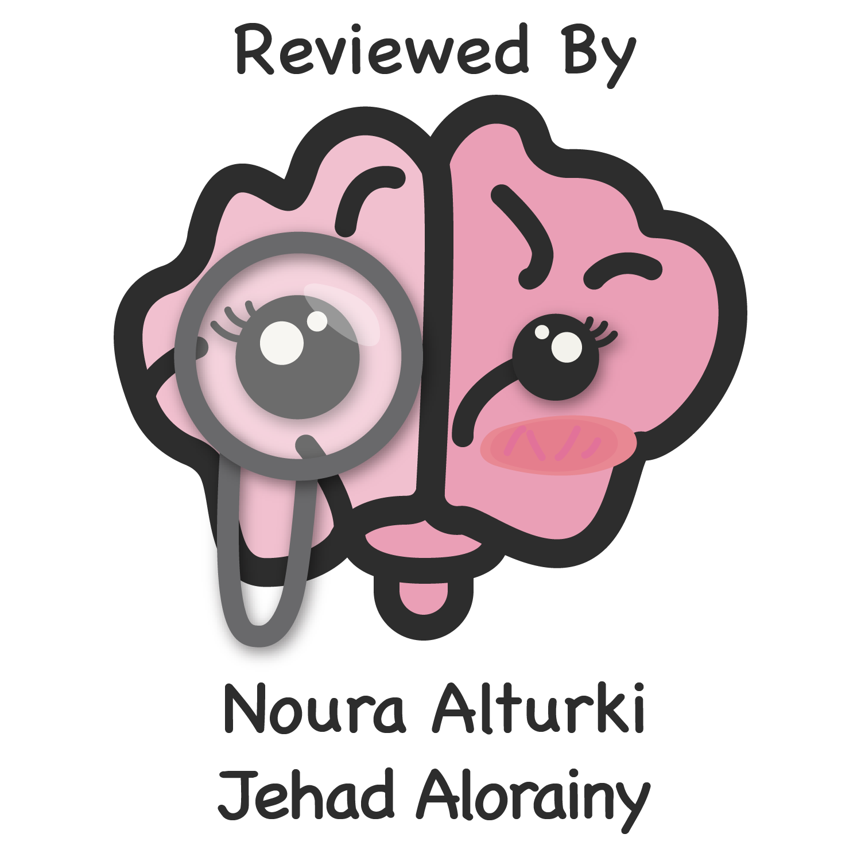
Lecture 62
Editing file
Neuromuscular junction disorders
Objectives:
Recognize the symptoms and signs of neuromuscular junction disorders (e.g., myasthenia gravis, MG)
Understand the pathophysiology of MG.
List the appropriate workup for MG.
List management options for MG.
Color index:
Color index:
Original text Females slides Males slides
Doctor’s notes Textbook Important Golden notes Extra

Slide 2
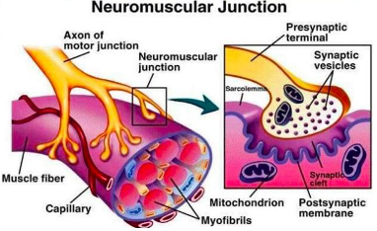
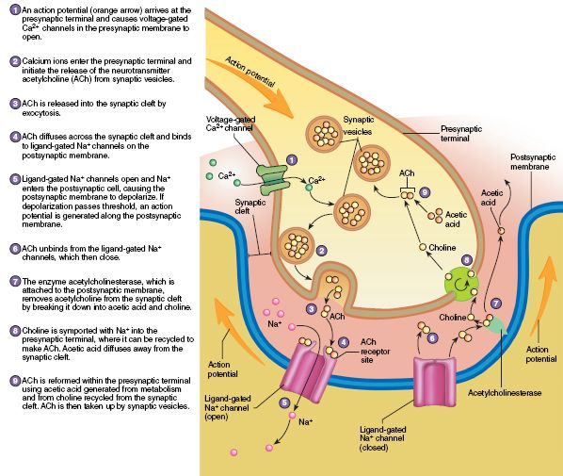
Introduction
Anatomical description of a NMJ
Neuromuscular junction consists of :
The Axon terminal of a motor neuron
motor end plate of a muscle fiber.
the synaptic cleft between these 2 parts.
The Motor Neuron Part:
The axon of a motor neuron enters the structure of skeletal muscle and forms many branches called axon terminals.
There is a swelling called a synaptic end bulb at the end of each axon terminal.
Each synaptic end bulb contains many synaptic vesicles each of which contains an important neurotransmitter called acetylcholine.
The Muscle Fiber Part:
The part of the sarcolemma of the muscle cell that is in closest proximity to the synaptic end bulb is called the motor end plate.
The Synapse or Neuromuscular Junction (NMJ):
The area between the axon terminal and the sarcolemma is called the 'synaptic cleft'
Neuromuscular junction physiology
Release of ACH → that activates the muscle
When a nerve pulse
reaches a synaptic end bulb (nerve terminal), it triggers release of the neurotransmitter acetylcholine (ACh) from synaptic vesicles that contain acetylcholine (ACh).
ACh then diffuses across the synaptic cleft between the motor neuron and the motor end plate.
Activation of ACH receptors:
The motor end plate contains receptors onto which the free ACh binds after diffusing across the synaptic cleft.
This binding of ACh to ACh receptors in the motor end plate causes ion channels to open & so allow the sodium (Na+) ions to flow across (influx) the membrane into the muscle cell.
Generation of muscle action potential:
The flow of sodium (Na+) ions across the membrane into the muscle cell generates a muscle action potential.
This action potential then travels along the sarcolemma. Generating muscle contraction.
Breakdown of Ach:
The ACh that is released is only available to take part for a short time before it is broken down (catabolized) by an enzyme called acetylcholinesterase (AChE) available in the synaptic cleft. This breakdown of ACh occurs within the synaptic cleft.

Slide 3
Classification of NMJ disorders
According to the mechanism of action or etiology
Immune mediated
Toxic / Metabolic
Congenital
Myasthenia gravis
Lambert Eaton Syndrome
most common examples
Snake venom poisoning
Botulism
Arthropod poisoning
Organophosphates
Hypermagnesemia
Congenital myasthenic syndrome
According to the location of the disruption
Some can affect the Ca++ channels of the pre-synaptic membrane and some the Na+ channels or ACh receptors of the post-synaptic membrane.
Different mechanisms.
Most often this causes a decrease in the release of acetylcholine.
Mechanism of action can also impair the calcium channels that induce exocytosis of the vesicles.
Other ion channels can also be disrupted, such as the potassium channels causing inefficient repolarization at the presynaptic membrane as in neuromyotonia.
Examples include:
Lambert Eaton Syndrome The most common
Botulism
Congenital myasthenic syndrome
Hypermagnesemia
Envenomation
Aminoglycosides
Autoimmune neuromyotonia
Presynaptic
Synaptic
Congenital myasthenic syndromes
Cholinesterase inhibitors
Organophosphate
The highest number of diseases affect the neuromuscular junction postsynaptically. either affects the Na+ channels or the ACh receptors.
Immune mediated myasthenia gravis (most common)
All the diseases that affect the postsynaptic membrane are forms of myasthenia gravis. Examples includes:
Neonatal Myasthenia Gravis
Drug Induced Myasthenia
Gravis: Penicillamine
Postsynaptic
Congenital myasthenic syndromes can either affect the pre-synaptic or mostly the post-synaptic membrane

Slide 4
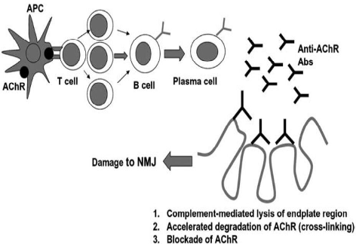
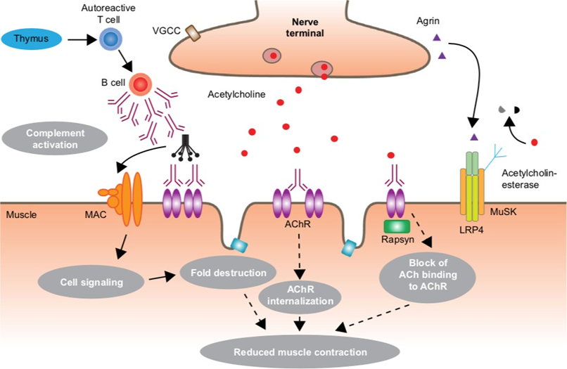
Myasthenia gravis
Definition
Myasthenia gravis is the most common disorder of neuromuscular transmission.
The hallmark of the disorder is a fluctuating degree and variable combination of weakness in ocular either alone or in combination with , bulbar, limb, and respiratory muscles.
Epidemiology
Myasthenia gravis is a relatively uncommon disorder with an annual incidence of approximately 7 to 23 new cases per million, 10 – 20 per 1,000,000/year and Prevalence of 20 per 100,000
Gender and age influence the incidence of MG
Myasthenia gravis occurs at any age, but there is a bimodal distribution to the age of onset:
Early peak in the second and third decades (female predominance) in younger age groups
Women are affected nearly three times more often than men before age 40.
Late peak in the sixth to eighth decade (male predominance). in older age groups, however, it can occur to male patients at any age
The incidence is higher in males after age 50 and roughly equal during & before puberty.
Pathogenesis
Antigen presenting cells present Ach Receptor peptides to T cells, creating Ach specific T cells.These T cells produce Anti-AChR Abs. These autoantibodies reduce the no. of ACh receptors mainly by:
Complement mediated destruction of postsynaptic membrane.
Cross-linking the receptors.
This causes enhanced endocytosis & destruction of these receptors. While direct blockade of AChR is less frequent
Mechanisms underlying the pathology of MG:
Anti-bodies activate the the complement cascade which will lead to the activation of membrane attack complex (MAC), which is C5,6,7,8 and 9. The MAC will destroy the membrane (Most important mechanism)
Anti-bodies will bind to the binding site of ACh on the ACh receptor
Anti-bodies cross link 2 receptors together → Internalize the receptor and degraded

Slide 5
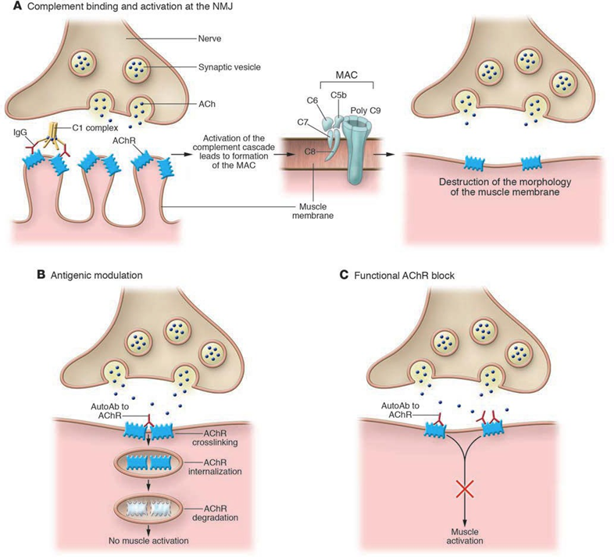
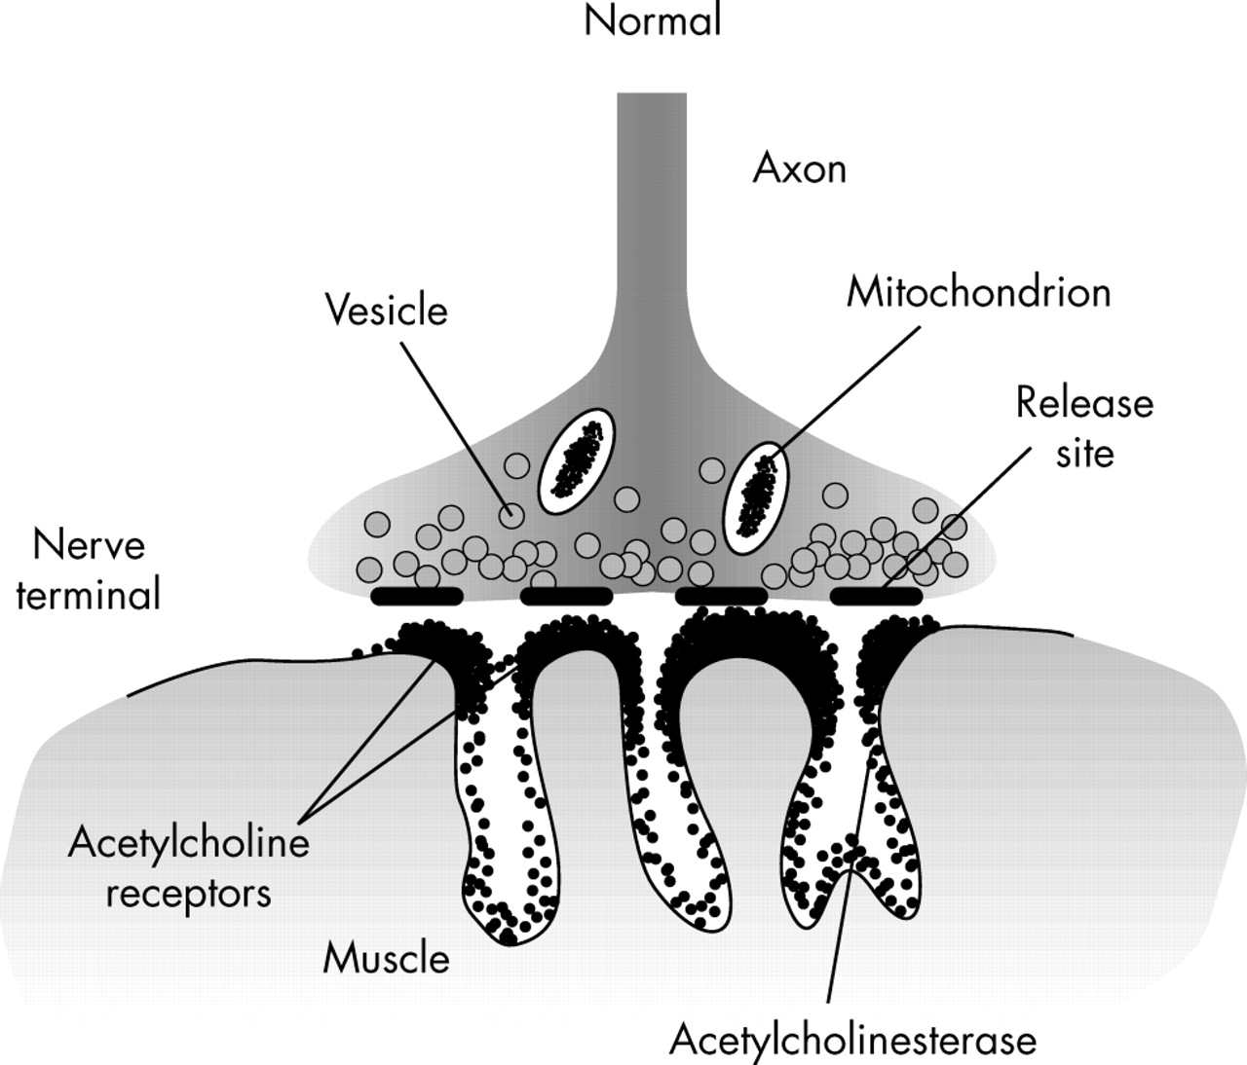
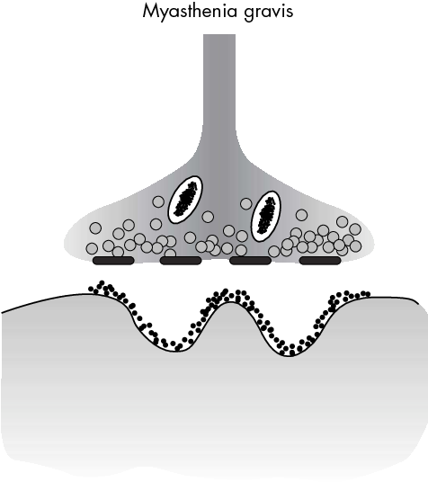
Myasthenia gravis
Pathophysiology of MG
1
2
3
Remaining AchR’s not localized to peaks of the membrane.
4
Simplified postsynaptic membrane.
Decreased of AchR’s.
Lower safety factor
It is an autoimmune response that affects the post-synaptic membrane
The amount of ACh released by the presynaptic motor neuron normally decreases with every nerve impulse because of a temporary depletion of the presynaptic ACh stores (a phenomenon referred to as presynaptic rundown) which is a normal physiological phenomena.
There are primary (closest to the synaptic cleft), secondary, and tertiary storage vesicles → whenever the primary vesicles are used, it takes time for the secondary and tertiary vesicles to get closer to the cleft.
In MG, there is reduction of postsynaptic AChRs due to production of anti-AChR antibodies that block receptors from binding to Ach and causes damage the postsynaptic membrane.
Reduction in the number of AChRs available at the muscle endplate and flattening of the postsynaptic folds.
Even if a normal amount of ACh is released, fewer endplate potentials will be produced, and they may fall below the threshold value for generation of an action potential. The end result of this process is inefficient neuromuscular transmission. → no muscle contraction because there in no muscle AP
Inefficient neuromuscular transmission together with the normally present presynaptic rundown phenomenon results in a progressive decrease in the amount of muscle fibers being activated by successive nerve fiber impulses. This explains the fatigability seen in MG patients
Patients become symptomatic once the number of AChRs is reduced to approximately 30% of normal.
The cholinergic receptors of smooth and cardiac muscle have a different antigenicity than skeletal muscle and usually are not affected by the disease. MG only affects nicotinic receptors of skeletal muscles.

Slide 6
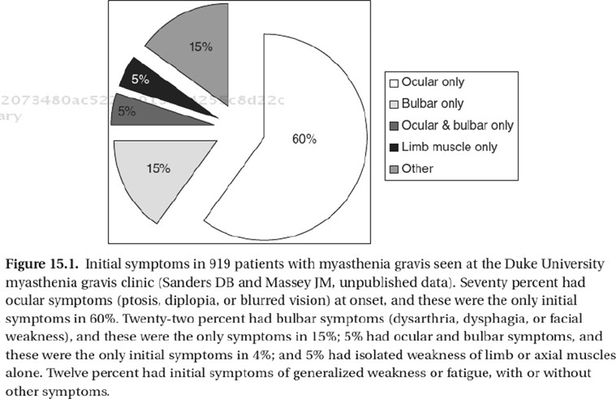
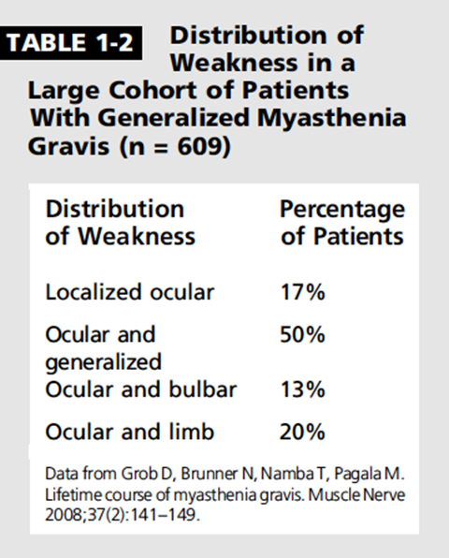
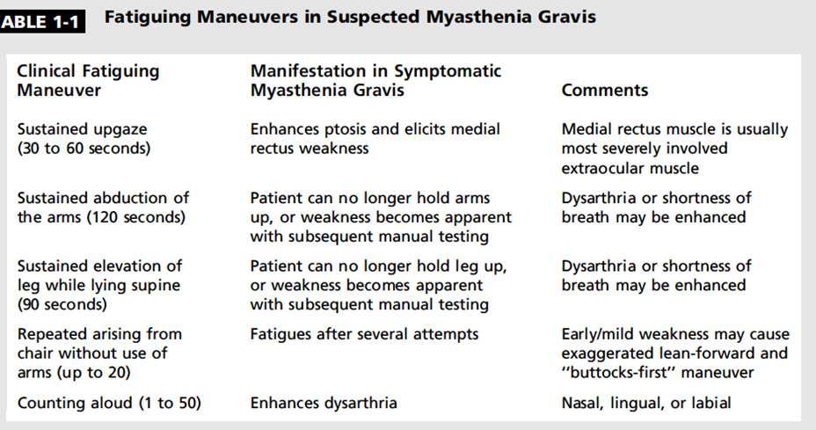
Myasthenia gravis
Clinical features
>50% of patients present with ocular symptoms of ptosis (drooping of eyelids) and/or diplopia (double vision). most common manifestations.
Of those who present with ocular manifestations, about half (80%) will develop generalized disease within two years.
After 2 years with no limb Sx, disease usually remains purely ocular.
15% of patients present with bulbar symptoms.
These include dysarthria, dysphagia, and fatigable chewing
<5% present with proximal limb weakness alone.
Usually progresses for weeks-months, and maximum severity is usually in first year of disease
There are no sensory signs or signs of involvement of the CNS, although weakness of the oculomotor muscles may mimic a central eye movement disorder.
It tends to run a relapsing and remitting course
The distinguishing clinical feature in MG is fatigable weakness.
Weakness: better in the morning and after rest, and worse with use
Usually progresses for weeks-months, and maximum severity is usually in first year of disease
of ocular MG progress to generalized MG within 2 years.
Ocular muscle involvement is very common.
Diagnosis is questionable if ocular muscles aren’t involved.
● Typically it starts with the ocular or bulbar muscles, then it progresses to occupy the limb muscles.
● Only a minority of patients get limb involvement without ocular/ bulbar.
Ocular myasthenia | Generalized disease
The weakness is limited to the eyelids and extraocular muscles. | The weakness commonly affects ocular muscles, but it also involves a variable combination of bulbar, limb, and respiratory muscles.
The vast majority of MG pts present with ocular manifestation at onset, and as the disease progress in the first 2 yrs they will develop limb and bulbar weakness. After 2yrs, only a minority will be having ocular manifestations only.

Slide 7
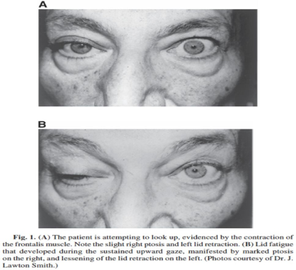
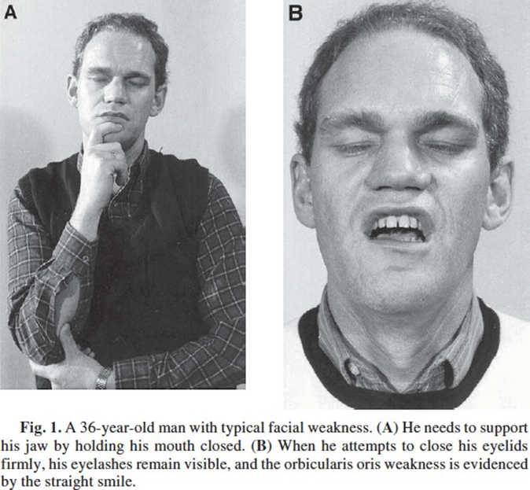
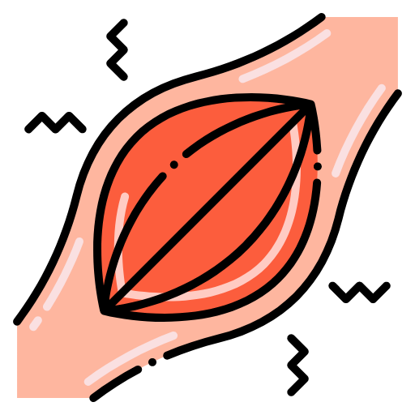
Myasthenia gravis
Clinical features
Ocular muscles:
Weakness of the eyelid muscles can lead to Asymmetric ptosis (fluctuating).
The ptosis may start bilaterally and improve in one eye, resulting in unilateral ptosis or alternate.
Variable severity from one patient to another.
Extraocular muscles involvement -weakness-( binocular diplopia) double vision that is apparent when both eyes are open and typically disappears when one eye is closed. It may be horizontal or vertical. depending on the extra-ocular muscles involved.
Pupils spared
Bulbar muscles
Muscles of jaw closure (fatigable- prolonged chewing). Sometimes this can be severe to the extent that it will lead to jaw drop.
Oropharyngeal muscle weakness produces dysarthria , dysphagia and difficulty clearing secretions.
Palatal muscles weakness causing breathy nasal speech and nasal regurgitation patient complains that liquids swallowed regurge through the nose
Facial muscles
Frequently involved and causing expressionless face.
Transverse smile may be evident on examination "myasthenic sneer," where the mid- lip rises but the outer corners of the mouth fail to move.
Orbicularis oculi weakness> Weak eye closure.
Neck and limb muscles :
Neck extensor and flexor muscles are commonly affected.
Neck Flexors> Neck Extensors (Musk : NE>NF) Musk anti-bodies is a subtype of MG, they tend to involve neck extensors more than neck flexors
Dropped head syndrome. if significantly weak
Limb weakness: Proximal > distal, usually symmetric (unlike ocular), (the arms > the legs).
UL: Deltoid, triceps, wrist extensors (WE), finger extensors (FE) and finger flexors.
LL: Hip flexors (HF) , and Ank. DF (dorsiflexion)
Wrist and finger extensors and foot dorsiflexors. if the distal limbs were involved
Respiratory muscles :
SOB that's worse in supine position due to diaphragm weakness (orthopnea)
Respiratory muscle weakness can leads to respiratory insufficiency and pending respiratory failure "myasthenic crisis.“ serious consequence
It may occur spontaneously during an active phase of the disease or may be precipitated by a variety of factors (any stressors) including surgery, infections, certain medications (a list of medications is given to any patient with MG to avoid myasthenic crisis, eg. Abx or some cardiac medications), or tapering of immunotherapy.

Slide 8
Myasthenia gravis
Differential Diagnosis
Muscle Disease¹
Thyroid ophthalmopathy Ocular pharyngeal muscular dystrophy (OPMD) Myotonic dystrophy Progressive external ophthalmoplegia
NMJ Disorders
LEMS Botulism Congenital MG Penicillamine-induced myasthenia Tick paralysis
Motor neuron disease
ALS Amyotrophic Lateral Sclerosis PMA Progressive Muscular Atrophy
Peripheral nerve
Oculomotor cranial nerve pathology GBS Guillain Barre Syndrome CIDP Chronic Inflammatory Demyelinating Polyneuropathy Cavernous sinus pathology
Brain stem pathology
Stroke MS Tumors Infections
Other
Isolated ptosis (? Weak tissues) Isolated dysconjugate gaze (decompensated strabismus)
Investigations
CBC, LFT, RFT, CK (To exclude myopathies), TSH, ESR, ANA.
Anti-MUSK Antibodies.
Ocular Cooling /“ice-pack” test.
Repetitive nerve stimulation (RNS).
Acetylcholine Receptor (AChR) Antibodies.
(Best initial)
SFEMG.
(MOST SENSITIVE TEST)
Edrophonium Chloride (Tensilon) Test.
CT chest
(To exclude thymoma)
1- Fatigability isn’t a feature of muscle diseases

Slide 9
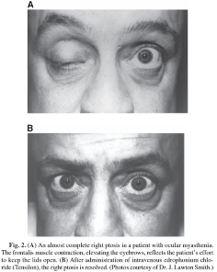
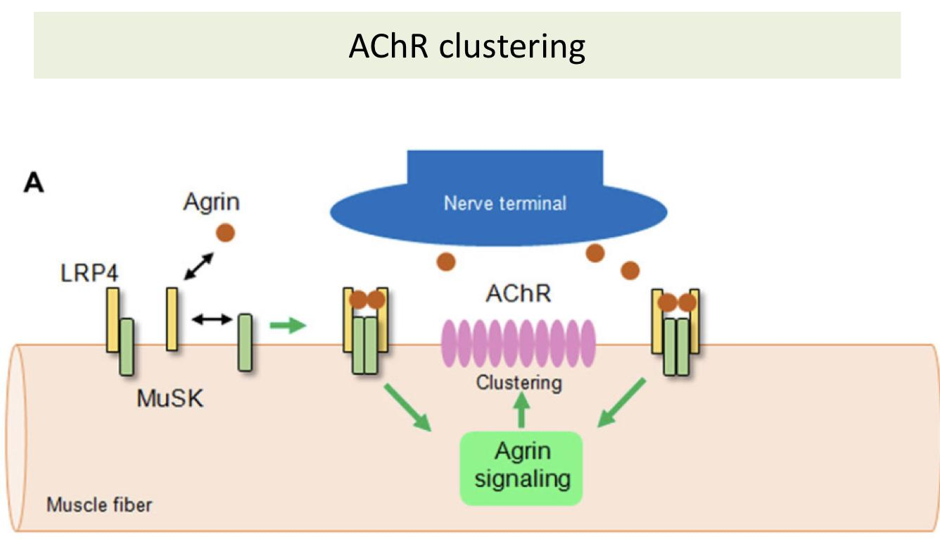
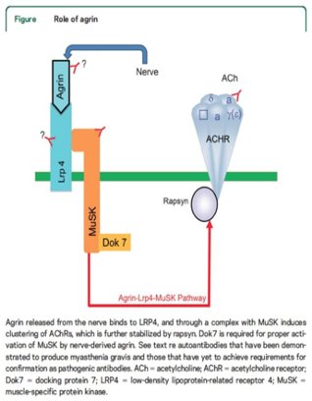
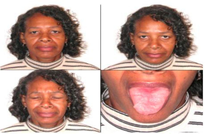
Myasthenia gravis
Ocular Cooling/“ice-pack” Test
A bag (or surgical glove) is filled with ice and placed on the
closed lid that has ptosis for 2 minutes. The ice is then
removed and the extent of ptosis is immediately assessed.
prolongation of the opening of Na+ channels that are responsible for the binding of ACh with AChR → transient ptosis improvement
A meta-analysis showed this test to have high sensitivity (appears to be about 80%) and specificity in MG ,suggesting that it may be useful in patients with lid ptosis, particularly if the edrophonium test is negative or contraindicated.
It can be used in patients with ptosis.
Edrophonium Chloride (Tensilon) Test
Rarely used now because it causes bradycardia.
The test is most reliable when the patient has ptosis or diplopia,
and is positive in more than 90% of patients with MG.
Is an acetylcholinesterase inhibitor injection with rapid onset
(30 to 45 seconds) and short duration of action (5 to 10 minutes).
Inhibits the action of acetylcholinesterase, thus allowing ACh to
diffuse more widely throughout the synaptic cleft and to have a
more prolonged interaction with AChR on the postsynaptic
muscle membrane.
Used in patients with obvious ptosis or ophthalmoparesis,
in whom improvement after infusion of the drug can easily be observed
Cover with intravenous atropine is necessary to avoid bradycardia
When the test is positive, there is substantial improvement in weakness within seconds and this lasts for up to 5 minutes.
Acetylcholine Receptor binding Antibodies
Typically mostly used, measured from the serum.
Not all patients have +ve antibodies, it’s found in 80-90% with generalized disease (15% are seronegative, out of these, 7% are Anti-Musk abs positive and 7% are double seronegative) and 40-55% with ocular myasthenia
highly specific for MG and confirm the diagnosis.
Anti- MuSK antibodies
If they were seronegative to antiAchR do anti Musk. What is the chance of it to be positive ? 38-50%
MuSK antibodies are present in 38-50% of those with generalized myasthenia gravis who are AChR-Ab negative
Present in up to 40 % of GMG patients who are seronegative for AChR antibodies and in some patients with OMG.
Anti-MuSK antibodies define a sub- group of MG patients characterized by weakness predominantly in bulbar, facial and neck muscles.
Typically seen in young female

Slide 10
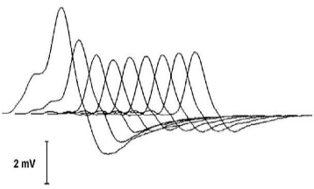
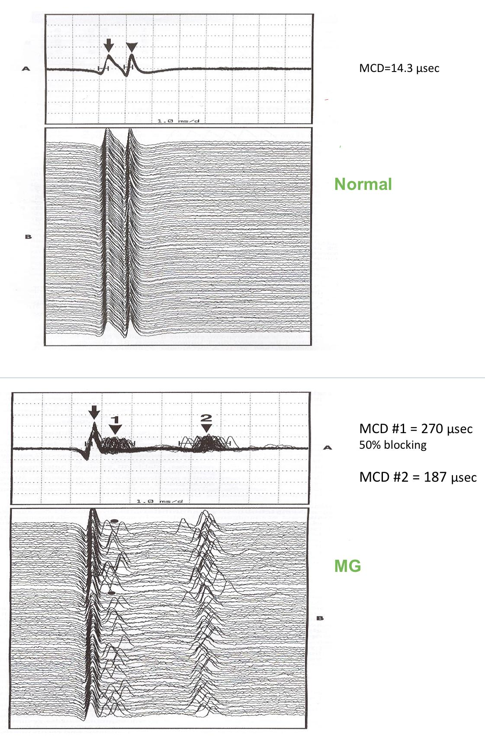
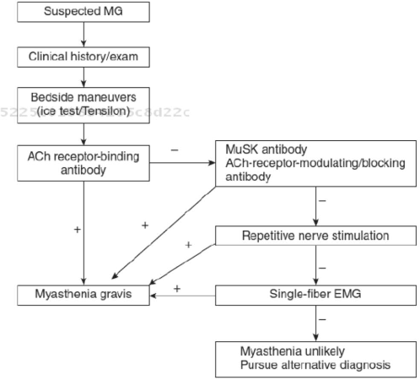
Myasthenia gravis
Repetitive Nerve stimulation (RNS)
The sensitivity of RNS for diagnosing MG reportedly ranges
from 53% to 100% in GMG and 10% to 48% in OMG
The nerve is electrically stimulated repetitively 6 to 10 times
at low rates (2 or 3 Hertz).
In normal muscles, there is no change in CMAP (compound muscle action potential)amplitude with repetitive nerve stimulation from the 1st to the 10th stimuli.
In myasthenia there may be a progressive decline in the CMAP amplitude with the first four to five stimuli
Repetitive stimulation during nerve conduction studies may show a characteristic decremental response
Single Fiber Electromyography (SFEMG) (Most sensitive)
Decreased # of interactions between Ach and receptors > takes longer to reach threshold
Single-fibre EMG of orbicularis oculi is more sensitive than repetitive stimulation and shows block and jitter.
Time required for EPP to reach threshold varies – JITTER
Sometimes EPP fails to reach threshold – BLOCKING
It is positive in greater than 90% of those with generalized myasthenia
Jitter
CT mediastinum
To detect common conditions associated with MG.
In AChR antibody positive myasthenia gravis,>75% of patients have thymic abnormalities.
Thymic hyperplasia is most common 85%.
Thymic tumors (primarily thymoma) in up to 15%. usually in elderly groups although can be seen in young age group.
All patients should have a thoracic CT to exclude thymoma
especially those without anti-acetylcholine receptor antibodies.
Autoimmune disorders
Autoimmune thyroid disease is common (3-8%) in patients with myasthenia.
Screening for thyroid abnormalities should also be part of the initial evaluation.

Slide 11
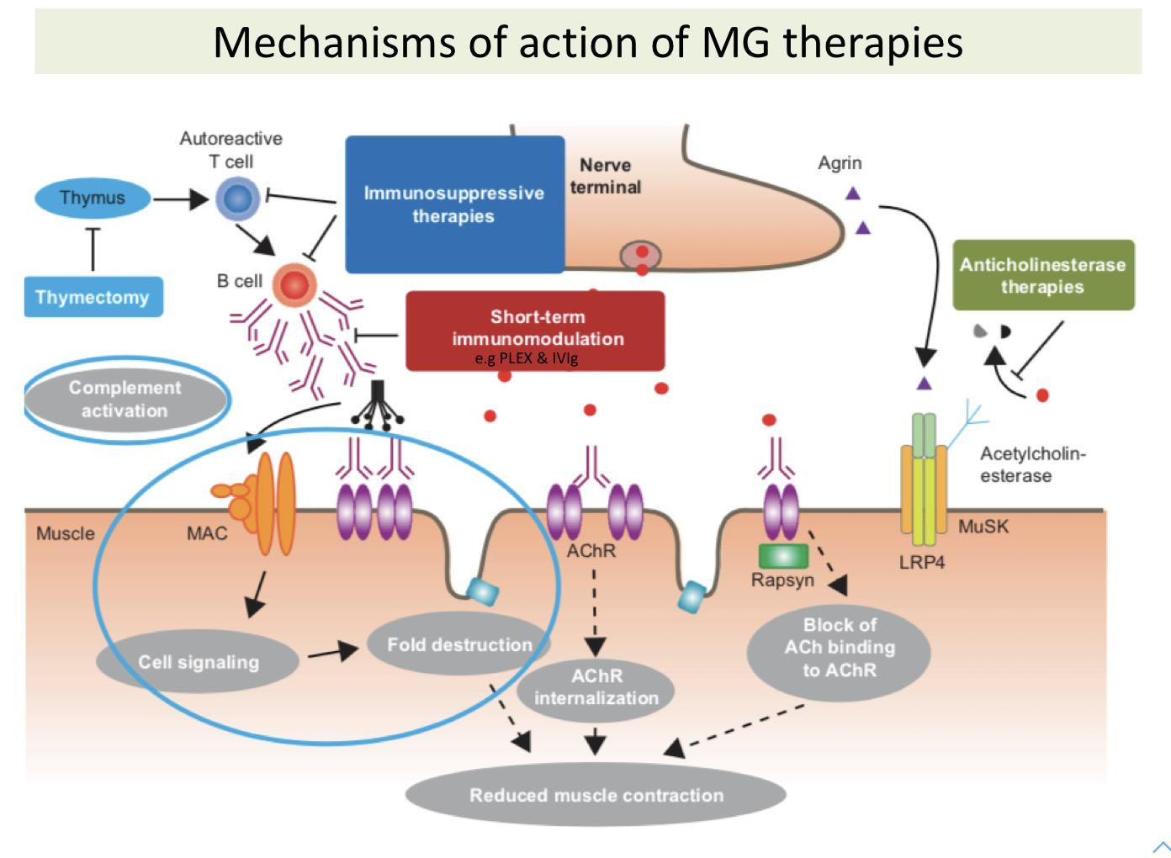
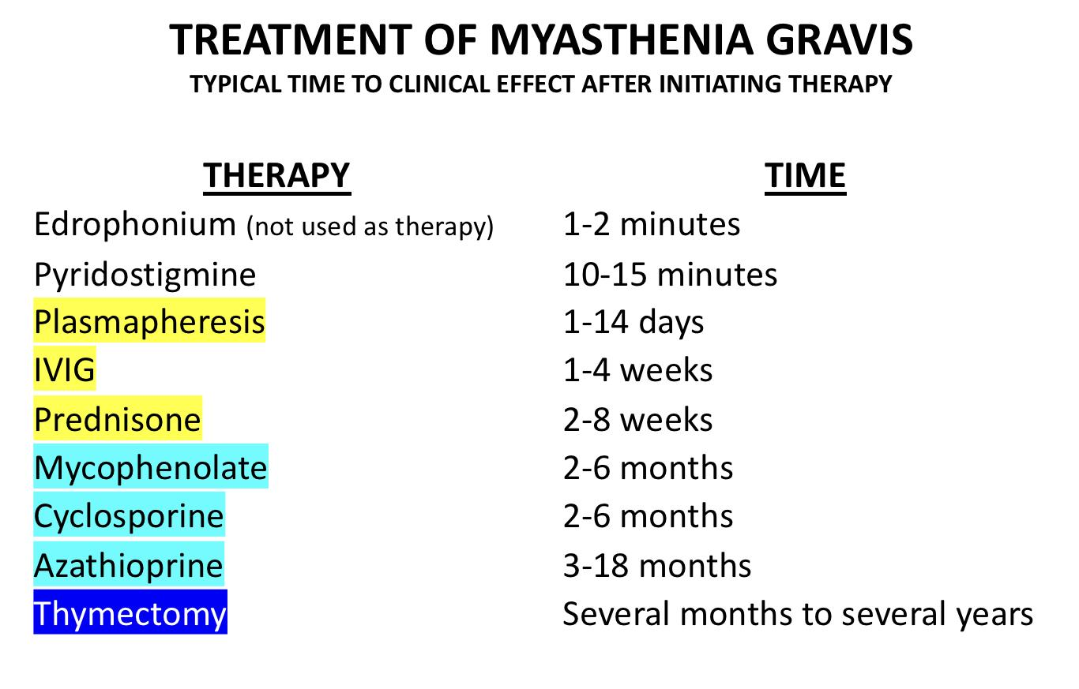
Myasthenia gravis
A combination of symptomatic treatment and long term immunomodulating therapy. The goals of treatment are to maximise the activity of acetylcholine at remaining receptors in the neuromuscular junctions and to limit or abolish the immunological attack on motor end plates.
Symptomatic treatment (anticholinesterase agents)
Cholinesterase Inhibitors: Pyridostigmine (Mestinon). symptomatic relief , taken multiple times per day. consider it as panadol for headache. Overdosage may cause a ‘cholinergic crisis’ due to depolarisation block of motor end plate with muscle fasciculation, paralysis, pallor, sweating, excessive salivation and small pupils.
chronic Immunotherapy
(glucocorticoids/immunosuppressive drugs). Prednisone (Main one), Azathioprine (Imuran), Methotrexate Cyclosporine, Mycophenolate (CellCept), Cyclophosphamide, Tacrolims,. We start with steroids and combine it with cellcept or imuran as it takes time to act (6-8 months). The advantage of prednisolone over other immunomodulators that it has a fast onset 7-10 days. Usually we use imuran or cellcept to avoid steroids side effects .
MG crisis (Rapid therapy)
Plasma exchange and intravenous immune globulin [IVIG] Intravenous Immune Globulin (IVIG) Lowers production of antibodies and rapidly reduces weakness Plasmapheresis Removing antibody from the blood may produce marked improvement; this is usually brief, so is normally reserved for myasthenic crisis or for pre-operative preparation.
Refractory MG
– Eculizumab (Works on C5 of the MAC), rituximab (Works on B-cells), maintenance IVIG or PLEX, steroids +/-
Surgery
Thymectomy Thymectomy is performed only in 2 scenarios: Patient has thymoma Or Positive ACh receptor antibodies + Generalised MG + Young patient Studies showed benefit from thymectomy in those patients and they might reach complete remission. The onset of improvement is variable and doesn’t always mean complete remission, it means reducing the number of relapses , admission and the ability to reduce steroid dose. Should be considered in any antibody-positive patient under 45 years with symptoms not confined to extraocular muscles, unless the disease has been established for more than 7 years
Done to all pts. with thymoma or hyperplasia of the thymus and for anyone with +ve Ach receptor antibodies (because recent studies show benefit and improvement that is variable; doesn’t always have to be full remission, could mean reducing medication doses or episodes of relapses and admission) with GMG except for those who are above 65.
If they are above 65 and have thymoma then thymectomy is performed.
Benefits: lower doses of steroids needed and lower MG crisis

Slide 12
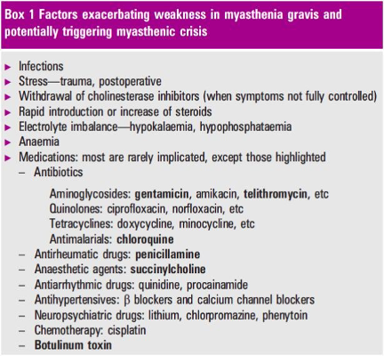
Myasthenia gravis
Prognosis
Prognosis is variable and remissions may occur spontaneously.
When myasthenia is entirely ocular, prognosis is excellent and disability slight.
Rapid progression of the disease more than 5 years after onset is uncommon.
MG conclusions
MG causes fatigable muscle weakness and often presents with ptosis and ophthalmoplegia.
Early onset (<40 years) MG more commonly affects women, late onset is more common in men.
AChR antibodies are found in 80–85% of generalised and 50% of ocular MG patients, MuSK antibodies in 5–8% of generalised MG.
Decremental response to RNS and prolonged jitter or blocking on SFEMG are the neurophysiological hallmarks of MG.
Monitoring of FVC is vital in patients with severe bulbar weakness.
Myasthenic weakness is often exacerbated by infections and can lead to myasthenic crisis.
Pyridostigmine, steroids and immunosuppressants are the mainstay of treatment.
All patients with MG should be screened for thymoma.
Thymectomy is often advised in mild to moderate AChR antibody positive generalised MG with onset less than 65 years of age.

Slide 13
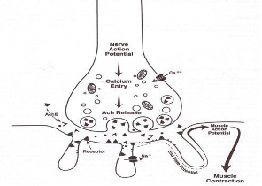
Lambert-Eaton Myasthenic Syndrome (LEMS)
It is a rare presynaptic disorder of neuromuscular transmission in which quantal release of acetylcholine (ACh) is impaired. Rather than post-synaptic like in MG, so there is no problem with ACh binding, but a problem on ACh release.
Epidemiology
The true incidence of LEMS is unknown, but the condition is uncommon and occurs much less frequently than myasthenia gravis
Approximately 1/2 of LEMS cases are associated with a malignancy, mainly small cell lung cancer (SCLC)
The incidence and prevalence of LEMS in patients with SCLC are estimated to be approximately 3%
The other tumors associated with LEMS are lymphoproliferative disorders (Hodgkin lymphoma).
Pathophysiology
1
Caused by an autoimmune attack directed against the voltage-gated calcium channels (VGCCs) on the presynaptic motor nerve terminal results in a loss of functional VGCCs at the motor nerve terminals. no influx of Ca++ → no exocytosis of ACh
2
The number of quanta (vesicle that contains 5000-10000 molecules of ACh) released by a nerve impulse is diminished.
3
Because presynaptic stores of ACh and the postsynaptic response to ACh remain intact, rapid repetitive stimulation or voluntary activation that aids in the release of quanta will raise the endplate potential above threshold and permit generation of muscle action potential. Increased nerve AP → temporarily increase in ACh release → generation of muscle AP → temporary facilitation of movement and muscle strength.
4
Clinically, this phenomenon is noted by the appearance of previously absent tendon reflexes following a short period of strong muscle contraction by the patient.
Temporary improvement.
5
Parasympathetic, sympathetic, and enteric neurons are all affected Ca++ channels. Another difference from MG.
Etiology
Autoimmune
Paraneoplastic
Antibodies directed against the voltage-gated calcium channel (VGCC).
These antibodies interfere with the normal calcium flux required for the release of acetylcholine.
Typically in younger age groups.
The expression of functional VGCCs in the surface membrane of small cell lung cancer (SCLC) cells (among numerous other neural antigens) is responsible for most cases of paraneoplastic LEMS.
The manifestation of an underlying malignancy.
Usually in elderly age groups.

Slide 14
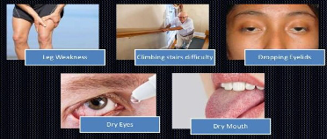
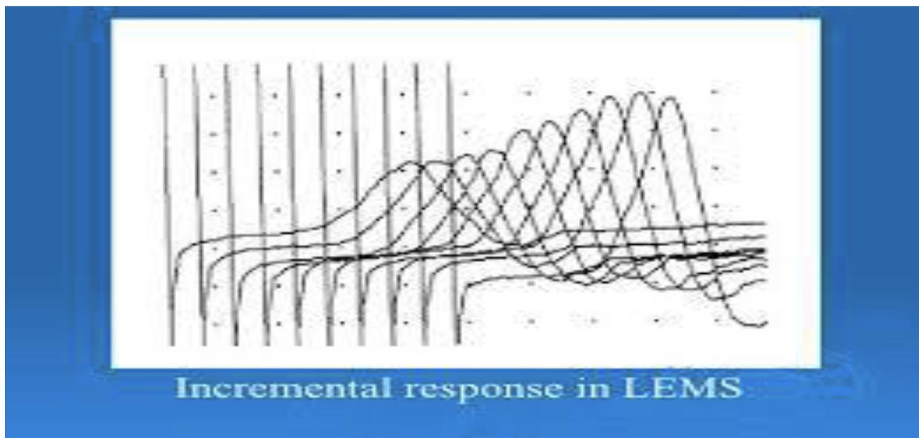
Lambert-Eaton Myasthenic Syndrome (LEMS)
Clinical features
Weakness/Fatigue (LL>UL) in Limb-Girdle Distribution (Unlike MG, weakness improves with use in LEMS bc the more you use the muscle the more Ca enters → More ACh release)
Most patients with LEMS present with slowly progressive proximal muscle weakness, particularly involving the legs. More than the arms.
Deep tendon reflexes are typically depressed or absent only at the beginning, after repetitive muscle stimulation they appear.
Autonomic symptoms including dry mouth (most common among autonomic symptoms) and erectile dysfunction ,postural lightheadedness, sphincter disturbance, dilated pupils
Occas Paresthesias, Myalgias
Dysphagia, Dysarthria may occur
Ocular symptoms, especially ptosis and diplopia, may occur with LEMS but are
rarely the presenting or dominant feature of the illness. (Unlike MG)
Most patients do not have significant respiratory muscle weakness
Post-tetanic potentiation: Recovery of lost deep tendon reflexes or improvement in muscle strength with vigorous, brief muscle activation is a unique aspect of LEMS
Hypo or areflexia
Poorly reactive pupils
May have mild distal sensory loss in feet
Diagnosis
1
2
3
The diagnosis of LEMS is usually clinical and confirmed by the presence of antibodies to voltage-gated calcium channel (VGCC) and by electrodiagnostic studies
Antibodies against the P/Q-type VGCC are present in approximately 85-95% of patients with LEMS
High frequency (10, 20 to 50 Hz) repetitive nerve stimulation (RNS) or brief (10 seconds) maximal isometric muscle activation result in significant increment (>60%, unlike MG in which there’s decrement) with a marked increase in the CMAP amplitude
temporary 100-200% improvement
Treatment
● Underlying Malignancy
●
3,4 diaminopyridine DAP (amifampridine)
Guanidine hydrochloride
Similar to MG treatment
1st Rx
Search for and treat a primary underlying malignancy in patients with any risk factors for small cell lung cancer.
2nd
Symptomatic therapies for LEMS include medications that increase the amount of acetylcholine available at the postsynaptic membrane.
These are guanidine hydrochloride, aminopyridines such as 3,4-diaminopyridine (3,4-DAP, aka Amifampridine), and acetylcholinesterase inhibitors such as pyridostigmine
Immunologic therapies include intravenous immune globulin (IVIG) or oral immunosuppressive agents.

Slide 15
Botulism
Botulism
Definition
It is an uncommon and life-threatening disease caused by bacteria in the Clostridium family including C. botulinum, C barati and C butyricum That affects the pre-synaptic membrane.
They are all gram-positive, anaerobic, spore-forming rods, which have evolved to produce a potent neurotoxin.
Eight types of botulinum toxins (A, B, Ca , Cb , D, E, F, and G).
Types A and B are the cause of most cases of botulism in the United States
Transmission of type E is in seafood
All forms of the toxin block ACh release from the presynaptic motor nerve terminal and the parasympathetic and sympathetic nerve ganglia.
The intracellular target is the SNARE proteins of the presynaptic membrane.
Neuromuscular symptoms usually begin 12 to 36 hours after ingestion of contaminated food and are preceded by nausea and vomiting.
It occurs in 4 forms, differentiated by the mode of acquisition:
Food borne botulism
Infant botulism
Wound botulism
Adult enteric infectious botulism
Botulism
it occurs in 4 forms, differentiated by the mode of acquisition:
Food borne botulism
Infant botulism
Wound botulism
Adult enteric infectious botulism
occurs after ingestion of food contaminated by preformed botulinum toxin
occurs after the ingestion of clostridial spores (Typically in honey) that then colonize the host's gastrointestinal (GI) tract and releases toxin
occurs after infection of a wound by Clostridium botulinum with subsequent production of neurotoxin
or adult infectious botulism of unknown source is similar to infant botulism in that toxin is produced in the GI tract of an infected adult host
Botulism
Epidemiology
An average of 110 cases of botulism is reported each year in the United States.
Approximately 72% of these cases are infant botulism, 25% are food borne botulism (typically from homemade foods like jam), and 3% are wound botulism.

Slide 16
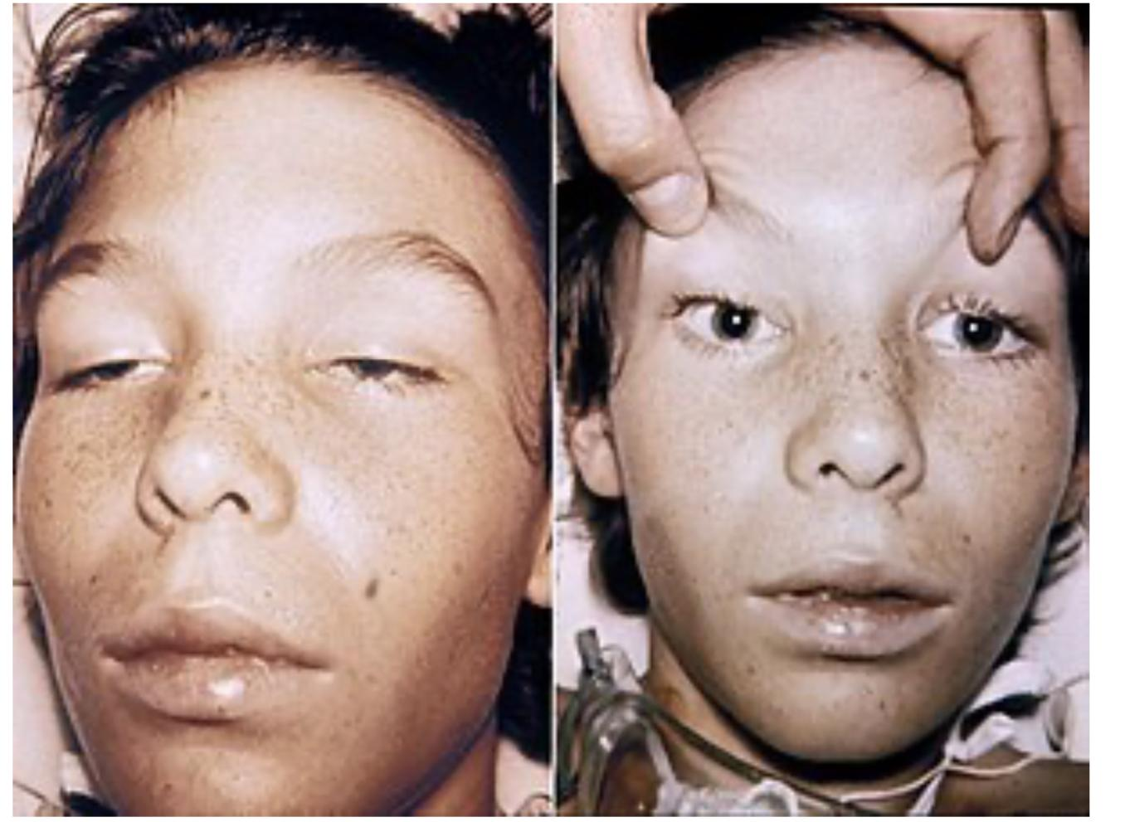
Botulism
Clinical features
Acute presentation
Cranio-ocular symptoms begin at same time or soon after
initial GI symptoms (nausea & vomiting) with ingested toxin.
Descending weakness
Pupils dilated and fixed in 50-75% of the patients.
Blurred vision
Ptosis, EOM weakness nearly universal, symmetrical (may improve a bit with Tensilon)
Bulbar weakness: dysarthria, dysphagia, facial
Limb weakness proximal > distal, symmetrical
Respiratory weakness.
Acute onset (Unlike MG) of bilateral cranial neuropathies associated with symmetric descending weakness.
Cranio-ocular symptoms begin at same time or soon after initial GI symptoms (nausea & vomiting) with ingested toxin.
Pupils dilated and fixed in 50-75% of the patients.
Blurred vision
Ptosis, EOM weakness nearly universal, symmetrical (may improve a bit with Tensilon)
Bulbar weakness: dysarthria, dysphagia, facial
Limb weakness proximal > distal, symmetrical
Respiratory weakness.
Symptoms usually start from the eyes and descend down
Key features of botulism syndrome
Absence of fever
Symmetric neurologic deficits
The patient remains responsive doesn’t affect level of consciousness.
Normal or slow heart rate and normal blood pressure
No sensory deficits
Diagnosis
The diagnosis is usually clinical as routine lab tests are nonspecific and specific laboratory confirmation may take up to days.
Electrodiagnostic studies are helpful in diagnosis of botulism.
Repetitive nerve stimulation (RNS) at low frequencies of 2 to 5 Hz causes decremental response.
RNS at high frequencies stimulation or exercise causes incremental response, or postactivation facilitation ( in 60% of adult botulis).
The amount of facilitation seen with botulism (40-100%) is usually less than that seen in Lambert-Eaton myasthenic syndrome (200%).
Treatment
Treatment consists of administration of bivalent (type A and B) or trivalent (A, B, and E) antitoxin.
Supportive.
Infantile botulism: IV human botulism immune globulin (BIG-IV)
Suspected cases should be hospitalized immediately and monitored for signs of respiratory failure.
There are two botulism antitoxin therapies available.
Equine serum heptavalent botulism antitoxin is used to treat children older than one year of age and adults.
Human-derived botulism immune globulin is used for infants less than one year of age

Slide 17
Females slides
Other NMJ disorders
Tick paralysis
Several tick species produce a toxin that inhibits transmission at the neuromuscular junction by blocking influx of sodium ions In the postsynaptic membrane.
This prevents presynaptic terminal axon depolarization and inhibits release of acetylcholine at the nerve terminal.
The ticks primarily responsible include the Rocky Mountain wood tick (Dermacentor andersoni), the American dog tick (Dermacentor variabilis), the Lone Star tick (Amblyomma americanum), the black-legged tick (Ixodes scapularis)
Symptoms include anorexia, lethargy, muscle weakness, nystagmus, and an ascending flaccid paralysis.
Symptom onset occurs three to seven days after attachment of the tick.
The diagnosis of tick paralysis usually relies on the finding of a tick attached to the
patient.
Unexposed areas such as the scalp, genitalia, and external meatus should be inspected carefully.
Removal of the tick is the primary treatment of tick paralysis.
Snake venom
The toxins produced affect either the presynaptic or postsynaptic junction Toxins affecting the presynaptic junction include beta-bungarotoxin (krait), notexin( tiger snake), taipoxin (Taipan), and crotoxin (Brazilian rattlesnake).
The exact mechanism of toxicity is undefined, but initial fusion of synaptic vesicles with the presynaptic membrane is induced, followed by inhibited reformation of the vesicles after exocytosis. Further neurotransmitter release is therefore prevented
The postsynaptic-acting toxins bind irreversibly to the acetylcholine receptor site, and prevent the opening of the associated sodium channel (an example is alpha- bungarotoxin).
Cranial nerves neuropathy resulting in ptosis, ophthalmoplegia, dysarthria, dysphagia, and drooling.
Weakness of limb muscles.
impaired coagulation profile.
The postsynaptic toxins produce findings on electrodiagnostic studies identical to those seen in myasthenia gravis, since the mechanism of disease is similar.
Repetitive nerve stimulation produces a decremental response
Antivenom is available and effective for postsynaptic neurotoxins. It accelerates dissociation of the toxin from the postsynaptic receptor.
Presynaptic toxins have no response to antivenom. Only supportive therapy.
Clinical features
Management

Slide 18
Females slides
Other NMJ disorders
Organophosphate and carbamates toxicity
Commonly seen.
Organophosphates and carbamates are potent inhibitors of acetylcholinesterase, causing excess acetylcholine concentrations in the synapse.
Commonly used as pesticides.
Exposure routes include oral ingestion, inhalation, or dermal contact.
Both sympathetic and parasympathetic systems are involved.
Symptoms include muscarinic signs (lacrimation, bradycardia, bronchospasm) and
nicotinic signs (mydriasis, tachycardia, weakness, hypertension).
Increased depolarization at nicotinic neuromuscular synapses results in muscle weakness and flaccid paralysis.
Central nervous system symptoms may be present including anxiety, confusion, seizures, and coma
The diagnosis is made clinically by the presence of clinical features of cholinergic excess and history of exposure.
Emergency management (ABC management) often requires endotracheal intubation and volume resuscitation.
Aggressive decontamination with complete removal of the patient's clothes and vigorous irrigation of the affected areas
Atropine is used for symptomatic relief of muscarinic symptoms.
It does not reverse the paralysis caused by neuromuscular blockade that results from nicotinic receptor stimulation.
Clinical features
Management & diagnosis
Hypermagnesemia / hypocalcemia
Causes inhibition of acetylcholine release
Magnesium has a calcium channel blocking effect that decreases entry of calcium into cells. It also decreases the amount of acetylcholine released and depresses the excitability of the muscle membrane.
This produces proximal muscle weakness, which may progress to respiratory insufficiency. Ocular muscles are generally spared

Slide 19
STEP UP
 | Myasthenia Gravis
General characteristics | 1. Autoimmune disorder—Auto antibodies are directed against the nicotinic acetylcholine receptors of the neuromuscular junction, which leads to a reduced postsynaptic response to acetylcholine and results in significant muscle fatigue. 2. Muscles that are stimulated repeatedly (e.g., extraocular muscles) are prone to fatigue 3. The peak incidence in women is age 20 to 30; in men, 50 to 70. It is more common in women.
Clinical features | Skeletal muscle weakness with preservation of sensation and reflexes. a. Weakness is exacerbated by continued use of muscle and improved by rest Symptoms worsen toward the end of the day (due to fatigue). b. Involved muscles vary and may include the following: Cranial muscles: extraocular muscles, eyelids (ptosis), facial muscles (facial weakness, difficulty in chewing, slurred speech). Limb muscles (proximal and asymmetric). Ptosis, diplopia, and blurred vision most common initial symptoms. Generalized weakness, dysarthria, and dysphagia. The condition progresses slowly with periodic exacerbations. Myasthenic crisis is a medical emergency that occurs in 15% of patients. Diaphragm and intercostal fatigue result in respiratory failure, often requiring mechanical ventilation
Diagnosis | Acetylcholine receptor antibody test is the test of choice (most specific). Nevertheless, 20% of patient with clinical manifestations of myasthenia gravis may be “antibody negative.” EMG shows a decremental response to repetitive stimulation of motor nerves. A CT scan of the thorax can rule out thymoma. Edrophonium (Tensilon) test—anticholinesterase (AChE) medications cause marked improvement of symptoms, but a high false-positive rate limits utility
Treatment | AChE inhibitors— pyridostigmine. Inhibiting AChE increases concentration of acetylcholine at the synapse by decreasing the breakdown of acetylcholine. This is a symptomatic benefit only. 2. Thymectomy. a. This provides a symptomatic benefit and complete remission in many patients, even in the absence of a thymoma. b. Although usually benign, thymoma is an absolute indication for thymectomy. 3. Immunosuppressive drugs. Use corticosteroids for patient with a poor response to AChE inhibitors. Azathioprine and cyclosporine are alternative third-line agents.

Slide 20
Q1: A 70-year-old woman presents with asymmetrical ptosis, which is more pronounced on her right eye, and intermittent diplopia. Her symptoms ﬂuctuate daily, and they improve with rest but worsen in the evening. Her symptoms have been present for more than 1 year, with periods of spontaneous remission. On the whole, the symptoms do not interfere with her daily activities. On clinical examination, mild fatigability of neck extensors and arm proximal muscles is also evident. Myasthenia gravis is diagnosed by detecting anti-AChR antibodies, increased jitter on SF-EMG, and a positive response to neostigmine. Thoracic computed tomography scan is negative. The patient also has diabetes controlled by diet. Which of the following is the correct recommendation as ﬁrst treatment in this patient?
A. Pyridostigmine
B. Prednisone and azathioprine
C. Thymectomy
D. Plasmapheresis
Q2: A 55-year-old woman complains of double vision. She finds that she is more tired than usual and has difficulty climbing stairs, especially when they are very long. She has difficulty getting items off high shelves at work and lately even brushing her hair is a problem. During the consultation, her voice fades away during conversations. Reflexes are present and equal throughout. Which sign or symptom is most indicative of myasthenia gravis?
A. Proximal weakness
B. Normal reflexes
C. Diplopia
D. Fatigability
E. Bulbar symptoms
Q3: A 55-year-old woman complains of double vision. She finds that she is tired all the time and has difficulty climbing stairs. She has difficulty getting items off high shelves at work. Reflexes are absent but elicited after exercise. Shoulder abduction is initially 4−5 but on repeated testing is 4 +/5. What pathology is associated with this female’s diagnosis?
A. Thyrotoxicosis
B. Peptic ulcer
C. Diabetes
D. Stroke
E. Lung cancer
Q4: A 54-year-old man has been recently diagnosed with anti-AChR-positive myasthenia gravis. The disease has had an acute onset and rapid progression, leading in few weeks to severe generalized weakness with marked bulbar symptoms, including dysphagia, dysarthria, neck weakness, and impaired respiratory function. A thymoma is detected on thoracic computed tomography scan. Symptoms are not satisfactorily relieved by fulldose pyridostigmine treatment. Which of the following should be considered as ﬁrst therapeutic option in this case?
A- . Immediate thymectomy
B. Plasmapheresis (or immunoglobulin infusion) and prednisone
C. Plasmapheresis
D. Azathioprine
E. Rituximab
Quiz explanations:
Question 1:
The correct answer is X. Explanation
Question 2:
The correct answer is X. Explanation
Question 3:
The correct answer is X. Explanation
Question 4:
The correct answer is X. Explanation
Question 5:
The correct answer is X. Explanation
Q1: Answer: A
the patient has mild generalized myasthenia gravis with predominantly ocular symptoms. The disease has a slow course and is not disabling. In this context, treatment with pyridostigmine can be suﬃcient to control patient’s symptoms and should be tried ﬁrst. Immunosuppressive therapy (prednisone and azathioprine) and plasmapheresis should be considered if the disease worsens. #ymectomy is not indicated because the patient has late-onset nonthymomatous disease. Fluoxetine blocks AChR channels; it is contraindicated in myasthenia gravis, and its use is limited to the treatment of the slow-channel myasthenic syndrome.
Q2: D
Disease of the muscle and neuromuscular junction can be similar. Both generally tend to affect proximal muscles (A). Cranially, this may result in ptosis and ophthalmoplegia (C) as well as bulbar symptoms (E) such as dysphagia and hypophonia. In both cases, reflexes (B) and muscle bulk tend to be preserved or, if severe and longstanding, reduced. A key clinical feature that differentiates myopathies and MG is fatigability (D). As patients with myasthenia use their muscles, they exhaust the supply of acetylcholine, resulting in increasing weakness. This can be elicited by asking the patient to repeatedly abduct and adduct one arm and compare it to the other arm that has remained at rest. Alternatively, you can ask the patient to count to 100 and their voice will fatigue, or ask them to do squats or test neck flexion.
Q3: E
In contrast to MG, patients with Lambert–Eaton myasthenic syndrome (LEMS) experience increased strength upon repetition. LEMS is a rare disease caused by autoantibodies against the voltage-gated calcium channels on the presynaptic motor nerve terminal. It is a paraneoplastic disorder, most often associated with small-cell lung cancer (E), although a variety of underlying malignancies may be the culprit. LEMS may be difficult to differentiate from MG clinically, an EMG is key for diagnosis as well as testing for autoantibodies and searching for underlying malignancy. MG is associated with other autoimmune disease such as thyrotoxicosis (A), haemolytic and pernicious anaemia, connective tissue disease, as well as thymomas, which is why a thymectomy is often performed. Neither MG nor LEMS are directly associated with petic ulcer, diabetes or stroke (B, C, D).
Q4: B
thymectomy is indicated and should be performed as soon as possible because of the presence of a thymoma.the patient has severe and poorly controlled symptoms. In this situation, surgery should be deferred until the myasthenia gravis improves. Plasmapheresis (or immunoglobulin infusion) provides a rapid onset of improvement, which is, however, shortlived unless immunosuppressive treatment is added. Prednisone is the ﬁrstchoice immunosuppressant because of its short-latency eﬀect; the association of plasmapheresis (or immunoglobulin infusion) can enhance the therapeutic eﬀect and minimize the temporary exacerbation that can occur at the start of prednisone administration. Because of its long-latency eﬀect, azathioprine is not the ﬁrst option in this case. Rituximab is reserved for refractory disease.
Answers: Q1:A | Q2:D | Q3:E | Q4:B
Answers Explanation File!

Slide 21
THANKS!!
This lecture was done by:
Amirah Aldakhilallah
Taif Alotaibi
Renad Alkanaan
Quiz and summary maker:
Lama Alassiri
Note taker:
Dana Alhalees
Mashal AbaAlkhail
Females co-leaders:
Raghad AlKhashan
Amirah Aldakhilallah
Males co-leaders:
Mashal AbaAlkhail
Nawaf Albhijan
Send us your feedback:
We are all ears!

