Slide 1
Lecture 63
Editing file
Lymphomas
Dr: “At your level, you are only expected to know what I have taught you in this lecture”
Objectives:
Describe the pathology classification of Lymphoma.
Describe the Clinical Presentation of Lymphoma.
Work up lymphoma.
Know the treatment of lymphoma.
Color index:
Color index:
Original text Females slides Males slides
Doctor’s notes Textbook Important Golden notes Extra

Slide 2
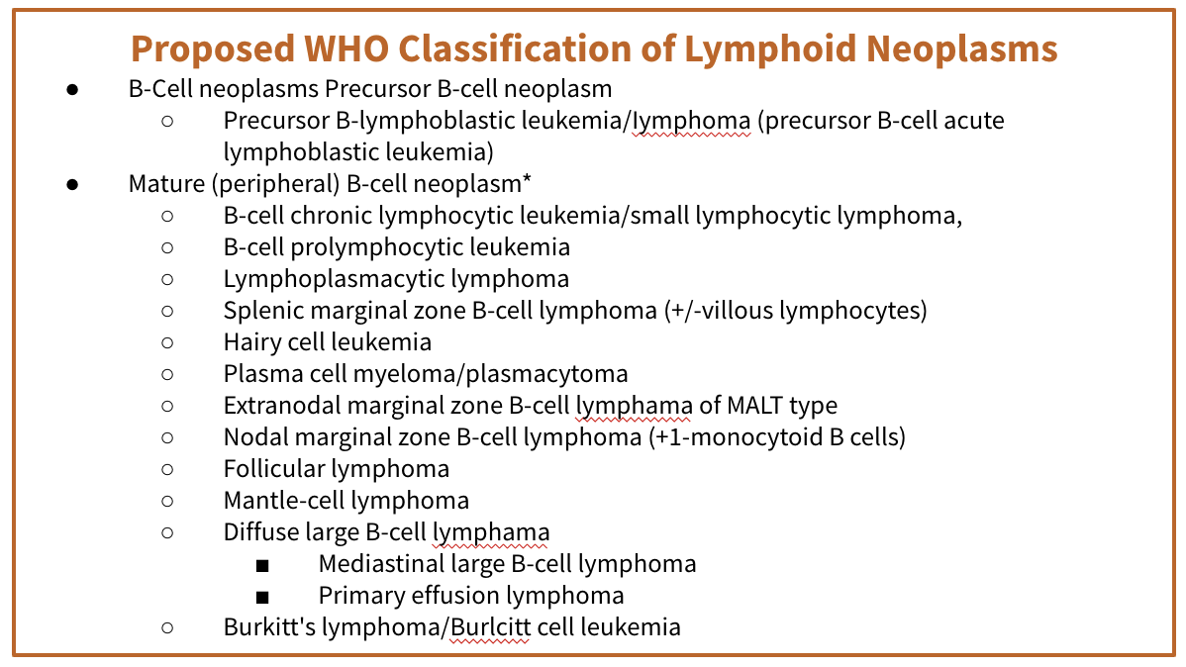
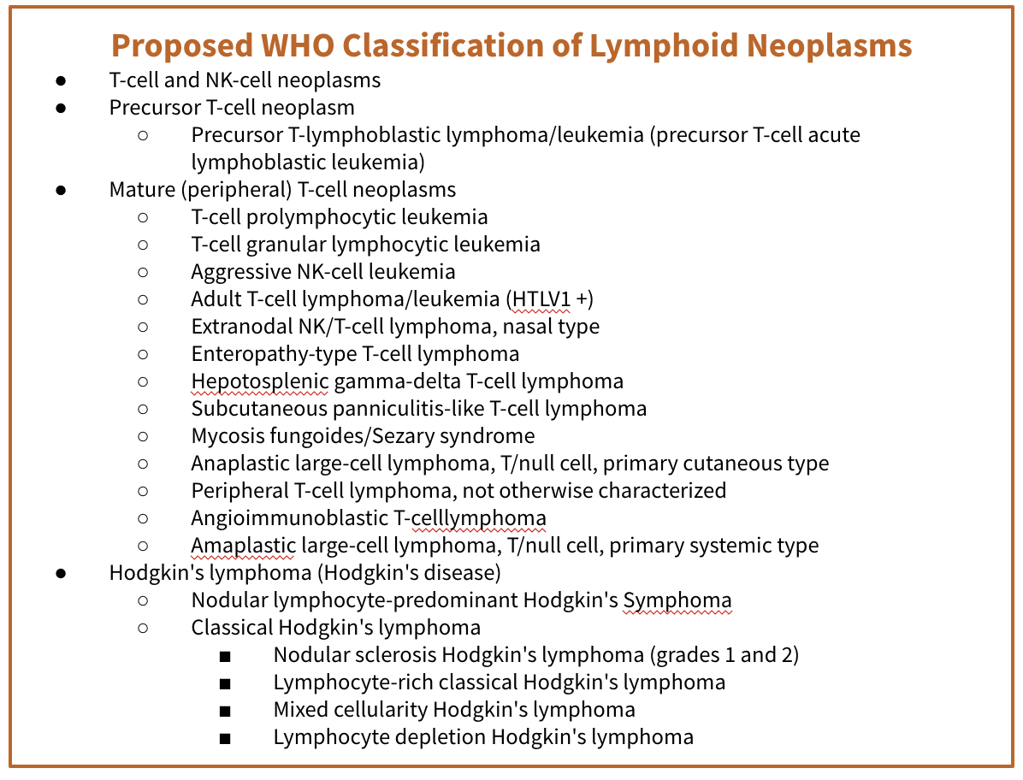
Introduction to lymphomas
Definition
Lymphoma is a cancer of the lymphatic system, which is part of the body's germ-fighting network.
It’s a neoplastic proliferation of lymphoid cells that forms a mass, and may arise in LN or in extranodal sites. The lymphatic system includes:
Lymph nodes (lymph glands)
Spleen
Thymus gland
Bone marrow
Lymphoma can affect all the above mentioned areas as well as other organs throughout the body. This is because every organ in the body has its own lymphatic structure. For example, the stomach can have a gastric carcinoma or lymphoma
Main subtypes of lymphomas
1
2
Hodgkin's lymphoma (formerly called Hodgkin's disease)
(~15% of lymphomas)
Non- Hodgkin's lymphoma
Note: Hodgkins is more common in the Lymph nodes while NHL is more common in the lymphatic vessels
WHO Classification of Hematological Neoplasms
Classification:
Myeloid
Lymphoid
B cell neoplasms
Includes plasma cell myeloma
T cell neoplasms
Hodgkin’s lymphoma
Histiocytic
Mast Cell
Dr: There are A LOT of subtypes of lymphoid neoplasms. At your level you don’t need to know any of the details, i only want you to know “رؤوس الأقلام” . The below classification is just to show you that there are many subtypes (differs in cells, risk factors and prognosis).
Proposed WHO Classification of. Lymphoid Neoplasms
B-Cell neoplasms
Precursor B-cell neoplasm
Precursor B-lymphoblastic leukemia/Iymphoma (precursor B-cell acute lymphoblastic leukemia)
Mature (peripheral) B-cell neoplasm*
B-cell chronic lymphocytic leukemia/small lymphocytic lymphoma
B-cell prolymphocytic leukemia
Lymphoplasmacytic lymphoma
Splenic marginal zone B-cell lymphoma (+/— villous lymphocytes)
Hairy cell leukemia
Plasma cell myeloma/plasmacytoma
Extranodal marginal zone B-cell lymphama of MALT type
Nodal marginal zone B-cell lymphoma (+1— monocytoid B cells)
Follicular lymphoma
Mantle-cell lymphoma
Diffuse large B-cell lymphama
Mediastinal large B-cell lymphoma
Primary effusion lymphoma
Burkitt’s lymphoma/Burlcitt cell leukemia
Proposed WHO Classification of. Lymphoid Neoplasms (cont’d)
T-cell and NK-cell neoplasms
Precursor T-cell neoplasm
Precursor T-lymnphoblastic lymphoma/leukemia (precursor T-cell acute lymphoblastic leukemia)
Mature (peripheral) T-cell neoplasms
T-cell prolymphocytic leukemia
T-cell granular lymphocytic leukemia
Aggressive NK-cell leukemia
Adult T-cell lymphoma/leukemia (HTLV1 +)
Extranodal NK/T-cell lymphoma, nasal type
Enteropathy-type T-cell lymphoma
Hepotosplenic gamma-delta T-cell lymphoma
Subcutaneous panniculitis-like T-cell lymphoma
Mycosis fungoides/Sezary syndrome
Anaplastic large-cell lymphoma, T/null cell, primary cutaneous type
Peripheral T-cell lymphoma, not otherwise characterized
Angioimmunoblastic T-celllymphoma
Amaplastic large-cell lymphoma, T/null cell, primary systemic type
Hodgkin’s lymphoma (Hodgkin’s disease)
Nodular lymphocyte-predominant Hodgkin’s )ymphoma
Classical Hodgkin’s lymphoma
Nodular sclerosis Hodgkin’s Iymphoma (grades 1 and 2)
Lymphocyte-rich classical Hodgkin’s lymphoma
Mixed cellularity Hodgkin’s lymphoma
Lymphocyte depletion Hodgkin’s lymphoma

Slide 3
Risk factors
Risk factors for lymphomas
 | Hodgkin lymphoma | Non-Hodgkin lymphoma
Age | People aged 20-30 years and those 55 years of age and above have a higher risk of lymphoma. | Most lymphomas occur in people aged 60 years and older. However, some types are more likely to develop in children and young adults.
Sex | Slightly more common in males than females. | Some types are more likely in women. Men have a higher risk of other types.
Family history | If a sibling has Hodgkin lymphoma, the risk is slightly higher. If the sibling is an identical twin, this risk increases significantly. | -
Ethnicity and location | - | In the U.S., African American and Asian American people have a lower risk for non-Hodgkin lymphoma than white people. Non-Hodgkin Lymphoma is more common in developed nations.
Chemicals & Radiation | - | Nuclear radiation and certain agricultural chemicals have links to non-Hodgkin lymphoma. (Job-induced malignancy)
Immunodeficiency | HIV infection can weaken the immune system and increase the risk of lymphoma. | A person with a less active immune system has a higher risk. This may be due to anti-rejection medications following a solid organ transplant or HIV.
Autoimmune diseases |  | This type of disease occurs when the immune system attacks the body’s own cells. Examples include rheumatoid arthritis and celiac disease.
Infectious factor | Infectious mononucleosis: The Epstein-Barr virus (EBV) can cause mononucleosis. This disease increases the risk of lymphoma. | Certain viral and bacterial infections that transform lymphocytes, such as the Epstein-Barr virus (EBV), increase the risk. This virus causes glandular fever.
Grouping/ subtypes | Nodular lymphocyte-predominant HL Classical HL: Nodular sclerosis HL Lymphocyte-rich classical HL Mixed cellularity HL Lymphocyte depletion HL | Indolent Aggressive Highly aggressive
Formerly was:
Low grade
Intermediate grade
High grade

Slide 4
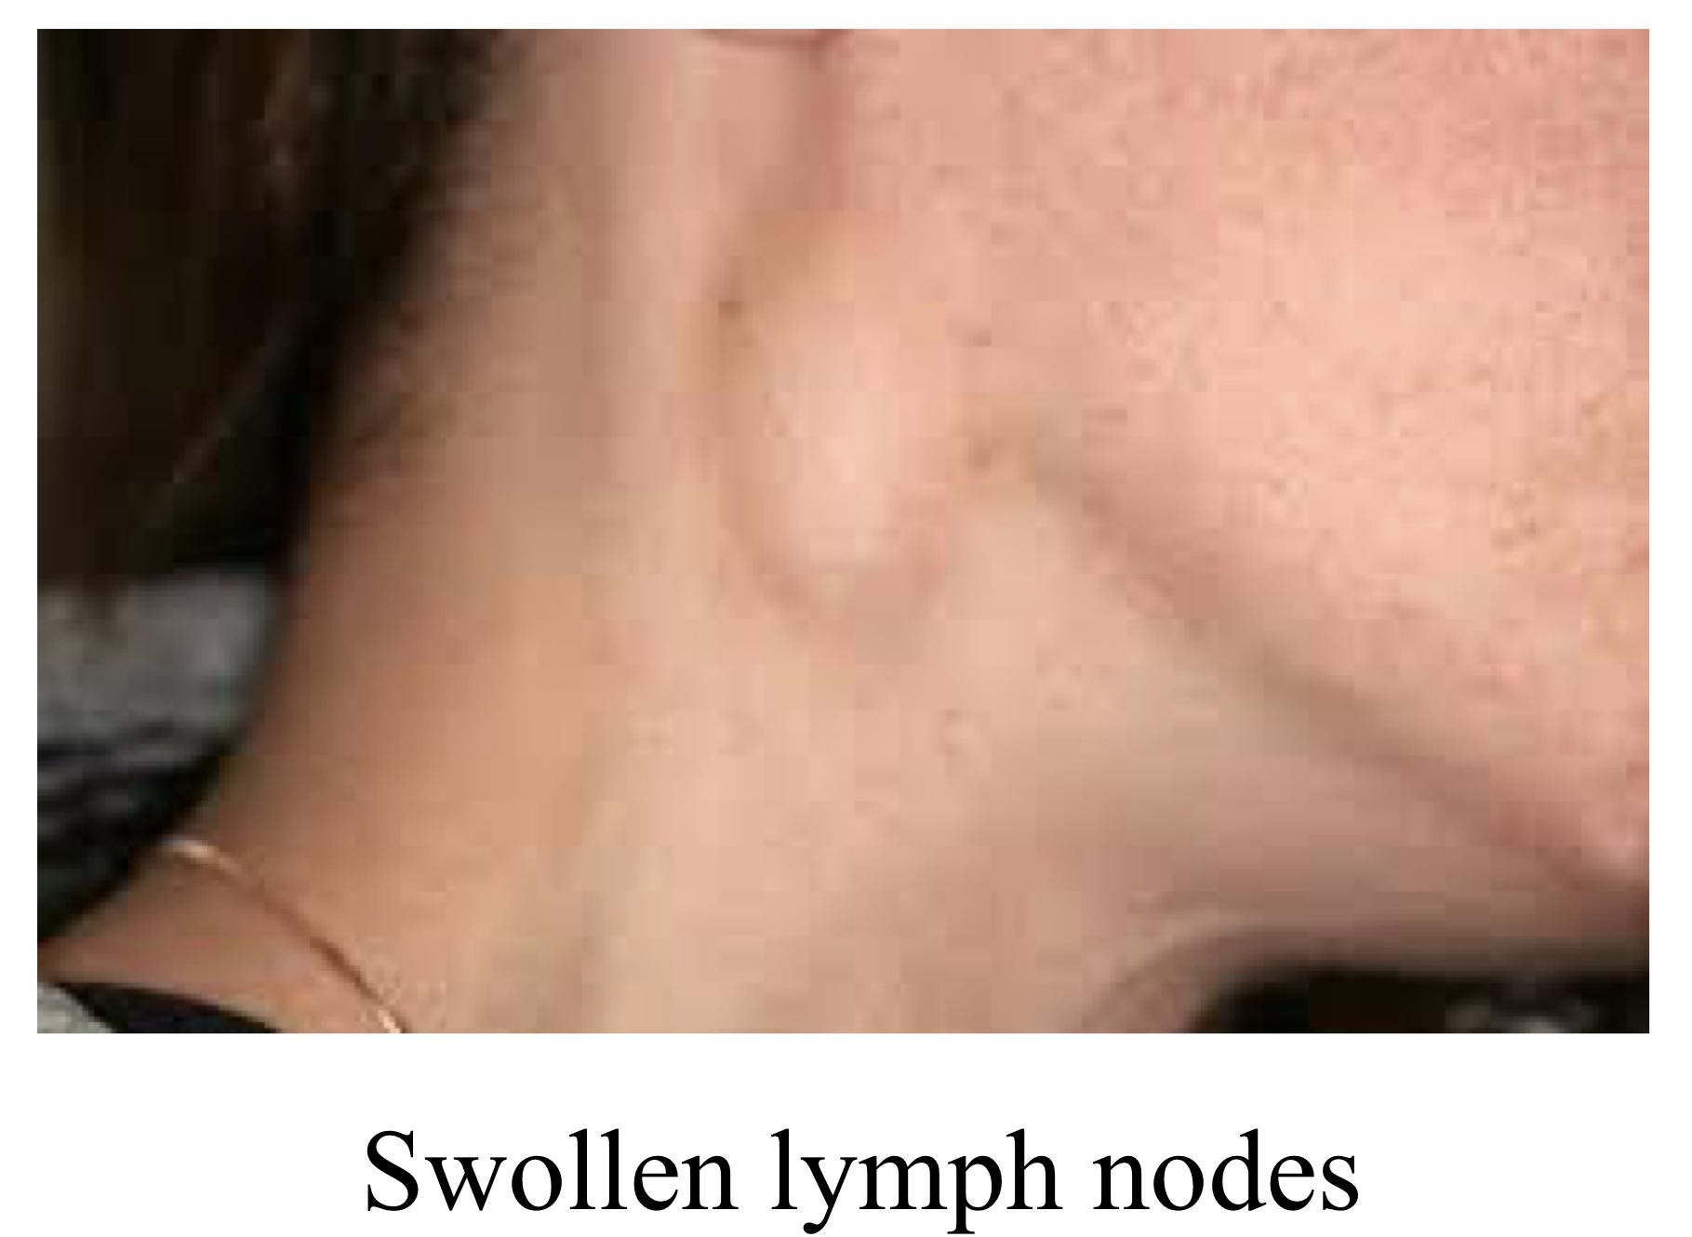
Clinical presentation
Signs and symptoms of lymphoma
Painless swelling of lymph nodes (Most common presentation) in the neck , armpits or groin , get painful after drinking alcohol. (In reactive lymphadenitis (in response to infection) there will be painful lymphadenopathy and it won’t be persistent) | B symptoms: Persistent Fever without infection. Night sweats Unexplained Weight loss and reduced appetite
Persistent fatigue (This could be due to anemia or as a result of the disease process itself) | Itchy skin “Pruritus”
Shortness of breath (Due to enlarged mediastinal LN which may compress the respiratory tract)
Some additional symptoms of non-Hodgkin lymphoma include (Depends on the location):
Persistent coughing (If in the mediastinum)
Shortness of breath
Pain or swelling in the abdomen (If it involves the abdomen)
Pain, weakness, paralysis, or altered sensation may occur if an enlarged lymph node presses against spinal nerves or the spinal cord.
Lymphoma can spread rapidly from the lymph nodes to other parts of the body through the lymphatic system.(Which is why it’s important to act quickly) As cancerous lymphocytes spread into other tissues, the immune system cannot defend against infections as effectively. (The rapidity of spread, depends on the subtype)
Diagnosis of lymphomas
Follow this sequence
History
Painless lymphadenopathy (If painful, think of reactive lymphadenopathy)
B symptoms and Performance status (It is a subjective assessment of the patient's activity; for example 100% or 70%...)
Physical examination
lymph nodes, liver, spleen, oropharynx
You must examine all the body’s lymph nodes. For para-aortic lymph nodes it has to be >10cm to be felt, so for mediastinal and para-aortic, you need to do imaging to discover them. Other sites can be palpated in the physical examination.
Lab tests
CBC (To check WBC, plt etc.), Creatinine, liver function tests, LDH, calcium
Creatinine is used to check if the pt has any renal impairment (for future investigations/treatment)

Slide 5
Diagnosis (cont. )
Biopsy
A biopsy is usually required for diagnosis. What are the types of biopsy?
Fine needle aspiration
Takes only few cells out. It can be done in the clinic and doesn’t take time.
It’s useful when the Dr needs to take an urgent decision and can’t wait for a tru-cut biopsy.
Tells you there is a malignancy but doesn't tell you what type.
Incisional biopsy “Tru-cut Biopsy ” (The best)
Takes small part of the lymph node, requires local anesthesia and it’s done by interventional radiologists
This is the one used for the diagnosis of lymphoma because it gives you more details.
Excisional biopsy
Take the whole lymph node out, requires general anesthesia and done in OR.
If biopsy is +ve, the next thing you should do is stage it, by performing bone marrow aspiration/biopsy (to make sure it hasn’t reached the bone marrow, it should always be done, but it’s especially important if the patient had low WBC ). If lymphoma is confirmed, do CT-scan of neck, thorax, abdomen and pelvis for staging (This is what the books say, but in real life we use PET scan (Discussed below))
Additional staging investigations
PET scan (IMPORTANT)
When should PET-scan be performed? Before and after treatment.
Why perform before altho we have confirmed the diagnosis with by biopsy? To test the validity of the test and to establish a baseline.
What if the biopsy was +ve for lymphoma but the PET-scan was -ve? This means that you can’t use it for the staging nor follow-up (doesn’t mean that the pt does not have a lymphoma, it’s just false-negative)
How is it performed? First we inject an isotope called fluorodeoxyglucose (FDG), FDG has high affinity for cancer cells, especially lymphomas. The cancer cells will take up this isotope and appear bright on imaging, this is called standardized uptake value (SUV). This technique is not used in patients with uncontrolled diabetes or an active infection bc the isotope will precipitate in these areas instead of the cancer. Also, if the LN was very small, it may not be appear in the PET-scan.
PET scan can differentiate between fibrosis/necrosis from treatment, and active cancer
67Ga scan (Not used nowadays bc it has high false-negative rate)
The rest of the investigations depend on the presentation/suspicion to determine the stage:
CT / MRI of head & neck, MRI - CNS, bone, head & neck presentation
For Gastric lymphoma
Cytology of effusions, ascites, Endoscopy, Endoscopic U/S
HIV, CSF cytology - testis, paranasal sinus, periorbital, paravertebral, CNS, epidural, stage IV with bone marrow involvement.
Summary of diagnosis
Take Hx, do physical examination and do the labs, if you suspect lymphoma you move right away to Incisional biopsy for diagnosis. If biopsy is positive and diagnosis is made? You then stage it with bone marrow aspiration and CT. Then you do a PET scan before and after Tx for establishing a baseline and staging.

Slide 6
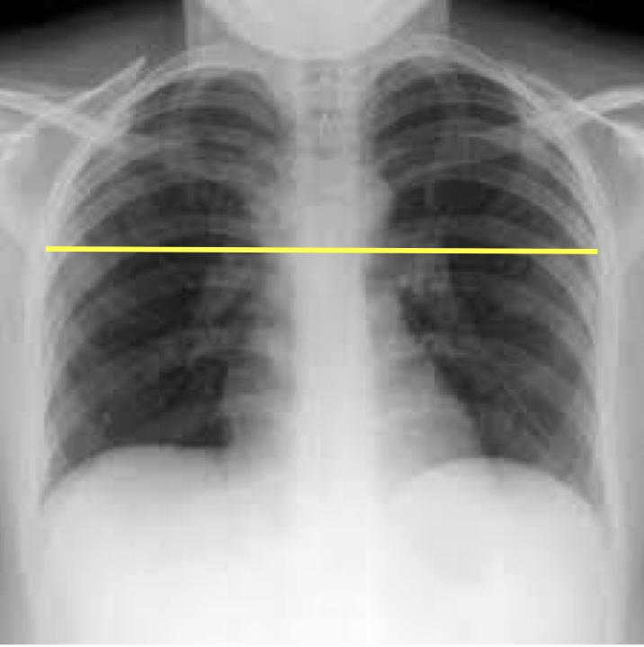
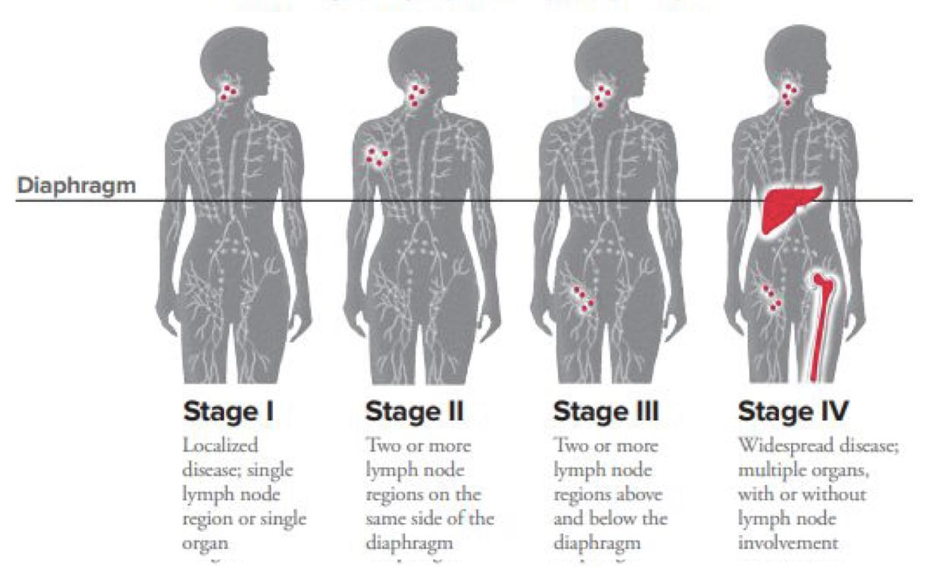
Staging system
Staging system
Cotswolds Meeting modification of Ann Arbour Classification:
Consist of a number and a letter e.g. IA, IIIB
Stage | Description
I (Early) | Involvement of a single lymph-node region or lymphoid structure (e.g. spleen, thymus, Waldeyer’s ring) or involvement of a single extralymphatic site
II (Early) | Involvement of two or more lymph node regions on the same side of the diaphragm; localized contiguous involvement of only one extranodal organ or site and lymph node region(s) on the same side of the diaphragm (IIE). The number of anatomical regions involved should be indicated by a subscript (e.g. II3) Example: Supraclavicular + Infraclavicular LNs involvement
III (Advanced) | Involvement of lymph node regions on both sides of the diaphragm (above and below), which may also be accompanied by involvement of the spleen (IIIS) or by localized involvement of only one extranodal organ site (IIIE) or both (IIISE) Example: Supraclavicular + Inguinal LNs involvement
IV (Advanced) | Extensive extranodal disease (more extensive than “E”) Diffuse or disseminated involvement of one or more extranodal organs or tissues, with or without associated lymph node involvement
Designations applicable to any disease state
A | Asymptomatic
B | One of the following is enough: (It indicates aggressive disease → needs aggressive therapy) Fever: > 38º, recurrent (Spiking up and down, not stable.) Night sweats: Drenching (Excessive sweating, they change clothes frequently), recurrent. Weight loss: unexplained loss of >10% of the ideal body weight within the previous 6 months
X | Bulky disease: (If you see the letter X in the description of lymphoma → Bulky) Mediastinal: ≥ 10 cm or > 1/3 internal transverse diameter at T5/6 on PA CXR. Example: if the diameter here is 21 cm and the lymph size is 8 cm is it bulky? Yes because its > ⅓ of the diameter. Non-mediastinal: > 5cm
E | Limited extranodal extension from adjacent nodal site
Examples: (From 437 team)
Stage IIA:
Asymptomatic patient with ≥ 2 lymph nodes that are both 3cm in size on the same side of the diaphragm.
Stage IBx:
Patient with B symptoms and one lymph node that is 11 cm in size “Bulky disease”.
Stage IIIA:
Asymptomatic patient with one lymph node in his neck and one lymph node in his abdomen “below the diaphragm” that are both 4 cm in size.

Slide 7
All info mentioned before this page applies to both HL and NHL
Hodgkin’s lymphoma (HL)
Introduction
Characterized by the presence of Reed-sternberg (RS) cells, which is a large B cell with multilobed nuclei and prominent nucleoli (Positive for CD15 and CD30).
RS cells release cytokines which attract reactive lymphocytes, plasma cells, macrophages and eosinophils. The reactive inflammatory cells are what make up the bulk of the tumor, RS only make up 15% of the tumor (So, only 15% of the cells of HL are malignant → Better prognosis than NHL)
HL subtypes
Nodular lymphocyte-predominant HL
Classical HL
Nodular sclerosis HL (Most common)
Lymphocyte-rich classical HL
Mixed cellularity HL (Associated with abundant eosinophils)
Lymphocyte depletion HL
Note: Lymphocyte-rich classical HL has the best prognosis while Lymphocyte depleted HL has the worst prognosis and it’s usually seen in elderly.
Dr: SURGERY HAS NO ROLE IN THE TREATMENT OF LYMPHOMAS, except some situations in ER e.g. gastric or intestinal obstruction.. I only want you to know the type of treatment (I.e. Chemotherapy or radiotherapy or both), you don’t need to know the names of the treatment or any other details.
HL treatment
Early stage (1A, 2A)
Very favourable prognosis
Stage 1A Nodular Lymphocyte Predominant HL (NLPHL) Usually localized, peripheral nodal sites Good prognosis, but some late relapses (>10yr) Treatment: IFRT 35 Gy / 20 (Local radiation only)
Favourable prognosis | Unfavourable prognosis
1-3 sites Age ≤ 40 ESR < 50 Nodular sclerosis, Lymphocyte-rich classical HL | >3 sites Age >40 ESR >50 Mixed cellularity/Lymphocyte depletion HL
Treatment
ABVD X 3 - 4. Then IFRT 30 Gy / 20 (Chemotherapy 3-4 cycles followed by radiation) | ABVD X 4 - 6. Then IFRT 30 Gy / 20 (Chemotherapy 4-6 cycles followed by radiation)
Advanced stage (stage 3,4, B symptoms, bulky disease)
Treatment:
ABVD X 6 - 8
IFRT (At sites of bulky disease or At sites of residual disease (35 Gy / 20))
Chemotherapy: 6 cycles if stage A, 8 cycles if stage B. followed by radiation, only if bulky disease or there is residual cancer

Slide 8
Non-Hodgkin’s lymphoma (NHL)
Clinical grouping of NHL
Dr: Only know the most common types
Clinical grouping | Type | Approximate international incidence
Indolent “low grade” (Very slow progression¹, usually in very old people. The problem with this subtype is that there’s no clear treatment, unless localized or stage 1) | Follicular lymphoma Grade 1,2. (Most common indolent subtype). driven by t(14;18) (May turn into grade 3 which is aggressive if not treated) What is t(14:18)? BCL2 on chromosome 18 translocates to Ig heavy chain locus on chromosome 14 → Results in overexpression of Bcl2, which inhibits apoptosis | 22%
 | Marginal zone lymphoma Nodal Extranodal (MALT): may regress with treatment of H.pylori Note: Marginal zone lymphoma is associated with chronic inflammatory states e.g. Hashimoto’s thyroiditis, Sjogren's syndrome, H.pylori gastritis | 1% 5%
 | Small lymphocytic lymphoma (when CLL involves LN) | 6%
 | Lymphoplasmacytic association with Waldenstrom's macroglobulinemia | 1%
Aggressive “intermediate grade” (Rapid progression, do investigations then start treatment) | Diffuse large B-cell lymphoma (Most common) (In KSA, it’s 80%) | 21%
 | Primary mediastinal large B cell lymphoma | 2%
 | Anaplastic large T / null cell lymphoma | 2%
 | Peripheral T cell lymphoma | 6%
 | Extranodal NK / T cell lymphoma, nasal type | -
 | Follicular lymphoma Grade 3 | -
 | Mantle cell lymphoma, driven by t(11;14) What is t(11;14)? Cyclin D1 on chromosome 11 translocates to Ig heavy chain locus on chromosome 14 → Overexpression of cyclin D1 promotes G1/S transition in cell cycle | 6%
Highly Aggressive (Very rapid progression, requires admission²) | Lymphoblastic lymphoma | 2%
 | Burkitt's lymphoma driven by t(8;14) and associated with EBV infection (African → involves jaw, Sporadic → involves abdomen) | 1%
 | Burkitt's like lymphoma | 2%
1- It could take up to years. So if the patient is old, we could offer them to just watch it, & treat it if it starts growing or causing symptoms (ex: bothering them when they sleep or when they turn their head)
2- You don't accept to wait months for the investigations to be done, you start them urgently right away as they could grow while admitting the patient

Slide 9
Non-Hodgkin’s lymphoma (NHL)
There is conflict in the treatment of indolent advanced stage, but keep in mind that all of them are right (No Qs will come on advanced stage, bc all of them are correct). For the rest just know if it’s radio or chemotherapy, you don’t need to know the doses or any other details
Treatment
Indolent lymphoma e.g. Follicular Grad ½, small lymphocytic, marginal zone
Limited disease (Stage 1A, 2A if 3 or less adjacent node regions) | Advanced stage (some Stage 2, Stage 3, 4)
IFRT 30-35 GY (Local radiotherapy only) Involved Field Radiotherapy. 35 Gy for follicular. 30 Gy for Small Lymphocytic and marginal Lymphomas Alternate: Chemotherapy Observation. Treat when symptomatic. | Palliative radiation therapy for localized symptomatic disease IFRT 15-20 Gy / 5 Palliative chemotherapy for disseminated symptomatic disease CVP, chlorambucil, “Cyclophosphamide, vincristine, prednisone” Observation only if low bulk, asymptomatic Treat when symptomatic
Aggressive lymphoma (e.g. Diffuse large B cell)
Stage I, some Stage II | Stage III, IV, B symptoms (one symptom is enough), or bulky disease
CHOP “or CHOP-R” x 3 + IFRT (35-45 Gy) “higher radiation dose if residual” disease (Chemotherapy 3 cycles followed by radiation) | CHOP or “CHOP-R” x 6-8 IFRT (35-45 Gy) to sites of initial bulk residual disease (i.e. PR) (Chemotherapy: 6 cycles if stage A, 8 cycles if stage B. followed by radiation, only if bulky disease or there is residual cancer)
MALT lymphoma
It’s an indolent subtype, but discussed separately because it has special treatment Marginal zone B-cell lymphoma of extranodal (MALT) type Stomach: associated with Helicobacter pylori infection Salivary Gland: associated with Sjogren’s syndrome Thyroid: associated with Hashimoto’s thyroiditis Orbital (lacrimal, conjunctiva) Other: Waldeyer’s ring, breast, bladder, lung, skin
Treatment of gastric MALT (Important bc it’s common in KSA)
Stage IE (H. pylori +ve) | Stage IE (H. pylori -ve or antibiotic failure) | Stage 2 or higher
PPI, 2 antibiotics (e.g. clarithromycin, amoxicillin) (H.pylori eradication) Follow up gastroscopy with Biopsy every 6 month for 2 yrs, then every 1 year | IFRT 30 Gy (95% local control) (Local radiotherapy only) | Treat as indolent lymphoma + H. pylori eradication
Chronic antigen stimulation

Slide 10
Lymphoma is a cancer of the lymphatic system. it is of two main subtypes
 | Hodgkin lymphoma | Non-Hodgkin lymphoma
Age | aged 20-30 years and those 55 years of age | aged 60 years and older. However, some types are more likely to develop in children and young adults.
Sex | more common in males. | more likely in women.
Chemo/Radio exposure | - | Nuclear radiation and certain agricultural chemicals have links to non-Hodgkin lymphoma.
Immunodeficiency | HIV infection can weaken the immune system and increase the risk | A person with a less active immune system has a higher risk.
Grouping/ subtypes | Nodular lymphocyte-predominant HL Classical HL: Nodular sclerosis HL (most common) Lymphocyte-rich classical HL (best prognosis) Mixed cellularity HL Lymphocyte depletion HL (worst prognosis) | Indolent Aggressive Highly aggressive
Signs and symptoms The definition, presentation, diagnostic tests, “B” symptoms, and staging of Hodgkin disease (HD) are the same as NHL. HD has Reed-Sternberg cells on pathology.
Painless swelling of lymph nodes (most common) B symptoms: Persistent Fever without infection, Night sweats, Unexplained Weight loss and reduced appetite Persistent fatigue itchy skin shortness of breath
Diagnosis
Biopsy: FNA: Tells you there is a malignancy but doesn't tell you what type. Tru-Cut Biposy: This is the one used for the diagnosis of lymphoma because it gives you more details. If biopsy is +ve, perform bone marrow aspiration/biopsy next (to make sure it hasn’t reached the bone marrow). PET Scan: Before and after treatment, PET scan can differentiate between fibrosis/necrosis from treatment, and active cancer
MALT lymphoma | Stage IE (H. pylori +ve) | Stage IE (H. pylori -ve or antibiotic failure) | Stage 2 or higher
 | PPI, 2 antibiotics (e.g. clarithromycin, amoxicillin) (H.pylori eradication) Follow up gastroscopy with Biopsy every 6 month for 2 yrs, then every 1 year | IFRT 30 Gy (95% local control) (Local radiotherapy only) | Treat as indolent lymphoma + H. pylori eradication
Stomach: associated with Helicobacter pylori infection Salivary Gland: associated with Sjogren’s syndrome Thyroid: associated with Hashimoto’s thyroiditis Orbital (lacrimal, conjunctiva)

Slide 11
Q1: A 19-year-old woman presents for evaluation of a nontender left axillary lymph node. She is asymptomatic and denies weight loss or night sweats. Examination reveals three rubbery firm nontender nodes in the axilla, the largest 3 cm in diameter. No other lymphadenopathy is noted; the spleen is not enlarged. Lymph node biopsy, however, reveals mixed-cellularity Hodgkin lymphoma. Liver function tests are normal. How would you manage this patient?
A- Chemotherapy 4-6 cycles followed by radiation
B- Chemotherapy 3-4 cycles followed by radiation
C- Local radiation only
D- Surgical excision
Q2: A 53-year-old man comes to the physician for recurring fever and night sweats for the past 6 months. The fevers persist for 7 to 10 days and then subside completely for about a week before returning again. During this period, he has also noticed two painless lumps on his neck that have gradually increased in size. Over the past year, he has had an 8.2-kg (18.1 lbs) weight loss. Two years ago, he had a severe sore throat and fever, which was diagnosed as infectious mononucleosis. He has smoked a pack of cigarettes daily for the past 10 years. He does not drink alcohol. His job involves monthly international travel to Asia and Africa. He takes no medications. His temperature is 39°C (102.2°F), pulse is 90/min, respirations are 22/min, and blood pressure is 105/60 mm Hg. Physical examination shows 2 enlarged, nontender, fixed cervical lymph nodes on each side of the neck. Which one of teh following would be seen in tha Microscopic examination of a specimen obtained on biopsy of a cervical lymph node?
A- Acid Fast Bacilli
B- CD15/30 positive cells (Reed-Sternberg Cells)
C- Proliferation of monomorphic lymphocytic cells on biopsy
Q3: The nurse understands that Hodgkin's disease is suspected when a client presents with a painless, swollen lymph node. Hodgkin's disease typically affects people in which age group?
A- Older adults (ages 41-50 years)
B- Teenagers (ages 13-20 years)
C- Young adults (ages 21-40 years)
D- Children (ages 6-12 years)
Q4: A 29-year-old man comes to the physician because of a 3-month history of fatigue, weight loss, and multiple painless swellings on his neck and axilla. He reports that his swellings become painful after he drinks alcohol. Physical examination shows nontender cervical and axillary lymphadenopathy. A lymph node biopsy specimen shows giant binucleate cells. Which of the following is the most likely diagnosis?
A- Adult T-cell lymphoma
B- Hodgkin lymphoma
C- Diffuse large B-cell lymphoma (DLBCL)
D- Mycobacterial infection
Q5: A 68-year-old man is evaluated because of worsening chronic epigastric pain. He now has fatigue and early satiety. He has iron deficiency anemia. Results of upper gastrointestinal endoscopy reveal diffuse gastritis, along with mucosal thickening in the gastric antrum associated with a mass lesion. Abundant Helicobacter pylori organisms are noted on biopsy, and histologic evaluation of the mass lesion shows it to be a gastric lymphoma of mucosa-associated lymphoid tissue (MALT) type. What is the most appropriate next step in the management of this patients illness?
A- Combination chemotherapy with 5-fluorouracil, doxorubicin, and mitomycin C (FAM)
B- Combination chemotherapy with cyclophosphamide, doxorubicin, vincristine, and prednisone (CHOP)
C- Eradication of Helicobacter pylori
D- Total gastrectomy followed by radiation therapy
Q6: A 70-year-old man comes to the physician because of fatigue and intermittent epigastric pain. The symptoms began about one year ago. He describes the pain as diffuse and 3 out of 10 in intensity. Recently, he has had unusually large black stools. He appears pale. His pulse is 72/min and his blood pressure is 110/70 mm Hg. Physical examination shows epigastric tenderness. A urea breath test is positive. Upper gastrointestinal endoscopy reveals an ulcerating mass in the gastric antrum. Biopsies of the mass show diffuse infiltrates of small lymphoid cells that are positive for CD20 antigen. A CT scan of the chest and abdomen shows normal regional lymph nodes. Which of the following is the most appropriate therapy with curative intent at this time?
A- Reassurance
B- Distal gastrectomy with gastrojejunostomy
C- External beam radiation therapy
D- Amoxicillin, clarithromycin, and omeprazole
Quiz explanations:
Question 1:
The correct answer is X. Explanation
Question 2:
The correct answer is X. Explanation
Question 3:
The correct answer is X. Explanation
Question 4:
The correct answer is X. Explanation
Question 5:
The correct answer is X. Explanation
Answers: Q1:A | Q2:B | Q3:C | Q4:B | Q5:C | Q6:D
Answers Explanation File!

Slide 12
THANKS!!
This lecture was done by:
Mashal AbaAlkhail
Quiz and summary maker:
Abdulaziz Alshoumar
Jehad AlOrainy
Note taker:
Mashal AbaAlkhail
Haifa Alwaily
Special thanks to:
Mohammed Alhumud
Females co-leaders:
Raghad AlKhashan
Amirah Aldakhilallah
Males co-leaders:
Mashal AbaAlkhail
Nawaf Albhijan
Send us your feedback:
We are all ears!

