Slide 1
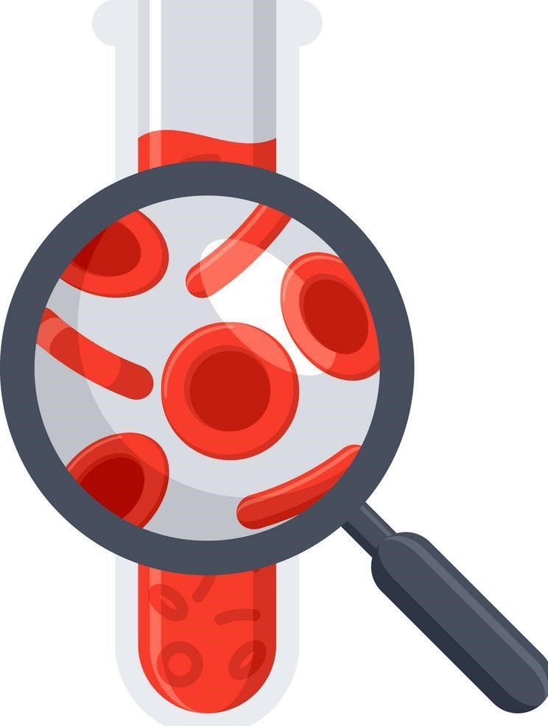
Lecture 64
Editing file
Introduction To Cancer Diagnosis & Treatment
Objectives:
Definition of cancer.
Etiology of cancer.
Staging of malignant diseases.
Principles of pathological classification of malignant diseases.
General symptoms and signs of malignancy.
Principles of cancer management (curative Vs palliative concept).
Principles of immuno- oncology.
Color index:
Color index:
Original text Females slides Males slides
Doctor’s notes Textbook Important Golden notes Extra

Slide 2
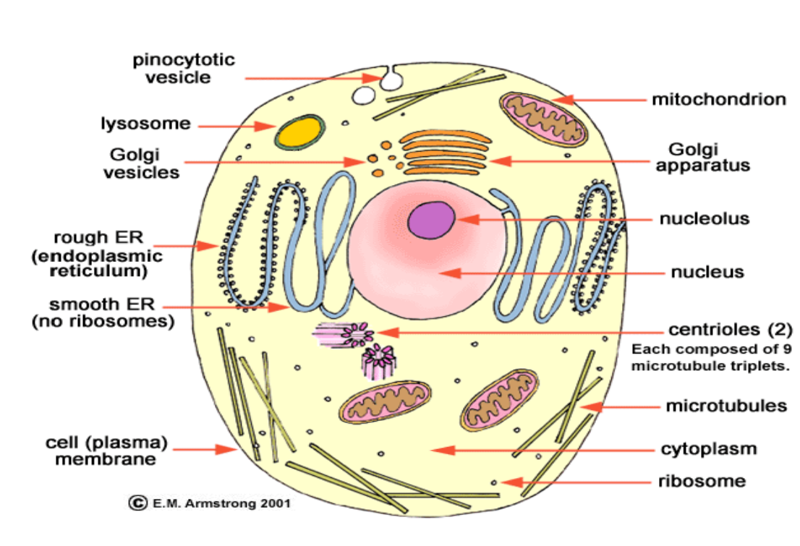
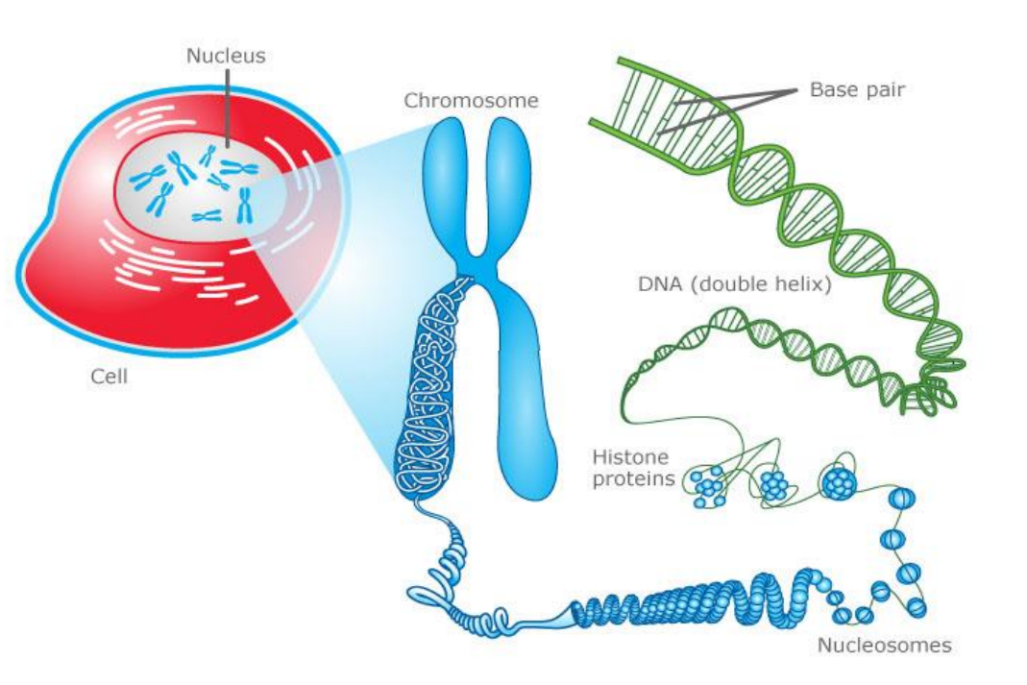
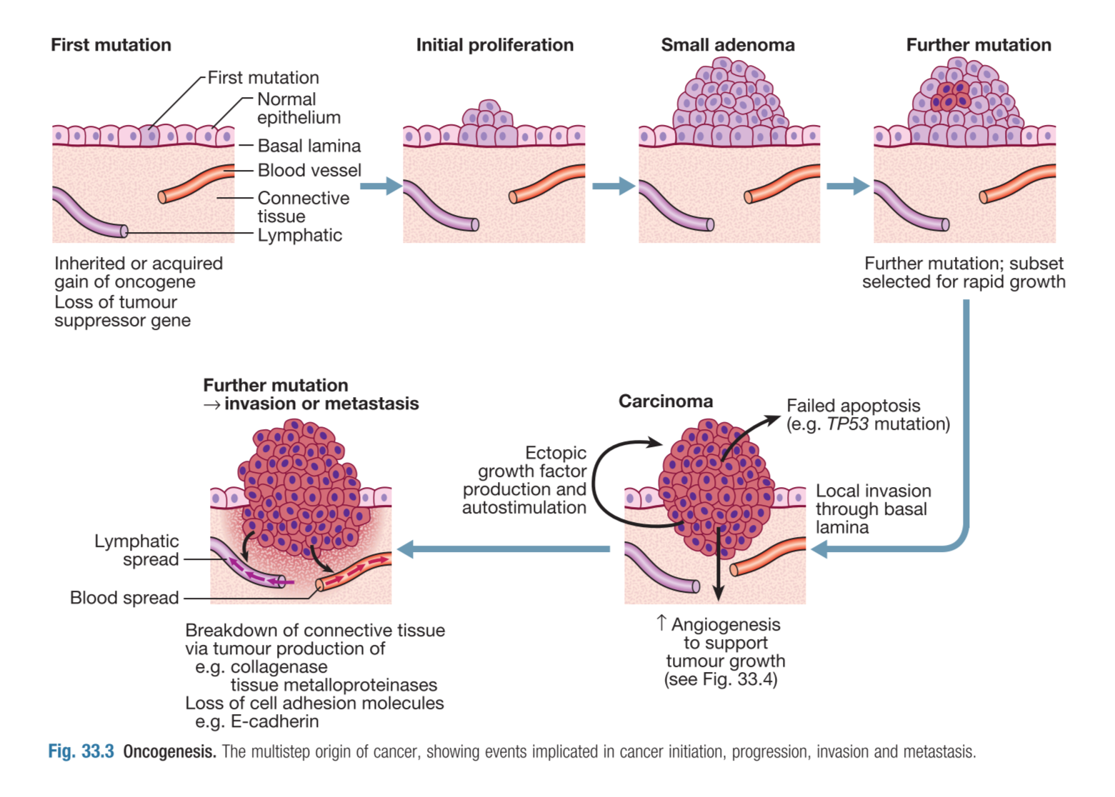
Introduction To Cancer Diagnosis & Treatment
History
The origin of the word ‘‘cancer’’ is credited to the Hippocratic physicians, who used the terms karkinos and karkinoma.
Claims that cancer is only a ‘modern, man-made disease’ are false and misleading.
This is not only scientifically incorrect, but misleading.
Cancer has always been with us, from ancient civilizations to today.
Defining Cancer
Cancer
A term used for diseases in which abnormal cells divide and escape the body control, these cells are able to:
Invade surrounding tissues (benign tumors like lipoma and fibroma cannot invade. Locally malignant tumors like Osteoclastoma can invade locally but cannot send distant metastasis. The ture malignant tumors can both invade locally and send metastasis.)
Send distant metastases.
Lose their functions.
Primary tumors:
Represent de novo tumors in their initial site e.g. Breast cancer inside the breast tissue.
Metastatic tumors:
Originate from the distant growth of the primary tumors to lymph nodes or other organs like liver, lung, bone, brain, etc..
Basic structure of human body
The body is made of different systems → The systems are made of organs → The organs are made of tissues → The tissues are made of cells → The cell is made of cytoplasm + nucleus → The nucleus has chromosomes which carry the genes which are made of DNA → DNA controls cell functions → Cell division
Development of Malignant Disease
Activation of pro=oncogene
Cell Arrest & clonal expansion
01
02
03
04
Stem cell
Genetic mutation

Slide 3
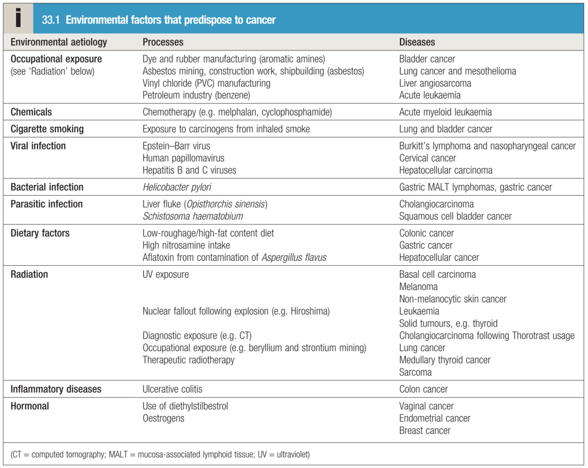
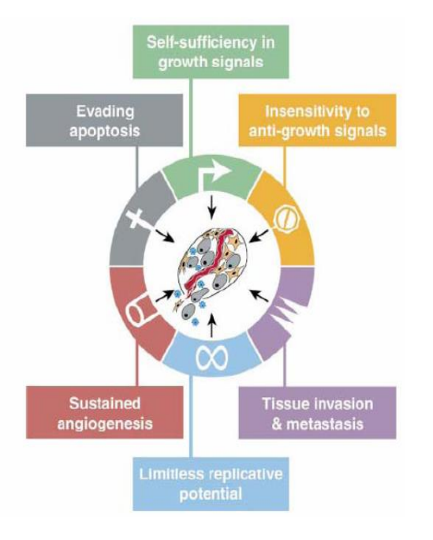
Introduction To Cancer Diagnosis & Treatment
Causes of Cancer
Alter in immunity in cases of autoimmune or immunodeficiency diseases (e.g. AIDS) will alter the process of capturing cancer cells and killing it which can predispose to cancer.
1
1
DNA Mutations
Cancer arises from the mutation of a normal gene.
Mutated genes that cause cancer are called oncogenes.
What causes DNA to be mutated?
Radiation and other environmental factors (Tobacco, Alcohol, Radon, Asbestos, etc).
Random somatic mutations.
Inherited germline mutations (Not every pt carrying germline mutation will develop cancer)
Cancer Prevention and Screening Breast cancer—mammogram every 2 years beginning at age 40 years for females Cervical cancer—HPV vaccine (Gardasil) approved for males and females ages 9 to 26; pap smears every 3 years for females ages 21 to 30 (even if not sexually active) and every 5 years with HPV co-testing for females ages 30 to 65 Colorectal cancer (CRC)—colonoscopy every 10 years for average risk individuals starting at age 50; if first-degree relative with CRC, begin screening at age 40 or 10 years before the age of diagnosis of relative (whichever is earlier) Prostate cancer—no consensus that screening with prostate-specific antigen (PSA) testing decreases mortality Lung cancer—screen any previous or current smoker with minimum 30 pack year history ages 55 to 80 using low-dose CT annually (NLST trial showed 20%
reduction in mortality in CT cohort vs. chest x-ray cohort)
2
Genetic Predisposition
Retinoblastoma, p53 (tumor suppressor gene), APC, CDKN2A, BRCA1, BRCA2
3
Infectious agents
Viral:
HPV – cervical cancer
Hepatitis – liver cancer
EBV - Lymphoma
Bacterial
H. pylori – stomach cancer
Hallmarks of Cancer
1
Self-sufficiency in growth signals.
2
Insensitivity to growth inhibitory signals .
3
Absence of apoptosis.
4
Limitless proliferative capacity.
5
Sustained angiogenesis
6
Tissue invasion and metastasis.
In order of occurrence, the most common cancers in males are prostate, lung, and colon. The cancer with the highest mortality in males is lung, followed by prostate and colon.
In order of occurrence, the most common cancers in females are breast, lung, and colon. The cancer with the highest mortality in females is lung, followed by breast and colon.

Slide 4
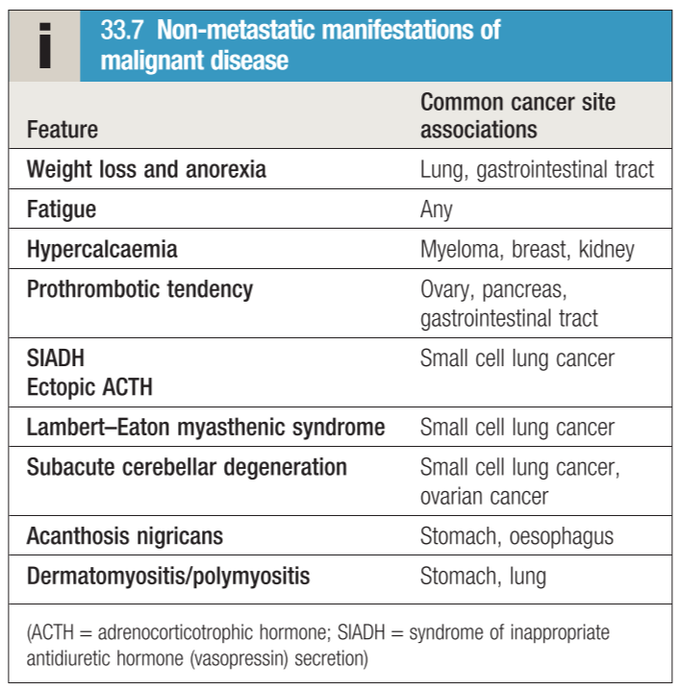
Introduction To Cancer Diagnosis & Treatment
If you decided to be an oncologist , what should you know ?
How to diagnose cancer ?
How to treat cancer ?
01
02
03
04
05
When & how to suspect cancer ?
What the essential work up for staging ?
What is the prognosis of your patient ?
Q1: When to suspect cancer?
Cancer Signs and Symptoms:
Cancer gives most people no symptoms or signs that exclusively indicate the disease.
Unfortunately, every complaint or symptom of cancer can be explained by a harmless condition as well for example:
The most common cause of hemoptysis is not lung cancer or TB, it’s bronchitis.
The most common cause of hematemesis is not stomach cancer or peptic ulcer, it’s gastritis.
Do not forget the constitutional symptoms:
Fatigue, fever, sweating, weight loss.
Sometimes cancer patients present only with constitutional symptoms, especially leukemia and lymphoma patients
What are the clues?
Persistent, Progressive, Disabling (prevent the patients from doing daily activity)
Symptoms & Signs changes according to the site of origin e.g. stomach cancer causing hematemesis, colon cancer causes bleeding per rectum.
Think about the pathology and site:
The Mass is able to invade locally and spread distantly → To bone, brain, lung, liver
Mass (lump):
Pressure on vital organs e.g. cancer in stomach will cause abdominal discomfort
Obstruction of lumens e.g. cancer in colon will cause constipation or obstruction
Invasion :
Blood vessels → bleeding .
Nerves → pain (if sensory), weakness or paralysis (if motor).

Slide 5
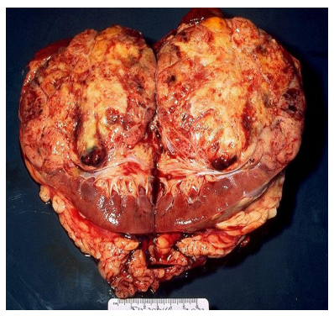
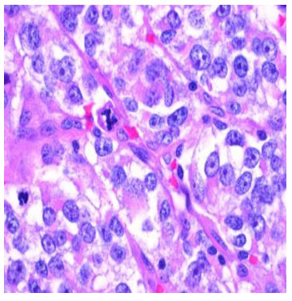
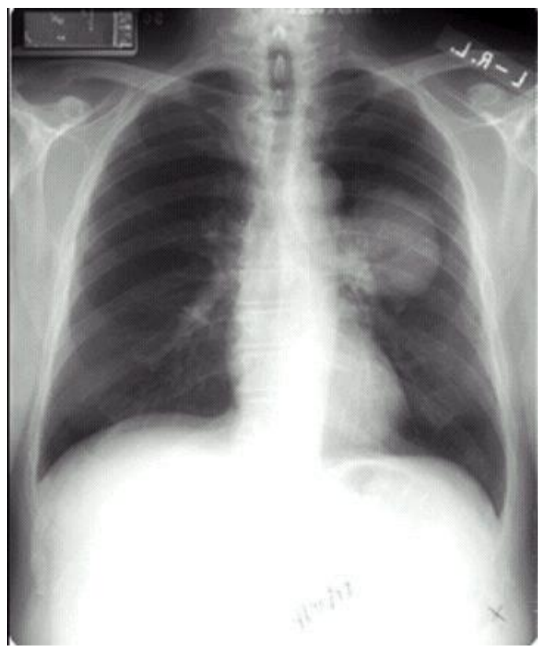
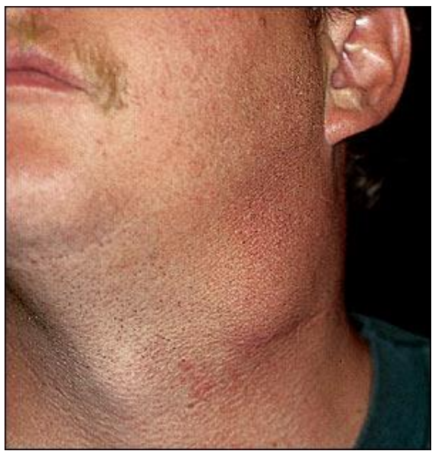
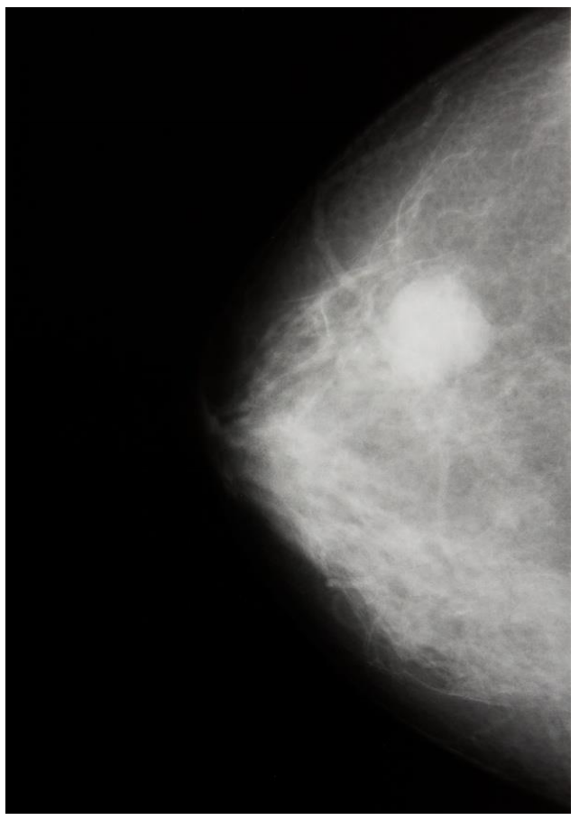
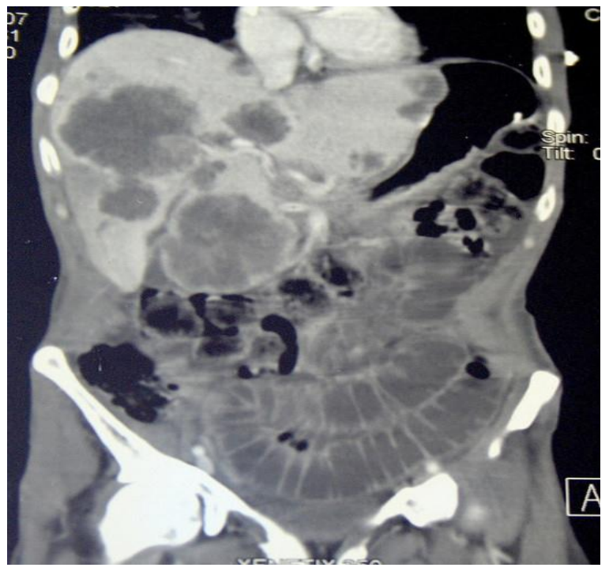
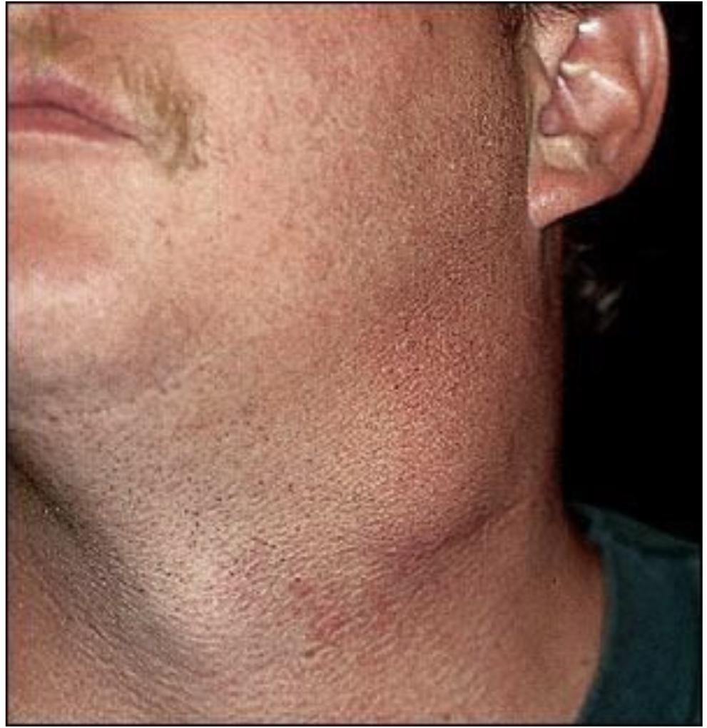
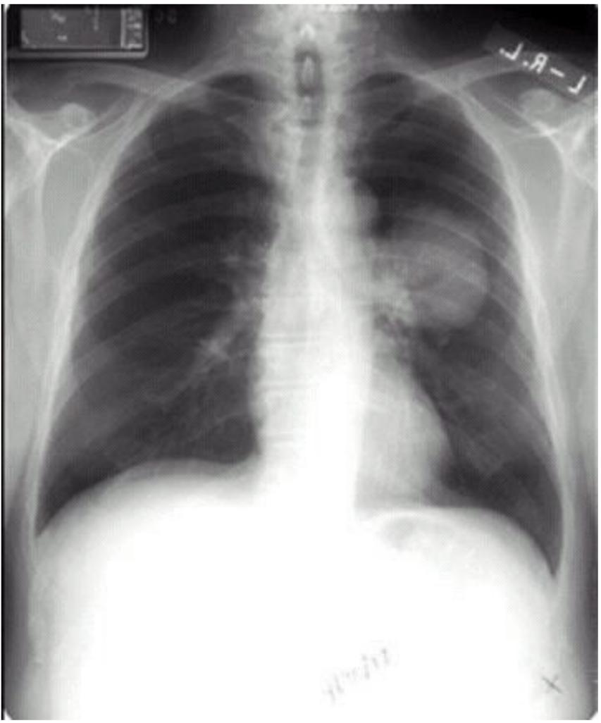
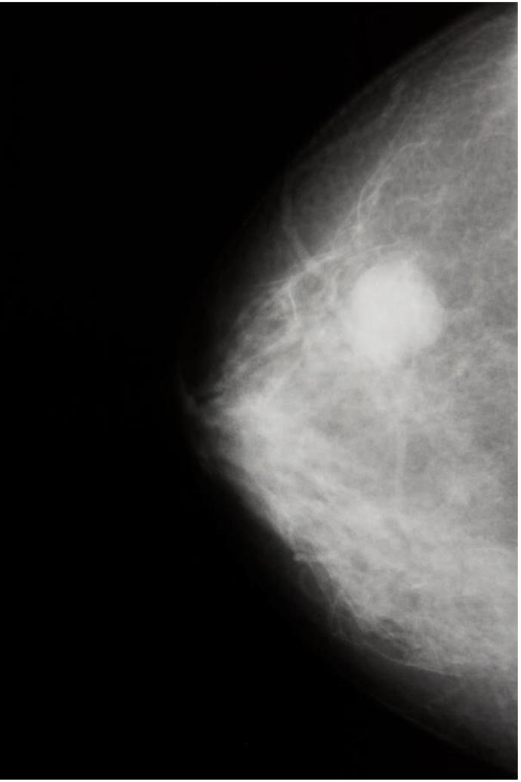
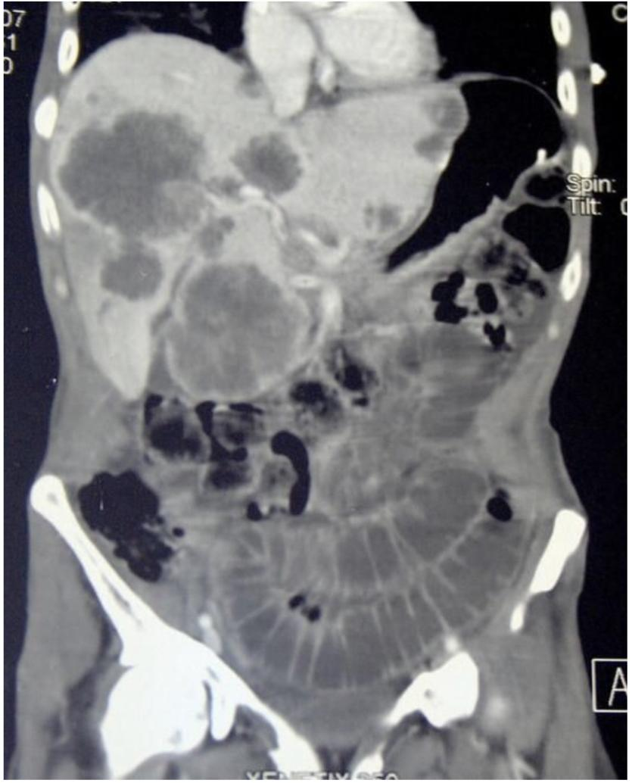
Introduction To Cancer Diagnosis & Treatment
Q2: How to diagnose cancer?
General Staging of solid malignancies
Early
Locally Advanced
Metastatic
1
IT IS NOT A CLINICAL DIAGNOSIS
2
IT IS NOT A RADIOLOGICAL DIAGNOSIS
local +/- Systemic
local & Systemic
Systemic +/- Local
3
IT IS NOT SEROLOGICAL DIAGNOSIS
4
IT IS A PATHOLOGICAL DIAGNOSIS
GROSS AND MICROSCOPIC PICTURE OF Renal Cell Carcinoma
5
IT IS A TISSUE DIAGNOSIS
Lung cancer
Lump in the neck (lymphoma)
Breast cancer with nodule in the breast
liver metastasis in the left and right lobes
Categories of malignant disorders
Categories of malignant disorders
Liquid malignancies
(leukemia)
Solid malignancies
Left lump
further tests CT scan + Biopsy.
Left Hilar Lymph node
probably malignancy
Myeloproliferative disorders
(CML, AML)
Lymphoproliferative disorders
(CLL, ALL)
Epithelial tissues
(Carcinoma)
Connective tissues
(Sarcoma)
Surface Tissue
(Squamous cell carcinoma)
Glandular
(Adenocarcinoma)
Bone
(Osteosarcoma)
Soft
Eg. (Fibrosarcoma)
An area for your notes or something..
Breast lesion on Mammogram
Multiple metastasis in the liver on CT scan

Slide 6
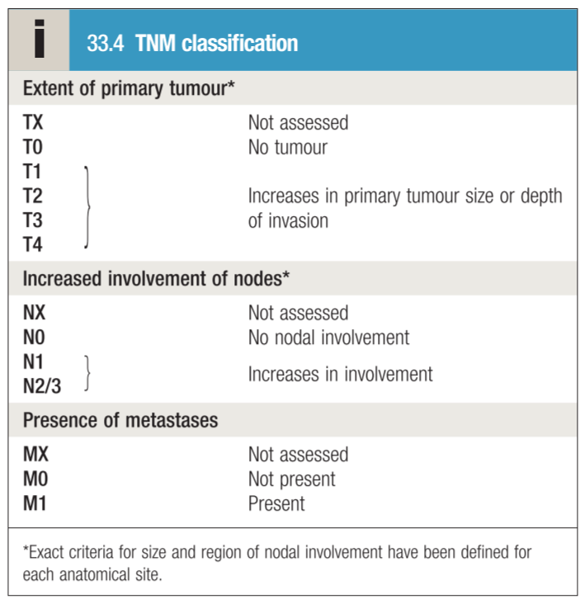
Introduction To Cancer Diagnosis & Treatment
Q3: What the essential work up for staging?
TNM (T= tumor, N= Node, M= Metastases)
Clinical TNM
Radiological TNM
Pathological TNM
Radiology:
XRay
MRI: preferred technique for brain and pelvic imaging. It is widely employed for the staging of rectal, cervical and prostate cancers.
CT: is a key investigation in cancer patients and is particularly useful in imaging the thorax and abdomen.
US: is useful in characterising lesions within the liver, kidney, pancreas and reproductive organs. Endoscopic ultrasound is helpful in staging upper gastrointestinal and pancreatic cancers.
PET scan: It can accurately assess the severity and spread of cancer by detecting tumour metabolic activity following injection of small amounts of radioactive tracers such as fluorodeoxyglucose (FDG).
Surgical Staging
Q4: How to treat cancer?
1) Types of oncology problems:
Patient with Suspected Cancer diagnosis
Patient with Established Cancer diagnosis (Answer the following questions):
Does the patient have cancer?
What type of cancer?
What stage of cancer?
2) Management Multidisciplinary:
Surgery, Radiation, Medical ONC.
Others Disciplines: Radiology, Pathology, Lab, Combined clinics, Tumor board.
3) Determine the treatment Objective:
Either Curative or Palliative (Surgical procedures are often the quickest and most effective way of palliating symptoms.)
Curative
Therapy: Aggressive, Expensive, recent, updated, complex. Toxicity: Long term, irreversible
Palliative
Therapy: Simplest , Avoid hospitalization, Availability Least toxic Toxicity: Short term, acute, quality of life
Different Treatment Modalities
Local therapy: Surgery & Radiation therapy | Systemic therapy: Chemotherapy Hormones Biologicals Immune therapy

Slide 7
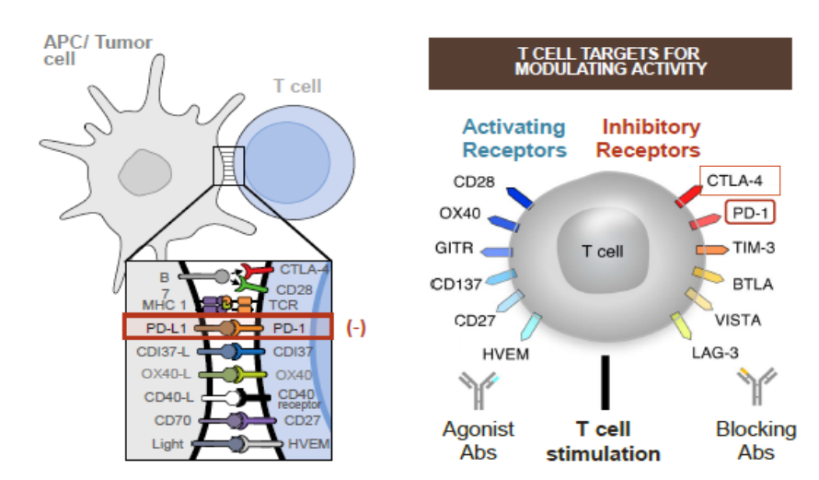
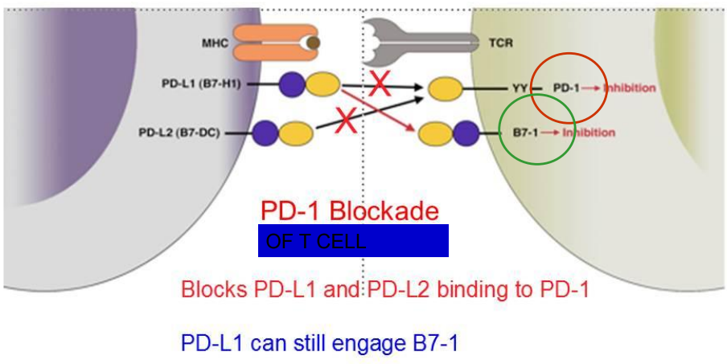
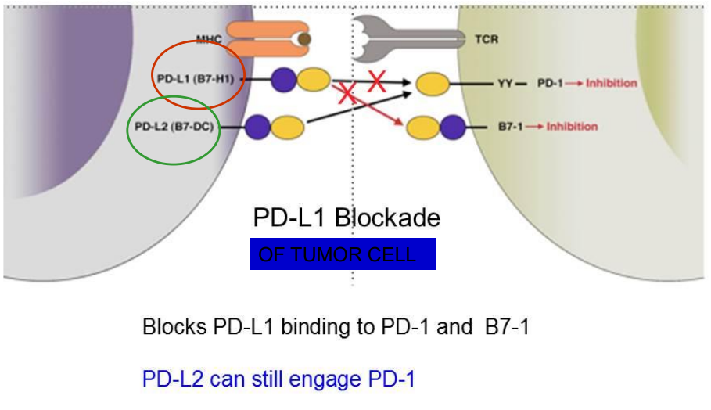
Introduction To Cancer Diagnosis & Treatment
Q4: How to treat cancer? cont.
Mechanism of Action of Immunomodulators
The theory is to use the immune system (which is inhibited by the tumor) by removing the inhibition and allowing the cytotoxic T cells kill the cancer cells.
PD-1 (cell receptor) is overexpressed on tumor
infiltrating T cells and these are functionally exhausted cells
Ligands: PDL-1 and PDL-2 (tumor cell /APC)
Higher tumoral PDL-1 expression correlates with decreased OS
Rationale:
Blocking the PD-1 or PDL-1 pathway would restore/promote the function of chronically exhausted tumor-specific T cells and decrease tumor-induced immune suppression
Liquid malignancies:
Treated systemically
Solid malignancies:
Treated according to stage
General Staging of solid malignancies
Early
Locally Advanced
Metastatic
local +/- Systemic¹
local & Systemic²
Systemic +/- Local³
An area for your notes or something..
Q5: What is the prognosis of your patient?
What can medicine offer the cancer patient?
The cancer type & extent ( stage)
The host factors (age, sex, comorbidities)
The available tools
1
2
Tumors that can have prolonged survival
Tumors that can be cured
3
Tumors that can be palliated
lymphomas, leukemia, early solid tumors.
Locally advanced and some of the metastatic tumors.
Metastatic solid tumors.
1- local treatment mainly, systemic treatment is adjuvant.
2- start systemic to decrease the size then local to remove it.
3- mainly systemic, local for symptoms control.

Slide 8
Cancer Definition:
A term used for diseases in which abnormal cells divide and escape the body control, these cells are able to:
Invade surrounding tissues (benign tumors like lipoma and fibroma cannot invade. Locally malignant tumors like Osteoclastoma can invade locally but cannot send distant metastasis. The ture malignant tumors can both invade locally and send metastasis.).
Send distant metastases
Lose their functions.
Primary tumors:
Represent de novo tumors in their initial site e.g. Breast cancer inside the breast tissue.
Metastatic tumors:
Originate from the distant growth of the primary tumors to lymph nodes or other organs like liver, lung, bone, brain, etc..
Causes of Cancer
DNA Mutations:
Cancer arises from the mutation of a normal gene.
Mutated genes that cause cancer are called oncogenes.
Radiation and other environmental factors (Tobacco, Alcohol, Radon, Asbestos, etc).
Random somatic mutations.
Inherited germline mutations.
Genetic Predisposition
Retinoblastoma, p53 (tumor suppressor gene), APC, CDKN2A, BRCA1, BRCA2
Infectious agents
Viral: HPV – cervical cancer, Hepatitis – liver cancer, EBV - Lymphoma
Bacterial: H. pylori – stomach cancer
Hallmarks of Cancer:
Self-sufficiency in growth signals, Insensitivity to growth inhibitory signals, Absence of apoptosis, Limitless proliferative capacity, Sustained angiogenesis, Tissue invasion and metastasis.
Q1: When to suspect cancer?
Cancer Signs and Symptoms:
Cancer gives most people no symptoms or signs that exclusively indicate the disease.
Unfortunately, every complaint or symptom of cancer can be explained by a harmless condition as well.
Do not forget the constitutional symptoms:
Fatigue, fever, sweating, weight loss.
What are the clues?
Persistent, Progressive, Disabling and prevents it’s patients from doing daily activity.
Symptoms & Signs changes according to the site of origin.
Think about the pathology and site:
The Mass is able to invade locally and spread distantly → To bone, brain, lung, liver .
Q2: How to diagnose cancer? Categories of malignant disorders
1
IT IS NOT A CLINICAL DIAGNOSIS
2
IT IS NOT A RADIOLOGICAL DIAGNOSIS
3
IT IS NOT SEROLOGICAL DIAGNOSIS
4
IT IS A PATHOLOGICAL DIAGNOSIS
5
IT IS A TISSUE DIAGNOSIS

Slide 9
Q3: What the essential work up for staging?
TNM (T= tumor, N= Node, M= Metastases)
Clinical TNM
Radiological TNM
Pathological TNM
Radiology:
XRay, MRI, CT, US, PET scan.
Surgical staging.
Q4: How to treat cancer?
Types of oncology problems:
Patient with Suspected Cancer diagnosis
Patient with Established Cancer diagnosis (Answer the following questions):
Does the patient have cancer?
What type of cancer?
What stage of cancer?
Management Multidisciplinary:
Surgery, Radiation, Medical.
Others Disciplines: Radiology, Pathology, Lab, Combined clinics, Tumor board.
Determine the treatment Objective:
Either Curative or Palliative
Mechanism of Action of Immunomodulators
Blocking the PD-1 or PDL-1 pathway would restore/promote the function of chronically exhausted tumor-specific T cells and decrease tumor-induced immune suppression
Liquid malignancies:
Treated systemically
Solid malignancies:
Treated according to stage
Q5: What is the prognosis of your patient?
What can medicine offer the cancer patient?
The cancer type & extent ( stage)
The host factors (age, sex, comorbidities)
The available tools
Curative
Therapy: Aggressive, Expensive, recent, updated, complex. Toxicity: Long term, irreversible
Palliative
Therapy: Simplest , Avoid hospitalization, Availability Least toxic Toxicity: Short term, acute, quality of life
Different Treatment Modalities
Local therapy: Surgery & Radiation therapy | Systemic therapy: Chemotherapy Hormones Biologicals Immune therapy
2
Tumors that can have prolonged survival
1
Tumors that can be cured
3
Tumors that can be palliated
lymphomas, leukemia, early solid tumors.
Locally advanced and some of the metastatic tumors.
Metastatic solid tumors.

Slide 10
Q1: Cancer is diagnosed:
A- Clinically.
B- Radiologically.
C- Serologically.
D- Tissue & Pathology.
Q2: Which ONE of the following is a characteristic of locally malignant tumors?
A) Invade locally but cannot send distant metastasis
B) Invade locally and can send distant metastasis
C) Cannot invade locally but can send distant metastasis
D) Cannot invade locally and cannot send distant metastasis
Q3: Which ONE of the following is considered a characteristic of malignant tumors?
A) Ability to form their own blood vessels
B) Consuming and responding to the host growth factors
C) High apoptotic activity
D) Low mitotic activity
Q4: All of the following are hallmarks of cancer , except:
A- Sustained angiogenesis .
B- Tissue invasion .
C- Insensitivity to growth inhibitory signal .
D- Presence of apoptosis .
Q5: In liquid malignancies , the proper treatment is:
A- Systemic therapy .
B- Local therapy .
C- Local & systemic .
D- Local , +/- systemic .
Answers: Q1:D | Q2:A | Q3:A | Q4:D | Q5:A

Slide 11
THANKS!!
This lecture was done by:
Nawaf Albhijan
Faisal AlMusaeed
Note taker:
Nawaf Albhijan
Females co-leaders:
Raghad AlKhashan
Amirah Aldakhilallah
Males co-leaders:
Mashal AbaAlkhail
Nawaf Albhijan
Send us your feedback:
We are all ears!

