Slide 1
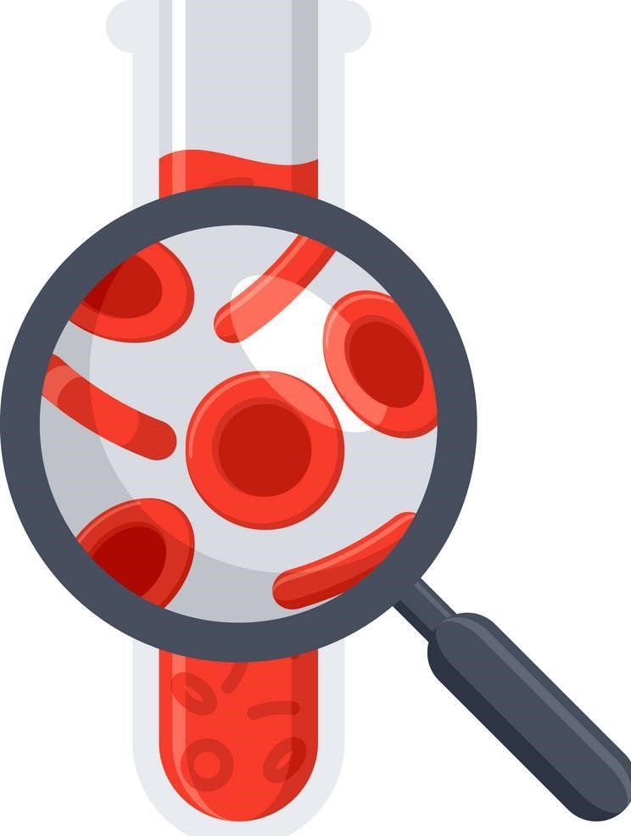
Lecture 67
Editing file
Hypercoagulable state \ DVT
Objectives:
By the end of the lecture the student should be able to:
Learn definition DVT/Hypercoagulable state
Know Physiology of Hemostatic system
Learn the Etiology of thrombosis (venous)
Discuss Inherited thrombotic conditions
Know the Acquired thrombotic condition
Learn Clinical manifestations and diagnosis of thrombosis
Learn the Treatment of thrombosis
Color index:
Color index:
Original text Females slides Males slides
Doctor’s notes Textbook Important Golden notes Extra

Slide 2
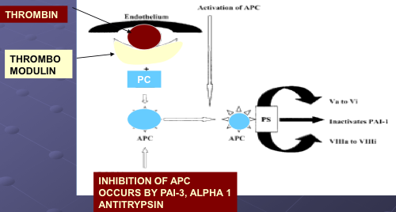
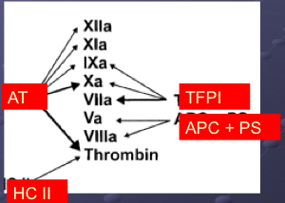
Introduction
Hemostasis
Coagulation cascade
Balance of bleeding and clotting.
Imbalance in either would lead to:
Hypocoagulable state > bleeding
Hypercoagulable state > thrombosis
Anti-thrombotic functions of the endothelium:
1
Prostacyclin (PGI2)
2
Nitrous oxide (NO2)
3
Thrombomodulin
●
●
●
●
●
●
4
Heparans (proteoglycans)
5
Tissue factor pathway inhibitors (TFPI)
6
Plasminogen activator inhibitors (PAI-1)
Antithrombotic Factors
The body has natural anticoagulants circulating in the blood during a state of thrombosis (such as in cases of trauma or pregnancy). These anticoagulants serve to decrease blood clots. This also explains why some people who get infected with COVID-19 or those who get the COVID vaccine develop blood clots, while others do not.
Normal plasma contains a sophisticated system of serine protease inhibitors capable of inhibiting many of the activated proteases generated during coagulation
1.AT and HC II – serine protease inhibitors
2. PC – when activated degrades Va and VIIIa
3. TFPI – inhibits tissue factor pathway
Mechanisms associated with prothrombotic states:
Vascular (Endothelial dysfunction)
Platelets (increase activity and/or numbers).
1
2
Pathological conditions (e.g.: cancer, CCF, antiphospholipid syndrome, Contraceptive pills, etc.)
6
3
Coagulation factors (↑) Like during pregnancy
5
4
Natural anticoagulants (↓ and/or dysfunction)
Fibrinolytic system (↓)

Slide 3
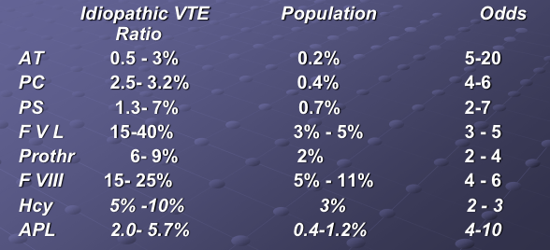
Introduction
Virchow’s triad
Describes the pathophysiology of thrombosis
Alterations in blood flow (stasis):
Disrupted laminar flow allows greater interaction between platelets and endothelial surface.
Prevents dilution of locally activated clotting factors.
Prevents inflow of clotting factor inhibitors.
Promotes endothelial cell damage and activation.
Examples include: Heart failure, Immobility or paralysis , Venous insufficiency or varicose veins, Venous obstruction from tumor, obesity or pregnancy.
Vascular endothelial injury:
Causes exposure of sub-endothelium and release of tissue factor, thereby activating coagulation cascade.
Examples include: Surgery, Trauma, Heart valve disease or replacement, Indwelling catheter, Atherosclerosis, central venous catheter (can happen when inserting the cannula of the IV fluid --> pt will complain from pain at insertion site), tumor thrombosis (the cancer invades the blood vessels & causes injury), fractures and Covid-19.
● Alterations in constituents of blood (i.e., hypercoagulability)
Acquired vs inherited coagulopathies
Predisposing factors for thrombus formation
Examples include : Acute phase postop, Cancer, Thrombophilia, Estrogen therapy, Pregnancy and postpartum period, Inflammatory bowel disease
Thrombophilia
Characterized by clinical tendency to thrombosis or molecular abnormalities of hemostasis that predisposes to thromboembolic disease.
Alteration in the hemostatic balance between blood fluidity and clot formation due to genetic or acquired disorders which shift the balance toward excessive platelet aggregation and thrombin generation (clot formation) that lead to thrombosis
Synonyms:
Hypercoagulable state
Pro-Thrombotic state
Thrombogenic state
Thrombophilia
Thrombophilia Prevalence and Ratios for Idiopathic VTE:

Slide 4
Hypercoagulable states
Causes of venous thromboembolism can be divided into two groups and are often multiple in a given patient:
i think it would be better to make it a triad shape so it's easy to understand
Acquired
Hypercoagulable States
Antiphospholipid antibodies syndrome
Hyperhomocysteinemia
Cancer
Nephrotic syndrome
Heart failure
Presence of a central venous
catheter
Crohn disease
Myeloproliferative disorders
Polycythemia vera
essential thrombocythemia
Paroxysmal nocturnal hemoglobinuria
Bechets disease
Recent major surgery
Especially orthopedic (hip & knee replacement and Spine surgery)
Immobilization
Trauma ¹
Medication(chemotherapy ², HIT -heparin induced thrombocutepnia-, OCP -oral contraceptives- or HRT -hormonal replacement therapy-)
Pregnancy ³
DIC happens in COVID/TTP (thrombocytopenic purpura)
Obesity & older age (>60)
Hyperviscosity syndromes(Multiple myeloma or Waldenstrom’s macroglobulinemia)
Inherited Hypercoagulable States
Protein C deficiency
Protein S Deficiency
Antithrombin lll Deficiency
Factor V Leiden
(hereditary resistance to activated protein c)
There could be other causes, still under study.
dysfibrinogenemia
Elevated factor VIII
Factor XII deficiency
Lipoprotein A
An area for your notes
1- A female pt developed DVT bc her brother hit her on her thigh, so even mild traumas can cause thrombus in some Ppl not necessarily a car accident.
2- some pt needs prophylaxis such as in MM and leukemia patients receiving chemotherapy.
3- Decreased proteins C & S and elevated factor 8 --> acquired hyper-coagulability. it increases as a protective mechanism against postpartum hemorrhage.

Slide 5
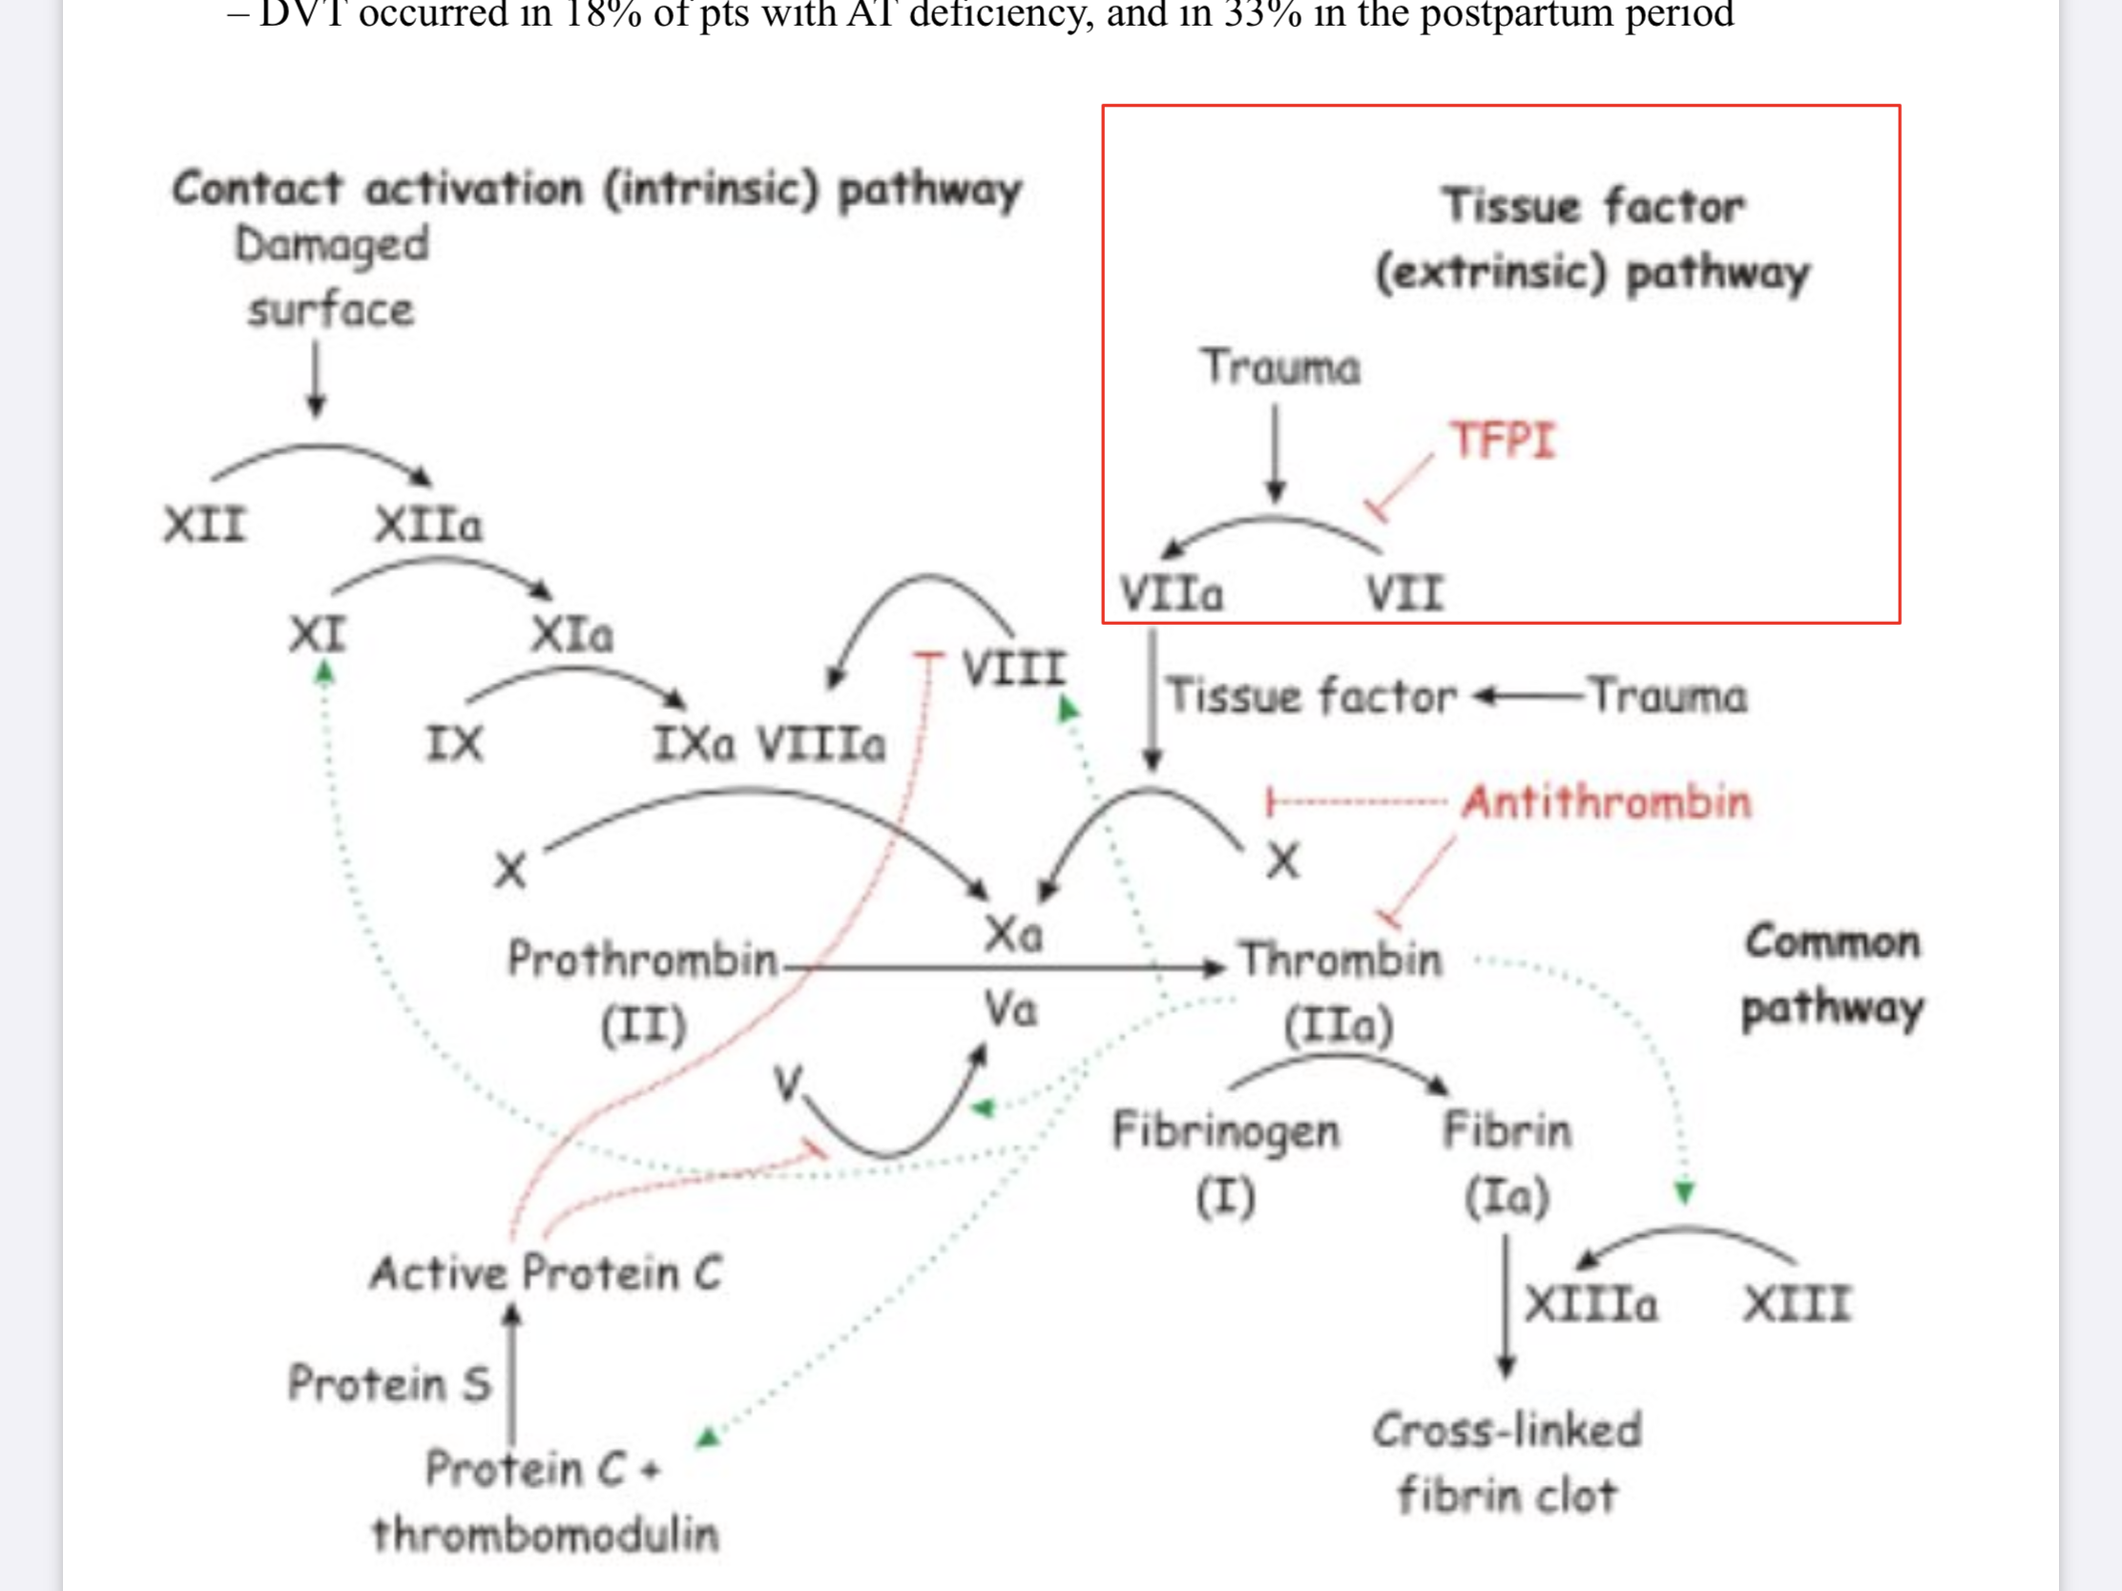
Inherited hypercoagulable states
Antithrombin
Alpha-2 globulin that is synthesized in the liver¹ and circulates in the plasma
Major plasma inhibitor responsible for neutralizing the activity of thrombin (IIa), Xa,
XIa, XIIa and plasmin
Heparin greatly accelerates antithrombin activity
AT deficiency typically occurs in a Autosomal dominant (AD) inheritance pattern, thereby affecting both sexes equally
Type I (dec. number)
Type II (function)
Overall incidence of AT deficiency is low: 1-2% DVT/PE
Strong risk factor for VenousThromboembolism (VTE): RR 30-40 x
Females with AT deficiency are at particularly high-risk for VTE during pregnancy.
DVT occurred in 18% of pts with AT deficiency, and in 33% in the postpartum period.
Antithrombin Functional Assays
2 Types:
Antithrombin-heparin cofactor assay –
measures the ability of heparin to bind lysyl residues on antithrombin and catalyze the neutralization of coagulation enzymes such as Factor Xa (TOH, check IIa)
Progressive antithrombin assay
quantifies the capacity of antithrombin to neutralize the enzymatic activity of thrombin in the absence of heparin
no need to get into the details
Skipped by the dr
Prothrombin
Prothrombin Gene mutation
Prothrombin G20210A mutation is the 2nd most common.
Mutation discovered in 1996 as a transition (G→A) at nucleotide 20210, resulting in elevated plasma levels of Factor II.
Genetic Test (20210GA)
Autosomal dominant
Heterozygotes have a 30% higher plasma prothrombin level compared to normals.
Incidence 1-2% normal Caucasions; 5% DVT/PE
Weak risk factor for VTE: RR 3-5 x (heterozygotes), 80x (homozygotes)
Normal prothrombin (Factor II) circulates as Vitamin K-dependent cofactor w/ 1⁄2 life of 3-5 days.
Prothrombotic mutation (→ ↓ thrombin inactivation).
1- patients with liver disease may have antithrombin deficiency.

Slide 6
Inherited hypercoagulable states
Protein C & S deficiency :
The majority of our pt in the kingdom are protein C or S deficient
Protein C and S inhibit activated cofactors Va and VIIIa, respectively.
Protein C is consumed and levels are low in vitamin K deficiency, DIC,liver disease, etc
Protein C & S deficiency ;
Heterozygous or homozygous
Congenital or acquired
Clinical expression of hypercoagulability variable, and do not necessarily correspond with absolute concentration of Protein C.
Acquired Protein S deficiency may be induced by OCPs, pregnancy, or nephrotic syndrome.
Protein S
A necessary co-factor for PC
Vitamin K dependent, made in liver
MW 70,000 d; not a zymogen
Circulates in two forms:
1= C4bBP – 60% (acute phase reactant)
2=Free, active form – 40%
Hereditary deficiency: 1:330
ACQUIRED PROTEIN S: PREGNANCY, ORAL CONTRACEPTIVES, INFLAMMATION, DIC, ACUTE THROMBOSIS, HIV MEN
Exclude acquired causes first.
Protein S Deficiency
Autosomal Dominant
Incidence 1-2% of DVT/PE
Strong risk factor for VTE – RR – 30-40 x
Classification of Hereditary PS
Subtype | Total PS | Free PS | PS Activity
l | Low | Low | Low
lla | Normal | Low | Low
llb | Normal | Normal | Low
Protein C and S inhibit activated cofactors Va and VIIIa, respectively.
Protein C is consumed and levels are low in vitamin K deficiency, DIC,liver disease, etc
Protein C & S deficiency ;
They are inherited conditions(autosomal recessive)
Heterozygous or homozygous,
Congenital or acquired
Clinical expression of hypercoagulability variable, and do not necessarily correspond with absolute concentration of Protein C.
Acquired Protein S deficiency may be induced by OCPs, pregnancy, or nephrotic syndrome.
1- The majority of our patients in KSA are protein C or S deficient.
2- strong relation with relative marriage, the baby might be born with stroke or blindness, needs early identification and intervention.

Slide 7
Inherited hypercoagulable states
Protein C
MW 62,000 d
Vitamin K dependent serine protease
Potent anticoagulant acts by proteolytically inactivating factors Va and VIIIa, Also enhances fibrinolytic activity in plasma.
Decreased Levels:
Hereditary
Hepatic disorders (hepatitis, cirrhosis)
Oral AC therapy
Oral contraceptives
Infants and children under age 6 c/w adults
Vitamin K deficiency
D.I.C.
After 24h of administration of heparin
Pregnancy esp. 2nd and 3rd trimester
Protein C Deficiency
Autosomal Dominant
Incidence 1-2% of DVT/PE
Strong risk factor for VTE – RR – 30-40 x
Congenital Protein C Disorders ¹
Deficiency Type | Protein C (Ag) | Functional Protein C
l | Decreased | Decreased
ll | Normal or slightly decreased | Decreased
Factor V Leiden
Most common form of inherited thrombophilia (~50% of cases)
Commonest cause of thromophilia in West
Activated Protein C Resistance
Autosomal Dominant
Incidence 5% normal Caucasions ; 10-20% of DVT/PE
Weak risk factor for VTE: RR = 3-5 x (heterozygotes)
RR = 80 x (homozygotes)
Discovered in Leiden, the Netherlands (1993) amongst a group of subjects with unexplained VTE.
Mutant Leiden gene product is not susceptible to cleavage by APC (APC-R results in decreased ability of APC to inactivate Factor Va resulting in a pro- thrombotic state)
Dual prothrombotic state of Factor V Leiden Increased coagulation.
FV Leiden → ↑ thrombin generation, (↓ anticoagulation) and ↓ inactivation of factor FVIIIa (also ↓ PAI inactivation → ↓ fibrinolysis)
Inhibitors to APC
Functional PS deficiency
Mutated forms of Factor V and III
Commonly Factor V point mutation at codon 506 of exon 12 (arginine 506> glutamine 506 or Factor V Leiden)
Thrombosis continue as protein C cant deactivate the mutated factor V
1-Strong relation with relative marriage, the baby might be born with stroke or blindness, needs early identification and intervention while the lady is pregnant.

Slide 8
Acquired Hypercoagulable States
Antiphospholipid syndrome
Patients with this have up to 50% incidence of VTE. Usually in young patients
Strong risk factor for arterial and venous events.
An autoimmune multisystem disorder, either primary or secondary
characterized by venous, arterial, or small vessel thromboembolic events.
And/or recurrent abortions in the presence of persistent antiphospholipid antibodies (aPL). aPLs are a heterogeneous group of autoantibodies which are directed against phospholipid-binding proteins.
Primary : suddenly & extensively arterial or venous thrombosis. Secondary(autoimmune): SLE, Sjögren’s syndrome & RA .
Clinical manifestations:
● Stillbirths (62.5%)
● Skin rash
● Livido reticularis
● Thrombocytopenia
●Sometimes they present with catastrophic syndrome (3 organs blocked by thrombosis)
● Deep vein thrombosis (31.4%)
● Pulmonary embolism (23.8%)
● Stroke (14.9%)
● Transient ischemic attack (11.9%)
● Early spontaneous abortions (67.1%)
Diagnostic criteria
A diagnosis of definite antiphospholipid syndrome requires the presence of at least one of the clinical criteria and at least one of the laboratory criteria. No limits are placed on the interval between the clinical event and the positive laboratory findings
Clinical criteria | Laboratory criteria
Vascular thrombosis One or more clinical episodes of arterial, venous, or small - vessel thrombosis, occurring within any tissue or organ Complications of pregnancy One or more unexplained deaths of morphologically normal fetuses at or after the 10th week of gestation; or One or more premature births of morphologically normal neonates at or before the 34th week of gestation; or Three or more unexplained consecutive spontaneous abortions before the 10th week of gestation | Anticardiolipin antibodies Anticardiolipin IgG or IgM antibodies present "persistently" at moderate or high levels in the blood on two or more occasions at least six weeks apart Lupus anticoagulant antibodies Lupus anticoagulant antibodies detected in the blood on two or more occasions at least six weeks apart, according to the guidelines of the International Society on Thrombosis and Hemostasis *
The following antiphospholipid antibodies are currently not included in the laboratory criteria: anticardiolipin IgA antibodies, anti-B2 - glycoprotein I antibodies, and antiphospholipid antibodies directed against phospholipids other than cardiolipin (eg, phosphatidylserine and phosphatidylethanolamine) or against phospholipid - binding proteins other than cardiolipin - bound B2- glycoprotein I (eg, prothrombin, annexin V, protein C, or protein S) The threshold used to distinguish. moderate or high levels of anticardiolipin antibodies from low levels has not been standardized and may depend on the population under study. Many laboratories use 15 or 20 international "phospholipid" units as the threshold separating low from moderate levels of anticardiolipin antibodies. Others define the threshold as 2.0 or 2.5 times the median level of anticardiolipin antibodies or as the 99th percentile of anticardiolipin levels within a normal population. Until an international consensus is reached, any of these three definitions seems reasonable.

Slide 9
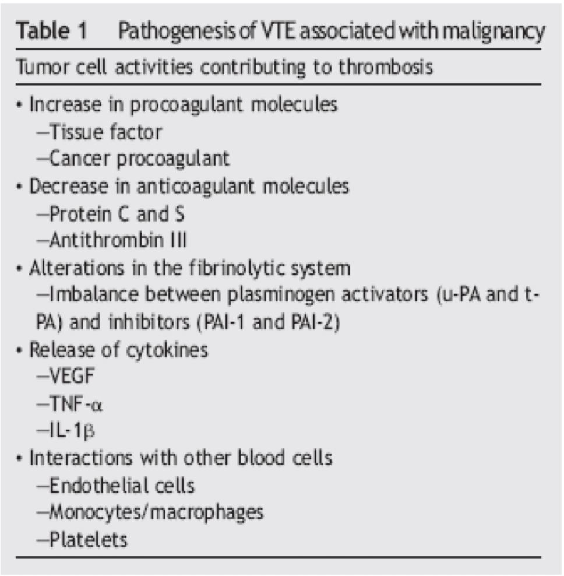
Acquired Hypercoagulable States
Oral Contraceptives and Hormone Replacement Therapy ¹
Oral contraceptives by their own are considered to be an important & strong cause of hypercoagulability, but if the pt also had factor V Leiden the risk increases a lot, Factor V Leiden + OCP – 50 x
Epidemiologic studies have clearly established an association between oral contraceptives and VTE.
Pharmacologic doses of estrogen are associated with increased factor Vlla levels as well as depressed antithrombin and protein S activity.
The thrombotic risk is dependent on the estrogen dose, with preparations containing more than 50 ug of estrogen being associated with the highest risk.
The overall relative risk of VTE is 2.9, corresponding to a calculated absolute risk of approximately 3.3 per 10,000 users.
Postmenopausal estrogen replacement dose is approximately one sixth those in oral contraceptives, however, recent data supports a small thromboembolic risk at these doses as well.
Prior thrombotic event or family H/O VTE.
Recent major surgery
- Especially orthopedic (hip & knee replacement and Spine surgery)
Immobilization
Malignancy: You think of cancer when there is unexplained thrombosis.
Heart failure
Presence of a central venous catheter
Pregnancy
Oral contraceptive or hormone replacement therapy
Antiphospholipid antibody syndrome
Myeloproliferative disorders
Polycythemia vera or essential thrombocythemia
Heparin induced thrombocytopenia & thrombosis (HIT)
Obesity & older age (>60)
Hyperviscosity syndromes
- Multiple myeloma or Waldenstrom’s macroglobulinemia
Trauma
Pregnancy and Postpartum
Postpartum: 3 months after delivery
Advise them to hydrate, move around, not wear tight clothing
The increased thrombotic risk associated with pregnancy has been attributed to an acquired prethrombotic state in combination with impaired venous outflow because of venous compression.
Most of pregnancy induced thrombosis are seen in the left leg due to the compression of the uterus on the left iliofemoral vein.
Population based studies using Doppler ultrasound suggest an incidence of 0.75 per 1,000 deliveries.
The risk of postpartum DVT is thought to be two- to three - folds higher than that during pregnancy.
Cancer
Risk for thrombosis is multi-factorial.
Malignancy can increase the risk of thrombosis even when the plts are low
Increased production of tissue factor by tumours (Gastric carcinoma or pancreatic cancer) found in many patients which can activate FX directly.
Malignancy increases the risk of DVT by -applying the whole triad-:
direct tumor compression of the veins
invasion of the vessels causing endothelial damage,
increased secretion of procoagulant factor VIII and fibrinogen.
Remember, also chemotherapy induces thrombosis
DVT may complicate 19% to 30% of malignancies with idiopathic thrombosis present in 3% to 23% of patients a the time of diagnosis or may develop 1 to 2 years after
1- Not related to the amount or the type (estrogen or progesterone) neither the method (transdermal, oral or injection) of OCP, but related to factor V Leiden. A 16 y/o female developed a stroke after taking only one tablet. Some pt needs hormonal therapy to induce ovulation, it should be combined with prophylaxis.
Malignancy ( Cancer) :
● Homocystinuria or severe hyperhomocysteinemia is a rare autosomal recessive disorder characterized by developmental delay, osteoporosis, ocular abnormalities, VTE, and severe premature CAD.
● Less marked elevations of homocysteine are more common, occurring in 5-7% of the population, and are associated with a number of clinical factors.
– Vitamin deficiencies (i.e., folate, Vit B6, and/or Vit B12).
● Homocysteine has primary atherogenic and prothrombotic properties.
● Meta-analyses of case-control studies have found an odds ratio of 2.5-3 for VTE in patients with
homocysteine levels > 2 standard deviations above the mean value of control groups.

Slide 10
Acquired Hypercoagulable States
Hyperhomocysteinemia
not very common
Homocystinuria or severe hyperhomocysteinemia is a rare autosomal recessive disorder characterized by developmental delay, osteoporosis, ocular abnormalities, VTE, and severe premature CAD.
Endothelial damage leading to increased arteriosclerosis.
Very common risk factor for both venous and arterial disease.
Modest elevations (> 11.0 nmol / L) associated with increased risk of atherosclerosis Levels over 18 nmol / L associated with increased risk of venous thrombosis High homocysteine levels are synergistic risk factor with factor V Leiden.
Less marked elevations of homocysteine are more common, occurring in 5-7% of the population, and are associated with a number of clinical factors.
Vitamin deficiencies (i.e., folate, Vit B6, and/or Vit B12).
Homocysteine has primary atherogenic and prothrombotic properties.
Meta-analyses of case-control studies have found an odds ratio of 2.5-3 for VTE in patients with homocysteine levels > 2 standard deviations above the mean value of control groups.
Combined effect of inherited thrombophilias on tendency for VTE:
Pooled analysis of 2310 cases and 3204 controls amongst 8 case-control studies (from UK, Denmark, France, Italy, Sweden, Brazil) evaluating the risks in patients with FVL and/or prothrombin 20210A
Of patients with VTE,
23% were heterozygous for prothrombin gene mutation
12% were heterozygous for Factor V Leiden
2.2% were double heterozygotes
Inherited hypercoagulable state | Odds ratio for VTE
Prothrombin gene mutation 20210A heterozygotes | 3.8
Factor V Leiden mutation heterozygotes | 4.9
Combined Prothrombin and Factor V Leiden heterozygotes | 20.0
50%-60% of thrombotic events in patients with inherited thrombophilia are associated with the additional presence of an acquired risk factor (eg, surgery, prolonged bed rest, pregnancy, oral contraceptive).
Some patients have more than one form of inherited thrombophilia or more than one form of acquired thrombophilia and appear to be at even greater risk for thrombosis
Combined effect of inherited thrombophilias on tendency for VTE:
Pooled analysis of 2310 cases and 3204 controls amongst 8 case-control studies (from UK, Denmark, France, Italy, Sweden, Brazil) evaluating the risks in patients with FVL and/or prothrombin 20210A
Of patients with VTE,
23% were heterozygous for prothrombin gene mutation
12% were heterozygous for Factor V Leiden
2.2% were double heterozygotes
Inherited hypercoagulable state | Odds ratio for VTE
Prothrombin gene mutation 20210A heterozygotes | 3.8
Factor V Leiden mutation heterozygotes | 4.9
Combined Prothrombin and Factor V Leiden heterozygotes | 20.0
Odds ratio is a measure of association between an exposure and an outcome.
50% of thrombotic events in patients with inherited thrombophilia are associated with the additional presence of an acquired risk factor (eg, surgery, prolonged bed rest, pregnancy, oral contraceptive).
Some patients have more than one form of inherited thrombophilia or more than one form of acquired thrombophilia and appear to be at even greater risk for thrombosis

Slide 11
Hypercoagulable state
Clinical presentation
Arterial
VS
venous
coronary, carotid and femoral
Acute MI, Angina
CVA, TIA
Claudication
Superficial vein or deep veins
Deep vein thrombosis: Swollen, painful extremity.
Pulmonary embolus.
DVT and pulmonary embolism are the two most common manifestations of the same disease
90% of cases of acute PE are due to emboli emanating from the proximal veins of the lower extremities; proximal DVTs are clinically most significant due to high morbidity and mortality
Clinical presentation: pulmonary embolism
Shortness of breath that may occur suddenly.
(most common presentation)
Sweating and anxiety
Dizziness and fainting (low BP).
Palpitation (tachycardia)
Sudden, sharp chest pain that may become worse with deep breathing or coughing (can be pleuritic type).
Hemoptysis or pink, foamy sputum
Rapid breathing (tachypnea)
PE with low BP (<90 mmHg) is called massive PE (IMPORTANT)
(most serious condition and the management will be different)

Slide 12
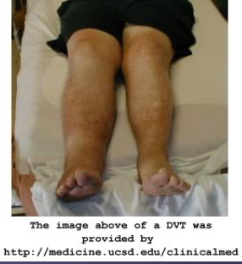
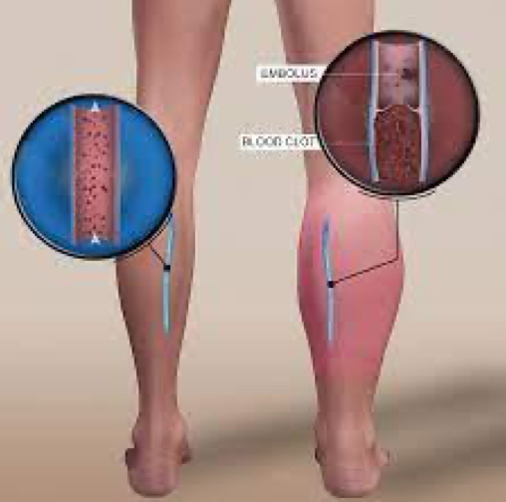
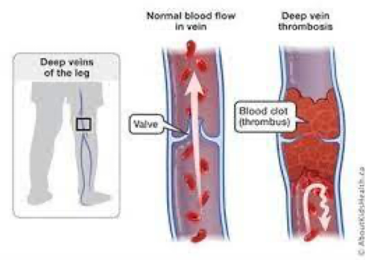
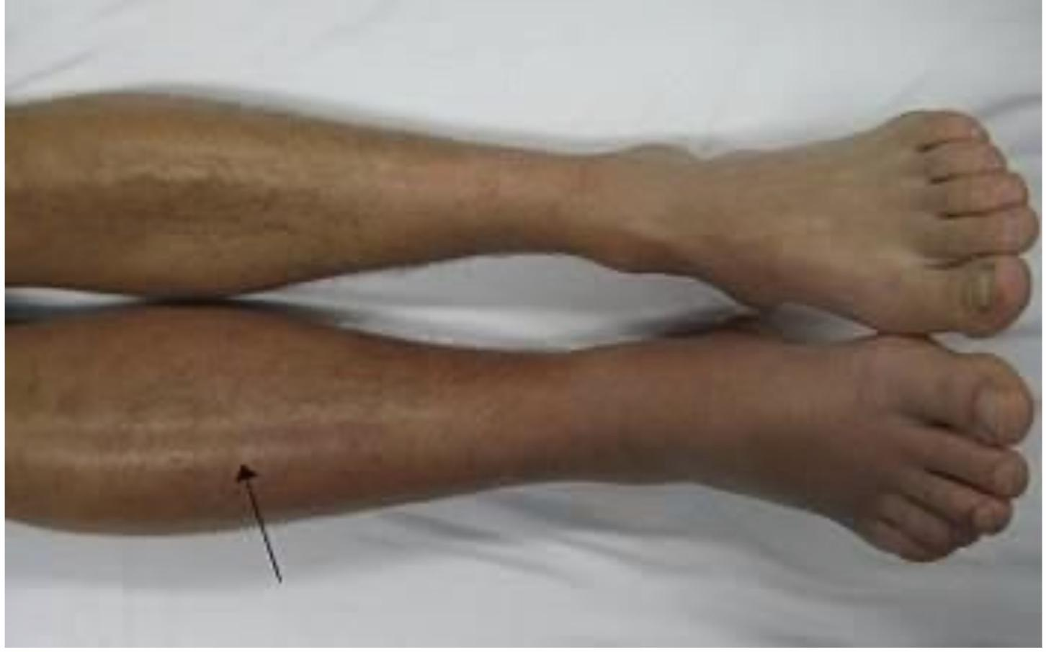
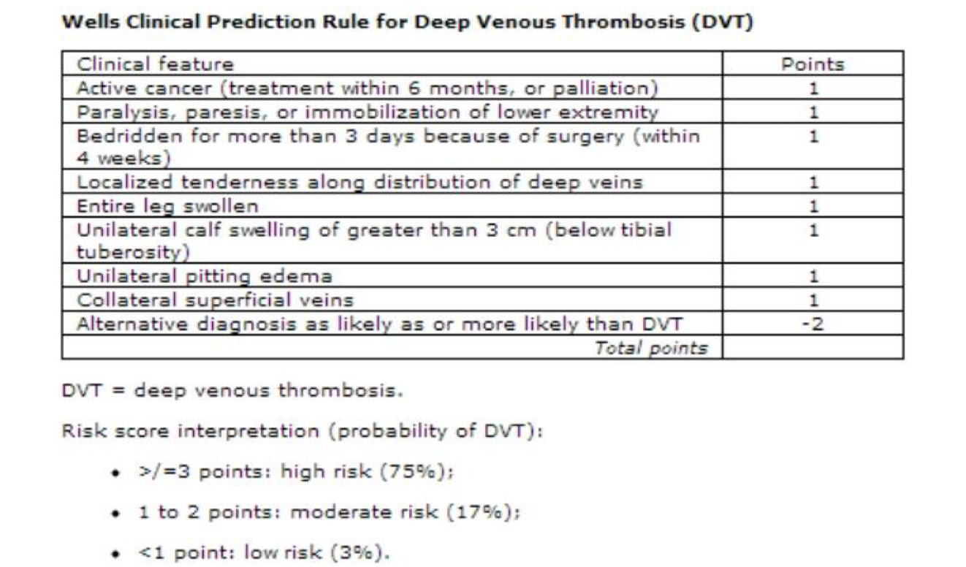
DVT( Deep Vein thrombosis) ¹
Lower limb most common site. Mostly From femoral and iliac veins, anything distal than that is unlikely to cause a DVT big enough for PE.
Can happen in upper limb, abdominal veins, cerebral veins & sinuses
Symptoms & signs depend on the site
Leg (or arm) pain (The most imp and sometimes first symptom in DVT is pain “ischemic pain”) tenderness , swelling ,Redness, Skin changes like shiny skin
Sensation of muscle cramping
Risk factors usually present
Homans’ sign. No one use it
May be acute or develop over days or longer
Symptoms are neither sensitive nor specific for DVT ²
S/S
Risk factor
A right-sided acute deep vein thrombosis. The leg is swollen and red due to venous outflow obstruction.
Investigations
Clinical examination
Physical findings may include a palpable cord over the calf, ipsilateral edema, warmth, and/or superficial venous dilatation.
Modified Wells Prediction Rule (criteria) for Diagnosing Pulmonary Embolism: Clinical Evaluation Table for Predicting Pretest Probability of PE
Treatment
Clinical characteristics | Score
Previous pulmonary embolism or DVT | +1.5
Heart rate >100 beats per minute | +1.5
Recent surgery or immobilization (within the last 30 days) | +1.5
Clinical signs of DVT | +3
Alternative diagnosis less likely than pulmonary embolism | +3
Hemoptysis | +1
Cancer (treated within the last 6 months) | +1
Lower limb most common site
Can happen in upper limb, abdominal veins, cerebral veins & sinuses
Symptoms & signs depend on the site (Limb swelling², Pain, Redness, Skin changes like shiny skin)
If the score is :
0-1 → there is low probability of pulmonary embolism and we don't need to investigate
2-6 →intermediate probability we need to investigate
≥6 → high probability
you need to know what does the score mean but you won’t be asked to calculate
1- 1st cause of maternal mortality is bleeding followed by PE which is derived from DVT.
2- sickle cell anemia pt presented with tachycardia and bilateral leg pain & normal-looking legs (not the common bony pain in SCA; confusing), sickle cell anemia patient have arthralgia, but he described it as unusual pain and upon investigation (dopplex) it appeared to be extensive bilateral iliofemoral thrombosis.
S/S
Risk factor
Investig.
(Patient Factors: Clinical)
Treatment
Previous VTE
Malignancy
Advancing age
Obesity
Prolonged immobility
Trauma
Surgery
Pregnancy/ postpartum
Indwelling central venous catheter
Medical illness
-stroke
-MI
- CHF
- pneumonia
- COPD
-infections
- nephrotic syndrome
- inflammatory bowel disease
Oral contraceptives
Varicose veins
(Suspecting the Diagnosis…are risk factors present?)
The presence of risk factors is a clue that VTE may develop or that it may already be present

Slide 13
DVT( Deep Vein thrombosis)
Previous VTE
Malignancy
Advancing age
Obesity
Prolonged immobility
Trauma
Surgery
Pregnancy/ postpartum
Indwelling central venous catheter
Oral contraceptives
Varicose veins
Suspecting the Diagnosis…are risk factors present? The presence of risk factors is a clue that VTE may develop or that it may already be present
S/S
Medical illness
Stroke
MI
CHF
pneumonia
COPD
Infections
Nephrotic syndrome
Inflammatory bowel disease
Risk factor
Investigations
Inherited
Deficiency of antithrombin III, protein C, protein S, heparin, cofactor II
Activated protein C resistance (factor V Leiden)
Prothrombin G20210A mutation
Hyperhomocysteinemia
Other
Acquired
Myeloproliferative disease
Hyperhomocysteinemia
Antiphospholipid antibodies:
lupus anticoagulant
anticardiolipin
Elevated levels of factor XI, factor VIII
Treatment
S/S
What D.D?
Muscle strain,tear,twisting injury to the leg 40%.
Lymphangitis/ Lymph obstruction 7%.
Venous insufficiency 7%.
Popliteal ( Baker’s ) cyst 5%.
Cellulitis 3%.
Knee abnormality 2%.
unknown 26% .
superficial thrombophlebitis,
D-Dimer:
Only used in outpatient, inpatients might have high D-dimer.
Among those with suspected of DVT of the LE, a minority (17-32%) actually have the disease.
Useful in low pre-test probability to exclude diagnosis of VTE, Sensitivity and negative predictive value are high (~99%).
Consider pre-test probability for VTE before proceeding further in diagnostic evaluation.
> 500ng/ml.
A meta-analysis of 11 studies pooling 1337 pt, revealed a negative predictive value of D-dimer assays 94%.
<500ng/ml the likelihood of VTE remained <10% even when pretest probabilities is high as 55%.
Risk factor
Investigations
Treatment

Slide 14
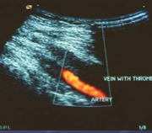
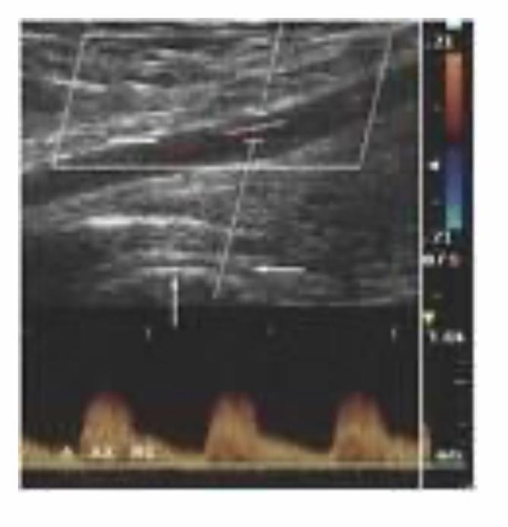
DVT( Deep Vein thrombosis)
2. Compression US: Very quick
(Direct approach to Dx DVT.)
Recommended in moderate to high pre-test probability.
If well’s criteria score is high and the US was negative, don’t forget the probability of human error.
Dx is made by finding;
Abnormal compressibility of the Vein.
Abnormal doppler color flow.
The presence of an echogenic band.
Abnormal change in diameter during the Valsalva maneuver(sent&specifity is low for DVT).
Limitations:
Does not detect isolated thrombi in the iliac vein /superficial vein
Limited in pts with deformities or aplast cast.
If US was negative and you have high suspicion and high Wells score, Serial studies need to be performed when initial test is –ve (2%-ve ,retested 7days later +ve).
Pelvic neoplasms /abscesses may demonstrated noncompressibility of the femoral vein when thrombosis is absent.
S/S
Risk factor
Investigations
An ultrasound image demonstrating a blood clot (which produces hyperechogenicity on US) in the left common femoral vein.
Treatment
Red = blood not flowing
3. Contrast venography : Golden standard
it is the most accurate test for diagnosing blood clots but it is an invasive procedure
Non-invasive testing:
Impedance plethysmography
Magnetic resonance venography
(MRI can provide images of veins and clots, but they are not generally used to diagnose DVT. Helpful for assessing brain thrombosis.
Computed tomography.
Echocardiography,
ventilation-perfusion (V/Q) scanning
pulmonary angiography.

Slide 15
DVT( Deep Vein thrombosis)
Primary objectives of treatment of DVT are to prevent:
S/S
Further clot extension
Acute PE
Recurrence of thrombosis
Development of late complication. Formation of the collaterals can cause dilated veins, congestion and infections
Treatment of DVT
Anticoagulation (AC):
Heparins: unfractionated (UFH) and low-molecular weight heparin
Vitamin K antagonists : (warfarin)
AC is initiated with heparin and warfarin is added
Factor Xa inhibitors : (fonduparinux)
Hirudins : (lepirudin, bivalirudin)
Direct oral Anticoagulants (DOACs)
Thrombolysis (Usually reserved for massive PE)
Tissue plasminogen activators: (t-PA, u-PA, urokinase, alteplase)
Thrombectomy (arterial)
IVC filter
Risk factor
Investigations
Conventional Anticoagulation
Treatment
Heparin + warfarin is more effective than warfarin alone; all cases of VTE should be “bridged” with heparin
Treatment always started with heparin (immediate action)
Warfarin can be started at the same time
Warfarin takes time to work (preferable to measure INR over PT as its value is standardized worldwide. The normal INR value is between 1.3 and 1.4)& may increase the tendency to further thrombosis initially (reduces level of Protein C & S)
Around 4 days of warfarin & heparin overlap needed • Heparin can be stopped when INR reaches therapeutic levels (2-3)
LMWH (SC) in stable cases of VTE but UFH (IV) needed in hemodynamically unstable patients or pts who need procedures

Slide 16
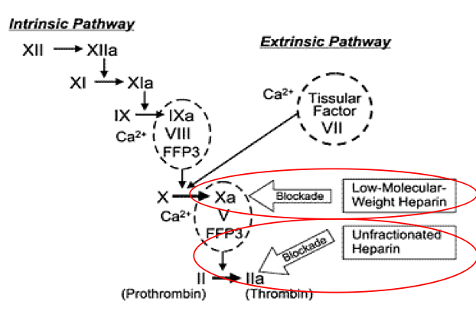
DVT ( Deep Vein thrombosis)
Heparin
Heparin is a mucopolysaccharide with a molecular weight ranging from 6,000 to 40,000 Da.
The average molecular of most commercial heparin preparations is in the range of 12,000 - 15,000.
Enable antithrombin to accelerate many-fold its inactivation of thrombin
IV route
Need Monitoring and hospitalization
Increase incident rate of Heparin induced thrombocytopenia
The efficacy of Heparin therapy depends upon achieving a critical therapeutic level of heparin within the first 24Hr of treatment.(via continuous infusion)
aPTT is 1.5 times the mean of the control value, target range = 1.5- 2.5.
LMWT
enoxaparin, tinzaparin, dalteparin.
LMW 4,000-6,000 daltons.
Bioavailability SC> UFH.
Duration > once /twice .
Anticoagulant response (anti-Xa) is highly correlated with body wt, permitting administration of fixed dose.
Laboratory monitoring is not necessary, No need to admit the patient
Risk of thrombocytopenia is less.
Contraindicted in Dialysis dependent renal failure .
Should be avoided in CKD (Cr clearance < 30 ml/min)
LMWH (SC) in stable cases of VTE but UFH (IV) needed in hemodynamically unstable patients or pts who need procedures
Meta-analysis LMWT Vs UFH Rx acute VTE .
Result :lower rate both recurrent DVT(2.7 vs 7.0) major bleeding (0.9 vs 3.2%) than unfractionated.
Mortality rate ; Meta-analysis of 11 RC trials .
Result : a significantly lower MR at 3-6 mo,pts treated with LMWT compared those receiving UFH Bleeding complications & recurrent thromboembolism were statistically or/ clinically insignificant.d
Outpatient use:
Pts with proximal DVT can be safely treated with LMWH in outpatient setting without loss of efficacy .
S/S
Risk factor
(Duration of treatment is between 3-6 months)
Investigations
Treatment

Slide 17
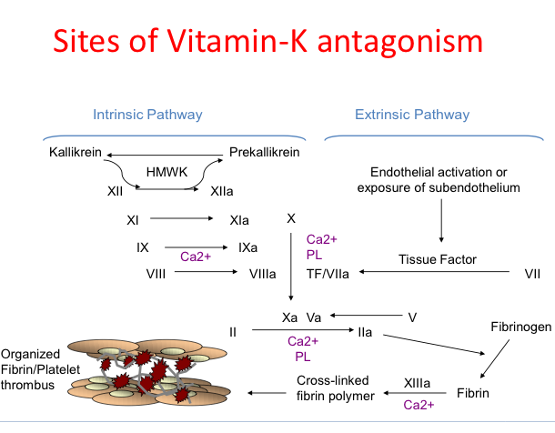
DVT( Deep Vein thrombosis)
Warfarin (Vitamin K antagonists)
The anticoagulant effect is mediated by inhibition of the vit K- dependent gamma- carboxylation of Factor (II,VII,IX, &X ) 1972
The peak effect 36-72 hr.
During the first few days prolongation of INR mainly reflects the depression of factor VII(t1/2=5-7hr)
Treatment & Monitoring
No fixed dose of warfarin, every patient needs a different
dose (loading dose+maintenance)
Monitor INR (International normalized ratio)
Therapeutic INR 2-3 in most cases
Initially heparin is a must as warfarin slow to act and initially pro-thrombotic
Treatment continued for 3-6 months mostly but longer or life long AC may be needed in recurrent cases of VTE
initiation of oral anticoagulation, doses between 5 and 10 mg for the first 2-3 days are recommended for most individuals and subsequent dosing based on the INR response
In patients starting warfarin therapy for initiation of oral anticoagulation, doses between 5 and 10 mg for the first 2-3 days are recommended for most individuals and subsequent dosing based on the INR response
A loading dose (ie, > 10 mg) of warfarin is not recommended. As it will result in a very high INR
A starting dose of < 5 mg might be appropriate in elderly patients; in patients with impaired nutrition, liver disease, or congestive heart failure (CHF); and in patients who are at high risk of bleeding e.g have had recent major surgery
Fluctuations in INR may occur because of any one or more of the following conditions:
Patient non-compliance
Changes in vitamin K intake (diet)
Effect(s) of concomitant drug(s) use
Changes in warfarin metabolism & vitamin K dependent coagulation factor synthesis or metabolism
Inaccuracy in INR testing
S/S
Risk factor
Investigations
Treatment

Slide 18
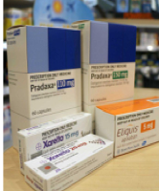
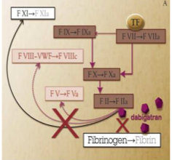
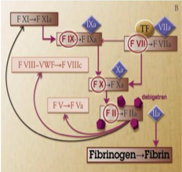
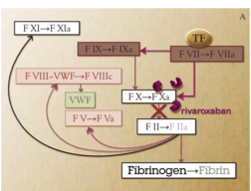
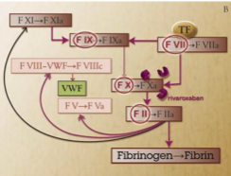
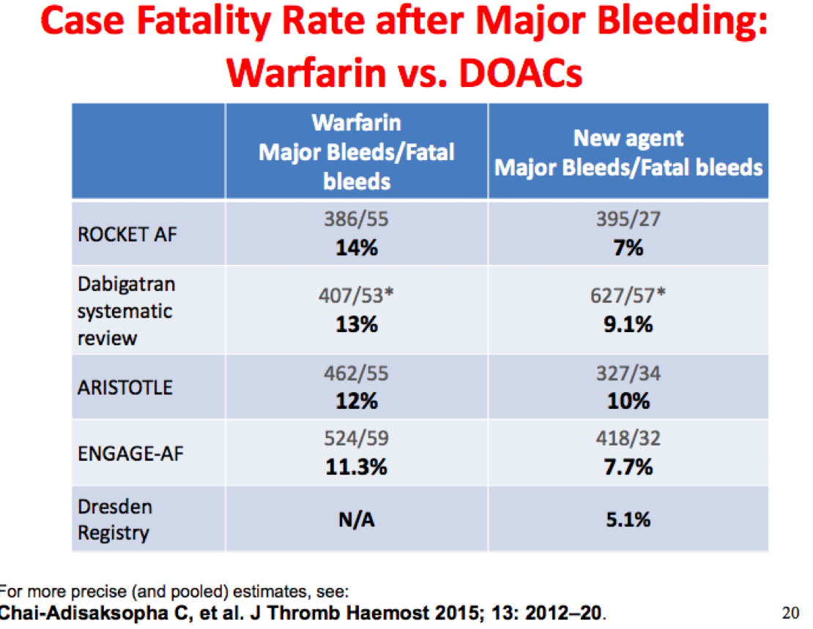
DVT( Deep Vein thrombosis)
Direct Oral Anticoagulnts
S/S
Direct thrombin(factor 2)inhibitors (DTI)
Dabigatran (Pradaxa, Boehringer)
Factor X inhibitors
Rivaroxaban (Xarelto, Bayer/Janssen)
Apixaban (Eliquis, Pfizer/BMS)
Edoxaban (Savaysa, Daichii Sankyo)
Betrixaban (Bevyxxa, Portola)
(DOAC should now be the default choice for patients with DVT and/or PE)
Risk factor
Investigations
Treatment
Dabigatran | Rivaroxaban | Apixaban | Edoxaban | Betrrixaban
-Direct thrombin inhibitor -Twice daily dosing -P - glycoprotein drug -drug interactions | - Factor Xa inhibitor Once or twice daily dosing depending on Indication -P - glycoprotein and CYP 3A4 drug drug interactions Not advised to patients with GI ulcers | -Factor Xa inhibitor Twice daily dosing P - glycoprotein and CYP 3A4 drug - drug interactions Not advised for >85 year olds & under 60 kgs --> adjustment | • Factor Xa inhibitor Once daily dosing | -Factor Xa inhibitor. Only approved for VTE prophylaxis in hospitalized patients P - glycoprotein drug - drug interactions Not currently available in US
Dabigatran | Rivaroxaban | Apixaban | Edoxaban | Betrrixaban
-Direct thrombin inhibitor • -Twice daily dosing -P - glycoprotein drug - drug interactions | • Factor Xa inhibitor Once or twice daily dosing depending on Indication • P - glycoprotein and CYP 3A4 drug drug interactions | -Factor Xa inhibitor Twice daily dosing P - glycoprotein and CYP 3A4 drug - drug interactions | • Factor Xa inhibitor Once daily dosing | -Factor Xa inhibitor. Only approved for VTE prophylaxis in hospitalized patients P - glycoprotein drug - drug interactions Not currently available in US
(DOAC should now be the default choice for patients with DVT and/or PE)

Slide 19
DVT( Deep Vein thrombosis)
Direct Oral Anticoagulnts
S/S
DOACs- indications
Treatment of venous thromboembolism (VTE)
VTE prevention in atrial fibrillation
Prophylaxis in orthopedic surgery
Treatment of VTE in cancer patients
VTE prophylaxis in cancer patients
Risk factor
Advantages of Direct Oral Anticoagulants
(Advantages) | (Clinical implications)
Rapid onset of action Predictable anticoagulant effect Low potential of food interactions Low potential for drug interactions Specific coagulation enzyme target Prophylactic dose | No need for bridging No need for routine coagulation monitoring No dietary precautions Few drug restrictions Low risk of off-target adverse effects Smaller doses can be used as prophylaxis? Yes, 20mg of Rivaroxaban can be used for treatment and 10mg can be used as prophylaxis.
Disadvantages of Direct Oral Anticoagulants
More expensive Reversal (was) a problem (Antidote available now) Can not be used in end stage renal failure (apixaban) Not suitable for AC for prosthetic heart valves (Increase risk of thrombosis)
Warfarin still treatment of choice for longer term AC Patients with end stage renal failure Patients with prosthetic heart valves Antiphospholipid syndrome (high risk)
Investigations
Treatment
Some Important Facts about DOACs
The risk of bleeding with the DOACs, and particularly intracranial bleeding, is less with the DOACs than with VKA (warfarin) therapy
GI bleeding may be higher with dabigatran, rivaroxaban, and edoxaban than with VKA therapy
Based on indirect comparisons, the risk of bleeding may be lower with apixaban than with the other DOACs
Despite the lack of specific reversal agents for the DOACs, the risk that a major bleed will be fatal appears to be no higher for the DOACs than for VKA therapy.

Slide 20
DVT( Deep Vein thrombosis)
Direct Oral Anticoagulnts
S/S
Anticoagulants in VTE: Current Recommendation Statements & Remarks:
The minimum duration of anticoagulant therapy for DVT or PE is usually 3 months; this period of treatment is referred to as “long-term therapy.”
Treatment longer than 3 months but for a limited period “longer time-limited period” (eg, 6, 12, or 24 months).
A decision to treat patients for longer than 3 months, which we refer to as “extended anticoagulant therapy,” usually implies that anticoagulant therapy will be continued indefinitely (for life).
Initial parenteral anticoagulation (e.g., heparin) for VTE is given before dabigatran and edoxaban, is not given before rivaroxaban and apixaban.
In patients with a first VTE that is an unprovoked proximal DVT of the leg or PE and who have a
(i) low or moderate bleeding risk, we suggest extended anticoagulant therapy (no scheduled stop date) over 3 months of therapy (Grade 2B),
and (ii) high bleeding risk, we recommend 3 months of anticoagulant therapy over extended therapy (no scheduled stop date) (Grade 1B).
Patient sex and D-dimer level measured a month after stopping anticoagulant therapy may influence the decision to stop or extend anticoagulant therapy. In all patients who receive extended anticoagulant therapy, the continuing use of treatment should be reassessed at periodic intervals (eg, annually).
Risk factor
Investigations
Treatment
Recall from PE lecture
Identify category of Venous Thromboembolism [VTE] event
Provoked by transient risk factor
Unprovoked
Cancer association
- Women at high risk of recurrent VTE
- Men or women at low or moderate risk of bleeding
- Women at low risk of recurrent VTE.
- Men or women at high risk of bleeding
3 months anticoagulant
Indefinitive anticoagulant therapy
3-6 months anticoagulant therapy
6 months anticoagulants or as long as cancer is active

Slide 21
DVT( Deep Vein thrombosis)
Overdose & Anti-dotes
S/S
For heparin
protamine sulphate
Its very easy to naturalize unfractionated heparin over LMWH as it present freely in the blood.
For warfarin
vitamin K but may take time (many hours) to act
An actively bleeding patient on warfarin may also need fresh frozen plasma (FFP) or prothrombin complex (Contain Vit K dependent factors)
Reversal of direct thrombin inhibitors (Dabigatran)
Idarucizumab
Idarucizumab is a humanized monoclonal antibody fragment that binds dabigatran with 350-fold higher affinity than that of dabigatran for thrombin.
In addition to binding dabigatran, idarucizumab also binds the active glucuronide metabolites of dabigatran to form essentially irreversible 1:1 stoichiometric complexes.
Idarucizumab and idarucizumab-dabigatran complexes are cleared by the kidneys, as is dabigatran
After intravenous infusion, the half-life of idarucizumab is about 45 min in subjects with normal renal function.
Reversal of Factor-X Inhibitors
Andexanet alfa
Andexanet alfa is a recombinant human FXa variant with the
active-site serine residue replaced with alanine to eliminate catalytic activity and with the membrane-binding domain deleted to prevent incorporation into the prothrombinase complex.
Andexanet serves as a decoy for the oral FXa inhibitors because
it binds them with affinities similar to those of native FXa. Because andexanet also binds tissue factor pathway inhibitor (TFPI) to form a non-productive andexanet–TFPI complex, it reduces TFPI activity
Risk factor
Investigations
Treatment

Slide 22
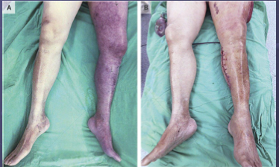
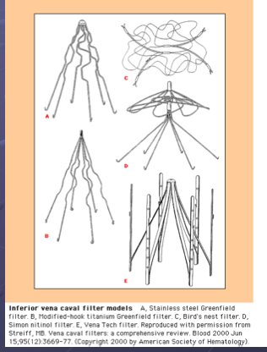
DVT( Deep Vein thrombosis)
Thrombolytic Therapy¹:
(Usually reserved for massive PE)
Tissue plasminogen activators (t-PA, u-PA, urokinase, alteplase)
Controversial.
Reduction in incidence of postphlebitic syndrome.
May consider in pts with significant swelling &
symptoms as Phlegmasia cerulea dolens.
Inferior vena caval filters
1868 Trosseau.
1893 Bottini.
1967 clinically feasible.
Types.
Retrievable filters.
They mainly prevent MAJOR thrombi from passing
through
Indications:
Indicated in cases absolute contraindication. When we can't give anticoagulants
I.E recent surgrery, history of hemorrhagic stroke, active bleeding, HIT, recurrent VTE despite adequate anticoagulation.
Acute VTE ,conventional anticogulation proven ineffective.
Complication:
Complication related to the insertion process.
Venous thrombosis at the site of insertion
Filter migration.
Filter erosoin through the IVC wall.
IVC obstruction
Thrombectomy (arterial)
S/S
Risk factor
Investigations
Treatment
1- for extreme cases. Not used routinely as they aren’t much different in mortality expect in cases of massive PE

Slide 23
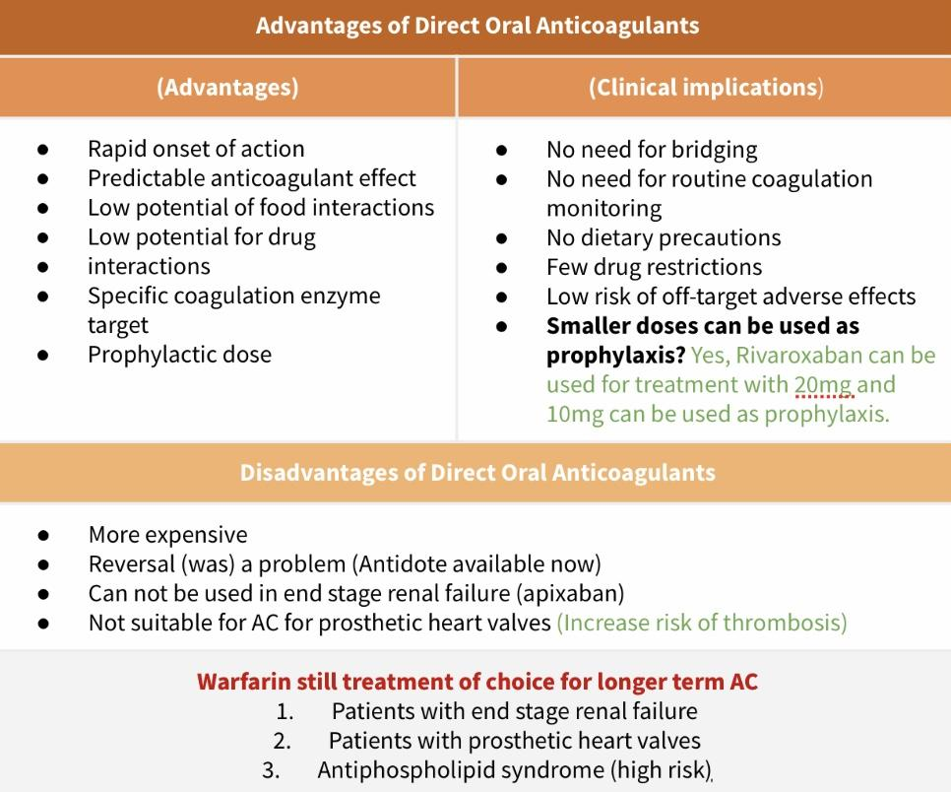
Hypercoagulable state (Thrombophilia)
It’s genetic or acquired disorders which shift the balance toward excessive platelet aggregation and thrombin generation (clot formation) that lead to thrombosis. Virchow’s triad (risk factors for thrombosis): Hypercoagulable state, endothelial injury, and venous stasis.
Etiology | Inherited | Acquired |  | Mix/Unknown
 | Antithrombin deficiency Protein C deficiency Protein S deficiency Factor 5 Leiden mutation (most common) Prothrombin gene mutation Dysfibrinogenemia (rare) | Advancing age Pregnancy Prolonged air travel Previous thrombosis Immobilization Major surgery Presence of a venous catheter | Estrogen Heparin-induced thrombocytopenia (HIT) Malignancy Myeloproliferative disorders Hyperviscosity syndromes Antiphospholipid syndrome | Hyper homocysteinemia Acquired protein C resistance High level of Factor 13 High level of Factor 9,11
Diagnosis | Clinical pictures (1st step) The presence of risk factors is a clue that VTE may develop or that it may already be present. PE with low BP (<90 mmHg) is called massive PE Non-invasive testing: Impedance plethysmography, Compression ultrasonography very quick recommended in moderate to high pre-test probability its Imp in DVT. D-dimer used in outpatient, inpatients might have high D-dimer. Magnetic resonance venography Computed tomography Echocardiography. Invasive testing: contrast venography (gold standard and most accurate in diagnosing blood clots)
Treatment | Anticoagulation: Conventional anticoagulant — Heparin(LMWH), Coumadin, Warfarin Heparin + warfarin is more effective than warfarin alone; all cases of VTE should be “bridged” with heparin Increase incident rate of Heparin induced thrombocytopenia LMWT Contraindicated in Dialysis dependent renal failure Warfarin treatment is continued for 3-6 months mostly but longer or life long AC may be needed in recurrent cases of VTE DOACs — Direct thrombin inhibitors(Dabigatran) and FX inhibitors(Rivaroxaban, Apixaban, Endoxaban) Thrombolysis: Tissue plasminogen activators ( t-PA , u-PA , urokinase , alteplase ) Thrombectomy: IVC filter Embolectomy ( surgical or catheter)

Slide 24
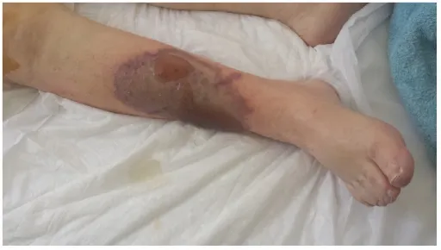
Q1: A 42-year-old man presents to the emergency department with a one week history of a red, painful swollen left lower extremity. The patient reports he recently returned from Hawaii, where he was running a marathon. He reports his symptoms began shortly after landing and is worried he may have injured his leg during the race. His medical history is non-contributory. His temperature is 37.0°C (98.6 °F), pulse is 94/min, respirations are 20/min, blood pressure is 152/73 mmHg, and oxygen saturation saturation is 97% on room air. Physical examination shows a swollen and mildly erythematous left lower extremity that is painful to palpation, with 2+ pitting edema compared to the right lower extremity. Pulses are 2+ with capillary refill <2 seconds bilaterally. WBC is 9000/mm3 and creatine kinase is 30U/L. Which of the following is the most appropriate next step in diagnosis?
A. Left tibia and fibula x-ray
B. Measurement of compartment pressures
C. CT-angiogram of the left lower extremity
D. Blood cultures
E. Ultrasound of the lower extremities
Q2: A 24-year-old woman comes to the clinic due to leg pain and swelling that started suddenly 2 days ago. History is significant for traveling back from Australia 3 days ago and smoking 1 pack of cigarettes per day for 5 years. The patient denies any trauma, and she does not use excessive alcohol or illicit drugs. Vitals are within normal limits. On physical examination, the right calf is red, warm, and swollen. The left calf appears normal. Lower extremity ultrasounds reveal a deep vein thrombosis. Laboratory testing shows a PTT of 30 seconds. Heparin is administered. Six hours later, PTT is 32 seconds. Which of the following is the most likely diagnosis?
A. Vitamin K deficiency
B. Prothrombin gene mutation
C. Factor V Leiden deficiency
D. Antithrombin III deficiency
E. ADAMTS13 deficiency
Q3: A 45-year-old man is brought to the emergency department (ED) due to right leg pain. A week ago, the patient was hospitalized for deep vein thrombosis and consequently started on warfarin treatment with heparin bridge. The patient’s condition improved, and he was discharged. Upon return to the ED, the patient’s temperature is 37.6°C (99.7°F), pulse is 92/min, and blood pressure is 142/76 mmHg. On physical examination, the patient is in acute distress due to pain. Cardiopulmonary examination is within normal limits. A picture of the patient’s leg is shown, Which of the following findings is most likely to be found in this patient upon further evaluation?
A. Elevated prothrombin levels
B. Elevated protein S levels
C. Normal platelet count and increased PTT time
D. Low protein C levels
E. Low levels of ADAMTS13
Q4: A 25-year-old Caucasian woman presents to the emergency department due to difficulty breathing. Two hours ago, she suddenly felt chest pain accompanied by dyspnea. The patient denies any recent trauma, and she does not smoke or use illicit drugs. She is sexually active with her partner and uses condoms for contraception. The patient’s temperature is 37.1°C (98.8°F), pulse is 75/min, and blood pressure is 118/73 mmHg. On physical examination, the patient appears distressed. Heart sounds are normal and the lungs are clear to auscultation. Labs show an elevated d-dimer. PT and PTT are 12 and 10 seconds, respectively. Purified protein C is added to the patient’s plasma and causes no change in the lab values. Which of the following is the most likely diagnosis?
A. Factor V Leiden deficiency
B. Antiphospholipid syndrome
C. Prothrombin gene mutation
D. Antithrombin deficiency
E. Protein S deficient
Q5: A 27-year-old woman who suffers from rheumatic mitral stenosis develops atrial fibrillation. She is placed on warfarin therapy. What is the most appropriate target international normalized ratio (INR) range?
A. <1.0
B. 1.0–2.0
C. 2.0–3.0
D. 3.0–4.0
E. >5.0
Quiz explanations:
Question 1:
The correct answer is E. This patient likely has a deep vein thrombosis (DVT), which classically presents as a unilateral, swollen, erythematous, and painful lower extremity. Virchow's triad summarizes the pathophysiology leading to thrombosis, and includes endothelial injury, hypercoagulability, and venous stasis. Venous stasis occurs during periods of extended immobility, including long-distance plane flights (as in this patient), hospital stays, post-op, or sedentary lifestyles. Diagnosis is confirmed with compression ultrasound with doppler.
Question 2:
The correct answer is D. Antithrombin III deficiency is a type of thrombophilia that can be inherited (autosomal dominant) or acquired. Patients are at increased risk for venous or arterial thrombotic events. One characteristic of AT deficiency is failure of PTT to prolong following heparin administration since heparin requires functional AT for its action.
Question 3:
The correct answer is D. Protein C and S deficiency are uncommon causes of inherited, autosomal dominant thrombophilias. The primary role of Proteins C and S is to inactivate factors Va and VIIIa and inhibit coagulation. Patients with these disorders are at increased risk for venous or arterial thromboembolism, neonatal purpura fulminans, fetal loss, stroke, and warfarin-induced skin necrosis.
Question 4:
The correct answer is A. This young patient who has no acquired risk factors for hypercoagulability (e.g., smoking, OCP use) is presenting with a pulmonary embolism, raising concerns for a hereditary cause. Factor V Leiden is an autosomal dominant condition and is the most common cause of inherited hypercoagulability in Caucasians. Point mutations alter the cleavage site of factor V at locus Arg 506, resulting in factor V that is resistant to degradation by protein C.
Question 5:
The correct answer is C. The INR is the ratio between the prothrombin time compared to a control sample and provides a means of monitoring bleeding risk. The normal INR is between 0.9 and 1.3 (B), an INR <1.0 (A) suggests a high thrombotic risk. The SIGN guidelines state a patient suffering from rheumatic mitral valve disease with/without atrial fibrillation should have a target INR of 2.5 with a range between 2.0 and 3.0 (C). An INR between 3 and 4 (D) would be appropriate in a patient with lupus anticoagulant syndrome or suffering from venous thromboembolism. It would also be appropriate following a mitral valve replacement with a metallic valve where a high INR is important. An INR >5.0 (E) indicates a high bleeding risk.
Answers: Q1:E | Q2:D | Q3:D | Q4:A | Q5:C
Answers Explanation File!

Slide 25
THANKS!!
This lecture was done by:
Lina Alnassar
Amirah Aldakhilallah
Quiz and summary maker:
Lama AlAssiri
Razan Alrabah
Note taker:
Khalid Alharbi
Amirah Aldakhilallah
Rema Almutawa
Special thanks to Shahad Selayem & Haifia Alwaily!
Females co-leaders:
Raghad AlKhashan
Amirah Aldakhilallah
Males co-leaders:
Mashal AbaAlkhail
Nawaf Albhijan
Send us your feedback:
We are all ears!

