Slide 1
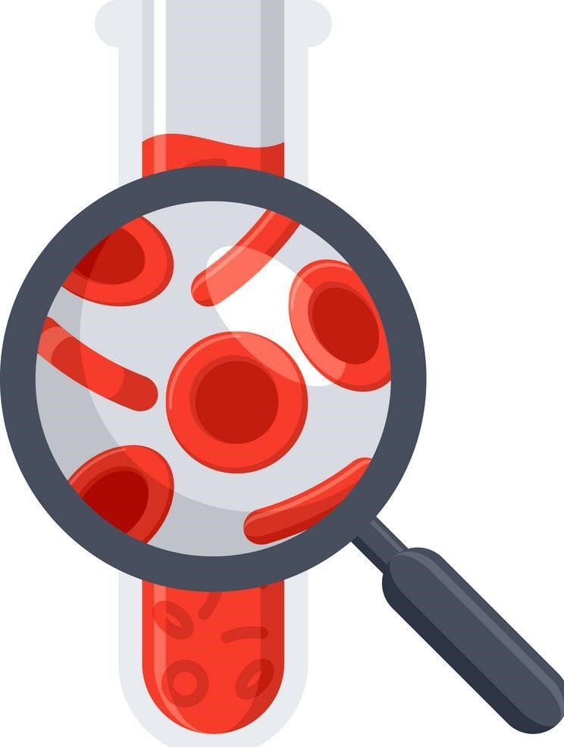
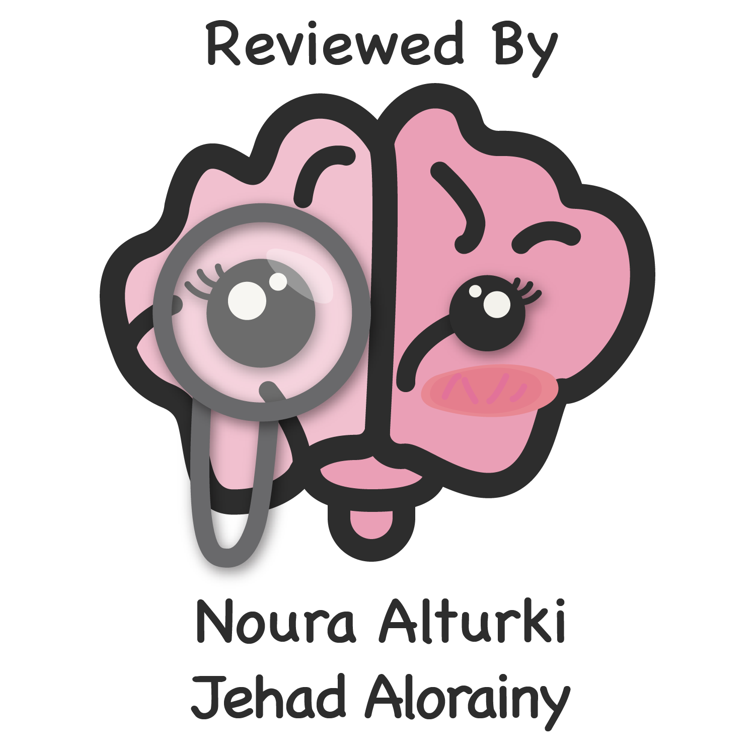
Lecture 68
Editing file
Bleeding disorders
Objectives:
Overview of Hemostasis.
Congenital Bleeding Disorders.
Acquired Bleeding Disorders.
Platelet Disorders (Number & Function).
Approach to the bleeding Pt.
Management of Bleeding Pt.
Color index:
Color index:
Original text Females slides Males slides
Doctor’s notes Textbook Important Golden notes Extra

Slide 2
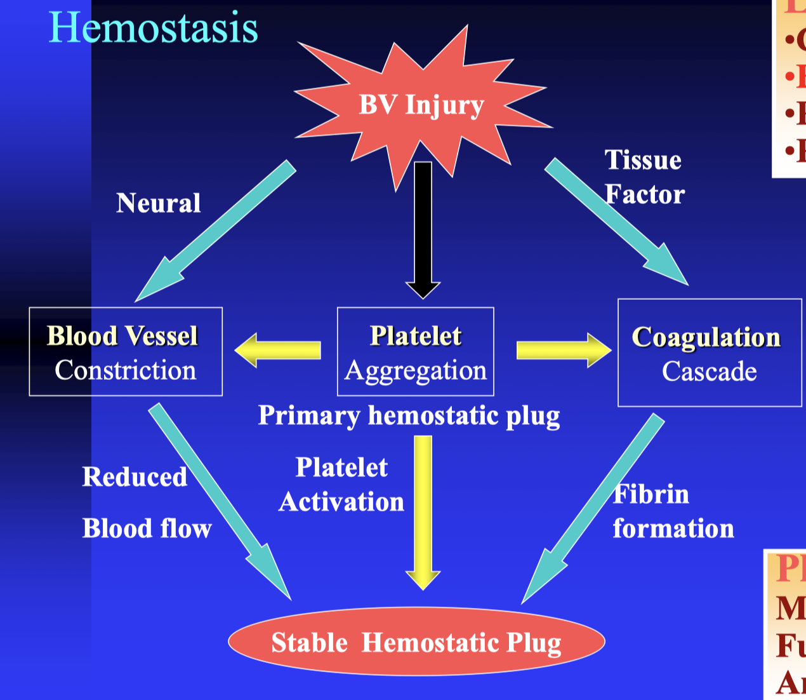
Overview
Bleeding disorder
Bleeding disorders are a group of disorders that share the inability to form a proper blood clot. They are characterized by extended bleeding after injury, surgery, trauma or menstruation.
Hemostasis
The process through which bleeding is controlled
at a site of damaged or disrupted endothelium.
A dynamic interplay between:
Cellular Components: ( PLTs & Endothelium )
Plasma Proteins Components: 3 protein systems :
Blood Coagulation ( Clot Formation )
Fibrinolysis ( Clot Lysing )
Anticoagulant ( Regulating ) ¹
Recall the normal hemostatic process which comprises 4 main steps :
Injury of blood vessels and rapid vasoconstriction.
Temporary platelet plug.
Blood coagulation by activation of the clotting cascade.
Fibrinolytic system activation
( clot dissolve by plasmin).
BV injury
Lab test ²
CBC to look for the Plt.
Bleeding time,(CT).
PT.
PTT.
Tissue factor
Neural
BV
Constriction
Platelet Aggregation
Coagulation
cascade
Primary Hemostatic plug
Plt Study
Morphology.
Function.
Antibody.
Reduced blood
flow
Platelet Activation
Stable
Hemostatic plug
Fibrin formation
1- It is a natural process in our body to stop further thrombosis events .
2- To assess the hemostatic system if it works probably .

Slide 3
Platelets
Platelet:
Produced in the Bone Marrow by fragmentation of the cytoplasm of megakaryocytes.
Each megakaryocytes rise Plt from 1000 to 5000.
Time interval from differentiation of the human stem cell to the production of Plts (~10 days) (MCQ)
Thrombopoietin is the major regulator of Plt production via c-MPL receptor (produced by the liver & kidney).
Normal PLT counts ( 150 – 400 x 10⁹). (Usually we can do surgeries if plt count was <50k, except CNS surgeries, it has to be >100k.)
PLT Life Span ( 7 – 10 days). MCQ
Platelet ultrastructure :
Extremely small & discoid (3 x 0.5 μm in diameter).
F
Clotting Factors
VWF
PDGF
ILGF1
α Granules
An area for your notes
3 types of storage granules
Dense Granules
(δ)
ADP & ATP¹
Serotonin
Histamine
Ionized Ca²
Lysosomes
Hydrolytic enzymes.
PLTs functions :
Deficiencies in any of them produce a different disease
1
Adhesion
Adhesion between the PLT and the vessel wall by VWF through GP Ib/IX/V (synthesized in endothelial cells & megakaryocytes / stored in storage granules of endothelial cells & α granules of Plt / Rise with stress, exercise, adrenaline, infusion of DDAVP).
2
Aggregation
By cross linking of PLT to PLT by VWF & Fibrinogen through GP IIb/IIIa receptors (on the surface of the PLT).
3
Release Reaction & Amplification
(aggregation formation & stabilization )
Release of α granules contents, & ADP from dense granules.
Formation of Thromboxane A2 (through COX enzymes. Aspirin works by inhibiting COX enzyme thus decreasing TXA2 production) by various agonists induces intracellular signaling & thrombin formation
PLTs Inhibitors: The goal is just to stop the bleeding. We don’t want extra aggregation.
Prostacyclin (PGI2);
Nitric Oxide (NO);
Synthesized by vascular endothelial cells. Think of it as a TXA2 antagonist.
Potent inhibitor of PLT aggregation & causes mild vasodilation by rising cAMP.
Prevents Plt deposition on normal vascular endothelium
Released from endothelial cells, macrophages, & platelets.
Inhibits Plt activation & promotes vasodilation.
1- They provide the energy for the platelets to aggregate together in the fibrin.
2-essential co-factor in coagulation cascade.

Slide 4
Hemostasis
Hemostasis dependent upon :
Vessel Wall Integrity .
Adequate Numbers of Platelets.
Proper Functioning Platelets.
Adequate Levels of Clotting Factors .
Proper Function of Fibrinolytic Pathway.
Hemostatic phases :
(MCQ)
Primary Hemostasis:
Secondary Hemostasis
Endothelium Injury
Platelet plug
Von Willebrand Factor
Clotting Factors
Soluble Protein Fibrinogen converted to insoluble Fibrin.
01
Vascular phase :
02
Platelet phase:
release of locally active vasoactive agents (Endothelin, Thromboxane A2, Fibrinopeptides) lead to vasoconstriction at the site of injury that leads to reduced blood flow.
Plt Adhesion & Aggregation (via VWF, ADP, TXA2) will result in formation of PLT Plug.
03
Plasma coagulation phase:
04
Fibrinolysis change :
Propagation of the clotting process by the coagulation cascade lead to formation of Fibrin Clot.
Termination of clotting by antithrombotic control mechanisms & removal of the clot.
Overview of Hemostasis
Primary VS secondary hemostasis
Primary hemostasis refers to platelet aggregation and platelet plug formation. Secondary hemostasis refers to the deposition of insoluble fibrin, which is generated by the proteolytic coagulation cascade. This insoluble fibrin forms a mesh that is incorporated into and around the platelet plug.
Defect in 1ry → Mucosal bleeding; normal PT/PTT
Defect in 2ndry → Deep tissue bleeding; abnormal PT/PTT, depending of the pathway affected:
Intrinsic pathway → prolonged PTT
Extrinsic pathway → prolonged PT
If both are prolonged think of DIC

Slide 5
Hemostasis
Clotting factors: produced by the liver
for easy memorization
Congenital deficiency → hemophilia A
Congenital deficiency → hemophilia B
Coagulation cascade:
Fibrinolysis :
aka D-dimers
Coagulation cascade
Overall process:
- The intrinsic pathway gets activated when the blood vessel gets injured. It starts by the activation of factor 12 when it comes in contact with the Subendothelial collagen of the injured vessel.
- To prevent further coagulation: 1) platelet inhibitors 2) protein C & S: they deactivate factor 5 & 8
What are the VitK dependent factors? II, VII, IX, X, proteins C & S

Slide 6
Lab tests
LABORATORY EVALUATION
(to know the source of bleeding)
PLATELET COUNT
BLEEDING TIME (BT)
PROTHROMBIN TIME (PT)
PARTIAL THROMBOPLASTIN TIME (PTT)
THROMBIN TIME (TT)
Platelet count: 100,000 - 400,000 CELLS/MM3 (NORMAL) < 100,000 (Thrombocytopenia “ low platelet count “) 50,000 - 100,000 (Mild Thrombocytopenia) < 50,000 (Severe Thrombocytopenia)
Prothrombin time (PT): Measures the effectiveness of the extrinsic pathway. NORMAL VALUE (10-15 SECS) Prothrombin time tests the extrinsic and final common pathways
Bleeding time : PROVIDES ASSESSMENT OF PLATELET COUNT AND FUNCTION NORMAL VALUE (2-8 MINUTES.)
Partial Thromboplastin time(PTT) : Measures Effectiveness of the Intrinsic Pathway. NORMAL VALUE (25-40 SECS) Activated partial thromboplastin time Tests the intrinsic and common pathways
Thrombin time(TT) : Time needed for thrombin to convert fibrinogen (soluble) to stable fibrin. A Measure of Fibrinolytic Pathway. NORMAL VALUE 9-13 SECS. Evaluate fibrinogen and for inhibition of thrombin action.
An area for your notes
Prolongation in:
Liver disease.
vitamin K antagonism (i.e. warfarin) and deficiency
Disseminated intravascular coagulation
Factor VII, X, V, II and fibrinogen defect.
Prolongation in:
Liver disease.
Disseminated intravascular coagulation.
Heparin therapy.
Vitamin K antagonism or deficiency.
Factor XII, XI, IX, VIII, X, V, II, and fibrinogen defect.
Prolongation in:
Hypofibrinogenaemia.
Dysfibrinogenaemia
Heparin therapy.
Disseminated intravascular coagulation.
Hypofibrinogenaemia :
Congenital deficiency which has problems with stabilizing clot, hence once they start to form the clot, bleeding happens again.
Dysfibrinogenaemia:
is a coagulation (clotting) disorder characterized by having an abnormal form of fibrinogen. Having abnormal fibrinogen results in defective clot formation and can cause an increased or decreased ability to clot.

Slide 7
CONGENITAL BLEEDING DISORDERS
Hemophilia:
Hemophilia :
An inherited bleeding disorder caused by deficiency of coagulation. (The most common inherited disorder)
It’s characterized based on the residual or baseline factor activity level (also referred to as "factor level"); expressed as a % of normal or in IU/mL.
Factor levels typically correlate with the degree of bleeding Symptoms. (Important)
Coagulation defects:
1-Hereditary :
Hemophilia A .
Hemophilia B.
Hemophilia C.
Etc .
2- Acquired : ( skip)
Autoimmune disease where immune system attacks factor VIII.
Pregnancy.
Malignant neoplasms.
Etc.
Hemophilia
Congenital : | Acquired :
genetic mutation in F8 & F9 located on the long arm of X chromosome. Observed commonly in males due to their hemizygous state . Rarely in females due to (Heterozygous females as result from nonrandom X chromosome inactivation, skewed Lyonization¹, or the presence of other genetic abnormalities (Turner Syndrome or X autosomal translocations). | Development of autoantibodies most commonly directed against FVIII – ass. with pregnancy, malignancy, advanced age. (anything that triggers the immune system to produce autoantibodies)
Types
Hemophilia A: Inherited deficiency of factor VIII (8); an X-linked recessive disorder (male diseased and female carrier ). It is protected from proteolysis in the circulation by binding to vWF.
Hemophilia B : Inherited deficiency of factor IX (9); also called Christmas Disease; an X-linked recessive disorder.
Hemophilia C : Inherited deficiency of factor XI (11); also called Rosenthal Syndrome; an autosomal recessive disorder. Rarely, heterozygotes may have bleeding (ie, autosomal dominant transmission, due to heterodimer binding). especially common in Ashkenazi Jews (ie, Jews from Eastern Europe).
Clinically
hematomas, hemarthrosis, bruising, bleeding (mucosal, GI, GU, joint) deep bleeding. (traumatic bleeding)
Diagnosis
Increased aPTT, Factor level will be low, Mixing study (corrected in case of congenital only, not corrected in acquired), Normal VWF & PT.
Treatment
Replacement of the deficient coagulation Factor (recombinant or plasma derived) + Adjunctive therapy (Desmopressin (DDAVP levels of vwf will increase with this drug), Antifibrinolytic agents (Tranexamic Acid, Aminocaproic Acid), rFVIIa (with inhibitors).
1-It means the female has only one X and the other one is inactive .

Slide 8
CONGENITAL BLEEDING DISORDERS
Baseline factor activity level² (MCQ)
Severe Hemophilia : defined as <1 % factor activity (<0.01 IU/mL). ³
Moderate Hemophilia : defined as a factor activity level ≥1 % of normal and <5 % of normal ( ≥0.01 - <0.05 IU/mL).⁴
Mild Hemophilia : defined as a factor activity level ≥5 % of normal and <40 % of normal (≥0.05 - <0.40 IU/mL).⁵
Von Willebrand Disease :
The most common bleeding disorder.
Inherited VWD is classified into Three types.
Defect of Von Willebrand Factor:
Quantitative (type 1 & 3)
Qualitative (type 2)
Autosomal dominant. (MCQ)
The Normal function of VWF:
Mediate platelet adhesion.
Stabilize factor VIII in circulation.¹
Localize factor VIII to site of vessel injury.
Congenital : autosomal dominant (most types), recessive (rarely).
Acquired :rare, caused by autoantibodies against vWF & immune complex formation, vWF binding to cancer cells, Congenital Heart Disease, Aortic Stenosis, Angiodysplasia. Rx (of the underlying disorder)
Ristocetin-Induced platelet aggregation; a way to test PLT function
VWF func :
1- form an adhesive bridge between platelets and injured vascular epithelium.
2- carrier for factor VIII.
3- form a bridge between adjacent platelets allowing them to bind together and effectively form a platelet plug at sites of endothelial injury .
least to have bleeding
group F dr focused on the highlighted while males dr said you don't need to know the details
Diagnosis
&
Treatment
normal aPTT in (Type 1 & 2).
prolonged aPTT in (Type 2N, 2B, & 3)
vWF:Ag.
vWF:RCo.
vWF multimers (to differentiate subtypes)
FVIII assay (low in 2N & 3).
Plt count (low in 2M).
Replacement of exogenous vWF concentrate.
Desmopressin (DDAVP intranasal) Antifibrinolytic agents (Tranexamic Acid Aminocaproic Acid).
Conjugated Estrogens & oral contraceptive Agents (for menorrhagia) .
1- factor VIII it is imp for the intrinsic pathway + adhesion to vascular injury to allow the PLT to underline the clotting factor .
2- By knowing the Baseline factor activity level we can manage the haemophilic patient according to these definitions .
management :
3- They need regular transfusion /replacement of the factor to prevent any serious bleeding .
4-they don't suffer from frequent bleeding so they can have factor replacement at time of bleeding .
5- Minimal need for factor replacement.

Slide 9
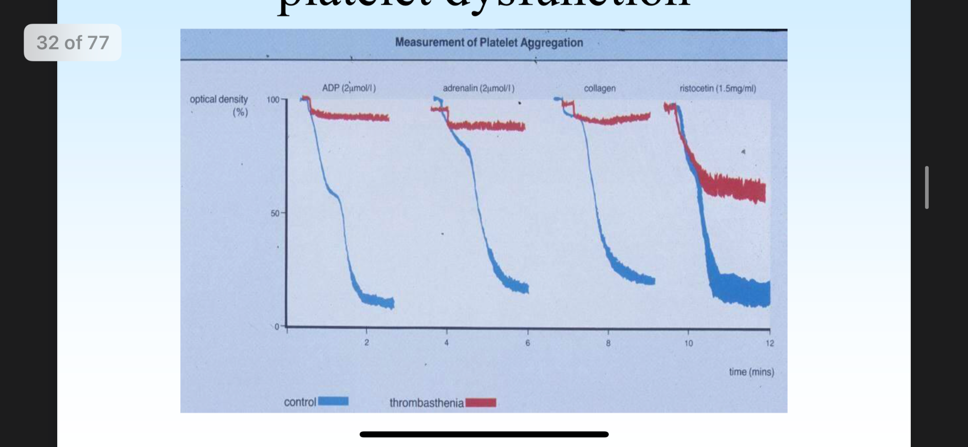
CONGENITAL BLEEDING DISORDERS
Platelet aggregometry:
Function of PLT depend on the secretion of certain substrates from the granules . Abnormality in the granules → “platelet function difficulty” or what is called “thrombasthenia” in which they will be unable to aggregate normally and give very weak wave (Red) while the blue waves are normal.
To confirm, test for platelet ristocetin activity. In case of VWF disease all will be normal except ristocetin.
Comparison between haemophilia and VWD :
 | Hemophilia A | Factor IX deficiency | Von Willebrand
inheritance | Sex linked | Sex linked | Dominant (incomplete)
Main sites of hemorrhage | Muscle,joints,post- trauma or postoperative | Muscle,joints,post- trauma or postoperative | Mucous membranes, skin cuts, post-trauma or postoperative
Platelet count | Normal | Normal | Normal
Bleeding time | Normal | Normal | Prolonged
Prothrombin time | Normal | Normal | Normal
Partial thromboplastin time | Prolonged | Prolonged | Prolonged or Normal
Factor VIII | Low | Normal | May be moderately reduced
Factor IX | Normal | Low | Normal
vWF | Normal | Normal | Low
Ristocetin-induced platelet aggregation | Normal | Normal | Impaired
1- It stimulate endogenous production of VWF .

Slide 10
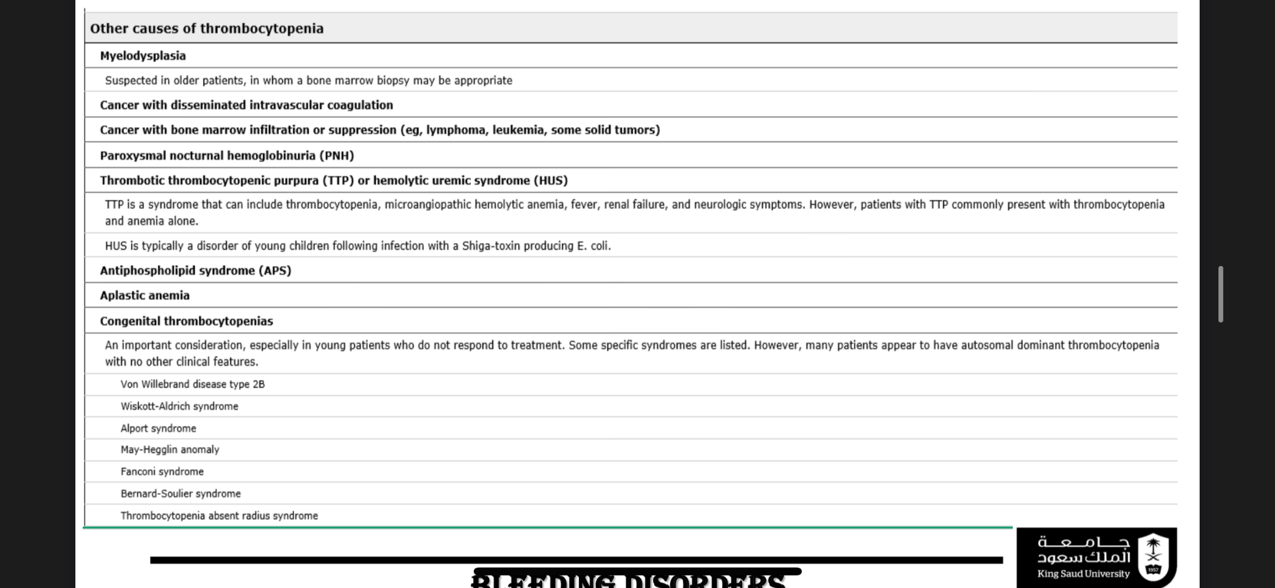
Platelets Disorders
Plt Disorders (Quantitative) :
Just know the name.
Causes of Thrombocytopenia:
Pseudothrombocytopenia or spurious thrombocytopenia is an in-vitro sampling problem which may mislead the diagnosis towards the more critical condition of thrombocytopenia. The phenomenon occurs when the anticoagulant used while testing the blood sample causes clumping of platelets which mimics a low platelet count.
An area for your notes

Slide 11
Platelets Disorders
Approach to Thrombocytopenia
I have a patient’s CBC that shows thrombocytopenia.
-First ask to examine the peripheral blood smear under the microscope, if there’s platelet plugging, then there’s pseudothrombocytopenia, & ask for the CBC to be repeated on citrate.
-If it is true thrombocytopenia:
Look in the peripheral blood morphology, if there is:
Fragmented RBCs, then this is consumption coagulopathy, which means there is a problem in the blood leading to more coagulation and platelet consumption. This is present in TTP, HUS, & DIC. It is diagnosed by elevated LDH & bilirubin, low haptoglobin, prolonged PT & aPTT.
If you take a BM biopsy and find blast cells, then it means that there is a problem in the factory (bone marrow; possibly leukemia) Refer to Hematologist.
Clumped or agglutinated RBCs → consider Evans syndrome (autoimmune hemolytic anemia with autoimmune thrombocytopenia; characterized by reticulocytosis & +ve Coomb’s test, increased LDH & bilirubin)
Elevated levels of lymphocytes/neutrophils → consider an infection
Isolated thrombocytopenia → consider ITP (idiopathic thrombocytopenia) or viral infection
An area for your notes
Immune Thrombocytopenic Purpura (ITP):
1
Primary : isolated thrombocytopenia due to immune Plt destruction & reduce production (auto AB to megakaryocytes)
2
Secondary : Associated with( disease/drug exposure) so look for any Viral (HIV, HCV, HBV, EBV, CMV, Parvovirus), SLE,APLS, H. Pylori Infection, If you didn't find any of the previous causes look for: Chronic Lymphocytic Leukemia (CLL), Hodgkin Lymphoma, AIHA .
Clinically
Diagnosis
RX
insidious onset of mucocutaneous bleed .( Ecchymosis , purpura)
M:F (3:1).
Dx of exclusion
no robust clinical or Lab parameters.
Typically CBC (Isolated low PLT <100.000) with normal PT/PTT.
10% have ITP + AIHA (Evans Syndrome).
PBS (Large Plts).
Anti-Plt AB (not useful).
Rarely indicated if PLT > 50.000 unless bleeding, trauma/surgery, anticoag, comorbidities .
Treatment options:
Steroids.
IVIG.
Splenectomy.
TPO agonists (Romiplostim, Eltrombopag).

Slide 12
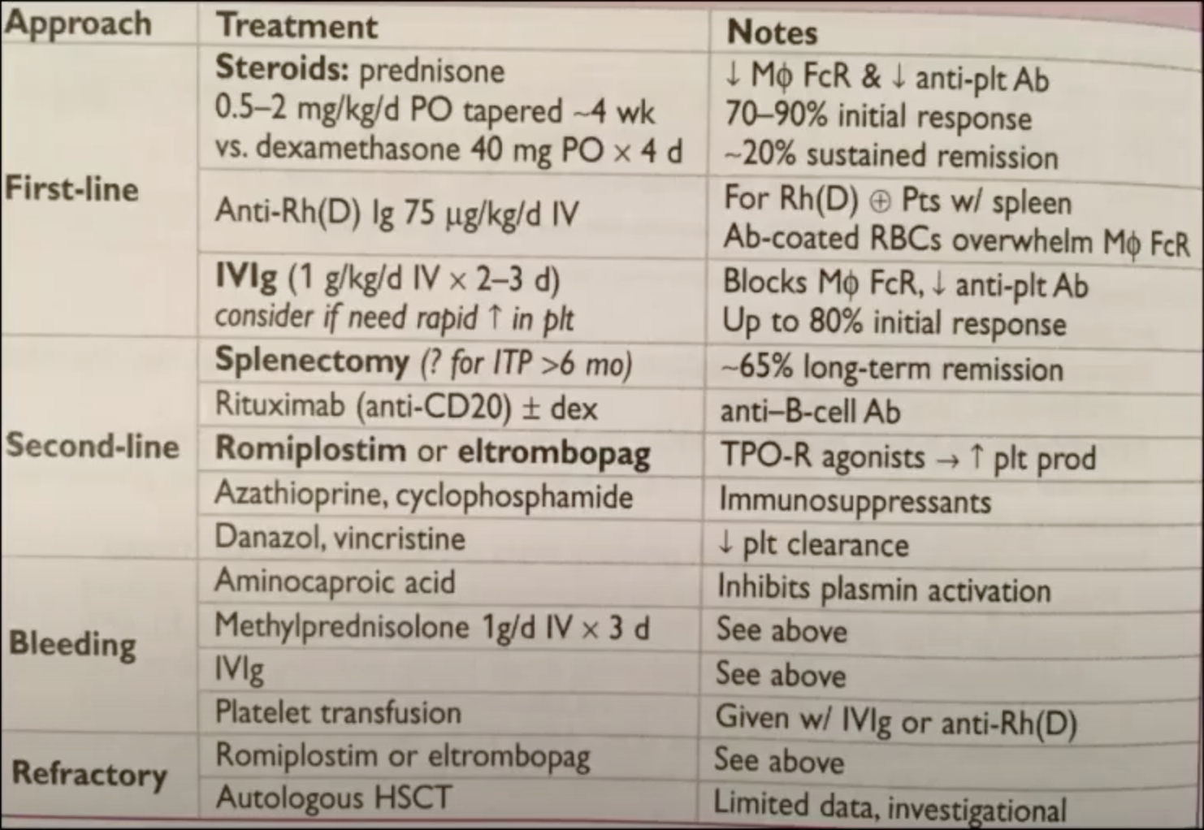
Platelets Disorders
Immune Thrombocytopenic Purpura (ITP) Treatment :
First line treatment:
Steroids
IVIG
It serves as a confirmatory step as well, if the pt doesn’t respond to the steroids, you have to revise your dx.
Second line treatment:
Splenectomy
Rituximab
Refractory cases :
Romiplostim or eltrombopag.
IF FAILED ALL THE ABOVE GO FOR STEM CELL TRANSPLANT .
Disseminated Intravascular Coagulation (DIC) :
Etiology :
Pathogenesis :
Trauma
Obstetric
Complications
Massive activation of coagulation cascade that overwhelms control mechanisms
Bleeding
Infection
Acute consumption of coagulation factors & plt ¹
Malignancy ( esp APML)
Excess thrombosis
Shock
PT, aPTT, Fibrinogen (may be N b/c acute phase), +ve D- Dimer/FDP, PLT, +ve Schistocytes, LDH, Haptoglobin
Diagnosis
&
Treatment
Prolonged PT and aPTT.
decreased fibrinogen.(may be N b/c acute phase)²
low plt.
high LDH.
+ve Schistocytes
Patient comes with fever & bleeding everywhere
Treat underlying process .
fresh frozen plasma (FFP)
Cryoprecipitate
(Goal Fibrinogen > 100 mg/dL)
PLT Tx .
low haptoglobin
+ve D- Dimer/FDP
Plt Disorders (Qualitative ) :
ACQUIRED PLT FUNCTIONAL (normal numbers) DISORDERS:
Congenital Liver Disease
Cardiopulmonary Bypass (cause plugging in the metallic valve used)
Uremia (by the toxins in renal failure)
Dysproteinemia ( Multiple Myeloma or Waldenstrom Macroglobulinemia ) Myeloproliferative Disorders (MPDs) Diabetes Mellitus .
Acquired Glanzmann thrombasthenia.
1-Consumption coagulopathy means more coagulation more consumption of PLT so more thrombosis , at the same time they will have bleeding because they consume all the PLT .
2-Fibrinogen is an acute phase reactant ( which is high in acute inflammation ) so if a DIC patient has high fibrinogen this indicate he has severe infection. so we can see it as high or low in DIC.

Slide 13
Platelets Disorders
Plt Disorders (Qualitative ) :
Bernard-Soulier Syndrome → Genetic GPIb deficiency
Glanzmann thrombasthenia → Genetic GPIIb/IIIa deficiency
INHERITED DISORDERS OF PLT FUNCTION: Know only the names (not imp )
Giant platelet disorders includes Plt GP abnormalities (eg, Bernard-Soulier Syndrome, Deficiency of Platelet Alpha granules (eg, Gray Platelet Syndrome), Deficiency May-Hegglin Anomaly (which also involves the presence of abnormal neutrophil inclusions (ie, Döhle-like bodies)), & some kindreds with type 2B vWD (Montreal Plt Syndrome).
Storage Pool Disorders such as Hermansky Pudlak Syndrome (HPS)
3. Wiskott-Aldrich syndrome .
4. Glanzmann thrombasthenia (aggregate in response to ristocetin) .
5. Platelet release disorders.
6. Glycoprotein VI defects
7. Sticky platelet syndrome .
8. Congenital Deficiency of the ADP
receptor P2Y 12.
9. Scott syndrome.
Approach to Pt with Potential Bleeding :
Two important points:
Detailed Pt & Family Medical History (Crucial & Vital regardless of the prior Lab testing)
Laboratory Testing.
establish likelihood of a bleeding disorder guide laboratory Testing.
Early in the newborn period (problem during circumcision, or bleeding in females)
After hemostatic Challenges ( Delivery, injury, trauma, surgery, invasive dental procedure, menstruation ).
Frequency & pattern .
Duration :
o Symptoms onset ( congenital vs. acquired ) .
o time required for cessation.
Sites of bleeding (specific or multiple) : (Very important)
Detailed Pt & Family Medical History
Mucocutaneous Bleeding :
Primary Hemostasis Defects
( PLT or vW Factor )
Easy bruising
Epistaxis
Menorrhagia
Secondary Hemostasis Defects ( Clotting Factors deficiency)
Deep Tissue Bleeding :
Joint ( Hemarthrosis)
Muscles
CNS ( intracerebral hemorrhage )
Current use of medications or herbal supplements .
Use of Bleeding Assessment Tools (differentiate bleeding phenotypes, require validation by prospective studies)

Slide 14
Drugs Used for Clotting Disorders
you should know them to rule them out from the history .
Direct Thrombin Inhibitors
Indirect Thrombin Inhibitors
Anticoagulants
Vitamin K epoxide reductase Inhibitor.
Direct Xa Inhibitors
Prostaglandin/COX Inhibitors
Antiplatelet
Glycoprotein IIb/IIIa Inhibitors
P2Y₁₂ ADP Inhibitors
Thrombolytics
Plasminogen Activators
Plasminogen
Plasminogen activator
Plasmin
Fibrin clot
Fibrin degradation products

Slide 15
Approach to Pt with Potential Bleeding
2. Laboratory Testing
Screening Tests :
CBC (Platelet count) .
Prothrombin Time (PT) : measures F VII, X, V, II, I - (N Time 10-14 secs) .
International Normalized Ratio (INR) : the ratio of a pt's PT to a normal (control) sample, raised to the power of the ISI value for the control sample used.
Activated Partial Thromboplastin Time (aPTT or PTT) : measures F XII, XI, IX, VIII, X, V, II, I - (N Time 30 – 40 secs) .
Thrombin (Clotting) Time (TT) : sensitive to deficiency of Fibrinogen or inhibition of thrombin - (N Time 14 – 16 secs) .
Bleeding Time : (3-8 secs) (not sensitive – not specific ).
Screening tests (not sensitive to all abnormalities associated with a bleeding disorder.
Causes of prolonged coagulation profile :
SUM

Slide 16
Approach to Pt with Potential Bleeding
Specialized Tests :
Mixing Study (one to one mix of Pt’s plasma & known normal standard plasma, only if PT of aPTT prolonged) used in case of antibody produced against the clotting factor ( Acquired hemophilia ) .
Corrected → clotting factor deficiency (risk of bleed).
Not corrected → inhibitors (directed against specific factor or global inhibitors “ Lupus Inhibitor, risk of thrombosis “).
PLT Function Assay (PFA - 100): assess PLT function
Specificity > 90 % for severe PLT dysfunction of vWD (vWF plasma levels < 25%)
Sensitivity > 24 – 41 % (low) in mild PLT secretion defect or Storage Pool Disease > ( not screening tool ).
PLT Aggregation Tests: (5 external aggregating factors; ADP, Collagen, Ristocetin, Arachidonic Acid, Adrenaline).
Von Willebrand Factor ( Antigen & Activity ).
Factor XIII assay (F XIII Deficiency >> normal PT & PTT).
Severe visceral bleeding (e.g. intracerebral hemorrhage) with normal labs? That’s probably Factor 13 deficiency, it’s an autosomal dominant inherited disorder.
Tx: Every 3wks factor XIII concentrate or FFP.
Human Plasminogen Activator Inhibitor (PAI-1) .
Alpha 2 AntiPlasmin Inhibitor (α2 AP).
Take home messages:
Although screening tests are used widely to identify hemostatic abnormalities associated with bleeding,
they are NOT perfect The Clinical suspicion for a bleeding disorder is Critical to determine extent of the laboratory investigations

Slide 17
Extra info (from Doctor’s slides)
Management in the Perioperative Stage:
Management of Bleeding PT:
Therapeutic decisions should not be based solely on laboratory testing, since abnormalities in Plt function as measured by the tests mentioned are not necessarily predictive of the presence or absence of clinical bleeding.
Since medications such as ASA are the most common causes of Plt dysfunction, a careful history of medication use, including use of over-the-counter aspirin-containing preparations, is crucial >> the most prudent decision prior to an operation or other invasive procedure may simply be to withhold any medication in question prior to the procedure.
If a pt has a Hx of clinically significant bleeding suggestive of Plt dysfunction, whether provoked or spontaneous, appropriate Plt function tests should be obtained so that risk for bleeding can be adequately assessed and therapy chosen more rational.
Desmopressin (dDAVP) is commonly used to correct the hemostatic defect in VWD (releases endogenous VWF from the endothelium) - effective in preventing bleeding after dental extraction and minor surgery in pts with milder Plt defects, including storage pool disease, acquired platelet dysfunction, cirrhosis or uremia, & cardiopulmonary bypass. significantly reduced mean operative and early postoperative blood loss. Plasma levels of vWF were higher after desmopressin than placebo.
Platelet transfusion may be required in pts with disordered Plt function - indicated in cases of severe, uncontrolled bleeding, when prior treatments (eg, dDAVP, estrogen) have been unsuccessful, and/or in the presence of, or anticipation of, excessive traumatic or surgical bleeding.
Antifibrinolytic Agents (Tranexamic Acid, epsilon Aminocaproic Acid) may be helpful in reducing bleeding in pts with disordered plt function following dental extraction.
Conjugated Estrogens used most commonly for uremic bleeding or in pts with mild to moderate type 1 vWD. Intravenous estrogen 0.6 mg/kg per day for 4-5 days, oral estrogen 50 mg/kg per day, or transdermal estradiol 50 to 100 mcg/24 hours applied as a patch twice weekly have been shown to be effective, particularly for GI bleeding.
Erythropoietin used successfully in uremic pts to both reduce and prevent bleeding.
Recombinant Factor VIIa (rFVIIa) some success for Rx of bleeding in pts with congenital Plt disorders. Potential mechanisms >> a local procoagulant effect at sites of vascular damage or tissue factor-independent thrombin generation induced by binding of rFVIIa to the surface of activated Plts. Pts who cannot receive platelet transfusions because of alloimmunization or antibody formation to the absent platelet glycoprotein (eg, Glanzmann Thrombasthenia and Bernard-Soulier Syndrome) may benefit from rFVIIa. one or more bolus infusions of approximately 90 to 100 mcg/kg. approved in Europe for use in pts with Glanzmann thrombasthenia refractory to Plt Tx. Benefits of rFVIIa must be balanced against the risk of thrombosis.

Slide 18
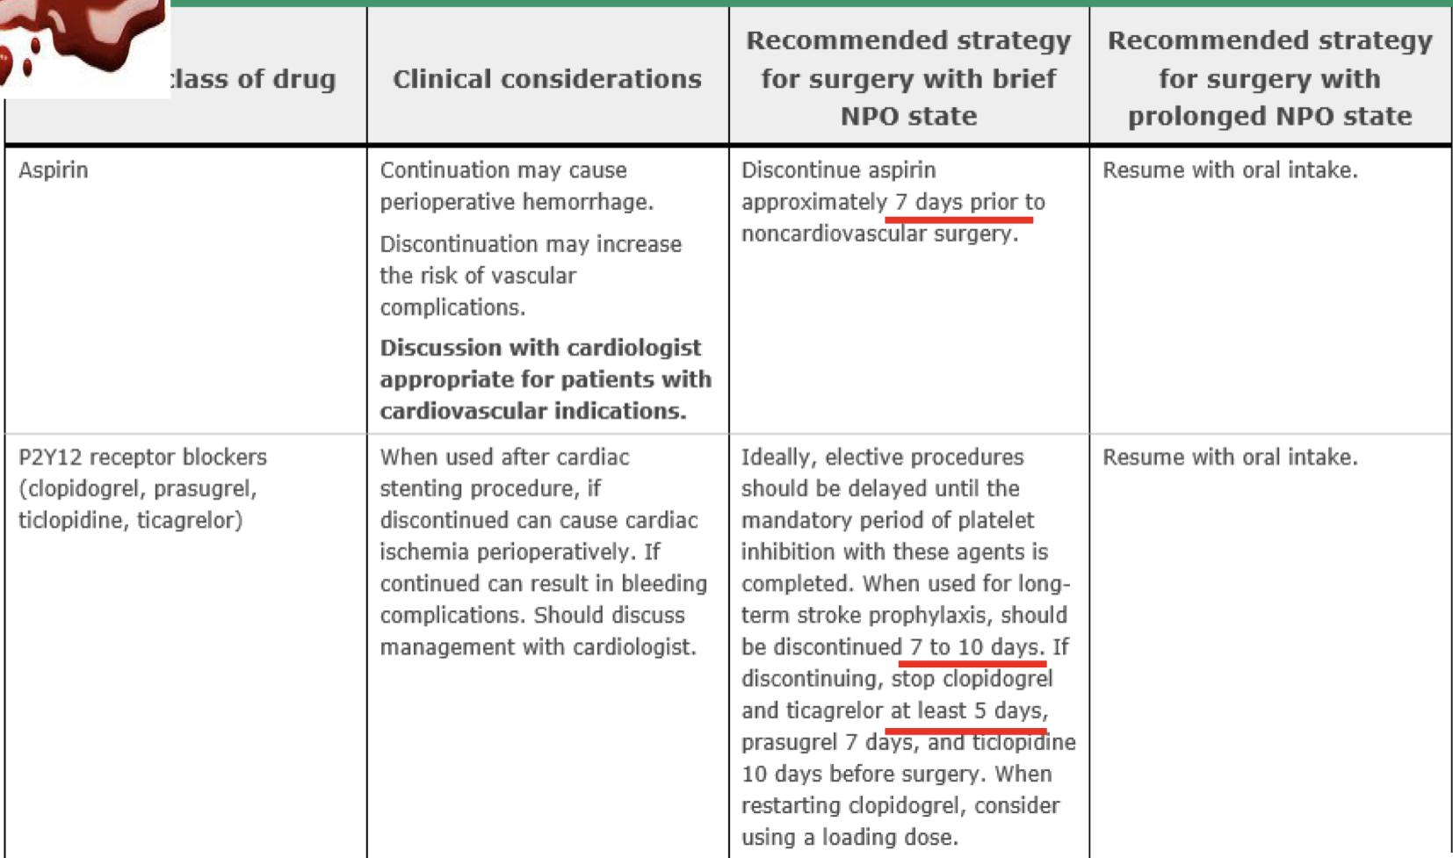
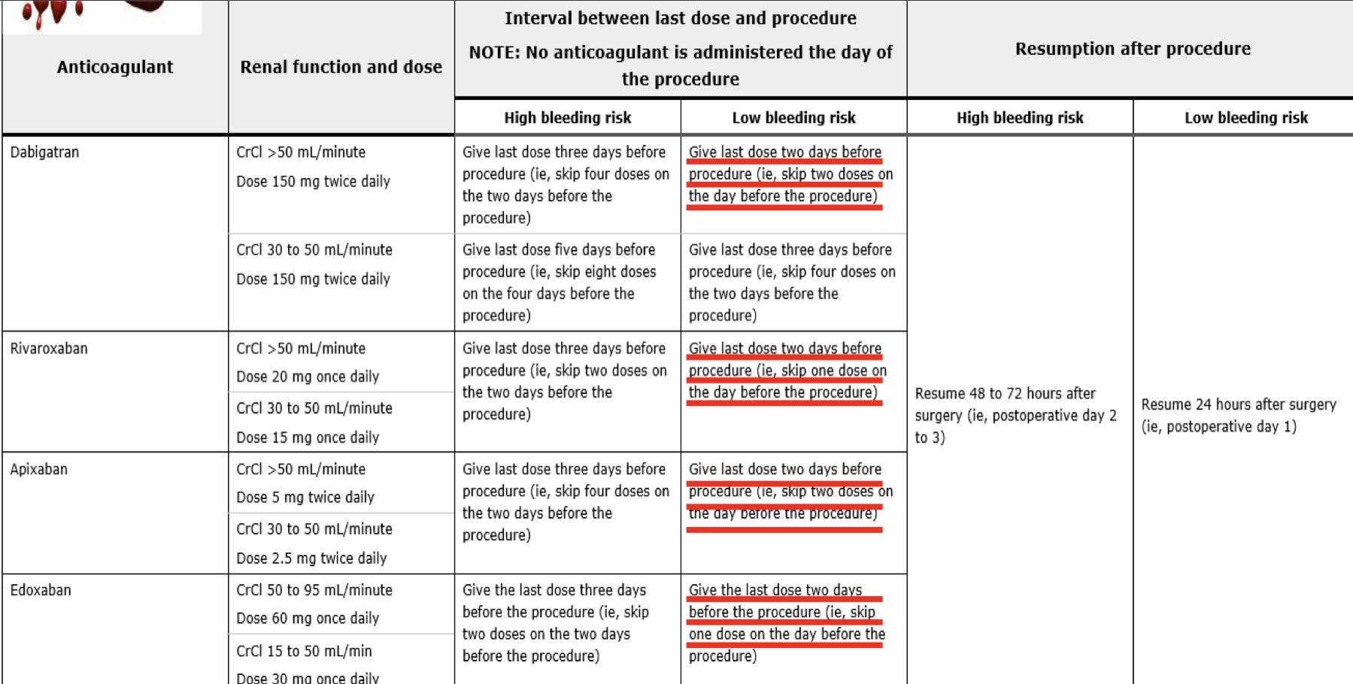
Extra info (from Doctor’s slides)
Preoperative Management of Agents Affecting Hemostasis:
Warfarin:
Typically discontinue 5 days before elective surgery (ie, last dose of warfarin is given on day minus 6).
Check the PT/INR on the day before surgery & If INR is >1.5 >> ?? administer low dose oral vitamin K (1 - 2 mg) to hasten normalization of the PT/INR and recheck the following day.
Proceed with surgery when the INR is ≤ 1.4 (An INR in the normal range is especially important in pts undergoing surgery with high bleeding risk (eg, intracranial, spinal, urologic) or if neuraxial anesthesia is to be used).
Heparin / LMWH Bridging considered >> Pts with very high or high thromboembolic risk.
Heparin:
Generally initiate heparin bridging 3 days before a planned procedure (2 days after stopping warfarin), when the PT/INR has started to drop below therapeutic range.
PRE OP:
LMWH: Discontinue 24 hours before the planned surgery or procedure, based on a biologic half-life of most subcutaneous LMWH of ~ 3-5 hours. If a twice-daily LMWH regimen is given >> evening dose the night before surgery omitted. If a once-daily regimen is given (Dalteparin 200 IUs/kg), ½ of the total daily dose is given on the morning of the day before surgery >> ensures that no significant residual anticoagulant will be present at the time of surgery.
UFH: Therapeutic dose IV infusion continue until 4-5 hours before the procedure, based on the biologic half-life of IV UFH of ~ 45 minutes. If SC UFH is used (dose of ~ 250 IUs/kg BID), the last dose can be given the evening before the procedure.
Post OP:
Resumption of UFH & LMWH is similar, based on the onset of anticoagulation at ~ 1 hour after administration for both forms of heparin (peak anticoagulant activity at ~ 3-5 hours).
The resumption of bridging, especially when given as a therapeutic-dose regimen >> should be delayed until there is adequate hemostasis based on a clinical assessment of the wound site, drainage fluid amount, and expected postoperative bleeding; coupled, where appropriate, with hemoglobin levels >> This assessment will vary depending on the surgery type and individual pt considerations, and it may be difficult for surgery where ongoing bleeding is not readily apparent (eg, cardiac, intracranial).
For Major Surgery or those with a high bleeding risk procedure >> therapeutic-dose UFH or LMWH should be delayed for 48 to 72 hours after hemostasis has been secured.
For Minor Procedures associated with a low bleeding risk in which bridging is used (eg, laparoscopic hernia repair) >> therapeutic-dose UFH or LMWH can usually be resumed 24 hours after the procedure.
Perioperative management of oral direct thrombin inhibitors and factor Xa inhibitors:

Slide 19
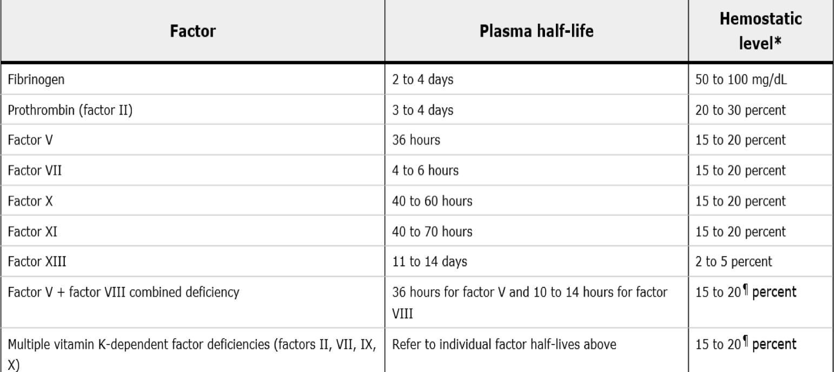
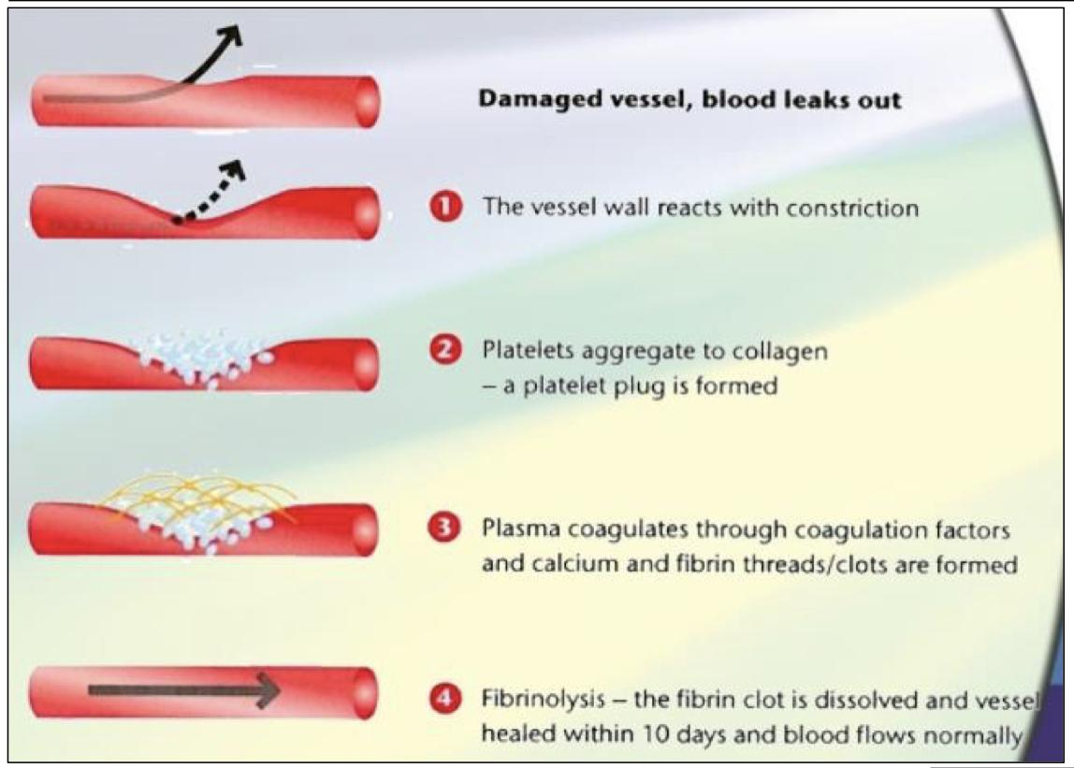
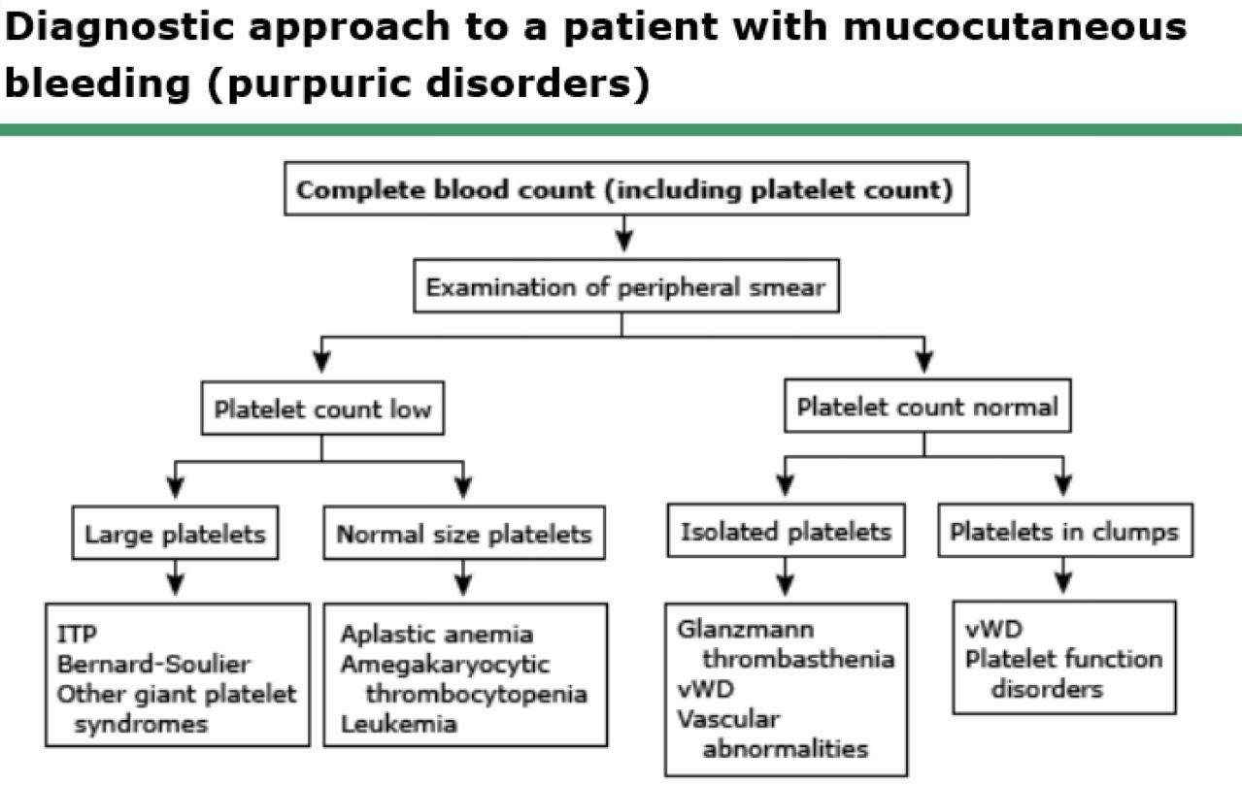
Extra info (from Doctor’s slides)
Coagulation Factor Levels Required For Hemostasis:
Inhibitors:
Antithrombin III
A serine protease inhibitor (serpin) that degrades the serine proteases; (thrombin, IXa, Xa, XIa, XIIa). Constantly active, but its adhesion to these factors is increased by the administration of heparin. Quantitative or qualitative deficiency of antithrombin (in born or acquired) leads to Thrombophilia.
Protein C & Protein S
Activated to PCa by thrombin bound to thrombomodulin (protein on the surface of endothelial cells); then degrades (VIIIa & Va), reducing further thrombin generation. PS acts as cofactor of PC by enhancing binding of PCa to phospholipid surface; both contain gal residues.
Tissue Factor Pathway Inhibitor (TFPI)
Inhibits VIIa-related activation of IX & X after its original initiation.
Hemostatic Phases:
Diagnostic Approach to Platelet Disorders:

Slide 20
Overview of Hemostasis
Hemostasis | The process through which bleeding is controlled.
 | Primary Hemostasis: Endothelium Injury Platelet plug Von Willebrand Factor | Secondary Hemostasis: Clotting Factors Soluble Protein Fibrinogen converted to insoluble Fibrin.
Lab tests | Platelet count (Normal: 150 – 400 x 10⁹). < 100,000 (Thrombocytopenia) 50,000 - 100,000 (Mild): Follow up < 50,000 (Severe): Needs intervention Platelets are produced in the Bone Marrow by fragmentation of the cytoplasm of megakaryocytes. PLT Life Span ( 7 – 10 days).
 | Prothrombin time (PT): Measures the effectiveness of the extrinsic pathway. NORMAL VALUE (10-15 SECS) | Partial Thromboplastin time : Measures Effectiveness of the Intrinsic Pathway. NORMAL VALUE (25-40 SECS)
 | Bleeding time : PROVIDES ASSESSMENT OF PLATELET COUNT AND FUNCTION NORMAL VALUE (2-8 MINUTES) | Thrombin time : A Measure of Fibrinolytic Pathway. NORMAL VALUE 9-13 SECS.
Bleeding disorders
Definition | Bleeding disorders are a group of disorders that share the inability to form a proper blood clot. They are characterized by extended bleeding after injury, surgery, trauma or menstruation.
Primary hemostasis (only) disorders: Characterized by Mucocutaneous bleeding - Petechial rash - Epistaxis - Menorrhagia. Thrombocytopenia? First ask to examine the peripheral blood smear
Disease | Etiology | Diagnosis | Treatment
Quantitative
Immune Thrombocytopenic Purpura (ITP) | - Primary: Isolated thrombocytopenia due to immune platelet destruction (auto AB to megakaryocytes) - Secondary. | Diagnosis of exclusion. CBC (isolated thrombocytopenia) PBS ( large platelet) Antiplatelet antibodies (Anti-GpIIb/IIIa) | No bleeding, count > 50,000: NO treatment - 1st line: Steroids & IVIG - 2nd line: Splenectomy & Rituximab - Refractory: Romiplostim.
Qualitative
Bernard soulier | Autosomal recessive Deficient platelet GPIb-IX | Peripheral smear: Giant platelets ↓ Platelets Abnormal ristocetin cofactor assay
Glanzmann thrombasthenia | Autosomal recessive Deficient platelet GPIIb-IIIa | Normal platelets Abnormal results on platelet aggregation testing confirm the diagnosis.
Secondary or Drug induced | Uremia (Renal disease) drugs: e.g. aspirin or clopidogrel |  | Treat underlying cause Stop the drug.

Slide 21
Bleeding disorders cont.
Secondary hemostasis (only) disorders: Characterized by hematomas, hemarthrosis, bruising, bleeding (mucosal, GI, GU, joint) deep bleeding.
Disease | Etiology | Diagnosis | Treatment
Hemophilia A | - Congenital: Inherited deficiency of factor VIII an X-linked recessive disorder - Secondary: Development of autoantibodies most commonly directed against FVIII (ass. with pregnancy, malignancy, advanced age). | Factor VIII Assay: low. Mixing study (corrected) Normal VWF & PT. | Replacement of the deficient coagulation Factor Desmopressin Antifibrinolytic agents (Tranexamic Acid, Aminocaproic Acid
Hemophilia B | Inherited deficiency of factor IX; also called Christmas Disease; an X-linked recessive disorder. | Factor IX Assay: low Mixing study (corrected) Normal VWF & PT.
Hemophilia C | Inherited deficiency of factor XI ; also called Rosenthal Syndrome; an autosomal recessive disorder (Ashkenazi Jews). | Factor XI Assay: Low Normal PT & PTT
Factor XIII Deficiency |  | Factor XIII Assay: FXIII Deficiency Normal PT & PTT
Baseline factor activity level Severe Hemophilia : defined as <1 % factor activity (<0.01 IU/mL). Moderate Hemophilia : defined as a factor activity level ≥1 % of normal and <5 % of normal ( ≥0.01 - <0.05 IU/mL). Mild Hemophilia : defined as a factor activity level ≥5 % of normal and <40 % of normal (≥0.05 - <0.40 IU/mL).
Disorders not specific to one step of hemostasis. Clinical features: Bleeding of Mucous membranes, skin cuts, post-trauma or postoperative
Disease | Etiology | Diagnosis | Treatment
Von Willebrand Disease | (most common bleeding disorder) Defect of Von Willebrand Factor: Quantitative (type 1 & 3) | Qualitative (type 2) Clinical features: Bleeding of Mucous membranes, skin cuts, post-trauma or postoperative
 | Congenital: Autosomal dominant. Normal function of VWF: - Mediate platelet adhesion. Acquired :rare, caused by autoantibodies | Normal aPTT in (Type 1 & 2). Prolonged aPTT in (Type 2N, 2B, & 3) vWF: Ag. FVIII assay (low in 2N & 3). Plt count (low in 2M). | - Replacement of exogenous vWF concentrate. - Desmopressin - Antifibrinolytic agents (Tranexamic Acid, Aminocaproic Acid
Disseminated Intravascular Coagulation | Trauma Septic shock Malignancy ( esp APML) Major trauma | Prolonged PT and aPTT. decreased fibrinogen. Low plt. High LDH. Low haptoglobin. | - Treat underlying process . - fresh frozen plasma (FFP) - Cryoprecipitate

Slide 22
How to differentiate between bleeding disorders?
Disorder | Platelets | Bleeding time | INR | PT | aPTT | Other:
Thrombocytopenia | ↓ | ↑ | Normal | Normal | Normal | -
Platelet dysfunction (e.g. aspirin therapy or uremia) | Normal | ↑ | Normal | Normal | Normal | -
Extrinsic pathway (e.g. Factor VII def.) | Normal | Normal | ↑ | ↑ | Normal | Specific factor assay: Low Mixing study: correctable
Intrinsic pathway (e.g. Hemophilia A, B & heparin therapy). | Normal | Normal | Normal | Normal | ↑ | -
Von Willebrand disease (vWD) | Normal | ↑ | Normal | Normal | Normal/ ↑ | vWF assay: low (dominant) FVIII assay (low)
Disseminated intravascular coagulation (DIC) | ↓ | ↑ | ↑ | ↑ | ↑ | -

Slide 23
Answer 1: The answer is c. This patient has thrombotic thrombocytopenic purpura (TTP). TTP is an acute life-threatening disorder that is characterized by the pentad of microangiopathichemolytic anemia, nonimmune thrombocytopenia, fever, renal insufficiency, and CNS involvement (confusion or multifocal encephalopathy). Not all patients have the full pentad; the essential features are the red blood cell fragmentation (schistocytes and helmet cells) and the thrombocytopenia. TTP may be triggered by endothelial damage and is associated with deficiency of a plasma protein (ADAMTS 13) that breaks down multimers of von Willebrand factor. Plasma exchange (with the infusion of fresh frozen plasma to provide the missing ADAMTS 13 protein) can be lifesaving. The hemolytic uremic syndrome (HUS), often associated with Shigatoxin-producing strains of E coli O157:H7), is similar but is usually not accompanied by CNS changes. The renal failure is usually more severe in HUS. Disseminated intravascular coagulation (DIC) associated with sepsis can resemble TTP, but the coagulation pathway is usually activated in DIC. In TTP the prothrombin time, PTT, and fibrinogen level are normal. Antiplatelet antibodies are associated with idiopathic thrombocytopenic purpura (ITP), but this patient has multiple abnormalities, not just thrombocytopenia. Hypersplenism can cause thrombocytopenia but rarely with a platelet count of below 50,000; it is not associated with red cell fragmentation
Answer 2: The answer is c. This woman’s lifelong history of excessive bleeding suggests an inherited bleeding problem, as does the positive family history. The prolonged PTT indicates a deficiency of factors VIII, IX, XI, or XII, but the commonest of these deficiencies (classic hemophilia A and Christmas disease, or hemophilia B) are vanishingly rare in women. Furthermore, the continued oozing from dental sites and the absence of ecchymoses or hemarthroses suggest a platelet function disorder, as does the prolonged bleeding time. Von Willebrand disease is an autosomal dominant condition that leads to both platelet and factor VIII dysfunction and is the likeliest diagnosis in this patient. Although factor VIII concentrates can be used for life-threatening bleeding, most will respond to desmopressin, which raises the von Willebrand factor level in the most common form (the so-called type 1 form) of this disease. Mild von Willebrand disease is fairly common (1 in 250 individuals). Fresh frozen plasma and whole blood are much less effective ways to deliver factor VIII. Platelet transfusion would not be as effective as correction of the von Willebrand factor level.
Answer 3 : The answer is c. Rifampin induces the cyto-chrome P450 that metabolizes warfarin; higher doses of warfarin are required to overcome this effect. When rifampin is stopped, the dose of warfarin necessary to produce a therapeutic prothrombin time will decrease. Barbiturates also accelerate the metabolism of warfarin. Many drugs interfere with the metabolism and clearance of warfarin. Drugs such as nonsteroidal anti-inflammatories can compete with warfarin for albumin-binding sites and will lead to an increased prothrombin time. The list of medications that can either increase or decrease the effect of warfarin is long; all patients given this drug should be advised to contact their physician before taking any new drug. They should also be counseled about over-the-counter drugs (aspirin and NSAIDs) and even health food supplements (such as ginkgo biloba) which can affect the prothrombin time in these patients. A stable intake of vitamin K–containing foods (ie, green leafy vegetables) is recommended.
Answer 4: The answer is b. This patient with gram-negative bacteremia has developed disseminated intravascular coagulation (DIC), as evidenced by multiple-site bleeding, thrombocytopenia, fragmented red blood cells on peripheral smear, prolonged PT and PTT, and reduced fibrinogen levels from depletion of coagulation proteins. Initial treatment is directed at correcting the underlying disorder—in this case, infection. Although heparin was formerly recommended for the treatment of DIC, it is now used rarely and only in unusual circumstances (such as acute promyelocyticleukemia). For the patient who continues to bleed, supplementation of platelets and clotting factors (with fresh frozen plasma or cryoprecipitate) may help control life- threatening bleeding. Red cell fragmentation and low platelet count can be seen in microangiopathic disorders such as thrombotic thrombocytopenic purpura (TTP), but in these disorders the coagulation pathway is not activated. Therefore, in TTP the prothrombin time, partial thromboplastin time, and plasma fibrinogen levels will be normal. Plasmapheresis, vitamin K therapy, and RBC transfusion will not correct the underlying cause.
Q1:A 38-year-old woman presents with a 3-day history of fever and confusion. She was previously healthy and is taking no medications. She has not had diarrhea or rectal bleeding. She has a temperature of 38°C (100.4°F) and a blood pressure of 145/85. Splenomegaly is absent. She has no petechiae but does have evidence of early digital gangrene of the right second finger. Except for confusion the neurological examination is normal. Her laboratory studies reveal the following: Hemoglobin: 8.7 g/dL, Platelet count: 25,000/μL ,Peripheral smear: numerous fragmented RBCs, few platelets, LDH 562 IU/L(normal < 180), Creatinine: 2.7 mg/dL, Liver enzymes: normal, Prothrombin time/PTT/fibrinogen levels: normal. What is the most likely pathogenesis of her condition?
A- Disseminated intravascular coagulation
B- Antiplatelet antibodies
C- Failure to cleave von Willebrand factor multimers
D- Verotoxin-induced endothelial damage
Q2:A 25-year-old woman complains of persistent bleeding for 5 days after a dental extraction. She has noticed easy bruisability since childhood, and was given a blood transfusion at age 17 because of prolonged bleeding after an apparently minor cut. She denies ecchymoses or bleeding into joints. Her father has noticed similar symptoms but has not sought medical care. Physical examination is normal except for mild oozing from the dental site. She does not have splenomegaly or enlarged lymph nodes. Her CBC is normal, with a platelet count of 230,000. Her prothrombin time is normal, but the partial thromboplastin time is mildly prolonged. The bleeding time is 12 minutes (normal 3-9 minutes).
What is most appropriate way to control her bleeding?
A- Factor VIII concentrate
B- Fresh frozen plasma
C- Desmopressin (DDAVP)
D- Whole blood transfusion e. Single donor platelets
Q3: A patient with bacterial endocarditis develops thrombophlebitis while hospitalized. His course in the hospital is uncomplicated. On discharge he is treated with penicillin, rifampin, and warfarin. Therapeutic prothrombin levels are obtained on 15 mg/d of warfarin. After 2 weeks, the penicillin and rifampin are discontinued. Which of the following is the best next step in management of this patient?
A- Cautiously increase warfarin dosage.
B- Continue warfarin at 15 mg/d for about 6 months.
C- Reduce warfarin dosage.
D- Stop warfarin therapy.
Q4:A 70-year-old intensive care unit patient complains of fever and shaking chills. The patient develops hypotension, and blood cultures are positive for gram-negative bacilli. The patient begins bleeding from venipuncture sites and around his Foley catheter. Laboratory studies are as follows: Hct: 38% WBC: 15,000/μL Platelet count: 40,000/μL (normal 150,000-400,000) Peripheral blood smear: fragmented RBCs PT: elevated PTT: elevated Plasma fibrinogen: 70 mg/dL (normal 200-400). Which of the following is the best course of therapy in this patient?
A- Begin heparin.
B- Treat underlying disease.
C- Begin plasmapheresis.
D-Begin red blood cell transfusion
Answers: Q1:C | Q2:C | Q3:C | Q4:B
Answers Explanation File!

Slide 24
THANKS!!
This lecture was done by:
Rawan Albayyat
Quiz and summary maker:
Maysoon Al-Tameem
Mohammed Alhumud
Note taker:
Rawan Albayyat
Mashal AbaAlkhail
Special thanks to..
Abeer almutairi
Haifa Alwaily
Nouf Alhumaidi
Females co-leaders:
Raghad AlKhashan
Amirah Aldakhilallah
Males co-leaders:
Mashal AbaAlkhail
Nawaf Albhijan
Send us your feedback:
We are all ears!

