Slide 1
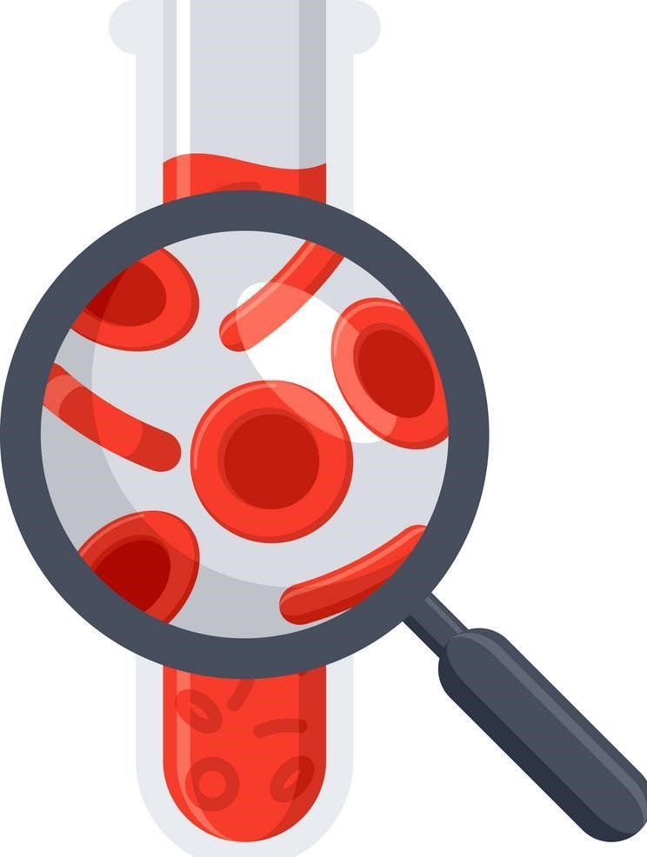
Lecture 69
Editing file
Acute & Chronic Leukemia
Objectives:
Identify the age and gender distribution of patients with ALL.
Name common symptoms/signs and common laboratory findings in a patient presenting with Acute/Chronic leukemia mentioning different types of each
Briefly describe two tests that can be used to distinguish leukemic blast cells of ALL from leukemic blast cells of AML.
Therapy of ALL commonly consists of an induction phase, postremission therapy (consolidation and maintenance therapy), and central nervous system prophylaxis. Describe the goals of each of these three elements of therapy.
Describe one complication that leads to mortality in leukemia.
Color index:
Color index:
Original text Females slides Males slides
Doctor’s notes Textbook Important Golden notes Extra

Slide 2
بسم الله الرحمن الرحيم
هذا العمل صدقةً جارية عن أخواتنا مي بابعير ونجود المطيري - رحمهما الله-
اللهم اغفر لهن وأرحمهم وعافهن واعف عنهن وأكرم نزلهن ووسع مدخلهن واغسلهن بالماء والثلج والبرد
اللهم إنهن في ذمتك وحبل جوارك فأعذهن من فتنة القبر وعذاب النار واجمعنا بهم في الفردوس الأعلى يا أرحم الراحمين
ربي أسألك أن تظلهم تحت ظلك، وأسألك أن تطيب ثراهم وأن تكرم منزلتهم ومثواهم، وأن تسكنهم الجنة وتجعلها سكنًا لهم ومأواهم
اللهم كما طيبت ذكرهم في أرضك بين خلقك ،طيب ذكرهم في سمائك بين ملائكتك، وارحمهم واغفر لهم وانظر إليهم بعين لطفك وكرمك يا أرحم الراحمين
اللهم اجعل قبورهن رياضًا من رياض جنتك
اللهم املأ قبورهن بالرضا والنور والفسحة والسرور
اللهم اجزهن عن الإحسان إحسانًا وعن الإساءة عفوًا وعرفانا
اللهم ادخلهن الجنة بلا حساب ولا سابقة عذاب.
اللهم أنزلهن منازل الصديقين والشهداء والصالحين.
The best logo ever was done by May Babaeer.. whenever you look at it don’t forget to pray for them.

Slide 3
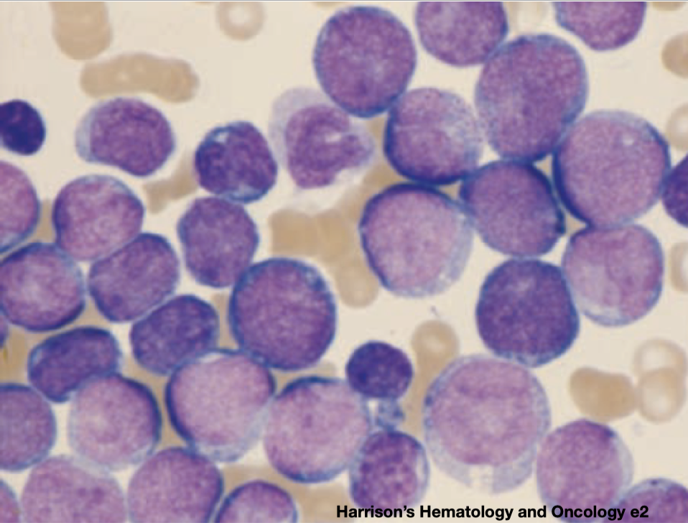
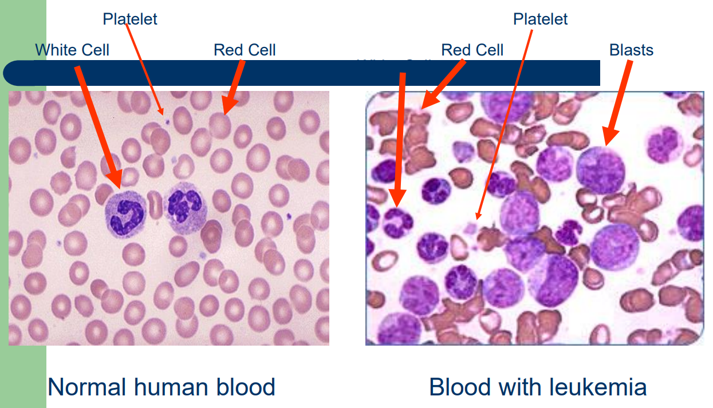
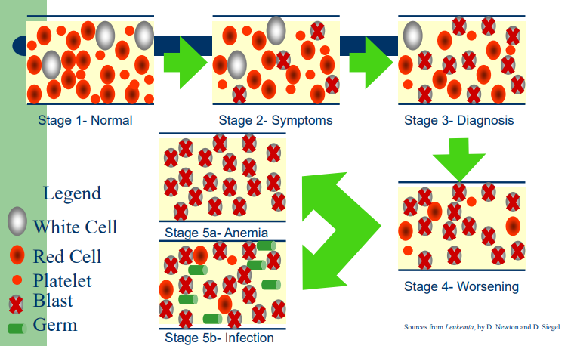
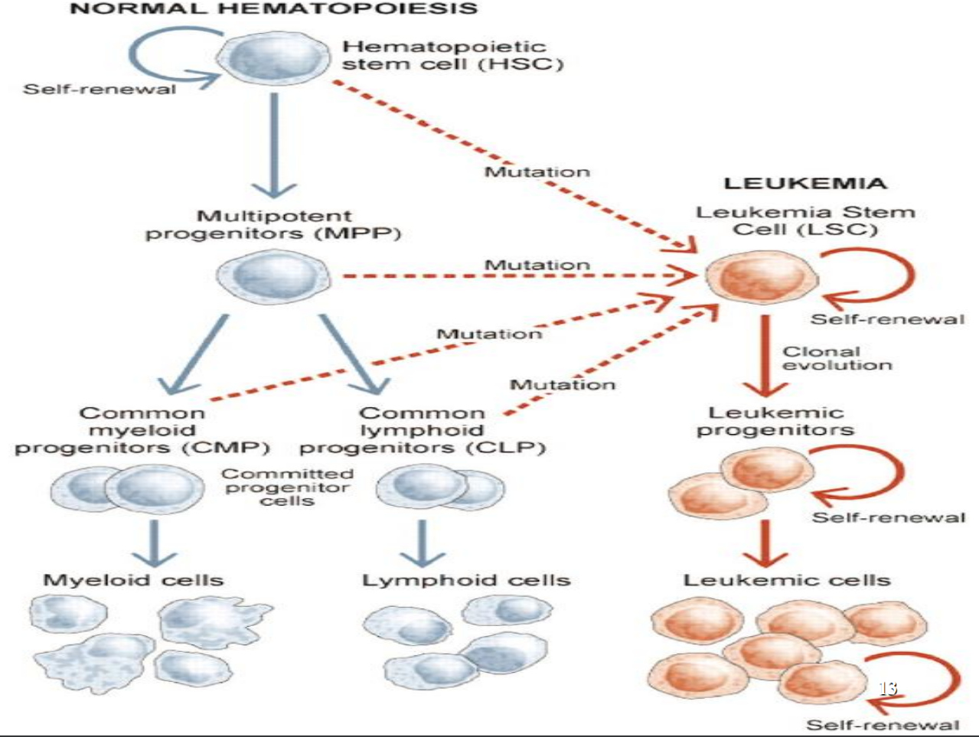
Introduction
Leukemia
A group of malignant disorders affecting the blood and blood forming tissues (Bone marrow, Lymph system, Spleen)
Results in an accumulation of dysfunctional cells because of a loss of regulation in cell division
Occurs in all age groups, Fatal if untreated (progressive).
Acute Leukemias carry high mortality but CURABLE.
Chronic Leukemias are carry lower mortality but they are INCURABLE. (This has changed nowadays)
Acute leukemias arise from the early stages of hematopoietic diﬀerentiation (Immature cells)
Chronic leukemias arise from late stages of diﬀerentiation (Mature cells)
Etiology and Pathophysiology
No single causative agent
Most from a combination of factors
Genetic and environmental influences
Associated with the development of leukemia:
Chemical agents, Chemotherapeutic agents, Viruses, Radiation, Immunologic deficiencies.
Development of Leukemia in the Bloodstream
Two-hit model of leukemogenesis
Mutation here leads to Myeloid leukemia
Mutation here leads to lymphoid leukemia
Loss of function of transcription factors needed for differentiation eg.( AML1-ETO, CBFb-SMMHC, PML-RARa “AML-M3”)
Gain of function mutations of tyrosine kinases eg. (FLT3, c-KIT mutations with myeloid leukemia, N- and K-RAS mutations, BCR-ABL“with CML”,
TEL-PDGFbR“in Acute leukemia”)
Differentiation block
Enhanced proliferation
Acute Leukemia
Clinical Manifestations
Relate to problems caused by:
Bone marrow failure | Leukemic cells infiltrate patient’s organs
Overcrowding by abnormal cells Inadequate production of normal marrow elements Anemia, thrombocytopenia, ↓ number and function of WBCs, pancytopenia | Splenomegaly Hepatomegaly Lymphadenopathy Bone pain, meningeal irritation, oral lesions (chloromas)
Diagnostic Studies
1) To diagnose and classify:
Peripheral blood evaluation (CBC and blood smear)
Bone marrow evaluation
2) To identify cell subtype and stage:
Morphologic, histochemical, immunologic, and cytogenic methods (each Leukemia has its genetic driven mutation. ex: Philadelphia chromosome in CML,PML-RARa in AML-M3)

Slide 4
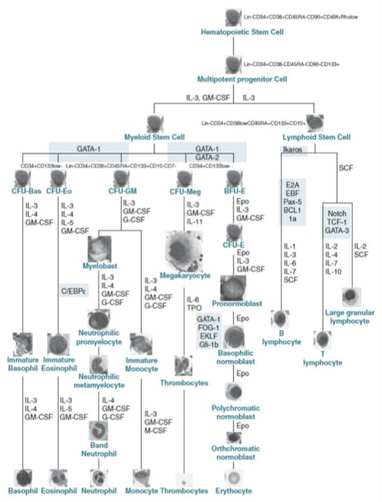
Classification of leukemias
Classification of leukemias
Acute leukemias
Chronic leukemias
Acute lymphoblastic leukemia (ALL)
Acute myelogenous leukemia (AML)
(also "myeloid" or "nonlymphocytic")
Chronic lymphocytic leukemia (CLL)
Chronic myeloid leukemia (CML)
All this tree occurs in the bone marrow. In adults، most of the active bone marrow is in the pelvic bone, hence why bone aspirates are usually taken from there.
In acute leukaemia, there is proliferation of primitive stem cells, with limited accompanying differentiation, leading to an accumulation of blasts, predominantly in the bone marrow, which causes bone marrow failure. In chronic leukaemia, the malignant clone is able to differentiate, resulting in an accumulation of more mature cells. Lymphocytic and lymphoblastic cells are those derived from the lymphoid stem cell (B cells and T cells). Myeloid refers to the other lineages: that is, precursors of red cells, granulocytes, monocytes and platelets
In acute leukemias the cells are undifferentiated so they are not functioning, unlike chronic leukemias in which there’s some degree of maturation (Hence why chronic leukemias have lower mortality than acute leukemias). Clinically, acute leukemias have a more aggressive course and pts develop symptoms rapidly (Within a month) unlike chronic leukemias where they usually develop symptoms over years.
Mutations here result in AML
Mutations here result in ALL
Mutations here result in APL (Subtype of AML)
Mutations here result in CML
Mutations here result in CLL
All this tree occurs in the bone marrow. In adults، most of the active bone marrow is in the pelvic bone, hence why bone aspirates are usually taken from there.
In acute leukaemia, there is proliferation of primitive stem cells, with limited accompanying differentiation, leading to an accumulation of blasts, predominantly in the bone marrow, which causes bone marrow failure.
In chronic leukaemia, the malignant clone is able to differentiate, resulting in an accumulation of more mature cells.
Lymphocytic and lymphoblastic cells are those derived from the lymphoid stem cell (B cells and T cells). Myeloid refers to the other lineages: that is, precursors of red cells, granulocytes, monocytes and platelets
In acute leukemias the cells are undifferentiated so they are not functioning, unlike chronic leukemias in which there’s some degree of maturation (Hence why chronic leukemias have lower mortality than acute leukemias). Clinically, acute leukemias have a more aggressive course and pts develop symptoms rapidly (Within a month) unlike chronic leukemias where they usually develop symptoms over years.
Acute versus chronic
Cell maturity
Acute: Clonal proliferation of immature hematopoietic cells (the formation of blood or blood cells ) | Chronic: mature forms of WBC; onset is more gradual so it's not an emergency like acute Leukemia
Nature of disease onset
Acute: Poorly differentiated blast population Rapidly fatal outcome, if untreated | Chronic: Well differentiated cell population Associated with longer survival, even if left untreated

Slide 5
Overview on leukemia treatment
This is just a general overview. Specific treatments will be discussed within the lecture
Treatment
Collaborative Care:
Goal is to attain remission (when there is no longer evidence of cancer cells in the body)
Combination Chemotherapy:
Mainstay treatment
3 purposes
↓ drug resistance
↓ drug toxicity to the patient by using multiple drugs with varying toxicities
Interrupt cell growth at multiple points in the cell cycle
1
Chemotherapy (Induction Therapy)
Attempt to induce or bring remission
Seeks to destroy leukemic cells in the tissues, peripheral blood, bone marrow
Patient may become critically ill (Provide psychological support as well), severe depression especially in children
what is remission:
The main aim of treatment for acute lymphoblastic leukaemia is to give a remission. This means that the abnormal, immature white cells or blasts can no longer be detected in the blood or bone marrow, and normal bone marrow has developed again.
For many people with acute lymphoblastic leukaemia the remission lasts indefinitely and the person is said to be cured.
2
Chemotherapy (Intensification therapy)
High-dose therapy
May be given after induction therapy. After CR1 “complete remission no.1”
Same drugs at higher doses and/or other drugs
3
Chemotherapy (Consolidation therapy)
Started after remission is achieved
Purpose is to eliminate remaining leukemic cells “you might have hidden cells anywhere in the body” that may not be evident
4
Chemotherapy (Maintenance therapy)
Lower doses of the same drug for 2 years (orally)
Bone Marrow and Stem Cell Transplantation: for Aggressive Leukemia: not responding to chemotherapy or response then relapse or Leukemia with poor prognosis.
First: The goal is to totally eliminate leukemic cells from the body using combinations of chemotherapy with or without total body irradiation
and then Eradicates patient’s hematopoietic stem cells
lastly Replaced with those of an HLA-matched (Human Leukocyte Antigen)
Sibling (is a brother or a sister; that is, any person who shares at least one of the same parents)
Volunteer
Identical twin
Patient’s own stem cells removed before

Slide 6
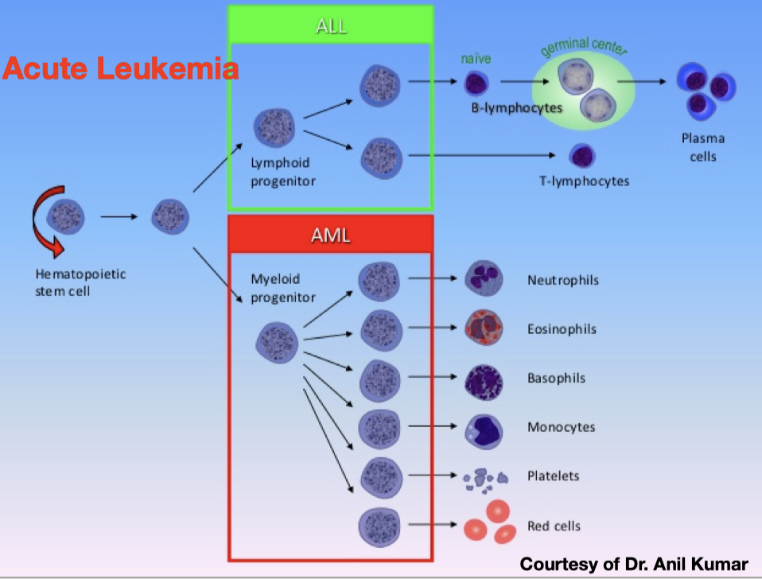
Leukemia Overview
Classification of acute leukemias
Acute Lymphocytic Leukemia (ALL) | Acute Myelogenous Leukemia (AML)
Mainly children | Mainly adults
M > F | M > F
Curable in 70% of children | -
Curable in minority of adults | Curable in minority of adults
1
Myeloid tissue
2
Granulocytes
Acute lymphoblastic Leukemia (ALL)
75%
B-ALL
Biologic tissue with the ability to perform hematopoiesis. It is mainly found as the red bone marrow in bones, and is often synonymous with this. However, myeloid can also be present in the liver and spleen
Category of white blood cells characterized by the presence of granules in their cytoplasm.
They are also called polymorphonuclear leukocytes (PMN or PML) because of the varying shapes of the nucleus, which is usually lobed into three segments.
10%
25%
T-ALL
Acute Leukemia
Ambigous Leukemia
(1-2%)
This is in adults, while in children it’s the opposite, 90% of leukemias in children are ALL
3
Myelocyte
4
Myeloblast
90%
Acute Myeloid Leukemia (AML)
APL
Young cell of the granulocytic series, occurring normally in bone marrow, but not in circulating blood (except when caused by certain diseases).
Unipotent stem cell, which will differentiate into one of the actors of the granular series.
Myelogenous Leukemia
1
Myeloid tissue
2
Granulocytes
Biologic tissue with the ability to perform hematopoiesis. It is mainly found as the red bone marrow in bones, and is often synonymous with this. However, myeloid can also be present in the liver and spleen
Category of white blood cells characterized by the presence of granules in their cytoplasm.
They are also called polymorphonuclear leukocytes (PMN or PML) because of the varying shapes of the nucleus, which is usually lobed into three segments.
3
Myelocyte
4
Myeloblast
Young cell of the granulocytic series, occurring normally in bone marrow, but not in circulating blood, if found in peripheral blood it's Leukemia (except when caused by certain diseases).
Unipotent stem cell “it has the ability to highly proliferate”, which will differentiate -Malignant differentiation- into one of the actors of the granular series.

Slide 7
Acute Myelogenous Leukemia (AML)
Acute Myelogenous Leukemia (AML) Cont’
Introduction
Heterogeneous group of diseases characterized by uncontrolled proliferation of myeloid progenitor cells (Blasts) that gradually replace normal hematopoiesis in the bone marrow.
Leukemia characterized by proliferation of myeloid tissue (as of the bone marrow and spleen) and an abnormal increase in the number of granulocytes, myelocytes, and myeloblasts in the circulating blood.
One fourth of all leukemias and (85%) (90%) of the acute leukemias in adults, rare in children. 20,000 new cases in the US/year.
Abrupt, dramatic onset (Serious infections due to pancytopenia “granulocytes is the first line of defense”, abnormal bleeding due to thrombocytopenia).
Uncontrolled proliferation of myeloblasts (Hyperplasia of bone marrow and spleen).
Median age of onset ~71.
Risk Factors: Cytotoxic chemo, Radiation, Benzene.
Predisposing conditions: Trisomy 21, Rare congenital syndromes: Severe congenital neutropenia, Shwachman-Diamond syndrome, falconi anemia, Li-Fraumeni, Klineﬁlter, Noonan Syndrome.
Pathophysiology
↑Blasts in BM & circulation
↓ Neut/Hgb/Plt (BM failure)
- Infection (↓WBCs)
- Bleeding (↓plt)
- Fatigue (↓ Hgb)
- Organ infiltration
Presentation
Due to BM failure
↓ Hematopoiesis
Tissue involvement
Rare Manifestations
Fatigue, SOB, Fever, Bleeding
Anemia with a normal or raised MCV.
Bone pain, splenomegaly (20-30%)
Gingival hyperplasia (Characteristic of AML-M5, aka acute monocytic leukemia)
CNS symptoms, visual symptoms.
Sweet syndrome
Chloroma (Myeloid sarcoma)
Extreme presentations
Leukostasis: risk if WBC >50k. Hypoperfusion/vascular occlusion. SOB/MI/CVA. Tx: IVF, cytoreduction (chemo, HU, leukopheresis).
Coagulopathy/DIC: Mainly in APL but can occur in any AML
Tumor lysis syndrome (TLS): More common in ALL, Ppx IVF allopurinol.
CNS involvement: 2-3% (RF WBC). No LP before CR

Slide 8
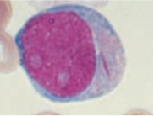
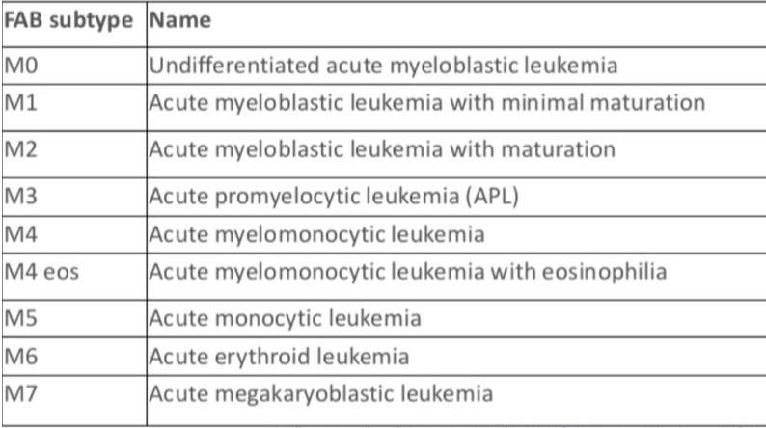
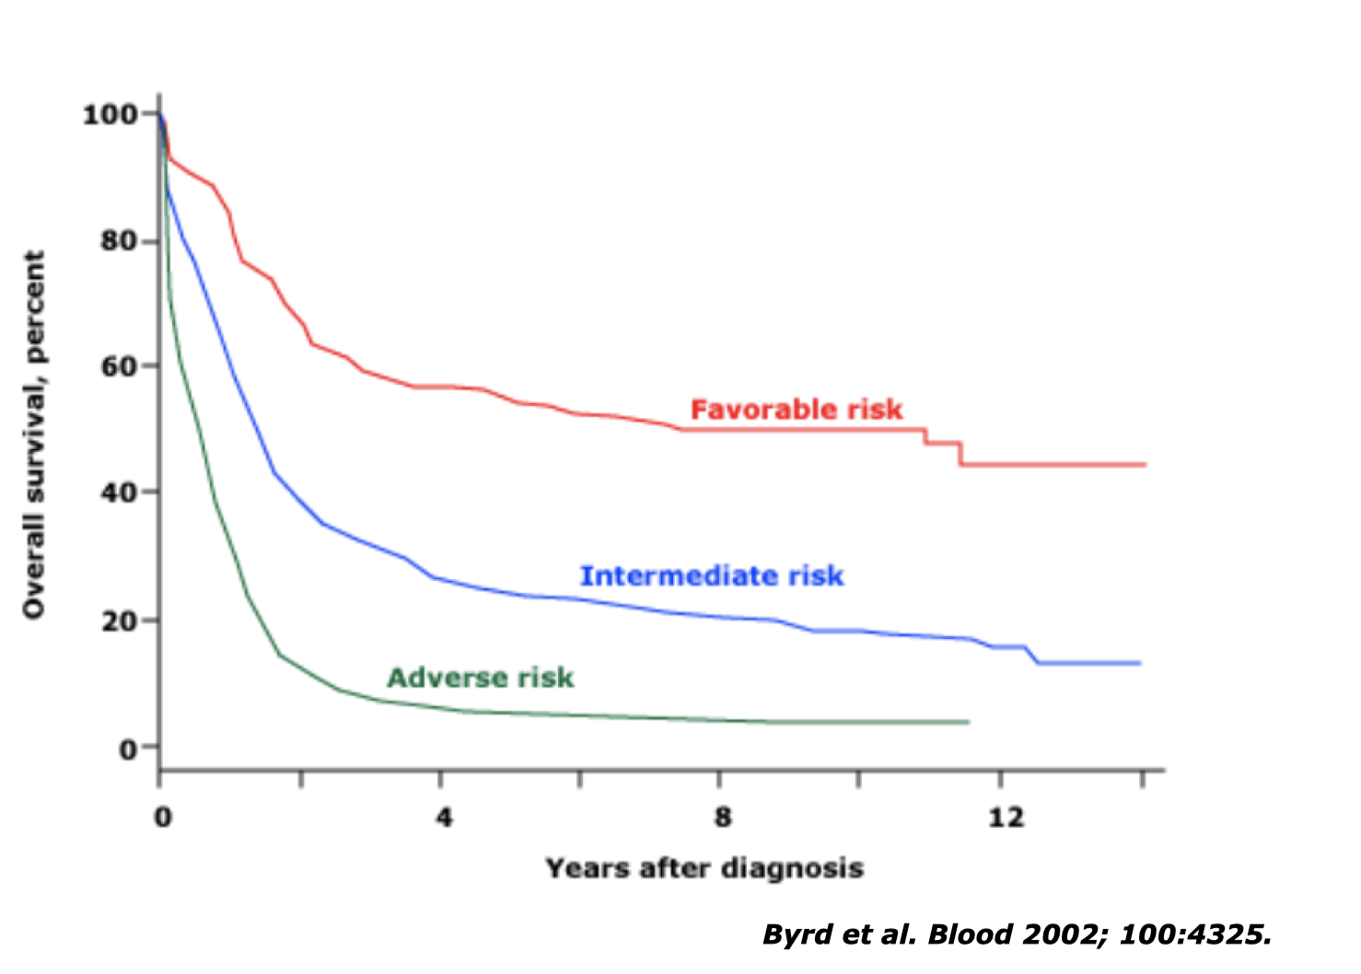
Acute Myelogenous Leukemia (AML) cont.
Diagnosis
Most patients present pancytopenia w/circulating blasts
~50% of patients will have ↓ or normal WBC.
20% of patients will have WBC >100k/micro L
Is it a an Acute Leukemia?
You just need >20% Myeloblasts (immature blood cells) in peripheral blood or Bone marrow. Make sure they are blasts either by morphology (Auer rods) or phenotyping with flowcytometry, IHC, cytochemical (MPO). Or by detecting certain cytogenetic abnormalities t(8,21), Inv(16), t(16,16), t(15,17)
What kind of an acute leukemia?
ALL Vs AML Vs Weird Leukemia
PHENOTYPE! Flow cytometry, IHC, cytochemical.
Genetics can help (cytogenetics, molecular studies)
Common myeloid Ag: CD13, CD33, CD34, CD117, MPO.
WHY DO YOU WANT TO KNOW WHAT KIND OF ACUTE LEUKEMIA?
Because treatment differs
Best initial test (for both ALL and AML): CBC with smear showing blast cells.
Most accurate test (for both ALL and AML): Bone marrow biopsy with flow cytometry to classify leukemia type.
Auer rods deriving from the crystallisation of myeloperoxidase (MPO) granules are the hallmark of Acute Myeloid Leukemia (AML). Auer rods are NOT seen in ALL.
Are there different types of AML?
Classiﬁcation changed over the decades. (OLD)
FAB relies on morphology to Identifying the lineage of the blast: Myeloblast, Monoblast, Erythroblast, megakaryoblast, promyelocyte) and the degree of diﬀerentiation
Prognosis
What’s the difference between prognostic factors and predictors? Prognosis is dependent on the characteristics of the disease and patient factors. Whereas predictors are dependent on the type of treatment.
Typically fatal in weeks-months if untreated.
Independent poor risk factors:
Age: >60 especially >75 for both disease and host factors
PS: Poor performance status ECOG >2
Treatment related AML, if proceeded with hematologic disorder (MDS, MPN)
The best pretreatment predictors of long-term outcome, together with age, are chromosomal and molecular genetic ﬁndings in leukemic cells.
CALGB Risk groups
>50% of pts will be alive after 12yrs
>20% of pts will be alive after 10yrs

Slide 9
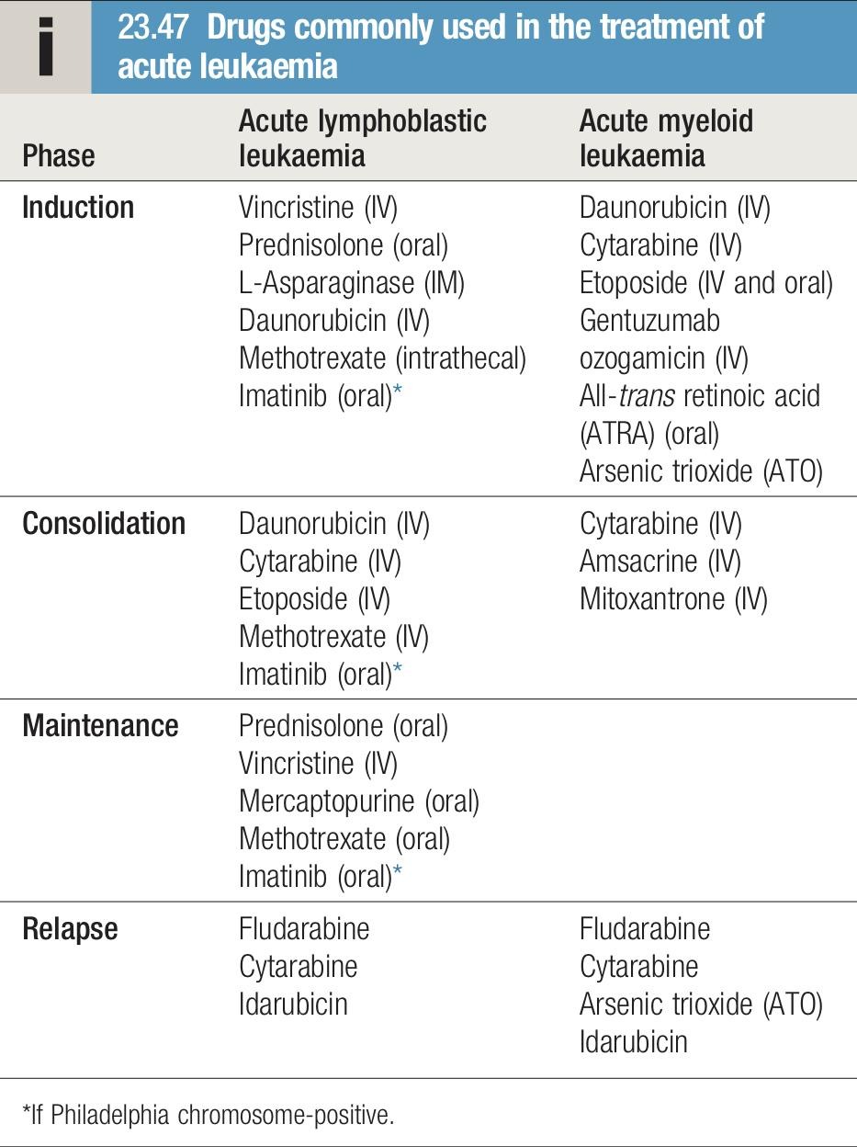
Acute Myelogenous Leukemia (AML) cont.
Treatment paradigm
Induction
Day 14 BM
Remission
Consolidation
In this phase, a fraction of the tumour is destroyed by combination chemotherapy. The patient goes through a period of severe bone marrow hypoplasia lasting 3–4 weeks and requires intensive support
BM day 30 or after count recovery
If remission has been achieved, residual disease is attacked by therapy during the consolidation phase.
Induction:
Goal: is to achieve remission deﬁned < 5% blasts in a BM that is 20% or more cellular, absent extramedullary leukemia, a neutrophil count greater than 1,000/μL, and a platelet count greater than 100,000/μL. (deﬁnition est 60 y ago)
To prevent tumor lysis syndrome (hyperuricemia, hyperkalemia, hypocalcemia, renal insufficiency, as blasts are destroyed by chemotherapy), patients should be well hydrated.
AML induction is similar across all AML-risk groups
Consolidation or “post remission” therapy
Goal: Long term remission and CURE.
All patients relapse if they don’t receive consolidation.
Common Induction regimens:
7+3: Cytarabine 100 to 200 mg/ m2 by continuous intravenous (IV) infusion over 7 days with 3 days of an anthracycline (e.g., daunorubicin 60 to 90 mg/ m2 or idarubicin 12 mg/ m2). (7+3 regimen is the one use in most centers)
FLAG-IDA: Fludarabine, Cytarabine, GCS-F Idarubicin.
~ 70-80% of younger pts (<60 y) & ~40-50% of older pts (>60 y) will achieve CR w/ Induction chemo. CR Correlates with Survival
Consolidation (post remission tx):
Depends on risk group
Favorable | Intermediate | Poor
High dose Cytarabine (HDAC) x 2-4 cycles | HDAC 2-4 cycles OR Allogeneic stem cell transplant | Allogeneic stem cell transplant
I know you have no time for notes but i don’t know what to write here..

Slide 10
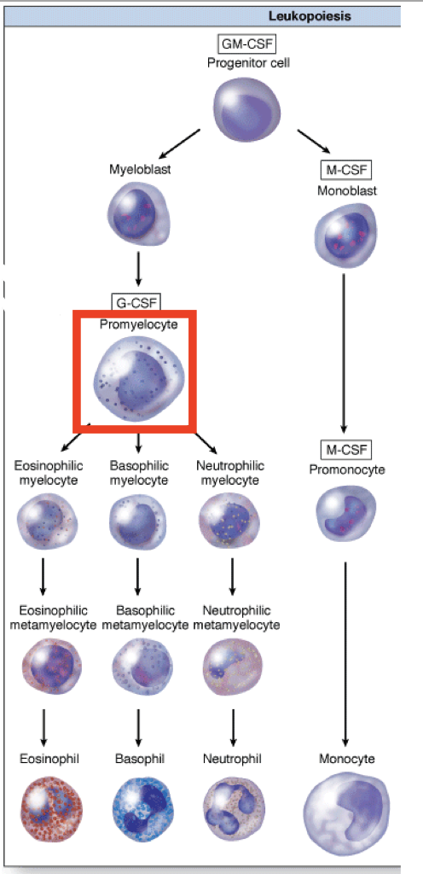
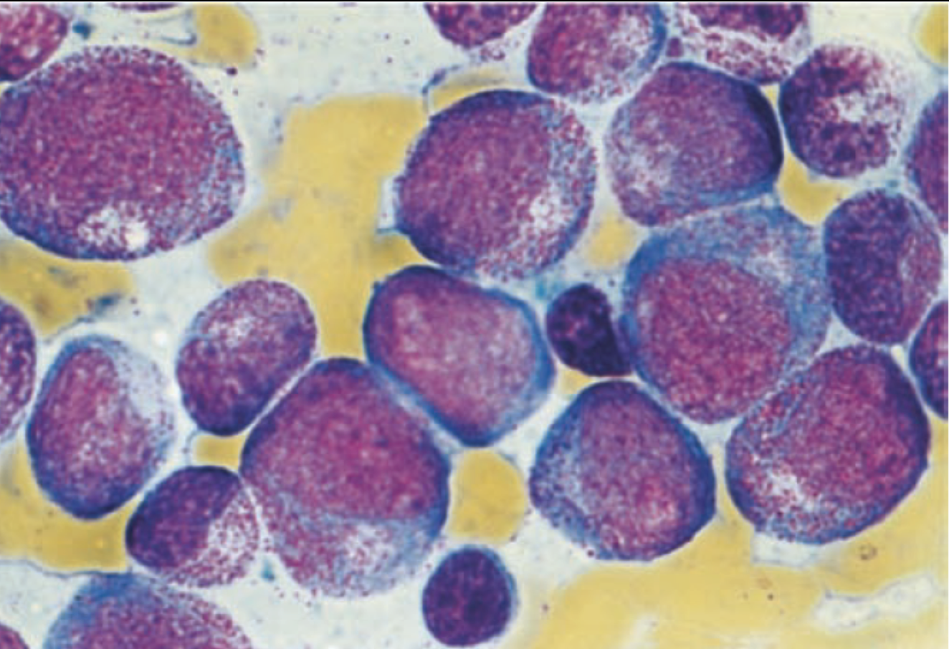
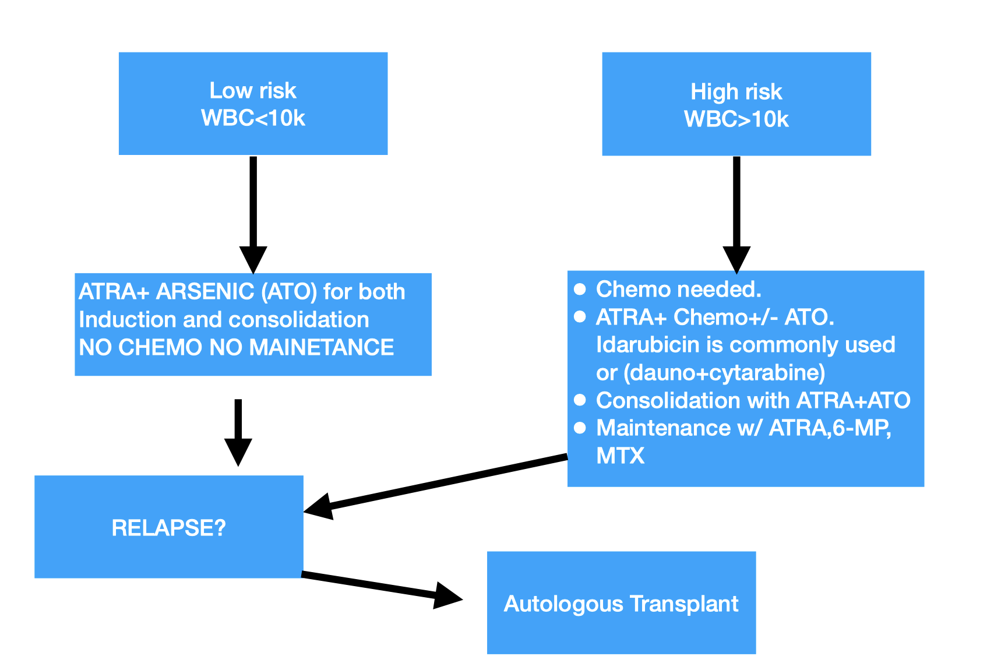
Acute Promyelocytic Leukemia (APL)
Why APL is an important AML subgroup?
Because cure rate is >90% and mortality usually occur early in the course of the disease due to coagulopathy which can be mitigated by early initiation of ATRA. So, prompt diagnosis can save a lot of patients. Diagnosis is also fairly straight forward, by identifying t(15,17) using FISH.
Pathophysiology
Arrest of maturation at the promyeloctye stage due to t(15,17) PML-RARA “ProMyelocytic Leukemia-Retinoic Acid Receptor α” fusion protein block normal myeloid diﬀerentiation which leads to proliferation of promyelocytes.
These atypical promyelocytes are considered blast-equivalent.
Associated with DIC. Early hemorrhagic death rates generally ranging from 5% to 11%.
Why do APL patients bleed (coagulopathy)?
As the abnormal promyelocytes lysed and liberated the procoagulant contents of their
granules including TF causing consumption of coagulation factors leading to DIC and
bleed and in small number can cause thrombosis.
Other symptoms related to bone marrow failure like fatigue, infection also exist and patients
might not have coagulopathy. Approximately 80% of pts with APL present with coagulopathy
in addition to thrombocytopenia
Promyelocytic stage
Initial management | Management after conﬁrming APL
Similar to any AML case. However peripheral smear review of great importance especially in patients with overt signs of bleeding. Send FISH (or PCR) for t(15,17) using peripheral blood sample. Start ATRA (All-Trans Retinoic Acid) immediately if there is any suspicion of APL even if it turns out it wasn’t APL. ATRA DOESN’T HARM (It’s just a vit A derivative). START ATRA even before the results of the cytogenetics are out. Monitor for coagulopathy very closely. PT/PTT/Fibrenogin/ platelets (keep ﬁbrinogen >150 mg/dL and platelet >50k/ micro L).
Differentiation Syndrome
As a consequence of treatment of APL with ATRA. Recall that in acute leukemias there’s failure of differentiation, and in the case of APL the underlying pathophysiology of this failure is the disrupted RAR receptor, therefore once pts are given ATRA, there will be excessive differentiation of cells leading to this so-called differentiation syndrome
Occurs in 25% of APL patients.
High WBC is a risk factor.
Promyelocyte starts “diﬀerentiating” to neutrophils releasing all kinds of inﬂammatory cytokines a massive inﬂammatory state.
Characterized by fever, peripheral edema, pulmonary infiltrates, hypoxemia, respiratory distress, hypotension, renal and hepatic dysfunction, and serositis resulting in pleural and pericardial effusions. Can mimic sepsis.
Dexamethasone 10 mg IV BID. Hold ATRA/ATO in some cases

Slide 11
Acute Lymphocytic Leukemia (ALL)
Acute Lymphocytic Leukemia (ALL)
Lymphoblastic neoplasms can present as leukemia or lymphoma.
Acute lymphoblastic leukemia (ALL): if >25% BM lymphoblasts.
Acute lymphoblastic LYMPHOMA (LBL): if <25% BM blasts + mass lesion.
ALL & LBL are the same disease & treated the same.
They can be further classified by lineage:
Ph+
What is Ph? Philadelphia chromosome which is an abbreviated chromosome 22 that was shortchanged in a reciprocal exchange of material with chromosome 9.
Precursor B-cell ALL
(Pre-B ALL)
Ph-
Precursor T-cell ALL
(Pre-T ALL)
More common in children and adolescents than in adults.
It is the most common malignancy in children (25% of all cancers).
15% of acute leukemia in adults
6500 cases/year in the US (2% of all lymphoid neoplasms) in ADULTS.
Immature lymphocytes proliferate in the bone marrow
Certain conditions predispose to ALL, most notably trisomy 21 (Down syndrome), in which the relative risk is increased 15-fold
Down syndrome: Before the age of 5 → usually AML (specifically acute megakaryoblastic leukemia). After the age of 5 → usually ALL
Disease-free survival (DFS) rates in children is 90% and in adults is 50%.
The success in pediatric ALL led to the adoption of similar approaches in the treatment of adults.
Clinical presentation
Signs and symptoms:
May appear abruptly (Fever, bleeding).
Insidious with progressive Weakness, fatigue.
Central nervous system manifestations .
Similar to AML: Pancytopenia & circulating blasts and signs & symptoms related to BM failure leading to decrease Hematopoiesis:
Fever and bleeding (appear abruptly)
Fatigue, Weakness (Insidious with progressive)
SOB, infection, bony pain.
Same as AML except for:
Lymphadenopathy & Hepatosplenomegaly more common in ALL>AML
Anterior mediastinal mass suggests T-ALL. (Not B-ALL)
CNS involvement in 5-15% (More common than AML).¹
CN neuropathy, leukemic meningitis, mass lesion (T-cell).
Testicular involvement seen on US (Sanctuary site)
TLS more common in ALL > AML and can be spontaneous.
Leukostasis if WBC >100k. More common in AML>ALL.
Sign or symptoms related to Organ infiltration
Will present with sign or symptoms related to:
Pancytopenia
Organ infiltration
Pancytopenia
⬇ WBC ➡ infection
⬇ Hb ➡ anemia
⬇ Platelets ➡ bleeding
Diagnosis
Similar to the diagnostic steps followed in any Acute leukemia:
Ask the following questions:
1.Is this a leukemia?
2. What kind of a leukemia?
Quickly try to answer these questions by:
1. CBC and peripheral blood smear
2. Flow cytometry on peripheral blood.
Absence of granules / Auer rods
+ve TDT
1- In patients with ALL, it is necessary to give prophylactic treatment to the central nervous system, as this is a sanctuary site where standard therapy does not penetrate. This usually consists of a combination of cranial irradiation, intrathecal chemotherapy and high-dose methotrexate, which crosses the blood–brain barrier. That's why if it's ALL specially T-cell type, we have to give the Pt intrathecal chemotherapy prophylaxis and do imaging to rule out

Slide 12
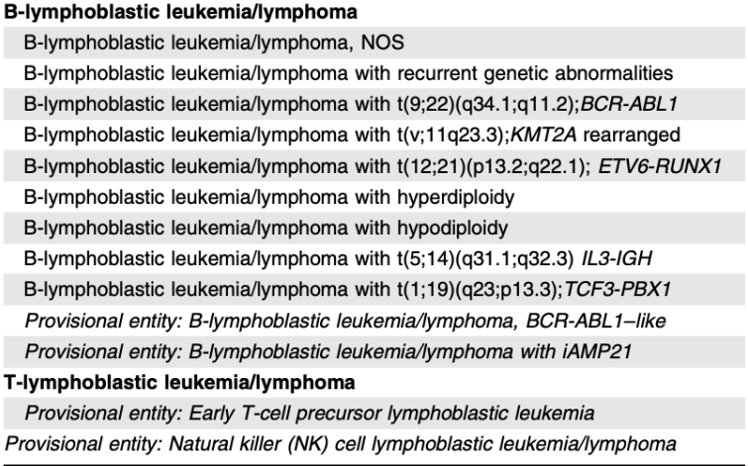
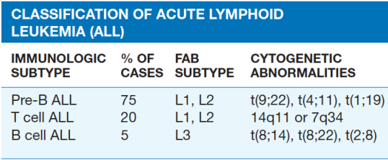
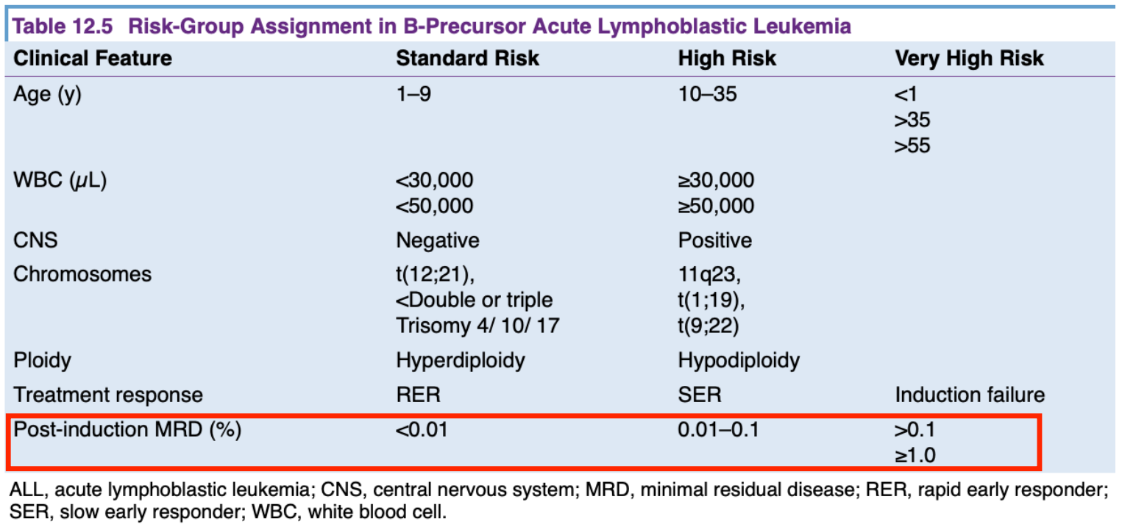
Acute Lymphocytic Leukemia (ALL) cont.
Classifications
+ve MPO (Auer rods) → AML
+ve TdT → ALL
+ve CD10, CD19, CD23 & -ve CD3 → B-ALL
-ve CD10 & +ve CD3 → T-ALL
FAB Classification
WHO Classification of ALL
Are there prognostic tools?
Indicators of poor prognosis:
ALL: Age < 1 or > 10 years; an ↑ in WBC count to > 50,000/mm3; presence of the Philadelphia chromosome t(9,22) (associated with B-cell cancer); CNS involvement at diagnosis.
AML: Age > 60 years; elevated LDH; poor-risk or complex karyotype.
Do we base our treatment on these prognostic risk groups?
Common treatment paradigm ALL
Induction 4-6 weeks
Consolidation 3 months
Late Intensification (re-induction) 3 months
Maintenance 2-3 years
MRD assessment post induction will further diverge patients treatment.
All B-ALL should be checked for Philadelphia chromosome t(9,22) and if positive TKI (Imatinib or Dasatinib) should be added throughout therapy.
All B-ALL should be checked for CD20 and if positive Rituximab should be added.
Frequent IT MTX if documented CNS disease +/- cranial radiation.
Special questions
Who gets allogeneic transplant after remission?
Everyone should be considered in 1st remission but especially important in high risk groups:
MRD+, t(4,11), Ph+.
Older patients?
Low intensity regimens exist including Dex + TKI (Ph+)
Supportive care in the treatment of Acute leukemias
Infections:
Febrile neutropenia. Abx Ppx.
Transfusions:
Platelets
PRBC
TLS monitoring in the beginning of treatment.

Slide 13
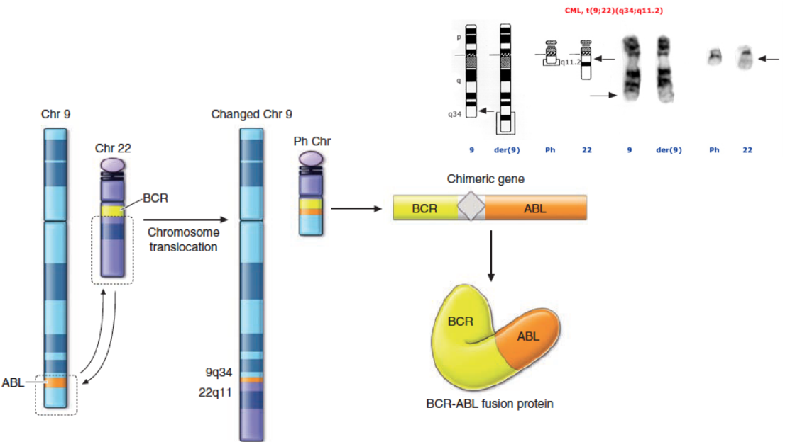
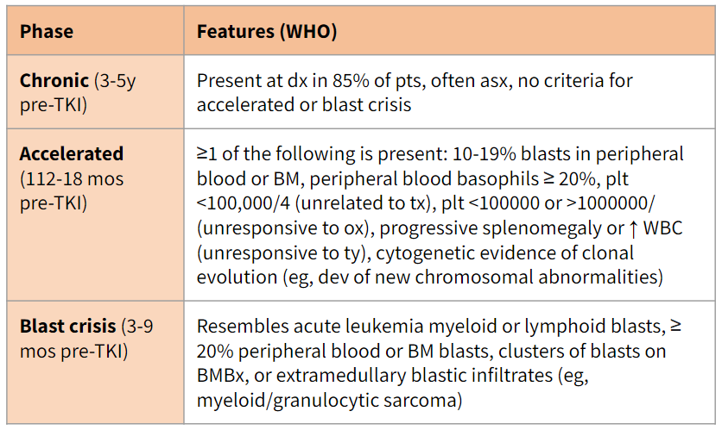
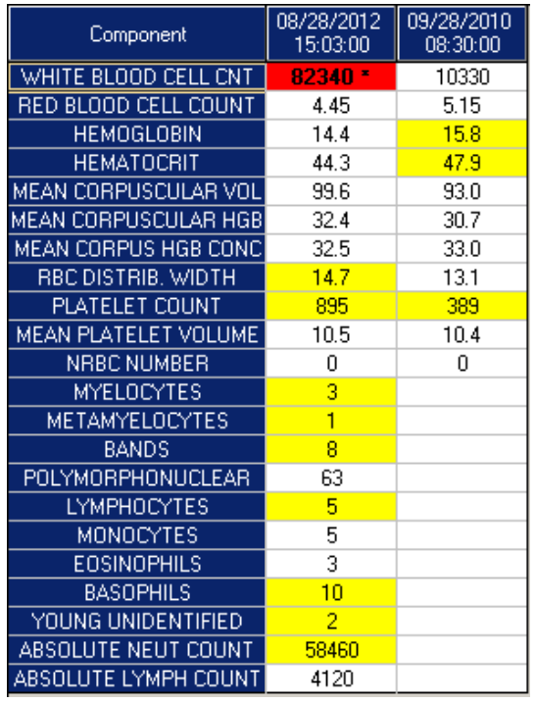
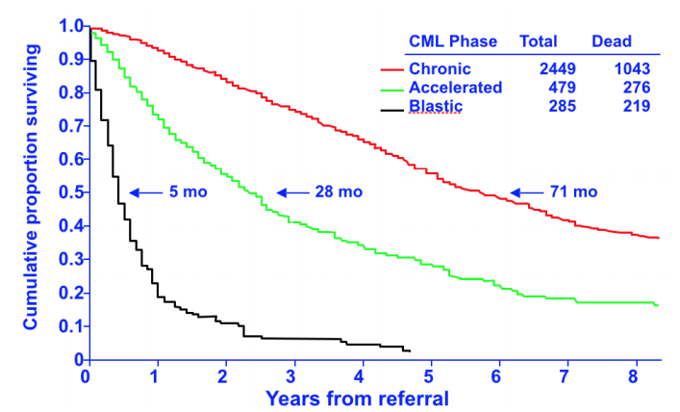
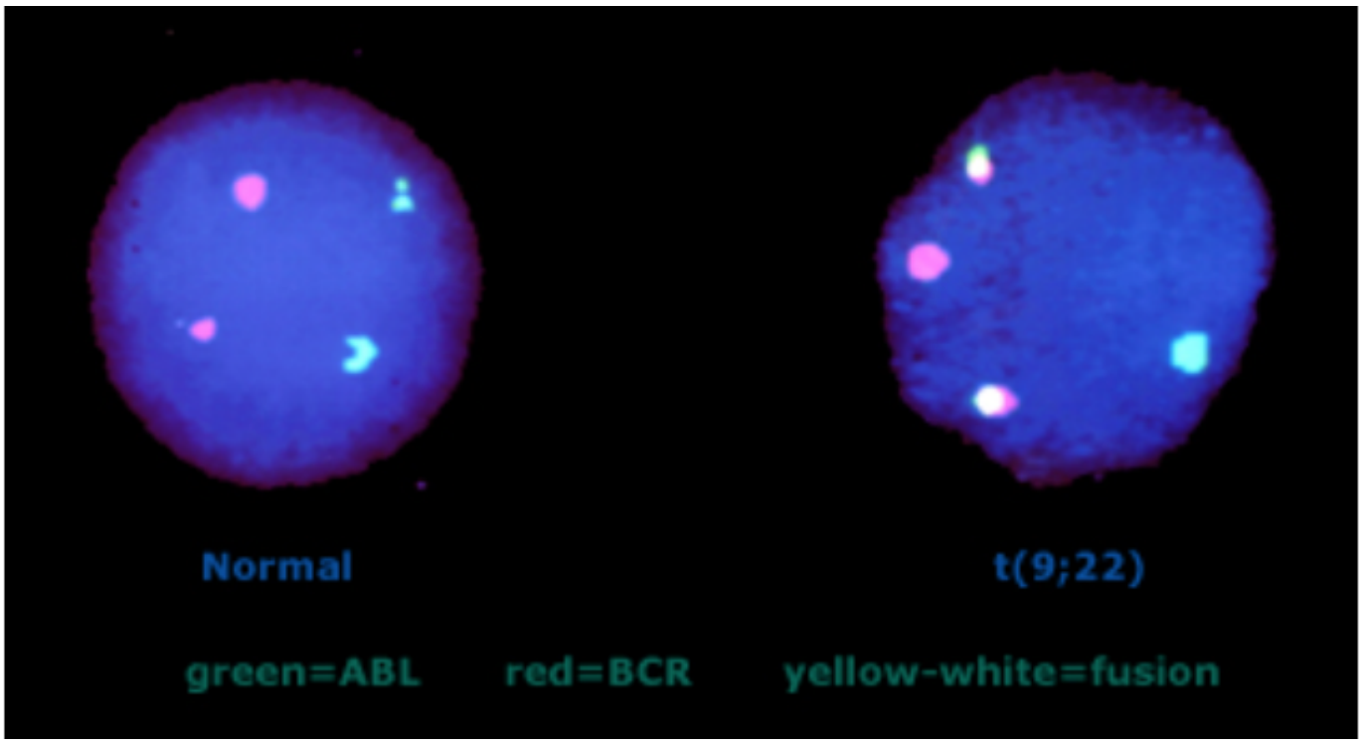
Chronic Myelogenous Leukemia (CML)
Chronic Myelogenous Leukemia (CML)
Have very clear pathology unlike ALL and AML in which there are a lot of genetic abrasions
Excessive development of mature neoplastic granulocytes in the bone marrow
Move into the peripheral blood in massive numbers
Ultimately infiltrate the liver and spleen, causing hepatosplenomegaly.
Maturation of cells proceeds fairly normally.
Chronic, stable phase followed by acute, aggressive (blastic) phase, if left untreated
Philadelphia (Ph) Chromosome → BCR-ABL gene
The chromosome abnormality that causes chronic myeloid leukemia (CML) (9&22)²
Genetic marker
Philadelphia (Ph) Chromosome → bcr-abl gene
Typical CML presentation
85% present in the chronic phase.
30-50% of patients in chronic phase are asymptomatic, present with leukocytosis on CBC done for other purposes.
Elevated WBC with left shift and basophilia and thrombocytosis¹ are common (Majority of pts will have high WBC unlike acute leukemias)
The rest of chronic phase signs: Fatigue, weight loss, night sweats, symptoms related to splenomegaly (early satiety, and fullness). (Usually there’s normocytic normochromic anemia)
Signs: Splenomegaly is present in 90%; in about 10%, the enlargement is massive, extending to over 15 cm below the costal margin. A friction rub may be heard in cases of splenic infarction. Hepatomegaly occurs in about 50%. Lymphadenopathy is unusual.
Phases of CML
The chromosome abnormality that causes chronic myeloid leukemia (CML) (9 &22)
Genetic marker
1
2
CBC
3
Treated as acute leukemias
Simplified phases:
A chronic phase, in which the disease is responsive to treatment and is easily controlled
An accelerated phase (not always seen), in which disease control becomes more difficult.
Blast crisis, in which the disease transforms into an acute leukaemia, either myeloblastic (70%) or lymphoblastic (30%), which is relatively refractory to treatment. This is the cause of death in the majority of patients.
Phases of CML
Phase | Features (WHO)
Chronic (3-5y pre-TKI) | Present at dx in 85% of pts, often asx, no criteria for accelerated or blast crisis
Accelerated (112-18 mos pre-TKI) | ≥1 of the following is present: 10-19% blasts in peripheral blood or BM, peripheral blood basophils ≥ 20%, plt <100,000/4 (unrelated to tx), plt <100000 or >1000000/ (unresponsive to ox), progressive splenomegaly or ↑ WBC (unresponsive to ty), cytogenetic evidence of clonal evolution (eg, dev of new chromosomal abnormalities)
Blast crisis (3-9 mos pre-TKI) | Resembles acute leukemia myeloid or lymphoid blasts, ≥ 20% peripheral blood or BM blasts, clusters of blasts on BMBx, or extramedullary blastic infiltrates (eg, myeloid/granulocytic sarcoma)
Diagnosis
The diagnosis of CML is first suspected by identifying the typical findings in the blood and bone marrow, and then confirmed by the demonstration of the Philadelphia chromosome (Most accurate test), the BCR-ABL1 fusion gene or the BCR-ABL1 fusion mRNA by conventional cytogenetics, fluorescence in situ hybridization (FISH) analysis, or reverse transcription polymerase chain reaction (RT-PCR).
In some patients in whom conventional chromosomal analysis does not detect a Ph chromosome, the BCR ABL gene product is detectable by molecular techniques.
Do patients with positive FISH for Ph Ch still need a BM?
A bone marrow (BM) aspirate is essential to ensure sufficient material for a complete karyotype and for morphologic evaluation to confirm the phase of disease
Need peripheral blood flow to quantify blasts
1- In patients with thrombocytosis, very high platelet counts may persist during treatment, in both chronic and accelerated phases, but usually drop dramatically at blast transformation. Basophilia tends to increase as the disease progresses. CML can be confused clinically with a leukemoid reaction (acute inflammatory response to infection with ↑ neutrophils and a left shift). LAP is low in CML and other hematologic malignancies, and LAP is high in leukemoid reactions.
2- This translocation could be bc of viral infection, radiation or previous chemotherapy.

Slide 14
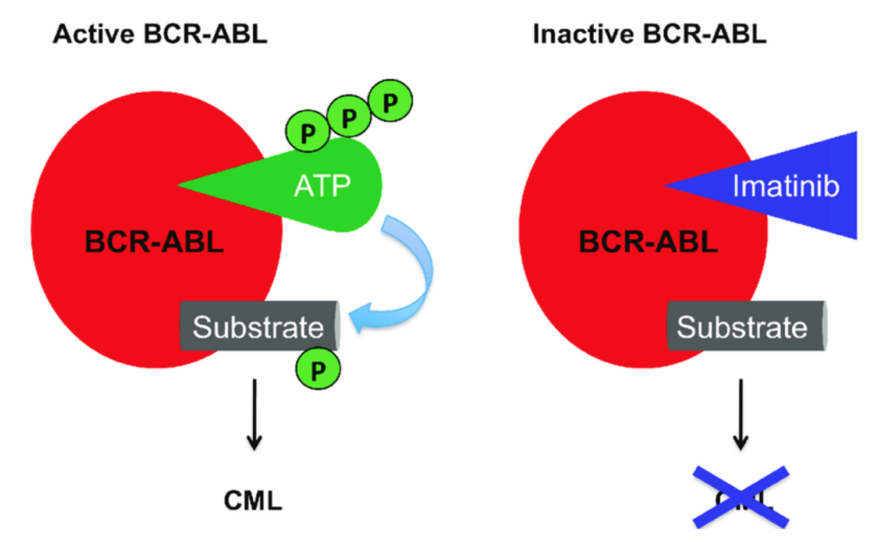
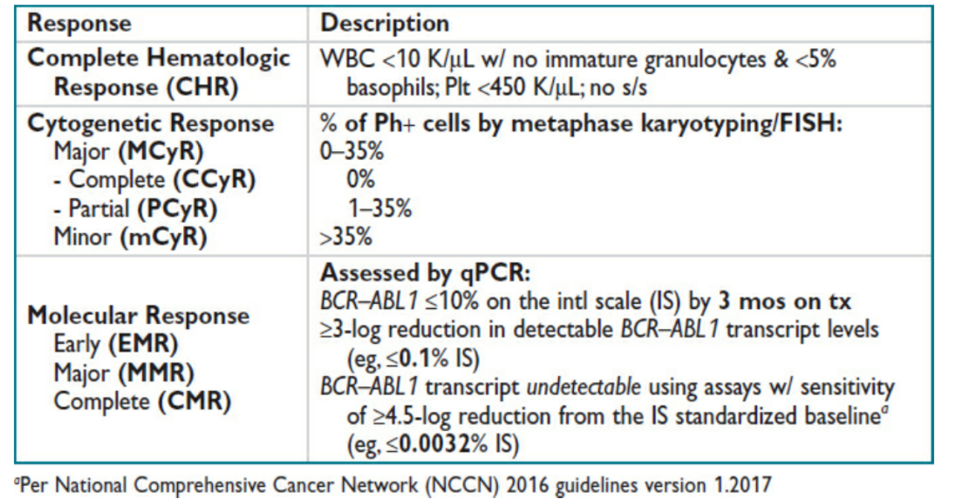
Chronic Myelogenous Leukemia (CML) cont.
Treatment
BCR-ABL tyrosine kinase enzyme exists only in clonal cancer cells and not in
normal patient cells.
Imatinib, is a Tyrosine-kinase inhibitor which prevents the BCR-ABL enzyme
product from initiating the signaling cascade necessary for cancer development,
thereby causing cancer cell apoptosis.
Imatinib binds to BCR-ABL kinase domain by preventing the transfer of a phosphate group to tyrosine on the protein substrate and the subsequent activation of phosphorylated protein. As the result, the transmission of proliferative signals to the nucleus is blocked and leukemic cell apoptosis is induced.
Stem cell transplant for selected patients.
Treatment of blast crisis: When blast transformation occurs, the type of blast cell should be determined. Response to appropriate acute leukaemia treatment is better if disease is lymphoblastic than if myeloblastic. Second- or third-generation TKIs such as dasatinib are used in combination with chemotherapy to try and achieve remission. In younger and fitter patients an allogeneic HSCT is appropriate therapy if a return to chronic phase is achieved.
TKI (comparison) | Imatinib | Dasatinib | Nilotinib | Bosutinib | Ponatinib
Year approved by FDA | 2001 | 2006 | 2007 | 2012 | 2012
Approved for 1st line? | Yes | Yes | Yes | Yes | No
Dose | CP:400-800/day AP/BP:600-800/ day | CP:100 mg OD AP/BP: 140 mg OD | CP:300 mg BID 2nd line CP/AP: 400 mg BID w/o food | CP/AP/BP: 500-600 mg w/food | CP/AP/BP: 45 mg OD w/ food
Dose adj Hepatic imp Renal imp | Yes Yes | No No | Yes No | Yes No | Yes No
Common Side effects | Nausea, periorbital edema, myalgia, LFT, cytopenia | Fluid retention, pleural effusion, bleeding, cytopenia, PA HTN. Skin tox. LFT | Qtc prolongation, Vascular occlusive events, pancreatitis. alopecia, electrolyte imbalance. Cytopenia | GI tox, diarrhea, cytopenia, fluid retention, LFT. | Arterial thromboemb olic events, MI,Stroke. Arrhythmia. HTN, LFT, GI perf/fistula.
Types of response to treatment
Hematologic (CBC)
Cytogenetic (BCR-ABL1 by karyotype & FISH)
Molecular (BCR-ABL1 qPCR in peripheral blood)
Skipped by the doctor

Slide 15
Chronic Lymphocytic Leukemia (CLL)
Chronic Lymphocytic Leukemia (CLL)
Most common adult leukemia in Western countries.
Chronic Production and accumulation of functionally inactive (incompetent) but long-lived,
mature-appearing B-lymphocytes resulting in hypogammaglobulinemia (immunoparesis), usually monoclonal.
B cell involvement.
Lymph node enlargement is noticeable throughout the body causing ↑ incidence of infection.
CLL = Absolute B-lymphocyte count >5000/uL in blood, ± marrow, ± LN
SLL = <5000/uL absolute B-lymphocytosis w/ lymphadenopathy o/w same as CLL
CLL is a bigger umbrella for small lymphoblastic lymphoma (SLL). Both are treated in the same way. The disease is classified as SLL only if there was <5000/uL B-cells in the peripheral blood
Clinical presentation:
Sx: Most pts diagnosed incidentally by laboratory tests. (Lymphocytosis) not functioning
Those that present w/ sx have painless lymphadenopathy, fatigue, recurrent infxn, or uncommonly (5–10%) B symptoms (wt loss, fevers, NS)
PE: LAN, HSM, pallor, leukemia cutis (<5%)
Diagnosis
Best initial: CBC w/ diff → B-ALC >5000; “smudge cells” & small mature appearing lymphocytes w/ dense chromatin, scant basophilic cytoplasm Additional labs:
Most accurate: Peripheral blood flow cytometry → CD19+, CD20+ (dim), CD5+ (normally found on T-cells), CD23+, κ/λ restricted, surface Ig+ (dim), CD10–
BM biopsy unnecessary unless progressive cytopenias
Karyotype, cytogenetics, & FISH
Usually monosomy (deletion not translocation unlike CML) e.g. 17p or 13q deletions. In CLL, deletion of the short arm of chromosome 17 (17p) is associated with rapid disease progression as well as a poor response to treatment). CLL is also associated with TP53 mutation, all patients should be tested for this gene before initiating treatment.
PCR: Ig variable region (IGHV) Mt (Patients with this mutated gene have better prognosis)
CT scan optional unless concern for impaired/threatened organ function or pre-tx to allow response assessment
CLL Staging (Not used nowadays)
Rai | Description | Binet | Description | Survival (y)
0 | Lymphocytosis | A | <3 involved sites | ~12
I | + Lymphadenopathy | B | ≥3 involved sites | ~6-8
II | + Splenomegaly
III | + Anemia (Hgb <11)* + Thrombocytopenia (Plt <100k)* | C | Anemia (Hgb <10)* or Thrombocytopenia (Plt <100k)* | ~2
IV
*Due to progressive CLL & not autoimmune or other causes
Rai staging correlates very well for treatment regardless of the genetics e.g. Rai 0 indicates good response to treatment (even if the pt has 17p deletion)

Slide 16
Chronic Lymphocytic Leukemia (CLL) cont.
Complications
Complications from early-stage CLL is rare
May develop as the disease advances
Pain, paralysis from enlarged lymph nodes causing pressure¹
Immunodeficiency
Autoimmune hemolytic anemia (AIHA)
Pure red cell aplasia
Due to ↓ Ig & abnl B/T cell fxn,
infxn account for 50% death for CLL/SLL pts,
labs
↓ Hgb,
↑ retic,
↓ hapto,
+Coombs;
Treatment
Steroids
Rare <1% pts; labs
↓ Hgb,
↓ retic
BM bx w/ absent red cell precursors; r/o parvovirus, CMV, EBV.
Treatment
Cyclosporine
ITP
Transformation
Others
~5% pts, unrelated to disease status, standard tx for ITP = steroids, IVIG, ritux, splenectomy, or thrombopoietin analogs
5–10% pts, usu transforms to aggressive diffuse large B-cell lymphoma (Richter’s), heralded by rapid ↑ LN, new B sx, or ↑↑ LDH,
Leukostasis: rare, even w/ extremely high WBC;
Secondary solid neoplasms
Treatment
CLL is incurable (except by allo-SCT) → no evidence that treating early benefits OS Indications for treatment: Disease-related sx “active disease” = B-sx, rapid LAD, progressive cytopenias, or frequent repeated infections. Consider lymphocyte doubling <6 mos. Observation: ~1/3 of CLL pts never require tx; routine oncology visits w/ PE, CBC, monitor for complications; no survival benefit early tx | FCR: Fludarabine, cyclophosphamide & rituximab—for young pts w/ good PS,). Can produce long-term remissions in pt w/ mutated IGHV, Cant be used in 17p del. BR: Bendamustine + Rituximab. Less toxicity than FCR & can be used w/ renal insufficiency, >65 y/o, but shorter PFS compared to FCR Novel agents: (1st line therapy nowadays) Kinase inhibitors: ibrutinib (BTK) & idelalisib (PI3Kδ) + rituximab Pro-Apoptotic: venetoclax (BCL-2 inhibitor)
Common side effects of the new agents used in CLL | Kinase inhibitors | Ibrutinib (BTK): Atrial fibrillation, Bleeding (platelet dysfunction) and diarrhea
 |  | Idelalisib (PI3Kδ): Colitis Pneumonitis
 | Pro-Apoptotic | Venetoclax (BCL-2 inhibitor): Tumor lysis syndrome, Pancytopenia.
How does Rituximab work?
It’s a chimeric monoclonal antibody against the protein CD20, which is primarily found on the surface of immune system B cells. When it binds to this protein it triggers cell death. Before starting Rituximab you have to check HBV because it may cause reactivation.
1- Keep in mind that CLL in advance stage may present with Huge lymph node, depending on its size it may cause pressure. ex: if near spinal cord Pt will present with paralysis. In the neck might cause pain. If it is para-aortic Lymphadenopathy → erosion of the aorta → Bleeding.

Slide 17
Other Leukemias
Hairy Cell Leukemia
2% of all adult leukemias. Neoplastic proliferation of mature B cells characterized by hairy cytoplasmic processes.
Usually in males > 40 years old
Chronic disease of lymphoproliferation
B lymphocytes that infiltrate the bone marrow and liver
Cells have a “hairy” appearance (Cells are usually positive for TRAP)
Recently, all patients with hairy cell leukaemia have been found to have a mutation in the BRAF gene.
■Best initial test: CBC with smear showing pathognomonic “hairy cells”
(mononuclear cells with many cytoplasmic projections)
that stain with tartrate-resistant acid phosphatase (TRAP). Leukopenia can
sometimes be seen as well.
■ Most accurate test: Flow cytometry identifying the “hairy cells.”
Symptoms from | Treatment
Splenomegaly (90%, due to red pulp enlargement), pancytopenia, infection (especially with atypical mycobacteria such as Mycobacterium avium–intracellulare), autoimmunity in form of vasculitis | alpha-interferon, pentostatin, cladribine (Best initial)
Unclassified Leukemias
Subtype cannot be identified. very aggressive
Malignant leukemic cells may have:
Lymphoid, myeloid, or mixed characteristics.
Frequently these patients do not respond well to treatment (Poor prognosis).
Differential Diagnosis of Leukemia
1
Aplastic anemia
bc of pancytopenia
2
Myelodysplastic syndromes
“ Dysfunctional Bone marrow”
3
Multiple myeloma “abnormal plasma cells”
4
Lymphomas
”lymphadenopathy”
5
Severe megaloblastic anemia “drop in vit B12”
6
Leukemoid reaction
“Common with severe infection result in abnormal WBC formation”
Case:
17 ys lady presented to th Er with CBC : WBCs 50,000 HGB 10 PLT 15000, Abnormal circulating blasts 30%
An area for your notes
Diagnosis and Risk stratification
Peripheral blood morphology:
Abnormal blasts
Peripheral blood flow cytometry:
30 % blasts with CD 33 , CD 34 +ve “to know whether it's ALL or AML”
BMBx bone marrow biopsy for:
Morphology (myeloblasts)
Cytogenetics ( t 8:22)
Flow cytometry (50% blasts express M antigens)
Molecular (FLT 3 –ITD +ve) “AML”
Treatment Goals:
Remission induction (chemo for 28 days)
Response assessment ( D 28)
Consolidation (chemo / SCT) whether to proceed with chemo or SCT
Maintenance
Dr notes:
- History: to know if it's acute or chronic and manifestation: infection, Bleeding tendency and for how long.
- family history (genetic?)
- examination: lymphadenopathy,
hepatosplenomegaly?
-Lab: CBC, peripheral blood morphology and flow cytometry
morphology: myeloblast
or lymphoblast.

Slide 18
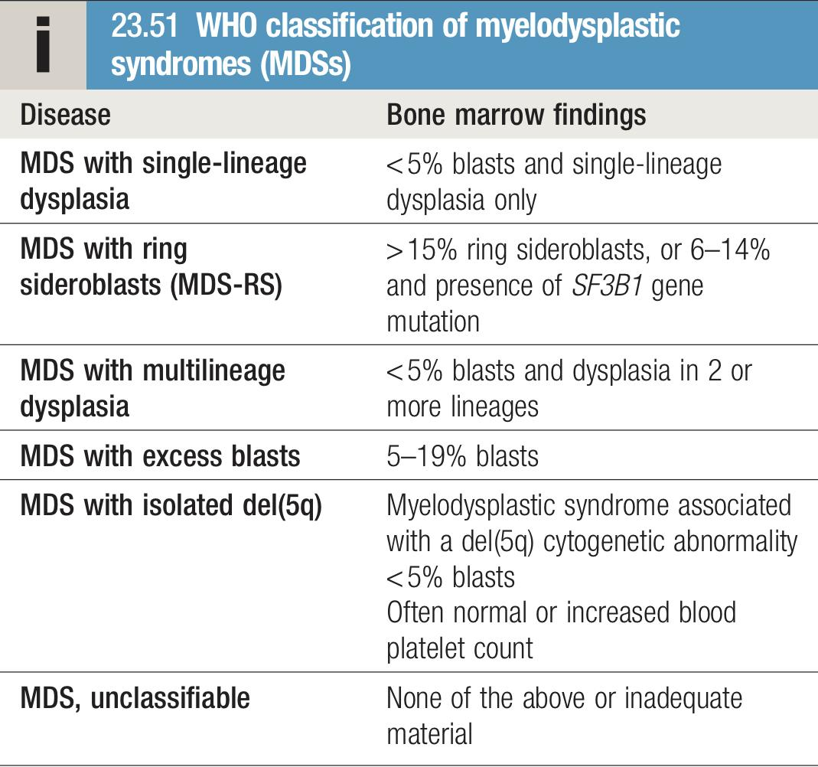
EXTRA
Other related conditions
Prolymphocytic leukemia
Definition | Prolymphocytic leukaemia (PLL) is a variant of chronic lymphocytic leukaemia found mainly in males over the age of 60 years; 25% of cases are of the T-cell variety
Characteristics | There is typically massive splenomegaly with little lymphadenopathy and a very high leukocyte count, often in excess of 400 × 10⁹/L. The characteristic cell is a large lymphocyte with a prominent nucleolus.
Treatment | Treatment is generally unsuccessful and the prognosis very poor. Leukapharesis, splenectomy and chemotherapy may be tried.
Myelodysplastic syndromes (MDSs)
Definition | Myelodysplastic syndromes (MDSs) constitute a group of clonal haematopoietic disorders with the common features of ineffective blood cell production and a tendency to progress to AML. As such, they are pre-leukaemic and represent genetic steps in the development of leukaemia.
Characteristics | MDS presents with consequences of bone marrow failure (anaemia, recurrent infections or bleeding), usually in older people (median age at diagnosis is 73 years). The blood film is characterised by cytopenias and abnormal-looking (dysplastic) blood cells, including macrocytic red cells and hypogranular neutrophils with nuclear hyper- or hyposegmentation The bone marrow is hypercellular, with dysplastic changes in at least 10% of cells of one or more cell lines. Blast cells may be increased but do not reach the 20% level that indicates acute leukaemia.
Prognosis | The natural history of MDS is progressive worsening of dysplasia leading to fatal bone marrow failure or progression to AML in 30% of cases.
Treatment | For the vast majority of patients who are elderly, the disease is incurable, and supportive care with red cell and platelet transfusions is the mainstay of treatment
Congratulations you have officially finished medicine, take a few seconds and enjoy this moment because you deserve it!

Slide 19
Introduction
A group of malignant disorders affecting the blood and blood forming tissues and results in an accumulation of dysfunctional cells because of a loss of regulation in cell division.
Clinical Manifestations
Bone marrow failure | Leukemic cells infiltrate patient’s organs
Overcrowding by abnormal cells Inadequate production of normal marrow elements Anemia, thrombocytopenia, ↓ number and function of WBCs | Splenomegaly Hepatomegaly Lymphadenopathy Bone pain, meningeal irritation, oral lesions (chloromas)
Acute leukemias
Overview | Acute leukemias arise from the early stages of hematopoietic diﬀerentiation (Immature cells). Acute Leukemias carry high mortality but are CURABLE. Abrupt onset.
Cell line | Acute Myelogenous Leukemia (AML) | Acute Lymphocytic Leukemia (ALL)
Characteristics | Leukemia characterized by proliferation of myeloid tissue (as of the bone marrow and spleen) and an abnormal increase in the number of granulocytes, myelocytes, and myeloblasts in the circulating blood. One fourth of all leukemias and (85%) (90%) of the acute leukemias in adults | More common in children and adolescents than in adults. It is the most common malignancy in children (25% of all cancers). 15% of acute leukemia in adults Lymphadenopathy, Splenomegaly, Hepatomegaly & CNS: 15%
Group | Adults | Males > Females | Children | Males > Females
↑Risk: | Cytotoxic chemo, Radiation, Benzene. | Trisomy 21 (Down syndrome) 15-fold ↑ in risk
Diagnosis | >20% blasts in peripheral blood or BM. Blasts either by morphology (Auer rods) or phenotyping with ﬂowcytometry, IHC, cytochemical: myeloperoxidase (MPO). In Acute Promyelocytic Leukemia (APL) - (PML-RARA) (M3): t(15,17) using FISH. “ProMyelocytic Leukemia-Retinoic Acid Receptor α” | Flow cytometry on peripheral blood. Acute lymphoblastic leukemia (ALL): if >25% BM blasts. Acute lymphoblastic LYMPHOMA (LBL): if <25% BM blasts + mass lesion. Absence of granules/ Auer rods
Management | Induction (to achieve remission -deﬁned < 5% blasts in a BM that is 20% or more cellular-): Chemotherapy. Consolidation or “post remission” therapy: Chemotherapy or Allogenic stem cell transplant. APL: Low risk: All trans retinoic acid (ATRA) + Arsenic (ATO) High risk: ATRA + Chemo + ATO. Relapse? Autologous transplant. | ALL & LBL are the same disease & treated the same: Induction 4-6 weeks > Consolidation 3 months > Late Intensification (re-induction) 3 months > Maintenance 2-3 years B-ALL should be checked for Philadelphia chromosome t(9,22); if positive TKI (Imatinib or Dasatinib) is added throughout therapy. All B-ALL should be checked for CD20 and if positive Rituximab should be added. Frequent IT MTX if documented CNS disease +/- cranial radiation.

Slide 20
Chronic leukemias
Overview | Chronic leukemias arise from late stages of diﬀerentiation (Mature cells)
Cell line | Chronic Myelogenous Leukemia (CML) | Chronic Lymphocytic Leukemia (CLL)
Characteristics | Chronic, stable phase followed by acute, aggressive (blastic) phase Philadelphia (Ph) Chromosome → BCR-ABL gene The chromosome abnormality that causes chronic myeloid leukemia (CML) (9 &22) Genetic marker | Most common adult leukemia in Western countries.
Diagnosis | Typical findings in blood and bone marrow > then confirmed by the demonstration of the Ph chromosome by conventional cytogenetics, FISH analysis, or RT-PCR. | CBC w/ diff → B-ALC >5000; “smudge cells” & small mature appearing lymphocytes w/ dense chromatin, scant basophilic cytoplasm Additional labs: Peripheral blood flow cytometry → CD19+, CD20+ (dim), CD5+, CD23+, κ/λ restricted, surface Ig+ (dim), CD10– BM bx unnecessary unless progressive cytopenias;
Management | Imatinib: a Tyrosine-kinase inhibitor. Stem cell transplant for selected patients. | CLL is incurable Indications for tx: Disease-related sx “active disease”.
Complications |  | Immunodeficiency, Autoimmune hemolytic anemia, Pure red cell aplasia, immune thrombocytopenia, Transformation..
Other Leukemias
 | Hairy Cell Leukemia: 2% of all adult leukemias Usually in males > 40 years old Cells have a “hairy” appearance Multiple myeloma, Aplastic anemia, | Others: Myelodysplastic syndromes, Leukemoid reaction, Severe megaloblastic anemia, Lymphomas

Slide 21
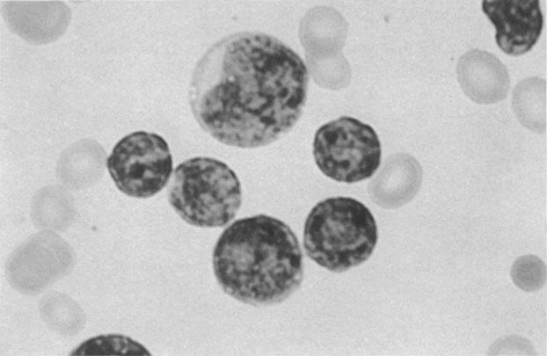
Q1: A 5-year-old girl presents with her parents who have become concerned about the small petechiae and ecchymoses on her skin. An abdominal examination reveals hepatosplenomegaly. You suspect an acute leukaemia. The most appropriate initial investigation for diagnosis is:
A. Chromosomal analysis of bone marrow cells
B. Cytochemical analysis of bone marrow cells
C. Direct microscopy of bone marrow cells
D. Electron microscopy
E. Flow cytometry
Q2: A 65-year-old man presents to you reporting he has become increasingly worried about his lack of energy in the last 2 weeks. He mentions he has been increasingly tired, sleeping for long periods and has suffered from fevers unresponsive to paracetamol. He became increasingly worried when he noticed bleeding originating from his gums. A blood film shows auer rods, hypogranular neutrophils and stains with Sudan black B. The most likely diagnosis is:
A. Acute lymphoblastic leukaemia
B. DiGeorge syndrome
C. Disseminated intravascular coagulation
D. Acute myeloid leukaemia
E. Afibrinogenaemia
Q3: A 70-year-old woman complains of tiredness, fatigue and weight loss. Blood tests reveal an elevated WBC and on examination splenomegaly is palpated. Cytogenetics are positive for the Philadelphia chromosome and the patient is diagnosed with chronic myeloid leukaemia. The most appropriate treatment is:
A. Hydroxycarbamide
B. Imatinib
C. Venesection
D. Stem cell transplant
E. Dasatinib
Q4: 75-year-old male presented with fatigue and exertional shortness of breath. On examination, he was pale, CBC showed low hemoglobin, MCV: 102, WBC: 2.9, neutrophil: 0.96, platelets: 65, bone marrow show hypercellularity (50% ) blast 8% + trilineage dysplasia + abnormal karyotype. What's the diagnosis?
A- MDS
B- Aplastic anemia
C- Acute leukemia
D- B12 vitamin deficiency
Q5: A 60-year-old asymptomatic man is found to have leukocytosis on a preoperative CBC. Physical examination shows the spleen tip to be palpable 2 cm below the left costal margin. Rubbery, nontender lymph nodes up to1.5 cm in size are present in the axillae and inguinal regions. Laboratory data include the following:
Hgb: 13.3 g/dL (normal 14 to 18)
Leukocytes: 40,000/μL (normal 4300 to 10,800)
Platelet count: 238,000 (normal 150,000 to 400,000)
His peripheral blood smear is shown in the accompanying photo.
A. Acute monocytic leukemia
B. Chronic myelogenous leukemia
C. Chronic lymphocytic leukemia
D. Tuberculosis
E. Infectious mononucleosis
Quiz explanations:
Question 1:
The correct answer is C. In order to diagnose an acute leukaemia, defined as ≥20 per cent of bone marrow cells being blasts, an examination of a bone marrow aspirate under microscopy (C) is necessary. Flow cytometry (E) is useful in distinguishing AML from ALL. Electron microscopy (D) has a reduced role with advanced immunotyping techniques available. (A) and (B) are useful investigations once a leukaemia is confirmed.
Question 2:
The correct answer is D. This patient is suffering from an acute myeloid leukaemia (D). There are many mutations that cause the disorder and it can occur in young or old patients, peak presentations tend to be in middle-aged males. Blood investigations may show a variable WCC, anaemia, thrombocytopenia and neutropenia. A blood smear may have auer rods and leukoerythroblastic cells. ALL (A) may have a similar count to AML although the lymphoblasts are usually seen on blood smear and stain with Periodic acid achiff stain. DiGeorge’s syndrome (B) is a genetic disorder caused by a deletion at 22q11, young patients present with cardiac anomalies (Tetralogy of Fallot’s), abnormal facies, thymic aplasia, cleft palate and hypocalcaemia. Disseminated intravascular coagulation (C) is a consumptive coagulopathy which does not feature auer rods. Congenital afibrinogenemia (E) is characterized by blood clotting disorder rather than increased predispositions to infections.
Question 3:
The correct answer is B. Chronic myeloid leukaemia occurs due to the reciprocal translocation of chromosome 9 (Abl) and 22 (BCR) causing the BCR/ABL fusion gene, otherwise termed the Philadelphia chromosome, which has uncontrolled tyrosine kinase activity. Treatment begins with imatinib (B), a tyrosine kinase inhibitor which blocks the activity of BCR/ABL. Over time, the action of multiple drug resistance proteins which pump out imatinib and a change in the shape of the active site of BCR/ABL cause resistance. Dasatinib (E) and eventually stem cell transplantation (D) are then required for treatment. Hydroxycarbamide (A) is a chemotherapy drug used primarily in the treatment of polycythaemia rubra vera alongside venesection (C) to reduce viscosity and haematocrit.
Question 4:
The correct answer is A. GIFTS.
Question 5:
The correct answer is A. GIFTS.
Question 6:
The correct answer is C. Chronic lymphocytic leukemia is the most common of all leukemias, with incidence increasing with age. Patients are usually asymptomatic, but may complain of weakness, fatigue, or enlarged lymph nodes. The diagnosis is made by peripheral blood smear, as mature small lymphocytes constitute almost all the white blood cells seen. Smudge cells are often present. No other process produces a lymphocytosis of this morphology and magnitude. The leukemic cells in acute leukemia are immature blast cells that are easily distinguished from the normalappearing mature lymphocytes of CLL. Both chronic myelogenous leukemia and the leukemoid reaction associated with illness such as TB are associated with increased numbers of a variety of cells of the myeloid series (mature polymorphonuclear leukocytes, metamyelocytes, myelocytes, etc). The peripheral blood is said to resemble a dilute preparation of bone marrow. The presence of basophilia would suggest CML. Infectious mononucleosis would be rare at this age and causes large “atypical” lymphocytes that are easily distinguished from mature lymphocytes on peripheral smear.
Answers: Q1:C | Q2:D | Q3:B | Q4:A | Q5:C
Answers Explanation File!

Slide 22
Medicine Team leaders would like to thank all the participating members for their efforts and making 438 Medicine teamwork the best in the history of this college !
Hashem Bassam
Aued Alanazi
Faisal Al-Zahrani
Fahad Alsultan
Faisal Al-Gfari
Raed Alojayri
Abdulrahman Bedaiwi
Abdullah Alghamdi
Mohanad makkawi
Abdulaziz Alghamdi
Mohammed Alqahtani
Khalid Alharbi
Sami aljuhani
Tariq Aloqail
Naif Al-Husainy
Faisal AlMusaeed
Fawaz Alotaibi
Joud aljbreen
Maha Alnahdi
Deana Awartani
Jude Alkhalifah
Rema Almtawa
Ghada Alsadhan
Sarah Alhelal
Shahad Alsahil
Arwa Alemam
Taif Alotaibi
Haifa Alwaily
Sarah alfarraj
Norah alharbi
Danah AlHalees
Njoud alali
Renad Almutawa
Lama Alzamil
Leen AlMazroa
Razan alzohaifi
Rawan ALbayyat
Shahad Bin Selayem
Sarah Alarifi
Rahaf alshabri
Ghalia alnufaei
Renad AlKanaan
Wjdan Alshamry
Nouf Alhumaidhi
Ghaida AlBraithen
Maysoon AlTameem
And SPECIAL, SPECIAL THANKS! Goes to our GOLDEN soldiers during this tough journey :
Razan Alrabah
Amirah Alzahrani
Lama Alassiri
Taif Alotaibi
Shahad Bin Selayem
Mohammed Alhumud
Abdulaziz Alshoumar
Mohammed Ajarem
Abdullah Shadid
To the amazing academic leaders who didn’t hesitate to help us whenever we needed, our work wouldn’t have been as smooth as it has without you! We’re so grateful to have such an amazing leaders, thank you will never be enough ♡
Noura Alturki
Jehad Alorainy
And lastly.. لا تنسونا من دعواتكم
Raghad AlKhashan, Amirah Aldakhilallah, Mashal AbaAlkhail , Nawaf Albhijan

Slide 23
THANKS!!
This lecture was done by the legendary:
Nawaf Albhijan
jehad Alorainy
Abdulaziz Alshomar
Fawaz Alotaiby
توضيح: يعني شايل الدفعة
Quiz and summary by the king:
Mohammed Alhumud
Note taking by the amazing:
Mashal AbaAlkhail
Sarah Alfarraj
Females co-leaders:
Raghad AlKhashan
Amirah Aldakhilallah
Males co-leaders:
Mashal AbaAlkhail
Nawaf Albhijan
Send us your feedback:
We are all ears!

