Slide 1
Radiology of Urinary System Disorders
Dr. Husain Alturkistani
Assistant Professor & Consultant

Slide 2
Categories:
- Renal Colic
- Infections
- Urosepsis
- Masses
- Renal Failure
- Trauma

Slide 3
Renal Colic
- Caused by renal calculi
- Most urinary calculi are calcified
- Classic presentation: (sudden onset of severe flank pain radiating inferiorly and anteriorly +/- nausea and vomiting)
- Diagnosis often made clinically
Imaging: to confirm and evaluate calculi

Slide 5
KUB: to assess total stone burden, size, shape, location
Often: US or CT is required in conjunction

Slide 10
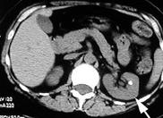
Renal Calculus– CT Scan

Slide 11
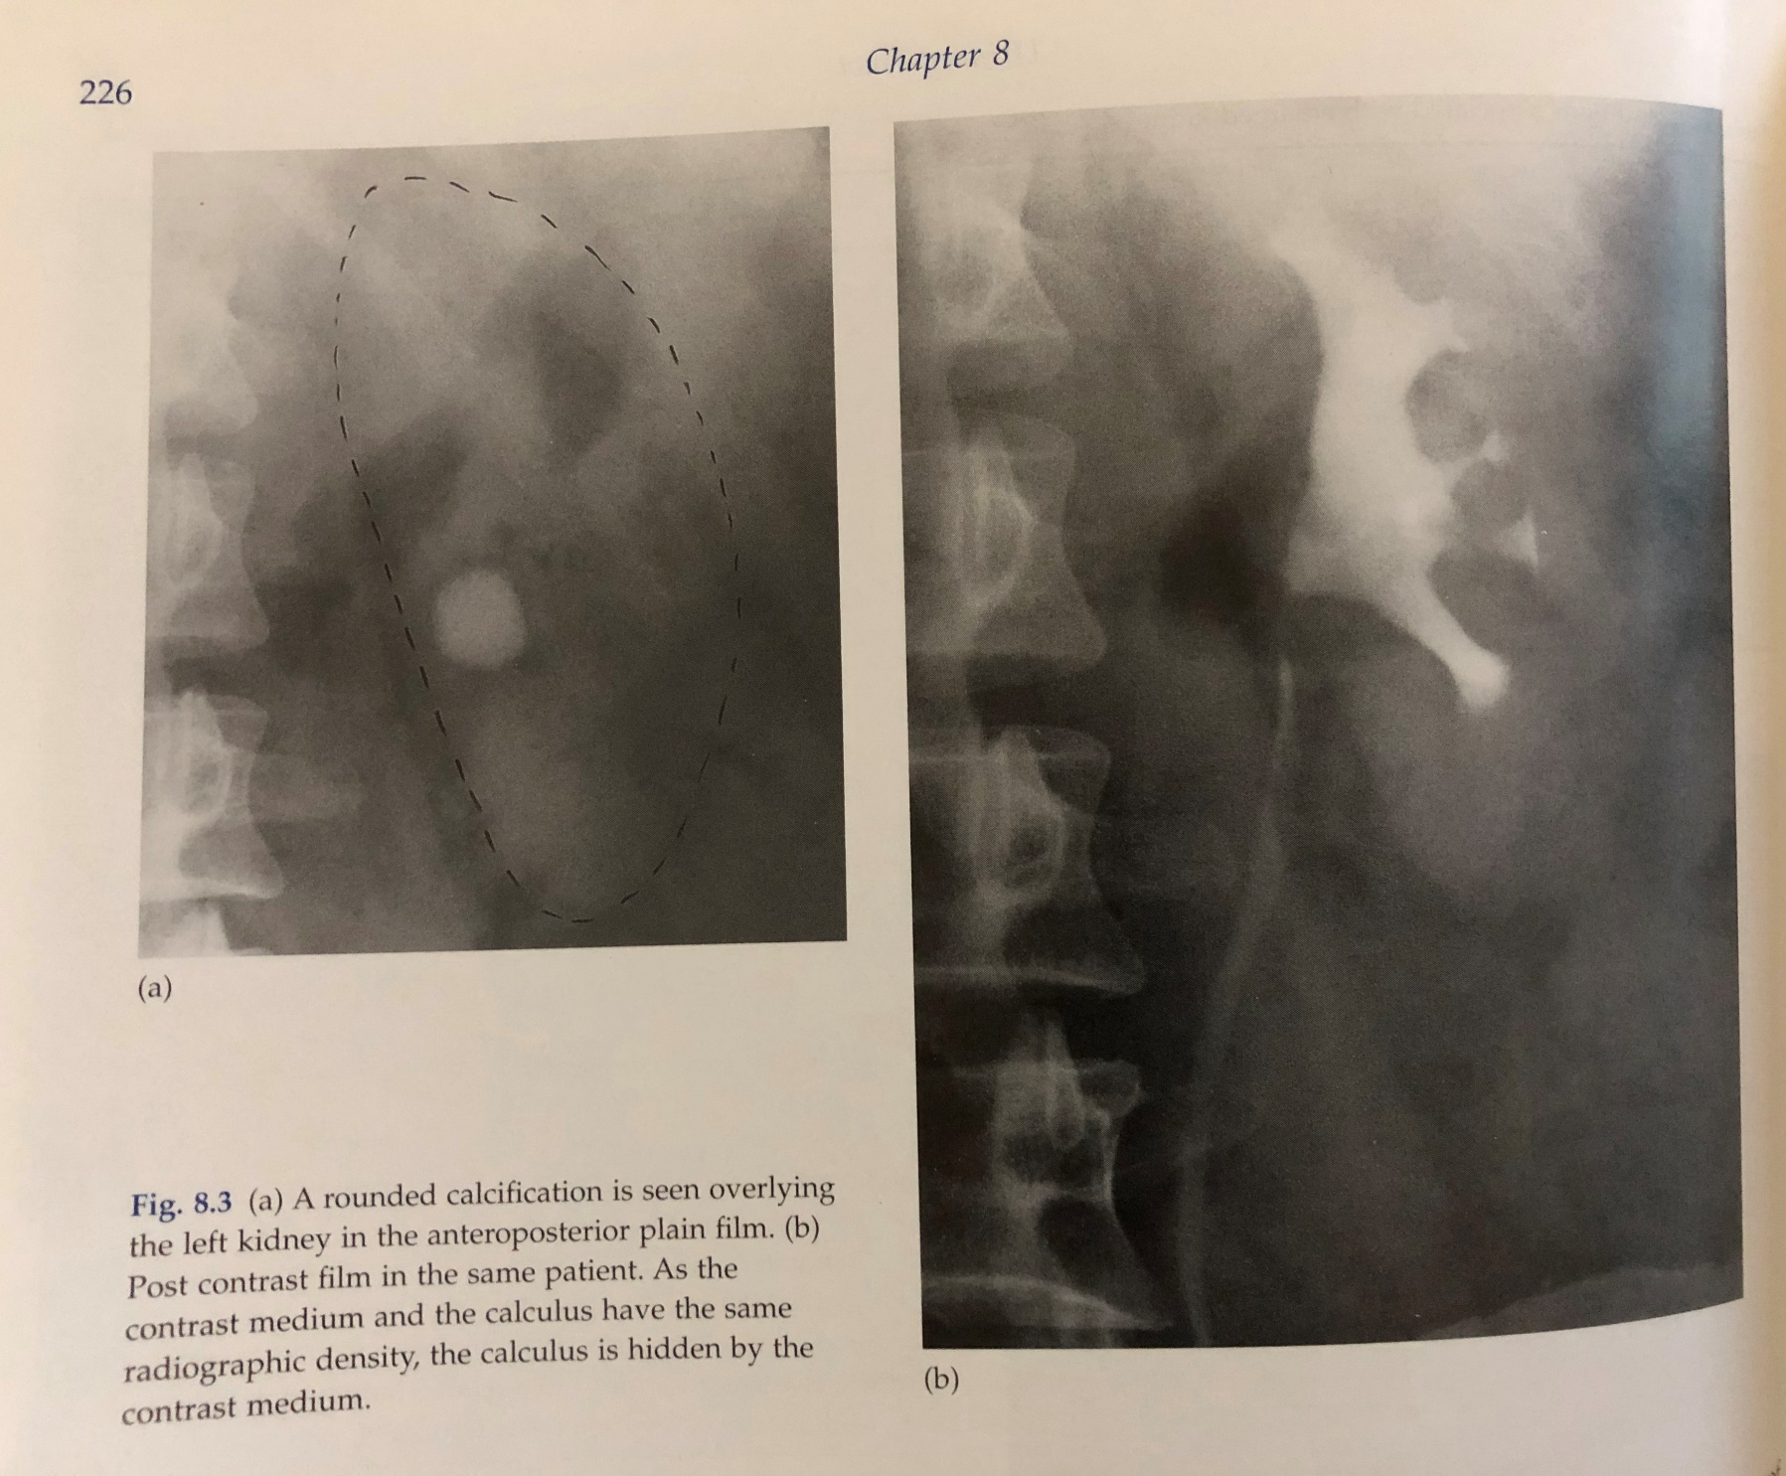

Slide 12
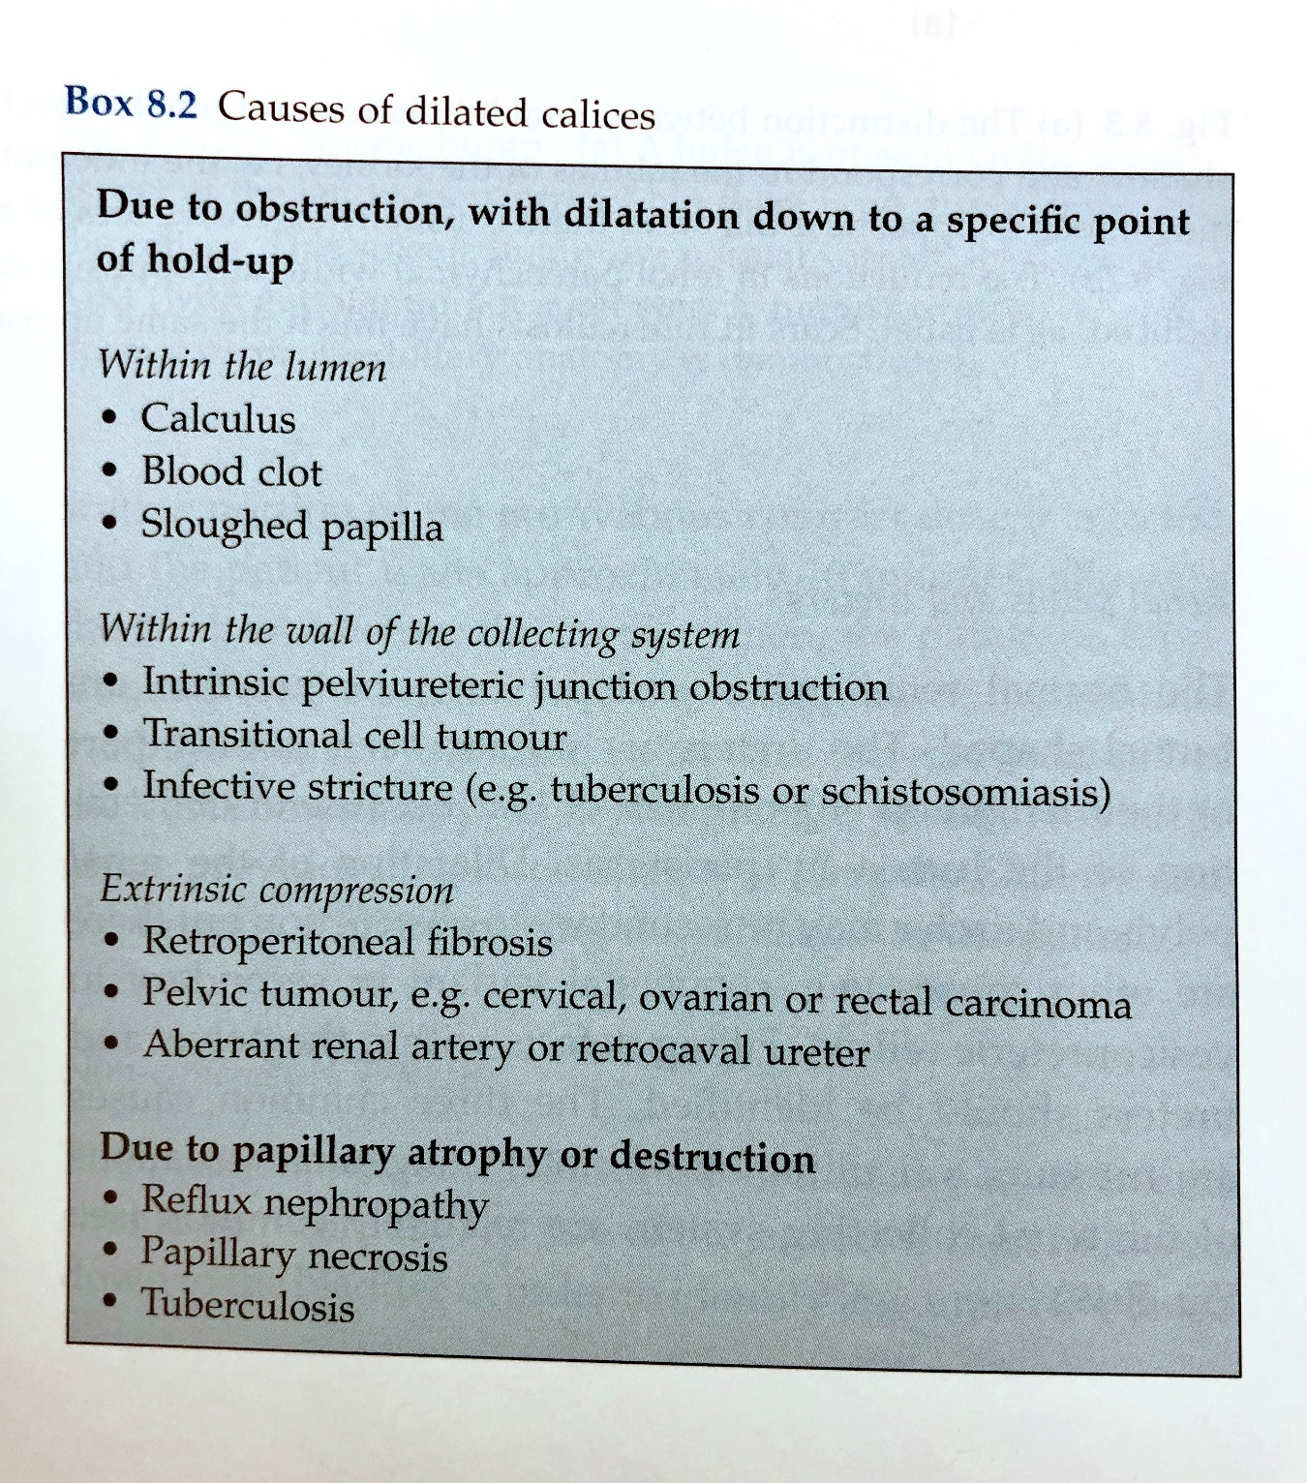

Slide 13
Acute Pyelonephritis
- Life threatening infection & medical emergency
- Through lower urinary tract
- Early diagnosis and management has significant impact on patient outcome
- Presentation: (Fever, loin pain, nausea/vomiting)
- Diagnosed mainly clinically

Slide 14
Predisposing Factors:
- Stones
- Obstruction
- Reflux
- DM

Slide 15
Pyelonephritis: Wedge shaped hypoperfused lesion

Slide 16
Cystitis
- Presentation: (Fever, suprapubic pain, frequent urination)
- As upper UTI, more common in females

Slide 20
Renal Masses
- Most solitary renal masses are either: malignant tumor or simple cyst
- In adult, a malignant tumor is almost certain to be a renal cell carcinoma (RCC) whereas in young children it is usually Wilm’s tumor
- Other causes of renal mass include: renal abscess, benign tumor (Oncocytoma, angiomyolipoma), metastasis

Slide 21
Multiple renal masses include:
- Multiple simple cysts
- Polycystic disease
- Malignant lymphoma
- Metastases
- Inflammatory masses

Slide 25
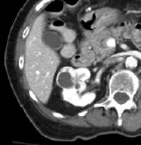

Slide 29
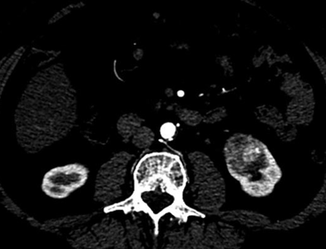
70 y/o female presented with painless hematuria

Slide 34
Large TCC of Rt renal pelvis

Slide 36
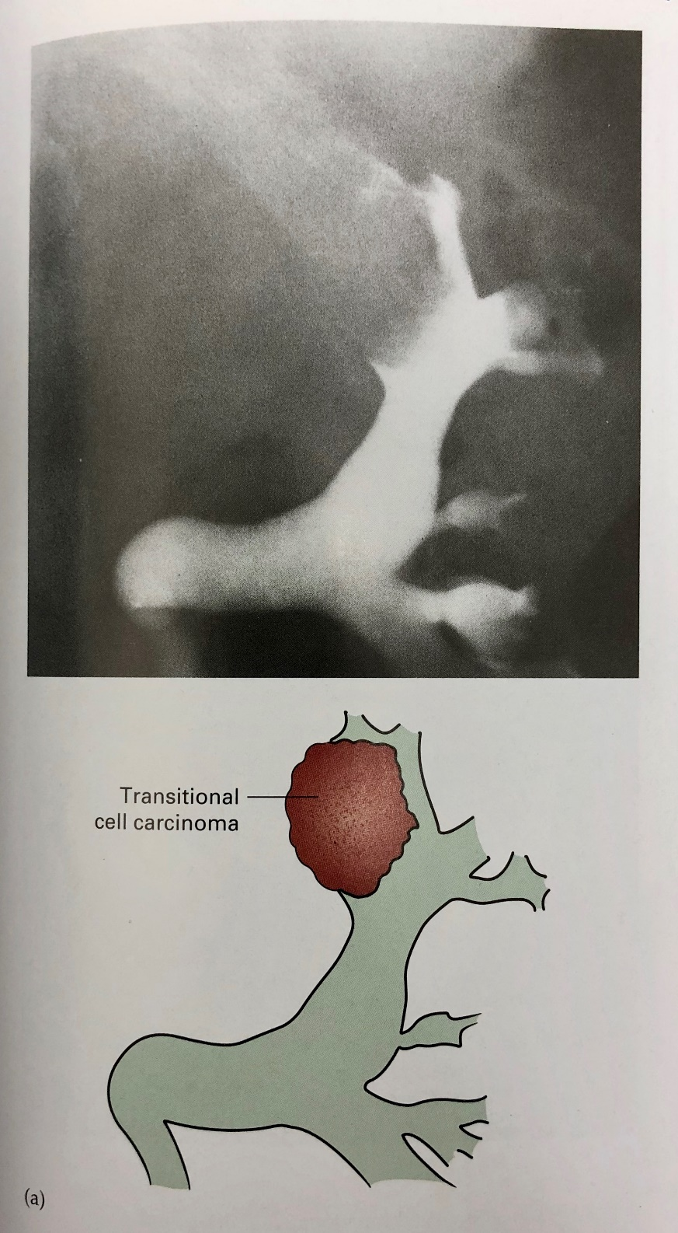

Slide 41
Grade 1-2 injury

Slide 42
Grade 3 injury

Slide 47
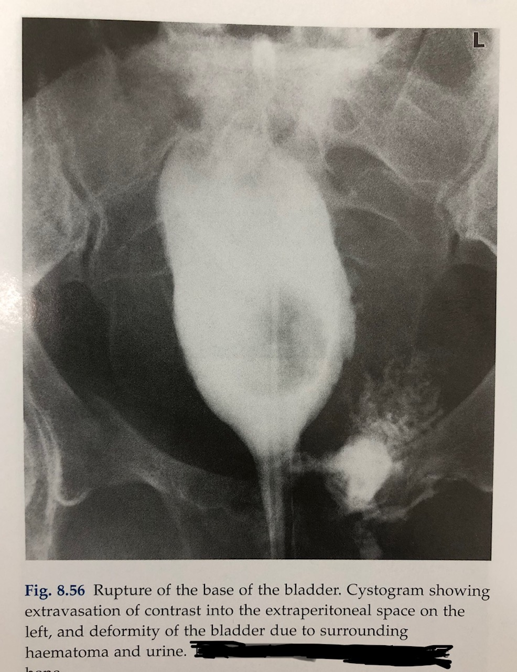

Slide 49
Thank you

