Slide 1
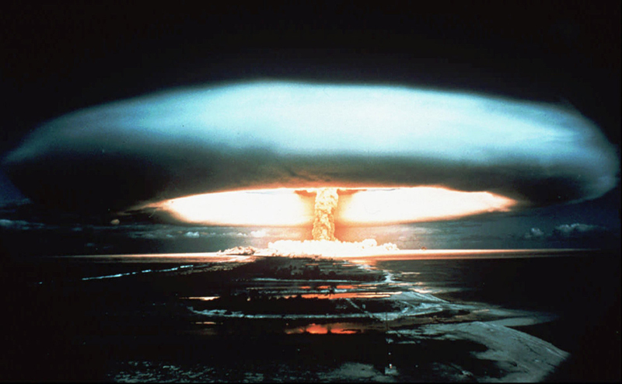
Nuclear Oncology
Saleh Othman , MD
Asso. Prof.& Consultant Nuclear Medicine
King Khalid University Hospital & School Of Medicine
King Saud University

Slide 2
Nuclear Oncology
LEARNING OBJECTIVES…
At the end of the lecture you will be able to
answer the following questions:
What are the tumor imaging and therapeutic radiopharmaceuticals?
What are the nuclear medicine tumor imaging methods?
What are the objectives of tumor imaging?
What are the potential values of nuclear medicine tumor imaging
methods?
What is the role of nuclear medicine in the treatment of tumors?

Slide 3
Tumor Imaging Tumor Metabolic properties
Increased vascularization
Increased capillary permeability
Newly proliferated capillaries
Increased blood flow
Metabolically active cells
Increased energy demand

Slide 4
Tumor Imaging Tumor Specific useful properties
High density of some common receptors
Expression of several specific receptors
Expression of some specific tumor antigenes
All these properties could be used for
imaging and therapy

Slide 5
Tumor Non-specific Diagnostic radiopharmaceuticals
PET or PET-CT
F-18 FDG – anaerobic metabolism
Planar, SPECT or SPECT-CT
Diphosphonates – bone scan
Ga-67 citrate – similar to FDG – localising agent
Tc99m Nanocolloid – bone marrow scan
Tc99m MIBI / Thallium 201 – several tumors
Demonstrate tumor sites but are not specific for malignancy

Slide 6
Tumor Specific Diagnostic radiopharmaceuticals
PET or PET/CT:
Gallium -68 –octreotide analogues (Ga-68 DOTA): For neuroendocrine tumors
Fluorine -18-fluorodeoxythymidine(F-18-FLT): For tumor proliferation
Fluorine -18-fluoromisonidazole(F-18-FMISO): For tumor hypoxia
Planar, SPECT or SPECT/CT:
I-123/131 MIBG for neuroendocrine tumours
I-131 for differentiated thyroid carcinomas
In-111 or Tc99m octreotide for tumours expressing somatostatin receptors.
Monoclonal antibodies labelled with In-111, I-123/131 or Tc-99m
Binds directly to special tumor antigens or receptors
or are accumulated by special metabolic pathway

Slide 7
Therapeutic radiopharmaceuticals
Non-specific
Sr-89, Sm-153, Re-189
Bone pain palliation
Specific
I-131
Thyroid cancer, as specific diagnostic if tumor significantly accumulates
Y-90
Zevalin – monoclonal antibody for B-cell lymphomas

Slide 8
NM Imaging modalities Planar Imaging

Slide 9
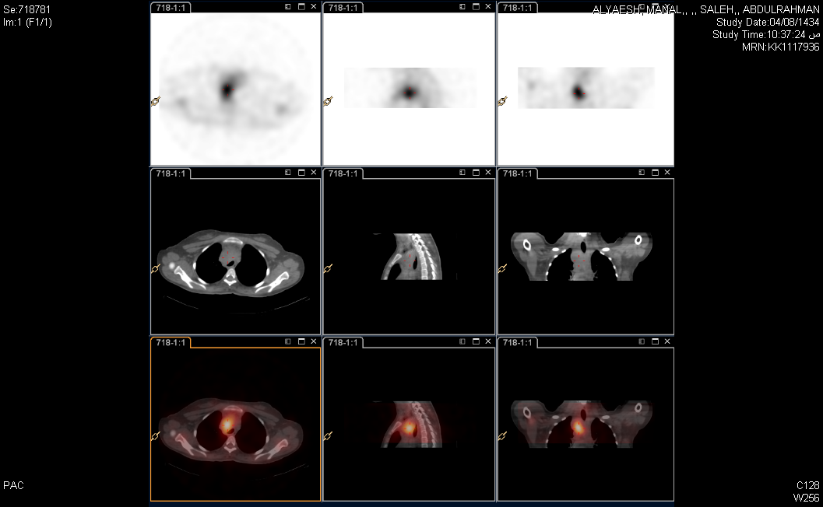
NM Imaging modalities
Single Photon Emission Computed Tomography (SPECT) and SPECT CT
Whole Body Gallium Scan : Planar Image
SPECT
SPECT/CT

Slide 10
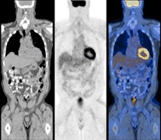
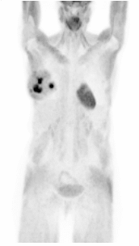
NM Imaging modalities
Positron Emission Tomography (PET) and PET CT
PET
PET/CT

Slide 11
Role for Nuclear Medicine In Oncology
Diagnosis
Specific or non-specific
Staging
Important for proper therapy
Follow-up
Early detection of recurrence
Treatment
Specific or non-specific

Slide 12
Tumor Imaging
Non specific tumor imaging agents:
Tc-99m MDP bone scan: Detection and follow up of bone metastasis
Gallium 67 : Staging ,Restaging & therapy assessment
of HD , NHL , Lung cancer
Thallium 201 : Tumor viability & tumor seeking.
{Tc-99 m Agents (MIBI ,TETRO.).}
F18 – FDG : Staging ,Restaging & therapy assessment
of HD , NHL , Lung cancer
Specific tumor imaging agents:
In–111 ( TC99m) Octreotide : Neuroendocrine tumors
I -123 MIBG : Neuroendocrine tumor
I -131 : Lung mets. thyroid carcinoma

Slide 13
Bone scan “Procedure”
Radiopharmaceuticals
Technitium 99m Methylene DiPhosPhonate (Tc-99m MDP)
Tissue accumulation depends on
blood flow
capillary permeability
metabolic activity of osteoblasts and osteoclasts
mineral turnover
Dose: 500 to 800 MBq (Megabequerel) / 15- 20 mCi (millicurie)
Imaging time: 2 to 3 hours postinjection – WB + SPECT
Potentials of bone scan: Positivity many months before an abnormality can be detected on X ray

Slide 14
Bone Scan In Oncology Indications
I- Metastatic Disease: Lung cancer, prostate, breast, thyroid, and renal tumours
Diagnosis.
Initial staging.
Restaging.
Asses response to therapy.
II- Primary Bone Tumors :
Malignant or Benign
Therapy planning for patients with primary bone malignancy ( e.g. Osteogenic & Ewings sarcoma)
III- Soft tissue tumors :
Primary
Metastases

Slide 15
Bone Scan In Oncology Imaging features
a. Hot lesions : Majority of bone tumors.
b. Cold lesions : Purely osteolytic tumors ( renal cell carcinoma,
thyroid cancer, anaplastic tumors),radiation therapy
c. Superscan : Diffuse increased skeletal uptake with no soft tissue
or kidney activity (e.g. CA prostate ,breast ,..etc).
d. Normal distribution : Marrow tumors
(e.g. lymphomas, leukemia, multiple myeloma).
e. Soft tissue uptake : Soft tissue tumors may concentrate the tracer.
f. Flare phenomenon – increased number of lesions in the case of effective therapy

Slide 16
Normal
Whole Body
Bone
Scan
An 8 year old child A 25 yrs old adult

Slide 17
Bone Scan : In Metastatic Disease
Access of Nonosseous Tumors To Bone:
Direct Extension.
Retrograde venous flow.
Arterial Circulation ( after venous or lymphatic access).
Epithelial Tumors:
Reach red marrow of axial skeleton via venous and arterial flow.
Distribution of red marrow in adult : calvarium, spine , pelvis , and proximal femurs and humerus
90% of metastasis from epithelial tumors are found in red marrow.
Metastatic Foci:
Grows in red marrow space.
The surrounding bone remodels through osteoclastic (resorption) and osteoblastic (deposition) activity.
The relative balance between resorption and deposition determine whether the lesion is hot (sclerotic) , cold (lytic) or mixed pattern.
The tracer does not concentrate in the metastatic foci (cancerous tissue) but in the surrounding reactive bone.

Slide 18
Bone Scan : In Metastatic Disease
Scan Patterns:
Solitary lesions.
Multiple focal lesions.
Diffuse involvement ( Superscan ).
Photon deficient lesions (cold lesions).
Flare phenomenon.
Normal (false negative).
Soft tissue lesions (tracer uptake in tumor).
Sensitivity:
In early stage superior to x-ray.
In advanced stage both have high sensitivity.
The accuracy of bone scan not known because of the lack of reference standard.
The sensitivity is agreed to be 90% or more.

Slide 19
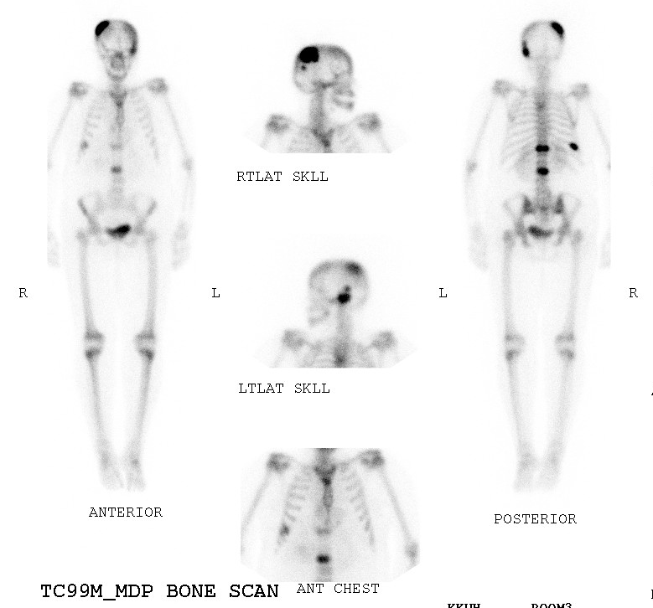
TUMOR STAGING
Ca Breast
CA LUNG
CA STOMACH

Slide 20
Bone Scan In Metastatic Disease Diffuse involvement ( Superscan )
Definition : Bone scan with diffuse symmetrical increased uptake and almost absence of soft tissue activity, lack of kidney activity and bone uptake seen in blood pool images.
Causes :
a. Bone metastases : Prostate, breast, lung, bladder and lymphoma.
b. Non tumor causes: HPT, osteomalacia, Pagets disease
and fibrous dysplasia
Important clues :
In metabolic bone disease the calvarium and long bones are involved unlike in bone metastases.

Slide 21
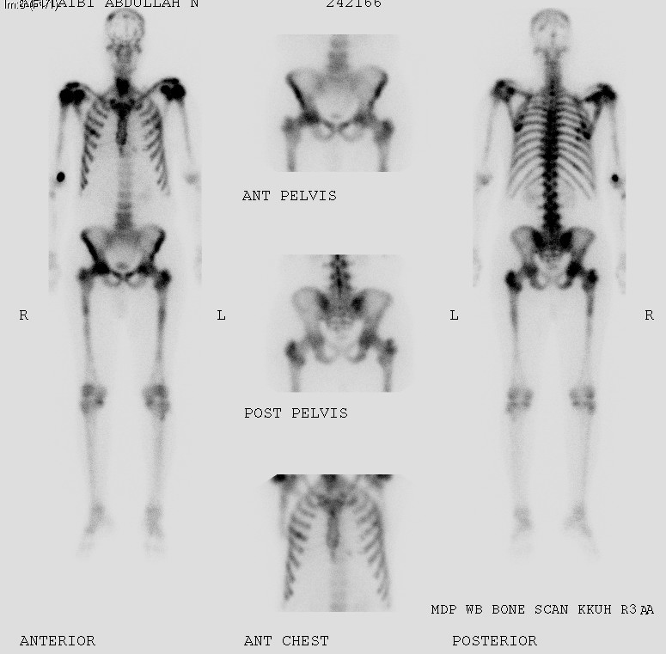
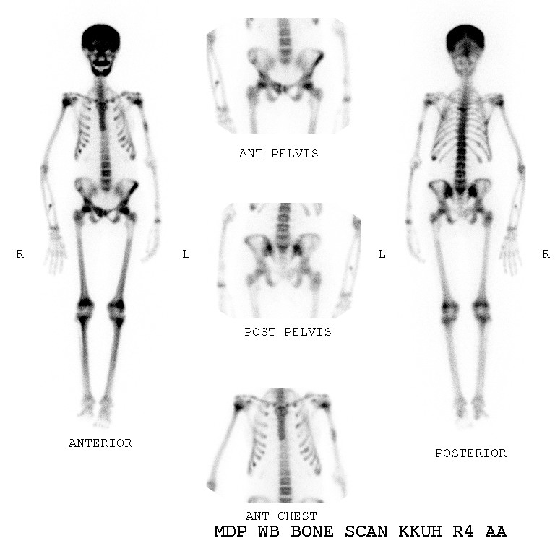
Superscan
CA Prostate
HPT

Slide 22
Pure Lytic Lesions

Slide 23
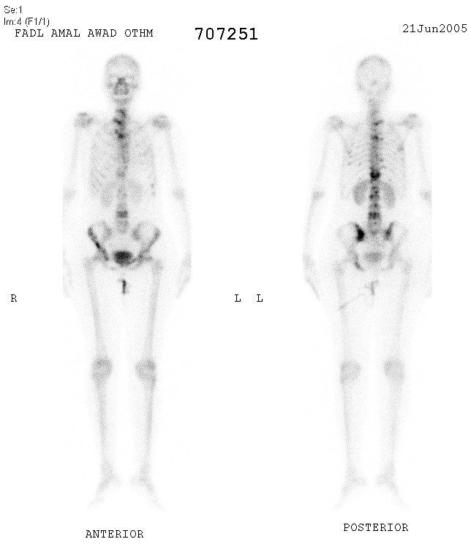
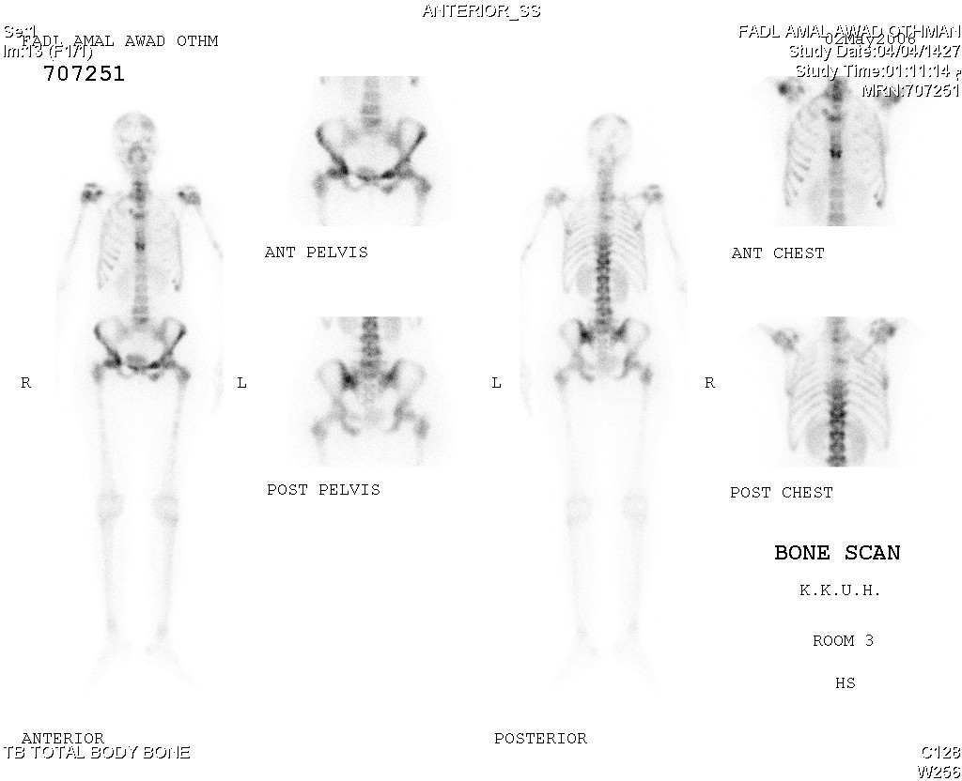
Bone Scan : Radiation Effects
Hours following radiation : Increased uptake due to increased blood flow and vascular permeability.
3-6 months post radiation : Decreased uptake due to microvascular injury. Dose related (>2000 rads).
Following Radiotherapy : Spontaneous ribs fracture may occur.

Slide 24
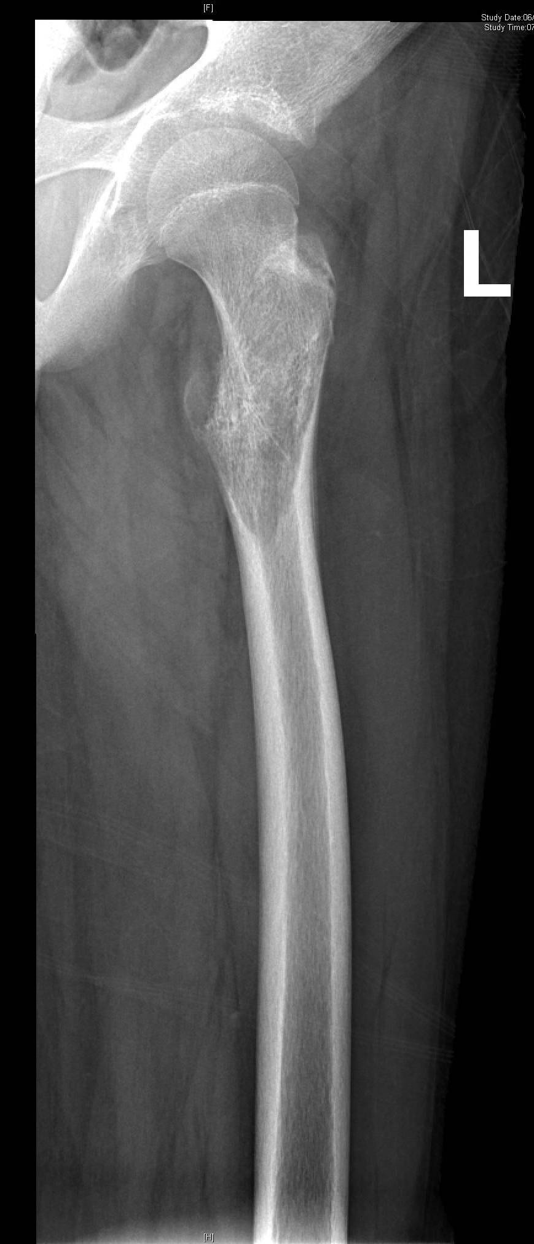
Ewing's Sarcoma
Notes:
‹#›

Slide 25
Bone Scan In Bone Tumors
Osteoid Osteoma

Slide 26
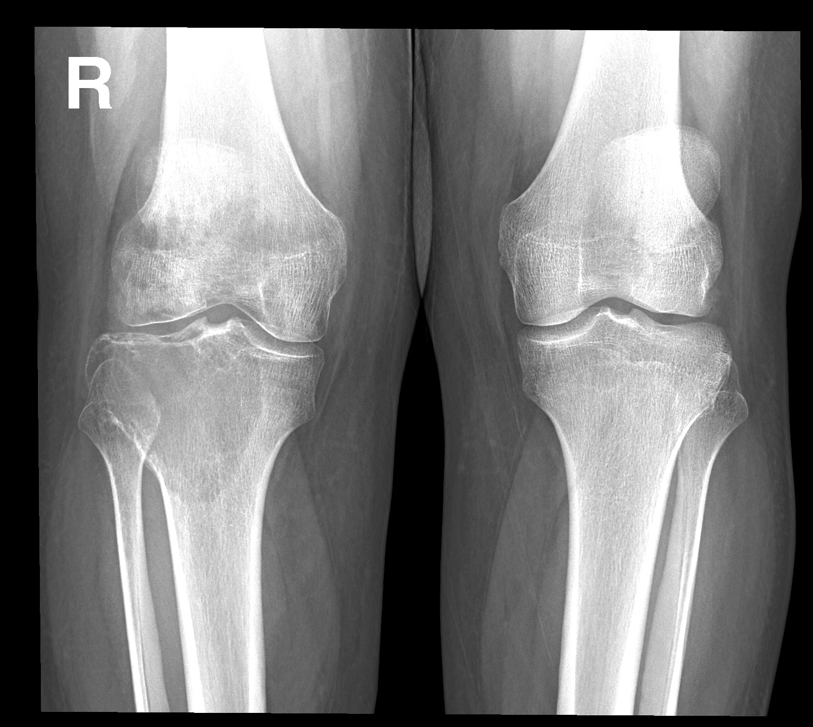
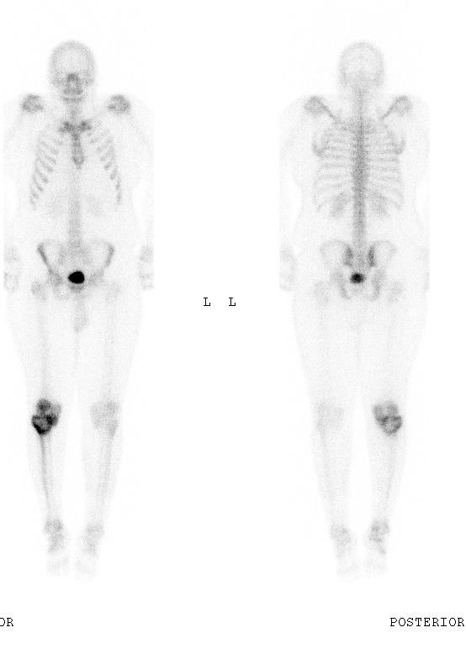
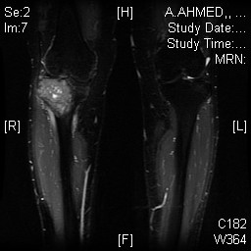
Giant Cell Tumor

Slide 27
Soft Tissue Sarcoma

Slide 28
Gallium 67 (Ga-67) scan
Properties: Introduced in seventies of 20th century for lymphomas
Mechanisms of accumulation
Tumour viability
Blood flow
Capillary permeability
Lymphatic drainage
Binds to Transferrin receptors on the tumour cells
Non specific for infection-inflamation and tumors
Excretion: Kidneys and large bowel
Imaging Protocol:
Patient preparation : Laxatives for bowel preparation post injection, nothing else
Several weeks post tumor therapy (FN)
Radiation therapy and chemotherapy can alter the normal pattern of gallium distribution
180 MBq (4-5 mCi) is usually administered
Imaging follows after 48 – 72 hours
WB + SPECT/SPECT CT, midium-energy collimator

Slide 29
Normal Ga-67 scan
Normal scan
Accumulates in bone marrow and liver.
Splenic uptake is variable.
The kidneys are usually visualized and
also lacrimal, salivary, nasopharyngeal
and genital activity is often present.
Female breasts can be visualized, but
accumulation is physiologically symmetrical
Radioactivity is commonly seen in the colon
Clinical indications
Lymphoma
Melanoma
Lung cancer
Hepatoma

Slide 30
Gallium Scan in Lymphomas
Staging
Follow up and monitoring of therapy
Detection of tumor recurrence
Differentiate postherapy changes : tissue necrosis and fibrosis from local recurrence.

Slide 31
Ga-67 Scan In Lymphoma Prediction of response to therapy
Normalization of a positive pre-therapy scan : A negative scan after one cycle
or at mid cycle is associated with a high likelihood of complete response .

Slide 32
Ga-67 Scan In Lymphoma
Prediction of outcome
Residual gallium uptake after treatment is a poor prognostic sign,
indicates viable tumor and treatment should be modified.

Slide 33
Gallium Scan NHL
Planar Vs SPECT CT

Slide 34
Neuroendocrine Tumors
In-111 octreoscan.
I123 MIBG Scan.

Slide 35
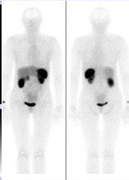
Somatostatin Receptor Imaging
Indium-111 Octreoscan
NORMAL STUDY

Slide 36
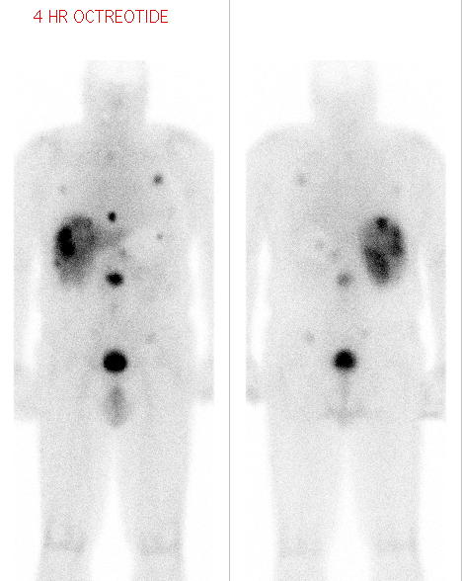
In - 111 octreoscan Insulinoma
Clinical History
The patient is a 66-ys
male with insulinoma,
now being evaluated for
evidence of recurrent
and/or metastatic disease.
Findings :
Multiple lung,
mediastinum , liver and
abdominal metastases.

Slide 37
I123 MIBG Scan
MIBG : Meta Iodo Benzyl Guanidine
Is a nor adrenaline analog
Localizes in adrenergic tissues: catecholamines producing tumors and their metastases.
Patient preparation: stop drugs interfering with MIBG uptake. Lugols solution to protect thyroid gland

Slide 38
I123 MIBG Scan Indications
Pheochromocytoma
Paraganglioma
Insulinoma
Neuroblastoma
Medullary thyroid carcinoma
Carcinoid tumors

Slide 39
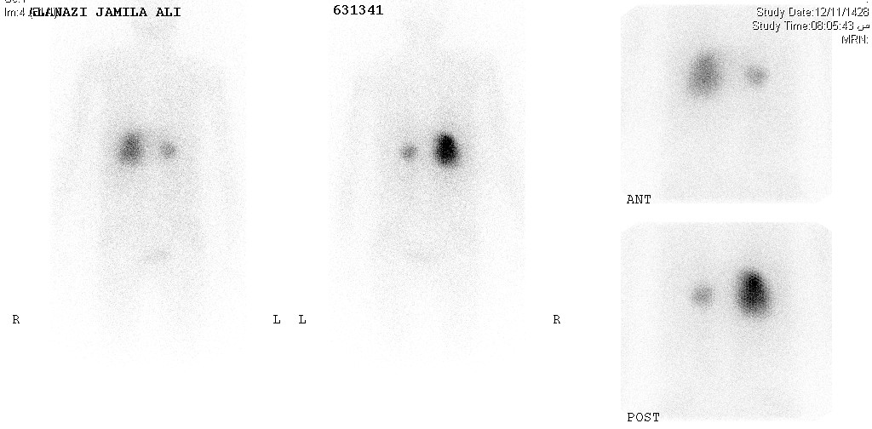
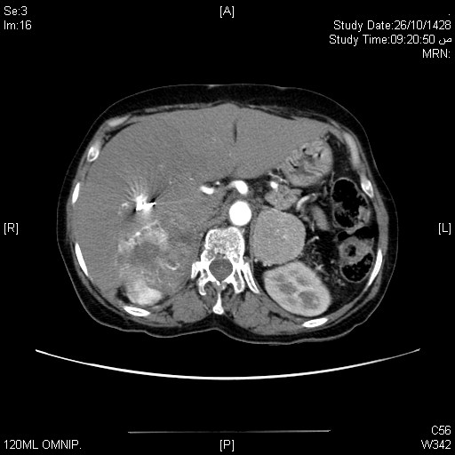
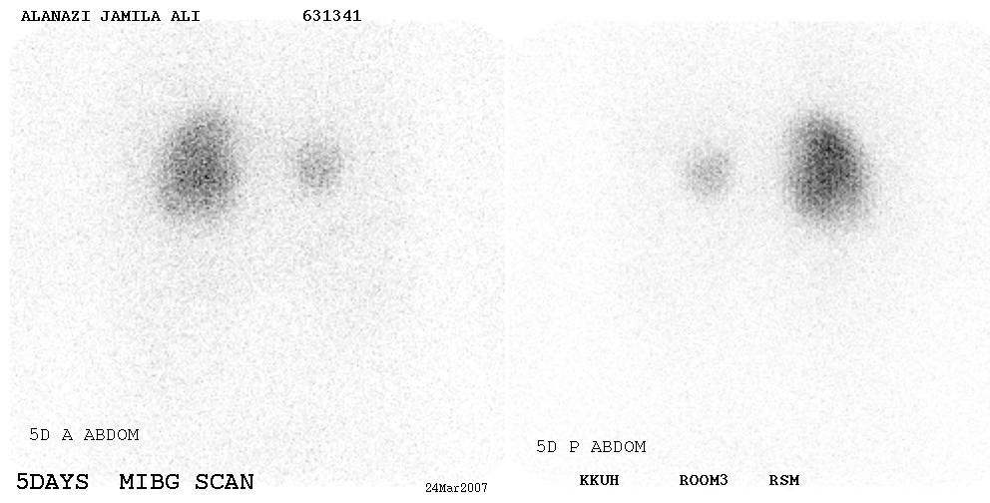
MIBG In Pheochromocytoma Bilateral Disease
Notes:
‹#›

Slide 40
Pheochromocytoma
Planar Vs SPECT CT
A 41 years old female patient is with 2ndary
hypertension. Right adrenal mass.
?Pheochromocytoma.

Slide 41
Neuroblasoma
Planar Vs SPECT CT

Slide 42
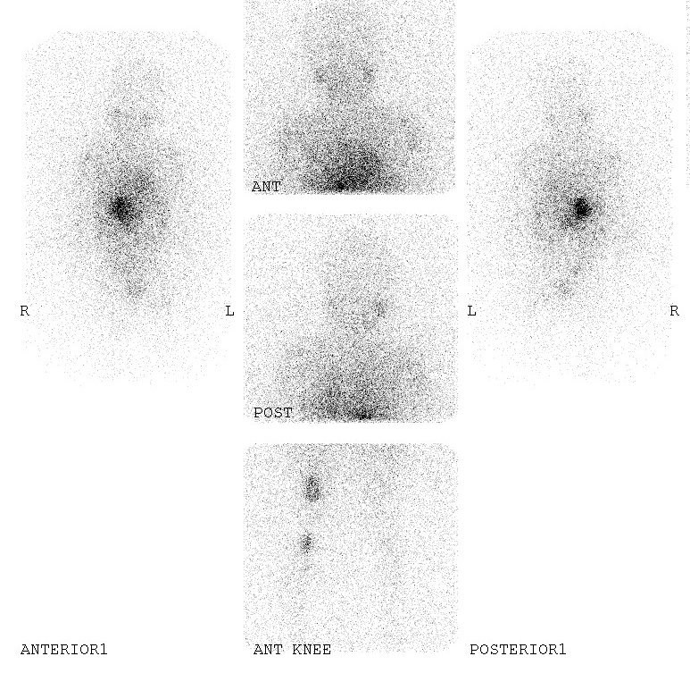
I131 MIBG Total body scan
1ry neuroblastoma /bone mets
Notes:
‹#›

Slide 43
THYROID METASTASES STUDY (I-123 or I-131 as Sodium Iodide)
Indications • Detection and localization of persistent or recurrent local or distant functioning thyroid cancer
Patient Preparation • Stimulation of potentially functioning thyroid tissue: A. Inject recombinant human thyrotropin on 2 consecutive days and administer the iodine on the third day .
B. Withdraw thyroid replacement hormones : 1. Thyroxine (T-4) for at least 4 weeks. 2. Triiodothyronine (T-3) for at least 10 days. • The patient must not have had i.v iodinated contrast material (IVP, CT with contrast, myelogram, angiogram) for at least 3 weeks . • The patient should be NPO for at least 4 hours prior to radiopharmaceutical administration and for at least 1 hour afterwards .
Tracer , Dose, & Technique of Administration • Radiopharmaceutical: Oral administration a. I-123 as sodium iodide : 2 mCi b. I-131 as sodium iodide : 2-10 mCi
Imaging using Gamma camera : Whole body scan

Slide 44
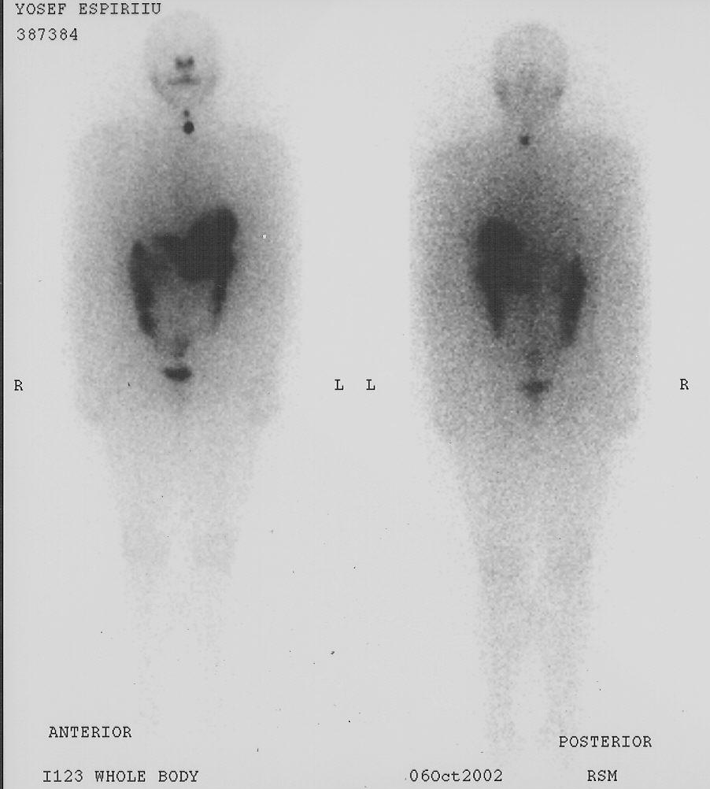
Thyroid Cancer I-123 WB Scan
Negative I-123 WB Scan
I-123 WB Scan : Post operative Thyroid remnants
Notes:
‹#›

Slide 45
I-123 WB Scan
Post operative Thyroid remnants
Planar Vs SPECT CT

Slide 46
THYROID METASTASES STUDY (I-123 or I-131 as Sodium Iodide)
Local Recurrence
Bone Metastases
Lung Metastases
Notes:
‹#›

Slide 47
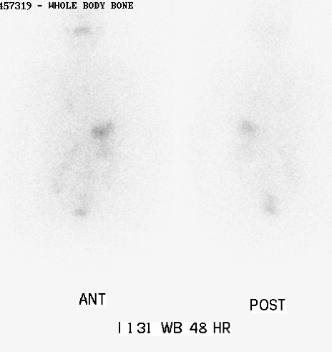
Thyroid Cancer I-131 Pre & Post therapy
Dec04
March06
Notes:
‹#›

Slide 48
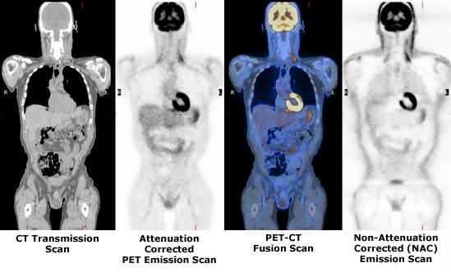
Onco PET ( PET and PET CT)
What is PET - CT ……?
PET : Positron Emission Tomography.
CT : Computerized Tomography.
PET-CT is the fusion of functional and anatomic information acquired almost simultaneously from which we are able to visualize form and function.
PET CT = PET + CT = Function + Form

Slide 49
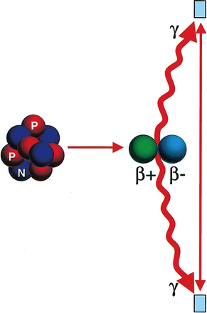
PET : How it is performed…?
detector
Positron emitters (e.g. F18) labelled with
biologically active natural compounds such
as oxygen, carbon or glucose give intravenously
and reacting in the body identically to their
non-radioactive counterparts.
Positrons are emitted from F18 and react with
tissue electrons.....Anhillation occurs...
Two photons 511 kev each in opposite
direction are emitted and detected by PET
SCANNERgiving an image of the normal and
abnormal distribution of tracer in the body.
detector

Slide 50
Positron Emitting Isotopes
Cyclotron produced isotopes:
Isotope T/2
Oxygen-15 2 min
Nitrogen-13 10 min
Carbon-11 20 min
Fluorine-18 110 min
Generator produced isotopes:
Parent T/2 daughter T/2
Strontium-82 25 days Rubidium-82 75 seconds
Zin-62 9.3 hrs Copper-62 10 min.
Germanium-68 288 days Gallium-68 68 min

Slide 51
FDG : Fluoro-2-deoxy-D-Glucose Uptake Mechanism
FDG is a glucose analogue used to asses glucose metabolism.
FDG transported from intravascular space to the cells by the same mechanism as the glucose.
In the cell, hexoKinase acts on both FDG and glucose to form:
FDG-6-phosphatase (FDG-6-PO4-)
Glucose-6-phosphatase.
FDG-6-PO4- cannot progress further into glucose metabolism and remains trapped intracellularly in proportion to glycolitic rate of the cell.
N = nucleus
In tumors, there is high rate of glycolysis compared to normal cells as well as higher level of hexoKinase.
FDG is labeled with F18

Slide 52
FDG : Normal distribution
Brain & heart --- High uptake
Liver --- Less uptake
Kidneys --- Unlike glucose, FDG is
excreted with urine
GI --- Mild clearance, faintly seen
Muscles --- Low, increase with exercise

Slide 53
FDG in Oncology
Tumors do not have a blood tumor barrier
FDG transport into tumors occurs at a higher rate than in the surrounding normal tissues.
FDG is de-phosphorylated and can then leave the cell.
The de-phosphorylation occurs at a slower rate in tumors.
Applications of FDG
•Locating unknown primaries
•Differentiation of tumor from normal tissue
•Pre-operative staging of disease (lung, breast, colorectal,
melanoma, H&N, pancreas)
•Recurrence vs necrosis
•Recurrence vs post-operative changes (limitations with FDG)
•Monitoring response to therapy

Slide 54
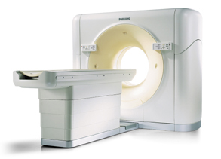
PET CT
F18 FDG IMAGING PROTOCOL
Fasting : 4 – 6 hours
Dose : Inject 10 mCi F18 FDG
Wait (uptake phase): 45 -60 min then scan
Scanning time : 30 min to complete PET CT study
SUV : Standard uptake value ( N:0.5-2.5 and Tumors > 3.0 )

Slide 55
FDG PET
FDG PET : Normal
FDG PET : Staging of NHL

Slide 56
FDG PET-CT Normal
FDG PET-CT
FDG PET-CT Staging Of Lymphoma

Slide 57
FDG PETCT
NHL : Stage IV

Slide 58
FDG PETCT : Hodgkin's lymphoma
Post 6 cycles of chemotherapy
for assessment.
Baseline
24.10.2018
Interim
1.1.2019
Final
19.5.2019

Slide 59
FDG PETCT: Hodgkin's lymphoma.
Post 6 cycles of chemotherapy for assessment.
“Partial metabolic response
(Deauville Score 5).
Baseline
31.3.2019
Interim
9.6.2019
Final
4.8.2019

Slide 60
FDG PETCT: Marginal zone lymphoma
Progressive disease (Deauville Score 5)
Baseline
19.2.2019
Interim
17.7.2019

Slide 61
FDG PETCT
Rectal cancer with liver metastases

Slide 62
FDG PET CT : Nasopharyngeal cancer with LN metastasis

Slide 63
FDG PET CT : RCC with bone and lung metastases
309756
" FDG-avid left renal mass coupled with FDG-avid locoregional nodal disease and multiple FDG avid pulmonary metastasis. "Solitary sclerotic area of hypermetabolism at the right iliac bone, worrisome for bone metastasis.

Slide 64
FDG PET CT : Metastatic Lung Cancer

Slide 65
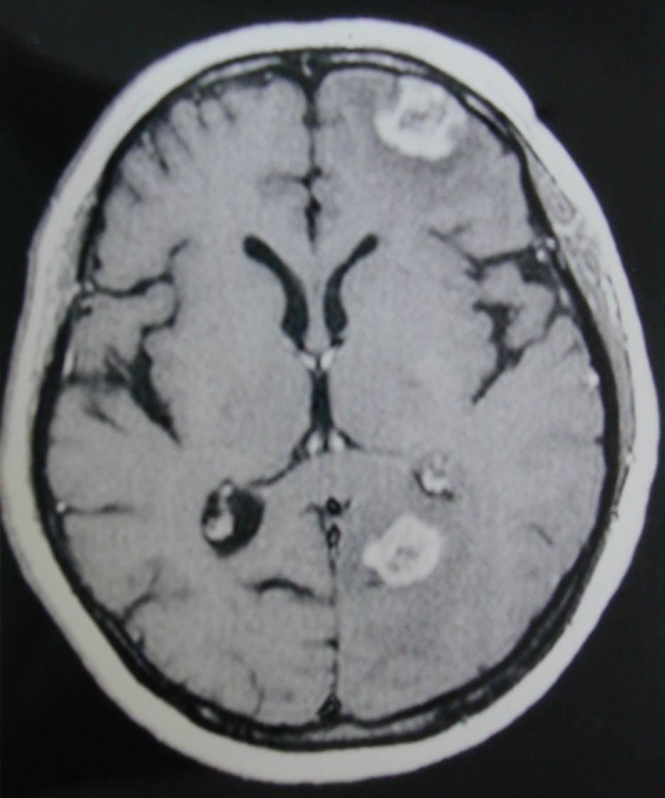
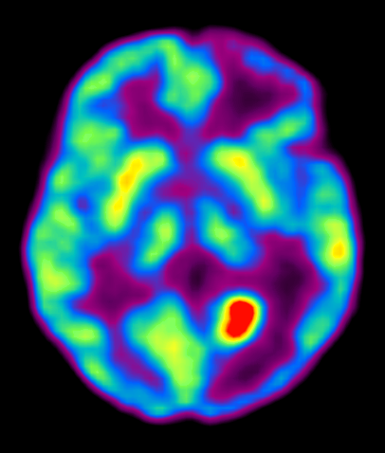
FDG PET – brain tumor

Slide 66
Indications of PET CT
Breast Cancer* | Staging*, restaging*, and monitoring response to therapy*
Colorectal Cancer | Diagnosis*, staging* and restaging*
Esophageal Cancer | Diagnosis*, staging* and restaging*
Head & Neck Cancers (excluding CNS and thyroid) | Diagnosis*, staging* and restaging*
Lung Cancer (Non-Small Cell) | Diagnosis*, staging* and restaging*
Lymphoma | Diagnosis*, staging* and restaging*
Melanoma (Excludes evaluation of regional nodes) | Diagnosis*, staging* and restaging*
Solitary Pulmonary Nodule | Characterization of indeterminate single pulmonary nodule
Thyroid Cancer* | Restaging
Cervical Cancer* | Staging as an adjunct to conventional imaging

Slide 67
Somatostatin receptor PET tracers Ga-68 DOTANOC
Radiopharmaceutical: DOTANOC , DOTATOC or DOTATATE is labeled with Ga-68
Dose: 3-5 mCi given intravenously.
PET Imaging time: 45-60 min postinjection
Clinical value: higher lesion detection rate than is achieved with (18)F-fluorodihydroxyphenyl-l-alanine PET, somatostatin receptor SPECT, CT, or MR imaging.
Sensitivity: 70-100% ( depends on density of somatostatin receptors in the tumor)
Indications: Tumours with high expression of receptors of somatostatin
1. Gastroenteropancreatic tumours (e.g. carcinoids,gastrinoma, insulinoma, glucagonoma, VIPoma, etc.),
2. Sympathoadrenal system tumours (phaeochromocytoma, paraganglioma, neuroblastoma, ganglioneuroma)
3. Medullary thyroid carcinoma
4. Pituitary adenoma
5. Medulloblastoma
6. Merkel cell carcinoma
7. Small-cell lung cancer (mainly primary tumours)
8. Meningioma

Slide 68
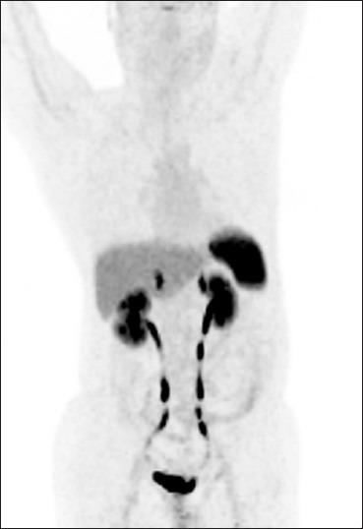
Normal Distribution 68Ga-DOTA peptide PET/CT
Normal tracer uptake is seen in the pituitary, salivary glands, thyroid, liver, spleen, adrenals, pancreas, kidneys, ureters, and bladder

Slide 69
Ga-68 DOTANOC PET
NET with multiple metastatic disease confined to the liver and abdominal cavity
NET with extensive metastatic lesions throughout the body

Slide 70
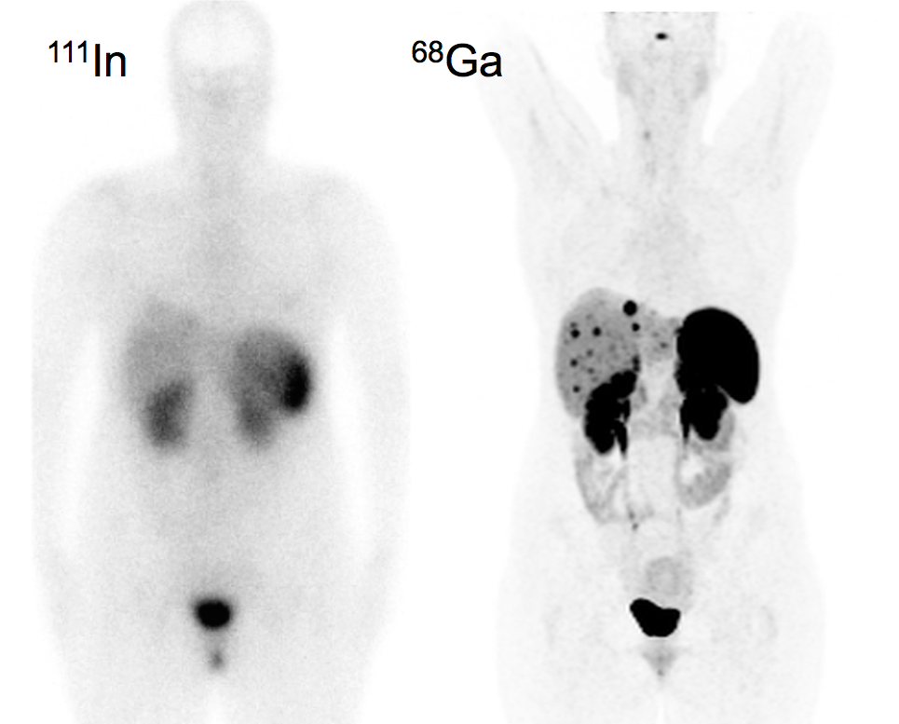
Ga-68 DOTANOC PET superior to In- 111 Octreoscan
Carcinoid tumor :
Positive ⁶⁸Ga-DOTA-NOC and
Negative ¹¹¹In-Octreoscan.
⁶⁸Ga DOTA-NOC Findings:
Multiple metastatic lesions in the liver. (The pituitary also expresses somatostatin receptors and is visualized in the ⁶⁸Ga PET image, along with normal uptake in the spleen, kidneys, and bladder.)
Indication of ⁶⁸Ga DOTA-NOC: The ⁶⁸Ga PET scan was performed because the patient’s symptoms were inconsistent with the ¹¹¹In-Octreoscan findings.

Slide 71
Pheochromocytoma
Ga68 DOTANOC superior to MIBG
SPECT CT - I123 MIBG
PET CT Ga68 DOTANOC

Slide 72
Radionuclide Therapy Properties of the Ideal Therapeutic Radiopharmaceutical
1. Pure beta minus emitter
2. Medium/high energy (>1 meV).
3. Effective half-life = moderately long, e.g., days.
4. High target:nontarget ratio
5. Minimal radiation dose to patient and Nuclear Medicine personnel
6. Patient Safety
7. Inexpensive, readily available radiopharmaceutical.
8. Simple preparation and quality control if manufactured in house.

Slide 73
Radionuclide Therapy
Agent Indication Dose
I131 : Thyroid cancer 100-200 mci
131 MIBG : Neuroblastoma 100-300 mCi
Strontium-89 : Bone metastasis 40-60uCi/kg
Sm-153-EDTMP: Bone metastasis 1.0 mCi per kg
Phosphorus- 32 : Polycythaemia 2.3 mCi/m2
Y-90-Ibritumomab
Tiuxetan [Zevalin®]: B-Cell NHL 0.3 mCi/kg
> Platelet count > 150,000 cells/mL: 0.4 mCi/kg
> Platelet count 100,000-150,000 cells/mL: The dose should never exceed 32 mCi (1,184 MBq)
Notes:
‹#›

Slide 74
Strontium-89 Therapy for Palliation of Bony Metastases
History :
A 65 Ys ,M, with CA prostate and widespread bone metastases and severe bony pain.
Admitted for palliative Strontium-89 therapy.
Procedure :
Bone metastases was confirmed by bone scan.
The patient was given 40 mCi of Strontium-89 I.V.according to body weight of the patient.
The patient experienced one day of exacerpated
pain which was controlled by opiates but the following day showed gradual pain relieve.
Notes:
‹#›

Slide 75
Teaching Points
NM tumor imaging
Functional
Sensitive
Whole body evaluation
Specific : Some tumors
Targeted therapy
Objectives of NM tumor imaging
Diagnosis
Staging
Guiding biopsy
Follow up and therapy monitoring
Detection of recurrence.

Slide 76
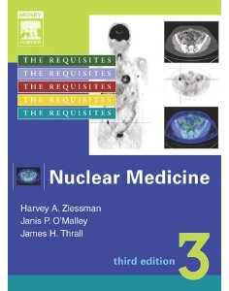
Reference book and the relevant page numbers..
Nuclear Medicine: The Requisites, Third Edition (Requisites in Radiology) [Hardcover]
Harvey A. Ziessman MD, Janis P. O'Malley MD, James H. Thrall MD
Relevant Pages :
Oncology : 264-274 , 279 -283 ,302 -345 ,
119-133 , 109 -112 ,296 -299

