Slide 1
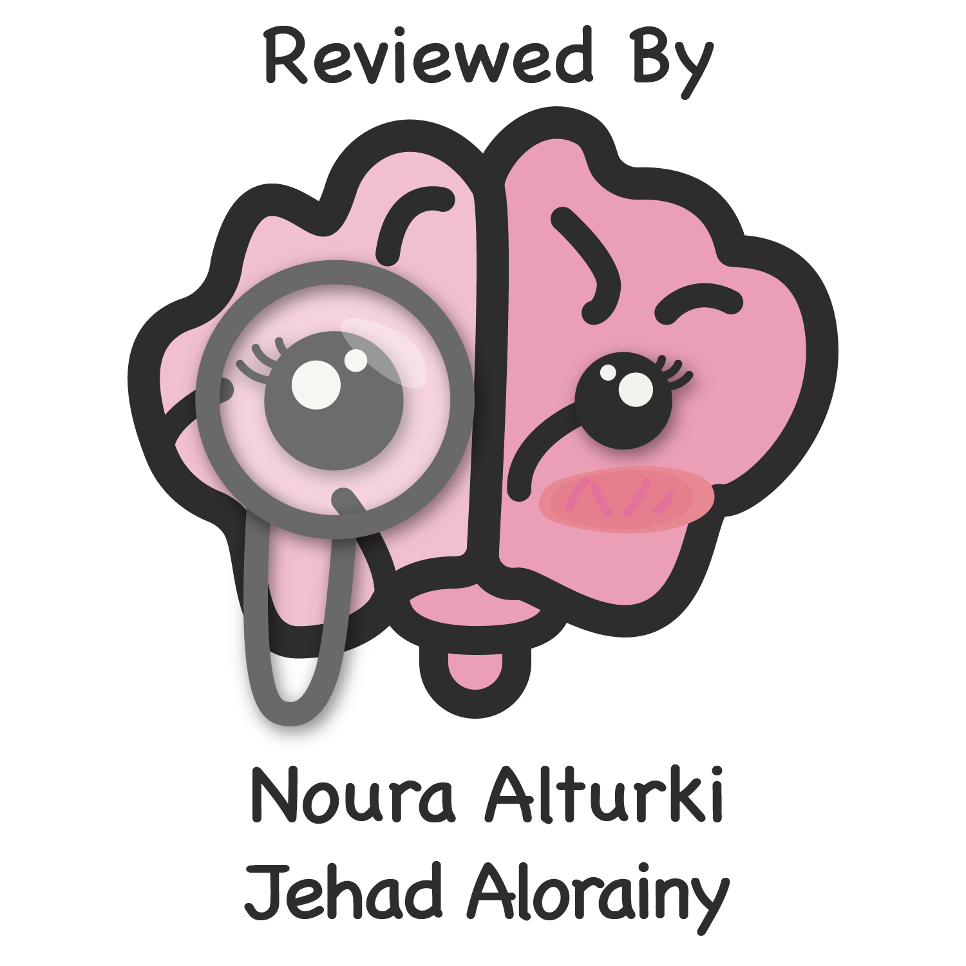
Editing file

Slide 2
Personal history
Chief complaint/ Duration
History of present illness
Past medical history
Past surgical history
Medication/allergies
Family history
Social history
Obstetric history

Slide 3
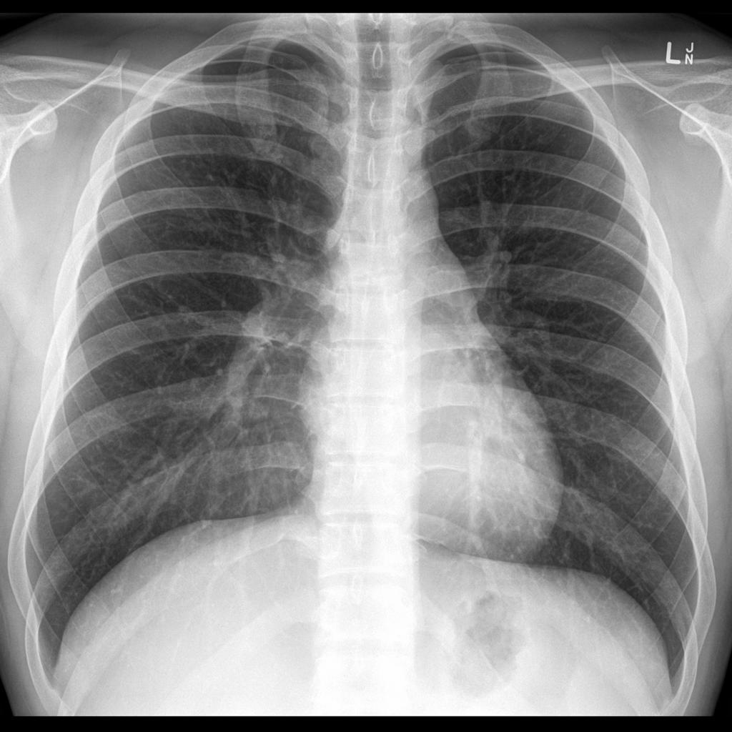
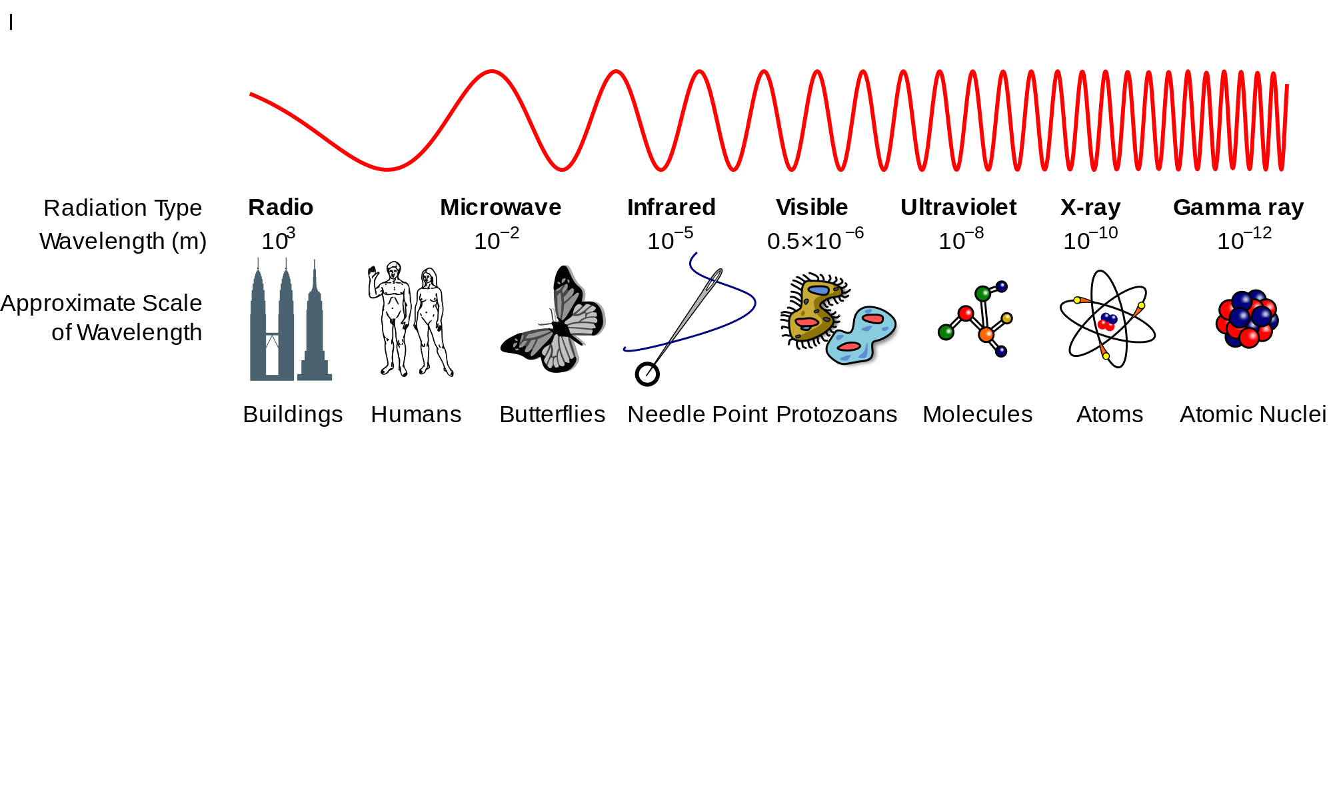
Radiology
What is Radiology?
Medical specialty that supervises, perform and interprets imaging studies.
Reports findings to referring physicians to help in the patients management.
Medical specialty that use medical imaging technologies to diagnose and treat patients.
Diagnostic Modalities used in radiology
plain
X-Ray
Computed Tomography
(CT)
Magnetic Resonance Imaging (MRI)
Ultrasound
(US)
Nuclear Medicine (NM)
Angiography
(ANG)
Which of these modalities use ionizing radiation? • X-Ray • CT • Nuclear medicine
Contrast Media
Natural contrast in the body
Added contrast in the body
Air
Fat
Bone
Barium sulfate (non water soluble) safe for GI tract, given orally because it precipitates and cause blocking of the vessels if given IV
Iodine (water soluble) can be given as IV
X-RAY
It is a form of Electromagnetic energy that travel at the speed of light.
Discovered and named by Dr. W. C. Röentgen at University of Würzburg, 1895.
X-Rays are emitted and detected in cassette generating, either a hard copy film or a digital image.
Image key = shades (Densities)
(Q:where on this image have x-rays passed through the body to the greatest degree?lungs)
Electromagnetic energy wave spectrum
Gamma Rays
X-rays
Visible light
Infrared light
Microwaves
Radar
Radio waves
Air Fat Soft tissue Bone
The higher frequency and shorter wavelength, the higher penetration ability
1

Slide 4
X-RAY & Fluoroscopy
The X-RAY Beam Interaction
Projections (views) are usually described by the path of the x-ray beam.
Thus, the term PA (poster anterior) view designates that the beam passes from the back to the front. (standard projection for a routine chest film).
X-rays are emitted and detected in cassette which generate either a hard copy film or a digital image
1) Pass all the way through the body:
2) Be deflected, scattered or absorbed:
Render the film DARK (BLACK shadow) Radio-LUCENT
Low atomic number, eg; air
Air has a low atomic number
X-rays get through → image is DARK
Render the film LIGHT (WHITE shadow) Radio-OPAQUE
high atomic number, eg; bone / Fat / Soft tissue/fluid /Metal / Mineral
Bone has a high atomic number
X-Rays are blocked → image is LIGHT
Advantages
Disadvantages
Widely available
Inexpensive
Doesn’t require advanced technologist knowledge
Can be performed quickly
Can be portable
Ionizing Radiation. can be carcinogenic / to the fetus → mutagenic or even lethal
Relatively insensitive
Requires patient cooperation
FLUOROSCOPY
A dynamic contrast study, (dynamic) real-time imaging, utilizes image intensifier.
It’s a combination of:
X-Rays
Contrast agents
Technique
Real-time imaging
Using intensifier
dynamic, detect the movement of the contrast fluid in certain organs
e.g. (to assess esophagus leakage after swallow in the GIT)
Using intensifier: to magnify the X-Rays without increasing the amount of radiations for patient’s safety.
since Fluoroscopy study is continuous it has more exposure to radiation. but, using an intensifier leads to less energy intensity but still have a good image.
Uses of FLUOROSCOPY
GIT imaging
(e.g. dysphagia, peristalsis)
Angiography
Foreign body removal
Musculoskeletal
Intraoperative (during surgery)
Genitourinary imaging
commonly used for recurrent UTIs, vesicoureteral refluxObstructions, dilatations, collecting system abnormalities
2

Slide 5
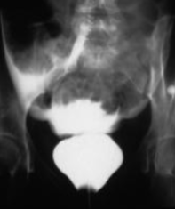
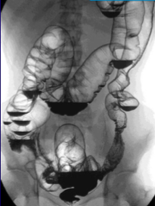
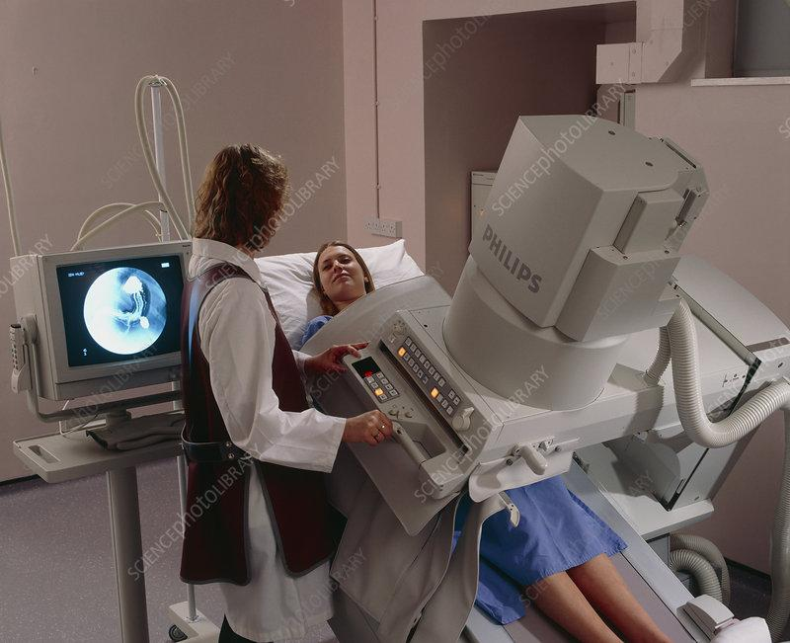
FLUOROSCOPY and CT
Advantages
Disadvantages
Widely available.
Inexpensive
Functional and anatomic imaging.
No sedation required
Requires ingestion/injection of contrast medium.
Patient cooperation.
Radiological hazard
Time consuming
It is time consuming because we are following contrast agent inside organs
COMPUTED TOMOGRAPHY (CT)
How Does CT Works?
Rotating an X-Ray tube with the X-Ray detector, & the patient will go through these rays
cross-sectional images (like slices) is received (Axial) from the body. Each slice is an image itself
Data displayed in multiple window settings (lungs parenchyma, bone, etc.)
these images are reconstructed to create other images from different views (e.g. coronal) which are 3D images
To show coronal (frontal) or Sagittal images, data are manipulated (reconstructed) by a computer
Relies on X-Rays transmitted through the body that differs from conventional Radiography (plane X-Ray) in that a more sensitive X-Ray detection system is used.
It has the capability to measure the density by analyzing the chemical component of tissue, “Hounsfield Unit (HU)”
Density
Density is measured by Hounsfield Unit (HU)
CT has very small differences in X-Ray absorption values compared with conventional radiography; the range of densities recorded is increased approximately 10-fold.
So, gradations of density within soft tissues can be recognized, e.g. brain substance from cerebrospinal fluid, or tumor from surrounding normal tissues.
Air: -1000
Fat: -150
Water: 0
Soft Tissue: 20-80
Blood: 45-75
Bone/Ca: >100->1000
3

Slide 6
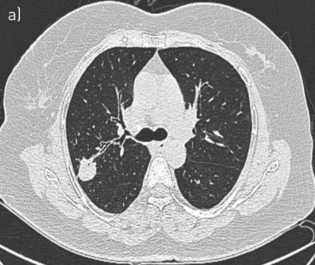
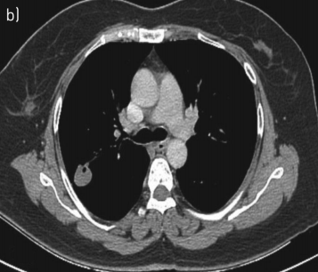
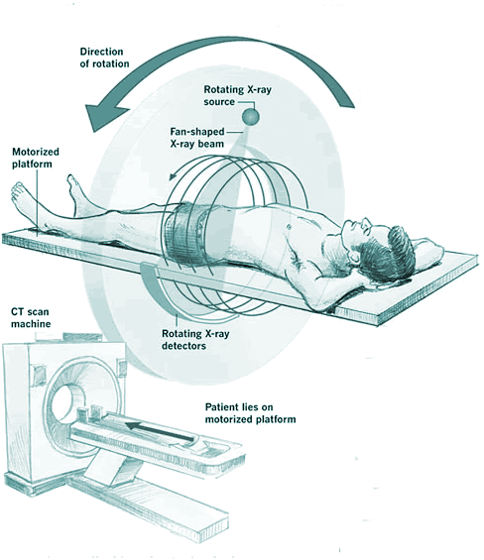
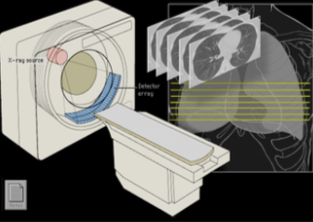
FLUOROSCOPY
COMPUTED TOMOGRAPHY
Different Windows
Wide window
Narrow window
to visualize more structure within a certain organ such as bronchi, vessels and alveoli in the lung (Lung window) (Bone to visualize cortex, medulla and trabeculae)
to visualize certain structures within certain region such as major vessels and heart in mediastinum “Vascular structures” (mediastinum window)
Uses of CT
Neuroimaging:
Emergency: Acute head trauma, acute intracranial hemorrhage.
Low sensitivity for:
Early ischemic stroke.
Intracranial metastatic disease.
White matter degenerative disease
Head and neck imaging:
Soft tissue of neck, paranasal sinuses, temporal bone, & orbital wall imaging
Body imaging:
Chest, Abdomen, Pelvis (with enteric and IV contrast)
Pulmonary nodules, Renal calculi (without contrast)
Acute appendicitis (with enteric and IV contrast)
Acute Abdomen:
Decrease rate of false laparotomy
Trauma spine imaging:
(Cervical, thoracic, lumbar) It can miss fractures.
Other osseous imaging:
pelvis and extremities
Vascular imaging:
CT angiography I.e. Coronary arteries.
Specialized protocols:
Liver masses, pancreatic tissue, renal masses, and adrenal masses
Advantages
Disadvantages
Can give: Cross sectional, Sagittal and Coronal Images
More sensitive
Expensive
High Radiation
So, don’t request a CT scan unless needed, and we can't use it for a pregnant women unless absolutely necessary
One brain CT scan radiation = 200 X-Ray radiation
One pelvic CT radiation = 400 X-Ray radiation
4

Slide 7
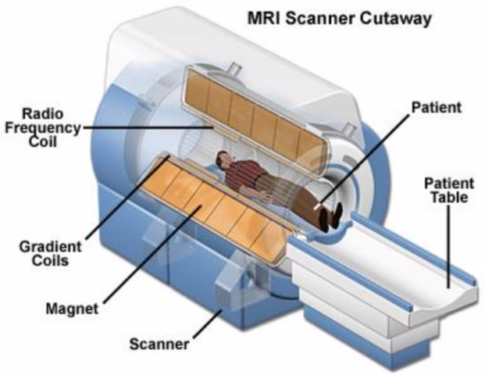
MRI
MRI
T1 weighted (T1WI). (Fat →whit) ( Fluid → dark) (Subacute hemorrhage → white)
T2 weighted (T2WI), (Fluid →whit),( Fat less white compared to T1 weighted)
Bone appear black on all sequences.
Air also appear black on all sequences.
On Flair fluid appear jet black. Very good for detection of demyelination plaques and haemorrhages
MRI contrast agent. Gadolinium DTPA (Ethylene Triamine Penta acetic acid) is used as contrast agent. It is used with T1W images only.
How can we produce an image by the MRI?
it depends on the idea of that the body is full of tiny magnets which are the atoms (Ex: hydrogen atoms,markedly abundant in the body organs) then follow these 5 steps:
Hydrogen Atoms (protons) in water molecules and lipids:
Magnetism affects all protons causes them to line up in one direction.
Magnets can be switched on and off to change the direction of the magnetic field.
Whenever the water molecule spin around they give a light radio wave.
MRI machine can detect it and shows it as images.
Like CT, gradation of density within soft tissues can be recognized e.g. brain substance from cerebrospinal fluid, or tumor from surrounding normal tissues.
Advantages
Disadvantages
The best soft tissue imaging and pathology (tumors and infections), Show better tissue characteristics
Better tissue construction then CT
No ionization.
Can be done on pregnant women.
Images can be obtained in any plane
(unlike CT which is taken in axial position)
Useful for soft tissue pathology (Tumor, infection) MSK
Multisequence play with characteristic abnormal tissues
MR angiogram can be perform without introducing contrast media
Expensive.
Time consuming. so we can’t use it on emergency patient
May evoke phobias Claustrophobia
No metals allowed
Motion.
Patients have to keep still during the producer
Sagittal
Axial
Coronal
Image key = shades (Intensities)
5

Slide 8
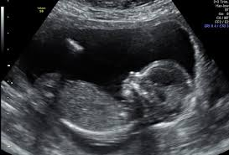
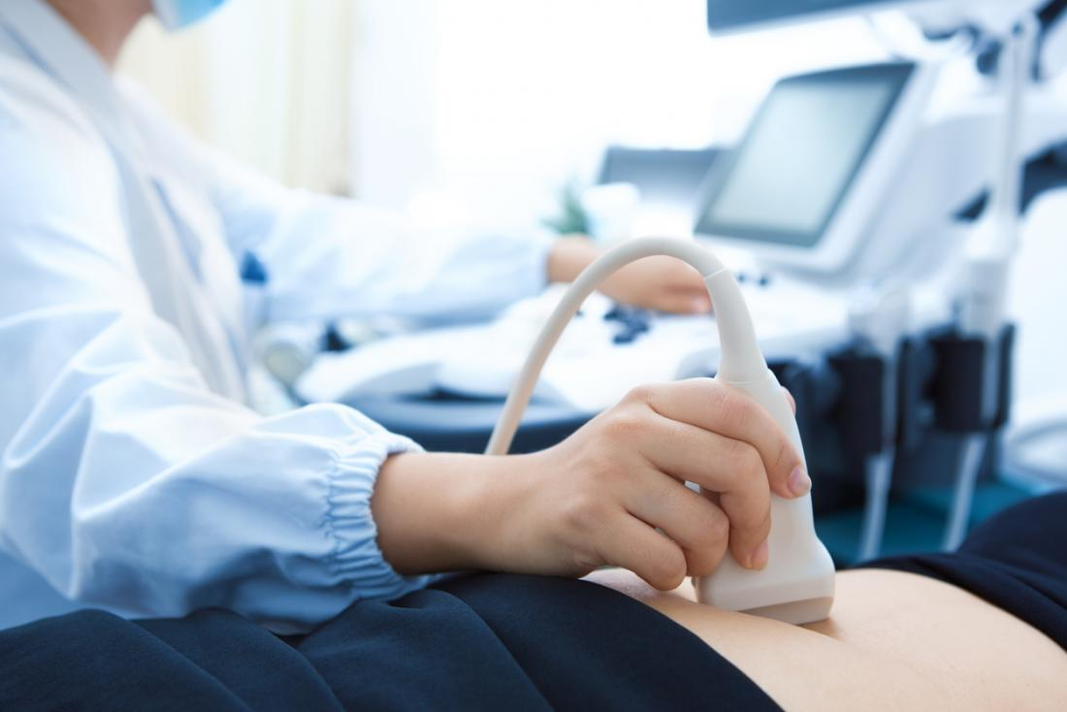
Ultrasound & Nuclear medicine
ULTRASOUND
Echogenicity
Ultrasound is sound waves with frequencies which are higher than those audible to humans (>20,000 Hz).
Ultrasonic images also known as sonograms are made by sending pulses of ultrasound into tissue using a probe.
The sound echoes off the tissue; with different tissues reflecting varying degrees of sound.
The echoes are recorded and displayed as an image to the operator.
Needs a well-trained operator.
A Doppler ultrasound is a noninvasive test that can be used to estimate the blood flow through the blood vessels, (can be used to differentiate the vessels (renal arteries) from the collecting system in the kidney.)
Shadowing
Doppler for flow
Advantages
1. No radiation (safest for pregnant ladies) 2. Can be portable “easily used in ICU” 3. Relatively inexpensive
White areas:
Shows echogenic structure which transmit & reflect sound waves e.g. fat, vessels, nodes soft tissue.
Black areas:
Shows anechoic areas. Fluids transmit but does not reflect sound waves
Lines:
Occur at boundary of two markedly different tissue reflectors (boundary of organs)
NUCLEAR MEDICINE
Uses gamma rays to produce an image (counts or activity).
Radioactive nuclide given IV, per OS or per rectum, etc.
Rays emitted from the patient.
Physiological imaging (abnormal function, metabolic activity)
Poor for anatomical information.
Radioactivity stays with the patient until cleared or decayed
In the nuclear medicine: the source is from patient while the
detector is outside unlike the others “source were outside”
Advantages
Disadvantages
Evaluation of the functional and anatomical features of the structure
Sensitive but not that much specific
6

Slide 9
SUMMARY
 | Advantages | Disadvantages | information
X-RAY |  | Ionizing Radiation. Relatively insensitive (superimposed structures) Requires patient cooperation | The X-RAY Beam Interaction: 1-Pass all the way through the body 2-Be deflected, scattered or absorbed
 | Widely available. Inexpensive Functional and anatomic imaging. No sedation required | Requires ingestion/injection of contrast medium. Patient cooperation. Time consuming
COMPUTED TOMOGRAPHY (CT) | Can give: Cross sectional, Sagittal and Coronal Images More sensitive | Expensive High Radiation
MRI | The best soft tissue imaging and pathology (tumors and infections). No ionization. Can be done on pregnant women. Images can be obtained in any plane | Expensive. Time consuming. so we can’t use it on emergency patient May evoke phobias Claustrophobia No metals allowed Motion. | MRI sees tissues based upon subatomic characteristics (magnetism).
ULTRASOUND | No radiation Can be portable Relatively inexpensive | Needs a well-trained operator. | Ultrasonic images also known as sonograms are made by sending pulses of ultrasound into tissue using a probe.
NUCLEAR MEDICINE | ⬩Used for Physiological imaging (abnormal function, metabolic activity) | ⬩Poor for anatomical information. ⬩Radioactivity stays with the patient until cleared or decayed | Uses gamma rays to produce an image (counts or activity).
Widely available
Inexpensive
Doesn’t require advanced technologist knowledge
Can be performed quickly
Can be portable
Uses:
⬩GIT imaging
⬩Foreign body removal
⬩Musculoskeletal
⬩Intraoperative
⬩Genitourinary imaging
FLUOROSCOPY
Types:
⬩Wide window
⬩Narrow window
Uses:
⬩Neuroimaging
⬩Head and neck
⬩Body imaging
7

Slide 10
quiz
1-Which of these modalities use ionizing radiation
Plain X-Ray
Ultrasound
Magnetic Resonance Imaging (MRI)
Nuclear Medicine (NM)
2-body imaging of chest,abdomen,pelvis using CT scan?
With IV contrast only
With enteric and IV contrast
Without enteric
Without contrast
3-Skeletal appearance on x-ray image is?
A)Dark grey
B) Dark
C) Bright grey
D) White
4--Which of the following axises will appear by direct CT scan?
A) Axial
B) Sagittal
C) Coronal
D) Oblique
5-What waves are used in fluoroscopy ?
A)X-rays
B) Gamma-rays
C) CT
D) Alpha
6-One of the specialized protocols for the uses of CT SCAN?
Pancreatic tissue
Pulmonary nodule
Acute appendicitis
Renal calculi
7-High atomic number substances will appear ...in x-ray?
Light
Dark
Answers
1)a & d
2)B
3)D
4)A
5)A
6)A
7)A
Extra questions
8

