Slide 1
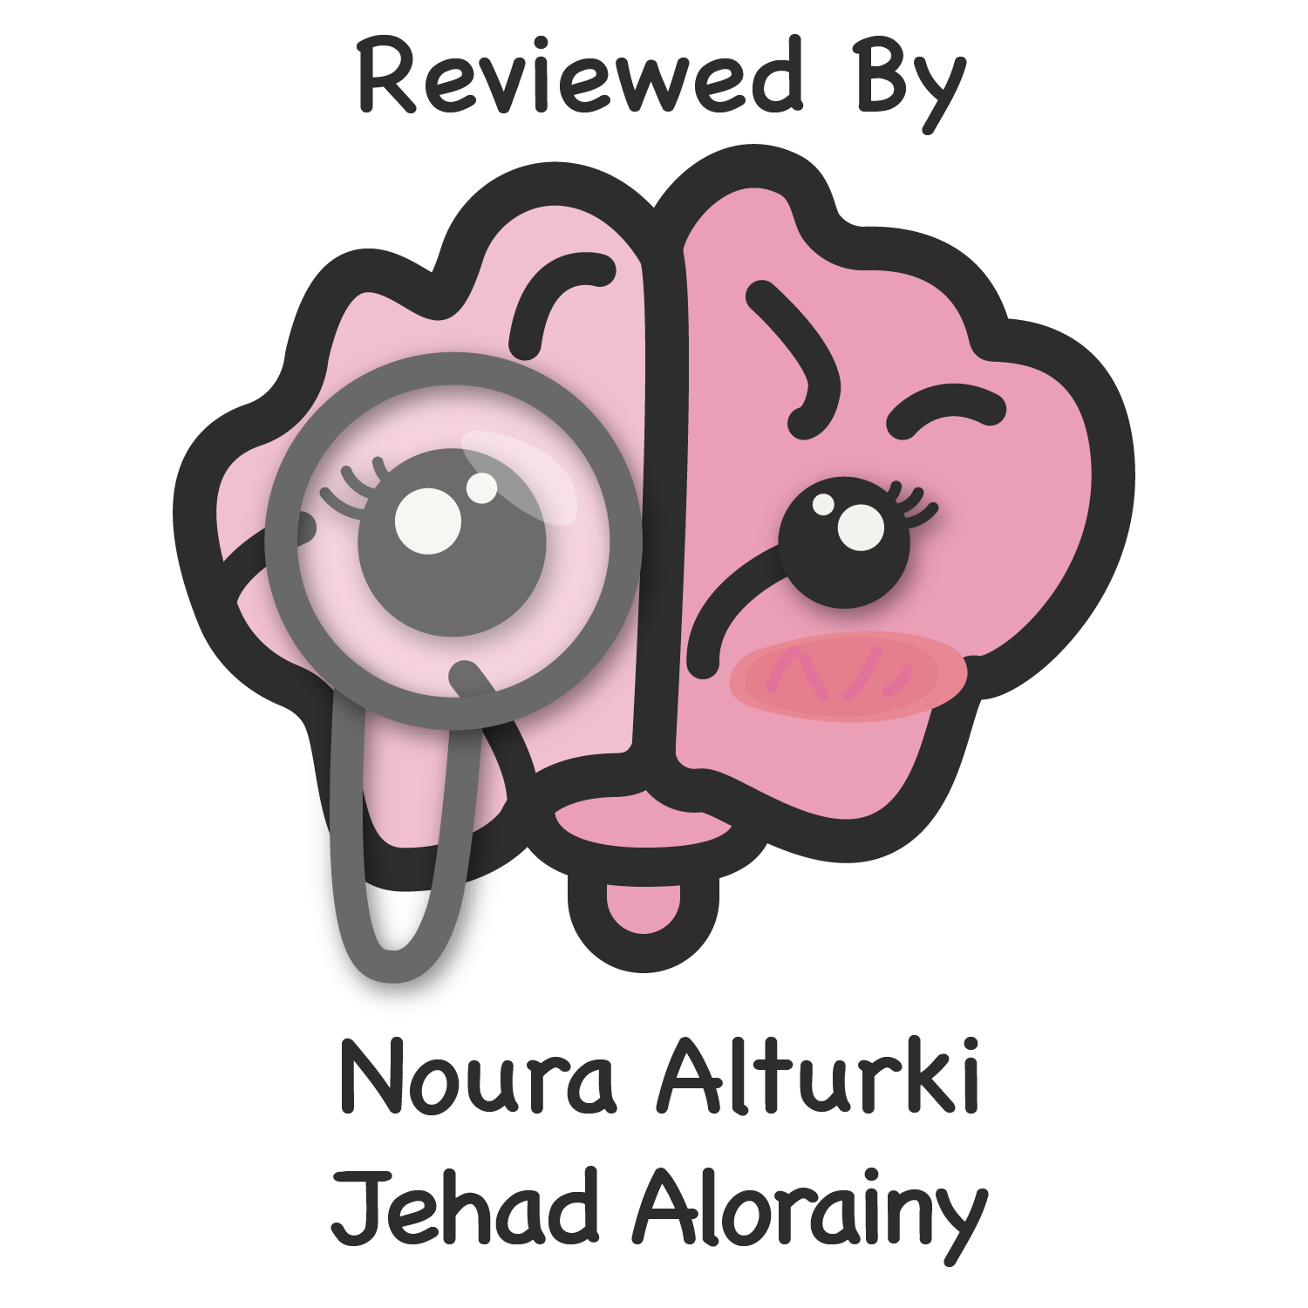
To know various radiological investigations used for GIT.
To understand step wise approach in requesting GIT radiology investigations.
To be familiar with radiological appearance (anatomy) seen in various imaging modalities.
To interpret plan x-ray radiograph of abdomen with common pathologies.
Abdullah bin Muammar
Editing file

Slide 2
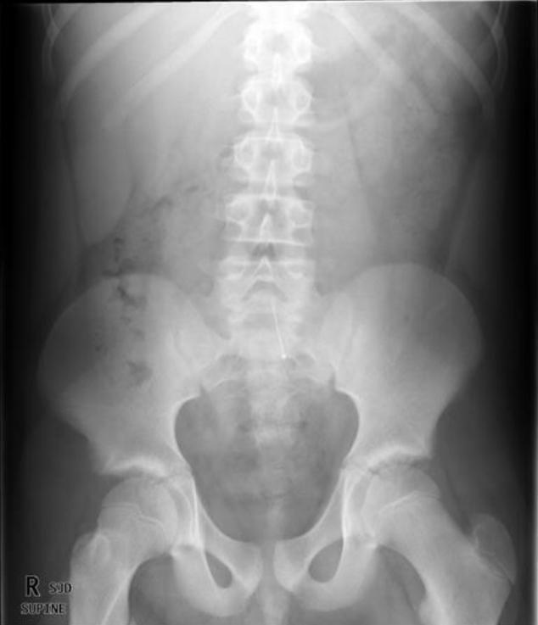
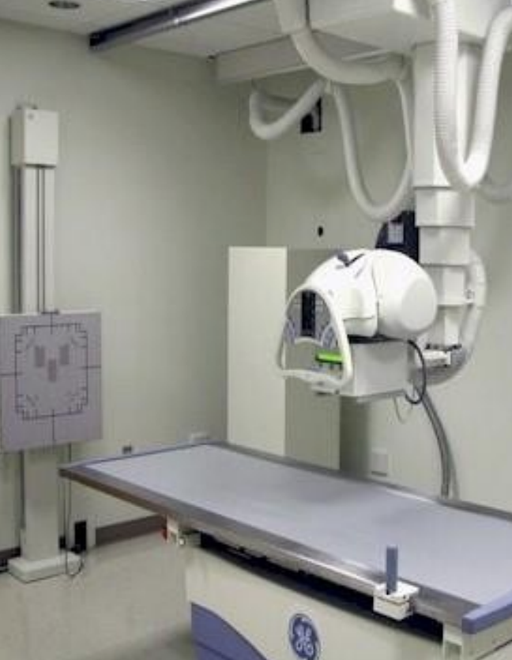
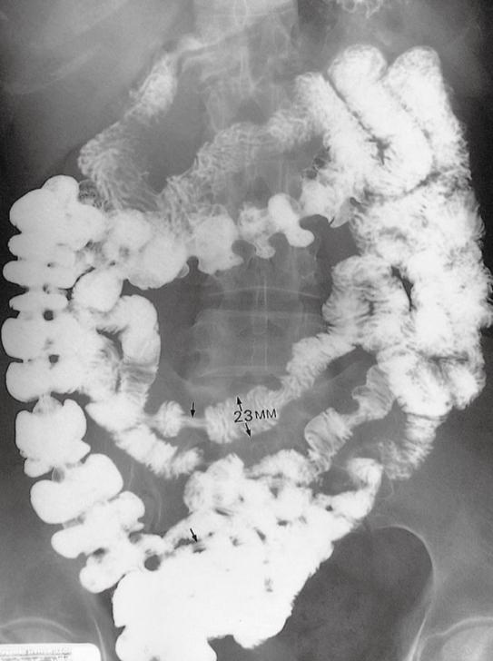
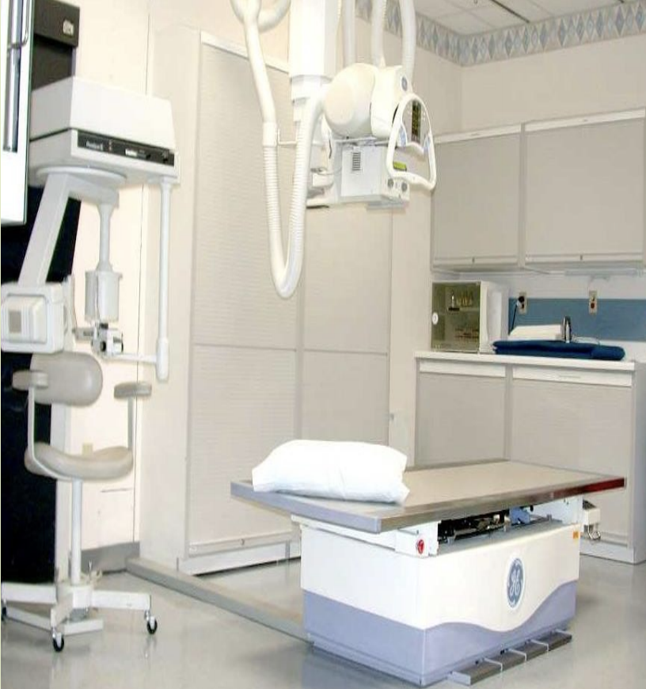
Introduction
What is peculiar about GIT? (GIT characteristics):
1- Hollow viscus (Not solid). 2-Usually filled with gas. 3-Motility.
Radiological Modalities :
Plain X-Ray
Fluoroscopy
Ultrasound
CT
MRI
Nuclear medicine
Angiography
X-ray (Plain radiography)
1- Often used as first imaging modality. 2- Cheap
3- Fast.
4- Can be done bedside (portable).
5- Useful for free gas and bowel obstruction.
Common Abdomen Films:
AP Supine (KUB)
AP Erect
Left lateral Decubitus, to see the gas floating and assess if there is any free gas in the abdomen.
5 basic densities on x-rays:
Metal
Bone/ calcification
Soft tissue/
Fluid
Fat
Gas
Intensive wite
White
Light
Gray
Dark
Gray
Black
Fluoroscopy ( contrast study )
1-Can be used as first imaging modality.
2-Cheap.
3-Use of contrast .
4-Recently replaced by CT & MRI.
5-Useful for intraluminal pathology. such as mass in the lumen or mucosal details
6-Can give clue about motility (function).
1

Slide 3
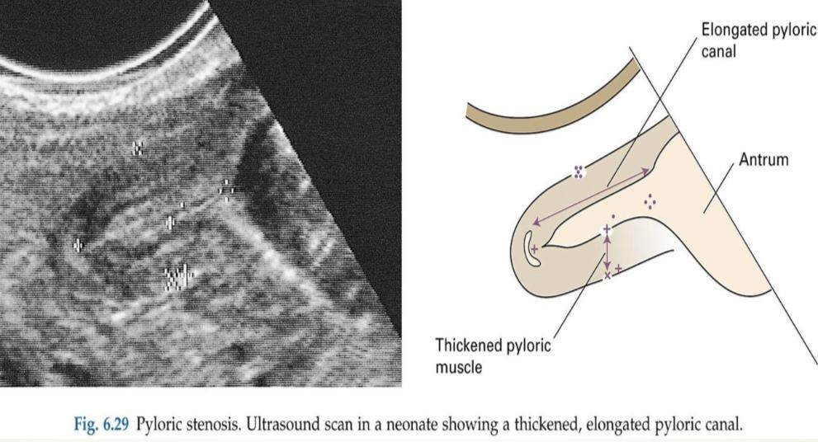
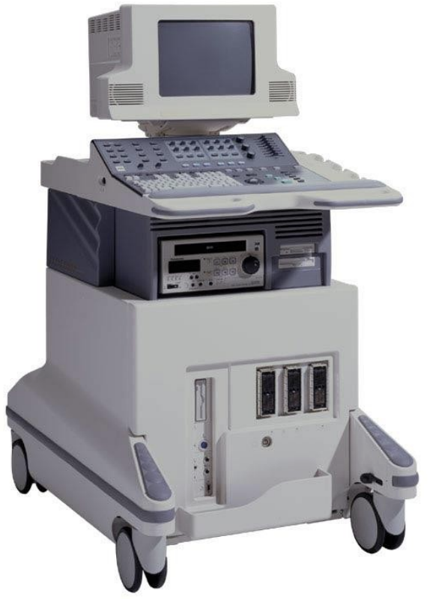
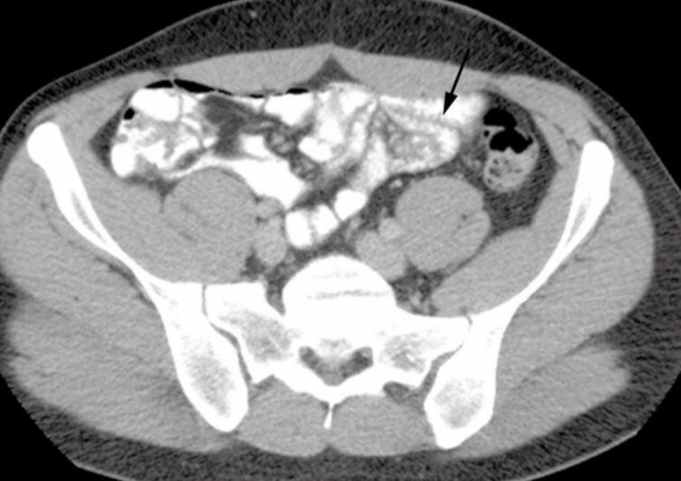
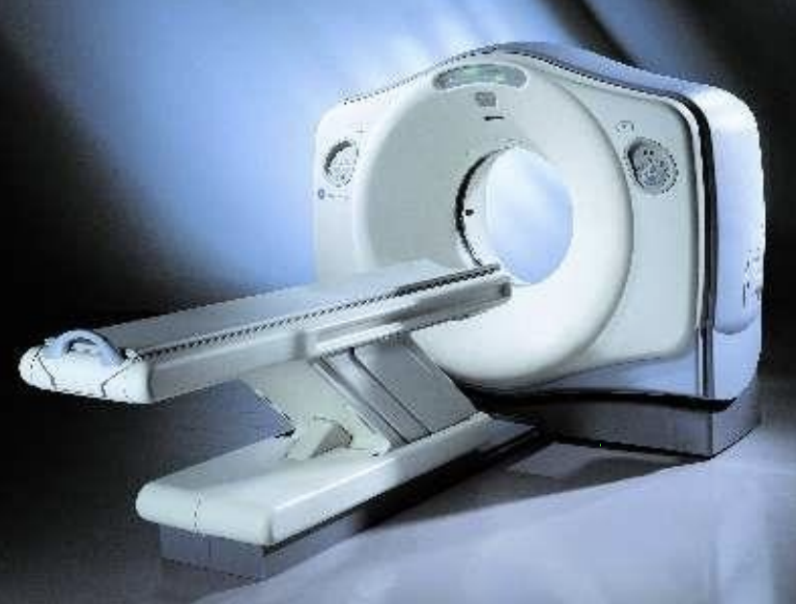
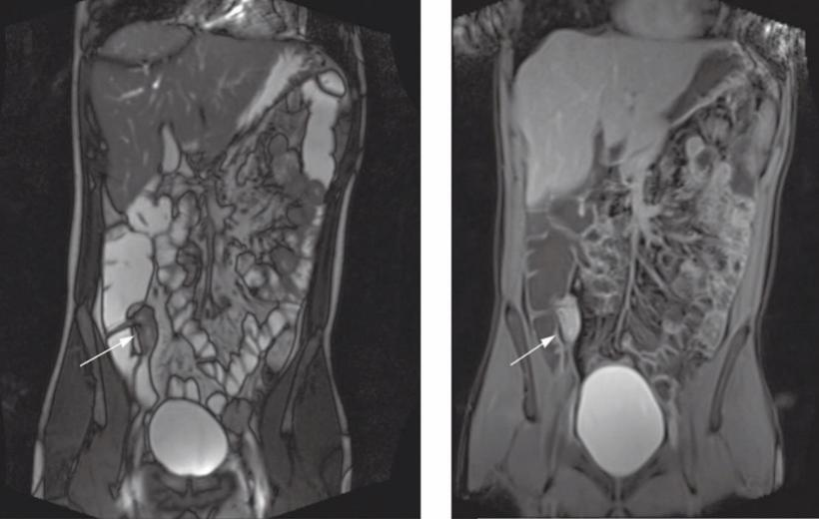
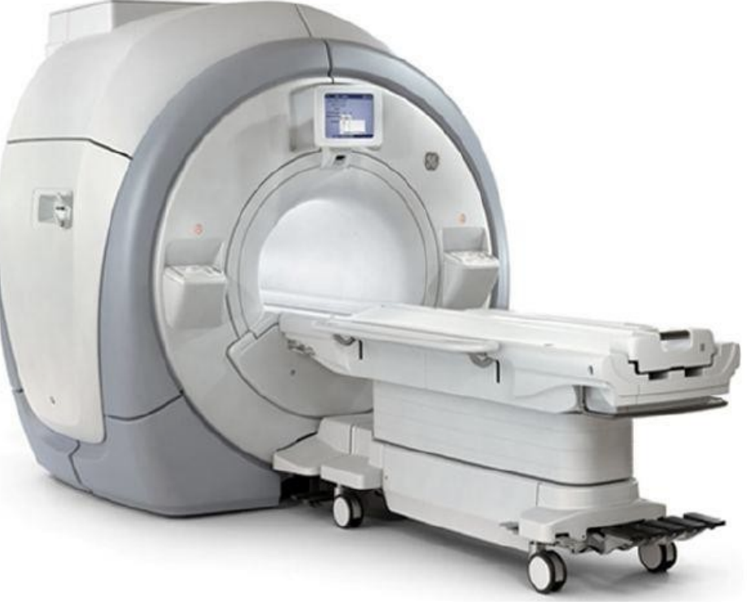
Radiological Modalities
Ultrasound
1- Relatively cheap.
2- No radiation.
3- Limited use in gas filled structures .such as stomach, small or large bowels. But if there is any mural mass we can detect it by US. so gas prevent us from seeing the whole anatomy.
4- Used in pediatrics and pregnant ladies.
Ultrasound studies have a limited role in GIT examinations because of Gas filled bowel
Indications for US is :
Acute Abdomen
Appendicitis
Pyloric stenosis
Pyloric stenosis. Ultrasound scan in a
neonate showing a thickened, elongated pyloric canal. In babies, 4 weeks old, males with swelling in epigastric area and projectile vomiting.
CT
1- Expensive.
2- More radiation.
3- Fast.
4- Contrast (IV to assess all vascular structures, Oral to assess esophagus, stomach, duodenum, small and large bowels, rectal assess the rectum and whole colon) usually used.
5- Used in emergency department.
MRI
1- More expensive than CT.
2- No radiation.
3- Slow and affected by artifacts. either respiratory or motion artifacts
4- Excellent for soft tissue.
5- Can’t be reformatted.
Unlike the CT.
We very rarely use it for emergencies.
2

Slide 4
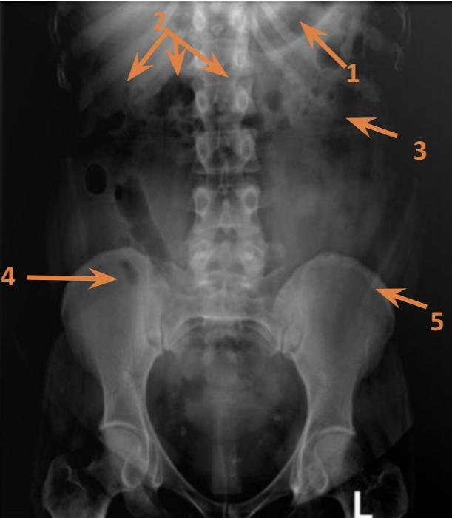
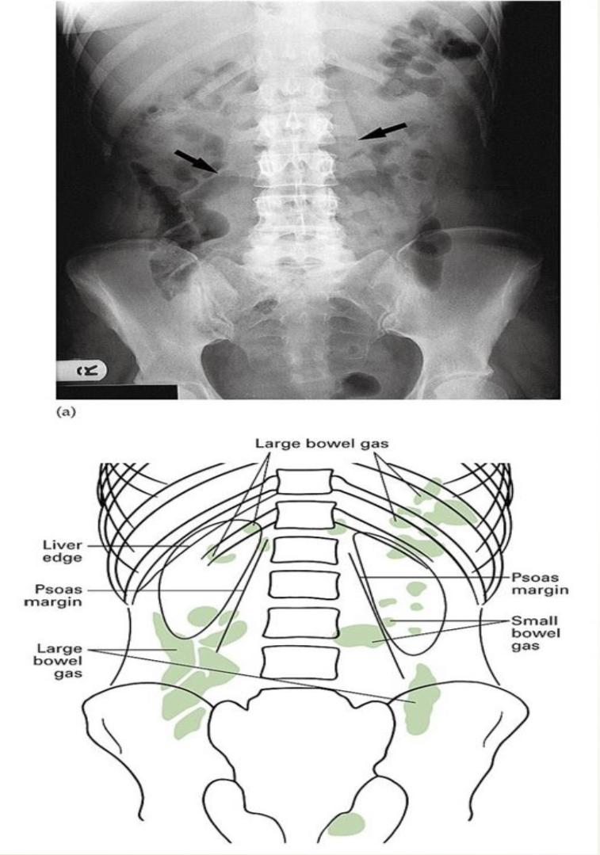
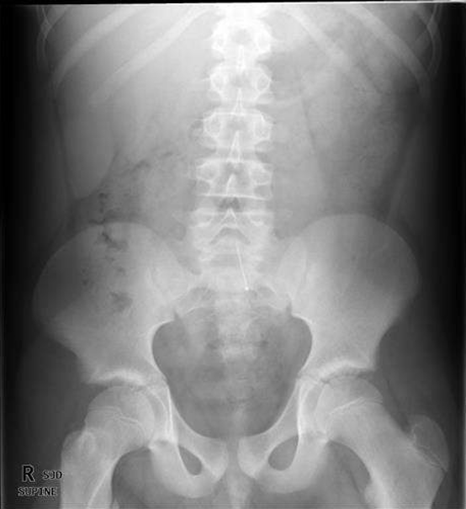
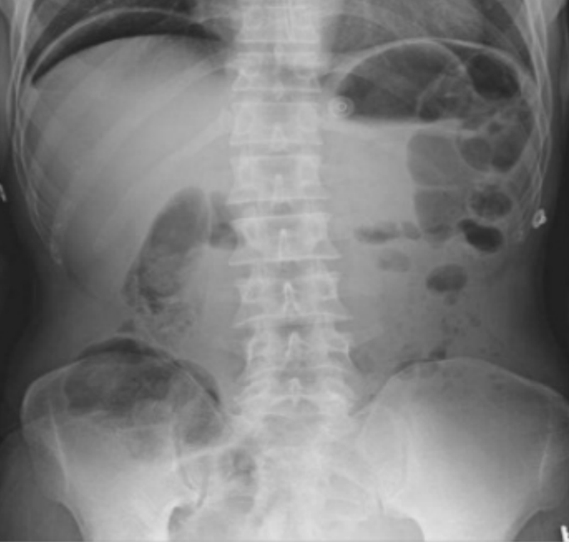
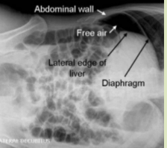
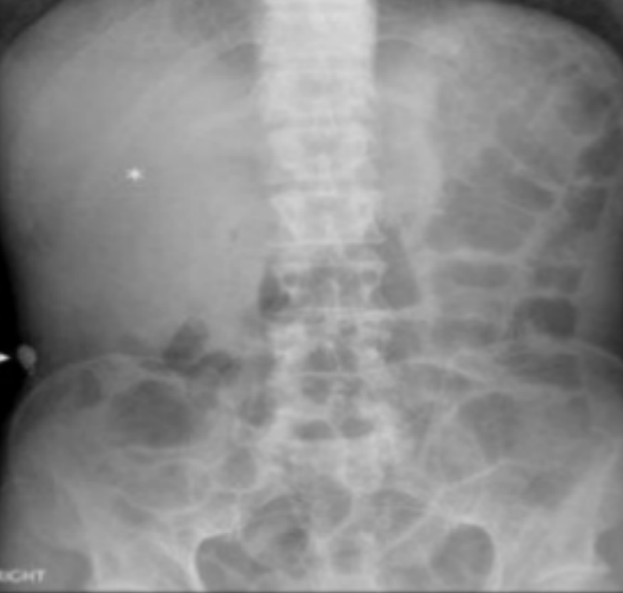
Radiological Appearance of the GIT
Abdominal X-ray
1- Stomach
2- Transverse Colon
3- Small bowel
4- Cecum
5- Descending colon
indication:
- bowel perforation
- bowel obstruction
- renal injury
- foreign body
- stones
Diaphragm
X-ray erect abdomen reveals crescentic gas under diaphragm in keeping with a visceral perforation
How to assess diaphragm?
If there is any raising or flattening of the diaphragmatic cupola , costophrenic angle is it blunted , see if there is any free gas under diaphragm
Lateral decubitus view shows free air between liver, right hemidiaphragm and lateral abdominal wall
Liver
X-ray abdomen shows enlarged liver displacing the ascending and transverse colon downward and to the left side
How to assess liver?
If it is enlarged or small , how does it displaces adjacent structures, if there any calcification within the parenchyma, or any gas projecting over the parenchyma
3
L ateral decubitus view shows free air between liver, right hemidiaphragm and lateral abdominal wall

Slide 5
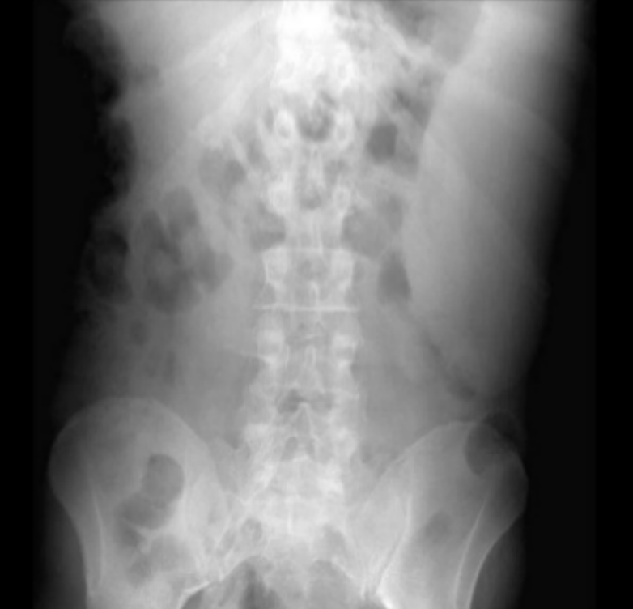
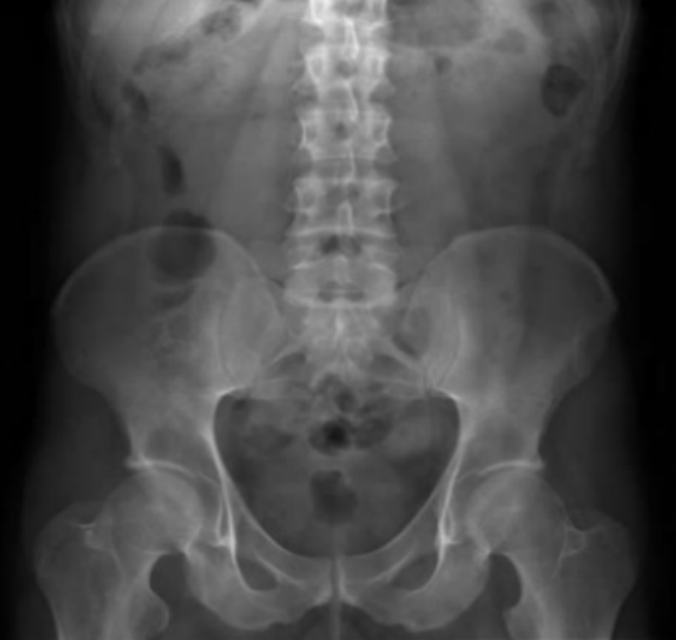
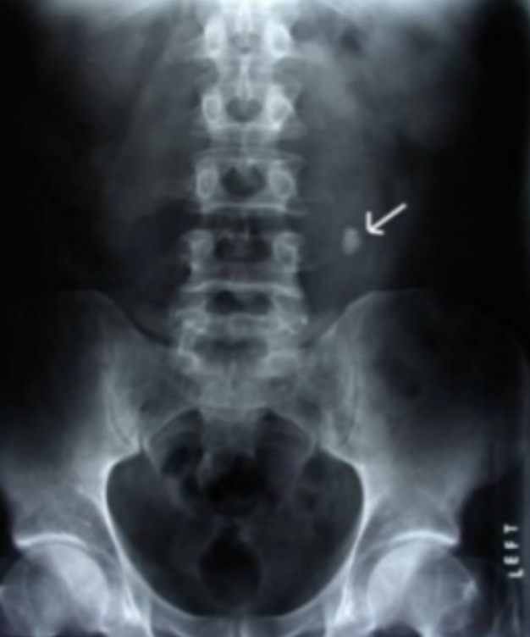
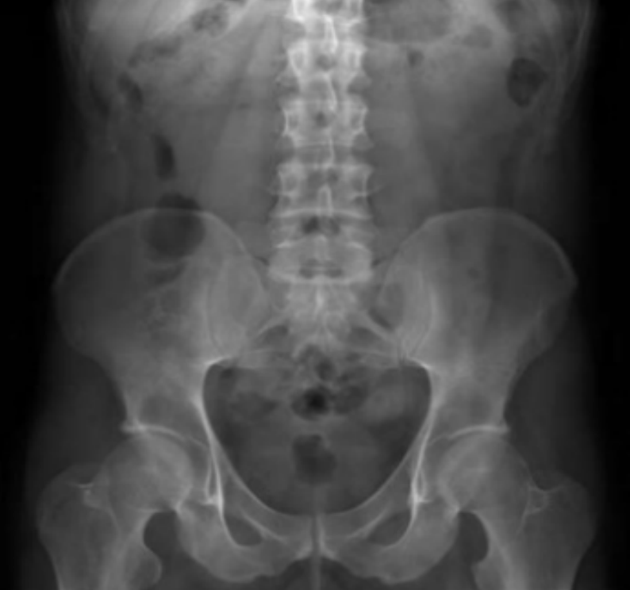
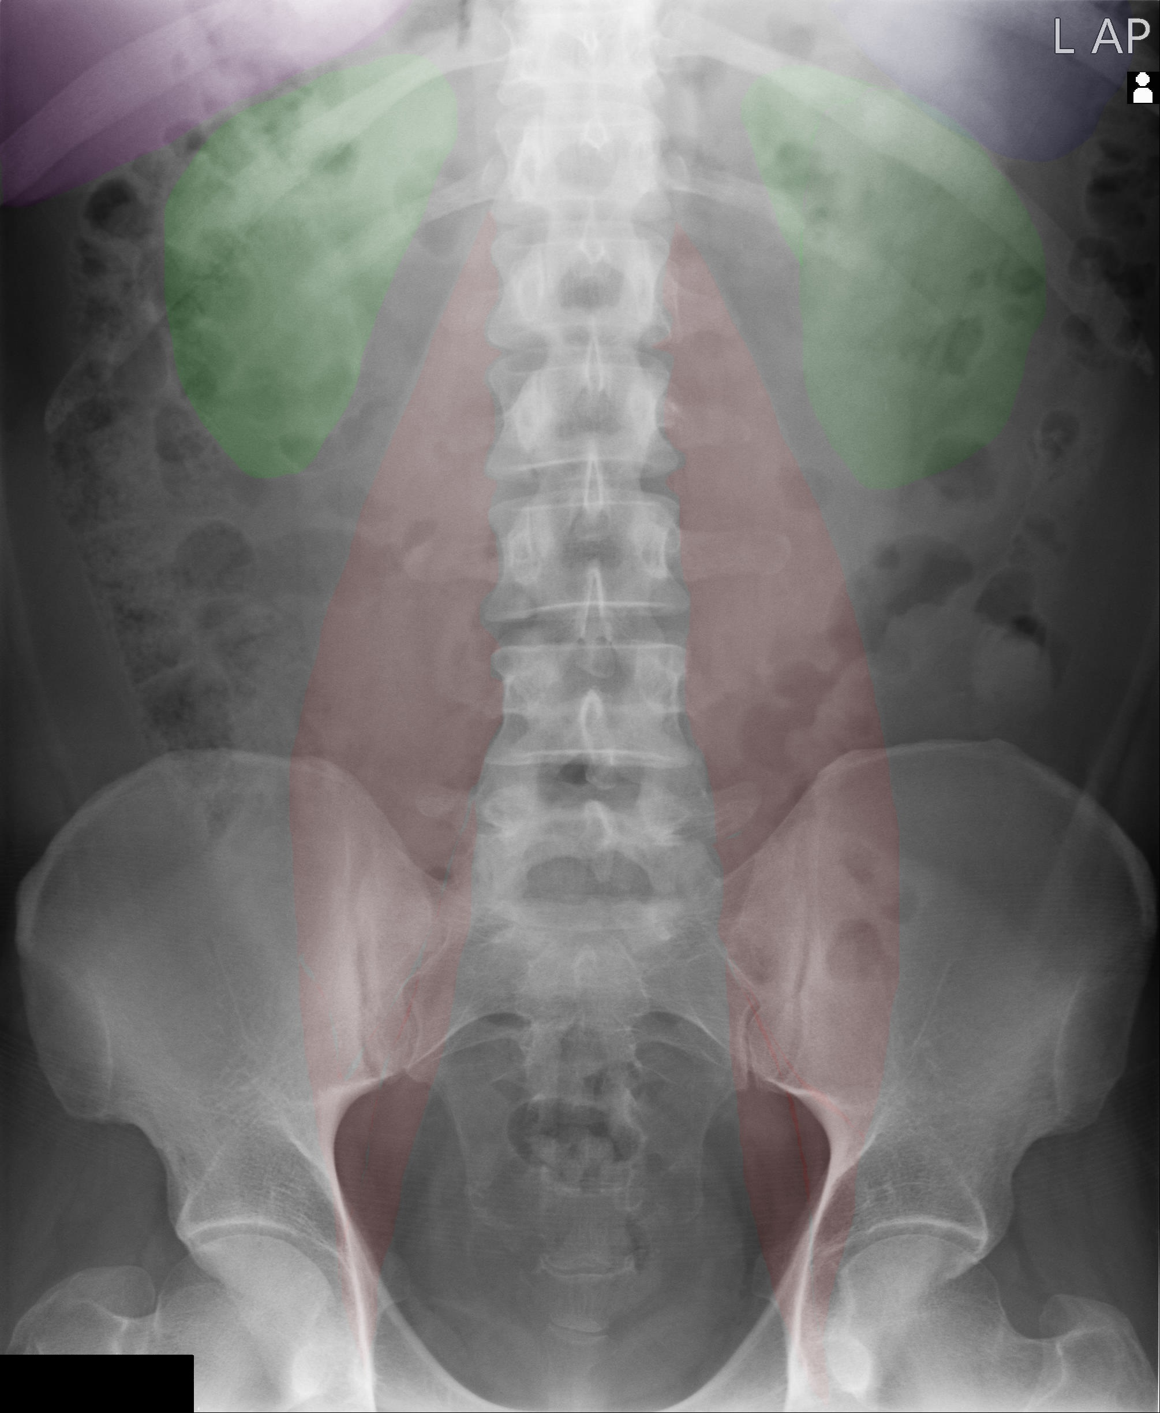
Radiological Appearance of the GIT
Spleen
X-ray abdomen shows enlarged spleen displacing the adjacent structures
How to assess spleen?
If it is enlarged or small, location usually located in the left upper abdomen, if there is any calcification
Kidneys
How to assess kidney?
Located between T12 and upper margin of L3, seen parallel to the psoas shadow, any calcification (stones)
You can see the outline bc the kidney’s outline is covered by the perinephric fat
- X-ray abdomen shows ovale white density to of spine: stone in left ureter
- * right side renal shadow
Psoas muscle
X-ray abdomen often shows lateral edges of psoas muscles as a near straight line
* left side psoas shadow (straight line)
If cant see the shadow that suggest a mass obscuring the area (usually within the retroperitoneal structures)
Extra
4

Slide 6
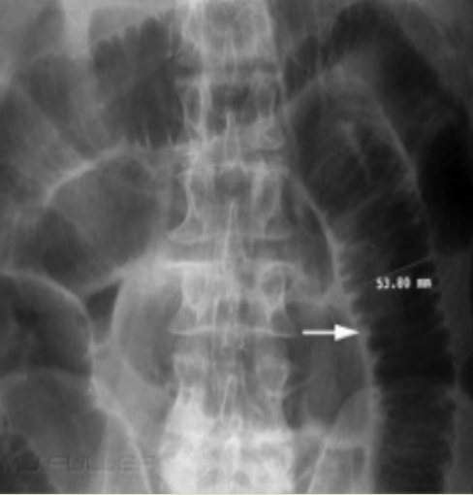
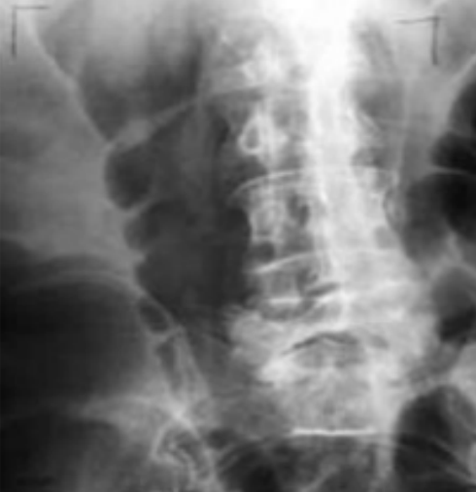
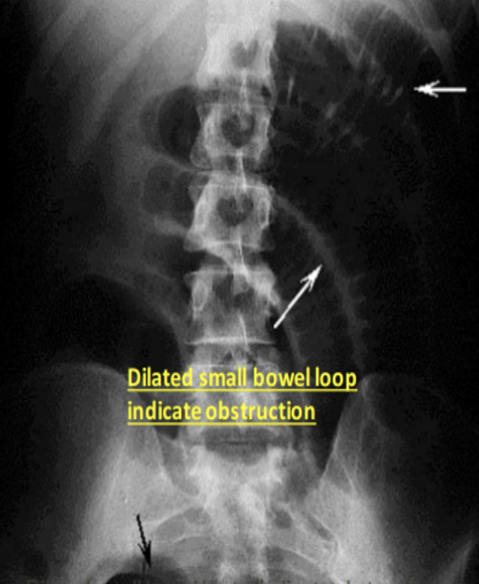
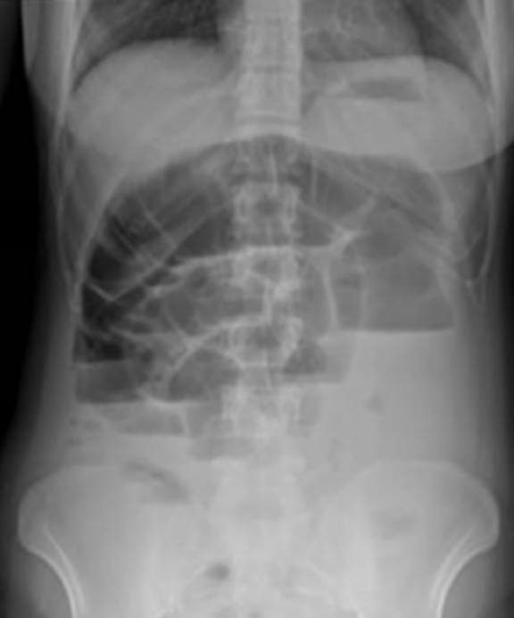
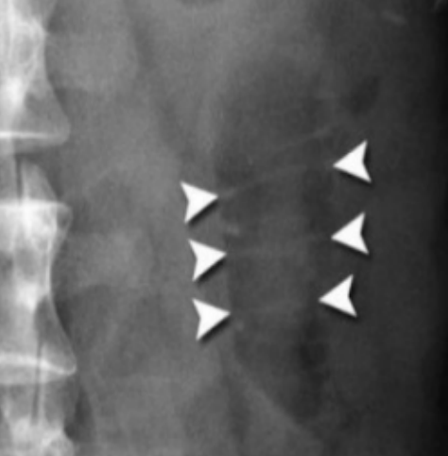
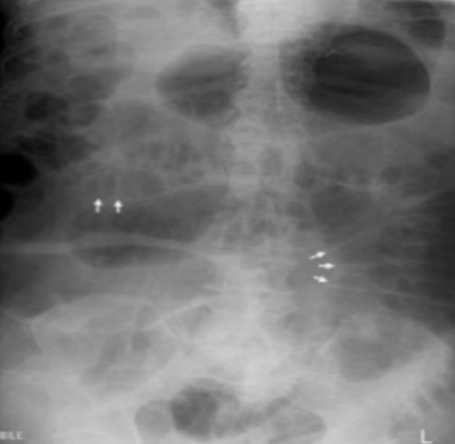
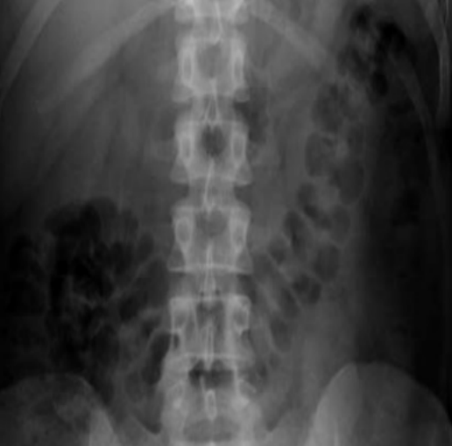
Radiological Appearance of the GIT
Bowel gas pattern
Where are the bowel loops located (central vs. peripheral?
What is the distribution of the gas in the abdomen?
What is the caliber of small and large bowel ?
Are any dilatation of small +/- large bowel ?
Identify any air-fluid levels ?
How to differentiate small from large?
Small: located in the center and have valvulae conniventes
Large: located peripherally and contain haustra
Valvulae Conniventes Small Bowel
Haustra
Large Bowel
Erect film showing multiple air filled level indicate obstruction
Small bowel lobe
Small bowel lobe central location
Large bowel contain haustra
Usually become visible when the small bowel is more distended (filled with gas)
5

Slide 7
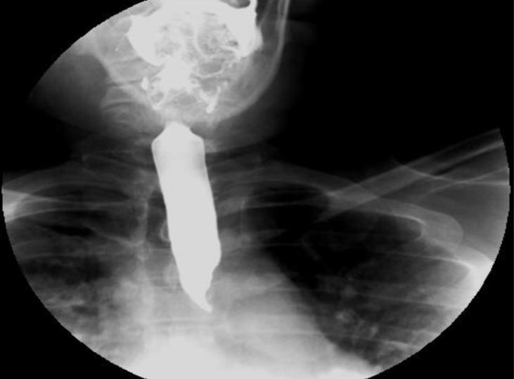
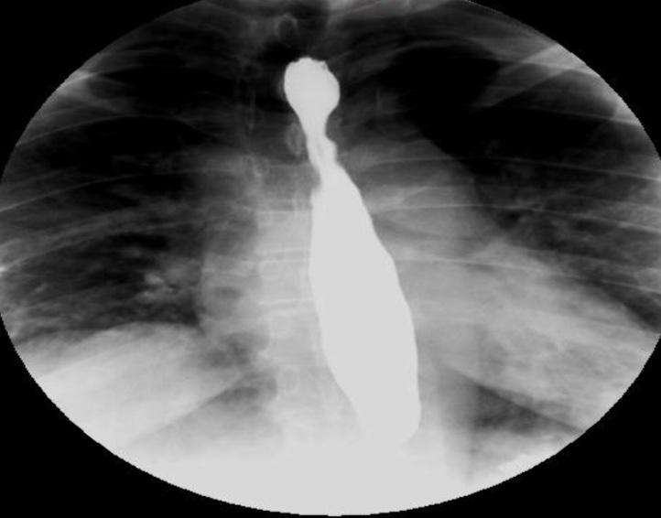
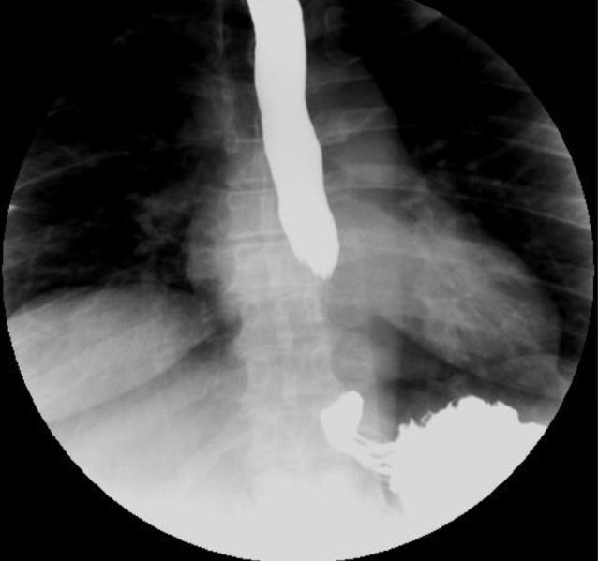
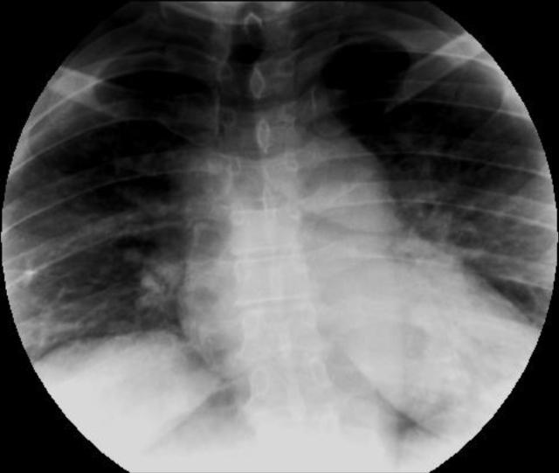
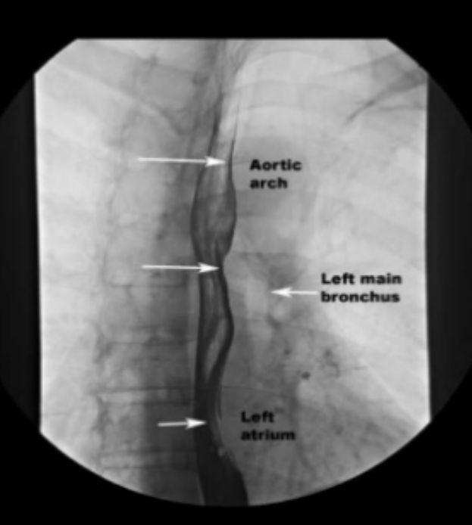
Radiological Appearance of the GIT
Barium Study
Barium Swallow
Barium Meal
Barium Follow through
Barium Enema
Esophageal Barium Swallow
1-It is a medical imaging procedure used to examine upper GIT, which include the esophagus and to a lesser extent the stomach
2- The contrast used is barium sulfate single contrast to assess anatomy or obstruction or double contrast to assess mucosal details
Esophagus starts at lower border of cricoid cartilage
Courses through posterior mediastinum
Ends at GI junction (gastroesophageal)
Normal impression in the Esophagus
Aortic arch, left main bronchus, left atrium
Normal impression in the Esophagus
Aortic arch, left main bronchus, left atrium
narrowings are most likely due to normal peristalsis, unless it was persistent
5

Slide 8
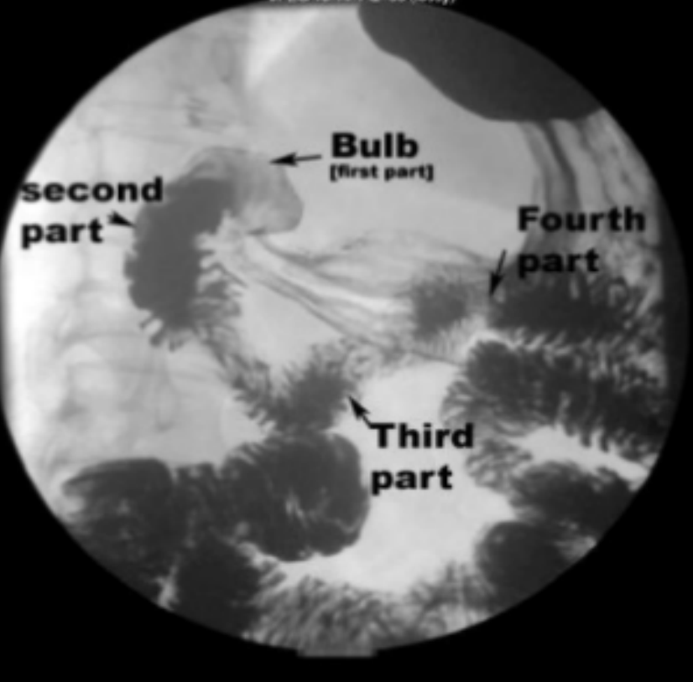
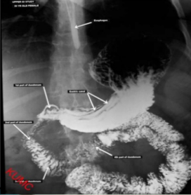
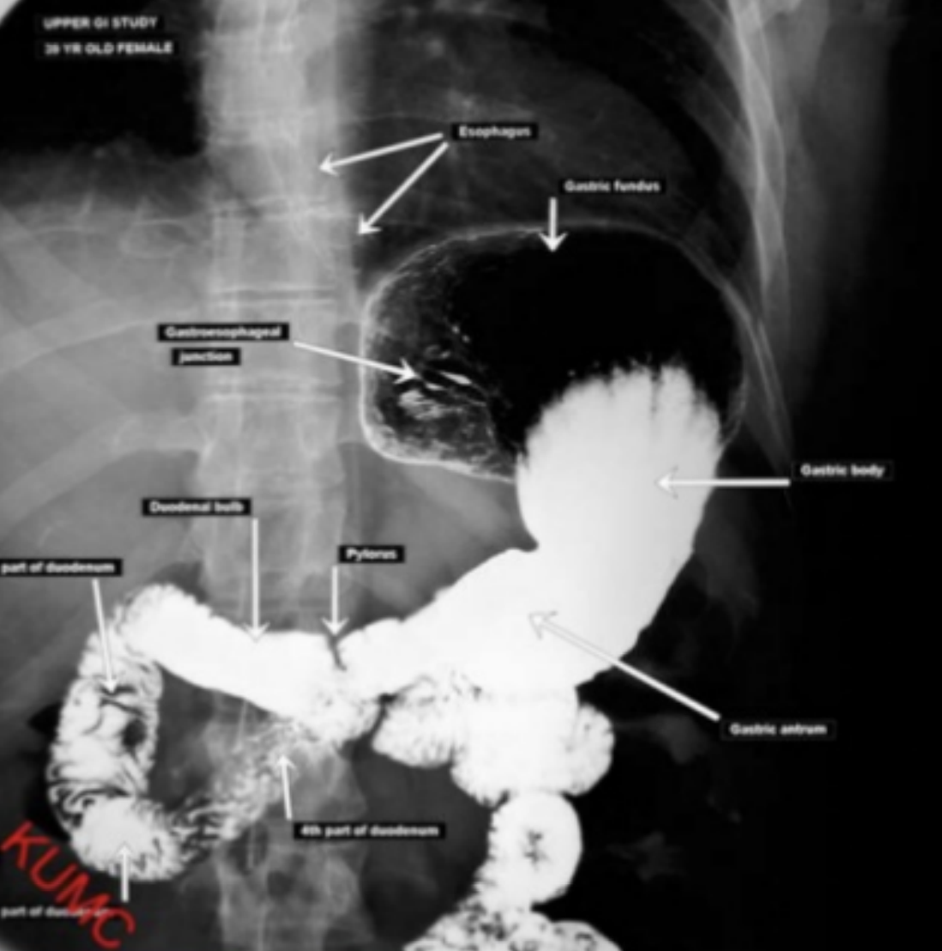
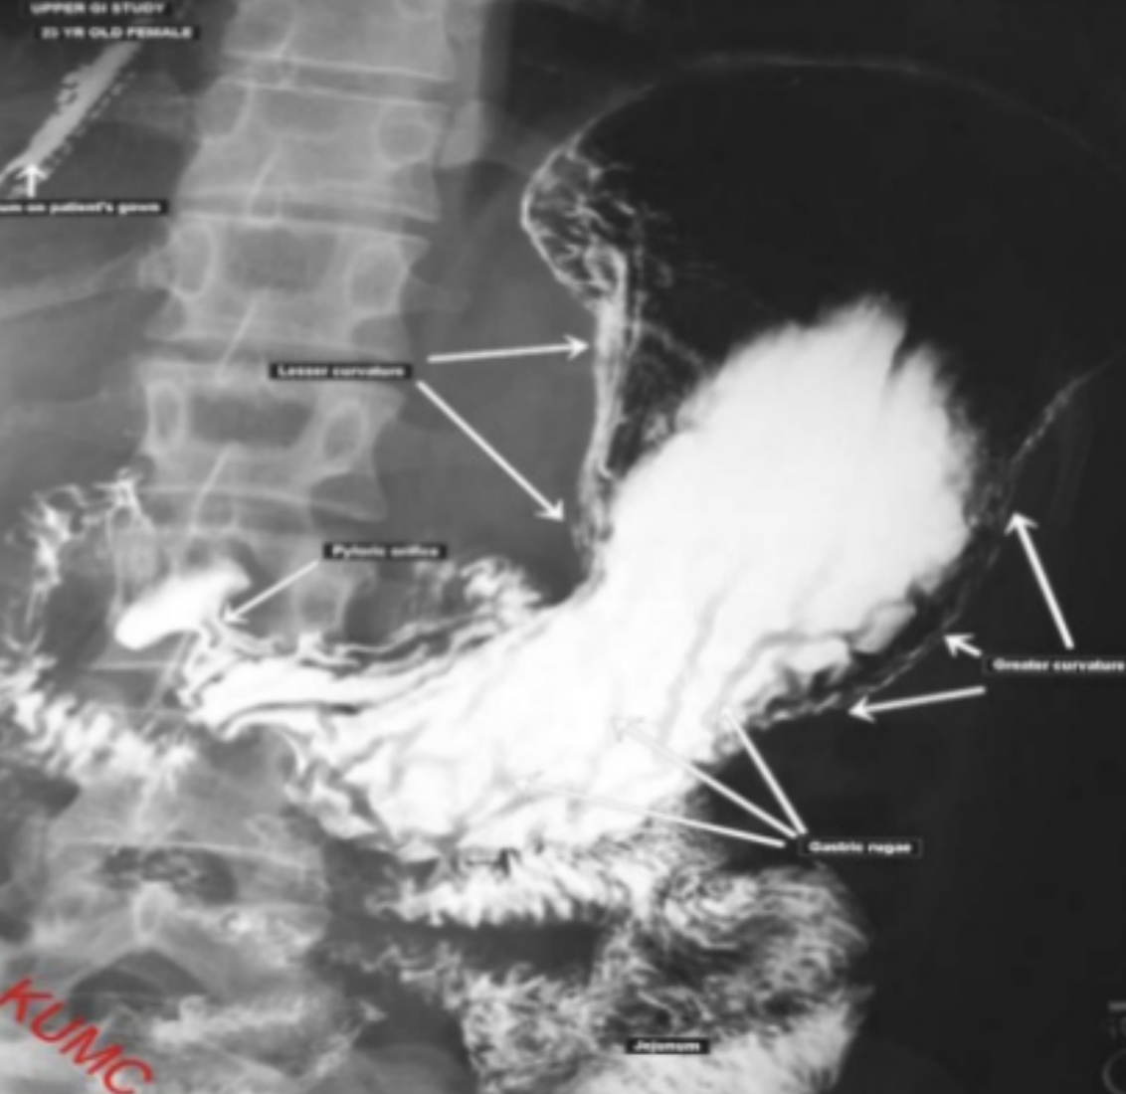
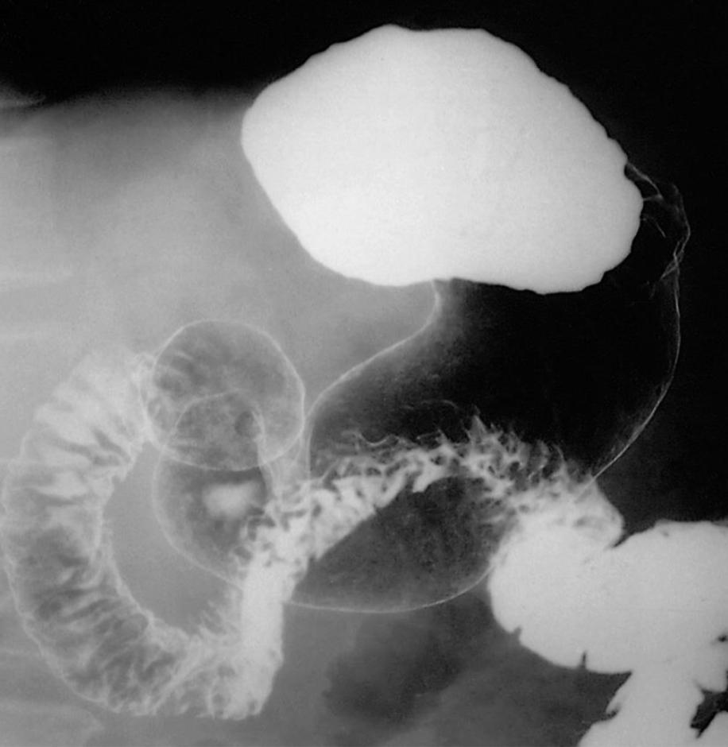
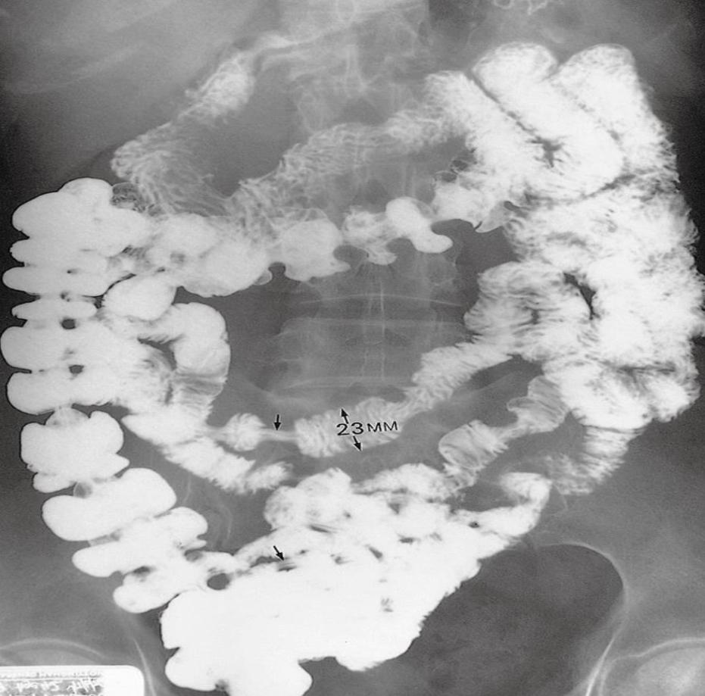
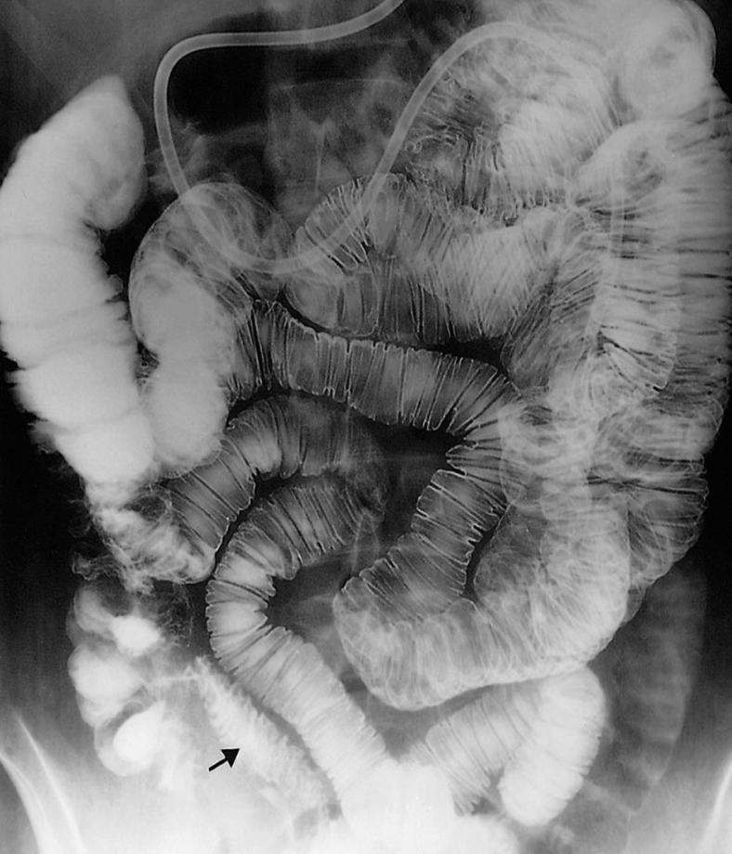
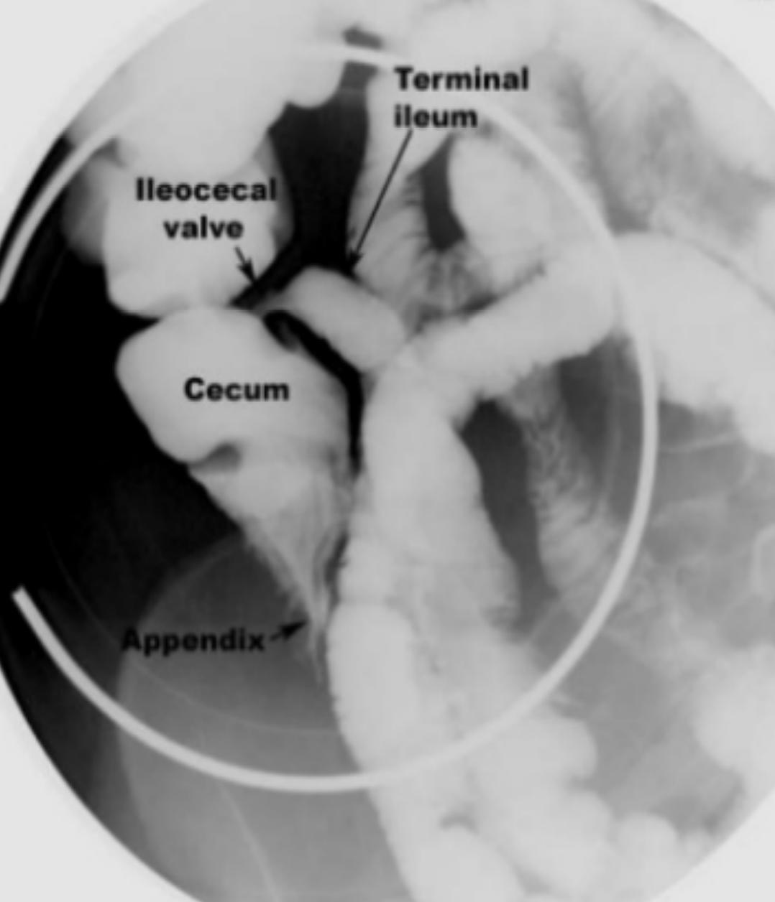
Radiological Appearance of the GIT
Barium Meal
In a barium meal test, X-ray images are taken of the stomach and the beginning of the duodenum.
Usually it is assessed by double contrast
Assess if there is any mucosal abnormality or any mass, assess the duodenum cap if there is any ulceration and the length
Single
Double
Barium follow through
1
In a barium meal test, X-ray images are taken for the small bowel loops.
Pic1: Small bowel follow through
Pic2: Small bowel enema
1
2
6

Slide 9
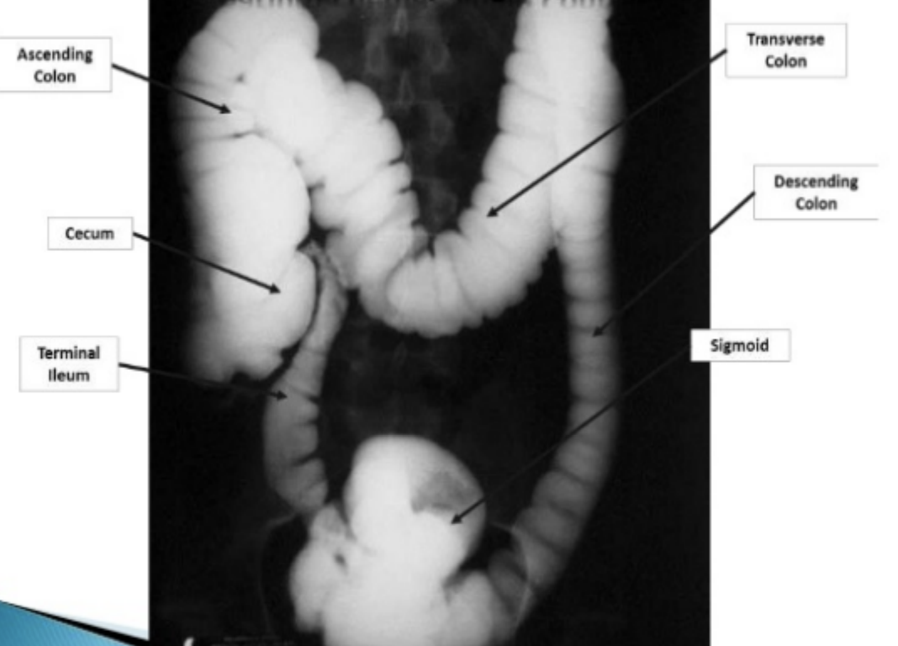
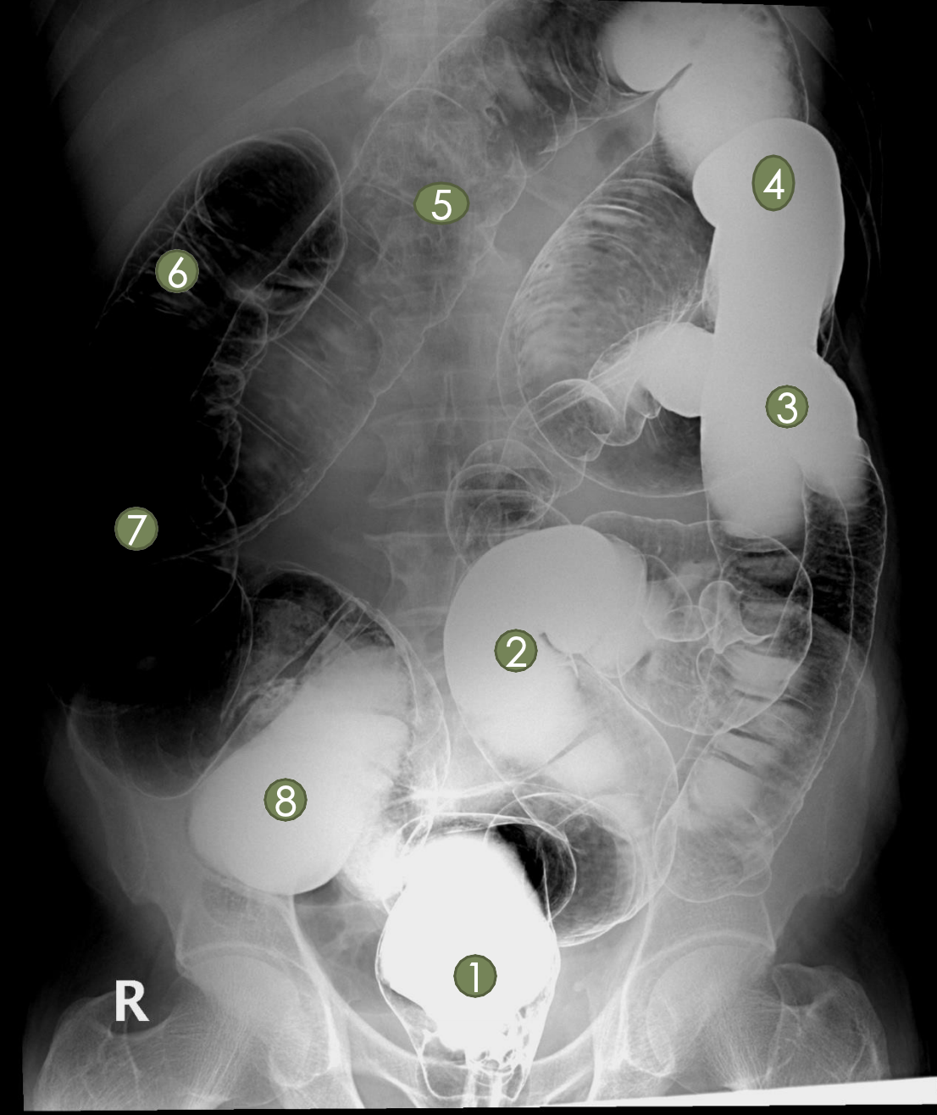
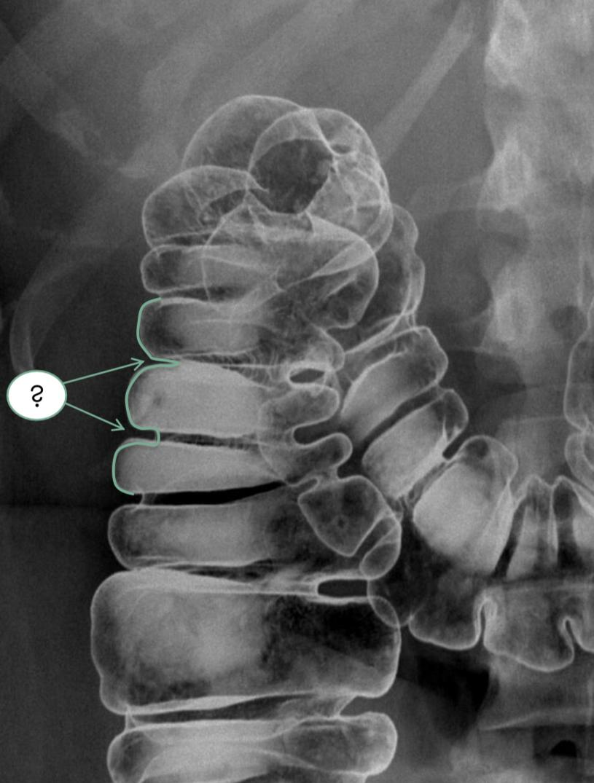
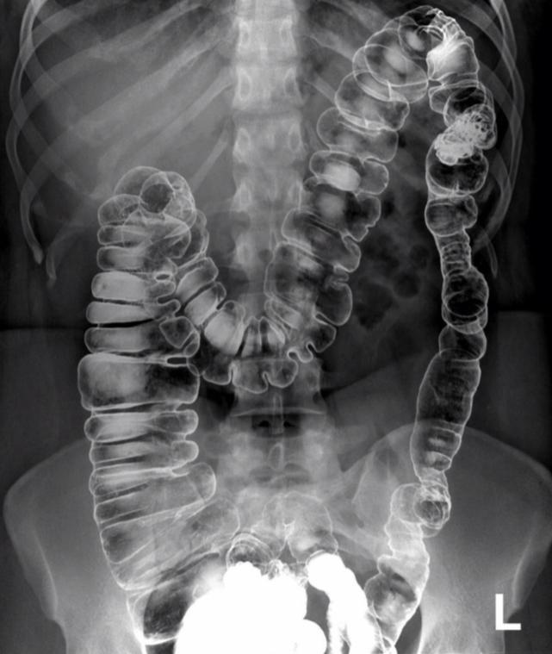
Radiological Appearance of the GIT
Barium Enema
1- Rectum
2- Sigmoid Colon
3- Descending Colon
4-Splenic Flexure
5- Transverse Colon
6-Hepatic Flexure
7- Ascending Colon
8-Cecum
SINGLE CONTRAST STUDY:
The colon is filled with barium which outlines the intestine and showing gross abnormalities. Example any obstruction or mass
DOUBLE CONTRAST with AIR
The colon is first filled with barium
Then the barium is drained out leaving only a thin layer of barium on the wall of colon
The colon is then filled with air
(single)
(double)
Ascending colon
Transverse Colon
Descending
Colon
Cecum
Terminal Ileum
Sigmoid
The light green line is the Hustra.
This is a double contrast of the large bowel: Haustra can be missing or diminished in the left side of the colon normally. But in right and transverse it MUST be present. Absent haustra in right or transverse is pathological.
7

Slide 10
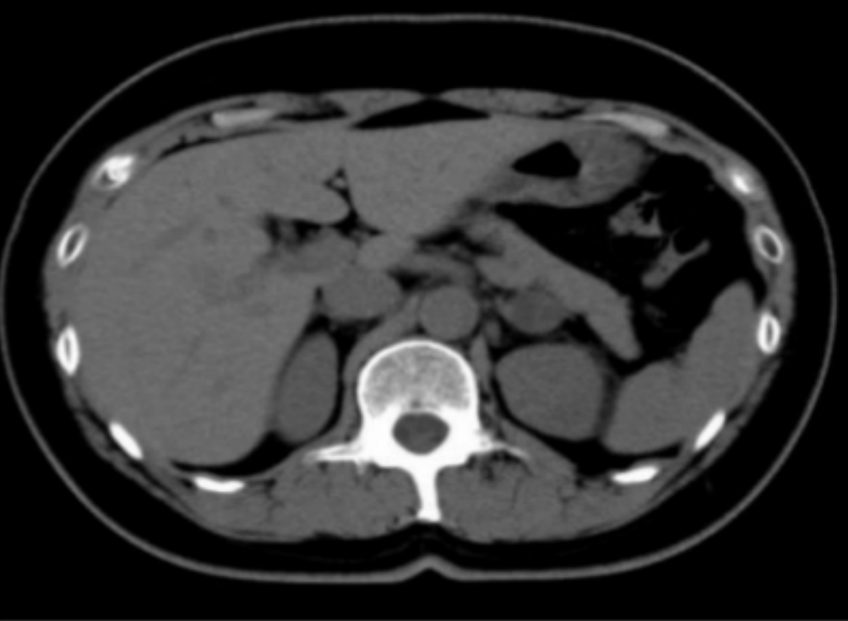
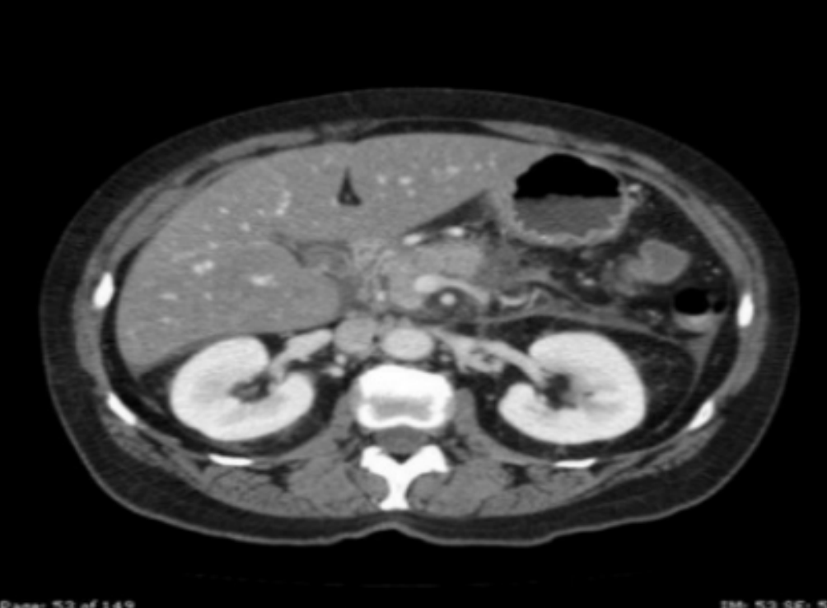
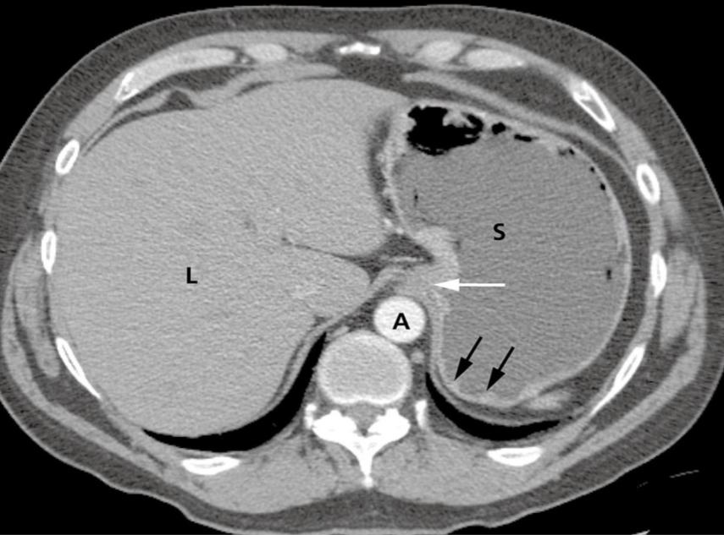
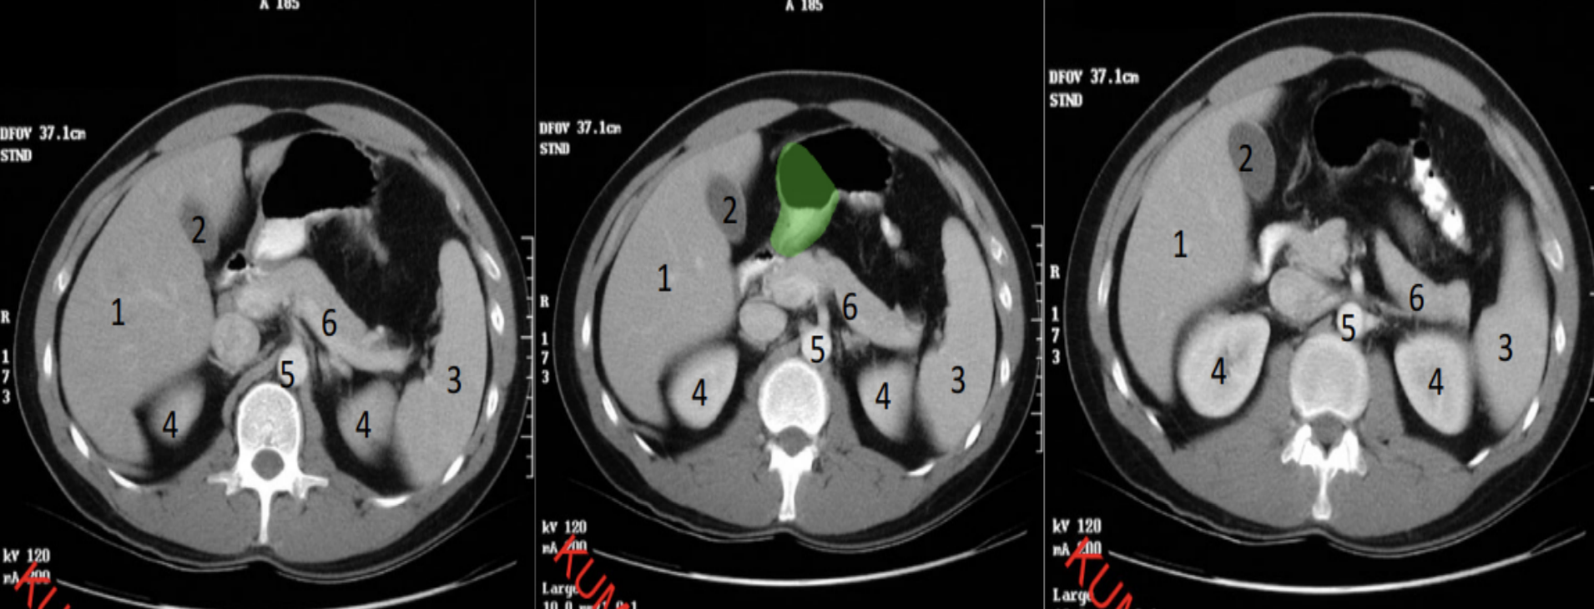
Radiological Appearance of the GIT
CT scan
CT provides cross-sectional images of the abdominal organs.
Multiple images are taken → Digitized in the computer → Reconstructed → viewed on a monitor.
CT without contrast
CT With contrast
L = liver
S= stomach
A= aorta
* Assess gastroesophageal area, gastric lumen, gastric wall, abdominal aorta, and liver parenchyma
8

Slide 11
Radiological Appearance of the GIT
Normal bowel:
1-Rectem 2-Sigmoid colon 3-Descending colon
4-Ascending colon 5-Transverse colon 6-Cecum
Coronal CT scan (reconstructed)
Descending colon
Splenic flexure
Hepatic flexure
Ascending colon
Cecum
Sigmoid colon
MRI Study
MRI is useful in evaluating abdominal soft tissues.
MRI is a type of non-invasive test that uses magnets and radio waves to create images of the inside of the body.
MRI Enterography
Used mainly to diagnose IBD (inflammatory bowel disease)
* Assess soft tissue, bowel wall , mucosa, the activity of the disease for example crohn’s disease
9
Normal bowel

Slide 12
Radiological Appearance of the GIT
Common plain X-ray abdomen radiograph finding
ABNORMAL AIR COLLECTION WITHIN ABDOMEN
Case 1
Crescentic gas shape seen under the right hemidiaphragm as well as the left hemidiaphragm (free gas)
What are the findings?
1- Black arrows pointing to the air bubbles.
2- If the air bubble was at the site of stomach, it would be normal bubble (left side).
3-While if it was on the right side, it indicates the perforation due to peptic ulcer.
4-We can see normal air fluid level in the stomach and cecum
Free AIR = Pneumoperitoneum
Case 2
Blue circle: Air fluid level (cavity filled with gas)
Orange circle: Gas filling structure usually gas within the gastric fundus area (so it appear as air fluid level but in normal location)
Loculated AIR = Abcscess! (Air-fluid level)
What is the difference between the 2 cases?
1- first case: free gas
2- second case: loculated gas in abnormal location (projecting over the liver parenchyma) so can be abscess cavity (air+fluid)
10

Slide 13
Radiological Appearance of the GIT
Small bowel
DILATED SMALL BOWEL LOOPS = SMALL BOWEL OBSTRUCTION
Case 3
Supine position
Erect position
Dilated small bowel loops in the center with prominent mucosal folds
Multiple air fluid levels at multiple location,
Suggestion: obstructed small bowel obstruction (colon is collapsed
Spine position: you can see the distribution of the bowels
Erect view: you can see the air fluid level
11

Slide 14
Radiological Appearance of the GIT
Large bowel
DILATED LARGE BOWEL LOOPS = LB OBSTRUCTION
Case 4
dilated large bowel located peripherally ( you can see haustra which does not cross the whole length of the bowel)
Collapsed Sigmoid and rectum so we can say it’s an obstruction at a distal level either sigmoid or rectal level
DISPLACED BOWEL LOOPS = SOFT TISSUE MASS LESION
Case 5
* With x-ray we can't tell if it is fluid or soft tissue
Soft tissue lesion (bc it is gray in color) it can be cystic or solid, projecting from the pelvis to the abdomen
So it is a large pelvic-abdominal mass causing displacement of the adjacent bowel
Will be evaluated properly using another modalities such as CT or US
12

Slide 15
Radiological Appearance of the GIT
Examples of calcified lesions in the abdomen
Case 6
(phlebolithes)
rounded calc with lucent center in both side of the pelvis
Usually it is vascular calcification called phlebolithes
(uterine fibroid)
large well defined calcification in addition to the plebolithes in the pelvis.
(Chronic pancreatitis)
viscus calcification seen along the normal anatomy of the pancreatic parenchyma.
So chronic pancreatitis + chronic calcification
(Mesenteric Mass which get calcified)
calcified lesion located peripherally in the center of the abdomen, it obscured the psoas shadow
Will be evaluated properly by CT or US
13

Slide 16
Quiz
1- 44 years old male presented with distended abdomen since 3 months , fatigue , leg swelling and yellowish eye discoloration, what is the most likely diagnosis ?
Ascites
Bowel obstruction
Abdominal calcification
Paralytic ileus
2- What is the finding in this CT scan?
Small bowel obstruction
Large Bowel obstruction
Bowel perforation
Appendicitis
3- A 79-year old male came to the ER complaining of
abdominal pain and severe constipation. What's the
diagnosis based on the x-ray below?
Small bowel obstruction
Large Bowel obstruction
Bowel perforation
Appendicitis
4- Which of the following modalities is used to asses the esophagus motility , transit time, and any obstruction or strictures?
Barium swallow
Barium enema
Barium follow through
Barium meal
5- :Which of the following represent the radiological study?
Barium follow through
Barium meal
Small bowel enema
Large bowel enema
Answers
1) A
2)A
3)B
4)A
5)A
14

