Slide 1
To know the common GIT pathologies presentation.
To understand step wise approach in requesting GIT
radiology investigations.
To know common radiologic pathologies in GIT.
Roaa Aljohani
Taif Alotaibi
Rahaf Alshuaniber
Editing file

Slide 2
Esophagus
Esophagus
Clinical Signs and symptoms
Dysphagia, Odynophagia (pain oropharynx).
Chest pain (Regurgitations or obstruction, it is complicated sometimes with esophagitis or esophageal ulcer),
Vomiting.
Age is also important (some diseases are common in specific age, a young patient will most likely have achalasia, but old one most likely have cancer).
Constitutional symptoms (Fever, Night Sweat, Weight Loss).
Recurrent chest infection (TOF). Some patients present with tracheoesophageal fistula and they are susceptible to recurrent infections, also during reflux some food regurge into the pulmonary system (particularly pediatric age group)
Imaging Modalities
• X-ray. Helps in esophageal perforation secondary to trauma or foreign body. Also in cases of distal esophageal obstruction e.g. achalasia, or esophageal tumor in lower esophagu, the esophagus proximally become dilated, showing air-fluid level or fluid-fluid level → significant widening of the mediastinum.
• Fluoroscopy (contrast-dynamic study - barium swallow) ‘’1st choice‘’ ​(Barium swallow = ​shows us the lumen and mucosal lining​)​ we do not use it if we suspect perforation.
• Ultrasound (​rarely used​), we use the endoscopic US. Helps to see the extent of the disease (locally staging of the tumor).
• CT helps in diagnosis, staging, and metastasis. but it’s not the study of choice​.
• MRI helps in characterization of the lesion (​limited role​).
• Nuclear Medicine > Of limited use.
• Angiography > of limited use.
*The most important thing in this lecture is to differentiate benign from malignant conditions.
wow, such empty
1

Slide 3
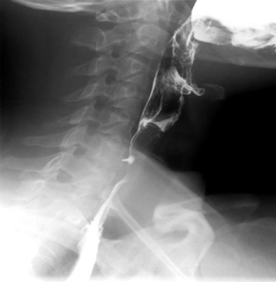
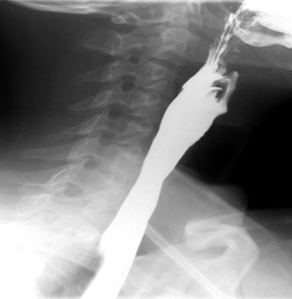
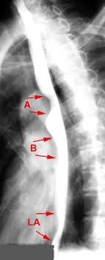
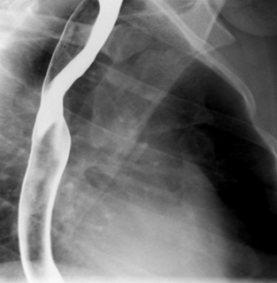
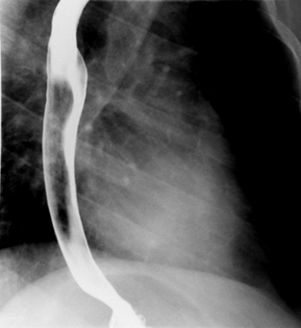
Barium swallow
Esophagus (Barium swallow)
Normal study
Normal Study-Double contrast
Double contrast (helps in mucosal details)
- upper esophagus
single contrast
(helps in gross pathology and anatomy)
- upper esophagus
extra picture
-Aortic arch
-Left main bronchus
-Left atrium
Mid esophagus
Lower esophagus
- Yellow: gastroesophageal junction
Dysphagia, Esophageal stricture (Barium swallow)
Benign stricture
corrosive esophageal stricture
peptic esophagitis stricture
Achalasia
malignant stricture
esophageal carcinoma stricture
Esophageal Stricture
a) Tapering ends with smooth outlines → benign
b) Overhanging edges or shouldering with irregular outlines→ malignant
(shouldering indicates overgrowth of the wall ”mass” so we can not see the wall clearly on barium swallow).
Short segment of strictures with luminal narrowing. Irregular outline. Deep ulceration. Shouldering proximally. All of these manifestations are of malignant strictures
2

Slide 4
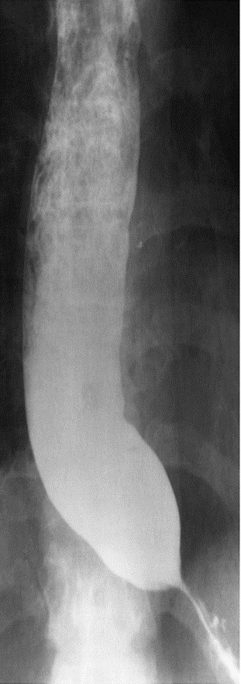
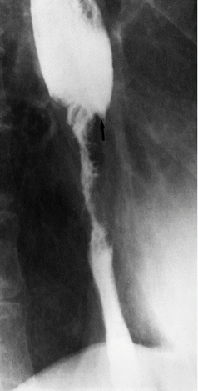
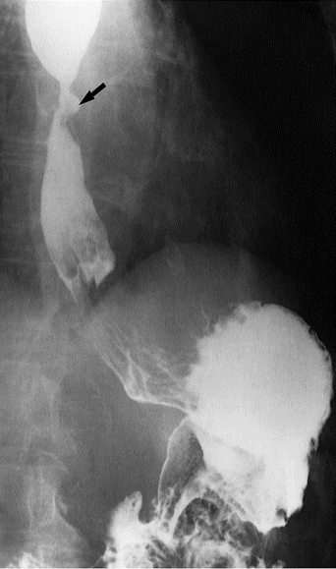
Barium swallow
Esophagus
Dysphagia, Esophageal stricture
Barium swallow
Esophageal Carcinoma
Short segment of strictures with luminal narrowing. Irregular outline. Deep ulceration. Shouldering proximally. All of these manifestations are of malignant strictures.
there is always dilatation before any stricture.
Achalasia Most of esophagus is dilated with food residuals and smooth narrowing at the lower End. Rat tail and bird beak sign with
no shouldering > benign.
Significant esophageal dilation proximally, some food particles and barium is pooling in the lower esophagus. Beak bird appearance of the distal esophagus with Smooth tapering.
Corrosive Stricture
Irregular narrowing in the whole esophagus with dilated inflow. no shouldering > benign *Corrosive are chemicals like acids or bases.
(long segment of esophageal stricture and narrowing with lobulated outline involving the mid and lower esophagus)
Peptic stricture due to GERD in a patient with hiatus hernia. There is smooth narrowing of the mid esophagus we see it in gastroesophageal junction with an ulcer within the stricture (arrow).
Short segment of stricture and narrowing with ulcer (arrow) and smooth outline
3

Slide 5
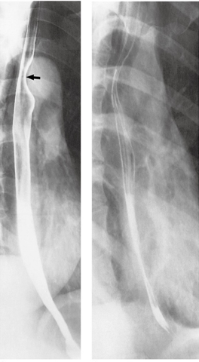
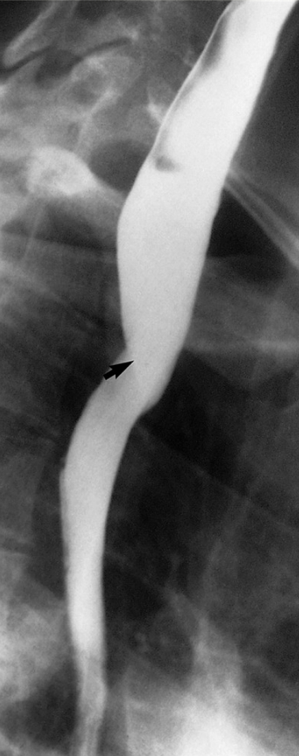
Barium swallow
Esophagus
Dysphagia, Esophageal web/Diverticulum
Barium swallow
Esophageal diverticulum (mucosa bulging outside and filled with contrast), no dilation proximally and normal esophagus
Esophageal web.
Shelf-like indentation (arrow)
from the anterior wall of esophagus, no shouldering
External posterior compression causes narrowing of esophagus due to apparent subclavian artery¹ as it passes behind the esophagus (arrow) anomalous right subclavian artery.
Esophageal impressions (normal)
Physiological impressions (indentation):
1- related to aortic arch
2- related to atrial enlargement
3- left main bronchus¹
1
2
3
¹In the reference as well as the golden notes this was said to be a pathology caused by the subclavian artery, but the doctor mentioned it as a normal physiological narrowing caused by the left main bronchus
4

Slide 6
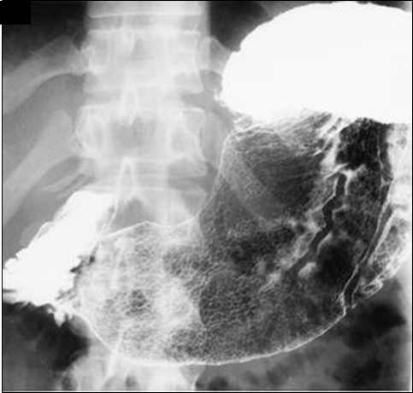
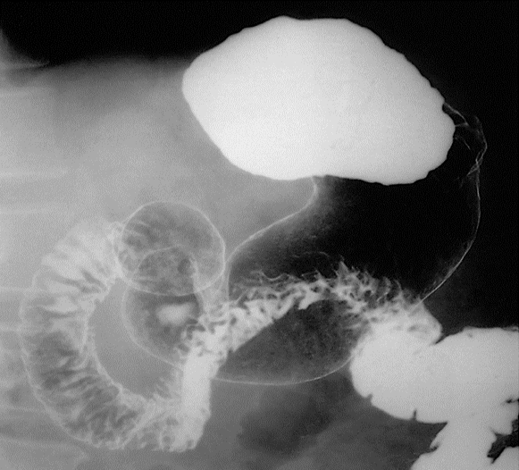
Stomach
Stomach
Clinical signs and symptoms
Epigastric pain.
Vomiting.
Hematemesis.
Age is also important (some diseases are common in specific age).
Constitutional symptoms (Fever, Night Sweat, Weight Loss).
Imaging Modalities
• X-ray. (initial), we can see stomach filled with gas
• Fluoroscopy, contrast study (Barium meal).
(used to visualize stomach mucosa).
• Ultrasound ​> in pediatric for pyloric stenosis.
• CT.
(For staging and characterization of the disease)
• MRI.
• Nuclear Medicine not used.
• Angiography not used
Barium meal
Normal
Normal Stomach and Duodenum on double contrast barium meal. ​On this supine view, barium collects in the fundus of the stomach. The body and the antrum of the stomach together with the duodenal cap and loop are coated with barium and distended with gas. Note how the fourth part of the duodenum and duodenojejunal flexure are superimposed on the body of the stomach.
5

Slide 7
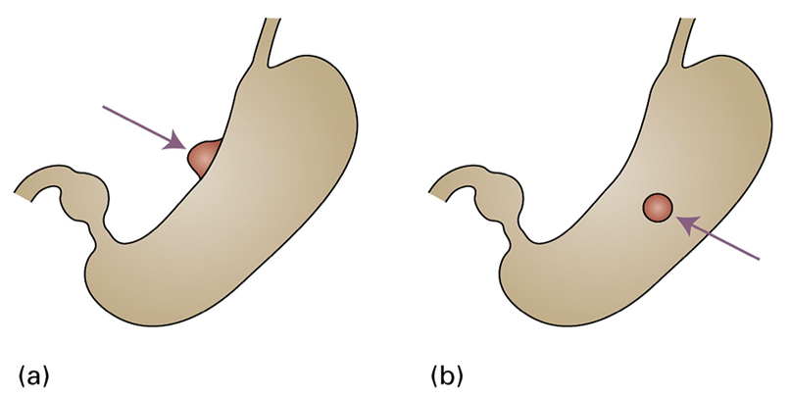
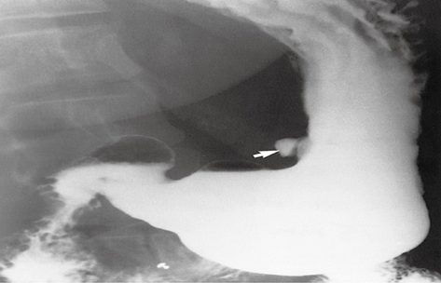
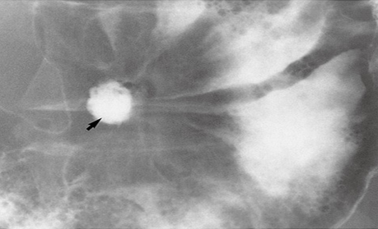
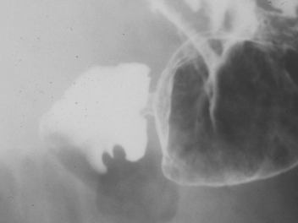
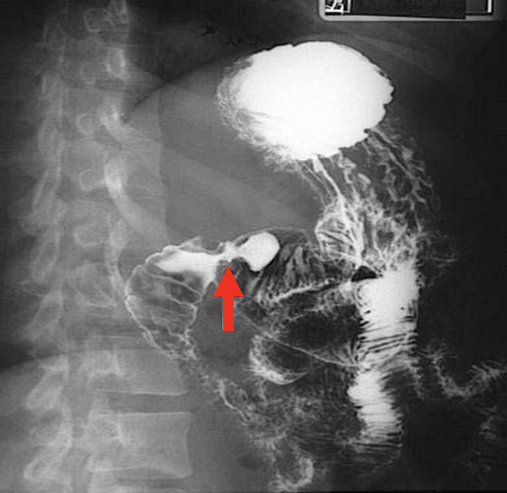
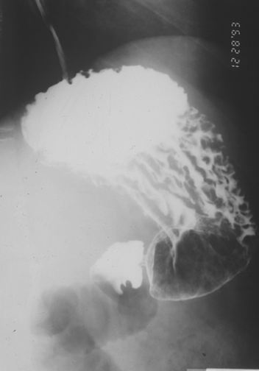
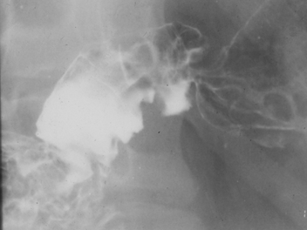
Barium meal
Stomach
peptic ulcer disease (Epigastric pain)
a) In profile the ulcer is seen as an outward projection
b) En face (facing forward, out profile) the ulcer appears rounded.
Barium meal:
Why do we see an ulcer as an outpouching? The ulcer makes the stomach walls weak, so it protrude outside the stomach. Notice the thin white lining (orange arrows) it represents the lesser curve, and the ulcer located far away from it, so it is En face ulcer.
Benign ulcer ​due to its regular lining
White arrow: In profile ulcer, outpouching filled with contrast in the lesser curve of the stomach (arrow).
Black arrow: En face of an ulcer ​(arrow)​ is seen as rounded collection of barium, زي الحفر تدخل فيها الصبغة.and edematous mucosa adjacent to it and directed towards the ulcer
Duodenal ulcer involving the duodenal cap
Barium meal
Single contrast study - filling defect
Narrowing, area of contrast pool, mucosal edema (distal gastric antral ulceration)
No proximal obstruction
A filling defect within the inferior aspect of the duodenal wall
Double contrast study (thickened edematous mucosal fold directed toward the ulceration)
6

Slide 8
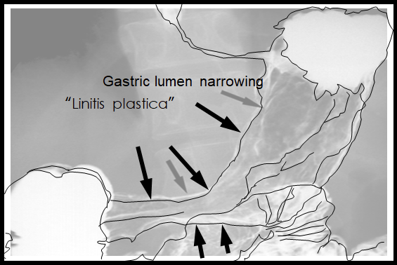
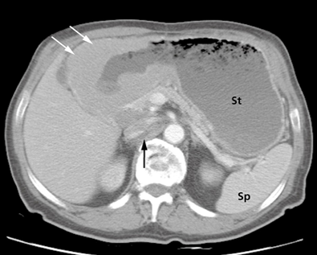
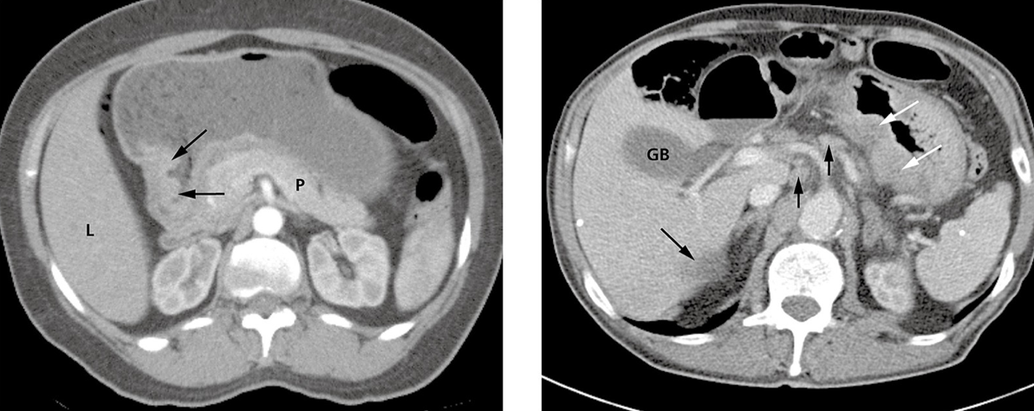
Barium meal
Stomach
(Epigastric pain) Gastric carcinoma Barium meal
Thickened mucosal fold, narrowing of gastric lumen with lobulation in the outline (seen in diffuse infiltrative process involving the gastric wall
e.g. infiltration by malignancy)
Linitis plastica related to the diffuse gastric luminal narrowing
Gastric Carcinoma on Barium study
Black areas (black clouds) are large filling defects in the antrum and body of stomach which indicates mucosal abnormality ​(infiltration)​. The difference between gastric masses and ulcer is that the ulcer will accumulate the contrast in ulcer site which will appear as dense but in case of mass, the mass will clear the contrast and will appear black.
1
2
3
Gastric Carcinoma on CT
1- In the first picture (white arrows) indicate wall thickening, and it’s what appeared in the barium study as filling defects. Mass in the gastric antrum
2- Black arrows on the second picture indicate a mass arising near the pyloric canal
3- In the third picture, there is diffuse thickening of the wall of the stomach (white arrows), several lymph nodes (short black arrows in the middle) and a liver metastasis (long black arrow) are also seen. These thickened walls could be: 1.Primary Gastric Cancer​ 2.​Infiltration​ 3.Metastasis​ ​4.Lymphoma​. (it is Gastric Carcinoma here) thickened walls and narrowed lumen with different axial levels.
7

Slide 9
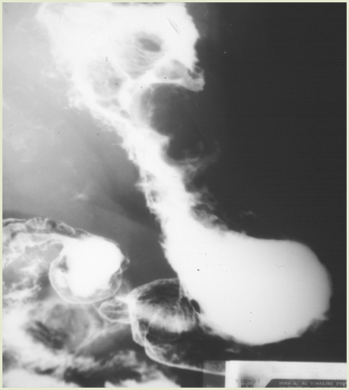
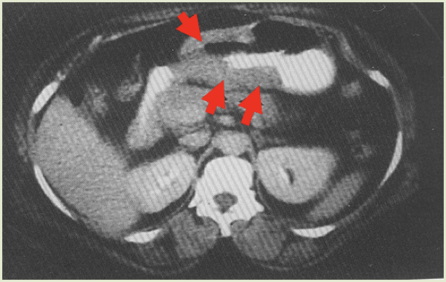
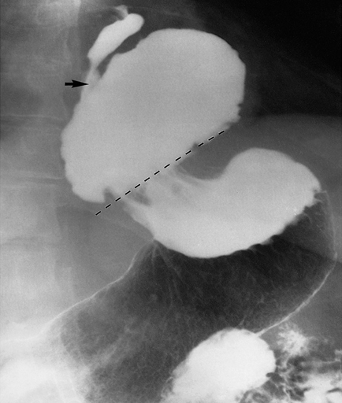
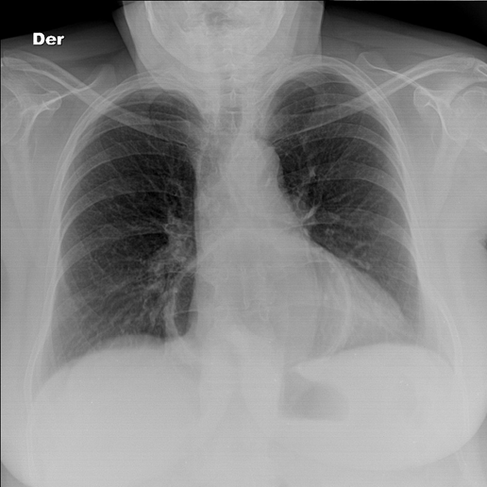
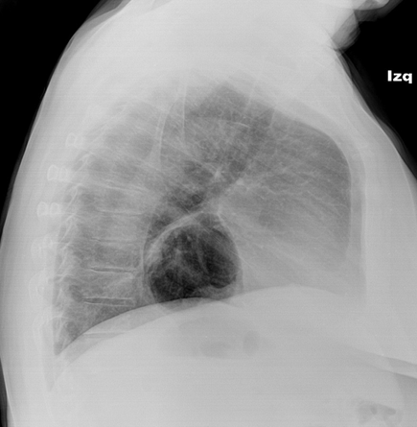
Barium meal
Stomach
Gastric lymphoma
Barium meal
Shouldering of the stomach
Thickening of the gastric wall
Diffuse luminal narrowing of stomach, with irregular outline, without significant obstruction proximally
Diffuse thickening involving the gastric antrum without proximal obstruction
Sliding hiatal hernia
Barium meal
Gas filled cavity projecting over the cardiac shadow
What is the next step after x-ray? Barium meal and swallow
Two types of hernia:
1- sliding hiatus hernia: the gastroesophageal junction is above the level of the diaphragmatic crus
2- paraesophageal hernia: gastroesophageal junction is below
8

Slide 10
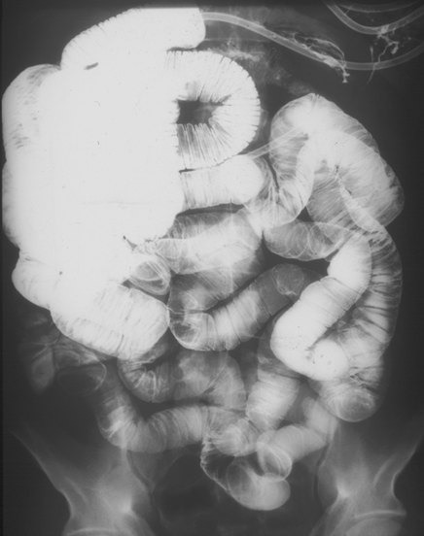
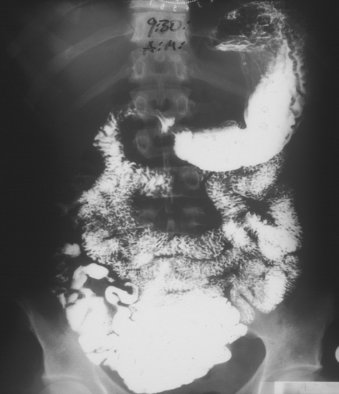
Small Bowel
Small bowel
Clinical signs and symptoms
• Malabsorption.
• Vomiting.
• Diarrhea.
• Age is also important (some diseases related to specific age).
• Constitutional symptoms (Fever, sweating and weight loss).
Imaging modalities
• X-ray (Bowel obstruction and perforation) best initially.
• Fluoroscopy (Barium follow through/Small bowel enema).
• Ultrasound (we don’t use it because small bowel is filled with gas and US can’t read gas).
• CT replacing the fluoroscopy these days.
• MRI replacing the Fluoroscopy and CT.
• Nuclear medicine > not used.
• Angiography > not used.
Normal
small bowel enema
barium meal- follow through
9

Slide 11
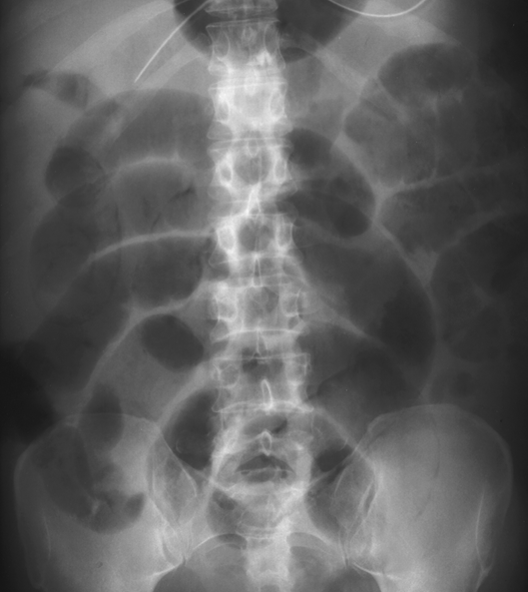
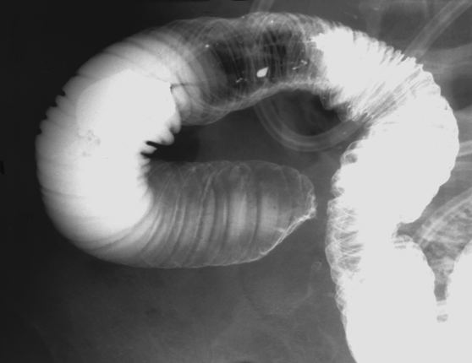
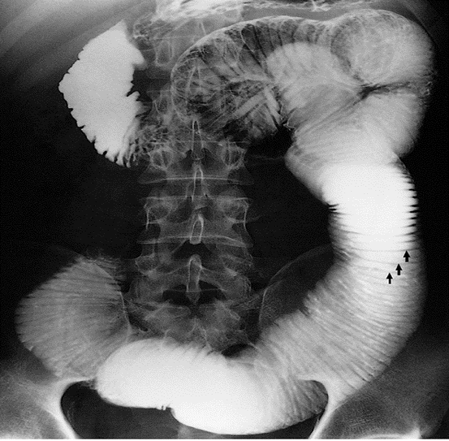
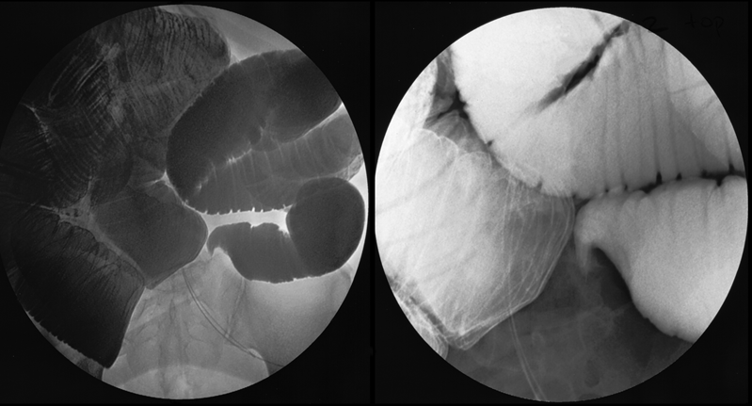
Small bowel
Small Bowel obstruction
Patient presenting with abdominal pain and distension
4
Picture 4: This is a plain x-ray. We see significantly dilated small bowel loops which centered in the mid-abdomen. Also there is Cutoff sign distally, thickened, mucosal folds, edema and complete cutoff distally and smooth tapering
1
Small bowel enema :
Significant ​dilation​ of the small bowel obstruction. The diameter of the wall is greatly increased. The feathery mucosal pattern is lost and the folds appear as thin lines traversing the bowel, known as valvulae conniventes (arrows).
Picture 2: The signs of small bowel obstruction secondary to adhesion :
1- Dilated small bowel loops proximally
2- Thickened mucosa (valvulae conniventes)
3- Cutoff sign distally
The diameter of the bowel is greatly increased.
(Keep in mind that The upper limit of normal diameter of the bowel is generally accepted as 3cm).
2
3
10

Slide 12
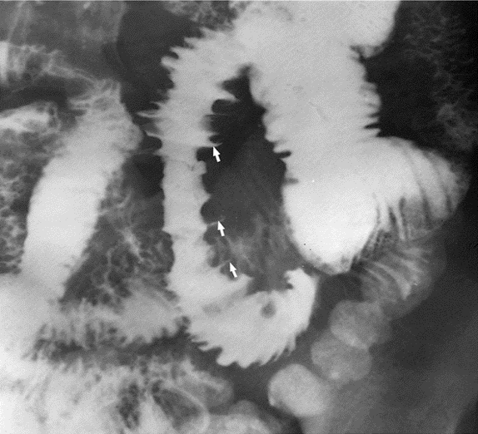
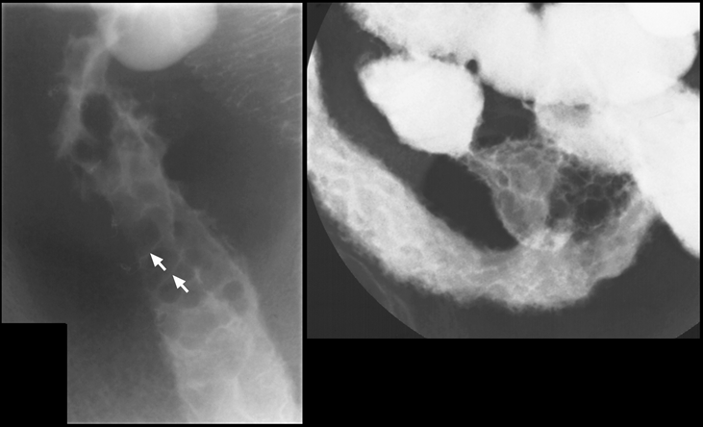
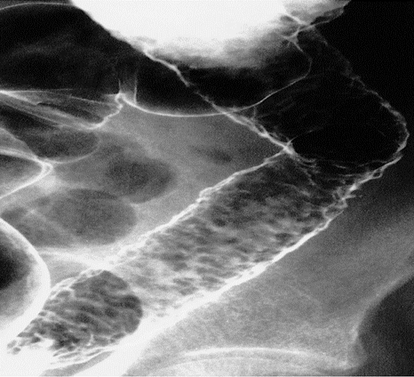
Small bowel
Crohn's disease
A patient presenting with Abdominal pain & weight loss and diarrhea
1-normal barium swallow
2-ileocecal narrowing on enema
small bowel inflammatory process
1
2
1
2
3
Picture 1: Small bowel loops separation due to fibrofatty proliferation
picture 2: Deep Ulceration abnormal loops of bowel in crohn's disease showing the ulcers as outward projections (arrows). If the erosion extends to submucosa we will see the contrast filling the submucosa ​(thorns rose) Streak of contrast filing the wall both of these changes are seen in the crohn’s disease (cobblestone sing & thorns rose)
picture 3: ​thickening of the mucosal folds
En-face: (mucosal ulceration​ ​the black spots in the picture​) small erosions of the mucosal lining ​(cobblestone sign)
سطح القمر المبقّع
Cobblestone appearance due to edema of the mucosa
Fibrofatty proliferation with separation of the bowel loops
FINDINGS:
Lumen narrowing & multiple stenotic segments (skip lesion)
Deep Ulceration with mucosal edema in between → Cobblestone Appearance
Bowel loop separation (fibrofatty proliferation)
11

Slide 13
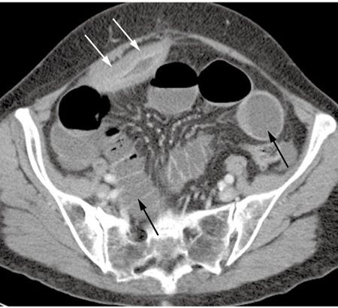
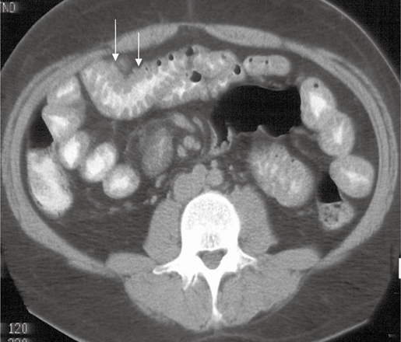
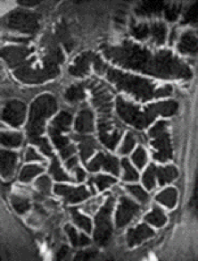
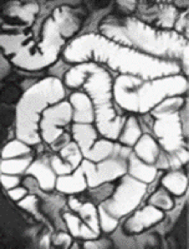
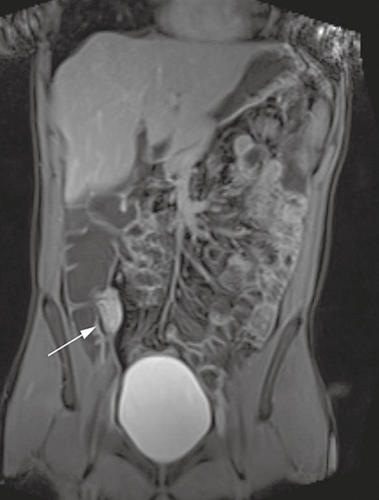
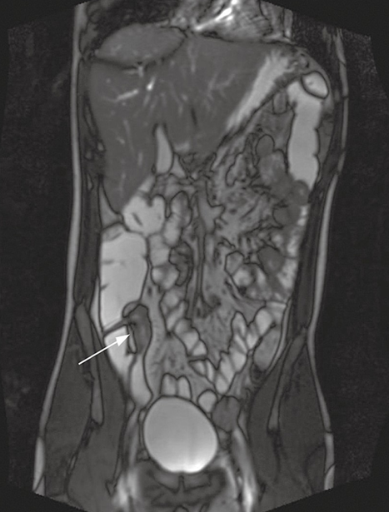
Small bowel
Crohn's disease
CT in the same patient demonstrating marked Non-uniform thickening with mucosal enhancement of the abnormal loop of small bowel, with a narrowed lumen​ (​white​ arrows)​. As compared to the normal bowel loops (black arrows)
Normal CT scan of the small bowel
MRI enterography - normal
• Mucosal thickening and enhancement involving the terminal ileum (arrows), characteristic of Crohn's disease.
• Narrowing of the lumen and thickening in the wall of ileocecal junction ​are seen by ​MRI enterography.
MRI enterography - CD
12

Slide 14
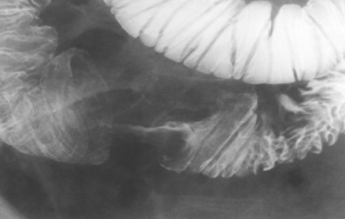
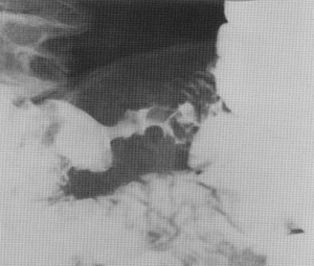
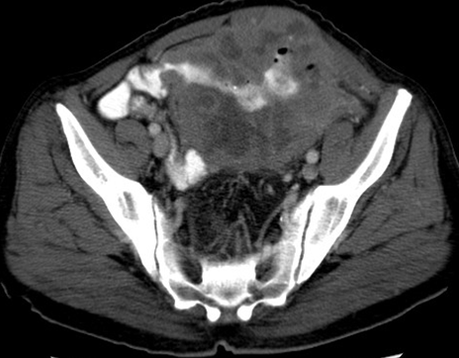
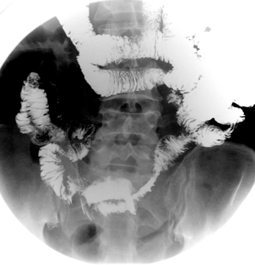
Small bowel
Small bowel Carcinoma
same here, add The patient presented with Gi bleeding and weight loss
FINDINGS in small bowel enema:
Lumen narrowing irregular with ulceration & shouldering margins.
Focal luminal narrowing, irregular outline, shouldering
Small bowel lymphoma
FINDINGS:
Lumen narrowing irregular
Mural wall thickening & bowel separation
Aneurysmal dilatation
no bowel obstruction
13

Slide 15
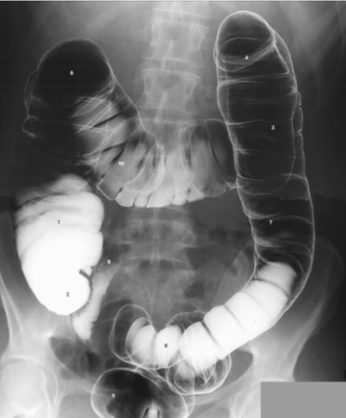
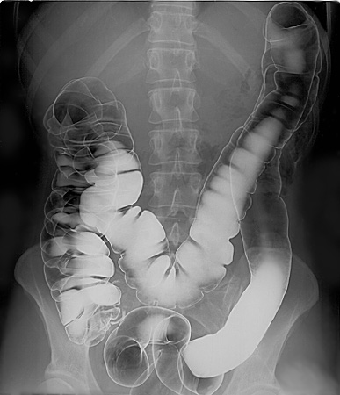
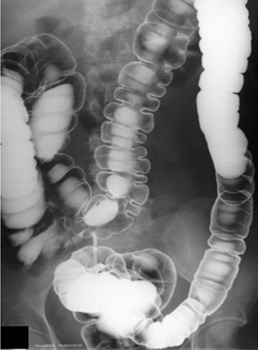
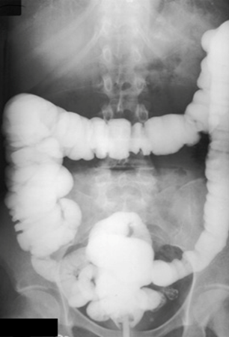
Large bowel
Large bowel
Clinical signs and symptoms
• Abdominal Pain.
• Diarrhea.
• Hematochezia،
• Vomiting (not always).
• Anal pain and Discharge.
• Age (some diseases related to specific age).
• Constitutional symptoms (Fever, sweating and weight loss).
Imaging Modalities
• X-ray. ​> for obstruction
• Fluoroscopy - Barium enema (Contrast study)
• Ultrasound
(we don’t use it because large bowel is filled with gas but we can use it to detect colonic mass ).
• CT.
• MRI.
• Nuclear medicine > not used.
• Angiography > not used.
Normal large bowel
Normal appearance of​ double contrast​ in the colon and it has normal mucosal lining and ​Haustration.
Normally, haustration must be seen clearly in ascending and transverse colon.
enema study
double contrast
single contrast
14

Slide 16
Large bowel
Large bowel
Colonic diverticulosis
Hx of abdominal pain.
CT shows : Colonic Diverticulitis → inflammation
En face
In profile
Complication:
Acute inflammation, Perforation, abscess
Barium enema (magnified view)
Multiple outpouching related to the sigmoid colon, smooth outline
Inflammatory process adjacent to the colon diverticulitis (likely a complication)
Gas dissecting to the inflammatory process which means there is some sort of perforation
Colonic Polyps
abdominal pain and GI bleeding
Double contrast barium enema
Colonic polyp
Colonic Polyposis
15

Slide 17
Large bowel
Large bowel
view the polyp by ct scan
metastatic deposits within the liver
Ulcerative Colitis
abdominal pain and diarrhea
single and double contrast enema
colonic Ulceration→ inflammation
the ulceration causes the normally smooth outline of the colon to be irregular. NO HAUSTRA which indicates ulceration due to repeated episodes of inflammation.
Double contrast study shows multiple mucosal black dots represents mucosal ulceration causes the normally smooth outline of the colon to be irregular.
Ulcerative colitis with longstanding disease. We can see clearly the​ lead pipe appearance​, and reflux into the ileum through an incompetent ileocecal valve has occurred.
We know the incompetence of the valve by the backflow of the contrast from the colon into the ileum + NO HAUSTRA.
16

Slide 18
Large bowel
Large bowel
Colon cancer (Apple core sign)
abdominal pain and lower GI bleeding
colonic Stricture→ colonic cancer.
Short segment with focal narrowing and shouldering effect which gives us Apple-core appearance
double contrast enema
Barium Enema and coronal CT showing a short, circumferential ​narrowing​ in the sigmoid colon​ ​(arrows)​ from carcinoma.
• Barium enema ​(left image)​ ​shows narrowing of the lumen due to presence of soft tissue mass ​ “Apple core sign”​ = (narrowing + shouldering).
• We can’t see the mass in the FLUOROSCOPY ​(only narrowing)​ BUT we can see it in the CT.
Multiple lesions
Colon carcinoma standard axial CT acquired on thin sections showing a tumor in the transverse colon. (thickened wall, tumor plugging into the lumen)
17

Slide 19
Large bowel
Large bowel
Acute Appendicitis
Right iliac fossa (RIF) pain - Acute Abdomen
• Blind ended tube in right iliac fossa. could present with white spot.
• Enlarged appendix measures ​more than 6mm.
• Appendicolith​ ​the white spot in the appendix ​(white arrow in image A), The white arrow points at the appendix.
• The complications of acute appendicitis: perforation, abscess formation and mass formation. tient has appendicitis!!!
Appendicitis
• In ​US ​there is ​thickening​ of the wall (double headed arrow) and we can see appendicolith​ in the tip of the appendix (single headed arrow).
• CT has higher sensitivity than US is assesing appendix but in situations like (pregnant lady or neonate) we can use US with 60% sensitivity.
What is the Diagnosis? ​ ​Appendicitis.
What is the best modality to diagnose ?
CT Scan (If it is a pregnant lady or pediatric patient then we do ultrasound​).
extra pic CT scan showing Normal
appendix
18

Slide 20
Large bowel
Rectal Carcinoma
MRI can help stage Rectal Carcinoma
Sagittal T2-weighted image demonstrating a polypoid growth (arrow) arising from the anterior wall of the rectum. Note the benign hyperplasia of the prostate (P) and a slightly trabeculated bladder (B).
Axial image of the same tumor (white arrow). Note the mesorectal fascia (black arrows) encases the mesorectal fat and the rectum.
• Posterior wall of the rectum is normal and in the lumen there is gas.
• In The anterior wall there is fungating mass (polypoid growth, A fungating lesion is a lesion that fungates, that is, becomes like a fungus in its appearance or growth rate). And because there is fat between the mass and the prostate, the mass is not invading. use MRI to search for lymph nodes metastasis
Perianal Fistula
Perianal fistula in crohn's disease. ​MRI with contrast is the best in perianal disease
Normal perianal area
19

Slide 21
Summary
Sign | Indication
Most of esophagus is dilated with food residuals and smooth narrowing at the lower End (bird beak sign) | Achalasia
Mass will clear the contrast and will appear black (filling defects) | Gastric Carcinoma
Cobblestone sign + thorns rose | Crohn’s disease
Lead pipe appearance | Ulcerative colitis
Enlarged appendix measures more than 6mm. marked thickening of the wall of appendix | Appendicitis
White spot in the appendix | Appendicolith
Apple core sign | Colon cancer
20

Slide 22
quiz
1- what can you see in the picture?
Ulcerative colitis
Colon cancer
Lymphoma
Colonic polyp
2-which one of the following is complication of acute appendicitis
thickening​ of the wall
abscess formation
Swelling
Bleeding
3-in gastric carcinoma there is diffuse thickening of the wall of the stomach which can be …?
Primary Gastric Cancer​ ​
Infiltration​
Metastasis
all
4- 32 years old, female, have peptic ulcer, came with severe abdominal pain, you suspect peptic ulcer perforation. What is the initial test you can order for her?
X-ray
MRI
CT
US
5-Patient with bloody diarrhea and vomiting
Ulcerative colitis
Crohn's disease
Colon cancer
Celiac disease
6- Elderly patient with progressive
dysphagia, what is the diagnosis?
Ulcerative colitis
Crohn's disease
Colon cancer
Celiac disease
Answers
1)D
2)B
3)D
4) a
5)a
6)c
21

