Slide 1
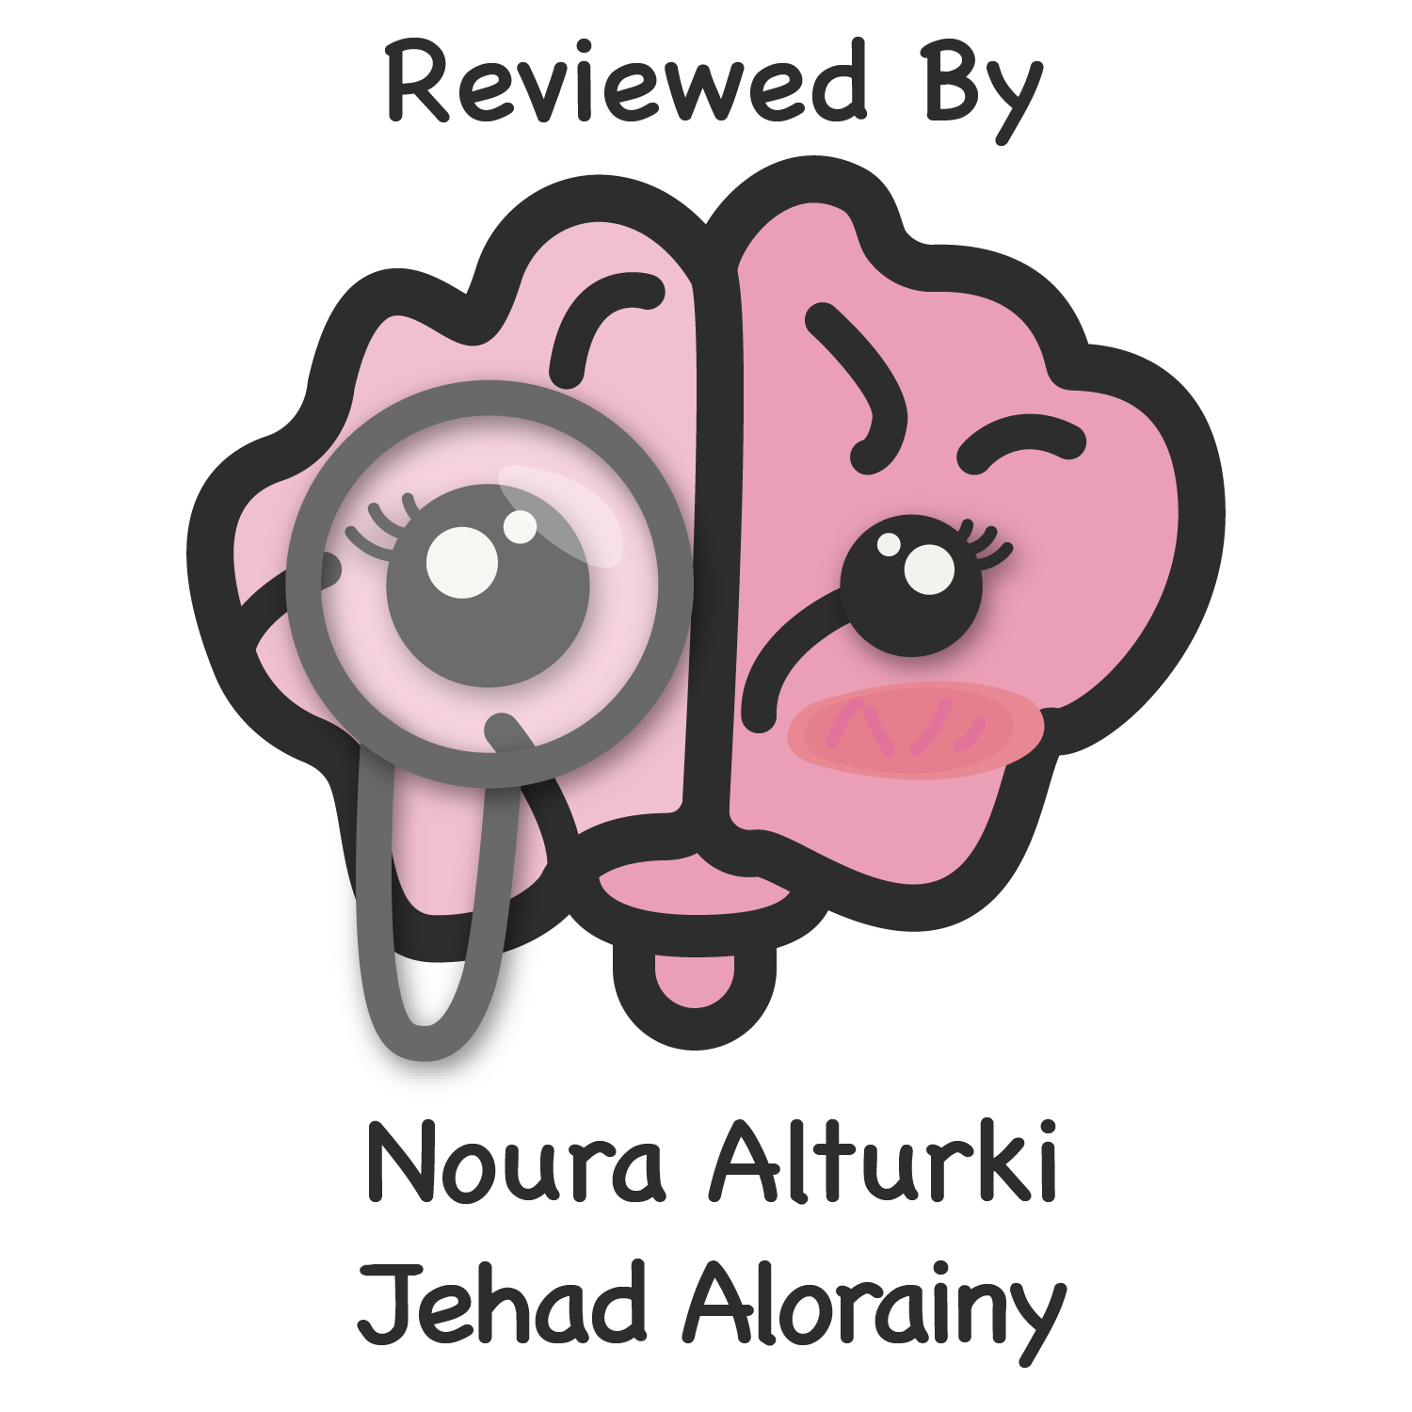
What is hepatobiliary system HBS?
Radiological modalities used in imaging HBS.
Advantages and disadvantages of each radiology modality.
Indications of imaging HBS.
Mohammed Ajarem
Editing file

Slide 2
Introduction
What is hepatobiliary system (HBS)?
It includes liver , gallbladder and biliary ducts.
what are the modalities used in imaging (HBS)?
X-Ray
Computed Tomography (CT)
Magnetic Resonance Imaging (MRI)
Ultrasound (US)
Nuclear Scan
we can use them all
each one has different indications and uses depend on what we are looking for
1. X-Ray
what is X ray? It is energetic form of electromagnetic and ionizing radiation that can penetrate solid objects and used to take images of the human body.
Uses: it can detect radiopaque stones depending on its composition size and location and it also can detect enlargement in the liver and calcifications in the gallbladder wall.
X-ray language
Radio-lucent = black = air
Radio-opaque = white = bone
Advantages
Disadvantages
Cheap.
Quick and widely available.
Can be done bedside (portable) for sick patients like patients in ICU.
Not skill based
Use ionizing radiation > avoid in pregnant & pediatric.
Very poor in tissue details including hepatobiliary system.
Very limiting in detecting gallbladder stones b/c they’re usually radiolucent due to their composition of fat, bile secretions, cholesterol. We only start seeing gallbladder stones when they start containing calcium
Won’t show bile duct dilatation.
1

Slide 3
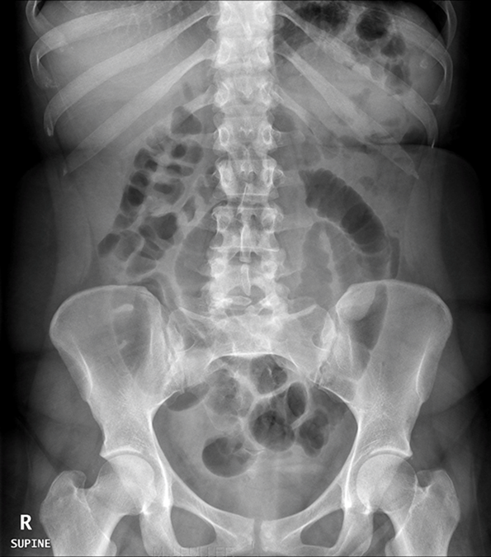
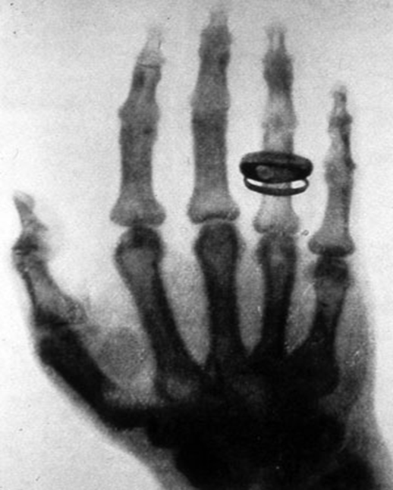
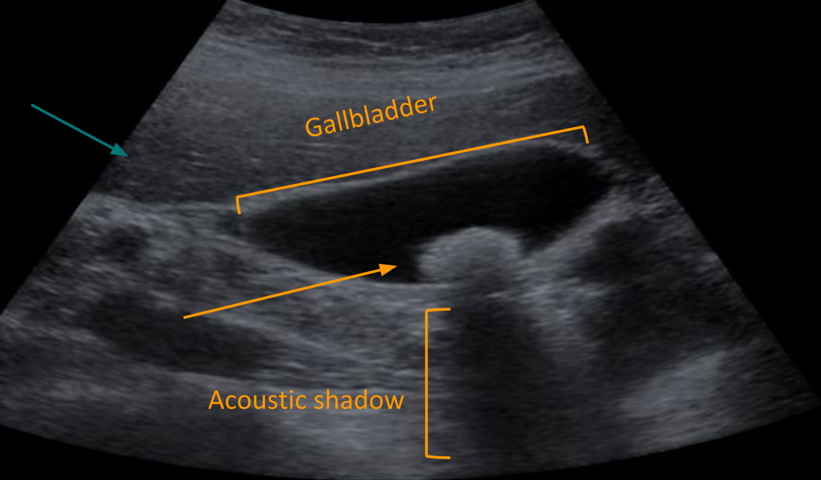
X-Ray and Ultrasound
What is this?
This is an Abdominal x-ray’’ or ‘’Abdominal radiography’’
We can see the edge of the liver here. (not always visible)
Gas inside the bowel “radiolucent”
what is this?
X-ray was first observed and documented in 1895 by Wilhelm Conrad Roentgen, and this is The First x ray taken in history
2. Ultrasound
what is US? A diagnostic technique in which high-frequency sound waves penetrate the body and produce multiple echo patterns.
It is diagnostic Medical applications in use since late 1950’s.
- The High frequency sound waves will pass through the body, and will be reflected according to the density of the structure.
- Dense structure e.g. bones, calcifications will reflect all sound waves (giving white color on the image).
- Fluid will pass without reflection (giving black color).
- Anything in between such as abdominal organs (as it’s dense as it reflects more waves).
Echo patterns we use it to describe the organs
Hyper-echoic = White
Hypo-echoic = Light Grey
(bones for example)
(in between hyper and anechoic)
An-echoic = Black
Acoustic shadow: black band behind dense object
No echoes are reflected from that area (fluid for example)
(e.g. stone) (acoustic shadow occurs because all/most sound waves that will travel & hit the stone will be reflected)
All organs/structures are not hyperechoic/hypoechoic all the time.
For ex: Fat is hyperechoic in relation to the liver but it is hypoechoic in relation to stone.
Acoustic shadow is very important to diagnose stones.
Fat
Gallbladder stone
Green Arrow: this is the liver (part of it)
2

Slide 4
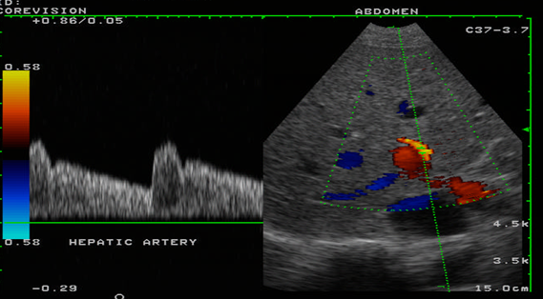
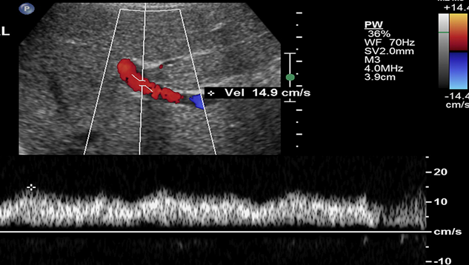
2. Ultrasound
Advantages
Disadvantages
No radiation > used in pregnant & Pediatric
Widely available.
Relatively cheap. Cheaper than MRI and CT.
Very good in evaluating abdomen solid organs.
Can be done bedside (portable).
Real time scan e.g. when scanning a pregnant lady, you will be able to see the fetus moving.
Good in assessing soft tissue compared to X-ray. ex, gallbladder inflammation.
Excellent in picking up stones.
The modality of choice to start with in HBS
Operator dependent means that if you have an expert in doing US he will give you a good image but if not you may not get a good study & may miss some important findings
Very limited in evaluating structures with air (e.g. bowel, lung) or calcification (e.g. bone like skull which makes it difficult to look at the brain except in newborns b/c they have sutures/fontanelles that you can penetrate & see the brain) why? B/c US waves won’t pass through air or calcifications
Dúplex:
When it’s difficult to know by a doppler whether it’s an artery or a vein we use duplex
Shows waves that differentiate between arteries and veins.
An artery wave usually contain systolic & diastolic while a vein is usually monophasic wave
One of duplex techniques is the ability to use the probe that allows to hear the sound but not seeing the image.
Here we see the pulse of an artery (notice the upstroke & downstroke waves in the graph).
This is a normal patent vein going toward the liver b/c it’s red.
Since this is a large vein entering the liver then most likely it’s portal vein
(Notice that the wave here is continuous because we are looking at a vein)
3

Slide 5
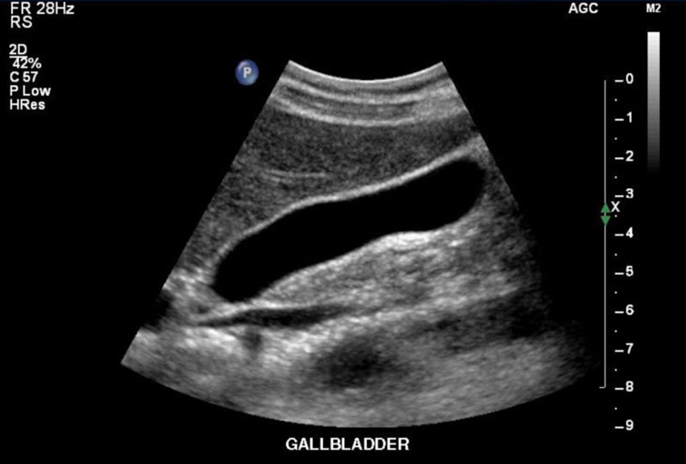
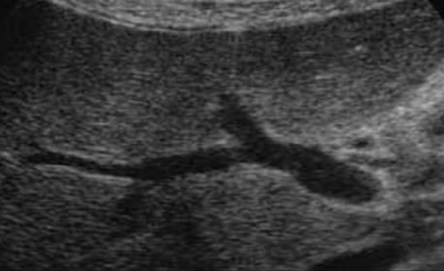
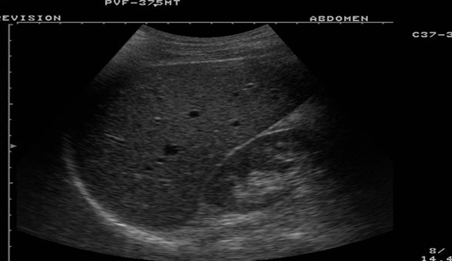
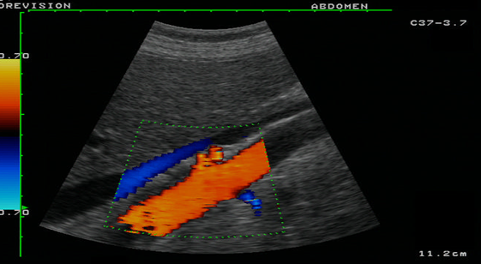
CT scan and Ultrasound
B-Mode
Normal gallbladder (anechoic gallbladder lumen)
This is portal vein without flow known as B-MODE or greyscale
Another example of B-Mode
Color Doppler
Doppler allows us to see vessels, blood flow, and its direction. what does these colors indicate?
they represent vessels. If the direction of the flow is toward the probe it will be red “artery”; if it’s moving away from the probe it will be blue “vein”.
In liver for example, the portal vein is going into liver so it will be red and hepatic veins is going away from liver so it will be blue.
In liver cirrhosis blood will flow to the opposite direction.
- Color Doppler is not of that help in biliary tree because the bile flow normally is slow to the degree that it won't be detectable; Doppler only shows faster flow
3. CT scan
what is a CT scan? A CT scan (Advanced technique of x-ray) makes use of computer-processed of many x-ray images taken from different angles to produce cross-sectional tomographic images = Create 3D image of specific areas of a scanned object.
CT scan can be done with and without intravenous IV contrast.
CT scan is limited in evaluating gallstones, Why?(1) (Important)
1-The composition of gallbladder is cholesterol which is fat which is black in CT, also fluid will be black “ gallbladder also filled with fluid”. And most of the stones are black or grey so you can’t see it. The same problem occurs with X-Ray. So you have to use US rather than exposing the patient to radiation for nothing.
4

Slide 6
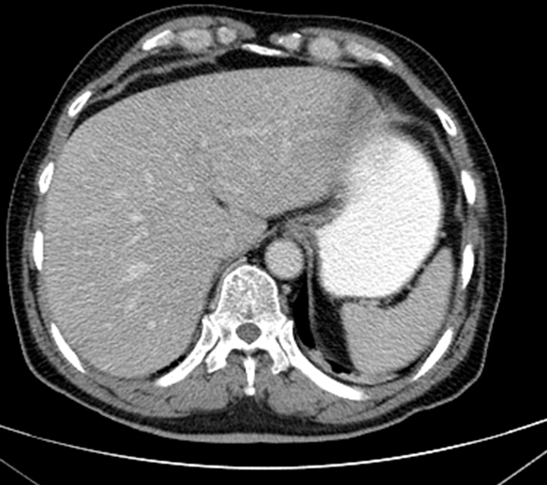
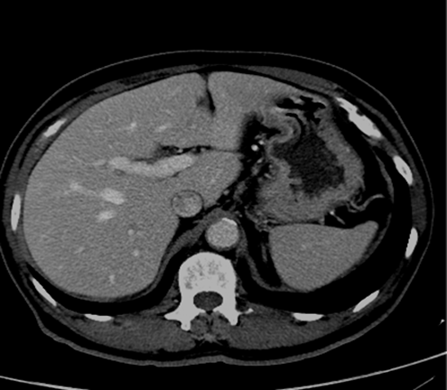
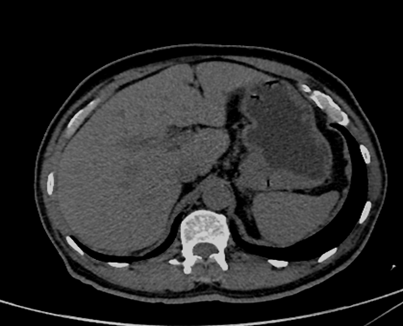
3. CT scan
CT language:
Hypo-dense = black to grey
Hyper-dense = white
e.g. Aorta is hyper-dense in comparison to the fat but hypo-dense in comparison to the bone or stomach (We compare organs with each other). -How to differentiate between CT and MRI? Bone will appear dense white in CT. However in MRI it will be grey to black.
Stomach
Aorta
Fat
Advantages
Disadvantages
It’s very good at evaluating solid organs especially if we use IV contrast.
Available more than MRI.
Cheaper & faster than MRI and more readily used.
Good assessing tumor.
It uses ionizing radiation (risk of cancer).
intravenous contrast maybe harmful in patient with impaired renal function b/c contrast in normally cleared by the kidneys. or allergy.
It is not widely available as U/S or X-ray.
It’s relatively expensive.
What is the difference between the two images?
CT with IV contrast
CT without IV contrast
How you know if there is contrast? You see more details and vessels.
It shows how good the image with contrast, which circulates in the body then into the vessels.
Contrast is also taken up by the liver so you can easily see details and this helps in case of mass in liver, which can be missed as it has a similar density to liver. But with contrast, liver will take it up in different way from the mass.
*these are vessels. before the contrast we weren’t able to see them clearly. (the arrow)
5

Slide 7
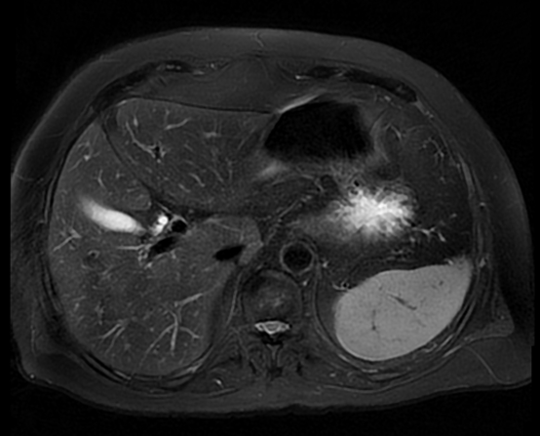
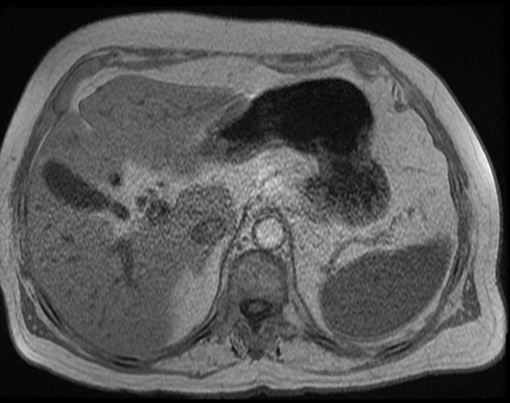
4. MRI
What is MRI?
A medical imaging technique using strong magnetic field and radio waves to form pictures of the anatomy.
It has no radiation.
It is more complex than CT scan and produces different images (or what called sequences), that can be taken like T1 and T2 etc.
It gives a far more great detail of information when compared to a CT scan as it uses a sequence system.
MRI language:
Hyperintense signal= more white
Hypo-intense signal = more grey/black
T1: The fluid will appear black
T2: The fluid will appear white
Advantages
Disadvantages
Excellent in tissue details.
No ionizing radiation.
Better than CT
Can pick up almost all stones, but US requires less time and money.
Good option for pregnant ladies but it is not used in the first weeks of pregnancy
Expensive.
Long scan time. Takes 25-45 minutes CT is shorter (5 - 10 minutes)
Less available than other modalities.
Intravenous contrast is not safe with poor renal function.
Not for all patient (such as: patients with pacemaker, claustrophobia etc).
6

Slide 8
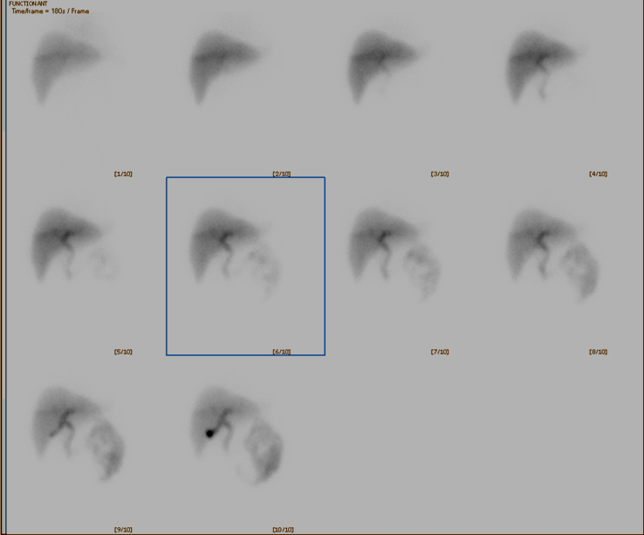
MRI and Nuclear Scan
How to differentiate between a CT and an MRI?
Always look at bone:
MRI: grey to black
CT: always white
5. Nuclear medicine
It’s a Medical specialty involving the application of radioactive substances in the diagnosis and treatment of a disease.
How is this procedure carried out?
Radioactive material given intravenously is labeled with a material that mimics normal physiology of the body e.g if we wanted to scan the liver or bile duct, to be sure this radioactive material reached the organ we label it with something like bilirubin “because it is metabolized in liver” so this will make all radioactive material directed to liver, then start to scan. But if we want to image the bone we will give a radioactive material that is labeled with phosphate so it will only target the bone.
Advantages
Disadvantages
Excellent in evaluating organ function/physiology.
Assessing HBS obstructions.
Use ionizing radiation (gamma rays).
Not widely available only big hospitals.
Very poor in evaluating anatomy.
Expensive
7

Slide 9
Summary
Radiological modalities used in hepatobiliary system
Modalities | Advantages | Disadvantages
X-RAY | Cheap. Widely available. | Radiation. Poor soft tissue details.
COMPUTED TOMOGRAPHY (CT) | Good at evaluating abdominal solid organs. | Contrast can be contraindicated.
MRI | Good at evaluating solid organs. No radiation | Long scan time. Less available than other modalities
ULTRASOUND | No radiation. Very good soft tissue details. | Operator dependant. Limited in evaluating bowel and calcification. Radiation
NUCLEAR MEDICINE | Excellent in evaluating organ function. | Radiation. Very poor in evaluating anatomy. Not widely available.
8

Slide 10
quiz
1- which one of the following modalities you think
had been taken?
CT
MRI
X-Ray
Ultrasound B. Mode
Insert picture if needed
2-which one of the following modalities you think
had been taken?
Ultrasound Dúplex
Ultrasound B. Mode
CT
Ultrasound Color Doppler
Insert picture if needed
3- Patient presented to ER with Right upper quadrant pain aggravated by fatty food, what is the first choice modality
MRI
CT
Ultrasound
Nuclear medicine
4- Which one of the following is the appropriate test to assess tumors?
Ultrasound
CT
MRI
Nuclear medicine
5- Which one of the following has no radiation
CT
X-Ray
Nuclear medicine
Ultrasound
6- Which one of the following gives a far more great detail of information when compared to a CT scan?
MRI
Nuclear medicine
Ultrasound
X-Ray
Answers
1) b
2)a
3)c
4)b
5)d
6)a
9

