Slide 1
To Interpret plan x-ray radiograph of abdomen with common pathologies.
To know the common pathologies presentation.
To understand step wise approach in requesting hepatobiliary radiology investigations.
To know common radiological pathologies in hepatobiliary system.
Norah Alharbi
Amirah Alzahrani
May Babaeer
Editing file

Slide 2
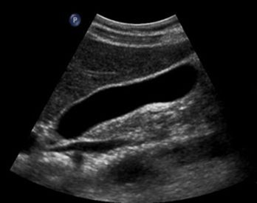
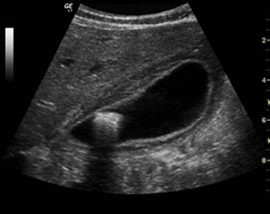
Case 1
45 year-old female with RUQ pain radiating to right shoulder and aggravated by fatty meals associated with vomiting.
What is the most likely diagnosis?
Gallstone +/- inflammation (cholecystitis)
What is the best radiology modality to start with?
Ultrasound. Why not CT? It can’t detect fat
Why not MRI? Too complicated
Why not X-ray? It’s not good at picking up gallstones. You can only see less than 10%, so you will miss 90%. It doesn’t provide enough information about the gallbladder. You can’t see inflammation.
Normal Gallbladder
Abnormal Gallbladder
(Acute calculous cholecystitis)
Hyperechoic filling defect = stone (anything inside a hollow structure we call it filling defect).
What is abnormal?
Hyperechoic structure inside the gallbladder
Posterior acoustic shadow
Thickening of the wall
Distended gallbladder because of obstruction.
Acute cholecystitis features in ultrasound:
Gallbladder wall thickening (more than 3mm)
Gallbladder distension
Surrounding fluid
Gallstone (calculous cholecystitis) without stone (Acalculous cholecystitis)
How do you know it’s a stone?
- We have white structure “hyperechoic” with shadow (classic gallstone).
1

Slide 3
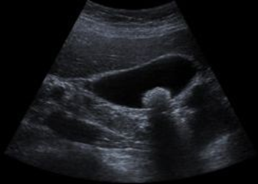
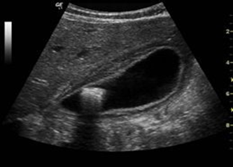
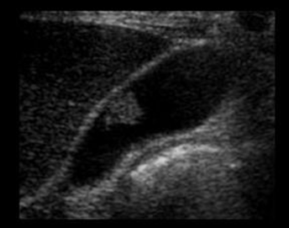
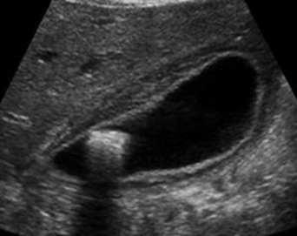
Case 1
What is the difference between the two images?
Stone WITHOUT inflammation
The stone is within the body of gallbladder.
The Wall is normal.
There is no inflammation.
Usually asymptomatic
Stone WITH inflammation
The Stone is in the neck.
The Wall is thickened.
There is inflammation.
WITHOUT acoustic shadow (GB polyp)
Greyish structure
No posterior shadow.
There is no inflammation.
It is a mass “gallbladder Polyp”.
Could be benign or malignant.
WITH acoustic shadow (GB stone)
Calculus shadow with inflammation
The key to differentiate between a polyp and stone is the acoustic shadow
2

Slide 4
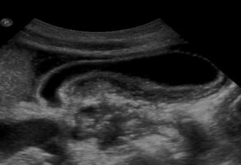
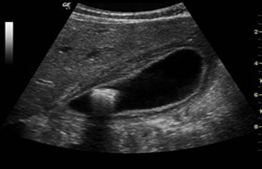
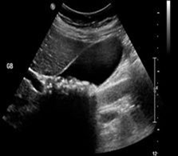
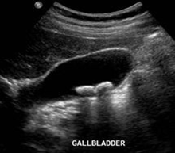
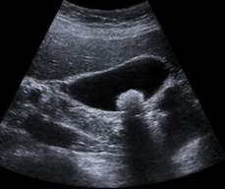
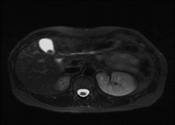
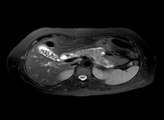
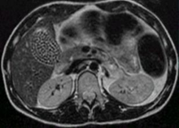
Case 1
Fluid
Normal Bowel
Acalculous cholecystitis
The inflammation without stone called (Acalculous cholecystitis)
It has some fluid around.
Tx by relieving the distention with tube
Calculous cholecystitis
Inflammation with stone
Treated by cholecystectomy
Acalculous cholecystitis less common & usually happens with very sick patients. Patients in the ICU are at higher risk because they are getting their nutrients either through NGT or IV and this won't stimulate GB to contract so it will be distended because of the accumulated bile and that will cause inflammation
Different gallstones on US:
Multiple tiny stones
Big shadow
2 stones (2 shadows)
Gallbladder stones with no features of cholecystitis
1 stone (1 shadow)
Gallstones on MRI:
1 stone, Usually gallbladder appear white/hyperintense
Multiple stones, Stones appear black/hypointense
Multiple stones replacing the whole gallbladder
3

Slide 5
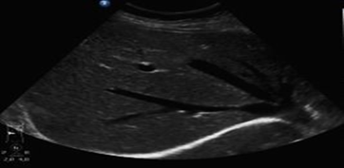
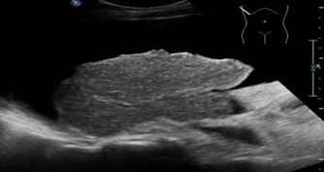
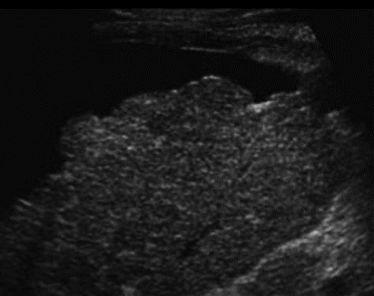
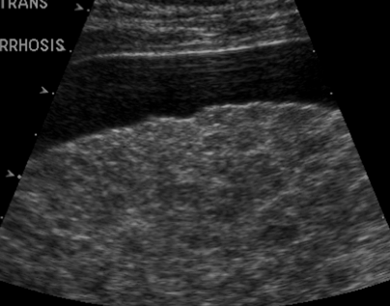
Case 2
60 year old male with chronic alcoholic consumption & complaining of fatigue, disorientation and abdominal distention.
What do you think this patient has?
Chronic liver disease (Liver cirrhosis) due to hepatitis
What radiology modality you will start with?
Ultrasound. Aim is to confirm if the liver in normal or abnormal
X-ray is not good for liver and soft tissue
what is abnormal
Fluid
Normal Liver
Smooth surface
Hypoechoic
Normally we can’t see the whole liver in one image
Liver cirrhosis
Nodular liver surface.
Shrunken size as part of the image contain no liver
Hyperechoic parenchyma due to fibrosis
Ascites (fluid)
In liver cirrhosis, we must look for masses
Other examples of cirrhosis:
Ascites
Coarse/heterogeneous appearance
4

Slide 6
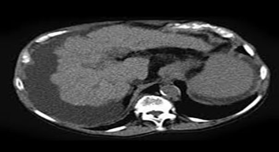
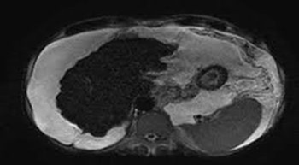
Case 2
Cirrhosis on CT scan and MRI:
CT
MRI
Fluid
Fluid
Liver cirrhosis with ascites
shrunken liver with irregular surface surrounded by fluid
Note: in liver cirrhosis there is spleen enlargement & fluid around live because of portal hypertension
wow, such empty
5

Slide 7
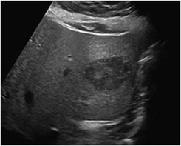
Case 3
US for chronic hepatitis B virus patient. What is your diagnosis?
Hypoechoic mass within the liver. US excluded cirrhosis but we can’t tell if the mass is benign or malignant.
What is DDx?
Benign:
1- Hemangioma. 2- Adenoma. 3- Focal nodular hyperplasia.
4- cysts e.g., hydatid cyst
b) Malignant:
1- Hepatocellular carcinoma. 2- Metastasis e.g., cholangiocarcinoma How to tell if it's benign or malignant? DO CT scan or MRI with intravenous contrast.
What do we mean by triphasic?
Scanning liver with IV contrast in three different phases:
- Phase 1 (arterial): when IV contrast in arteries → 30 to 40 seconds after IV contrast injection
We wait 30-40 sec because first we’ll give a contrast to a peripheral vein then it’ll go to right side of the heart → pulmonary circulation → left side of the heart → systemic circulation through the aorta → organs
- Phase 2 (portal-venous): when IV contrast in veins → 60 to 70 seconds after IV contrast injection.
- Phase 3 (delayed or equilibrium): after 3 to 5 minutes after IV contrast injection to give more time for mass to wash out the contrast.
Normal liver parenchyma is 80% supplied by the portal vein and only 20% by the hepatic artery, so liver will be enhanced in the portal venous phase.
However, all liver tumors gets 100% of their blood supply from the hepatic artery, so the tumor will be enhanced in the arterial phase.
We do 3 phases because:
To differentiate the tumor (e.g. HCC appears in arterial phase and doesn’t appear in portal).
In equilibrium phase the malignant tumor may be seen as a cyst.
When we want to do only one phase we prefer portal phase because the whole liver will uptake the contrast.
6

Slide 8
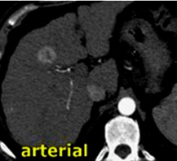
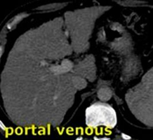
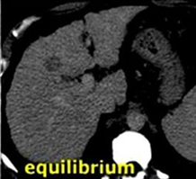
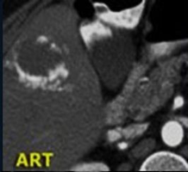
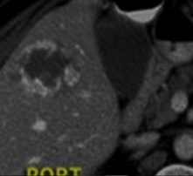
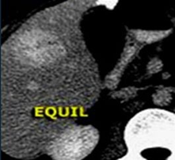
Case 3
Triphasic scan helps in differentiating benign from malignant masses:
- Benign: BLACK(no enhancement) in phase 1 / WHITE in phase 3 (e.g. hemangioma → most common benign tumor of the liver).
- Malignant: WHITE (enhancement) in phase 1 / BLACK (no enhancement) in phase 3 (e.g. HCC → most common malignant tumor of the liver which is hypervascular and take the contrast in a very early stage!).
437 notes
We do 3 phases because:
To differentiate the tumor (e.g. HCC appears in arterial phase and doesn’t appear in portal).
In equilibrium phase the malignant tumor may be seen as a cyst.
When we want to do only one phase we prefer portal phase because the whole liver will uptake the contrast.
What is the difference between both cases?
Hepatocellular carcinoma
White → uptaking contrast
Lesion Similar to liver
Black lesion (early washout from the lesion)
b. Hemangioma: blood accumulate very slowly (slower than the liver)
Slow accumulation of contrast only the peripheral of the lesion
Then becomes more white in late phase
7

Slide 9
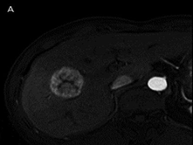
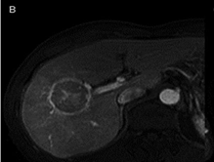
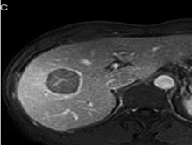
Case 3
MRI of the liver:
Is it Benign or Malignant? Malignant (HCC).
Arterial phase (white aorta)
it’s taking the contrast and rest of the liver not yet
Portal phase, liver start to uptake and lesion is almost similar, surrounded by capsule which is compressed and hyperintense
Late phase
liver uptake and lesion wash it out become black
wow, double empty
8

Slide 10
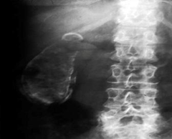
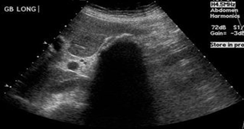
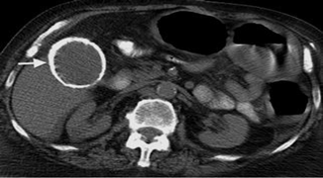
Case 4
Male patient with chronic abdominal pain.
What is abnormal?
Gallbladder calcification (Radiopaque oval shaped opacity):
• Porcelain gallbladder (calcification in whole GB wall).
• Gallbladder stones (NOT common to see on X-ray).
We can’t reach to the diagnosis by using x-ray.
How to confirm the diagnosis?
CT scan or US? CT scan because we don’t expect US to be helpful recall that one of US limitations is a calcified structure as US can’t see beyond the calcification
Which modality is better?
CT without contrast
Not beneficial for this case because the whole wall is calcified which appears as big area of shadow which will hide the gallbladder, we can’t differentiate between a large stone with shadow OR calcification on the wall
Porcelain gallbladder
In CT we can clearly see the calcification on the wall of gallbladder
Porcelain gallbladder (calcification of GB wall):
Complete or partial GB wall calcification
Risk of developing cancer 5 -7%.
Needs follow every year or surgical resection.
9

Slide 11
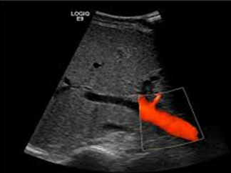
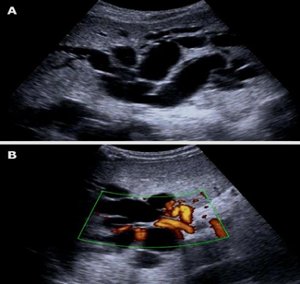
Case 5
50 year-old lady presented to the emergency with RUQ pain and yellow discoloration of sclera, pale stool and dark urine.
What is the most likely diagnosis?
Obstructive Jaundice
Stone (because it’s painful)
If it was painless we think about tumor as malignancy usually a silent disease patients will present if they start to have obstruction
Normal Ultrasound
Red color = blood in vessel
Which radiology modality you prefer to start with?
Ultrasound
Interpretation
Abnormal Ultrasound
A
Abnormally:
On ultrasound we see a tubular structures. is it bile ducts or blood vessels? you need to do doppler.
On doppler, not all the tubular structures are blood vessels. so there is a severe intrahepatic bile duct dilatation.
You can tell if its a bile duct or blood vessels by the flow (blood flow is continuous).
Doppler confirms the patient has post hepatic obstruction but we can’t tell what’s causing the obstruction
Multiple anechoic tubular structures
B
Dilated bile duct
What to do next?
MRCP to first exclude stones as unfortunately US didn’t help & sometimes common bile duct is deep & a lot of bowel over it & we can’t see the area of common bile clearly. Why not CT? Because CT will only help with calcified stones & most of biliary stones are not, also if CT was negative we still can’t exclude stones
10

Slide 12
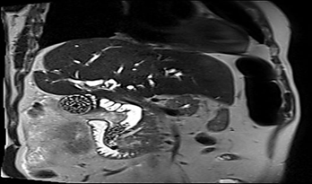
Case 5
Multiple gallstones in GB & common bile duct (CBD)
MRI without contrast
What is abnormal?
Multiple gallstones in GB and common bile duct (CBD).
Treatment: Remove the stones use (ERCP).
Labels:
1. Dilated common bile duct.
2. Stones.
3. Gallbladder.
4. Duodenum.
5. Dilated ducts within the liver.
5
3
1
2
4
Yes, this Lecture is full of emptiness
11

Slide 13
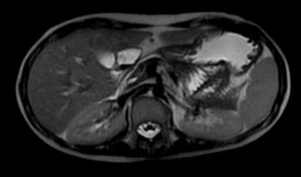
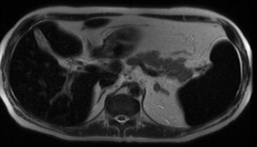
Case 6
20 year-old case of Thalassemia with repeated blood transfusion.
What is the Abnormality?
Normal MRI
The liver, spleen and bone marrow are dark in signal (hypo-intense) because of iron overload (Hemochromatosis), due to repeated blood transfusion.
There is splenomegaly.
The abnormalities are present in iron stores.
Abnormal MRI
Which radiology modality is the choice?
What is abnormal here?
MRI is the modality of choice to assess and quantify iron in solid organs, and to follow up treatment & dosing of chelation therapy (an agent that bind to iron and get rid of it)
For better understanding
(special thanks for team 436)
The orange lining represents the liver edges.
In MRI, the liver is hypointense in comparison to surrounding fat and fluid.
In CT the liver is hypodense and shrunken with irregular edges and surrounded by fluid.
12

Slide 14
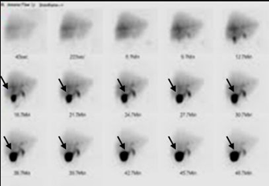
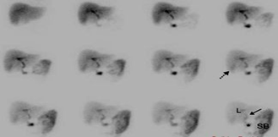
Case 7
Patient with RUQ pain suspecting cholecystitis. US and MRI were not conclusive
What to do next?
Normal HIDA scan
CT scan? MRI? Nuclear scan?
Nuclear scan (HIDA scan)
What is the difference between the images
Normally
Liver start to uptakes radioactive material by hepatocyte.
Slowly increase the uptake.
Liver start to excrete it in the bile duct
Slowly start to fill in gallbladder (black arrow).
Acute cholecystitis
there is no uptake in gallbladder, means there is an obstruction.
Abnormal HIDA scan
what is abnormal here?
Other indications for HIDA scan
Biliary atresia (children): everything accumulate in the liver
Bile injury post-surgery: instead of going to the normal pathway from bile duct to the bowel, it will escape from the bile duct into the peritoneal space
Bile obstruction: in functional obstruction (no contraction of gallbladder or no relaxation of the ampulla) it will accumulate in the gallbladder.
13

Slide 15
Summary
 | presentation | modality | information
Gallstone | Radiating right upper quadrant pain Aggravated by meals Vomiting | Ultrasound (acoustic shadow) | Can be with or without inflammation With(GB stones) or without(GB polyp) acoustic shadow
Chronic liver disease (liver cirrhosis) | Chronic alcohol consumptio Fatigue Disorientation Abdominal distention | Ultrasound | Nodular and irregular liver surface. Shrunken size. Hyperechoic parenchyma (fibrosis) +/- Ascites (fluid)
Mass | in our case: US for chronic hepatitis B, a mass was noted | CT or MRI with contrast | Triphasic scan help in differentiating benign from malignant masses
Gall bladder calcification | Abdominal pain | Better: CT (without contrast) or US | Complete or partial GB calcification need follow-up every year or surgical resection
Obstructive jaundice | RUQ pain Yellow discoloration of the sclera pale stool Dark urine | US | What to do next? MRI
Iron overload | history of: Thalassemia Repeated blood transfusion | MRI | present with Splenomegaly
Acute cholecystitis | RUQ pain suspecting cholecystitis Inconclusive US and MRI | Nuclear scan | Nuclear: No uptake by the gallbladder
14

Slide 16
quiz
1- what does the image show?
Acalculous cholecystitis
Hepatocellular carcinoma
Liver cirrhosis
Hemangioma
focal nodular hyperplasia
2- What does the arrow show?
Gallbladder
Dtones
Dilated duct within the liver
Dilated cystic duct
3- Which of the following not an indicator for HIDA scan ?
Bile obstruction
Bile duct dilatation
Biliary atresia in children
Bile injury post-surgery
4- What is the modality of choice in case of thalassemia ?
CT
Ultrasound
X-Ray
MRI
5- What is the most likely diagnosis of the
image given below ?
Gallbladder mass
Liver mass
Common bile duct stone
Porcelain gallbladder
1-
2-
3-
4-
6- For the following triphasic liver CT.
What is the most likely diagnosis ?
Liver cirrhosis with ascites
Hemangioma
Pancreatitis
Hepatocellular carcinoma
Answers
1)c
2) C
3) B
4) D
5) D
6) B
15

Slide 17
مي بابعير
اللهم ارحمها و اغفر لها و انظر اليها بعين لطفك و كرمك يا أرحم الراحمين
اللهمّ املأ قبرها بالرّضا، والنّور، والفسحة، والسّرور واجمعنا بها في جنتك يارب ياكريم
1-
2-
3-
4-
16

